Slide 1
ON THE PREDICTION OF BUBBLE SIZE DISTRIBUTION IN HIGHLY TURBULENT TWO-PHASE LIQUID METAL SWIRL FLOW
Elvis Dominguez-Ontiveros, ORNL-SNS
Walter Schwarz, Ansys Inc
Michael Hancock, Ansys Inc

Slide 2
Outline
Introduction
CFD methodology
  Meshing
  Models
  Results
Comparison with available data
Summary

Slide 3
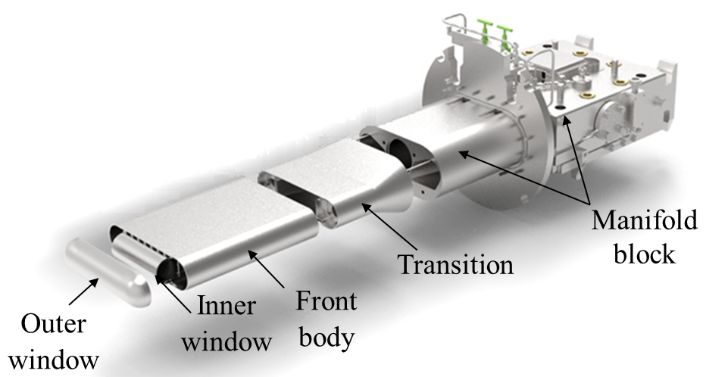
Introduction
The liquid mercury vessel (target) at SNS
Gas injection has proven to be an effective way for strain mitigation at the SNS

Slide 4
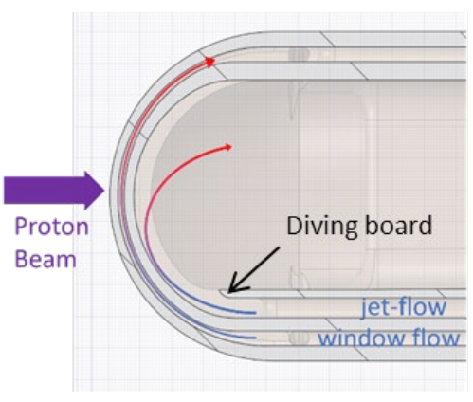
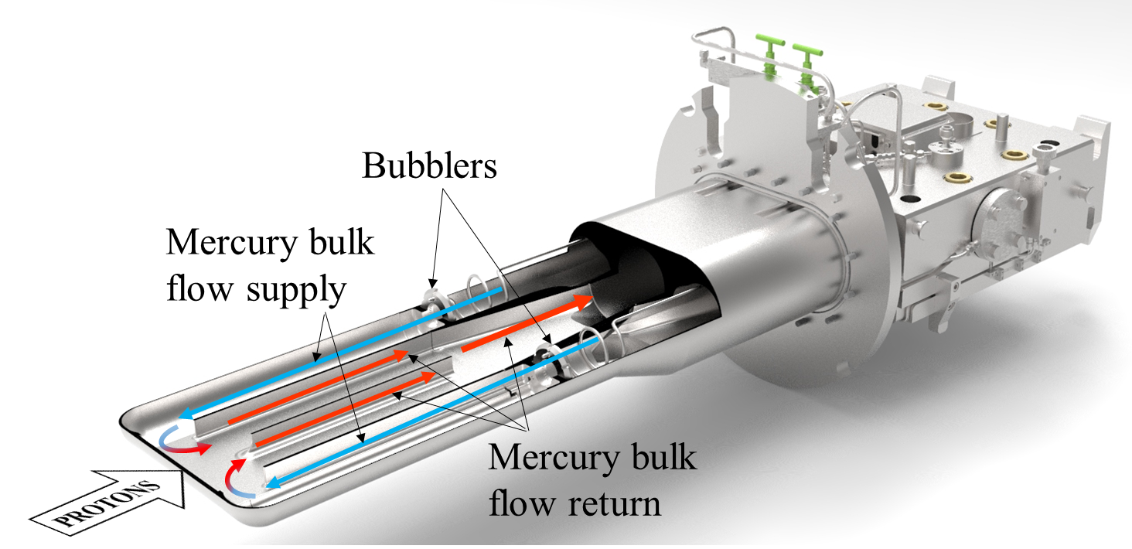
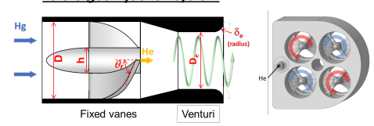
Introduction: Bubble production
Jet flow at nose
Swirl Bubblers

Slide 5
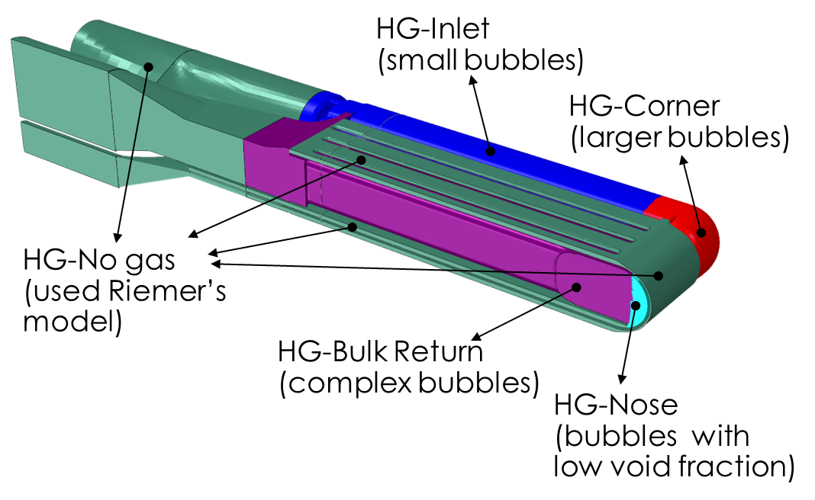
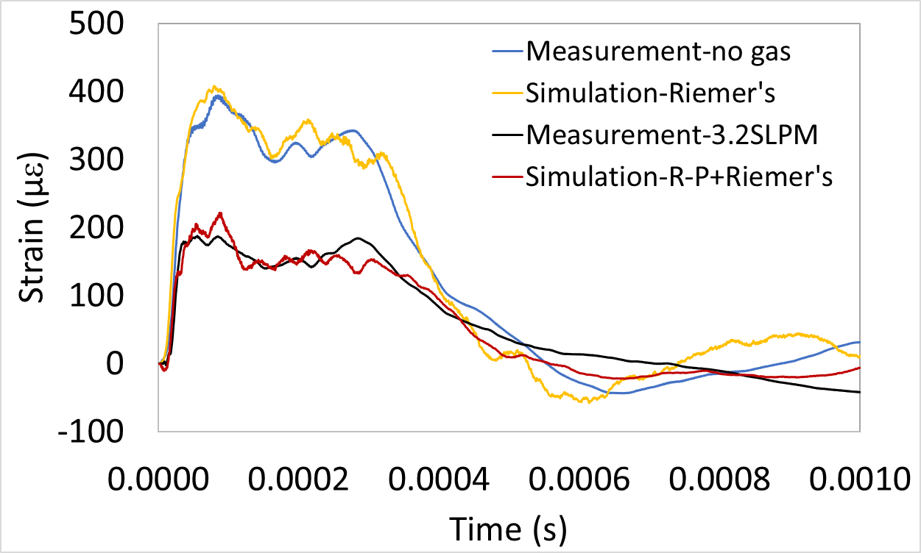
Introduction: Importance of BSD prediction
An improved simulation technique was developed to predict strain response of target with gas injection * (more details on later presentation by Hao et al)
FEA Lagrangian approach using R-P equations to account for gas phase
This approach assumes a given bubble
size distribution (BSD) through the target Prediction of BSD is of interest for these models
*H. Jiang, D. E. Winder, C. Barbier, B. W. Riemer, “Implementing bubbly mercury material model (R-P model) in the pulse simulation to predict strain on the Spallation Neutron Source target vessel with gas injection”, Results in Physics 49 (2023) 106511.

Slide 6
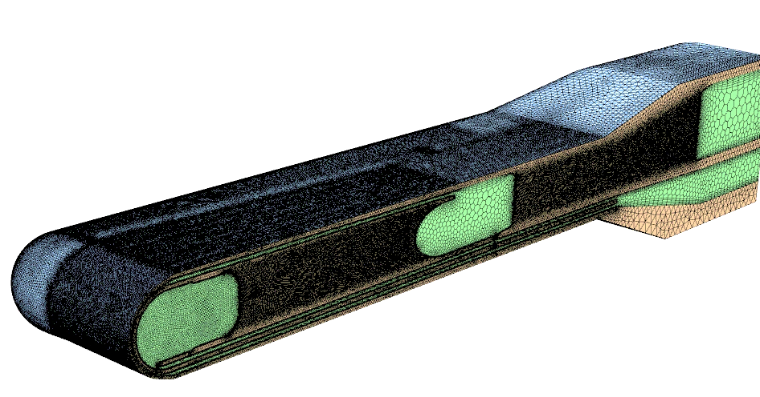
Non-Conformal Mesh for solid (tetrahedral) and fluid (poly-hexcore) regions
Bubbler location
Isometric view of surface mesh
Baffle
Nose
Jet flow channel

Slide 7
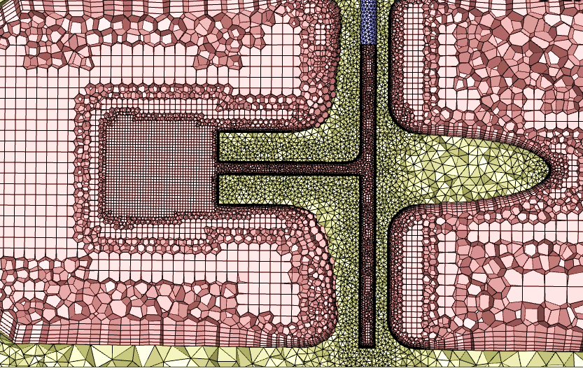
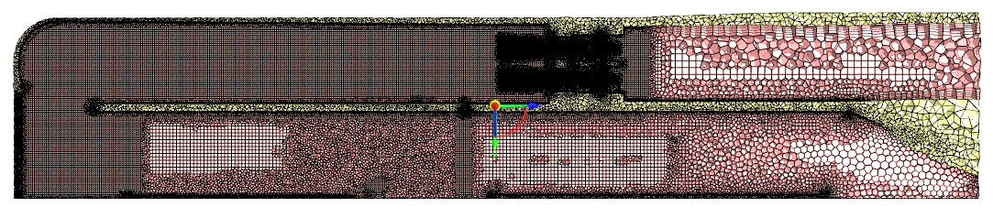
Horizontal sections plane showing internal mesh (non-conformal)
Mesh in vicinity of bubbler helium inlets
Bubbler location

Slide 8
Transient iFSI simulation details using ANSYS Fluent 2022R2 (with helium)
Physics Modeling
  SST-kω turbulence model
  3-Phase Multiphase mixture model with cavitation (Schnerr & Sauer,2001)
  Slip velocity (Manninen et al., 1996)
  Helium: Interfacial Area Concentration Transport (Hibiki-Ishii, 2000)
Pressure-Based Coupled Solver
  CFL=20, Explicit URFs: pressure=0.25, momentum =0.25
  2nd order numerics (flow, energy, turbulence, IAC)
  Modified body-force weighted numerics (pressure)
  QUICK numerics (volume fraction)
  1st order implicit timestepping: Δt = 2e-08 s
Mesh
19 M tetrahedral cells
  Solid 8.8 M cells
  Fluid 10.3 M cells
    5 inflation layers on all walls
conformal mesh
Properties:
Mercury liquid – density=ρ(p,T) (Holman & ten Seldam, 1994)
Mercury vapor – ideal gas law
Steel (ρ=8000 kg/m³, Cp = 502.48 J/(kg K), k= 16.27 W/(m K), Young’s modulus = 1.95e11 Pa, Poisson ratio = 0.3)
Boundary & Operating conditions:
303975 Pa operating pressure
Pressure Inlet-1: 1.5e05 Pa gauge, 60 ºC
Pressure Inlet-2: 6.6e04 Pa gauge, 60 ºC
External walls: 60 ºC
Helium injection
Power: 2 MW
g_{y} = -9.81 m/s²
G. H. Schnerr and J. Sauer. "Physical and Numerical Modeling of Unsteady Cavitation Dynamics". In Fourth International Conference on Multiphase Flow, New Orleans, USA. 2001.
M. Manninen, V. Taivassalo, and S. Kallio. "On the mixture model for multiphase flow". VTT Publications 288, Technical Research Centre of Finland. 1996.
T. Hibiki and M. Ishii. "One-group Interfacial Area Transport of Bubbly Flows in Vertical Round Tubes". International Journal of Heat and Mass Transfer. 43. 2711–2726. 2000.
Holman, G.J.F. & ten Seldam, C.A., A Critical Evaluation of the Thermophysical Properties of Mercury, Journal of Physical and Chemical Reference Data 23, 807 (1994).

Slide 9
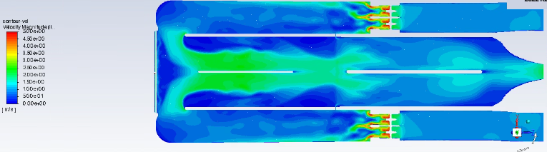
Velocity Magnitude
[m/s]
5
3
0

Slide 10
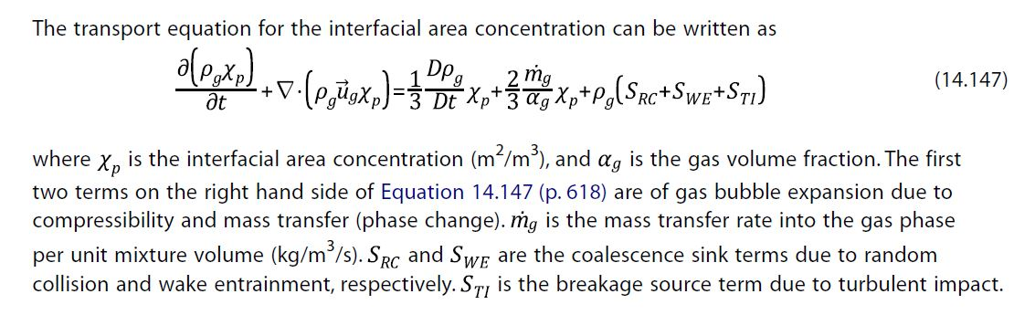
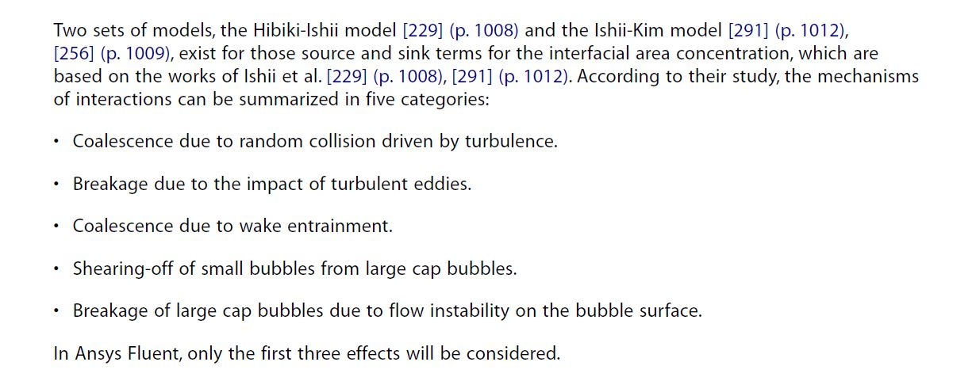
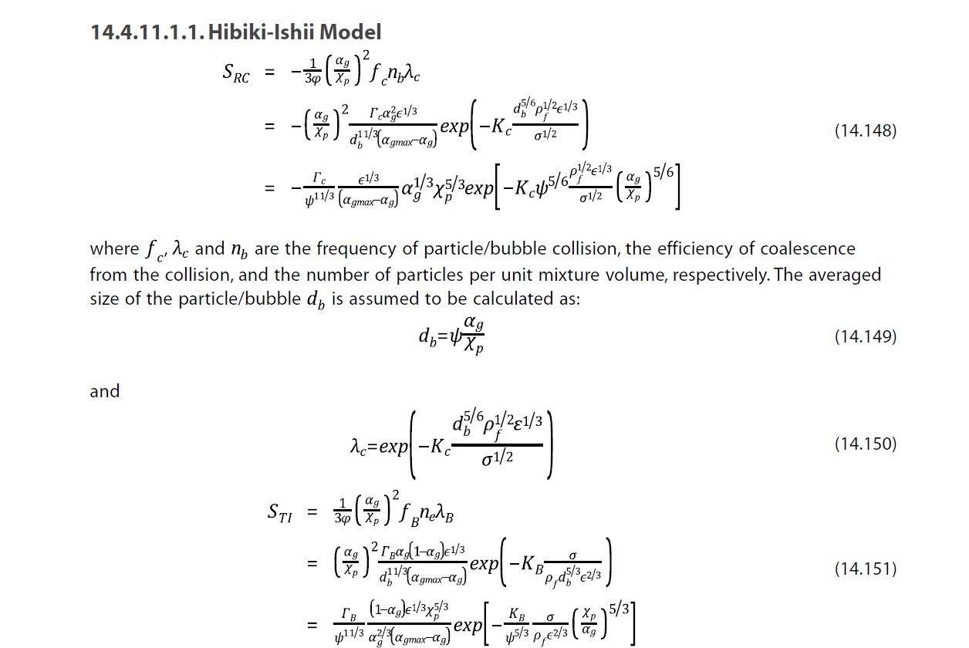
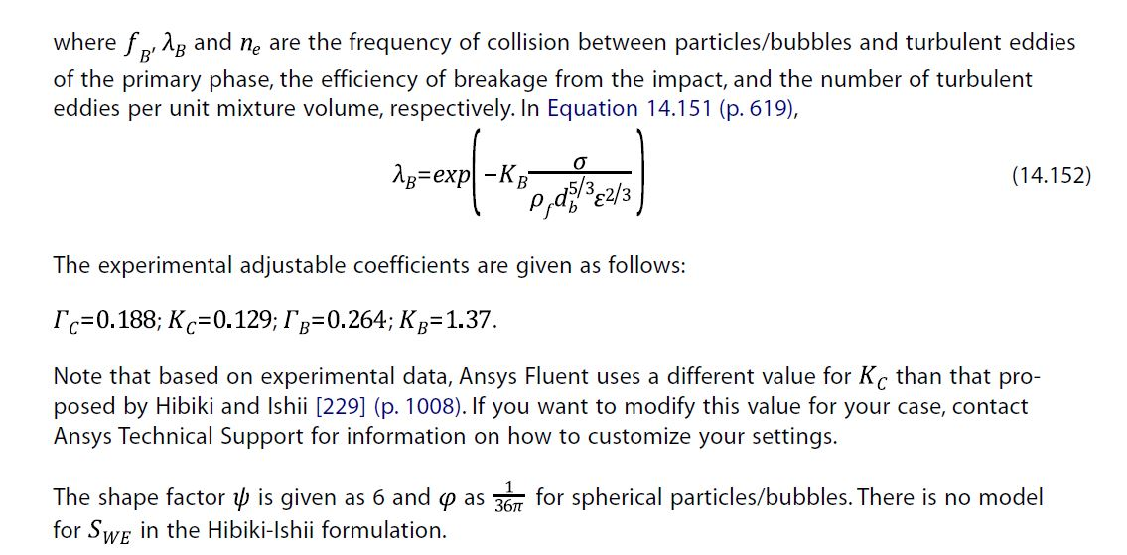
Interfacial area concentration transport (He BSD)
T. Hibiki and M. Ishii. "One-group Interfacial Area Transport of Bubbly Flows in Vertical Round Tubes". International Journal of Heat and Mass Transfer. 43. 2711–2726. 2000.

Slide 11
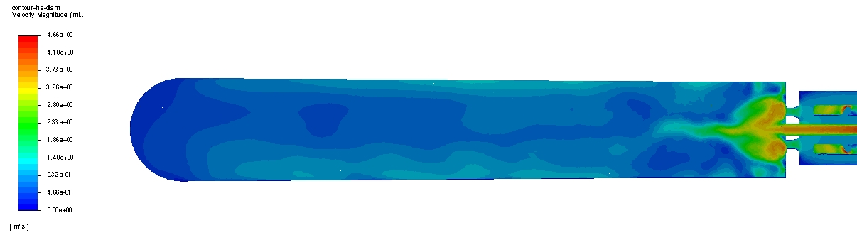
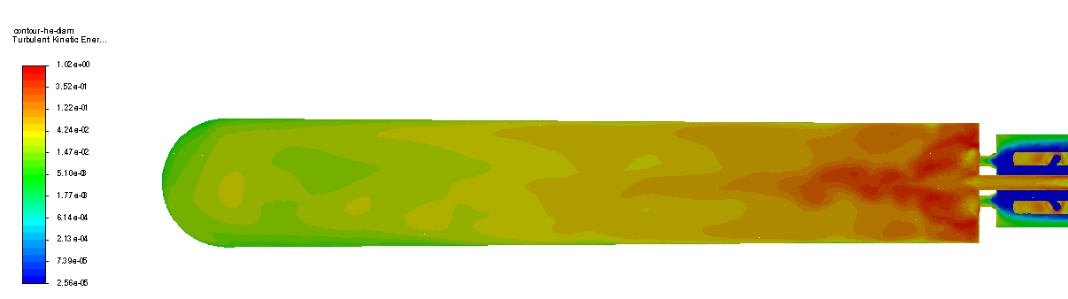
Velocity Magnitude
Velocity Magnitude
Low probability for bubble coalescence
Turbulent Kinetic Energy
Side View Midplane

Slide 12
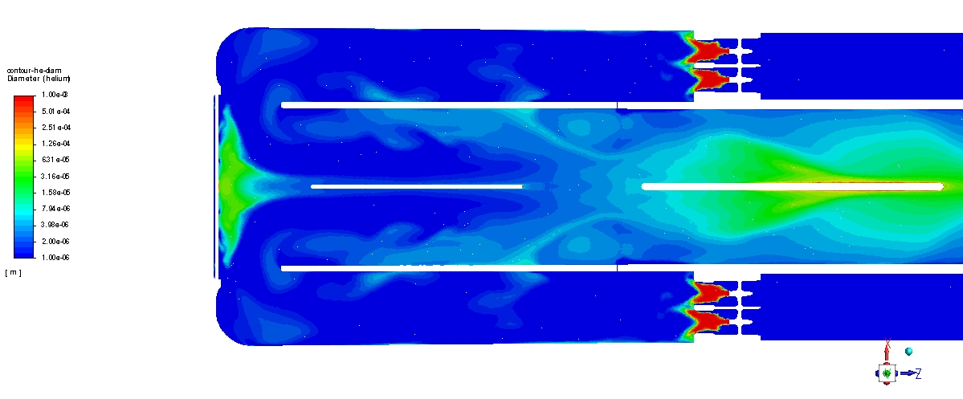
CFD Results-Bubble Size Distribution
Bigger than 1mm at swirl bubbler -gas outlet
Breakdown due to swirl
Bigger bubbles at nose center ~ 130 microns
Bubbles at nose ~ 20-60 microns
Top View Midplane

Slide 13
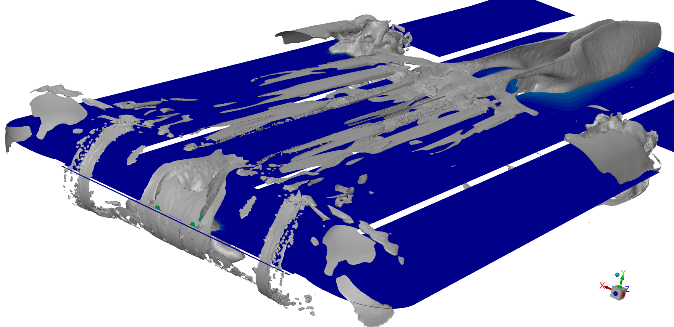
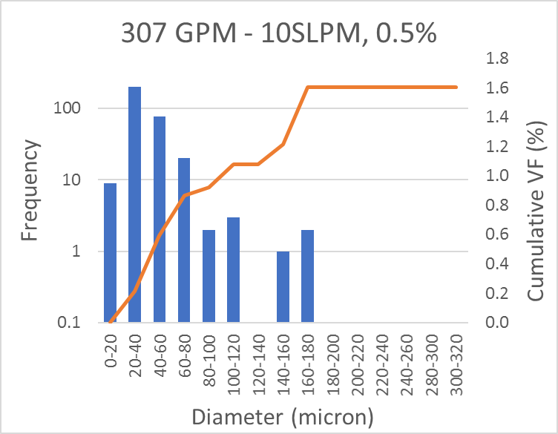
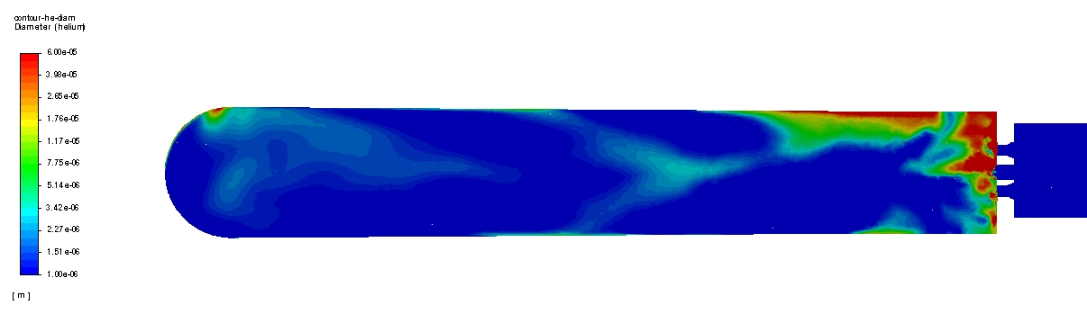
Side View Bubble Size Distribution at Inlet’s midplane
Measured BSD in mercury at the SNS-TTF for Swirl bubblers
CFD BSD Iso-surfaces 20 to 250 microns
6E-05
1E-06
CFD-BSD in Side View Midplane

Slide 14
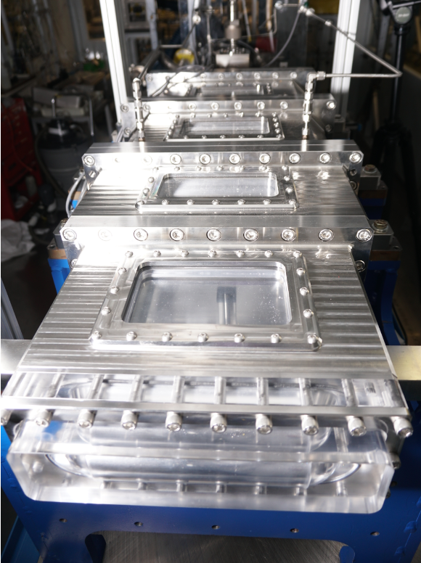
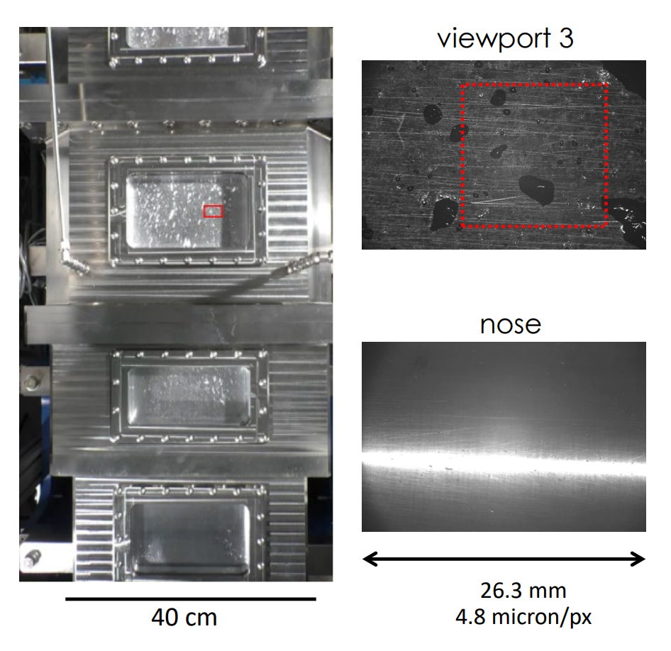
Updated Test Facility—2 MW Target Design
Experimental Setup
Scale 1:1
Working fluids: Liquid mercury and helium
Viewing ports: four top windows and transparent nose
Measurement capabilities
Shadowgraphic imaging
Flow visualization

Slide 15
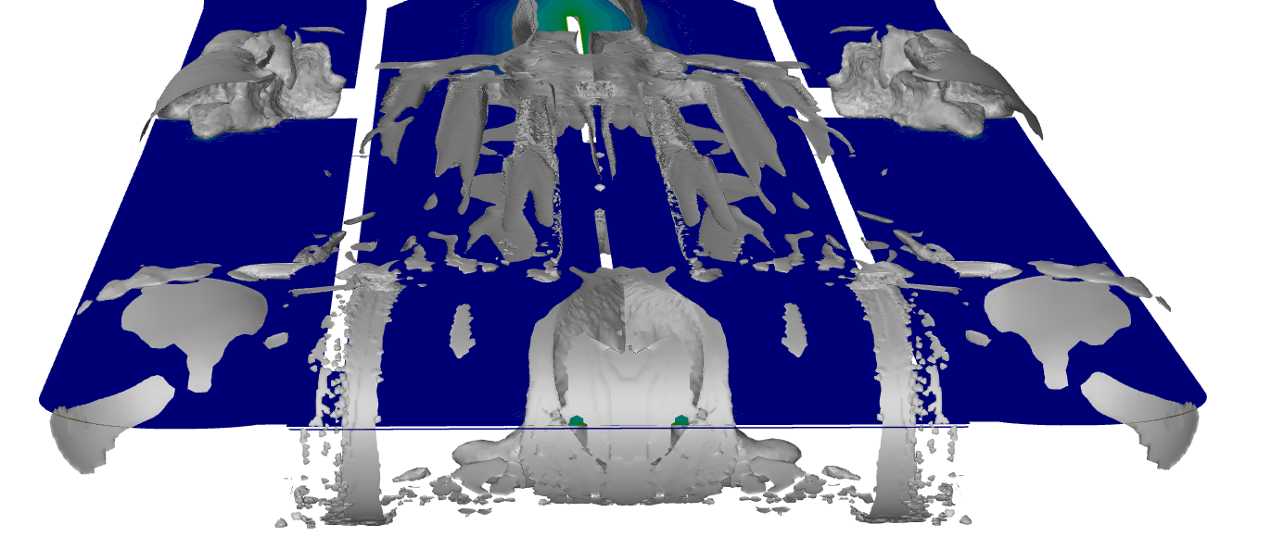
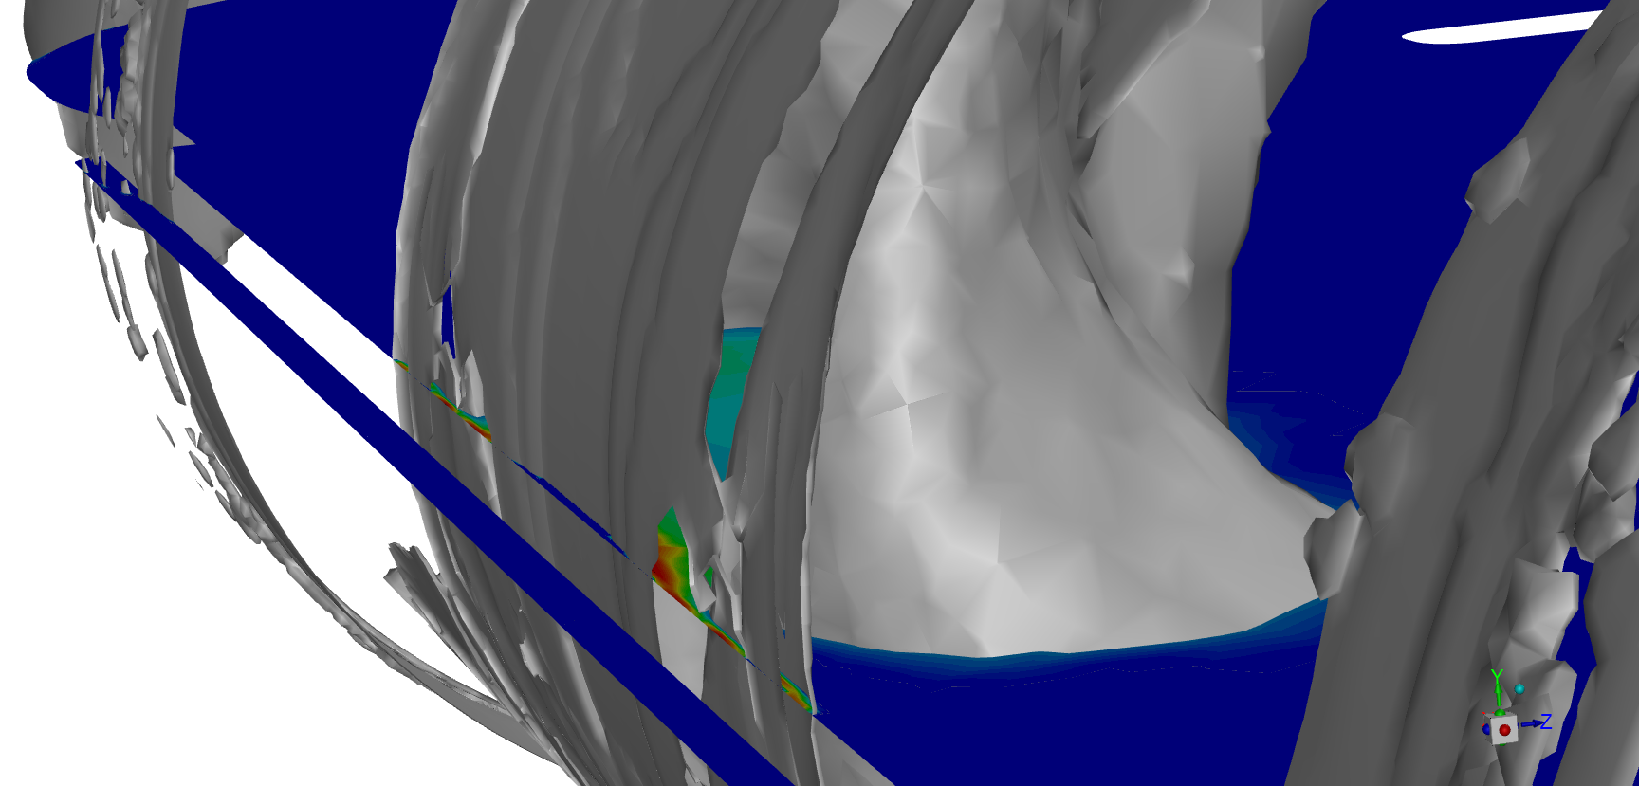
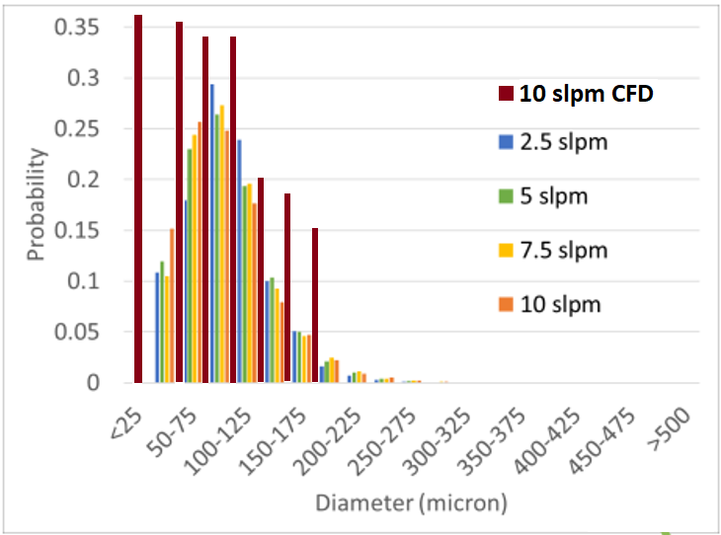
Comparison with measurements at the Nose
Iso-surface front view
--6E-05
--1E-06

Slide 16
Summary
Bubble injection is used as a mitigation mechanism for strain reduction and cavitation erosion at the SNS
Multi-phase CFD was used to obtain bubble size distributions produced by swirl bubble injectors
  Limited data was used to compare simulation results
  Current efforts to obtain further V&V data are undergoing
The technique was successfully implemented with encouraging results for bubble size distribution in prototypical target geometry using liquid mercury as the working fluid
CFD capabilities are expected to be used as tool to improve predictive models of BSD and fluid flow behavior in the SNS target

Slide 17
Backup slides

Slide 18

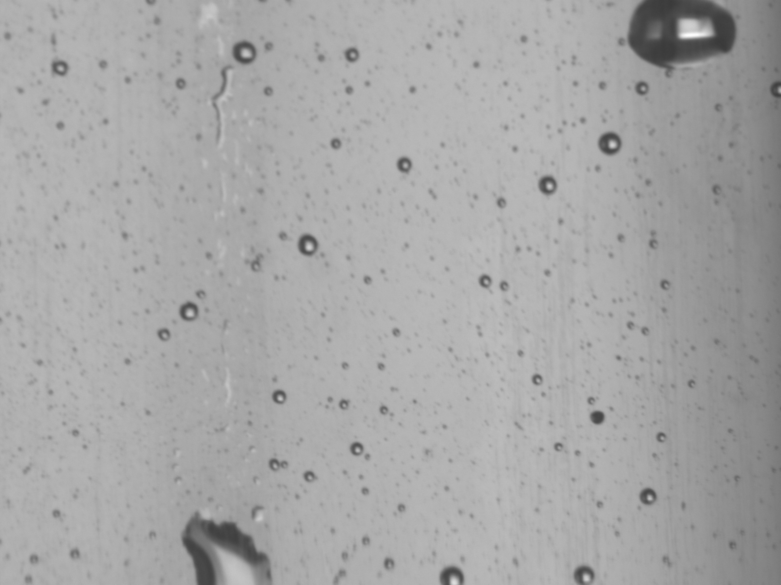
BSD Measurements in liquid mercury -Swirl Bubbler using a pitot tube sampler
11.2mm (~4.4 μm/px)
Valve 1
Valve 2
Example of obtained pictorial showing helium bubbles at top of viewing port
Sampler
tube
Bubble size measurements in mercury
Bubble size distribution
(BSD)

Slide 19
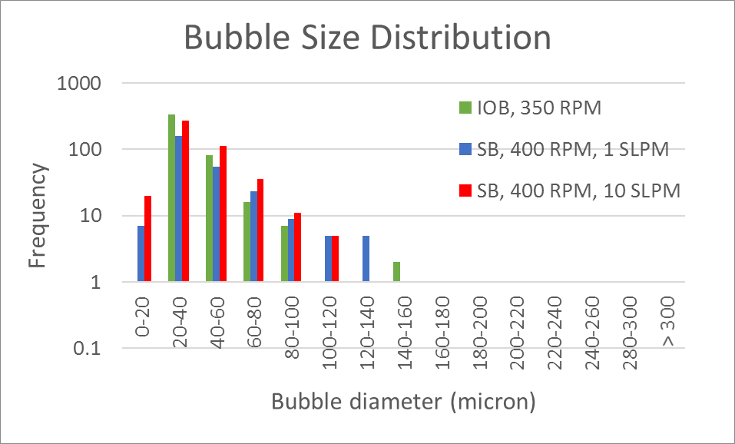
Comparison with measurements at the Nose
Iso-surface front view

