Slide 1
Overview of the design status of IFMIF-DONES Lithium Target System
J. Maestre on behalf of WPENS

Slide 2
Outline
Introduction to IFMIF-DONES
Validations and prototyping
Target System
Summary
Overview to Lithium systems

Slide 3
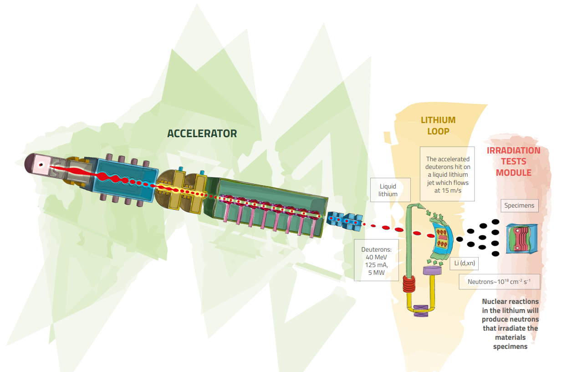
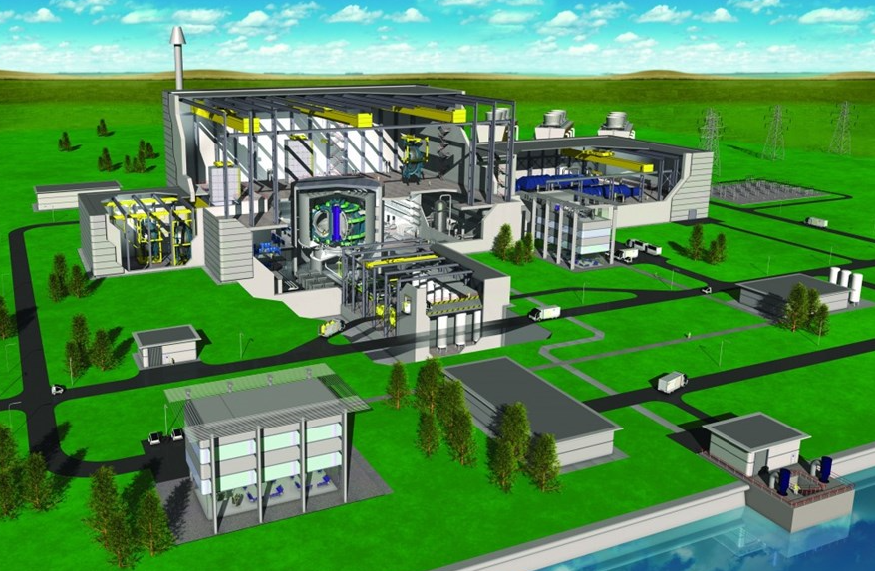
Introduction
IFMIF-DONES is and accelerator-based fusion-like neutron source for
the qualification of the materials oriented to DEMO
~20 dpa/year
DEMO: Fusion reactor
Being designed to operate continuously providing electricity to the grid (~2-4 GW), showing commercial nuclear fusion is technically feasible. Q>10, 2050
Neutron spectrum up to 55 MeV energy
High Flux Test Module:
20 dpa/fpy in 100 cm³ of material

Slide 4
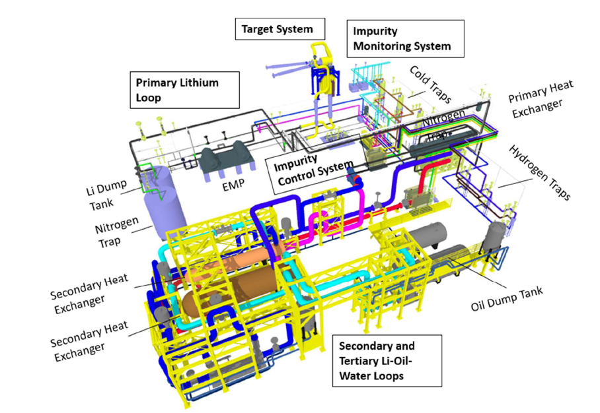
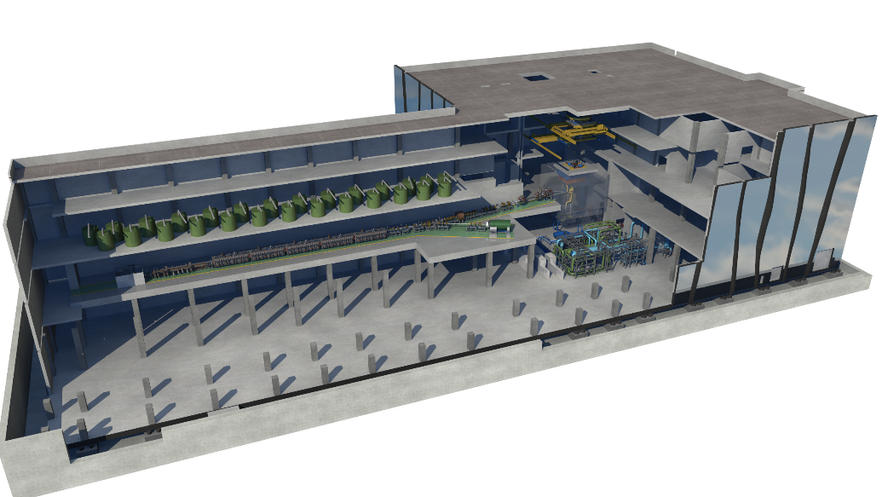
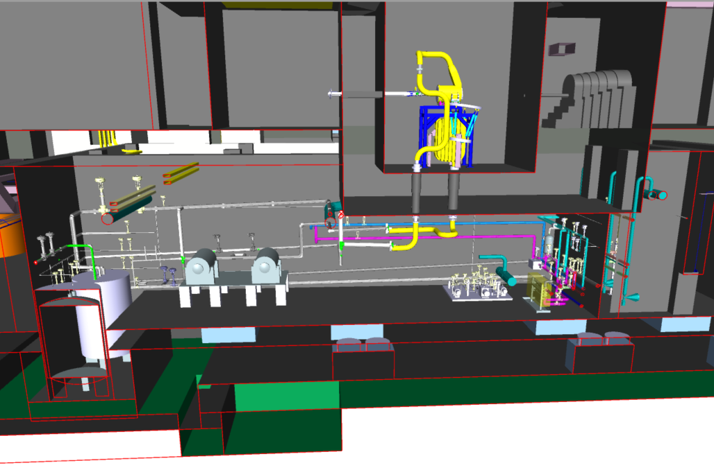
Lithium Systems: overview
Top level requirement: To generate a stable liquid lithium target for enabling D-Li stripping reaction and producing an adequate neutron flux to properly irradiate the test modules downstream.
Test System
Accelerator System
Lithium System
Main parameters:
Li inventory ~14 m³
Li flow rate ~100 l/s
Li working temperature (cold side) 300 °C
Deposited power: 5 - 10 MW
Test Cell
Li Target
beam
Li Systems
Target System: To provide a continuous Li jet whose interaction with D+ beam generates the Neutron flux.
Heat Removal Loop: To remove the energy deposition on the Lithium.
Impurity Control System: To localize and control the impurities in the Lithium.

Slide 5
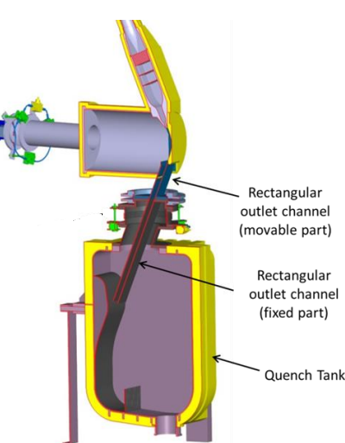
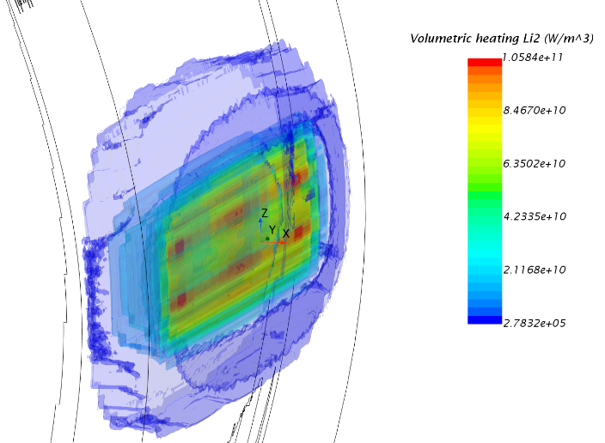
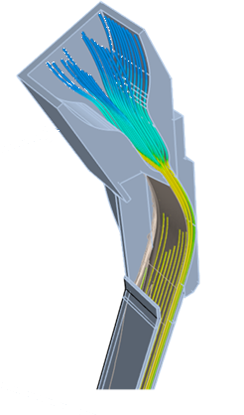
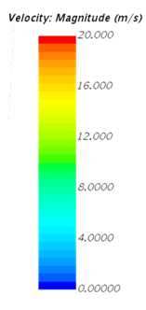
Target System: description
Main requirements
Fig. Distribution of the energy deposition in the Li jet as result of beam-Li interaction
To optimize the production of an intense enough neutron flux to irradiate the test module.
To remove beam energy deposition (5MW-10 MW)
Two type of beams 200 x 50 mm² and 100 x 50 mm²
Through wall beam duct
Inlet nozzle
Design
Nominal liquid Lithium jet speed of 15 m/s at the exit of the nozzle
Curvature of BP for avoiding Li boiling
25 mm thin Li jet and slim Back Plate to reduce neutron re-absorption (1.8 mm)
Hydrodynamic optimization preventing cavitation/boiling
10E-4 mbar
50 mm
200 mm
Many supporting analysis
Thermo-hydro-mechanics (most recent studies):
Updated thermo-mechanical and hydrodynamic analyse of the Target System (E2QEFZ9). (2023.Sep)
Update of seismic analysis of Target System (2QAPVV) (2023.Jun)
Detailed design of TCE penetrations and piping connections in the LS (2PMGUU) (2022) and other anchoring TSY-HFTM (2PE8MK)
Fatigue evaluation induced by fast Beam Transient (2020)
Final numerical analysis of Li jet, BP discharge line and QT for beam on operation conditions (2NTGD9) (2020.Oct).
Consequences on Beam shift in transversal direction (2NXPR9). (2023.Mar)
Thermal induce pressure waves due to beam trips (2NKLFE) (2021.May)
Consequences of reduced jet thickness during operation condition. (2NHYG5) (2019.Feb)
Etc.
Fig. Velocity field distribution in the nozzle and BP

Slide 6
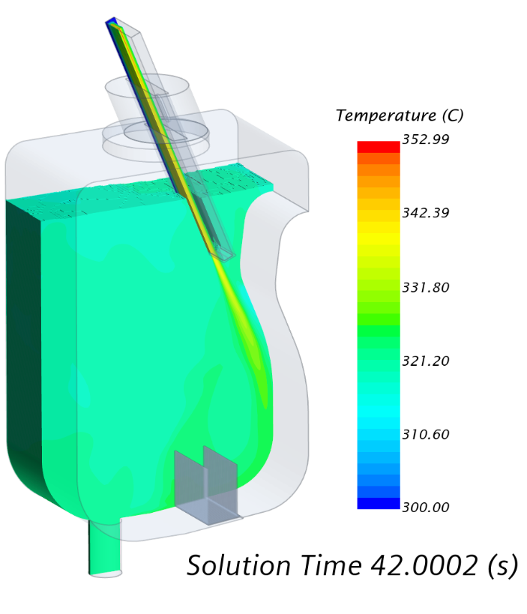
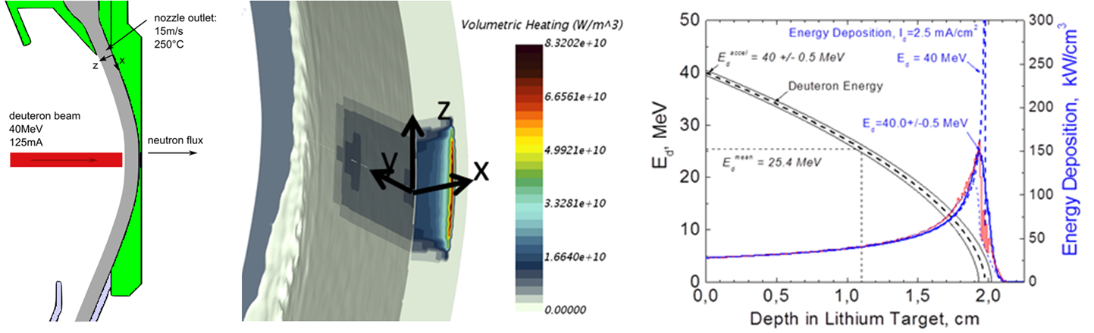
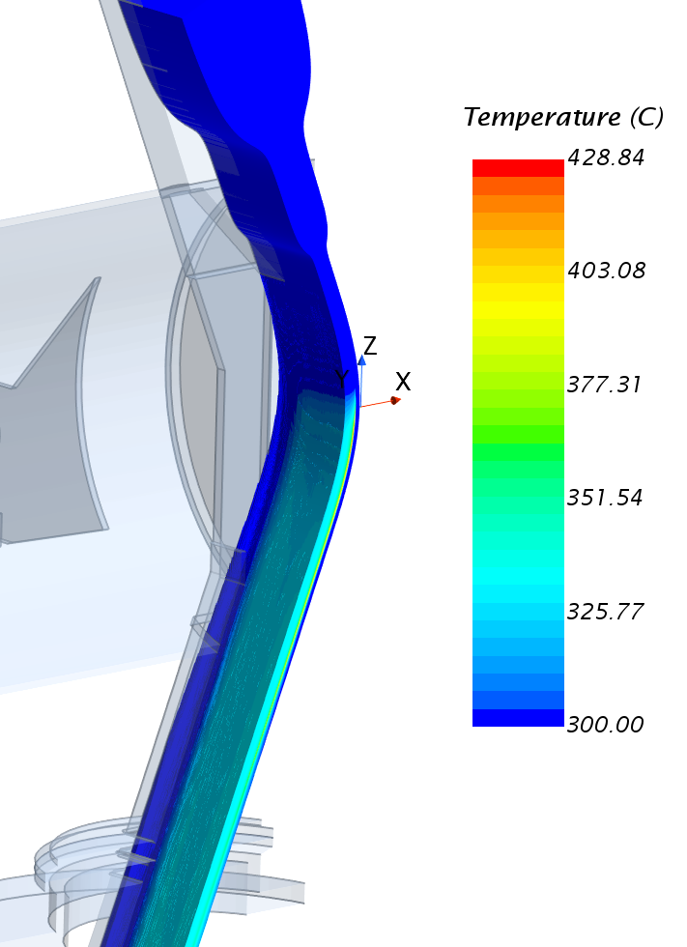
Target System: analysis
Analysis under nominal conditions
Courtesy of S. Gordeev, A. Serikov, Q. Yuefeng (KIT, Germany)
P= 10E-4 mbar
Fig. Beam energy deposition on the lithium jet
Fig. Temp distribution in the Li jet and Quench Tank during beam on
High density power deposition ~85 kW/cm³
Deuterium Bragg - Peak at 20 mm (25±1 mm thickness)
Design for two different Deuterium beam: 200 x 50 mm² and 100 x 50 mm²
High temperature in the bulk lithium (~425ºC), while the average temperature is 318 ºC
QT homogenizes the temperature and quenches the flowing lithium before being reinjected to the Li loop

Slide 7
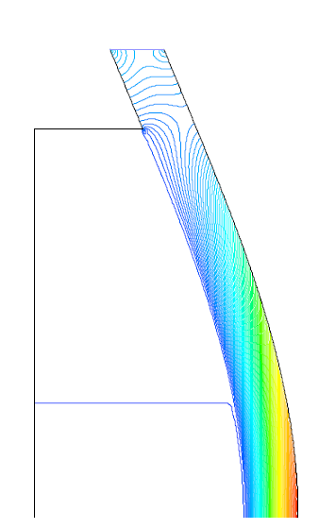
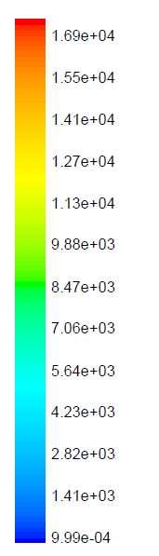
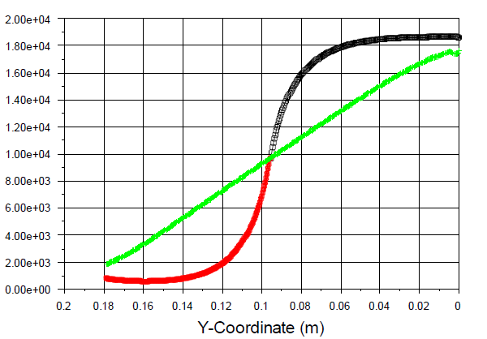
Target System: analysis
Analysis under nominal conditions
By f. S. Nitti (ENEA, Italy)
Lithium jet is exposed to the Accelerator vacuum 10⁻² Pa
Risk of Lithium boiling.
Pressure distribution in the Li jet
P [Pa]
Y
- V_{Li} 20 m/s
Pressure distribution along the back Plate
Margin in temp.
P [Pa]
Cte curvature
- V_{Li} 20 m/s
Margin in pressure
- V_{Li} 20 m/s
Variable curvature
- V_{Li} 15 m/s
P= 10E-4 mbar
- V_{Li} 10 m/s
BEAM
Variable curvature
Beam
Suitable design of the Back plate to prevent boiling at the free surface and inside Li jet.
Analysis of different Back Plate shapes and flow velocities. Variable curvature provide a smooth pressure variation along the BP.

Slide 8
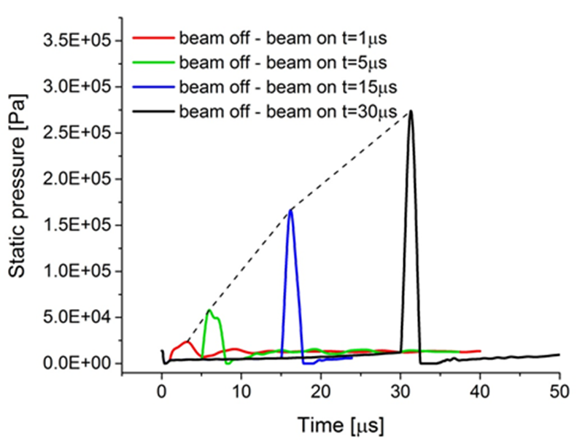
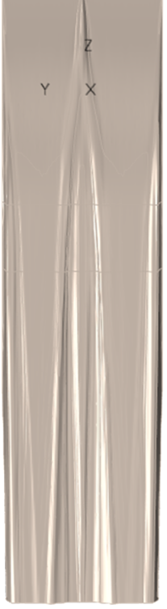
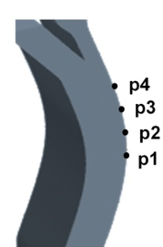
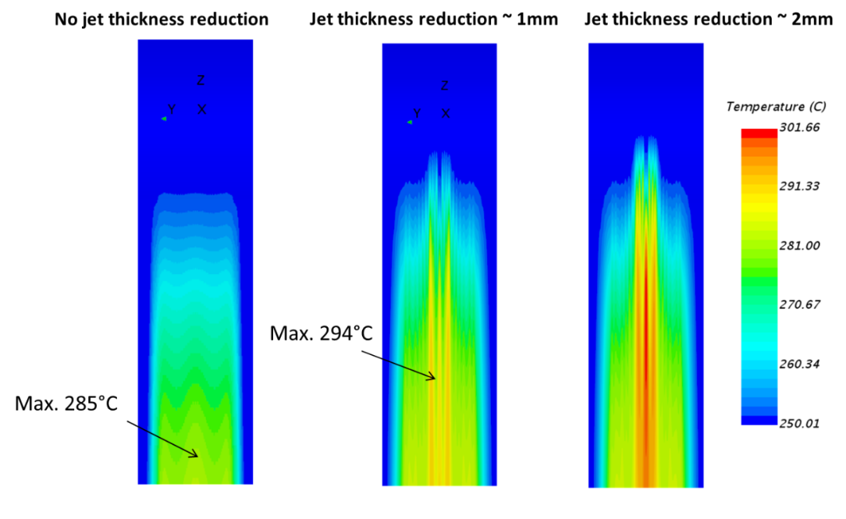
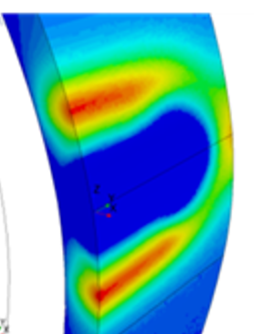
Target System: analysis
Analysis under off-nominal conditions
By S. Gordeev (KIT, Germany)
Li jet thickness reduction due to a degradation/defect of the Li inlet Nozzle
According to experts and previous operational experience (LIPAc), there can appear beam trips (beam off-on) O(μs).
Parametric analysis of trips
Inlet nozzle
Beam on
Beam on
Li jet
Beam on
Li jet
Beam on
Beam off
Simulations detect no occurrence of cavitation in the zone of low pressure after the beam-off.
Maximum pressure is reached for a sudden beam-on with a span of 30 us, this being 0.3 MPa.
No damage BP, including Fatigue analysis.
Temperature difference of 9ªC (1mm) and 16ºC (2mm) on the Back plate side.
No damage to the BP
Note that the simulation was made for a nominal temp of 250ºC

Slide 9
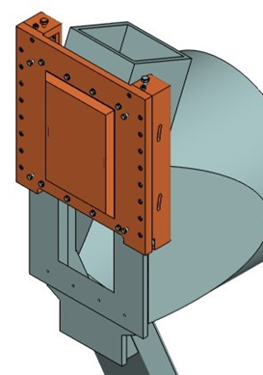
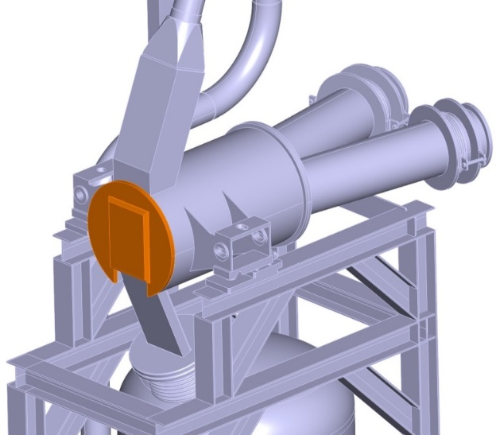
Target System: analysis
Analysis of lifetime
By D. Bernardi (ENEA, Italy)
EUROFER (Ferritic/martensitic steels ) exhibits a shift on its behaviour from ductile to brittle for a given range of temperature, called DBTT. No irradiated one is about ~ -90 °C, so it is not an issue for normal applications.
When the material is irradiated with high energy neutrons, the DBTT increases and, at high doses, it can eventually reach the operating temperature
Rough estimation of lifetime of the Back Plate based on DBTT as F(irradiation time)
The strategy is to periodically replace partially or completely the Target during the yearly long maintenance
Mechanism to remove BP. It relays on energized gaskets (Helicoflex)
welded BP
Working temp 300ºC + 90 (DBTT)
Integral concept of Target
Removable BP concept
Integral design concept is currently considered as baseline design whereas the removable version is validated.
~8-9 months working at full power

Slide 10
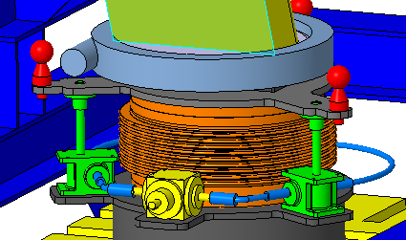
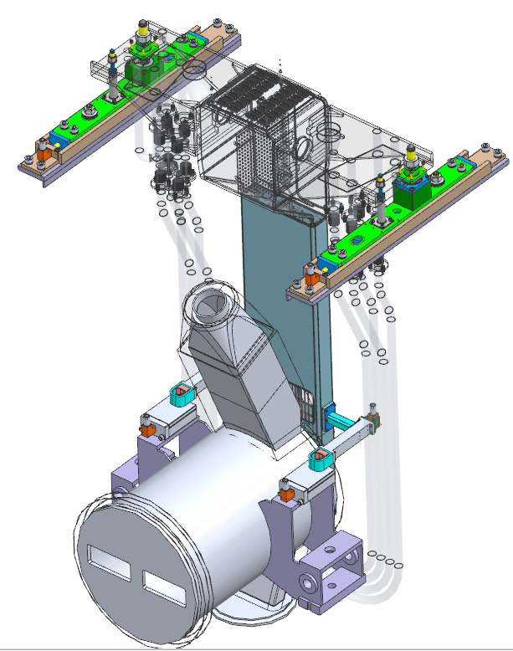
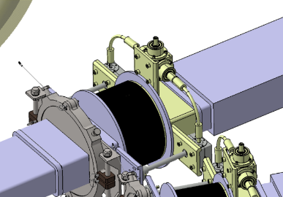
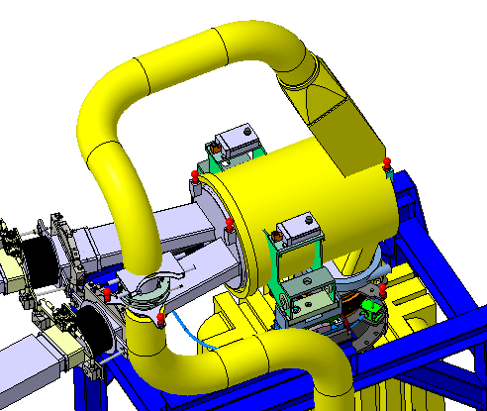
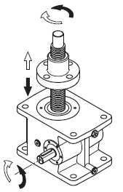
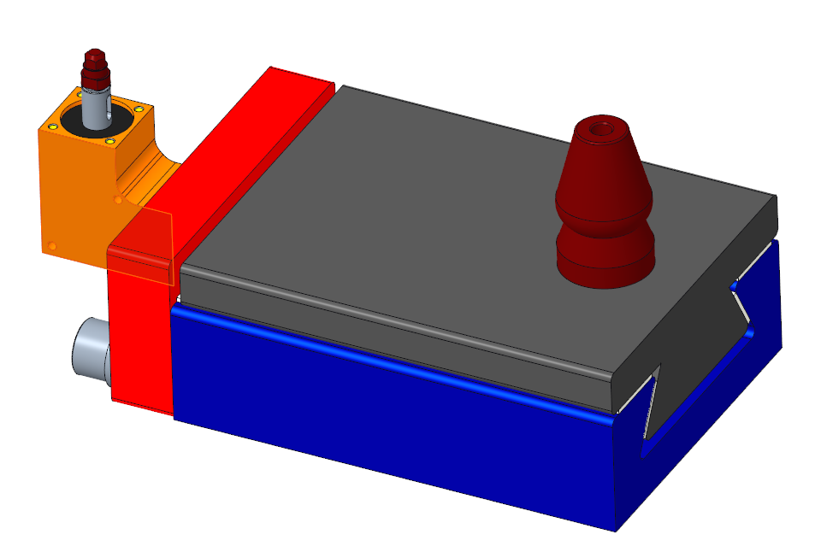
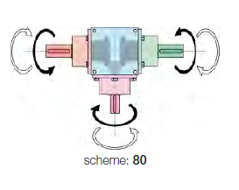
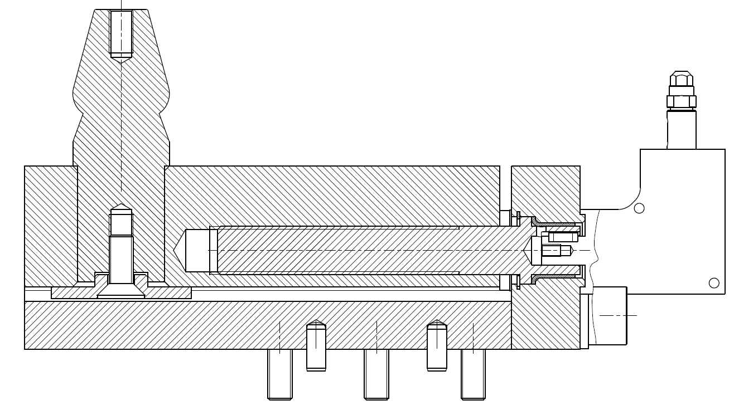
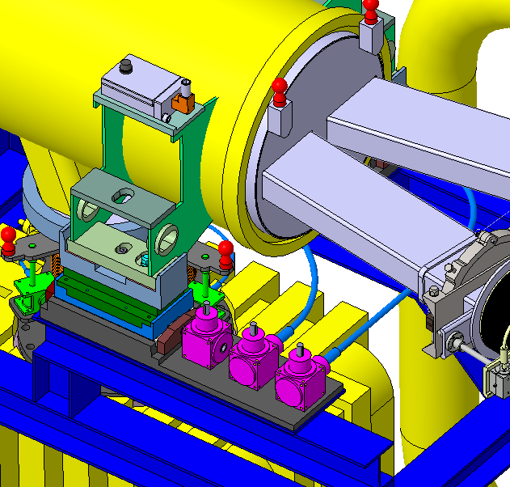
Target System: replacement
Replacement strategy and features
There are 4 connections points: Through wall beam ducts; Inlet pipe; Outlet channel
Target supported by the Target Support Structured attached to the floor of the Test Cell
Linked with the HFTM
Remote handling compatible
TX
Ball joints, slides
Fiducials
TY
Excentres
TZ
TX
Spindle drives, slides
QDS
Small gearboxes
Gearboxes, spindle/nut, flexible shafts (remain in the TC)
FDS
TZ
Guided Fast disconnection system
TY
TX
Small gearboxes, spindle/nut, slidings (ceramic/ceramic or steel/ceramic)

Slide 11
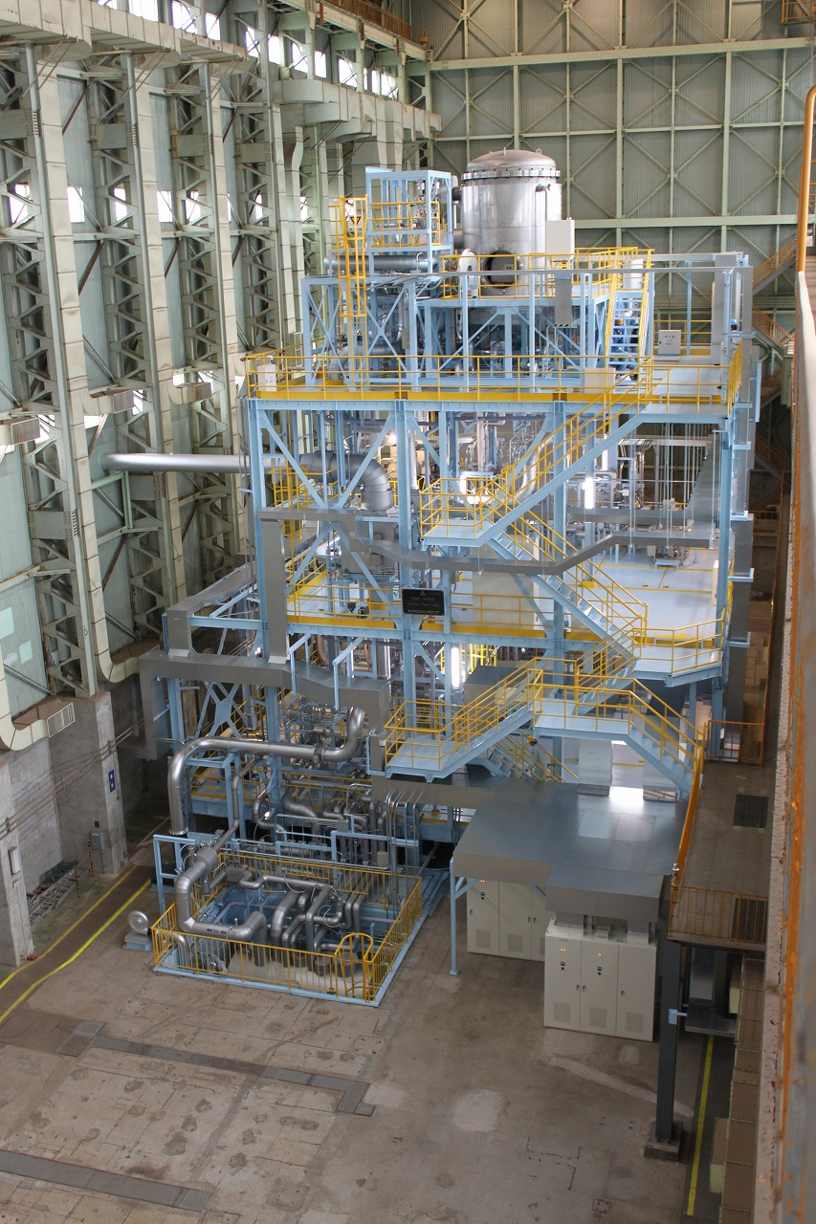
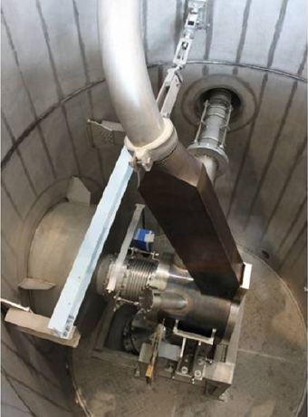
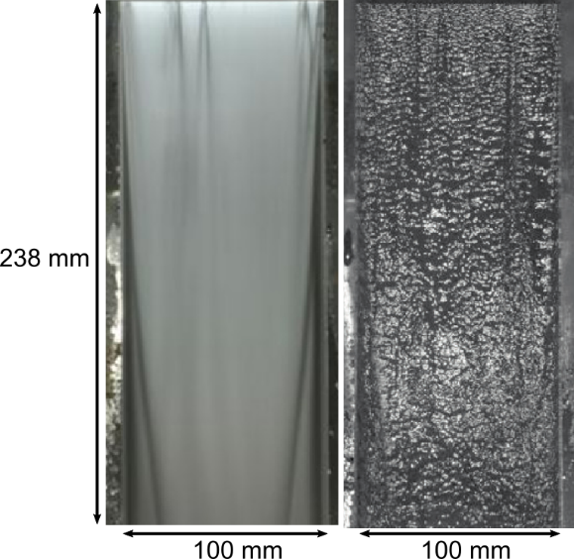
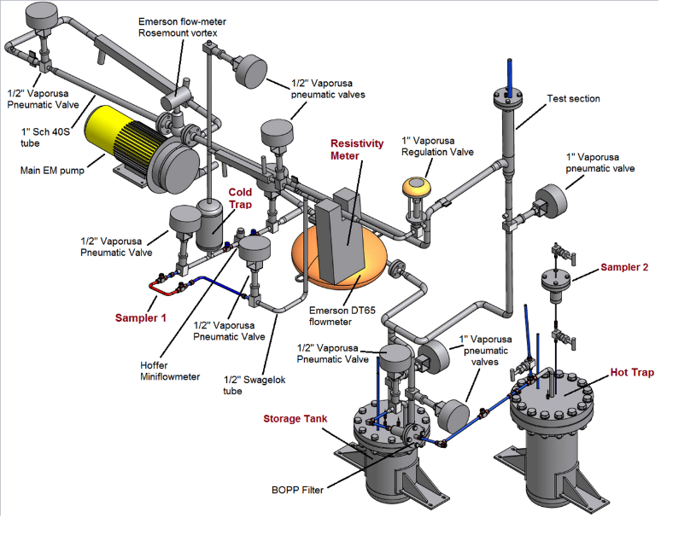
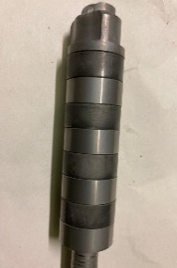
Validations and prototyping (IFMIF-EVEDA)
Lithium Test Loop (ELTL) at Oarai (Japan) during IFMIF/EVEDA
Lithium loop at real scale 1:1 for loop high and 1:2.6 for target width with respect to DONES.
Engineering validation for lithium target facility of the IFMIF under IFMIF/EVEDA project. Nuclear Materials and Energy, Vol 9, pag. 278-285 (2016)
Fig. Prototype of the Target
Fig. free jet taken with 2 s and 10 µs exposure time
Fig. ELTL facility in Japan
Validations
  Lifus-6
Long time operation (>3800 h)
Fluid-Dynamic stability of the Li jet (1300 h). Suitable flatness of the free surface (non uniformity < 0.28 mm)
Li jet ranging from 10 - 20 m/s
A. Aiello et al. Lifus (lithium for fusion) 6 loop design and construction. Fusion Engineering and Design Volume 88, Issues 6–8, October 2013, Pages 769-773
Facility for corrosion/erosion test under flowing lithium N-trap: Control of N impurities
Fig. Lifus-6

Slide 12
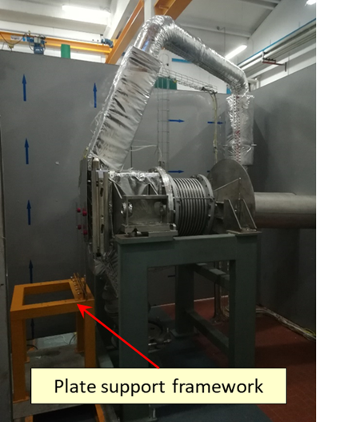
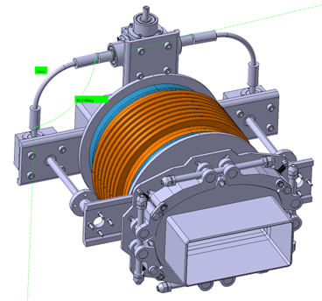
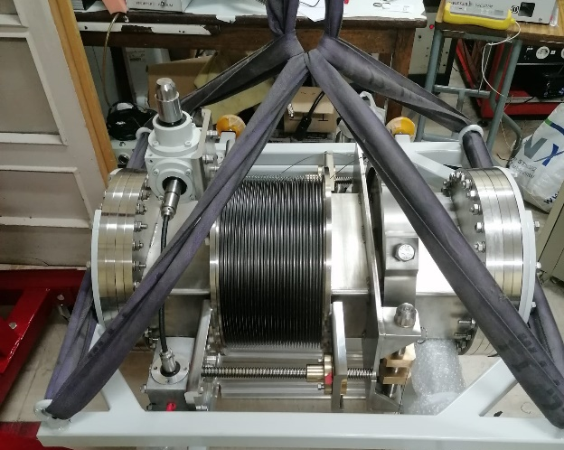
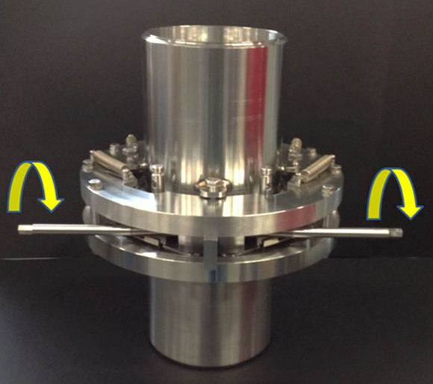
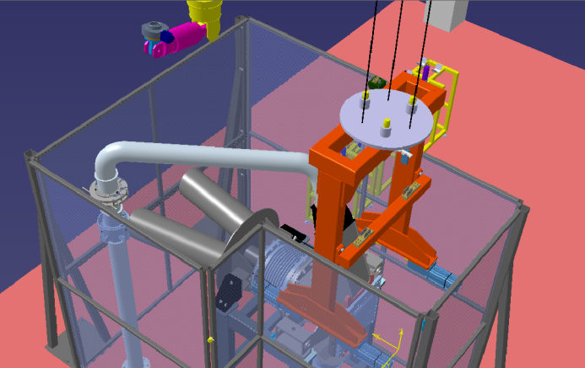
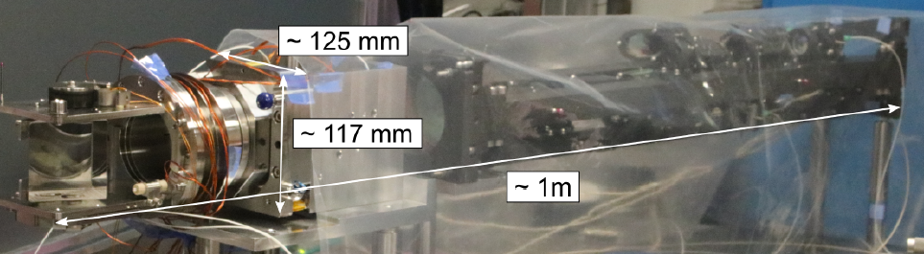
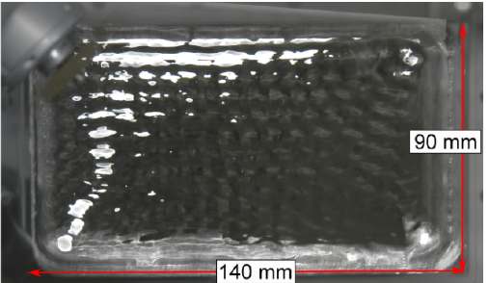
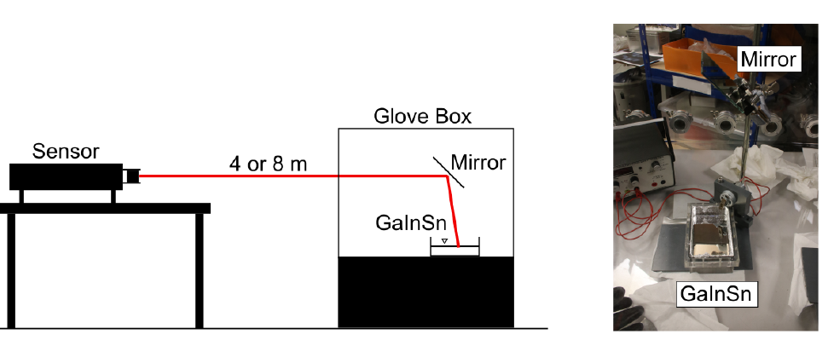
Validations and prototyping (WPENS)
Prototype of QDS/FDS
Target Mock-up
Li diagnostics
Results of Target Pre-heating Test (EFDA_D_2NHGLF v1.0)
Manufacturing of prototype for connection of the fast disconnection system (FDS) of the Li inlet pipe
Manufacturing of prototype for connection and disconnection mechanism (QDS) by remote control in IFMIF-DONES project
Heating jacket
Analysis of the RH procedure of the TSY
Back Plate
IVVS
Experimental campaign of IVVS sensor for the Li target 2022 (EFDA_D_2PGCLA v1.1)

Slide 13
Summary
Intense design & validation work was already carried out during IFMIF-EVEDA (2010), proving the successful operation and main key technologies of the Lithium system (including the construction of ELTL prototype).
This design work has been continued within EUROFUSION WPENS, reaching a higher definition level supported by many analysis, and thanks to the contribution of different Research Units (and industry).
Most of definition design activities are to be concluded soon, whereas engineering validation activities are on-going for gaining farther experience and increasing TRL before handover. Main pending validations:
  Removable concept of the Back Plate of the Target.
  Replacement strategy of the Target System and auxiliary sub-systems.
  Diagnostic.

Slide 14
Thanks
Any advice or suggestion is welcome

Slide 15
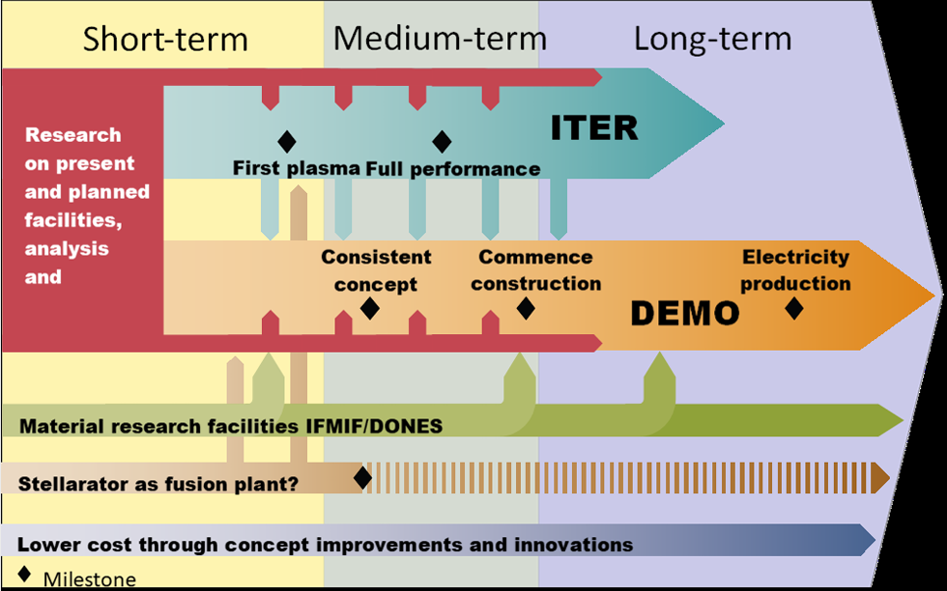
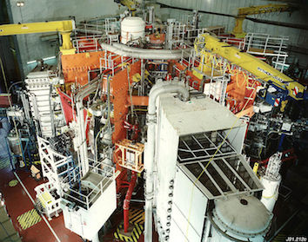
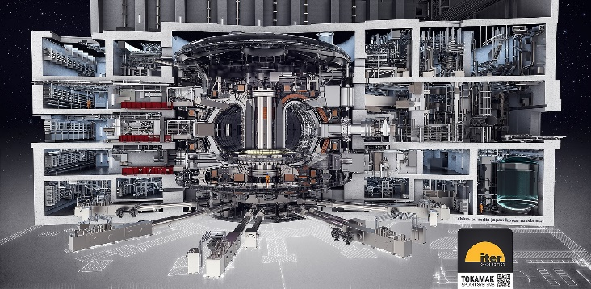
Introduction
MAGENETIC CONFINEMENT FUSION
Main challenge:
Materials capable of withstanding the thermal loads and irradiation effects that may occur on the chamber walls.
Engineering Standards
See https://www.euro-fusion.org/eurofusion/roadmap/
1-3 dpa/lifetime
~20 dpa/year
JET (80 m³)
JET started its operations in 1983. It was designed to study plasma behaviour in conditions close to those required for a fusion reactor. (16MW and Q<1 still)
ITER (800 m³)
ITER under construction in Cadarache (France). To demonstrate the scientific feasibility of fusion energy (500 MW of power from fusion energy with Q>10) no connected to the grid.
DEMO (~1000-3500 m³):
Being designed to operate continuously providing electricity to the grid (~2-4 GW), showing commercial nuclear fusion is technically feasible. Q>10, 2050

Slide 16
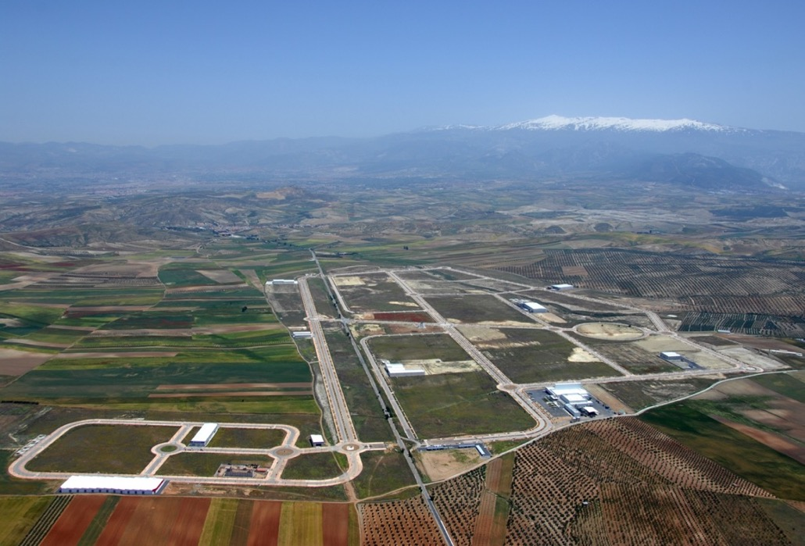
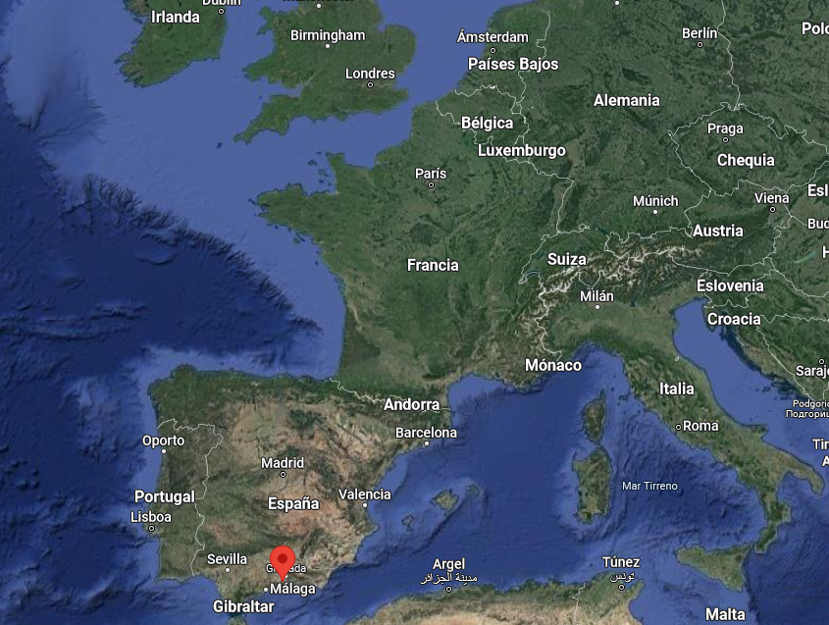
Introduction
Granada (Escúzar)

Slide 17
Lithium Systems: overview
Test System
Accelerator System
Lithium System

Slide 18
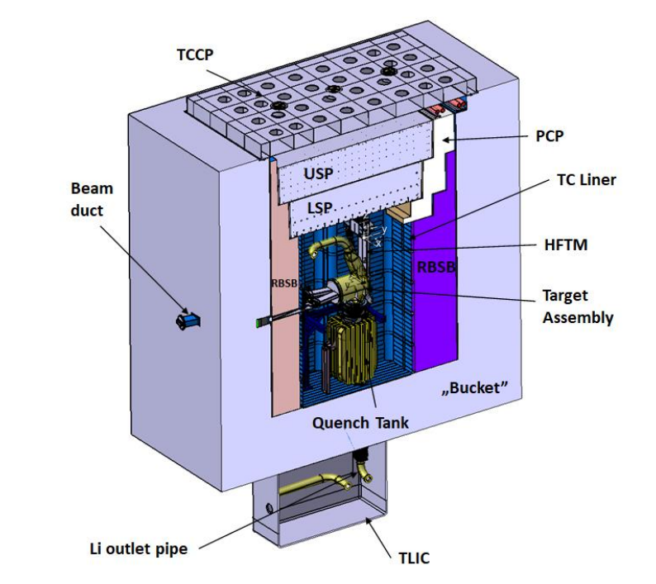

Target System: Description
Main parameters:
Li inventory ~14 m³
Li flow rate ~100 l/s
Li working temperature (cold side) 300 °C
Deposited power: 5 – 10 MW
Beam
Challenges:
Hydro-dynamic stability of the of Li
High corrosion and erosion of Lithium with structural material
High reactivity of Lithium
Target System exposed to extreme conditions: ~20 dpa/fpy; Thermo-mechanical loads
Target System is allocated inside Test Cell, concrete cell covered by a stainless-steel liner under a controlled environment (He or Ar)
No safety credit is provided to the Target. TC liner is considered the confinement barrier together with the penetration, closed by safety valves.
Temperature of the liner controlled by water cooling system on the outside

Slide 19


Target System: replacement
Replacement strategy and features
By T. Dezsi
There are 4 connections points: Through wall beam ducts; Inlet pipe; Oulet channel
Supported by the Target support structured attached to the floor of the Test Cell
Linked with the HFTM
Quench Tank
TWBD flange position
Through wall beam duct
RTASP2
RQTO
RTASP1/2
RQTO
RBD2
RBD1
RTASP1
RIPF
View without the Target
Target System Structure
Fixed references

