Slide 1
Coupling mercury/ bubble material model in the pulse simulation to predict strain on the Spallation Neutron Source target vessel with gas injection
Hao Jiang
Oak Ridge National Laboratory
High Power Targetry Workshop
Nov. 6-10, 2023

Slide 2
Outline
Background
  Strain measurement on SNS targets
  Strain simulation without gas injection using Riemer’s model
Strain simulation with gas injection
  Develop simulation technique with effect of gas bubble
  Validate simulation with strain data at gas rate of 3.2 SLPM
  Apply simulation technique to different gas injection condition
  Apply simulation technique to different target design
Conclusions

Slide 3
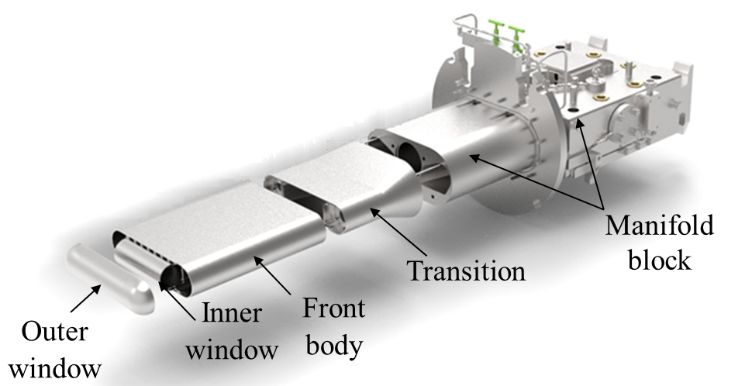
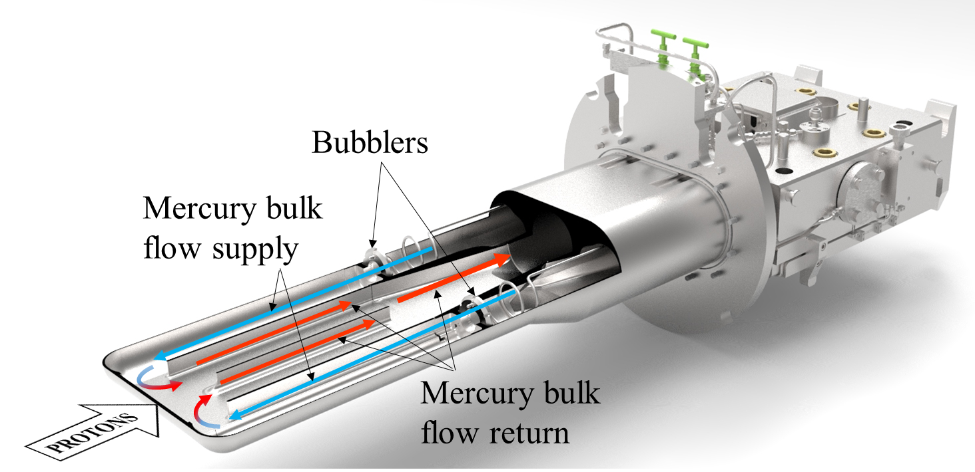
SNS target and strain measurement
SNS Jet-flow target
Strain measurement
ID 39, Yun Liu

Slide 4
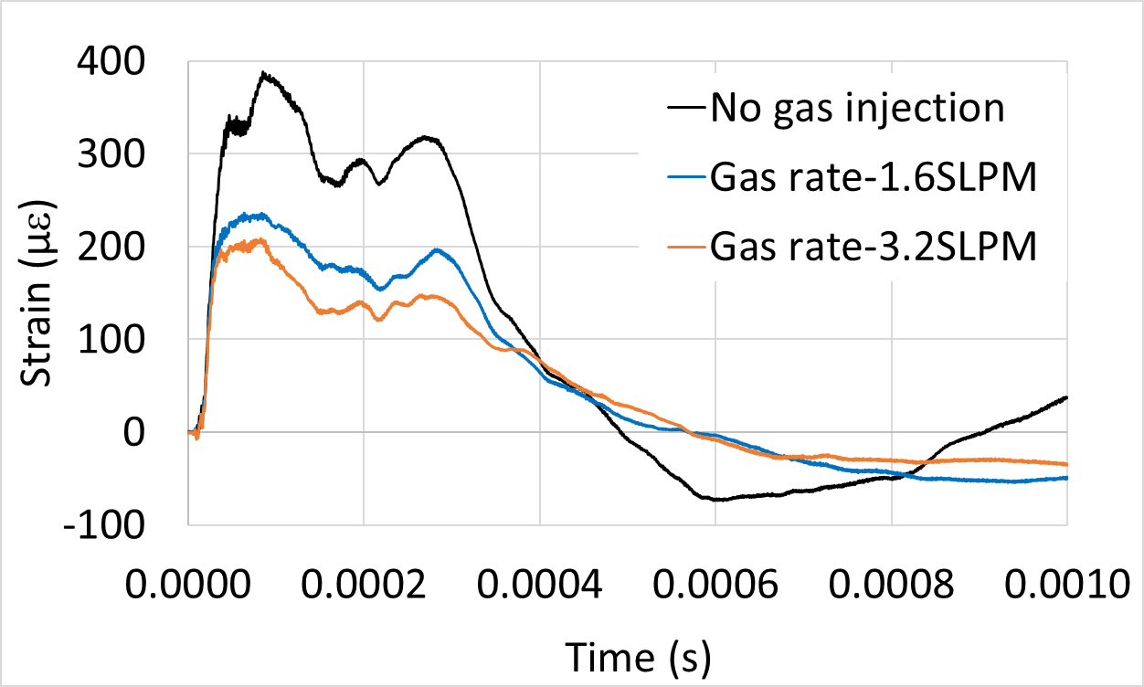
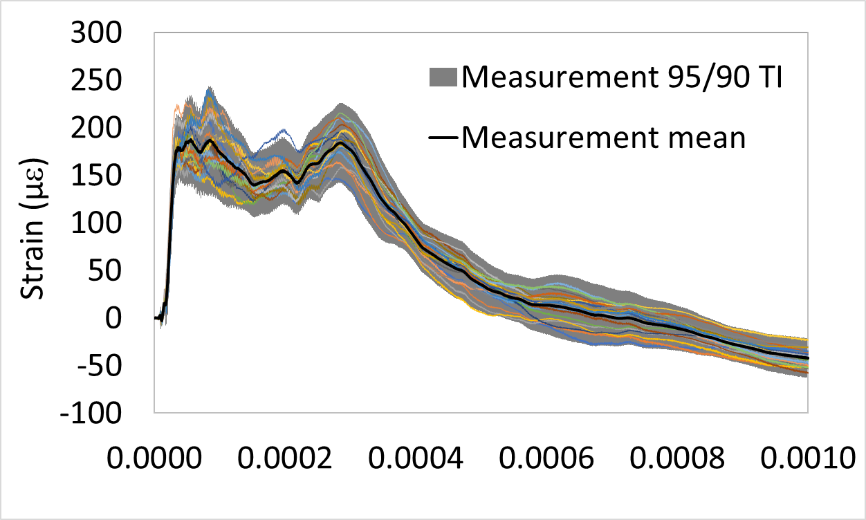
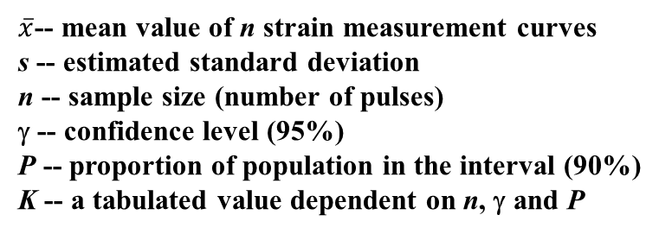

Strain measurement data
Tolerance intervals (TIs)
$$X=\overline{x}±K\left(n, γ,P\right)s$$
$\overline{x}$-- mean value of n strain measurement curves
s -- estimated standard deviation
n -- sample size (number of pulses)
γ -- confidence level (95%)
P -- proportion of population in the interval (90%)
K -- a tabulated value dependent on n, γ and P
Strain reduced 27% (1.6slpm) and 43% (3.2slpm).
95/90 TI results indicates moderate variances in the measured strain responses. The mean value will be used to validate the strain simulation.
Hao Jiang, Drew Winder, Yun Liu, “Repeatability and uncertainty study of strain measured on coupled fluid-structure vessels in response to high intensity proton pulses”, Proceedings of the ASME, Pressure Vessels & Piping Conference, PVP2023, July 16-21, 2023, Atlanta, Georgia, USA

Slide 5
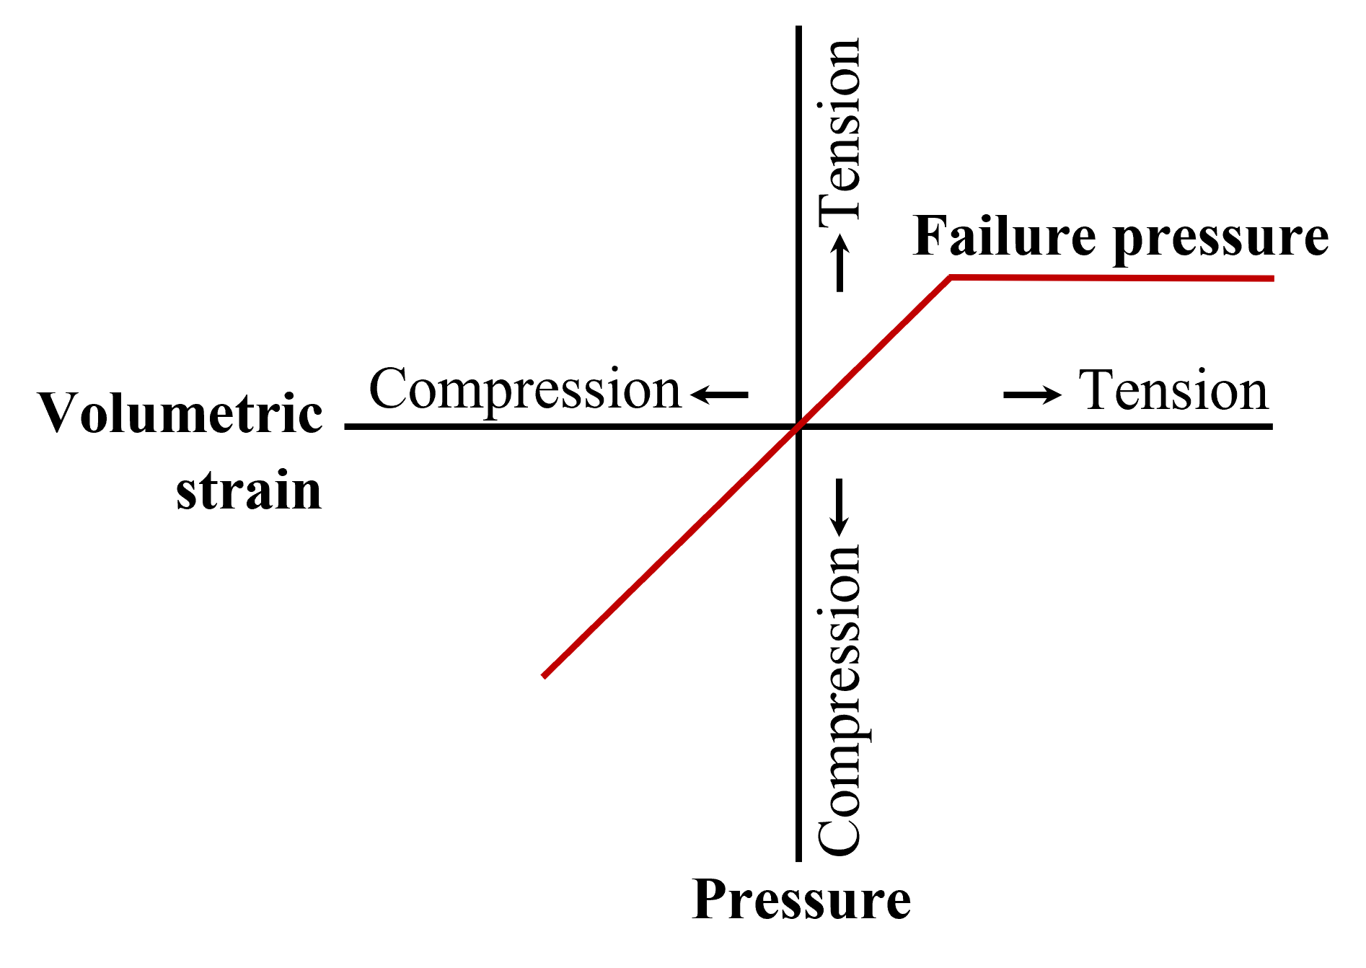
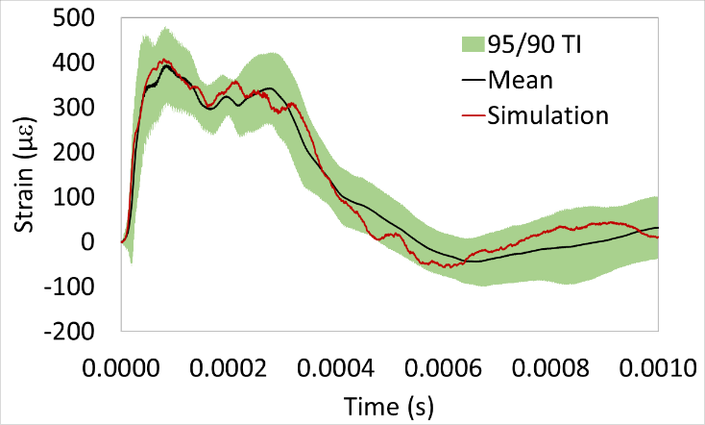
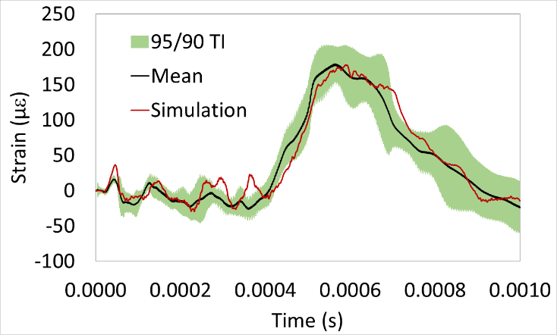
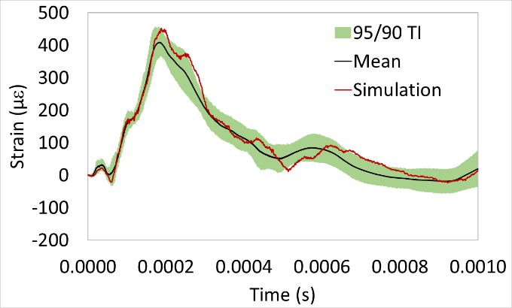
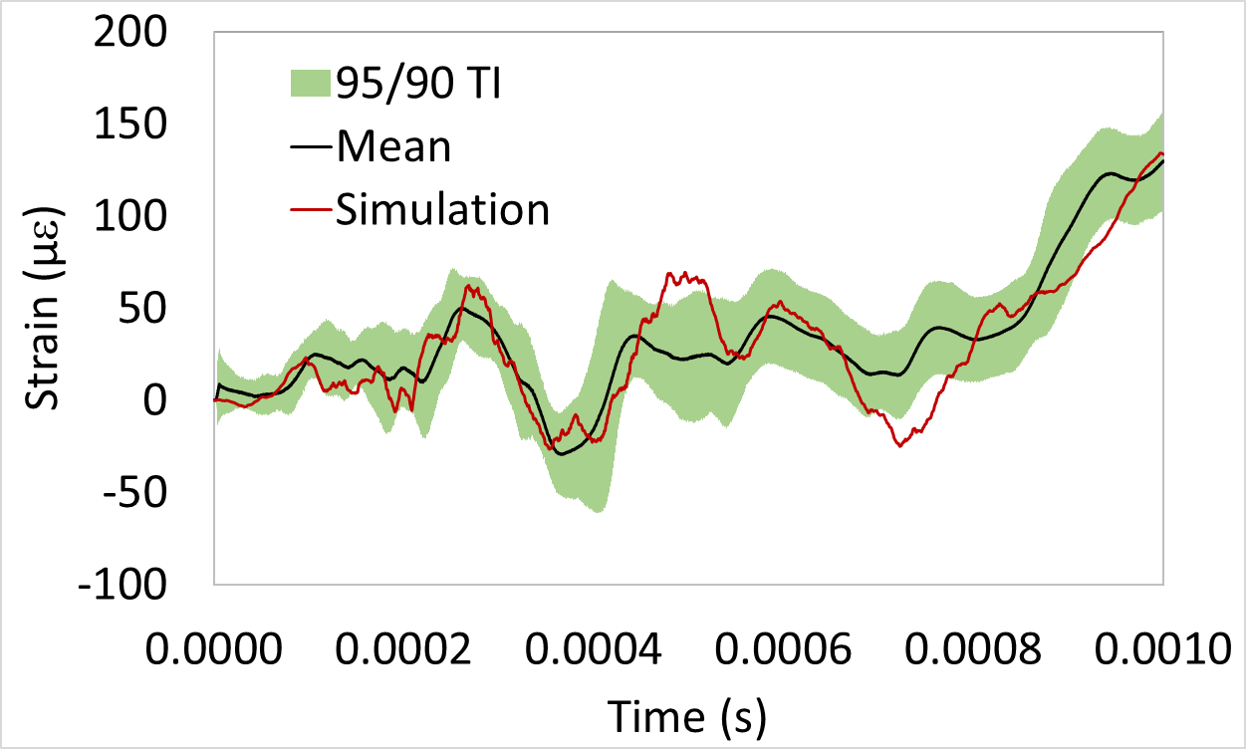
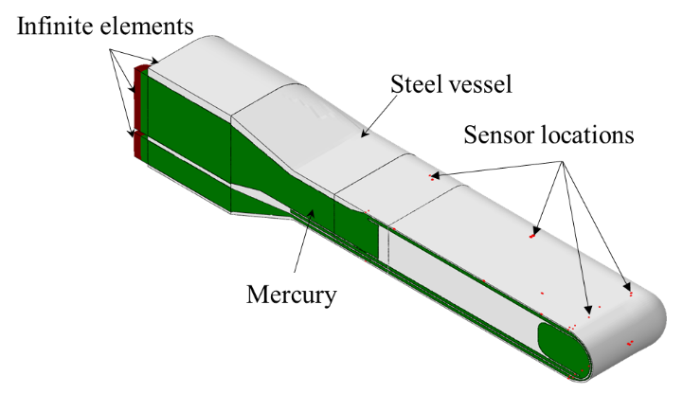
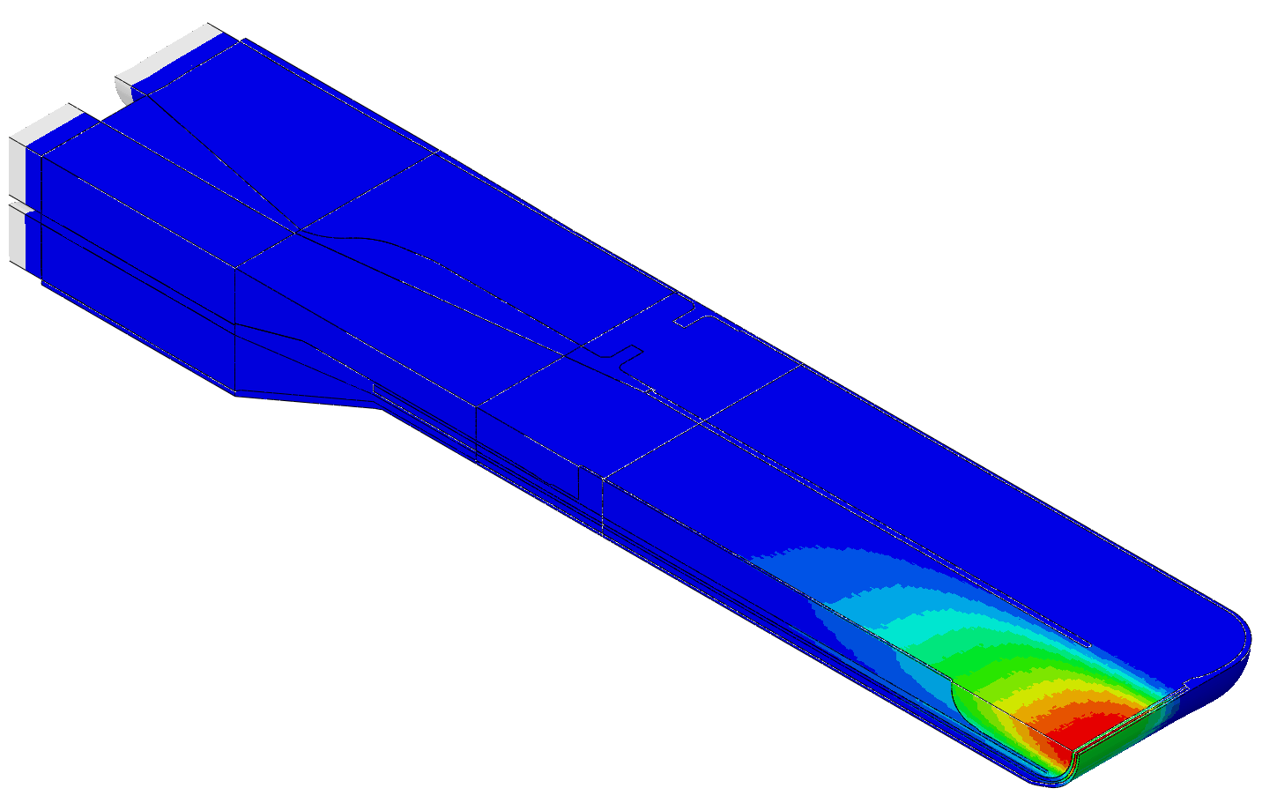
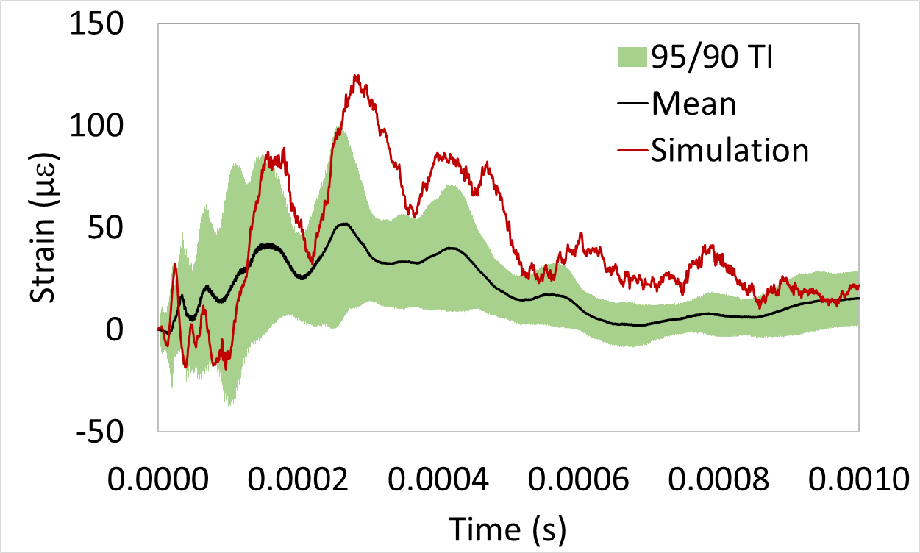
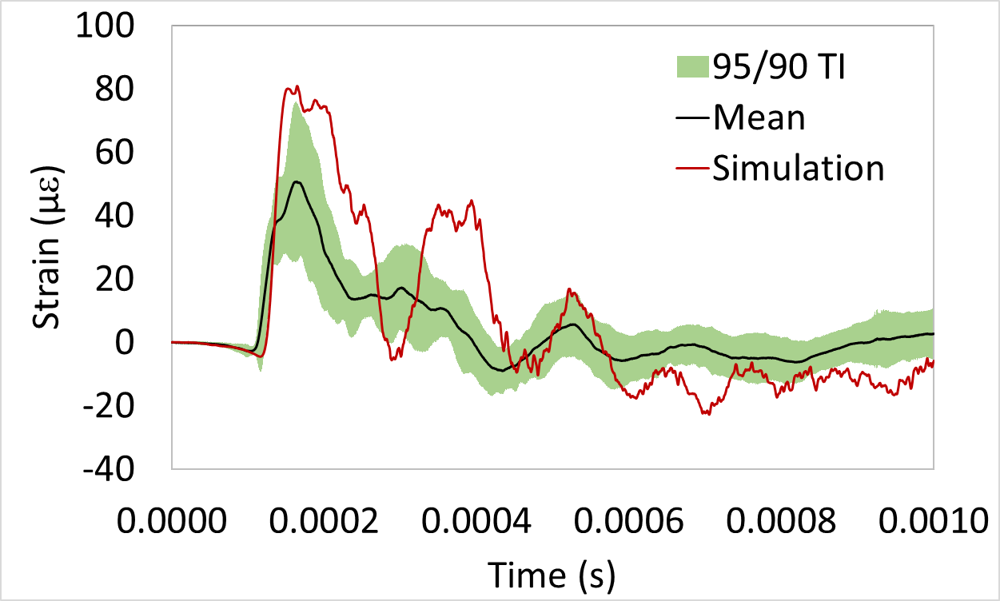
Strain simulation without gas injection using Riemer’s model
Sensor T (top front, in beam direction)
Sensor W (top corner, in transverse direction)
Riemer’s mercury material model
Sensor G (top middle, in transverse direction)
Sensor K (top side, in transverse direction)
Finite element model of jet-flow target
B. W. Riemer, H. Jiang, D. E. Winder, “Strain prediction and benchmark with measurement in the Spallation Neutron Source mercury target without gas injection,” Phys. Rev. Accel. Beams 25 (2022) 093001.
Senor P (bottom center, in transverse direction)
Sensor F (top back, in beam direction)

Slide 6
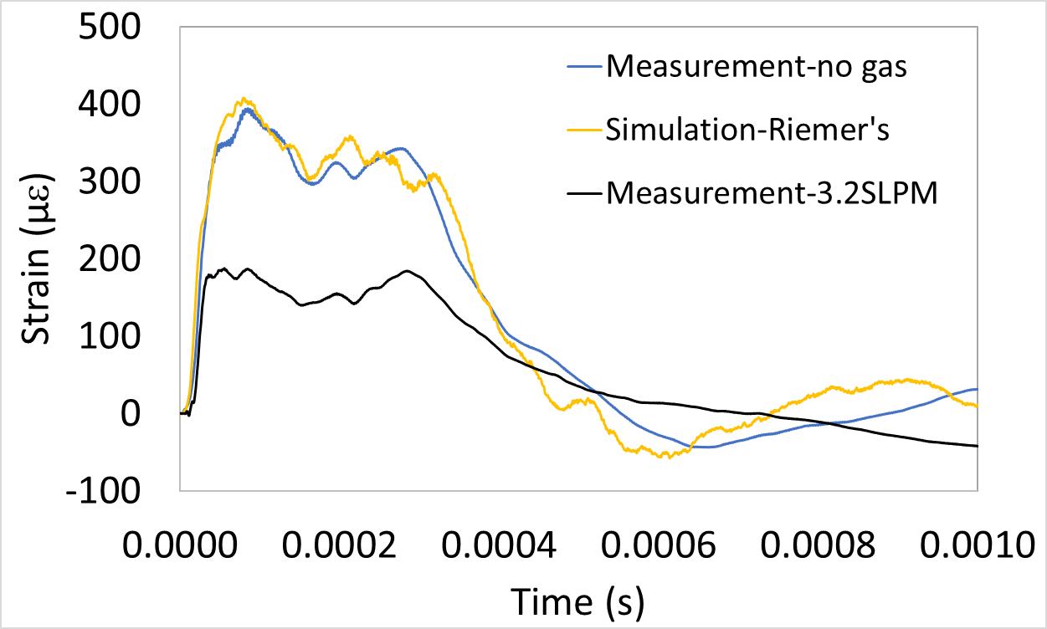
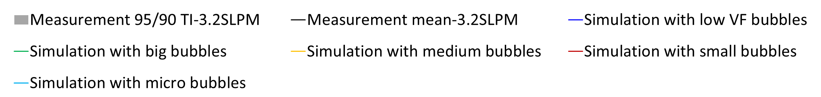
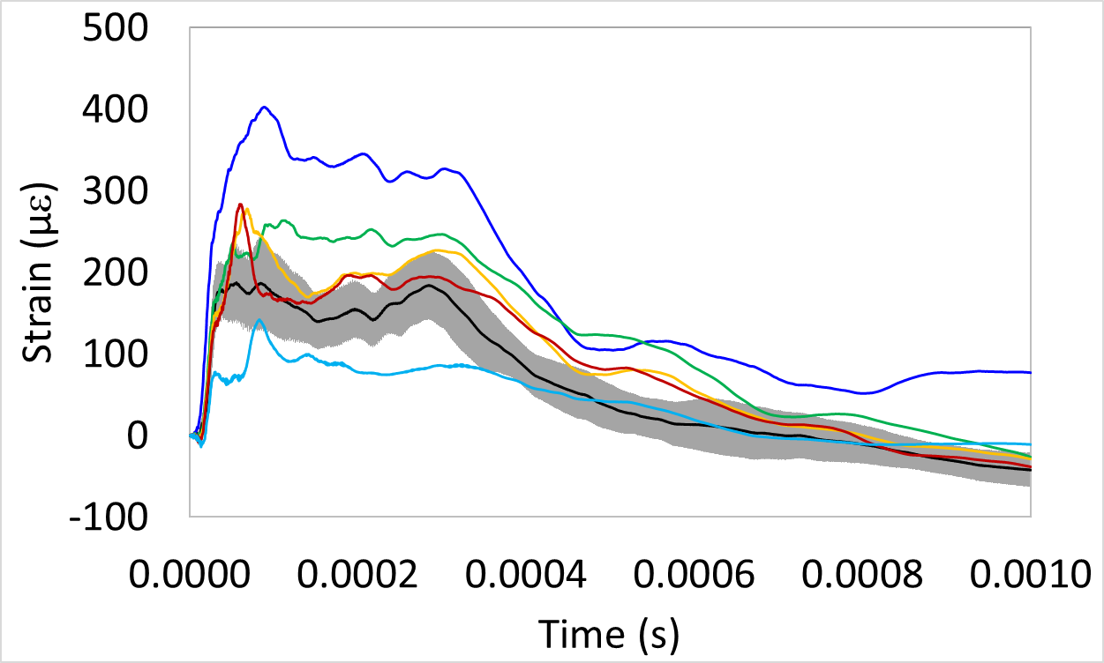
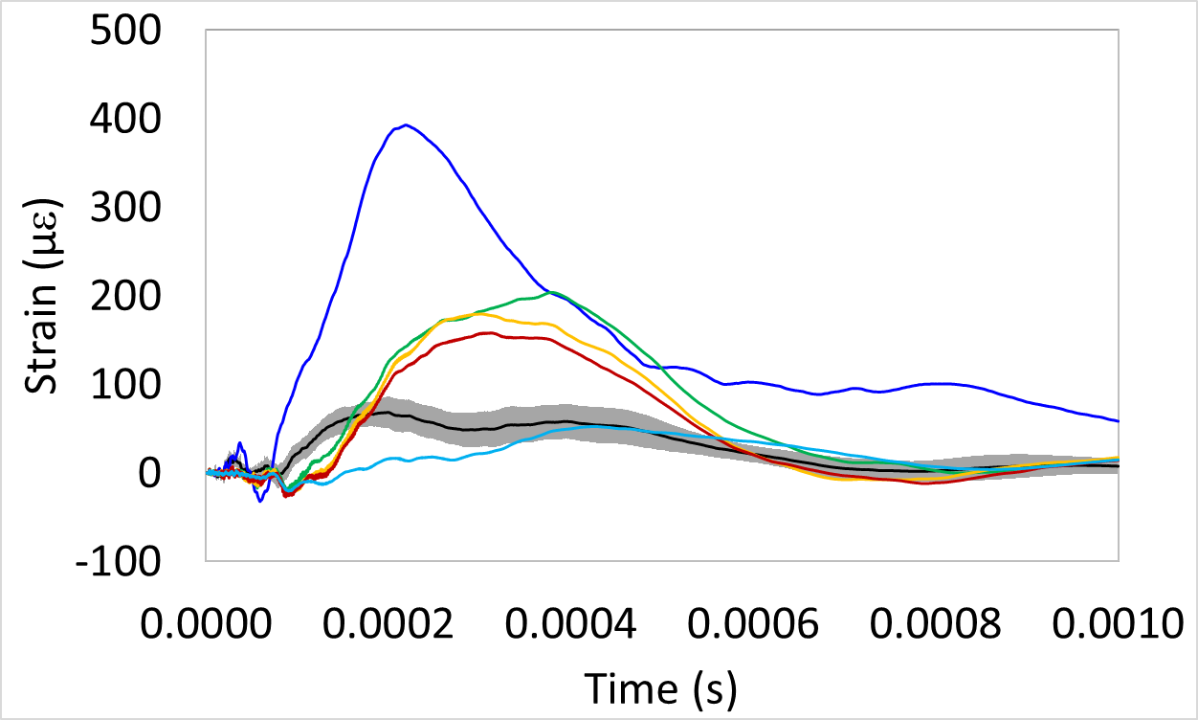

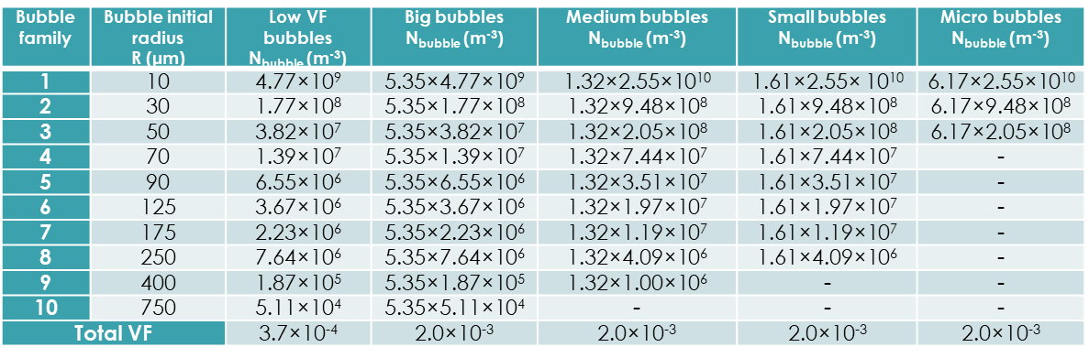
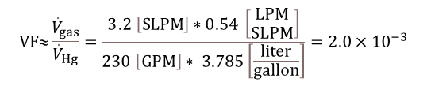
Develop simulation technique to predict strain with gas injection
Rayleigh-Plesset equation:
Sensor T (top front, in beam direction)
Sensor G (top middle, in transverse direction)
$$VF≈\frac{{\dot{V}}_{gas}}{{\dot{V}}_{Hg}}=\frac{3.2 \left[SLPM\right]∗0.54 \left[\frac{LPM}{SLPM}\right]}{230 \left[GPM\right]∗ 3.785\left[\frac{liter}{gallon}\right]}={2.0×10}^{−3}$$
Bubble size distributions (BSDs)
More gas bubbles suppress strain responses more.
Small bubbles effectively attenuate strain responses.
R-P model
D. Winder, L. Lin and J. Mach, “Incorporating bubble growth volume feedback to improve simulation of the response of a structure containing liquid and gas to sudden energy input,” Nucl. Inst. Meth. A 1005 (2021) 165371.

Slide 7
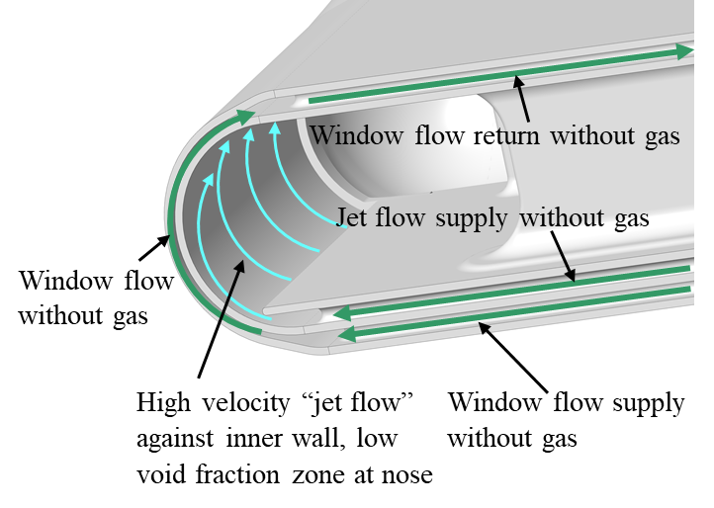
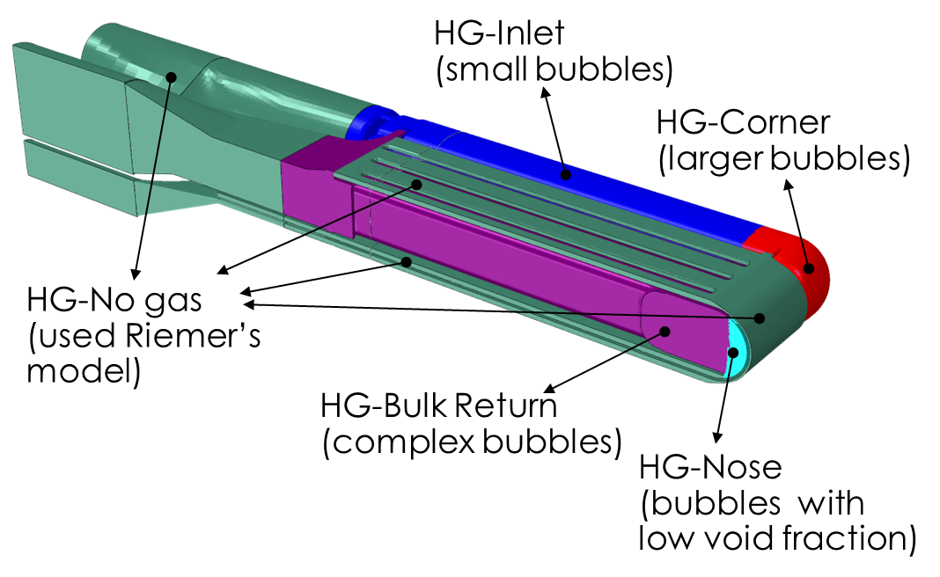
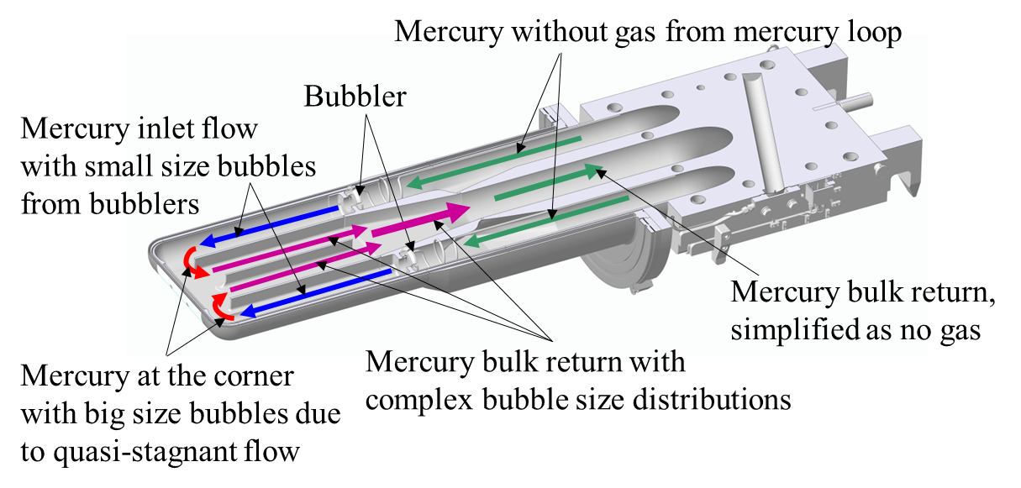
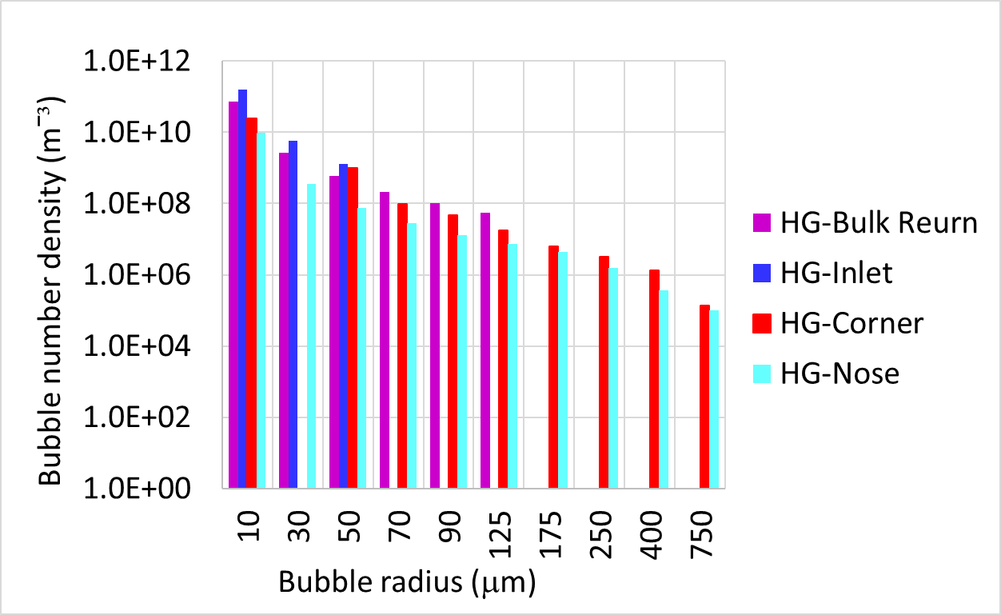
Combine Riemer’s and R-P model for different mercury zones
Mercury bulk flow
Window flow and jet flow
Mercury without gas bubble and bubbly zones
H. Jiang, D. E. Winder, C. Barbier, B. W. Riemer, “Implementing bubbly mercury material model (R-P model) in the pulse simulation to predict strain on the Spallation Neutron Source target vessel with gas injection”, Results in Physics 49 (2023) 106511.
Bubble size distributions for R-P model
Flow visualization experiment with water in an acrylic target

Slide 8
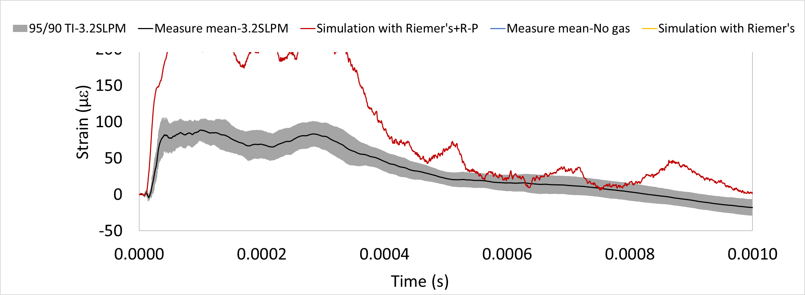
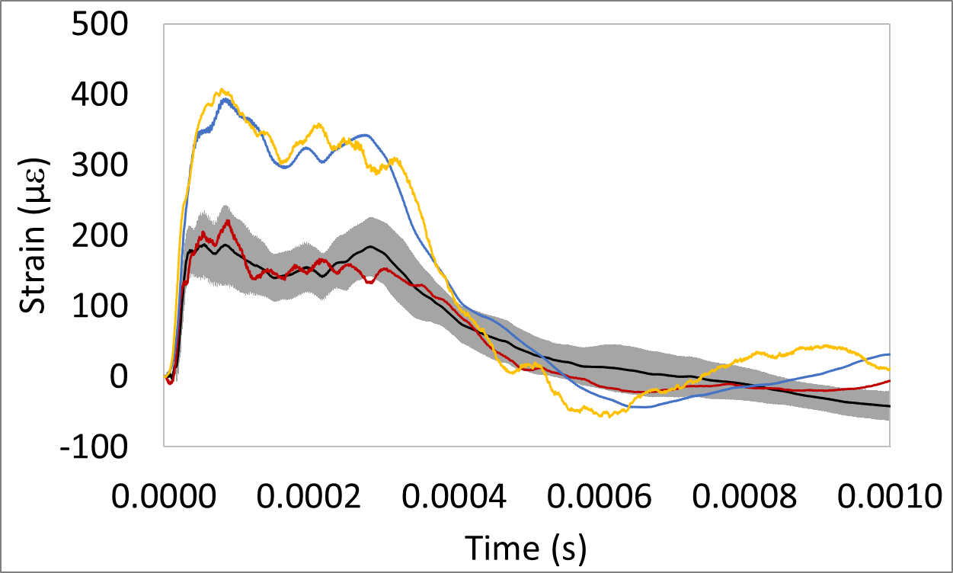
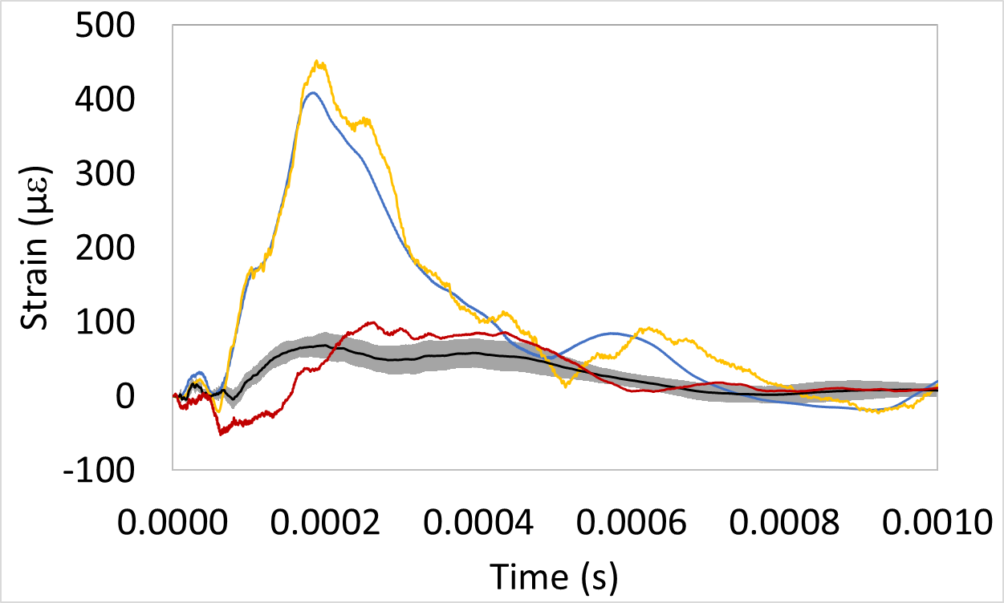
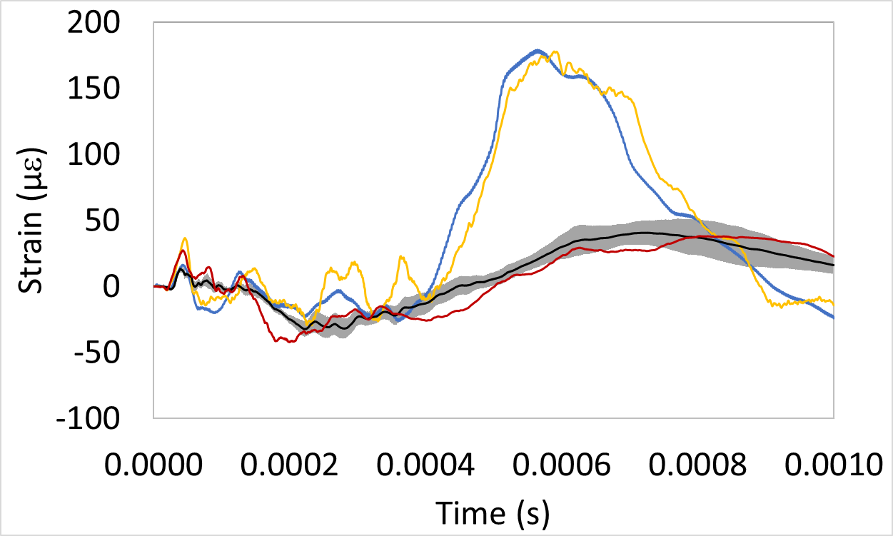
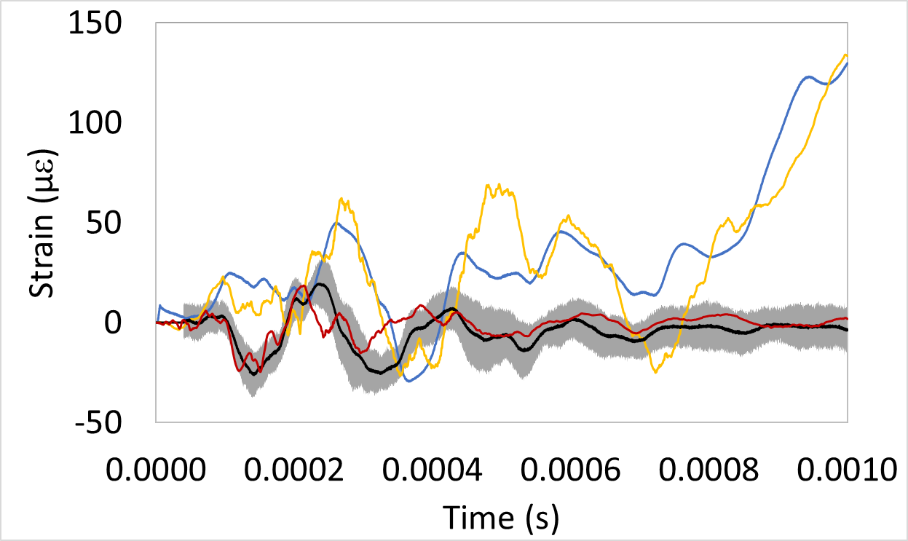
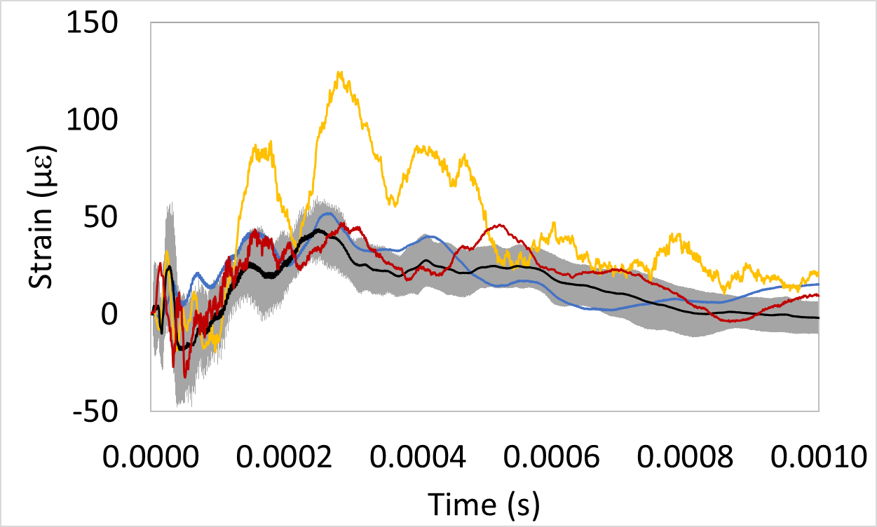
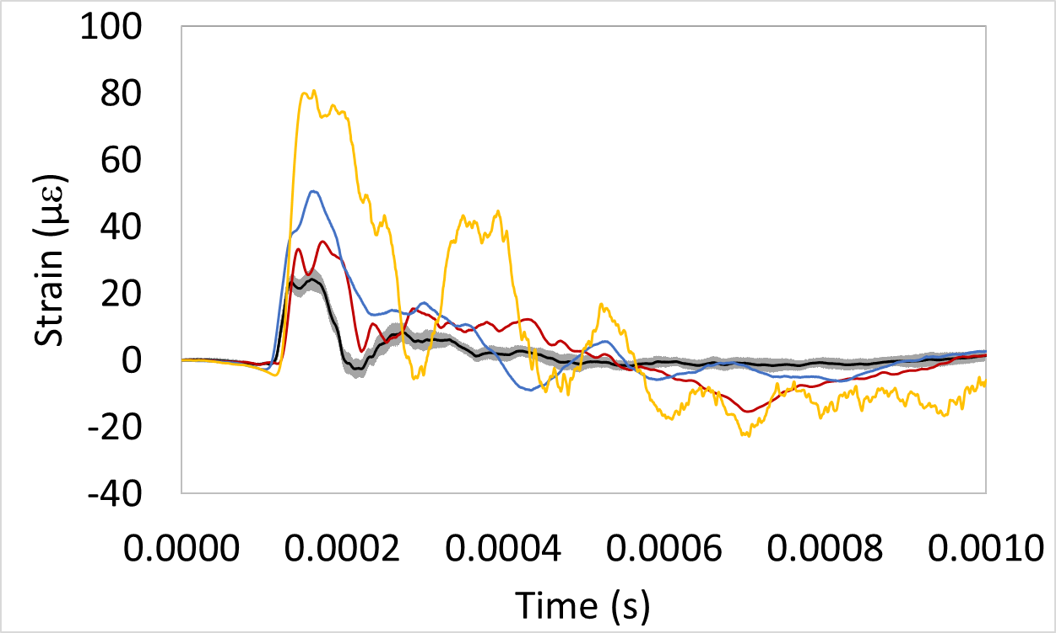
Promising results using combined Riemer’s and R-P model
Sensor T (top front, in beam direction)
Sensor G (top middle, in transverse direction)
Sensor W (top corner, in transverse direction)
Sensor K (top side, in transverse direction)
Senor P (bottom center, in transverse direction)
Sensor F (top back, in beam direction)

Slide 9
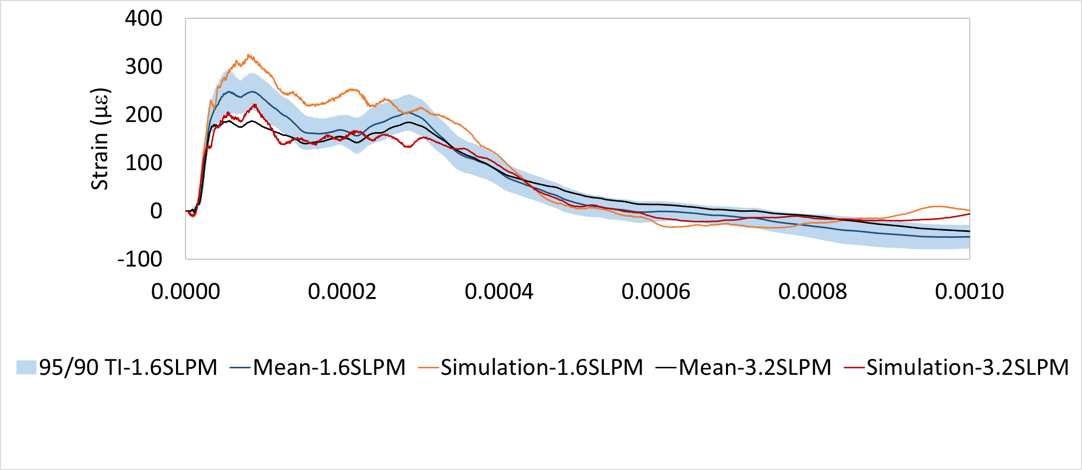
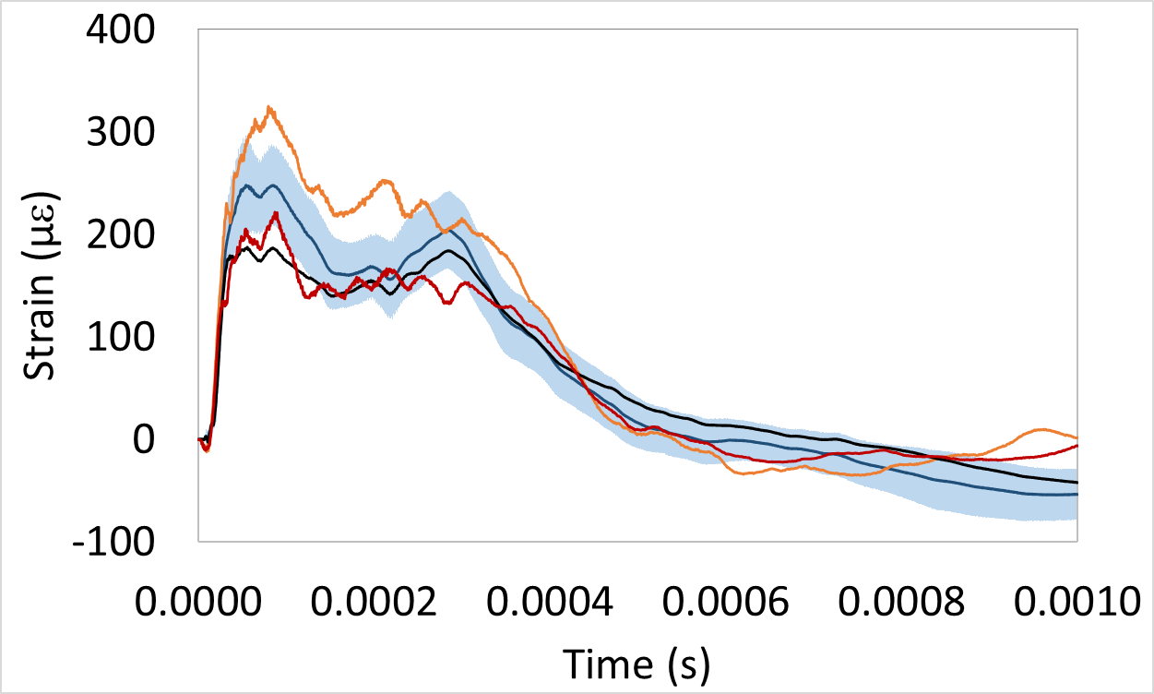
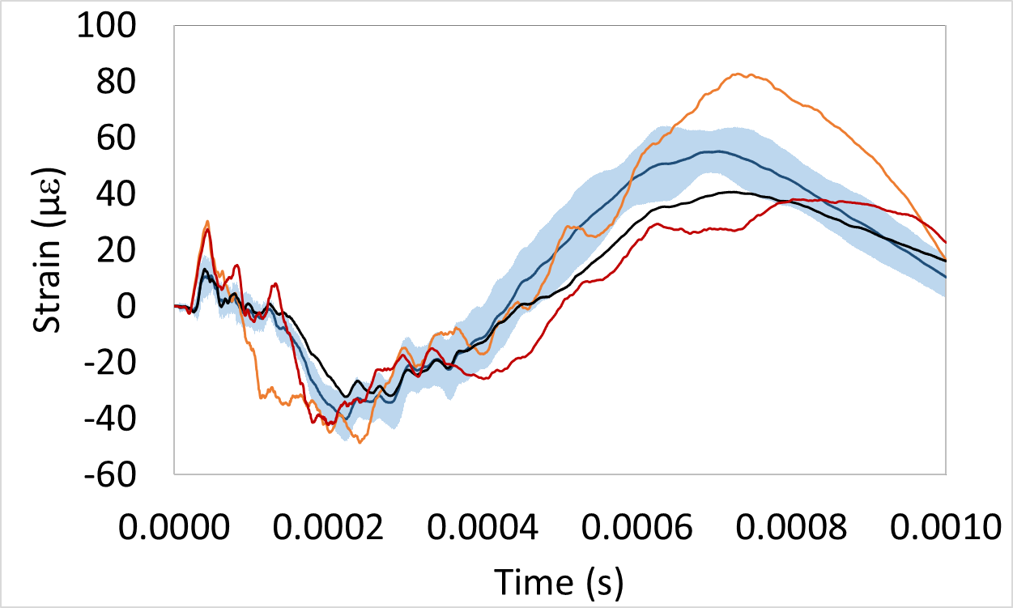
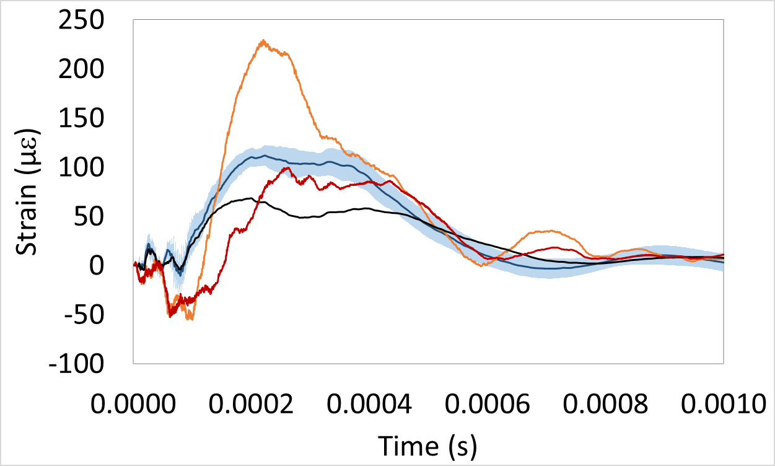
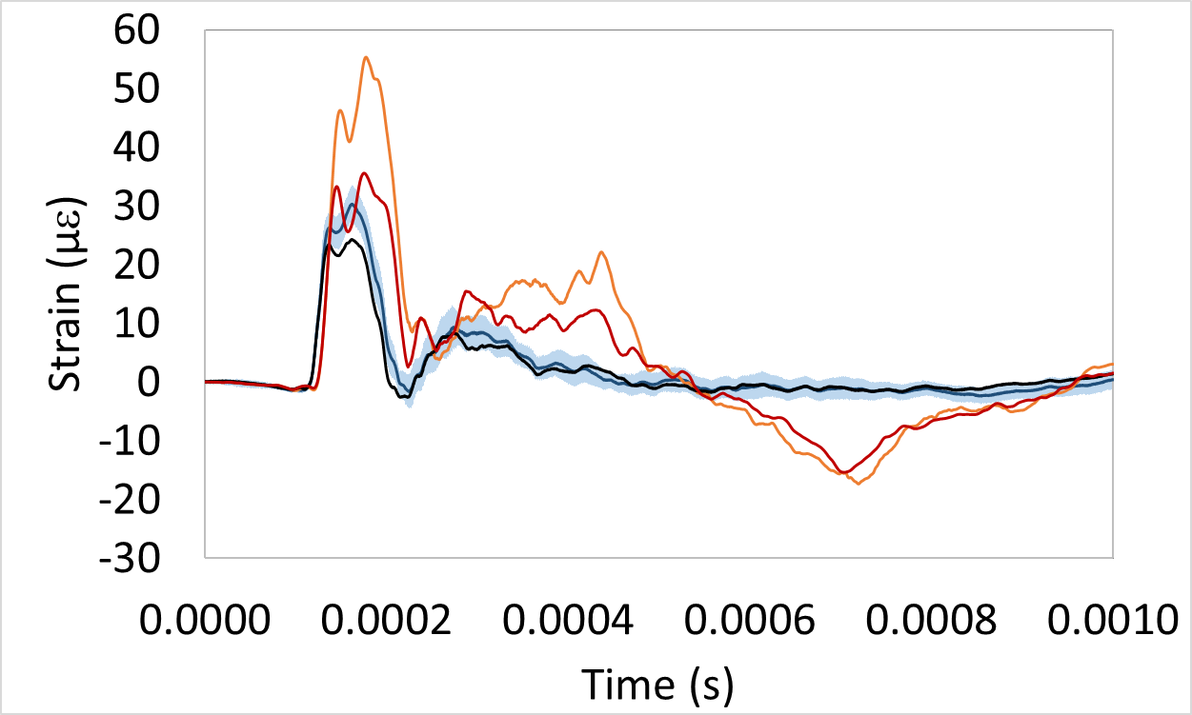
Apply combined Riemer’s and R-P model to different gas rate
Assumption:
Normalized BSD (in other words, the probability density function distribution) is invariant of gas injection rate.
Bubble number densities for different gas rates are scaled by the total VF.
The simulation dynamic character generally matches with the measured waveform.
The simulation overpredicts the strain peak.
The results indicate that BSDs might not be simply scaled by the total VF for different gas injections.
Sensor T (top front, in beam direction)
Sensor W (top corner, in transverse direction)
Sensor G (top middle, in transverse direction)
Sensor F (top back, in beam direction)

Slide 10
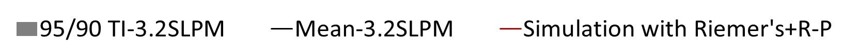
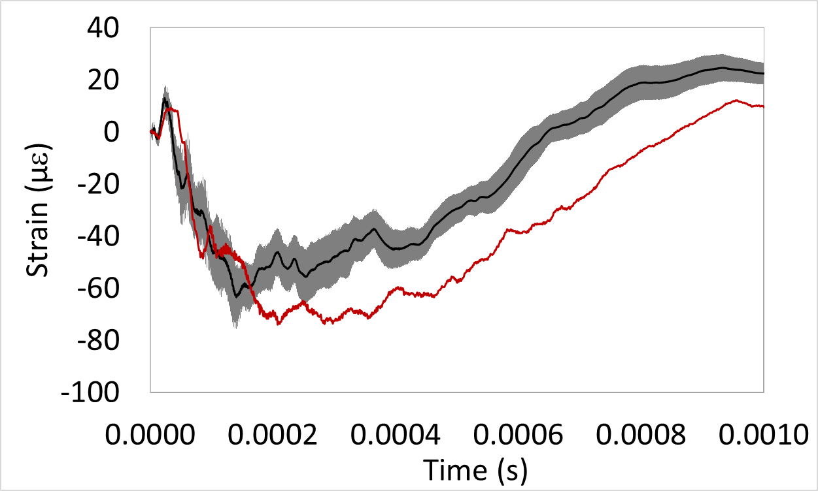
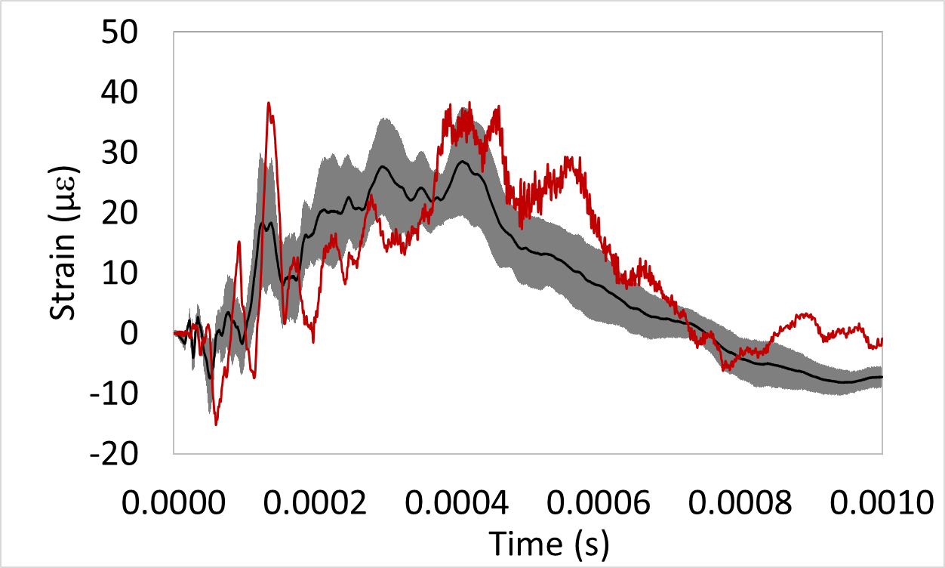
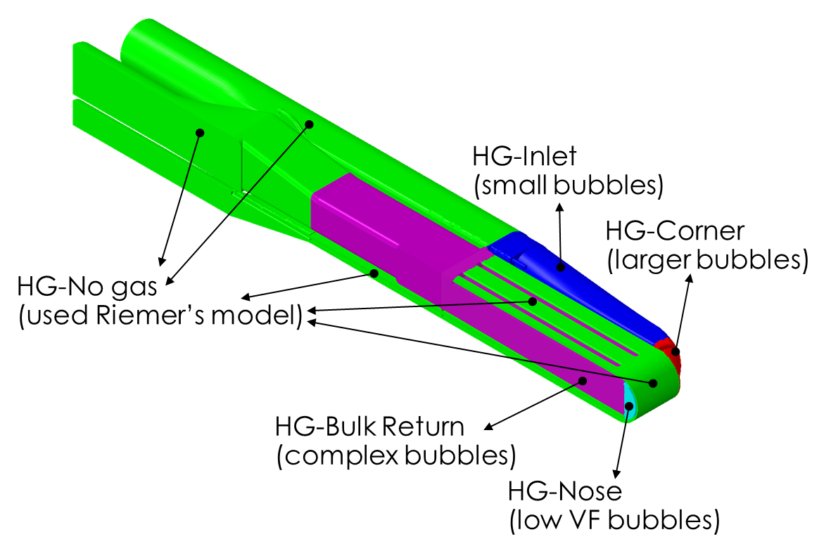
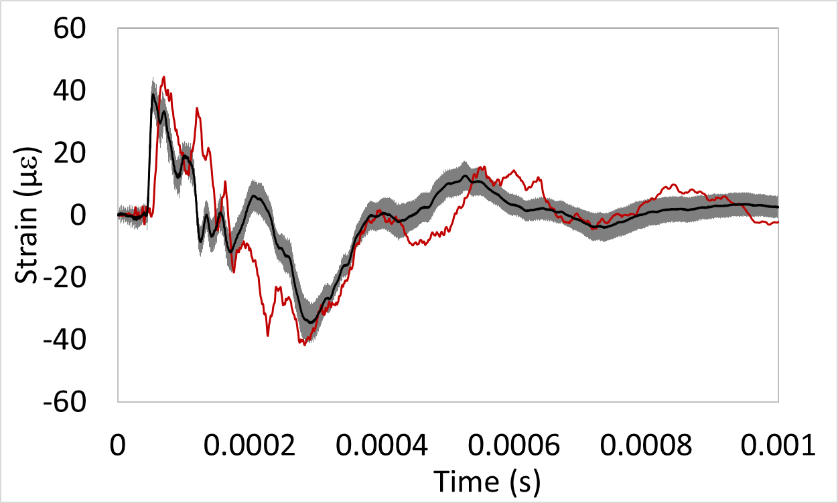
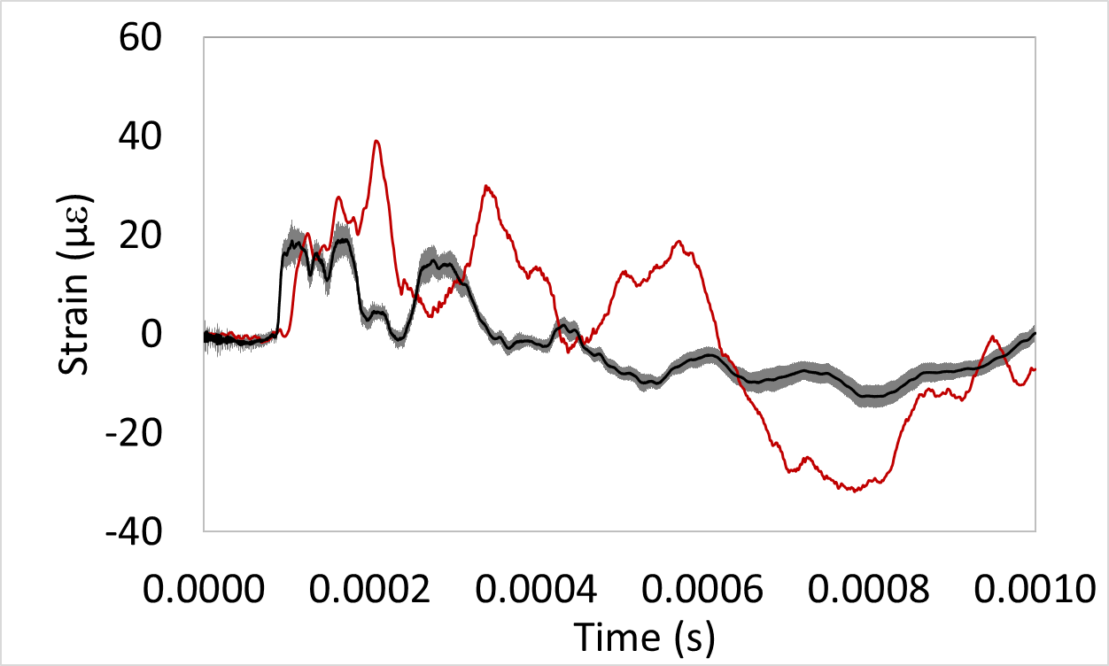
Apply combined Riemer’s and R-P model to 2 MW design target
Nose tapered
Center baffle removed
Corner wall thickened
Transition improved
Inner widow weld corner rounded
Mercury target vessel design for 2MW operation
Sensor H (top front, in transverse direction)
Sensor B (front side, angled 35°)
Sensor M (top middle, in beam direction)
Sensor Z (bottom back, in beam direction)
Mercury without gas bubble and bubbly zones
The simulation technique works similarly well for 2MW design target.

Slide 11
Conclusions
Strain measurement data are used to validate the strain simulation.
The simulations with Riemer’s model generally agree well with the measurement data for the no gas condition.
The new simulation technique was developed to predict the strain response with gas injection. The simulations combining Riemer’s and R-P model with estimated BSDs shows promising results.
The simulation technique works similarly well when applied to simulations for the different gas injection condition, and the different target designs.
Thank you! Questions?

