Slide 1
High Power Target R&D
Needs for Muon Colliders
Katsuya Yonehara
HPTW 2023
November 7, 2023

Slide 2
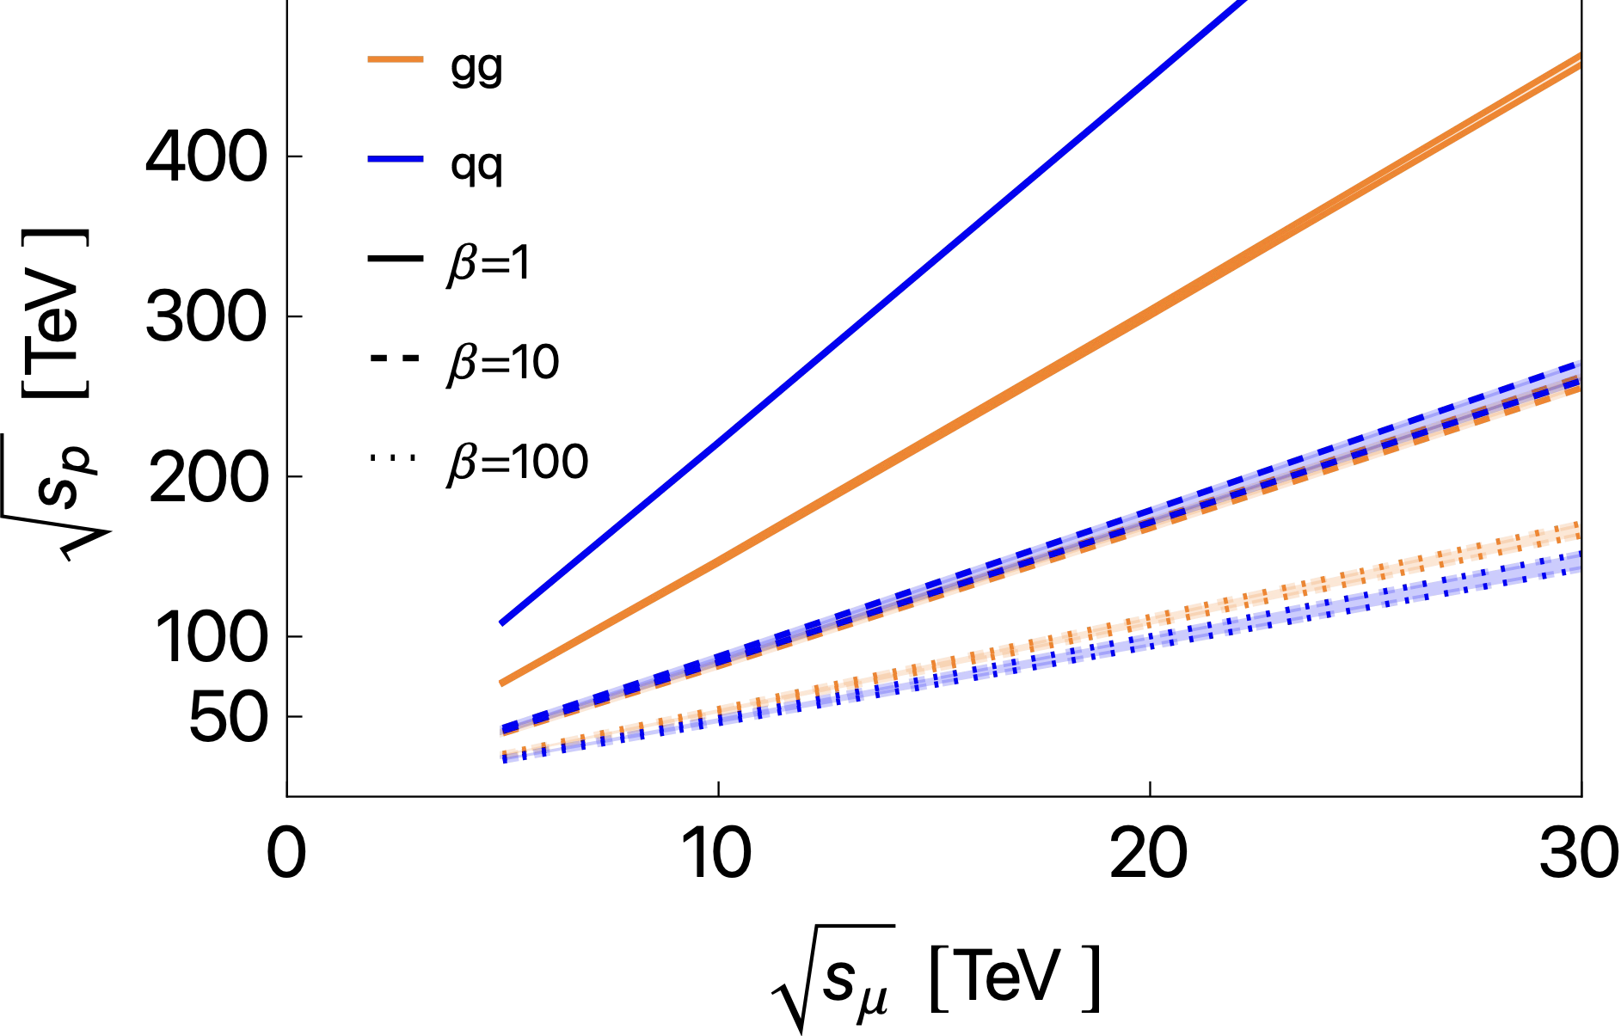
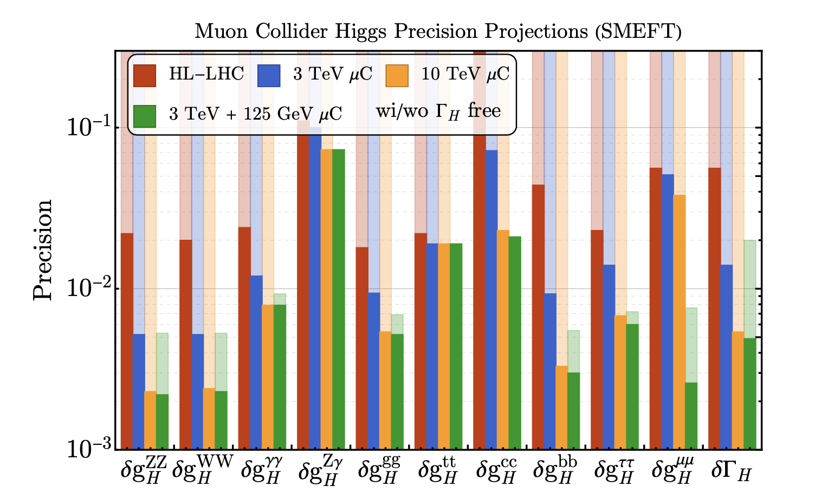
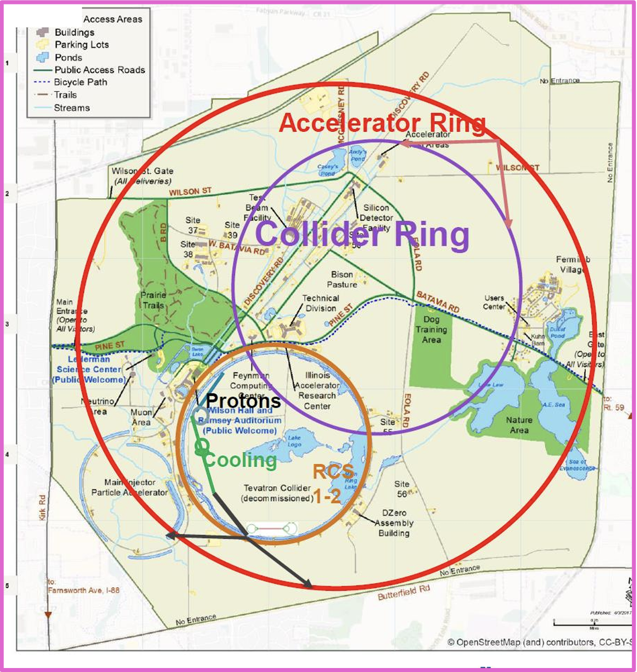
Discovery Machine Muon Collider and Challenge
MuC COM can be fully utilized for physics events
Clean lepton collision event allows for precise measurements
Footprint in Fermilab site

Slide 3
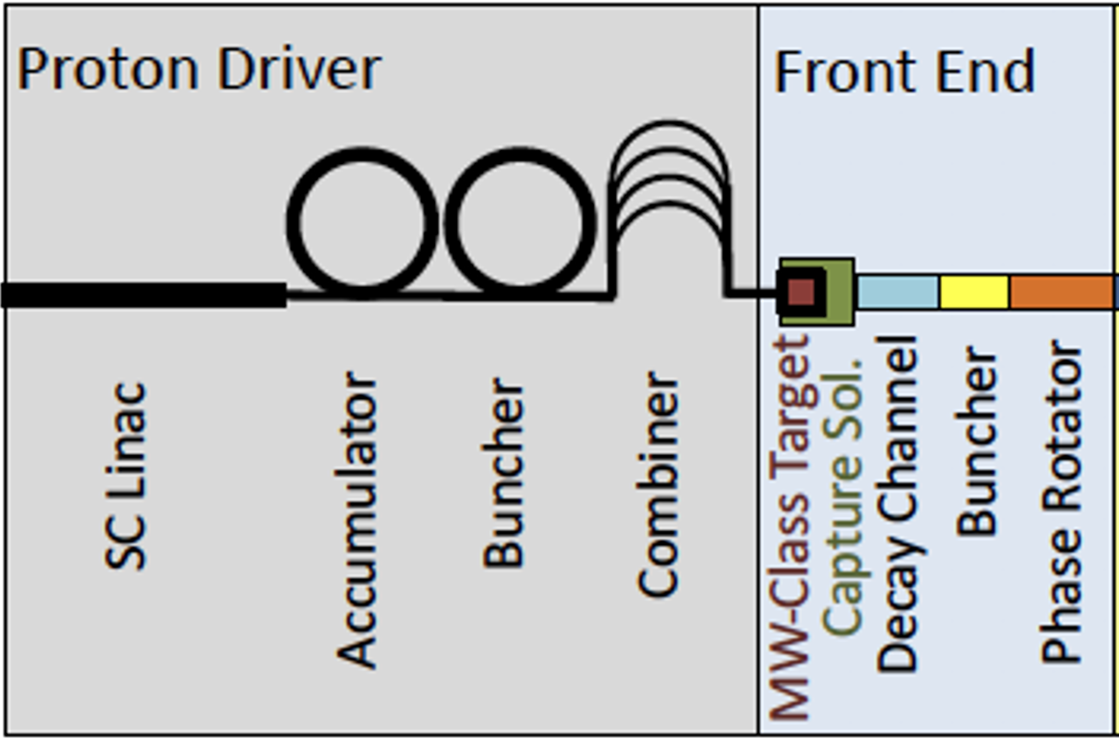
Proposed muon source parameter of proton-driver based muon collider Front End channel
Design provided by Muon Accelerator Program (MAP)
Proton driver: 10¹⁴-10¹⁵ protons per bunch, 1-3 ns bunch length, 5-15 Hz rep rate, 5-20 GeV
Front End: 2-4 MW class target, π/μ capture section (μ/p efficiency 10-15 % for each sign)

Slide 4
Typical beam parameter at intense beam facility
 | Neutron spallation source (ESS, SNS, CSNS) | Accelerator Neutrino beam (T2K, CNGS, NuMI, SBN) | Muon collider (MAP, IMCC design)
Proton beam energy | Low (1-3 GeV) | Wide range (8-400 GeV) | Medium (5-20 GeV)
Proton beam bunch length | Short (105-700 ns) | Long (4.2-10.5 μs) | Extremely short (1-3 ns)
Proton beam intensity per bunch | Medium (1e13-1.5e14) | Medium (4.8e13-3.2e14) | High (1e14-1e15)
Repetition rate | High (14-60 Hz) | Low (0.4-2 Hz) | Medium (5-15 Hz)
Target material | Liq. Hg, W, Liq. Li etc | graphite | ?
Extremely high beam density

Slide 5
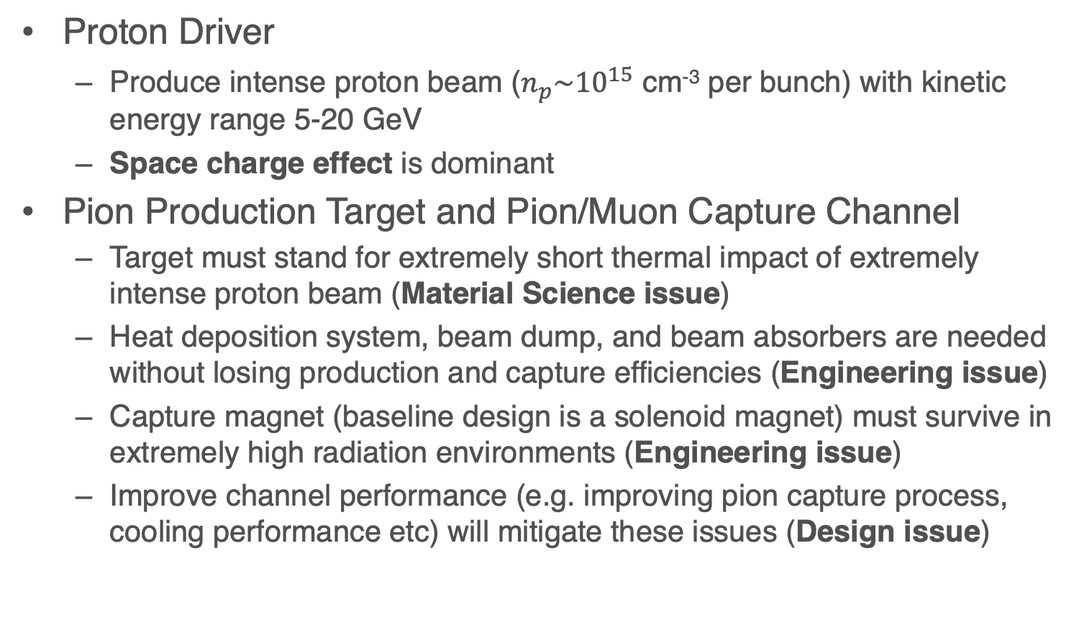
Challenge in Front End channel
Proton Driver
  Produce intense proton beam ($n_{p}\sim {10}^{15}$ cm⁻³ per bunch) with kinetic energy range 5-20 GeV
  Space charge effect is dominant
Pion Production Target and Pion/Muon Capture Channel
  Target must stand for extremely short thermal impact of extremely intense proton beam (Material Science issue)
  Heat deposition system, beam dump, and beam absorbers are needed without losing production and capture efficiencies (Engineering issue)
  Capture magnet (baseline design is a solenoid magnet) must survive in extremely high radiation environments (Engineering issue)
  Improve channel performance (e.g. improving pion capture process, cooling performance etc) will mitigate these issues (Design issue)

Slide 6
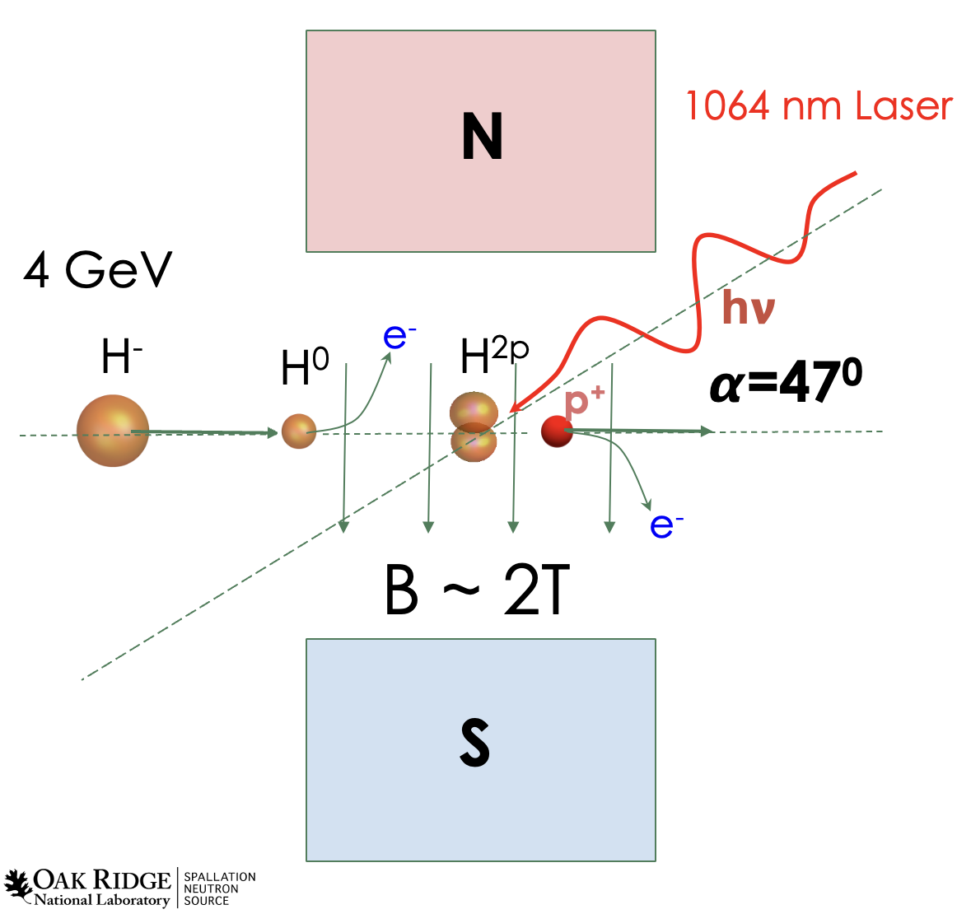
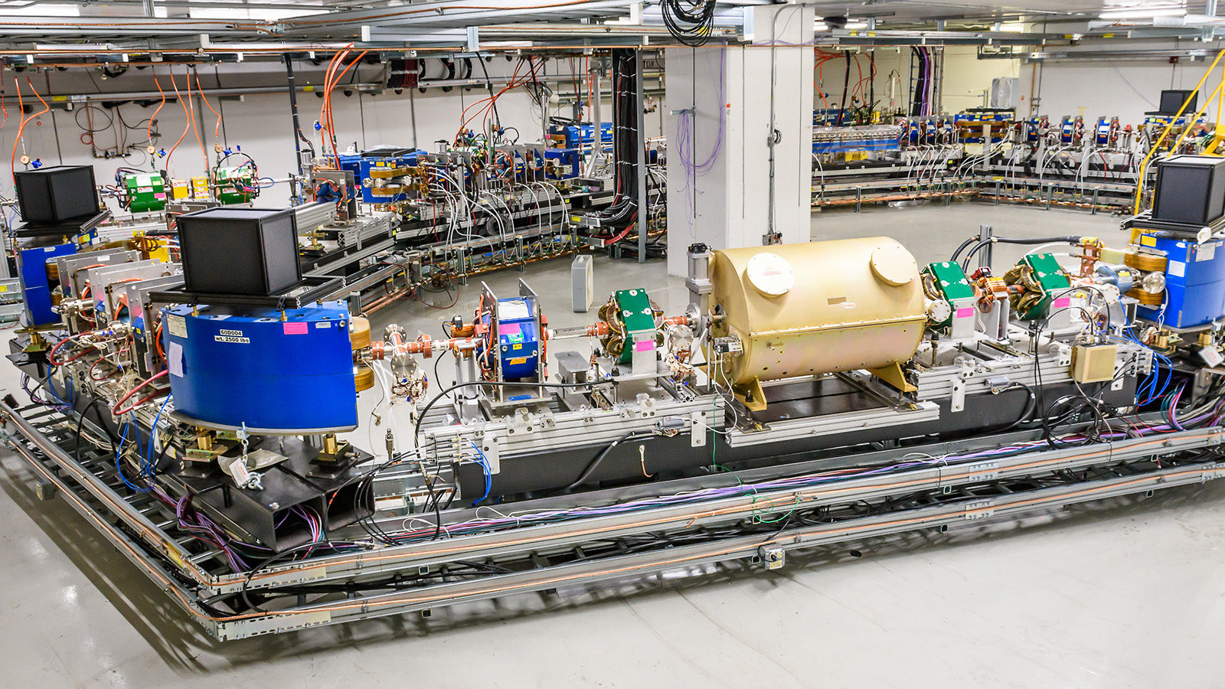
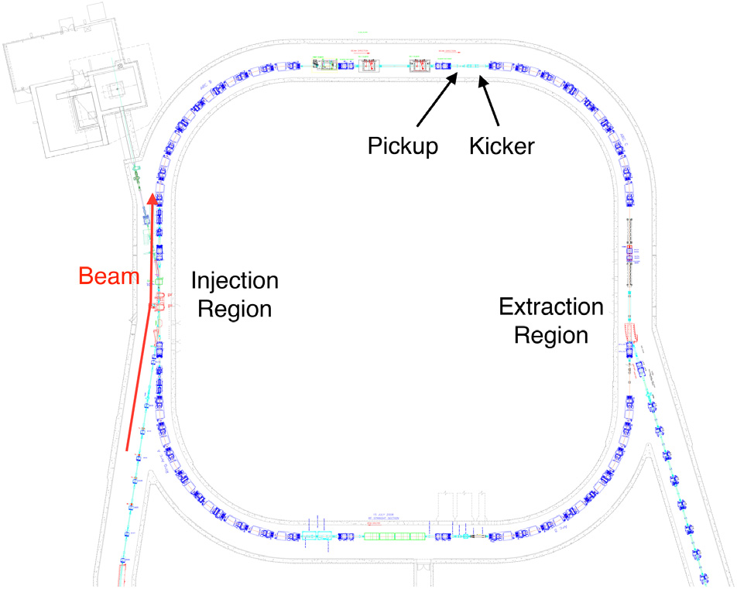
Challenging of Proton Driver
SNS Laser
stripper scheme
Proton accelerator
  Provide high power H- beam with 5-15 Hz rep rate
Accumulator
  Charge exchange to accumulate protons
    Laser stripping (prefer) vs Foil stripping
  Painting transverse/longitudinal phase space
    Beam loss due to instability or mismatching
  Extraction kicker and septum
Compressor
  Longitudinal phase rotation to make a short-bunched beam
    Low freq (a few MHz) and high gradient (100-300 kV) RF
  Large energy spread
    Large bore beam pipe
  Fight against space charge effect
  Extraction kicker and septum
Combiner
  Timing (< 1 ns)
SNS accumulator &
compressor study
IOTA prepared for proton program

Slide 7
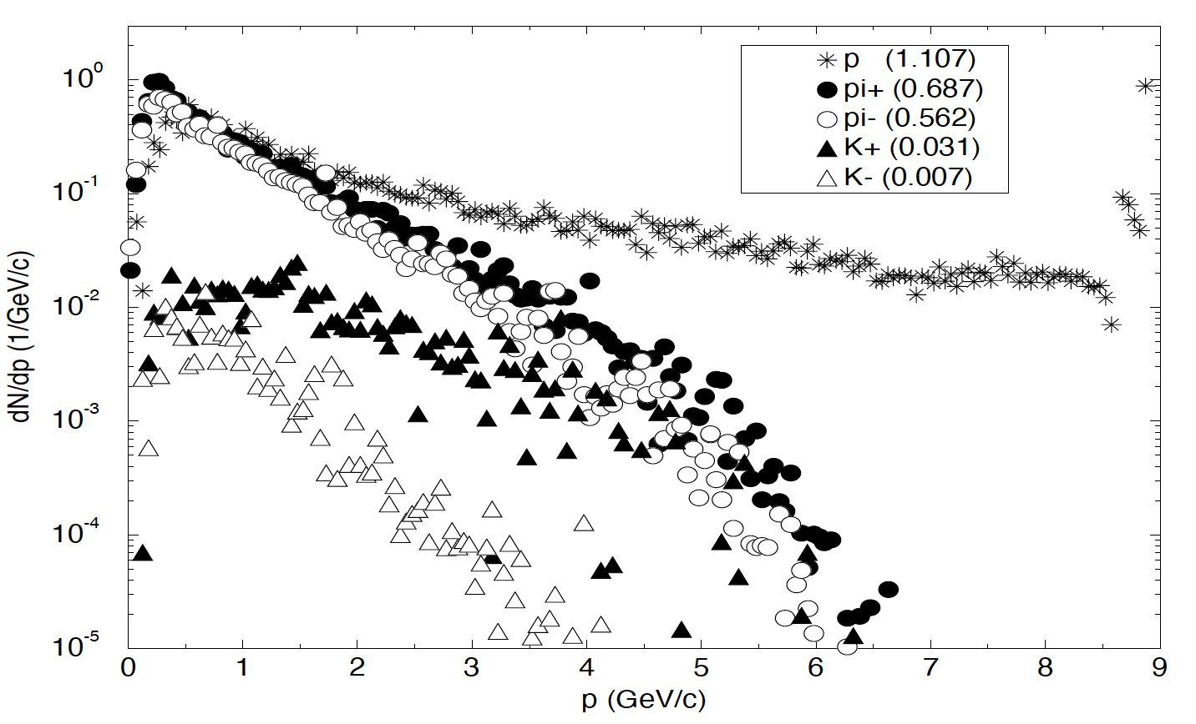
Function of muon collider Target + Front-End
Produce ”soft” charged pions
  Momentum range of soft pions is 100-400 MeV/c for ionization cooling
Manipulate the phase space of soft pions to direct them into the downstream channel
Pions are eventually decayed into muons and neutrinos in the transport line
Simulated pion and kaon spectra for 8 GeV protons incident on a copper target (1.5 interaction length, 1 cm radius) in a 28-Tesla solenoid. In the MAP simulation study, the designed m/p conversion ratio in the Front-End channel is 10-18 % for each sign.

Slide 8
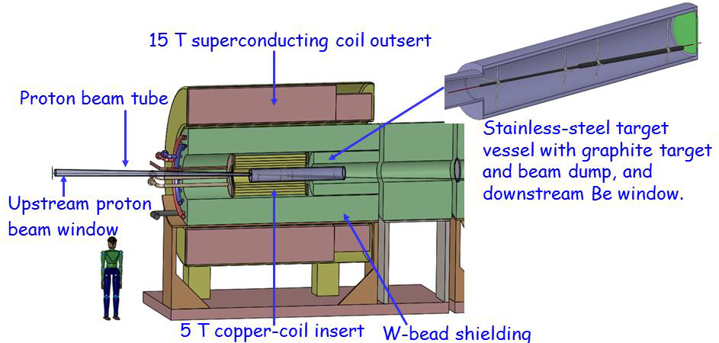
Baseline design of MAP target system
C Target
Option
Target inside a strong solenoid magnet
  Pros
  Capture soft pions most efficiently
  Both sign charged pions can be captured in a single solenoid magnet
  Cons
  Narrow volume which contains heat remove system, beam damper, radiation shielding etc

Slide 9
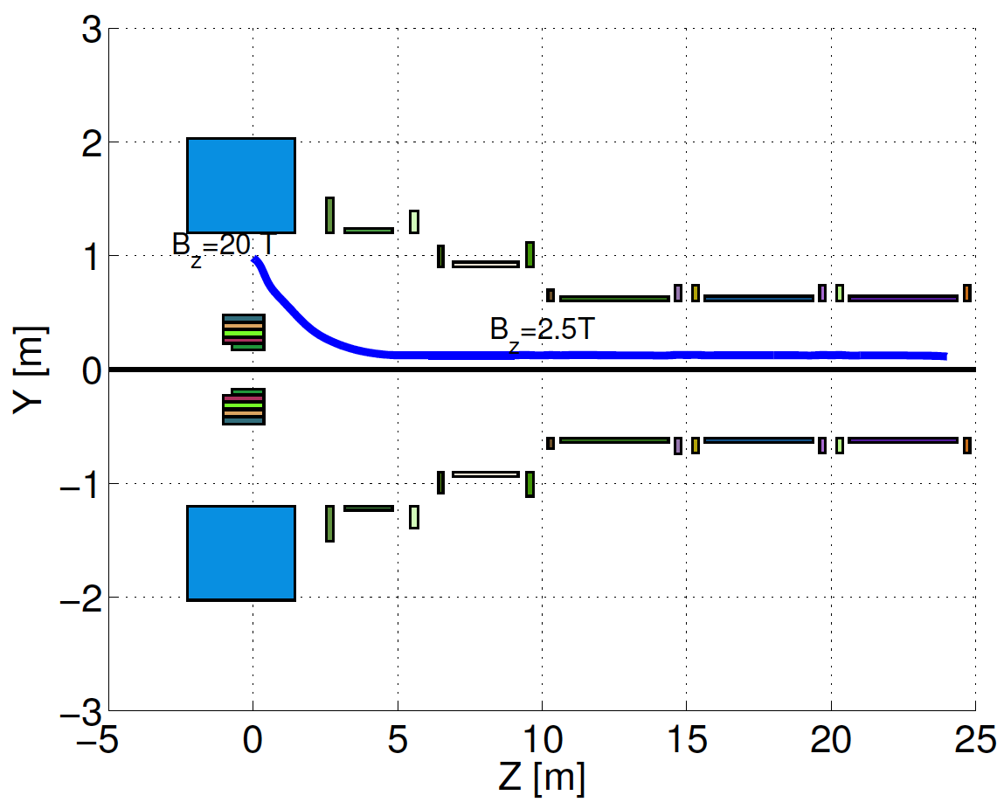
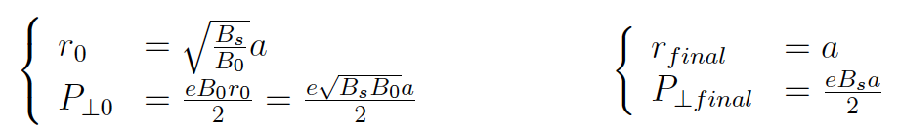
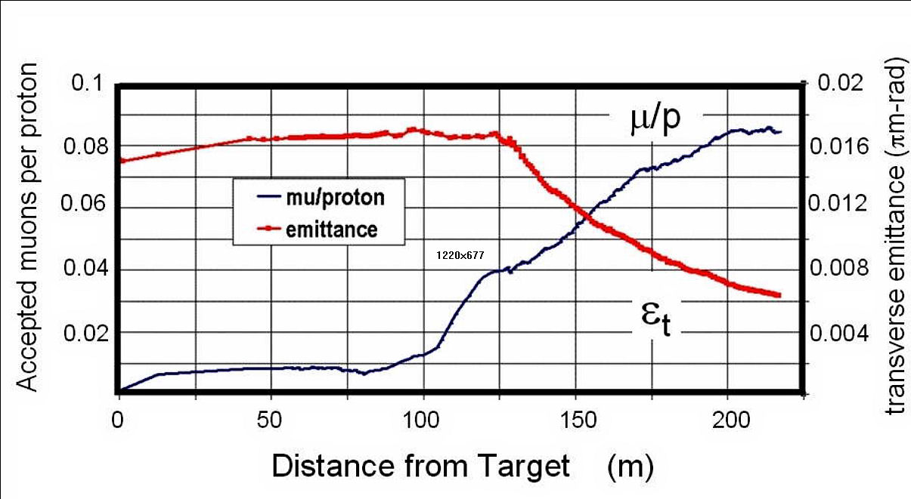
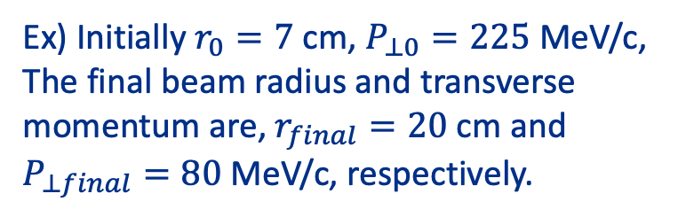
Design Solenoid Magnet as Beam Focusing
Result of the conservation for canonical angular momentum and magnet flux
Ex) Initially $r_{0}=7$ cm, $P_{⊥0}=225$ MeV/c,
The final beam radius and transverse momentum are, $r_{final}=20$ cm and $P_{⊥final}=80$ MeV/c, respectively.
Simulation result of μ/p ratio in the MAP Front End channel including an initial ionization cooling.

Slide 10
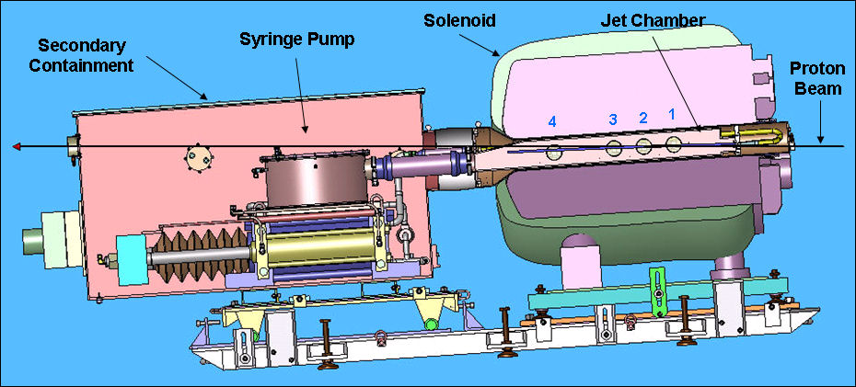

Demonstrate liquid (Hg) target
Layout of MERcury Intense Target (MERIT)
1 cm
Proof-of-principle demonstration of a free Hg jet target for a 4-MW proton beam, contained in a 15-T solenoid
MERIT was carried out in 2007 by using CERN nTOF11 beam line
  14 & 24 GeV protons up to 16 bunches/pulse, up to 3.5e12 protons/bunch with beam angle 67 mrad w.r.t. magnet
  360 beam pulses in total

Slide 11
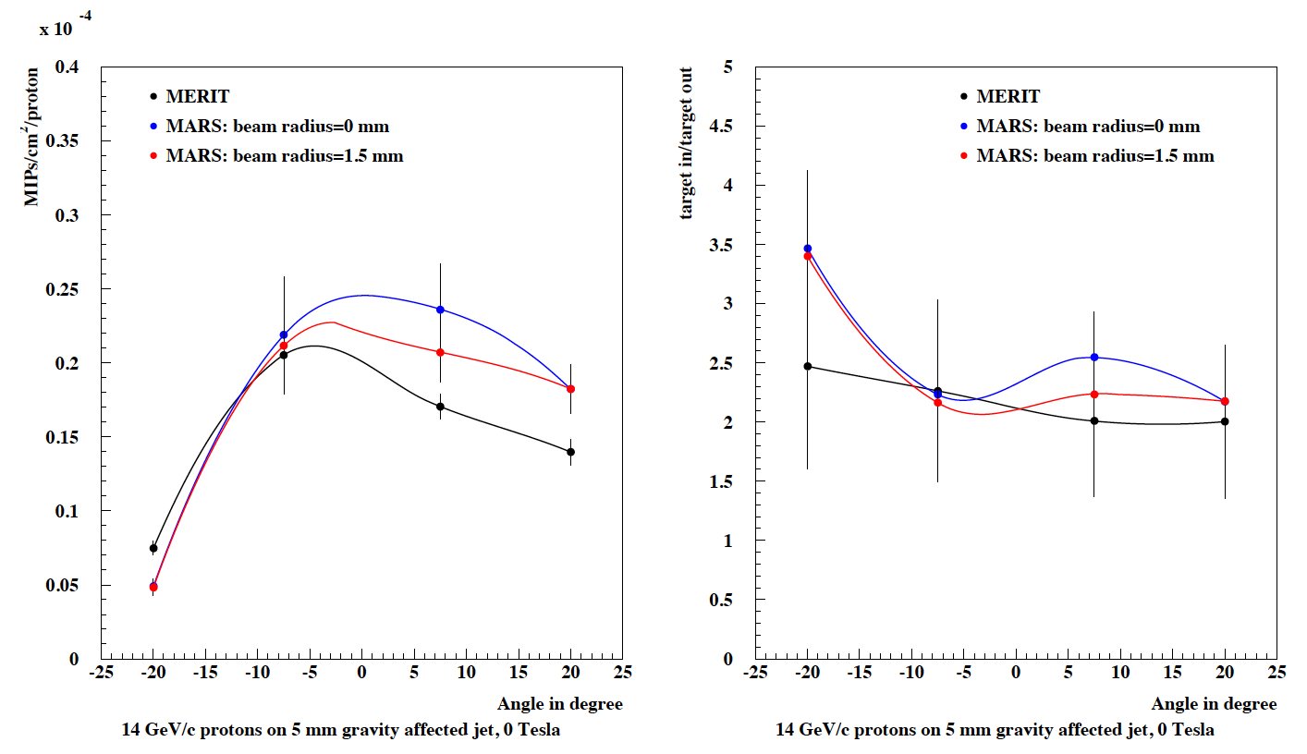
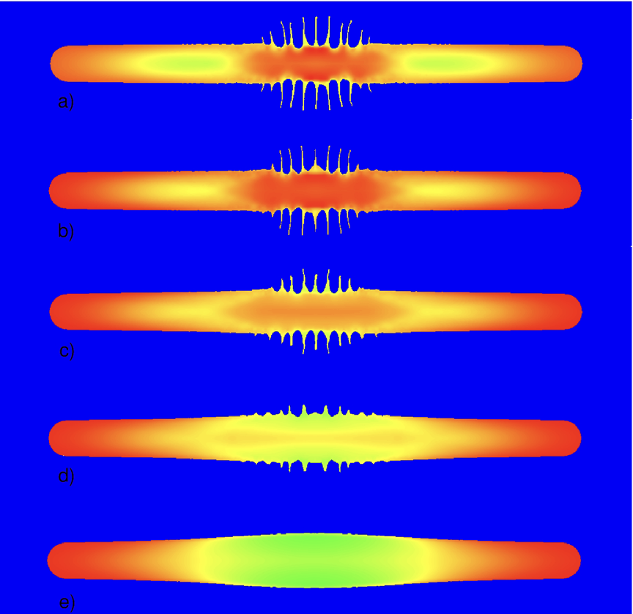
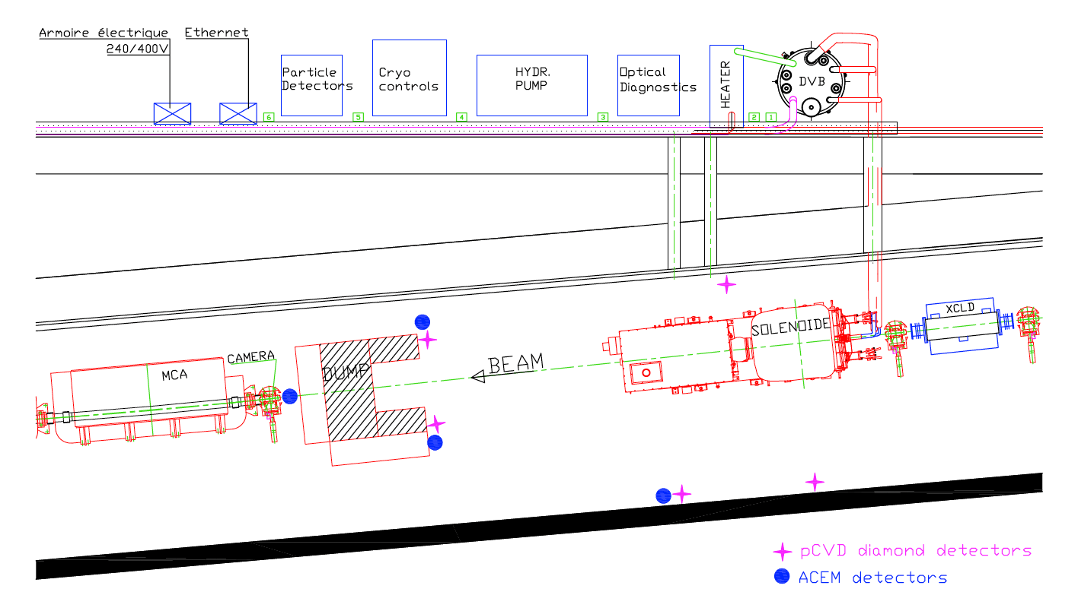
Jet splash in Magnet and Secondary yield measurement
0 Tesla
2 Tesla
4 Tesla
6 Tesla
10 Tesla
Plots show the observed integrated signal in pCVD detectors (position of detectors are shown a magenta cross mark below)
Plot shows side view of Hg jet profile with proton beam impact in a solenoidal field (simulation)

Slide 12
Summary of MERIT
Jet surface instability is significantly reduced at higher magnetic field strength
Jet disruption length is less than length of beam overlap with the jet
There is no jet disruption for pulses of less than 1 Tp (or higher in higher magnetic field)
Bunches more than 5 μs apart act separately in causing disruption
While visible disruption begins 50 μs after a proton pulse, secondary particle production is the same for pulses that follow at several times this value
Liquid (or high granular) target is attractive method for intense muon sources

Slide 13
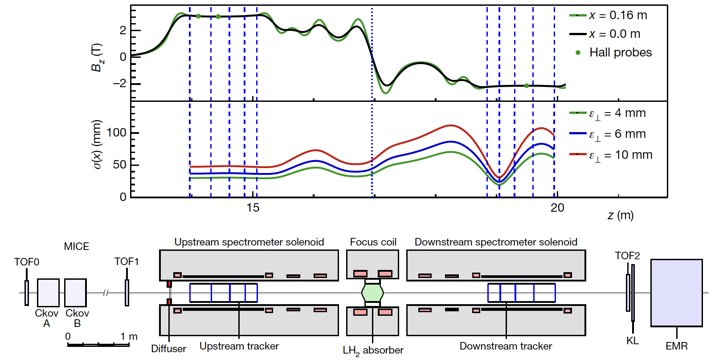
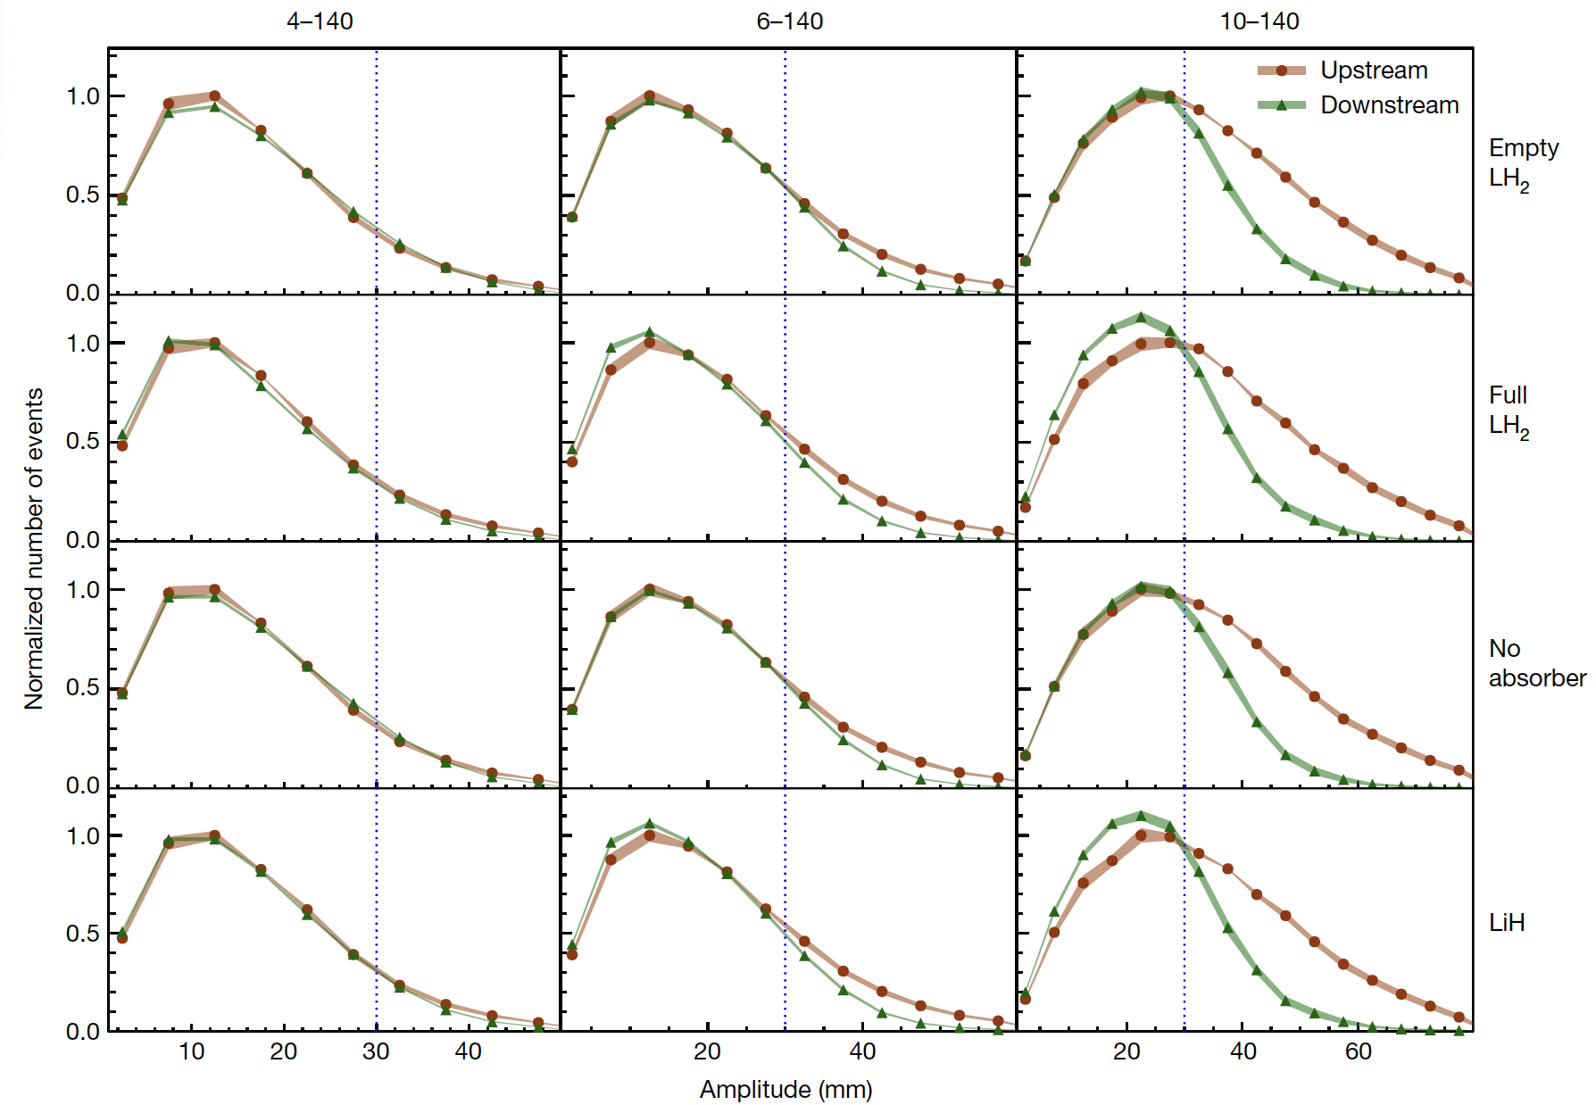
Post MAP
MAP was finished in 2015
  The results of the International Muon Ionization Cooling Experiment (MICE) were published in Nature in 2020
International Muon Collider Collaboration (IMCC) is formed in 2021
  They concerned about an environmental impact of Liquid Hg target. They consider an alternate option (please find Roberto’s talk)
The US HEP community may resume the muon collider R&D
  We will hear the P5 final report in December
Nature 578, 53-59 (2020)

Slide 14
US HEP scenario for muon accelerators
Accelerator Complex Evolution (ACE) has been proposed at Fermilab during P5 (Particle Physics Project Prioritization Panel) reviewing
ACE is capable to provide a 2.4 MW proton beam to the neutrino program earlier than the original beam power upgrade scenario with PIP-III
It will change the timeline of the Fermilab HEP program
Muon collider R&D scenario is made based on ACE

Slide 15
Accelerator Complex Evolution (ACE) plan
Increase protons on target to DUNE Phase I detector by
  Shortening the Main Injector cycle time to increase beam power
  Upgrading target systems for up to 2.4 MW
  Improving reliability of the Complex
Establish a project to build a Booster replacement to
  Provide a robust and reliable platform for the future of the Accelerator Complex
  Ensure high intensity for DUNE Phase II CP-Violation measurement
  Enable the capability of the complex to serve precision experiments and searches for new physics with beams from 1-120 GeV
  Create the capacity to adapt to new discoveries
  Supply the high-intensity proton source necessary for future multi-TeV accelerator research
Courtesy of M. Convery, ACE workshop 2023 at Fermilab

Slide 16
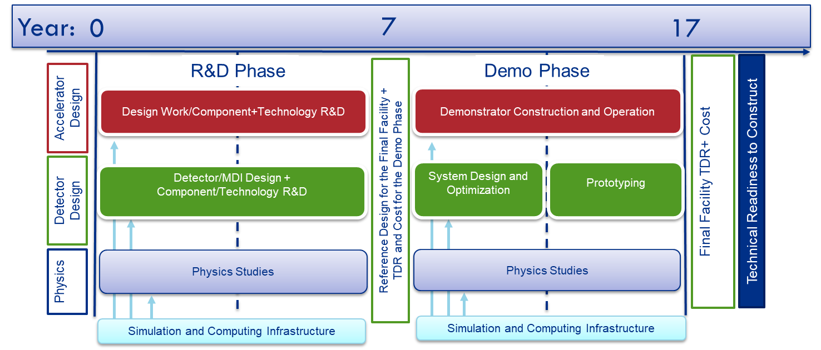
Suggested US Muon Collider R&D timeline to P5
ACE

Slide 17
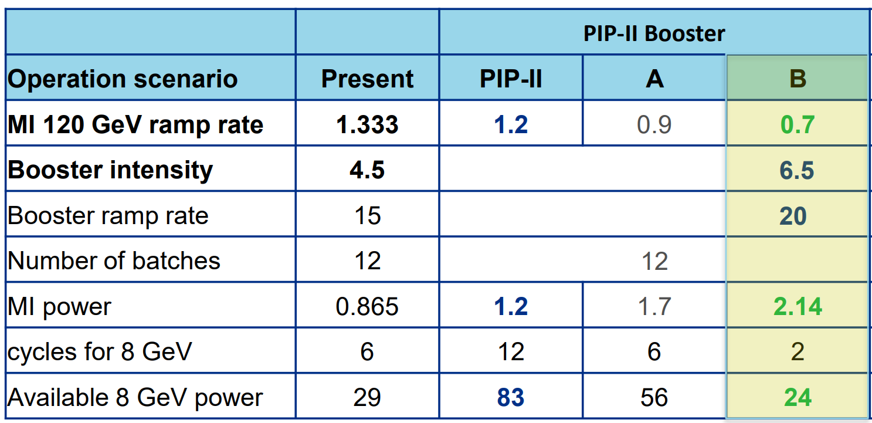
17
Possible 8 GeV Booster Beam parameter in Demo Phase
Share beam with BNB and LBNF programs
Booster provides 1.8μs pulses every 20 Hz of 6.5e12 protons at 8 GeV
Impacted by MI cycle rate, but at least as high as present
10/10/23
HB2023: Muon Acceleration for MuC, Yonehara
Notes:
17
17
17

Slide 18
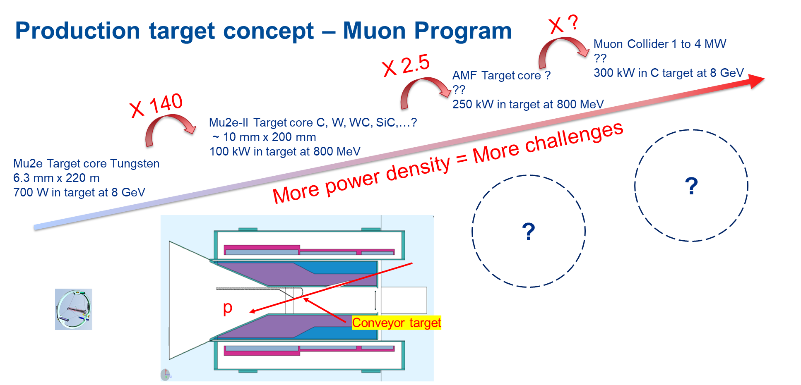
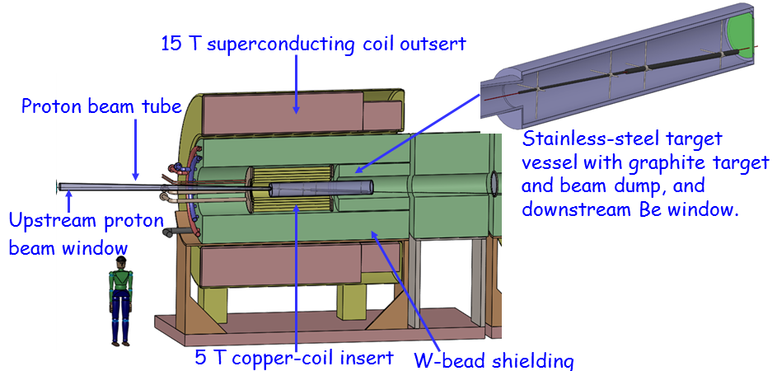
R&D of Targetry for Fermilab accelerator program
High Power Target technology has been developed for neutrino program
  Established 1.2 MW graphite target for LBNF
  ACE plan pushes the target R&D to produce 2+ MW target
ACE expands the high power target applications
  Target R&D roadmap to support Mu2e+, AMF and MuC
MAP + IMCC design

Slide 19
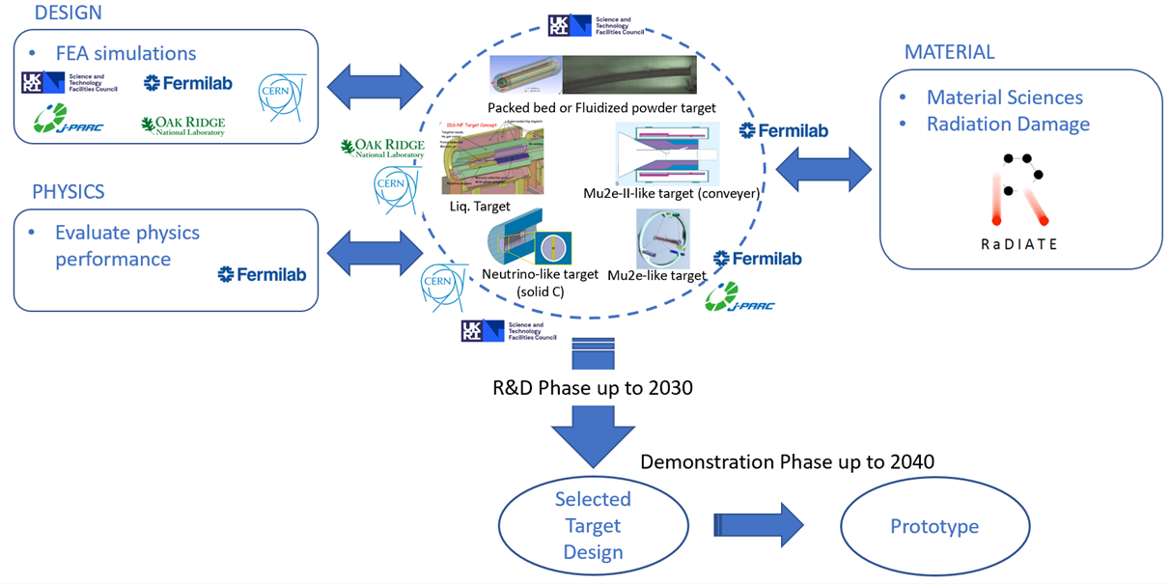
International Targetry R&D programs
MuC targetry is included in the proposed GARD High Power Targetry Roadmap with a plan to have a prototype in the late 2030s
ACE & SNS are potential to
carry on the high power target R&D
R&D
should start now!

Slide 20
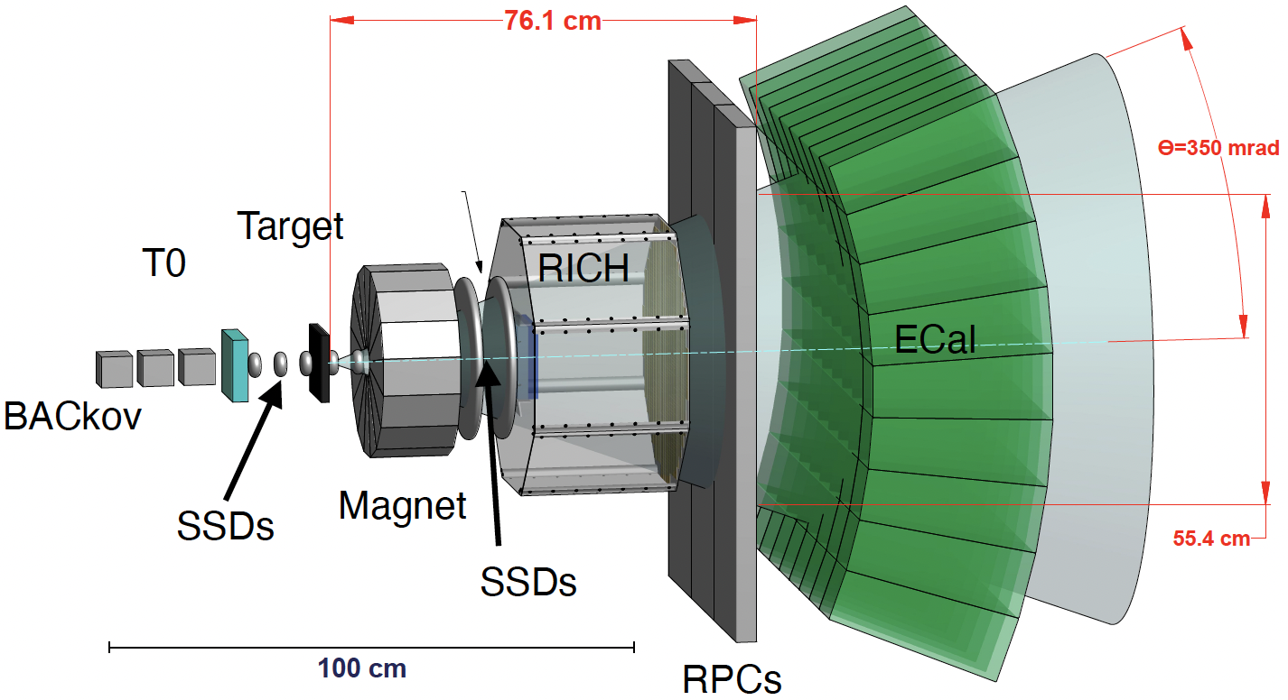
Optimize Muon Collider Target performance
Select the building material including shielding block, beam window based on the material study
  Study radiation & thermal stresses of building materials (RaDIATE)
Design dimensions of target system from engineering and physics point views
  Pion yield study
    Angular distribution
    Target Z dependence
    Energy dependence
    Hadronic shower
EMPHATIC
for yield study

Slide 21
Summary
MAP demonstrated the proof-of-principle Liq. Hg target
  Liquid or high granular target has a potential for Multi-MW beam applications
The US HEP community will resume the muon accelerator R&D in collaboration with IMCC
  Fermilab has developed the ACE concept
  Extensive R&D efforts in High Power Target technology are essential for the successful of the Fermilab Projects including LBNF and Mu2e
  The P5 final report will be released in December
  Stay tuned!

