Slide 1


8th High Power Targetry Workshop @RIKEN Wako Campus
Fabrication of Li-doped diamond
by nuclear transmutation
Hiroki Okuno¹, ○Yasuto Miyake¹, Hideyuki Watanabe^{1,2}
¹Nishina center for Accelerator-based science, RIKEN
²AIST
November 7, 2023
Notes:
Thank you for introduction.
I’m Yasuto Miyake from RIKEN.
I would like to make a presentation on behalf of Okuno-san.
Like Dr. Ogura’s presentation yesterday, this presentation is about ion implantation into semiconductor materials.

Slide 2

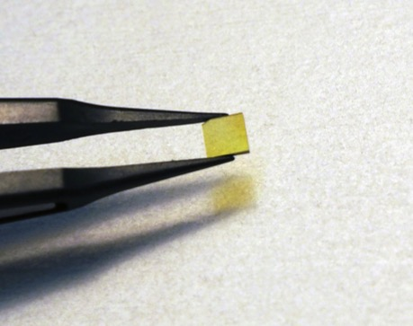
Contents
Background: Characteristics of diamond as semiconductor
Objective of this study
What is “in situ” nuclear transmutation?
Current situation
Summary
Diamond substrate
3mm × 3mm
Notes:
In this study, we treated diamond substrate as shown here, not jewelry.
First, as background of our research, we would like to talk about the characteristics of diamond as semiconductor.

Slide 3
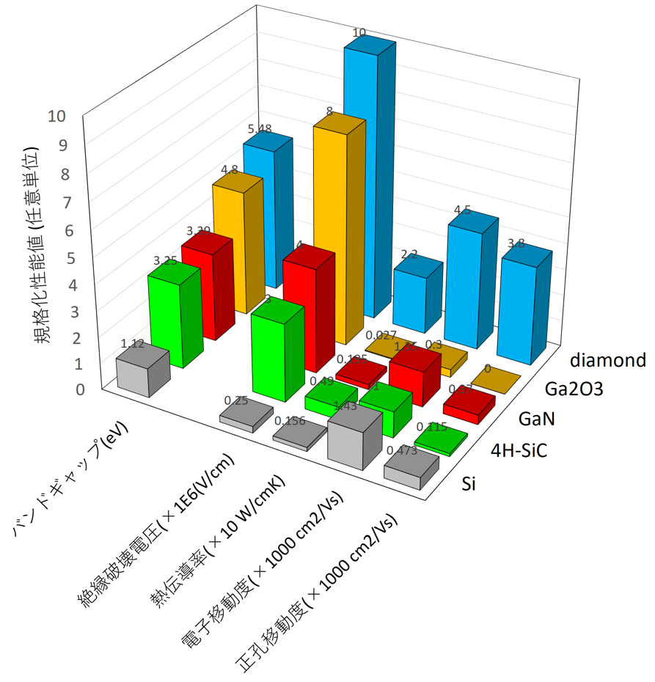
Characteristics of diamond as a semiconductor
Band gap
5.48 eV
✔Power & High frequency devices
✔Light emitting devices
✔Surface acoustic wave devices
✔Electronic emitters
✔Biosensors
✔Quantum magnetic sensor
✔Quantum computer
✔Quantum Communication devices
・
・
・
p-type
is needed
n-type
Physical properties (a. u.)
Diamond
Ga₂O₃
Donor level of Li is estimated to be about 0.1 eV(interstitial) for RT operation [1].
GaN
4H-SiC
band gap (eV)
There are technical difficulties to fabricate Li-doped n-type semiconductor.
SiC
breakdown voltage
(x 1E6 V/cm)
High carrier concentration is required at room temperature (RT).
Li does not diffuse easily within diamond [2].
Implantation of Li at high energies will occur damage of the lattice structure of diamond.
thermal conductivity
(x 10 W/cmK)
electron mobility
(x 1000 cm²/Vs)
hole mobility
(x 1000 cm²/Vs)
[1] Phys. Rev. Lett. 66 (1991) 2010-2013.
[2] Surface & Coating Technology 307 (2016) 236-242.
Notes:
This figure shows the physical properties of diamond and other semiconductor materials.
Diamond is a wide bandgap semiconductor with a bandgap of 5.48 eV.
As shown in this figure, it is superior to other semiconductor materials in various physical properties.
Therefore, diamond is expected to find applications in various devices and sensors, but this requires both p-type and n-type semiconductors.
Methods for fabricating p-type semiconductors have been established.
If Li is implanted, it is expected to be an n-type semiconductor that can be operated at room temperature.
However, there are technical difficulties in fabrication of Li-doped n-type semiconductor.
For example, Li does not diffuse easily within diamond.
Implantation of Li at high energies will occur damage of the lattice structure of diamond.

Slide 4
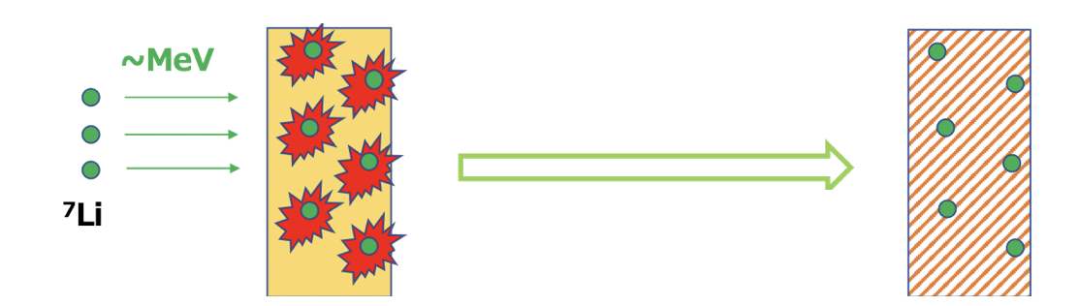
Fabrication of Li-dope diamond by nuclear transmutation of ⁷Be
Our proposal
Patent no. 2022-66822. 2022-04-14.
⁷Li-dope-diamond
without lattice defect
Ion implantation
Annealing
Thermal diffusion
Electron capture
~30 keV
No radiation
No recoil
Defect
by implantation
Remove defect part
“in situ” nuclear transmutation
Example of Conventional way
⁷Li-dope-diamond
(with lattice defect)
neutron
Lattice defect caused by implantation with high energy
α-ray with high energy
Repulsion
Notes:
To solve these problems, we propose to fabricate Li-dope diamond by nuclear transmutation of 7Be.
Since Li does not diffuse in diamond, in order to distribute Li, implantation with energy of several MeV is required.
However, in this way, lattice defect is caused by implantation with high energy.
As a result, even if 7Li-doped diamond is obtained, it will be diamond with lattice defect.
In our proposal, firstly, 7Be ion is implanted into the surface layer of diamond substrate with energy of around 30 keV.
Next, 7Be is thermally diffused into the diamond by annealing.
In this process, defect caused by ion implantation in the surface layer can be removed.
7Be is converted to the stable isotope 7Li by an electron capture reaction.
This reaction does not emit ionizing radiation and does not cause recoil.
Therefore, Li-doped diamond without lattice defect can be obtained after decay of 7Be.
Here we call the electron capture reaction in-situ transmutation, and I would like to explain a little about it.

Slide 5
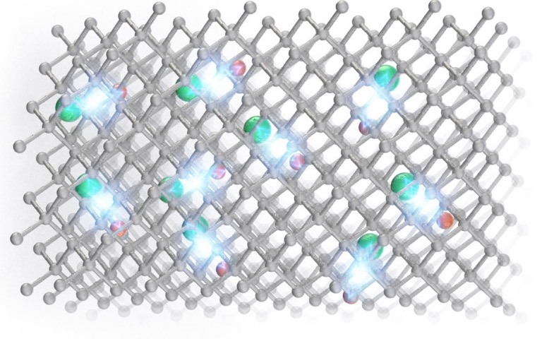
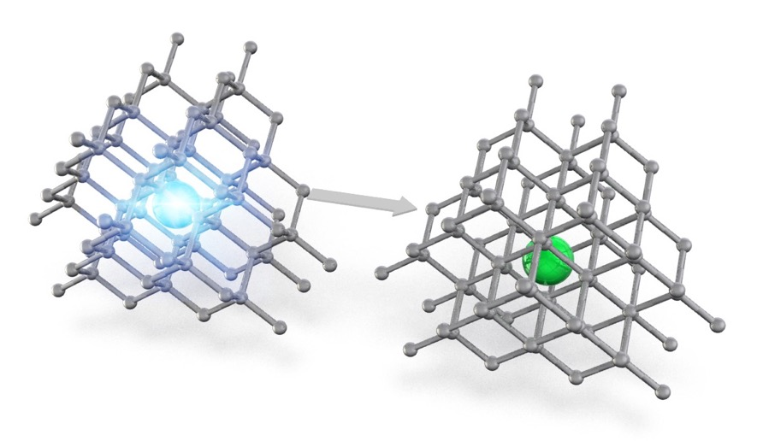


What is “in situ” nuclear transmutation?
“in situ” nuclear transmutation
nuclear transmutation by α-decay
⁷Be
⁷Li
α
⁷Li
“in situ” nuclear transmutation is an orbital electron capture.
Electrons are captured into the nucleus and react with protons to form neutrons, which emit electron neutrinos.
There is no external emission of radiation or recoil of atoms, so there is no damage to the lattice.
For example, in the case of α-decay, α-particles with energies of a few MeV are emitted, and the original atoms themselves are also displaced by the recoil of the α-particle emission.
Since the binding energy of the lattice is only a few eV, the lattice structure will be destroyed due to α-ray and recoil
(High Power for the lattice of diamond!!!).
Notes:
Let me explain “what is in situ nuclear transmutation”
As mentioned earlier, in situ transmutation is an orbital electron capture reaction.
In this reaction, there is no external emission of ionizing radiation and there is no recoil of atoms.
Therefore, there is no damage to the lattice.
On the other hand, assume nuclear transmutation by alpha decay.
In previous study, there is ion implantation of 7Li using nuclear transmutation of B-10.
This is based on the reaction here in which B-10 reacts with neutrons to change into 7Li and 4He.
This reaction is famous for Boron neutron capture therapy.
In this case, alpha rays of several MeV energy are emitted and the original atoms themselves are also displaced by recoil.
Since the binding energy of the lattice is a few eV, the lattice structure is destroyed by the alpha rays and recoil.
In this case, nuclear transmutation by alpha decay is quite high power for the lattice of diamond.

Slide 6
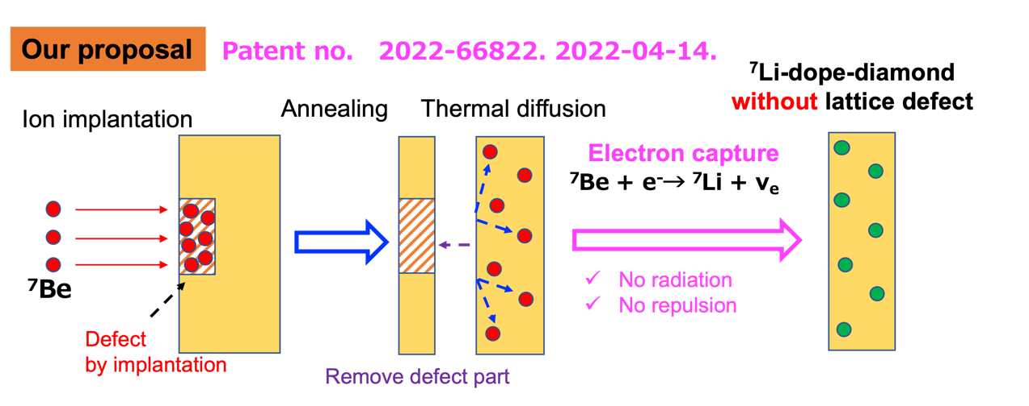
Objective and current situation of this study
Cold test prior to “Fabrication of Li-doped diamond by nuclear transmutation”
Ion implantation of stable isotope ⁹Be
Investigation of ⁹Be diffusion in diamond by thermal annealing
Investigation of the effects of ion implantation and thermal annealing on crystal structure
Notes:
Currently, Be-7 has been not used yet in this study.
In this study, a cold test prior to “Fabrication of Li-doped diamond by nuclear transmutation” was conducted.
In the cold test, ion implantation using stable isotope of 9Be was performed.
Be thermal diffusion in diamond by thermal annealing was investigated.
Also, the effects of ion implantation and thermal annealing on crystal structure of diamond was investigated.

Slide 7
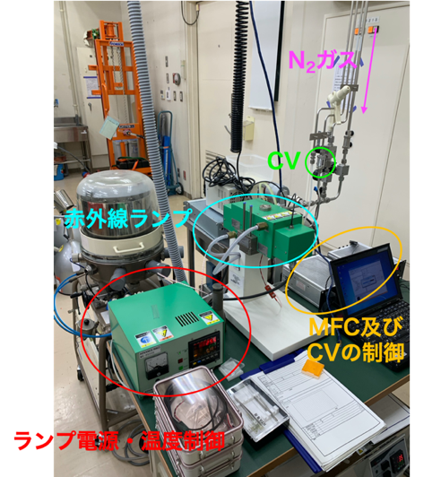
Experimental procedure
CL measurement
RTA
(Rapid thermal annealing)
SIMS
(Secondary ion mass spectrometry)
Evaluation of crystallinity
Investigation of band structure
Ion implantation
MS
CL measurement
Secondary ion
Primary ion(O₂, Cs)
SIMS
Evaluation of thermal diffusion
suputtering
CL measurement
RTA
CL measurement
Principle of SIMS
RTA device (AIST)
SIMS
For thermal diffusion of Be
RTA in N₂ or Ar/H₂ gas
800 ~ 1400℃
Flow rate: 100 sccm
Pressure: 150 Torr
For measurement of Be in diamond
…
CL: Cathode luminescence
Notes:
This is an experimental procedure.
First, Be was implanted into the diamond substrate.
Next, Be distribution in diamond was measured by SIMS.
SIMS is secondary ion mass spectrometry.
Then, Rapid thermal annealing was conducted.
RTA is done for thermal diffusion of Be.
Diamond substrate was annealed in N2 or Ar/H2 mixed gas.
Annealing temperature was between 800 to 1400°.
After RTA, Be distribution is measured again by SIMS to evaluate thermal diffusion in the diamond.
In between each process, Cathode Luminescence measurement was conducted to evaluate the crystallinity and investigate band structure.

Slide 8
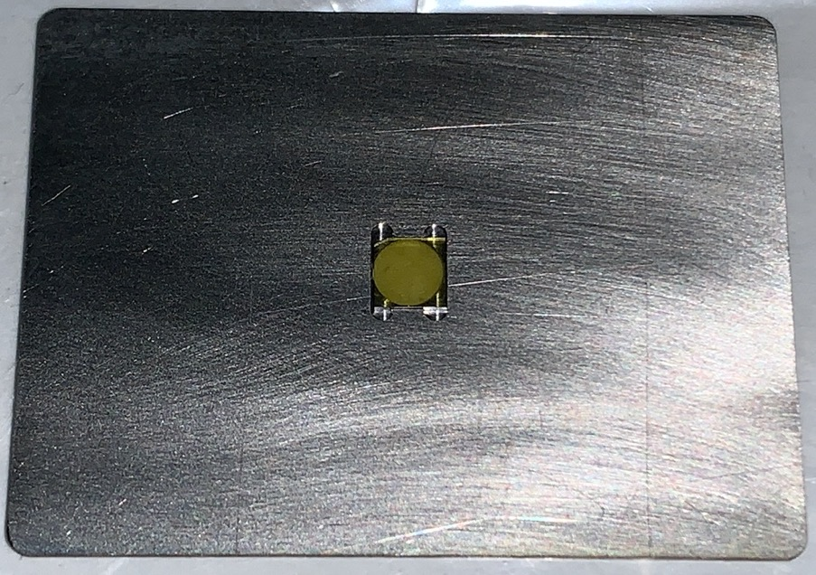
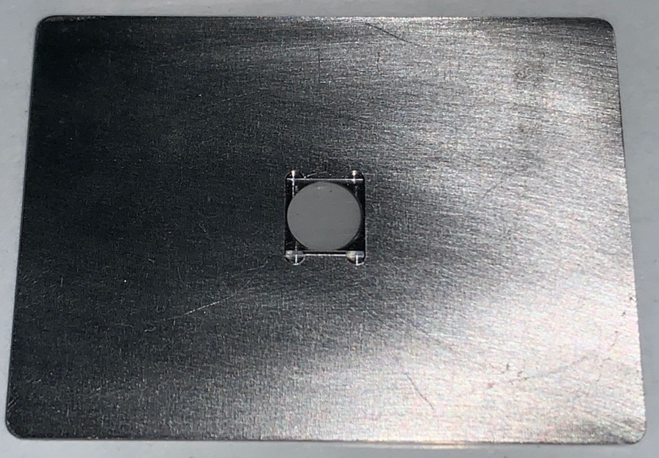
Examples of diamond substrate
type Ib diamond
type Ⅱa diamond
Ti holder
3
4
24
3
4
32
Nitrogen atoms are contained up to 1% as impurities.
Manufactured by HPHT(High Pressure High Temperature) method
3 x 3 x t0.5
Nitrogen atoms are contained less than 1 ppm.
Manufactured by CVD (Chemical Vaper Deposition)
4 x 4 x t0.5
Notes:
These are diamond substrates used in the experiment.
Mainly, two types of substrates have been used so far: Type 1b diamond and Type 2a diamond
In the case of type 1b diamond, nitrogen atoms are contained as impurities in more than 1%. This is why it looks yellow.
The substrates are manufactured by the HPHT method.
Substrate size is 3mm x 3mm x 0.5 mm thickness.
In contrast, for type IIa diamond, nitrogen atoms are contained less than 1ppm.
Therefore, it appears transparent.
This diamond is manufactured by the CVD method.
Substrate size is 4mm x 4mm x 0.5mm thickness.

Slide 9
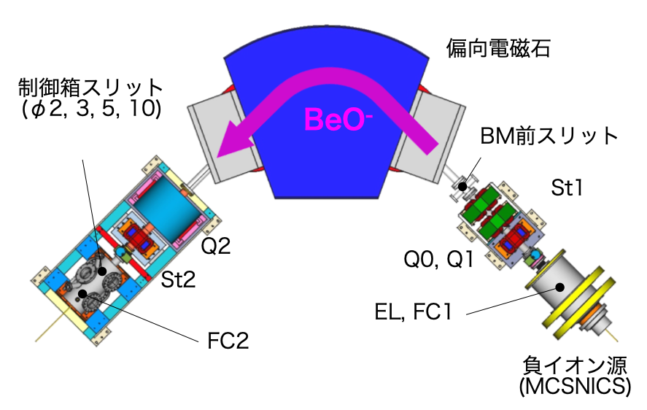
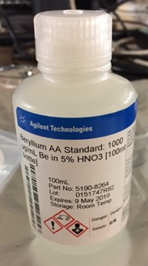
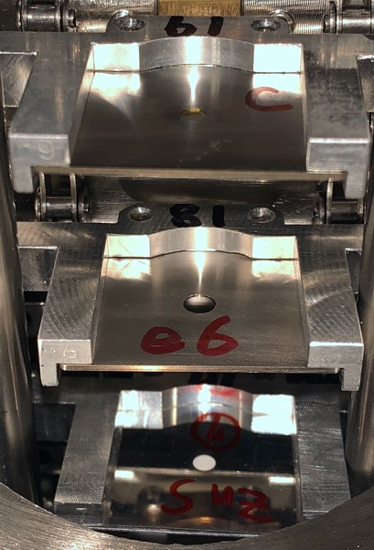
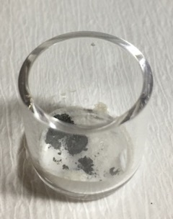
Ion implantation of Be into diamond substrate
Be(NO₃)₂ solution
Bending magnet
Ti sample holder
Slit(φ3, 5)
Slit
Evaporation-drying, and Sintering
Negative ion source
Beam line for ion implantation
(Radiation control area)
Beam line was constructed in radiation control area.
BeO powder is made from Be(NO₃)₂ solution.
BeO⁻ is extracted and accelerated to 20 keV.
Dose amount: 10¹³ - 10¹⁷ ions/cm²
Requesting a use permit application for the unsealed ⁷Be
BeO powder 1mg~
Notes:
In the future, Be-7 will be implanted into diamond.
So, a beam line for ion implantation was constructed in radiation control area.
The beam line consists of negative ion source, bending magnet, target chamber, and other components such as Quadrupole magnet.
The sample is BeO power, which is made from Be nitrate solution.
The BeO powder is prepared by evapolration-dyring and sintering of Be nitrate solution.
The BeO sample is loaded into the ion source to produce negative BeO- ion beam.
BeO is extracted and accelerated to 20 keV, and then it is mass-analyzed and implanted into diamond.
The diamond substrate is placed in a Ti holder in the target chamber.
Dose amount was 10^13 to 10^17 ions/cm2.
Permission is currently pending to use unsealed Be-7.

Slide 10
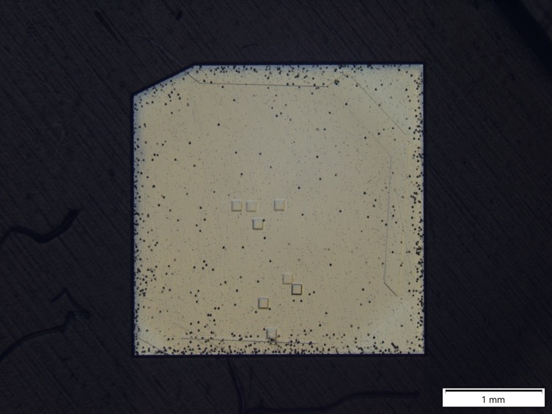
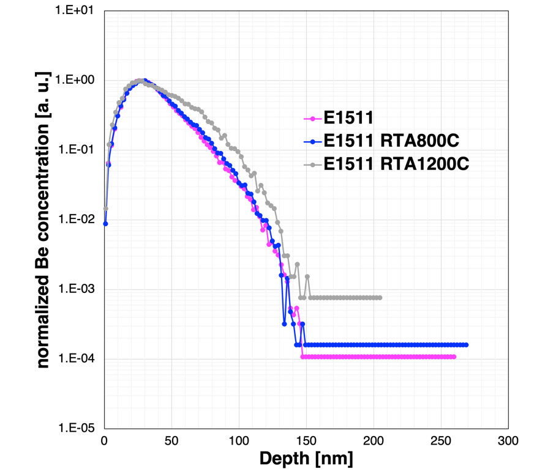
Example of SIMS measurement result
SIMS trace
E1511: Diamond deposited by CVD on type Ib diamond substrate
Movement of Be profile toward the depth direction was observed.
Experimental data is being accumulated to evaluate the diffusion coefficient of Be in diamond.
RTA time, temperature, temperature rise time, influence of ambient gas in RTA, etc. will be investigated.
Notes:
Here is an example of SIMS measurement result.
This figure shows Be distribution in diamond before and after RTA.
Horizontal axis shows depth from the surface and vertical axis represents Be concentration normalized by peak concentration.
The sample name is E1511, which is diamond deposited by CVD on type Ib diamond substrate.
In this figure, magenta one is the result as implanted, blue one is the result after RTA at 800℃, and gray one is the result after RTA at 1200℃.
As the RTA temperature increases, the Be profile was observed to move toward the depth direction.
It indicates thermal diffusion in diamond is expected.
Currently, experimental data are being accumulated to evaluate diffusion coefficient of Be in diamond.
Also, other parameters such as RTA time, temperature, temperature rise time, influence of gas in RTA, etc will be investigated.

Slide 11
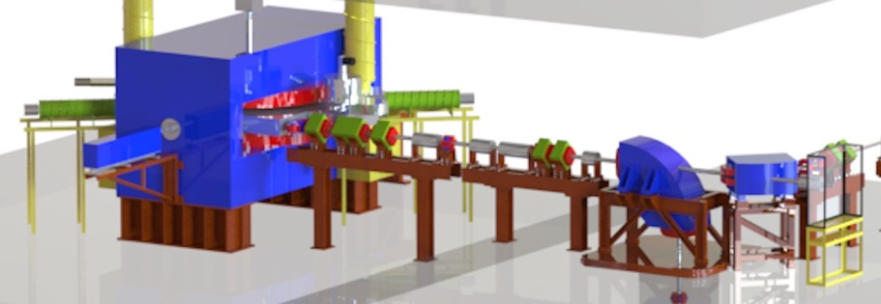


Preparation of ⁷Be
target
RIKEN RIBF
AVF cyclotron
$${}_{3}^{7}{Li}+{}_{1}^{1}p⟶{}_{4}^{7}{Be+{}_{0}^{1}n}$$
Nuclear reaction system
$${}_{6}^{12}C+{}_{1}^{1}p⟶{}_{4}^{7}{Be+{}_{2}^{4}{He}+{}_{1}^{1}p+{}_{0}^{1}n}$$
$$⋮$$
⁷Be(T_{1/2} = 53.2 d) will be produced by the AVF cyclotron at RIKEN RIBF.
Preparation of target chamber for irradiation
Nuclear reaction systems, sample forms, and post-irradiation chemical treatment are examined.
Required amount of ⁷Be is estimated to be more than 2 x 10⁻¹² g (2 pg).
Notes:
Finally, I would like to talk about the production of Be-7.
7Be will be produced by the AVF cyclotron at RIKEN RIBF.
The target chamber for irradiation as shown here will be manufactured.
Nuclear reaction system to produce 7Be, sample forms, and post-irradiation chemical treatment are also examined.
Required amount of 7Be is estimated to be more than pico gram.

Slide 12
Summary
The objective of this study is to fabricate Li-dope diamond using the nuclear transmutation reaction of short-lived RI, ⁷Be.
Investigation of the effect of ion implantation, Be diffusion, and RTA on the crystal structure by SIMS are proceeding (Cold test for the use of ⁷Be).
Application for a permit to use unsealed RI ⁷Be is pending.
Proof-of-principle demonstration of elemental strategy by nuclear transmutation using the accelerator.
Acknowledgement
This research was supported by the CANON foundation’s Research Grant.

Slide 14
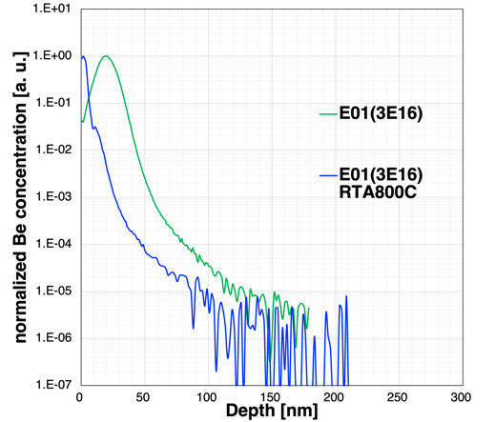
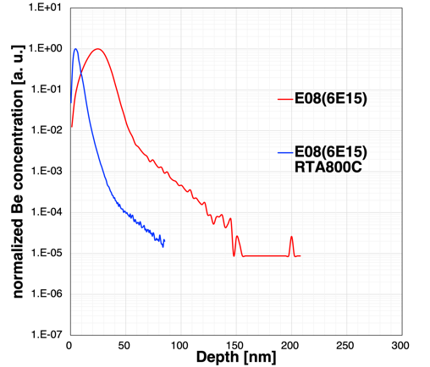
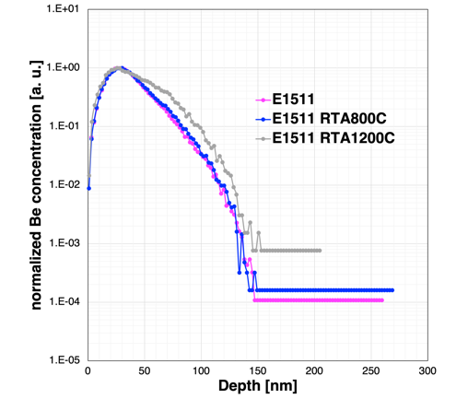
Change in Be profile and dose amount
Dose amount
3×10¹⁶
>
6×10¹⁵
>
6×10¹³
[1/cm²]
Peak conc.
1.80×10²²
>
3.26×10²¹
>
1.73×10¹⁹
[1/cm³]
A correlation was observed between the dose amount and changes in Be profile after RTA.
Vertical axis was normalized by the peak concentration.
If the dose amount is too large, it may be difficult to move due to clustering [1], or it may move in the surface direction due to irradiation damage.
Be profile did not migrate toward the surface direction in the sample with dose amount of 6 x 10¹³ atoms/cm².
[1] 谷口研二, 応用物理, 第69号 第4号 (2000)
Notes:
濃度の制限から、照射時間が非常に短いため、空間的に濃度のムラができてしまうから

Slide 15
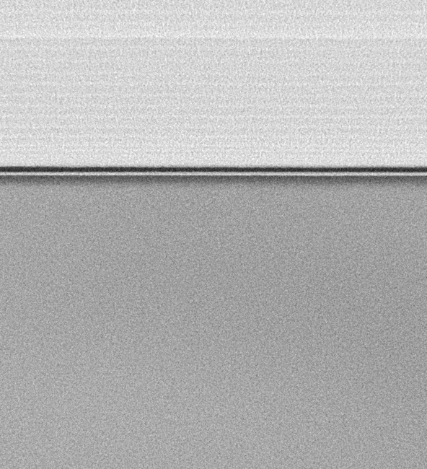



TEM分析結果
Be照射領域(RTA800℃済み)
Be未照射領域(RTA800℃12h)
Cコーティング
不明層
Ptコーティング
等厚干渉縞
エッジと並行の面から観察((110)面)
イオン注入面は(100)面
ほぼ同一
表層に等厚干渉縞
(加工に起因するコントラスト)
ダイヤモンド構造を維持
不明層のみ酸素を検出(TEM-EDX)
ダイヤモンド層

Slide 16
カソードルミネッセンスの比較
エピタキシャル成長薄膜
IIa基板
Ib基板
イオン注入前
バンド端発光
バンド端発光
H3センター
H3センター
イオン注入+加熱処理後
バンド端発光
バンド端発光
H3センター
バンド端発光(235 nm)を確認
基板(Substrate)がIb基板のため、成長膜を透過したH3センター(503 nm)のスペクトルが見られる
Notes:
H3センター: N(窒素)V(空孔)N(窒素)構造配置を起源とする

