Slide 1



Innovative material developments for target backings in superheavy element experiments
Kieran Kessaci
PostDoctoral Fellow
University of Strasbourg Institute for Advanced Studies
IPHC - Strasbourg
Kessaci Kieran – Innovative material development for target backings - HPTW2023 RIKEN – 07/11/2023
Notes:
Good afternoon, first of all, I want to thank the organizing committee of this conference for giving me the opportunity to present my work here.
I am Kieran Kessaci, I am a postdoctoral student from the Strasbourg University in France and II will show you our recent studies on on innovative material developments for the target backings we are using in superheavy elements experiments

Slide 2
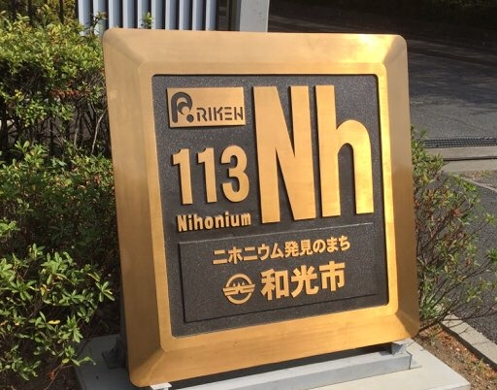
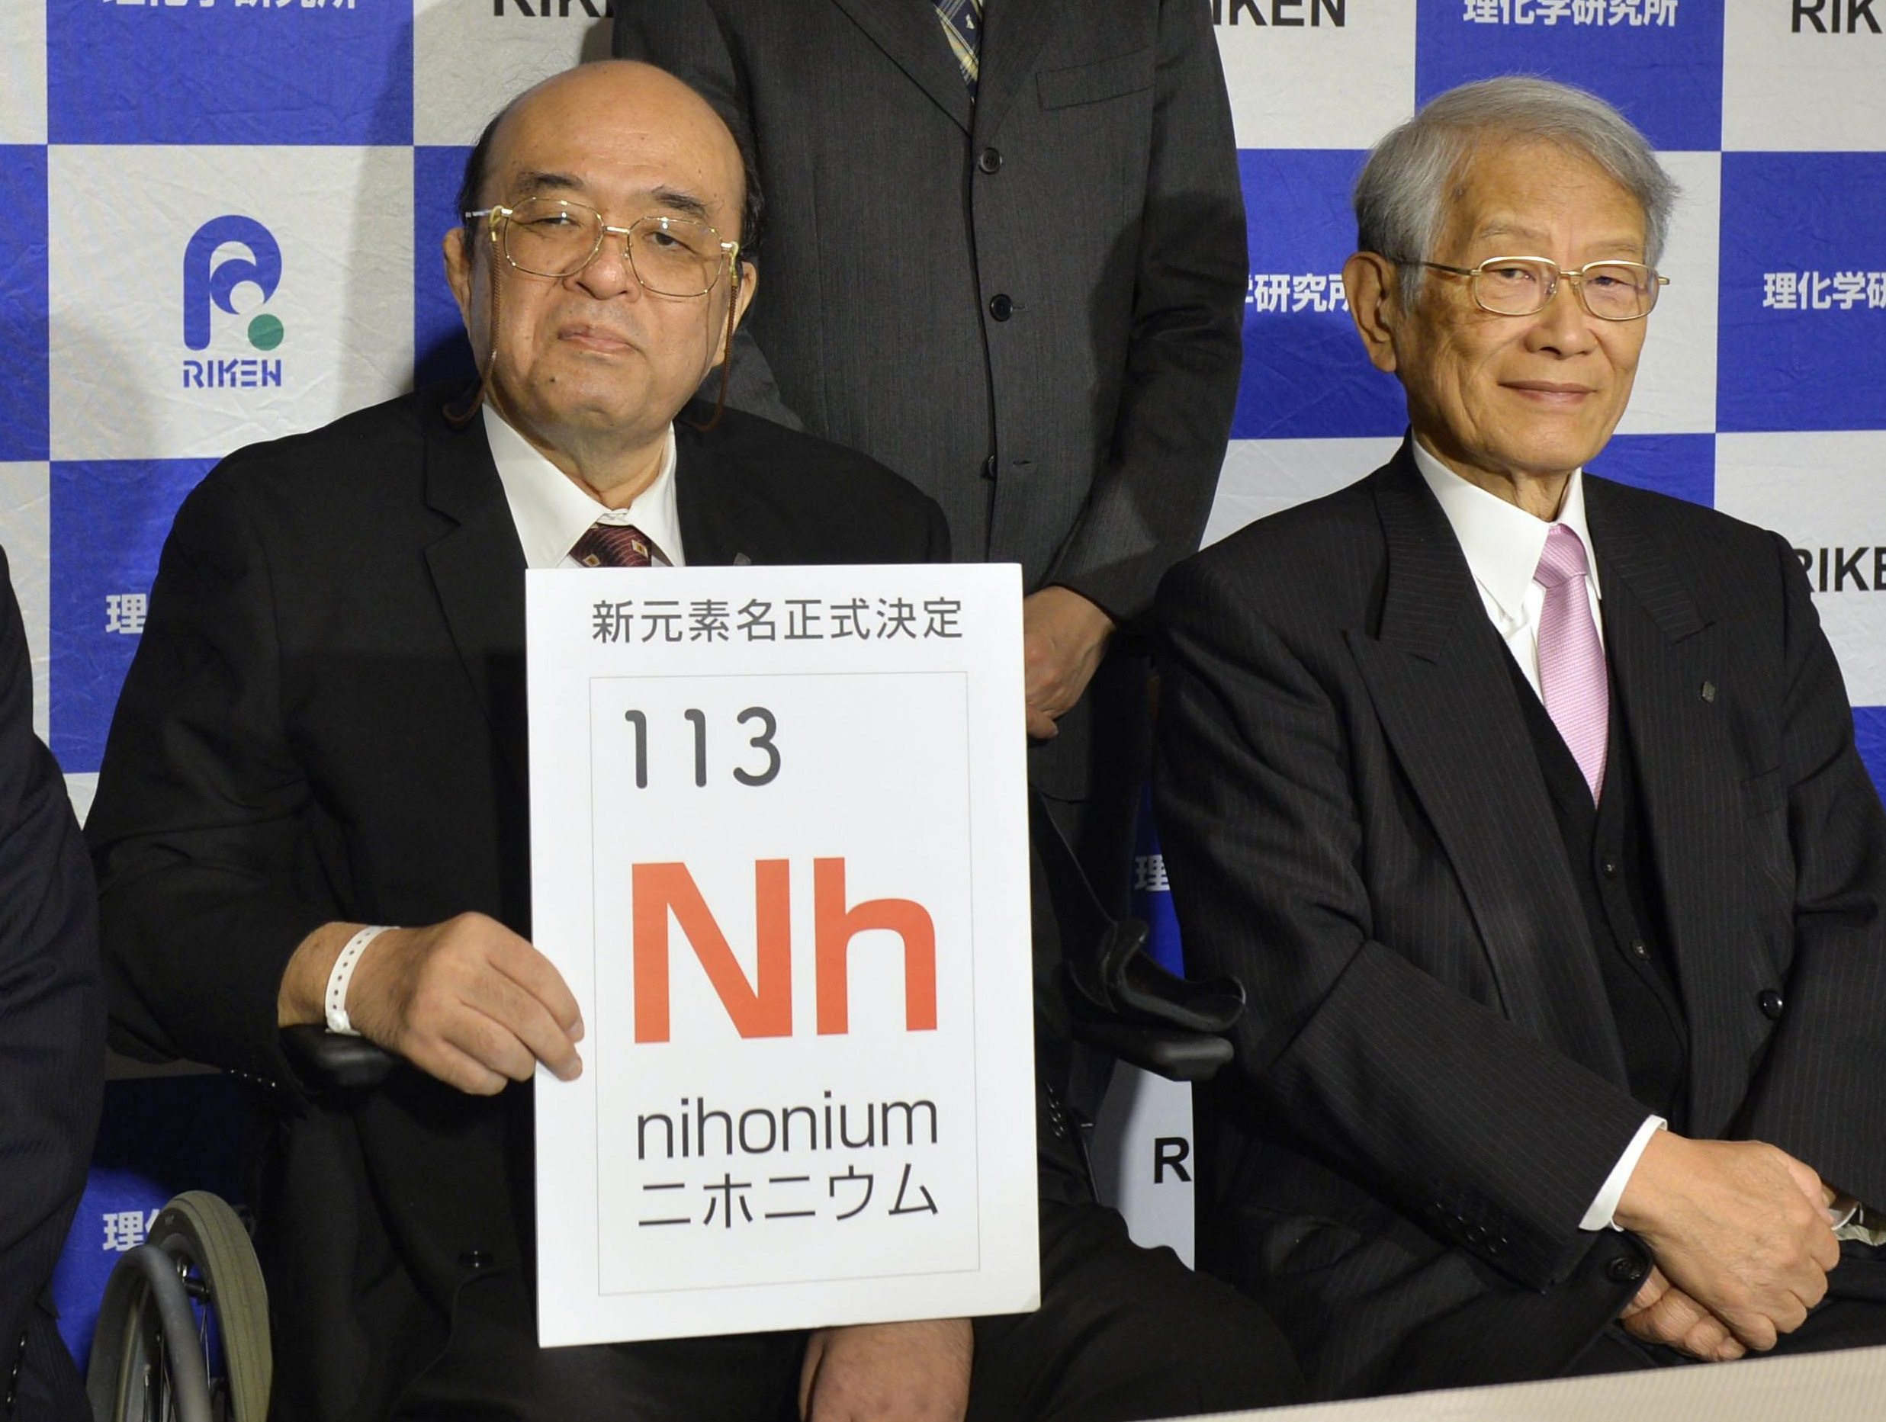
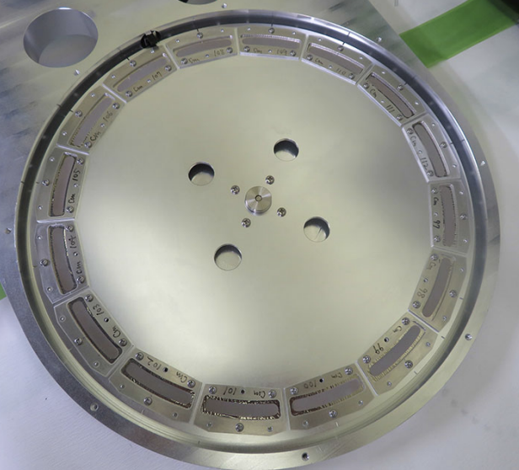
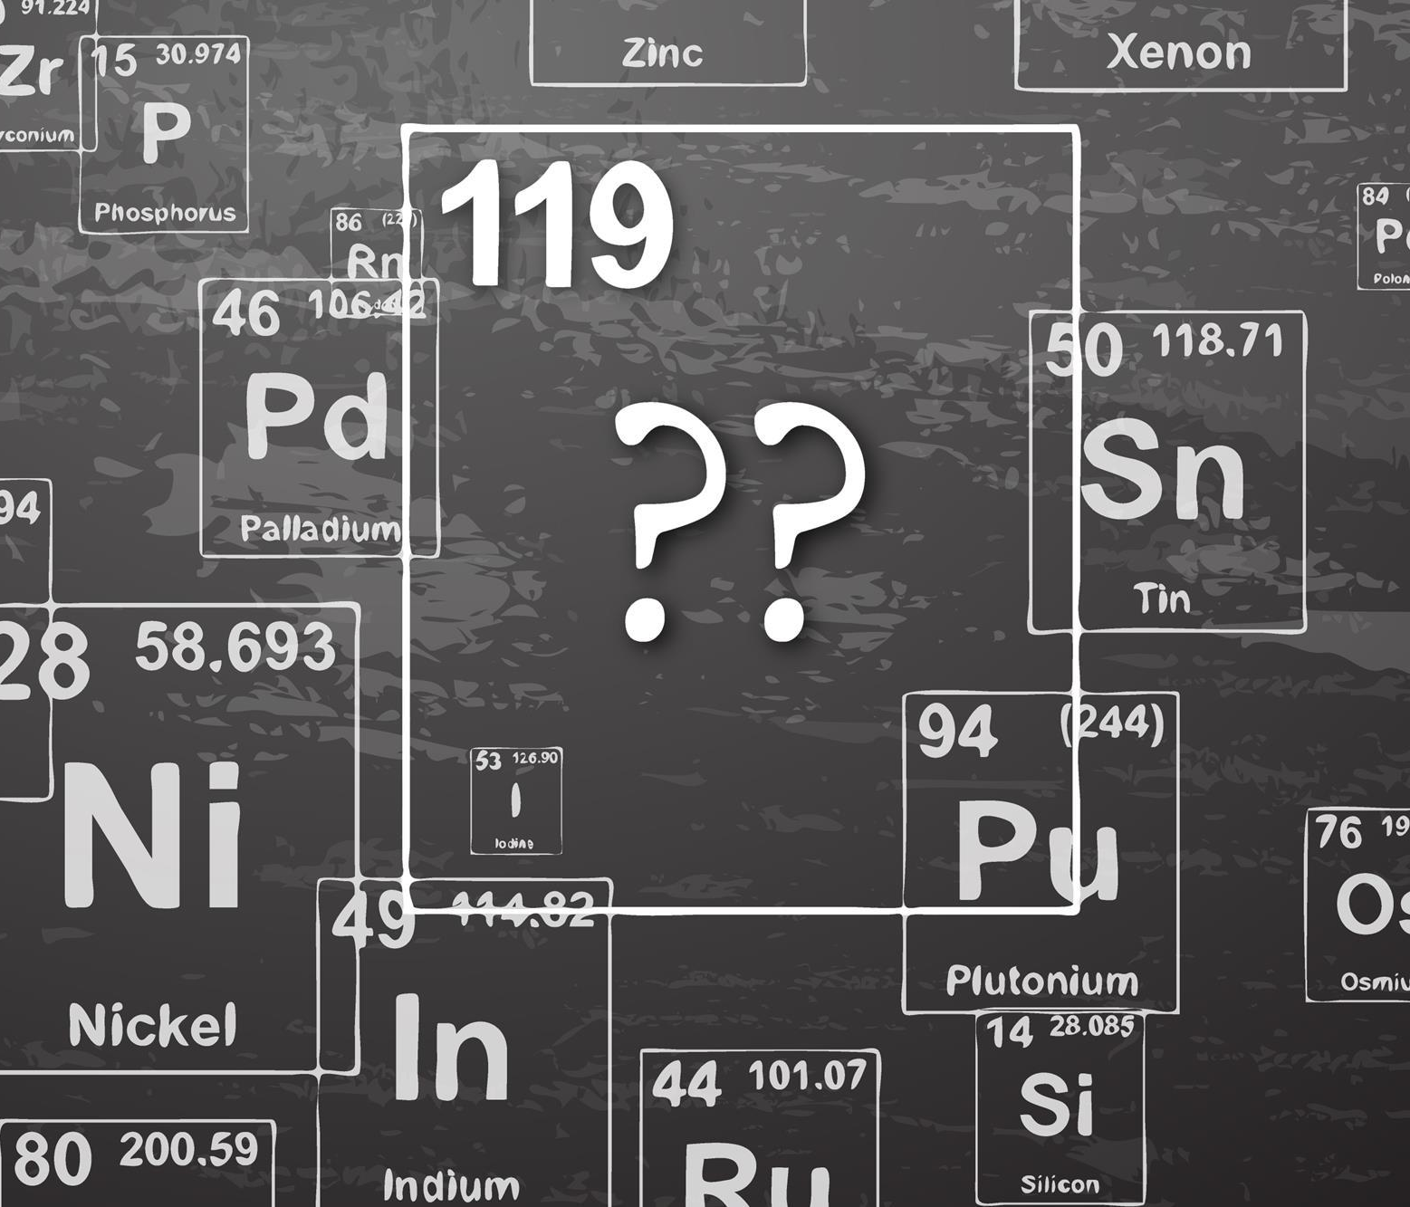
Outline
High intensity ion beams
Beam power – thermal effects
Beam dose – irradiation effects
Possible solutions and tests
²⁴⁸Cm
Kessaci Kieran – Innovative material development for target backings - HPTW2023 RIKEN – 07/11/2023
Notes:
I will start this presentation with a brief overview of the high intensity issue that motivate these developments
then i will describe our understanding of the situation starting by the description of the thermal effects and then the irradiation effetcs
and i will finish by the possible solutions under study in our laboratory

Slide 3
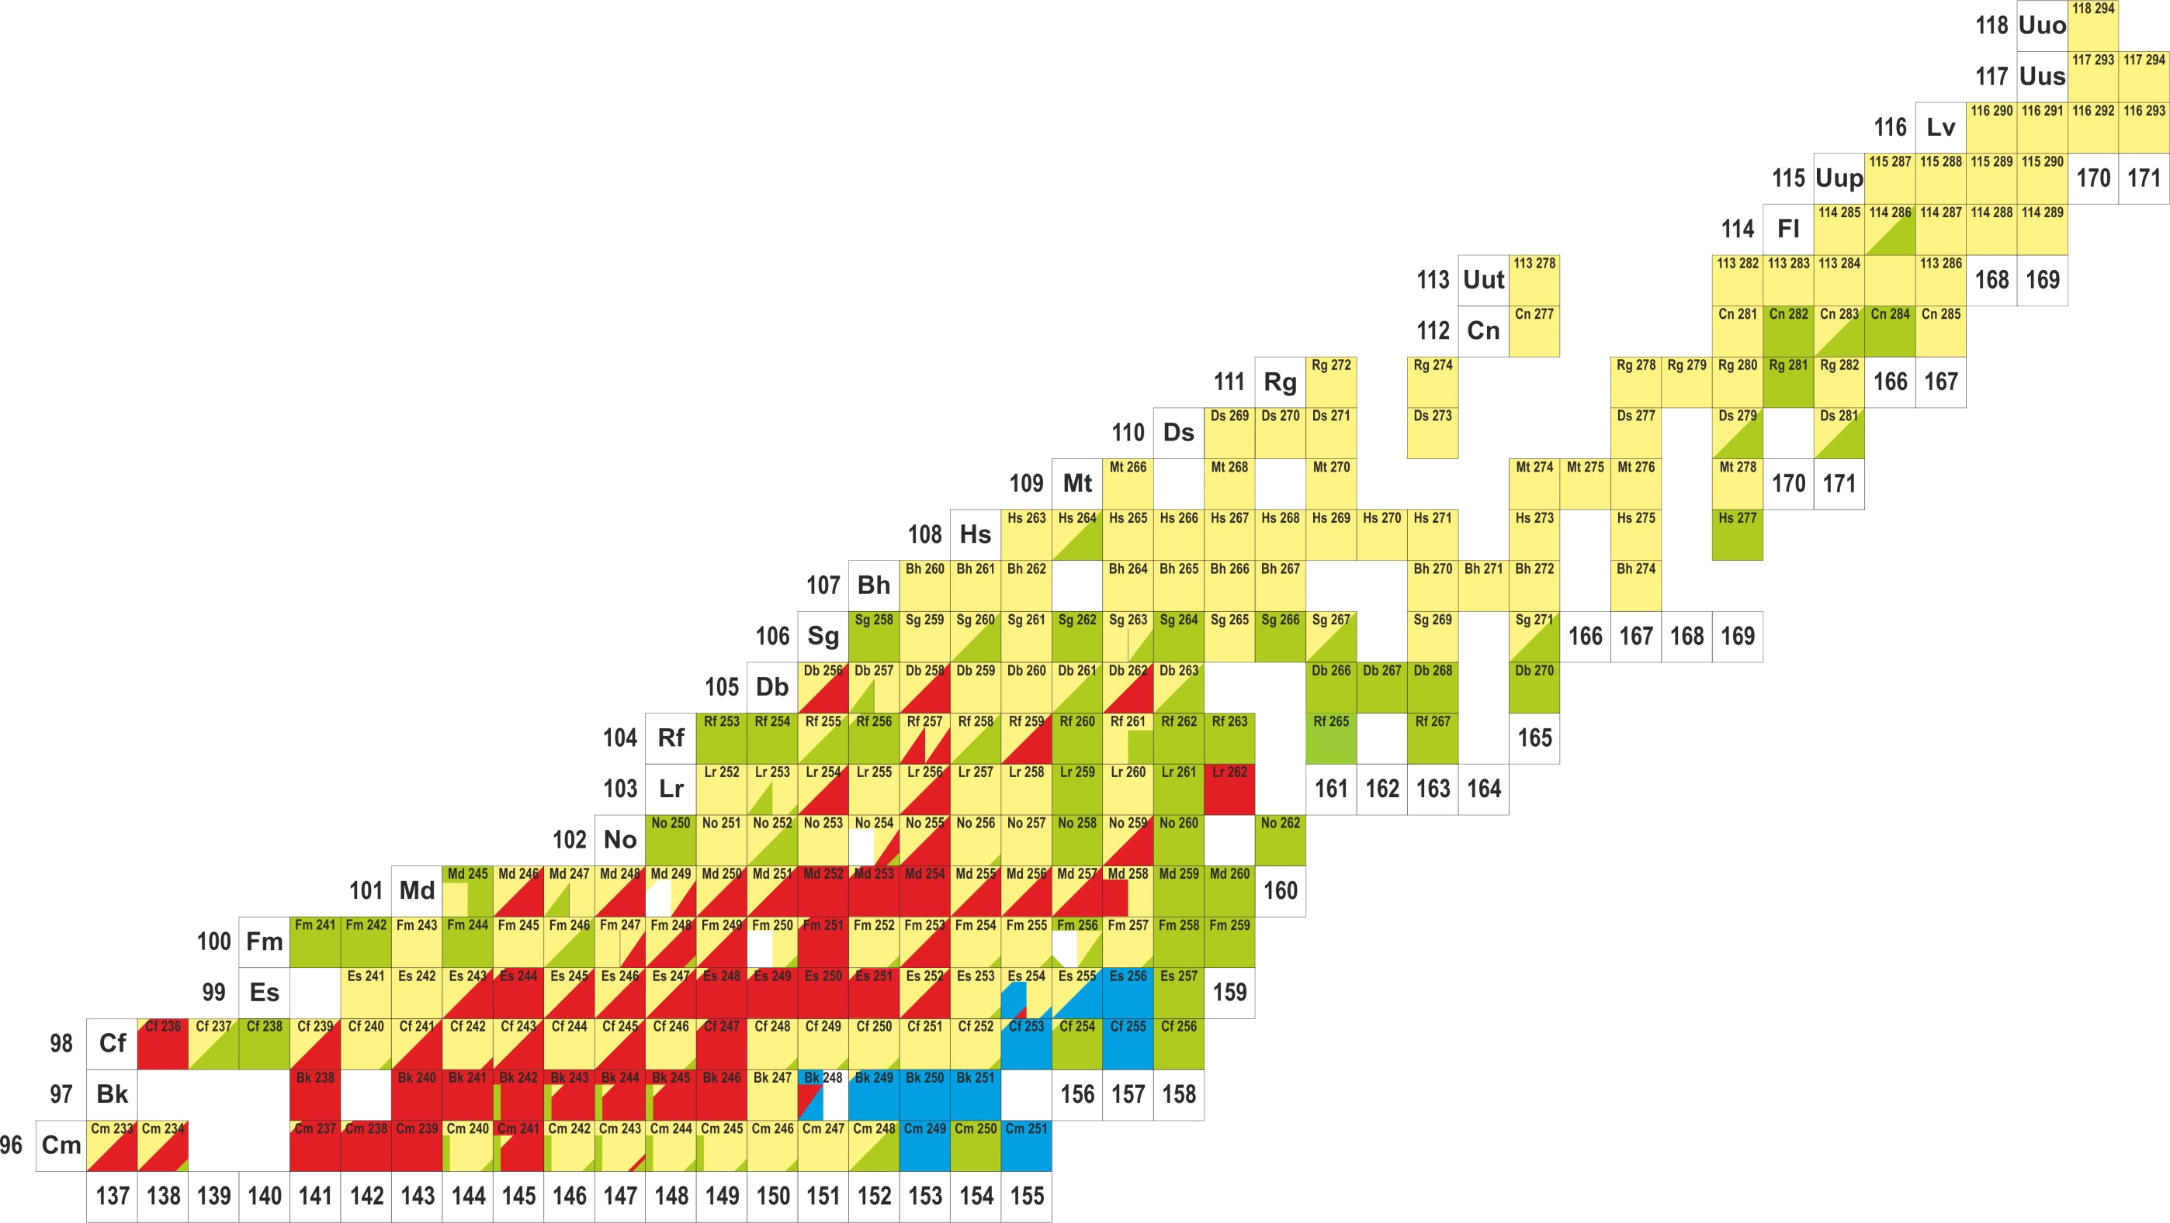
3
High intensity ion beams
Superheavy elements experiments → low cross sections (from nb to fb) :
  New elements synthesis → Z=119 synthesis here in RIKEN
  Spectroscopy
Many accessible unknown nuclei from Nobelium to Hassium (and more…)
New facilities (JINR, GANIL, RIKEN…)
→ Increased intensities heavy ion beams : 5-10 pµA
→ 10¹³⁻¹⁴ part/s for ⁴⁸Ca, ⁵⁰Ti, ⁵¹V…
121
120
119
Kessaci Kieran – Innovative material development for target backings - HPTW2023 RIKEN – 07/11/2023
Notes:
As superheavy element physicists, we are working at the extreme limit of the nuclear chart, we are studying super heavy elements through two different aspects. We are performing new element synthesis experiments

Slide 4
4
High intensity ion beams
Synthesis landscape
≈fb cross sections
Superheavy elements experiments → low cross sections (from nb to fb) :
  New elements synthesis → Z=119 synthesis here in RIKEN
  Spectroscopy
Many accessible unknown nuclei from Nobelium to Hassium (and more…)
New facilities (JINR, GANIL, RIKEN…)
→ Increased intensities heavy ion beams : 5-10 pµA
→ 10¹³⁻¹⁴ part/s for ⁴⁸Ca, ⁵⁰Ti, ⁵¹V…
121
120
⁵¹V + ²⁴⁸Cm ^{→ 299*}119
119
Kessaci Kieran – Innovative material development for target backings - HPTW2023 RIKEN – 07/11/2023
Notes:
As superheavy element physicists, we are working at the extreme limit of the nuclear chart, we are studying super heavy elements through two different aspects. We are performing new element synthesis experiments as the synthesis of the element 119 which is currently running here in RIKEN since 2017

Slide 5
5
High intensity ion beams
Synthesis landscape
≈fb cross sections
Superheavy elements experiments → low cross sections (from nb to fb) :
  New elements synthesis → Z=119 synthesis here in RIKEN
  Spectroscopy
Many accessible unknown nuclei from Nobelium to Hassium (and more…)
New facilities (JINR, GANIL, RIKEN…)
→ Increased intensities heavy ion beams : 5-10 pµA
→ 10¹³⁻¹⁴ part/s for ⁴⁸Ca, ⁵⁰Ti, ⁵¹V…
121
120
⁵¹V + ²⁴⁸Cm ^{→ 299*}119
119
Spectroscopy landscape
≈nb cross sections
Kessaci Kieran – Innovative material development for target backings - HPTW2023 RIKEN – 07/11/2023
Notes:
As superheavy element physicists, we are working at the extreme limit of the nuclear chart, we are studying super heavy elements through two different aspects. We are performing new element synthesis experiments as the synthesis of the element 119 which is currently running here in RIKEN since 2017
And on another hand we are performing spectroscopic studies of slightly lighter nuclei, and so with slightly higher cross sections but still not higher than few nanobarns.
In order to perform such low cross section experiments, new facilities were built around the world as the SRILAC here in RIKEN but also the SHE Factory in Russia or the SPRIAL2 facility in GANIL. These facilities are able to deliver very intense beams up to 10puA, which corresponds to 10 to the power of 14 part/s interacting with our targets.
And if these very high intensities gives us access to a fully new range of nuclei, the counterpart of these intense beams is that the

Slide 6
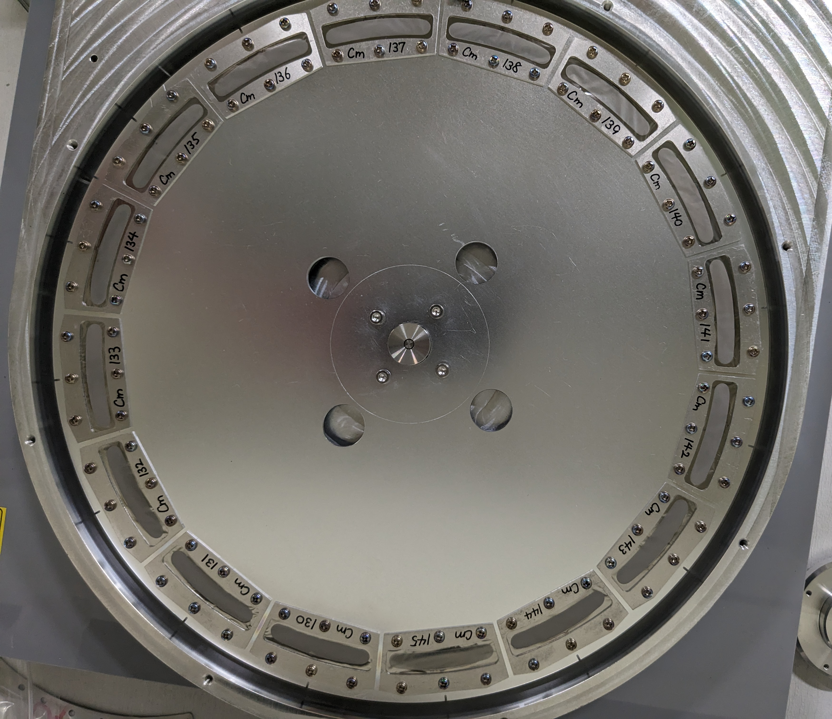
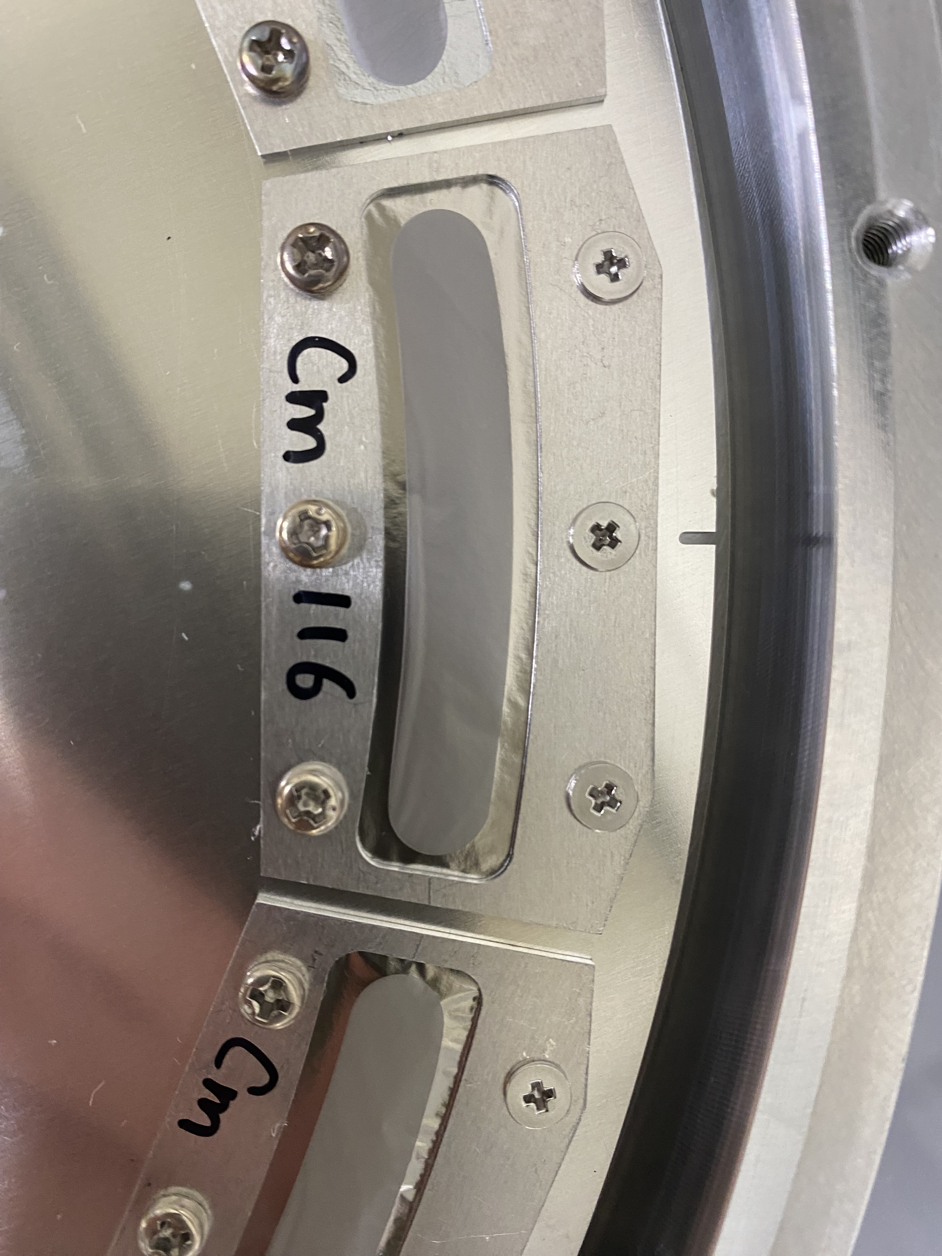
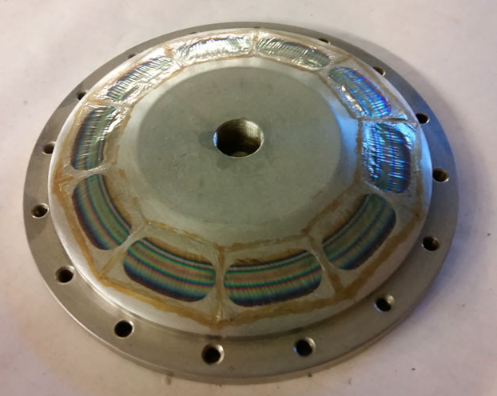
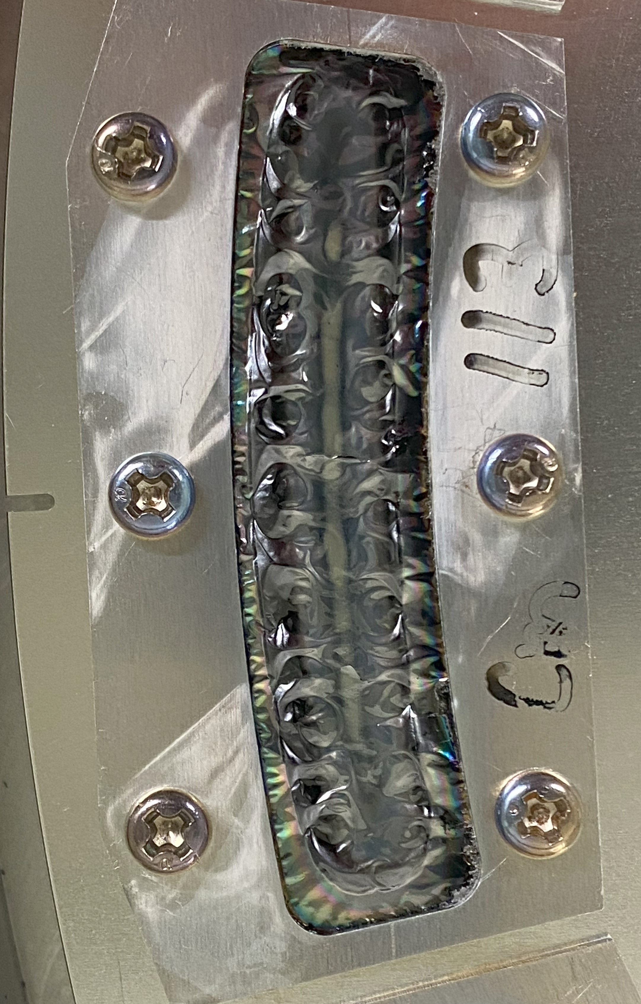
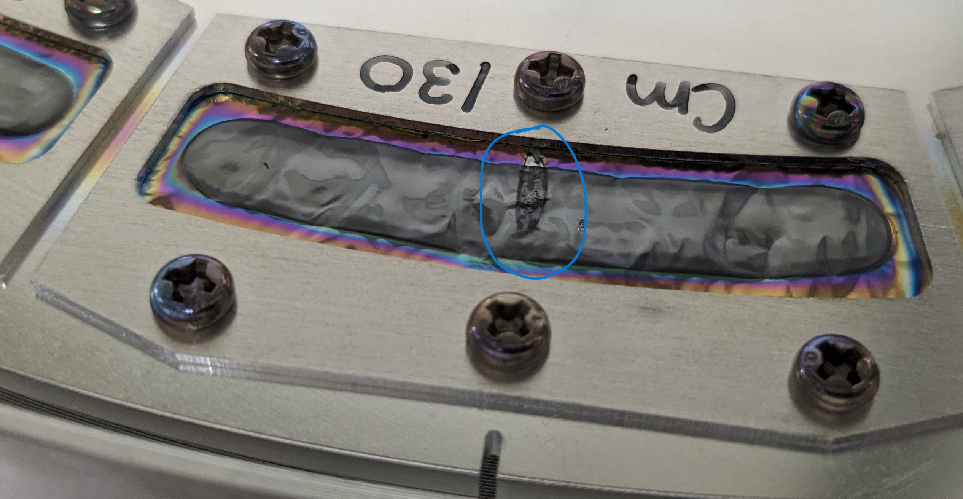
6
High intensity ion beams
²⁴⁸Cm provided by ORNL
²⁴⁸Cm rotating target used in the 119 exp
Superheavy elements experiments → low cross sections (from nb to fb) :
  New elements synthesis → Z=119 synthesis here in RIKEN
  Spectroscopy
Many accessible unknown nuclei from Nobelium to Hassium (and more…)
New facilities (JINR, GANIL, RIKEN…)
→ Increased intensities heavy ion beams : 5-10 pµA
→ 10¹³⁻¹⁴ part/s for ⁴⁸Ca, ⁵⁰Ti, ⁵¹V…
Usual Ti backings (2µm) can't survive long enough
Example : 10 pµA /15cm wheel
→ ≃ 1/2 weeks to break the target
USIAS grant dedicated to this project
2 major effects to consider :
- thermal effects (deformation)
- irradiation damages
[1] R. N. Sagaidak et al., Rad. effects and defects in solid, 2020, vol. 175
Notes:
As superheavy element physicists, we are working at the extreme limit of the nuclear chart, we are studying super heavy elements through two different aspects. We are performing new element synthesis experiments as the synthesis of the element 119 which is currently running here in RIKEN since 2017
And on another hand we are performing spectroscopic studies of slightly lighter nuclei, and so with slightly higher cross sections but still not higher than few nanobarns.
In order to perform such low cross section experiments, new facilities were built around the world as the SRILAC here in RIKEN but also the SHE Factory in Russia or the SPRIAL2 facility in GANIL. These facilities are able to deliver very intense beams up to 10puA, which corresponds to 10 to the power of 14 part/s interacting with our targets.
And if these very high intensities gives us access to a fully new range of nuclei, the counterpart of these intense beams is that the titanium backing that we were using for decades to sustain our rare targets can’t survive long enough to run such experiments.
As an instance, if we consider a 10puA beam and a 15cm rotating wheel with these classical titanium backing, such a target will break in one to two weeks…
Of course we can increase the diameter of our targets to sustain this irradiation slightly longer but the targets we are using are available in very small quantities and are very expensive. We have only few mg of 248Cm provided by the oak ridge national lab and we really need to find a new backing material which will allow us to run these experiments for longer runs.
This is a huge limitation in the superheavy element world which is limiting us to use these new facilities at their maximal potential and we decided to take this problematic in charge in ouf laboratory, with the help of a grant from the Institute of Advanced studies of the Strasbourg University.
As nuclear physicists we try to understand the situation in a first step and there are for us two major points to consider : the thermal effects and the irradiation damages.

Slide 7
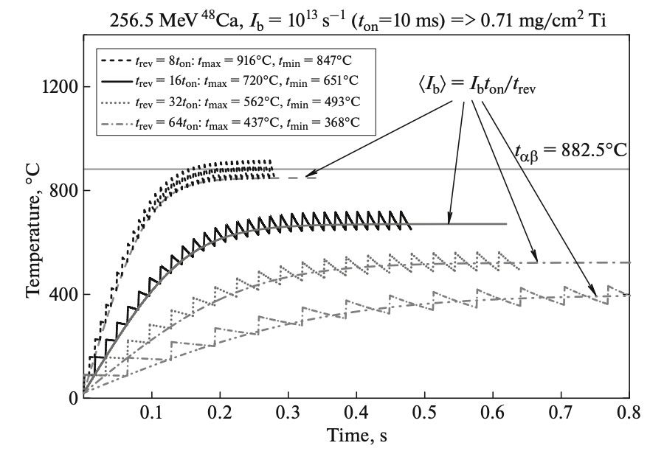
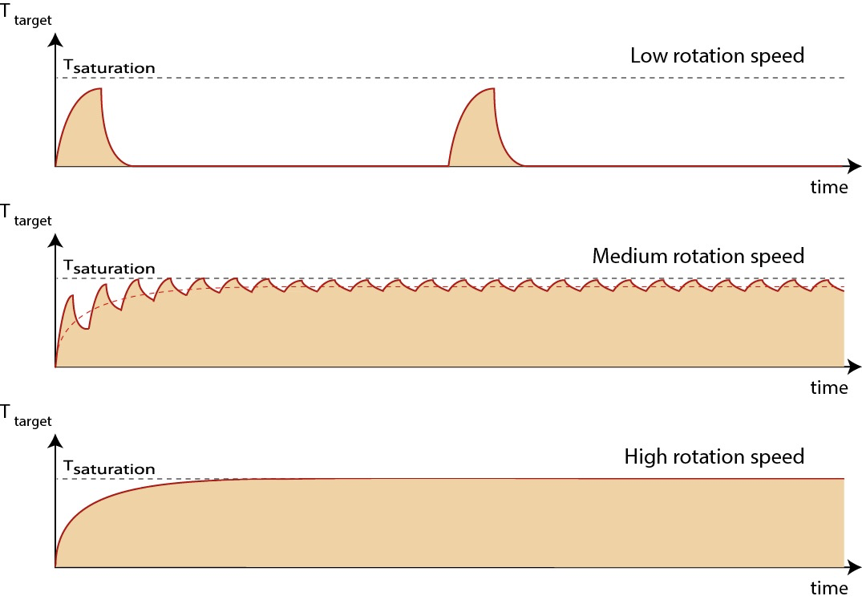
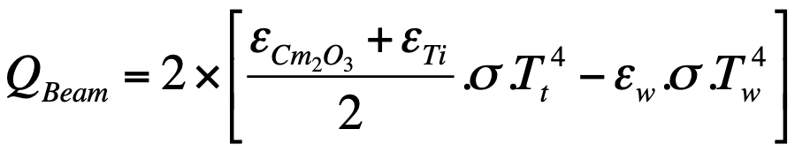
7
Thermal effects
Titanium T_{melting} = 1668°C
T_{saturation1}
Only radiation is considered
Upper limit of temperature can be estimate by an equilibrium between the power deposited in the target and the heat dissipation by radiation
I = 3 pµA → P= 80 W
T_{saturation2}
T_{saturation3}
→ No melting issue if rotation is fast enough
→ But α/β phase transition and dilatation
Kessaci Kieran – Innovative material development for target backings - HPTW2023 RIKEN – 07/11/2023
Notes:
In order to describe the thermal effects, we considered only the radiation for the heat dissipation what allows us to extract an upper limit for the temperature for the target
According to our calculations, if we consider a 3puA beam a standing target will reach a very high temperature but we know that for decades and that’s why we are using rotating targets
We can see that the temperatures goes from 300 to 500°, what is not really an issue in comparison with the melting temperature of titanium.
Thus, there is no real melting of the target problem, the temperature issue comes from another property of titanium -> the crystalline phase

Slide 8
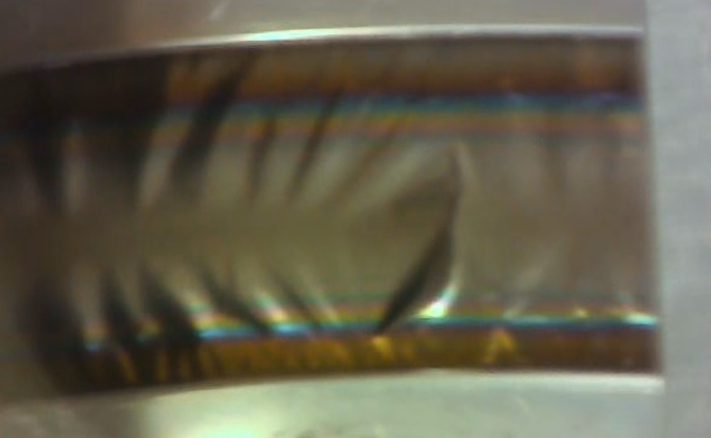
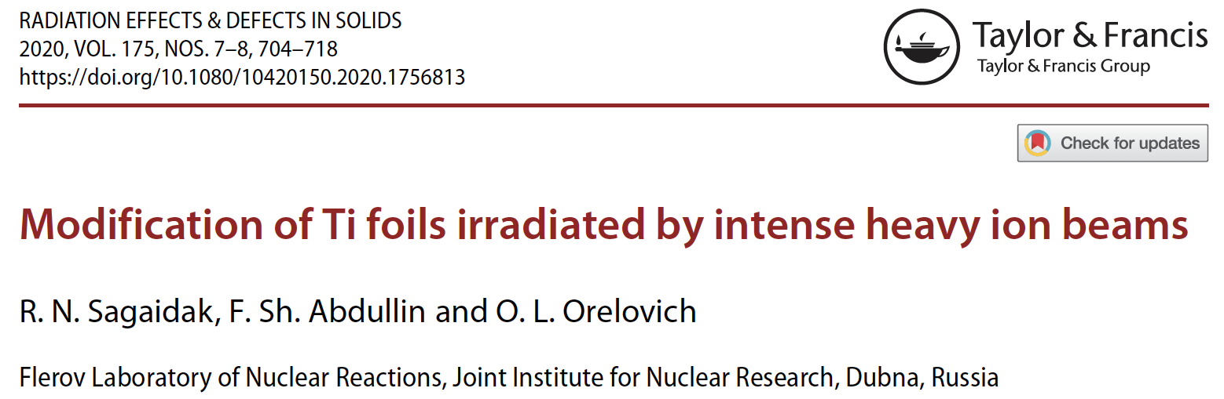
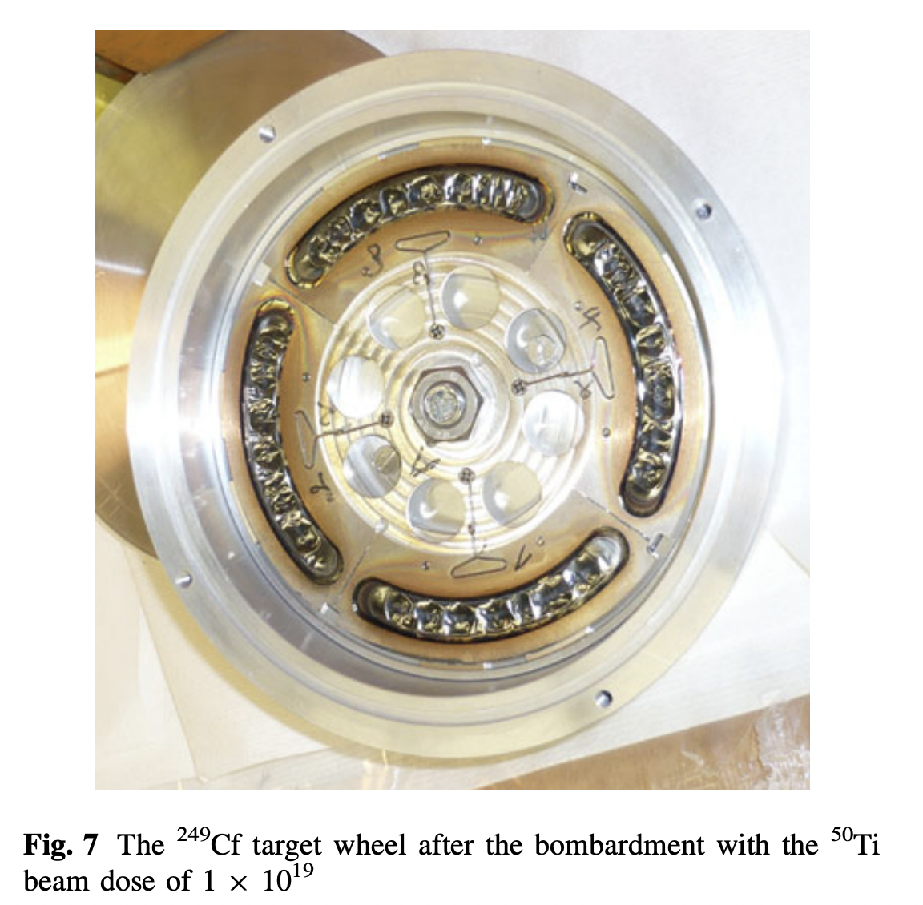
8
Thermal effects
Pure Titanium α/β phase transition : T=882,5°C
1 pµA → microscopic T° α/β cross → deformation
1 pµA
Kessaci Kieran – Innovative material development for target backings - HPTW2023 RIKEN – 07/11/2023
→
Notes:
There are not much publications on this topic for heavy ion beams but the temperature of the target was already studied during the synthesis of the 118 element in Dubna.
It was observed that with a 1puA beam the temperature finds an equilibrium around 400° but we know that very locally in the titanium cristal, the temperatures can by much higher in reality.

Slide 9
9
Thermal effects
Pure Titanium α/β phase transition : T=882,5°C
1 pµA → microscopic T° α/β cross → deformation
Oscillations at 10 pµA reach T_{max}=1402°C !!!
May cause changes in the crystal structure of Ti due to repetitive short-term crossing the α/β transition T°
In addition to the thermal deformations → breakage
10 pµA
1 pµA
Kessaci Kieran – Innovative material development for target backings - HPTW2023 RIKEN – 07/11/2023
→
Notes:
But now if we consider a 10puA beam the situation is totally different : the temperature will oscillate around the phase transition temperature of titanium what will induce multiple phase transitions in the titanium.
This causes local volume differences in the titanium backing and we also know that these T° oscillations cause multiple dilatation/contractions of the titanium.
Now I think that you understand that the titanium is no longer adapted to such intensities.

Slide 10
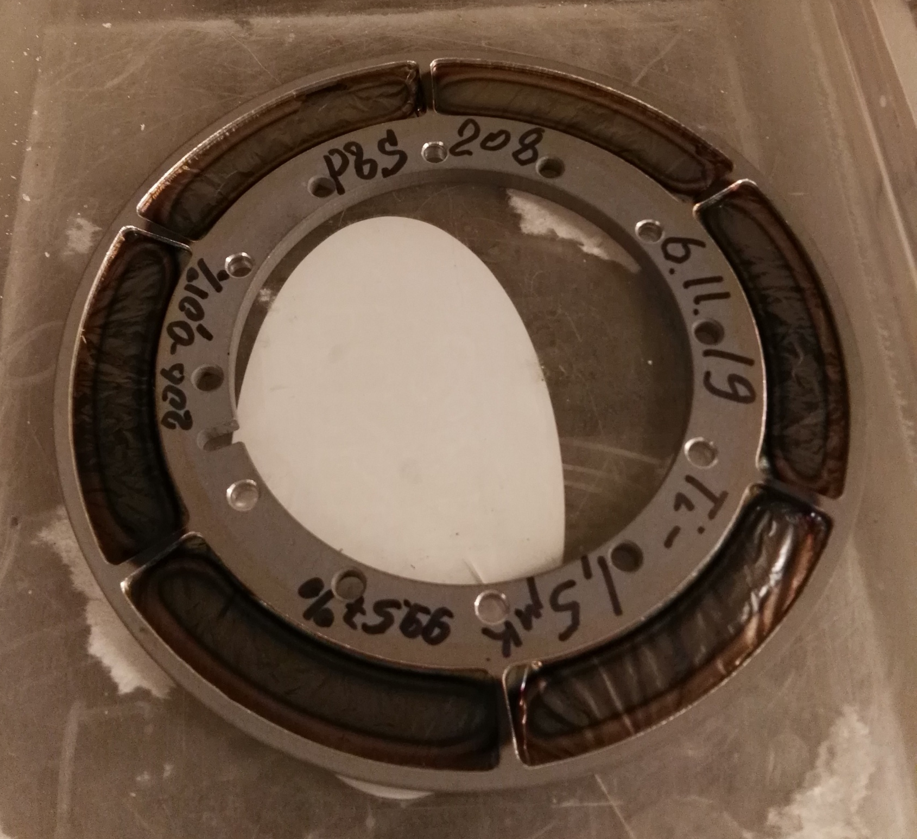
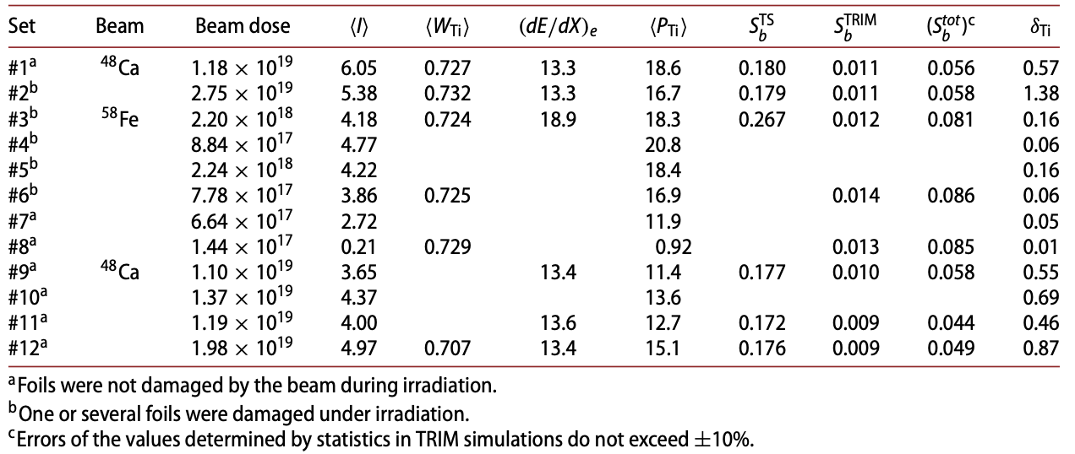
10
Irradiation effects
2nd conclusion from this study : dose limit
Experimentally (Og synthesis experiments) : beam dose up to 10¹⁸ part/cm² for the first cracks with a ⁴⁸Ca beam and a Ti backing
Beam dose for the full target
Average 1,1·10¹⁸ part/cm² limit
But why ?
Only few publications for heavy ion beams
Difficult to simulate
Require in-beam tests
[1] R. N. Sagaidak et al., Radiation effects and defects in solid, 2020, vol. 175
Kessaci Kieran – Innovative material development for target backings - HPTW2023 RIKEN – 07/11/2023
Notes:
The second conclusion of the study from Mr Sagaidak is that there is sort of a limit in terms of accumulated dose per cm2 where the titanium backings start to break, somewhere around 10^18 part/cm2
But what can explain this limit? We don’t have much inputs for heavy ion beams, this effects is now well known and difficult to simulate,
There are many studies of neutron/proton or light ions irradiation but not so much data from heavy ions irradiation. Moreover, we are not material physicists so this effects is difficult to understand for us that is why we are performing in beam tests to understand it better.

Slide 11
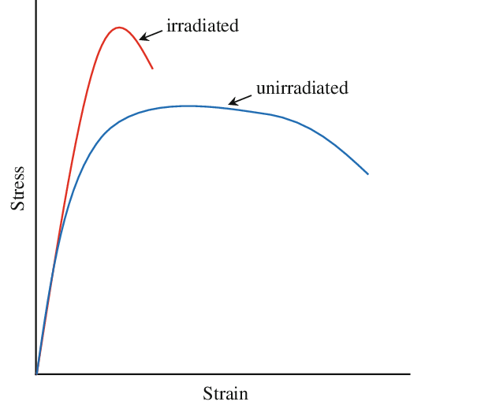
11
Irradiation effects
Well known from irradiated material studies that effects
of dose on steel are :
- getting harder
- getting more fragile
The yield and ultimate stress increase
The uniform and total elongations decrease
Effect due to crystal defaults induced by irradiation
The crystalline structure of titanium is perturbed
The combination of dose and thermal effects leads to the breakage of the titanium backing
This effect is less important for α/β and β alloys? Ti 15-3? Ti 6-4? → Very interesting !!
Ductile → Fragile transition
Kessaci Kieran – Innovative material development for target backings - HPTW2023 RIKEN – 07/11/2023
Notes:
As we saw many times in this conference, we know that materials are getting harder and more fragile with irradiation as it is represented by this graph.
This is called a transition ductile to fragile and it is known that this is caused by the crystal defaults induced by irradiation.
Our understanding of the situation is that the combination of this effect in addition to the thermal effects previously mentioned lead to the breakage of our targets.
I heard yesterday that this effect is less important for alpha/beta titanium alloys, this is a very interesting input for us and I would be very interested to learn more about this point !

Slide 12
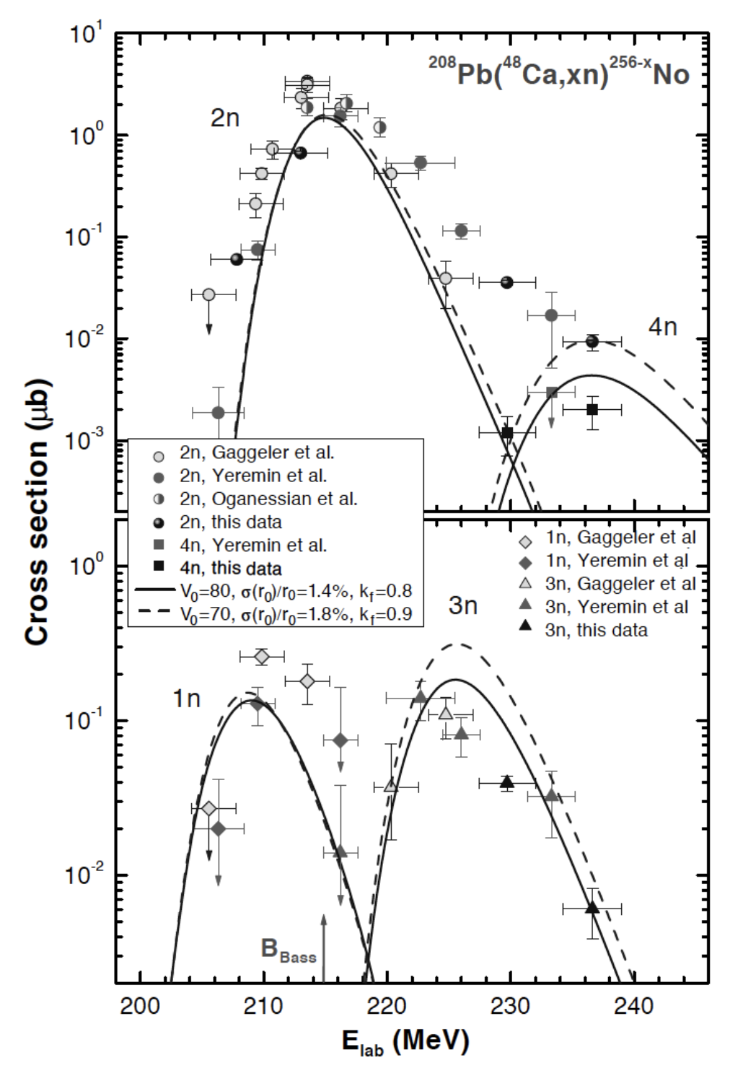
12
Energy loss problematic
Even if the target is not broken the deformation induces different energy losses depending on the incident angle
Example on a high cross section reaction :
  Mid target at 0° E_{loss}= 11 Mev
  With a 30° angle E_{loss}= 16 Mev
→ Almost a factor 10⁻¹ in cross section
→ Situation even worst for higher angles
→ We need targets as flat as possible !
⁵⁰Ti
²⁰⁸Pb
⁵⁰Ti
²⁰⁸Pb
⁴⁸Ca beam
⁴⁸Ca beam
30° deformation
1mg/cm²
0.6mg/cm²
Kessaci Kieran – Innovative material development for target backings - HPTW2023 RIKEN – 07/11/2023
Notes:
As we saw many times in this conference, we know that materials are getting harder and more fragile with irradiation as it is represented by this graph.
This is called a transition ductile to fragile and it is known that this is caused by the crystal defaults induced by irradiation.
Our understanding of the situation is that the combination of this effect in addition to the thermal effects previously mentioned lead to the breakage of our targets.
I heard yesterday that this effect is less important for alpha/beta titanium alloys, this is a very interesting input for us and I would be very interested to learn more about this point !

Slide 13
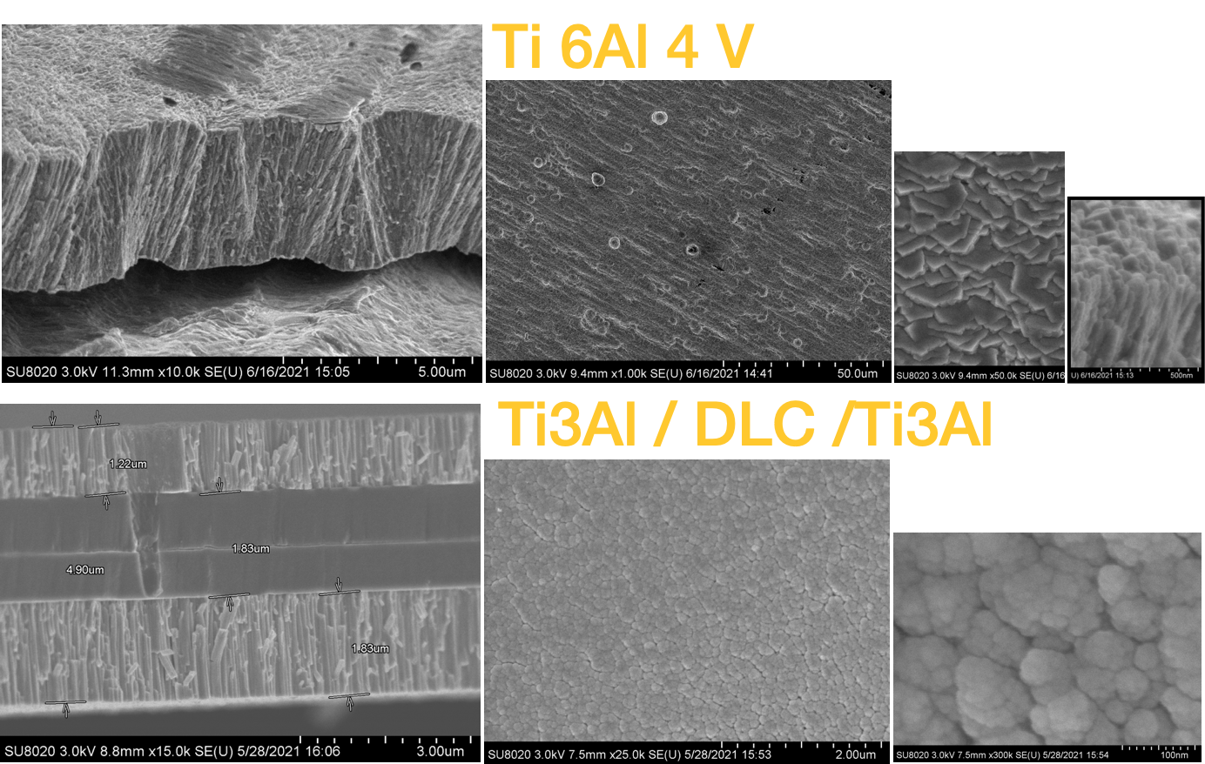
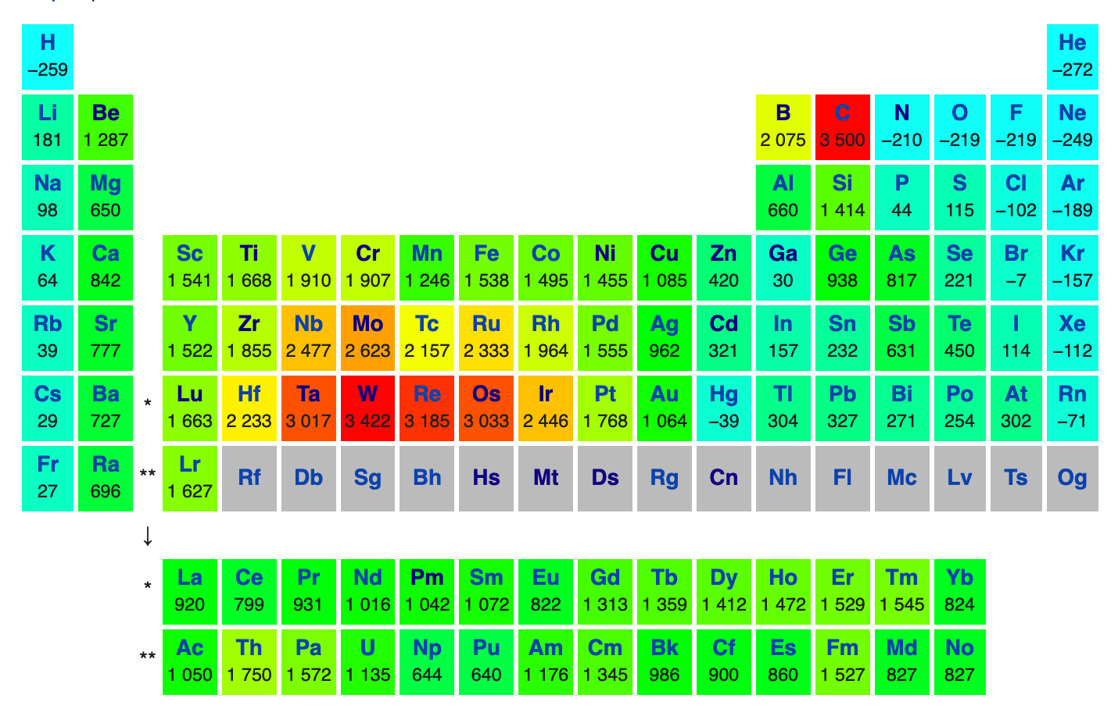
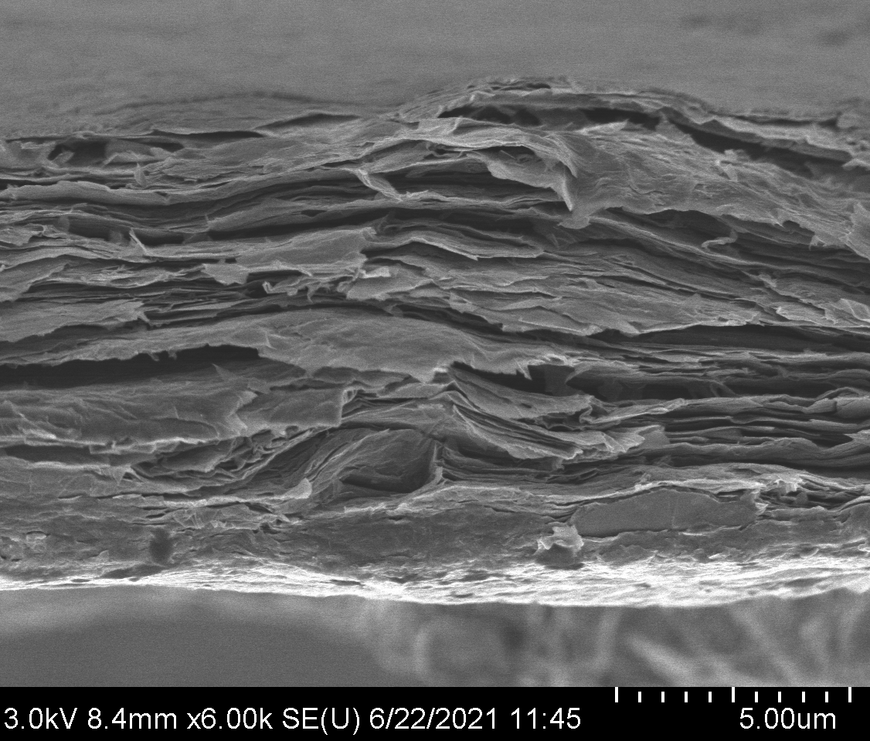
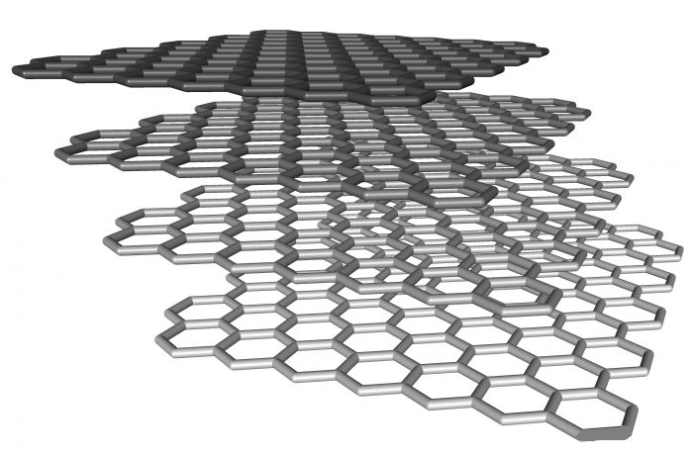
13
Possible solutions
Low-Z pure materials
High melting point / Young modulus
Ti based alloys (Ti6Al4V, Ti3Au, Ti3Al, Ti 15-333 …)
→ Interesting crystalline structure
Layered materials
Carbon-based materials
- Graphite
- Diamond
- Graphene
Graphene shows amazing mechanical and thermal properties
Kessaci Kieran – Topical Workshops on Modern Aspects of Nuclear Structure VI - 07/02/2023
Notes:
In order to solve this issue, we are working on different ideas at IPHC. We are considering all the possible solutions, starting by the low-Z materials, which are by definition adapted to a low power deposited by the beam. In this context, we are manly working on Bore and Carbon, which shows very high melting temperature and a high young modulus
As it was mentioned sooner, the titanium based alloys should also be seriously considered because of there interesting crystalline structure. Moreover, even the possibility to create an alloy fully specially designed for our requirements.
We are also working on layered materials, which can mix the properties of different materials and most of all, we are working on carbon-based materials, with a special interest for graphene which shows incredible mechanical properties as we will see later

Slide 14
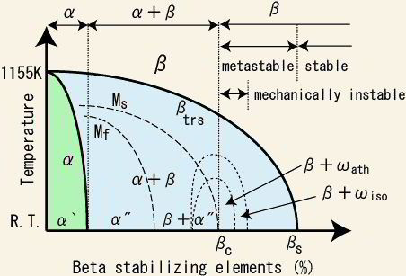
14
Titanium alloys
SEM (Scanning Electron Microscope) + EDX (Energy Dispersive X-rays) images
β alloys looks promising
Comparison before/after irradiation is mandatory
Will test Ti 15-3 and β-21-S very soon
Notes:
Ambition 10puA with new facilities as SPIRAL2, RILAC or SHE Factory
Confronted to sustainability of the target backing (usually titanium)
B. Gall proposed a project to the Strasbourg science institute and obtained a grant to develop innovative target materials
I already worked a little bit on that topic during my thesis but since May I started a PhD fully dedicated to that problematic
As u surely know, this need of high intensities is motivated by the very low cross sections experiments wee want to run
As an instance…
The dose limit before cracking for a target is around 10^18 ions
With a 10puA beam -> only 2 days before cracking

Slide 15
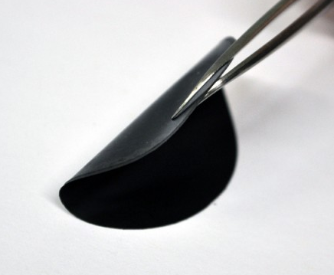
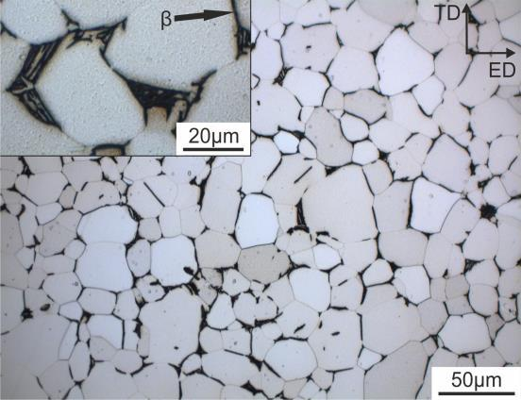
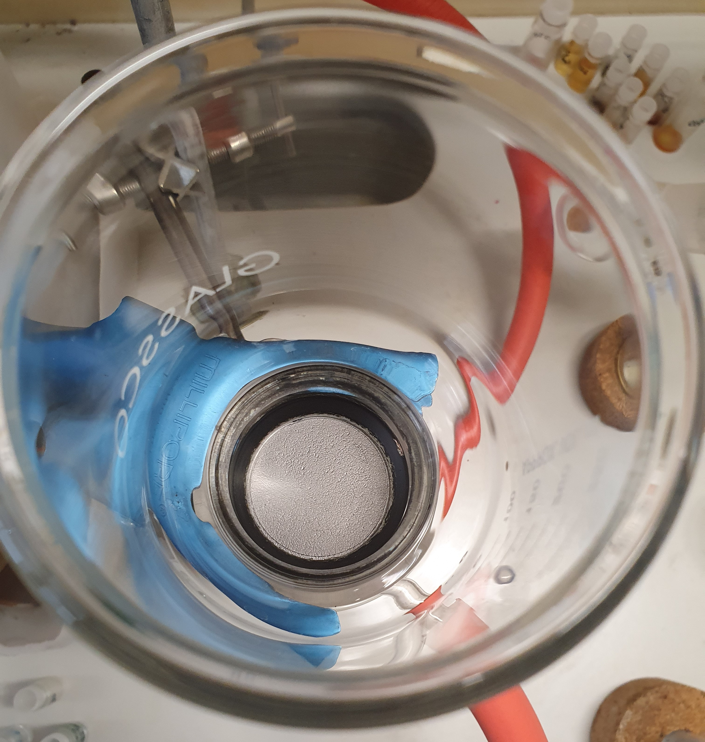
15
R&D @IPHC
University of Strasbourg Institute for Advanced Studies
Laboratory dedicated to R&D of innovative target backing
- Heat treatments
- Electrodeposition
- Thickness measurements
- Rolling
- Doping?
- Dedicated alloys on demand
Scanning Electron Microscope (before irradiation only)
Graphene/Metal/Alloys multilayer materials
3 types of multilayer graphene synthetized in IPHC :
- Hummers method
- Pure graphene suspension
- BlackLeaf collaboration
→ Very fragile, difficult to manipulate
Ti/Mo alloys
Kessaci Kieran – Innovative material development for target backings - HPTW2023 RIKEN – 07/11/2023
Notes:
In this context, we obtained a grand from the USIAS dedicated to the establishment of a laboratory full dedicated to these studies.
We will be able to produce graphene foils, to perform heat treatments, electrodepositions with an inductive oven and to characterize the produced materials
We have already 3 types of graphene under study, we synthetized two of them and the third one was produced by a company in collaboration with our laboratory.
We already started to test these materials under beam in RIKEN and we plan to start some tests in GANIL too, as soon as possible.

Slide 16
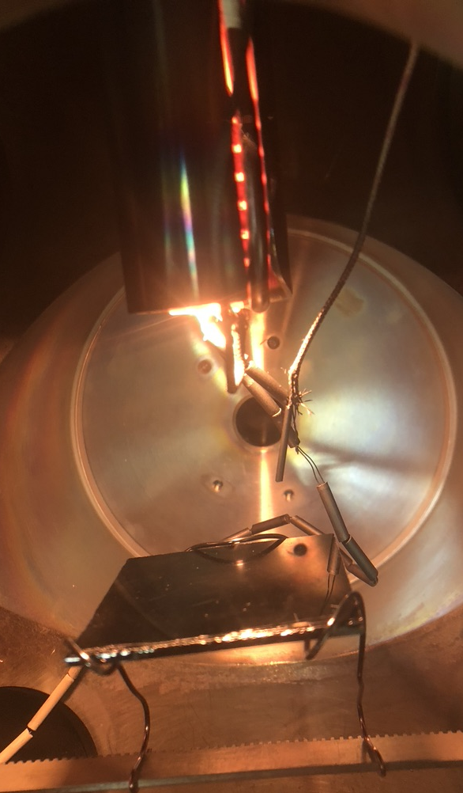
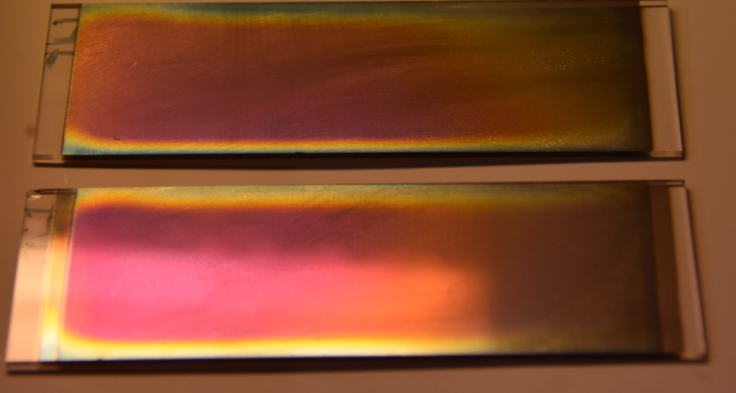
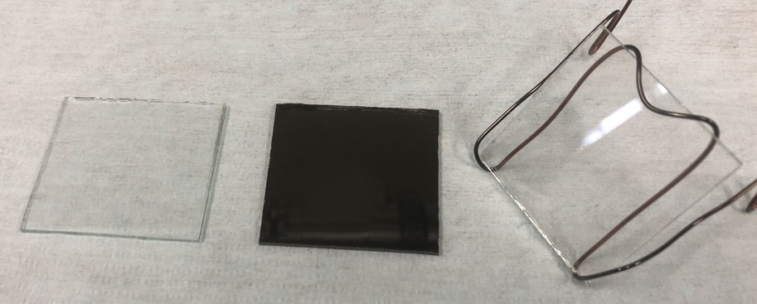
16
R&D @IPHC
University of Strasbourg Institute for Advanced Studies
Multi head deposition device
- Inductive oven sputtering (>2000°C)
- Magnetron sputtering
- All metal deposition possible (Titanium, Vanadium, Boron …)
→ Alloys
→ Layered materials
- Under vacuum or selected gas
HT° cooking device:
- Graphene from polymers
- Aging
- Cooking for multi-rolling
Kessaci Kieran – Innovative material development for target backings - HPTW2023 RIKEN – 07/11/2023
Notes:
In this context, we obtained a grand from the USIAS dedicated to the establishment of a laboratory full dedicated to these studies.
We will be able to produce graphene foils, to perform heat treatments, electrodepositions with an inductive oven and to characterize the produced materials
We have already 3 types of graphene under study, we synthetized two of them and the third one was produced by a company in collaboration with our laboratory.
We already started to test these materials under beam in RIKEN and we plan to start some tests in GANIL too, as soon as possible.

Slide 17
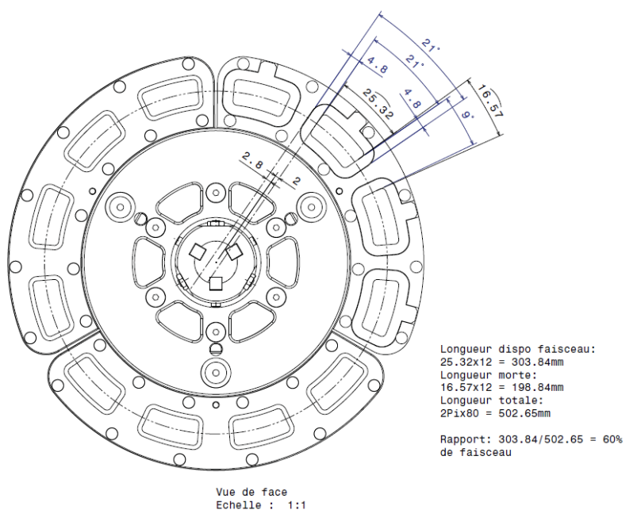
17
In-beam tests
Real condition in-beam tests in RIKEN (Z=119 synthesis)
  16 sectors wheel for dedicated test runs between
  two Z=119 synthesis campaigns
  2 sectors over the 16 sectors of the Cm wheel
  dedicated to tests during the experimental campaigns
  - Many different materials already tested
  - Promising results
  - Confidential up to publication
Kessaci Kieran – Innovative material development for target backings - HPTW2023 RIKEN – 07/11/2023
conduction negligible for Ti backing (… only a 2nd order correction)
With graphene, significant transoport of power to the frame …
Notes:
It may be interesting to perform a first crash test with many different backing candidates in order to exclude quickly the worst materials, and this can be done with “free” beam time in case of the cancellation or the delay of an experiment.
Maybe it can also be performed with the LINAC R&D beams?
If we take this LISE 8cm radius rotating wheel and its corresponding properties for a 10puA beam, we will need only 5 days to break the full target.

Slide 18
18
In-beam tests
Real condition in-beam tests in RIKEN (Z=119 synthesis)
  16 sectors wheel for dedicated test runs between
  two Z=119 synthesis campaigns
  2 sectors over the 16 sectors of the Cm wheel
  dedicated to tests during the experimental campaigns
  - Many different materials already tested
  - Promising results
  - Confidential up to publication
Test also under discussion with GANIL
  Dedicated beam time
  Small rotating wheel
  → possibility to reach the beam dose limit in few weeks
8 cm
Kessaci Kieran – Innovative material development for target backings - HPTW2023 RIKEN – 07/11/2023
conduction negligible for Ti backing (… only a 2nd order correction)
With graphene, significant transoport of power to the frame …
Notes:
It may be interesting to perform a first crash test with many different backing candidates in order to exclude quickly the worst materials, and this can be done with “free” beam time in case of the cancellation or the delay of an experiment.
Maybe it can also be performed with the LINAC R&D beams?
If we take this LISE 8cm radius rotating wheel and its corresponding properties for a 10puA beam, we will need only 5 days to break the full target.

Slide 19
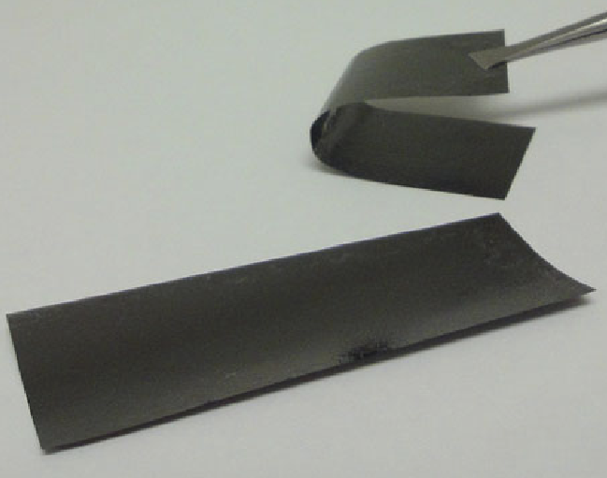
Conclusion
Ti 6Al 4V
As nuclear physicist we have built thin target expertise
for many years …
… But the unprecedented intensities killed any of our
state of the art targets knowledge
Dedicated lab at IPHC Strasbourg
Carbon-based materials, multilayer backings
titanium alloys…
In-beam tests ongoing
Open to any ideas/suggestions !!!
Open to collaborations with specialists
Diamond C
Graphene
Kessaci Kieran – Innovative material development for target backings - HPTW2023 RIKEN – 07/11/2023
Notes:
To summarize, BLABLA MERCI
Dépots de bore trés difficiles max 250nm

Slide 20
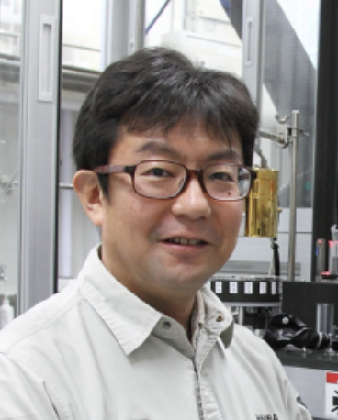

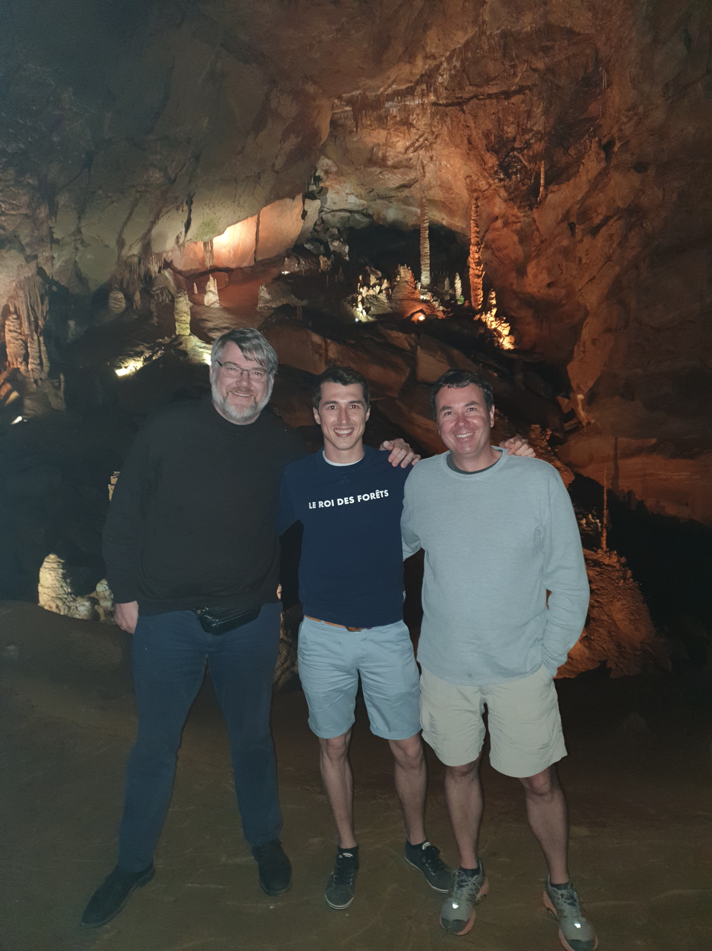
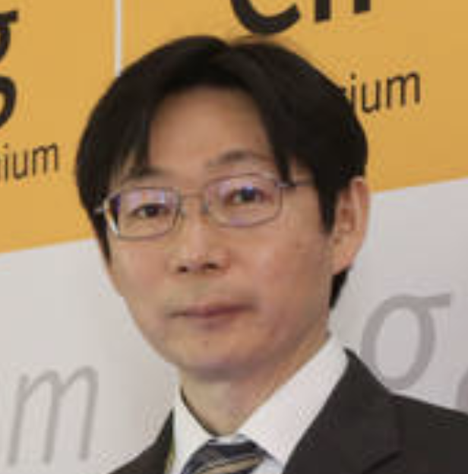


Thank you
Collaborators :
  Physics @IPHC: B. Gall, O. Dorvaux, M. Filliger, M. Bordeau
  Chemistry @IPHC: Z. Asfari, C. Charpentier, L. Charbonnière…
  Electronic microscope @IPCMS: T. Dintzer, C. Bouillet
  RIKEN nSHE collaboration (Z=119)
  Material science team @DUBNA
  GANIL Collaboration: G. Fremont, C. Stodel…
Kessaci Kieran – Innovative material development for target backings - HPTW2023 RIKEN – 07/11/2023
Notes:
25’
LOGO IPCMS

Slide 21
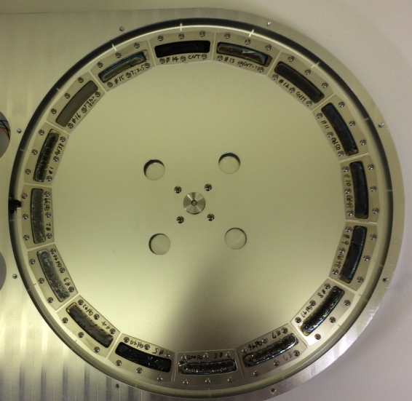
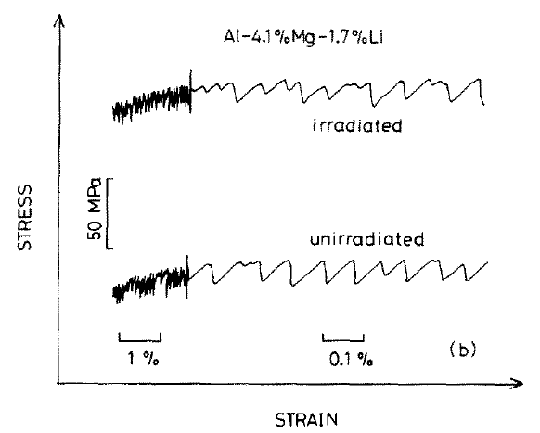
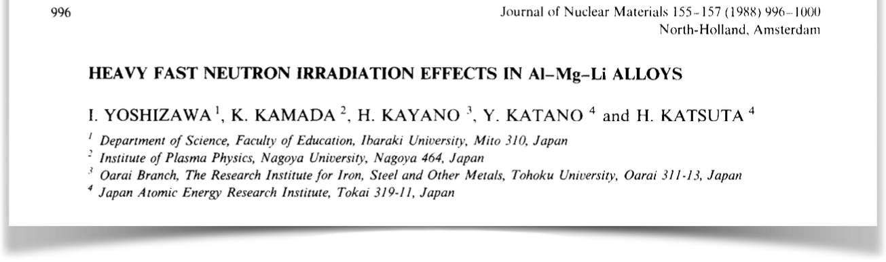
21
Beam dose
Transition ductile → fragile
Two effects must be considered :
  Pressure of the beam
  Thermal deformation (“waving” effect)
Pressure of the beam on the target negligible
(1pµA → 10⁻⁶ N → 0,1mg) but repetitive
As the backing become more and more fragile the repetitive thermal deformations + pressure will lead to breakage
Route to breakage
[2] I. Yoshizawa et al., Journ. Of Nucl. Mat/ 155-157 (1988) 996-1000
Kessaci Kieran – Innovative material development for target backings - HPTW2023 RIKEN – 07/11/2023
Notes:
Ambition 10puA with new facilities as SPIRAL2, RILAC or SHE Factory
Confronted to sustainability of the target backing (usually titanium)
B. Gall proposed a project to the Strasbourg science institute and obtained a grant to develop innovative target materials
I already worked a little bit on that topic during my thesis but since May I started a PhD fully dedicated to that problematic
As u surely know, this need of high intensities is motivated by the very low cross sections experiments wee want to run
As an instance…
The dose limit before cracking for a target is around 10^18 ions
With a 10puA beam -> only 2 days before cracking
Bas droite
Stress de base plus irradiation (représentées par stress oscillant
SAGAIDAK -> ca case -> argument transition ductile fragile -> + en + dur donc + en plus cassant
-> cracks
Force faisceau sur feuille extremement faible donc plutot fragiloté mécanique
Dose déplacement atomes
Cuves reacteurs acier nucléaire civil
1 arg :

Slide 22
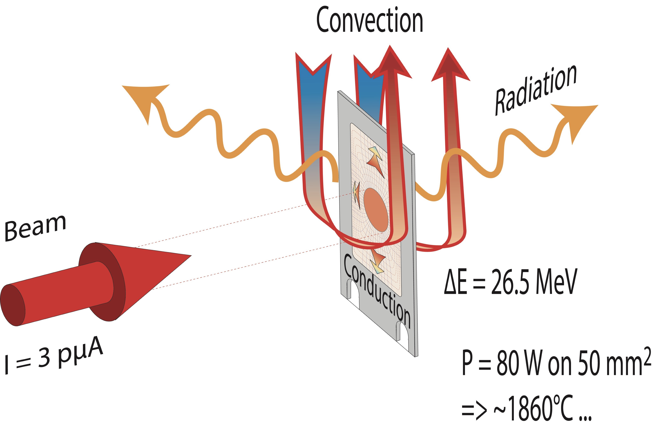
22
Beam power - thermal effects
Beam energy : ~6 MeV/A (⁴⁸Ca, ⁵⁰Ti, ⁵¹V or ⁵⁴Cr)
→ ~300 MeV
∆E in Ti Backing (3 µm) + Cm₂O₃ target:
→ 26.5 MeV
Heat dissipation :
P (W) = I (pµA) · ∆E (MeV)
Cooling by low pressure gas (GARIS)
Not the case for vacuum separators (SIRIUS, SHELS)
- Conduction is negligible for Ti (low k)
→ Radiation is dominant
→ No melting issue if rotation is fast enough (<300-400°C)
Kessaci Kieran – Innovative material development for target backings - HPTW2023 RIKEN – 07/11/2023
Notes:
The first effect that should be considered is the temperature of the target under irradiation
If we take some classical conditions for superheavy synthesis experiments, with a 6 MeV per nucleon beam energy and a Cm target with a Ti backing, some LISE calculation gives us an energy loss of 26.5 MeV
With our beautiful nuclear physics units, we have a direct access to the power deposited in the target which is 80W for a 3 puA beam
If 80W seems to be a low value, is is focused on the 50mm2 of the beam spot, what makes a high power density which leads to very high temperatures if the target is not rotating
Now if we consider the heat dissipation processes, 3 effects should be considered : convection, radiation and conduction.
1st of all there is no convection in vacuum (SIRIUS), the conduction is also negligible for Ti as we will see later in this presentation, the radiation is therefore the dominant heat dissipation process

Slide 23
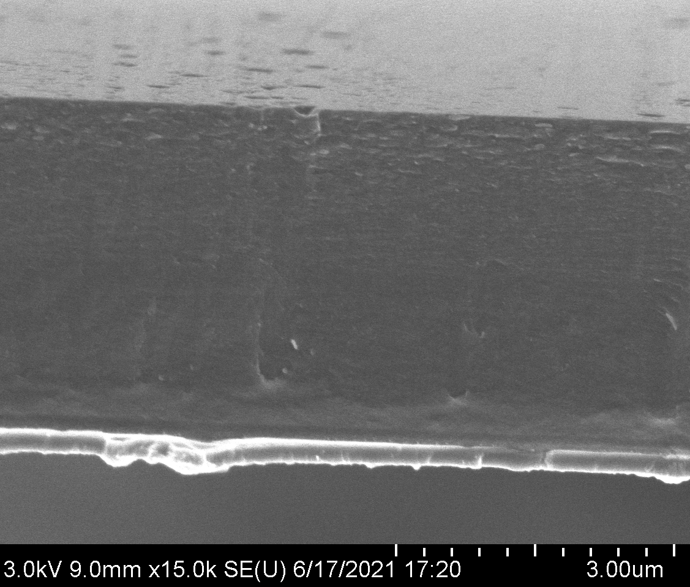
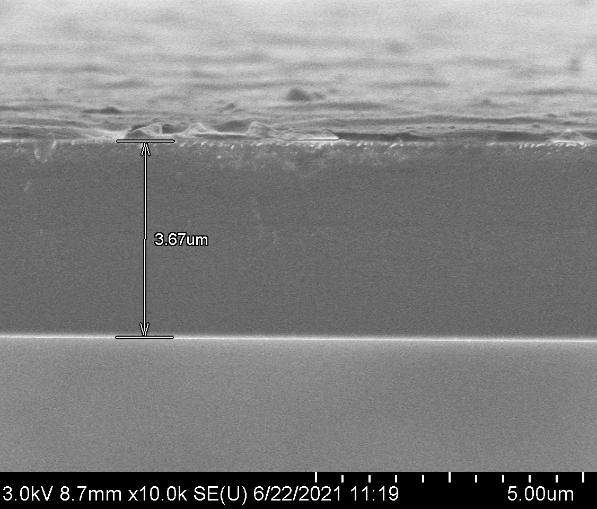
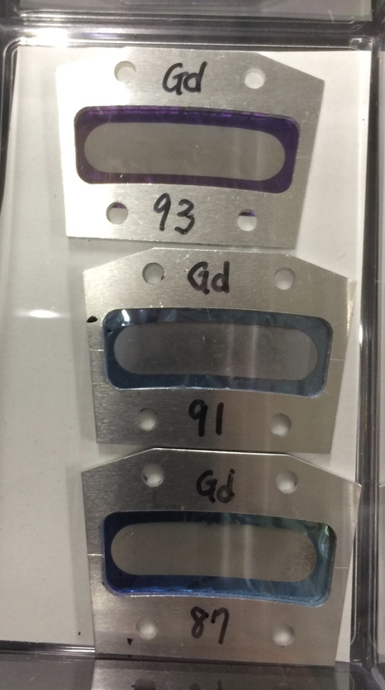
23
Carbon-based materials
DLC
Several materials produced by PLD were tested in RIKEN …
Graphite
Diamond-Like Carbon
Graphene
They were interesting, but too brittle
… working on heat treatment to make them less brittle ?
Kessaci Kieran – Innovative material development for target backings - HPTW2023 RIKEN – 07/11/2023
Notes:
As I just told u, the mechanical properties of graphene are incredible, especially on the thermal conductivity point.

Slide 24
24
Graphene thermal properties
Pure Titanium
Graphene
Melting point 1 668 °C 3900 °C
Thermal conductivity 20 W.m⁻¹.K⁻¹ 2000-5000 W.m⁻¹.K⁻¹
Tensile strength 240 MPa 130 GPa
Young modulus 120 Gpa 980 to 1040 GPa
Conduction from the target to the frame :
  For Ti (2µm) :
  For graphene (2µm) :
1,28.10⁻³ W.K⁻¹
128,20.10⁻³ W.K⁻¹
Conduction negligible for Ti backing but not for graphene → Require simulations
Kessaci Kieran – Innovative material development for target backings - HPTW2023 RIKEN – 07/11/2023
Notes:
I told u sooner that the conduction can be neglected for the heat dissipation calculations. It was true for titanium but not for graphene. With a thermal conductivity coefficient at least 100x higher for graphene, our calculations shows us that the heat dissipation of graphene is a dominant process which should be seriously considered.
Moreover, as u can see, the maximal tensile strength and the young modulus of graphene are one order of magnitude higher, this material have outstanding properties at all levels, and I don’t even mention its 3900° melting temperature.
We are very interested by this material which could be a final solution for these developpments if we manage to produce very thin foils large enought to make a backing.

Slide 25
25
Beam dose
2nd conclusion from this study : dose limit
Experimentally (Og synthesis experiments) : beam dose up to 10¹⁸ part/cm² for the first cracks with a ⁴⁸Ca beam and a Ti backing
Beam dose for the full target
Average 1,1·10¹⁸ part/cm²
Difficult to simulate
Require in-beam tests
[4] R. N. Sagaidak et al., Radiation effects and defects in solid, 2020, vol. 175
Kessaci Kieran – Topical Workshops on Modern Aspects of Nuclear Structure VI - 07/02/2023
Notes:
The second conclusion of the study from Mr Sagaidak is that the real limit of the titanium backing is the accumulated beam dose per cm2. They noticed that for all the experimental campains, the firsts cracks of the target were observed for a dose of 1.1.10^18 part/cm2
This effect is not well known and difficult to simulate, that is what we need some in beam tests to understand it better.

Slide 26
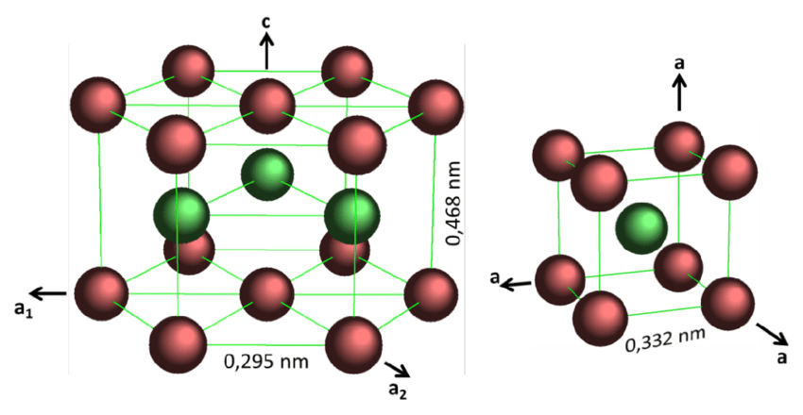
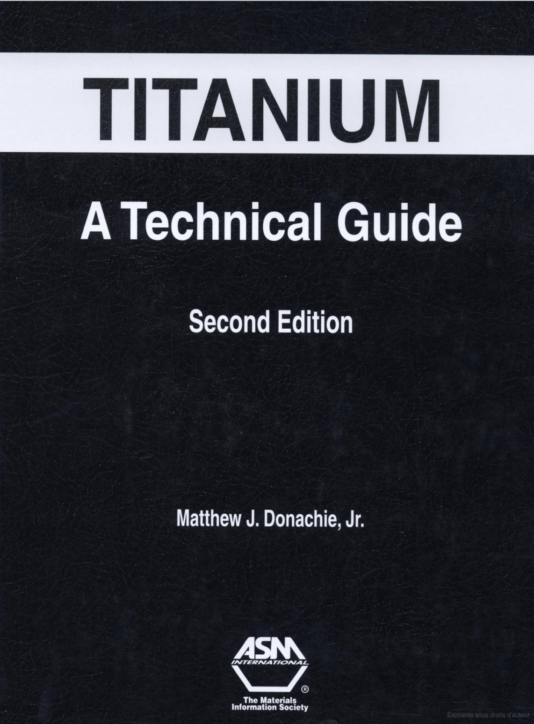
26
Titanium cristalline phase
Pure Titanium α/β phase transition T=882,5°C
Local volume differences → cracks
Titanium alloys ?
β : Body-centered cubic
Temperature (°C)
882,5
[6] M. J. Donachie et al., Titanium : A technical guide, ASM International, 2000
α : Close-packed hexagonal
Kessaci Kieran – Innovative material development for target backings - nSHE Workshops RIKEN – 20-21/06/2023
Notes:
Indeed, the titanium crystal can take 2 configurations, with a phase transition temperature of 882°C.
Décrire les 2 et dire difference VOLUME c’est tout
It is important to underline that the crystalline structure of alloys behaves differently, with a transition area where the two phases will be in equilibrium, what is interesting to investigate for these developpments

Slide 27
27
Rotating target- thermal effects
Titanium T_{melting} = 1668°C
T_{saturation1}
Only radiation is considered
Upper limit of temperature can be estimate by an equilibrium between the power deposited in the target and the heat dissipation by radiation
I = 3 pµA → P= 80 W
T_{saturation2}
T_{saturation3}
→ No melting issue if rotation is fast enough
Kessaci Kieran – Innovative material development for target backings - nSHE Workshops RIKEN – 20-21/06/2023
Notes:
Ceramiques -> much higher -> Not problematic
If we consider only radiation for the heat dissipation, we can extract an upper limit of temperature for the target
According to our calculations, under such conditions, a standing target will reach a very high temperature but for rotating targets, we can see that it goes from 300 to 500°, which are not problematic values as a function of the melting temperature of titanium.
Thus, there is no real melting of the target problem, the temperature issue comes from another property of titanium -> the crystalline phase

Slide 28
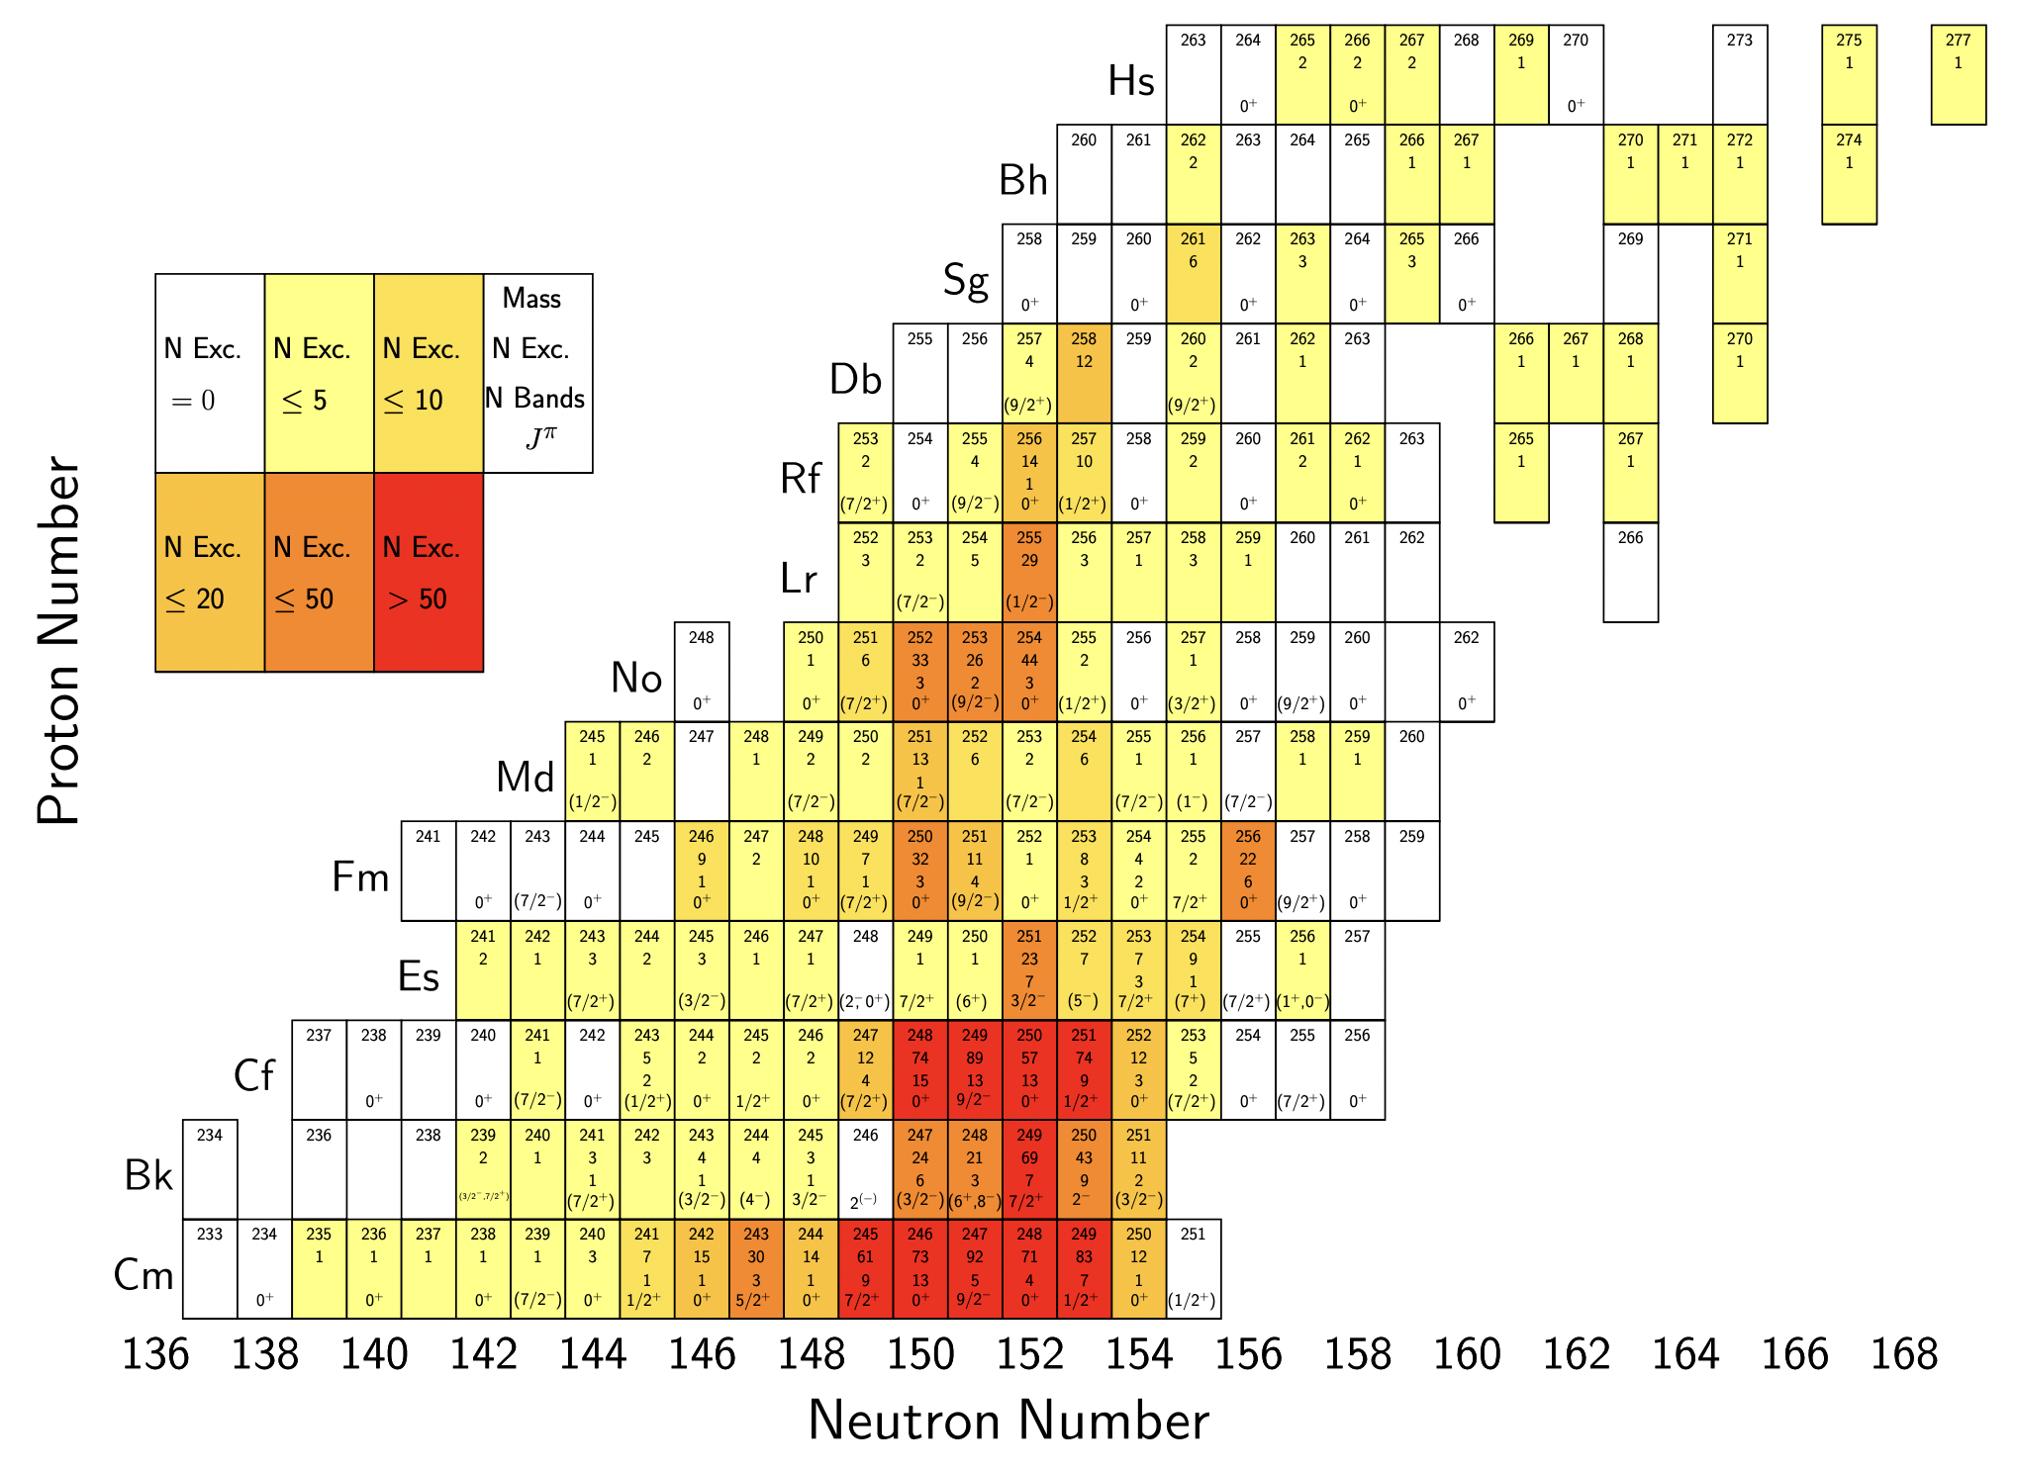
28
High intensity beams
Low cross section experiments :
  New elements synthesis
  Spectroscopy
Many accessible unknown nuclei from Nobelium to Hassium (and more…)
New facilities (JINR, GANIL, RIKEN…)
→ Increased intensities : 5-10 pµA
Usual Ti backings can't survive long enough at such intensities
Example : 10 pµA /15cm wheel
→ ≃ 1 week to break the target
USIAS grant dedicated to this project
[1] C. Theisen et al., Nuclear Physics A 944 (2015).
Spectroscopy landscape
Kessaci Kieran – Innovative material development for target backings - nSHE Workshops RIKEN – 20-21/06/2023
Notes:
ISO-K -> Orbitales quantiques autour de fermi -> Ilot de stabilité
As u surely know, the need for very intense beams is motivated by the very low cross sections of the experiments we want to run. It will open some new doors for new element synthesis experiments but also for spectroscopic studies
Indeed, we still have much to discover in the heavy and superheavy region where many nuclei from Rf (Z=104) are not known
With the new facilities available in GANIL, RIKEN, JINR or BNL we will have access to very intense beams up to 10puA for the usual isotopes around 48Ca that we are using for fusion evaporation reactions

Slide 29
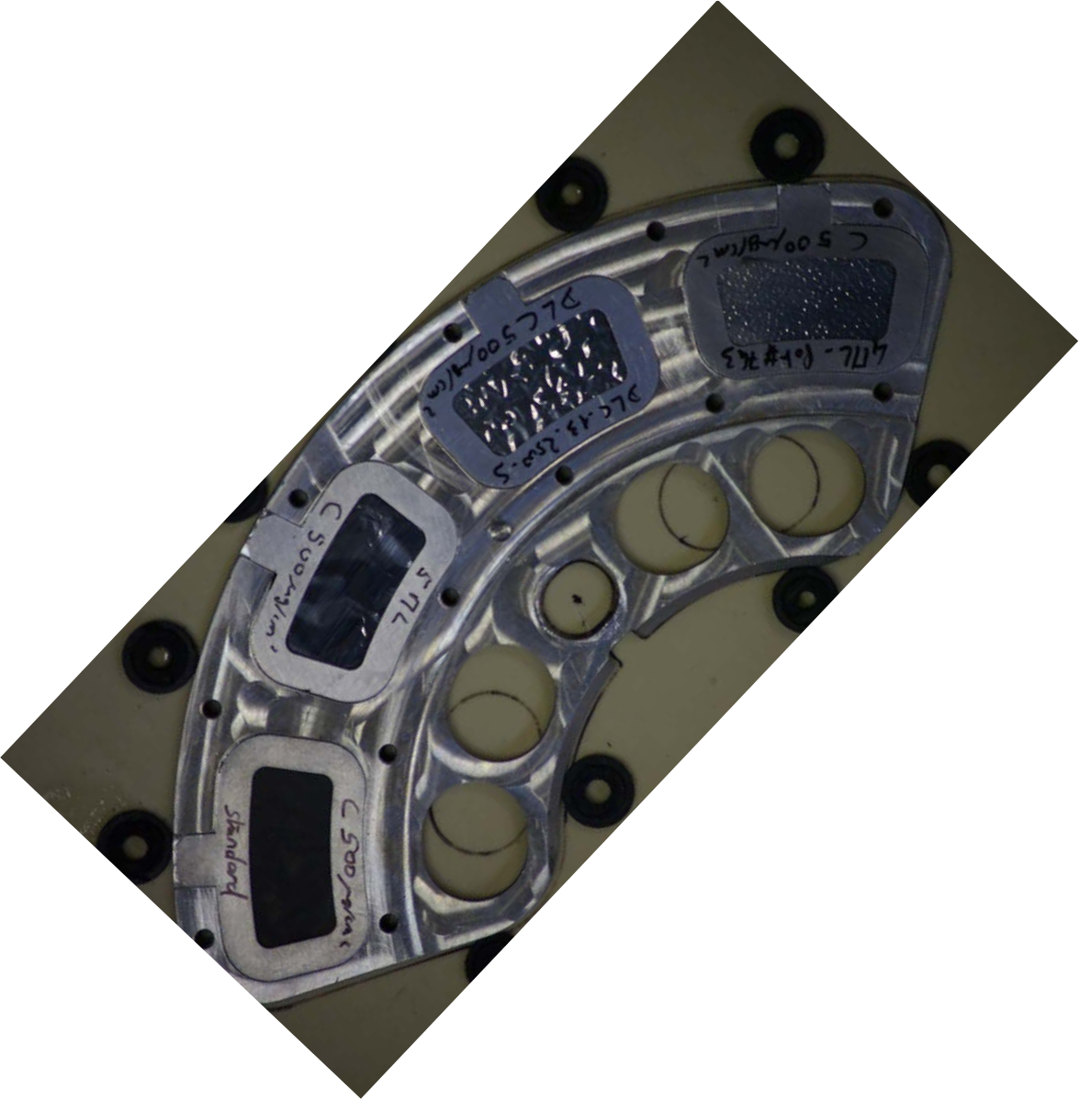
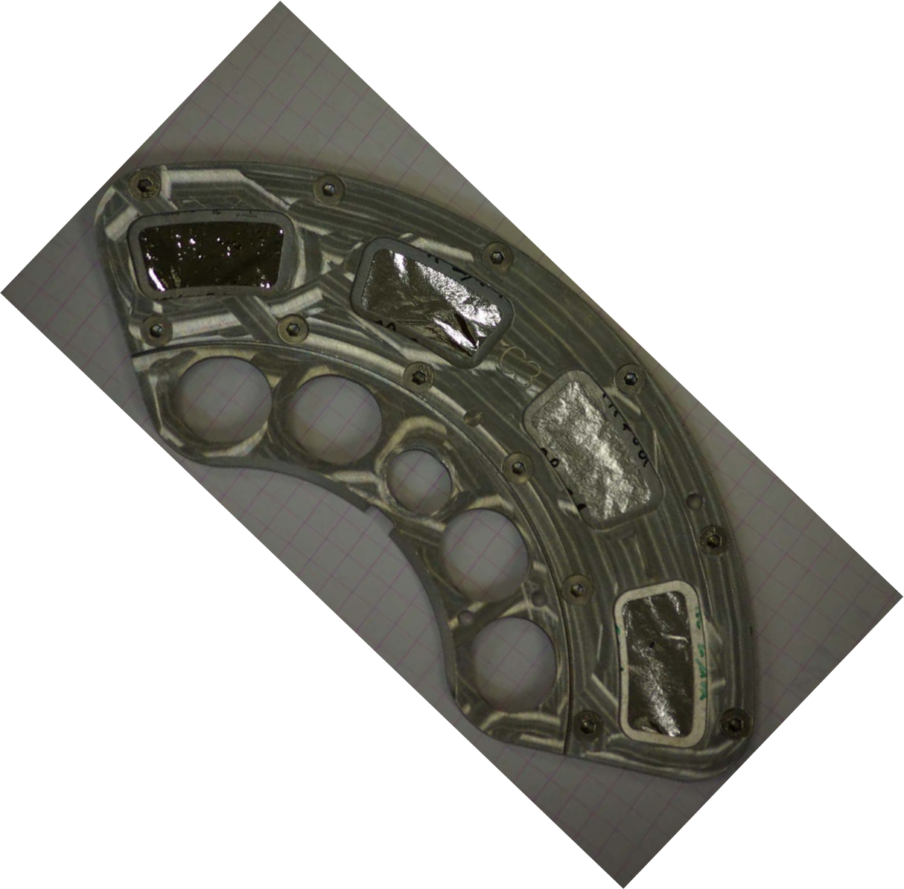
29
High intensity beams
Low cross section experiments :
  New elements synthesis
  Spectroscopy
  Many accessible unknown nuclei from Nobelium to Hassium (and more…)
New facilities (JINR, GANIL, RIKEN…)
→ Increased intensities : 5-10 pµA
Usual Ti backings can't survive long enough at such intensities
Example : 10 pµA /15cm wheel
→ ≃ 1 week to break the target
USIAS grant dedicated to this project
[2] K. Kessaci et al., ²⁵⁵No spectroscopy
[3] E. Jäger et al., (2014) 299:1073–1079
[4] R. N. Sagaidak et al., vol. 175
[5] J. Kallunkathariyil , 2014
→ New materials for target backings
Kessaci Kieran – Innovative material development for target backings - nSHE Workshops RIKEN – 20-21/06/2023
Notes:
But the counterpart of these very intense beams is that we will be confronted to a sustainability of the target backing issue
The usual titanium backings that we were using for decades will not sustain such intensities for more than one week, what is not enought to perform spectroscopic studies with such low cross section fusion evaporation reacions.
This is why we proposed a project to the University of Strasbourg institute for advanced studies and we obtained a grant to develop innovative target materials
with actual solutions -> 1 week

Slide 30
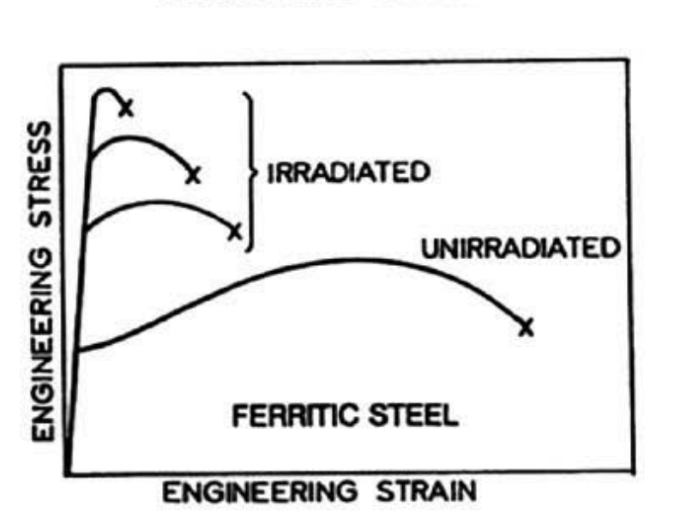
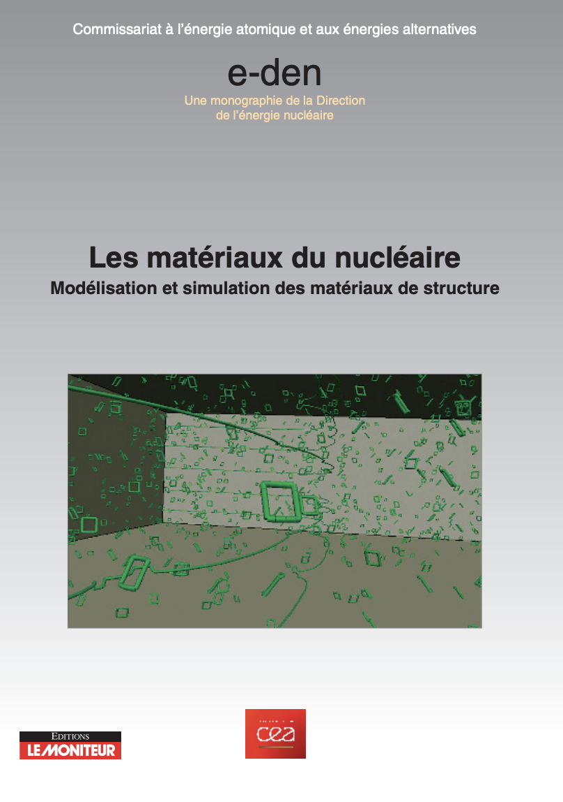
30
Beam dose
We know from nuclear power plants studies that effects of dose on steel are :
- getting harder
- getting more fragile
The yield and ultimate strengths increase
The uniform and total elongations decrease
Irradiated
Unirradiated
Stress
Ferritic Steel
Ductile → fragile transition
Strain (elongation)
[4] Les matériaux du nucléaire, Modélisation et simulation des matériaux de structure, CEA
Notes:
Indeed, the only informations we have come from the nuclear power plants studies on the irradiated still that they use.
We know that the still is getting harder and more fragile with irradiation as it is represented by this graph.
We can see that the unirradiated material goes up to a lower maximal stress/force -> it is more fragile but it goes further in strain -> it is more flexible than the irradiated one.
Which is harder but less flexible. This is what is called a transition ductile to fragile

Slide 31

31
Crystal defaults
Transition ductile → fragile
But why? This transition should be understood → crystallography
Substitution :
- can modify the mechanical properties of the crystal
- can be controlled ?
Insertion :
- created only by irradiation
- disturb the energy density
Holes :
- created by knock-out reactions
- significant concentration at high temperature (T > 0.7 T_{melting})
Characterization after irradiation is mandatory
Notes:
But all these effects are not due to the dose itself but to some internal processes occurring in the crystal which reach a limit with this 10^18 dose per cm2.
We know that there are 3 kinds of crystal defaults :
So the breakage of the target depends of the number of atoms moved, removed or even substituted in the titanium crystal. And up to a certain value, this structure is less and less pure, what leads to cracks.

Slide 32


32
Titanium alloys
α
β
Structure depends of their composition
Pure β alloys ?
Widely used in the industry
Under discussion with different companies
Open to any propositions
[3] M. J. Donachie et al., Titanium : A technical guide, ASM International, 2000
Kessaci Kieran – Innovative material development for target backings - HPTW2023 RIKEN – 07/11/2023
Notes:
Indeed, the titanium crystal can take 2 configurations, with a phase transition temperature of 882°C.
Décrire les 2 et dire difference VOLUME c’est tout
It is important to underline that the crystalline structure of alloys behaves differently, with a transition area where the two phases will be in equilibrium, what is interesting to investigate for these developpments

Slide 33






33
High intensity beams
²⁹⁴Og
²⁹⁴Ts
²⁹³Lv
²⁷⁸Nh
$${}_{30}^{70}{Zn+ {}_{83}^{209}{Bi→{}_{}^{278}{113}+n}}$$
$${}_{20}^{48}{Ca+ {}_{98}^{249}{Cf→ {}_{}^{294}{118+3n}}}$$
$${}_{20}^{48}{Ca+ {}_{97}^{249}{Bk→{}_{}^{294}{117+3n}}}$$
$${}_{20}^{48}{Ca+ {}_{96}^{248}{Cm→{}_{}^{293}{116+3n}}}$$
²⁴⁹Cf
With beams up to 1 pµA
²⁴⁹Bk
²⁴⁸Cm
Notes:
Ambition 10puA with new facilities as SPIRAL2, RILAC or SHE Factory
Confronted to sustainability of the target backing (usually titanium)
B. Gall proposed a project to the Strasbourg science institute and obtained a grant to develop innovative target materials
I already worked a little bit on that topic during my thesis but since May I started a PhD fully dedicated to that problematic
As u surely know, this need of high intensities is motivated by the very low cross sections experiments wee want to run
As an instance…
The dose limit before cracking for a target is around 10^18 ions
With a 10puA beam -> only 2 days before cracking

Slide 34
34
Test program
With a 5 pµA intensity → x2 (11 days)
12 sectors
  → 2 sectors per material
→ 6 different materials tested at the same time
Smaller targets?
8 cm
Optical pyrometer for thermal study during the irradiation
Characterization after irradiation?
- Electronic microscope
- Tensile tests
Possible in GANIL?
Electronic microscope available?
Under discussion in IPHC for activated backings
Kessaci Kieran – Topical Workshops on Modern Aspects of Nuclear Structure VI - 07/02/2023
[5] Jinesh Kallunkathariyil, Physique dans tous ses états, GANIL, 2014
conduction negligible for Ti backing (… only a 2nd order correction)
With graphene, significant transoport of power to the frame …
Notes:
Of course with a 5puA it will be multiplied by a factor 2 but this is still doable.
The huge interest of such a target is that we can tests 6 different materials at the same time, considering two sectors per material, what can allows us to test many possibilities at the same time.
And we can also make a smaller wheel fully dedicated to these developpments. If it is possible, we can make it with our technical staff in IPHC.
There is still the open question about the characterization of the backings after irradiation, we don’t have the authorization to perform such studies in IPHC but this is under discussion. And maybe it will be easier to characterize the backings directly in GANIL.

Slide 35


35
Sputtering
~0,01 Ti atoms sputtered per ⁴⁸Ca ion @5 MeV/A
Taking an overestimated dose of 10¹⁹ we have 10¹⁷ atoms sputtered from the all target wheel
2µm Ti backing ≃ 10²¹ atoms
30 mg actinide target ≃ 7.10²² atoms
→ Less than 0.01% atoms sputtered
→ Negligible
→ But material dependent (Au beam 10x more…)
→ Require in-beam tests for new backing materials
Kessaci Kieran – Physics with SPIRAL2 Heavy Ion Beams- 12/12/2022
Notes:
Ambition 10puA with new facilities as SPIRAL2, RILAC or SHE Factory
Confronted to sustainability of the target backing (usually titanium)
B. Gall proposed a project to the Strasbourg science institute and obtained a grant to develop innovative target materials
I already worked a little bit on that topic during my thesis but since May I started a PhD fully dedicated to that problematic
As u surely know, this need of high intensities is motivated by the very low cross sections experiments wee want to run
As an instance…
The dose limit before cracking for a target is around 10^18 ions
With a 10puA beam -> only 2 days before cracking
SAGAIDAK -> ca case -> argument transition ductile fragile -> + en + dur donc + en plus cassant
-> cracks
Force faisceau sur feuille extremement faible donc plutot fragiloté mécanique
Dose déplacement atomes
Cuves reacteurs acier nucléaire civil
1 arg :

Slide 36
36
Crystal defaults
Les matériaux du nucléaire Modélisation et simulation des matériaux de structure, CEA, Le Moniteur (2016)
Substitution
Substitution :
- can modify the mechanical properties of the crystal
- can be controlled ?
- Titanium doping ?
Insertion :
- created by irradiation
- disturb the energy density in the crystal
Holes :
- created by thermal agitation
- significant concentration at high temperature
(T > 0.7 T_{melting})
Insertion
Hole
Kessaci Kieran – Physics with SPIRAL2 Heavy Ion Beams- 12/12/2022
Notes:
Ambition 10puA with new facilities as SPIRAL2, RILAC or SHE Factory
Confronted to sustainability of the target backing (usually titanium)
B. Gall proposed a project to the Strasbourg science institute and obtained a grant to develop innovative target materials
I already worked a little bit on that topic during my thesis but since May I started a PhD fully dedicated to that problematic
As u surely know, this need of high intensities is motivated by the very low cross sections experiments wee want to run
As an instance…
The dose limit before cracking for a target is around 10^18 ions
With a 10puA beam -> only 2 days before cracking
SAGAIDAK -> ca case -> argument transition ductile fragile -> + en + dur donc + en plus cassant
-> cracks
Force faisceau sur feuille extremement faible donc plutot fragiloté mécanique
Dose déplacement atomes
Cuves reacteurs acier nucléaire civil
1 arg :

Slide 37

37
Crystal defaults
Frenkel pair :
gap and interstitial on the same lattice
b) Schotty defect :
an anionic vacancy associated with a cationic vacancy
c) Anti-site defect and impurity in substitution
d) Gap dislocation loop
e) Crystal twinning
Kessaci Kieran – Physics with SPIRAL2 Heavy Ion Beams- 12/12/2022
Notes:
Ambition 10puA with new facilities as SPIRAL2, RILAC or SHE Factory
Confronted to sustainability of the target backing (usually titanium)
B. Gall proposed a project to the Strasbourg science institute and obtained a grant to develop innovative target materials
I already worked a little bit on that topic during my thesis but since May I started a PhD fully dedicated to that problematic
As u surely know, this need of high intensities is motivated by the very low cross sections experiments wee want to run
As an instance…
The dose limit before cracking for a target is around 10^18 ions
With a 10puA beam -> only 2 days before cracking
SAGAIDAK -> ca case -> argument transition ductile fragile -> + en + dur donc + en plus cassant
-> cracks
Force faisceau sur feuille extremement faible donc plutot fragiloté mécanique
Dose déplacement atomes
Cuves reacteurs acier nucléaire civil
1 arg :

Slide 38


38
Titanium cristalline phase
Pure Titanium α/β phase transition : T=882,5°C
The temperature oscillations may cause changes in the crystal structure of Ti due to repetitive short-term crossing the temperature of the α (Close-packed hexagonal) to β (Body-centered cubic) phase
These oscillations in addition to the repetitive thermal deformations lead to the breaking of the Ti foils.
In-beam cooking of the backing
Kessaci Kieran – Innovative material development for target backings - HPTW2023 RIKEN – 07/11/2023
Notes:
Ambition 10puA with new facilities as SPIRAL2, RILAC or SHE Factory
Confronted to sustainability of the target backing (usually titanium)
B. Gall proposed a project to the Strasbourg science institute and obtained a grant to develop innovative target materials
I already worked a little bit on that topic during my thesis but since May I started a PhD fully dedicated to that problematic
As u surely know, this need of high intensities is motivated by the very low cross sections experiments wee want to run
As an instance…
The dose limit before cracking for a target is around 10^18 ions
With a 10puA beam -> only 2 days before cracking

Slide 39
A partir du moment ou ceramique pas possible il faut évacuer la chaleur
39
High intensity beams
New facilities
GANIL / RIKEN / JINR …
Increased intensities up to 5-10 pµA
Heavy beams : ⁴⁸Ca, ⁵⁰Ti, ⁵¹V, ⁵⁴Cr…
Low cross section experiments
Many accessible unknown nuclei from Nobelium to Hassium (and more…)
Usual Ti backings can't survive long enough at such intensities
Example : 10 pµA /15cm wheel
→ ≃ 1 week to break the target
USIAS grant dedicated to this project
Self-supported targets :
  Available in large quantities (²⁰⁸Pb, ²⁰⁹Bi…)
  Can just make larger rotating wheels
  Or change the target
Targets requiring a backing (Actinides, rare isotopes)
  Spectroscopy (²¹⁰Pb, xxx…)
  New elements synthesis (Cf₂O₃, Cm₂O₃…)
  All ceramic targets
  Low T_{melting} elements
→ New materials for target backings
2 problematiques :
plomb/Bi -> trop chaud
materiaux rares ->
Graphene pr Plomb/Bi ?
Notes:
Ambition 10puA with new facilities as SPIRAL2, RILAC or SHE Factory
Confronted to sustainability of the target backing (usually titanium)
B. Gall proposed a project to the Strasbourg science institute and obtained a grant to develop innovative target materials
I already worked a little bit on that topic during my thesis but since May I started a PhD fully dedicated to that problematic
As u surely know, this need of high intensities is motivated by the very low cross sections experiments wee want to run
As an instance…
The dose limit before cracking for a target is around 10^18 ions
With a 10puA beam -> only 2 days before cracking

Slide 40
40
Test program in GANIL
Real conditions :
E = 6 MeV/A
I = 1-10 pµA
⁵²Cr/⁵¹V/⁵⁰Ti beams
Cm, Bk, Cf, Es …
Tests :
Same energy
High intensities (Ar, Kr…)
Similar beams?
Gd, Tb, Dy…
In-beam test are mandatory
Real condition in-beam tests @RIKEN ongoing
How to reach the limit 10¹⁸ part/cm² dose?
- Real conditions (long)
- Smaller targets?
- Stationary targets for graphene?
Optical pyrometer for thermal study
Characterization after irradiation?
- Electronic microscope
- Tensile tests
Under discussion in IPHC for activated backings
LISE 2000 target (8cm radius)
Kessaci Kieran – Physics with SPIRAL2 Heavy Ion Beams- 12/12/2022
conduction negligible for Ti backing (… only a 2nd order correction)
With graphene, significant transoport of power to the frame …
Notes:
As I told u, some in-beam tests are mandatory to understand what is going on in the target backing with the increasing dose accumulated.
We are already performing some in-beam tests in RIKEN and the main question to answer is how to reach this 10 18 dose limit in a time as short as possible.
We can use smaller targets or even stationary targets for the candidate which don’t have any temperature issues as graphene.
Or we can run in the usual conditions with as an instance this LISE 2000 target with 12 sectors.
Whatever, we will need an optical pyrometer to measure the temperature during the irradiation and we will need to be able to characterize the irradiated materials, what is in discussion in our lab, but it may be easier to do it directly in GANIL.

Slide 41


41
Titanium-based materials
SEM (Scanning Electron Microscope) + EDX (Energy Dispersive X-rays) images
Titanium-based alloys
Layered materials
Required to be tested in-beam
Comparison before/after irradiation is mandatory
Electronic microscope
Notes:
Ambition 10puA with new facilities as SPIRAL2, RILAC or SHE Factory
Confronted to sustainability of the target backing (usually titanium)
B. Gall proposed a project to the Strasbourg science institute and obtained a grant to develop innovative target materials
I already worked a little bit on that topic during my thesis but since May I started a PhD fully dedicated to that problematic
As u surely know, this need of high intensities is motivated by the very low cross sections experiments wee want to run
As an instance…
The dose limit before cracking for a target is around 10^18 ions
With a 10puA beam -> only 2 days before cracking

Slide 42
42
Beam power - thermal effects
Beam energy : ~6 MeV/A (⁴⁸Ca, ⁵⁰Ti, ⁵¹V or ⁵⁴Cr)
→ ~300 MeV
∆E in Ti Backing (3 µm) + Cm₂O₃ target:
→ 26.5 MeV
Heat dissipation :
P (W) = I (pµA) · ∆E (MeV)
- No convection in vacuum (SIRIUS)
- Conduction is negligible for Ti (low k)
→ Radiation is dominant
Kessaci Kieran – Topical Workshops on Modern Aspects of Nuclear Structure VI - 07/02/2023
Notes:
The first effect that should be considered is the temperature of the target under irradiation
If we take some classical conditions for superheavy synthesis experiments, with a 6 MeV per nucleon beam energy and a Cm target with a Ti backing, some LISE calculation gives us an energy loss of 26.5 MeV
With our beautiful nuclear physics units, we have a direct access to the power deposited in the target which is 80W for a 3 puA beam
If 80W seems to be a low value, is is focused on the 50mm2 of the beam spot, what makes a high power density which leads to very high temperatures if the target is not rotating
Now if we consider the heat dissipation processes, 3 effects should be considered : convection, radiation and conduction.
1st of all there is no convection in vacuum (SIRIUS), the conduction is also negligible for Ti as we will see later in this presentation, the radiation is therefore the dominant heat dissipation process

Slide 43
43
Beam dose
Kessaci Kieran – Physics with SPIRAL2 Heavy Ion Beams- 12/12/2022
Notes:
Ambition 10puA with new facilities as SPIRAL2, RILAC or SHE Factory
Confronted to sustainability of the target backing (usually titanium)
B. Gall proposed a project to the Strasbourg science institute and obtained a grant to develop innovative target materials
I already worked a little bit on that topic during my thesis but since May I started a PhD fully dedicated to that problematic
As u surely know, this need of high intensities is motivated by the very low cross sections experiments wee want to run
As an instance…
The dose limit before cracking for a target is around 10^18 ions
With a 10puA beam -> only 2 days before cracking
Bas droite
Stress de base plus irradiation (représentées par stress oscillant
SAGAIDAK -> ca case -> argument transition ductile fragile -> + en + dur donc + en plus cassant
-> cracks
Force faisceau sur feuille extremement faible donc plutot fragiloté mécanique
Dose déplacement atomes
Cuves reacteurs acier nucléaire civil
1 arg :

