Slide 1

DIFFUSION BONDING BY MEANS OF HIP FOR BEAM INTERCEPTING DEVICES AT CERN
A. Perillo Marcone, R. F. Ximenes, S. Pianese, F. X. Nuiry, M. Calviani, G. Arnau Izquierdo, J. Busom Descarrega, K.E. Buchanan, S. Sgobba, T. Coiffet, T. Weißgärber, T. Griesemer, I. Aviles Santillana, A. Gallifa Terricabras, A. T. Perez Fontenla, M. Cusworth, T. Dutilleul, W. Kyffin
08/11/2023

Slide 2
Background
Several BIDs need to manage significant thermal power
“Efficient” and “quantifiable” thermal conductivity at the interface between different materials required
Some BIDs are meters long
Several BIDs are in UHV
    Many joining techniques are not compatible with UHV
    Welded connections/joints (water-vacuum barrier) inside vacuum are too risky

Slide 3
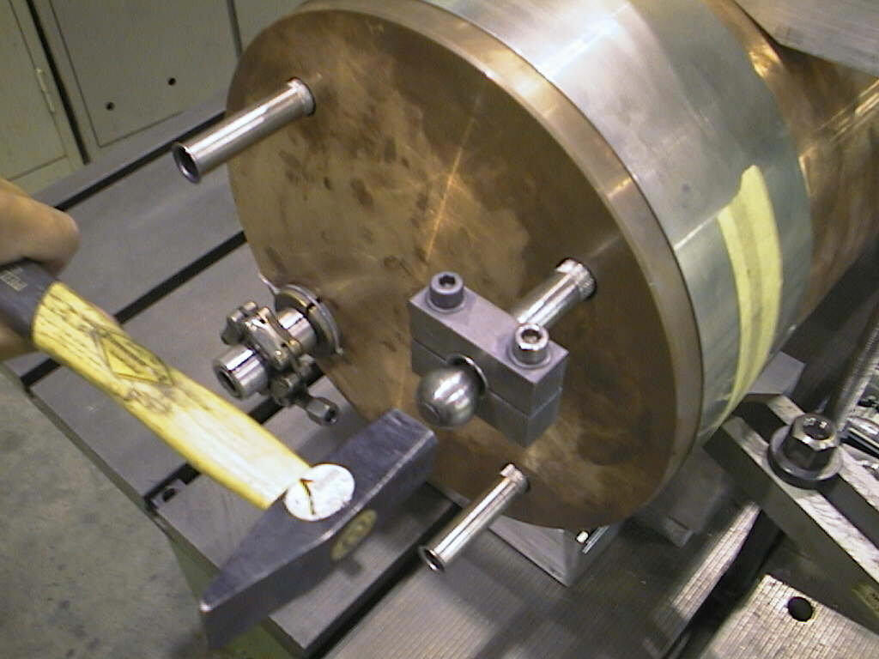
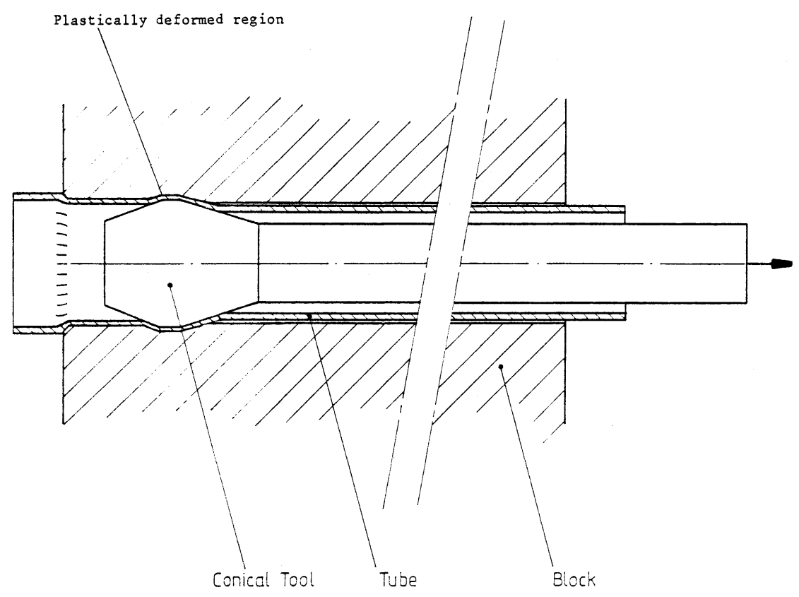
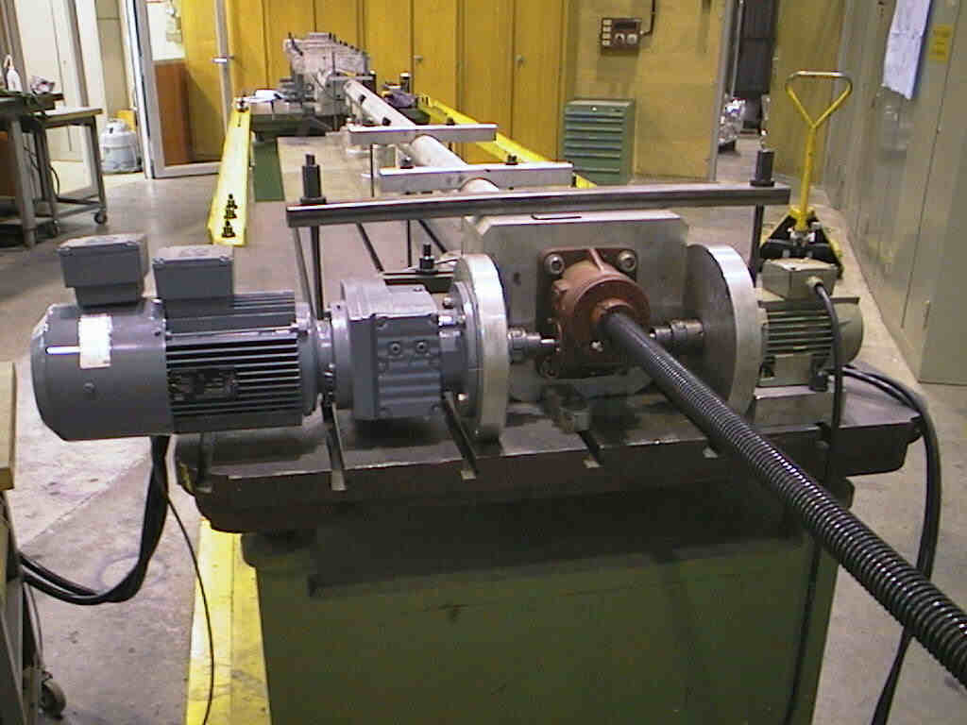
Contact with cooling pipes – techniques used for BIDs at CERN
Cold-expanded pipes
    Used for SPS beam absorbers
    Specific tooling required for each tube diameter
    Not compatible with UHV
    Only straight tubes
    Efficiency unknown
    Very long process
    Issues encountered

Slide 4
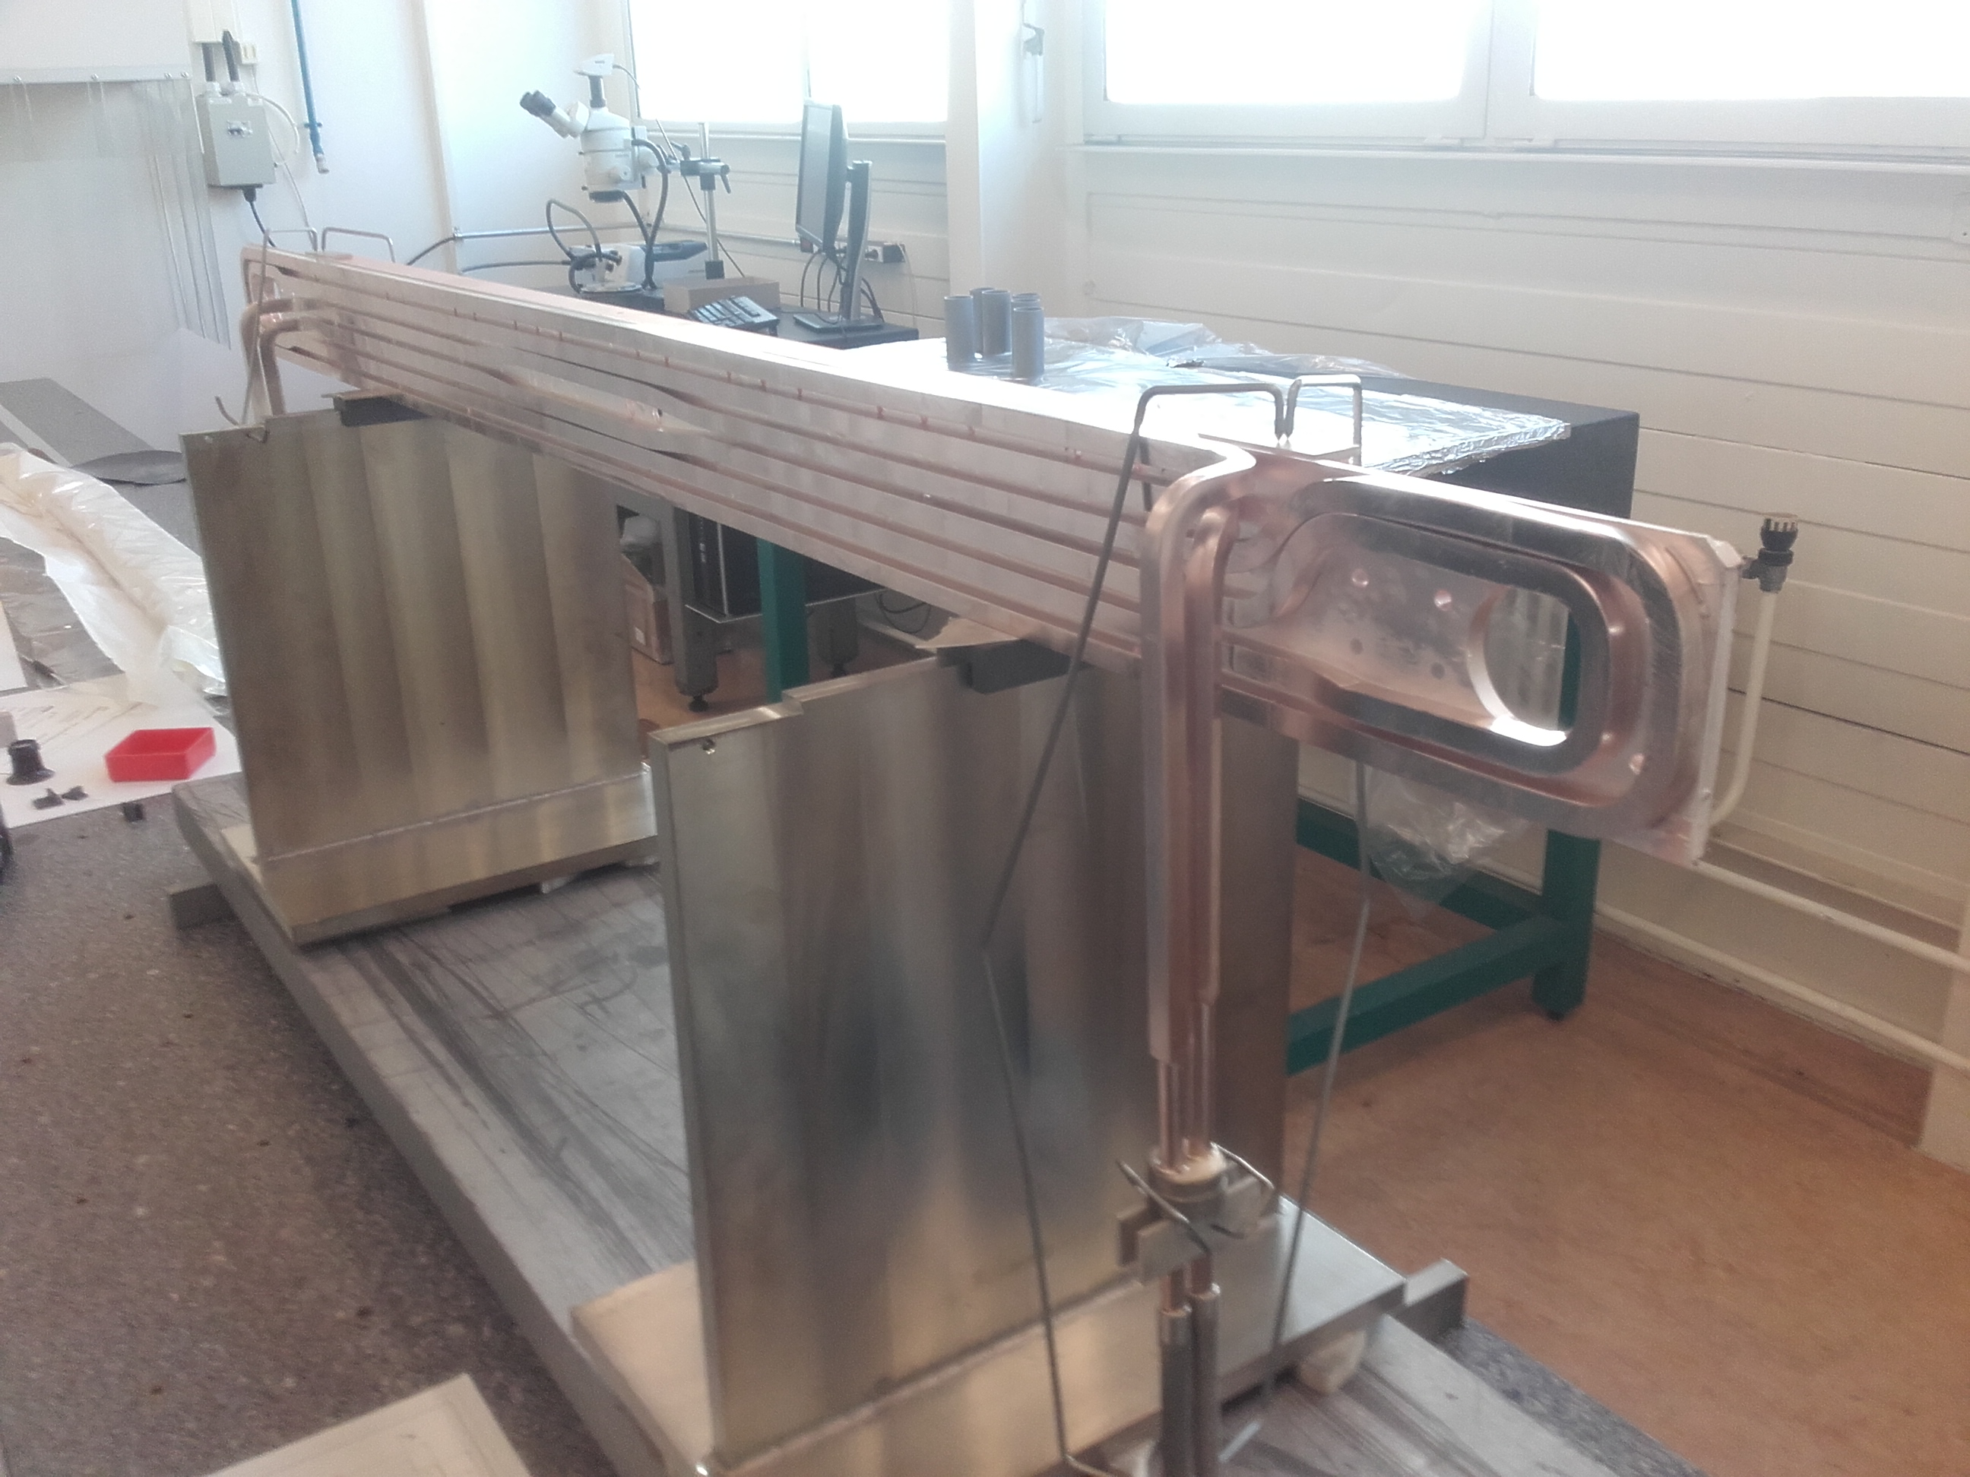
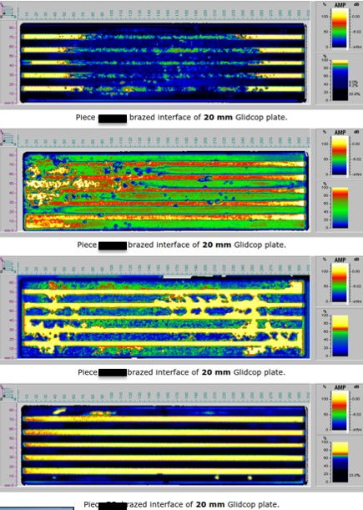
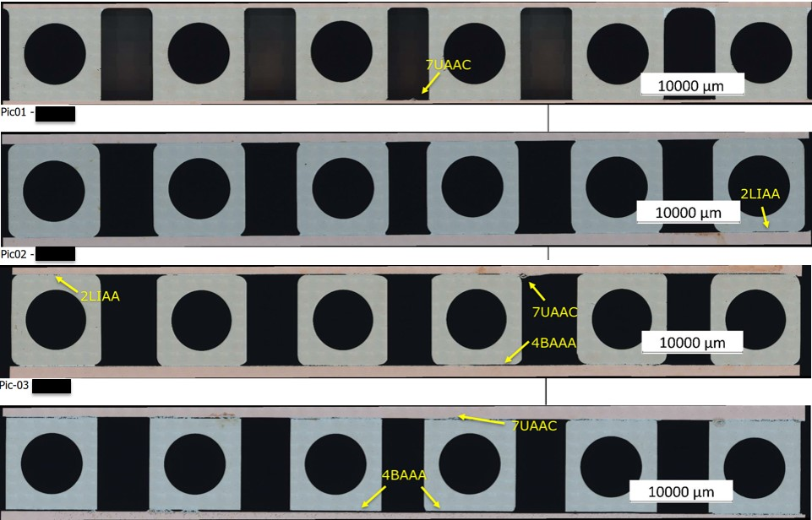
Techniques used for BIDs at CERN (2)
Brazing
    Used for Collimators
    Compatible with UHV
    Quality highly dependant on vendor’s expertise
    Good thermal efficiency

Slide 5
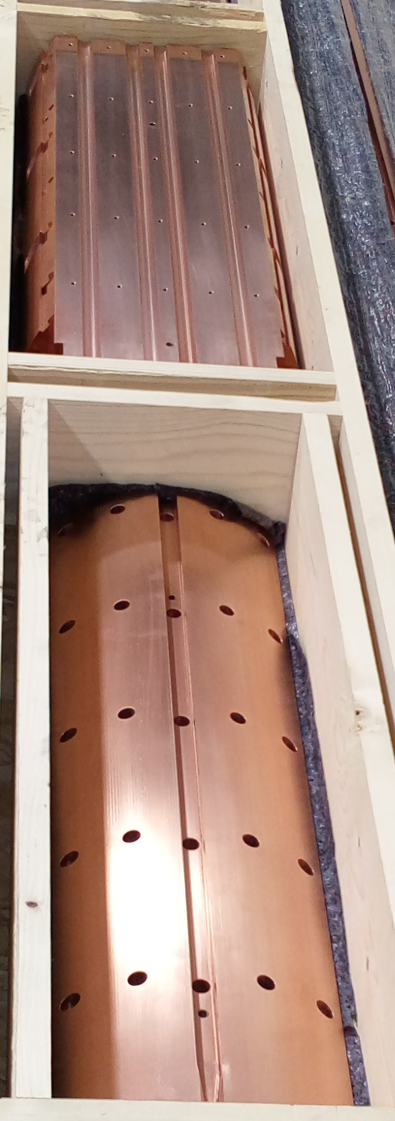
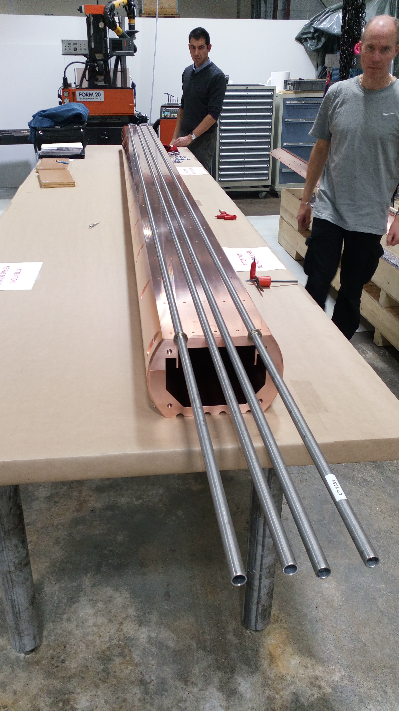
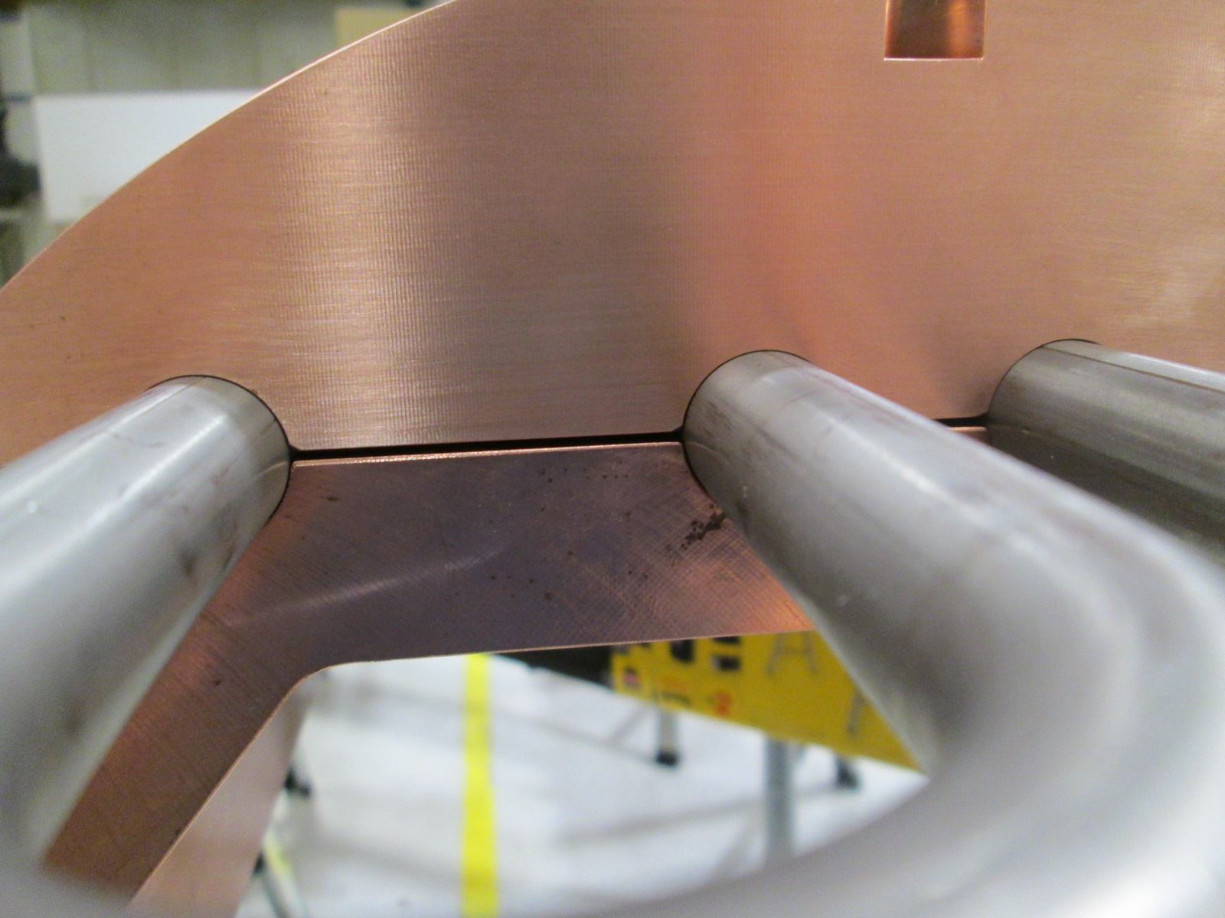
Techniques used for BIDs at CERN (3)
Clamping
    Used for TIDVG#4 (previous SPS beam dump 2017-2018)
    Compatible with UHV
    Sensitive to machining precision
    Dependent on contact pressure
    Efficiency low (unquantifiable)

Slide 6
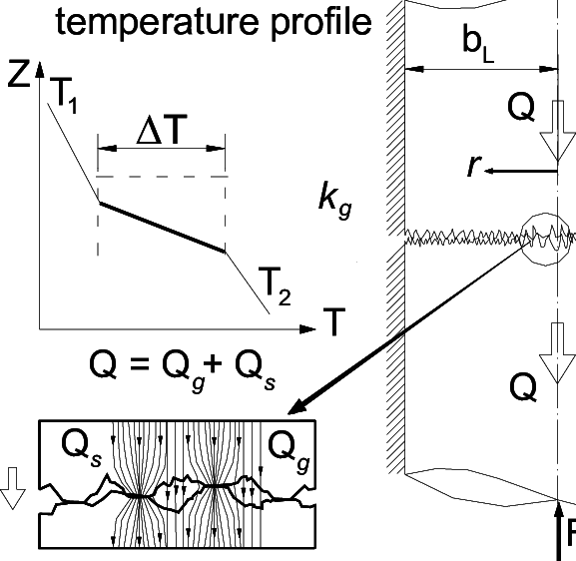
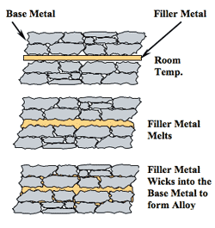
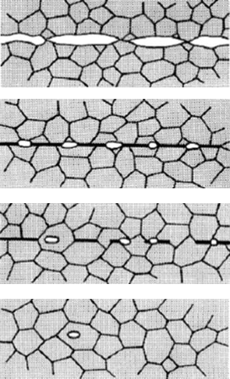
Heat transfer through interface
Mechanical contact
Brazing
Diffusion bonding

Slide 7
Good bonding…

Slide 8
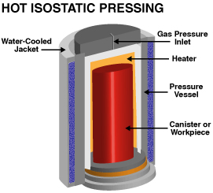
Diffusion Bonding by HIP
Hot Isostatic Pressing (HIP)
    High temperature (typically up to ~1400ºC with Mo heaters or up to ~2000ºC with Gr heaters) → promoting diffusion
    High pressure (up to ~200 MPa) → limiting grain growth
    Inherently “clean” process (under Argon)
    Compatible with UHV (inner porosity removed)
    Reproducible results
    Maximum thermal efficiency (thermal resistance at interface virtually removed)

Slide 9
Diffusion Bonding R&D and Applications at CERN
Two General Categories
Cuprous & SS
P ~ 100 MPa
T ~ 950 ºC
Refractory metals
P up to 200 MPa
T up to 1400 ºC
Cu-OFE
CuCr1Zr
ODS Cu
316L/304L
W
Ta, Ta2.5W
TZM
Nb, Nb1Zr, Nb10Hf1T1

Slide 10
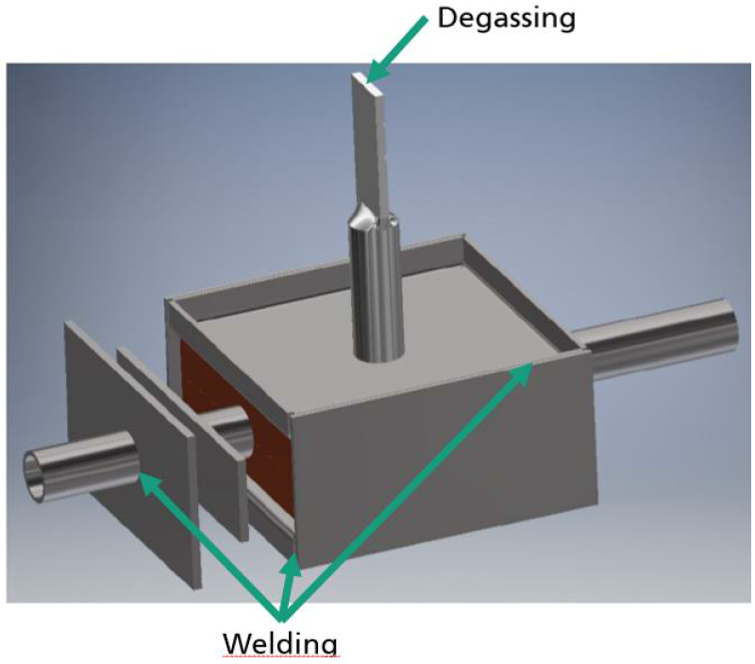
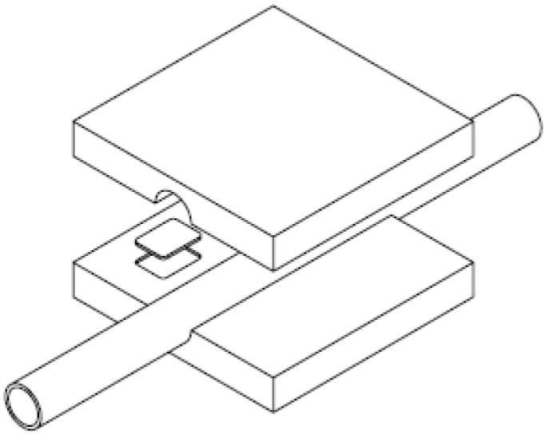
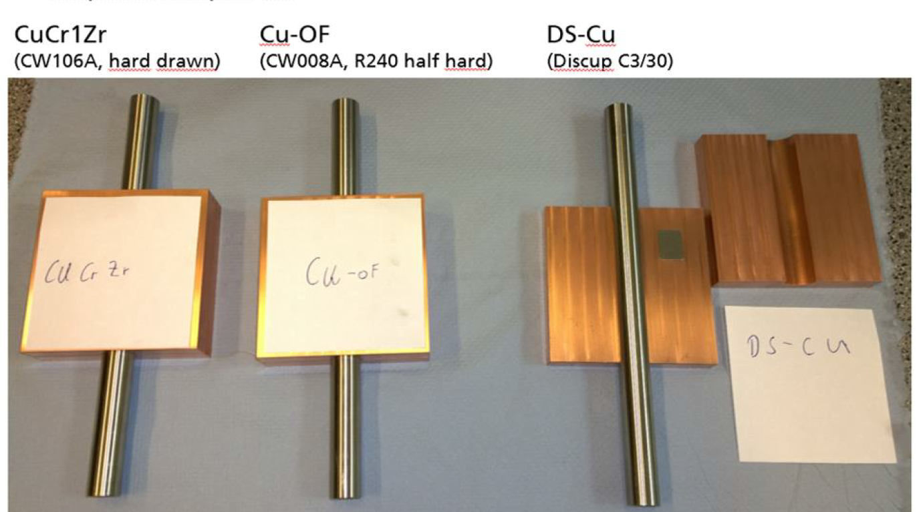
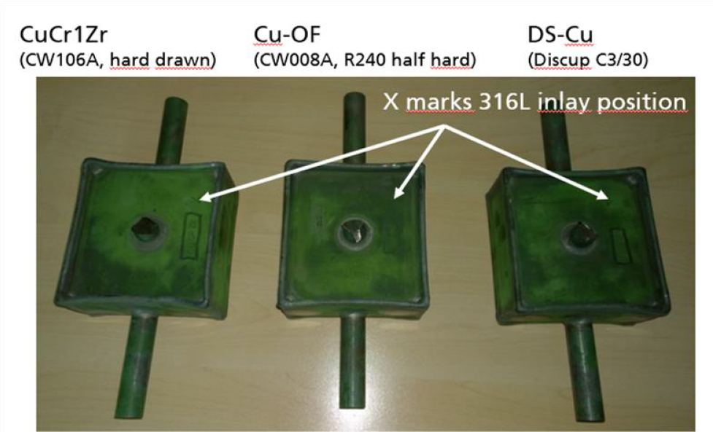
Cuprous Materials – Stainless Steel
First Tests

Slide 11
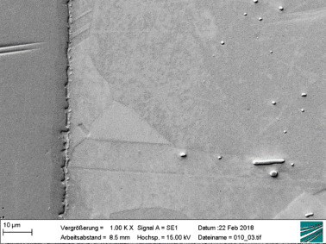
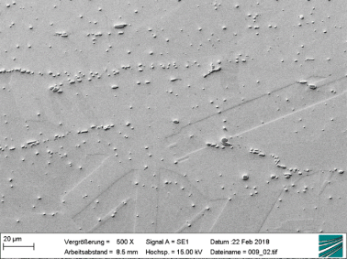
Microscopy
SEM Images
CuCrZr
CuCrZr
CuCrZr
SS
  Observations
  No discontinuities at SS/Cu interface
  No defects detected by PT
  Grains across Cu/Cu interface

Slide 12
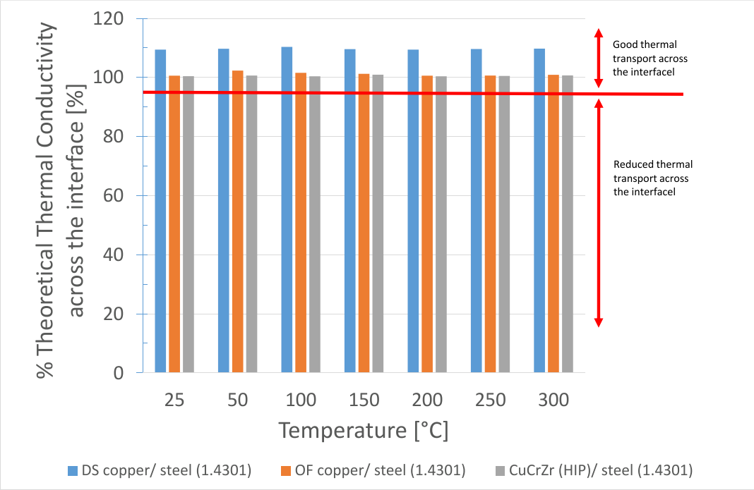
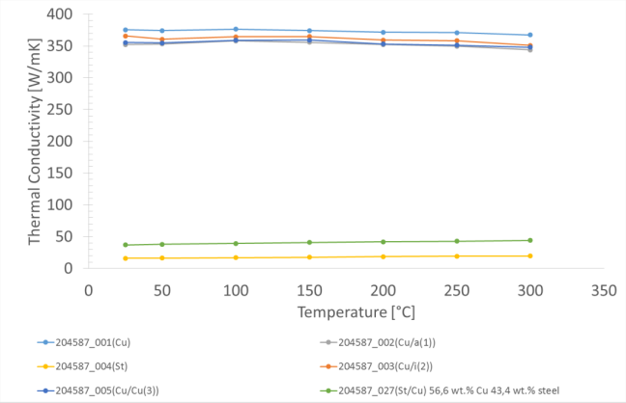
Thermal conductivity across interfaces
From the thermal point of view the bonding is “PERFECT”

Slide 13
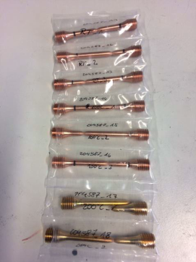
Mechanical Characterisation

Slide 14
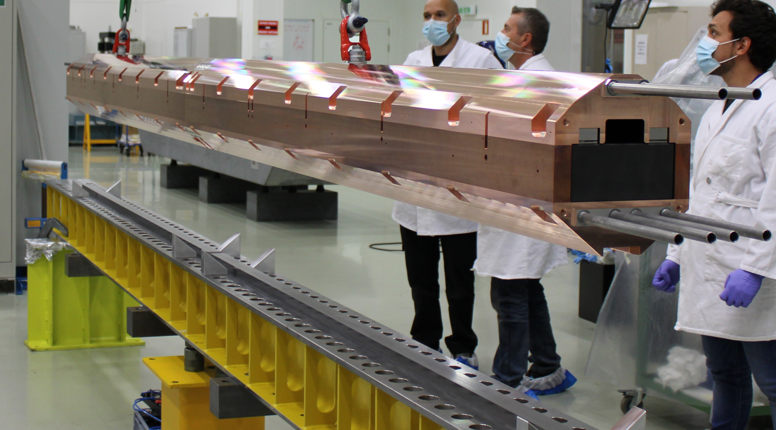
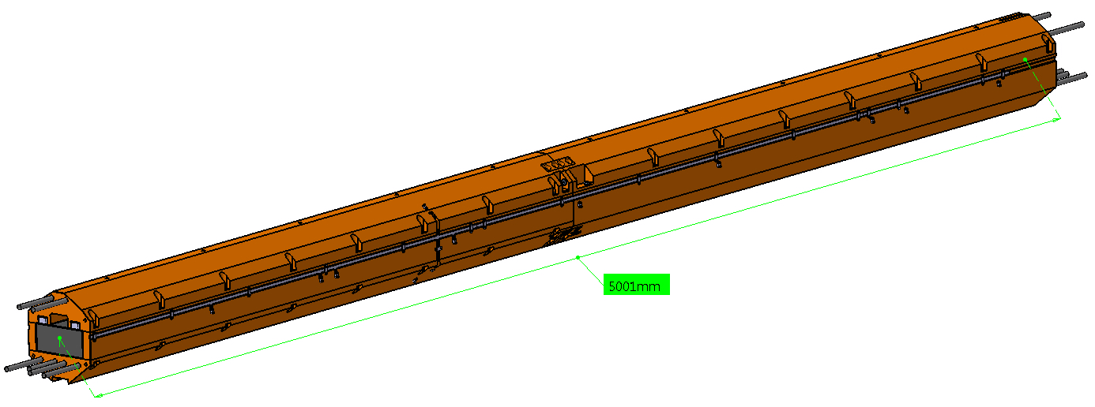
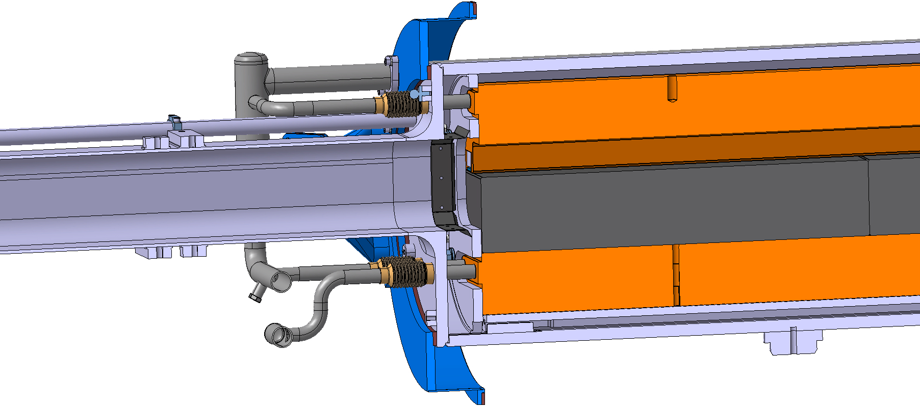
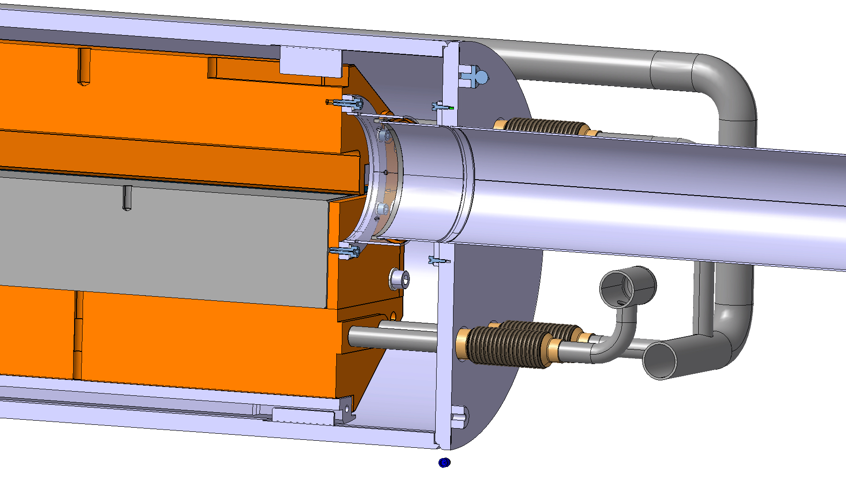
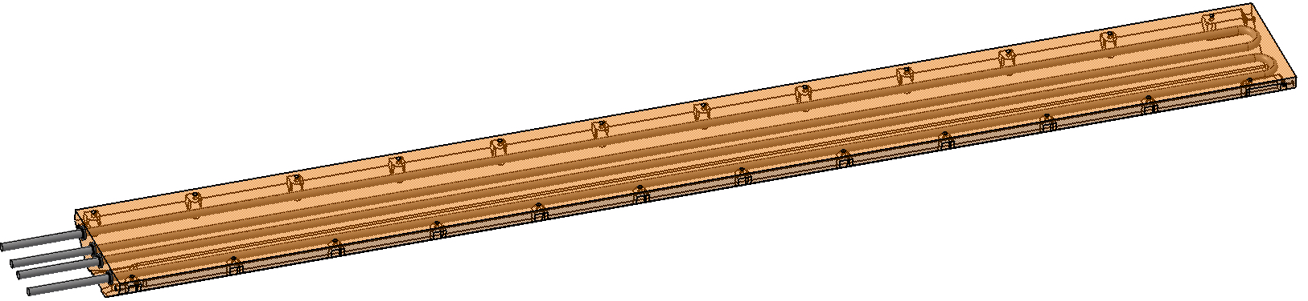
Application 1: SPS Dump
Seamless tube inside vacuum
2500mm-long plate
21/01/2019
14

Slide 15
SPS Dump
Successful installation of dump in readapted caverns in SPS LSS5

Slide 16
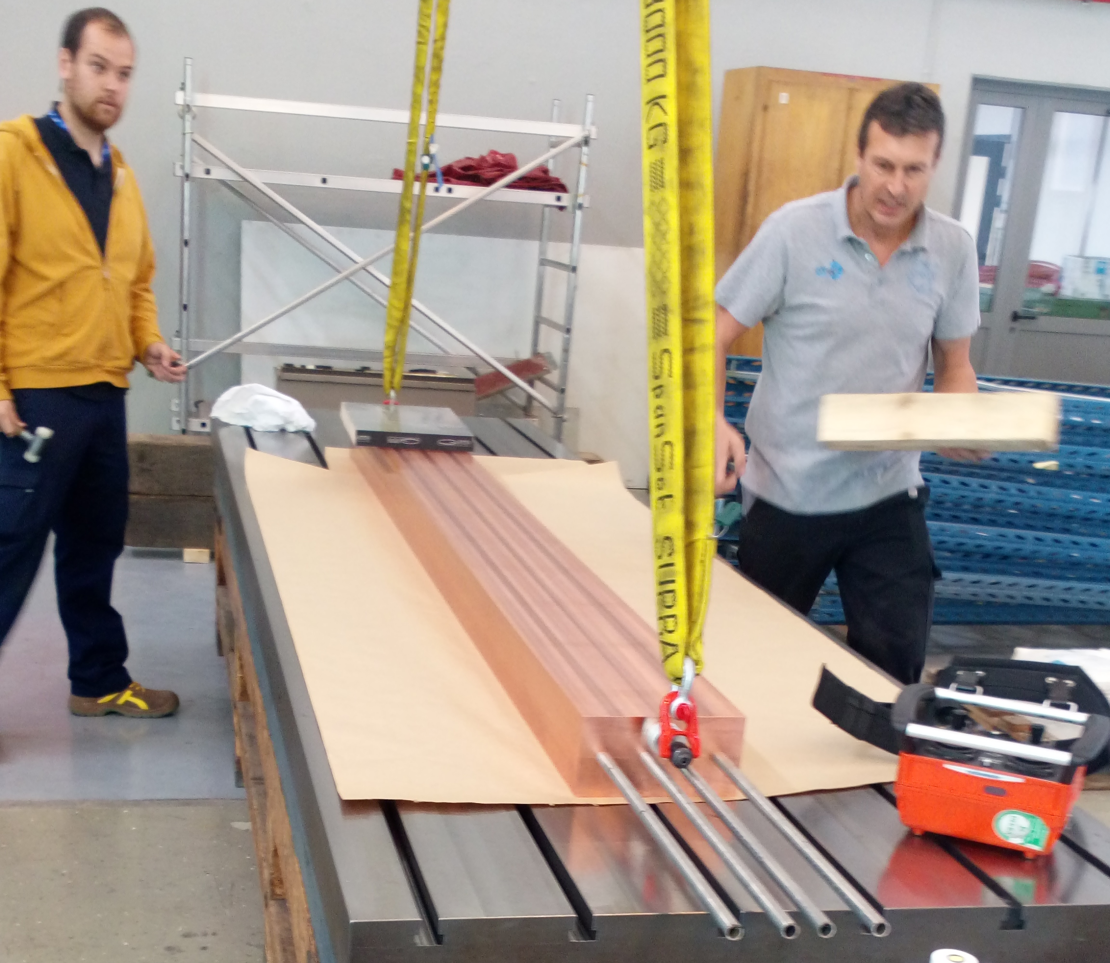
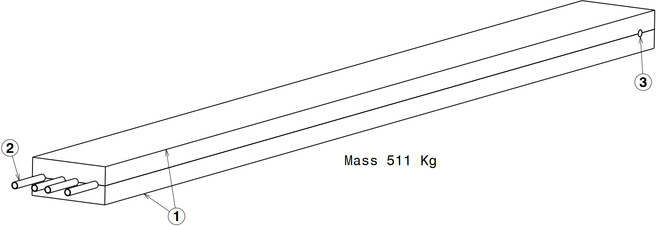
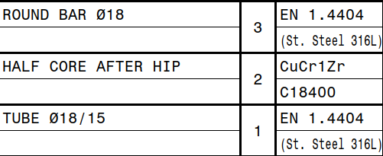
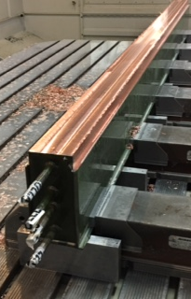
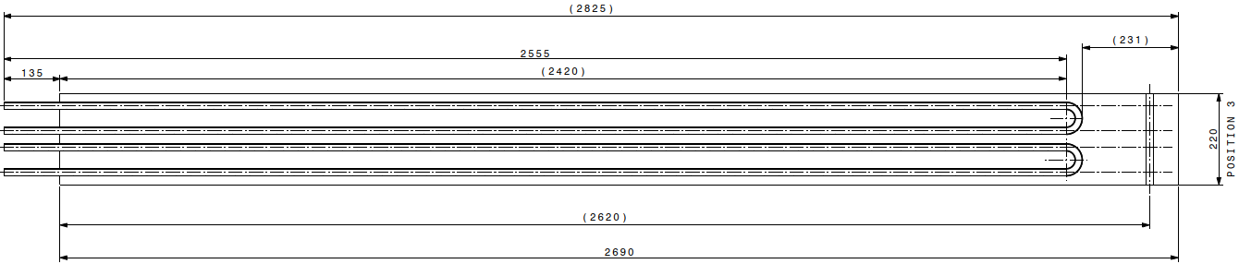
Full-Scale Prototype
1
2

Slide 17
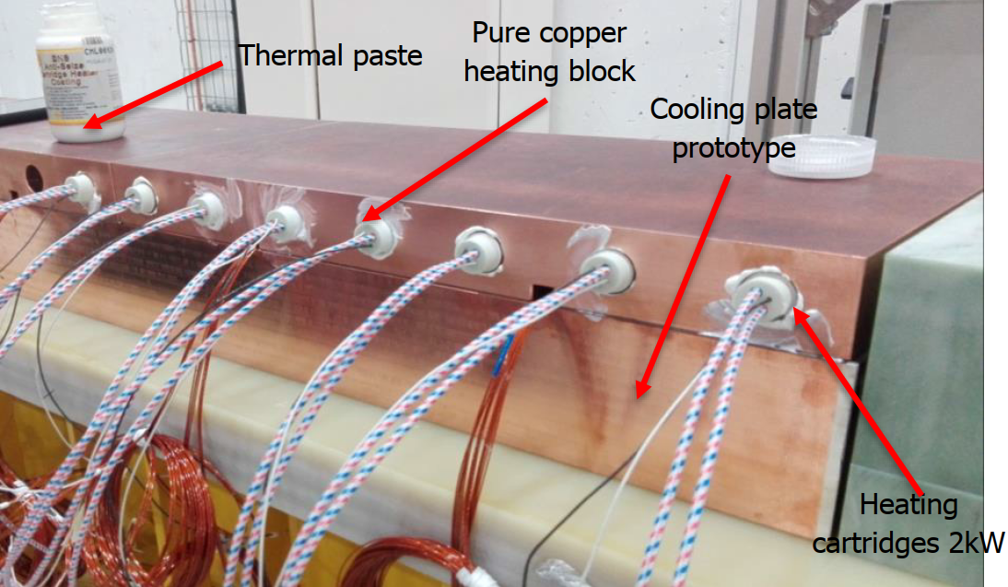
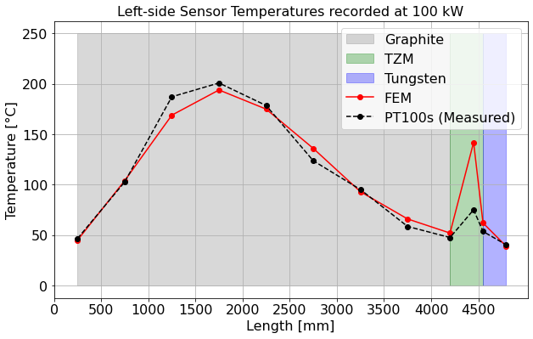
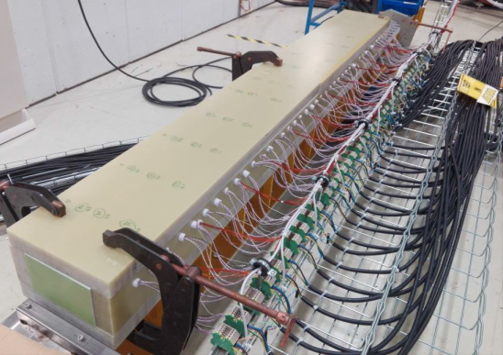
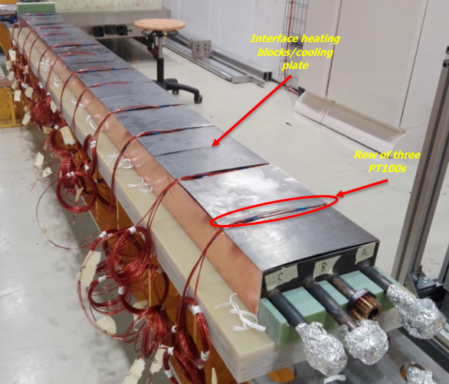
Real Behaviour
PROTOTYPE TEST
84 KW
(Pianese et al. https://doi.org/10.1103/PhysRevAccelBeams.24.043001)
OPERATIONAL EXPERIENCE OF REAL DUMP
BEAM POWER = 100 KW
see poster ID 118

Slide 18
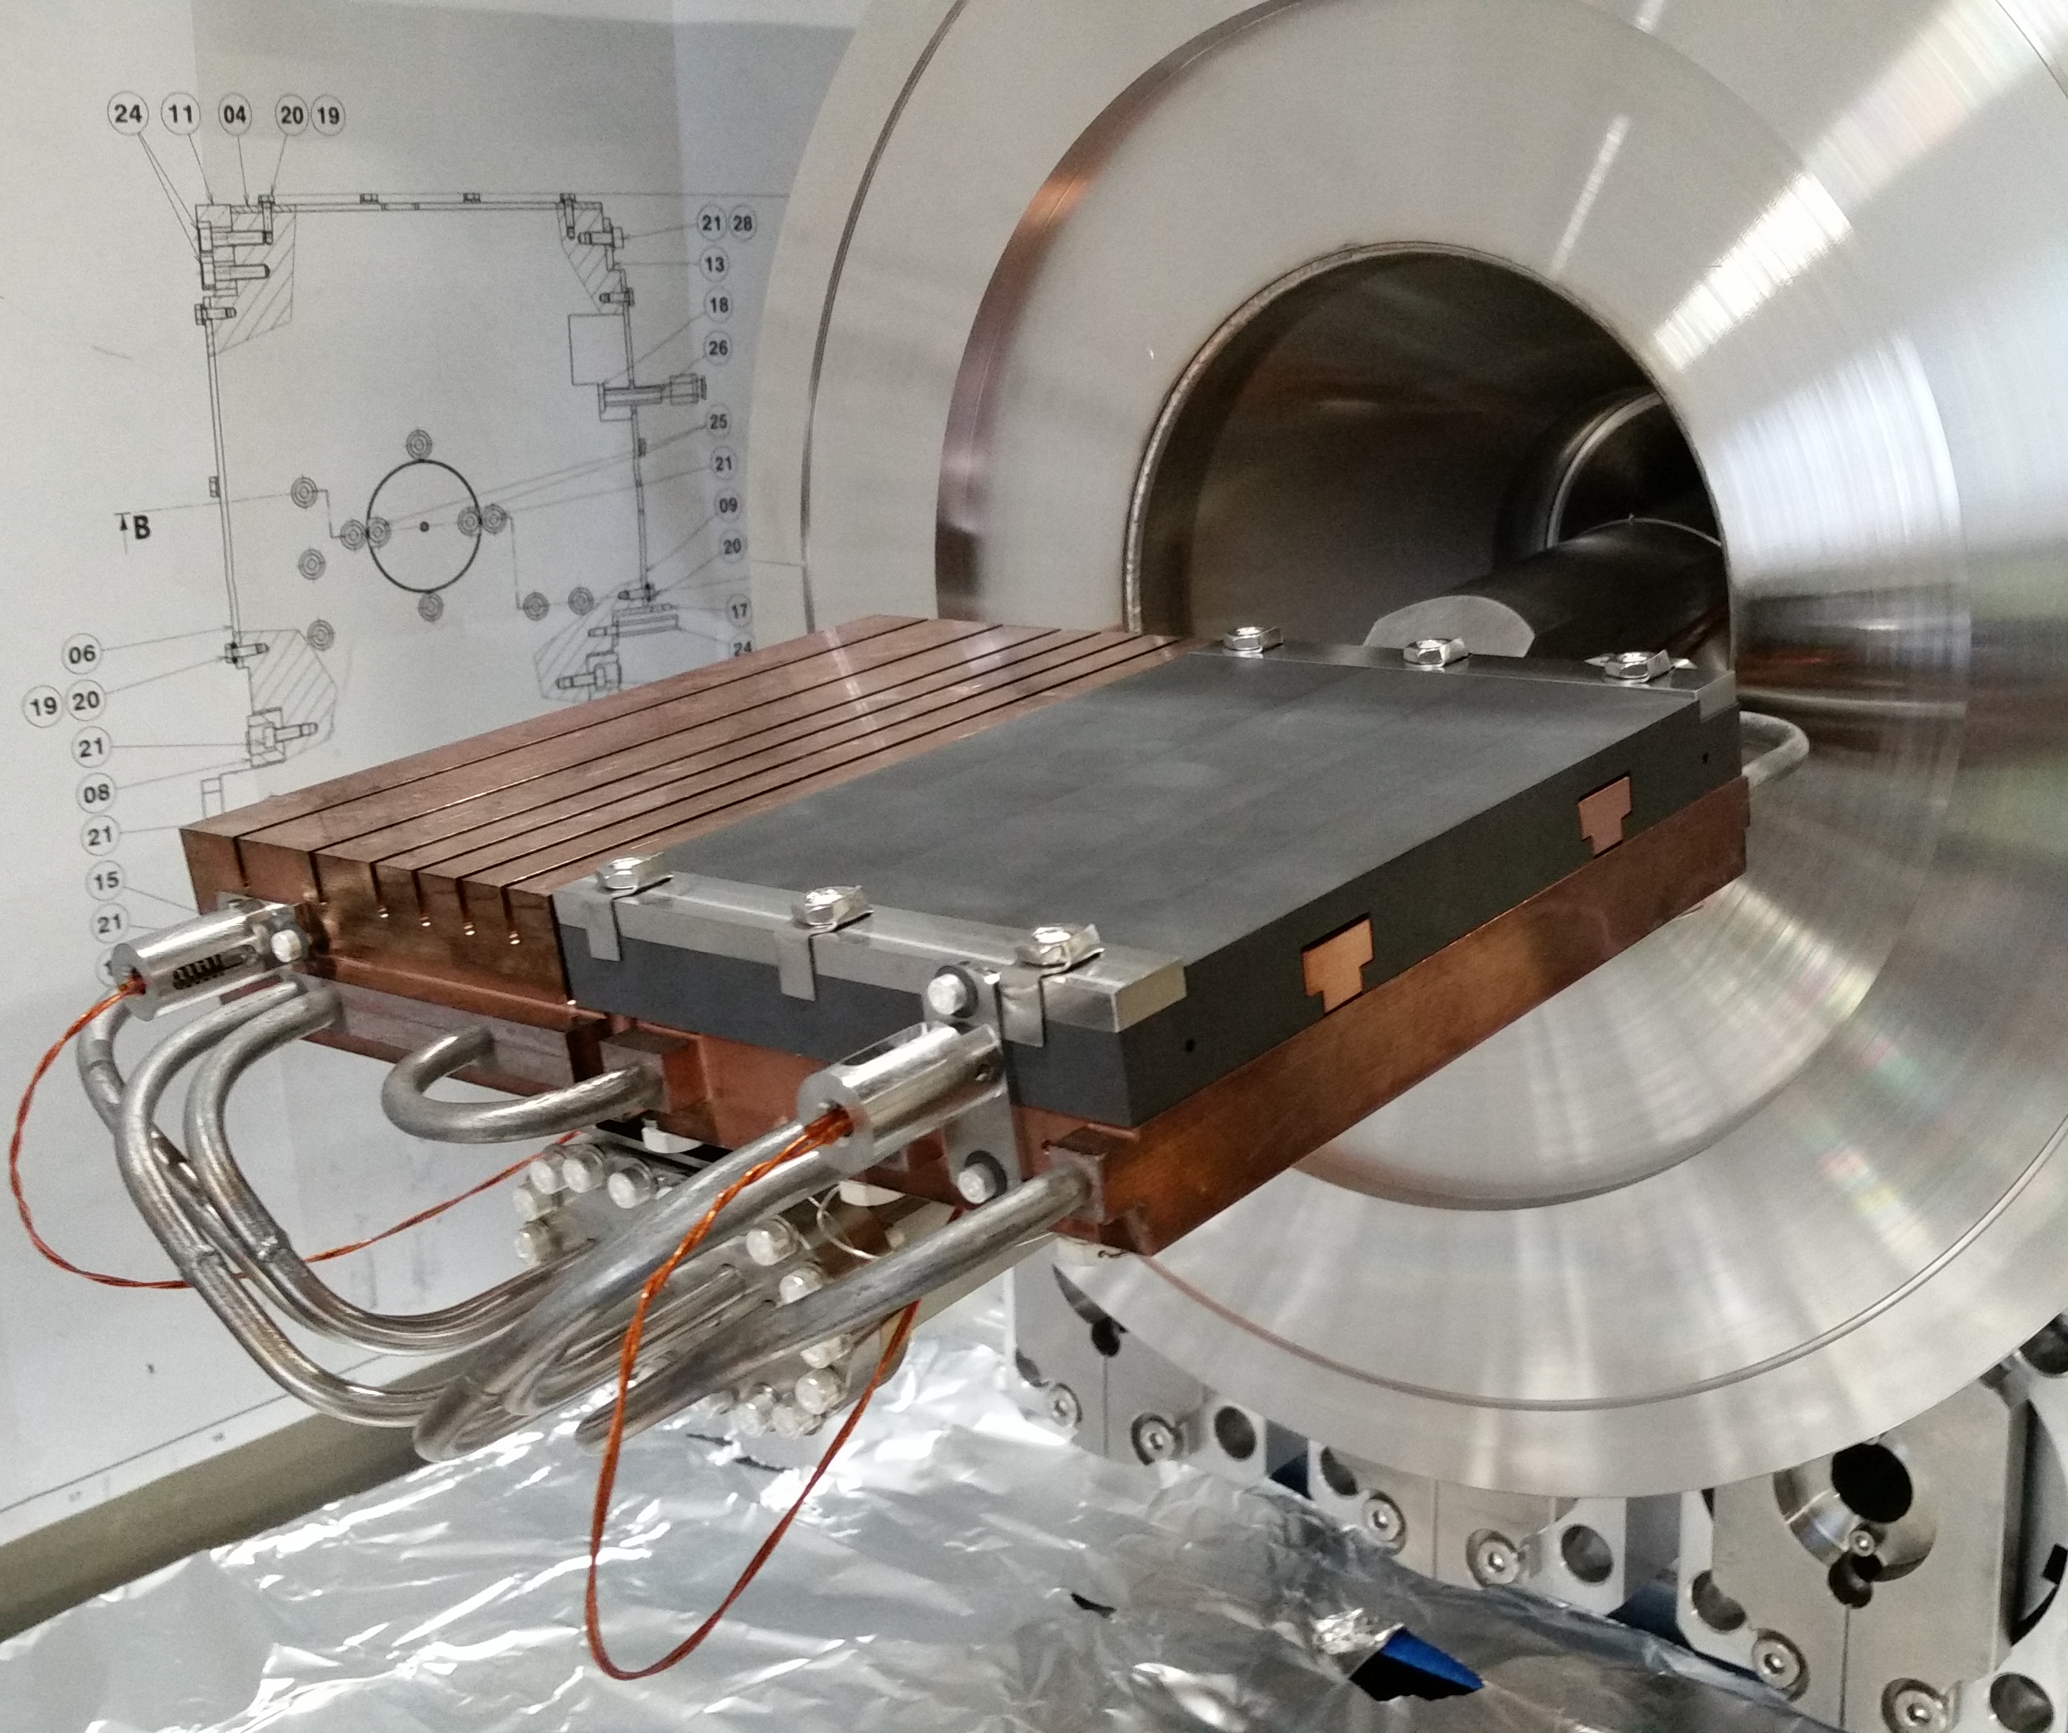
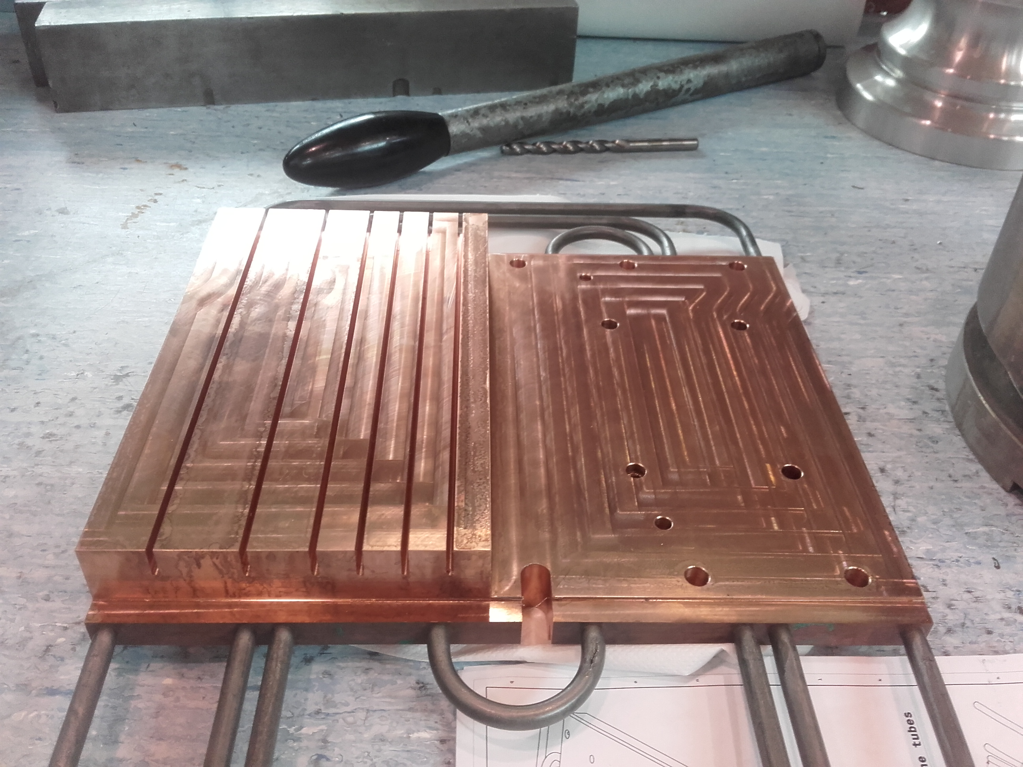
Application 2: PS Internal Dump

Slide 19
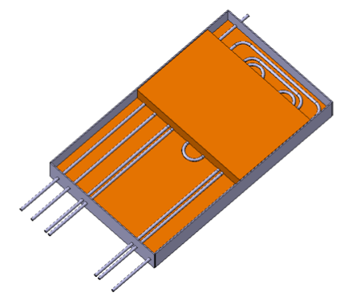
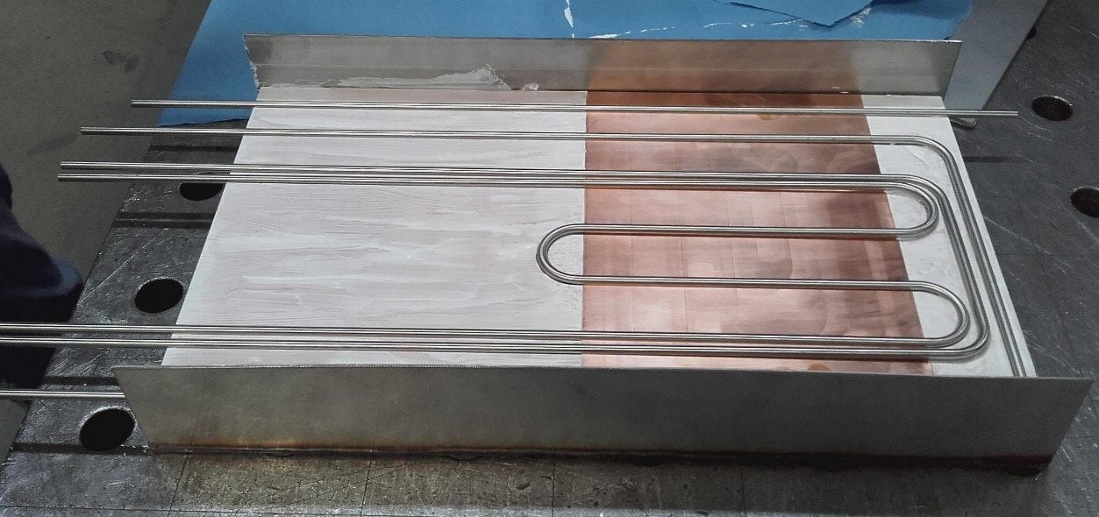
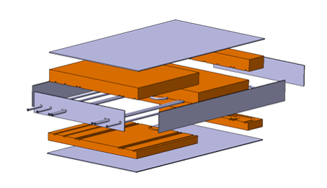
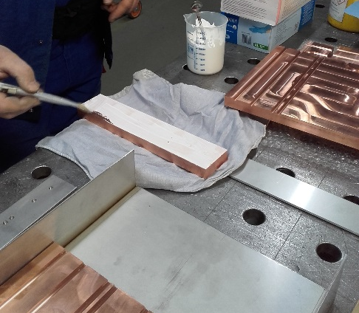
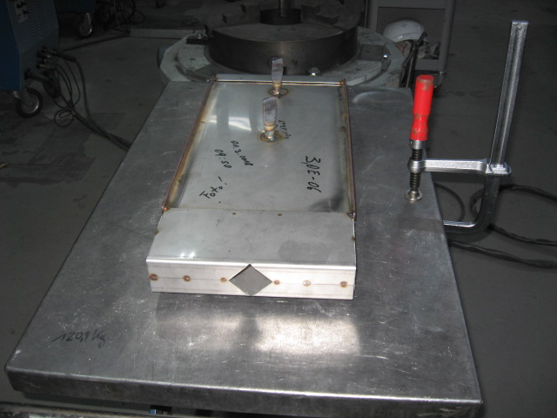
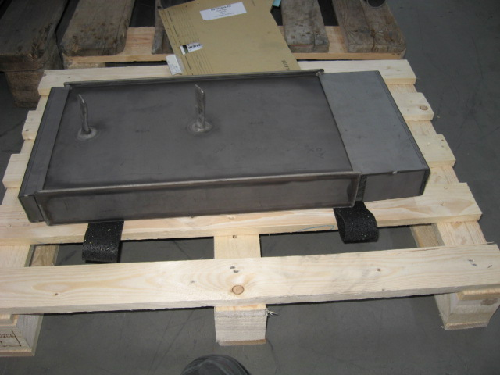
PS Internal Dump Construction
coated blocks removed after HIP
alumina coating (no bonding)
BEFORE HIP
AFTER HIP

Slide 20
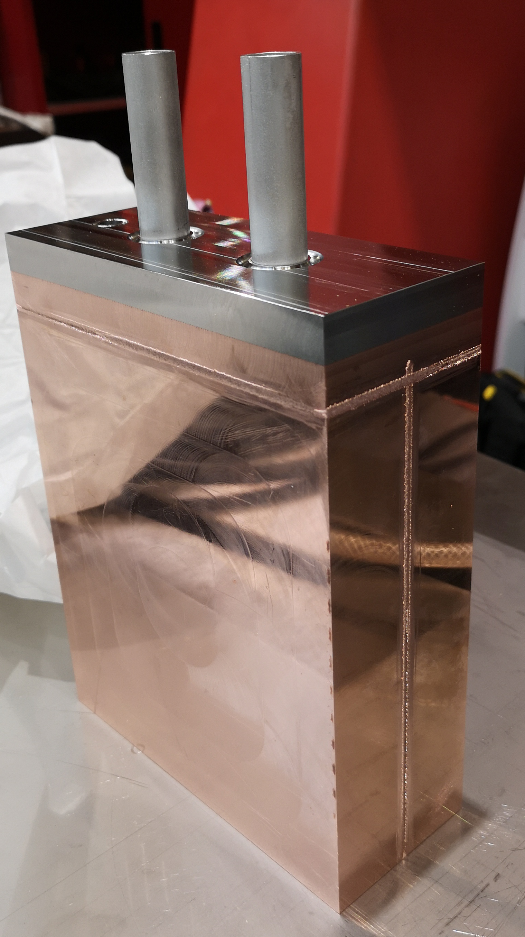
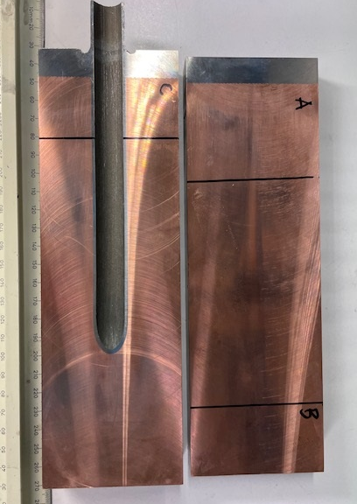
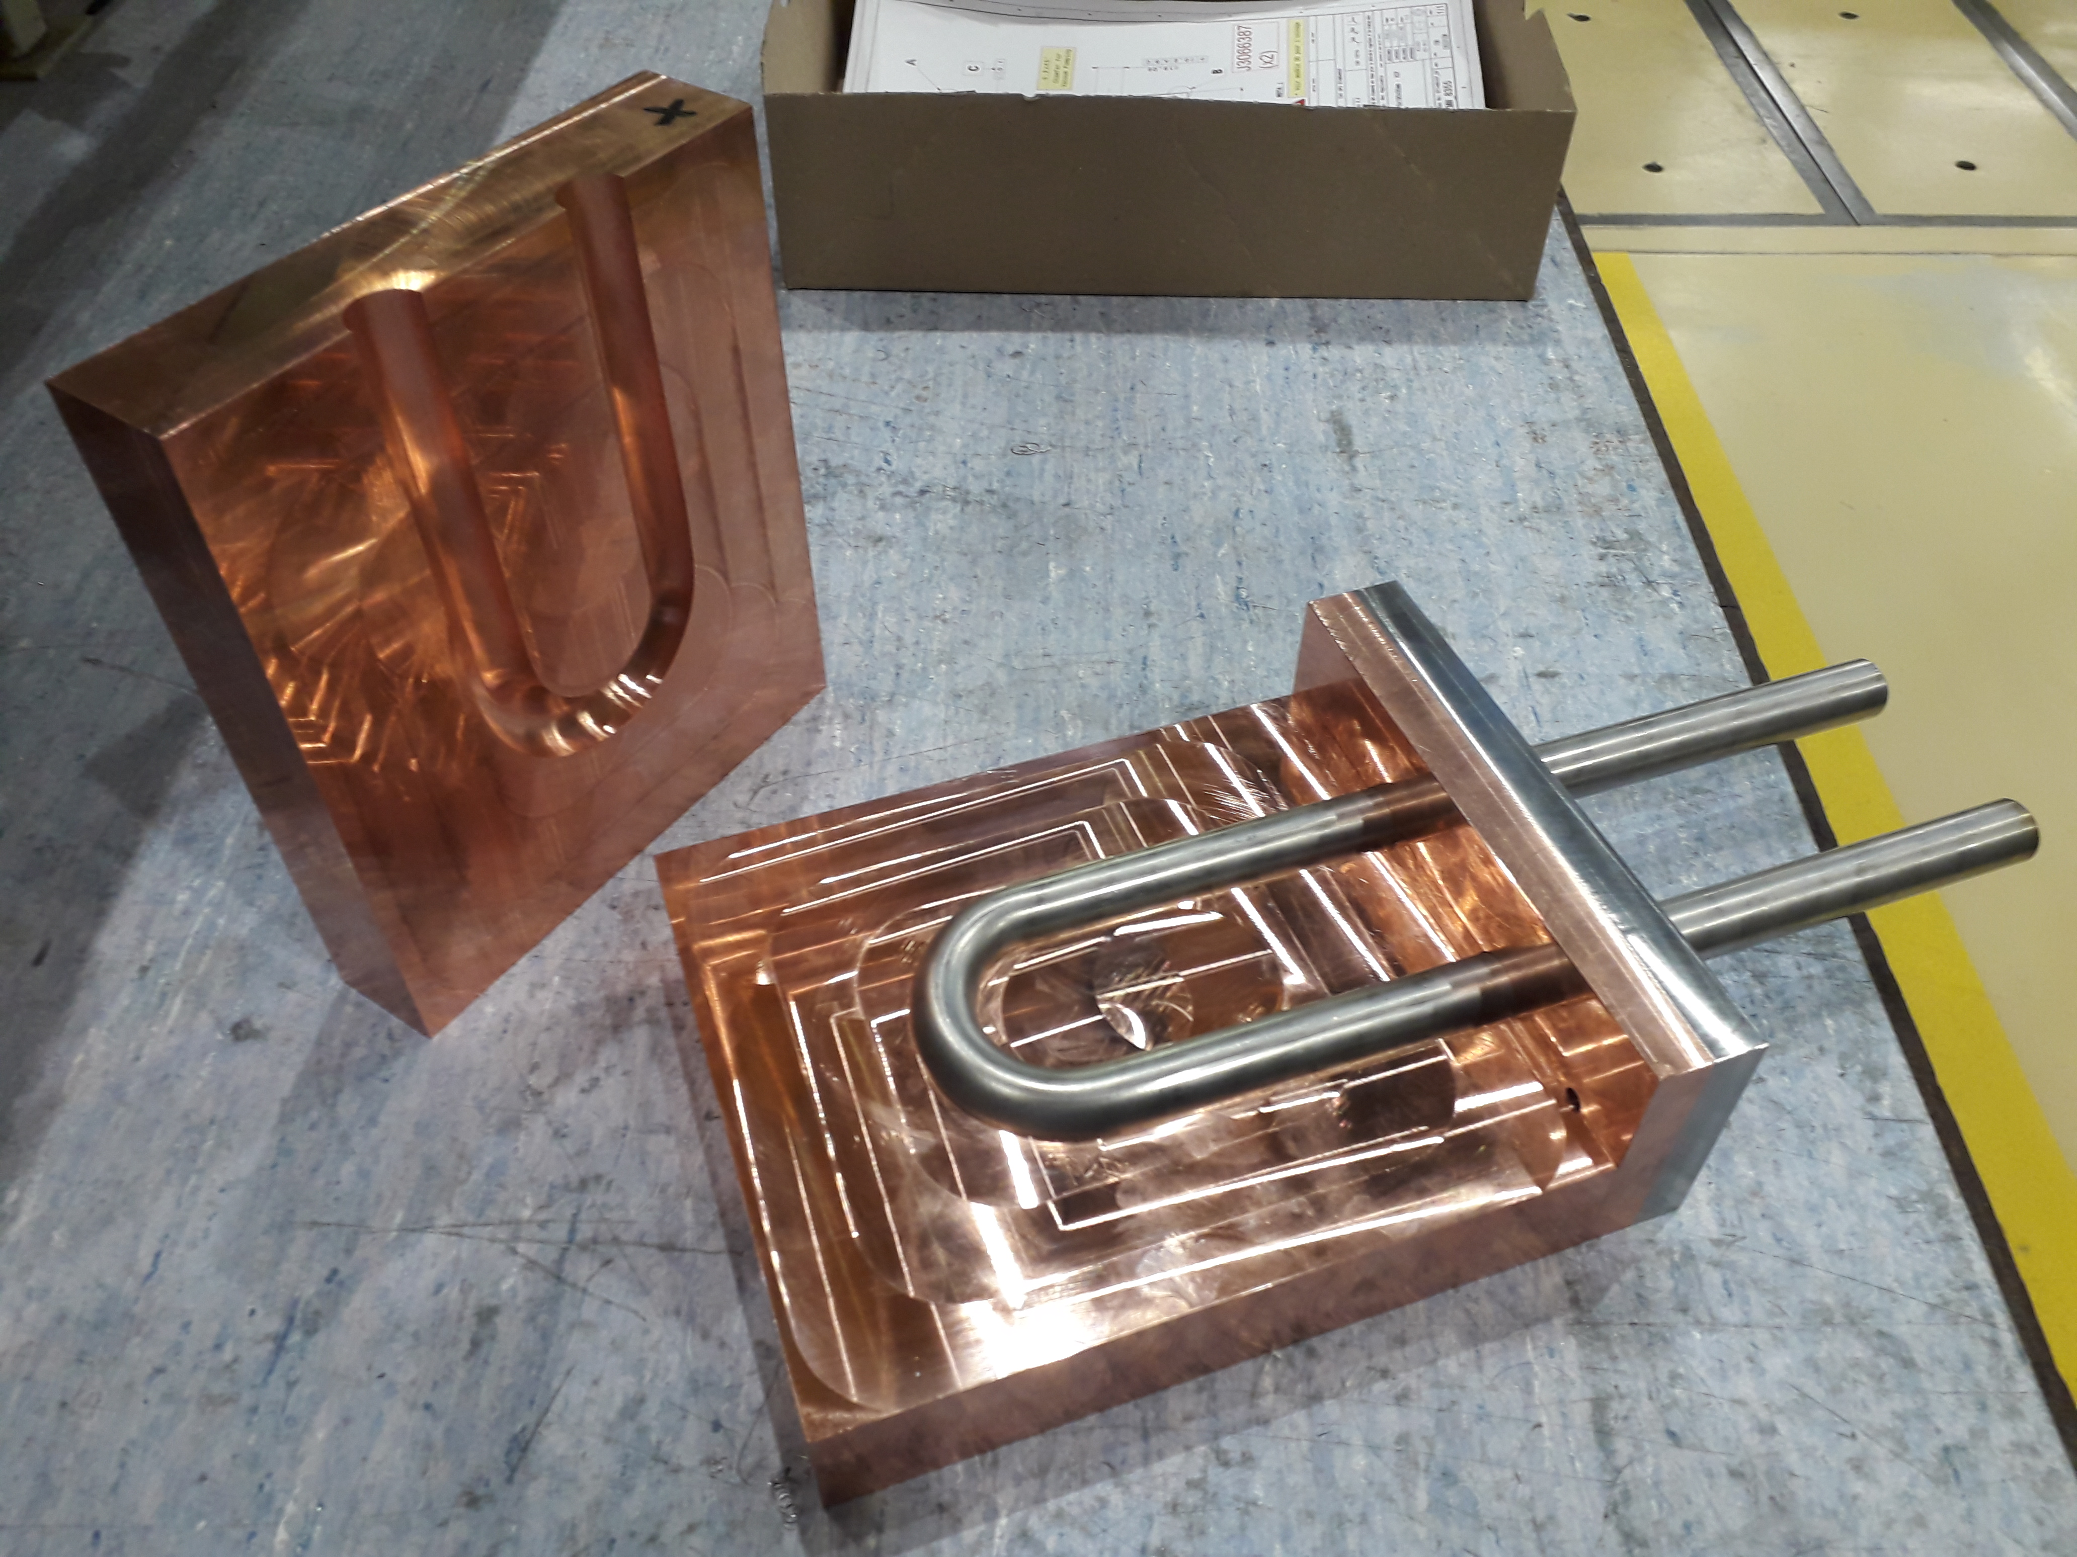
HIP without capsule – Prototype
EBW
Explosion bonding
S. Steel
CUCr1Zr
TIG
Before HIP
Cuts after HIP – Perfect bonding

Slide 21
Refractory metals
Preliminary investigations (2016)
HIP: 200 MPa / 1200 ºC

Slide 22
Refractory Metals – Extensive R&D
Details in Busom Descarrega et al.
https://doi.org/10.1002/mdp2.101
HIP
150 MPa
1200 ºC
HIP
200 MPa
1400 ºC
Main Observations
Bonding achieved in all interfaces apart from W/W and TZM/TZM
Bonding of TZM/W achieved only for High P&T HIP
Interface thermal resistivity removed in all cases
Mechanical strength of bonding is better for higher P&T HIP

Slide 23
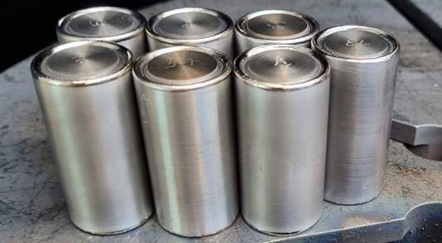
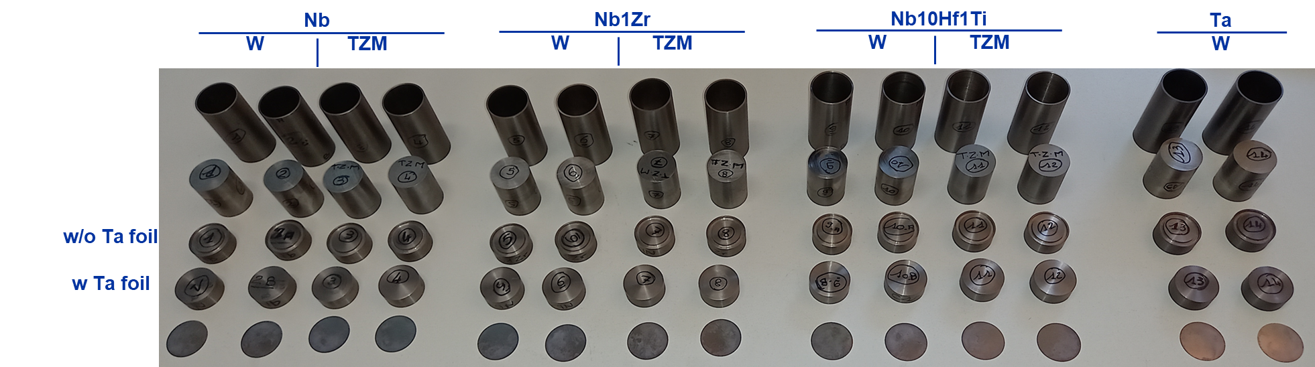
Alternative cladding materials – Nb alloys
Non-trivial procurement of Nb alloys (particularly C103).
Nb alloys tend to show inhomogeneous microstructure.
All Nb alloys successfully plastically deformed.
Virtually no thermal contact resistance for all combinations of materials.
Preliminary (fresh) results of the interface tensile tests show higher strength for Nb-TZM than for Nb-W
HIP Parameters
P = 200 MPa
T = 1200 ºC
1400 ºC

Slide 24
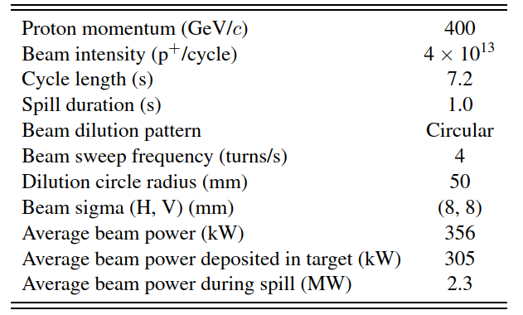





Application: BDF Target
Baseline beam parameters of the BDF Target operation. https://doi.org/10.23731/CYRM-2020-002
High thermal power (300 kW) → cooling needs
High POT → radiation damage
Slow extraction but high spill power density → Quasi-static thermal-induced stresses
TZM & W core Target as reasonable physics & engineering compromise. Ta2.5W HIPed cladding (Baseline design)
~ 4.0×10¹⁹ p⁺/y
See JL Grenard’s and C. Ahdida’s presentations on Friday
⌀250 mm
25-350 mm
BDF Target water cooling layout (20bar, 5m/s)
13 x TZM blocks (580 mm)
5x W blocks (780 mm)
1.5 mm
https://doi.org/10.1103/PhysRevAccelBeams.22.113001
Ta2.5W cladding

Slide 25


BDF Target – Alternative designs
TZM
Cu
W
TZM
W
W
TZM
W

Slide 26
Irradiation tests at CERN – BDF Target Prototype

Slide 27
BDF Target Prototype removal (2020)

Slide 28
BDF Target Prototype removal (2020)

Slide 29
BDF Target Prototype – PIE

Slide 30
Conclusions
Diffusion bonding provides excellent thermal/structural performance of the interfaces for several materials
Maximum cooling efficiency can be obtained in BIDs thanks to this technique
Reproducible results for a given set of parameters
UHV compliant
Extensive operational experience from different institutes

