Slide 1

Recent Advancements and in-house capabilities in Thermal and Mechanical Characterization of Conventional and Novel Materials
Sujit Bidhar
Target Systems

Slide 2
Outline
Thermal properties : Differential Scanning Caloriemeter,Dilatometer
New techniques-
  Transient Grating Spectroscopy to graphite swelling
  LDV (Laser Doppler Vibrometer) to electron irradiated graphite
New capabilities with Nano-indenter : stress-strain, high strain rate
DIC : Digital image correlation for localized strain

Slide 3
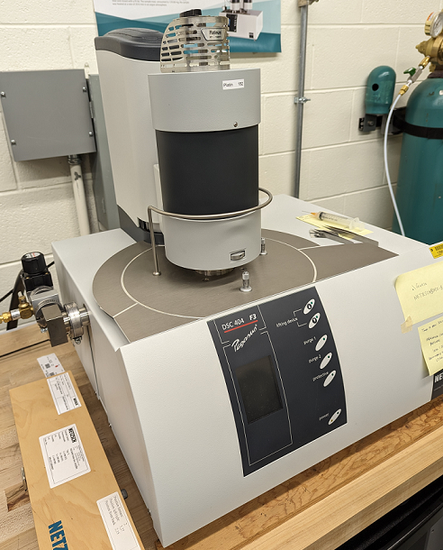
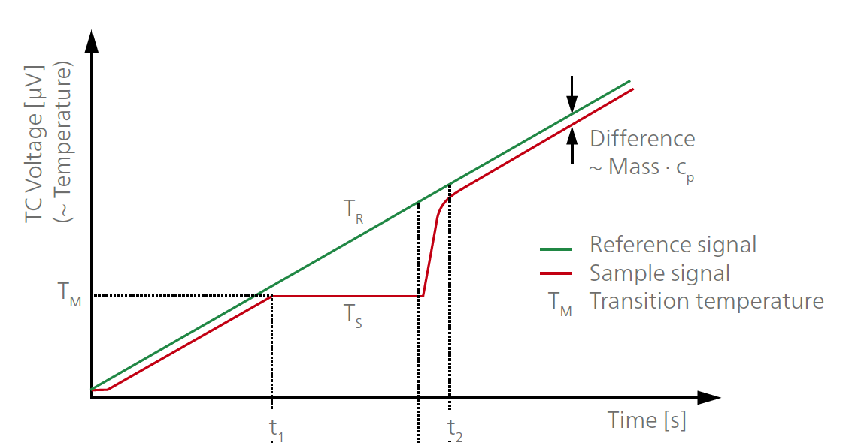
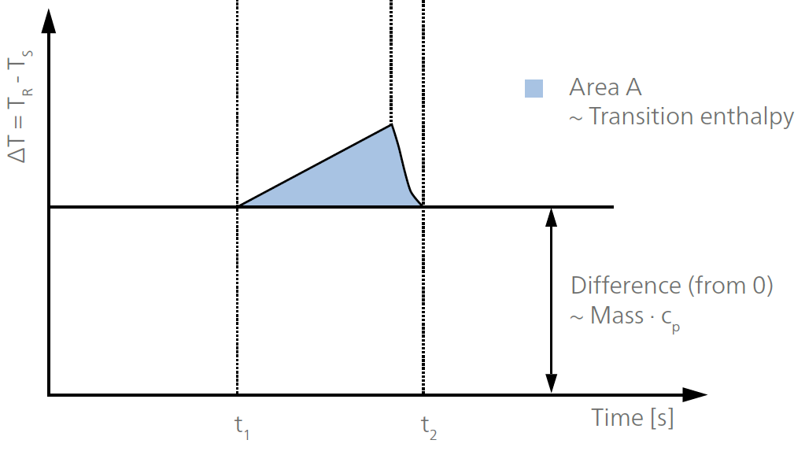
Differential Scanning Calorimeter
Accurate Cp determinations up to 1500°C
Enthalpy precision of better than ±0.5%
Operate according to the heat flux principle
Measured values: sample temperature, temperature difference between sample and reference
NETZSCH Pegasus F3

Slide 4
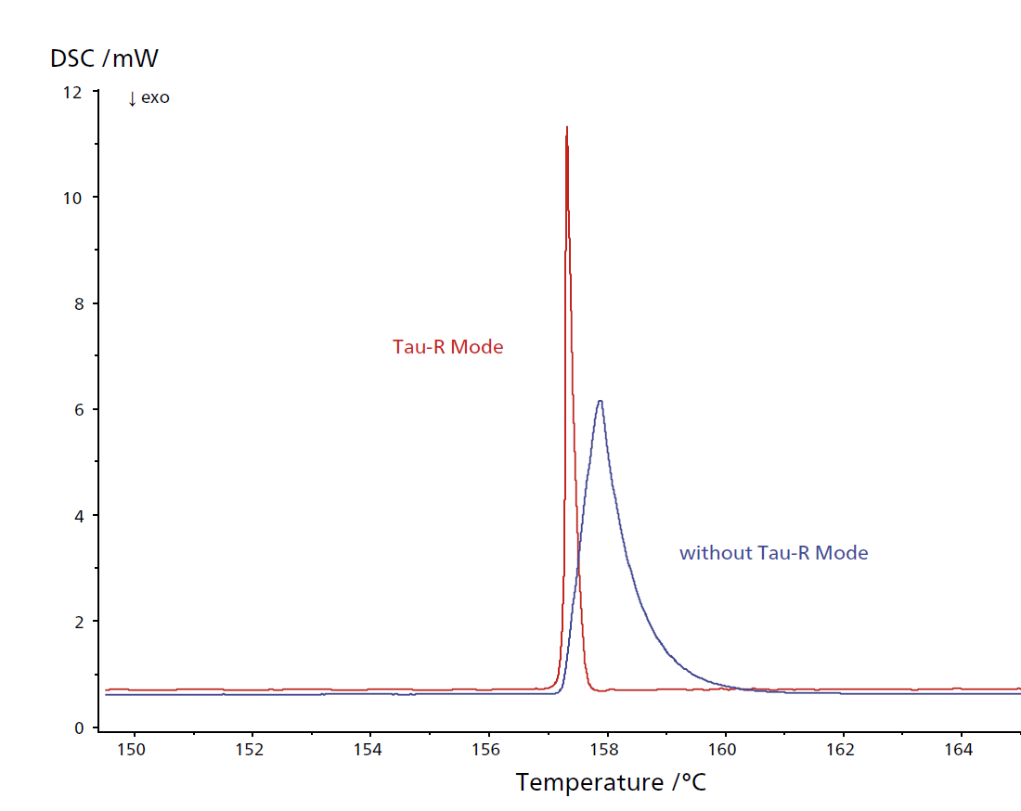
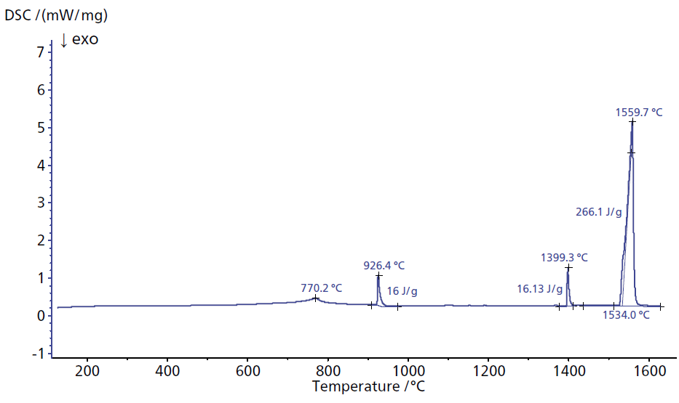
DSC features
ζ- R method
Iron
Melting
Magnetic property change
Change in crystal structure
Thermal resistance and time constant based correction factor to minimize instrument residuals
Sharp reliable peak, stable baseline
Intend to extract dislocation energy and their densities in irradiated material→ Defect characterization
Defects caused by stress wave

Slide 5
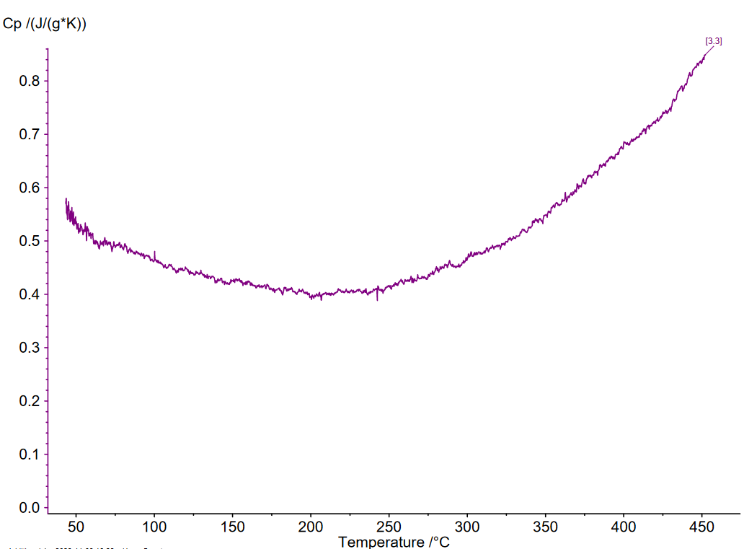
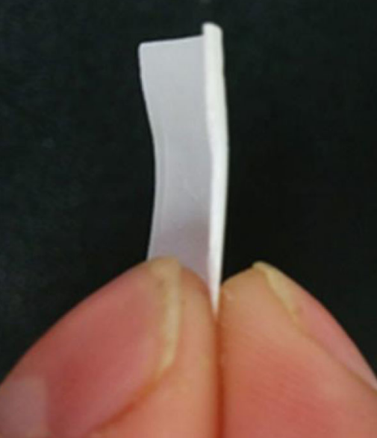
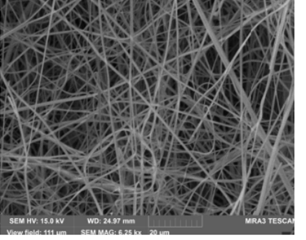
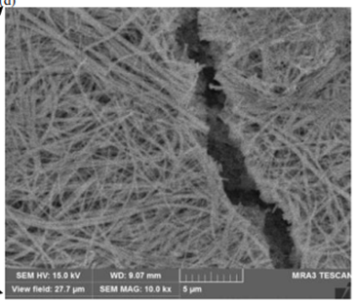
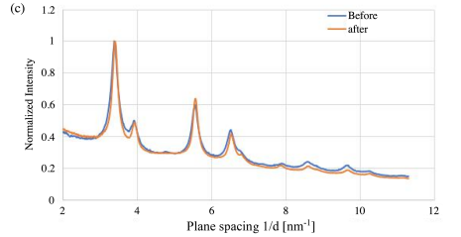
DSC on ceramic nanofiber(ZrO2)
Nanofiber target
Under 440GeV pulsed proton beam
Zirconia Nanofiber Cp by DSC
5%
15%
Packing density 13.5%
Measured porosity dependent nanofiber material within 5% error
  developing heat and mass transport simulation in nanofiber media
Useful tool for HEA and validate MD simulation
Working on improving accuracy
Radiation damage resistant

Slide 6
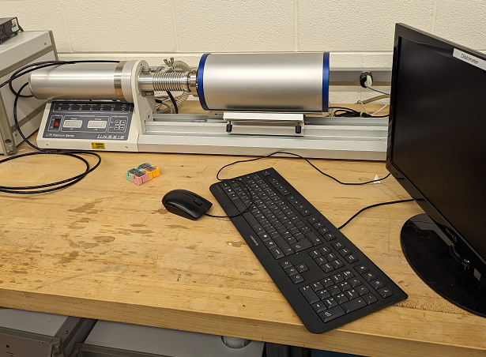
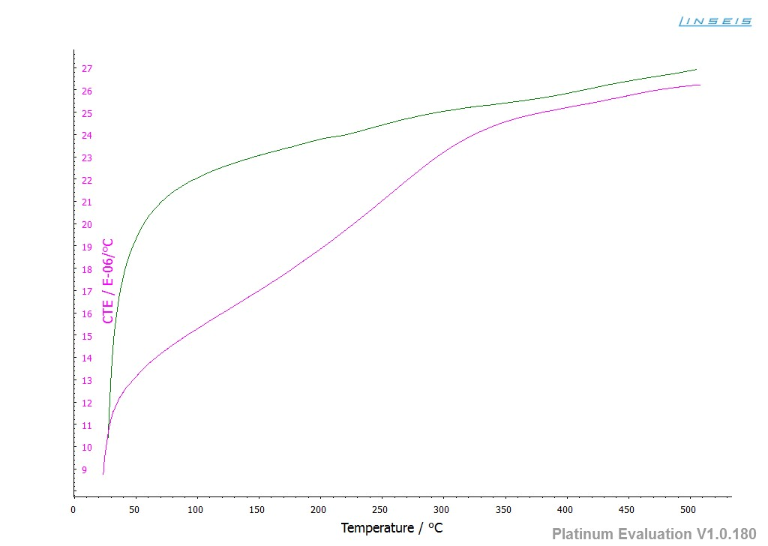
Dilatometer
Linseis L75
CTE Aluminum A6061
In Argon
In vacuum
CTE measurement upto 1600 C
dL-rel curve→ detecting atomic structure change
TGA (Thermo-Gravimetry Analysis)→ thermal stability
DTA(Differential Thermal Analysis)→ Determining phase diagram, transition

Slide 7
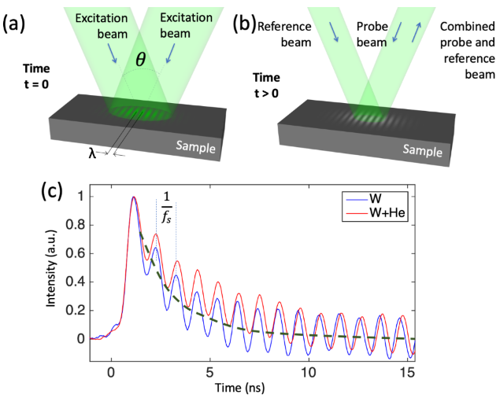



Transient Grating Spectroscopy (TGS)
Pulsed laser beams, 500 ps, λ500nm, few mJ
Interference generate periodic pattern
Absorption of the light within the intensity grating
Spot Size: 50~500 µm
spatially periodic temperature profile
SAWs
rapid thermal expansion creates two monochromatic, counter-propagating SAWs
Slow decay →low stiffness
Surface Acoustic Wave (SAW) velocity,

Slide 8
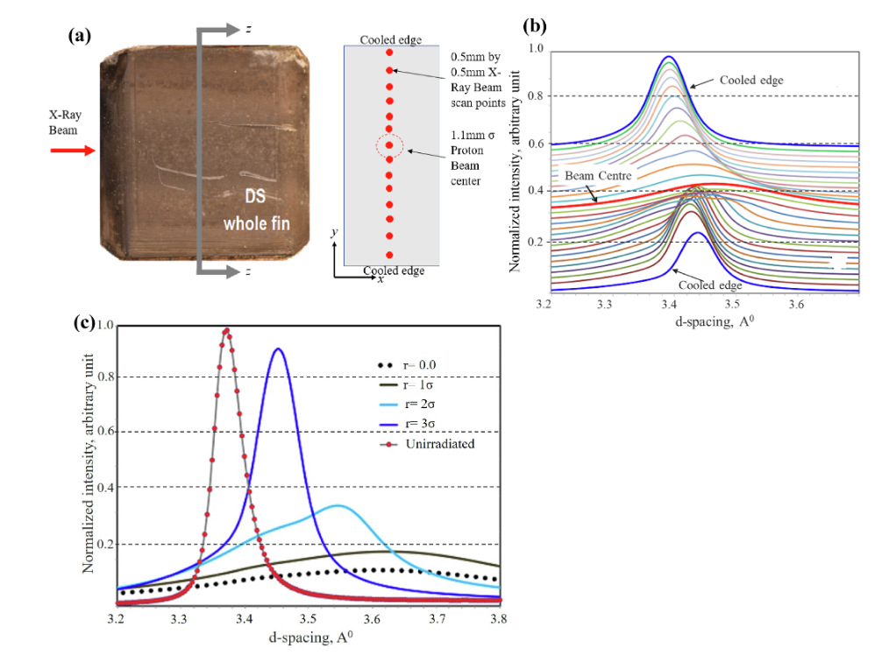
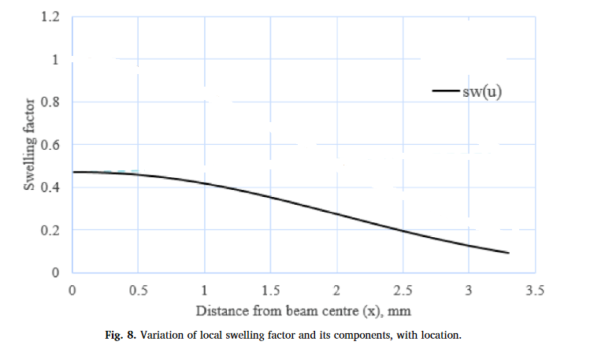
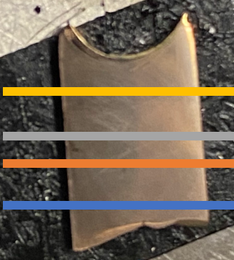
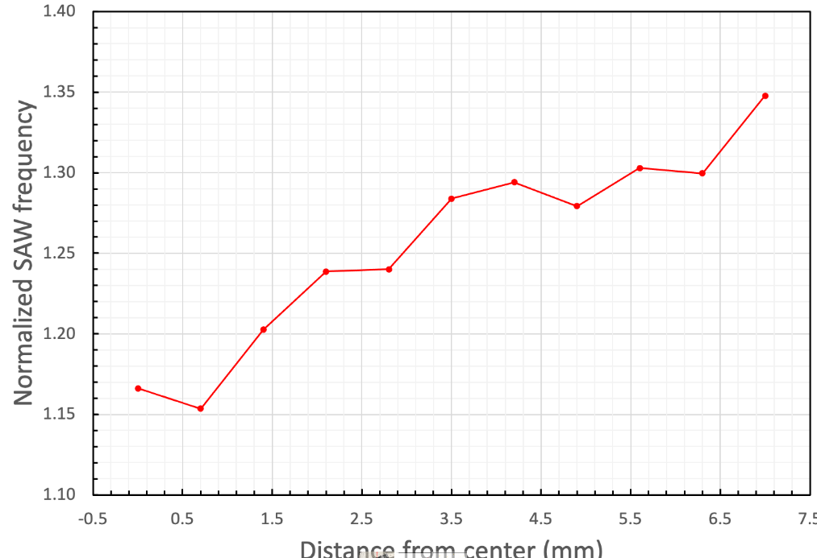
Sensitivity of TGS
Bidhar et al. NME (24), 2020
Gaussian beam
sigma 1.1mm
Proton beam 120GeV
Peak Fluence: 8.6x10²¹/cm²
50% swelling
10% swelling
Lattice swelling and reduction of SAW speed → He filled frankel defect
Hoffman, Acta Mater (89), 2015

Slide 9
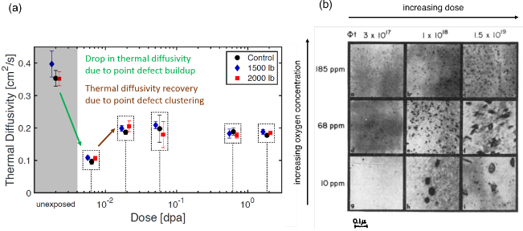
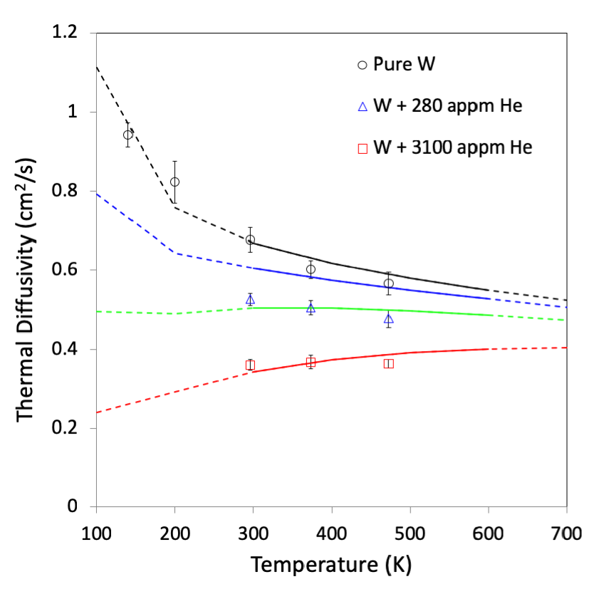
Thermal diffusivity Vs defects
TEM
TGS
On Nb, SE Ferry, MIT 2018
Correlating TGS-measurable changes with microstructural evolution, it can used as a non-destructive testing (NDT)tool, non-destructive material health monitoring.
Much faster, cheaper than TEM
Limitation:
L =2~3µm in metal, 5~8 µm in ceramics
Low L→ low signal

Slide 10
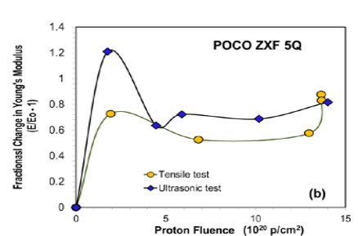
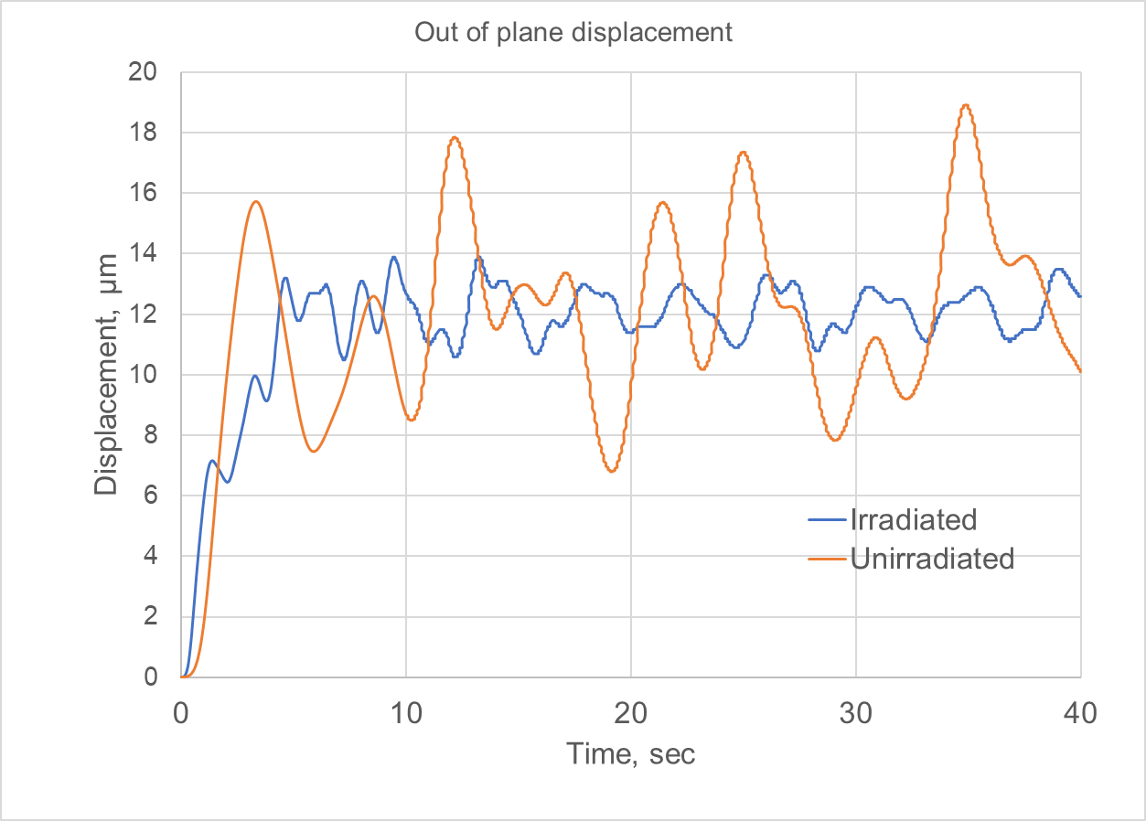
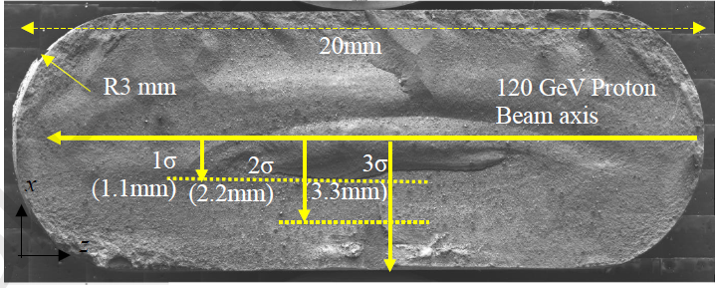
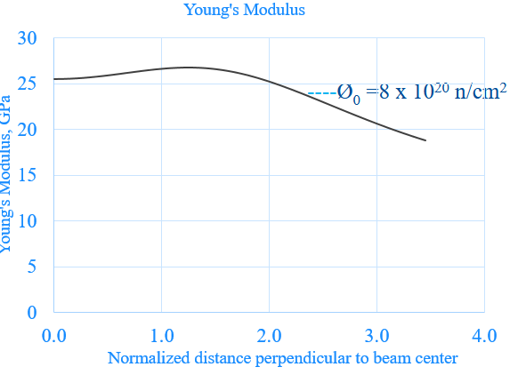
LDV for in-situ target health monitoring
NTO2 Target Fin
Transient thermal-structural analysis
There is clear change in frequency and magnitude of displacement

Slide 11
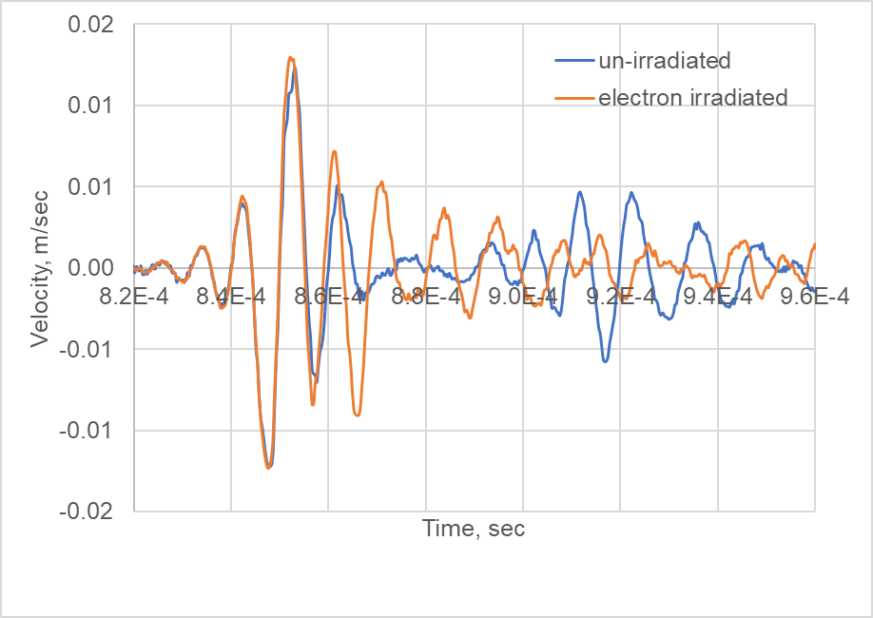
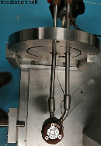
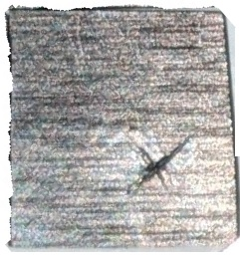
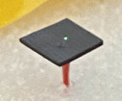
LDV on electron-irradiated graphite
Electron Irradiation at SIRIUS (Ecole Polytechnique)
Energy : 2.5MeV
Fluence: 3.4x10¹⁹/cm² ~0.017dpa
Irradiation area : 19x19 mm
LDV Measurement by Polytec
Excitation : 100 kHz
Piezoelectric at bottom
10mm
There is a difference in amplitude and frequency of LDV velocity due to electron irradiation

Slide 12
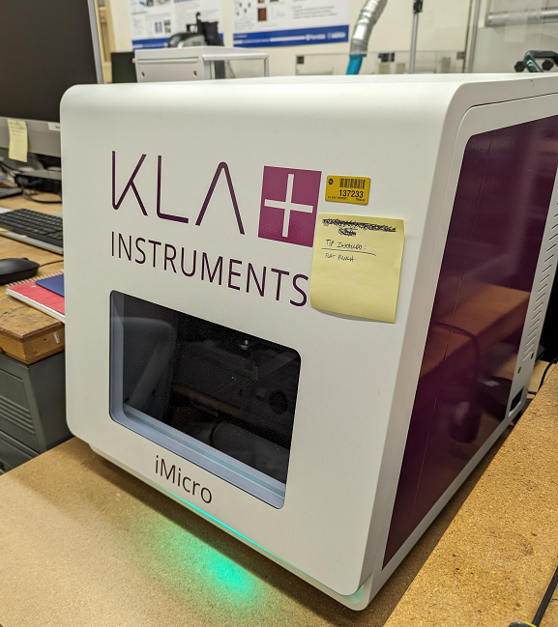
Nano-indenter
1000 mN load
Continuous Stiffness measurement (CSM) → E/H Vs Thickness
High strain rate indentation upto 1e4 /sec
Stress-strain curve→ Determining yield strength

Slide 13
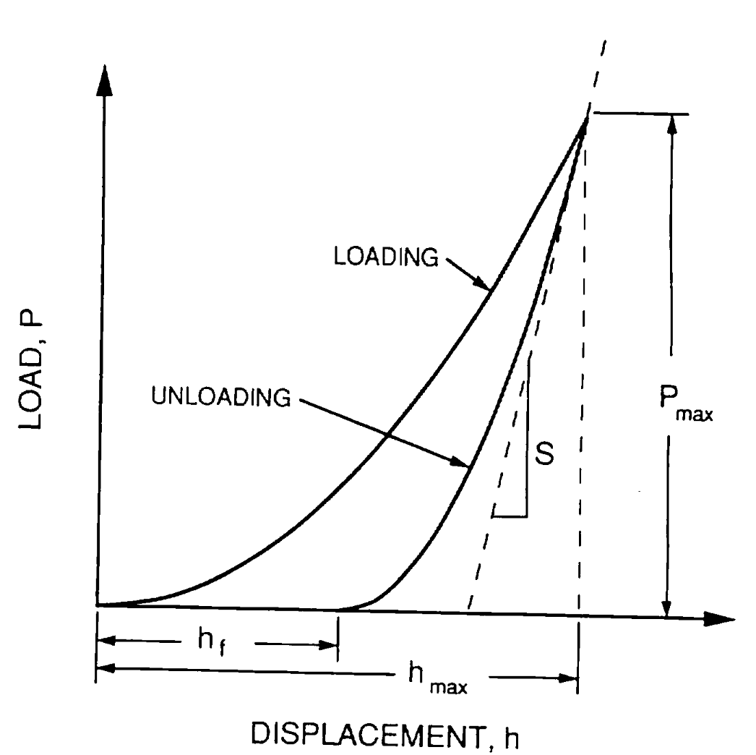
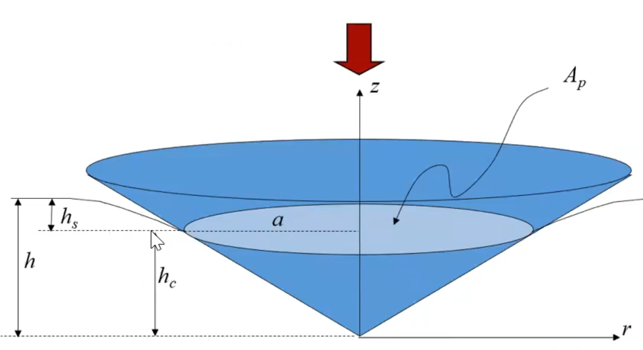
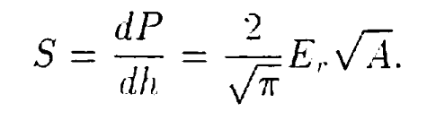
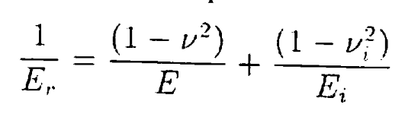
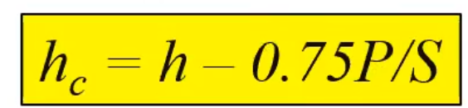
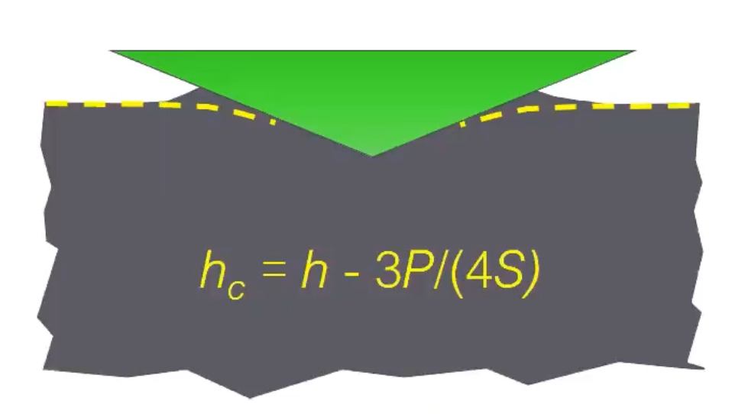
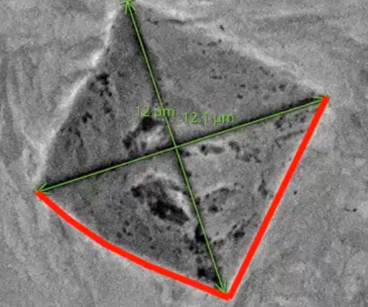
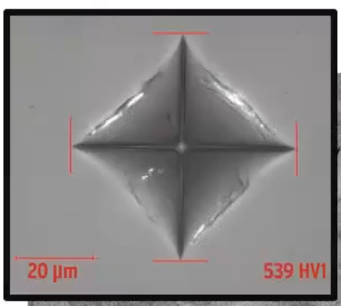
Nano-indentation- Young’s Modulus & Hardness
Surface deflection
Oliver Pharr⁺
S_{L}
S
Include only 0.8P_{max}
*Contact depth
H= P/Ap
Pile up
Sink in
Slope ratio S* = S_{L}/S
Degree of plasticity
0
0 : perfectly plastic
1: perfectly elastic
Error can be 15~20%!!

Slide 14
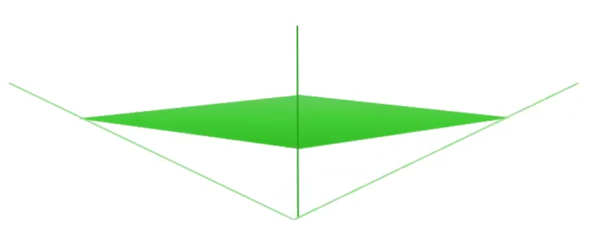

Nano-indenter- Nano Hardness Vs Vickers
Vickers
Force/ Surface Contact Area
Area Calculated from Optical measurement
Unit kg/mm2
Min indent diagonal >17µm
Operator bais
Nano-hardness
Force/ Projected Contact Area
Area Calculated from Load displacement
Unit Gpa
Can be small <100nm
More precise
Lateral contact surface
projected contact surface

Slide 15
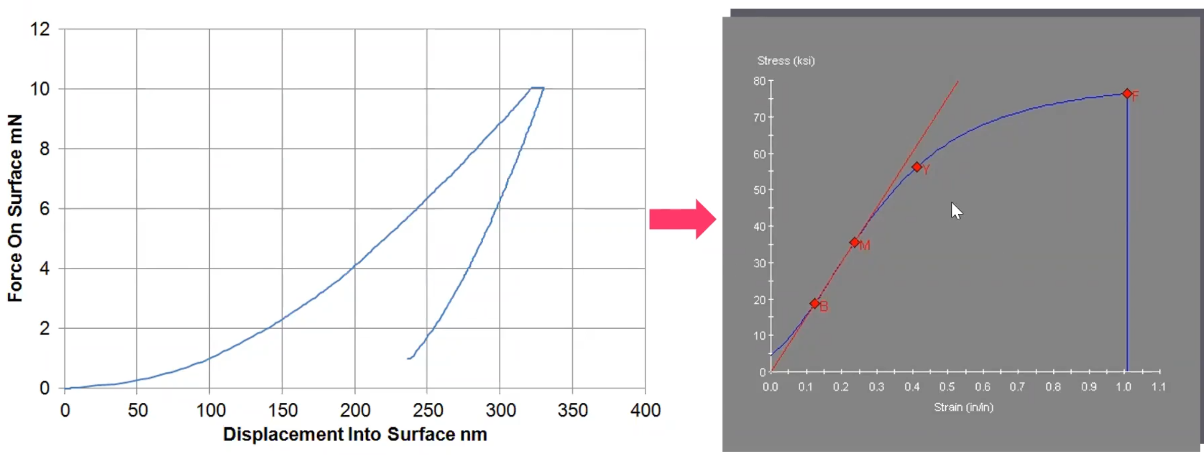
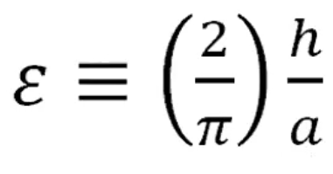
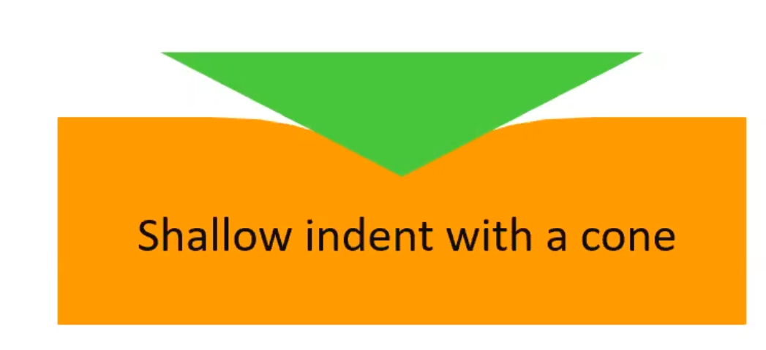
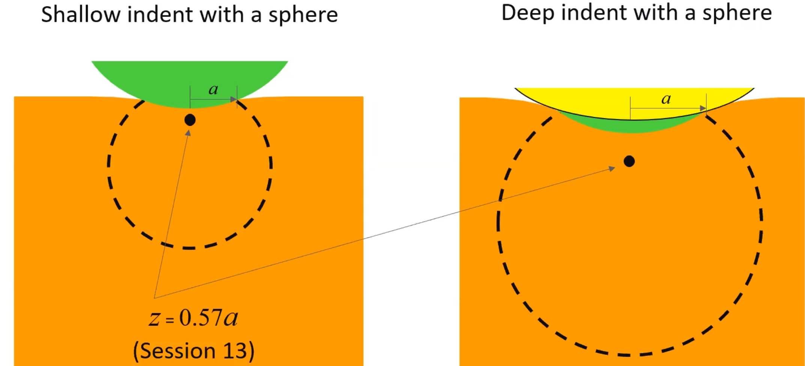
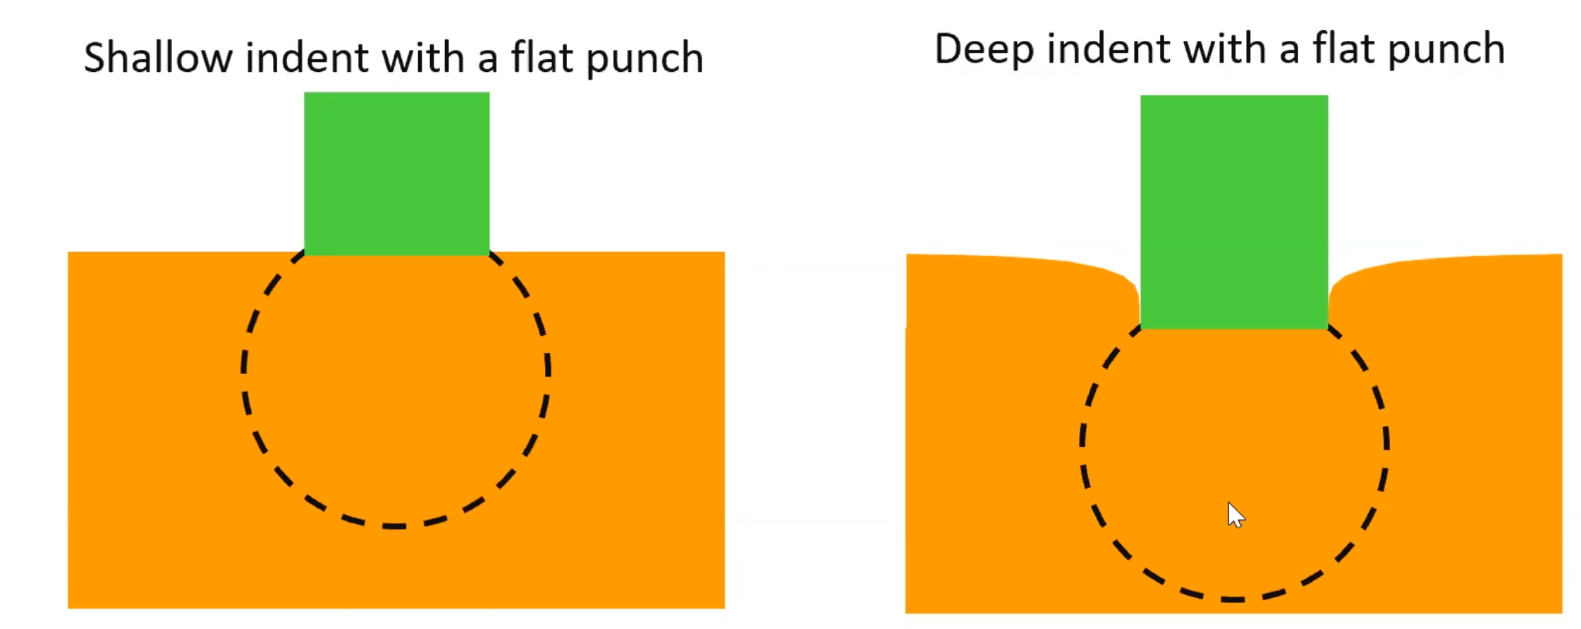
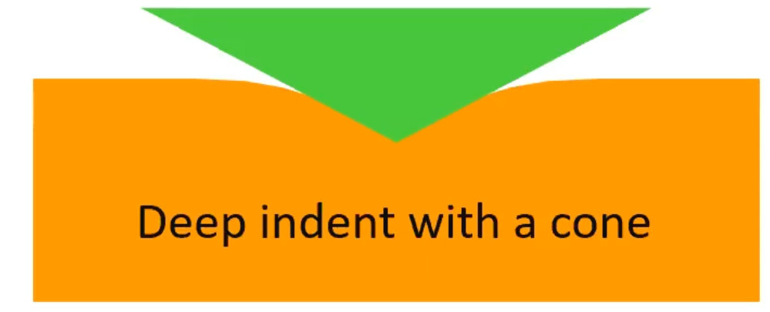
Nano-indenter- stress strain curve
Mean pressure σ_{mean}
Uniaxial stress σ
Scaling factor ς
σ = ς σ_{mean}
Sneddon’s model
Pyramidal (Berkowich )
Spherical
Flat punch
ζ_{max}
Affected volume scales with contact radius and grows during the test
Strain changes but affected volume stays constant
Strain doesn’t change.

Slide 16
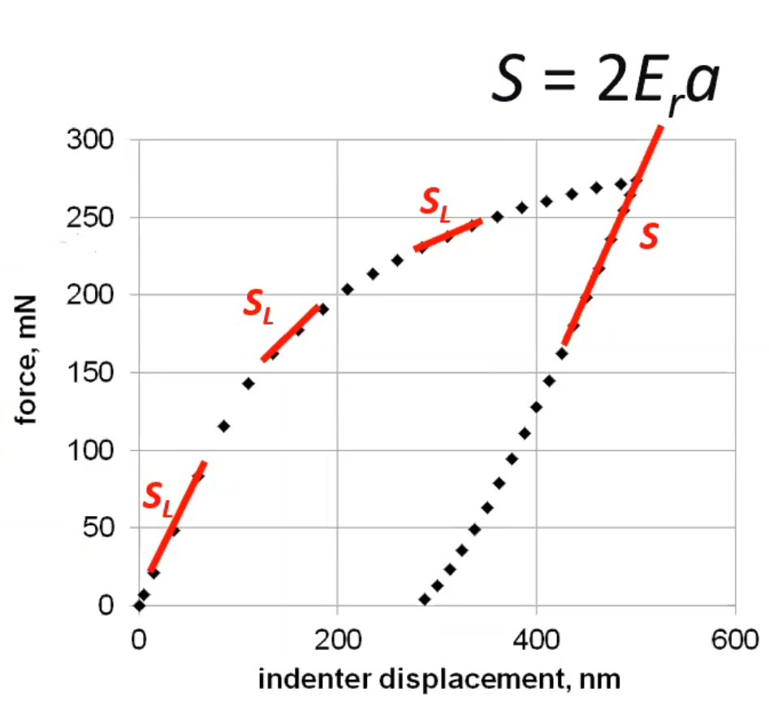
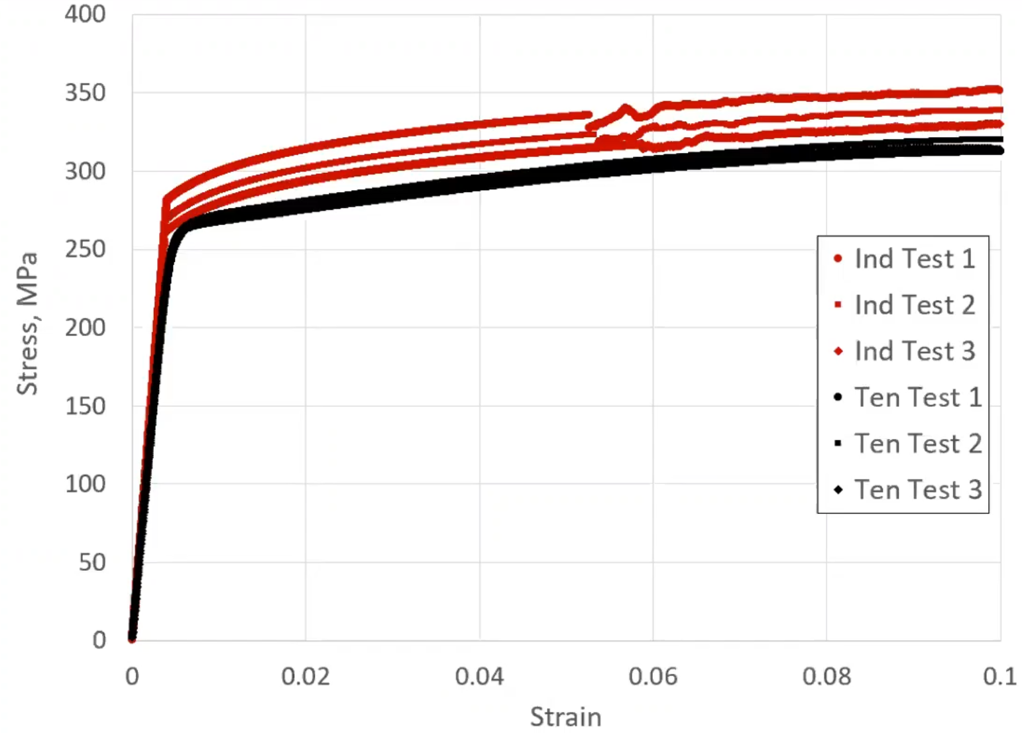
Nano-indenter- stress strain curve
Aluminum 6061
Full contact onset S=2E_{r}a
σ = Kε^{n}
σ_{y}
Flat punch
Extrapolate
Curve fit σ=kε^{n}
Modulus by Berkovich indenter
σ_{m} = mean pressure = P/contact area
Avoid substrate effect:
Punch radius < 0.2*thickness of interest
Over estimate→ size effect
May be accurate in micron size grain

Slide 17
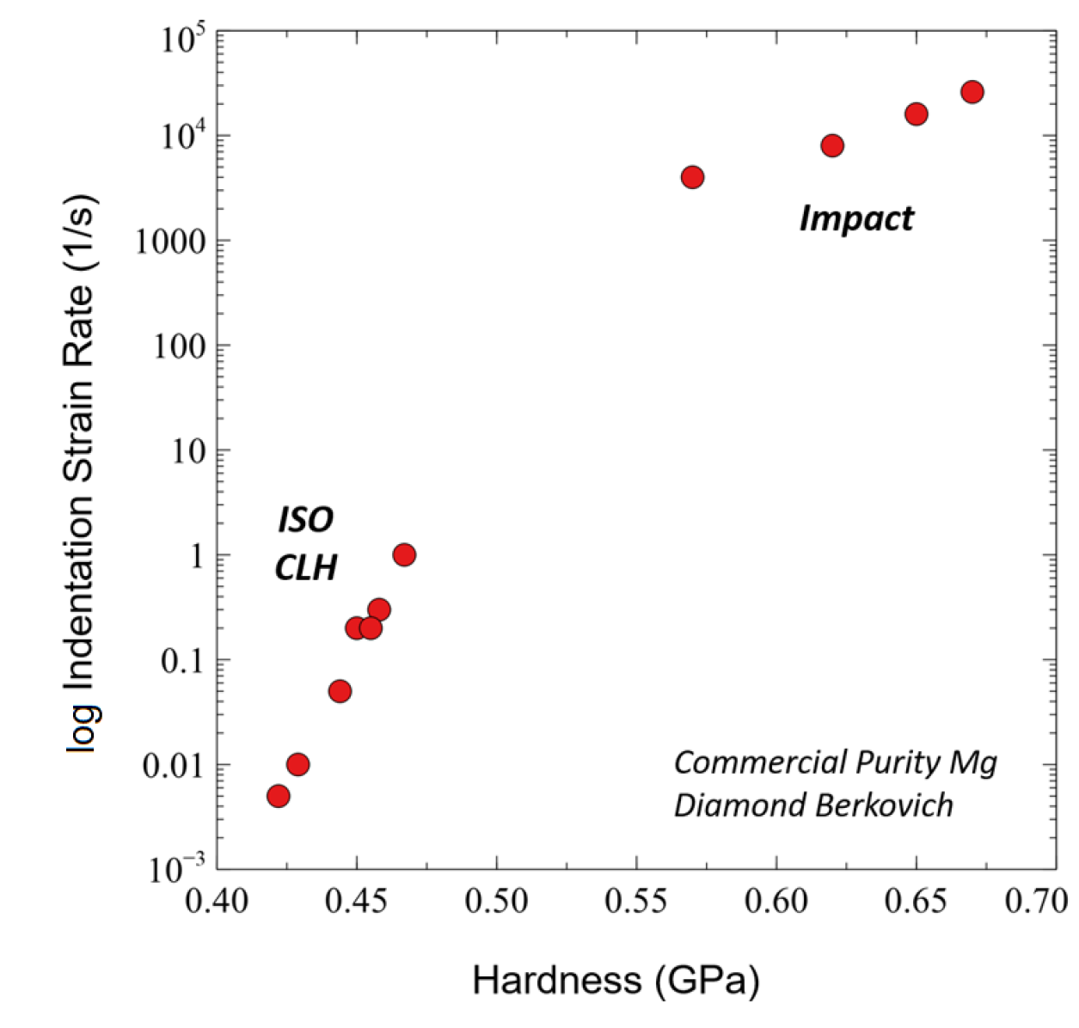
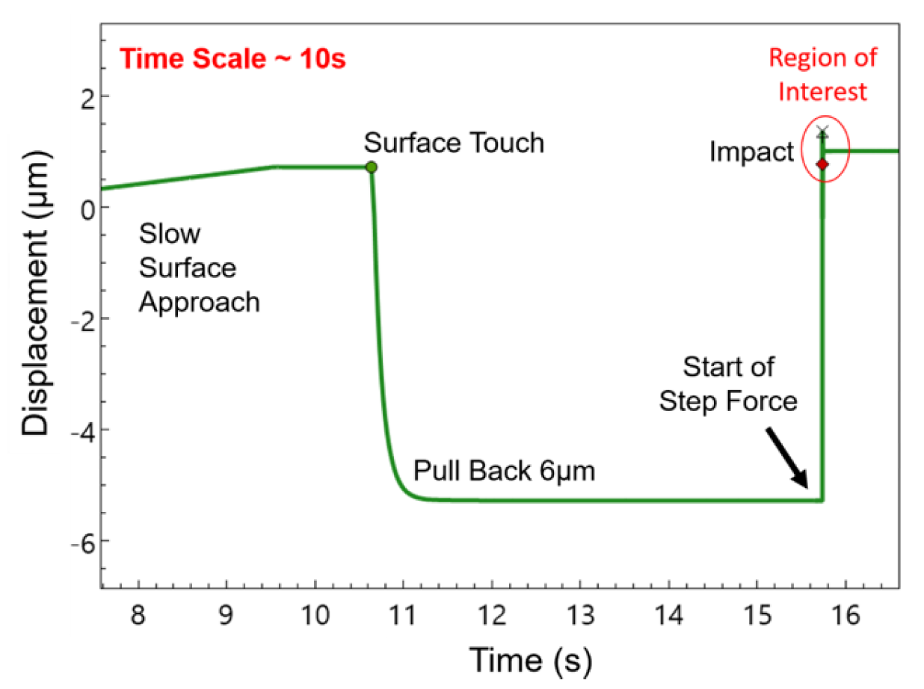
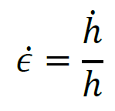
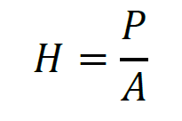
Nano-indentation- high strain rate
Beam induced strain rates are in order of 1000/sec.
Essential to test mechanical properties at these strain rates and mechanism of failure
Loading+unloading in ~100μsec
Failure mechanism is different in high strain rate events : Twinning Vs Slip

Slide 18
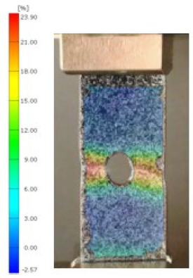



Digital Image Correlation (DIC) : strain measurement
Validation
Tensile tester
Avg strain 0.43%
Strain near hole 1.48%
K_{t}= 3.4
Specimen
Aluminum tensile sample
Strain distribution
Camera
Valid only for in-plane strain → thin sheets (plane stress)
Developing for full field 3D displacement using stereoscope camera set-up

Slide 19
Summary
Lab is equipped with some sophisticated instruments
Capability to explore thermal and mechanical properties of thin damaged layer
High strain rate dependent mechanical properties , comparable to beam induced strains, possible
Integrating new non-contact techniques (TGS, DIC,LDV) to evaluate radiation damaged properties

Slide 20
Thanks for your attention!

