Slide 1
HPTW 2023: New Cryogenic Helium Heat Exchanger for the ISIS Target Station Two Solid Methane Moderator
Mark Telkman
With thanks to Daniel Coates¹, Stephen Gallimore¹, David Jenkins¹, Alan Prothero¹, Domas Gerta
08/11/2023
ISIS Neutron and Muon Source, Harwell Campus, Oxfordshire, OX11 0QX, UK

Slide 2
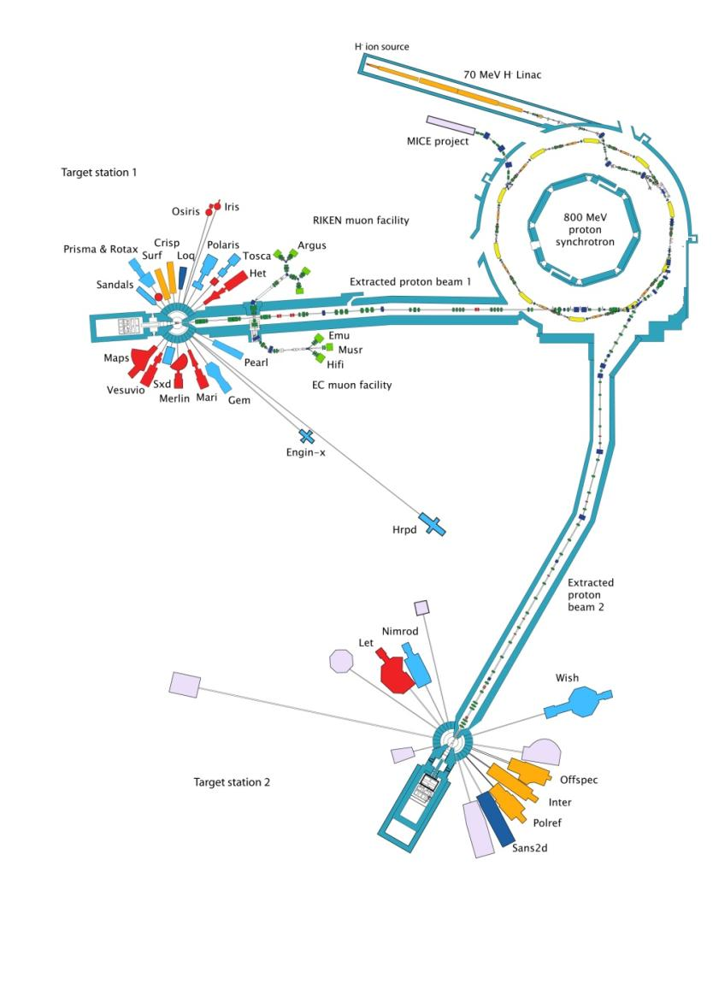
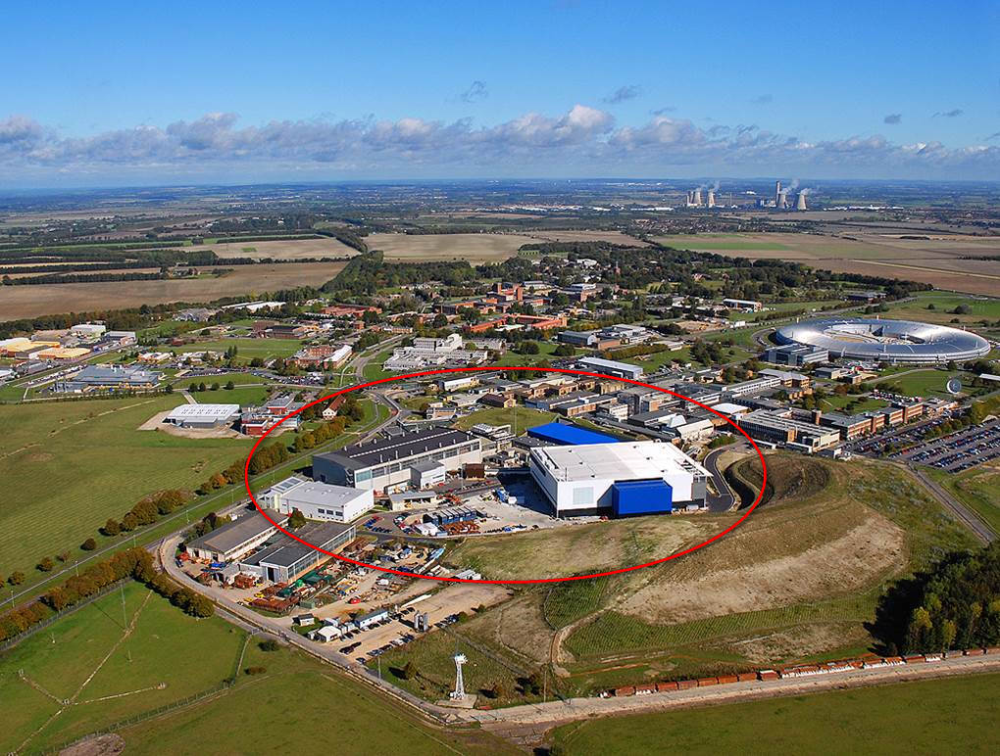

Slide 3
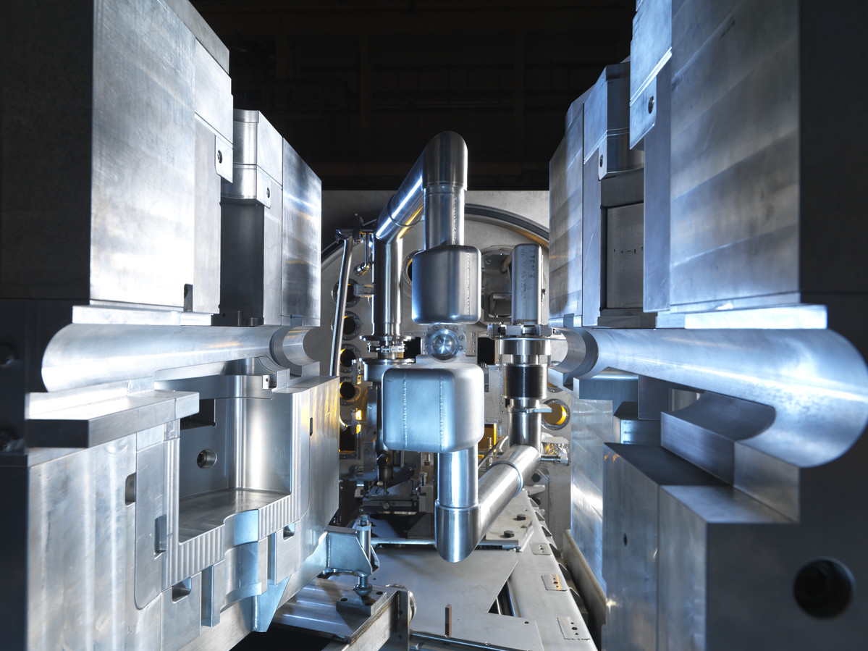
Target Station 2 Target, Reflector, and Moderators
Decoupled Methane Moderator
Target
Coupled Hydrogen Moderator

Slide 4
TS2 Methane Moderator
Methane-”pure” Al1199 foam composite
Bayonet connection to helium transfer line
8mm dia Helium Heat Exchanger (Al-1199) – brazed to foam
Shell (Al5083-AW-O)
4

Slide 5
TS2 Methane Moderator
Methane-”pure” Al1199 foam composite
Bayonet connection to helium transfer line
8mm dia Helium Heat Exchanger (Al-1199) – brazed to foam
Shell (Al5083-AW-O)
5

Slide 6
Why do we need a new heat exchanger for the solid methane moderator?

Slide 7
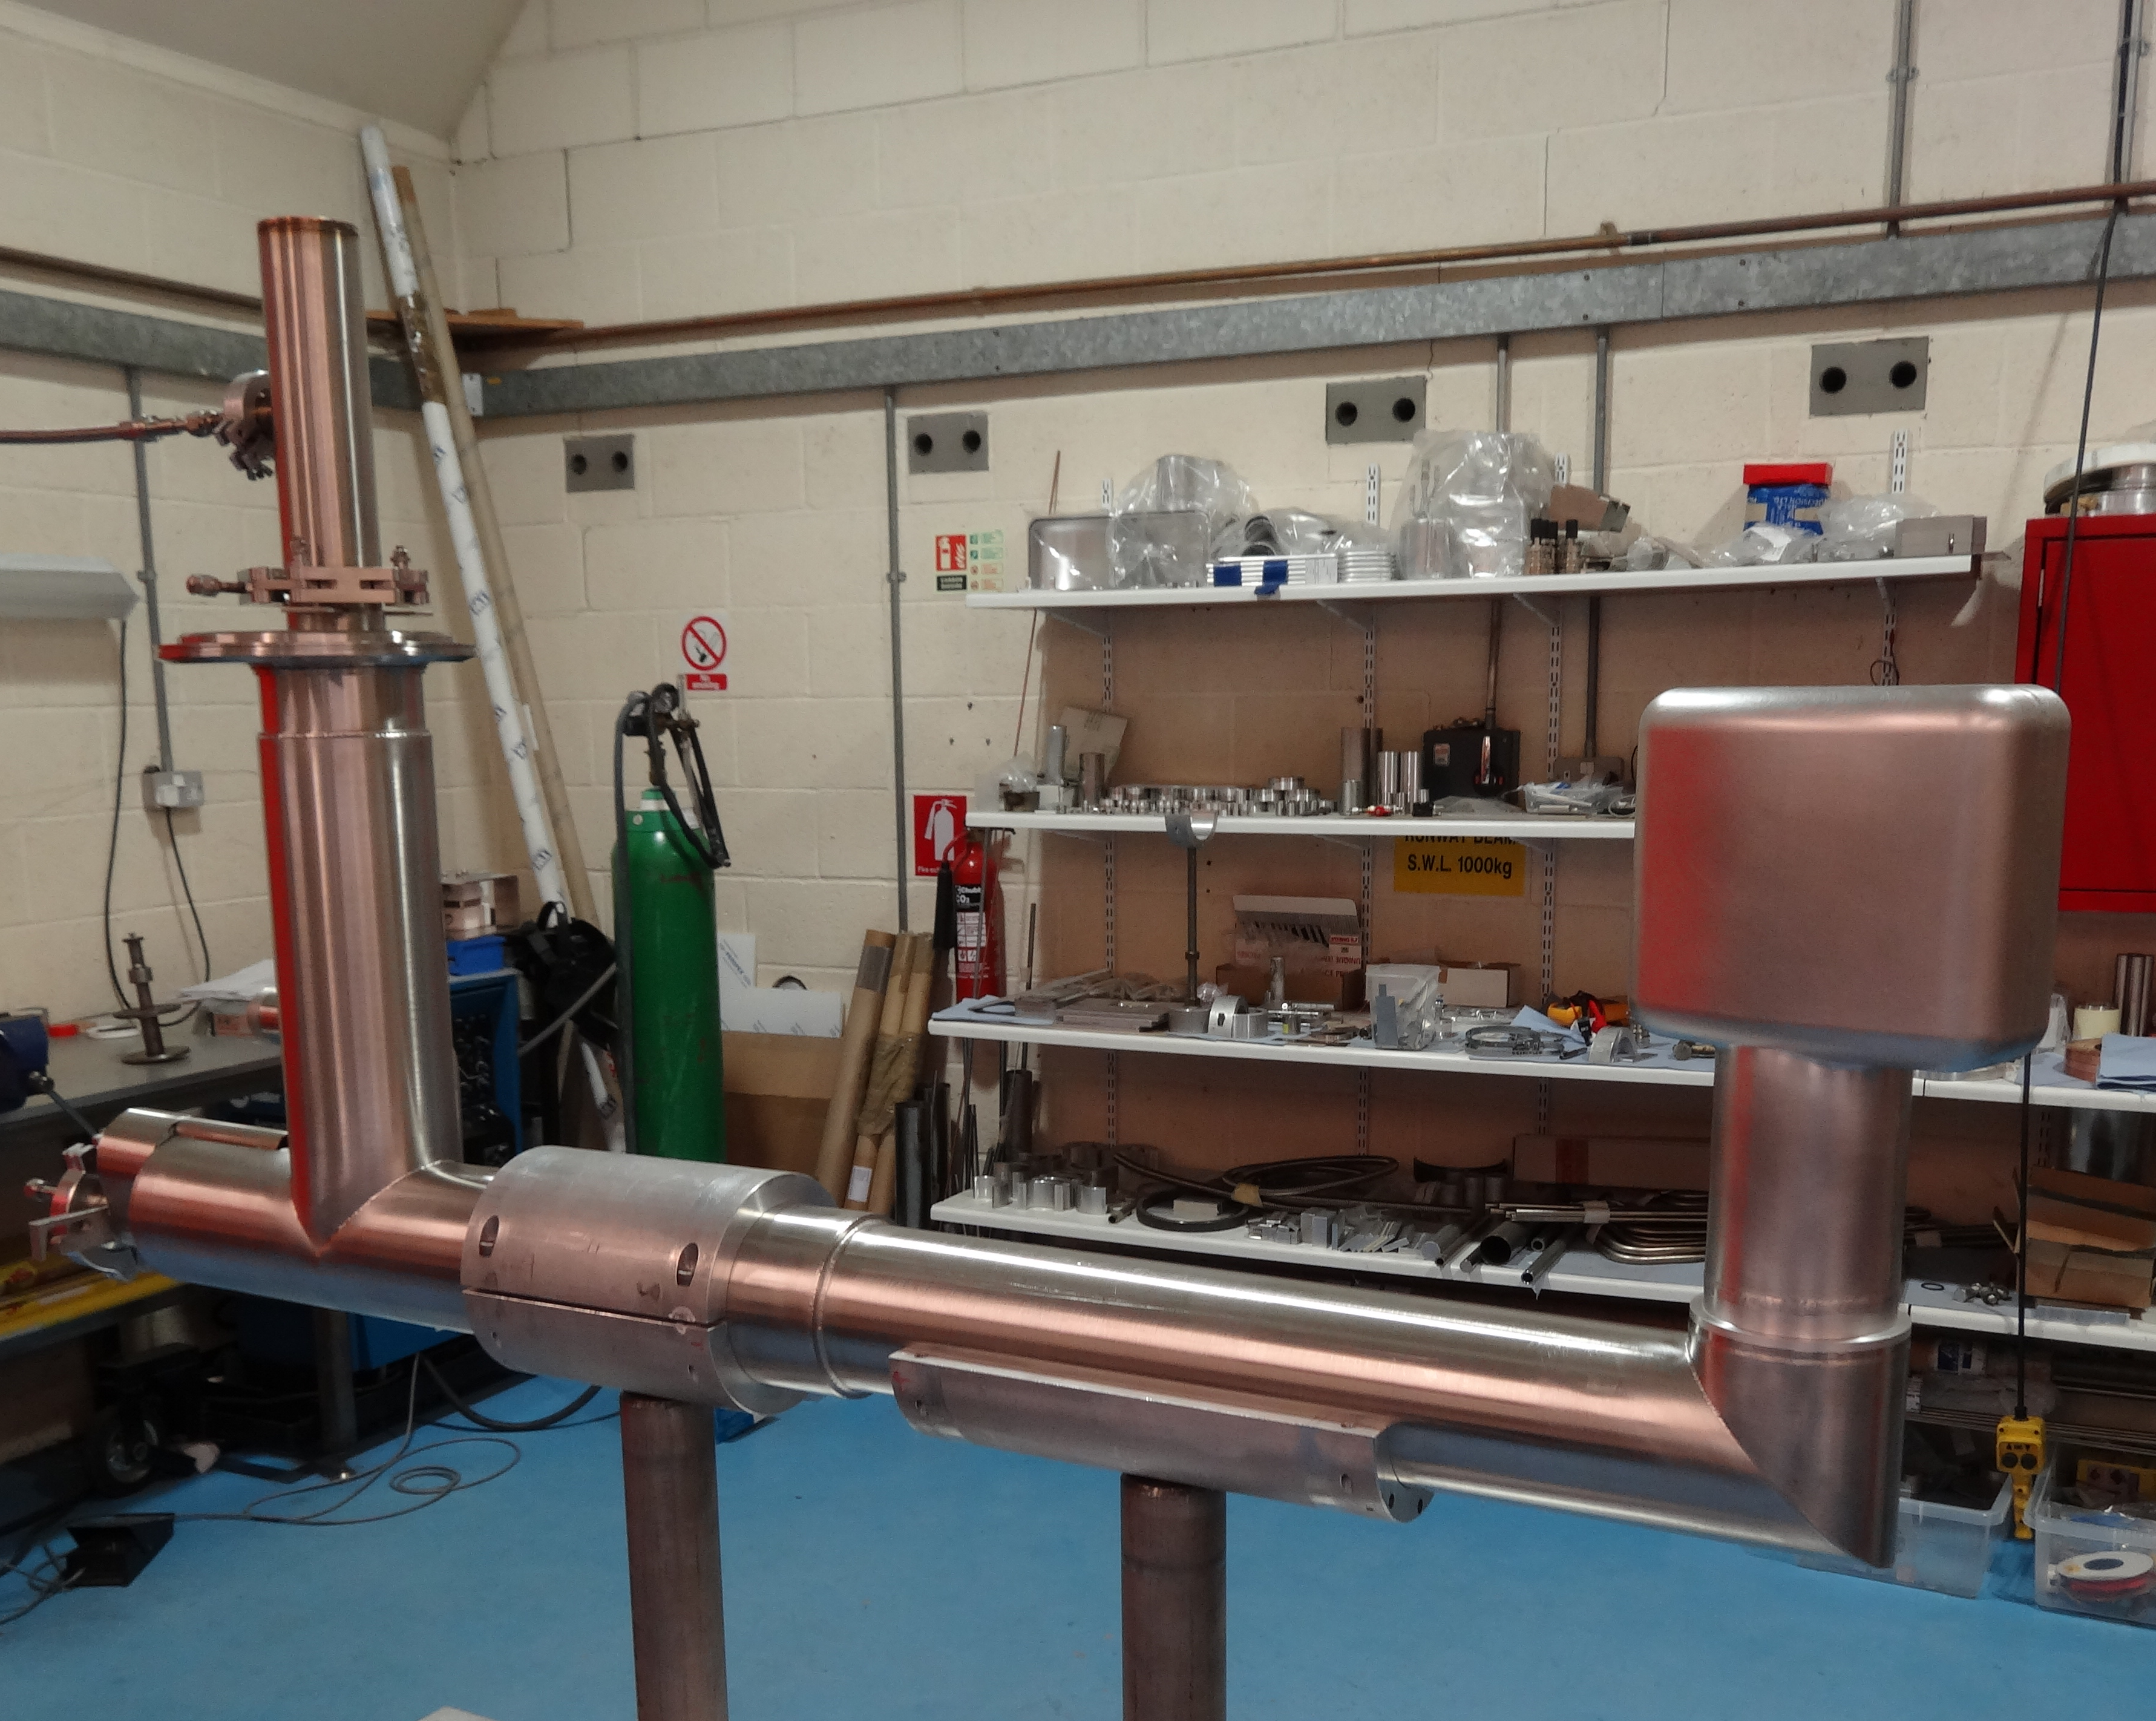
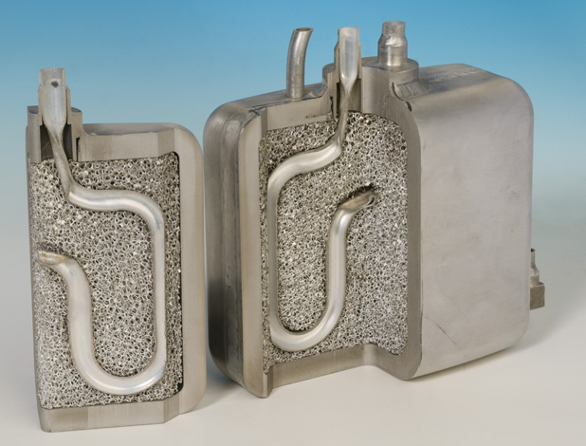
Current Solid Methane Moderator
Same thick-walled design since 2012 – 10 mm
35 bar pressure release on annealing
Charge change after 16 hours of operation – charge change time varies
Build-up of tar and other hydrocarbons - pressure “burp”
“Solid Methane Moderators: thermodynamics and chemistry” – O Kirichek et al, 2020
Cryogenic helium running at 7g/s, temperature starting at 25K, down to approximately 17K over life of moderator
Have capacity to increase mass flow rate to 26g/s
Moderator life maximum of two cycles – using 5 moderators every 2 years
Methane temperature ranges from 45k to 65K over lifetime
Uses pure aluminium foam to improve thermal conductivity
7
Notes:
Study showed that the pressure release from the methane is directly proportional to neutron radiation and irradiation time. Limited to 16 hour run time, with the pressure measured being 35 bar at this point – resulting in the need for a 10 mm vessel wall. The paper “Solid methane moderators: thermodynamics and chemistry” by O Kirichek, CR Lawson, GL Draper, DM Jenkins, DJ Haynes, and S Lilley, explains this in greater detail - https://epubs.stfc.ac.uk/manifestation/47786619/STFC-AAM-2020-060.pdf

Slide 8
Moderator Upgrade Specification
Increase mass flow rate through the heat exchanger by reducing the pressure drop
Include a gadolinium foil in the new design – additional beamline looking at the opposite side of the moderator
Improve overall cooling – increasing mass flow rate but also increase surface area for heat exchange
This design is likely to be first step toward improvement – it will be iterated based on performance
8

Slide 9
First Idea

Slide 10
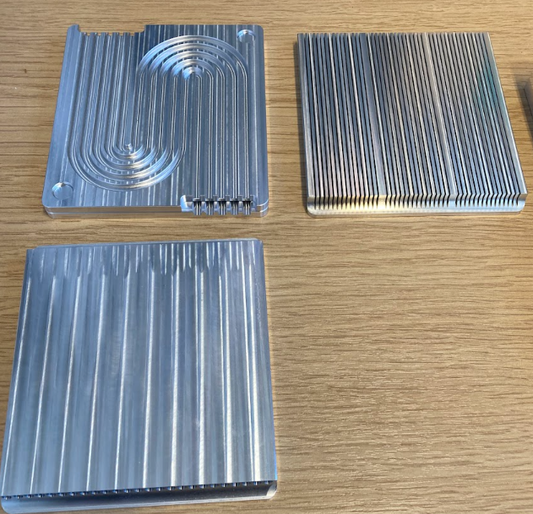
First design
Heat exchanger (HEX) holder part of the shell -also made from Al 5083-O
does not make shell stronger, therefore remains same thickness
HEX Insert electron-beam welded into the holder
Can change HEX design without changing the casing/shell design
Opened inlet to allow for more flow
Helium “shower” flows vertically downward and back up the outside red tube
Large p-drop through pipe
Flow tests performed on three different designs
All three based on increasing surface area without increasing pressure drop
10

Slide 11
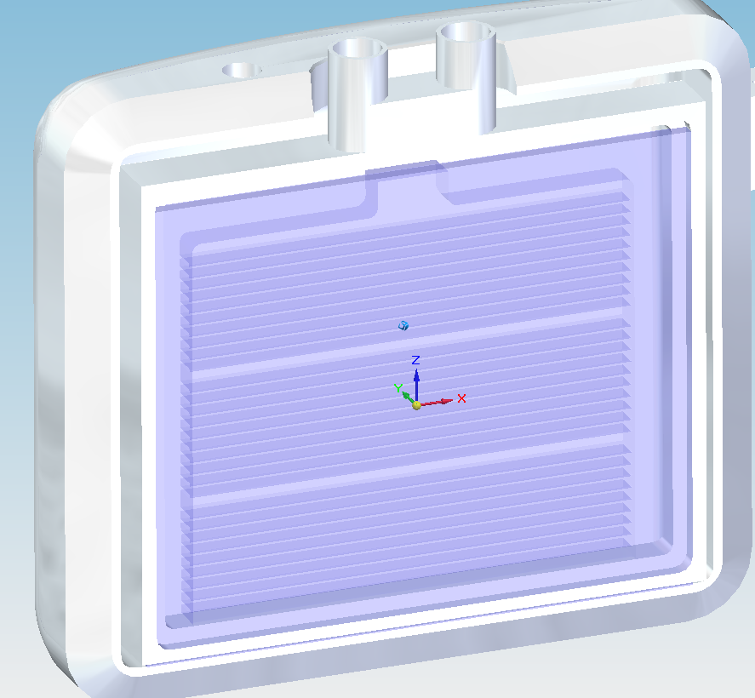
Reducing Pressure Drop…
Plate HEX rotated 90 degrees
NO longer have tube around the outside with sharp bends
Added thicker ribs for stake welds through the heat exchanger casing
No longer part of the outer shell
HEX case collar not changed; therefore, the shell design can remain the same.
Still have restricted inlets – how do we open these up?
11

Slide 12
Computational Fluid Dynamics – Material data
Gaseous Helium
Taken from the NIST database
https://trc.nist.gov/cryogenics/fluidProperties.html
Assumed 2 bar, 25 K
Solid-Methane & aluminium-foam composite (pure Al 1199)
Not much data!
Some historical experimental data on solid-methane
Rule of mixtures – foam is 10% density
Thermal conductivity is debatable! Dependent on contact between heat exchanger and foam.
Lowest value taken for CFD
Helium - Temperature = 25 K
Pressure | 2 bar
density (kg/m3) | 3.85
thermal conductivity (W/m.K) | 0.03
specific heat (J/kg.K) | 5258.10
viscosity (Pa.s) | 4.16E-06
Solid Methane-Al foam composite
density (kg/m3) | 496.5
thermal conductivity (W/m.K) | 5 - 20
specific heat (J/kg.K) | 1164
12

Slide 13
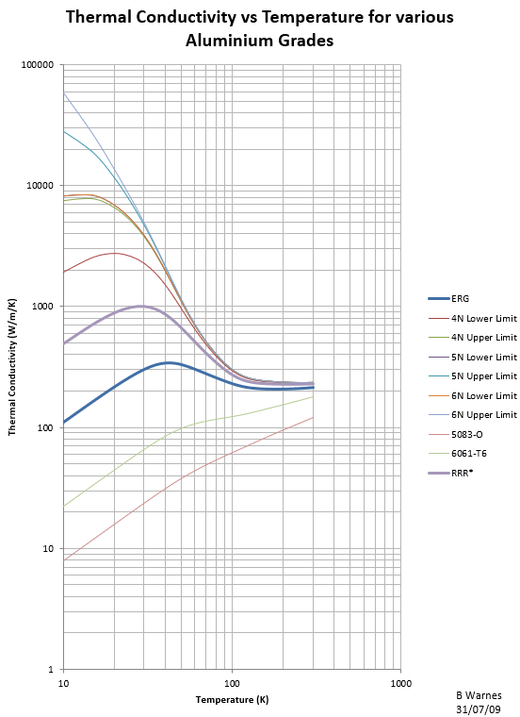
ISIS Foam Measurements
13

Slide 14
Baselining – Current Moderator
14

Slide 15
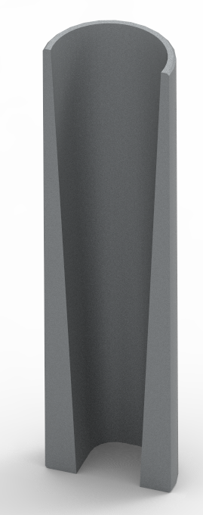
Design Optimisation
Inlet and outlet pipes
FWJs
Heat exchanger (Al5083-O)
Shell (Al5083-O)
15
Notes:
10 channels – bottom 8 are 5mm wide, then 6 mm, then 7mm. Ribs are 1mm thick.
Inlet and outlet pipes have smooth transition from 14mm diameter transfer tubes to 7x14mm rectangular cross section into the heat exchanger, allows for power pressure drop than offered by the current HEX (see next slide)
Guide vanes there for structural support (stress concentrations seen at weld sites under 35 bar pressure). Geometry of vanes optimised for flow direction.

Slide 16
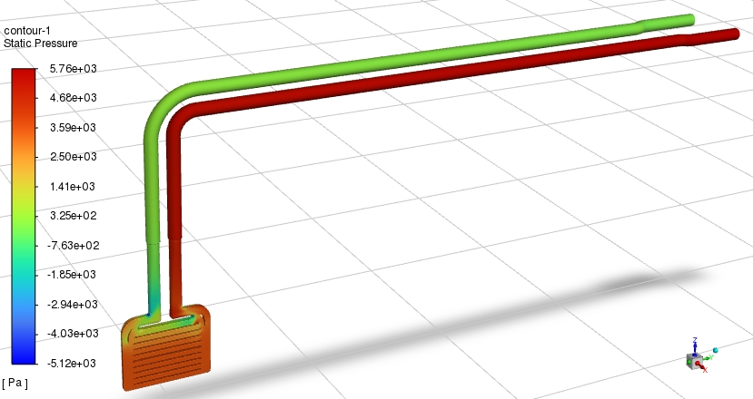
Fluid only – pressure drop CFD analysis
Current HEX:
Flow = 7 g/s
New HEX: Flow = 10 g/s
16

Slide 17
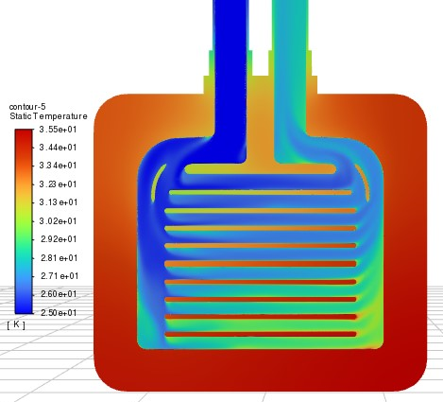
Conjugate Flow-heat transfer analysis
17
Notes:
At centre of moderator, methane temperature varies from 32 K to 35 K – good gradient.
Limitations – flow at the bottom is not optimal and would need refinement in the next iterations. Heat generation is assumed equal across the moderator, whereas the heat is from the target below – we would likely need more cooling at the bottom for a truly optimal gradient.
Need fluka/MCNPX data of heat generation in moderator for better idea of heat distribution across moderator.

Slide 18
Manufacturing Trials
18

Slide 19
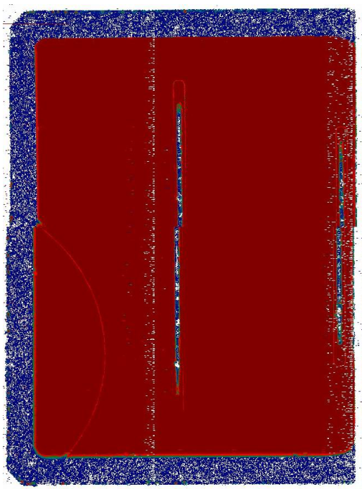
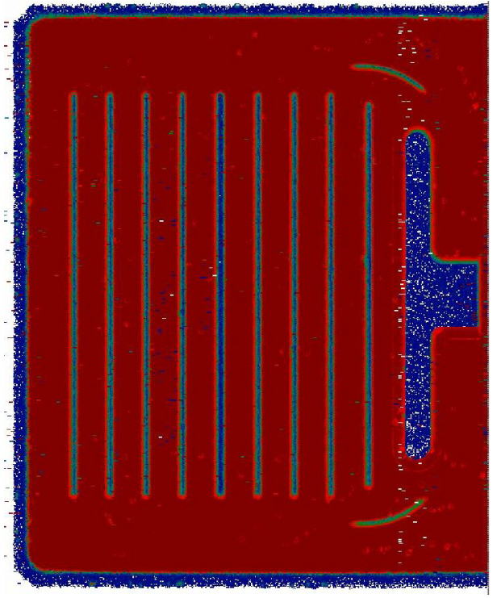
Electron Beam Welding – Manufacture and Ultrasound NDT
= Very good weld
= Very bad/no weld
Stake welds
Perimeter weld cross-section
Perimeter weld
19

Slide 20
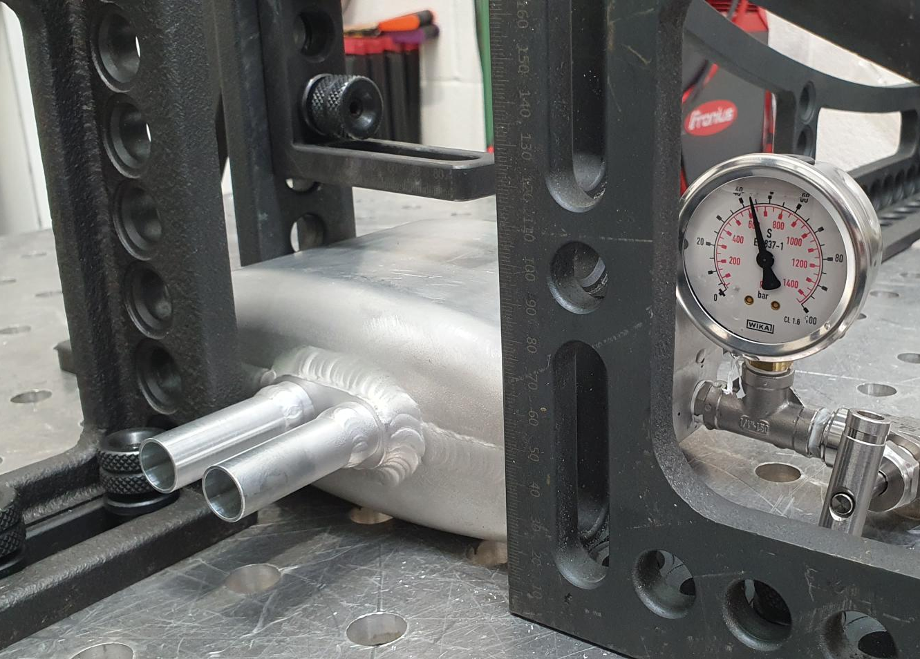
Pressure Vessel Welding & Pressure testing
20

Slide 21
Proposed Design
21

Slide 22
Any Questions?

Slide 23
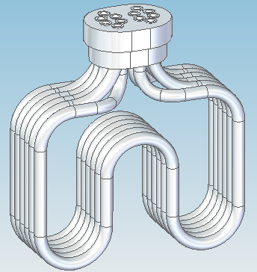
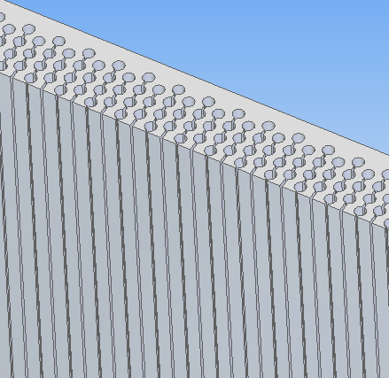
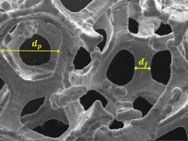
Early work
Pipe heat exchanger
Diffusion bonded (DB) plates
Spark eroded channels EDM drilled or wired
Foam as heat exchanger

Slide 24
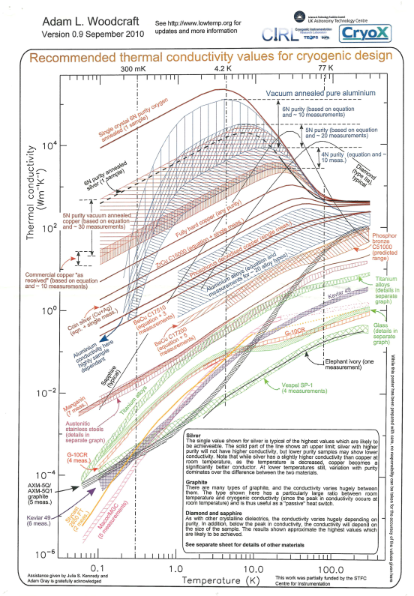

Slide 25
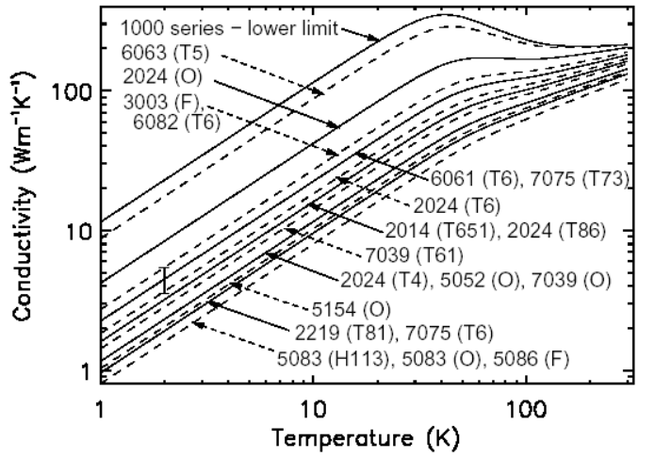
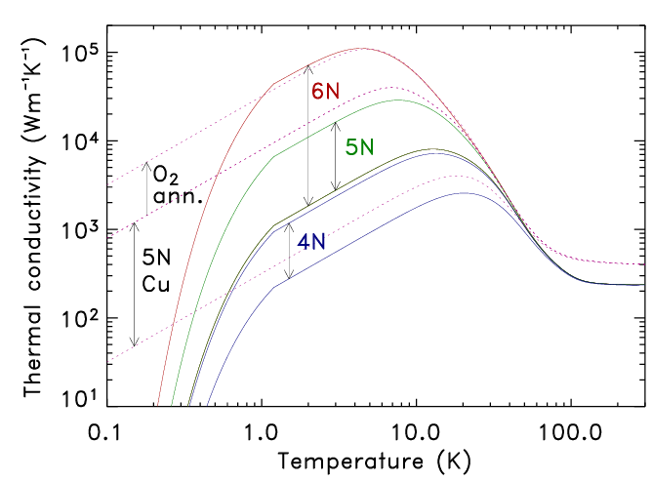
Pure Aluminium versus Al Alloys

