Slide 1
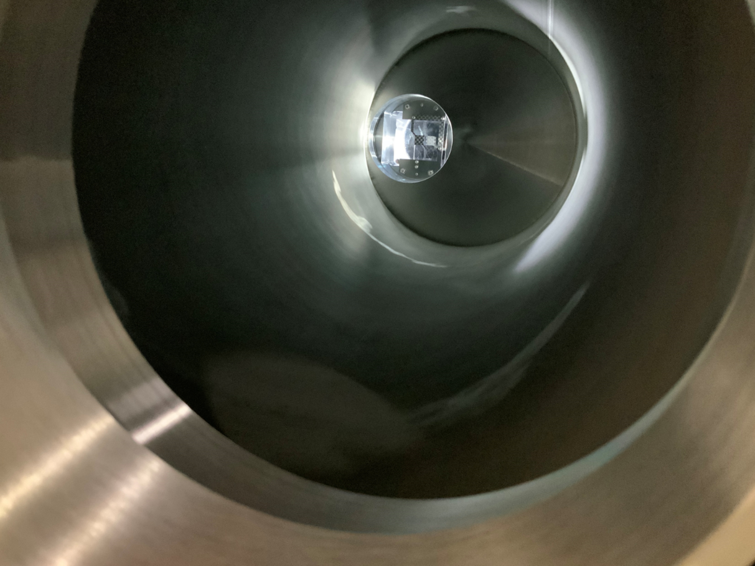
Present design status of
COMET target at J-PARC
High power targetry workshop 2023
at riken on 8th nov. 2023
J-PARC, KEK
Shunsuke Makimura
COMET Phase alpha target from pion transport beamline

Slide 2
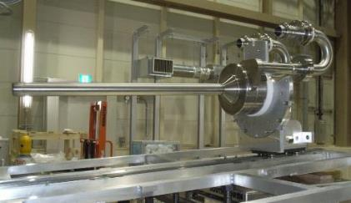
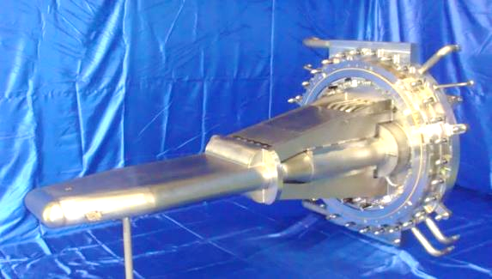
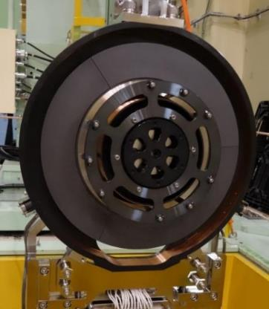
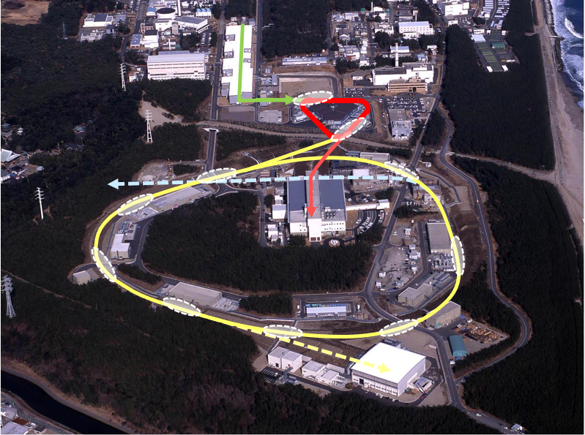
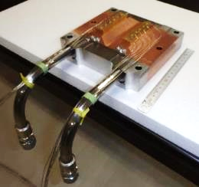
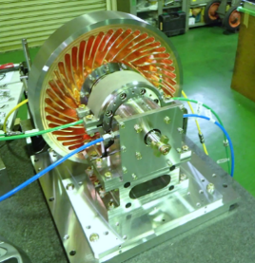
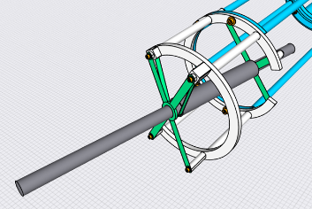

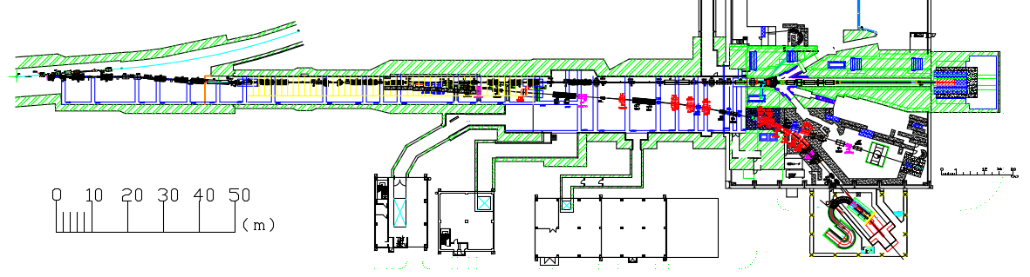
COMET target at J-PARC
Neutrino [ν]
He-cooled graphite
Neutron [MLF]
Liquid Mercury
Hadron [HEF]
Water cooled gold/ high-Z rotating target
Muon [MLF-MUSE]
Rotating Graphite
J-PARC Main Ring
Graphite (P1), W (P2) [COMET]
South experimental hall in Hadron facility
2

Slide 3
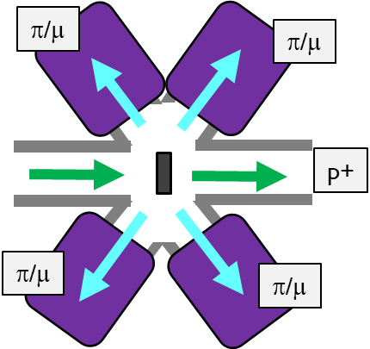
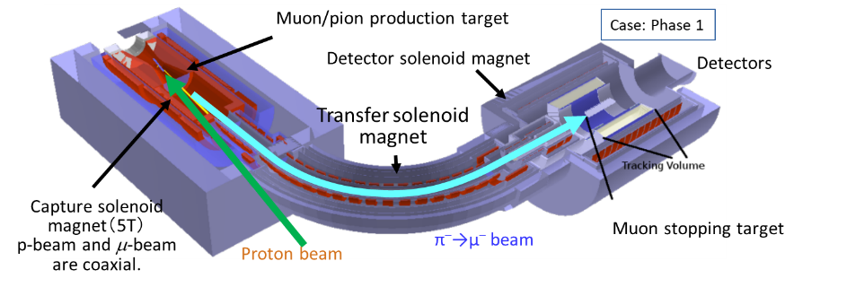
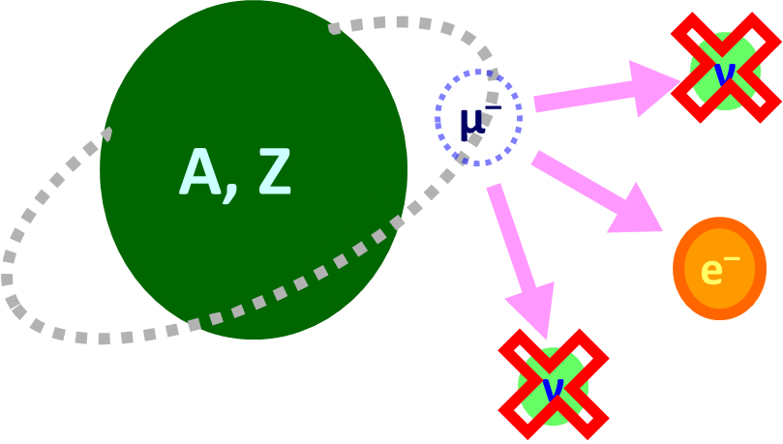
COMET target & MLF muon target
( MLF: Materials and Life Science experimental Facility )
COMET facility: Y. Fukao
Oral session
 | MLF target (Conventional) | COMET P1 | COMET P2
Proton beam | 3 GeV, 1 MW | 8 GeV, 3.2 kW | 8 GeV, 56 kW
Beam sigma | 3.5 mm | H: 2.3 mm, V: 2.3 mm | (H: 2.3 mm, V: 2.3 mm)
Target material | graphite | graphite | Tungsten
Target thickness | 20 mm | 700 mm | 160 mm
Beam loss on target | 3.3 kW | 110 W | 7 kW
Time structure | 25 Hz, Double Pulsed, 110 ns | 0.5 s. extraction in 2.5 s. | -
COMET target: Search for mu-e conversion
Located in high magnetic field to transport as large number of pions/muons as possible. Large Acceptance. Difficult to disperse the beam loss.
MLF muon target:
Multipurpose use

Slide 4
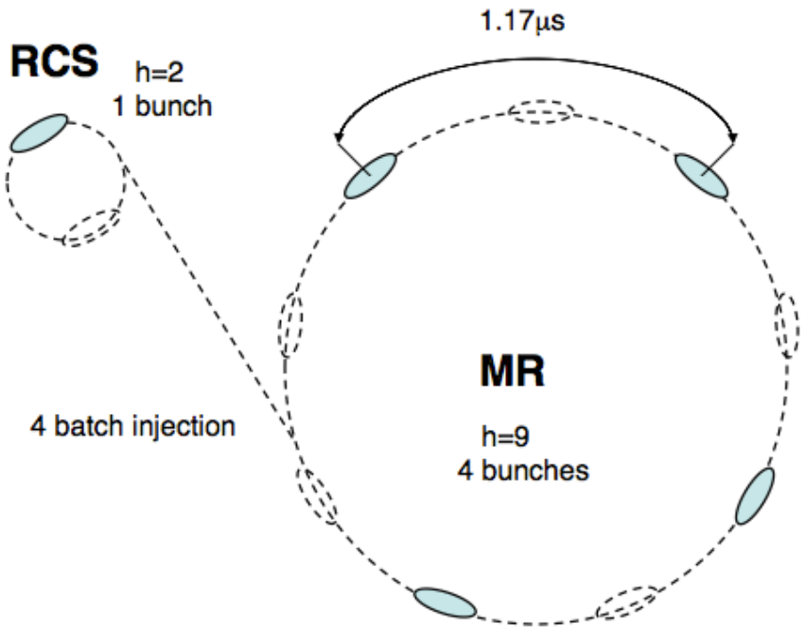
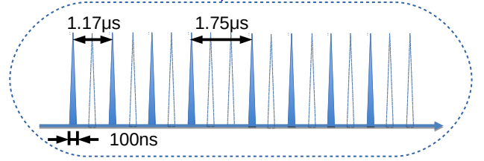
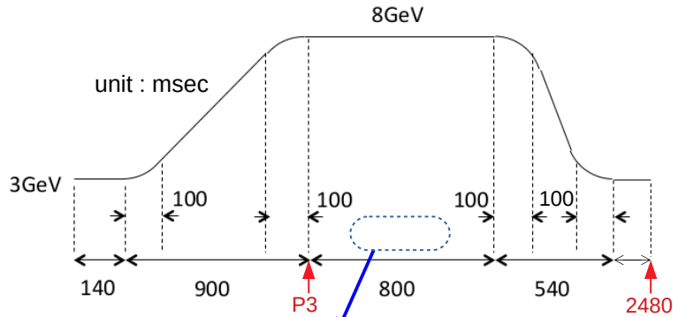
Time structure in COMET Phase 1
Case: COMET Phase1
energy | 8GeV
power | 3.2 kW
proton / bunch proton / spill | 1.6 x 10⁷ 6.2 x 10¹²
cycle extraction | 2.5 sec. 0.5 sec.
J-PARC
Bunched Slow Extraction
2.5 s
Extraction: 0.5 sec.
P-Intensity (a.u.)
0.5 s
Time (s)
Case: Phase2
Proton beam intensity: 56 kW

Slide 5
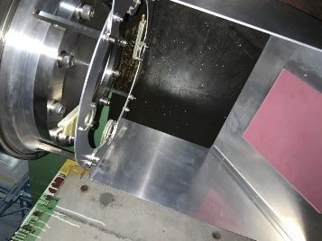
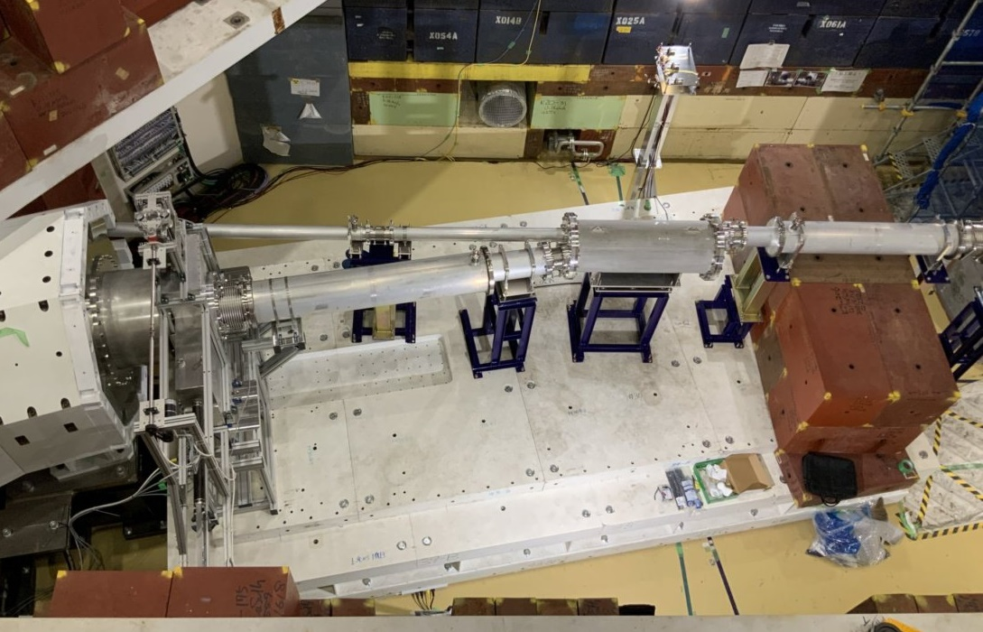
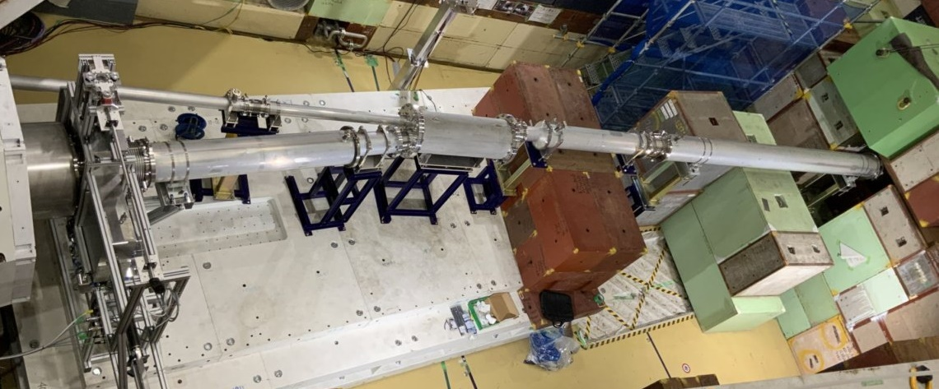
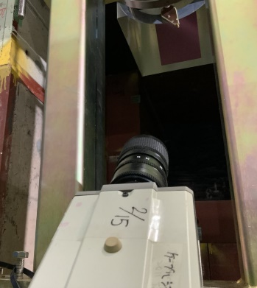
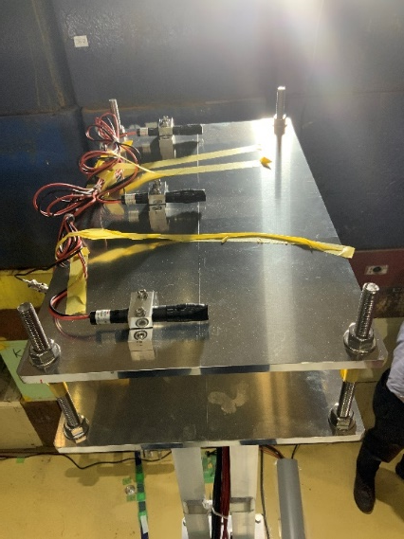
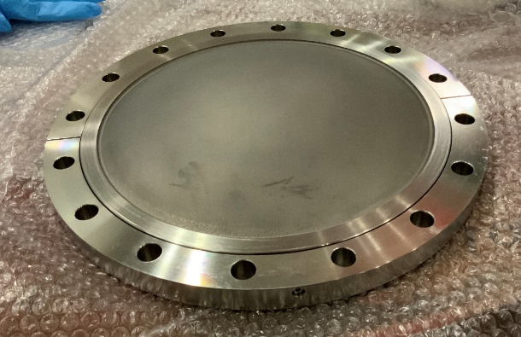
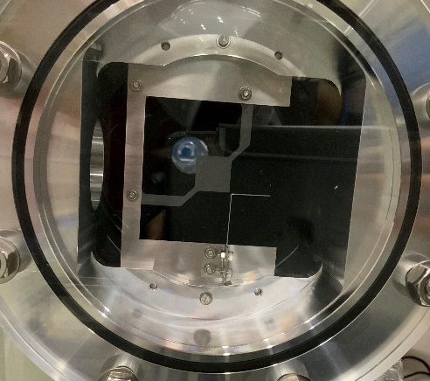
Engineering Run: Phase alpha
Operation in Feb. 2023
Transport of Proton beam w/o the capture solenoid magnet
Studies for secondary particles transport & detection
Extinction monitor & beam window
Phosphor plate & imaging tube camera
3D-printed beam window
Y. Nagasawa in poster session
Pi - production target
C/C composite, t=1.1 mm
Beam loss monitor
Coincidence measurement

Slide 6

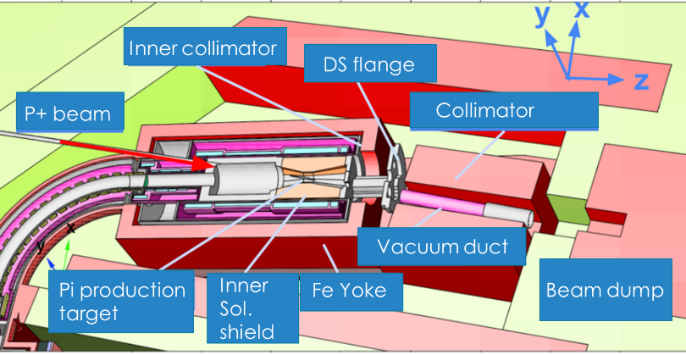
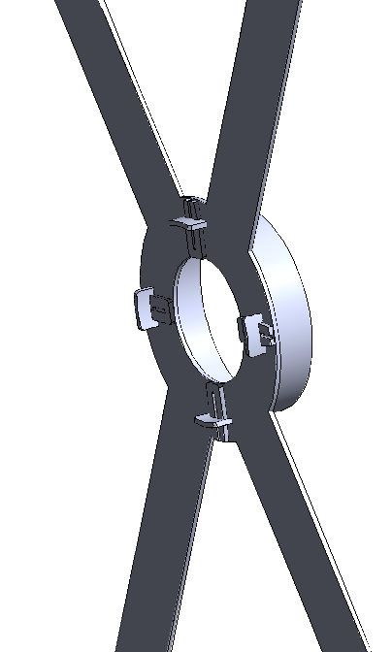
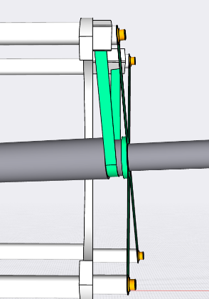
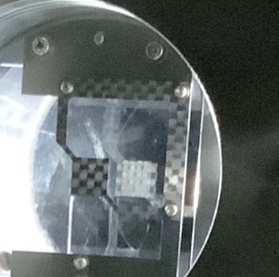
Pion production target for phase 1
The objective is to collect as many muons as possible.
Graphite rod, L=700 mm, is floating on the center of superconducting solenoid magnet.
Target support
Should not disturb the pion transport
Will be irradiated by proton beam
Material & Structure
Refractory material
Not-bulk material
Low-density is preferable
C/C composite
SS304, 64Ti, Inconel
Reinforcement of target support for the axial direction
Manufacturing of target support by C/C composite
6

Slide 7
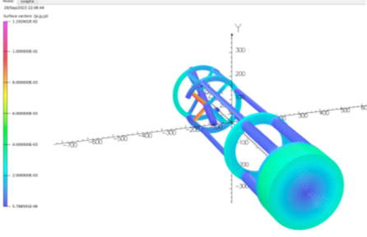
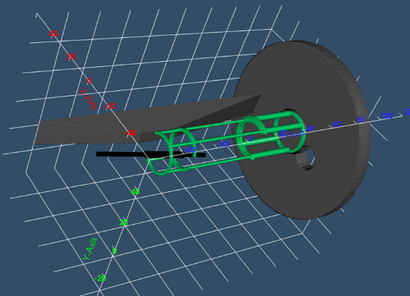
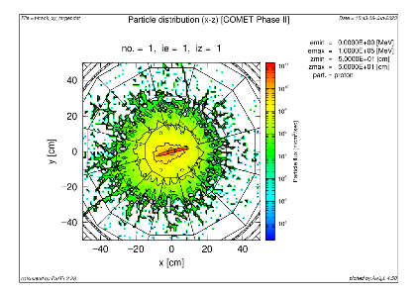
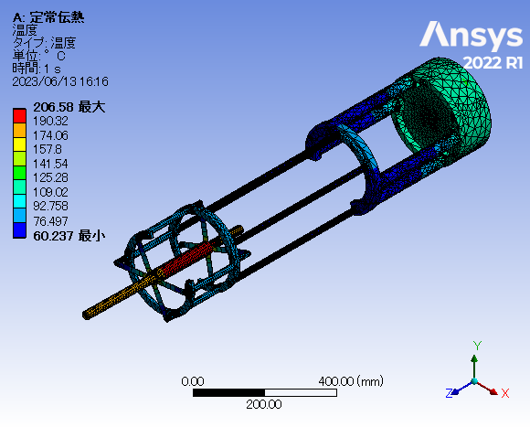
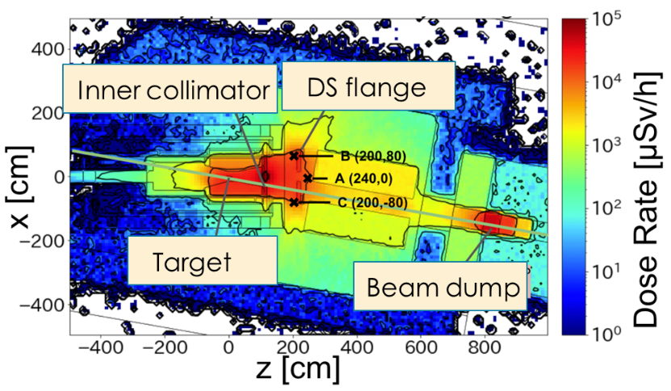
Dose analysis, Thermal analysis & Eddy current analysis
Proton distribution on upstream view
Eddy current analysis when the quench occurs by Sumi in Cryogenic section
Max. temperature: 200 °C
PHITS & ANSYS simulation by Metal technology Co., LTD.
Residual radiation dose analysis by Kyusyu University
7

Slide 8
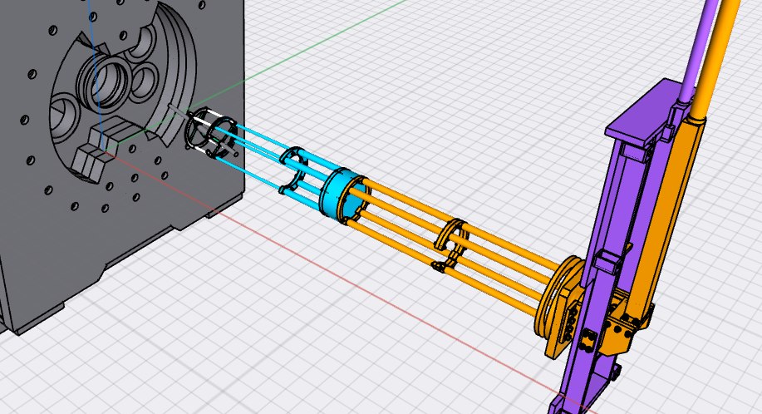
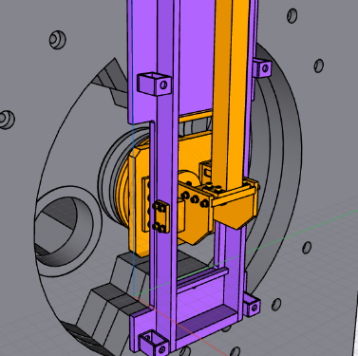
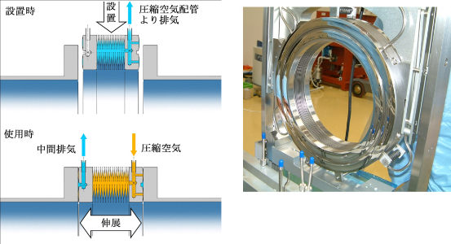
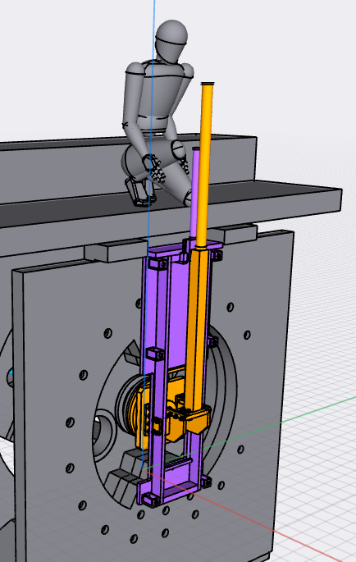
Target assembly in phase 1
3000 kgf of load by the air-pressure of pillowseal must be considered.
The target assembly is inserted into the solenoid shield by semi-remote-handling.
We must consider
How the structural strength is guaranteed.
How the accuracy is guaranteed.
How it is maintained in the high radiation area.
Maintenance with local shielding
8

Slide 9
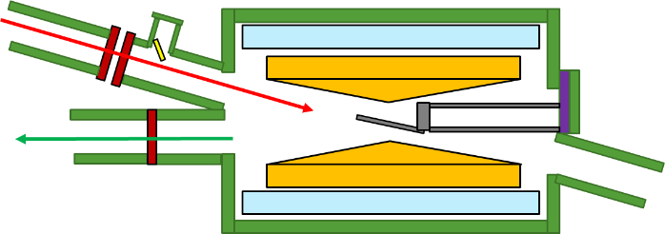
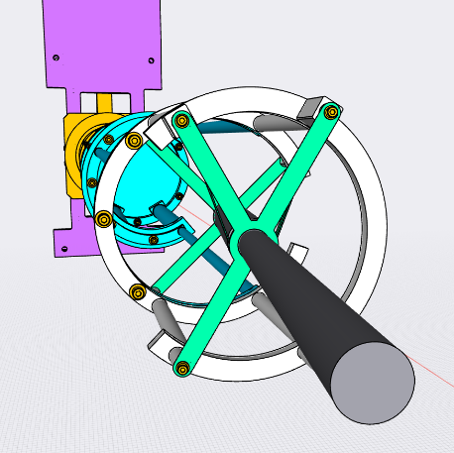
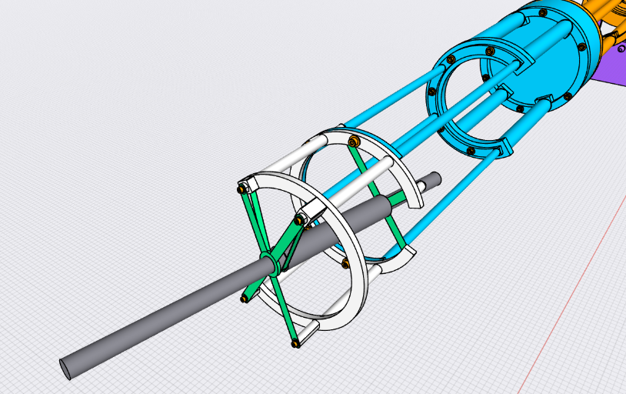
Beam profile monitor on target position
Proton beam twines around the axis of solenoid magnetic field.
Downward 40 cm on the dump position
Difficult to align the beam position on target
Collaboration with Hong Ming & Liang Wen in Institute of Modern Physics in China
Importance of beam profile monitor on target position.
Fluorescent material, Al2O3+Cr2O3 coating on graphite.
The image is transported by optical fiber.
Originally developed at ORNL for SNS measurement
Profile image is transported through mirror and optical fiber.
Side view
Target position
Profile measurement ＠CAFÉ Linac, IMP
9

Slide 10
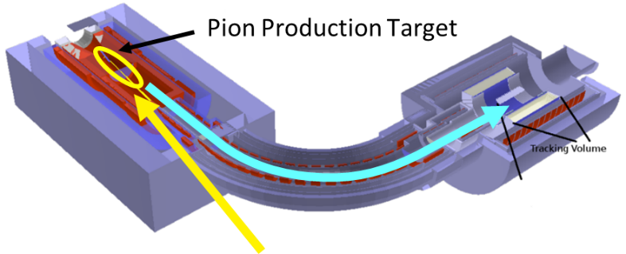
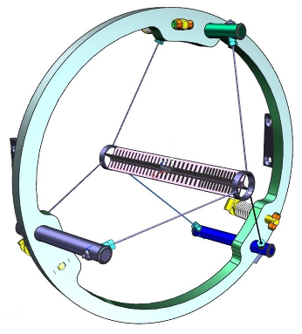
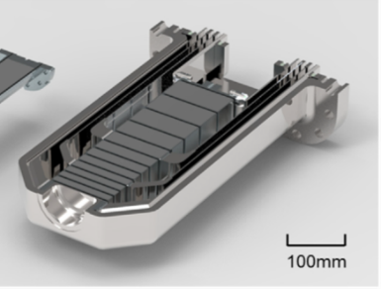
COMET Phase 2 target
TFGR tungsten: S. Makimura
He-embrittlement: T. Sakamoto
Water-cooling target: N. Kamei
Poster session
Oral session
 | graphite | tungsten
Density (g/cc) | 1.82 | 19.2
Transport efficiency | 1 | 3
The higher density of target material, the lower spatial volume of muon source
The lower spatial volume, the higher capture and transport efficiency of muon
COMET | Proton beam power | Target material | Cooling
Phase 1 | 3.2 kW | Graphite | Thermal radiation
Phase 2 | 56 kW | Ta-clad Tungsten | Water cooling
Water cooling Ta-cladding tungsten target at RAL
Mu2e@Fermi | Proton beam power | Target material | Cooling
Phase 1 | 8 kW | Tungsten | Thermal radiation
Thermal radiation cooling tungsten target at Mu2e
Design & Fundamental Research: US-JP collaboration with Fermi-lab is under discussion.
10

Slide 11
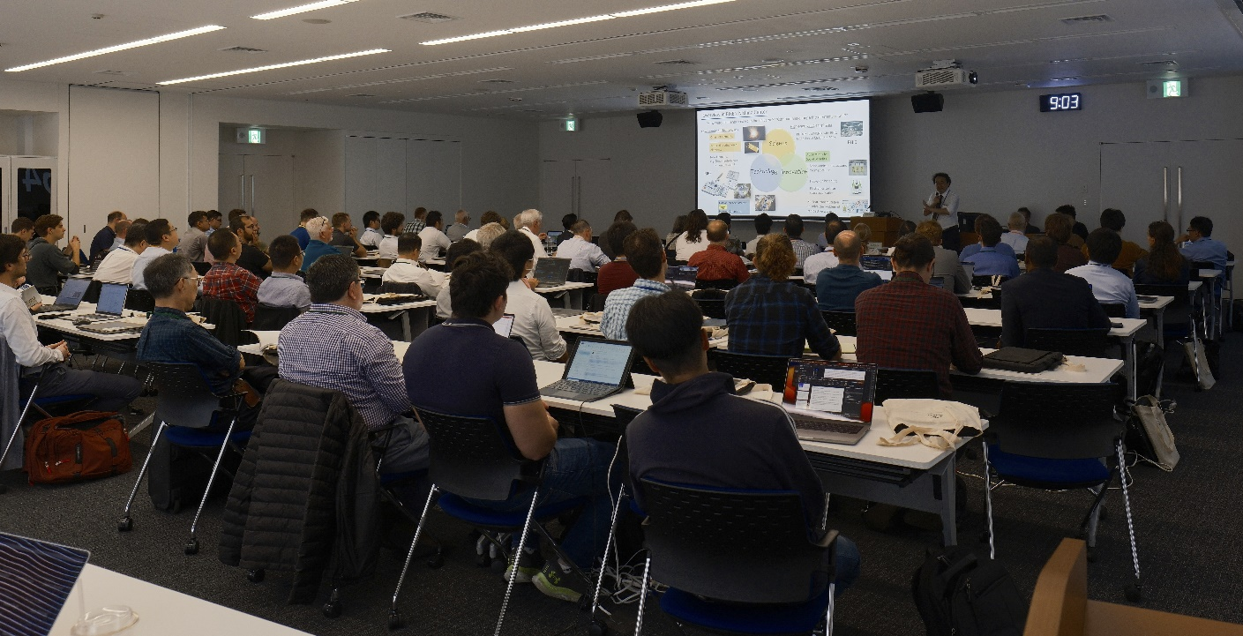
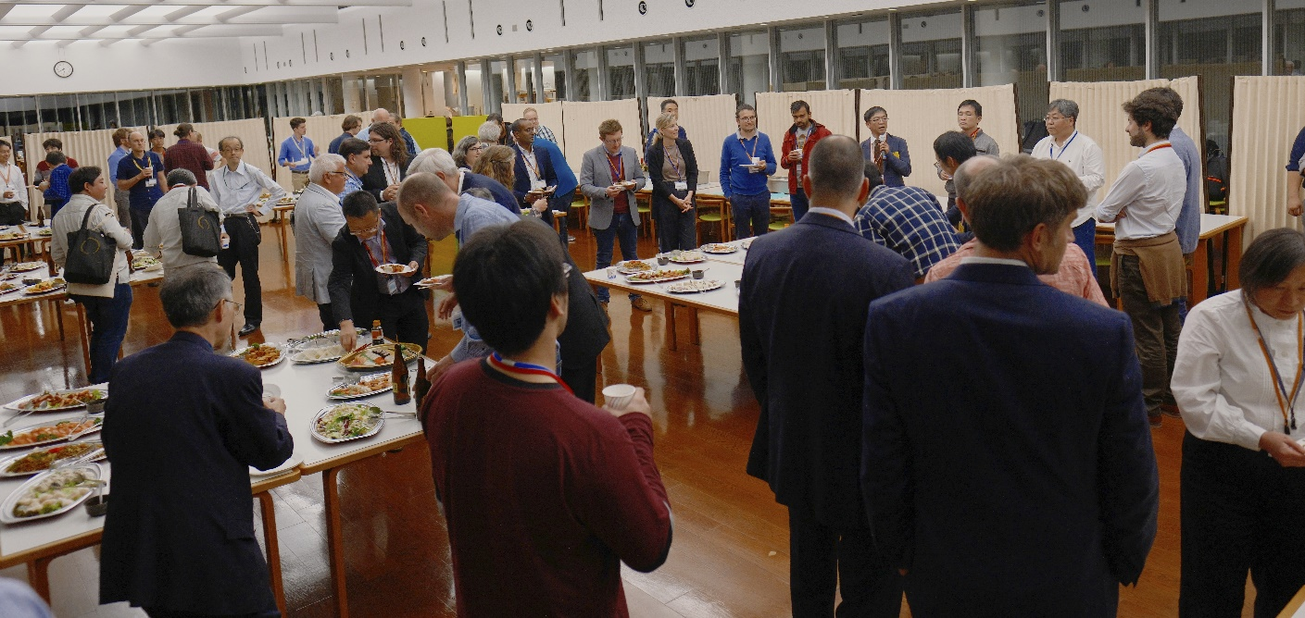
Summary
The developments of the COMET target, located on the center of solenoid magnetic field.
Phase alpha operation in Feb, 2023
Design of Phase 1 is on going.
Development for Phase 2 will start soon.
Thanks for your attention
11

Slide 12
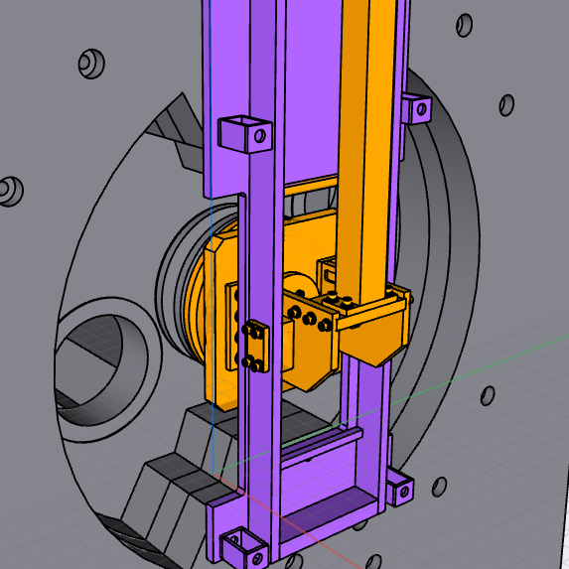
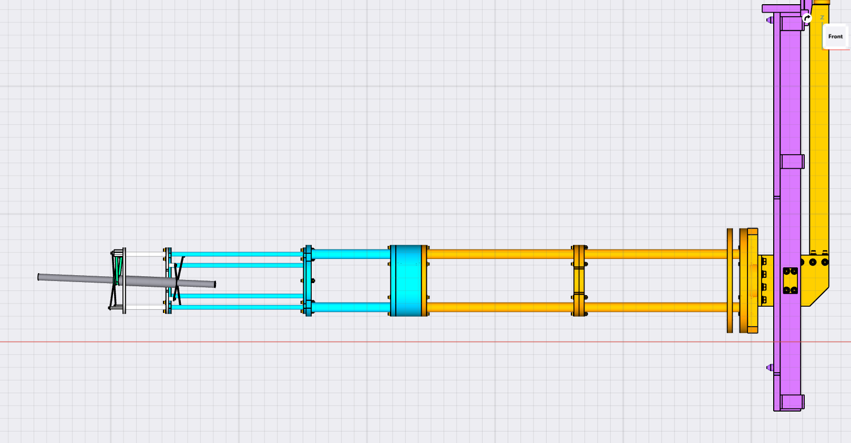
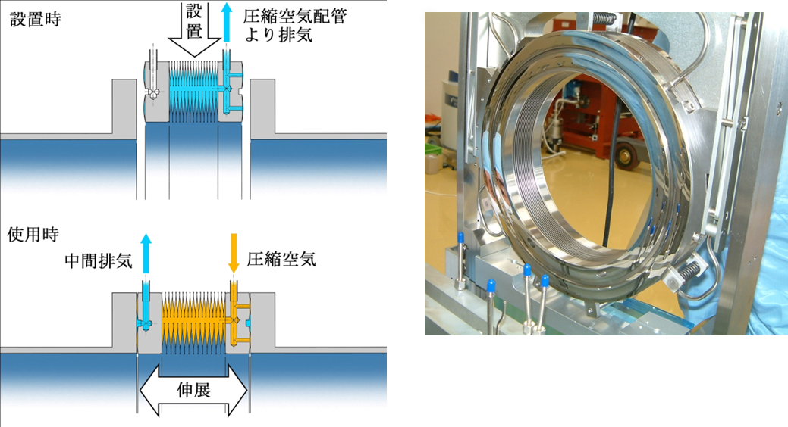
Target assembly in phase 1
The target assembly is inserted into the solenoid shield.
3000 kgf of load by the air-pressure of pillowseal must be considered.
Recent update:
The plug shield is necessary to decrease the residual radiation dose of the D.S. flange through PHITS simulation
We must consider
How the structural strength is guaranteed.
How the accuracy is guaranteed.
How it is maintained in the high radiation area.
Cantilever beam structure
The distortion of the target position is 2-3 mm due to the weight of the inner collimator, 50 kg.

Slide 13
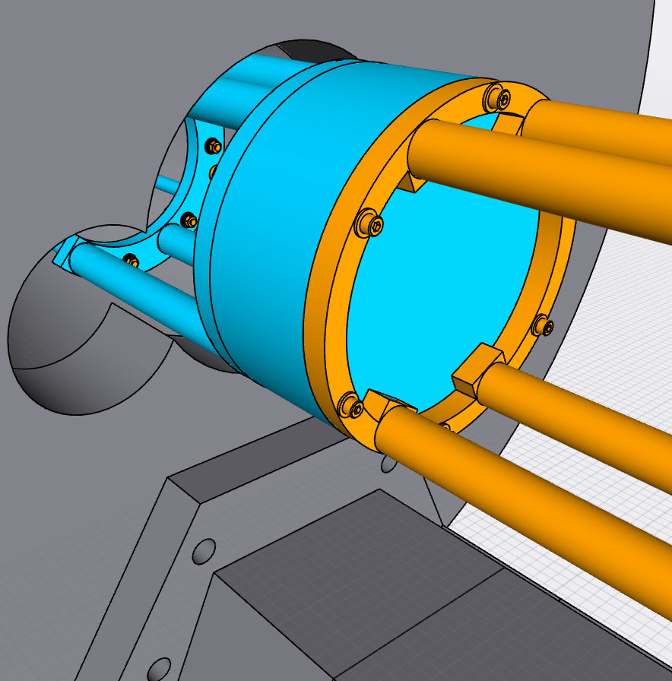
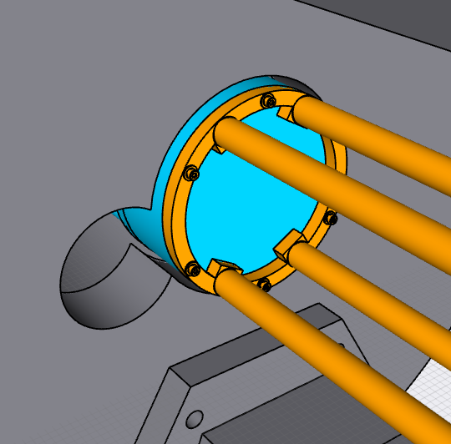
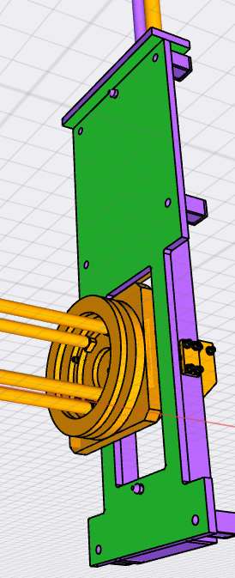
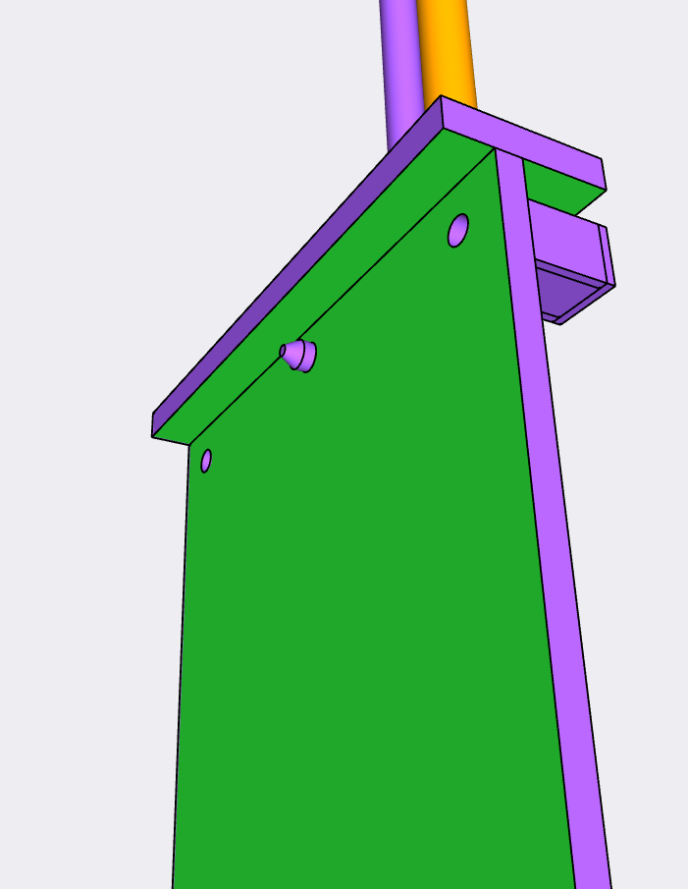

Accuracy and precision
Plug shield
Difficult to use guide pins because of the limitation of the space and the risk of the stuck here.
The weight of the plug shield is just supported by the inner collimator.
Need the space for guide pins
Inner collimator
6 screws integrate the fixing plate of the target assembly with the D.S. flange.
Two horizontal guide pins and two planes determine the accuracy and precision.
Two long holes against the pins on D.S. flange.

Slide 14


structure Against load of pillowseal and semi-remote maintenance
3000 kgf of load by the air-pressure of pillowseal
Shaft structure on the center position of the load
The position of the target assembly can be adjusted, and 6 screws can be fixed on the top of iron yoke that is low radiation area.
Adjustment arm
Shaft structure
Plug shield
Inner collimator
Fixing plate
The location of the target assembly can be adjusted against the fixing plate by the adjustment arm. The plug shield is just supported by the inner collimator.

