Slide 1
Lujan Center 1L Target TMRS Mark IV Upper Target Design and Thermal Hydraulic Analysis
Eric Olivas*, Lukas Zavorka, Joseph Otoole, Keith Woloshun, Michael Mocko
8th High Power Targetry Workshop (HPTW2023)
November 6th – 10th, 2023
RIKEN Nishina Center for Accelerator-based Science, Wako, Saitama, Japan
LA-UR-23-32368

Slide 2
Overview
Previous Mark III Target Moderator Reflector System (TMRS)
Motivation for Mark IV (TRMS): Physics and Performance
Mark IV Upper Target Design: Design Challenges
Upper target geometry
Coupled Physics Simulation

Slide 3
Mark III Target Moderator Reflector System (2010-2022)
The Target Moderator Reflector System (TMRS) is the neutron source for nuclear physics experiments at the Lujan Neutron Scattering Center user facility.
The assembly employs split tungsten target and two-tiered neutron flight path (FP) arrangement.
Upper target station consists of tantalum cladded tungsten disk stack, while the lower target is a tantalum cladded long tungsten cylinder.
The TMRS assembly is also comprised of a network of moderators, reflectors and flight paths that deliver neutrons of specified energies and fluxes to surrounding experiments and detector stations.
It can supply neutrons up to 16 different FPs. Six different moderators are utilized in the design: two in the upper tier and four in the lower tier.
Liquid hydrogen at 20K and chilled water are used as moderator materials supplying cold and thermal neutrons respectively.
The TMRS has a vertical, downward beam entry.
Production beam operation parameters: 800 MeV @ 150μA; beam spot size of 3.53 cm FWHM.

Slide 4
Mark III Target Moderator Reflector System (2010-2022)
Figure 1: Mark III assembly: Left panel shows the elevation view of the TMRS, the top-right panel displays the horizontal cut through the upper tier, the bottom-right panel shows the horizontal cut through the lower tier.

Slide 5
Motivation for Mark IV (TRMS): Physics and Performance
The main goals of the replacement target, Mark IV, are to
Improve target performance for nuclear science research
Neutron capture, neutron-induced fission, total cross section measurements
Preserving the thermal- and cold-neutron performance for material science.
Neutron radiography
Neutron scattering
The two‑tiered nature of the 1L target and associated beam lines naturally lends itself to this dual mission.
The resulting design offers significant improvements in both the resolution and the intensity of medium energy neutrons (keV-MeV) in the upper tier, while preserving the thermal- and cold-neutron performance in the lower tier.
Upper tier redesigned in Mark IV (4 FPs, nuclear science): The goal is to increase neutron flux and improve energy resolution.
Moderators and beryllium reflector are replaced with a NEW 3 disk target station.
Lower tier has no substantial modification in Mark IV (12 FPs, material science research): The goal is to minimize the impact of the upper tier design changes on the performance of the lower tier.
Design beam parameters: 800 MeV @ 200μA; Focused (off normal) FWHMx = 1.0148 cm x FWHMy = 2.4308 cm.
Nominal beam: 800 MeV @ 200µA; 3.53 cm FWHM.

Slide 6
Mark IV Target Moderator Reflector System
Figure 2: Mark IV assembly: Left panel shows the elevation view of the TMRS. The top right panel depicts the horizontal cut through the upper-tier target-moderator assembly showing the four upper-tier FPs. The lower right panel depicts the lower-tier moderator suite. The new double-chamber water moderator is depicted as “HR/HI.”

Slide 7
Mark IV Upper Target Design: Design Challenges
The new proposed physics design offers the best performance when the target disk is irradiated by the proton beam on edge.
Target disk cooling was the first priority.
Single target disk on edge did not provide adequate surface area for convective heat transfer.
Rod stack… surface area to volume ratio can be set by rod diameter, so heat flux can be set as necessary. However, the design was cost prohibitive.
Splitting the disk doubled the cooling surface; however, by going with 3 target disks this increased the surface area to volume ratio without adverse performance effects.
Keep fluid/solid interface temperature below saturation temperature of 170°C (698 KPa).
Proton Beam
Target Disks

Slide 8
Upper Target Geometry
Upper Target Supports (2x)
Inlet and Outlet Cover – Inconel 718
Inlet and Outlet Piping
Emission Frame – Inconel 718
Emission Be Window – Inconel 718
Emission Skin – Inconel 718
Emission
Side
Emission Back Cover – Inconel 718
Inconel 718 Housing Body
Target Holder – Inconel 718
Proton Beam
W Targets w/ Ta Cladding

Slide 9
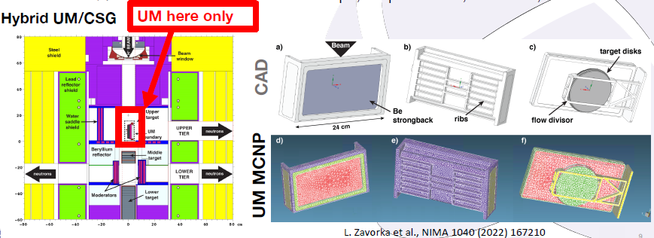
MCNP6 radiation transport calculations
Unstructured Mesh (UM) geometry model combined with the traditional MCNP constructive solid geometry (CSG) modeling
UM model contains all engineering realities as the original CAD model.
The same approach can be used to calculate dpa, He production, heat generation, etc.

Slide 10
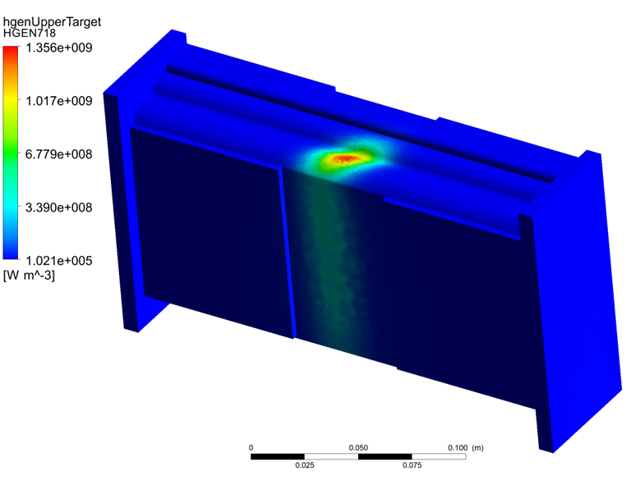
CFD and Conjugate Heat Transfer
MCNP volumetric power deposition output was coupled to a conjugate heat transfer CFD analysis to determine the following qualitative results:
Separation and stagnation points in the flow field.
Velocity profiles in the cooling channels.
Temperatures
Solid
Fluid
Fluid solid interface
Pressure drop
Integrated power in upper target
22.4kW in the W targets
3.1kW in the cooling water
6.2kW in the housing assembly
3.3kW in the Ta cladding
0.443kW in the Be window
Inlet cooling water:
698 kPa and 1.262 L/s

Slide 11
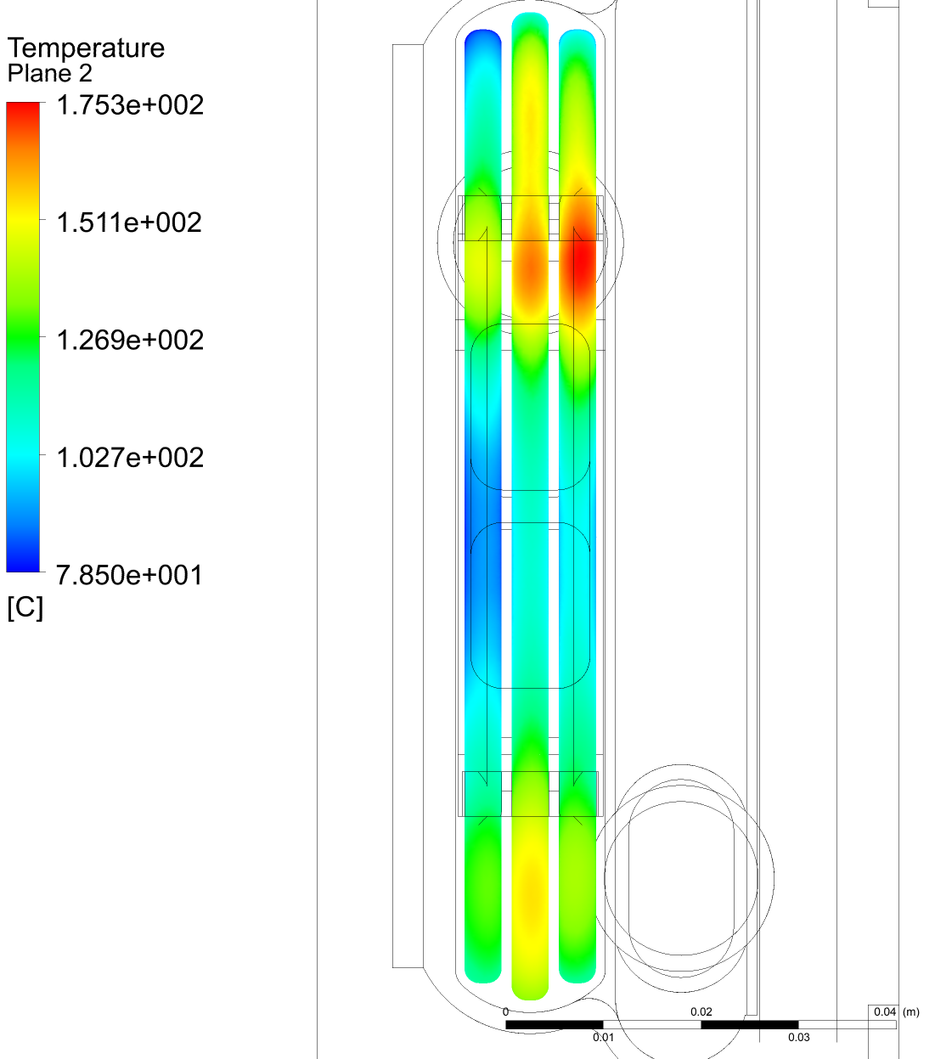
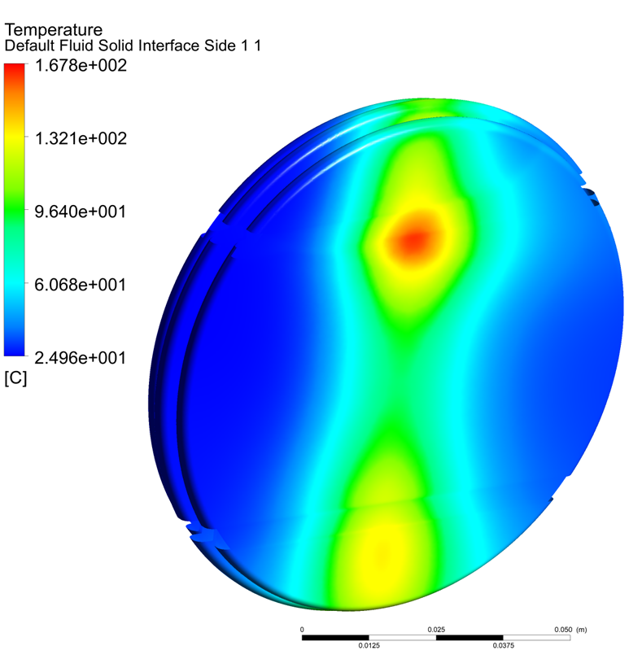
CFD and Conjugate Heat Transfer
We have an upper target design!
Focused beam results are shown.
Production beam yielded a peak fluid solid interface temperature of 78°C, and peak target temperature of 80 °C.

Slide 12
Conclusion
Successes:
A robust upper target design that meets engineering requirements
Increases neutron flux and improved energy resolution in the eV-MeV range in the upper tier
Lower tier maintains 74% of the current neutron flux
TMRS MK IV installed and Commissioned took place in the Spring of 2022

Slide 13
Thank you for your attention!

