Slide 1
Microstructures, strengths of Al6061-T6 after irradiation in SINQ Target-13
Peng Song, Yong Dai (PSI), Hossein Sina, Michael Wohlmuther (ESS)
HPTW2023, RIKEN, Wako, Japan 09.11.2023

Slide 2
Content
Backgrounds & Objective
Material & irradiation conditions
Results
Microstructures before irradiation
Microstructures after irradiation
Tensile test results
Ⅳ. Conclusions

Slide 3
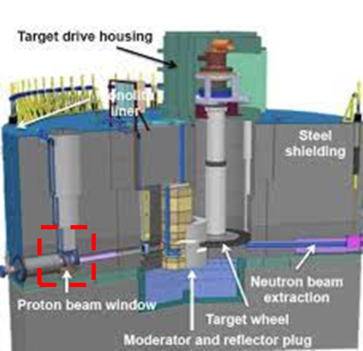
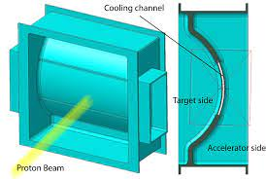
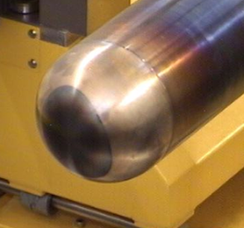
Background
Europe Spallation Source (ESS)
Materials applied to PBW
Thickness:
< 1.25 mm
Requirements :
Good radiation tolerance
Good thermal conductivity
Light atoms
Good strength
AlMg₃
Proton Beam Window (PBW)*:
Suffer from high-fluence protons (2 GeV)
Low scattering of proton beam (< 1%)
Thickness less than 1.25 mm
Al alloys:
Al6061-T6 for ESS (5 MW)
AlMg₃ for SINQ (1.4 MW)
Al5083 for MLF (1 MW)
Max. p-fluence: 8.6×10²⁵ p/m²
Max. 8.5 dpa
*R. Vivanco, et al. IOP Conf. Series: Journal of Physics: Conf. Series 1021 (2018) 012065
Notes:
The PBW (Proton Beam Window) is the device in charge to separate the ultra-high vacuum atmosphere of the accelerator, to the rough vacuum atmosphere present at target side.

Slide 4
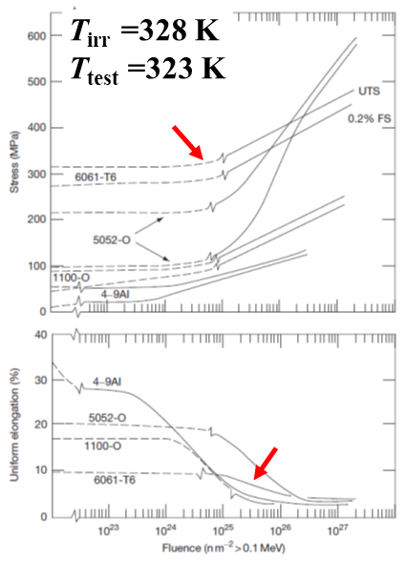
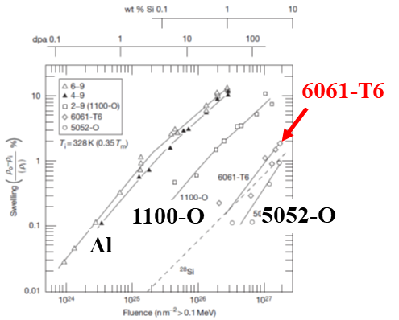
Objective
Objective
Radiation-induced changes in tensile properties of Al alloys*
Radiation-induced swelling as a function of Fast fluence
6061-T6
Stress, MPa
5052-O
Swelling, %
Uniform
elongation, %
4-9Al
5052-O
6061-T6
*Performance of Aluminum in Research Reactors, K. Farrel, Oak Ridge
Objective: Microstructures of Al6061-T6 after neutron or proton irradiation?
Seite 4

Slide 5
Content
Backgrounds & Objective
Material & irradiation conditions
Results
Microstructures before irradiation
Microstructures after irradiation
Tensile test results
Ⅳ. Conclusions

Slide 6
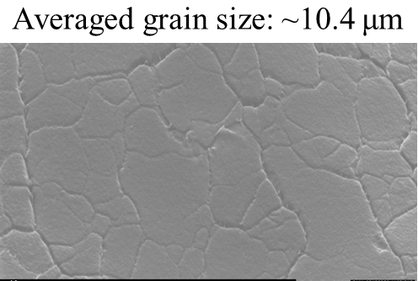
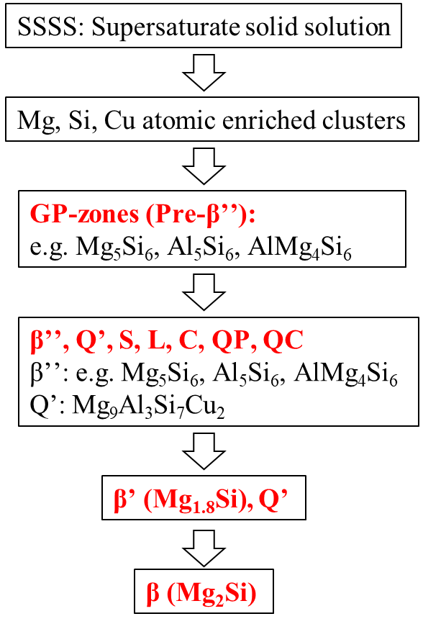
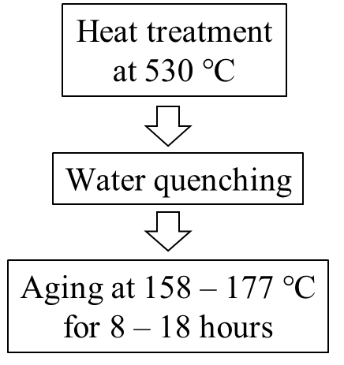
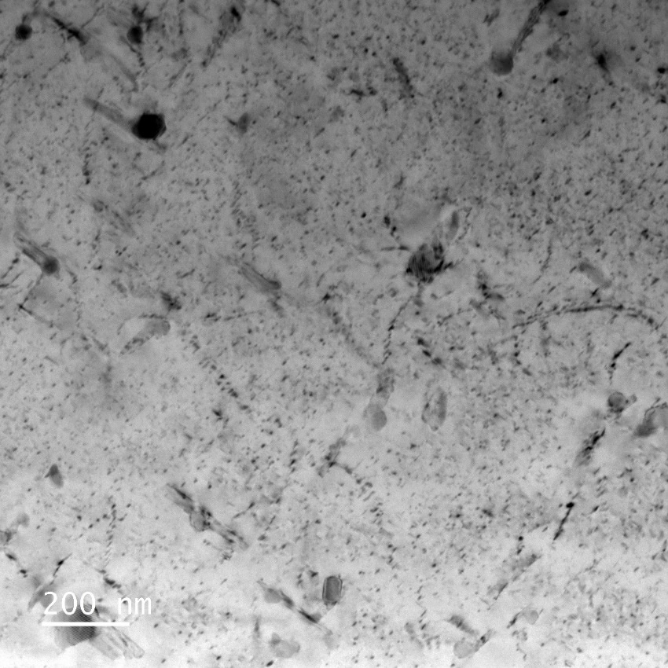
Material:Al6061-T6
Chemical Composition
wt.% | Si | Fe | Cu | Mn | Mg | Cr | Zn | Ti | Al
Max. | 0.8 | 0.7 | 0.4 | 0.15 | 1.2 | 0.35 | 0.25 | 0.15 | Bal.
Thermal treatments
Possible second phases*
Grain
morphology
10 μm
General
microstructures
200 nm
*Acta Materialia 132 (2017) 209-221.

Slide 7
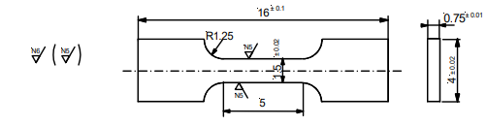
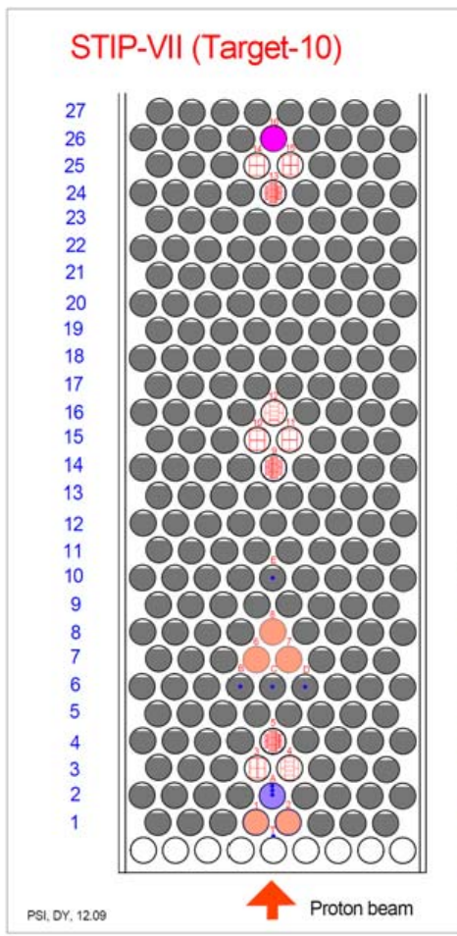
Irradiation conditions
SINQ at PSI
Specimen | Irrad. T (°C) | Dose (dpa) | He (appm) | H (appm) | Test T (°C):
7-LT-N20 | ⁓ 62 | 10.1 | 455 | 1095 | ⁓ 32
7-LT-N19 | ⁓ 62 | 10.1 | 455 | 1095 | ⁓ 152
7-LT-N20: As-irradiated
7-LT-N19: Irradiation + annealed (Irrad.+ ann.)

Slide 8
Content
Backgrounds & Objective
Material & irradiation conditions
Results
Microstructures before irradiation
Microstructures after irradiation
Tensile test results
Ⅳ. Conclusions

Slide 9
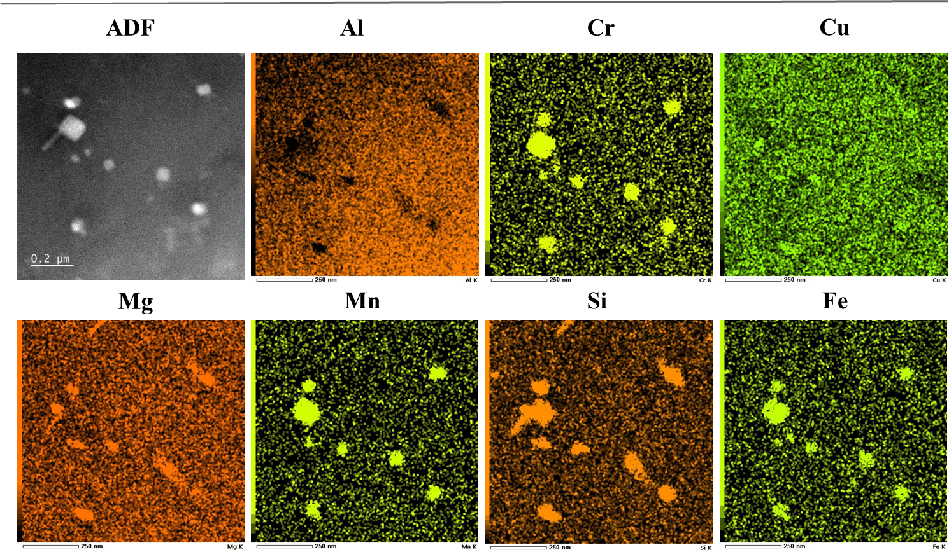
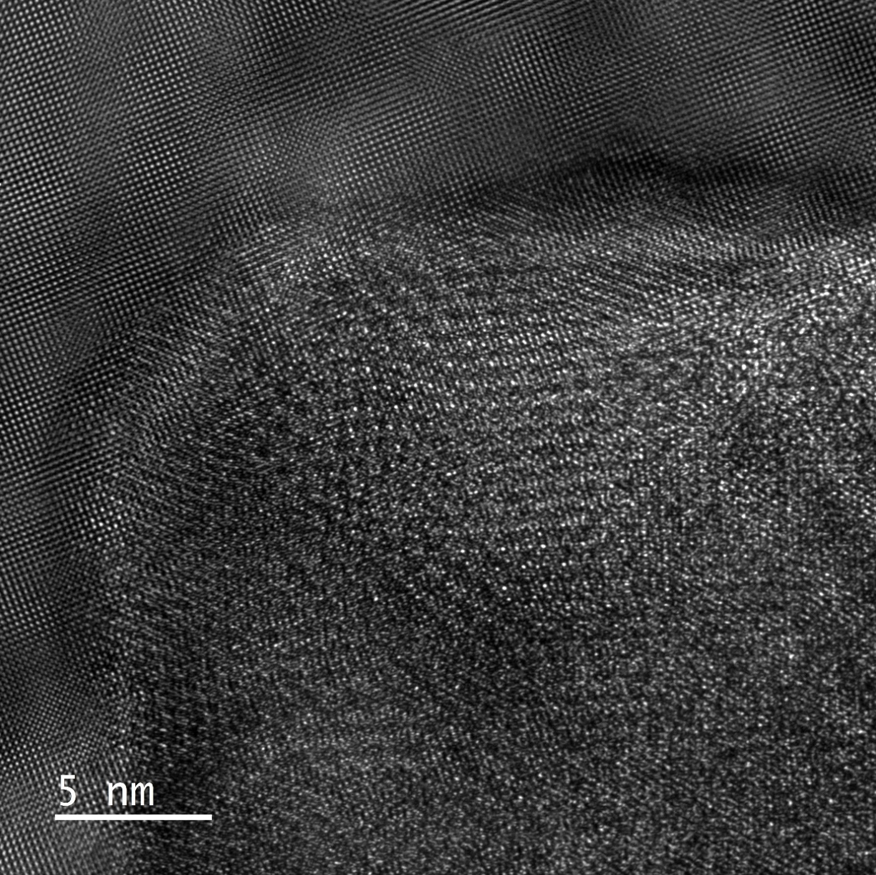
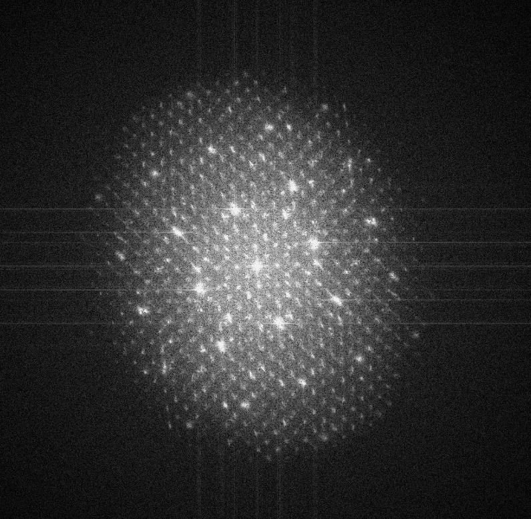
Microstructures before irradiation: big precipitates
Z = Al<001>
⁓ 30 nm
Al<002>
Si, Fe (Mn, Cr), Mg, Al
Mg, Si, Al
π-phase Al₉FeMg₃Si₅

Slide 10
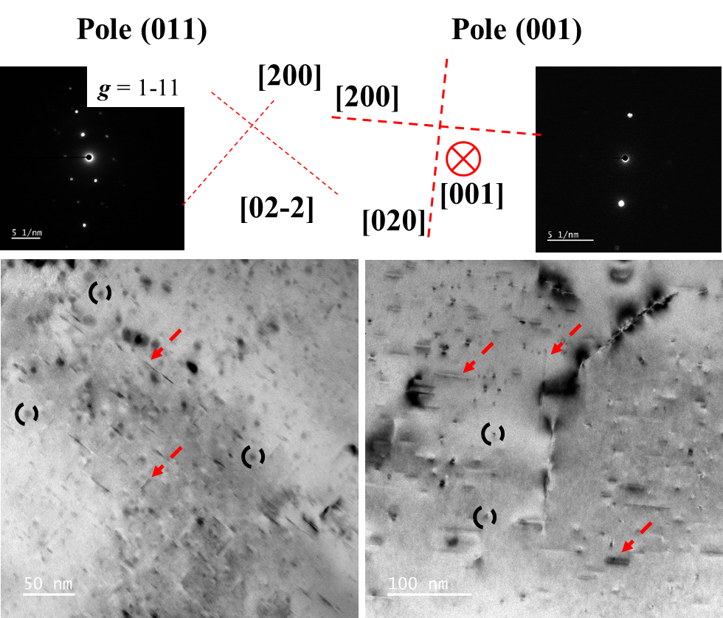
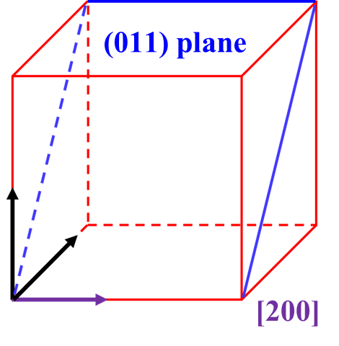
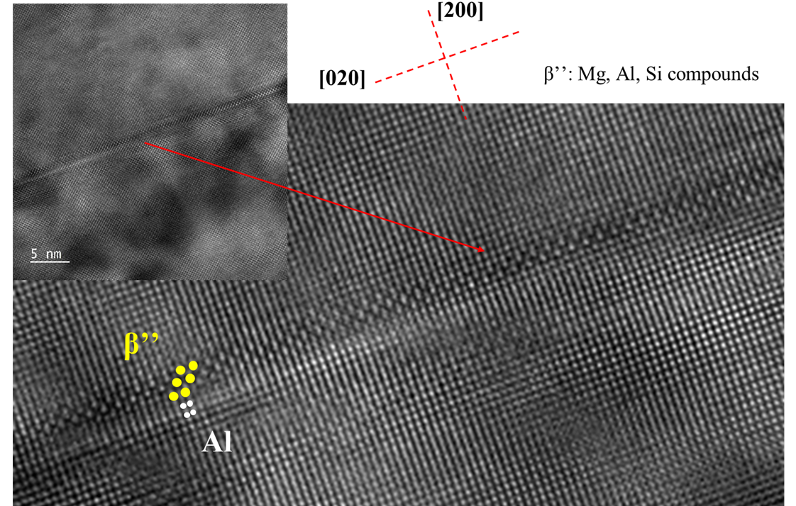
Microstructures before irradiation: Needle-shaped
Needle-shaped
precipitates ⁄⁄ Al <001>
Z = Al <001>
Averaged length: 22.1 ± 10.3 nm Number density: (1.7 ± 0.8) × 10²² m⁻³

Slide 11
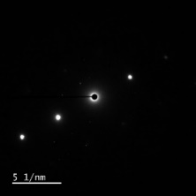
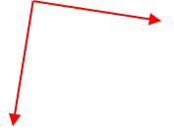
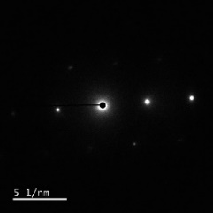
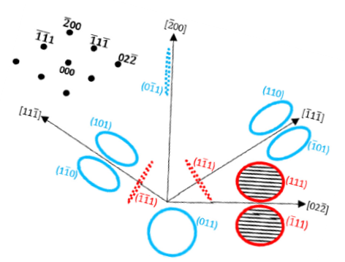
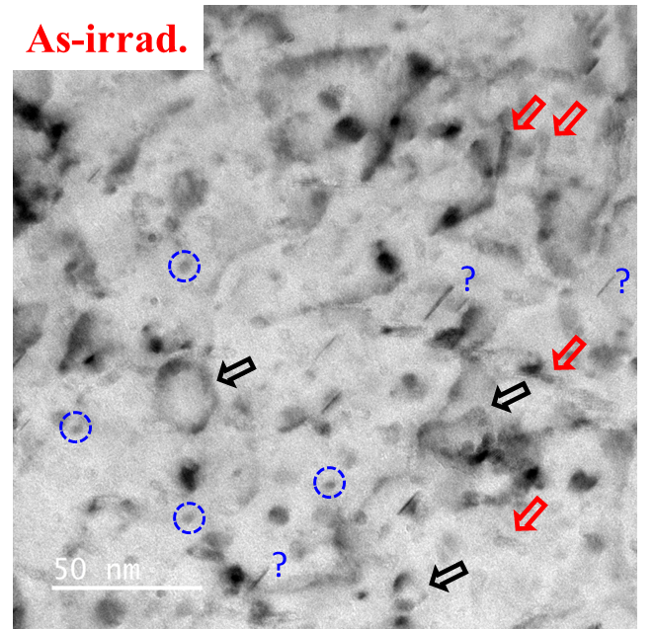
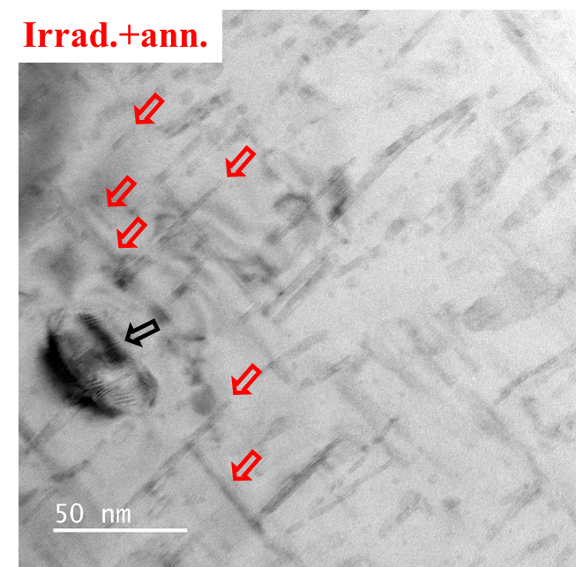
Microstructures after irradiation: general view
pole 110 g = [-1 1 -1]
pole 110 g = [-1 1 -1]
g220
g220
Perfect type: ½<110>
Faulted frank type: 1/3<111>
g200
g200
Project plane: fcc Al (110)

Slide 12
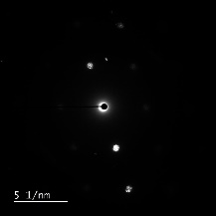
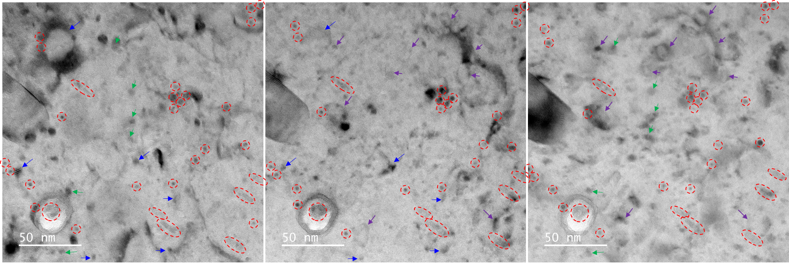
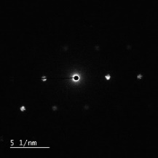
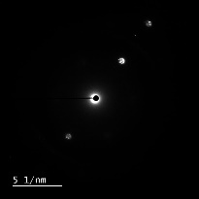
Microstructures after irradiation: loops & precipitates
g/B vectors | 1/2[1 1 0] | 1/2[-1 1 0] | 1/2[0 1 1] | 1/2[0 1 -1] | 1/2[1 0 1] | 1/2[-1 0 1]
[1 1 -1] | 2 | 0 | 0 | 2 | 0 | -2
[-2 0 0] | -2 | 2 | 0 | 0 | -2 | 2
[-1 1 -1] | 0 | 2 | 0 | 2 | -2 | 0
pole 011 g = 11-1
pole 011 g=-200
pole 011 g=-11-1
As-irrad.

Slide 13
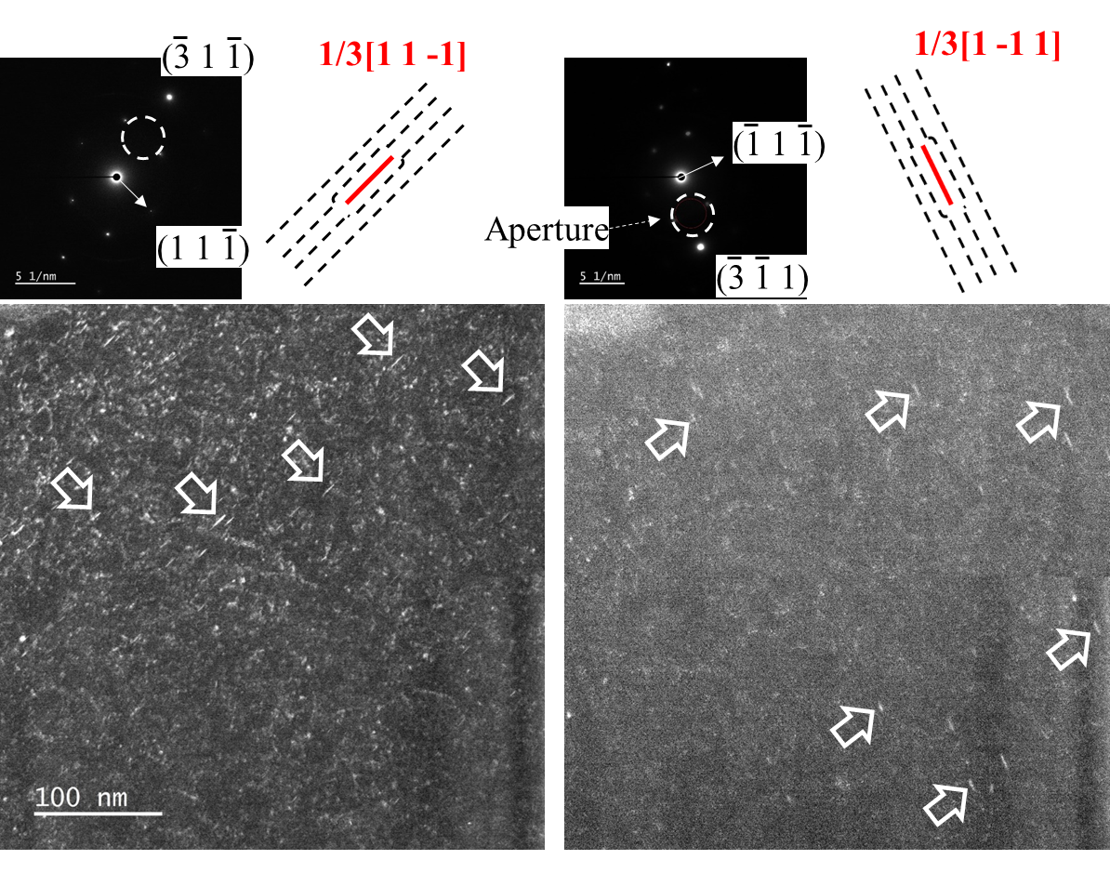
Microstructures after irradiation: faulted frank loops
Z = (011)_{Al}
rel-rod?
B vectors:
1/3[1 1 1]
1/3[1 1 -1]
1/3[1 -1 -1]
1/3[1 -1 1]
As-irrad.

Slide 14
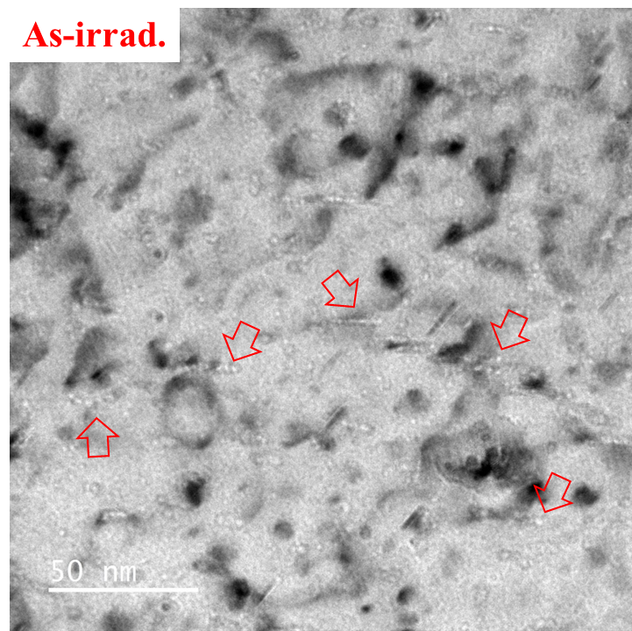
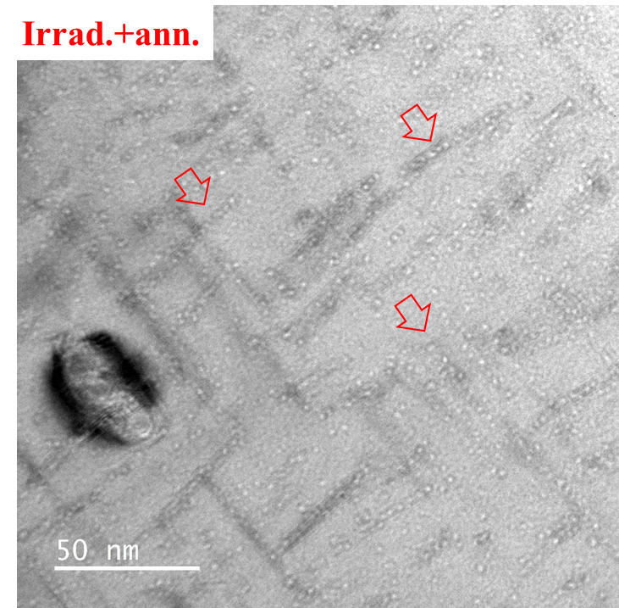
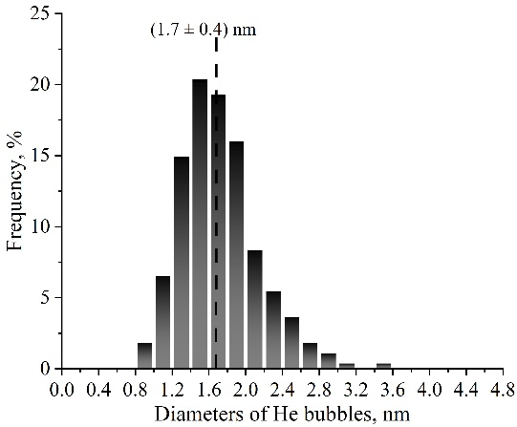
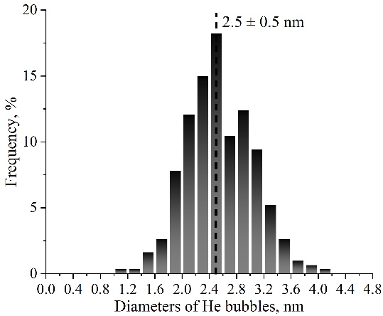
Microstructures after irradiation: bubbles inside grain
Under focus ~ -640 nm
Under focus ~ -750 nm
1.7 ± 0.4 nm
⁓ 2.6 × 10²³ m⁻³
2.5 ± 0.5 nm
⁓ 1.7 × 10²³ m⁻³

Slide 15
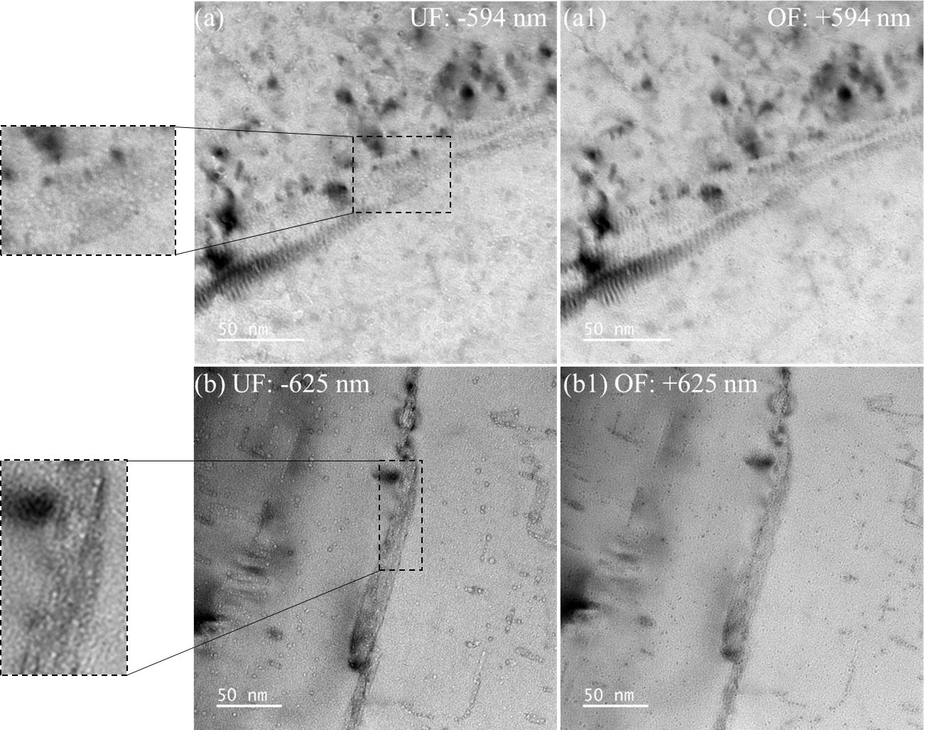
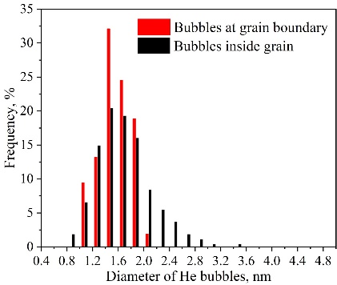
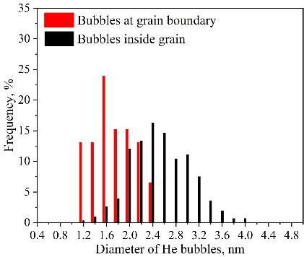
Microstructures after irradiation: bubbles at GBs
As-irrad.
Irrad.+ann.

Slide 16
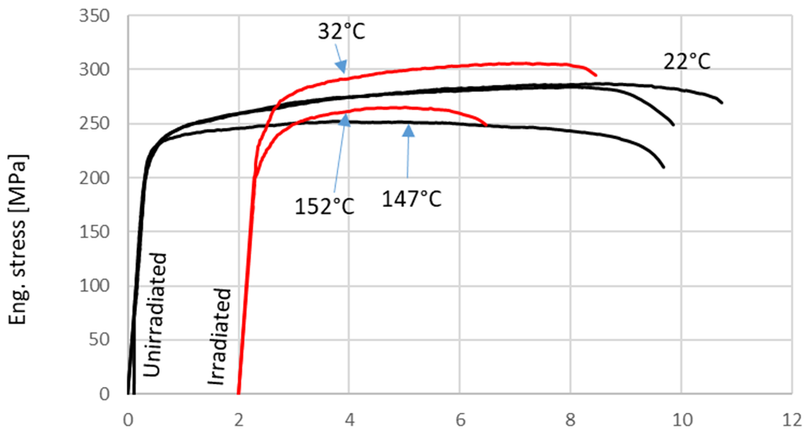
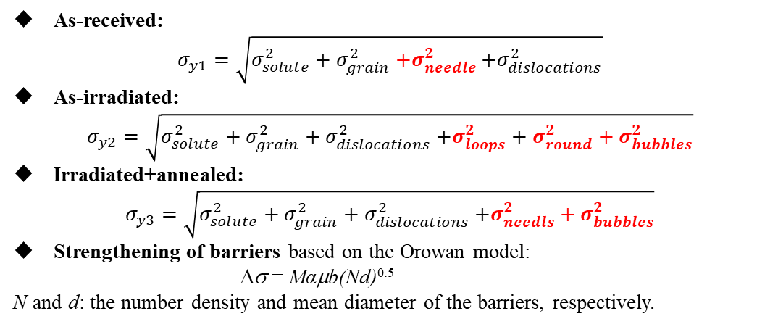
Tensile test results
•
Eng. Stress, MPa
ε: 10⁻³ s⁻¹
Obvious loss of ductility
but very small hardening!
Eng. strain ε, %
 | As-received @ 22 ℃ | As-received @ 147 ℃ | As-irradiated @ 32 ℃ | As-irradiated @ 152 ℃
Yield stress, MPa | 230 | 230 | 260 | 227

Slide 17
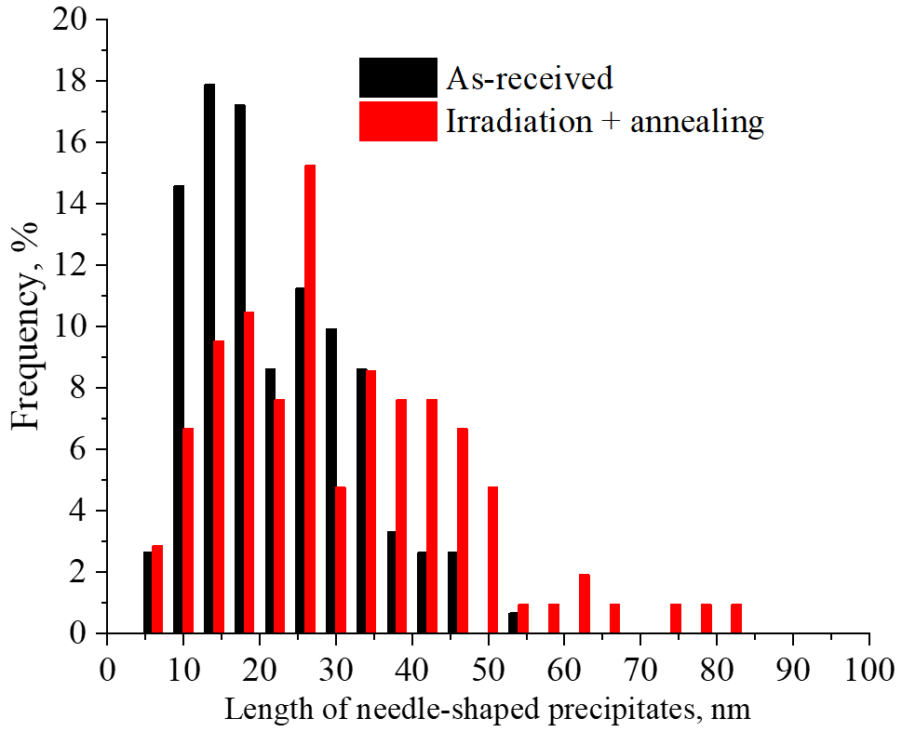
Conclusions
 |  | Needle-shaped | Small round | Frank loops | Perfect loops
As-received | Size, nm | 22.1 ± 10.3 | 6.0 ± 1.2 | × | ×
 | Density, m⁻³ | (1.7 ± 0.8) × 10²² | (6.6 ± 4.5) × 10²¹ | × | ×
As-irradiated | Size, nm | 11.6 ± 3.8 | 4.8 ± 1.9 | 7.9 ± 2.8 nm | 19.7 ± 8.6 nm
 | Density, m⁻³ | ~4.3 × 10²¹ | ~9.6 × 10²¹ | (6.3 ± 1.5) ×10²¹ m⁻³ | ~1.0 × 10²²
As-irradiated + annealing | Size, nm | 30.8 ± 15.9 | 4.1 ± 0.9 | × | 56 ± 20
 | Density, m⁻³ | (2.5 ± 0.1) × 10²² | (4.2 ± 0.7) ×10²¹ m⁻³ | × | ~9.9×10¹⁹
As received
Length distribution of needle-shaped precipitates
Irrad.+ ann.

Slide 18
Thanks a lot for your attention!

Slide 19
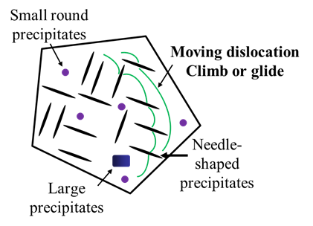
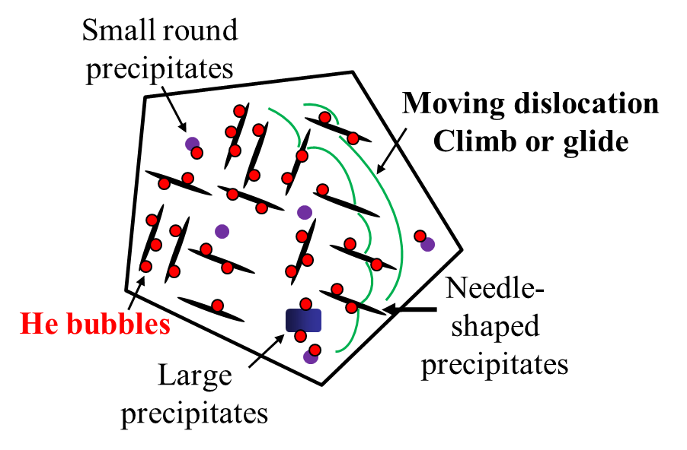
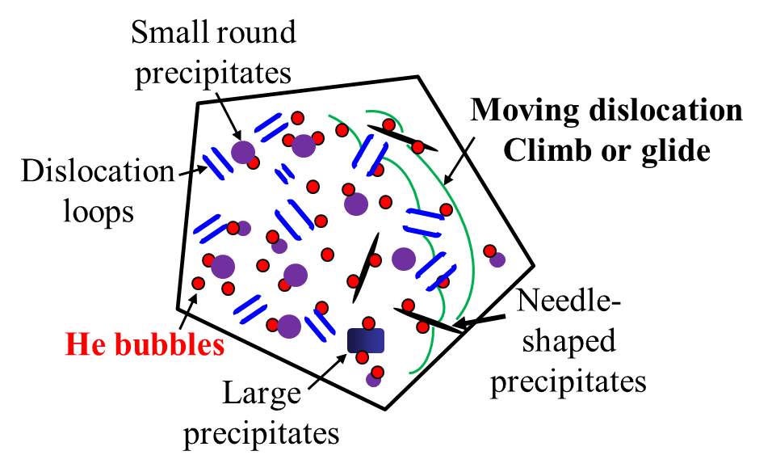

Discussion
As-received
As-irradiated
Irradiated + annealed

Slide 20
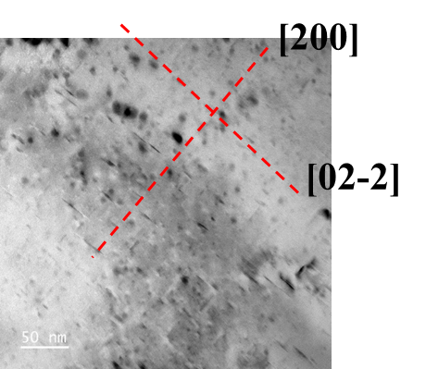
Size distribution of needle-shaped precipitates
22.1 ± 10.3 nm
(1.7 ± 0.8) × 10²² m⁻³

Slide 21
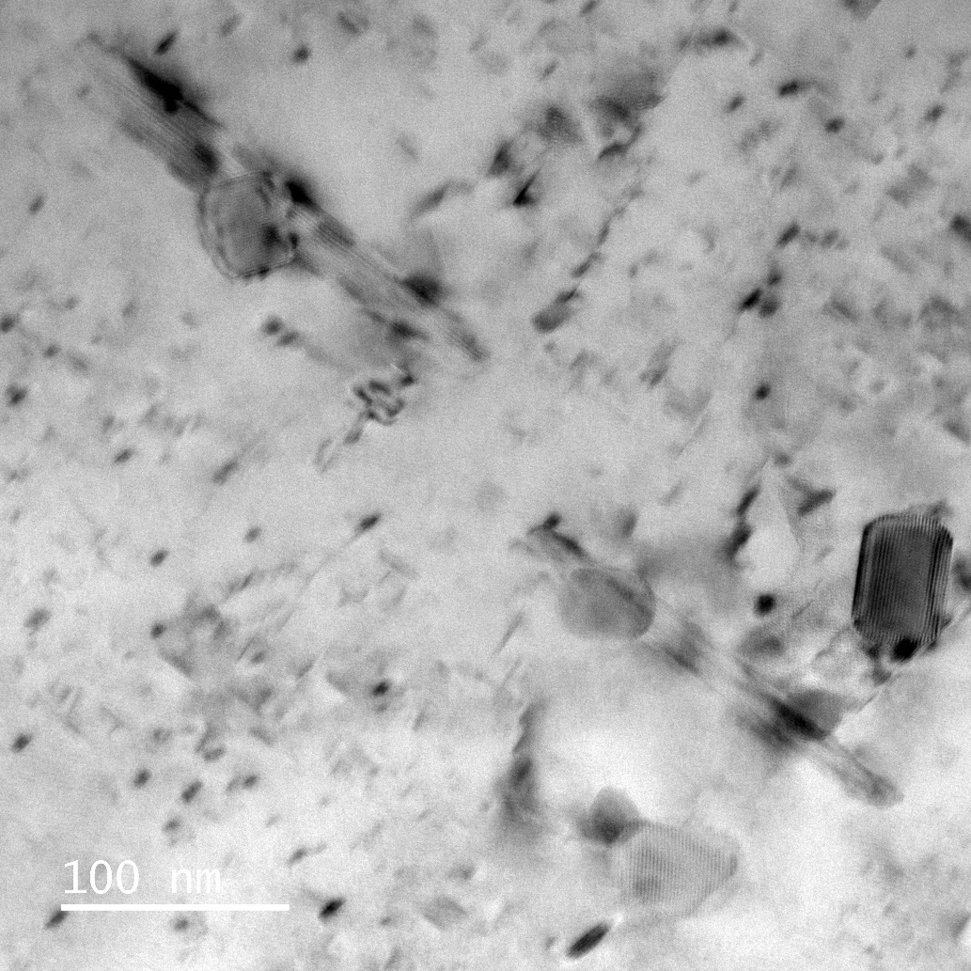
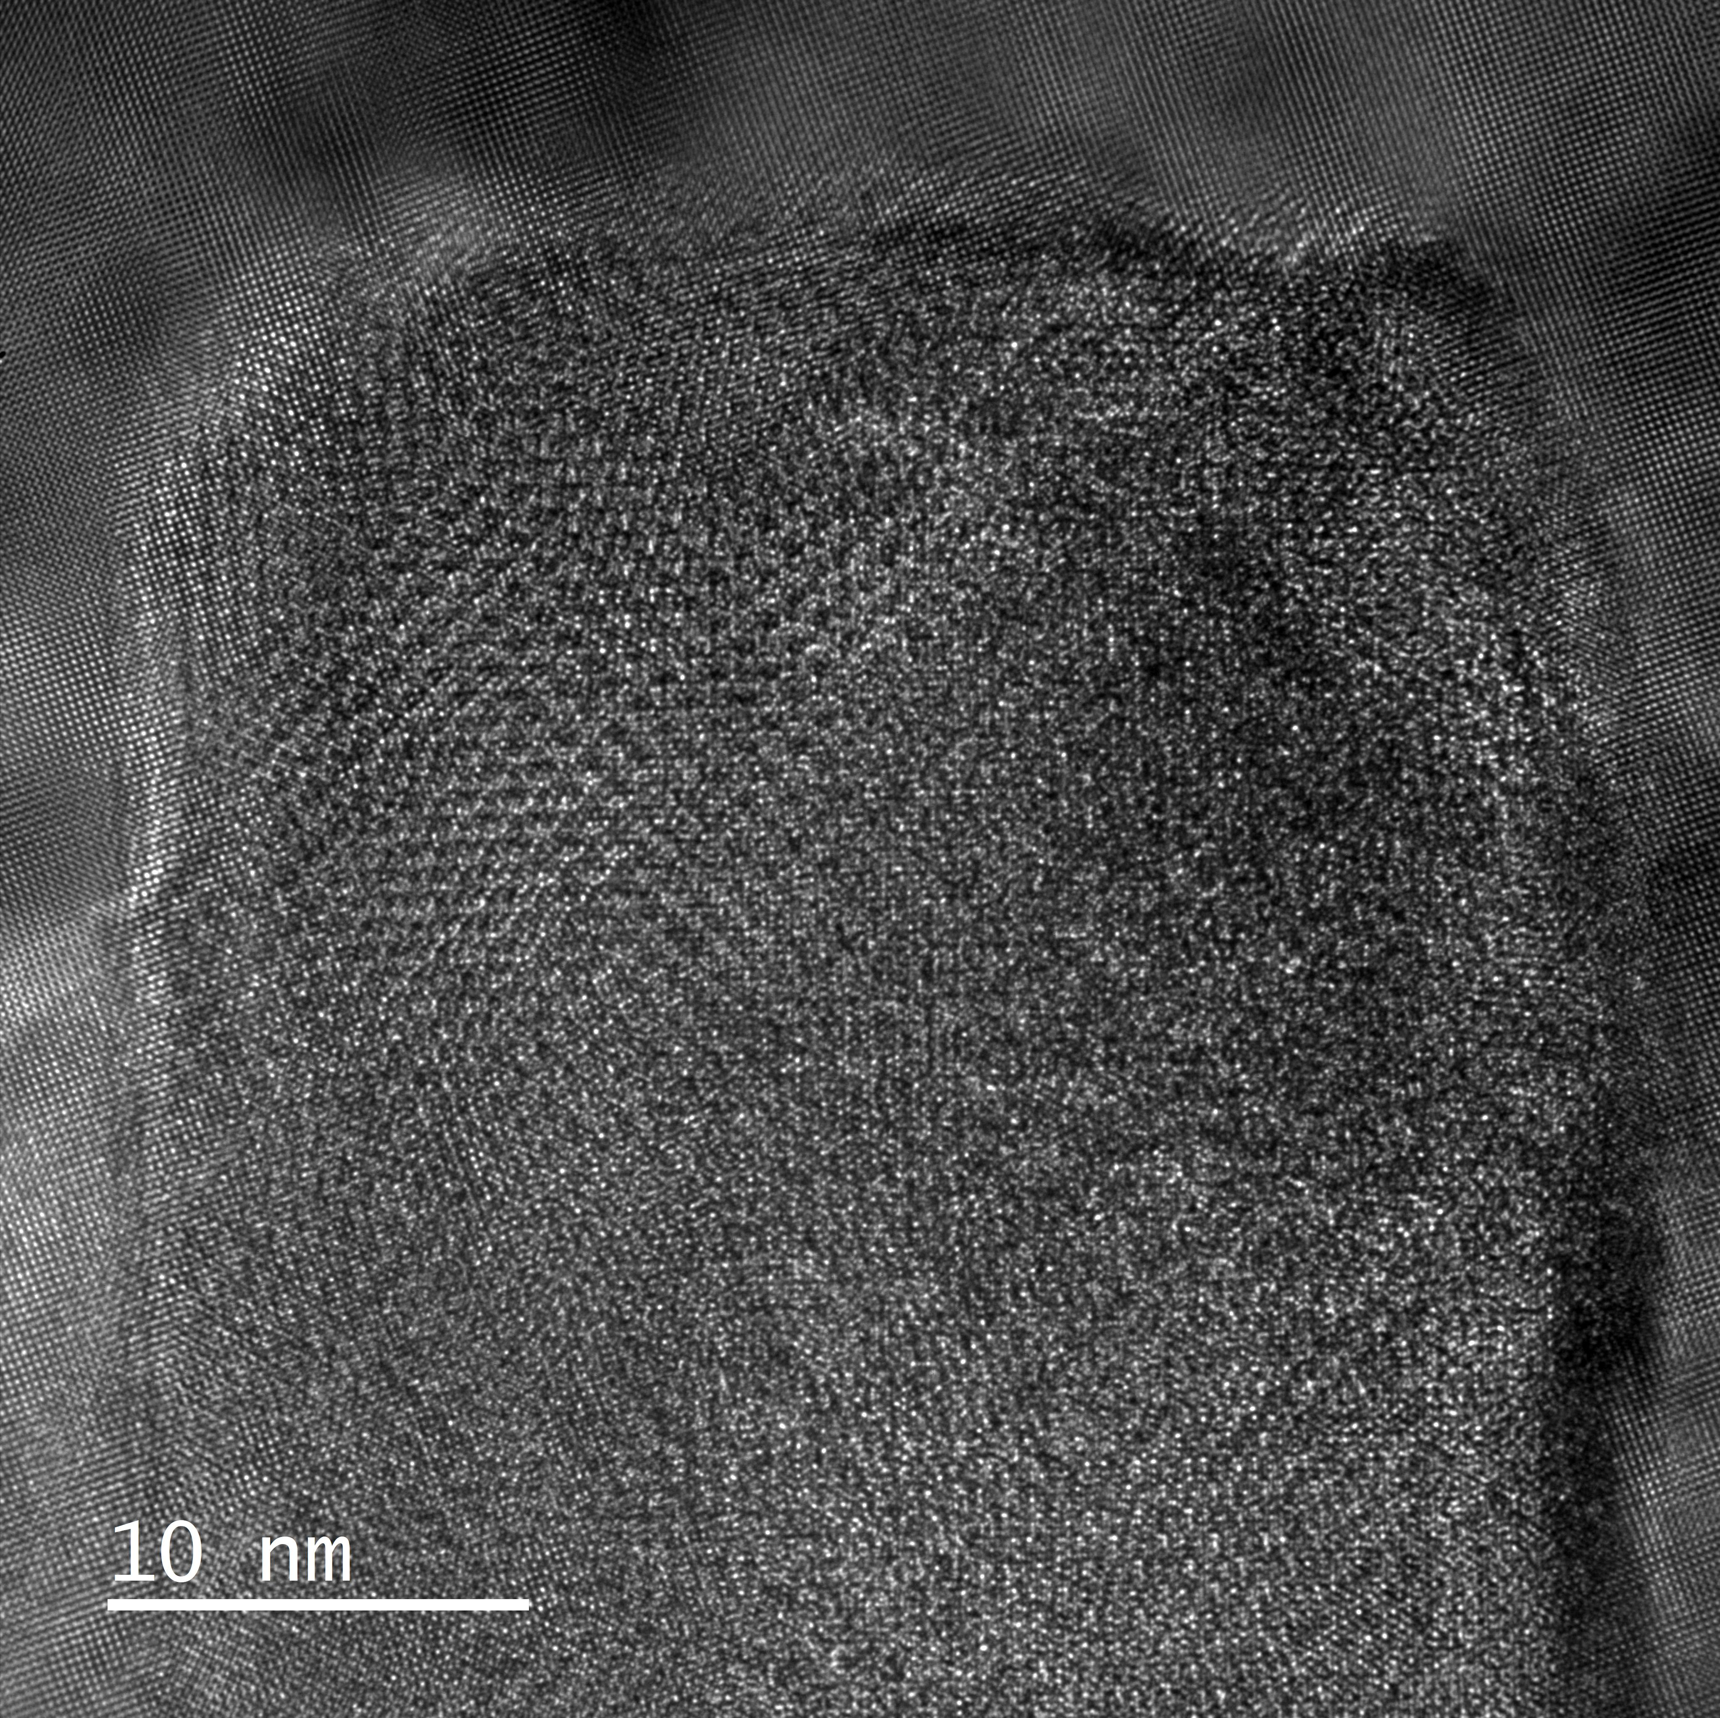
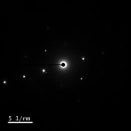
Microstructures before irradiation
Pole 110
g = [1-11]
3g excited
g = 02-2
g = 200

Slide 22
Al-alloys for PBW applications
Al-alloy: Al 6061-T6
Irradiation in STIP-7 (Target-10, 2013-14)
n-flu. | 9.5x10²⁵/m²
p-flu. | 1.6x10²⁵/m²
Dose | 10.1 dpa
He | 455 appm
H | 1095 appm
T_{irr} | 62°C
Inconel 718 (for LANSCE, SNS)
Al alloys ( for ESS, SINQ, MLF)
Ti-Al-V alloys
High Entropy Alloys (HEAs)
R4
to be finalized

