Slide 1
Long Baseline Neutrino Facility (LBNF) Beamline and Targetry Overview
Patrick Hurh, on behalf of the LBNF Beamline Project
High Power Targetry Workshop
10Nov23

Slide 2
Outline
Overview of LBNF Target Hall (LBNF-20)
Site Layout
Target Hall Chase
Target Shield Pile
Remote Handling
LBNF Beamline Beam-Intercepting-Devices (BID) Overview
Baffle and Target
Focusing Horns
Beam Windows (see following Q. Peterson talk)
Beam Absorber (see earlier J. Williams talk)
Thoughts on engineering motivations for radiation damage R&D
What is important for avoiding early failure? for predicting lifetime? for satisfying safety requirements?
Detectable flaws, fracture toughness, and ASME BPVC Section III (Rules for Construction of Nuclear Facility Components)

Slide 3
LBNF Drives DUNE Long Baseline Neutrino Facility – Deep Underground Neutrino Experiment
The effort involves a world-leading new particle accelerator (part of the PIP-II project), an upgraded neutrino beam (provided by the LBNF project) and a world-class experiment (built by the DUNE collaboration). DUNE includes a sophisticated particle detection system at Fermilab and the massive particle detector modules to be installed a mile beneath the surface at Sanford Underground Research Facility in South Dakota. Once PIP-II, LBNF and DUNE are complete, scientists will send trillions of neutrinos 1,300 kilometers (800 miles) through the earth, with no tunnel required, and study them when they interact in detectors on both ends of that journey.

Slide 4
LBNF at Fermilab

Slide 5
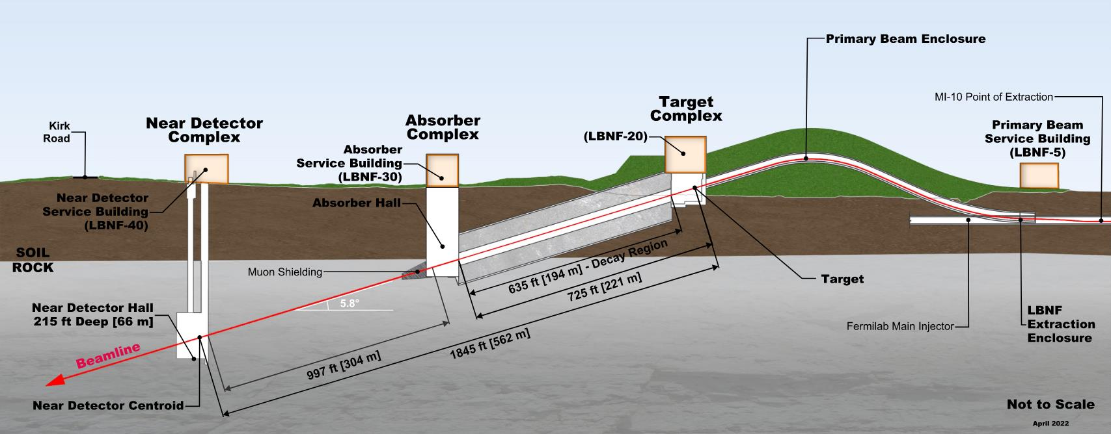
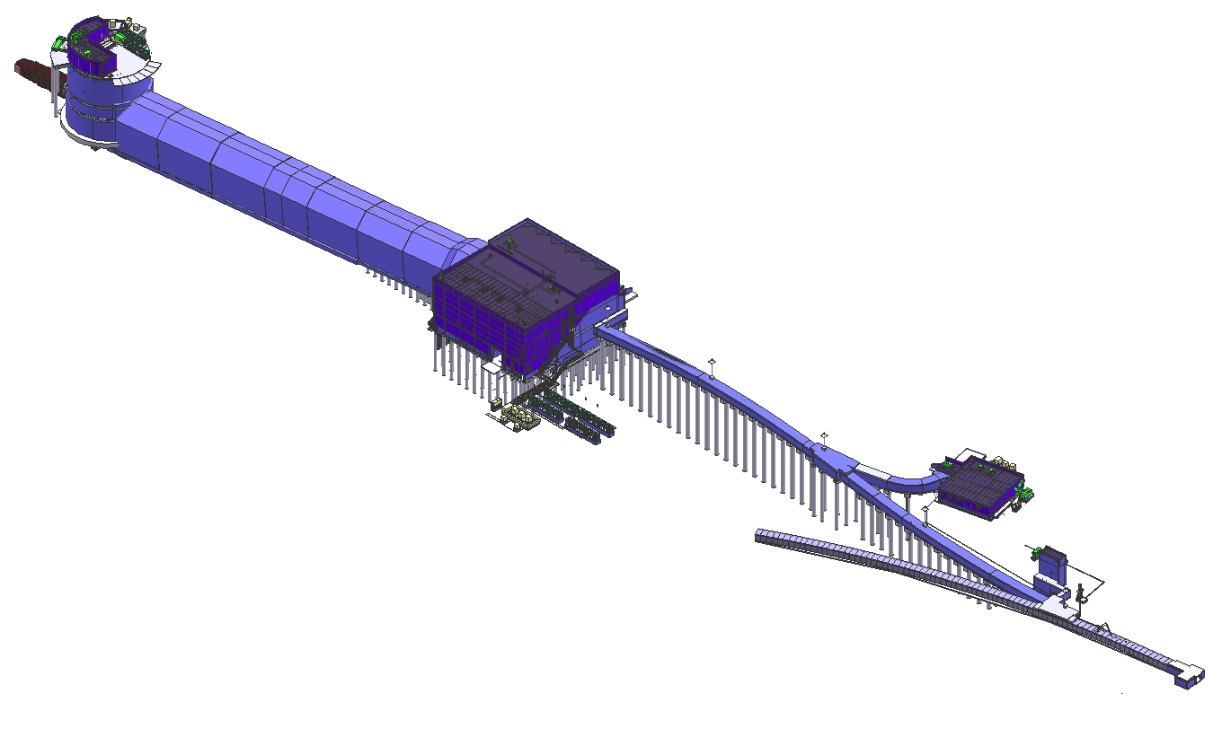
LBNF Beamline Construction
Absorber Complex
(LBNF-30)
Neutrino Beam
to SURF, SD
Absorber Complex Services:
Hadron Absorber
DS Decay Pipe Window
Hadron Monitor
Muon Monitors
Decay Region
Target
Complex
(LBNF-20)
Primary
Beamline
Enclosure
Primary Beam Service Building
(LBNF-5)
Target Complex Services:
Baffle
Target
Horns A, B, & C
US Decay Pipe Window
Beam on Target Instrumentation
Fermilab
Main Injector
Tunnel
Extraction
Enclosure
Primary Beam Services:
Beamline (magnets, vacuum, etc)
Primary Beam Instrumentation
Primary Beam Window
Proton Beam
From MI-10

Slide 6
Target Hall at LBNF-20 (Target Complex)
Removable
Steel Shielding
Sealed Hatch Covers
Morgue (Storage) Covers
Work
Cell
Beam
Decay Region Upstream Window
Primary Beam Window
Assembly
Baffle
Horn A with Target
Horn B
Cooling
Panels
Horn C
Steel Shielding

Slide 7
LBNF Beamline BID Irradiation Environment Parameter Table
Compnent Name | Material | Material Grade | LBNF Primary Beam Power Case (MW) | Required Lifetime (op year) | Peak dpa/year | dpa/life | Peak Fluence/year (p/cm^2) | Fluence/life (p/cm^2) | Mean peak temp (C)
Primary Beam Window | Beryllium | S200FH | 1.2 | 5 | 9.35E-02 | 4.67E-01 | 2.46E+21 | 1.23E+22 | 90
Target windows | Titanium | 6Al-4V Mill Anneal | 1.2 | 1 | 2.50E+00 | 2.50E+00 | 2.46E+21 | 2.46E+21 | 144
Target core | Graphite | IG-430 | 1.2 | 1 | 5.00E-01 | 5.00E-01 | 2.46E+21 | 2.46E+21 | 487
US Decay Pipe Window | Aluminum | 6061-T6 | 1.2 | 5 | 4.55E-01 | 2.27E+00 | - | - | 94
DS Decay Pipe Window | Stainless Steel | S304L | 2.4 | 30 | 1.19E-03 | 3.58E-02 | 2.24E+17 | 6.72E+18 | 107
Hadron Absorber | Aluminum | 6061-T6 | 2.4 | 30 | 3.10E-04 | 9.30E-03 | 2.24E+17 | 6.72E+18 | 70

Slide 8
Target Shield Pile Nitrogen Cooling
Nitrogen purge passes through T-Block Gaps.
Returns upstream to go through the Chase
N2 Shield pile purge along two sides
Each 7500 CFM
N2 purge above T-Blocks
15000 CFM
N2 to Stripline
10000 CFM
N2 Return through Chase
40,000 CFM total
H. Kanso, M. Slabaugh: FNAL

Slide 9
Target Hall Remote Handling
Components replaced with in-hall hot cell
Lead glass windows
Through-wall Manipulators (UKRI contributions)
Shielded Operations Center
Spent components stored in deep Morgue area
Stored until safe for over-road transport
Reconfigurable platforms for stacked storage
Provides temporary storage for T-block shielding
Remote vision system
Removable PZT cameras
Reconfigurable simple cameras
Mobile viewing station
Morgue (Storage) Covers
Morgue (Storage) Components
V. Sidorov, Keith Anderson: FNAL

Slide 10
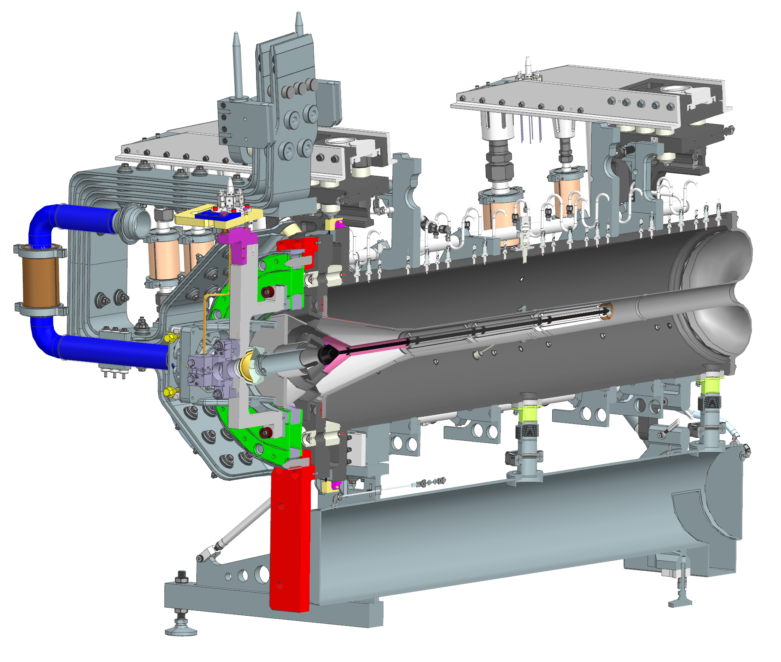
Target Integrated with Horn A and Support Module and requires careful Remote Handling Equipment

Slide 11
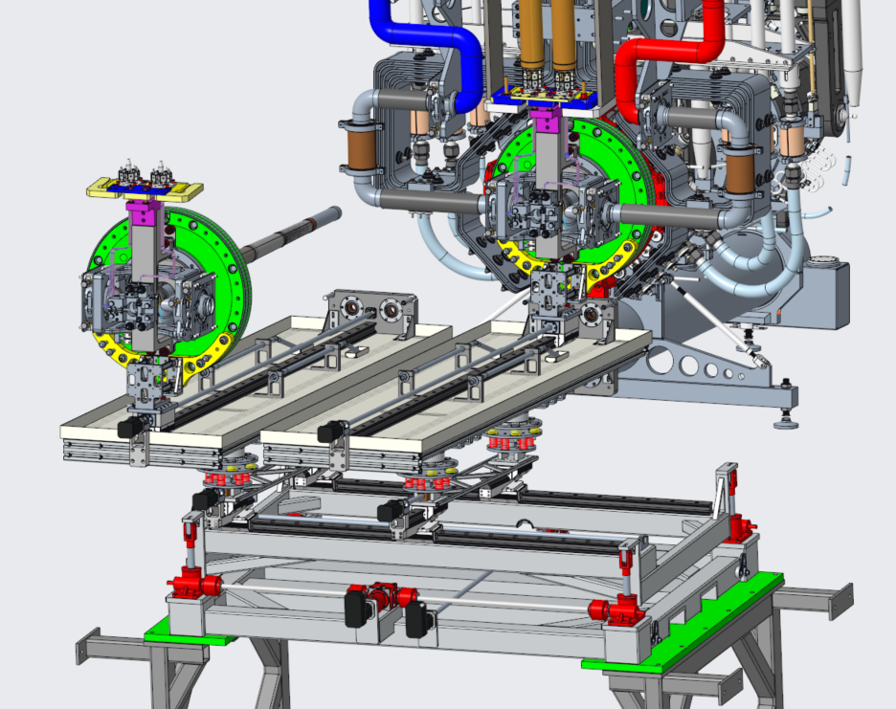
Target Exchanger Mechanism (UKRI-RAL) based upon T2K experience
E. Harvey-Fishenden; RAL

Slide 12
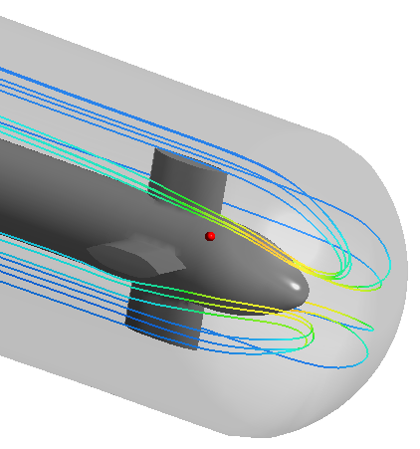
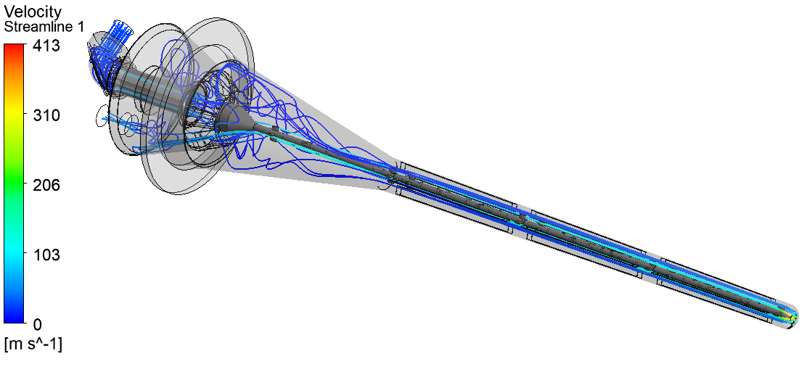
Target designed and built by RAL-UKRI (D. Wilcox talk earlier) Steady State Fluid
Peak Velocity = 413m/s
Peak Mach Number = 0.38
Pressure drop = 0.42bar
Target length = 1.5m
Beam power = 1.2MW
Inlet temperature = 35°C
Helium mass flowrate = 40g/s
Back-pressure at outlet = 4.5barA

Slide 13
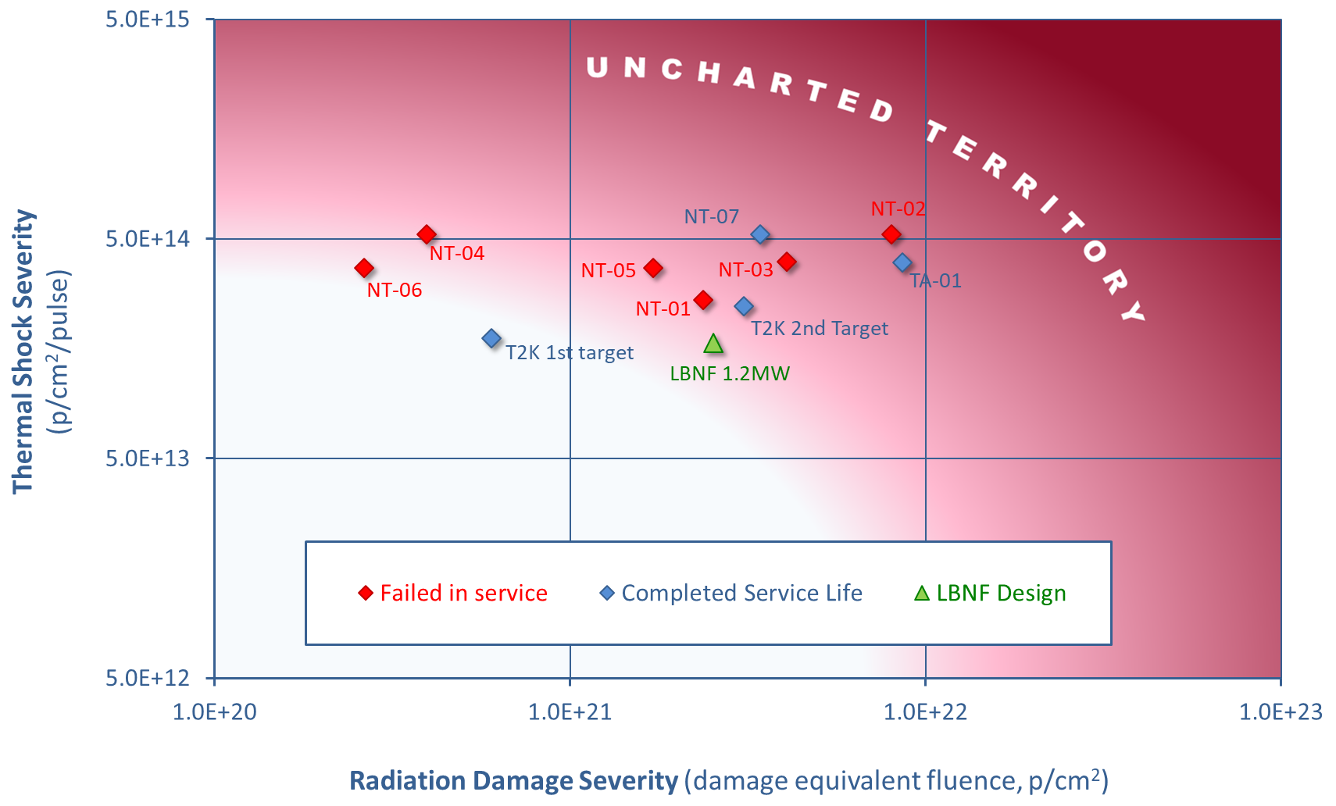
Radiation Damage
Limited relevant irradiated fatigue data for graphite
Operating experience at T2K gives confidence
The graphite core does not serve a safety function, but if it is damaged the neutrino output will be compromised
The likely graphite failure modes are:
Cracking due to thermal fatigue
Swelling due to irradiation
Large Beam spot means that beam intensity will be less severe than T2K or NuMI/NOvA
Peak graphite dose = 0.5 DPA per run year, from FLUKA simulations by John Back

Slide 14
LBNF Beamline BID Irradiation Environment Parameter Table
Compnent Name | Material | Material Grade | LBNF Primary Beam Power Case (MW) | Required Lifetime (op year) | Peak dpa/year | dpa/life | Peak Fluence/year (p/cm^2) | Fluence/life (p/cm^2) | Mean peak temp (C)
Primary Beam Window | Beryllium | S200FH | 1.2 | 5 | 9.35E-02 | 4.67E-01 | 2.46E+21 | 1.23E+22 | 90
Target windows | Titanium | 6Al-4V Mill Anneal | 1.2 | 1 | 2.50E+00 | 2.50E+00 | 2.46E+21 | 2.46E+21 | 144
Target core | Graphite | IG-430 | 1.2 | 1 | 5.00E-01 | 5.00E-01 | 2.46E+21 | 2.46E+21 | 487
US Decay Pipe Window | Aluminum | 6061-T6 | 1.2 | 5 | 4.55E-01 | 2.27E+00 | - | - | 94
DS Decay Pipe Window | Stainless Steel | S304L | 2.4 | 30 | 1.19E-03 | 3.58E-02 | 2.24E+17 | 6.72E+18 | 107
Hadron Absorber | Aluminum | 6061-T6 | 2.4 | 30 | 3.10E-04 | 9.30E-03 | 2.24E+17 | 6.72E+18 | 70
Ongoing studies at Birmingham/RAL/CCFE and FNAL/J-PARC on Ti alloys (fatigue), but need higher dpa and maybe fracture toughness(?)

Slide 15
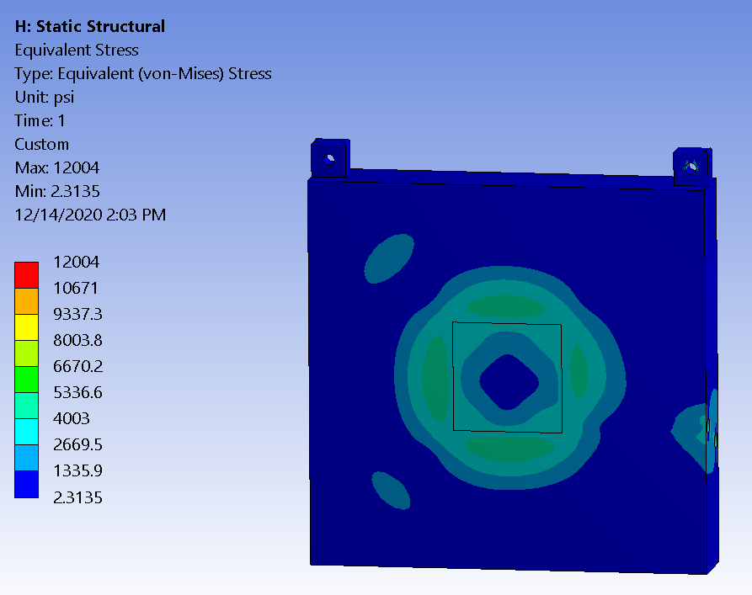
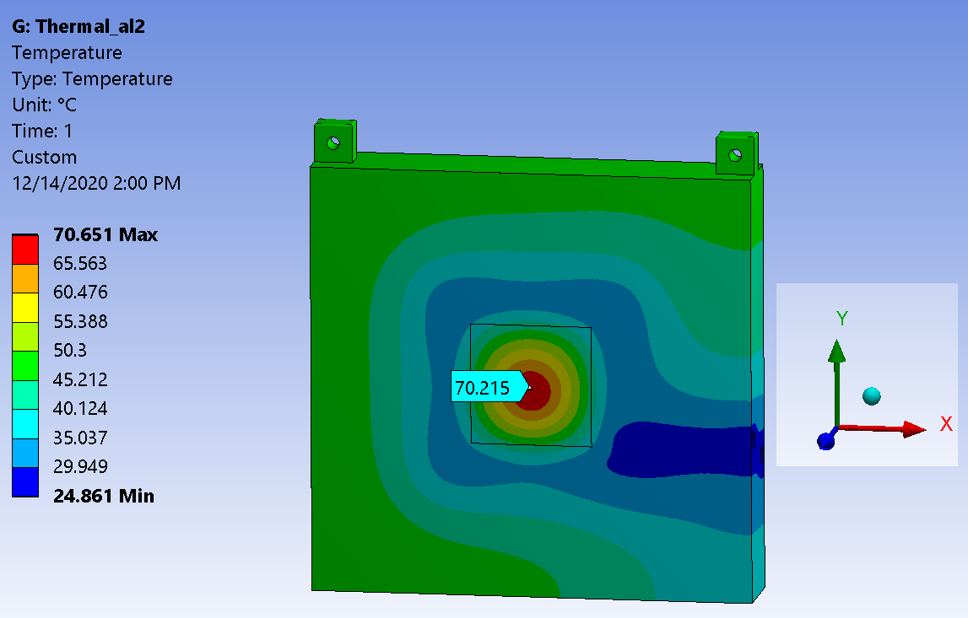
LBNF Absorber
Stress ~12 ksi <<40 ksi
Beam

Slide 16
LBNF Beamline BID Irradiation Environment Parameter Table
Compnent Name | Material | Material Grade | LBNF Primary Beam Power Case (MW) | Required Lifetime (op year) | Peak dpa/year | dpa/life | Peak Fluence/year (p/cm^2) | Fluence/life (p/cm^2) | Mean peak temp (C)
Primary Beam Window | Beryllium | S200FH | 1.2 | 5 | 9.35E-02 | 4.67E-01 | 2.46E+21 | 1.23E+22 | 90
Target windows | Titanium | 6Al-4V Mill Anneal | 1.2 | 1 | 2.50E+00 | 2.50E+00 | 2.46E+21 | 2.46E+21 | 144
Target core | Graphite | IG-430 | 1.2 | 1 | 5.00E-01 | 5.00E-01 | 2.46E+21 | 2.46E+21 | 487
US Decay Pipe Window | Aluminum | 6061-T6 | 1.2 | 5 | 4.55E-01 | 2.27E+00 | - | - | 94
DS Decay Pipe Window | Stainless Steel | S304L | 2.4 | 30 | 1.19E-03 | 3.58E-02 | 2.24E+17 | 6.72E+18 | 107
Hadron Absorber | Aluminum | 6061-T6 | 2.4 | 30 | 3.10E-04 | 9.30E-03 | 2.24E+17 | 6.72E+18 | 70
For Absorber, radiation damage effects in Al is not critical due to low dpa, except for physical properties (thermal conductivity). Possibility of collaboration on Al PBW at ORNL and Al windows at TRIUMF

Slide 17
Some observations on engineering design and standard compliance needs
Many of the recent RaDIATE studies have focused upon fundamental mechanisms of radiation damage effect, for good reasons:
Need to understand fundamental process and interactions to better predict and explain observed material behavior in our facilities
Lack of resources to do full engineering characterization and qualification of irradiated materials for every application and radiation environment
Lack of bulk volume irradiation and PIE facilities
This is not likely to change in the near to mid-future.
Engineers need to design and qualify targetry materials now to meet the near-future accelerator target facility project timelines
There is increasing pressure for design and operations engineers to show that designs and fabrication comply with national consensus standards, such as ASME BPVC

Slide 18
How to incorporate radiation damage into standards compliance
At Fermilab, we have safety policies that allow design and fabrication of vessels that provide the same “level” of safety and quality assurance of the applicable national consensus standard. Caveats:
Unlisted material
Physics limited geometries that do not fully satisfy the applicable standard
Necessary fabrication processes which cannot meet exact quality assurance (inspection) criteria
However, incorporating radiation damage effects has, to date, either not occurred or has been limited
Lack of irradiated data
Difficult to model gradients of radiation damage across the beam interaction continuum
Almost impossible goal of showing complete compliance to ASME BPVC Section VIII (which is aiming to produce vessels that never fail) – And does not address radiation dose dependent material behavior

Slide 19
How does ASME BPVC Section III (Rules for Constructions of Nuclear Facility Components) Consider Radiation Effects?
From very recent, very quick review it appears that Section III primarily utilizes a method of
Damage/flaw tolerance
Monitoring and Licensing periods
E.g. Minimum detectable flaw size and fracture toughness
Section III suggests a ¼ wall thickness flaw should be tolerable by ensuring fracture toughness of the pressure bearing vessel wall is greater than the K_{Ic} of the material at the end of the licensing period
IE If there is an existing crack in the vessel, or one develops, up to ¼ of the wall thickness, the crack will not propagate
Uses operational experience and fracture toughness data to arrive at a conservative licensing period
Include fracture toughness samples in reactor neutron field to monitor
If fracture toughness samples display enough toughness left as licensing period end approaches (as well as many other criteria), the reactor can be re-licensed for an extended period
Section III allows for increasing operating temperature to take advantage of increased ductility (fracture toughness) at higher temperatures (and this has been done at operating reactors!)

Slide 20
How does this inform our design/QA compliance efforts?
Within RaDIATE studies for targets, absorbers, and beam windows, we have been researching radiation effects on design properties (tensile, thermal, dimensional, fatigue)
Our devices are designed to avoid stress concentrations and notches
Our irradiated volumes are relatively small (just beam spot interaction regions)
Our devices are, for the most part, replaceable and can run to failure without significant consequences
Our devices are not usually part of the life-safety boundary (envelope)
However, adopting a reasonable flaw or damage tolerant approach may be very beneficial for compliance efforts and help focus QA programs
What is our minimum detectable flaw in, say, a beam window?
If we assume that flaw in the beam center region, what is the stress intensity?
What are fracture toughness limits for our dynamic beam pulse loading environment?
Can we say anything about fracture toughness from the data we already have (tensile or bending behavior)?

Slide 21
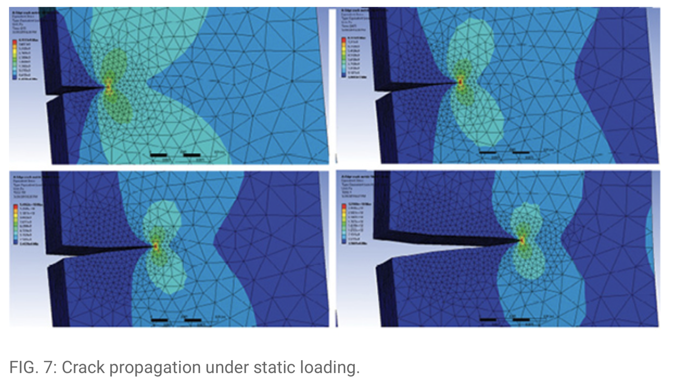
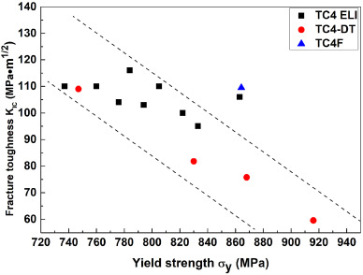
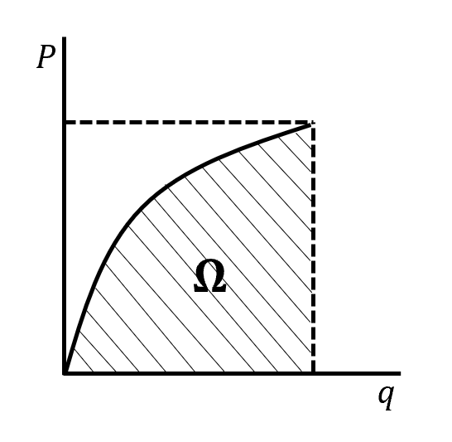
Stress Intensity is Calculable
Assuming a max flaw size possible, stress intensity can be easily calculated
Non-irradiated Ti critical stress intensities are available
https://www.digitalengineering247.com/article/get-cracking-with-ansys-workbench-19.2/
Stress Intensity factor directly proportional to energy release rate, G
Fuwen Chen, Yulei Gu, Guanglong Xu, Yuwen Cui, Hui Chang, Lian Zhou, Improved fracture toughness by microalloying of Fe in Ti-6Al-4V, Materials & Design, Volume 185, 2020,

Slide 22
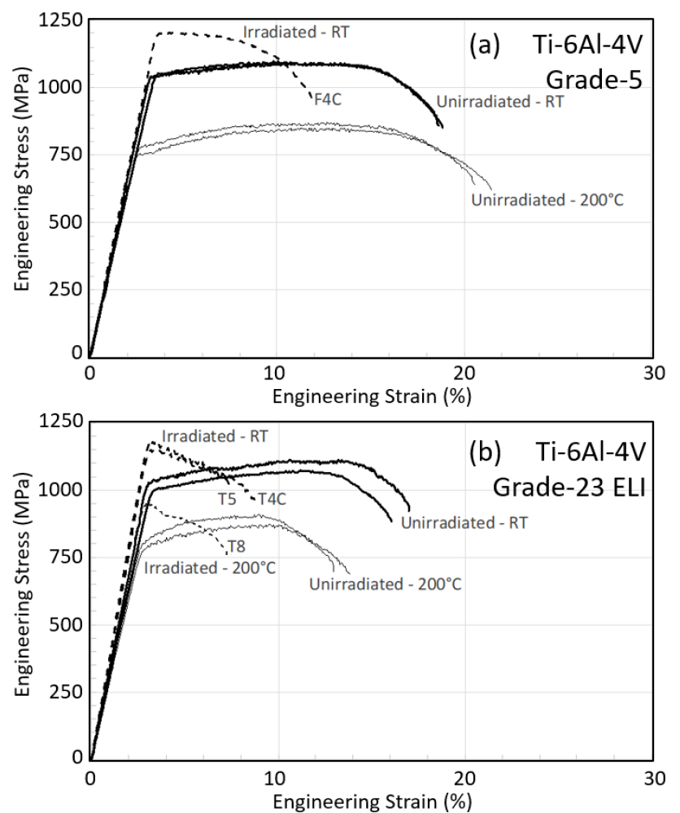
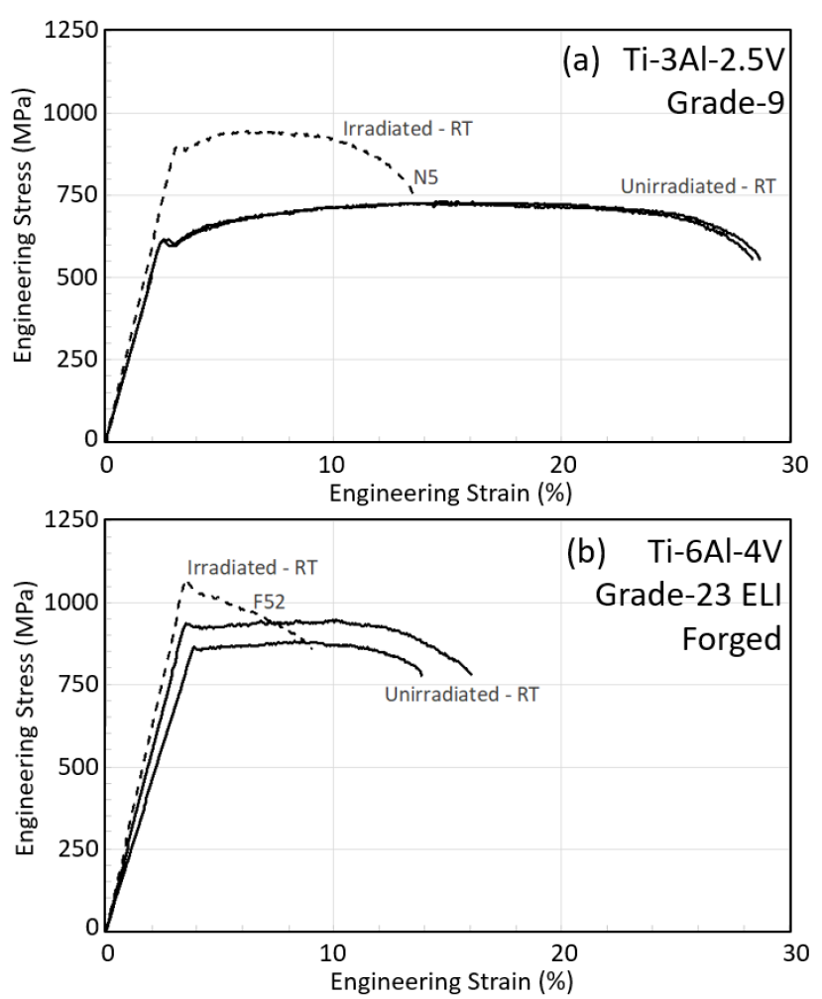
Can we get relative decrease in fracture toughness from tensile data for irradiated materials?
F4C=0.06 dpa at Tirr=47°C
N5=0.22 dpa @112°C
T4C=0.06 dpa @ 47°C,
T5/T8=0.23 dpa @ 125°C
F52=0.22 dpa @112°C

Slide 23
Conclusion
LBNF Target Facility Overview provided
BID radiation environment provided
Can we use an ASME Section III approach to show “same level of safety as provided by national consensus standards” for irradiation effects integration?
Suggest to refresh fracture mechanics and do some exploratory studies for a real-world beam on target application
Sujit Bidhar at Fermilab is just starting some literature review (slide in F. Pellemoine’s talk)
Future crack propagation test at HiRadMat proposal under development at FNAL
Collaborators welcome!

Slide 24
Back-up slides follow
H. Kanso, M. Slabaugh: FNAL
H. Kanso, M. Slabaugh: FNAL

Slide 25
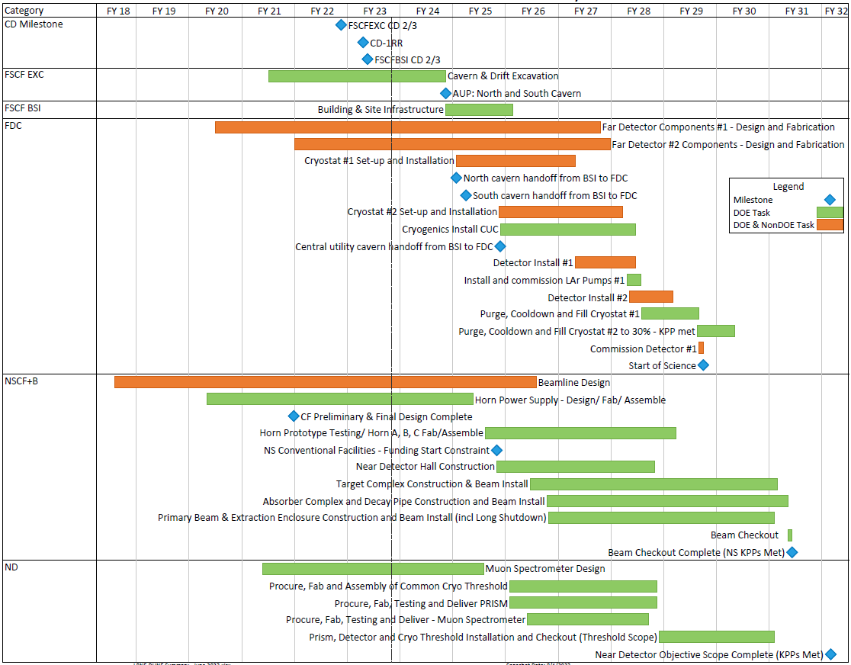
Summary Schedule with Critical Path
Far Site
Notes:
Fiscal Year display
June 2023 reporting cycle
Based on “CD-1RR ESAAB” funding profile
Early completion dates shown
Near Site

Slide 26
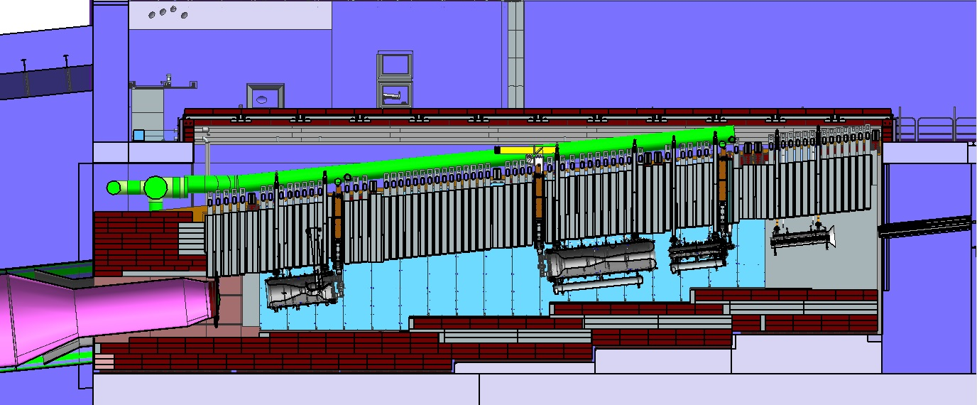
Target Hall at LBNF-20 (Target Complex)
Removable
Steel Shielding
Work
Cell
Sealed Hatch Covers
Beam
Decay Region Upstream Window
Horn A with Target
Primary Beam Window
Assembly
Steel
Shielding
Cooling
Panels
Baffle
Horn C
Horn B

Slide 27
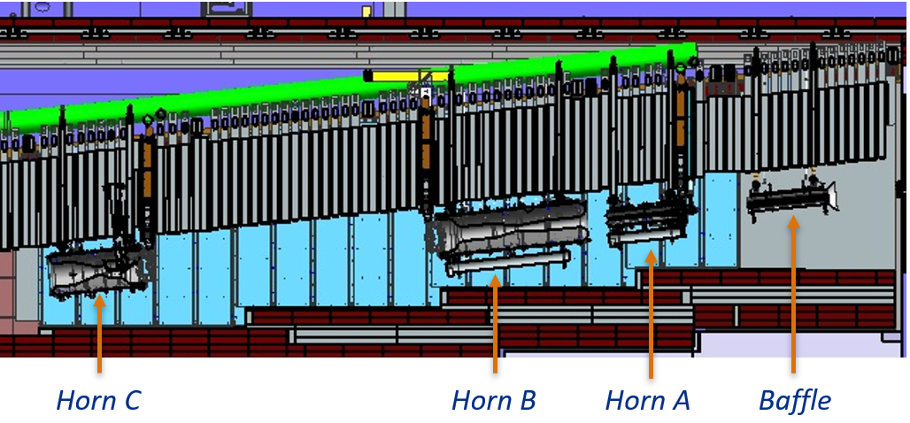
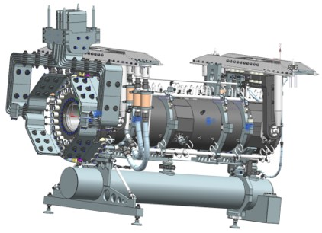
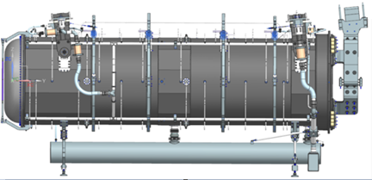
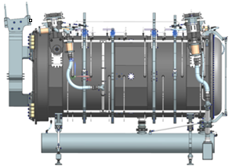
Overview of LBNF Horns
Three horn focusing system
Horn A followed by Horn B and Horn C
Pulsed at 300 kA
Designed for 1.2 MW and upgradeable to 2.4 MW
Horn B is largest horn to be built at Fermilab
4.5 m long and 1 m diameter
Horn C has same diameter as Horn B
Horn A
Horn B
Horn C

Slide 28
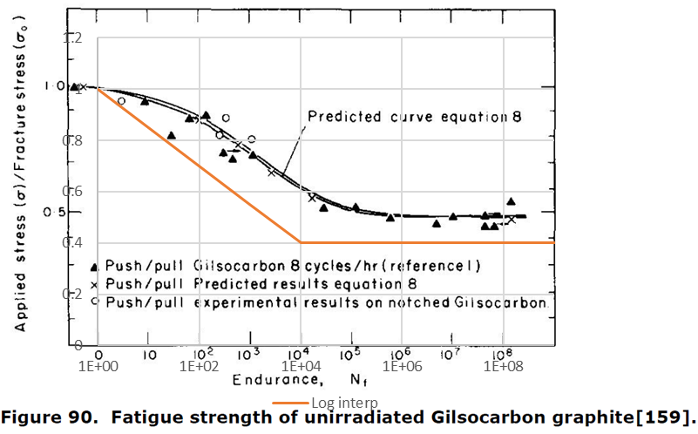
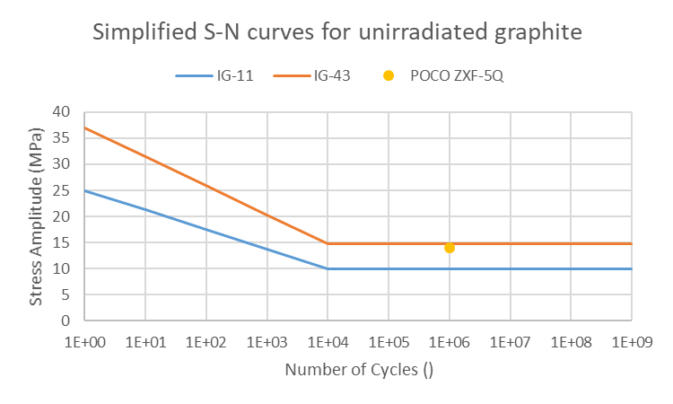
Available Fatigue Data – Graphite
Data for nuclear grade graphite (tested on Gilsocarbon) from [1] applied to IG-11 and IG-43
Endurance limit is approximately 50% of UTS, we assumed 40% to account for scatter
Tensile strength of POCO ZXF-5Q is 79MPa, so fatigue strength would be expected to be higher than for IG-43, but the one value given by Bidhar et al. suggests that it is similar [2]
Pulse cycles per year | 1.5E+07
Trip cycles per year | 5.0E+03
[1] “Literature Review On The Irradiation Response Of Be, W And Graphite for Proton Accelerator Applications”, NNL (13) 12703, Issue 1, 2013
[2] “Failure investigation of nuclear grade POCO graphite target in high energy neutrino physics through numerical simulation”, S. Bidhar et al., Nuclear Materials and Energy, 2020

Slide 29
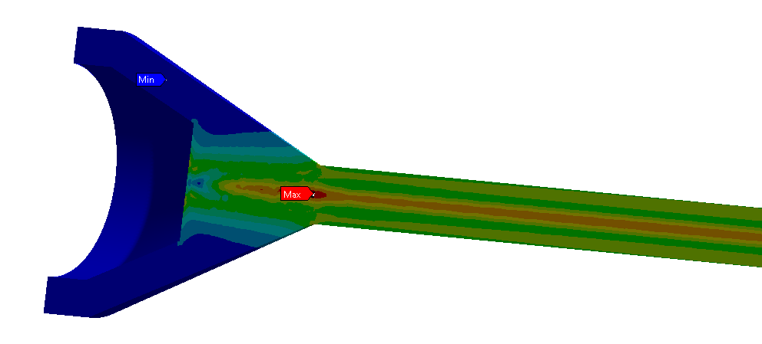
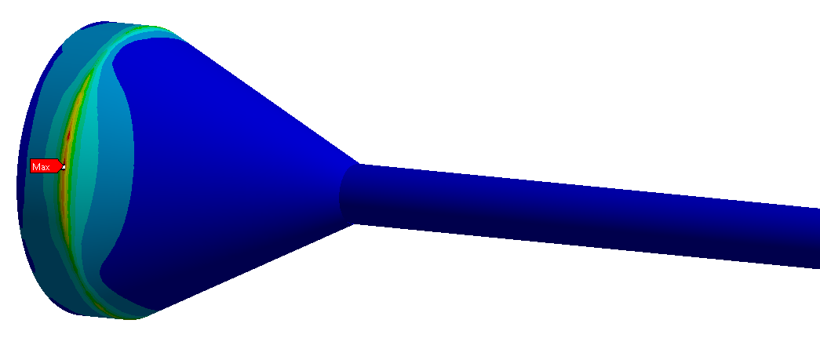
Results – Graphite Fatigue
Limits based on unirradiated data
Equivalent SE (MPa) | Design Limit | ANSYS Result
Target Pulses | 15 | 0.9
Target Trips | ~15 | 10.8
Target Trips, No Stress Conc. | ~15 | 1.0

Slide 30
Irradiated Titanium Data
Increase in UTS, but rapid loss of ductility. Results based on stress linearisation may no longer be conservative.
Tensile-tensile irradiated fatigue tests will also capture some effect of tensile strength.
No guidelines in ASME BPVC for how to account for radiation damage.
F4C=0.06 dpa at Tirr=47°C
N5=0.22 dpa @112°C
T4C=0.06 dpa @ 47°C,
T5/T8=0.23 dpa @ 125°C
F52=0.22 dpa @112°C
“Tensile behavior of dual-phase titanium alloys under high-intensity proton beam exposure: radiation-induced omega phase transformation in Ti-6Al-4V”, T. Ishida et al., Journal of Nuclear Materials, 2020

Slide 31
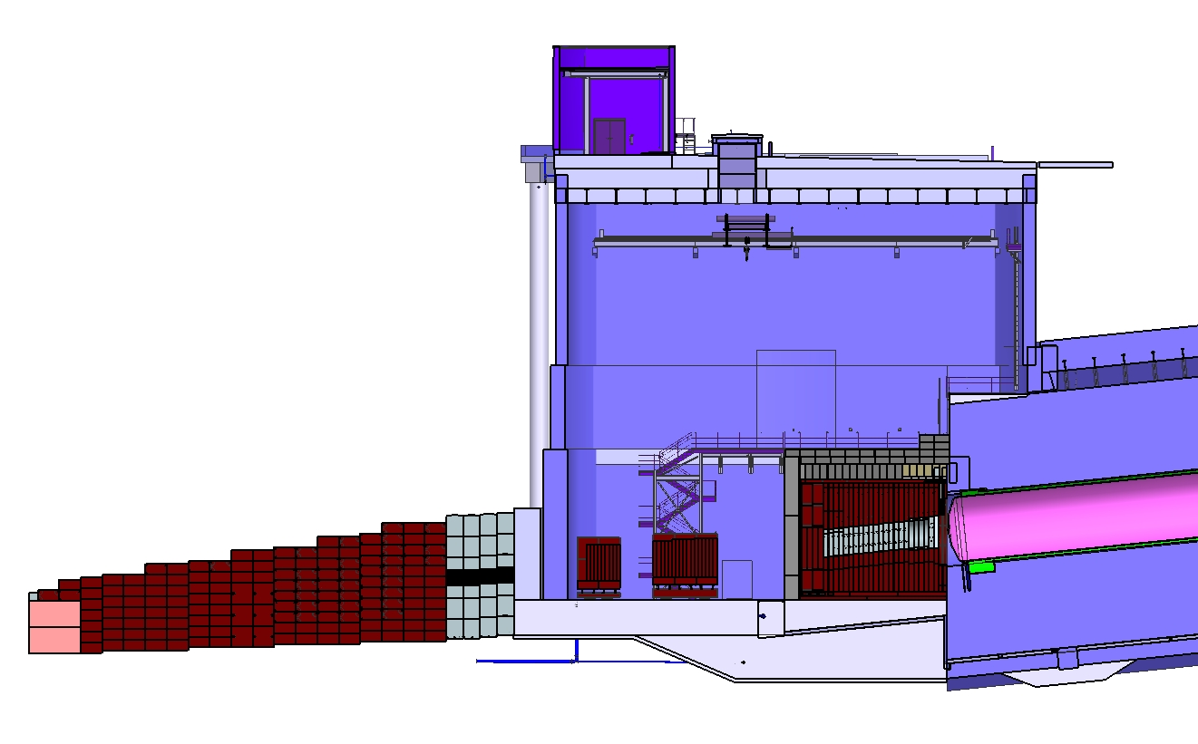
LBNF Absorber Facility and Downstream Decay Pipe
Surface
Hatch
Absorber
Service
Building
Absorber
Hall
Muon
Monitors
with
Shielding
Muon
Steel
Shielding
Neutrino Beam
to SURF, SD
Hadron
Absorber
DS Decay Pipe Window
Decay Region
Nitrogen Cooling
Decay Region
Helium Vessel

Slide 32
Target Shield Pile Overview
Battlement + Hatch Covers + Poly Covers
Carriage Beams
T-Blocks:
73 Weldments.
Total Weight ~ 1144 Ton.
Supported on TSP.
Target Shield Pile:
Total Weight ~ 8074 Ton.
Carriage Beam
8 Cross Beams.
Supported off Concrete Structure.
Target Shield Pile
T-Blocks
Water cooling Panels
Concrete Structure
H. Kanso, M. Slabaugh: FNAL

Slide 33
Primary Beam Window dpa scaling

