Slide 1
LBNF Beam Windows and Remote Handling R&D Needs
11/9/23
Quinn Peterson
HPTW 2023

Slide 2
Overview
LBNF Upstream Decay Pipe Window
  Design overview and 2.4 MW operation
  All Aluminum Window Analysis
LBNF USDPW Remote Handling
  System Requirements
  Subsystem Design Status
  Design Challenges

Slide 3
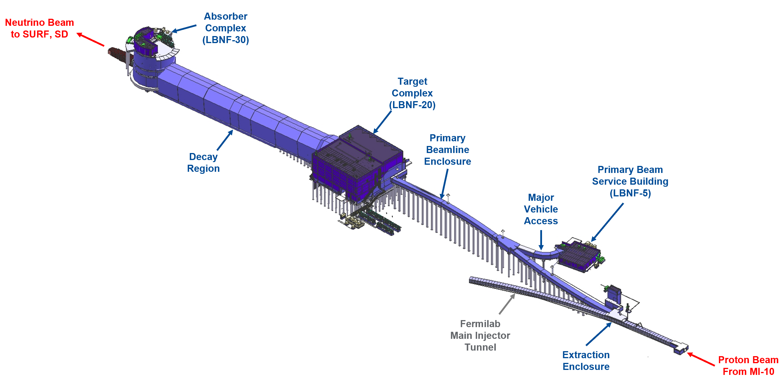
LBNF Target Facility and Beamline Overview

Slide 4
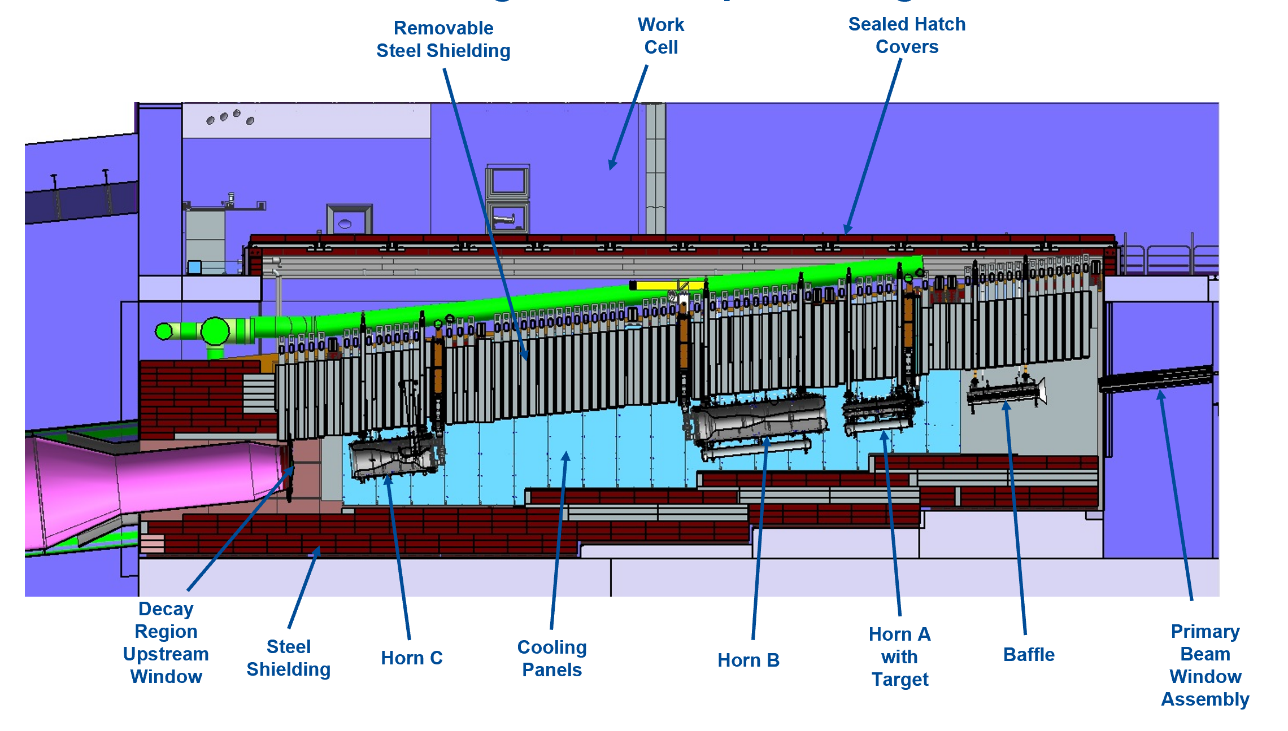
LBNF Target Facility and Upstream Decay Pipe

Slide 5
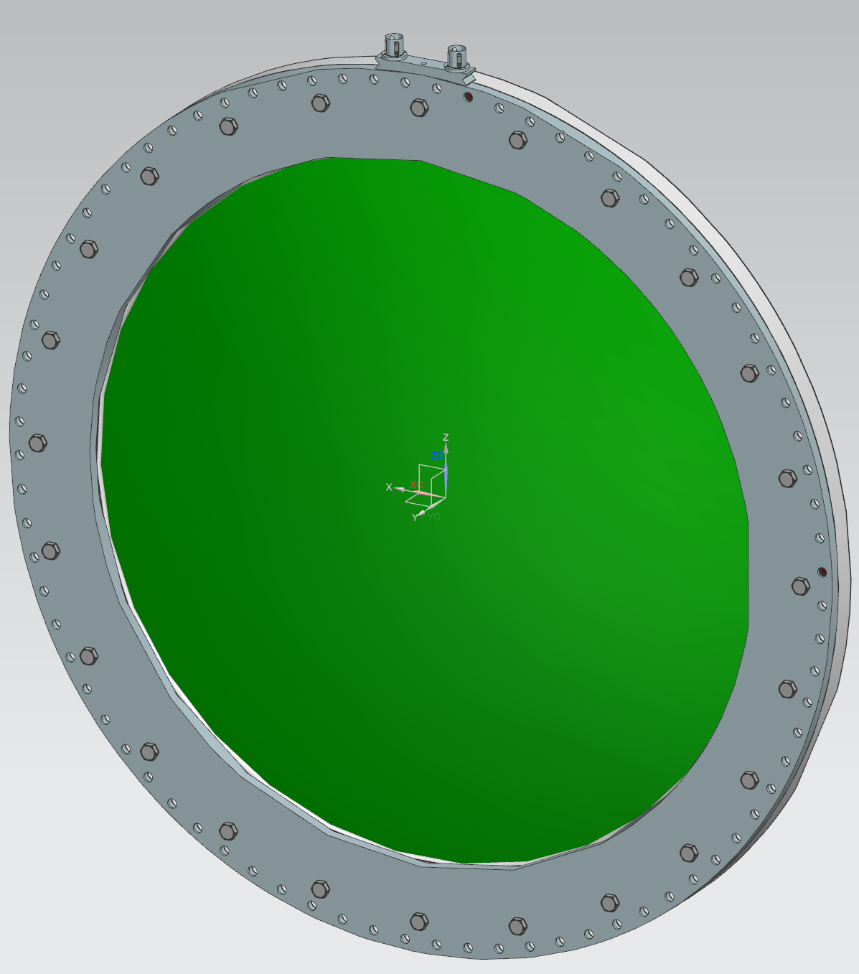
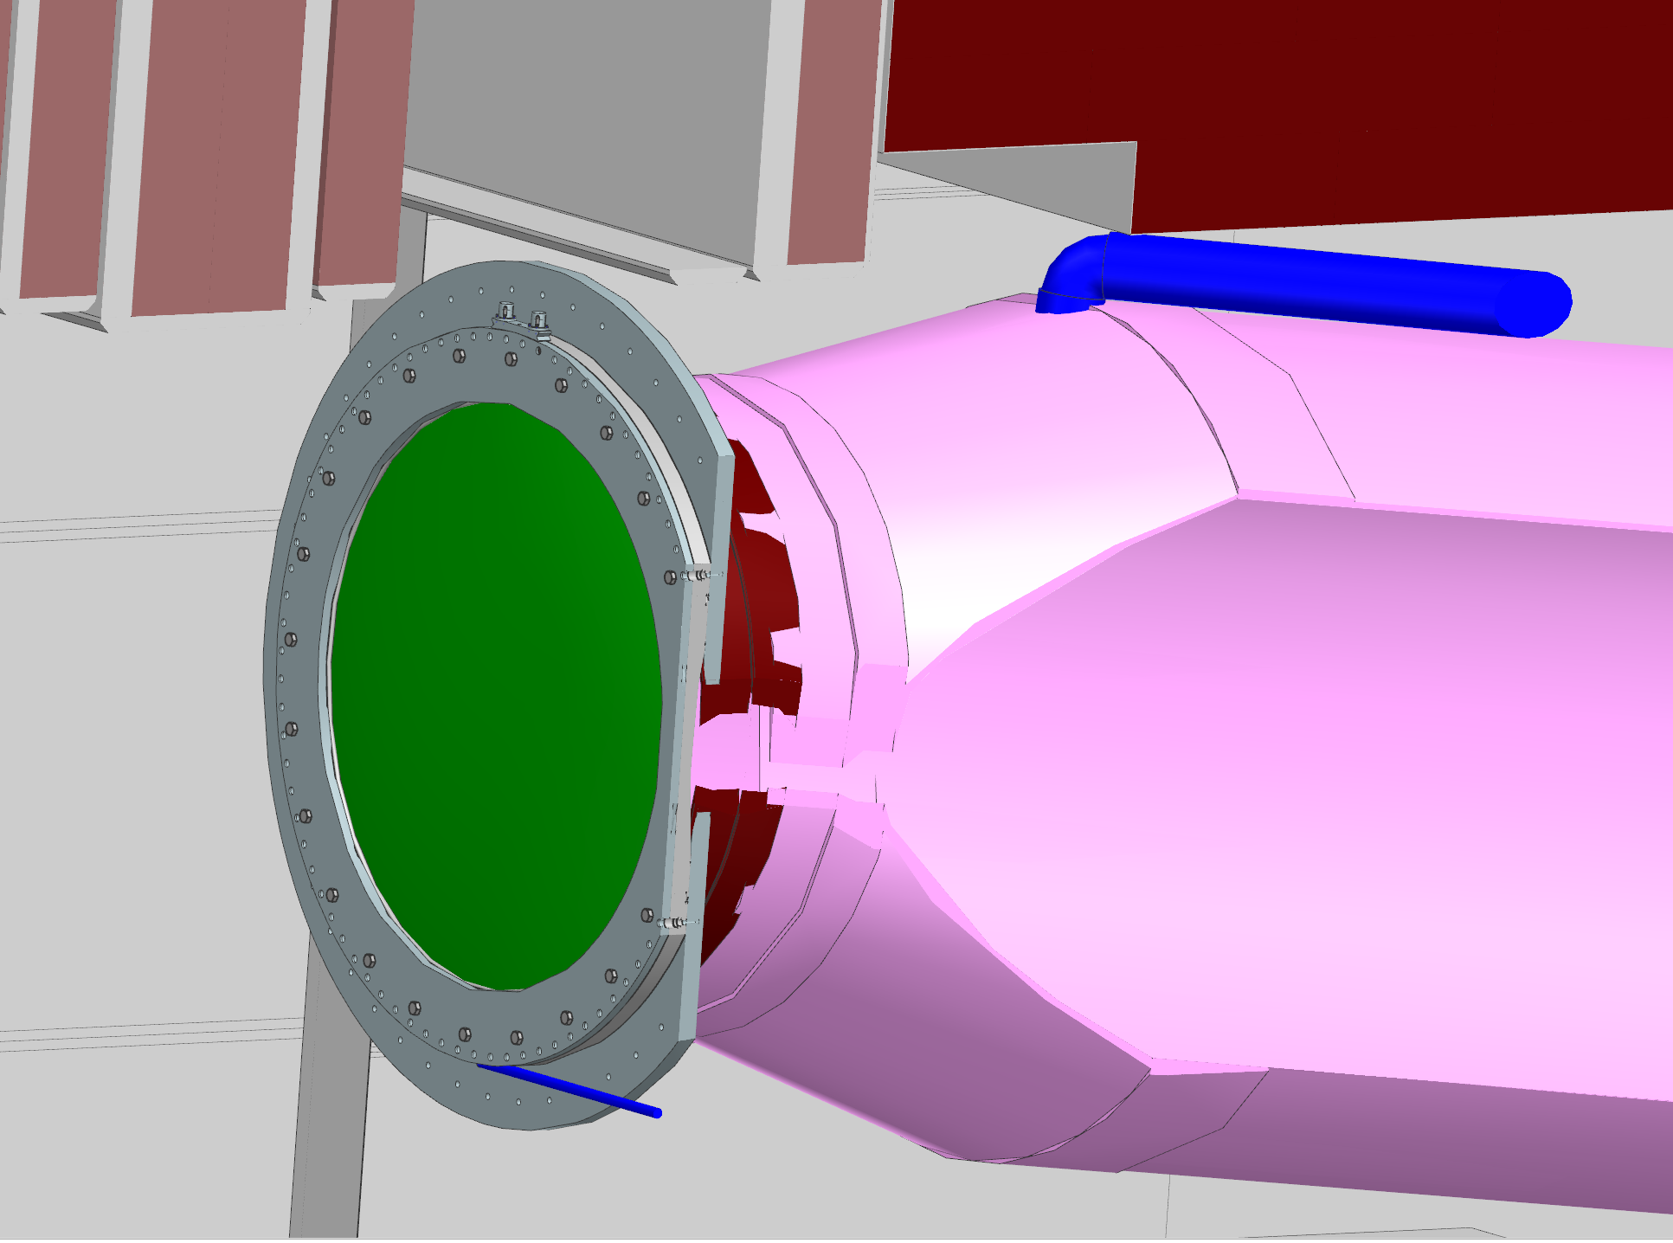
USDP Window Design Overview
Decay Pipe Internal Pressure.
  Ranges from 3 to 5 psig
Bolt hole pattern diameter
  70 in (1.78 m)
Aluminum Window Diameter:
  1.5 m (~4.9 ft)
Aluminum Window Thickness:
  1.5 mm (~0.06 in)
Outer Flange Diameter:
  1.8 m (~5.9 ft)
Window Desired Lifespan:
  5 Years
Window Weight:
  154.59 kg (~341 lbs)
Designed for accident condition of 2 No-Target pulses

Slide 6
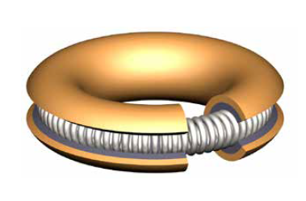
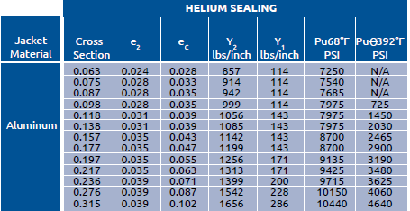
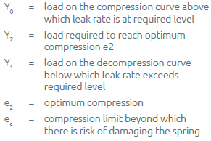
The Seal – Helicoflex HN100 Seal
Aluminum Ring Seal:
1542 lbs/in Compression Force
  27.5 kg/mm
Max 5 psi differential across seal
Total circumference = 222.61 in (5.65 m)
Seal Diameter = 67 in (1.7 m)
Total Seal Compression
  343269.64 lbs (155704 kg)
  w/ 80 bolts = 4290.87 lbs/bolt
Manufacturer Rated T_Max = 200 C
Experience shows additional force may be required for adequate seal compression
Testing is scheduled for verifying compressive force required for application

Slide 7
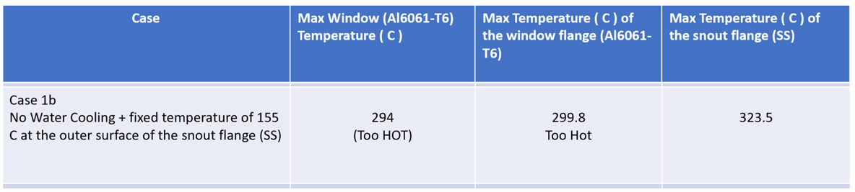
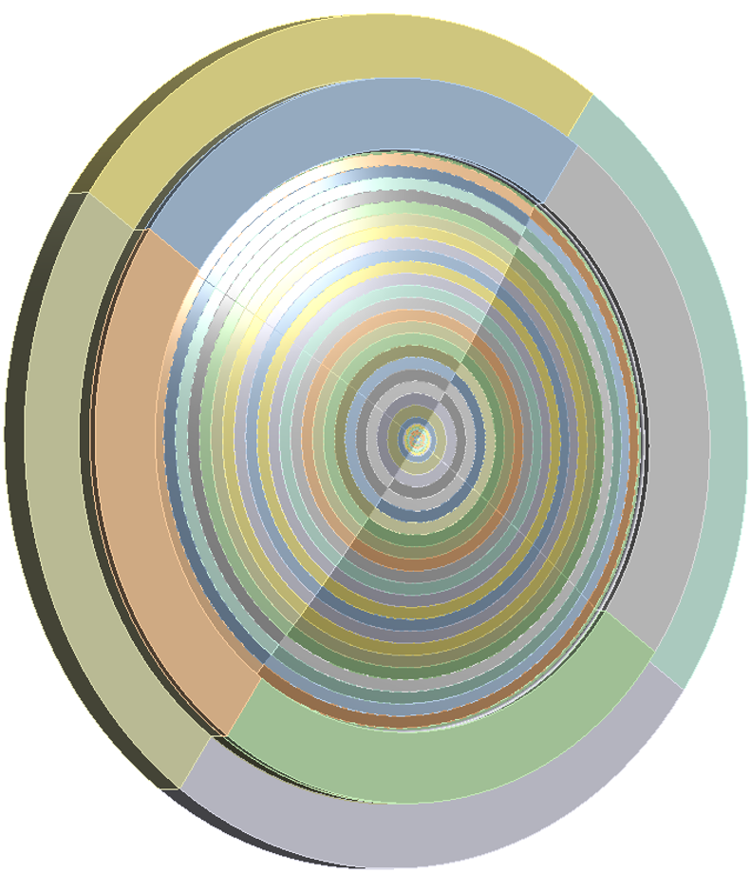
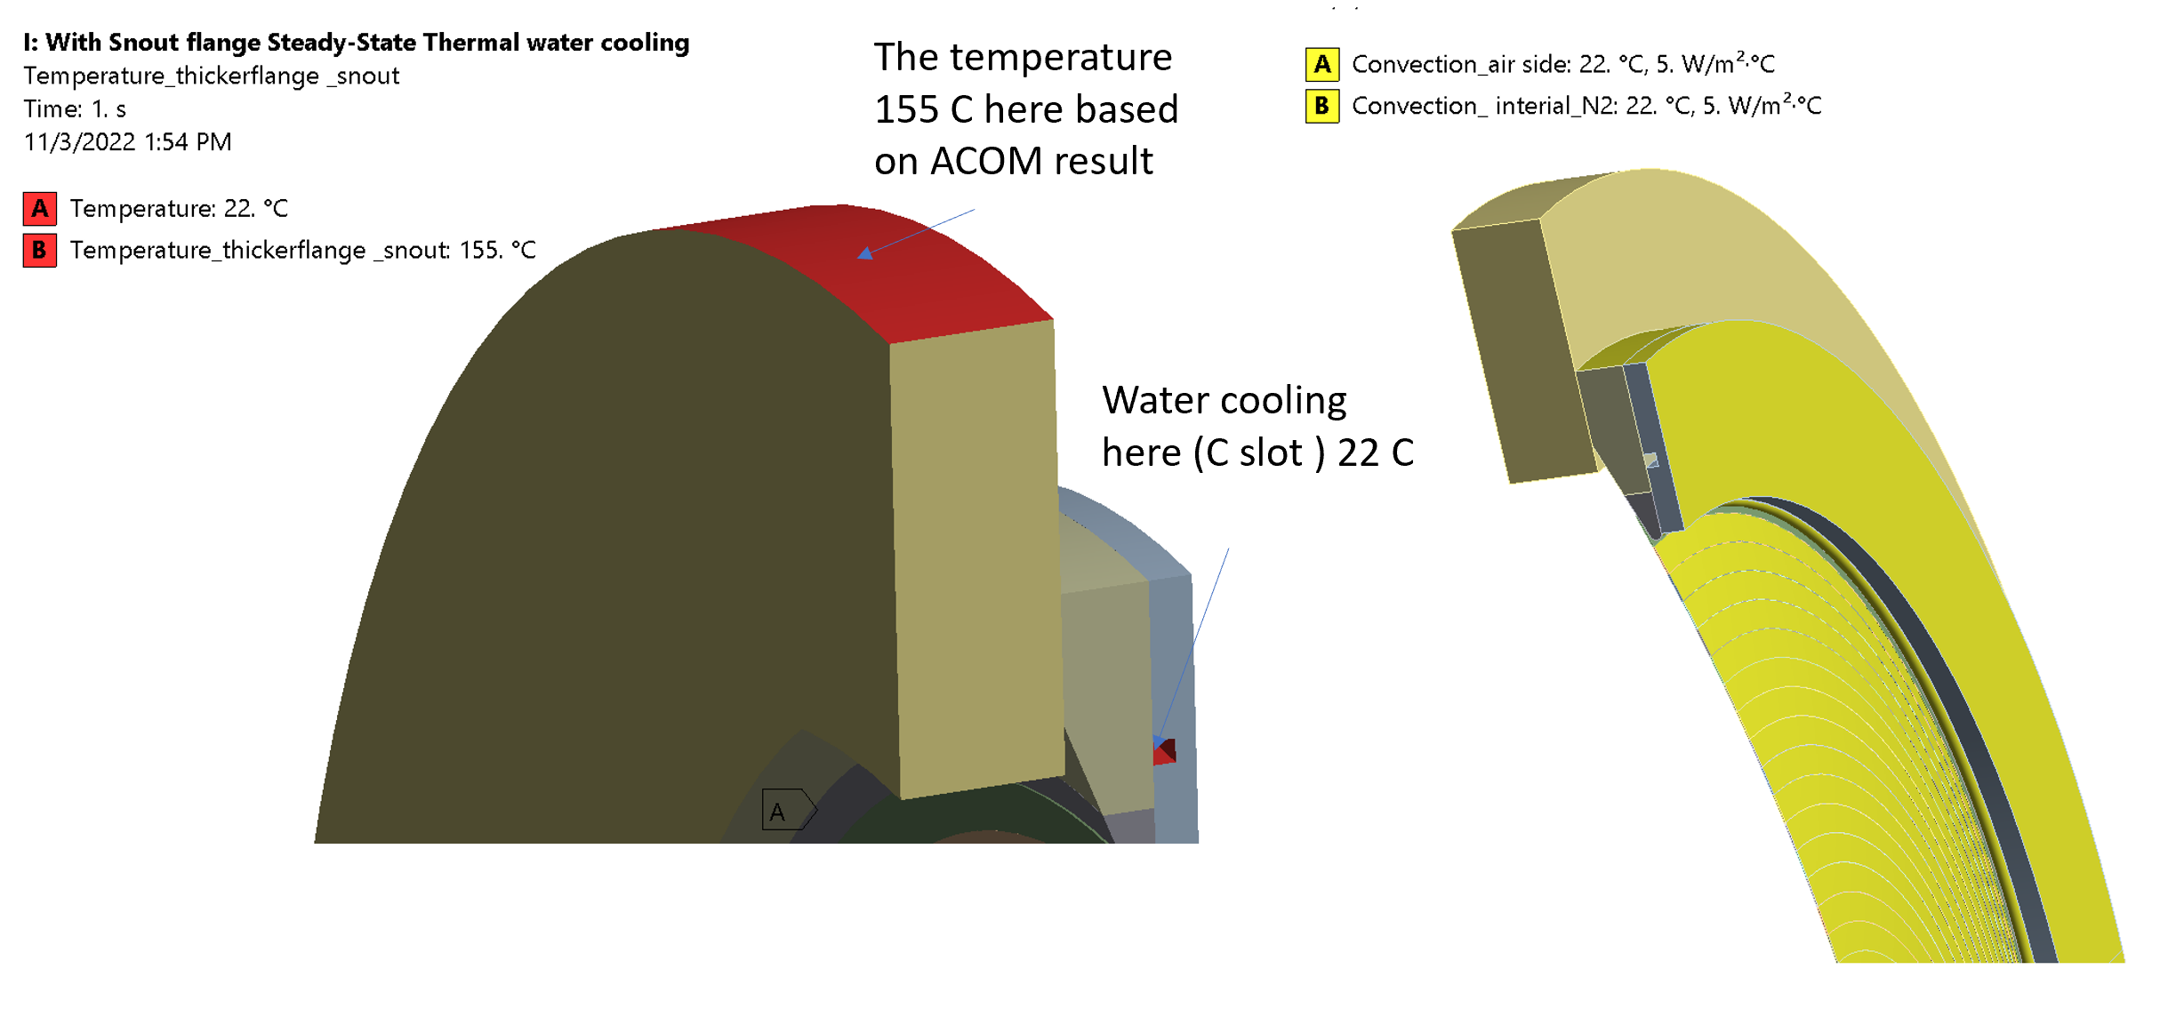
2.4 MW Beam Operation
Initially believed that an upgrade to a beryllium brazed center would be necessary for 2.4 MW beam operation. Require increase in R&D time and cost.
Analysis Parameters:
  2.4 MW Beam Parameters
  5 Accident Pulses No Target
  Beam center offset by 14.5 mm
  Convection cooling: 5 W/m^2
Results from original analysis show window flange is too hot
  Exceeds manufacturer rated temperature allowed for Helicoflex Seal
Necessitates cooling if 2.4 MW operation is desired for all aluminum

Slide 8
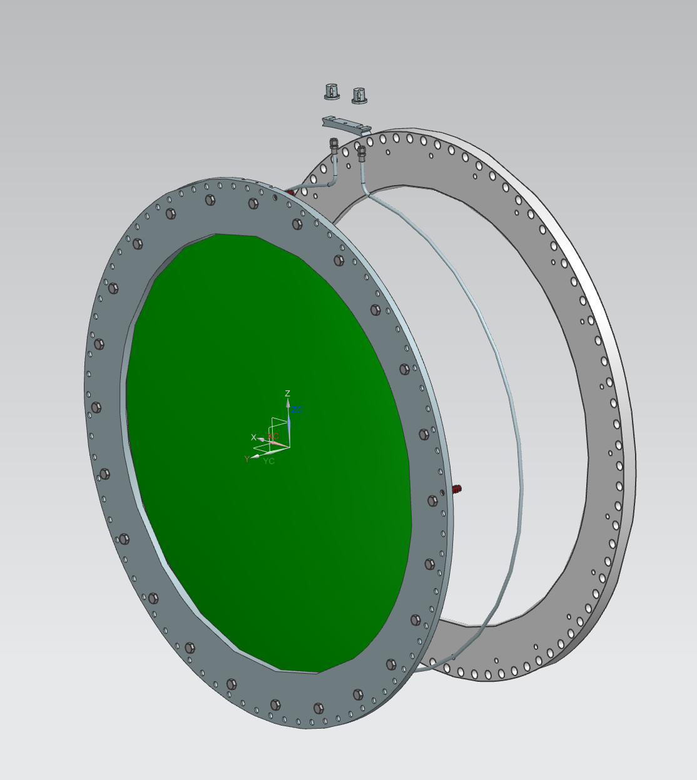
Cooling Loop Configuration
Cooling loop designed to be built into flange of USDPW.
Allows for removal should a leak be detected
Heat Density
  130 kW/m^3

Slide 9
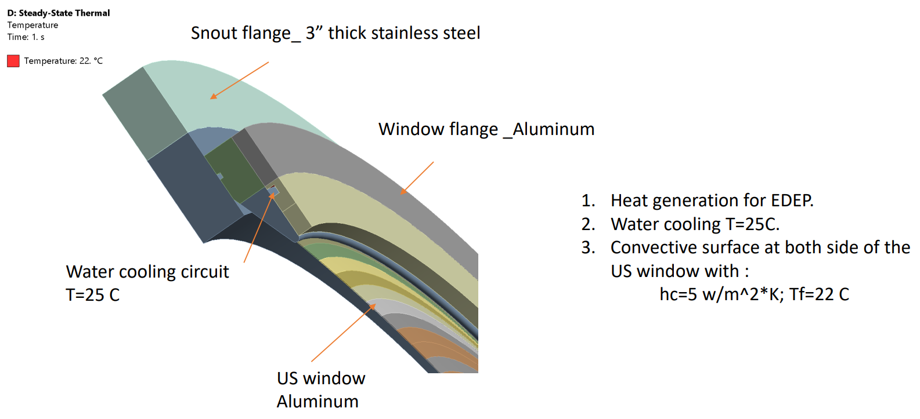
Thermal Analysis with Cooling Loop
Analysis Boundary Conditions:
  Steady State Thermal Analysis
  EDEP generated from MARS analysis
  Water Cooling Channel held at 25 C
  Convective cooling on both sides of USDPW
Beam Parameters:
  1.8m Target
  120 GeV proton beam
  1.2 second spill cycle
  1.5e14 protons/spill

Slide 10
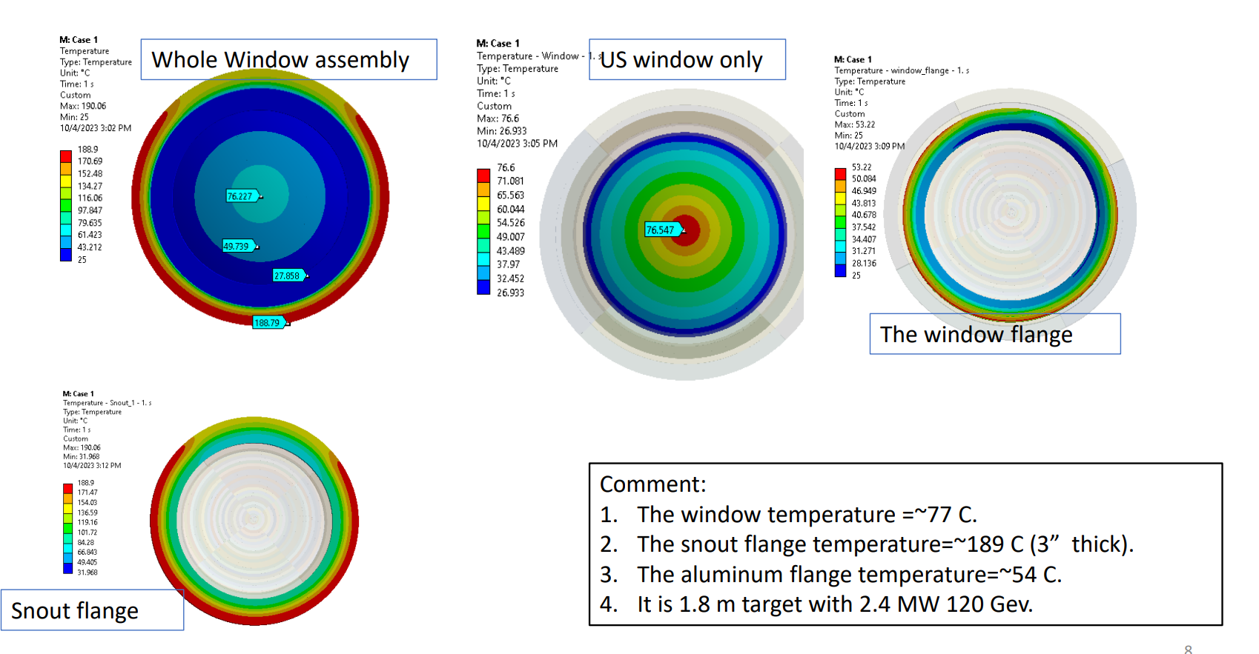
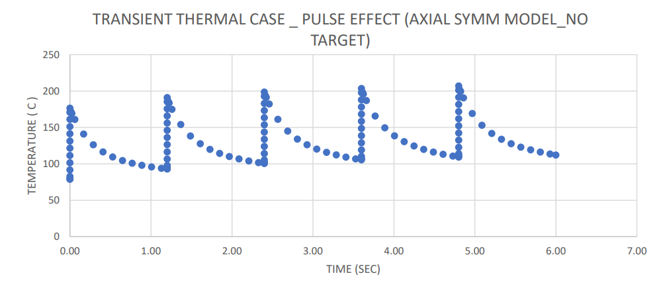
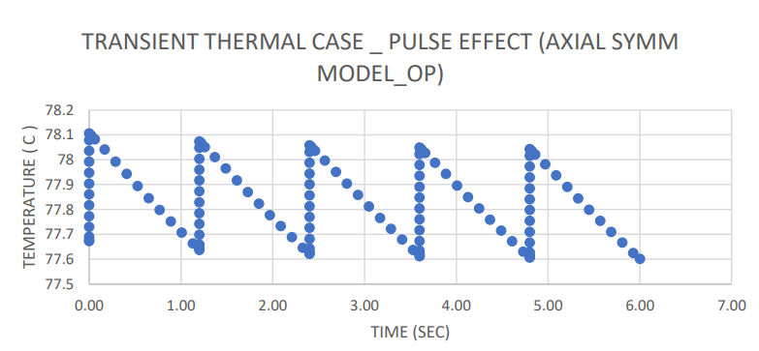
Thermal Results
Results:
  Nominal Operation:
    Window Temperature @ center
      77 C
    Snout Flange T_max = 189 C
      Location of Helicoflex Seal
      Below the 200 C manufacturer requirement
  Accident Condition:
    5 Accident Pulses
    ∆T=~120 C / Pulse
    Window T_max = 211 C after 5 accident pulses
  Cross checked with axial symmetric model for accident case and results are consistent with 3-D analysis

Slide 11
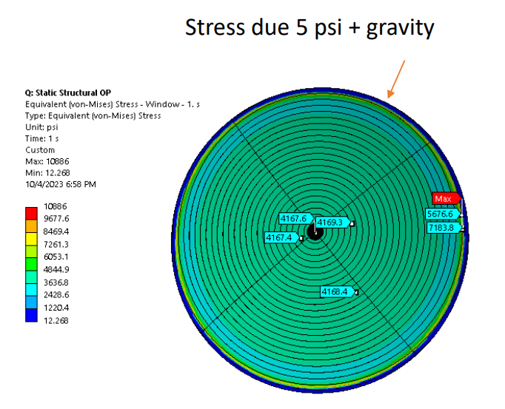
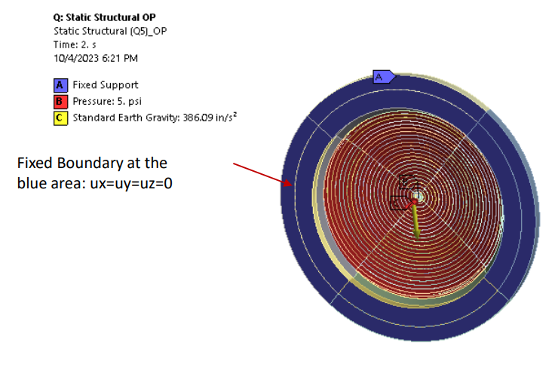
Structural Analysis
Analysis Boundary Conditions:
  5 psi internal pressure
  Thermal load due to beam heating
  Allowable stresses defined by ASME II D 2021

Slide 12
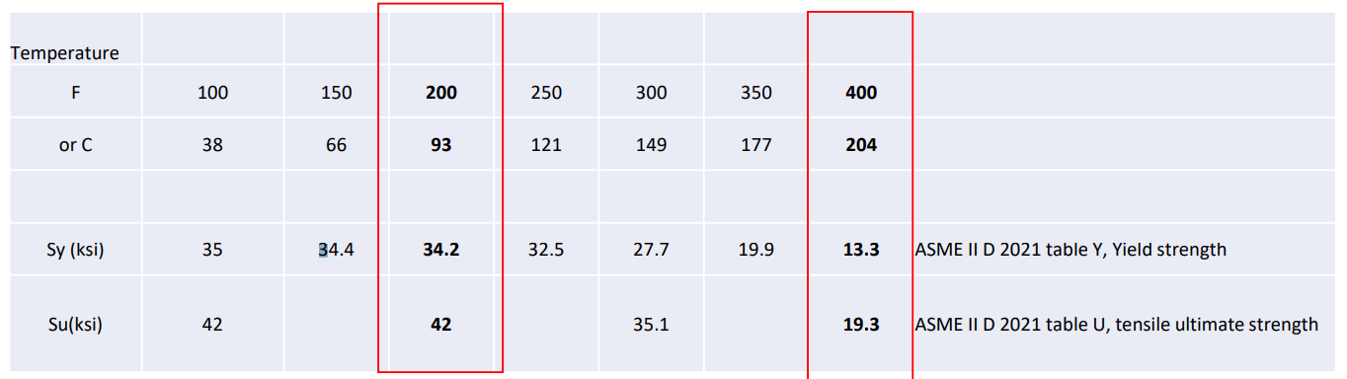
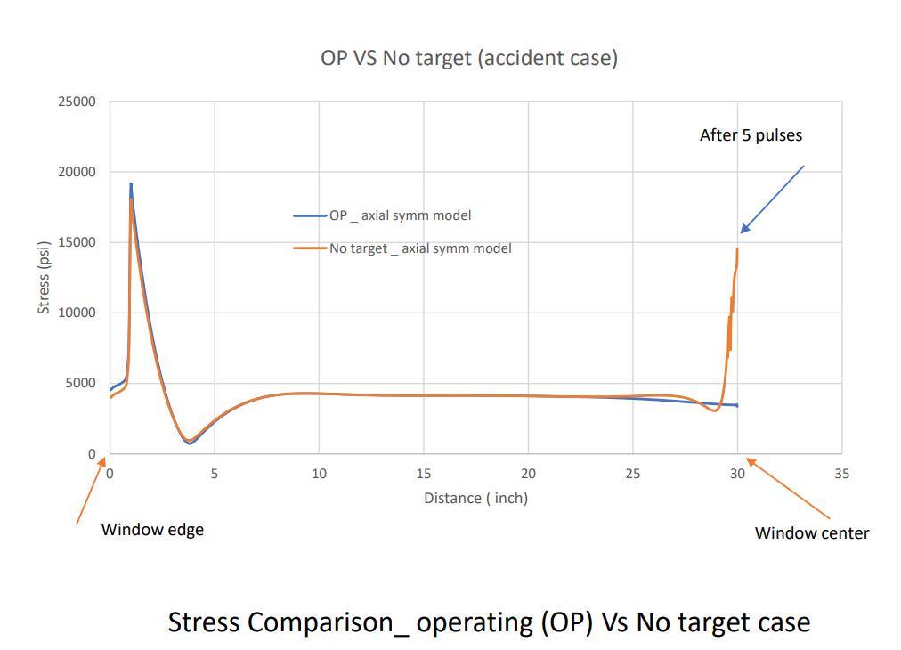
Structural Results
Results:
  Nominal Operation:
    operating condition (77C)
    Window Stress @ center
      <6.5 ksi with yield strength
    Yield Stress
      34.2 ksi yield listed by ASME
  Accident Case:
    Accident condition (210C) shows
    Window Stress @ center
      14.5 ksi.
    Yield Stress
      13.3 ksi
    Ultimate Stress
      19.3 ksi
    Above yield, but below ultimate
  Axisymmetric results in agreement

Slide 13
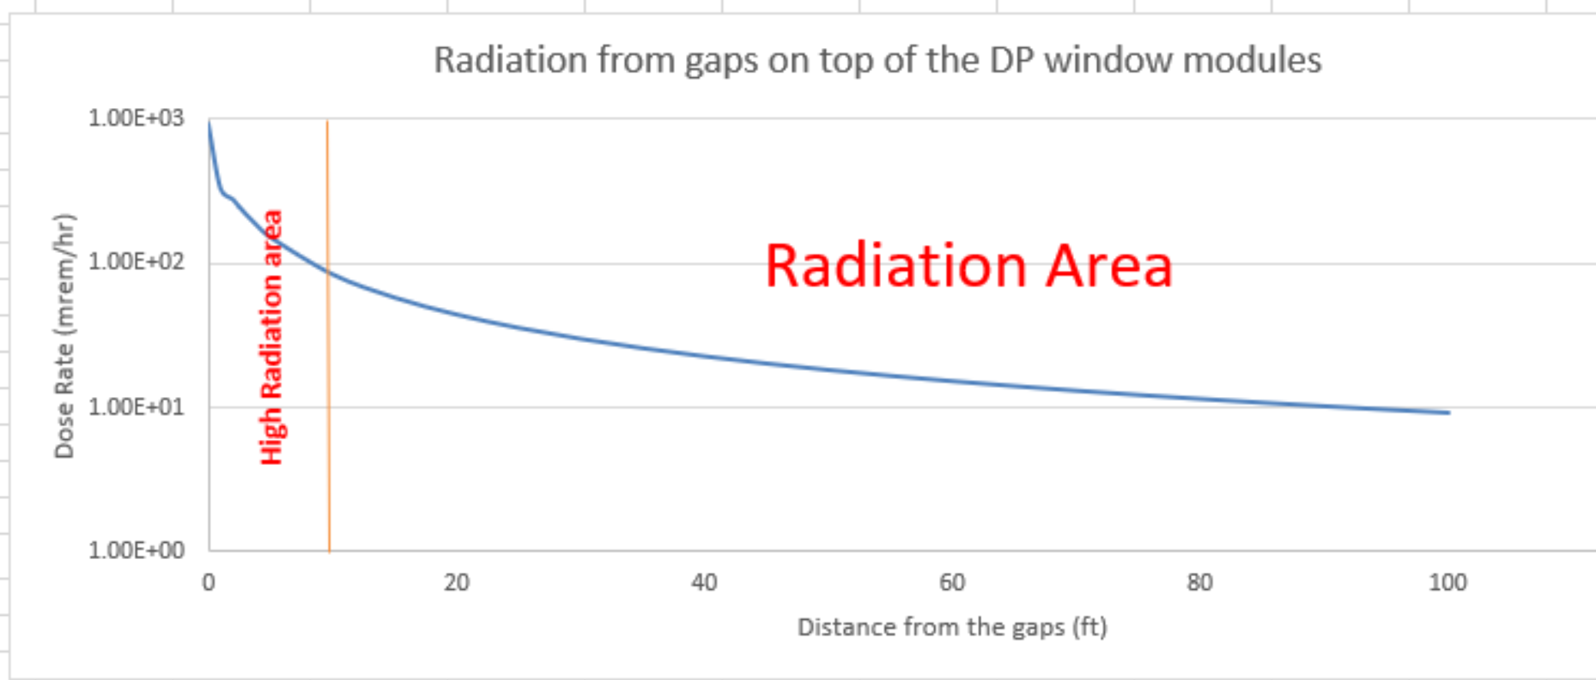
Window must be changed
While window is set to have a minimum lifespan of 5 years, it will inevitably need to be replaced.
Specific Remote Handling Tooling is required to conduct this changeout due to the radiation dose in the area.
Dose rates with T-Blocks over Upstream Decay Window removed.
  At opening: 1 rem/hr
  10ft: 100 mrem/hr
  100ft: 10 mrem/hr
Personnel allowed in limited capacity with Rad Safety approval
  Does rates provided by FNAL Radiation Safety

Slide 14
Requirements for Remote Handling Mechanism
Critical Requirements:
Limited personnel allowed within the target hall during procedure.
Retain Helium within the Decay Pipe.
Helium Purity within the Decay Volume cannot drop below 95% purity.
Do not remove downstream module.
Equipment must survive 6 Sv/hr Radiation dose at the window over procedure
Challenges:
Tight space constraints provides challenge in designing tooling to fit within allowable space.
Helicoflex Gasket Sealing necessitates larger bolt tooling to reach adequate compressive forces
Necessitates Remote Handling to be conducted inside a secondary pressure vessel to retain Helium.

Slide 15
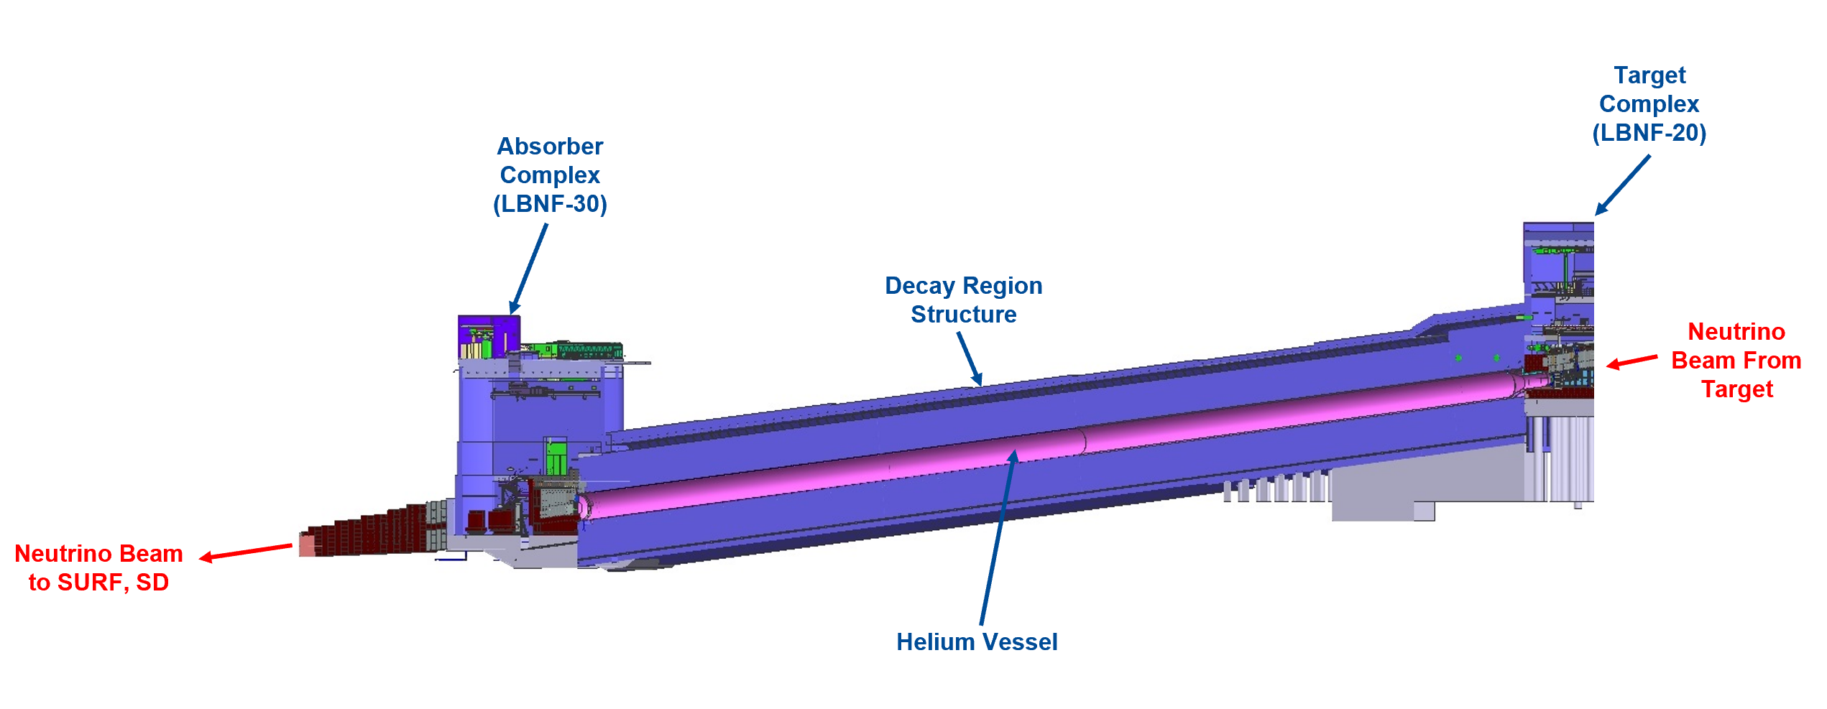
LBNF Decay Pipe and Helium Volume
204 m long Decay Pipe with an internal diameter of 4 m. Internal Volume is 2563.5 m^3.
Prohibitively costly to purge helium volume in order to replace component

Slide 16
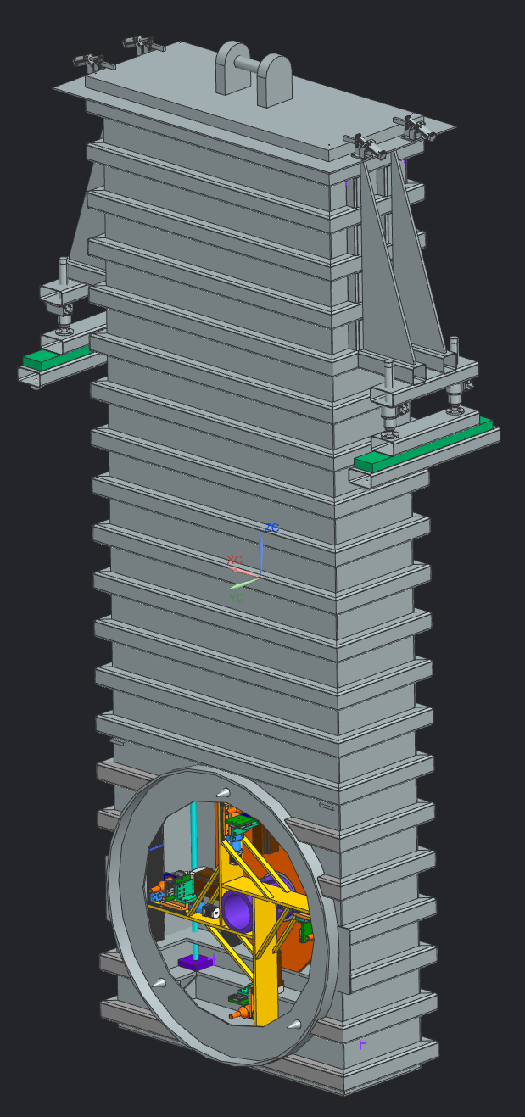
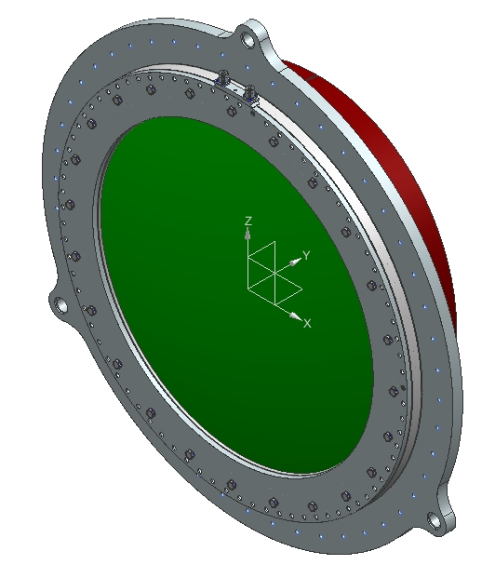
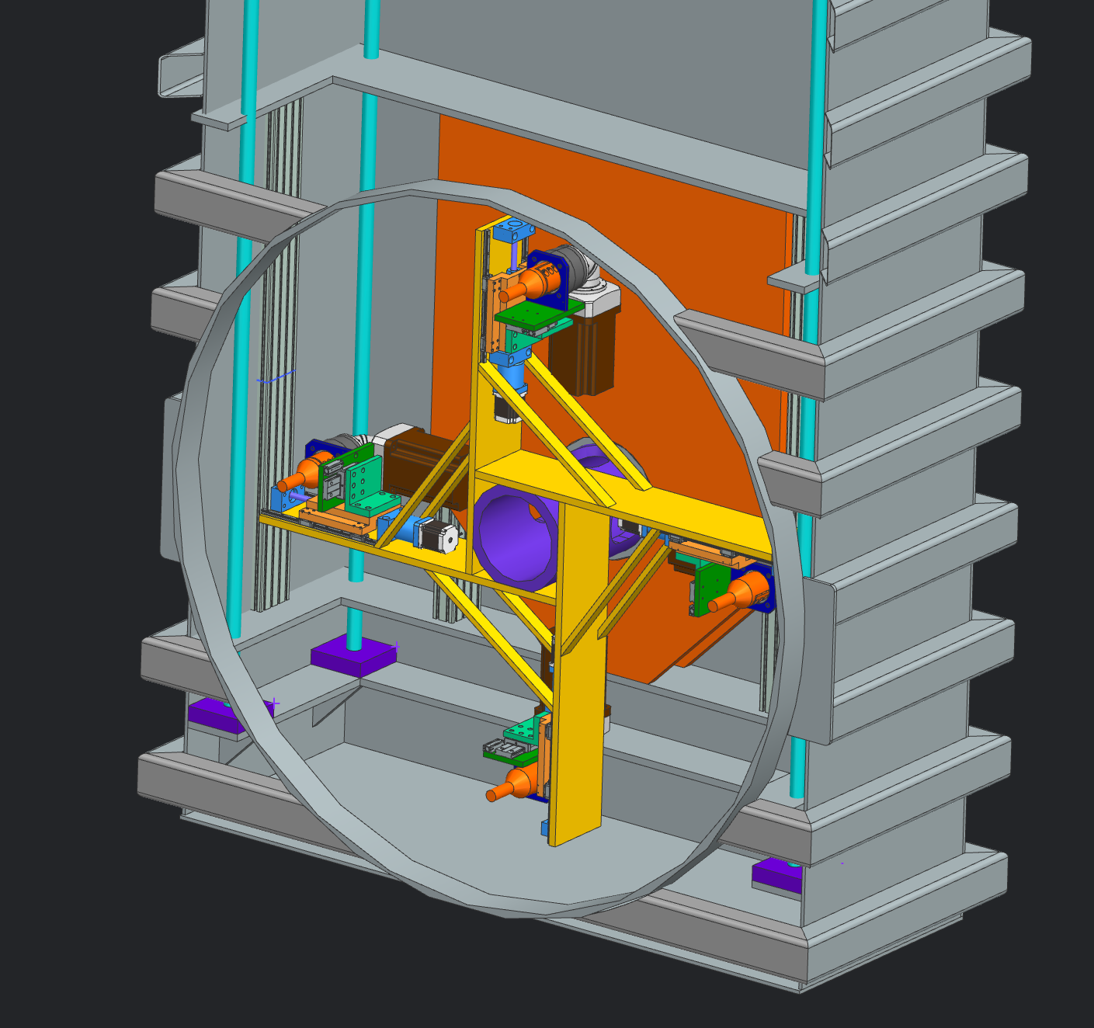
Device Concept
Bolting and window handling tooling will operate inside of secondary pressure vessel.
Vessel supported from T-Block Fixtures
Process Stages:
  1. Positioning of Remote Handling Pressure vessel onto USDPW Mounting Flange
    Create seal in order to pressurize system
  2. Remote Handling Tooling fastens Pressure Vessel to USDPW Flange
  3. Remote Handling Tooling removes original damaged window
  4. Window is removed and placed further up in pressure vessel to await retrieval
  5. New window is retrieved and installed.
  6. Pressure Vessel is removed and damaged window stored
USDP Window & Mounting Flange

Slide 17
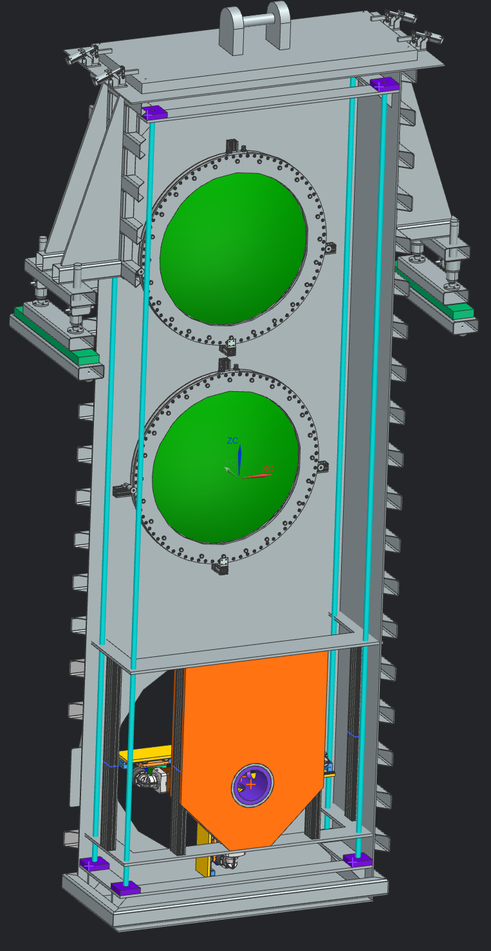
System/Subsystem Design Stages
Remote Handling Mechanism scheduled to have Preliminary Design Review in December.
Systems:
Low Pressure Vessel:
  Structural Integrity: Preliminary Complete
  Vessel to Snout Sealing: Preliminary Modeling
  Alignment: Proving Challenging
  Purge/Fill Procedure: Conceptual Complete
Mechanism:
  Bolt Tooling: Preliminary Complete
  Vertical Motion: Preliminary Modeling
  Window Gripping: Preliminary Modeling

Slide 18
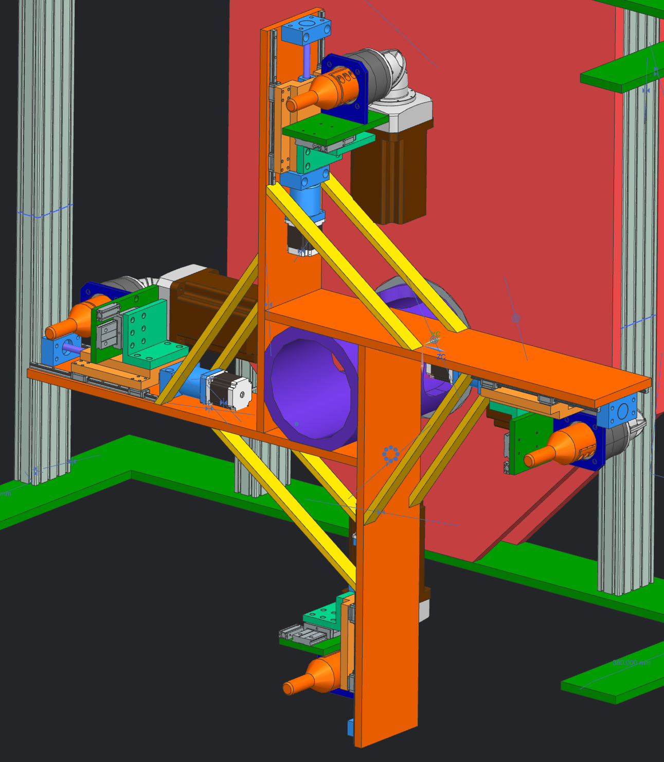
Bolt Tooling and Methodology
2 Circular bolt patterns needed
  Larger: Interface point for Low Pressure Vessel to USDP Snout Flange
  Smaller: Flange to Window mounting
4 Bolt drivers needed which can adjust to both patterns
Torque Required to reach seal compression
  135 ft-lbs (183 nm)
Each assembly moves independently, driven by pneumatic cylinders
  Learning from Mu2e application

Slide 19
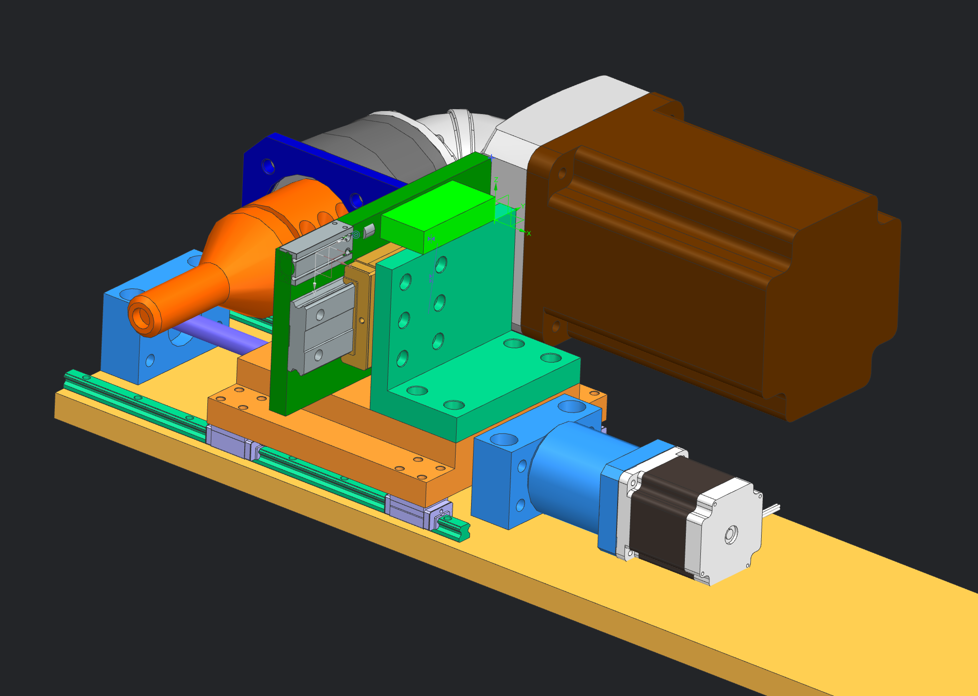
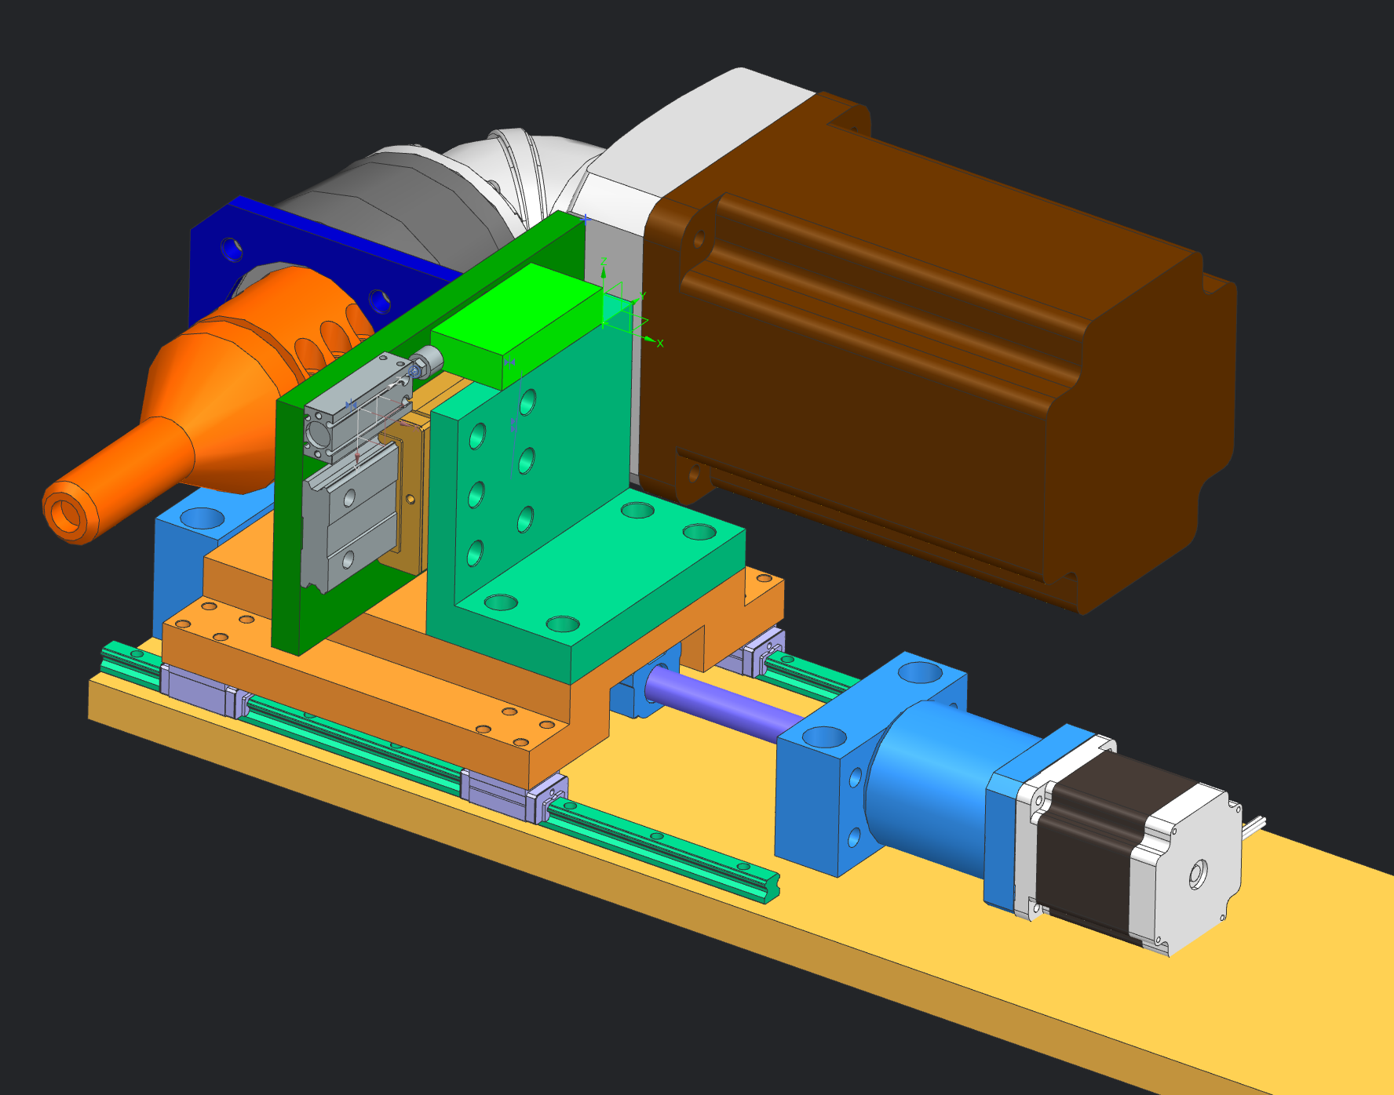
Bolt Tooling and Methodology

Slide 20
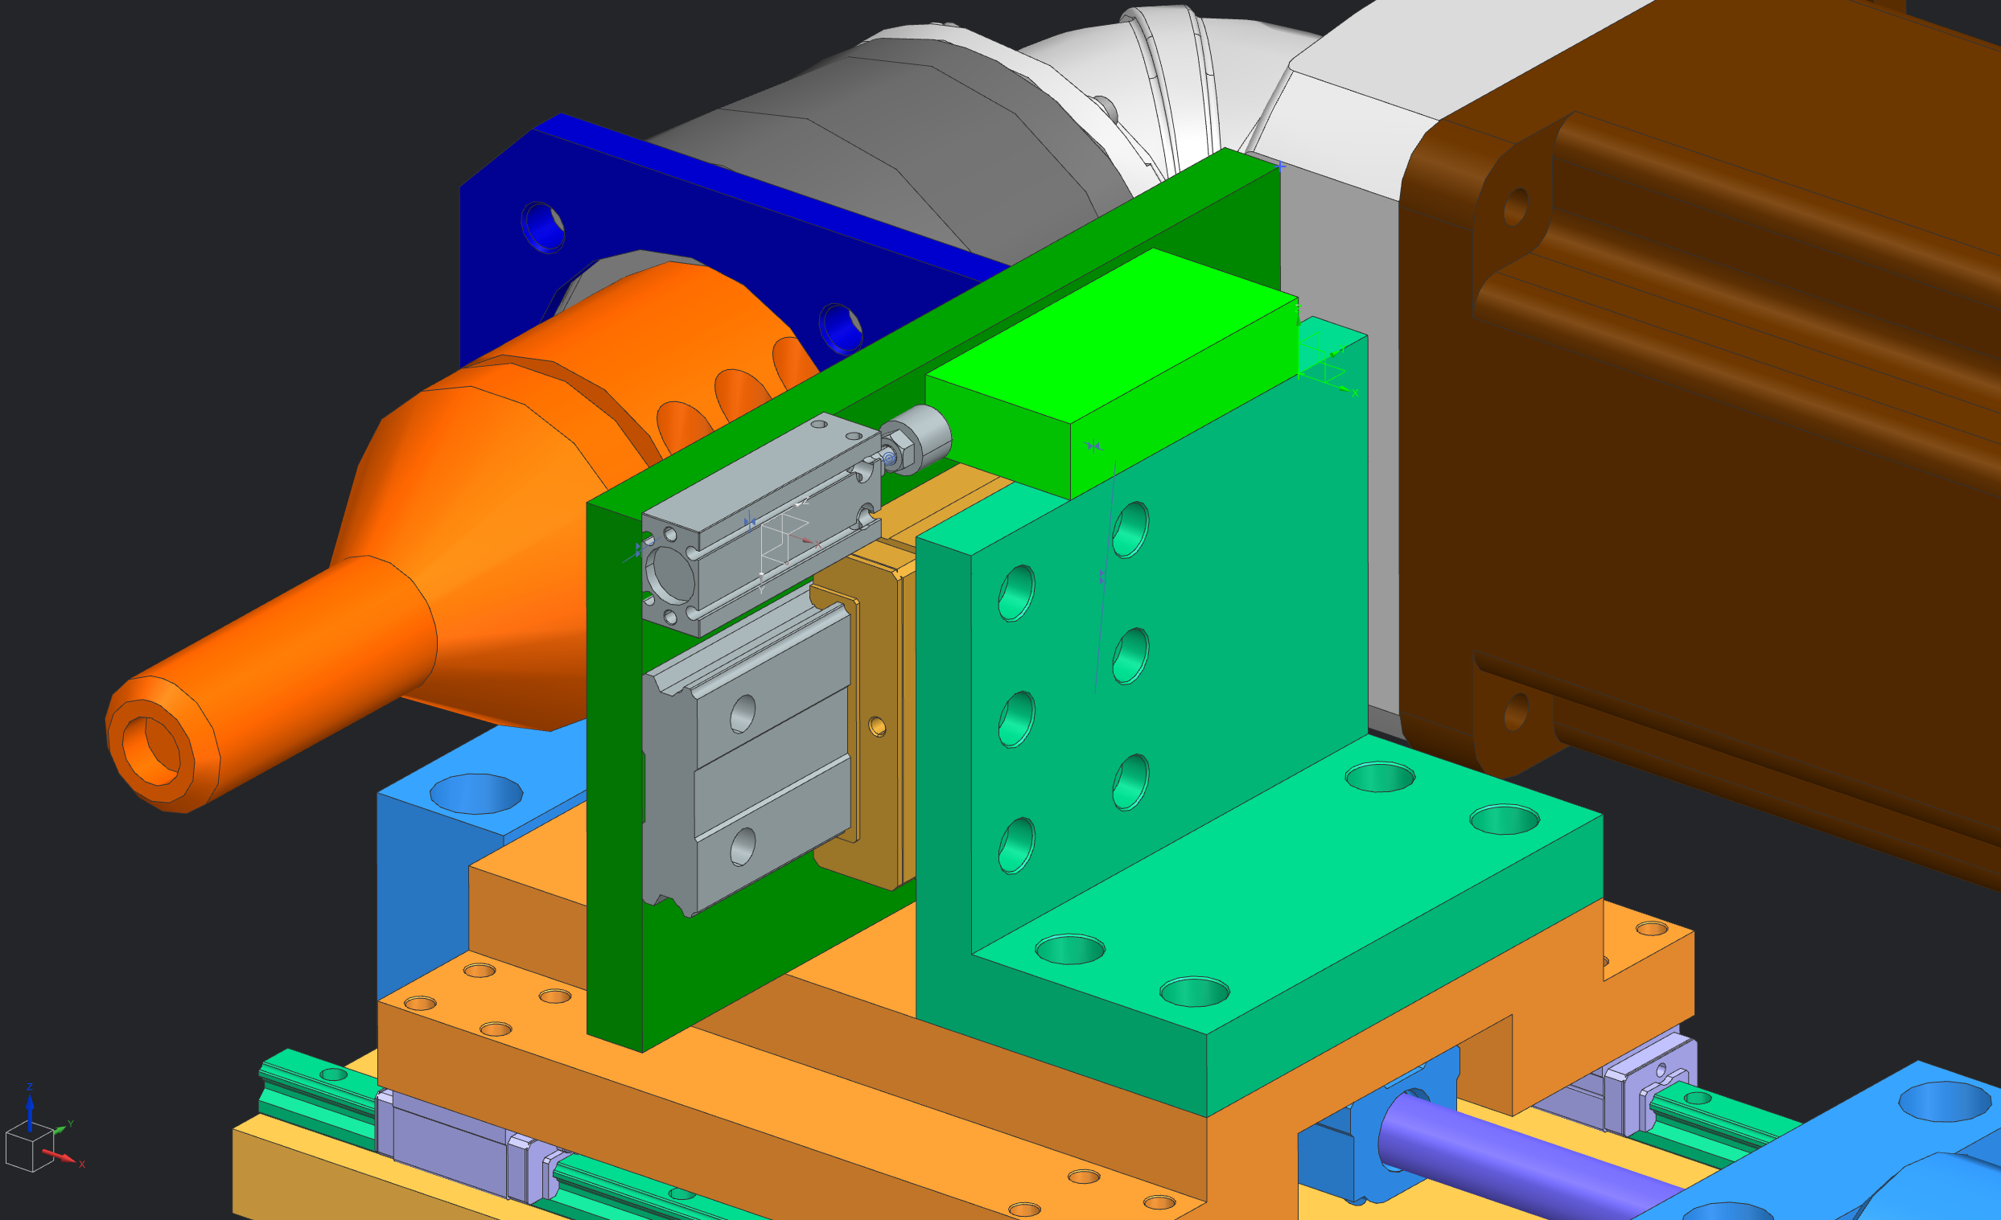
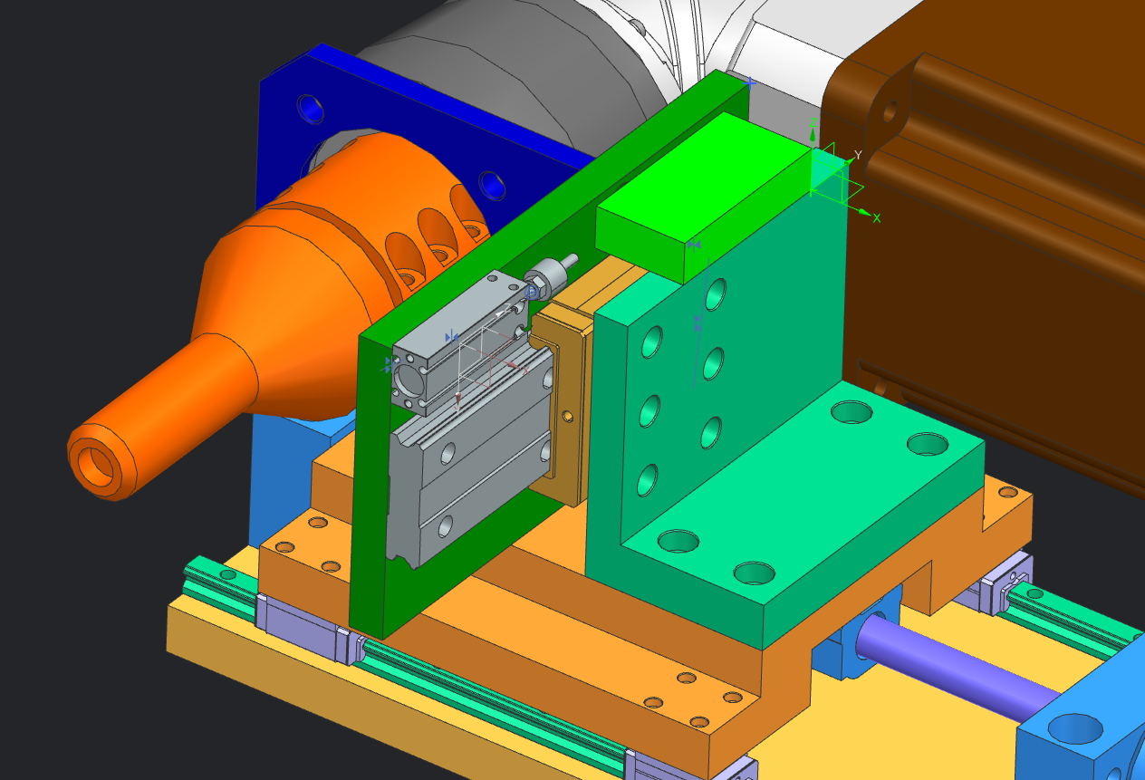
Bolt Tooling and Methodology

Slide 21
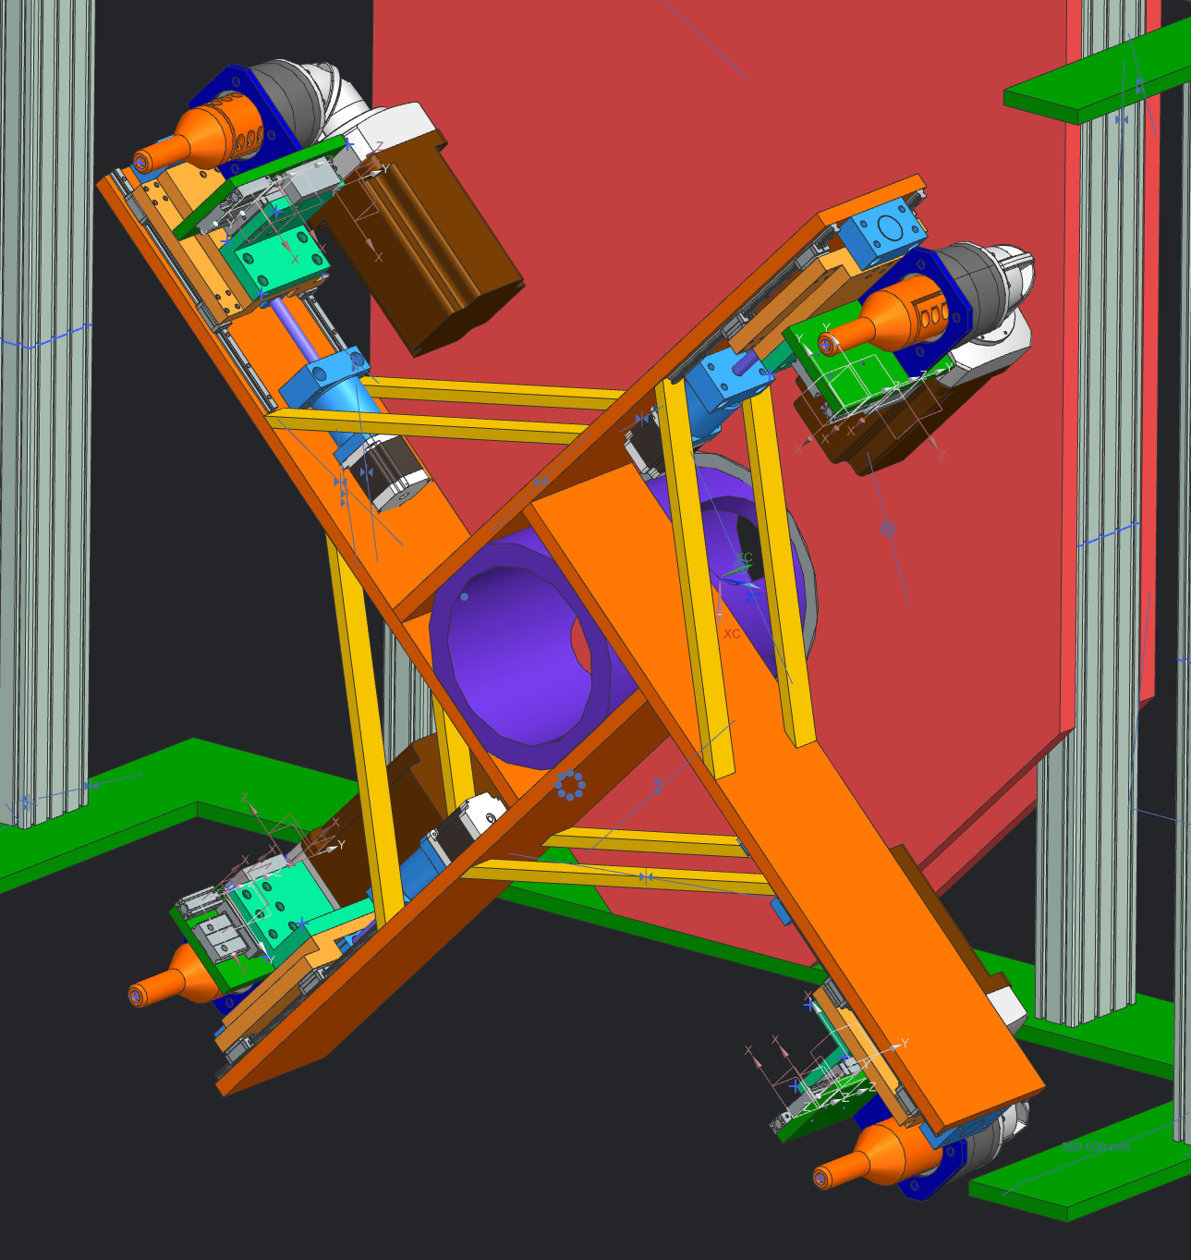
Bolt Tooling and Methodology

Slide 22
Challenge: Operation Space Envelope

Slide 23
LBNF Target Facility and Upstream Decay Pipe
Operation Area

Slide 24
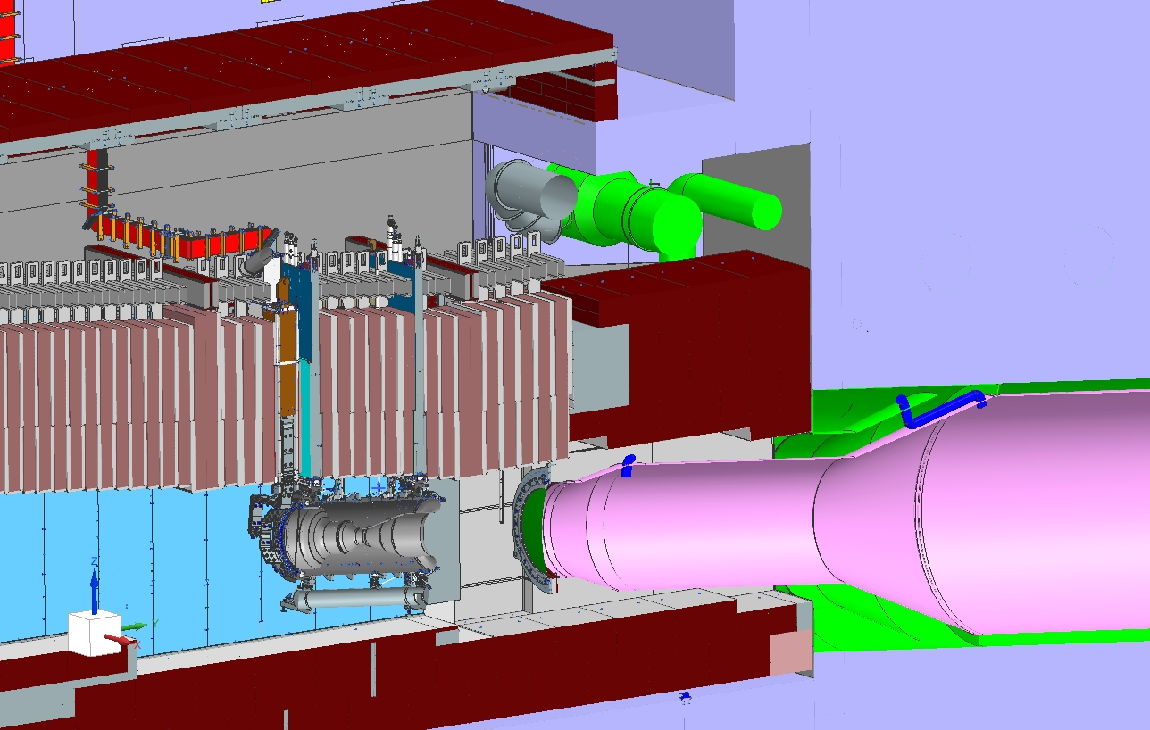
Challenge 1: Operation Envelope
Access to USDPW will be gained through T-Block shielding directly over Decay Pipe Snout
Downstream Module required to remain during procedure
Module
T-Blocks

Slide 25
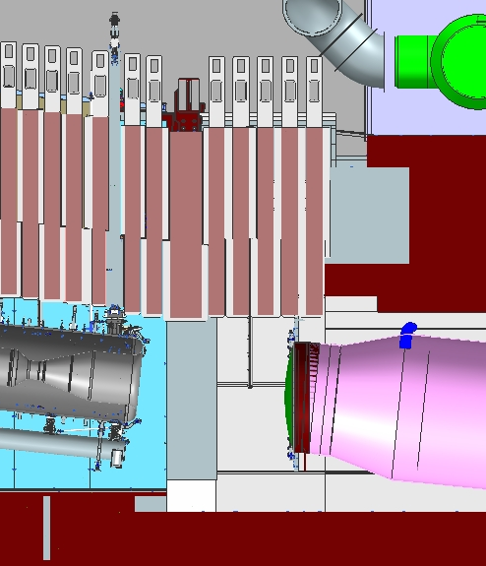
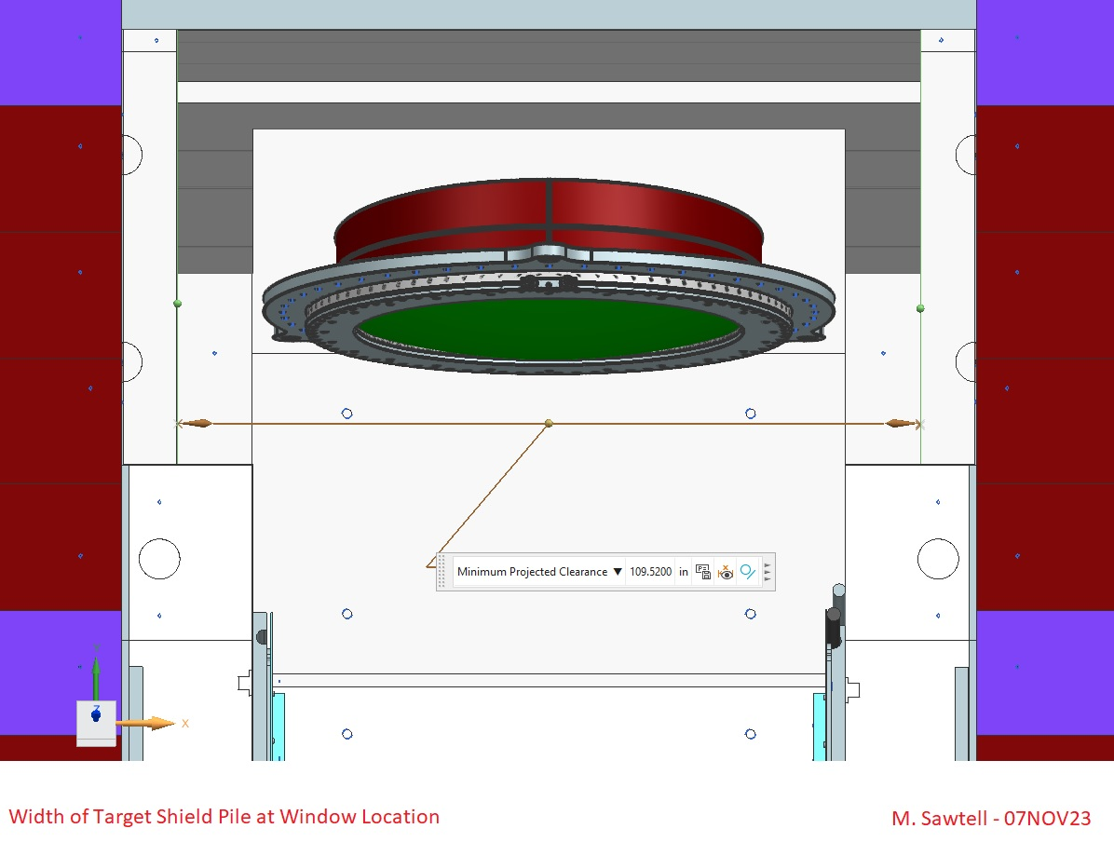
Challenge 1: Operation Envelope
While vertical space is quite available, horizontal and beamline room is extremely limited.
Horizontal envelope: 109.5 in (2.8m)
Beamline direction envelop: 49in (1.24m)

Slide 26
Challenge 1: Operation Envelope
Remote Handling Vessel Dimensions:
  Horizontal = 106 in (2.7 m)
    Clearance = 3.5 in (76 mm)
  Beamline Length = 45 in (1.12 m)
    Clearance = 5 in (127 mm)
  Height = 314 in (8 m)
  Tight envelope necessitates minimizing profile of all tooling equipment
  Limited room for any longitudinal motion of the system

Slide 27
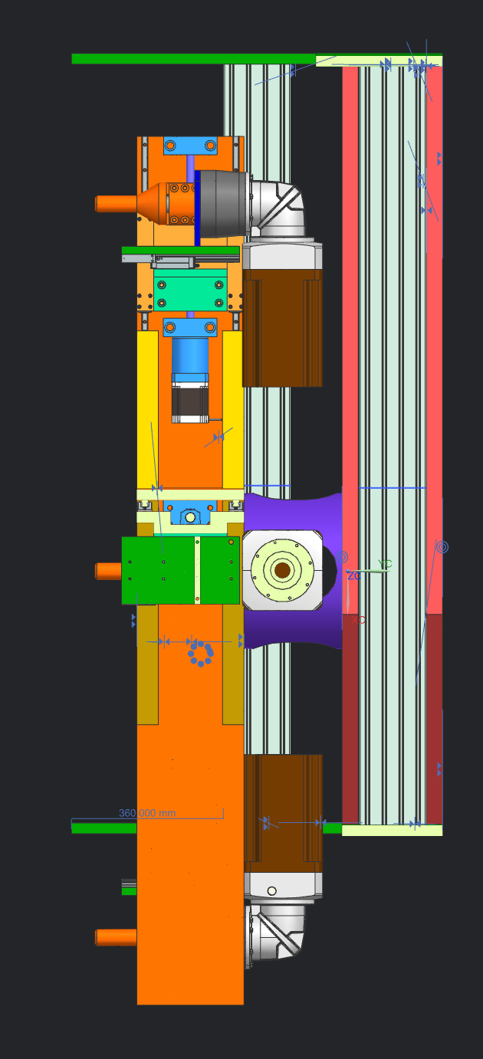
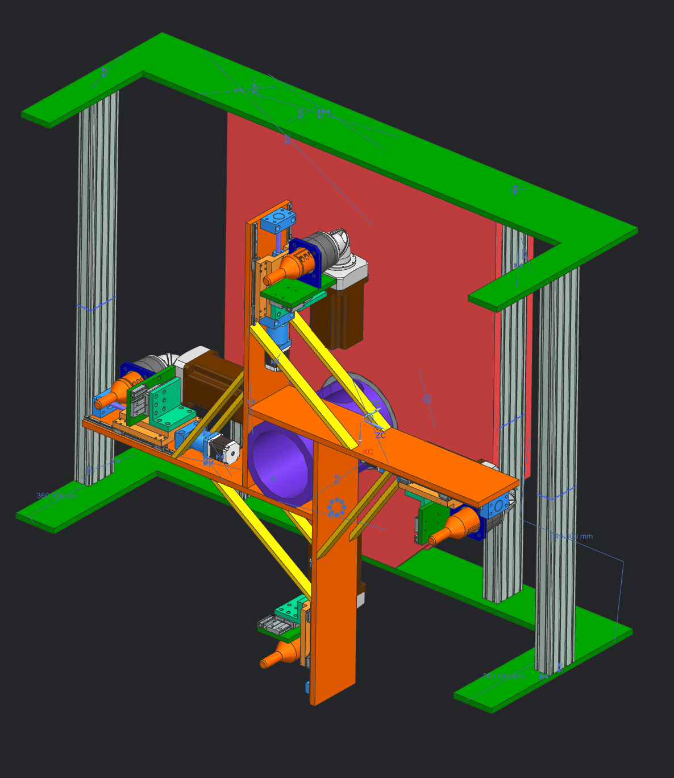
Challenge 1: Engineering Solutions
Bolting Device and Tooling:
  Challenge:
    Large compression force required for seal compression necessitates larger bolt drivers
  Solution:
    Beveled gearboxes to provide right angled bolt drivers to reduce beamline profile

Slide 28
Summary
LBNF Upstream Decay Pipe Window
  2.4 MW operation not possible for an all Aluminum window unless a dedicated cooling loop is implemented
  Recent analysis shows that the addition of the cooling loop reduced flange temperature to functional conditions
  Resulting stress from Thermal loading show promise for the windows ability to survive 2.4 MW operation
LBNF USDPW Remote Handling
  Remote handling will be conducted without purging helium volume within decay vessel
  A number of engineering challenges are currently being faced and solutions being investigated
  Preliminary designs reaching completion and set to be reviewed in December

Slide 29
Backup Slides

Slide 30
Thermal/Structural Analysis with Cooling Loop

Slide 31
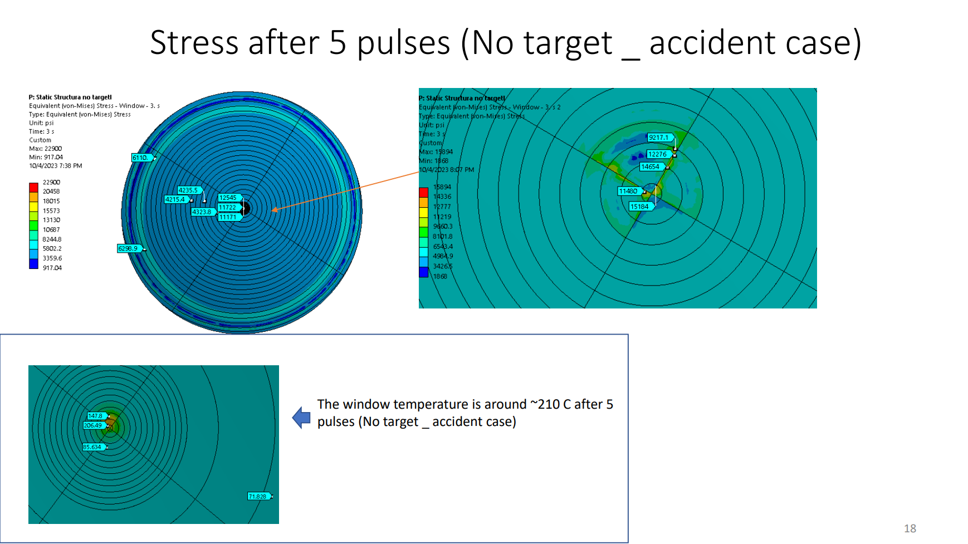
Thermal/Structural Analysis with Cooling Loop

