Slide 1

A new spallation-driven, two-step target at ISAC-TRIUMF
Luca Egoriti
8th HPTW, Wako
November 10th 2023

Slide 2
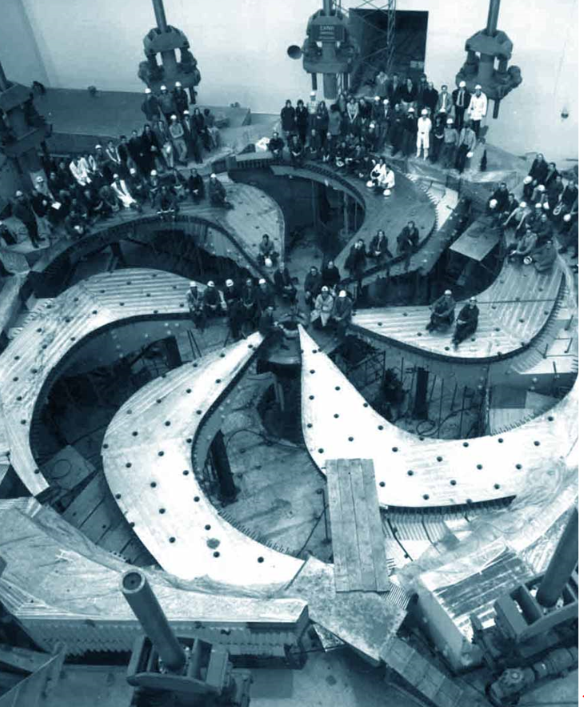

User facilities
Cyclotron & beamlines (since ~1975)
TRIUMF accelerators
ISAC ISOL targets (since 2000s)
RIB lines
ARIEL ISOL targets (from ~2025)
E-linac and beamline (since ~2013)
Radioactive Ion Beams
~10 user facilities
Nuclear & atomic physics
Material science
Medical isotopes
ISAC I and II halls
ISOL
(ARIEL)
TR: 13
APTW
AETE
TR: 30-1
TR: 30-2
ISOL
(ISAC)
CP: 42
120 MeV – 10 nA
Electronics irradiations
Proton FLASH
Ocular melanoma treatments (-2019)
ITW
ITE
PIF
TR: 24
Neutron Irradiations
BL4N
BL2A
NIF
⁸²Sr medical production
STF
BL2C
Muons for
material science
²²⁵Ac et al. production
T1
T2
IPF
30 MeV – 10 mA
e- LINAC
500 MeV – 400 μA
H⁻ Cyclotron
BL1A

Slide 3
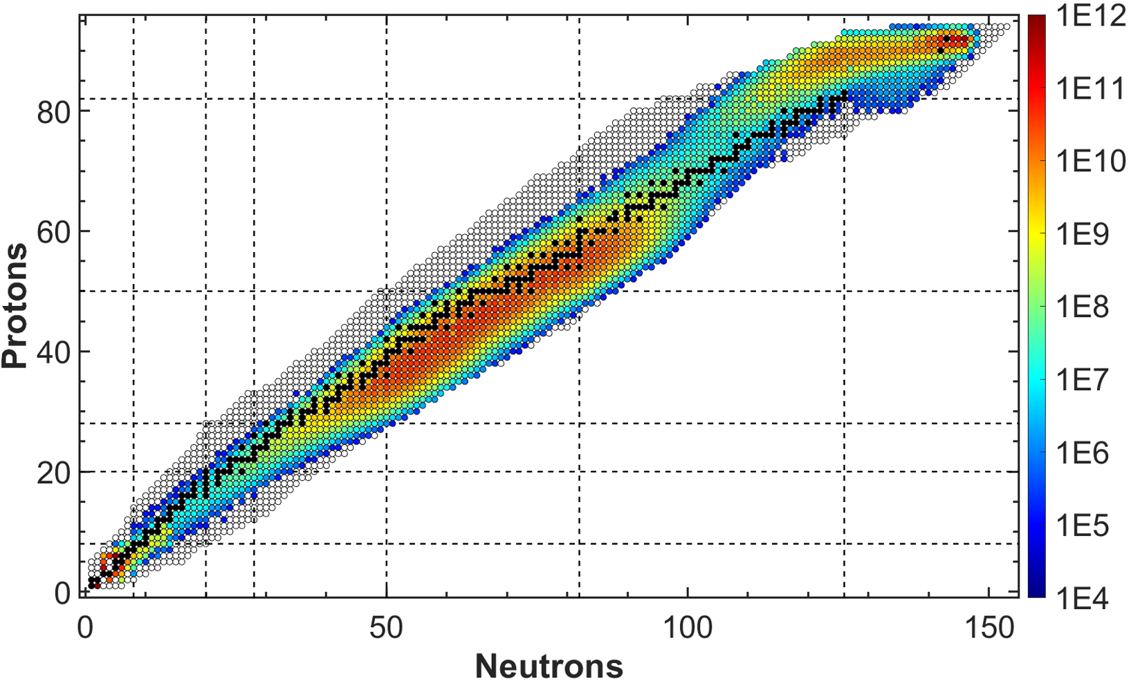
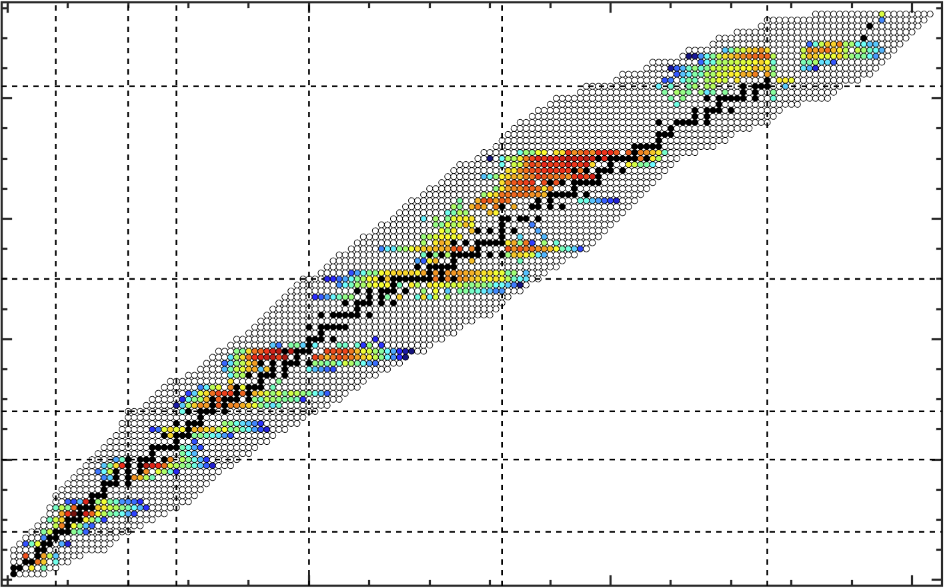
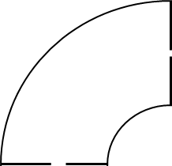
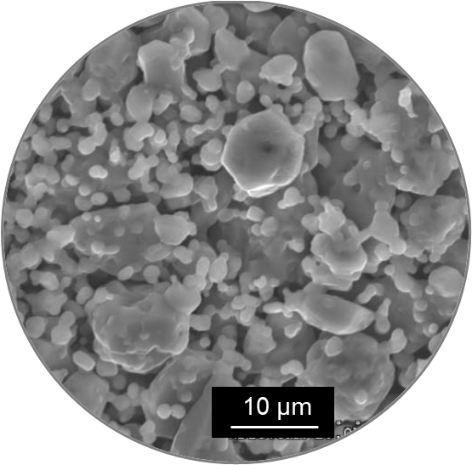
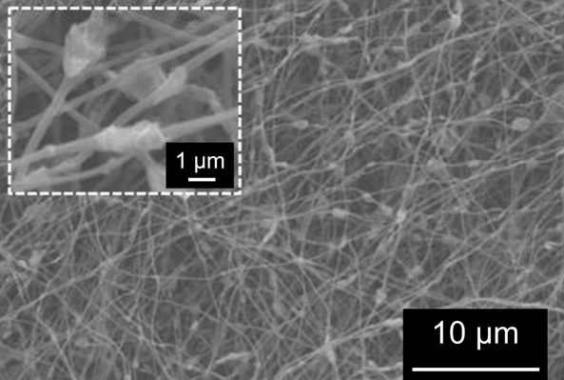
ISOL targets for RIB production
10 - 50 m
[pps]
Mass separator
Post-accelerator
Low energy experiments
High energy experiments
Radioactive
Ion
Beam
18 m
Extraction electrode
Neutrals
Isobars only
HV 60 kV
2 kV
Ions
Post-accelerated
Ionizer
Target
T=2000 °C
500 MeV – 100 μA
P+ Cyclotron
20 cm

Slide 4
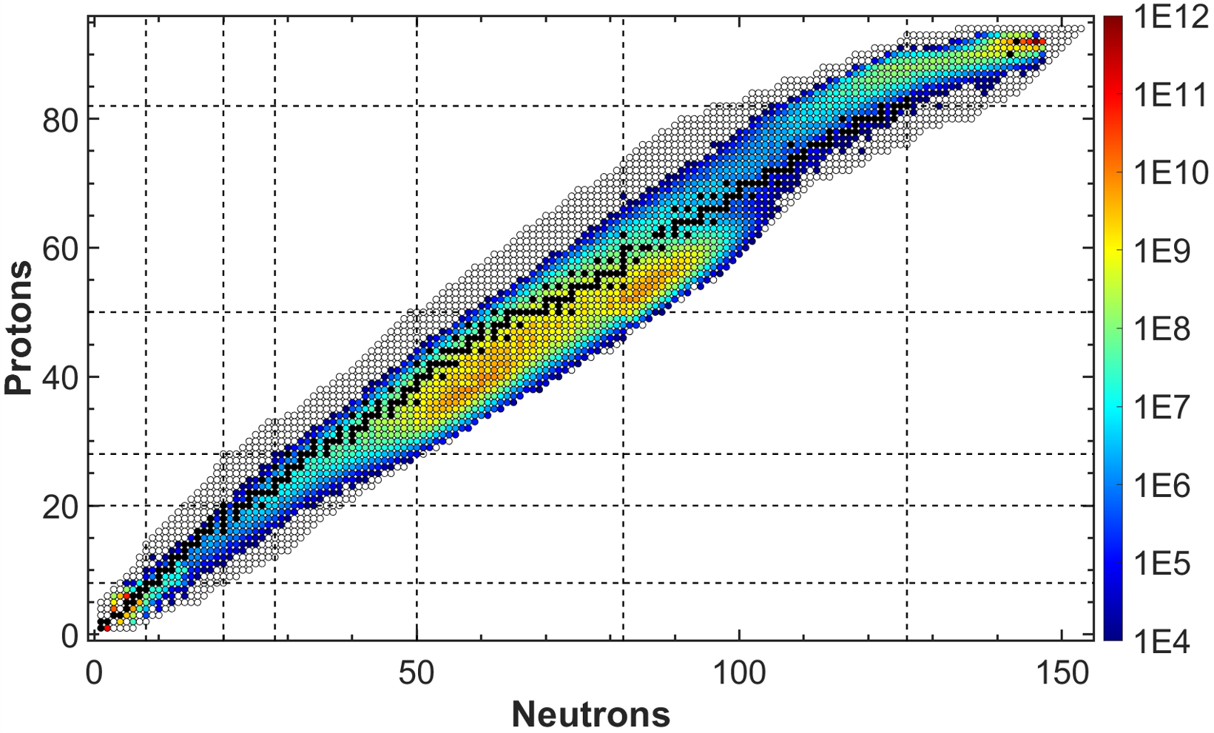
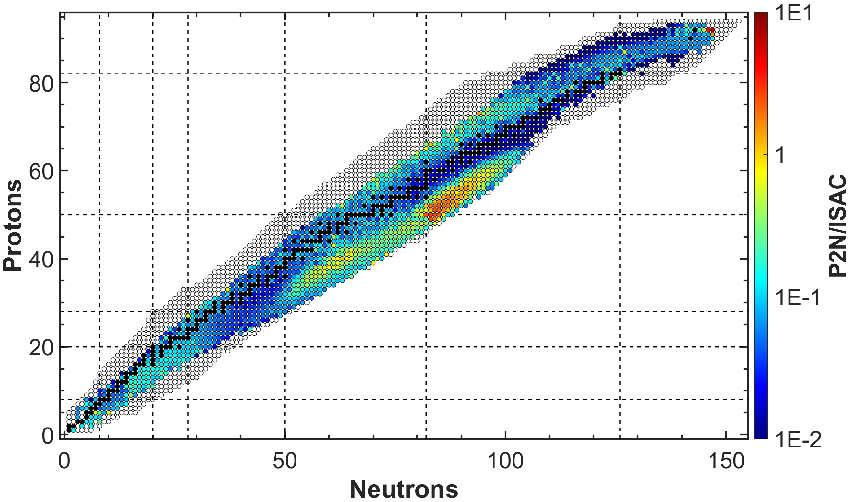
Target vs converter configurations
RIB
RIB
Extraction electrode
Extraction electrode
Ionizer
Ionizer
Target
T=2000 °C
Target
T=2000 °C
Spallation neutrons

Slide 5
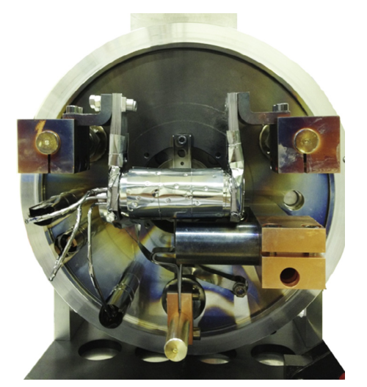
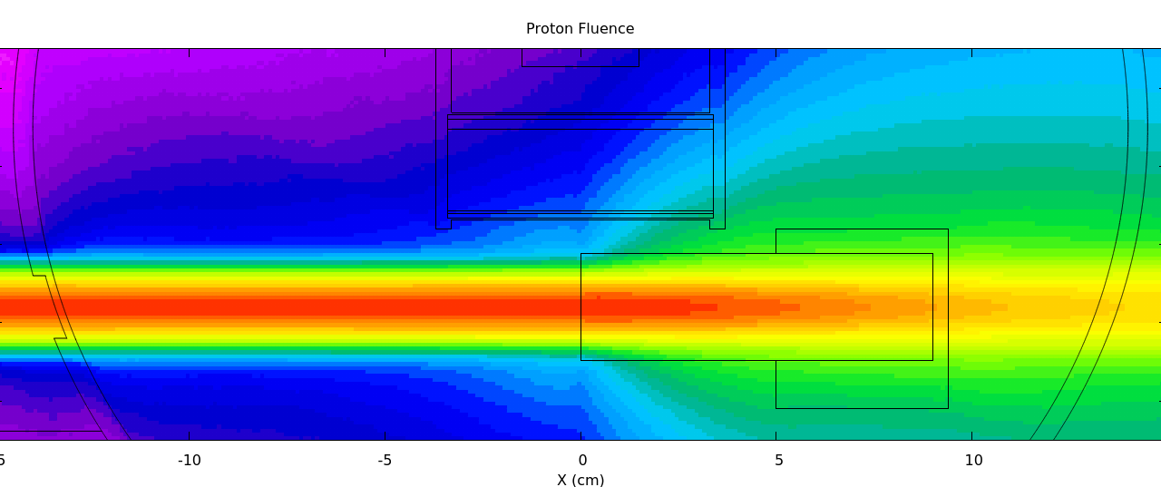
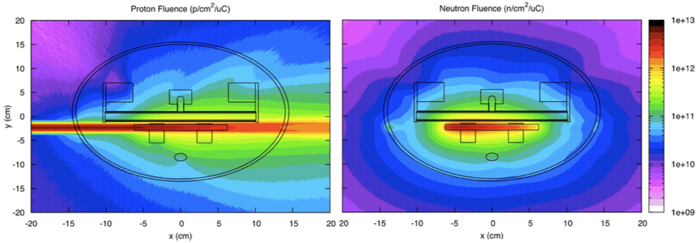
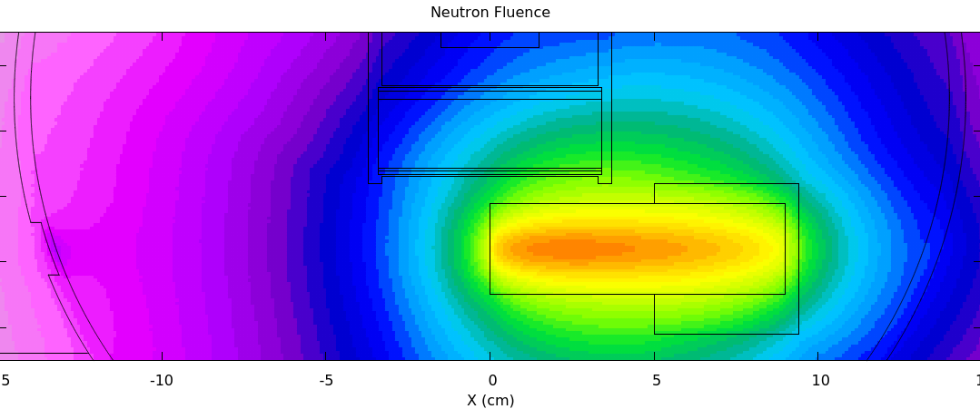
Concept history at ISOLDE
2003
2014
Target
(UC_{x})
Converter
(W rod)
Protons
Neutrons
Protons
Neutrons
5
R. Luis, et al., et al., EPJA 48 (2012) 90
A. Gottberg, et al., NIMB 336 (2014) 143–148.

Slide 6


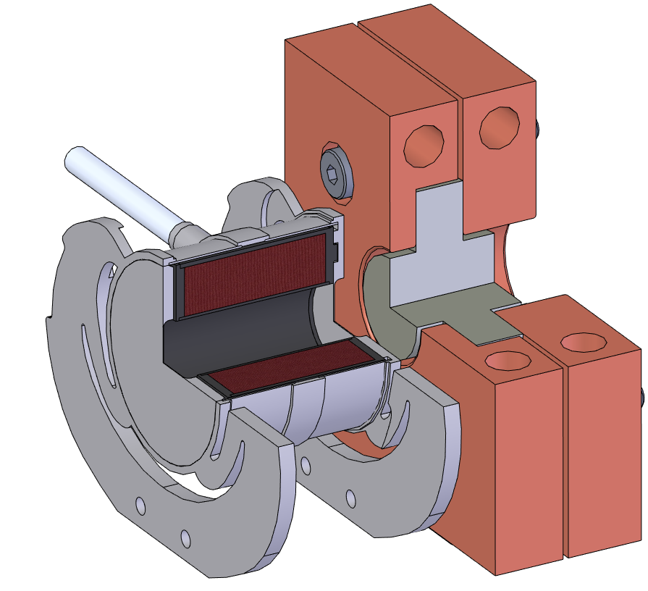
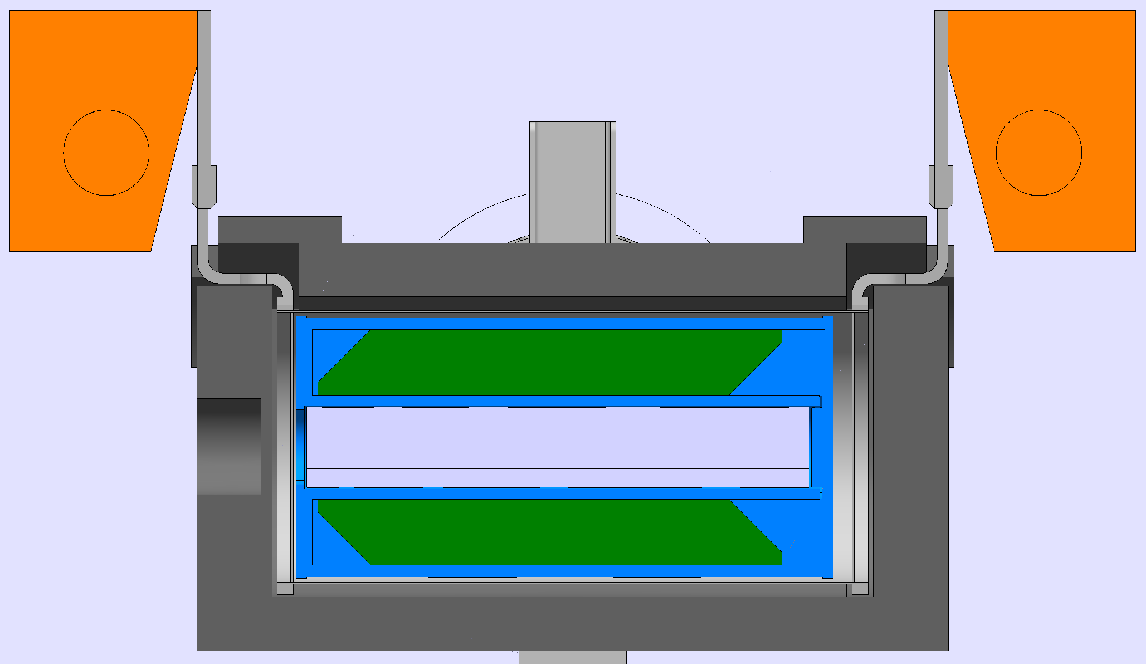


Spallation-driven, two-step RIB targets
Target
(UC_{x})
Converter
(W rod)
Ramos et al., NIM B 463 (2020) 357–36
Tested online in 2020, 2021, 2022
Tested online in 2018

Slide 7
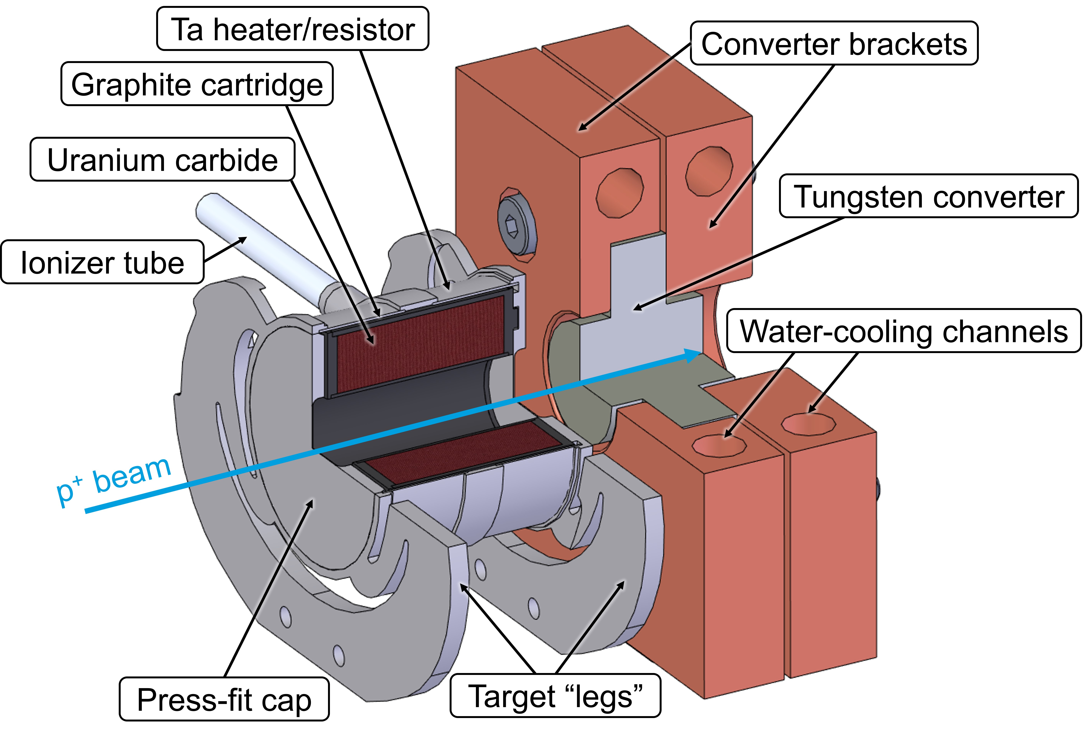
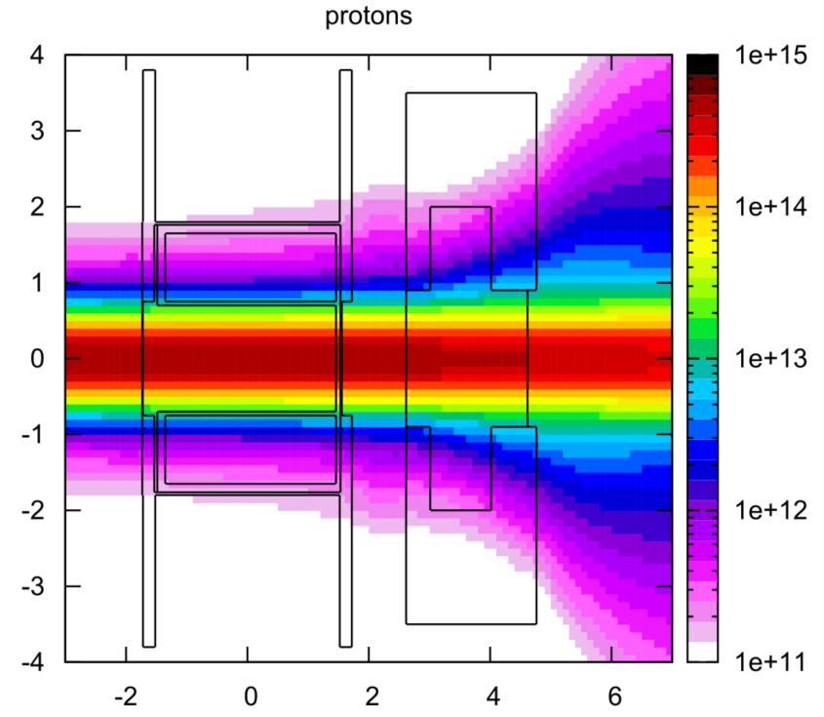
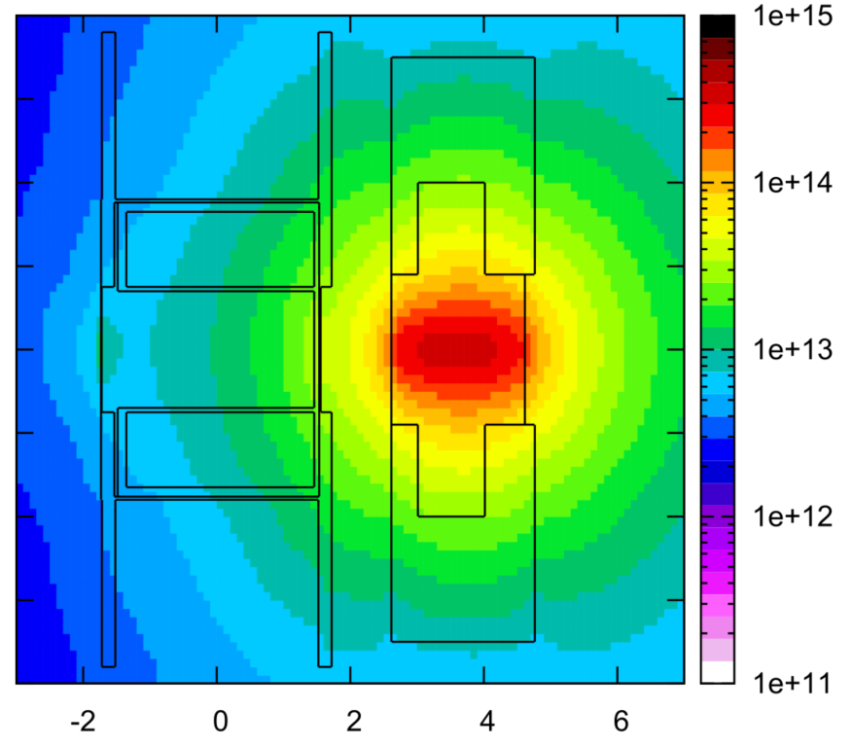
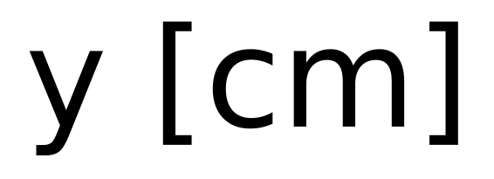
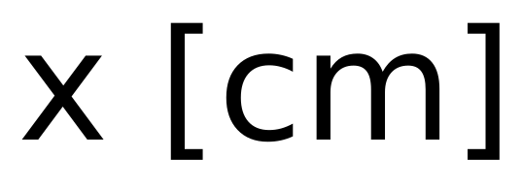
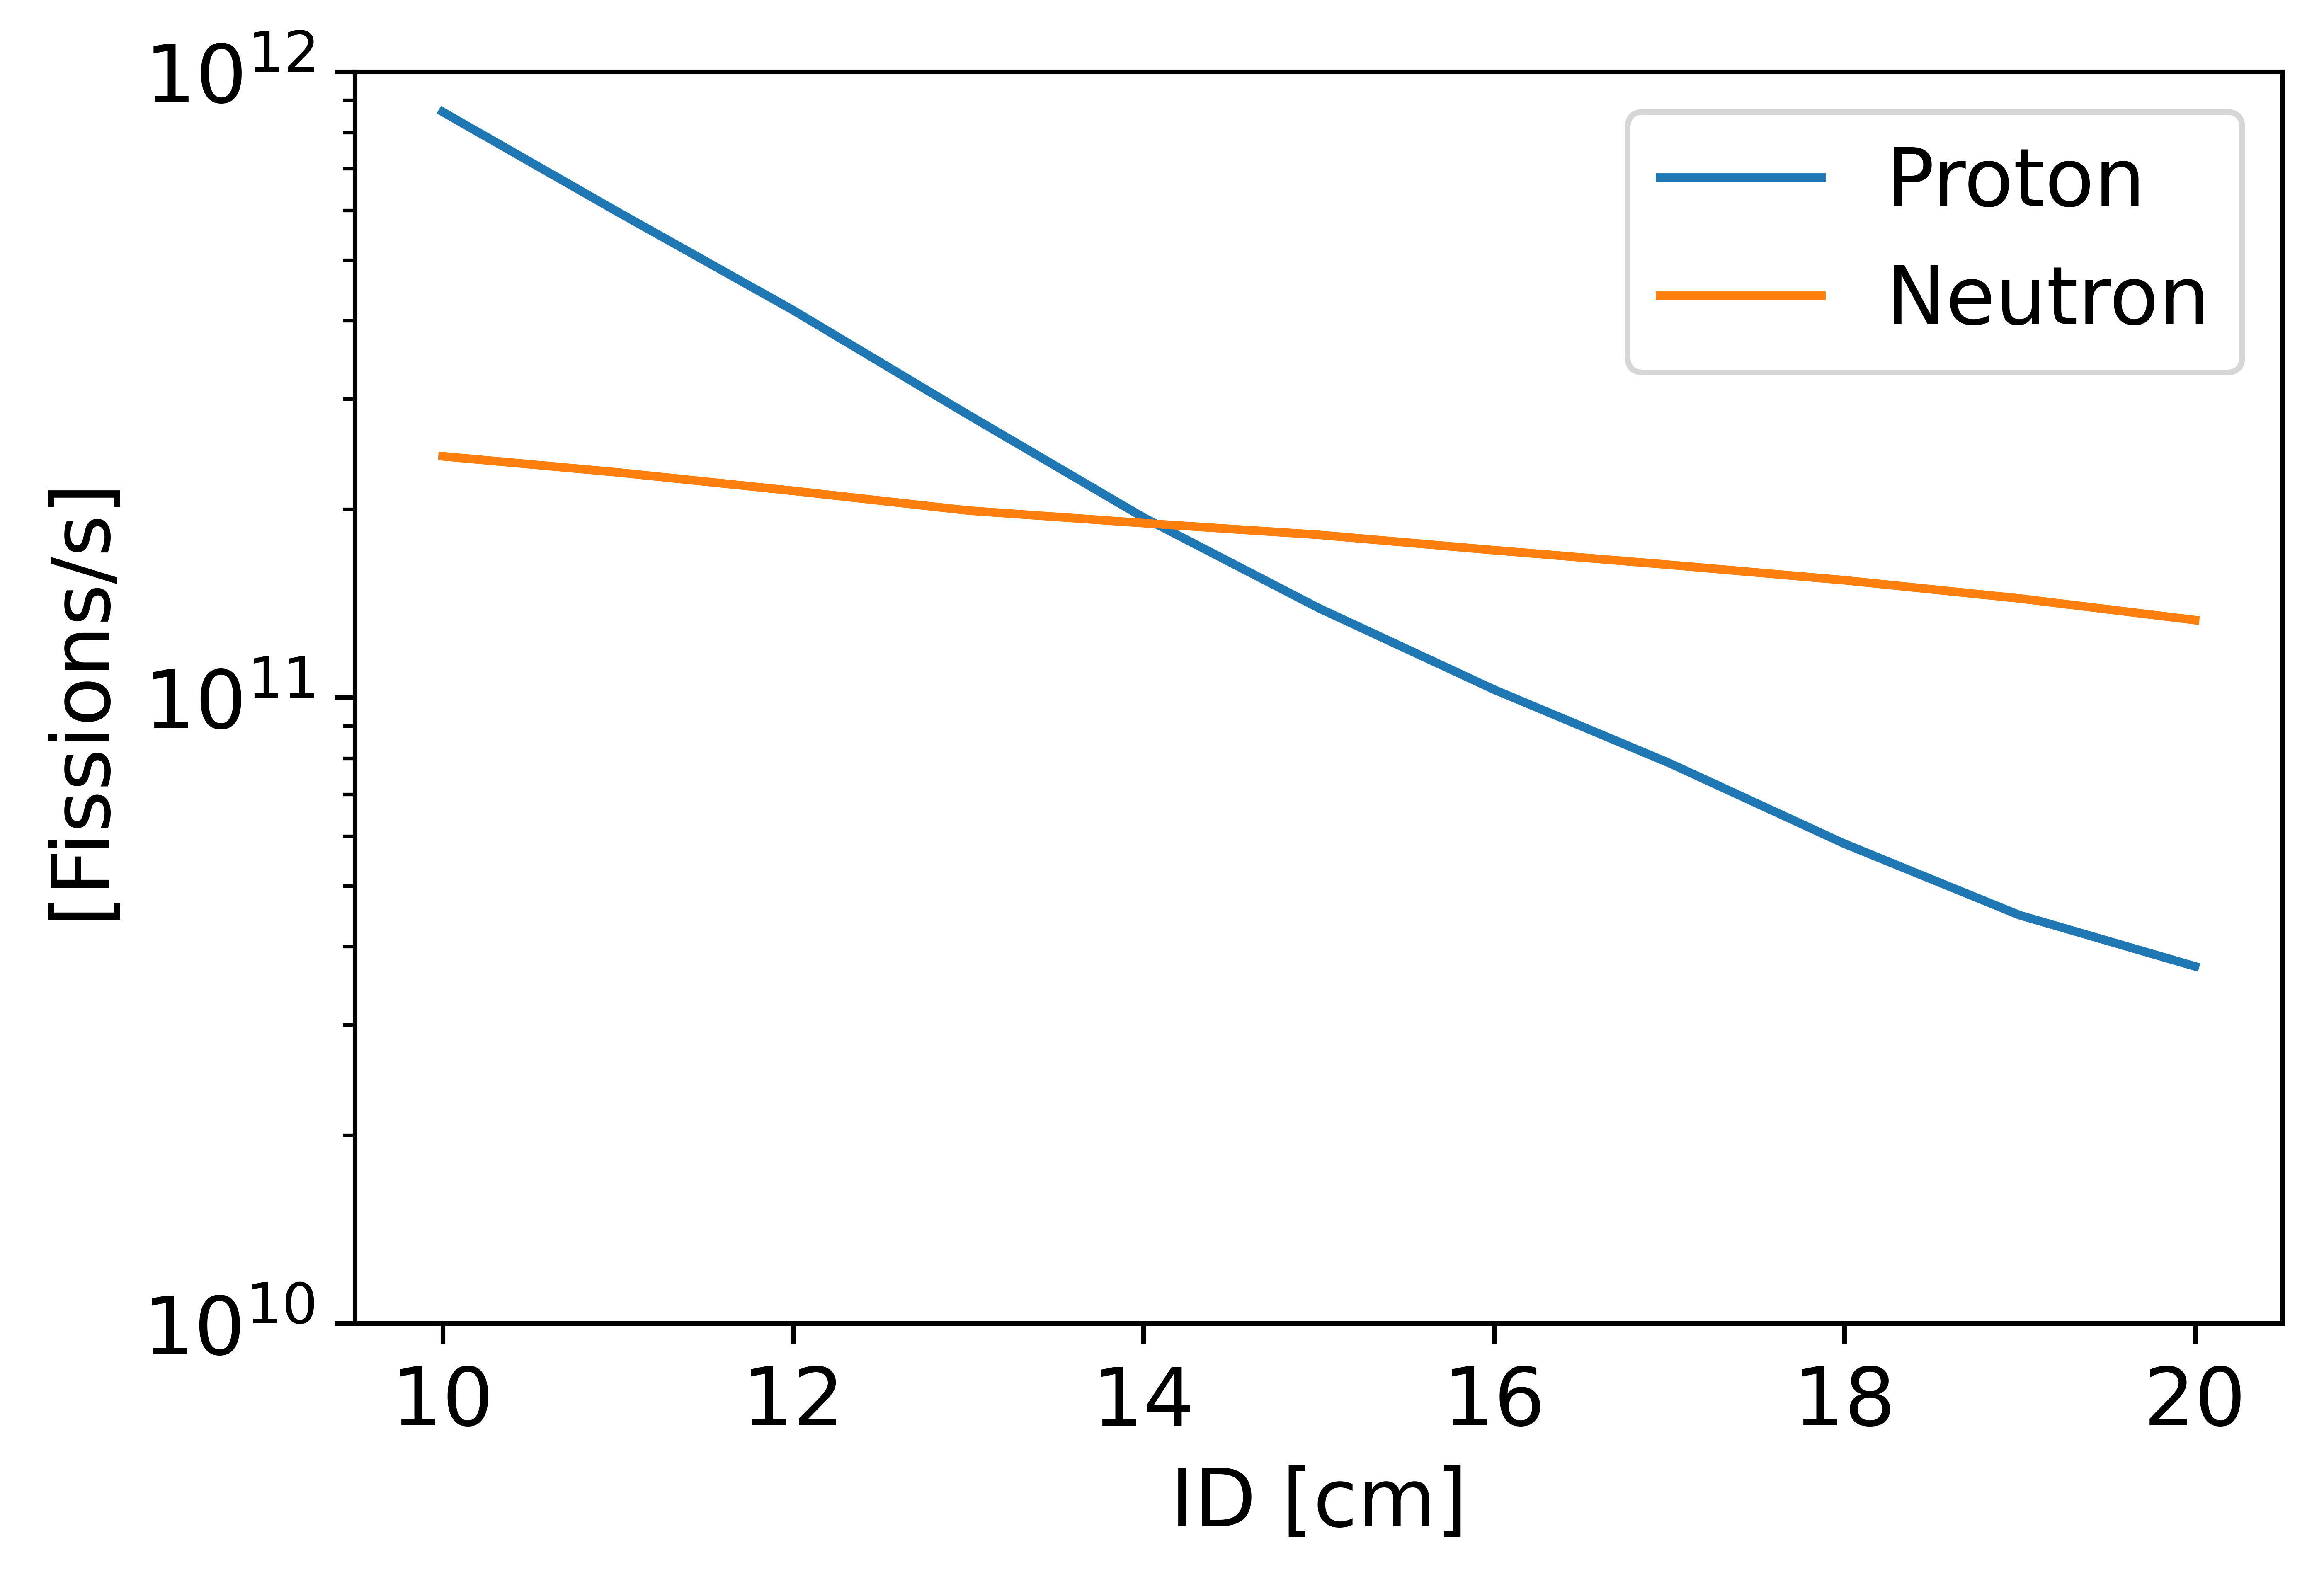
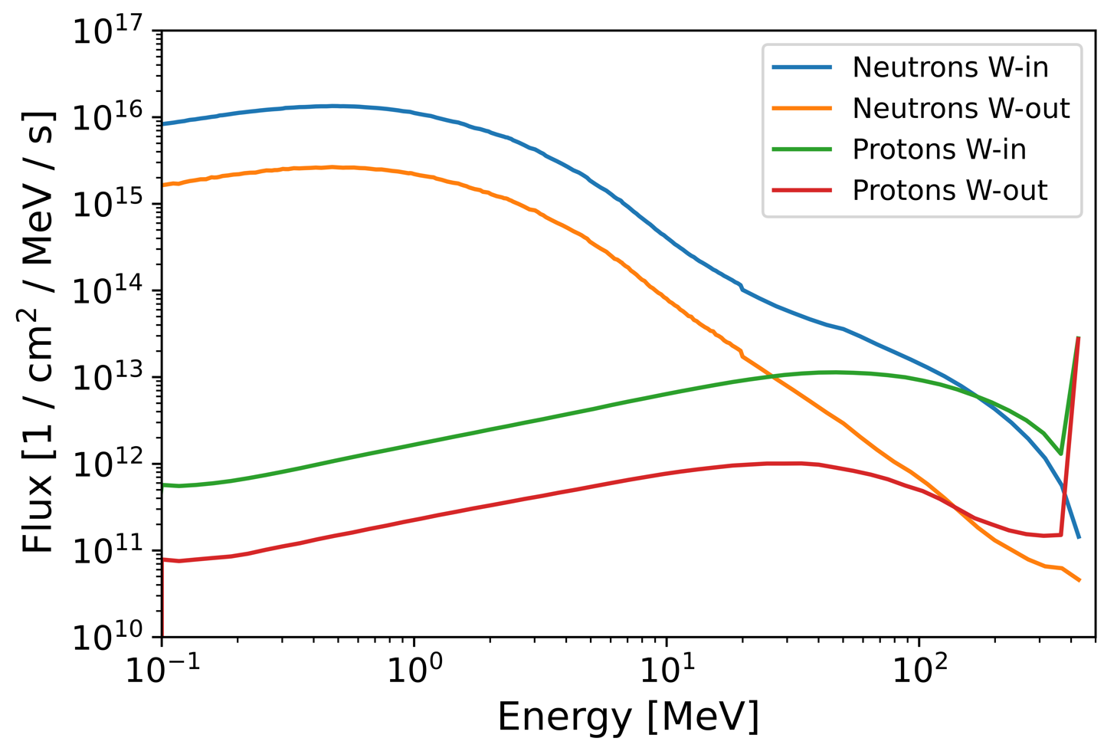
Target/converter optimization: Particle tracking
Protons
Neutrons
[1/cm²/100μA]
UC_{x}
UC_{x}
ID
W length
W
UC_{x}
UC_{x}
Parameters optimized:
Converter length (20mm)
UC_{x} inner diameter (15 mm)
Converter position (after target)
Principle:
Physics goals
Monte Carlo (FLUKA)
N-fiss: 1.45E11 [1/s]
P-fiss: 1.36E11 [1/s]

Slide 8
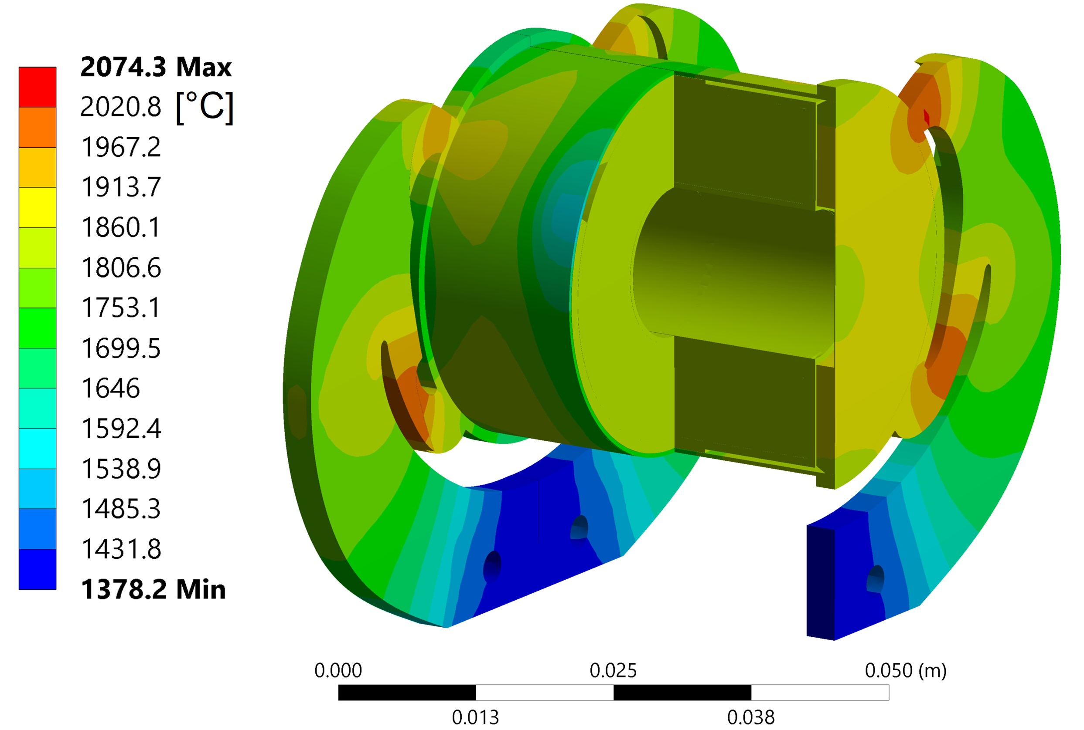
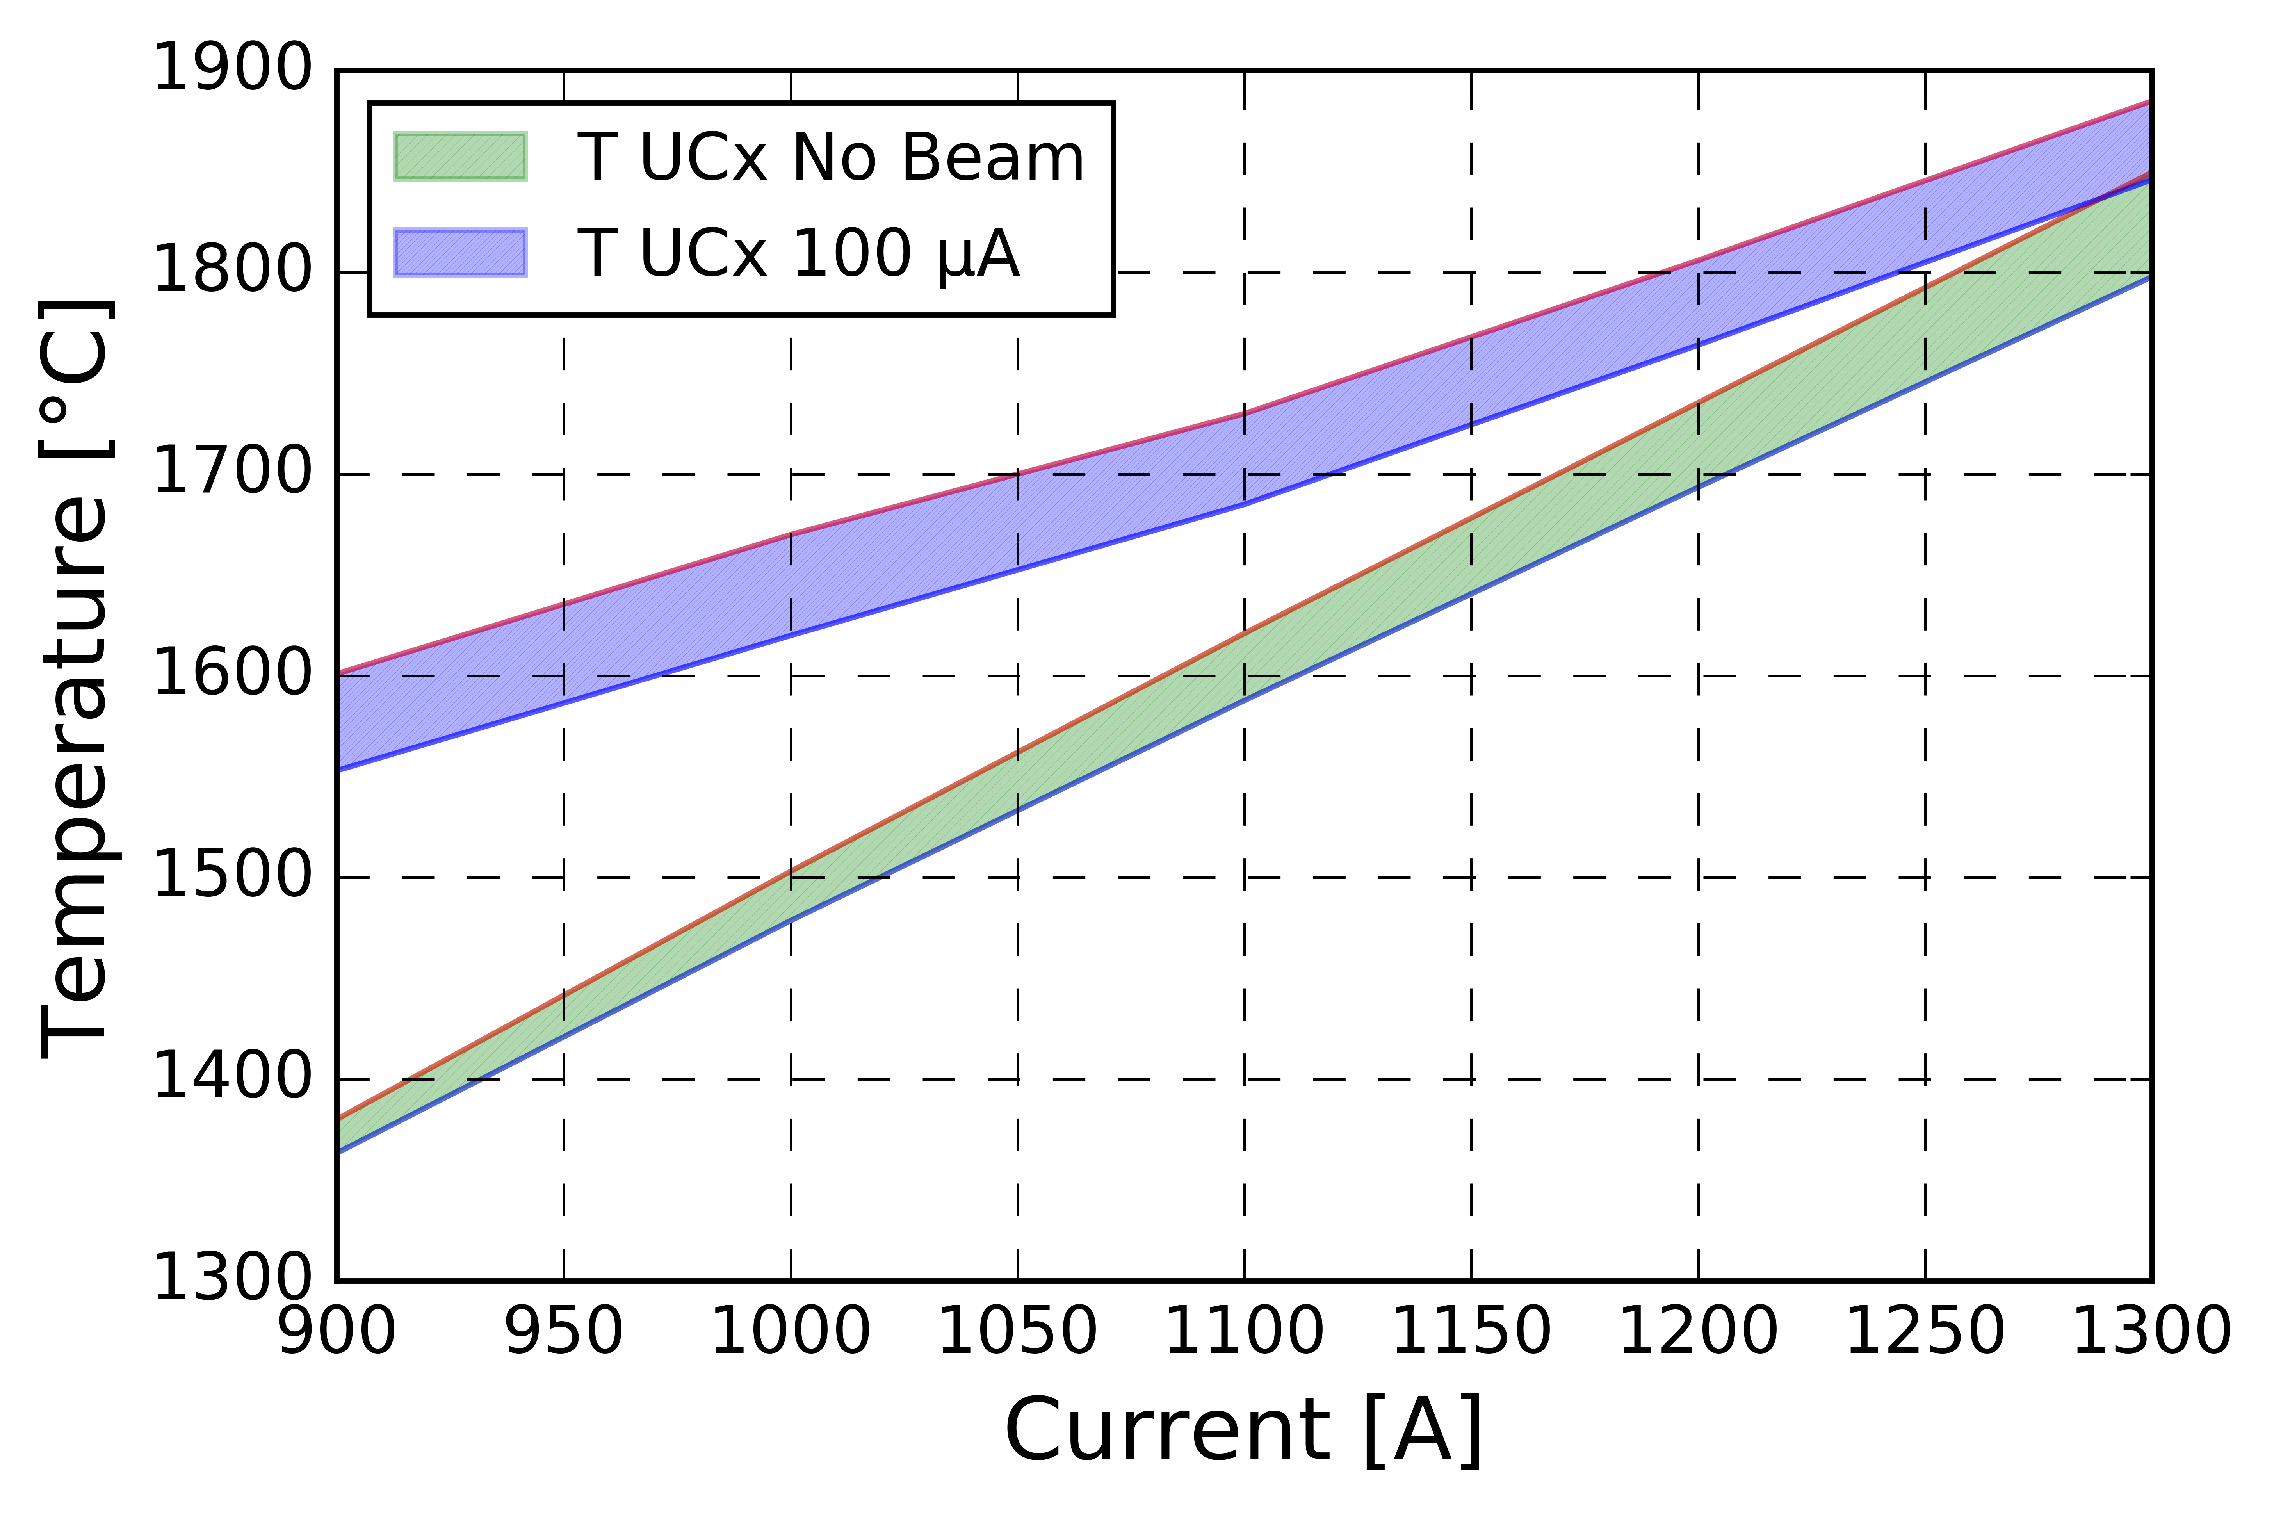
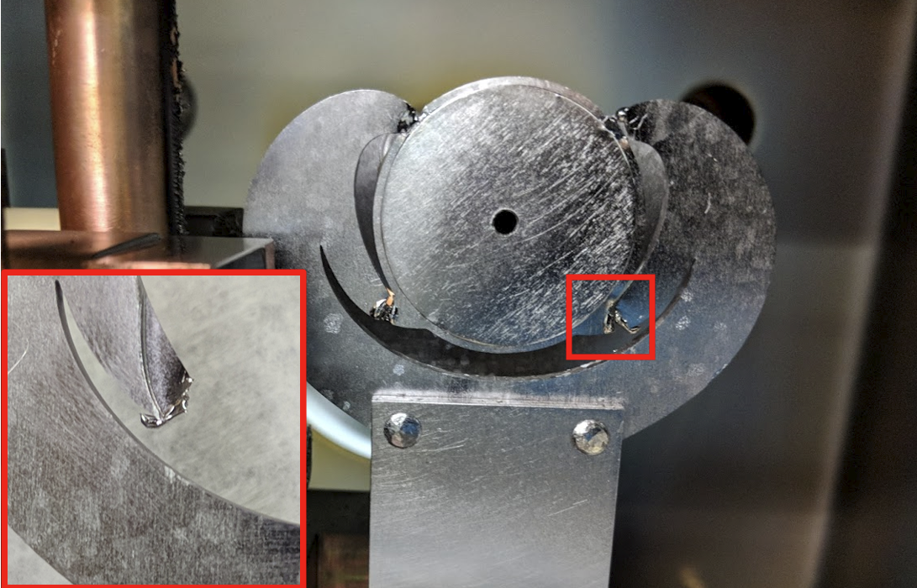
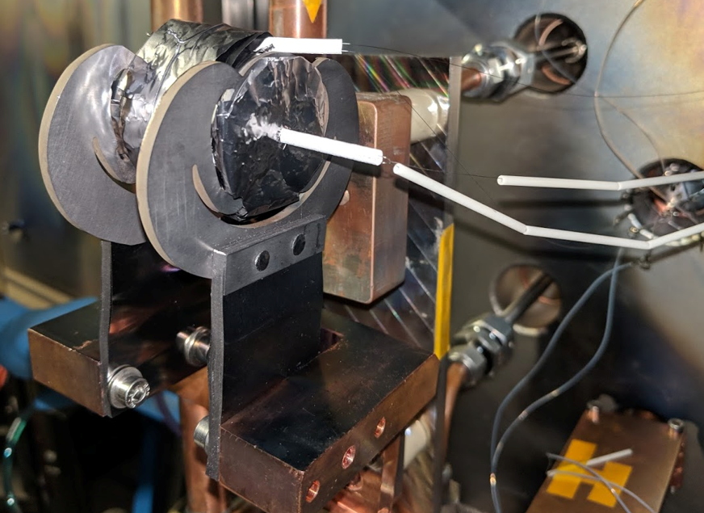
Target/converter optimization: FEA Thermo-mechanical
Optimization:
Leg shape → homogenize T in target
UC_{x} outer diameter → Affects target T_{max}
Principle:
Numerical FEA
Engineering design
(CAD, component prototyping & testing)
Manufacturing, assembly, installation
Results:
Homogeneous target material temperature (ΔT~50°C)
Measured temperature ≥ simulated temperature

Slide 9
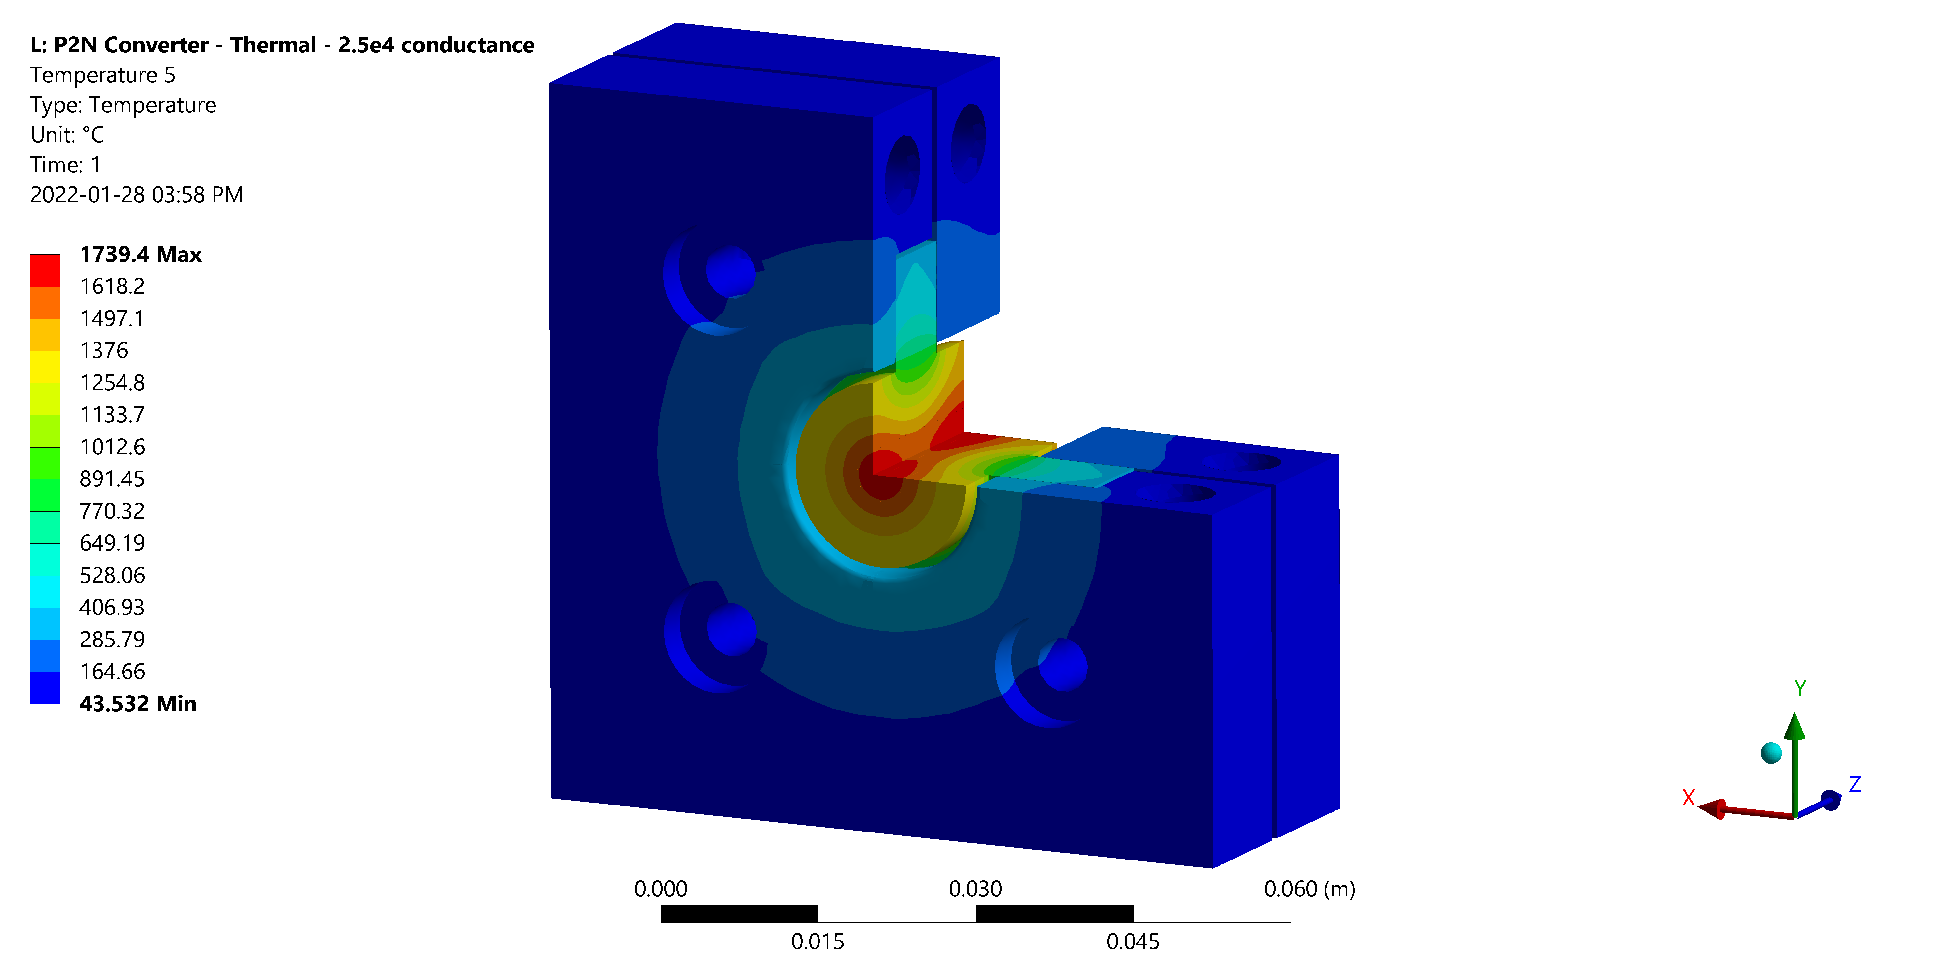
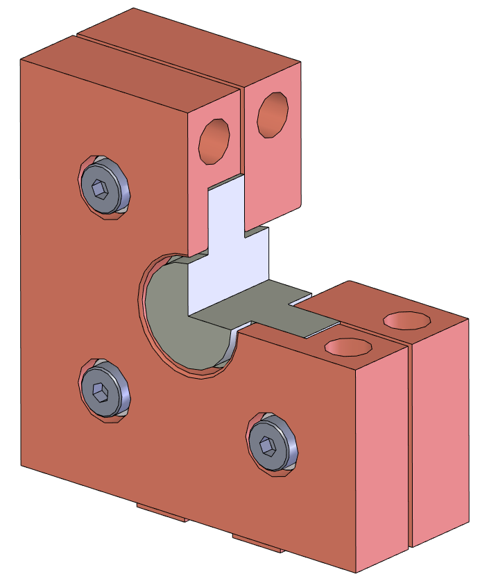
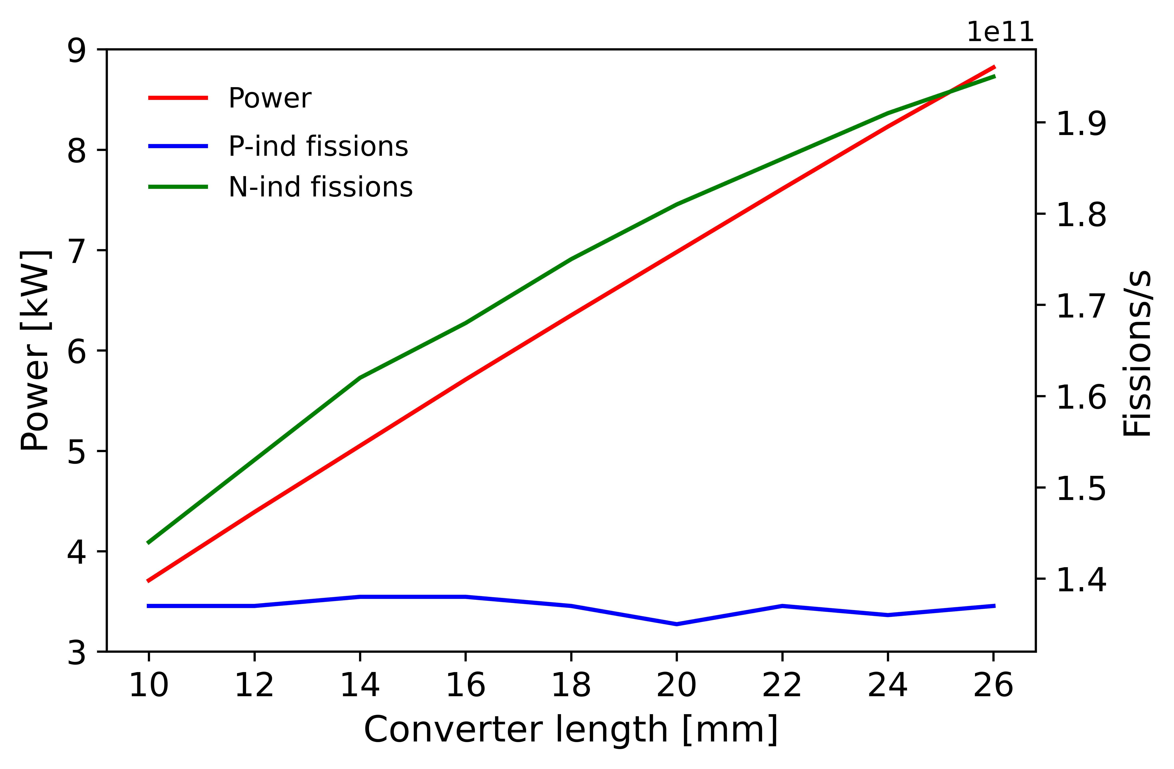
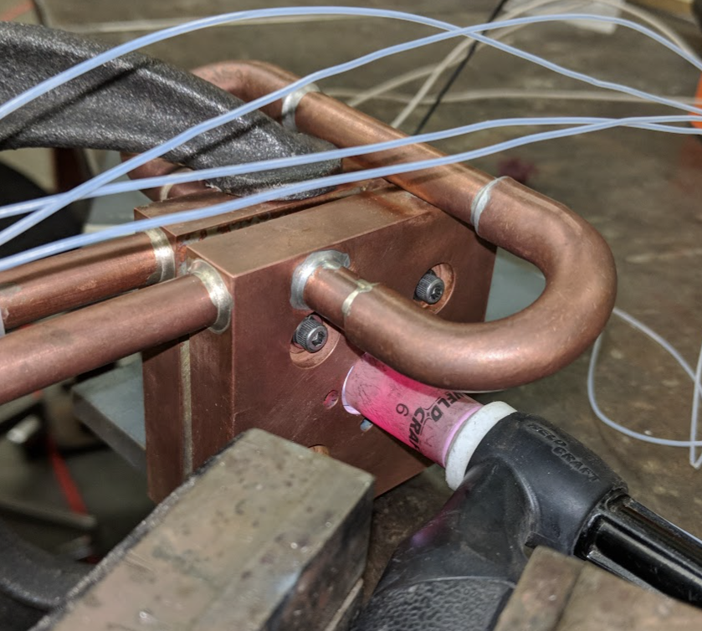
Converter optimization
Water channels
Available conditions:
Flow H₂O ~ 6 [lpm]
Pressure H₂O ~ 6.8 [bar]
T_{evap} (H₂O @ 6.8 [bar]) = 166 °C
Spring-loaded bolts
Creep resistant alloy CuCrZr
Thermal conductance through offline tests
Bolts for axial clamping
Tungsten (W) converter
CuCrZr
brackets
Results:
Optimum W length = 2 cm
Power deposited = 7525 W
T_{max} (W) = 1739 °C
T_{max} (CuCrZr) = 360 °C
T_{max} (H₂O) = 149 °C
Plastic stresses OK
Objectives:
Minimize thermal shine to target
→ Active water cooling
Maximize neutron-induced fissions
→ balancing power vs neutron production

Slide 10
Online results at
ISAC-TRIUMF

Slide 11
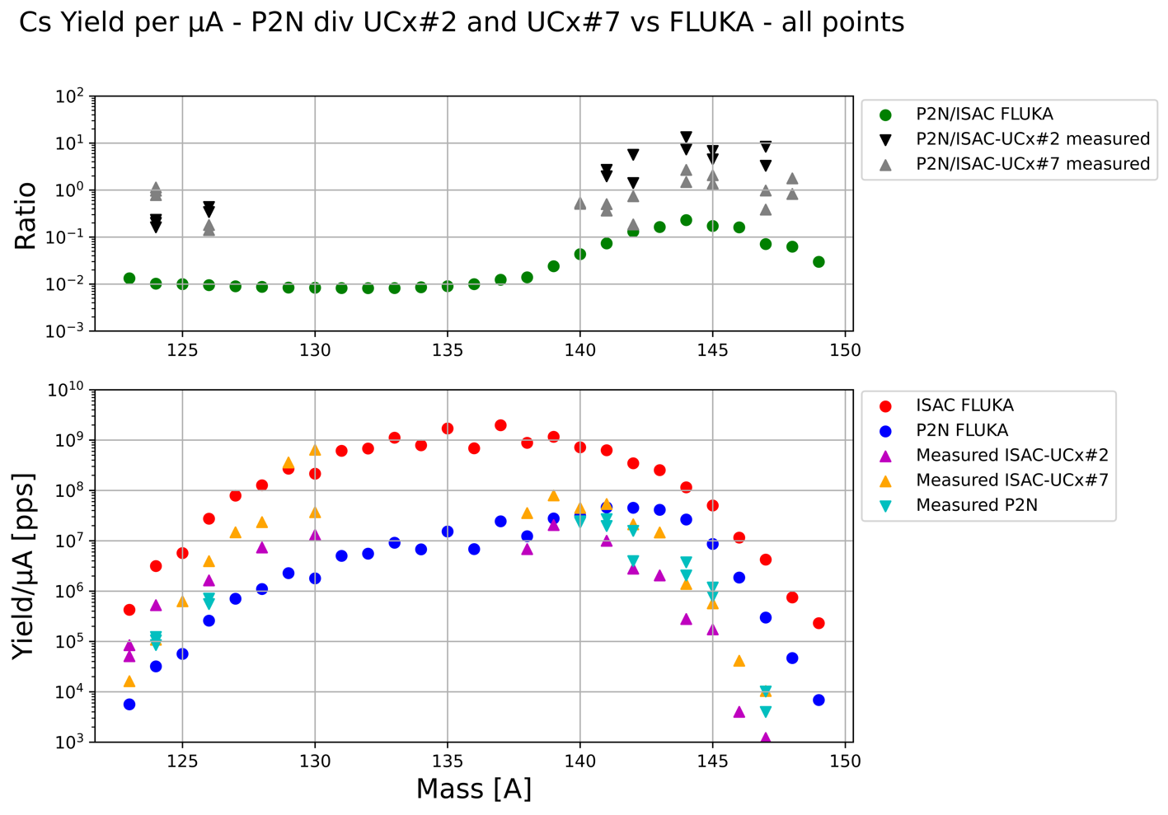
Increased neutron-rich purity by 5x – 20x
P2N improves production in n-rich region
Measured yield ratios P2N / ISAC-UC_{x}
NRIF
Ratios are half-life independent
Neutron-Rich Improvement Factor (NRIF):
Quantifies P2N performance to enhance n-rich production.
Yields/μA P2N can take ~4x more p⁺ current
Chains measured for Cs, Rb, Sn, Zn
Conventional ISAC-UC_{x}: In-target production (FLUKA)
Converter: In-target production (FLUKA)
Conventional ISAC: Measured yield
Simulation
Converter: Measured yield
Data

Slide 12
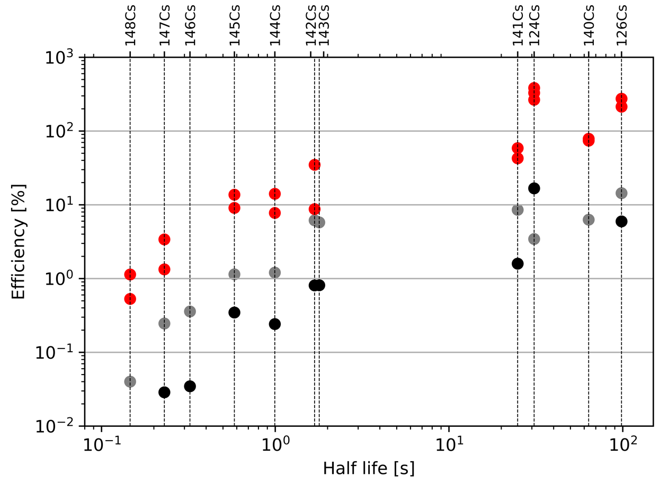
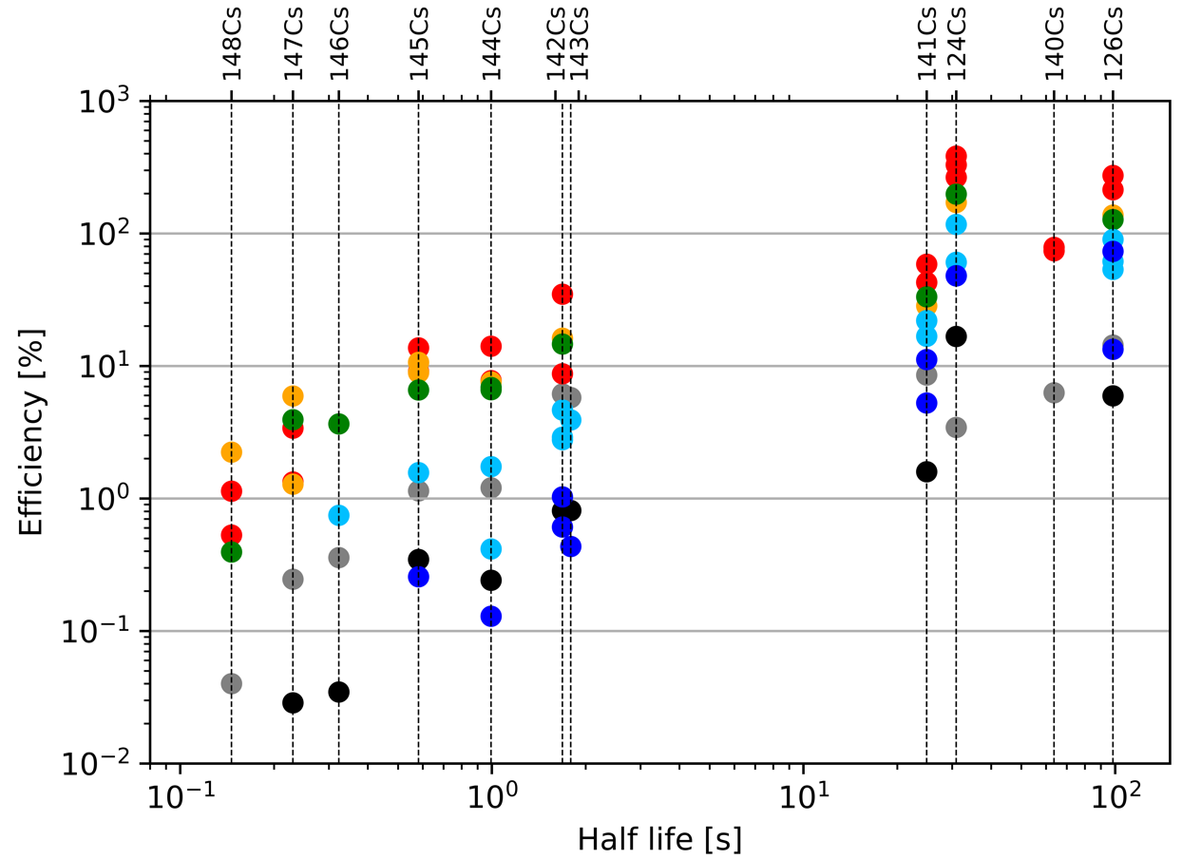

Beam-independent temperature control
Trend comparable with ISAC-UC_{x}
P2N release efficiency higher
  Temperature homogeneity
N-deficient efficiency > 100%
  P-beam mis-steered
Cs yields at lower temperature
  Temperature-controlled mode
  Enables cleaner Cs, Rb beams by suppressing n-deficient lanthanides by a factor ~1000
Spall neutrons
Target
Target
Target
Converter
P⁺ beam
Converter
ISAC-UC_{x} Target
ISAC-UC_{x} Target
P⁺ beam
Target
Target
Target

Slide 13
Yield vs p⁺ intensity: Linearity
Neutron rich Cs
Linear trend confirmed:
Temperature independence
Comparing yield/μA adequate
Neutron deficient Cs
Proton beam position likely changes when adjusting its intensity:
Inducing more spallation in annular UC_{x}
Increased n-deficient production
Confirms that yields can be presented per unit of primary beam [Yield/μA]
No Radiation Enhanced Diffusion noticed on broad p⁺ range

Slide 14
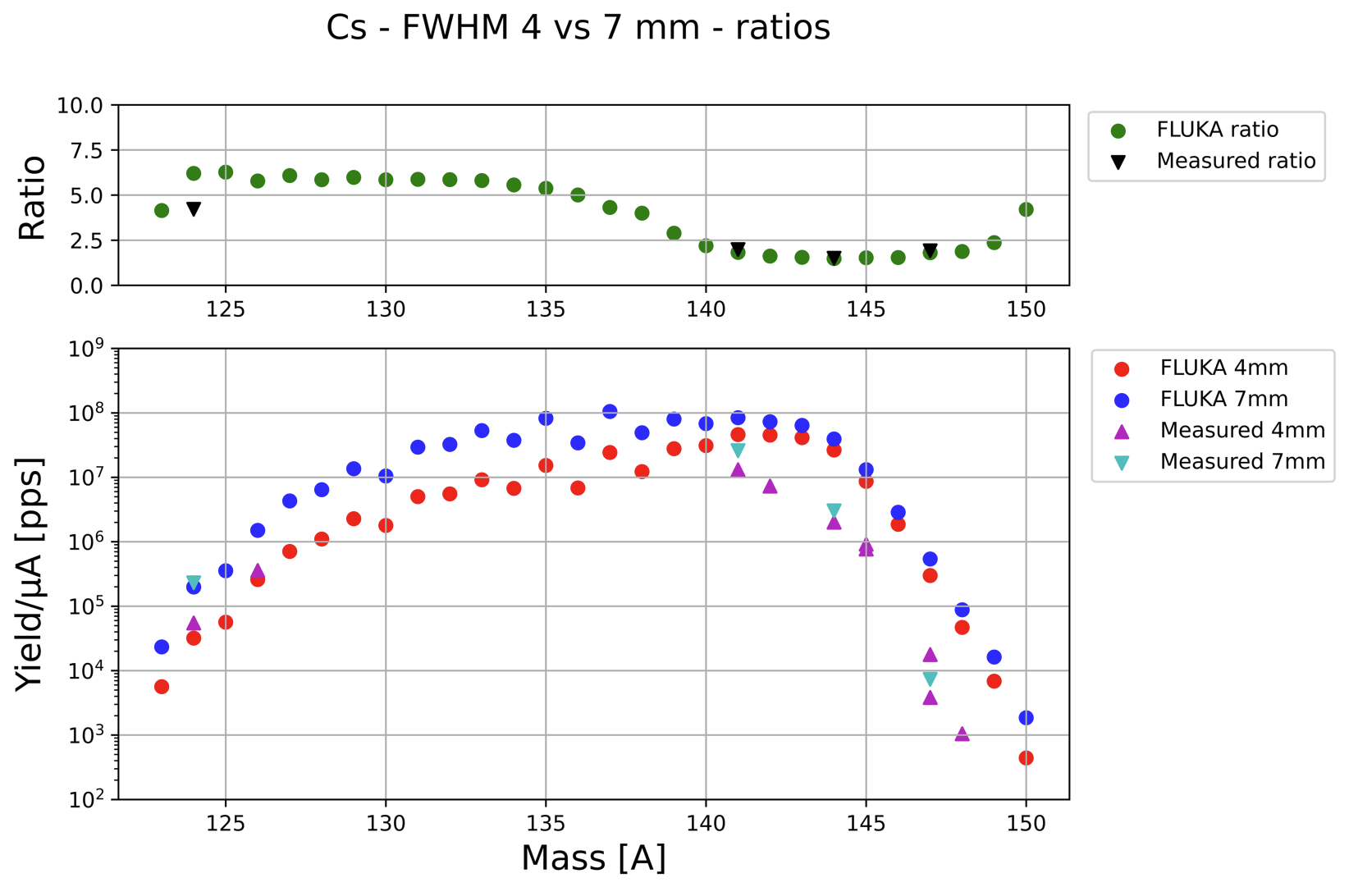
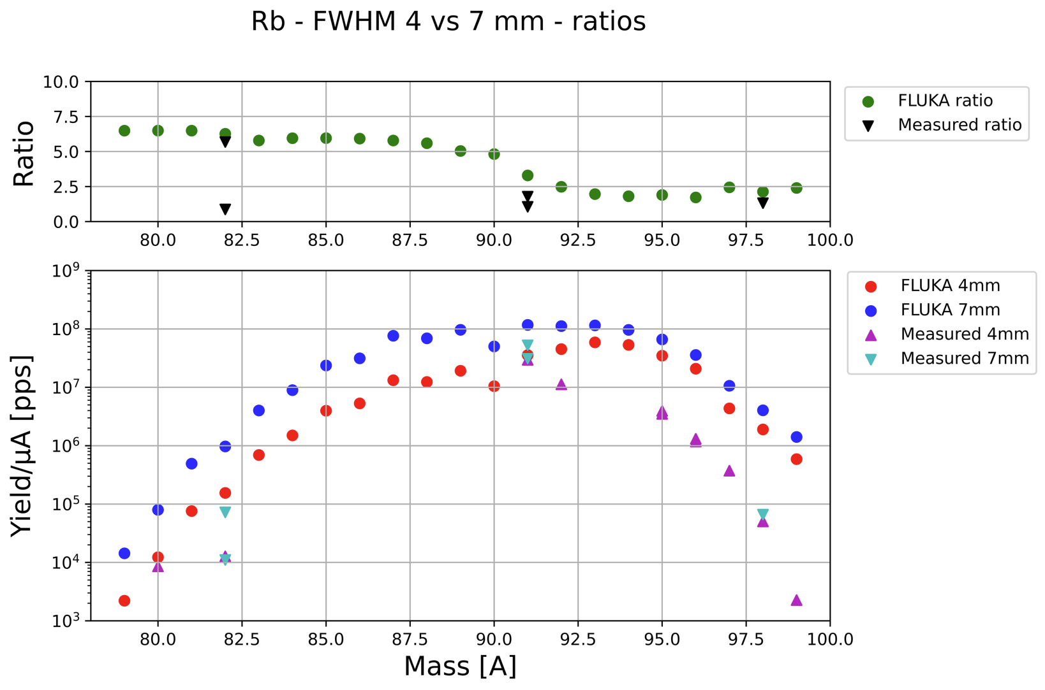
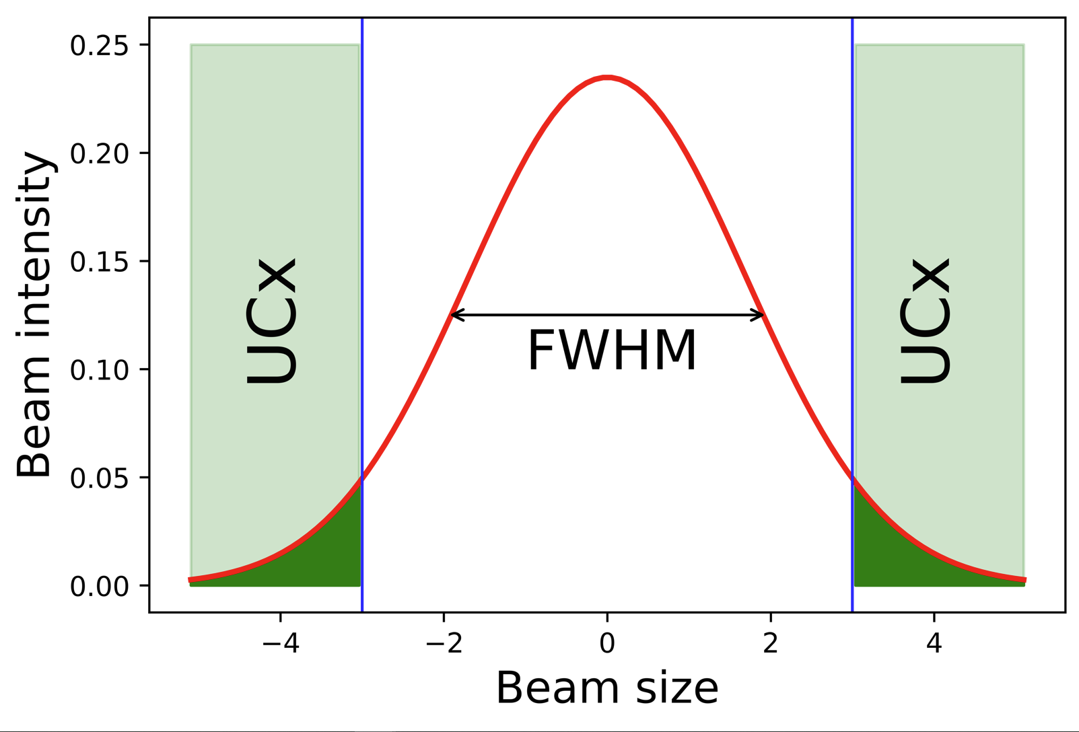
A bigger proton beam size (FWHM) increases contaminants
Cesium
Rubidium
FWHM considerations:
Larger beam → Higher spallation on UC_{x} from “beam tails”
Conservative operation of target module (Al6061) window:
  I_{p+ (max)} = 80 μA (@ FWMH = 4 mm)
  I_{p+ (max)} = 99 μA (@ FWMH = 7 mm)

Slide 15
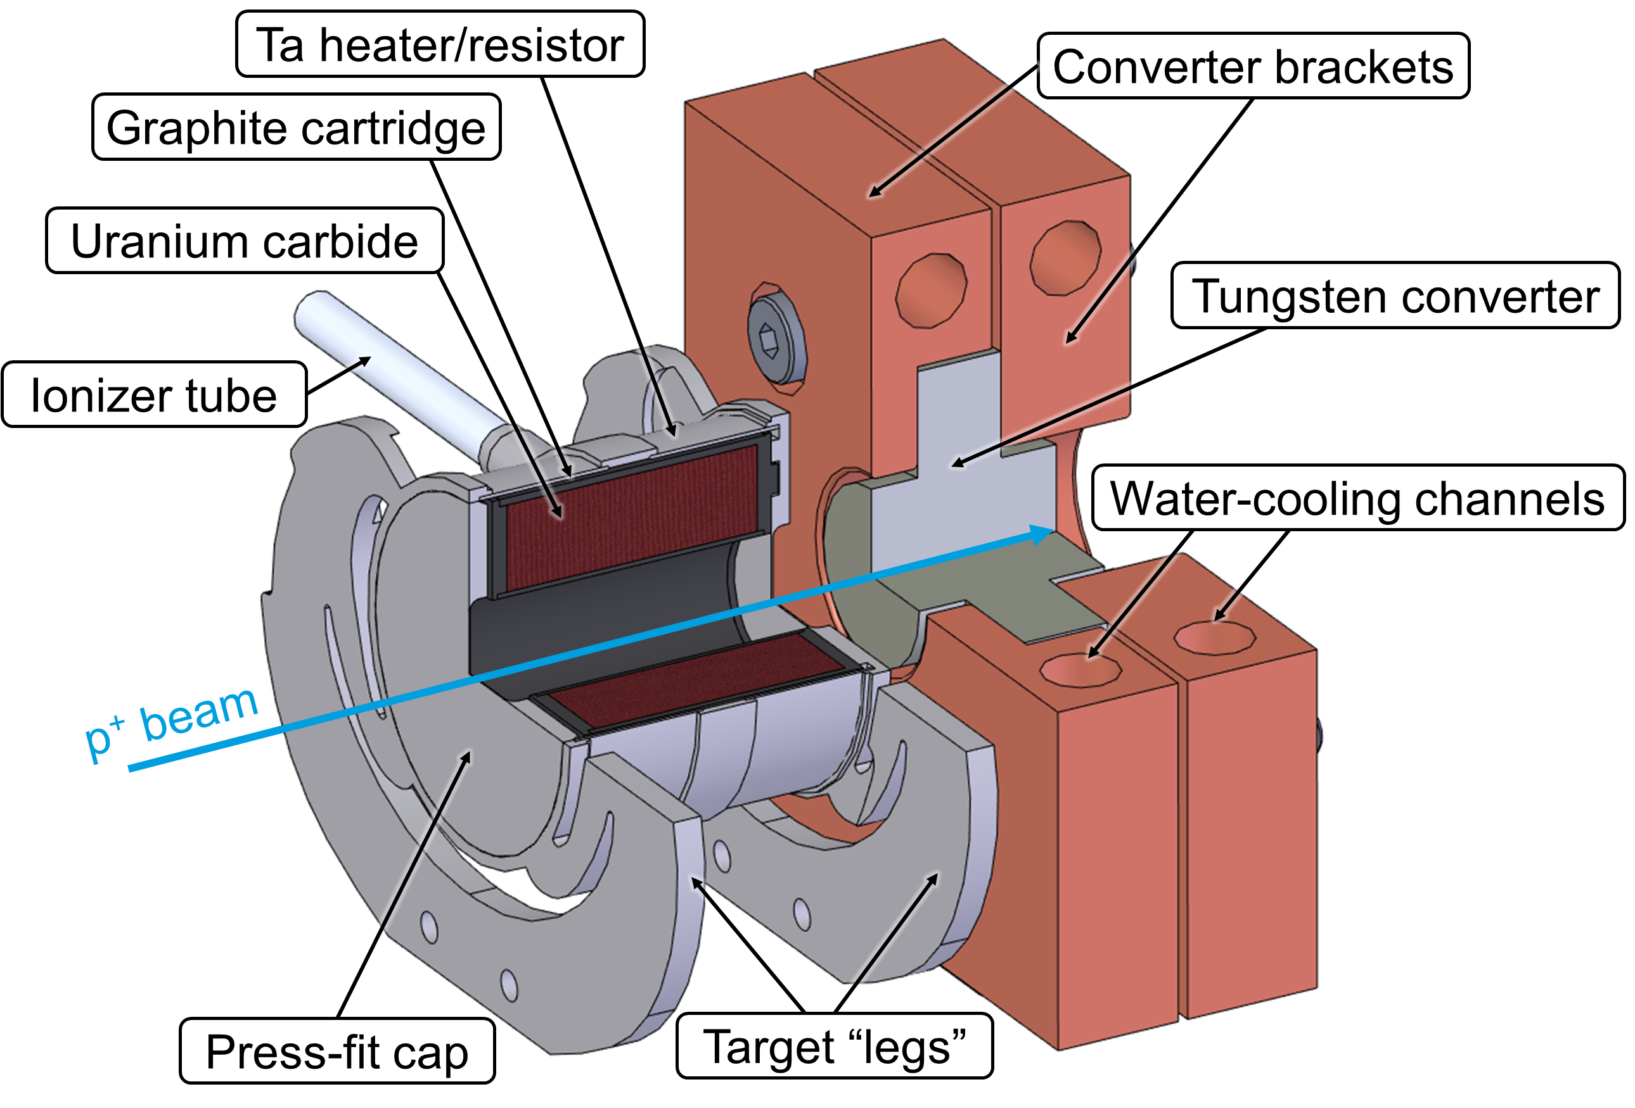
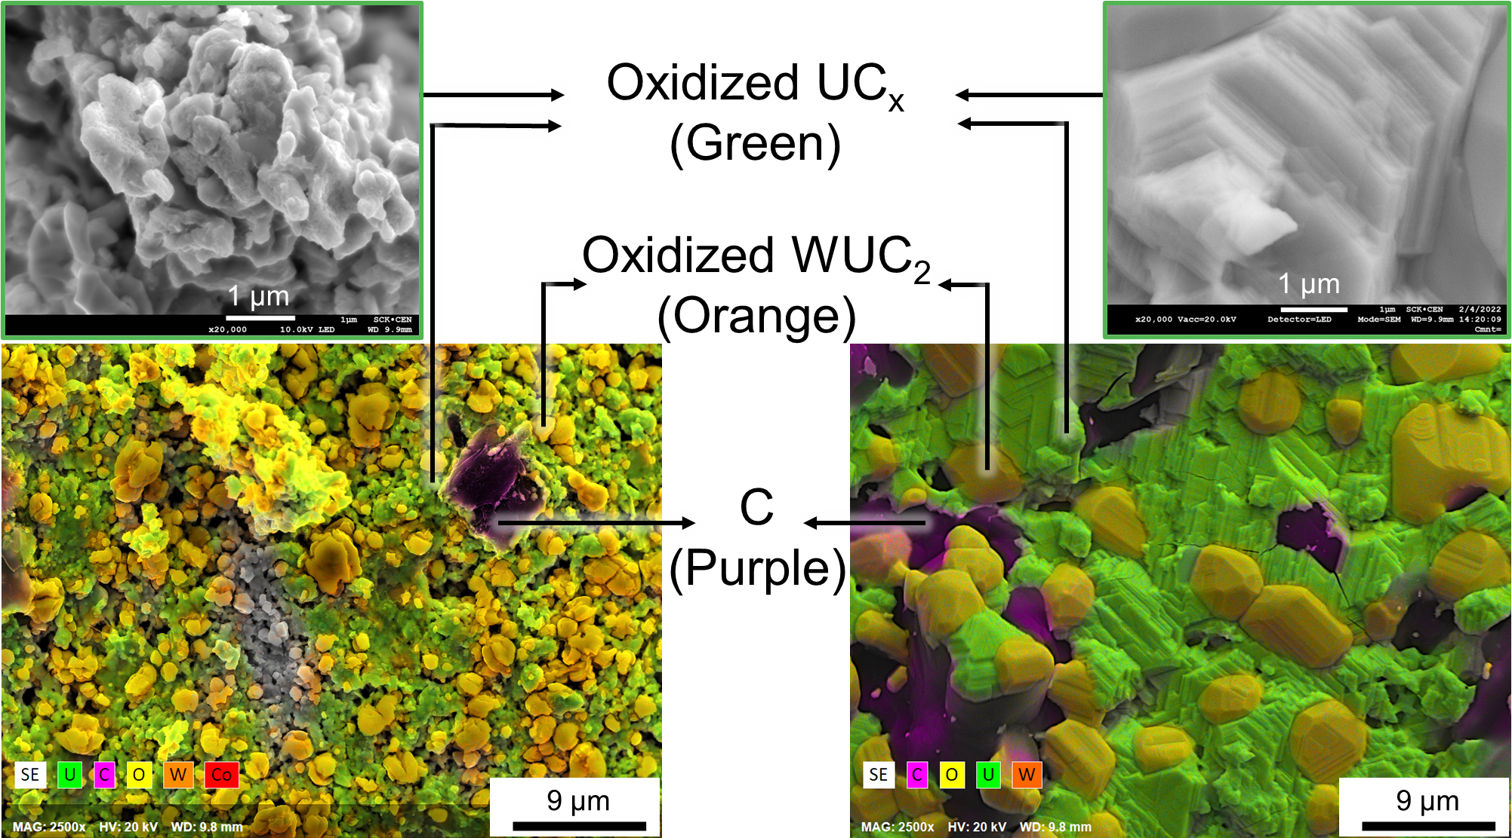
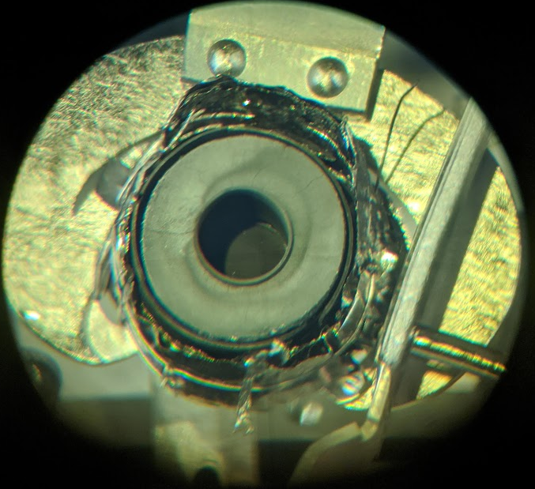
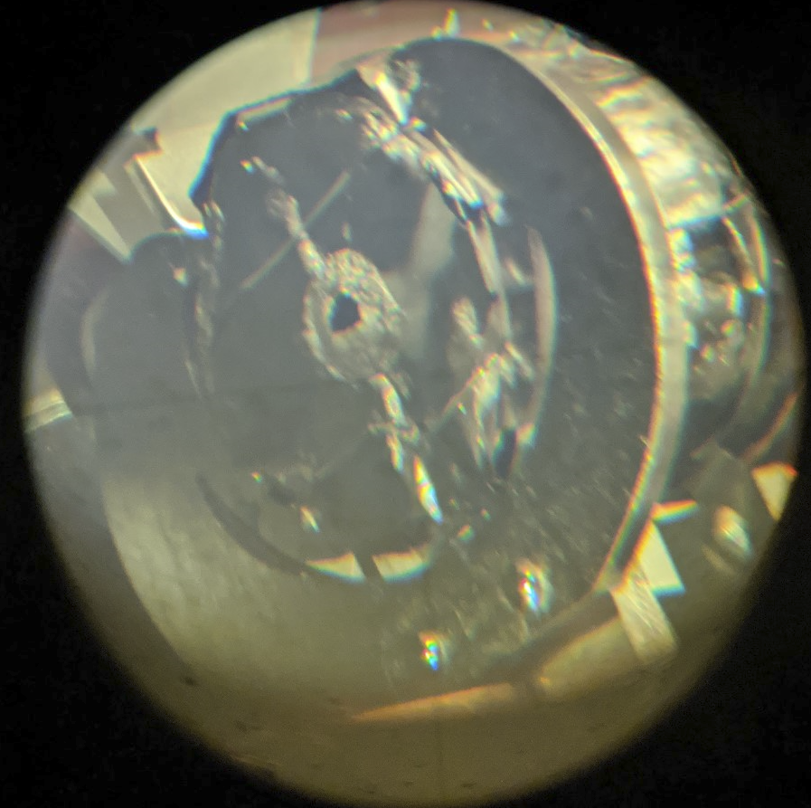
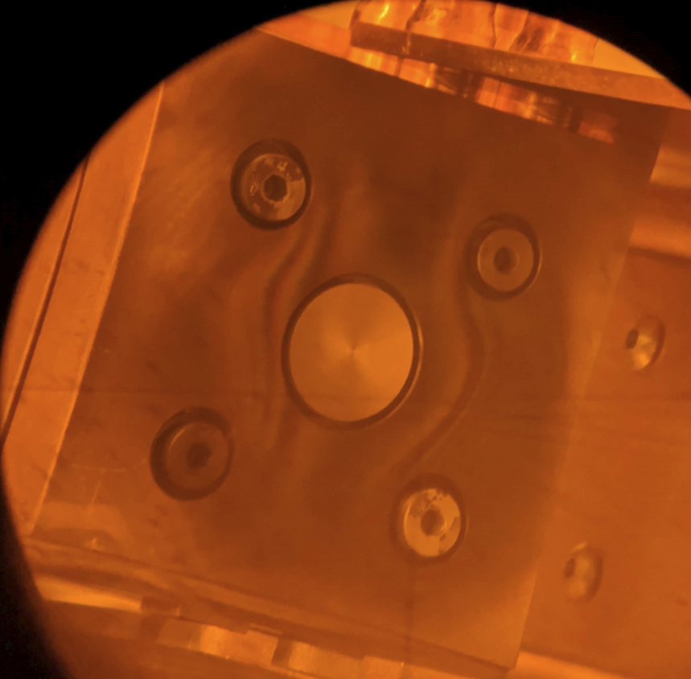
Post Irradiation Examinations (PIEs)
PIE observations
Converter always withstood beam power
Target windows broke only with I_{p+} > 50 μA
SEM and EBSD performed on irradiated UC_{x} at SCK CEN
  Carbides were oxidized due to air exposure
  UC_{x} particle size grew ~10x

Slide 16
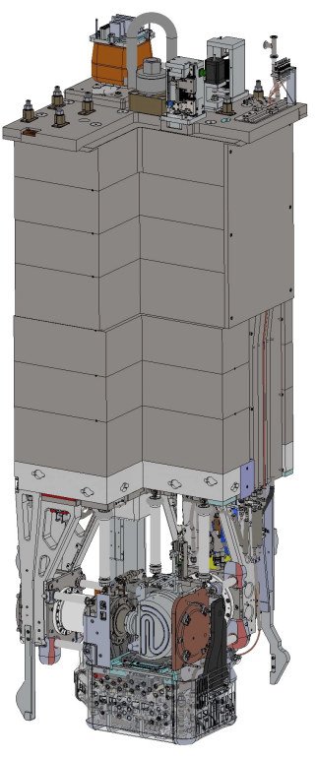
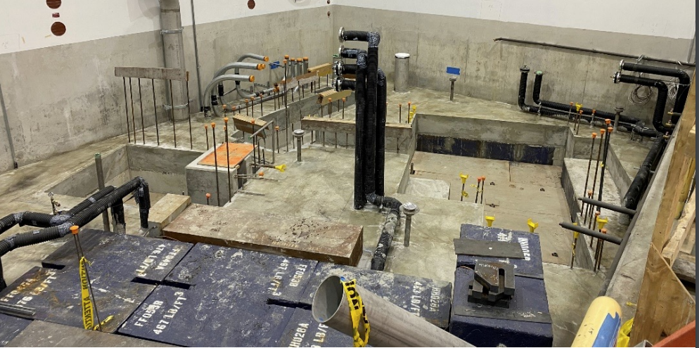
User facilities
Cyclotron & beamlines (since ~1975)
TRIUMF accelerators
ISAC ISOL targets (since 2000s)
RIB lines
ARIEL ISOL targets (from ~2025)
E-linac and beamline (since ~2013)
Radioactive Ion Beams
~10 user facilities
Nuclear & atomic physics
Material science
Medical isotopes
ISAC I and II halls
ISOL
(ARIEL)
TR: 13
APTW
AETE
TR: 30-1
TR: 30-2
ISOL
(ISAC)
CP: 42
120 MeV – 10 nA
Electronics irradiations
Proton FLASH
Ocular melanoma treatments (-2019)
ITW
ITE
PIF
TR: 24
Neutron Irradiations
BL4N
BL2A
NIF
⁸²Sr medical production
STF
BL2C
Muons for
material science
²²⁵Ac et al. production
T1
T2
IPF
30 MeV – 10 mA
e- LINAC
500 MeV – 400 μA
H⁻ Cyclotron
BL1A

Slide 17
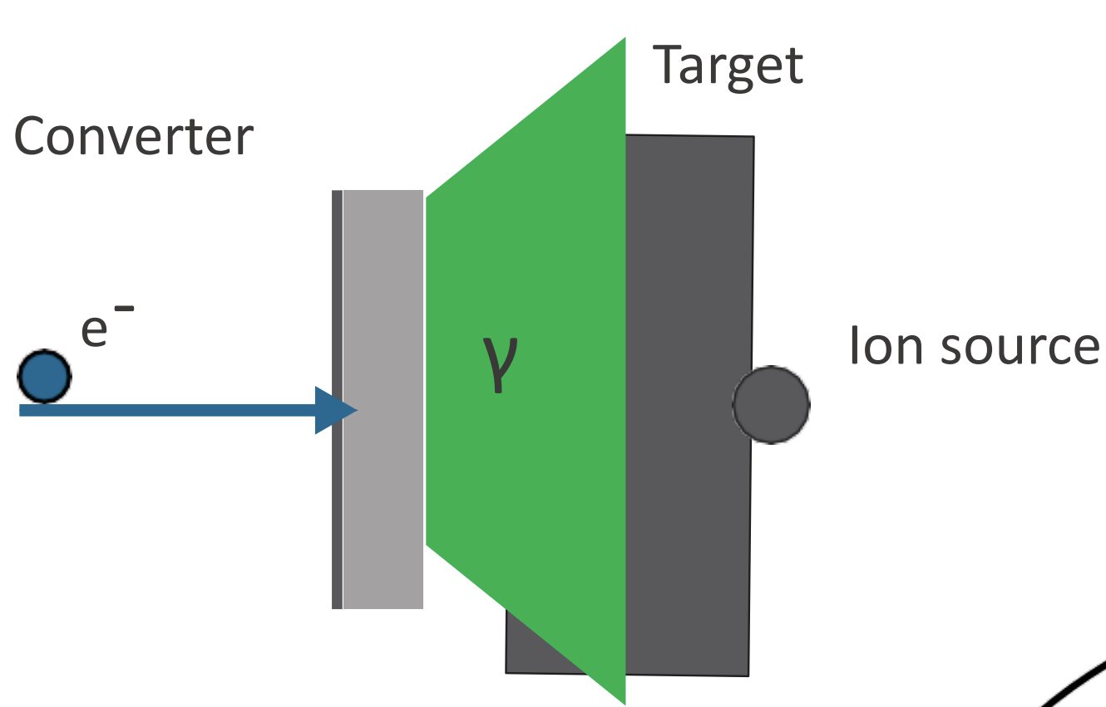
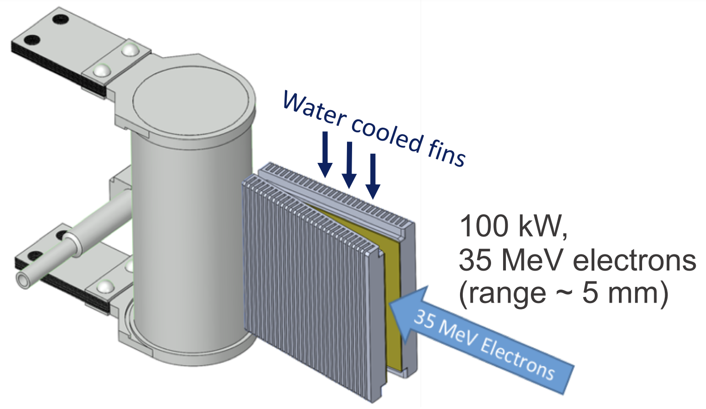
Converters for high-power RI Beam production
Electrons
Protons

Slide 18
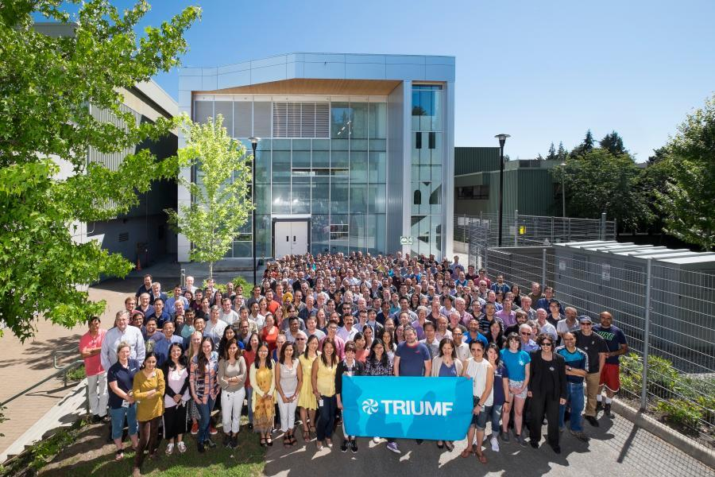





Slide 19
Backup

Slide 20
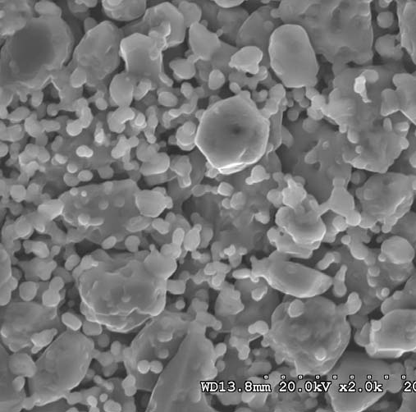
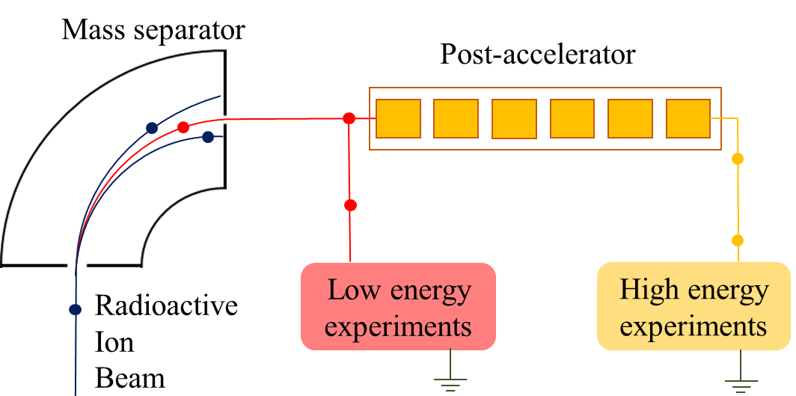
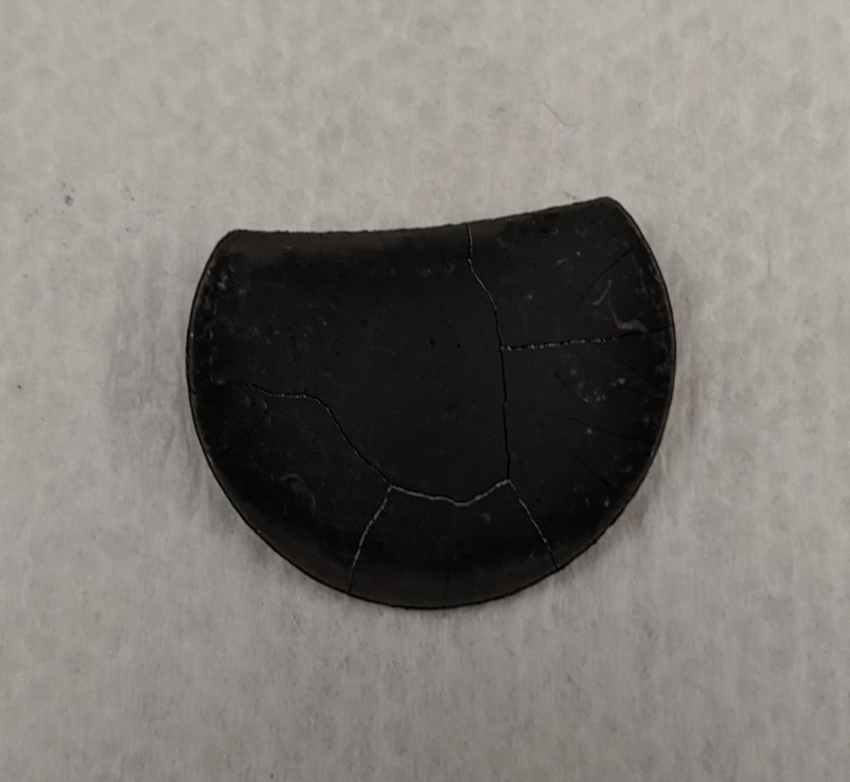
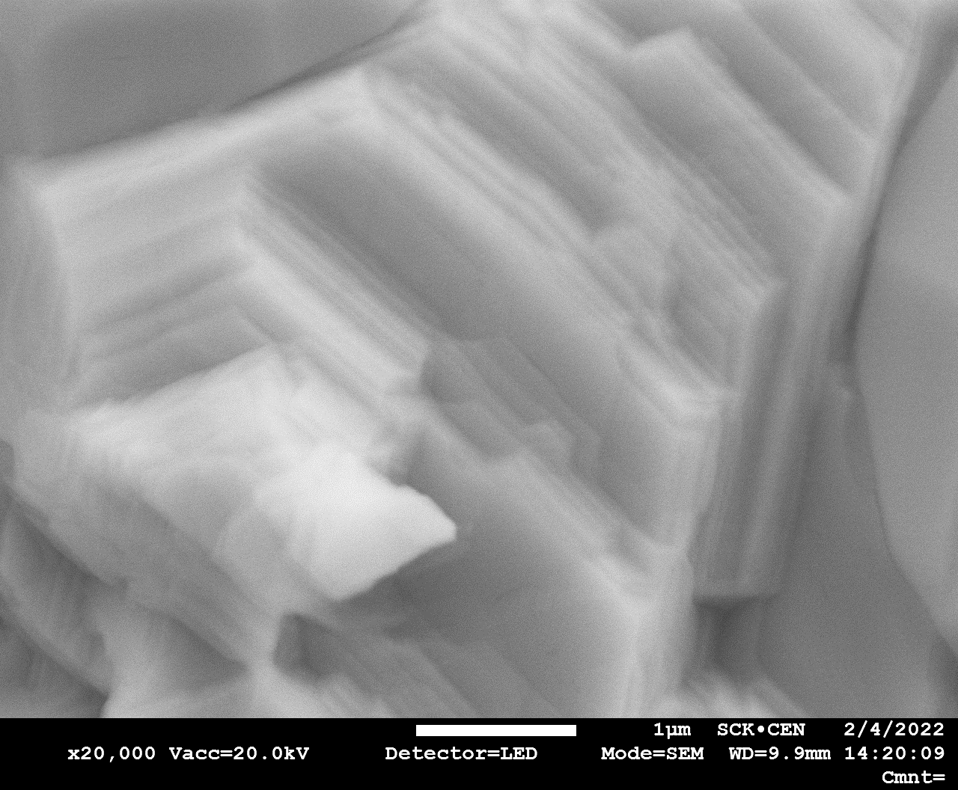





Release in ISOL targets
$$IRIB=I∙Ntarg∙σi∙ε$$
$ε=εR∙εI∙$ $εMS∙$ $εT$
UC_{x} disc
Radioactive
Ion
Beam
10 μm
Extraction electrode
HV 60 kV
Diff.
param
$$D=D0exp⁡(−\frac{∆Hm}{kBT})$$
$$τs= ν0 exp⁡(−\frac{∆Hdes}{kBT})$$
$\sim μs= \frac{π2D}{r2}$;
2 kV
Ionizer
Neutrals
Ions
Target
T=2000 °C
Isobars only
Isobars only
Post-accelerated
1 μm
1 μm
Post-accelerated
20 cm
UC_{x} + C
After conditioning
UC_{x} + C
heated and irradiated
n-SiC
Electrospun

Slide 21
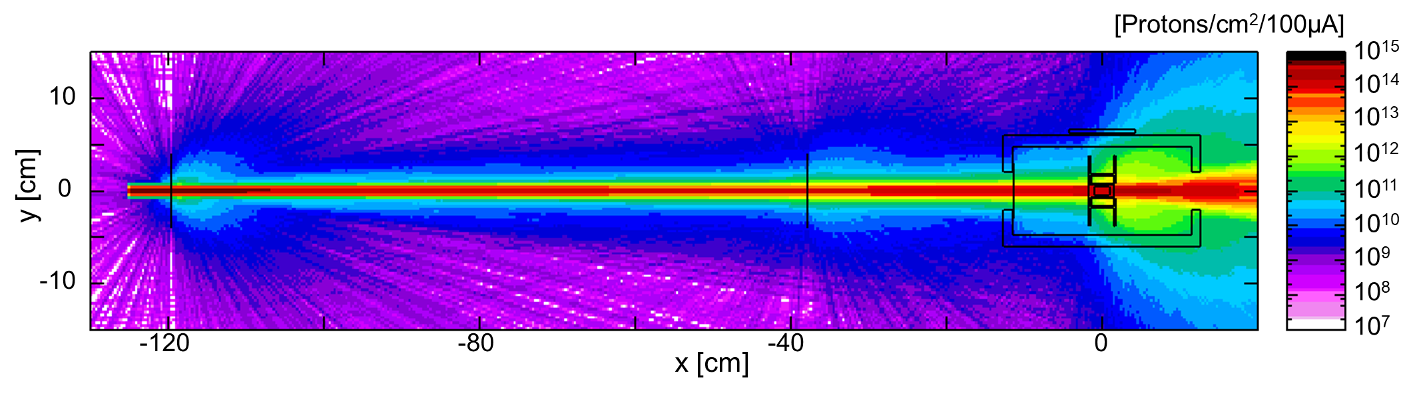
Effect of beam windows on proton beam

Slide 22





Target optimization process

Slide 23
Target/converter optimization: FEA/prototyping
Lateral surface
Optimization:
Leg shape → homogenize T in target
UC_{x} outer diameter → Affects target T_{max}
Converter shape → minimize temperatures in W/Cu
Principle:
Numerical FEA (ANSYS, thermal/electric/structural)
Engineering design (CAD, component prototyping & testing)
Central temperature
TIG
torch
Electrical connections
Results:
Homogeneous target material temperature (ΔT~50°C)
Converter T/stresses are compatible with online operation

Slide 24





Converter optimization - backup
Temperature [°C]
Available conditions:
Flow H₂O ~ 6 [lpm]
Pressure H₂O ~ 6.8 [bar]
T_{evap} (H₂O @ 6.8 [bar]) = 166 °C
Spring-loaded bolts
Creep resistant alloy CuCrZr
Thermal conductance through offline tests
Results:
Optimum W length = 2 cm
Power deposited = 7525 W
T_{max} (W) = 1739 °C
T_{max} (CuCrZr) = 360 °C
T_{max} (H₂O) = 149 °C
Plastic stresses OK
Plastic strains [Pa]

Slide 25

Cesium efficiency compared to ISAC-UC_{x} historical

Slide 26


Rubidium efficiency compared to ISAC-UC_{x} historical

Slide 27



Linearity: Yield vs p⁺ current
Linear fit:
Confirmation that yields can be presented per unit of primary beam [μA p⁺]
Confirms little thermal coupling between p⁺ and target windows
N-rich Cs isotopes used to suppress spallation contribution
Previous work
Radiation Enhanced Diffusion (RED) not seen in converter, yields are linear
Difficult to decouple it from thermal effects for high-power proton beams
ISOLDE yields from cold target show release higher than expected
ISAC enhancements might be thermally induced by the resistive heating adjustments
Ramos et al., https://doi.org/10.1016/j.nimb.2016.03.003

Slide 28




Radiation Enhanced Diffusion (RED)
Hints of RED effect:
Looking at one target only
Target heater and proton beam current “compensate” each other to aim for a constant temperature.
Historical data through 25 years:
No data close to origin to confirm over-linearity
Yields drop after 60μA
Temperature effects difficult to disentangle

Slide 29


MR-ToF (TITAN) results
Time split between yield measurements and MR-ToF measurements
  Assessing relative contaminant yields (50%)
  Measuring masses for relevant science cases (50%)
Maximum RIB current in MR-ToF ~ 10⁶ pps
Purity gains enabled measurements of 10 new masses:
  ⁸³Zn, ¹⁴⁹Cs, ¹⁵⁰Cs, ¹⁵¹Cs, ¹⁵¹Ba, ¹⁵²Ba, ¹³⁶Sn, ¹³⁷Sn, ¹³⁸Sn and ⁸⁶Ga
Molecular contamination reduced
P2N 2021
ISAC 2017
85Rb
85Ga
Mo
2H:3C12:⁴⁷Ti
⁸⁵Br
2H:2C12:⁵⁹Co

Slide 30




Assembly and online installation
Target module
Uranium carbide discs
Graphite cartridge
Target
Converter

Slide 31
Many people involved at several levels:
At TRIUMF: Alex Gottberg, Pierre Bricault, Mia Au, Marla Cervantes, Fernando Maldonado, Ferran Boix-Pamies, Tom Day Goodacre, Carla Babcock, Peter Kunz, Friedhelm Ames, Andres Mjos, Aaron Schmidt, Jens Lassen, Ruohong Li, Ricardo Dos Santos Augusto, Darwin Ortiz Rosales, David Wang, Frank Song, John Langrish, Chad Fisher, Matthew Gareau, Navid Noori, Aurelia Laxdal, Sundeep Gosh, Arthur Leung, Joe Mildenberger, Max Kinakin, Maico Dalla Valle, Dan MacDonald, John Wong, TITAN team, TRIUMF Machine Shop, Vacuum, Controls, Mechanical Services Group.
At SCK CEN and ISOLDE: Joao Pedro Ramos, Donald Houngbo, Jarno Van de Walle, Lucia Popescu, Marc Dierckx, Santiago Ramos Graces, Sebastian Rothe, Thierry Stora.

