Slide 1
Preliminary LES for Target Station 2 of the ISIS Neutron Source
Gregory Cartland-Glover, Jessica Gould, Stefano Rolfo, David Emerson, Scientific Computing, Daresbury Laboratory
Stephen Jago, Steven Gallimore, Steven Lilley, David Jenkins, Lesley Jones, Dan Blanco-Lopez, Dan Wilcox, Tristan Davenne, Chris Densham ISIS and Technology, Rutherford Appleton Laboratory

Slide 2
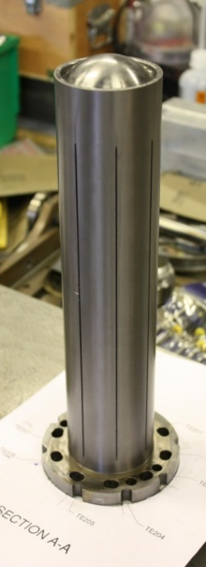
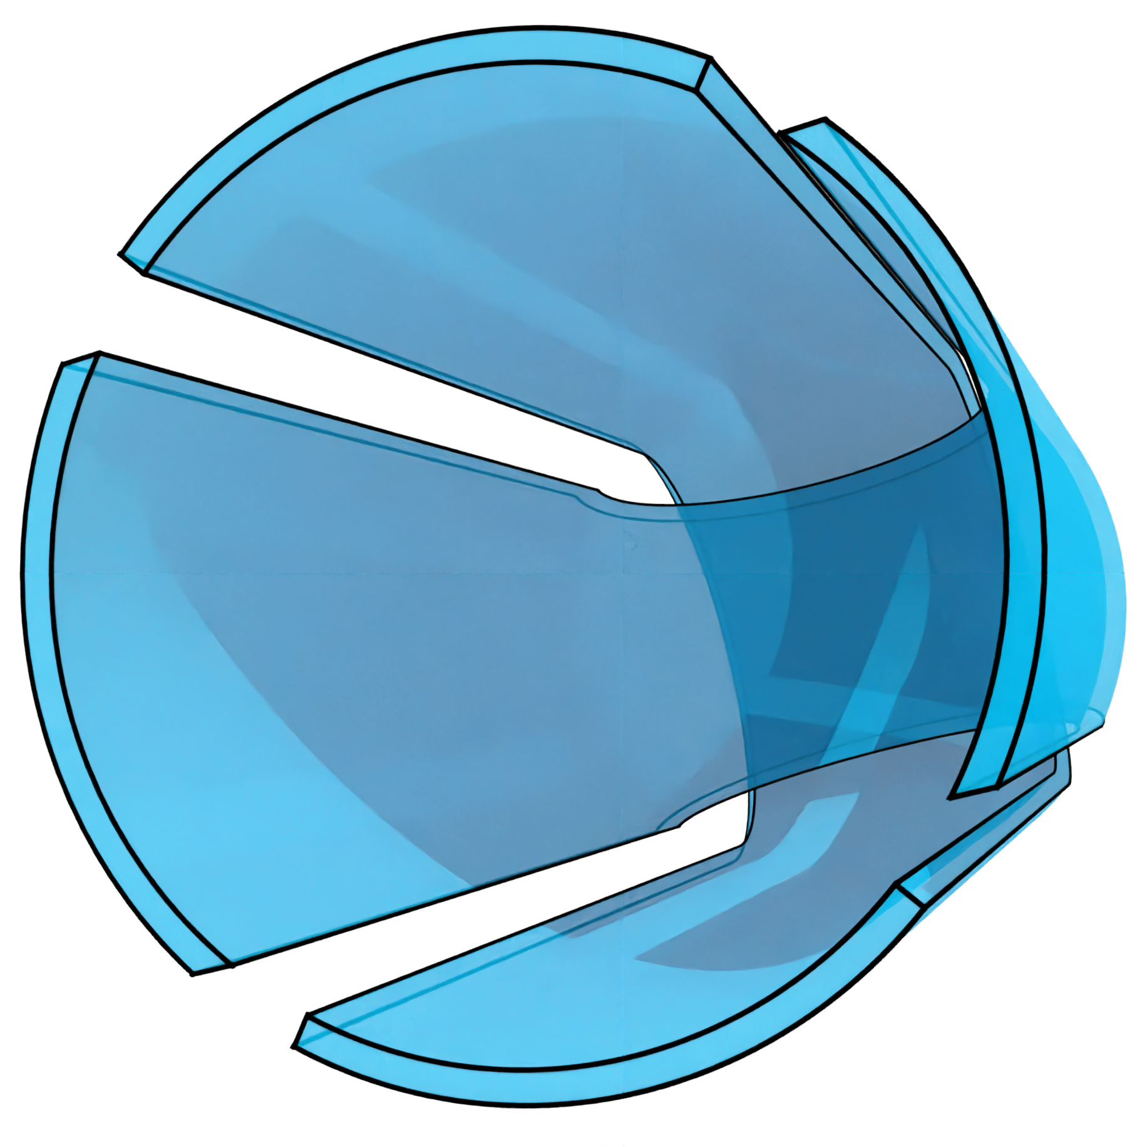
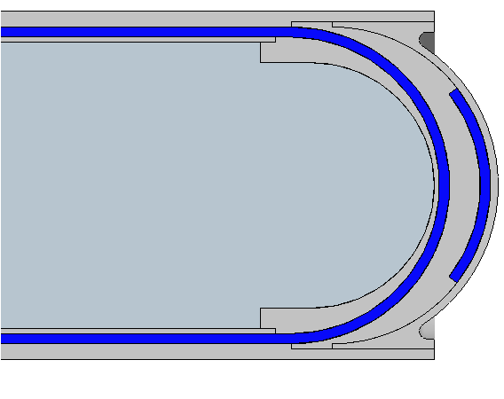
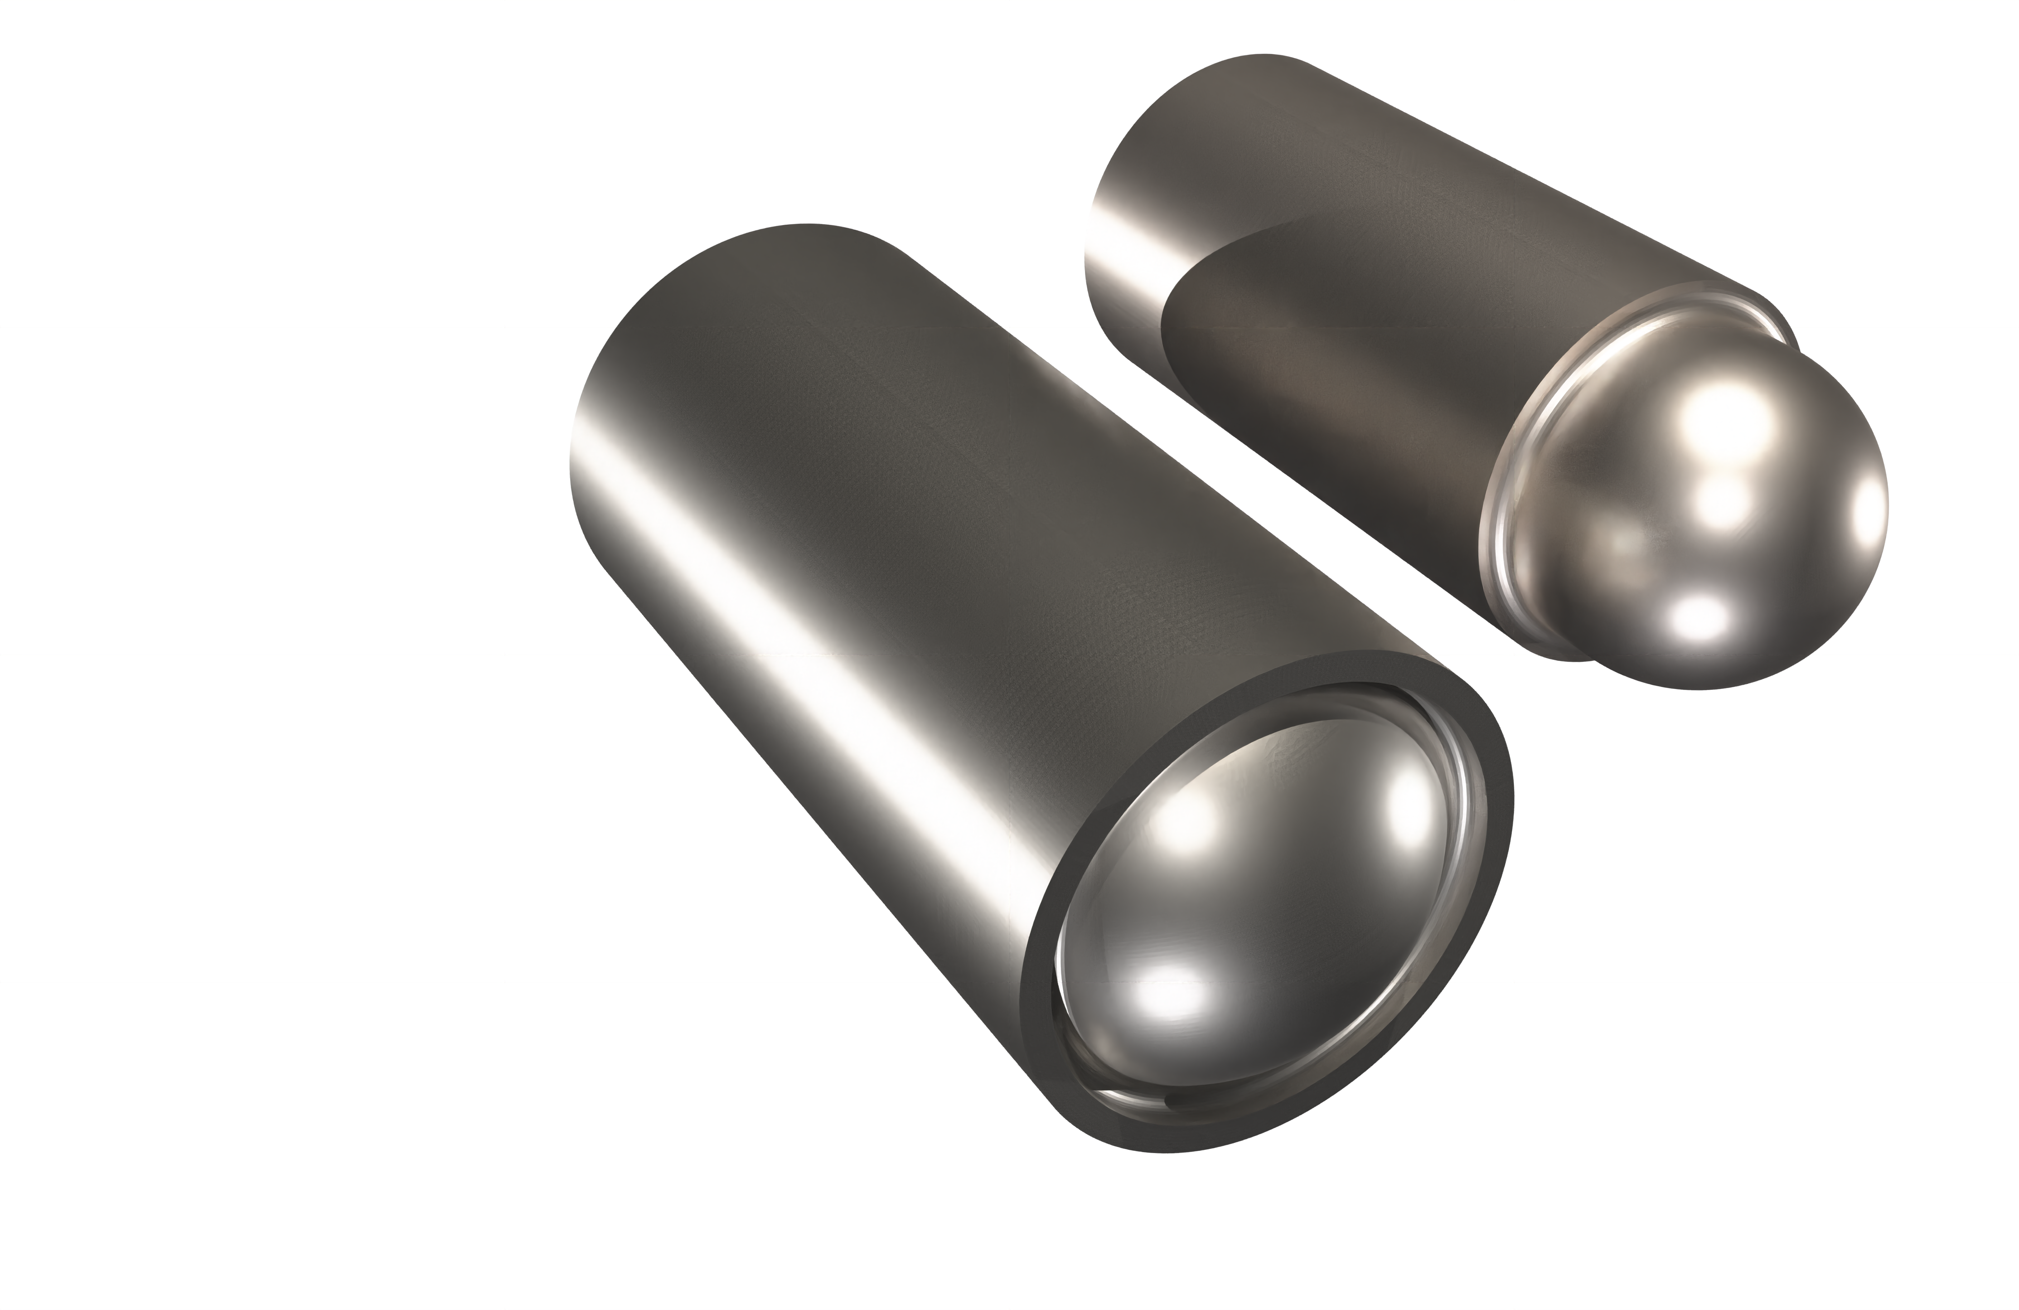
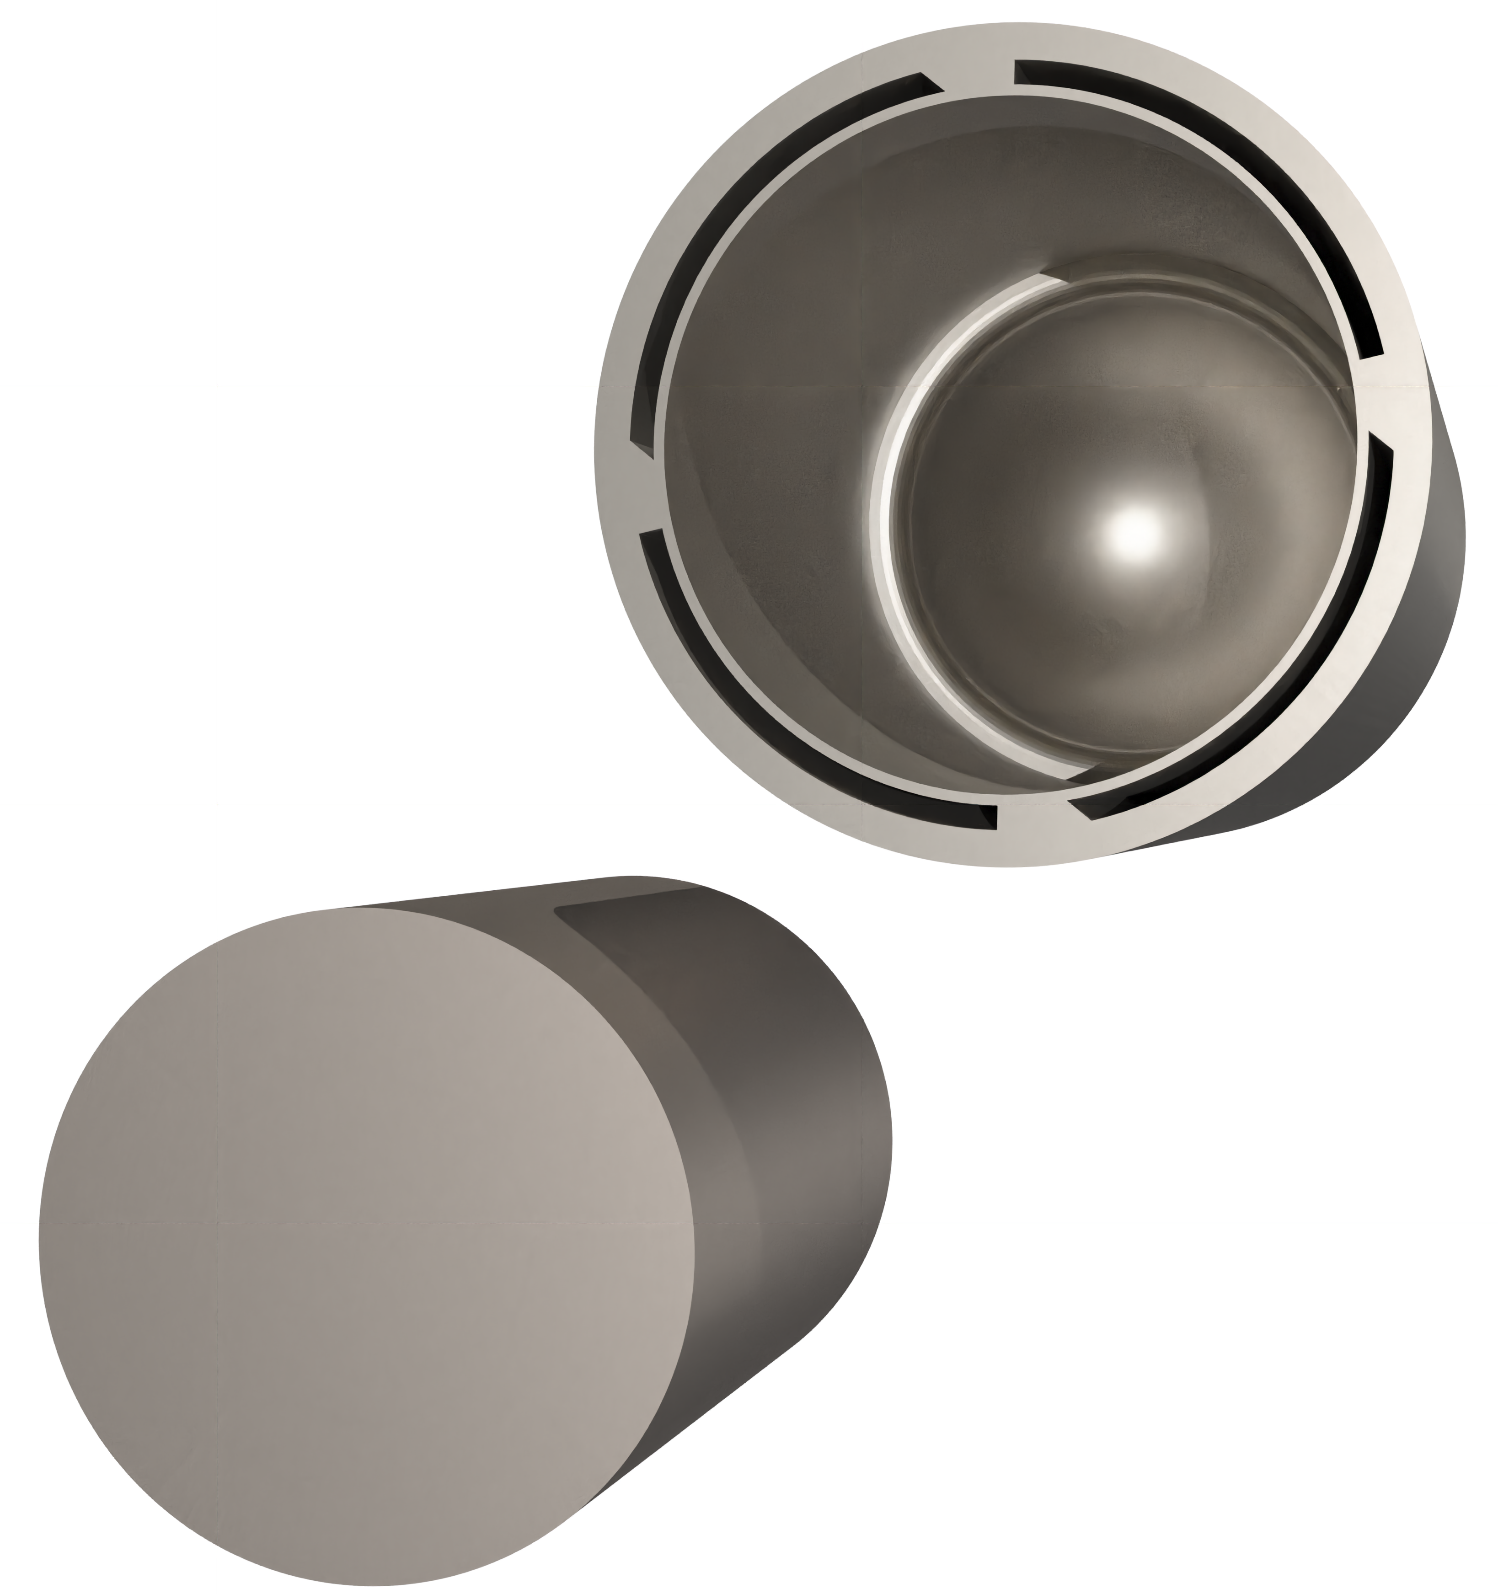
Target station 2 at ISIS
See Leslie Jones after this one for an update on the evolution of TS2
Operational lifetime is about 18 months for TS2
Need to extend operational performance & lifetime to reduce
Downtime
Amount of radiological waste
Approx. Scale
Coolant Channels
Tantalum Pressure Vessel
Tantalum Cladding
Inner Water Channel
Outer Water Channel
Tantalum Pressure Vessel and Cladding
800 MeV Pulsed
50 Hz Proton Beam 1/5 pulses (dual pulse)
Tungsten
Core
Tungsten
Core

Slide 3
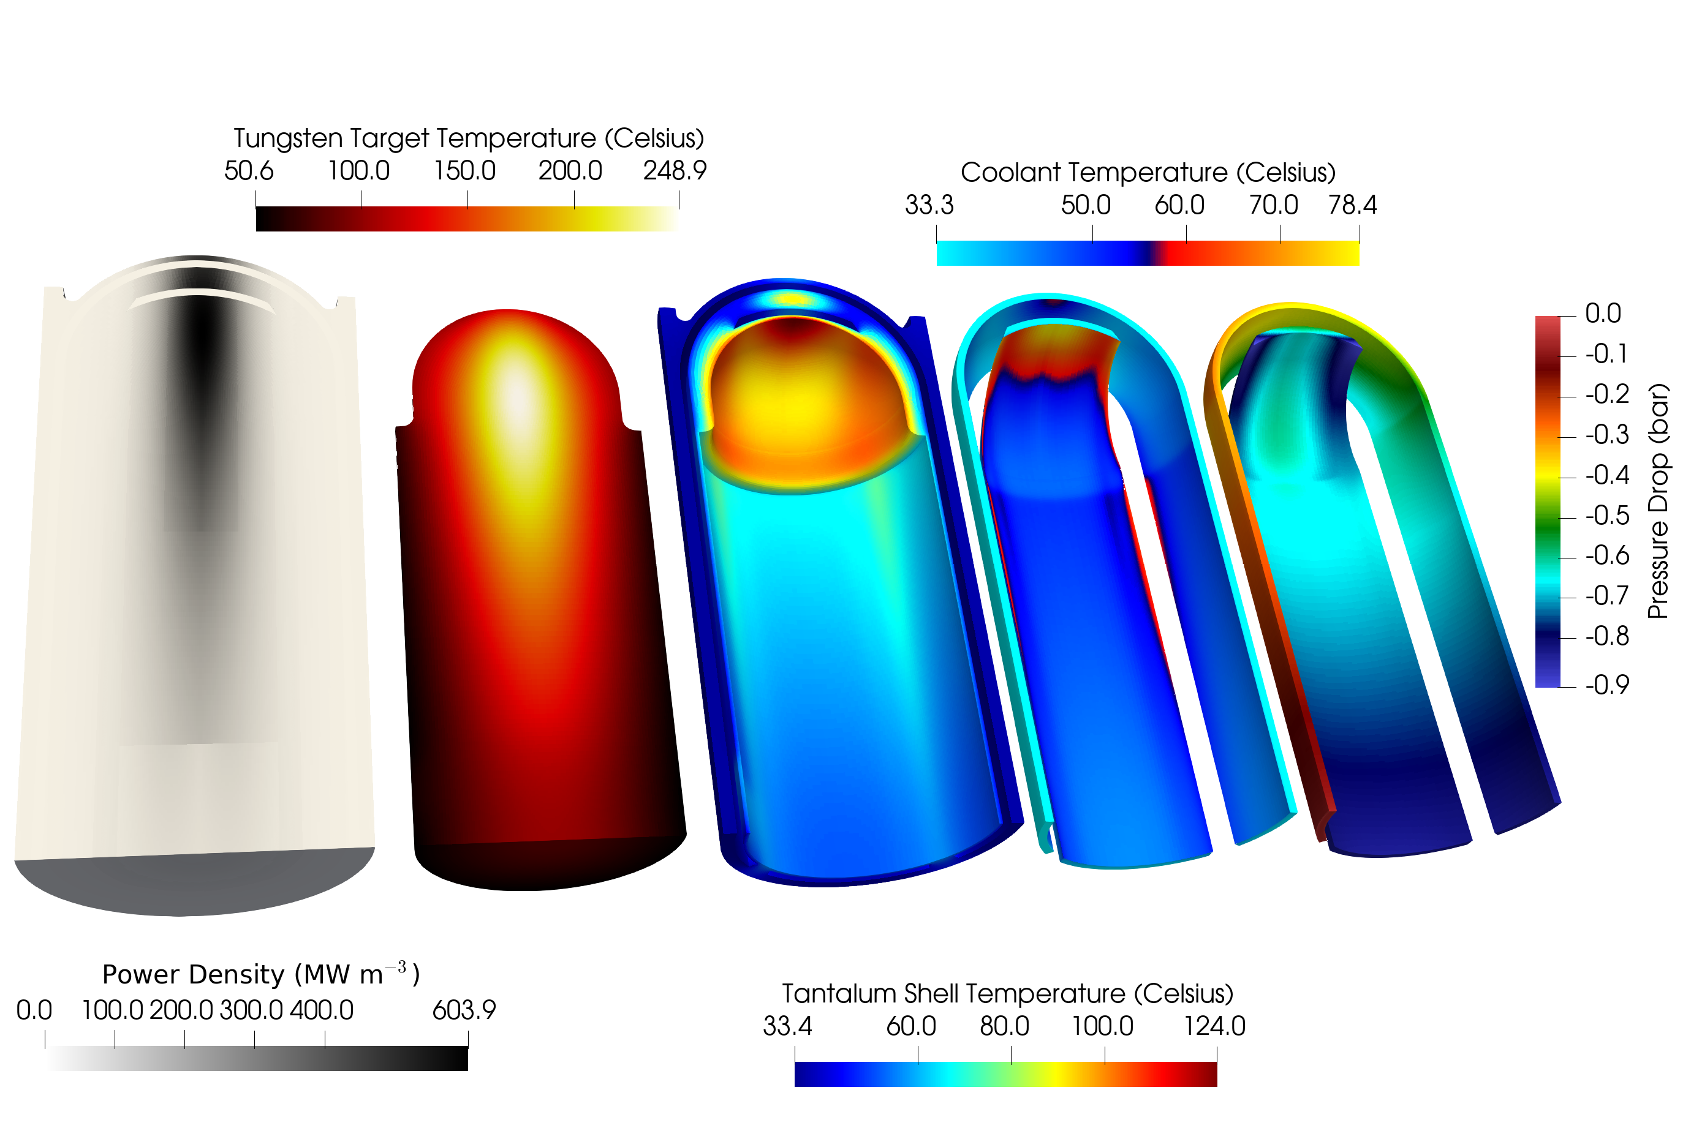
Modelling TS2
CHT with EBRSM turbulence and steady heating
~23M cells (16M solid+7M fluid)
Gain insight of physical phenomena
Radiolysis
Cavitation
Thermal fatigue
Solid stresses
Nuclear reactions
Material damage
Verify and benchmark earlier simulations

Slide 4
Modelling TS2
CHT with EBRSM turbulence
~23M cells (16M solid+7M fluid)
~98M cells (71M solid+27M fluid)
Steady heating
External thermocouples | EBRSM ~23M (40µA) | EBRSM ~98M (45µA) | Reference (37µA^{*+})
Maximum Temperature | 248.92 | 248.85 (-0.03%) | -
TE201 | 52.64 | 52.55 (0.17%) | 47.1 (11.6%)
TE202 | 35.94 | 35.95 (0.03%) | 37.9 (-5.1%)
TE203 | 56.36 | 56.02 (0.60%) | 49.2 (13.9%)
TE204 | 40.29 | 40.29 | 38.2 ( 5.5%)
TE205 | 54.26 | 54.51 (-0.46%) | 57.3 ( 4.9%)
TE206 | 36.58 | 36.56 (0.05%) | 39.5 (-7.4%)
TE207 | 55.88 | 56.27 (0.70%) | 53.3 ( 5.6%)
TE208 | 39.29 | 39.30 (0.03%) | 36.6 ( 7.4%)
*Yanling Ma, Report of themal analysis on ISIS TS2 Target. Technical Report, STFC (2011).
⁺ ~8% difference in beam current

Slide 5
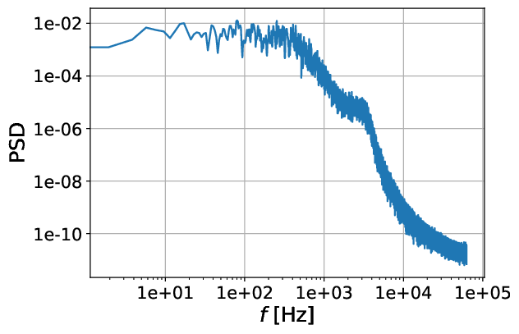
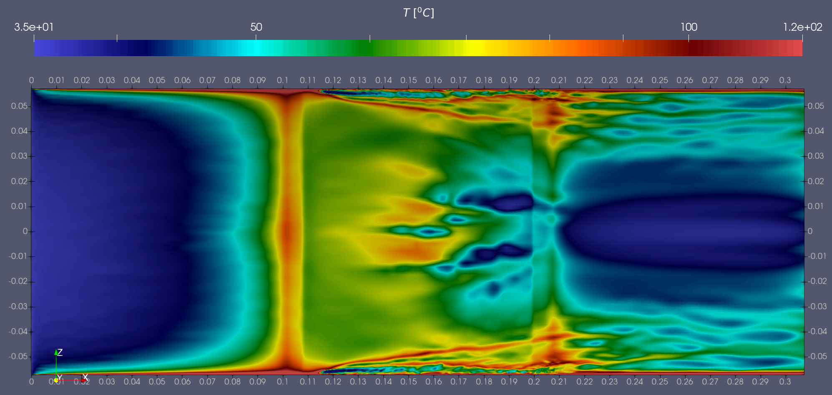
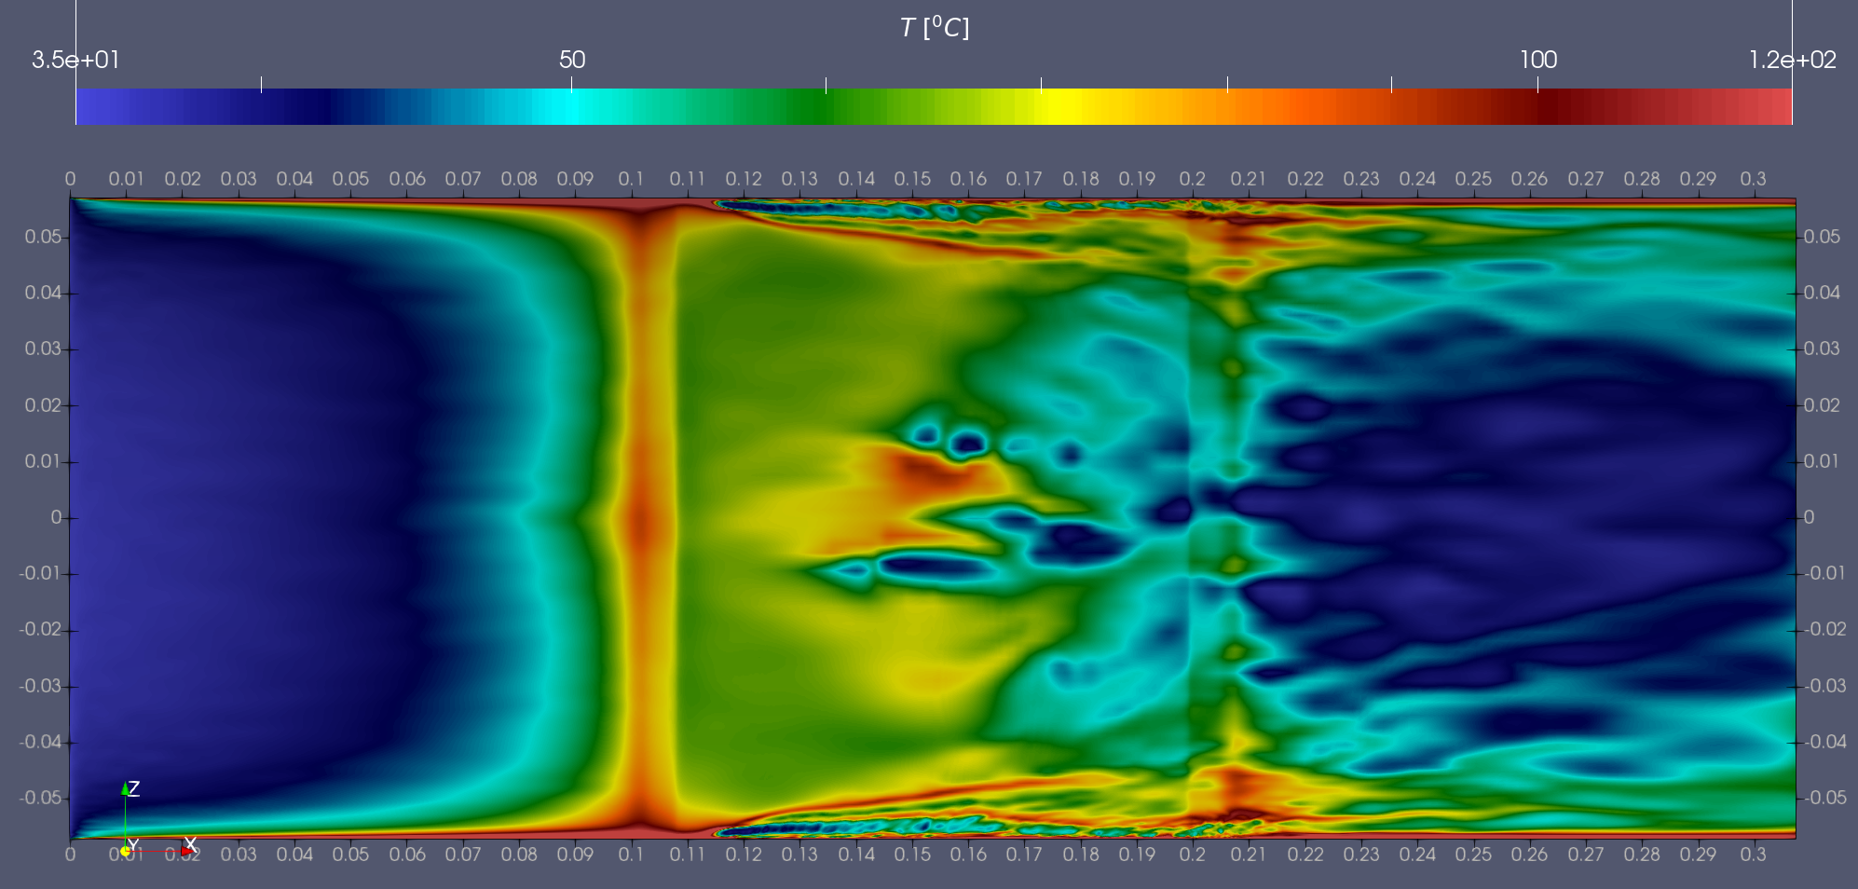
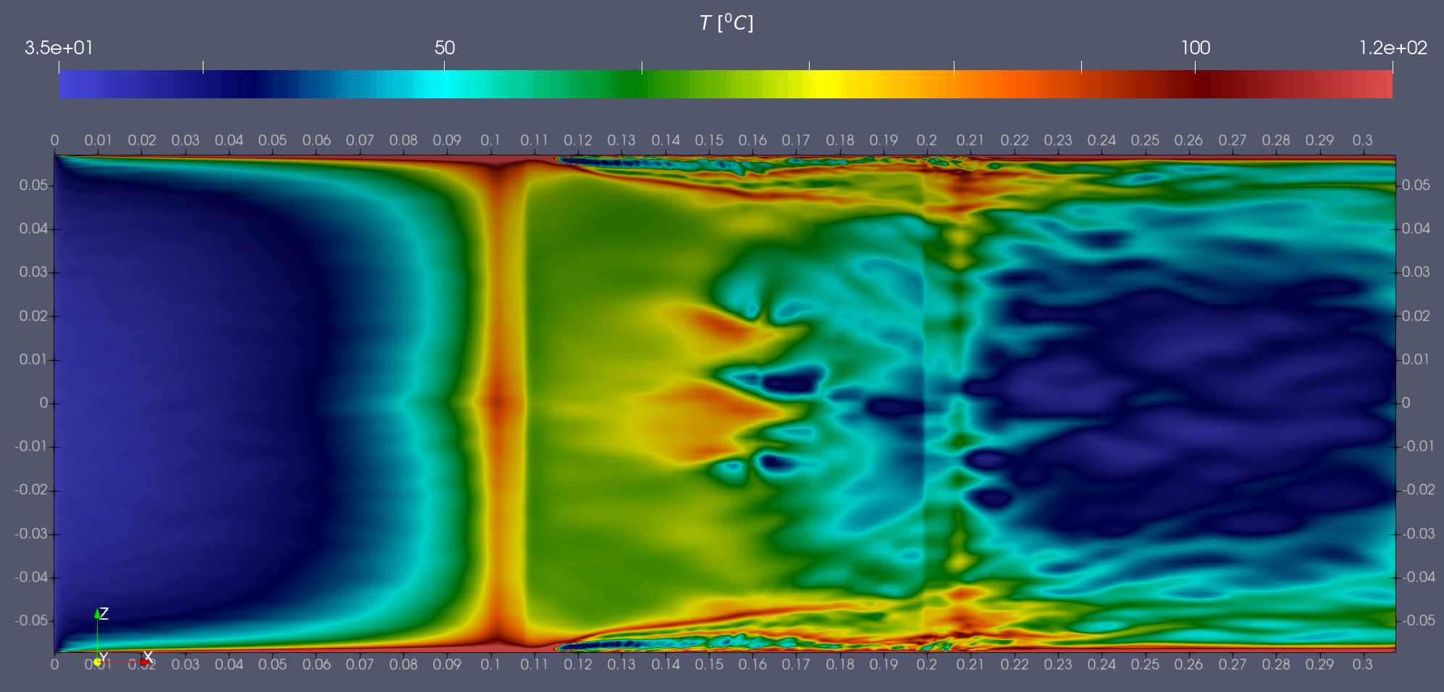
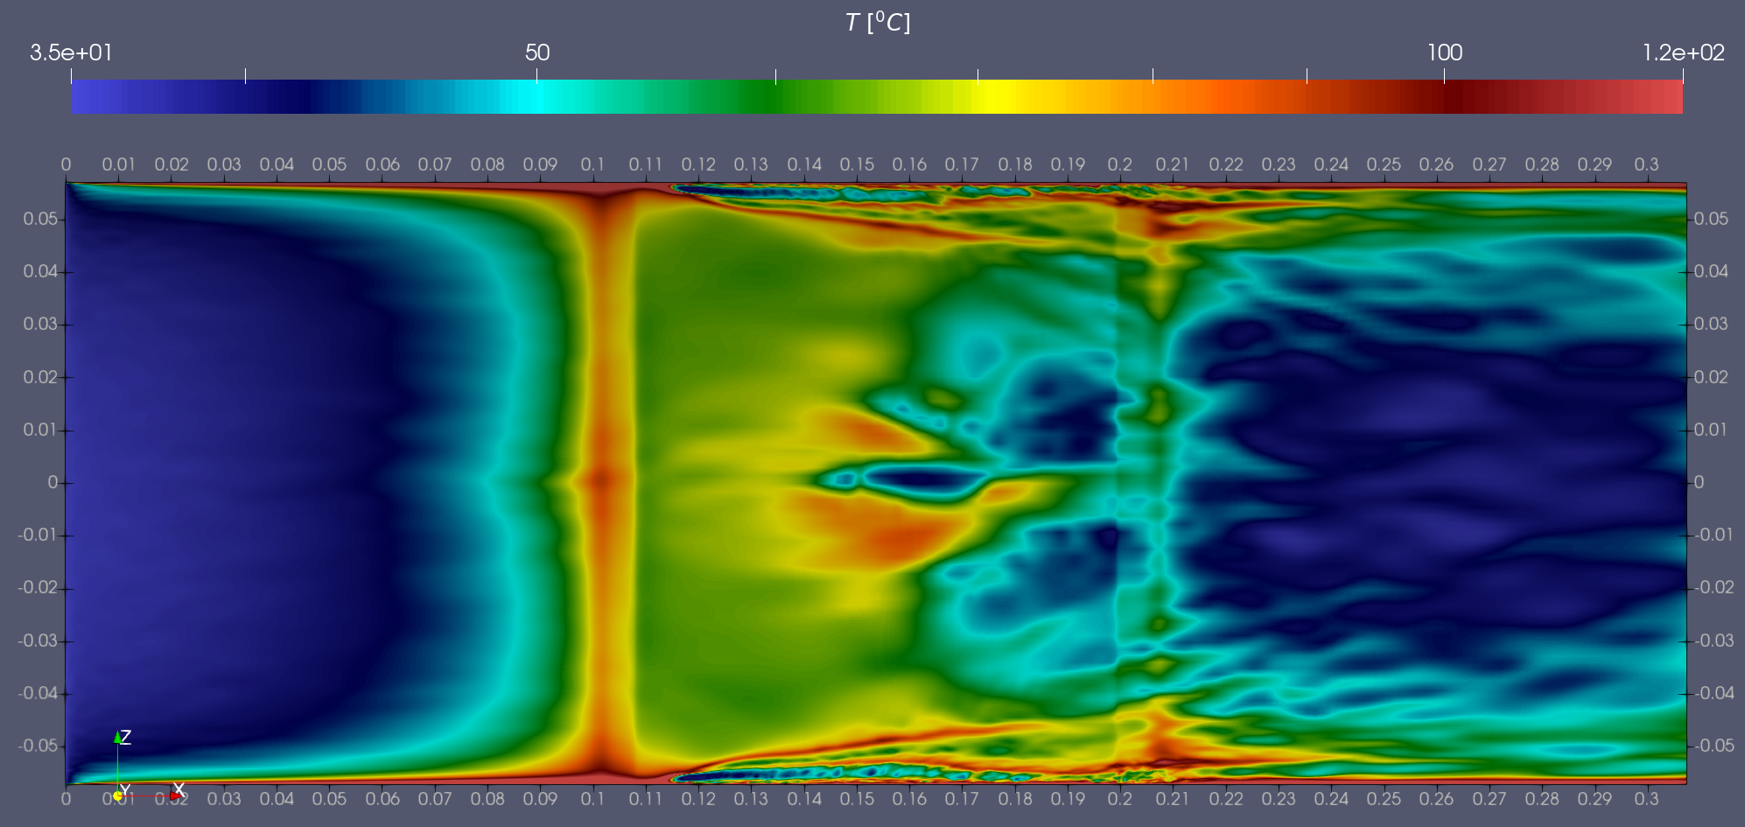
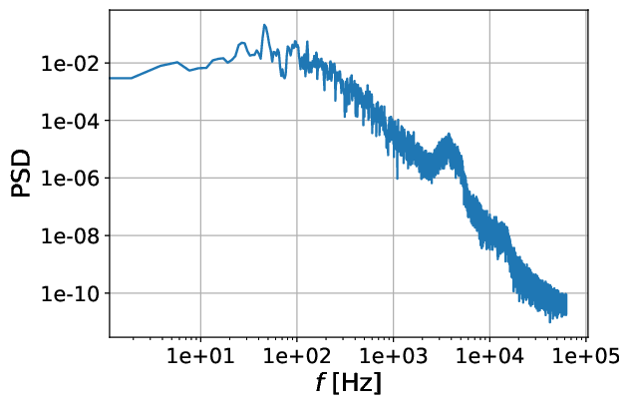
LES untapered inner channel, steady heat source ~10M
~40 Hz
~1200 Hz
~50 Hz
~1300 Hz

Slide 6
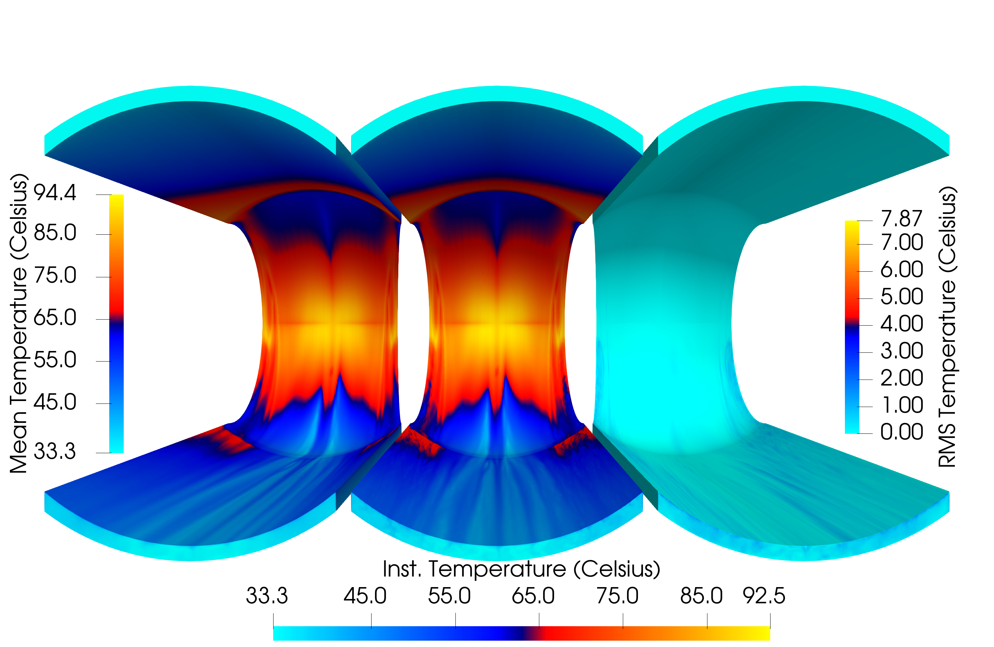
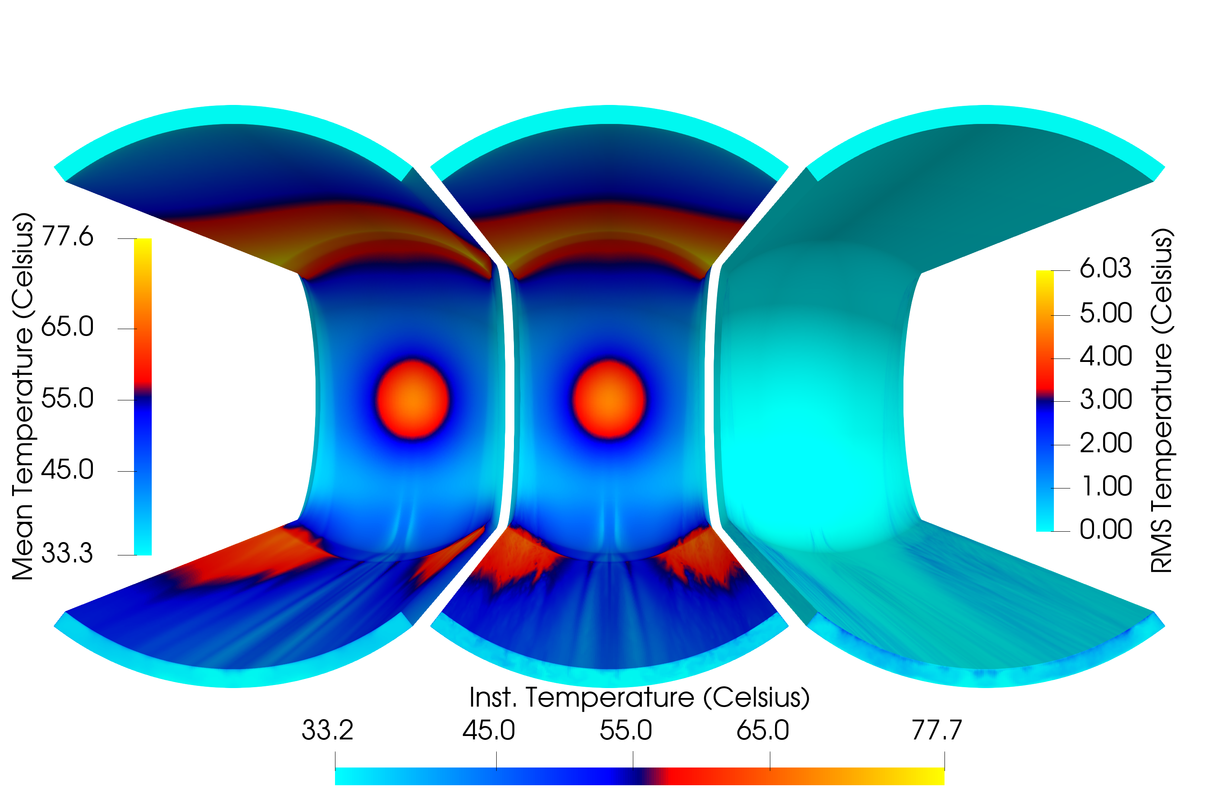
LES CHT steady heat source ~215M
Temperature fields
Inner Channel
Outer Channel
IN
OUT

Slide 7
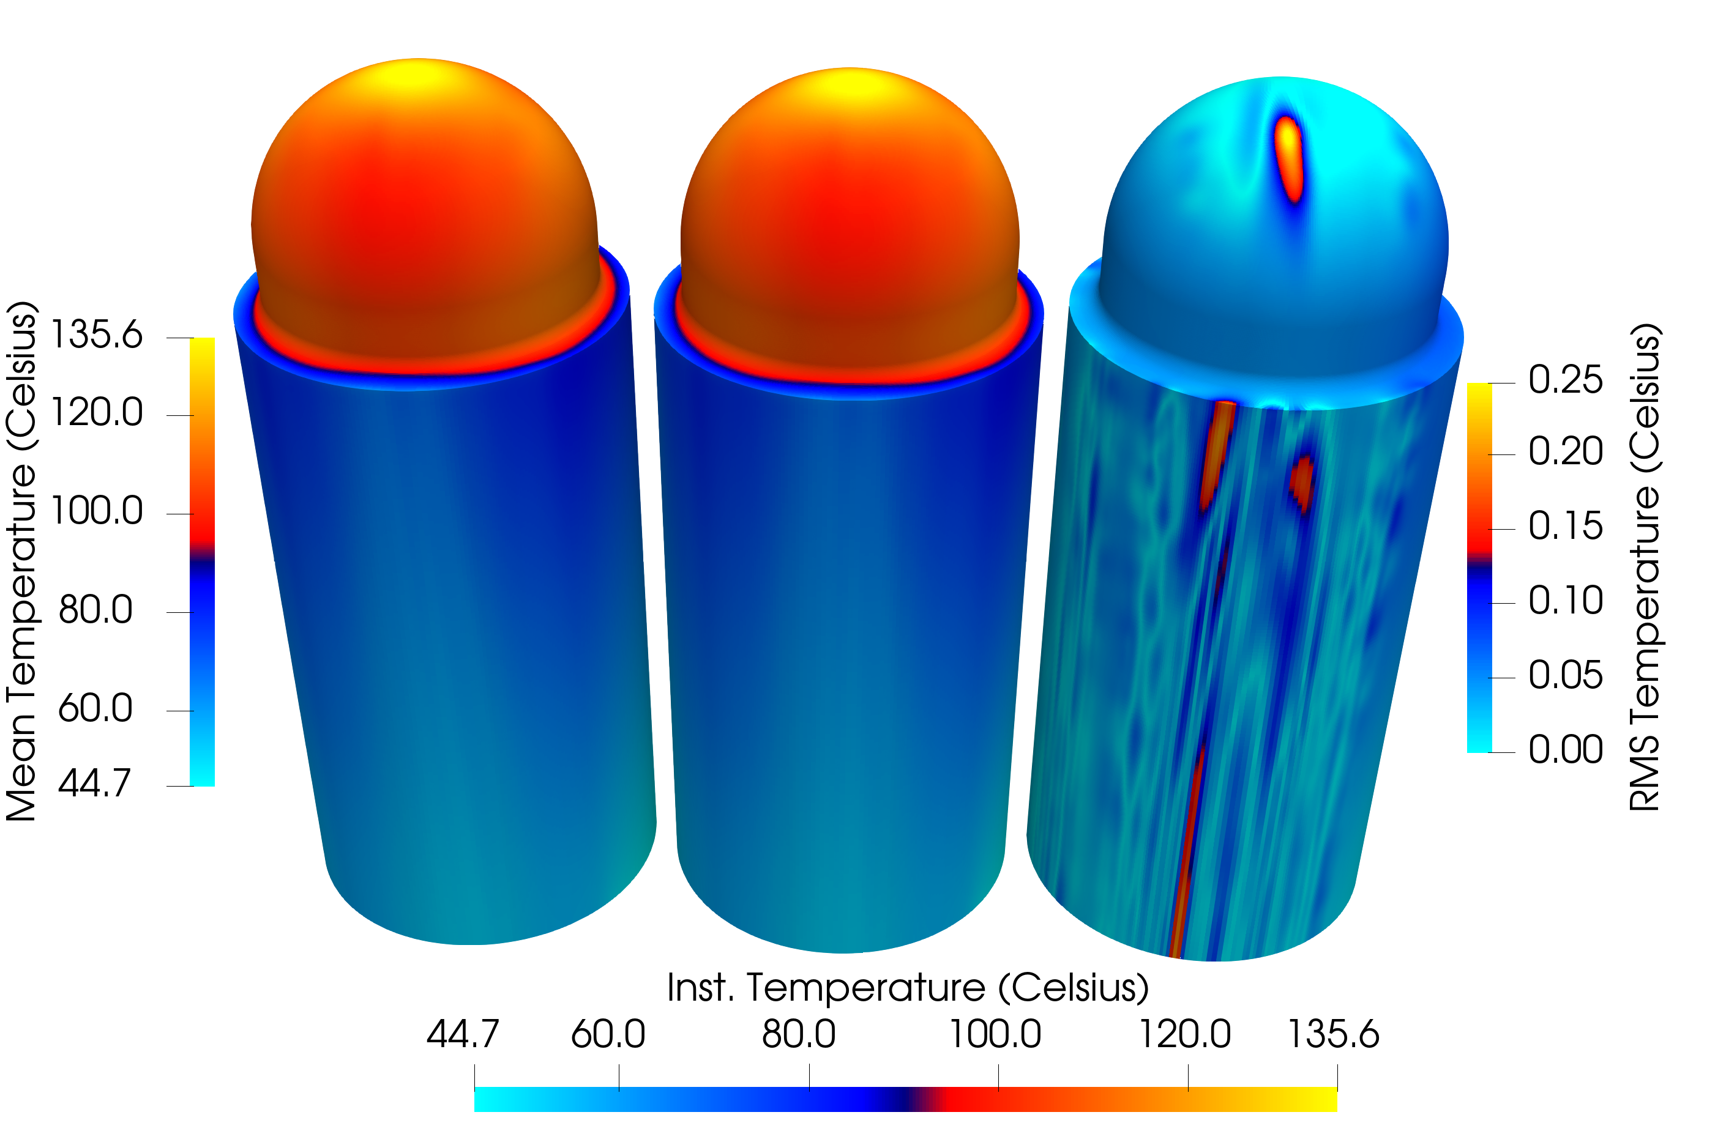
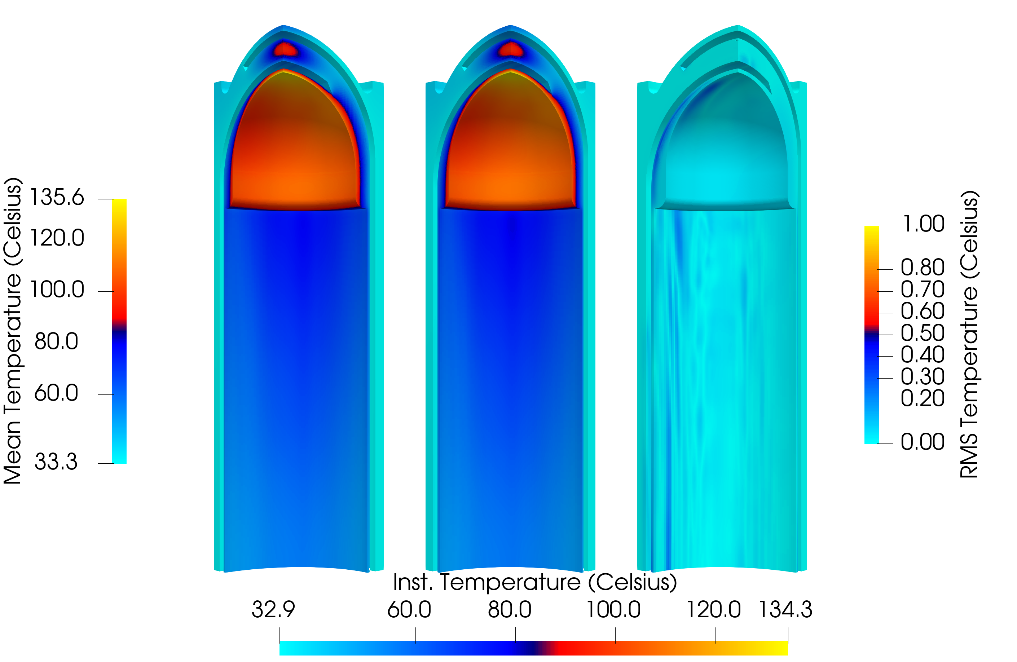
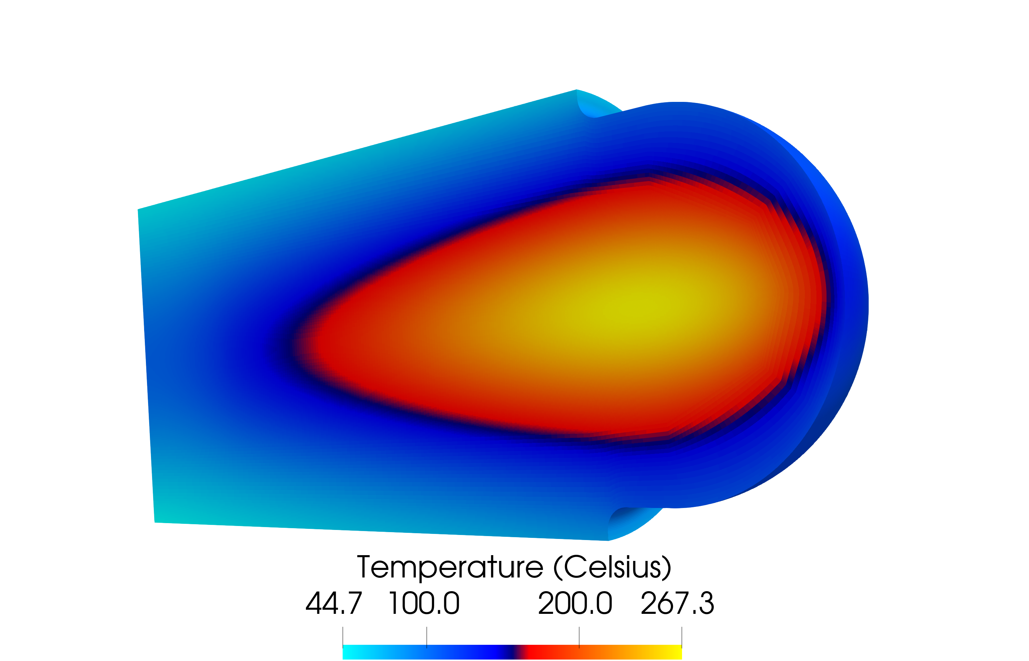
LES CHT steady heat source ~215M
Temperature fields
Target
Cladding

Slide 8
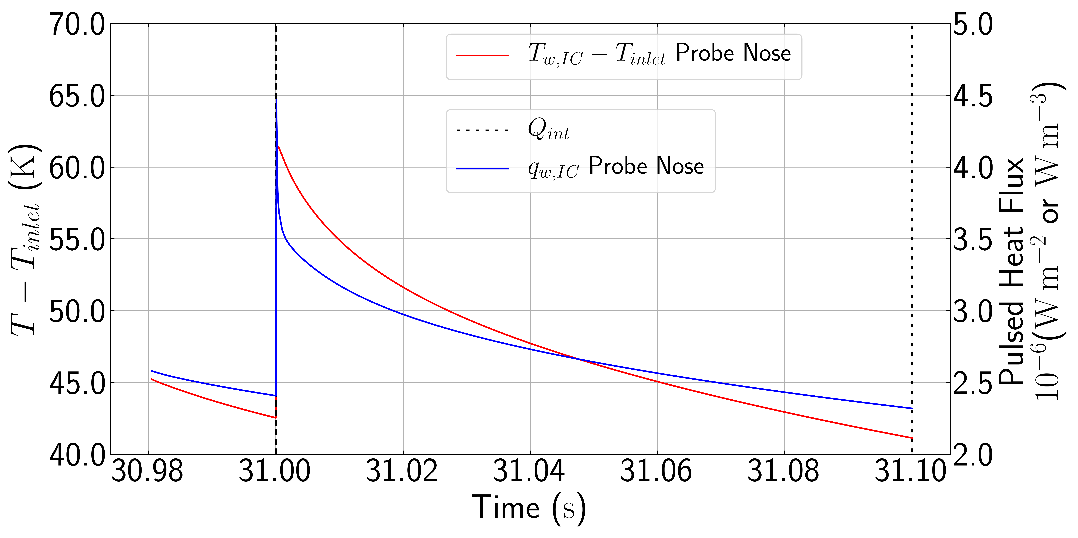
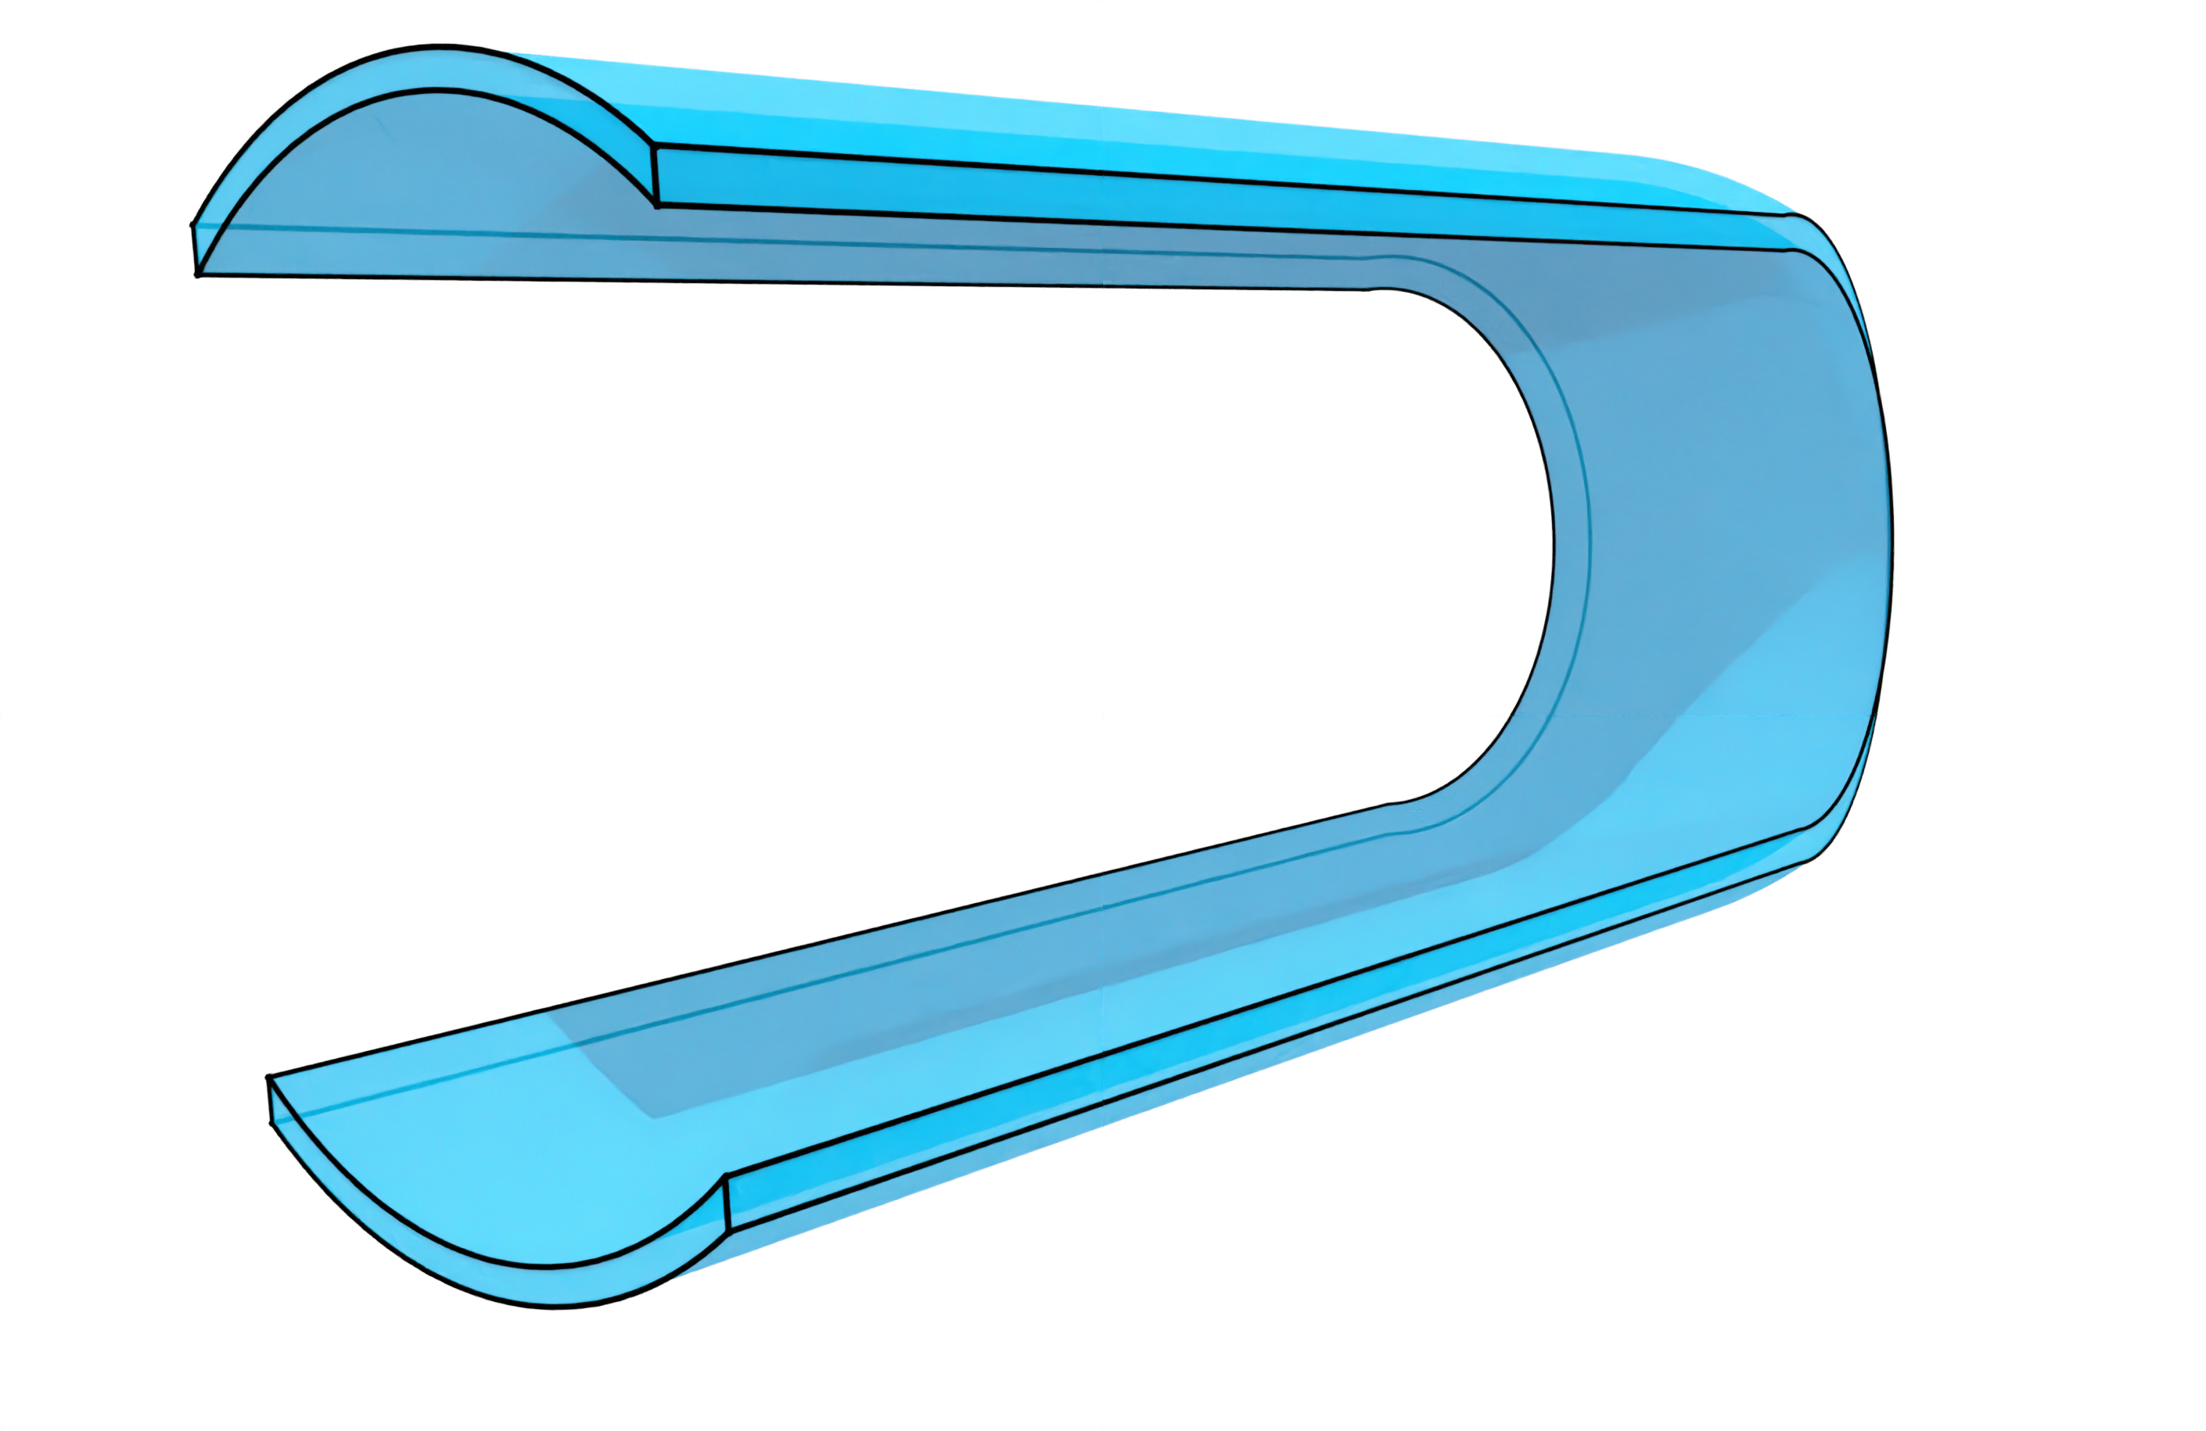
EBSRM CHT pulsed heat source ~23M
$$c_{HF}=\left\{\begin{matrix}\frac{\left(1/{δt}\right)}{fn} & t_{m}≤t_{m,max} \\ 0 & t_{m}>t_{m,max}\end{matrix}\right.$$
$c_{HF}=$ factor applied to heat flux
$δt=$ time step size, s
$f=$ pulse frequency, 10 Hz
$n=$ number of time steps heat is applied
$t_{m}=$ modulus of time
$t_{m,max}=$ modulus of time with respect to number of steps to which the heat is applied,
~100 ns
protons
Probe Nose
neutrons
neutrons

Slide 9
LES tapered inner channel pulsed heat source ~14M
40 times reduction in frame speed
Power discharge from a capacitor
$$q_{w,t}=q_{w,0}e^{{−t_{m}}/τ}$$
$q_{w,0} =$local steady surface heat flux
$τ=$ thermal resistance

Slide 10
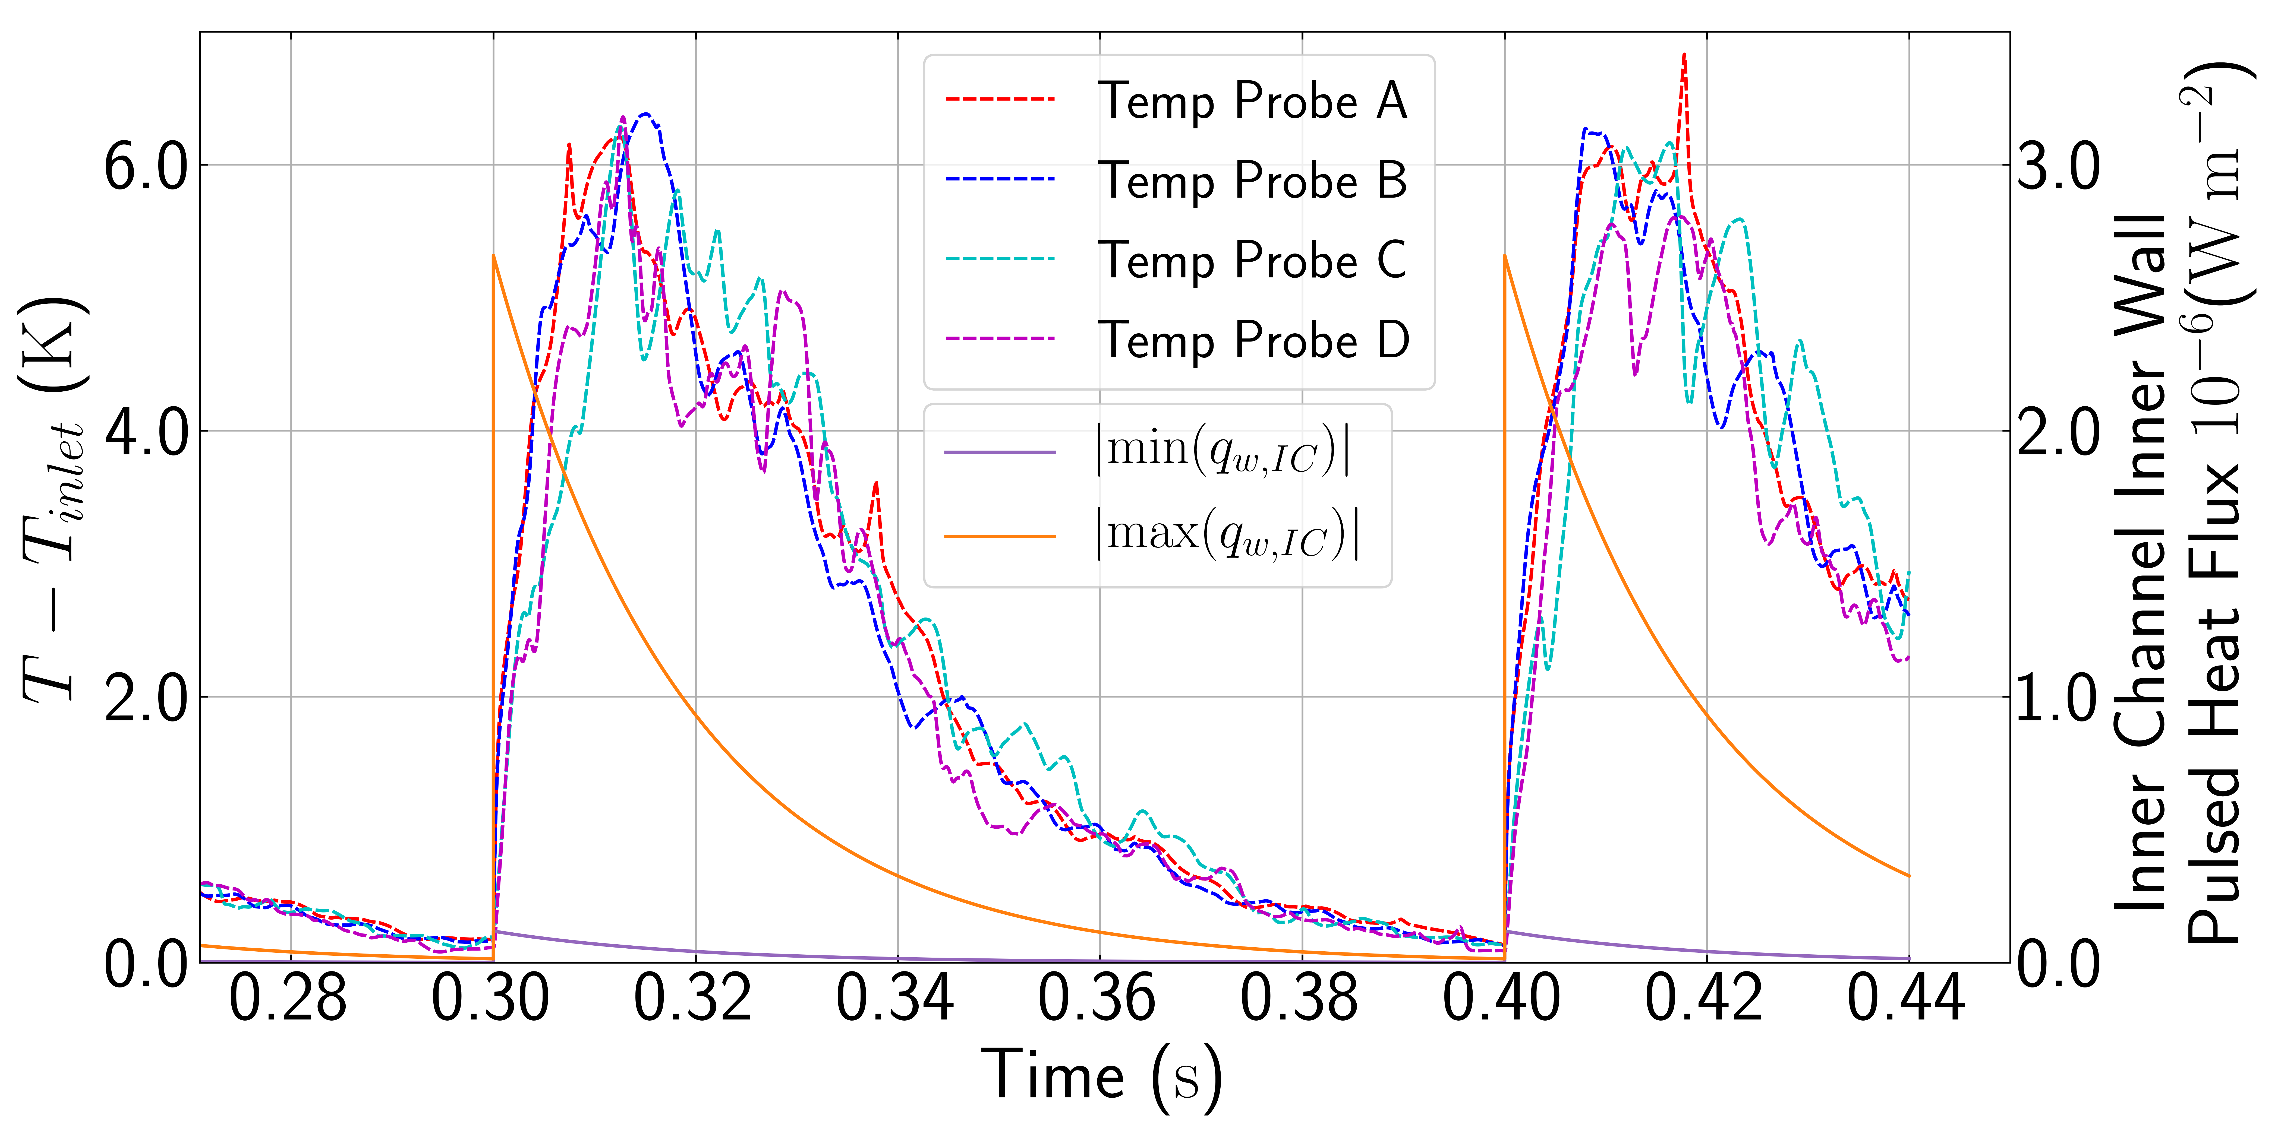
LES tapered inner channel pulsed heat source ~14M
Temp Probe A
Temp Probe B
Temp Probe D
Temp Probe C

Slide 11
Conclusions
EBRSM/RANS
calculations within 15 % of reference data
LES of steady and pulsed heat sources indicate
temperature hot spot in the target ~20 K higher for steady LES
RMS temperature
up to 7 K in fluid,
but only up to 1K in the cladding
bend generates low frequency fluctuations at 40-50 Hz
thermal striping and fatigue may be a problem
under-resolved meshes for LES
Notes:
Please remove or amend the image credit if you are using a different image to the one provided.

Slide 12
Further work
LES studies with CHT at Pr~5
determine the function that gives a steady integral of the pulsed heat flux
wall refined LES in channel flow with pulsed heat flux (maybe)
5B cells required in just one channel
5-10s of data to get lower frequency oscillations
verify mesh resolution required in the near wall region (both solid/fluid)
LES/DNS channel flow for various Pr and solid materials
determine alternative method to model the low frequency oscillations at lower resolutions or channel flow with CHT
Model thermally dependent stresses in the solids
placement student to implement models for temperature dependent solid stresses
coupled to EBRSM model of pulsed heating
Notes:
Please remove or amend the image credit if you are using a different image to the one provided.

Slide 13
Thank you
scd.stfc.ac.uk
@SciComp_STFC

