Slide 1
ISIS Target Station 2 Update on Target Evolution
Leslie Jones – ISIS Target Design Group
HPTW2023 – RIKEN, Japan
November 2023

Slide 2
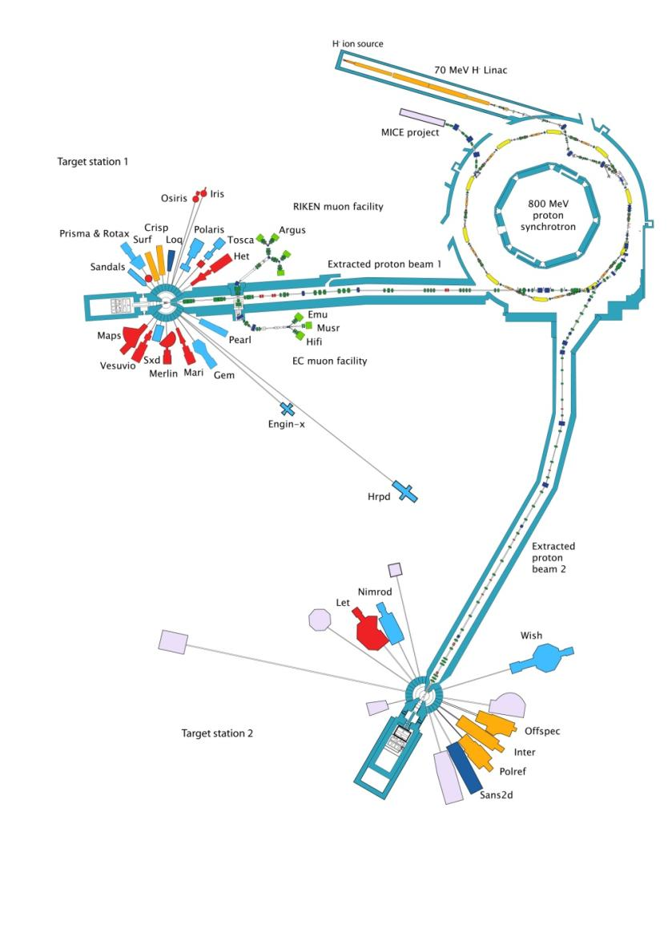
Agenda
1 ISIS Overview – TS1 & TS2
General description, basic statistics
2 TS2 Target MK1
1st generation
3 TS2 Target MK2 & 3
2nd generation (up to present day)
4 TS2 Target MK4 & Future
Proposed design changes – looking forward
5 Summary
Recap of main points - Questions?

Slide 3
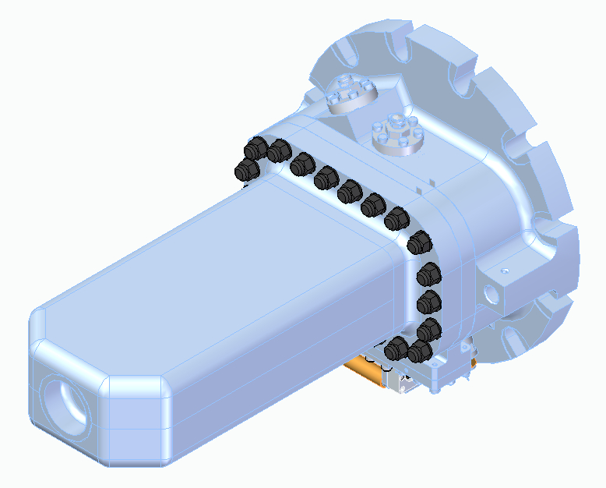
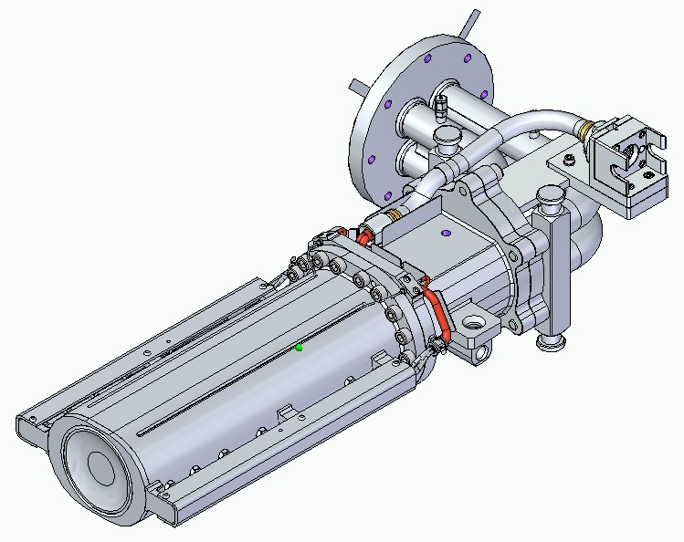
ISIS Overview – Target Station 1
The ISIS TS1 Target was designed to provide tight-pulse shapes and high-flux of epi-thermal neutrons to complement existing reactor sources.
Built to service a broad user programme.
Instruments requiring long wavelengths were the most compromised.
TS1 operational since 1985 through 4 generations of target design U/Zr Alloy, Ta, W/Ta (2 generations)
Operates @160µA, 800 MeV, 50 Hz (now 40 Hz) >5-year service life (latest design just installed)
Generation 1-3
Generation 4

Slide 4
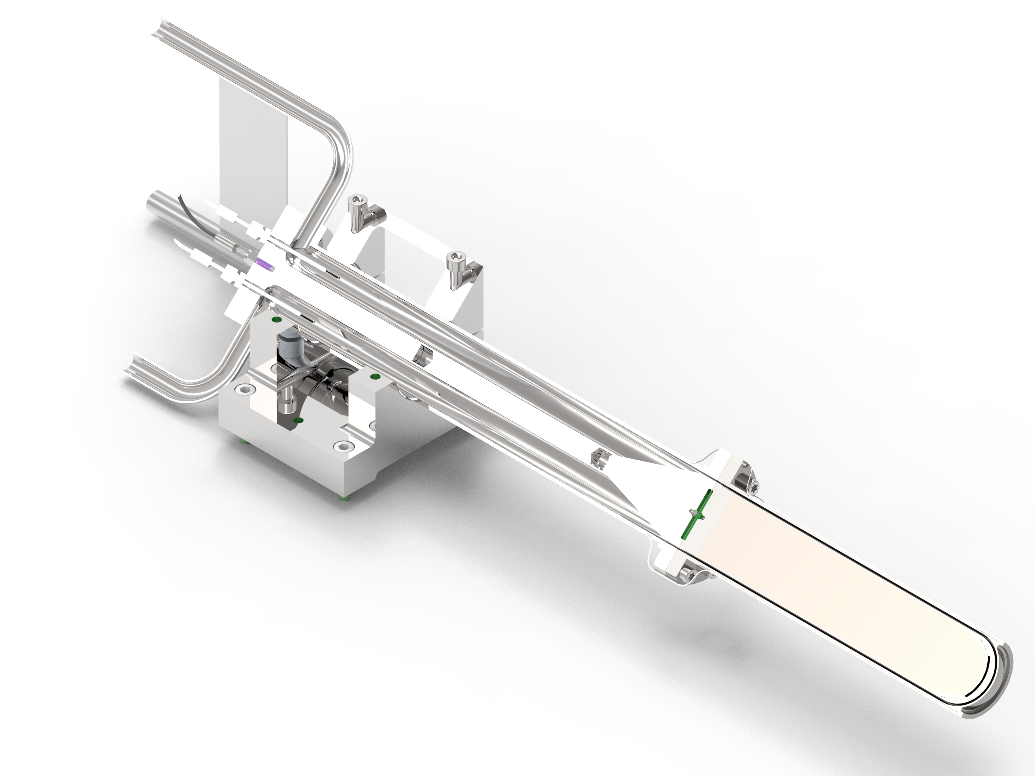
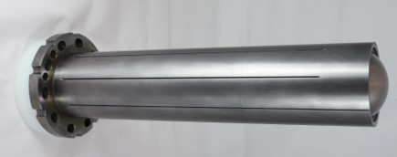
ISIS Overview – Target Station 2
The Science Case for the second target station was focused on overcoming that compromise.
A low repetition rate, low-power target station optimised to produce long wavelength neutrons.
Extending the facilities capabilities in the fields of biology, soft matter, and advanced materials.
The neutron techniques that can make the largest impact in these fields: small-angle scattering, reflectometry, long wavelength, and low energy spectrometry.
TS2 operational since 2009 through 2 generations of target design
Operates @40µA, 800 Mev, 10Hz 2-year service life (Avg. 250 MA hrs)
TS2 Target

Slide 5
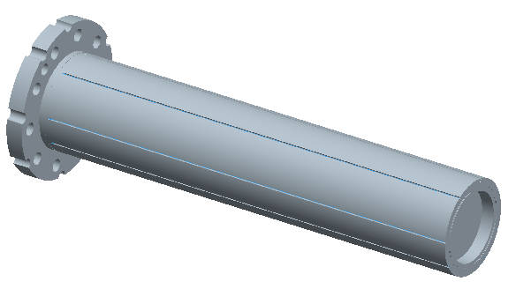
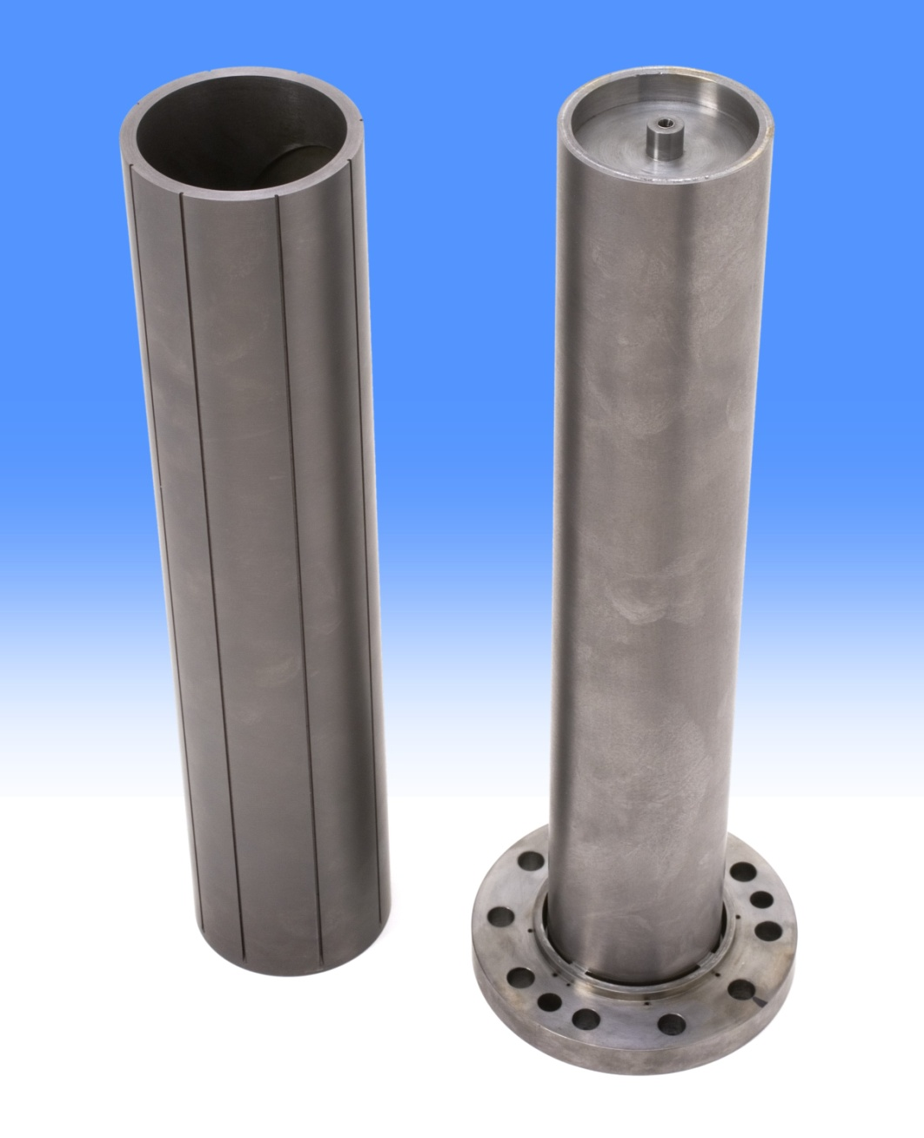
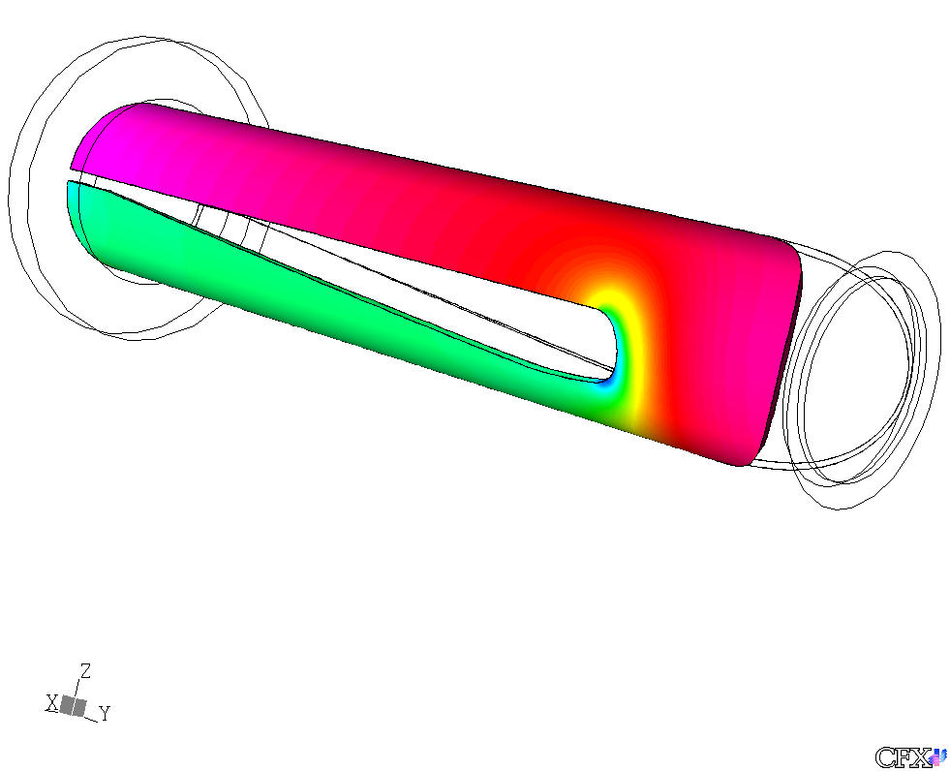
TS2 Target MK1 (1st generation)
Thermocouples
laid in grooves
Single solid rod of Tungsten clad in tantalum with flat front face.
Tantalum cooling sleeve with aerofoil cooling channels on both sides along the length of the target.
Front face uncooled
Thermocouples in the outer surface of the cooling sleeve only, terminating close to the front edge.
Aerofoil cooling channel
mirrored on opposite side

Slide 6
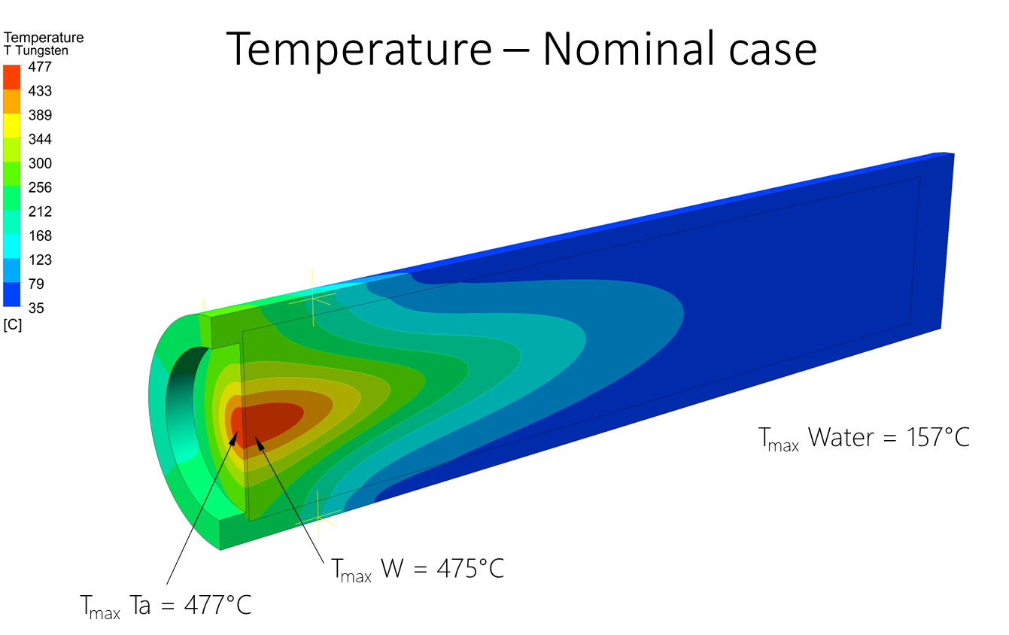
TS2 Target MK1
ISIS Target Station 2
Target Mark 1 Front End Failure
Mike Parkin – High Power Targets Group
August 2019
Operational from Sept 2009 at typically 40µA, beam 6mm sigma
Neutronic performance as predicted
Bulk cooling water heat extraction and pressure drop as predicted
But - thermocouples at front face edge of Cooling Sleeve temperature higher than predicted (200ºC v 100ºC).
Later analysis confirmed the front face temperature to be around 480ºC
Significant because………..
Temperature of the window at nominal conditions (1.507kg/s flow rate, 40uA beam, Beam 6mm sigma).

Slide 7
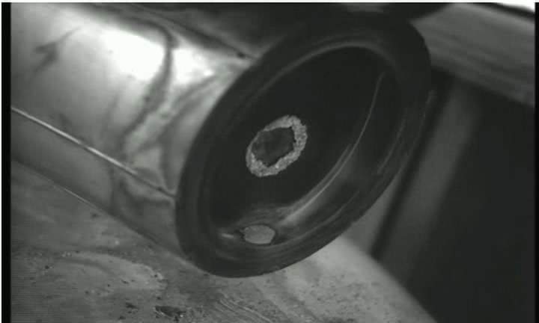
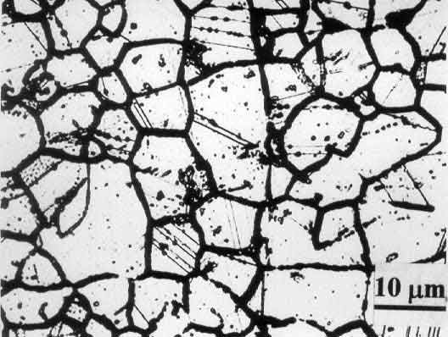
TS2 Target MK1
Hole in the Tantalum Cladding exposed the Tungsten core
Like some other high melting point materials, it reacts with oxygen and other gasses at high temperatures
According to information from Plansee Metals Ltd “at temperatures >200°C the presence of water vapour can bring about rapid oxidation of the material”
Front face temperature well above this - around 480ºC
Void Vessel atmosphere compromised by water leaks from pre-moderator.
INTERGRANULAR CORROSION
Oxides form at the grain boundaries
Grains drop out

Slide 8
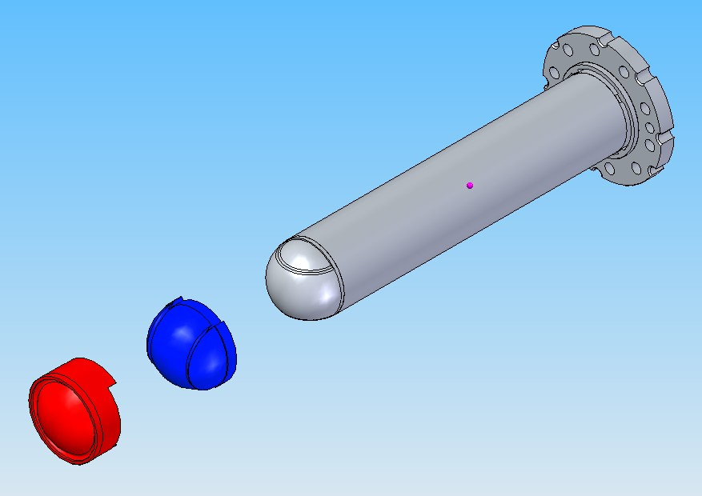
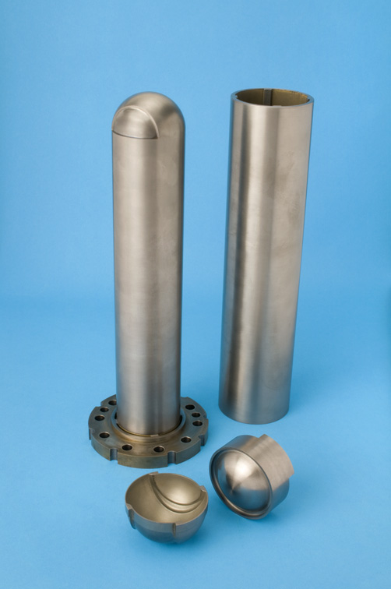
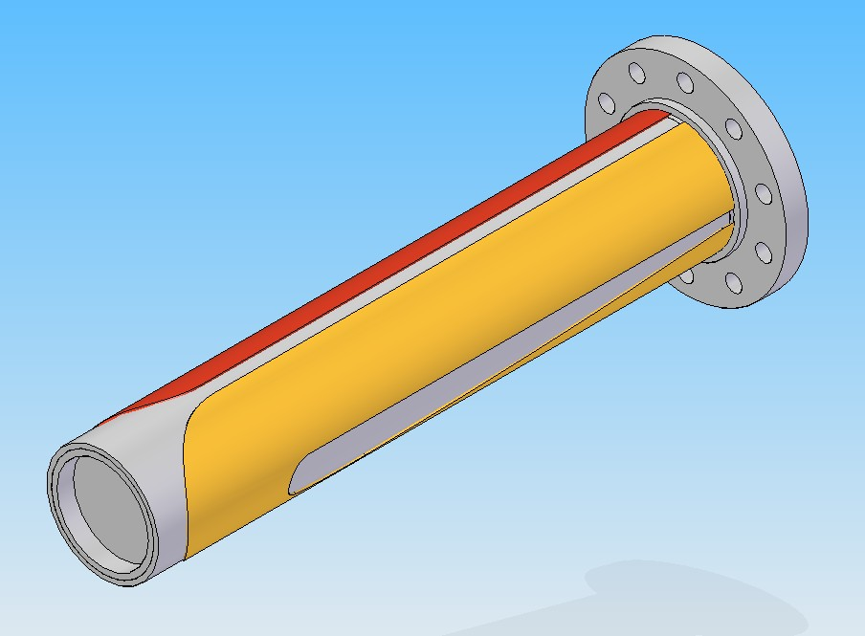
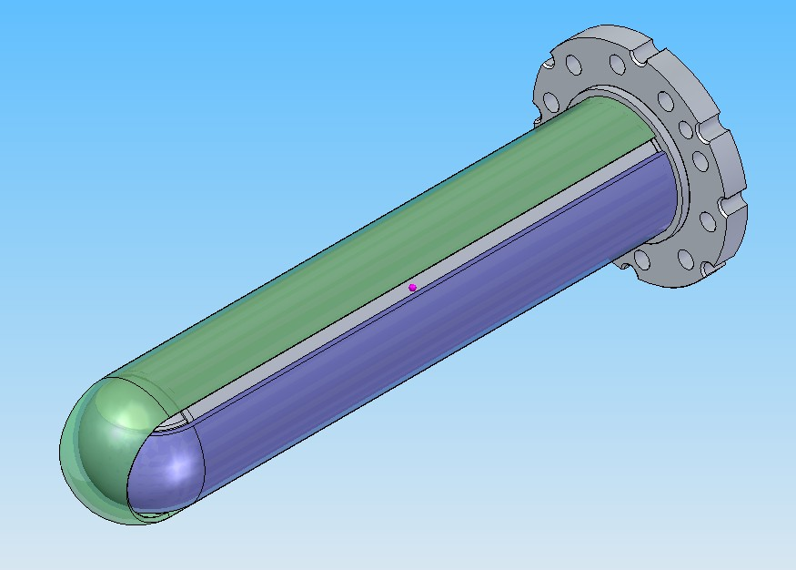
TS2 Target MK2 (2nd generation)
Only 8 months to re-design, manufacture and install (long shutdown).
Cross Flow Guide and Window Cap direct water across the front face.
Target
Cooling
Sleeve
TS2 Target MK 1
TS2 Target MK 2
Cross Flow
Guide
Window
Cap
Cooling Sleeves removed for clarity

Slide 9
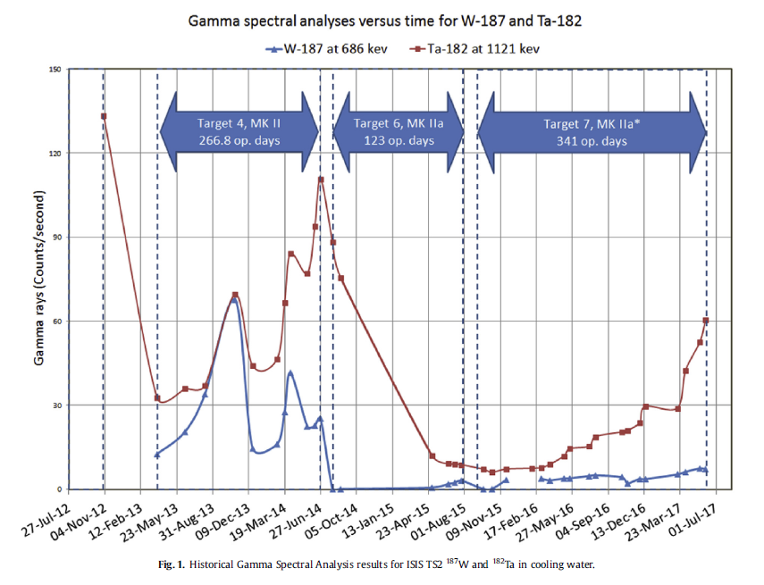
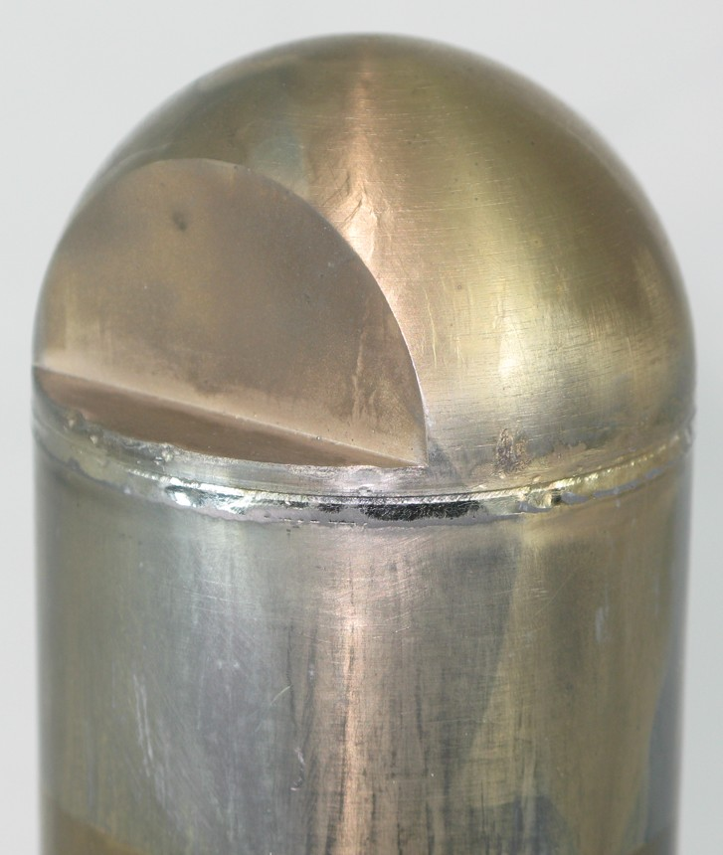
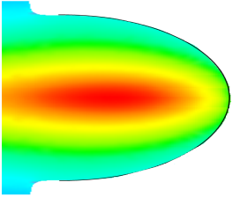
TS2 Target MK2
The MK 2 Target solved the original problem of the front face oxidising and extended the service life of the target - then presented a new problem!
Short lived isotopes Ta 182 & W 187 detected in the cooling water.
Early analysis suggested a breach in the Ta cladding in the location of an EB Welded joint in the Target HIP Assembly.
Reasoning
Arghya Dey, Leslie Jones. (2018). Strategies to improve ISIS TS2 target life.
Journal of Nuclear Materials
32 KW Energy deposited causes the core to expand in all directions
Electron Beam welding creates large grains in HAZ
The weld joint is in a vulnerable position
Tantalum and Tungsten have different material expansion rates.
In the cooldown after HIP Tantalum shrinks more and is in tension.
Potential for stress crack at the weld joint
EB Weld Line

Slide 10
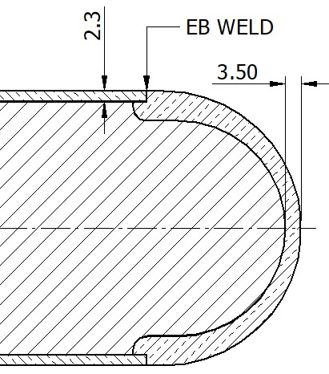
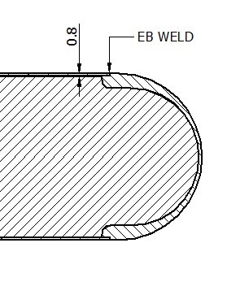
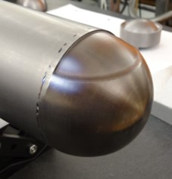
TS2 Target MK2
Now manufacturing targets in-house.
EB Weld trials concluded insufficient weld penetration.
Tantalum has extremely high density and melting point (3000°C ).
Post HIP machining operation reduces cladding thickness to 0.8 mm, likely removing most/all the weld.
Target no. 7 was rewelded after HIP/Machining and lasted longer
EB WELD/HIP
STAGE
POST WELD
MACHINING
Rewelded

Slide 11
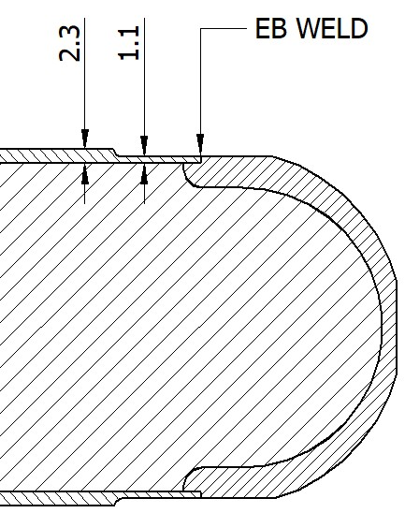
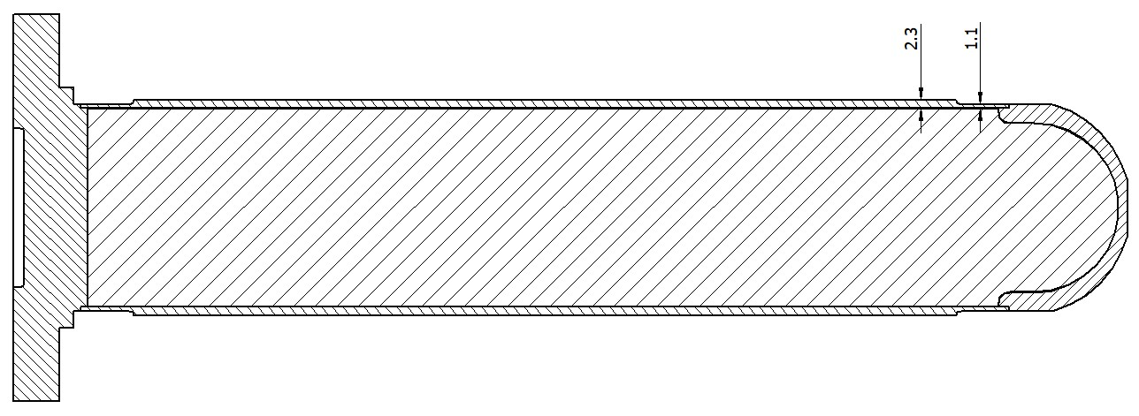
TS2 Target MK2
The cladding tube is now pre-machined before welding.
Service life has increased but eventually Ta 182 & W 187 levels increase in the cooling water, suggesting that other forces are at work.
Other factors to consider are:-
the high velocity of the cooling water over the surface that may be causing erosion of the cladding (9 M/sec).
the corrosive nature of the water as it has become acidic over time (3.2 Ph) causing corrosion.
Sheffield Hallam University has conducted a PhD study to help us understand these effects on Tantalum.

Slide 12
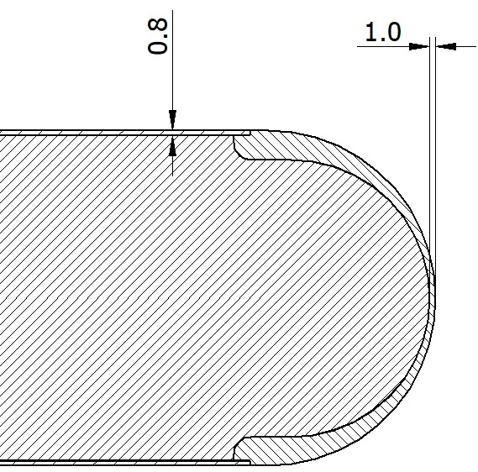
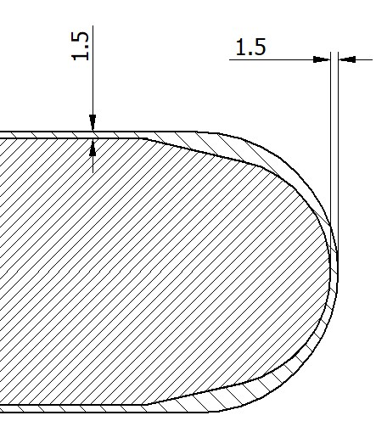
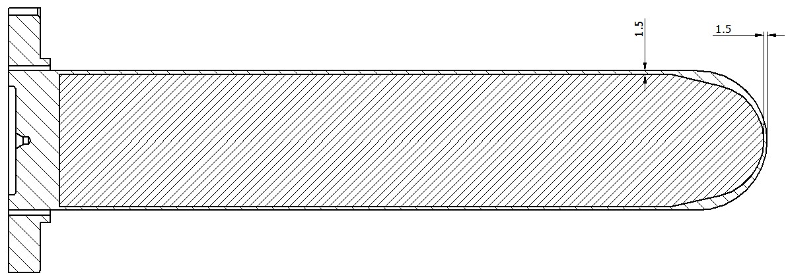
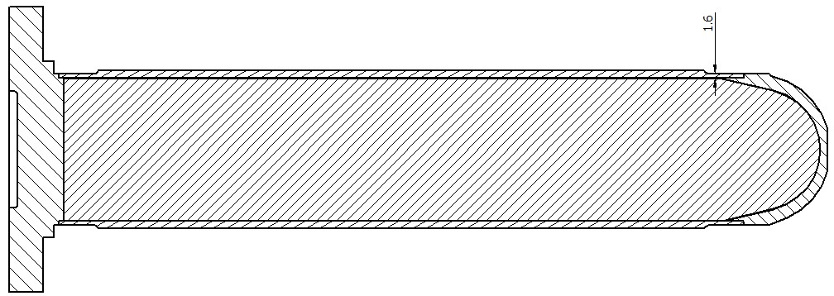
TS2 Target MK3
The MK 3 Target has a reprofiled front on the W Core.
Cladding thickness has been increased from 0.8 mm to 1.5 mm.
If erosion and/or corrosion are a big factor this should help prolong the service life of the target.
MK2 Target
MK3 Target
MK3 Target – fully machined
MK3 Target – EB Welding

Slide 13
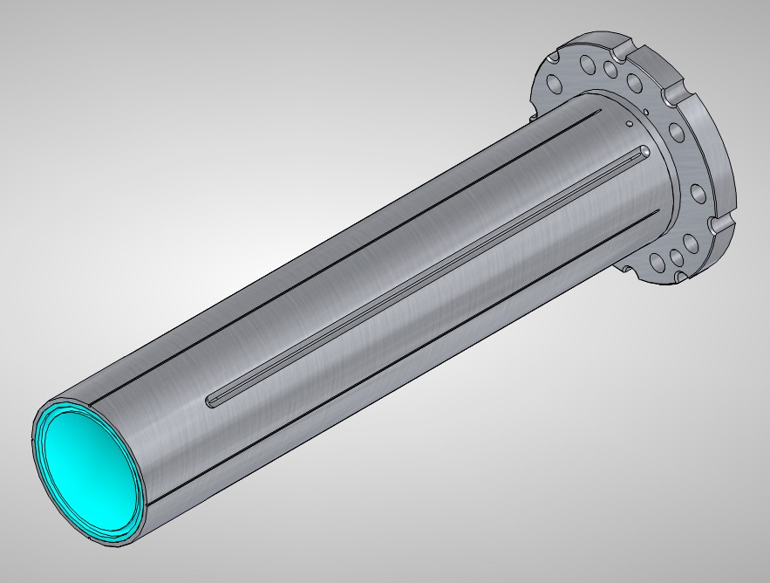
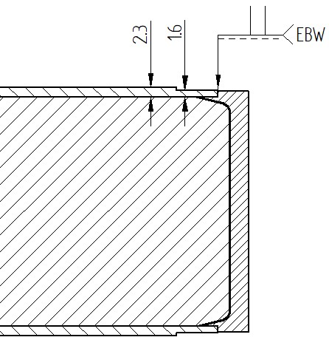
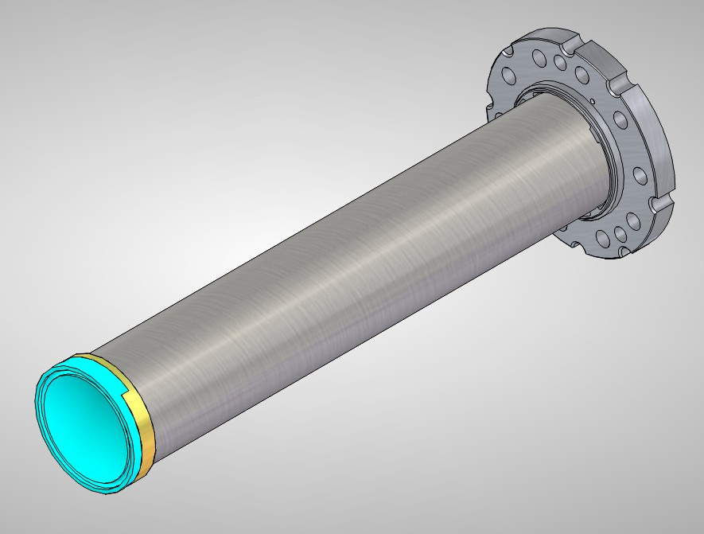
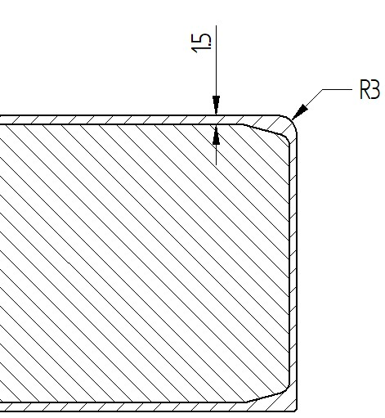
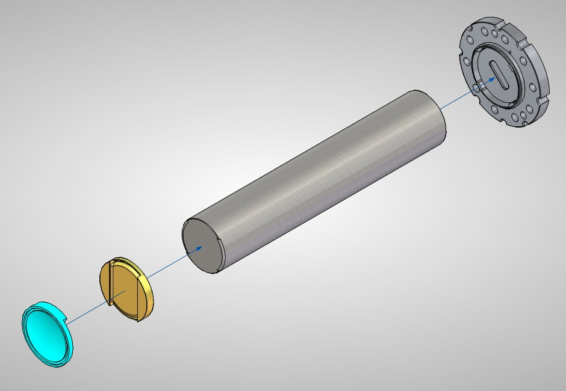
TS2 Target MK4 – single plate
A MK4 Target is in development.
Analysis shows that changing to a flat face relocates the position of the EB weld and reduces stress in the cladding.
Designs for single plate and multi-plate are being developed for different reasons.
Single plate is simpler to manufacture than MK3
Significantly reduces stress in the weld area
Core temp remains the same 250°C
Pre-weld Detail
Fully Machined

Slide 14
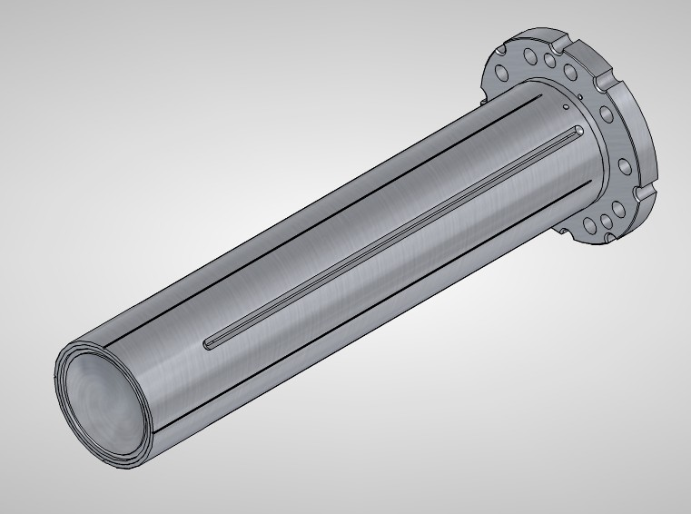
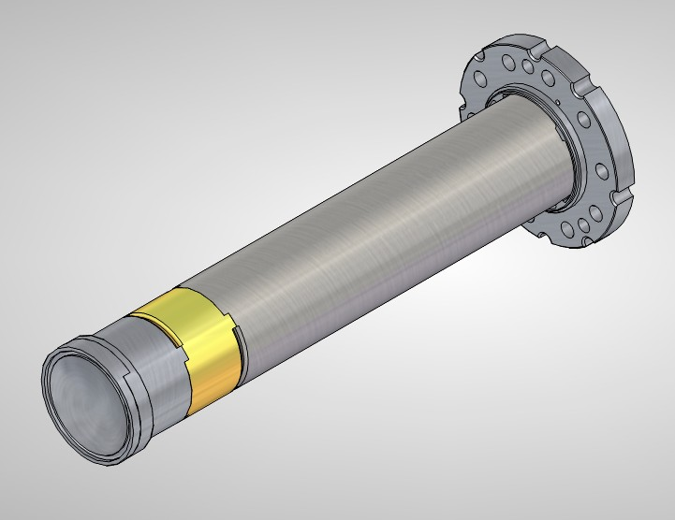
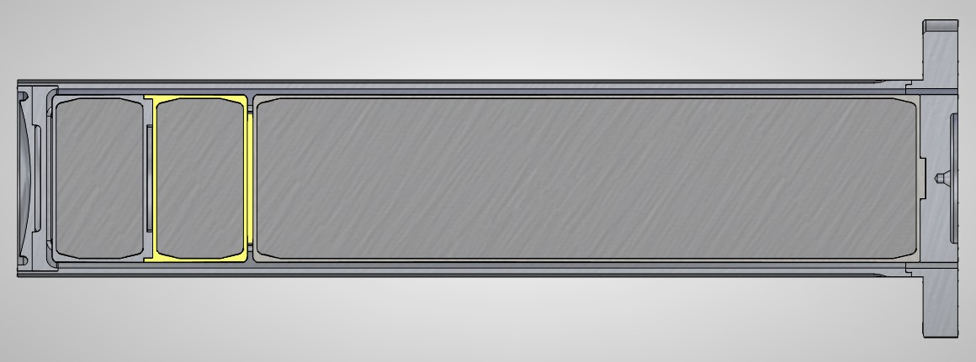
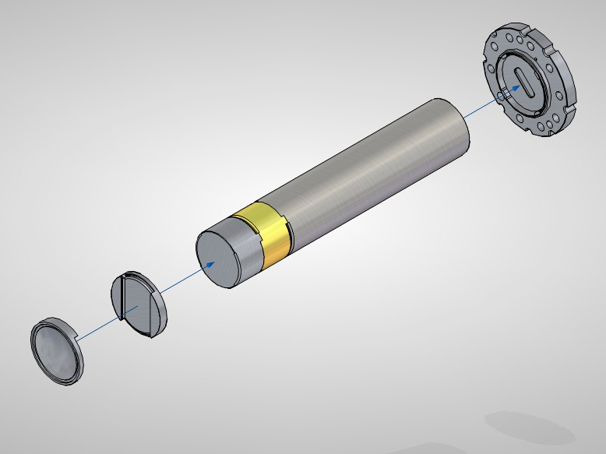
TS2 Target MK4 - Multiplate
Multiplate target is more complicated and costly to manufacture but would pave the way for increase in beam power
Investigating feasibility of increase to 50µA and eventually 60µA.
Multiplate design needed to dissipate additional heat load
Will be designed for 60µA but could be operated 40µA with possible benefit of extended service life.

Slide 15
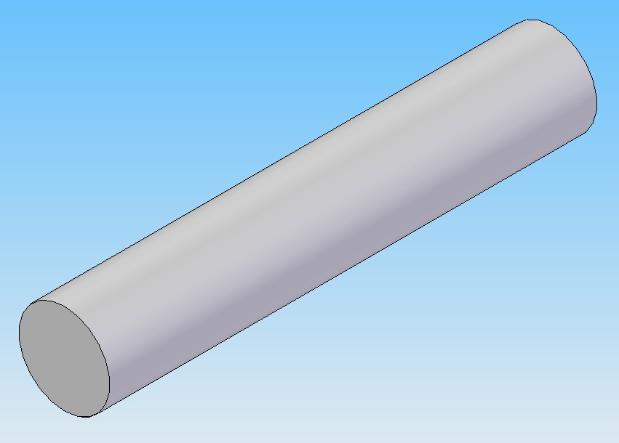
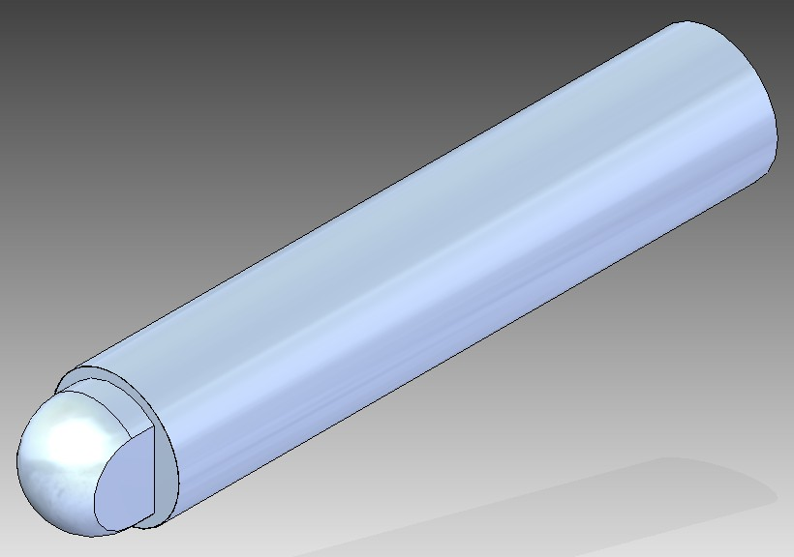
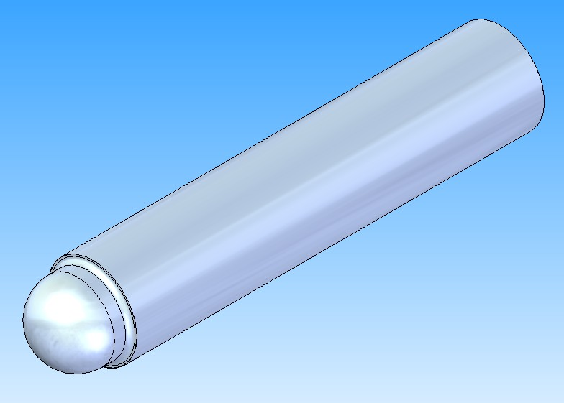
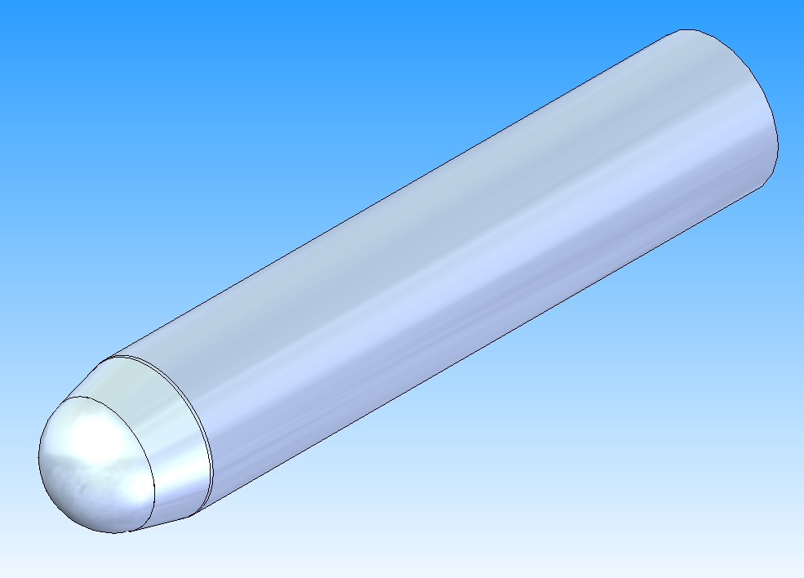
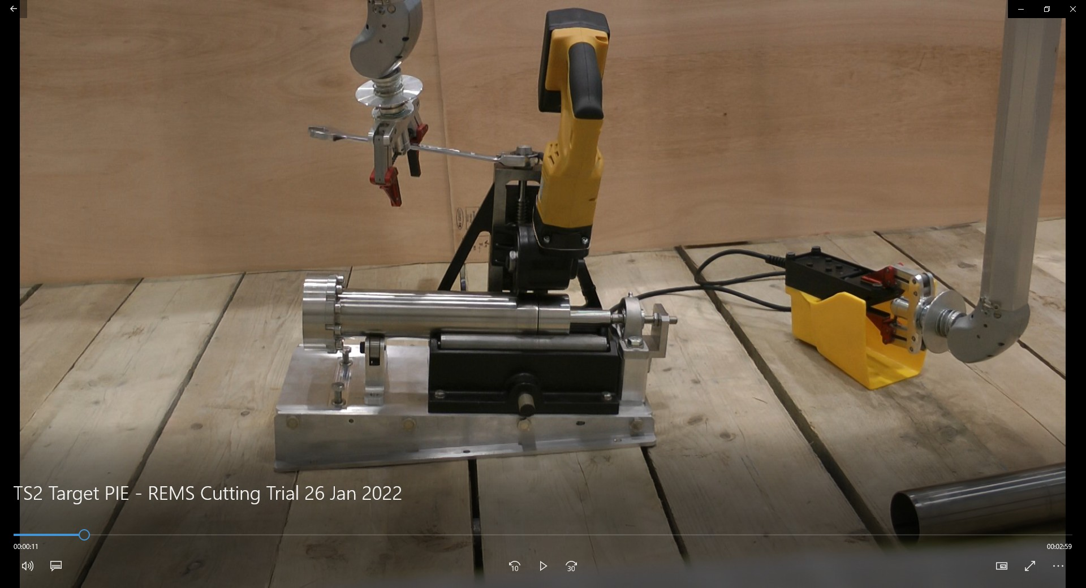
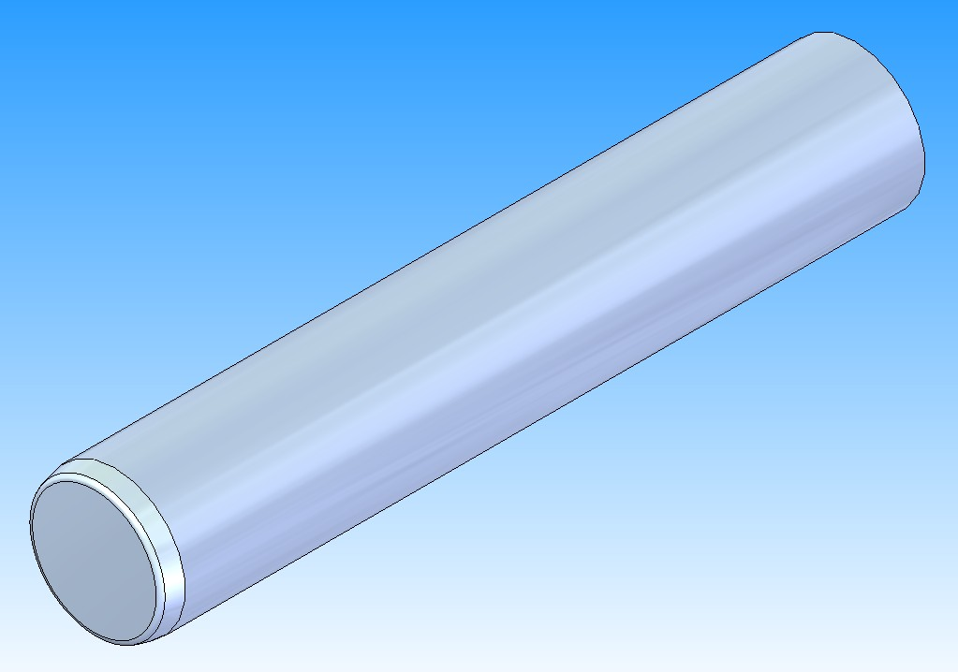
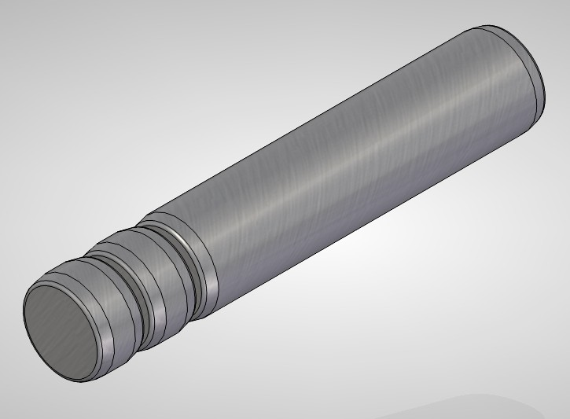
Summary
Target Core Evolution
MK1 Target uncooled front face, MK2 & MK3 cooled front face.
MK4 single and multiplate designs in development
Changes to design and manufacturing techniques have solved some issues and extended service life (aim to reach 5 years) some way to go!
Studies into erosion and corrosion of tantalum – Sheffield Hallam Uni
Detailed analysis of water flow in the target to understand possible cavitation and generation of Hydrogen in the water circuit - Daresbury Scientific Computing (Greg Cartland Glover)
PIE planned for Jan ‘24 to remove front cap from target and carry out visual examination
MK1 CORE
MK2 CORE
MK2a CORE
MK3 CORE
MK4 CORE?
MK4 CORE?

Slide 16
Questions ?

Slide 17
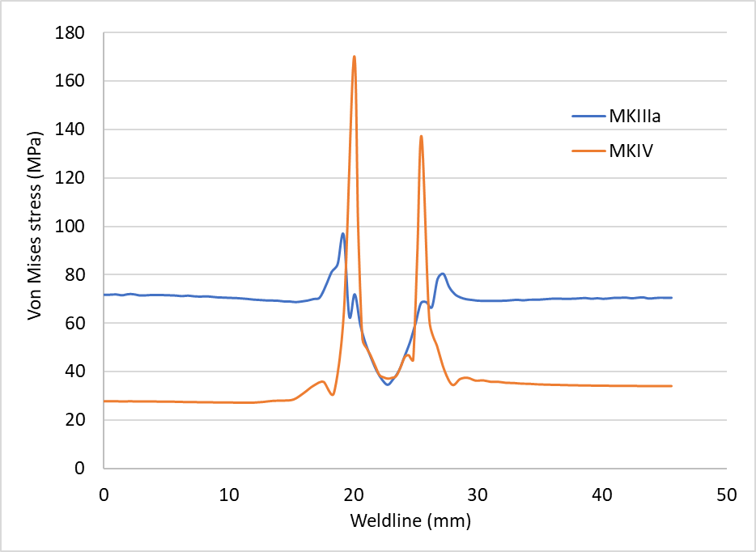
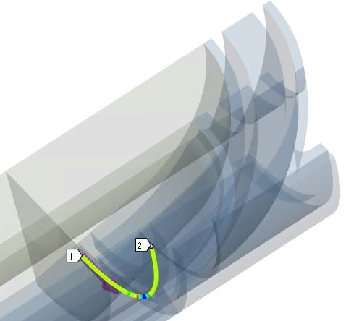
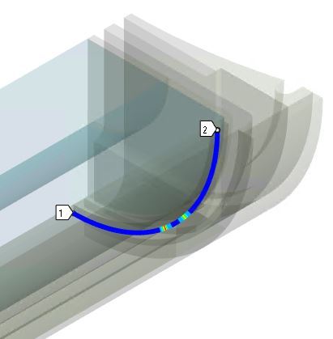
Steady-State Analysis
Results & Verification:
Similar Analysis is carried out for the MKIV concept.
In MKIV, Weld line stresses are reduced because of the change in the location.
Weld line Stress Value Comparison for MKIIIa & MKIV design concepts
Weld line stress | V. Godhani | D.B.Lopez [2]
MKIIIa (MPa) | 70 | 68
MKIV (MPa) | 30 | 36
Stress Singularities at the sleeve rib area

Slide 18
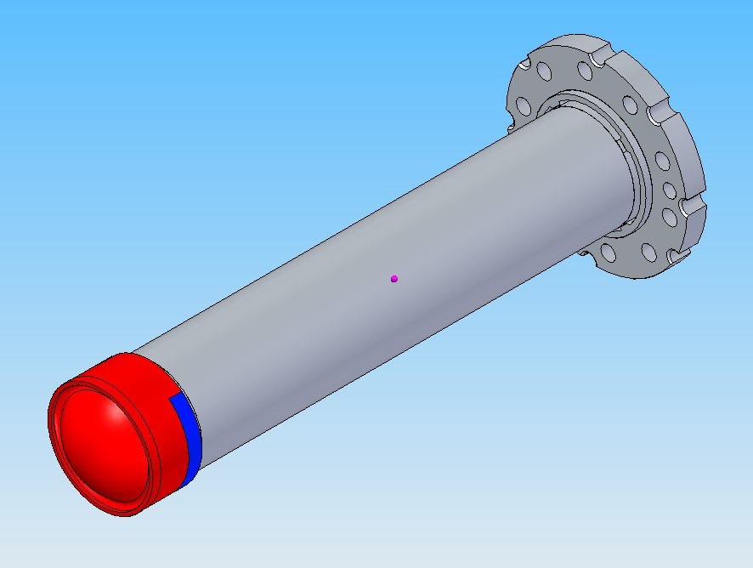
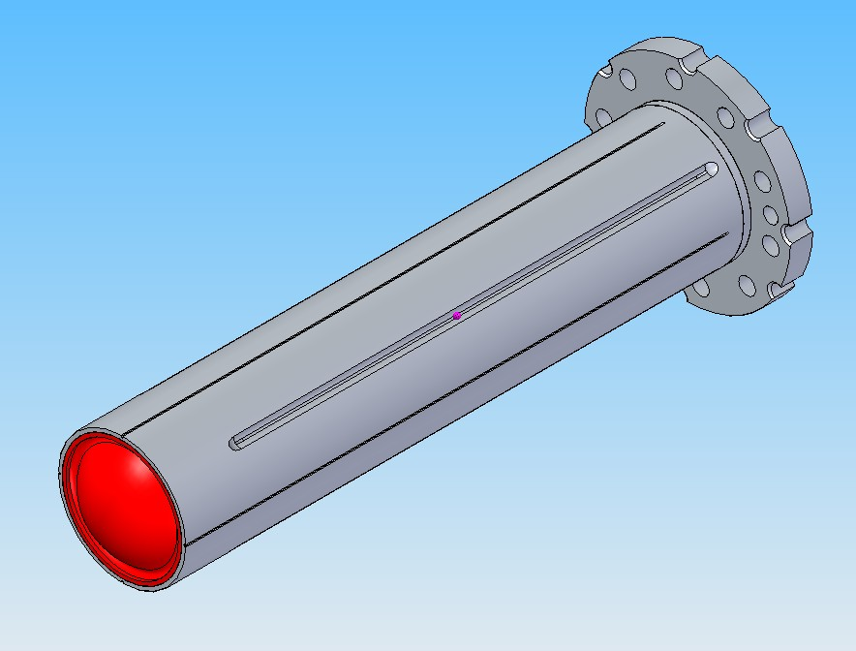
TS2 Target MK2
Target Assembly component breakdown
Target
(HIP Assy)
Cross Flow
Guide
Window
Cap

Slide 19
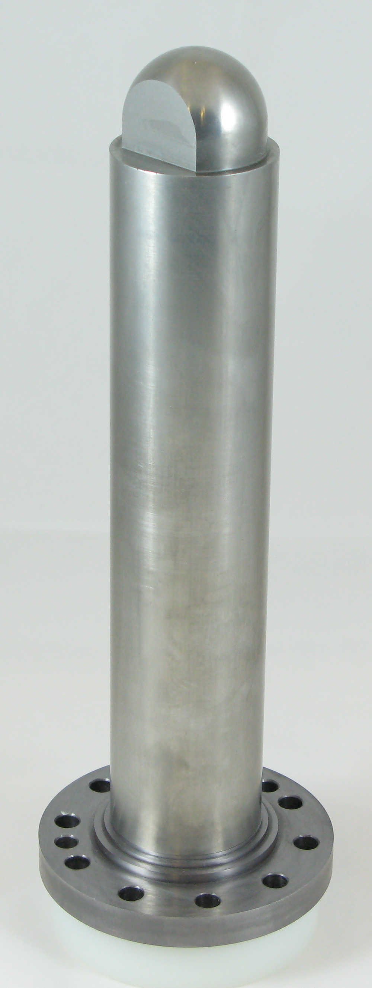
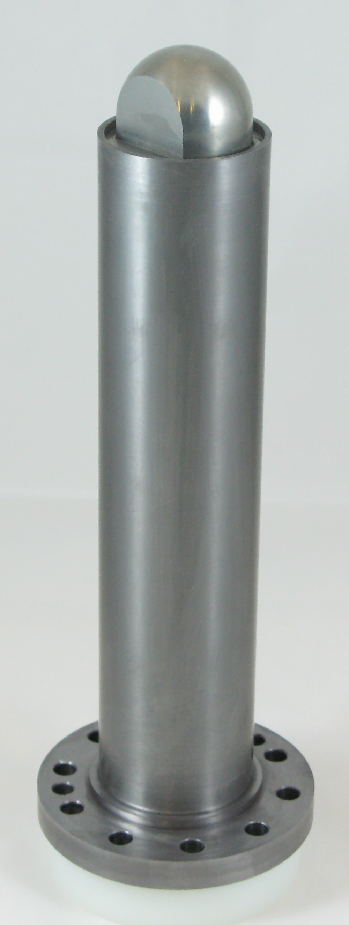
TS2 Target MK2 – Manufacturing
*Requires final
Machining
After HIP
Raw Materials
Ta Tube + W Core
Ta Flange
Ta Flange
+
W Core
Ta Flange
+
W Core
+
Ta Tube
Ta Flange
+
W Core
+
Ta Tube
+
Ta Cap
EB Welded
+
HIP
1250 °C
1400 MPa

Slide 20
TS2 Target MK2 – Assembly
Cross Flow
Guide
Window Cap
Target HIP Assembly
(after final machining)
Target HIP Assembly
+
Cooling Sleeve
+
Cross Flow Guide
+
Window Cap
Machined from
solid Ta rod
Final Assembly
(ALL COMPONENTS FITTED AND
THERMOCOUPLE GROVES MACHINED)

