Slide 1
Status and R&D of the target and beam dump at FRIB
J. Song, M. Reaume, N. Bultman, M. Patil,
R. Quispe-Abad and J. Wei

Slide 2
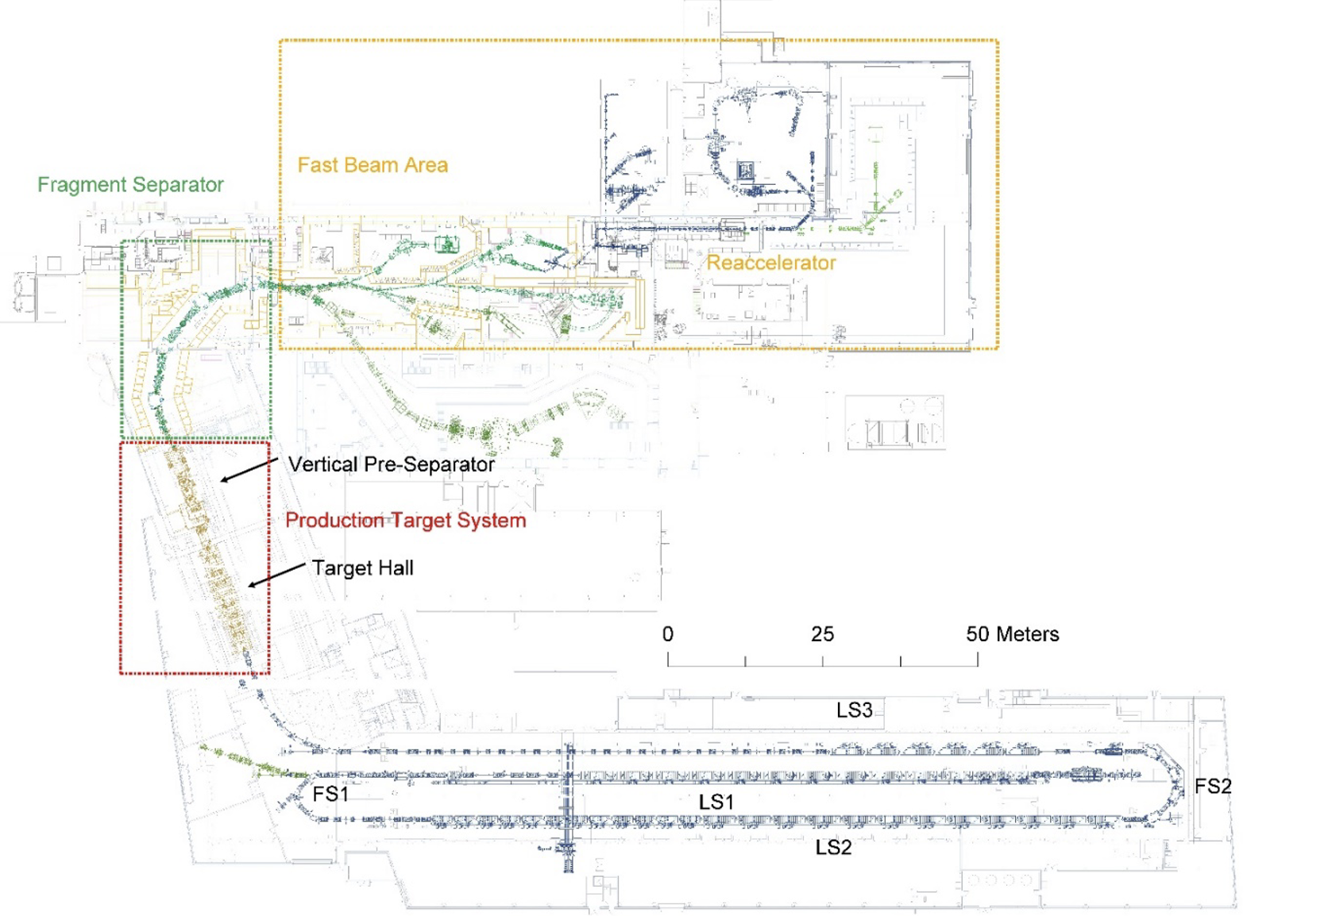
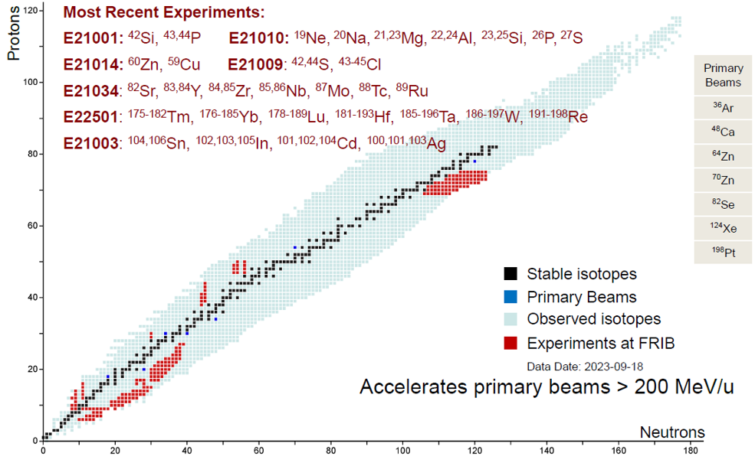
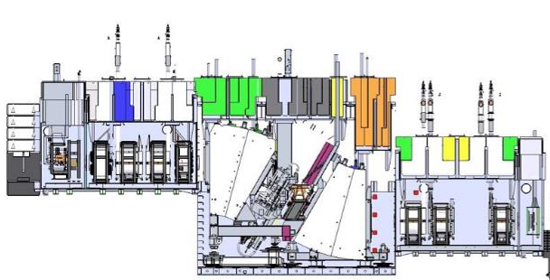
Targetry Systems Overview
FRIB Accelerator System
Target and beam dump for the experiments of PAC01 and PAC02
Single-slice rotating graphite target
6⁰ S-shape static beam dump
In FY2023, the primary beam power was operated a 5 kW
The 10kW operation has just started with a 28Si beam to produce the 25Al beam
Primary beams: ¹⁸O, ²⁸Si, ^{36,40}Ar, ⁶⁴Zn,¹²⁴Xe,¹⁹⁸Pt and ²³⁸U
User experiments
More than 210 Rare Isotope Beams Delivered to FRIB User Experiments for Year 1
Target Vacuum Vessel
Beam dump Vacuum Vessel
Fragments of Interest Production
~ 200MeV/u
Beam
Primary beam acceleration
Single-slice Target
~25% heat deposit
~ 150MeV/u FOI
Static Beam Dump
~75% heat deposit

Slide 3
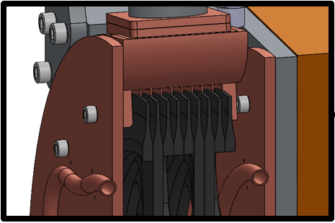
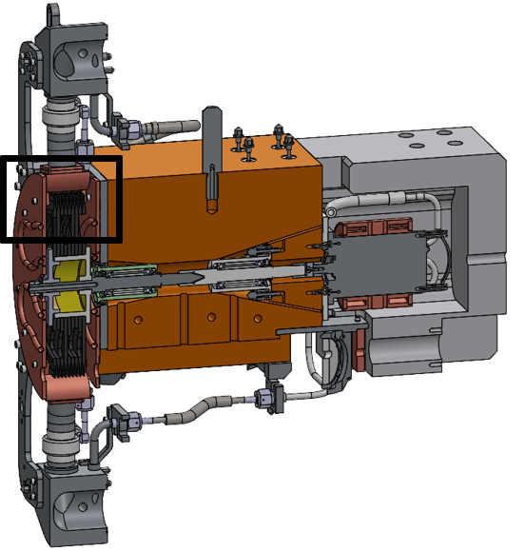
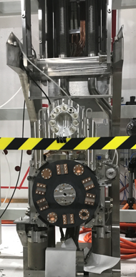
Power ramp up plan: Target System
10 kW
we are here
1 kW
40 kW
400 kW
Multi-slice
Single-slice
Static target

Slide 4
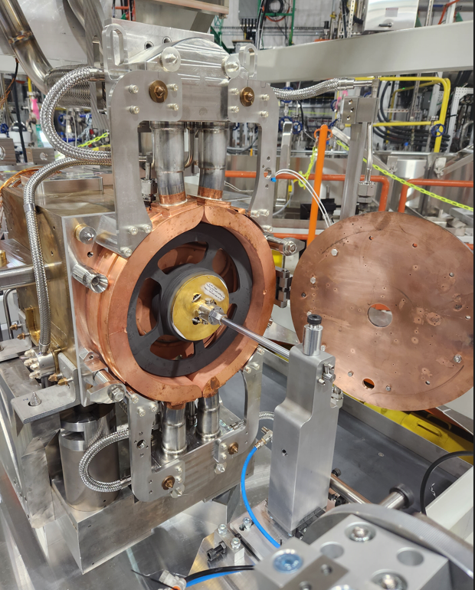
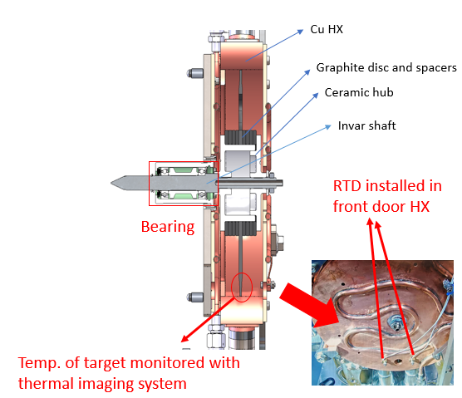
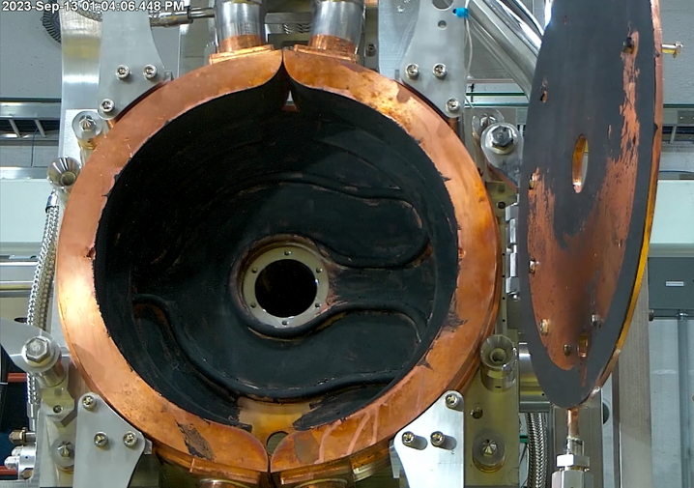
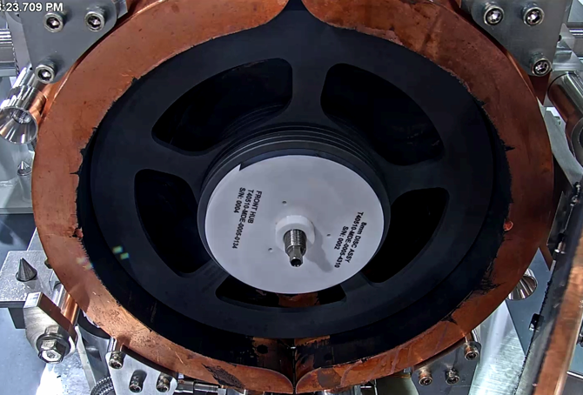
Current Production Target
Single slice target
Criteria for determining the maximum beam power
Graphite disc temp. < 1900 ⁰C
Bearing temp. < 150 ⁰C, New(NSK) bearing < 230 ⁰C
Moresco Lubricant temp. < 250 ⁰C
Radiation cooling
Primary beam size: $σx=$ $σy$ = 0.25 mm
Rotating speed: currently operating at 500 rpm
Disc
Single slice
Mersen Graphite, grade 2160
grain size: 5 μm, density: 1.86 g/cm³
Assumed ε=0.85
thickness: 1.2, 2.1, 3.5, 5, 8, 10, 15 and 18 mm
HX
Cu
Emissivity coating done, ε>0.6
Water cooling
Inside, Front and Rear Doors
DPA < 0.05 after 10 kW a week operation
Max temp ~ 800-900 C
Can be used multiple times
No temp monitoring system
High emissivity coating, Jul. 2023

Slide 5
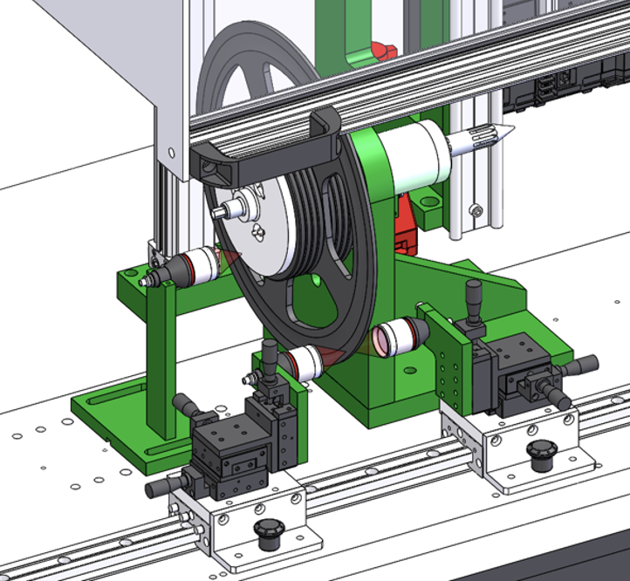
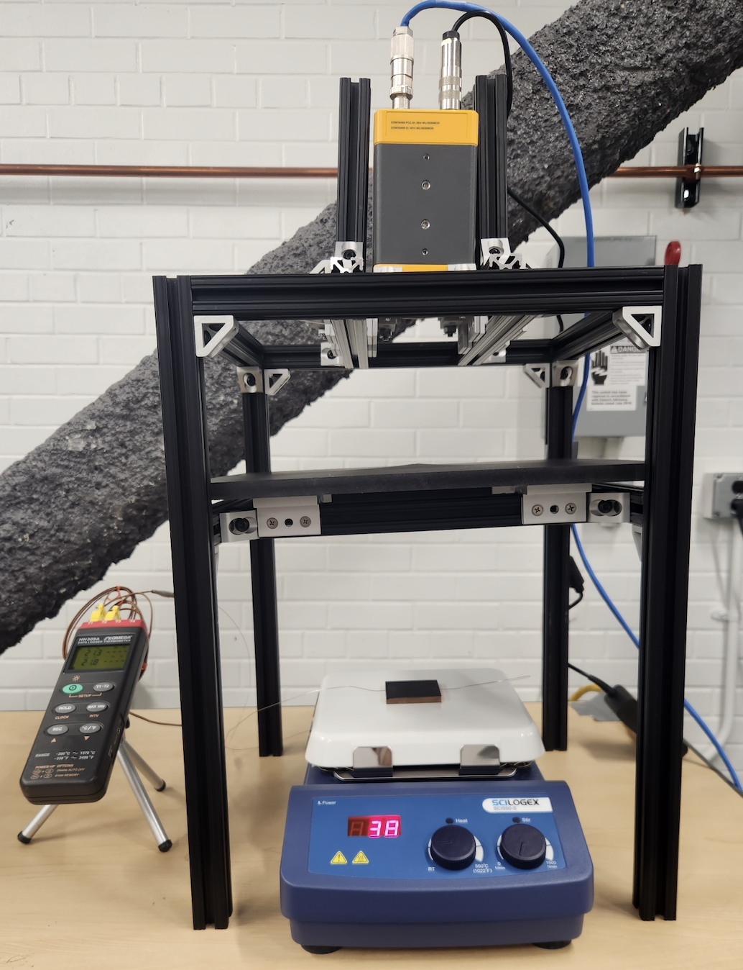
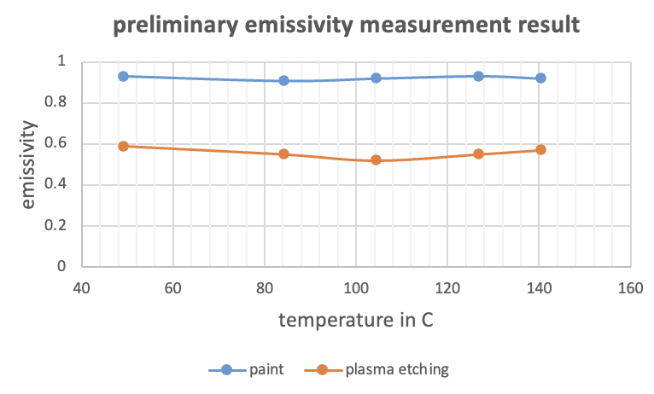
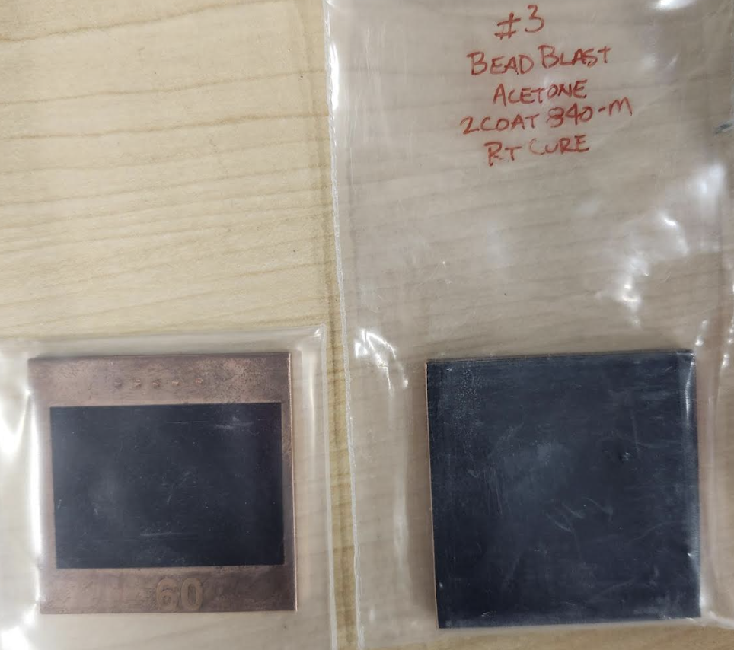
Target defect, emissivity and offline test
Target defect
Arising from machining tolerances, inhomogeneities, deformations, and etc.
Requirement: $±$2%
Current measurement (with beam) using a wedge viewer revealed that the target defect: $±$1.6 %
Thickness measurement
Currently 5 points measurement with a micrometer
Developing a device for continuous non-contact thickness measurement
Emissivity measurement
Developing a device
IR camera: RT – 1200 C
Heater temperature: RT to 580 C
Offline target system test
Developing a test system to perform
offline thermal test on the target system
Referred to C. Zhu et al., “An accurate instrument for emissivity measurements by direct and indirect methods”

Slide 6
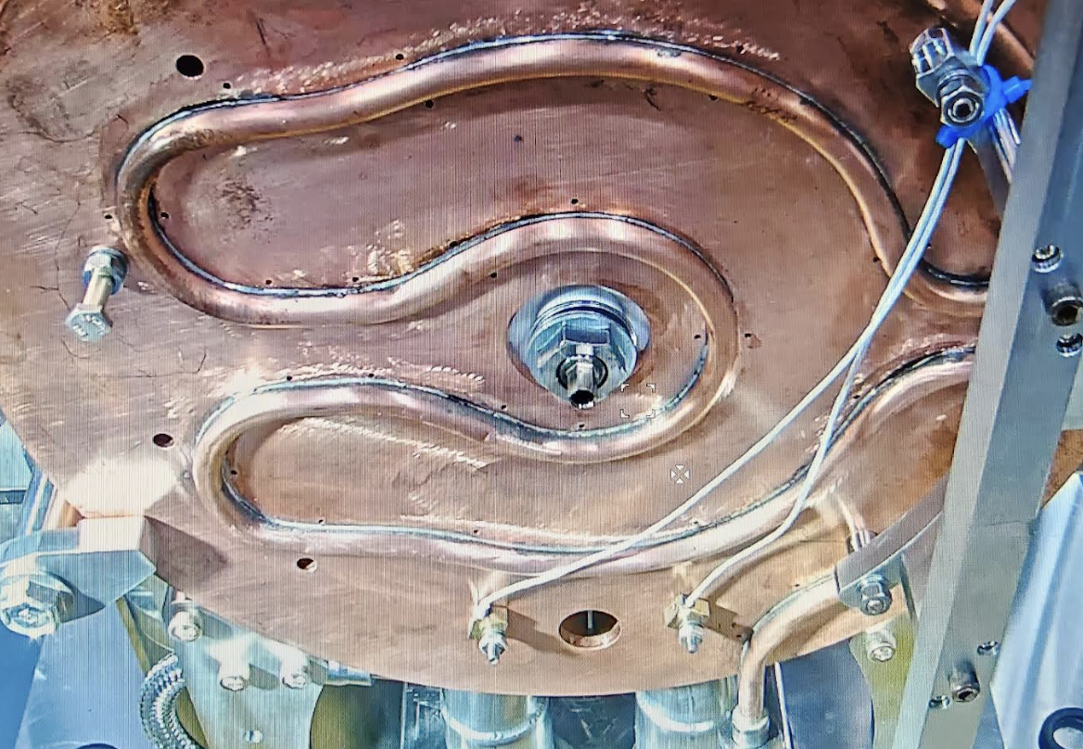
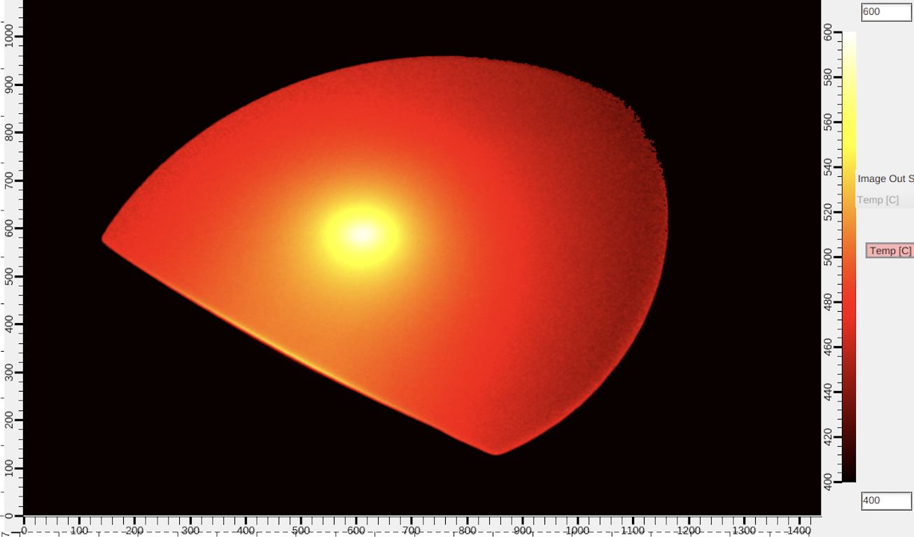
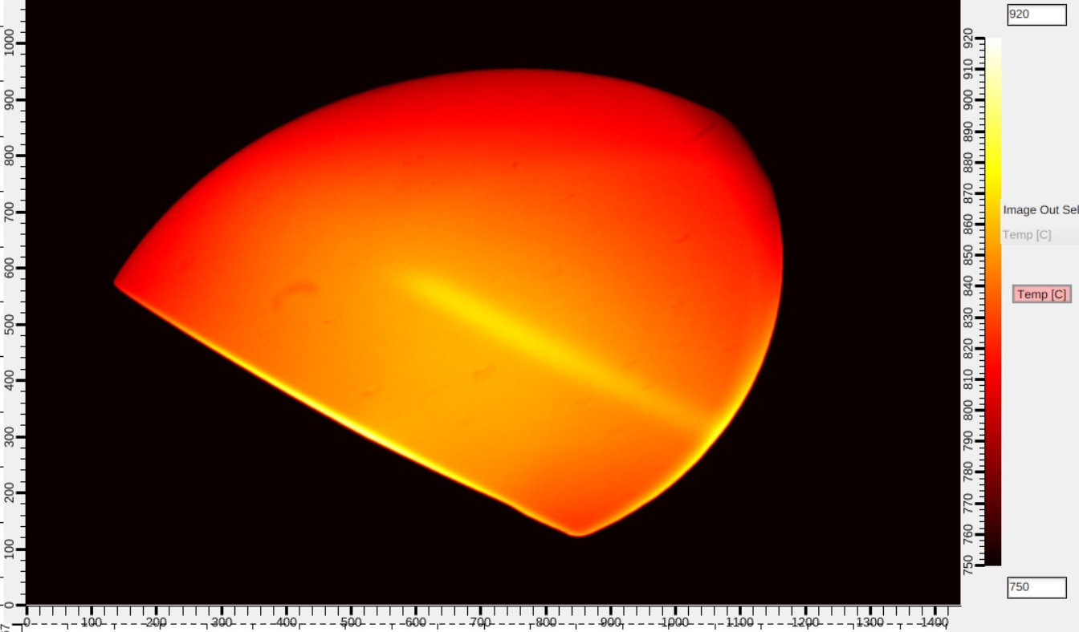
Target temperature measurements and power limit
Latest experiment (11/2/2023)
~10 kW 28Si beam with 155 MeV/u on an 8 mm thick graphite target
Temp distribution measured using a thermal imaging system
Max temp on graphite disc
887 ⁰C (measured), 885-854 ⁰C (simulation, HX $ε=0.6−0.8$)
$ε>0.6$
△T ~ 60 ⁰C
Power limit
With assumptions with $HX ε$=0.6 and utilizing low temp. bearing.
The bearing operates within the operational temp limit, even for the extreme case of primary beam power of ~ 20 kW
500 W 28Si beam on stationary target
5 mm
9.6 kW 28Si beam on rotating target
TIS

Slide 7
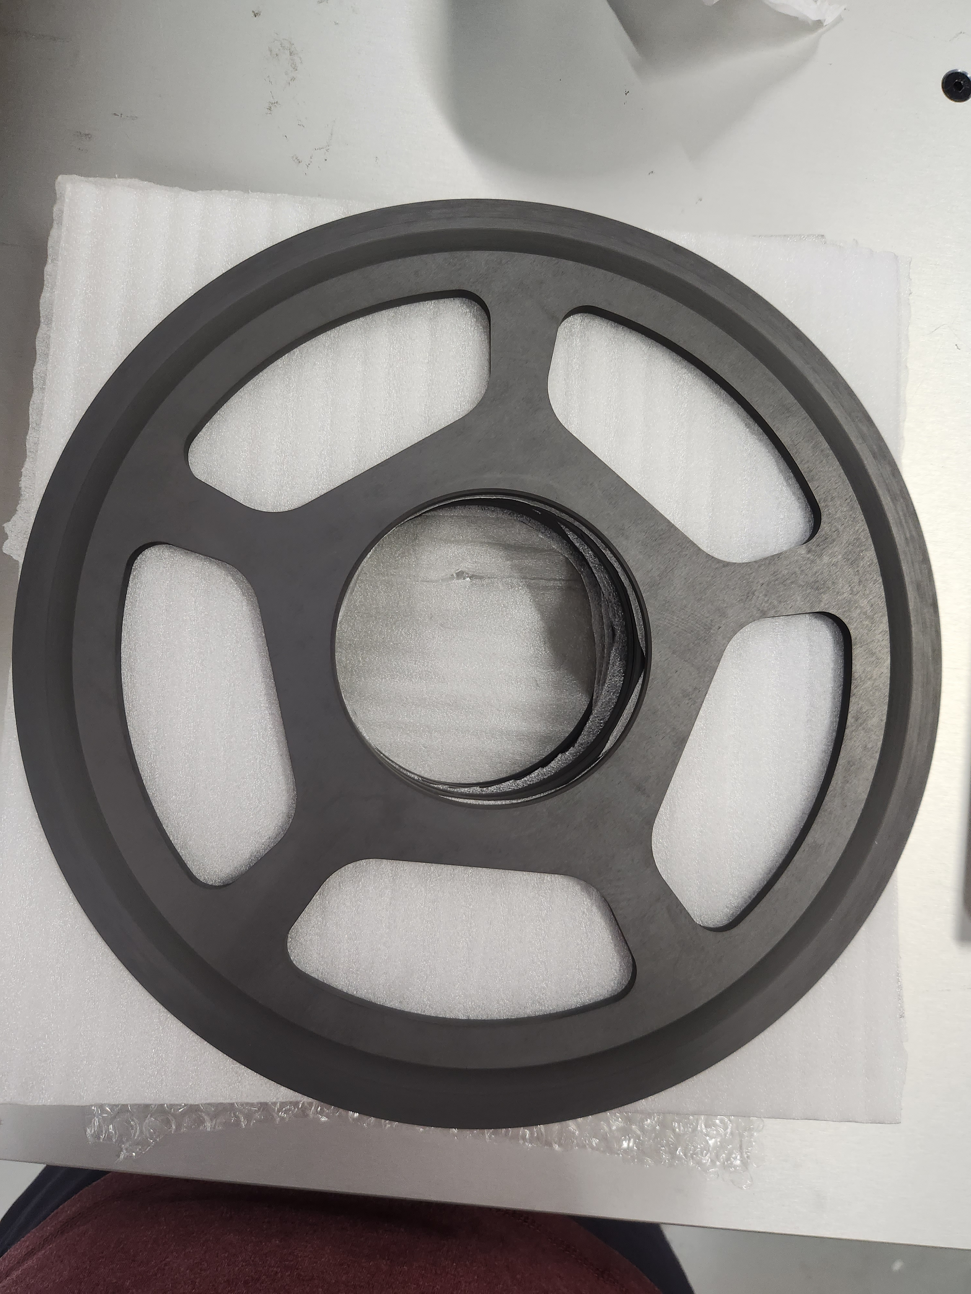
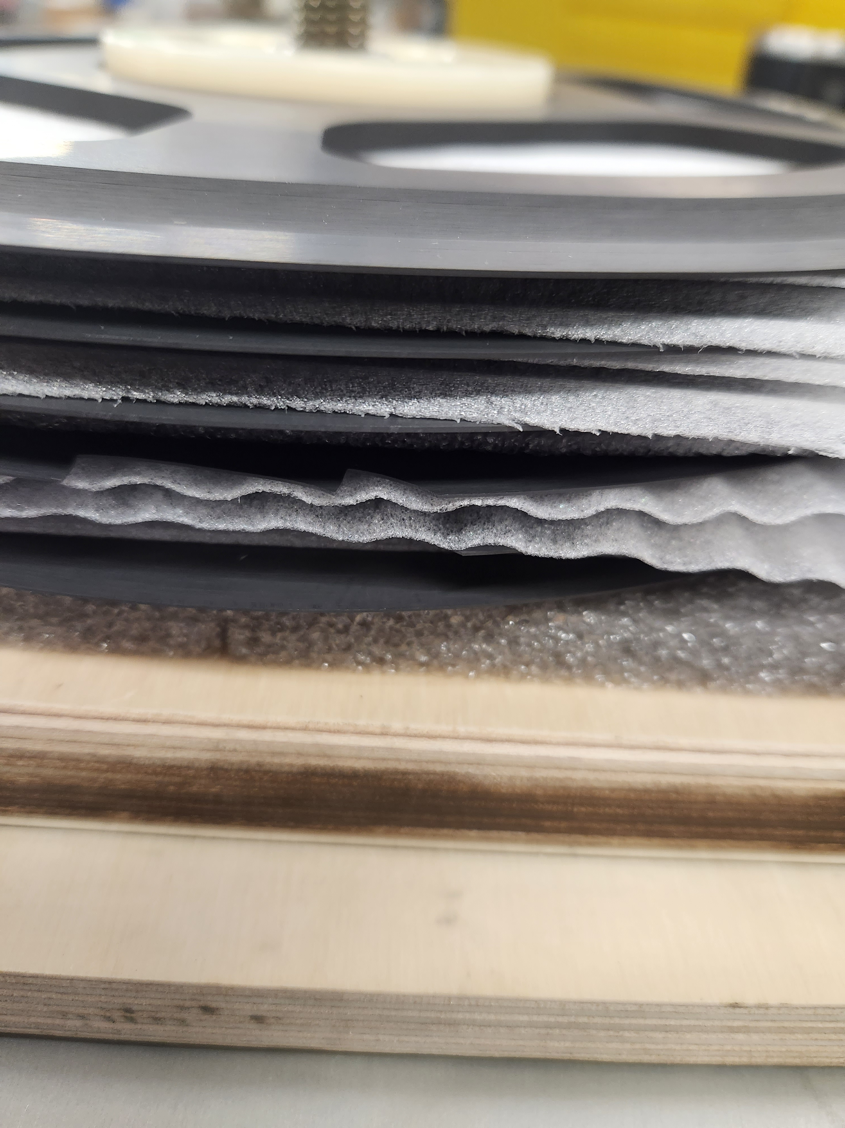
Multi-slice disc
Multi-slice target
A prototype graphite discs have been fabricated for the ²³⁸U
will require the total disc thickness to be ~ 1.2 – 2.1 mm
The disc comes in two thickness: 0.6 and 0.4 mm (~3 slice discs)
Mechanical tolerance ranges from 8 to 12 um
Thin poco graphite (AXF-5Q) discs

Slide 8
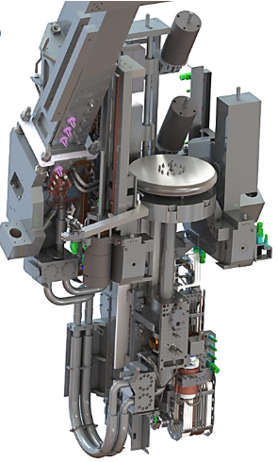
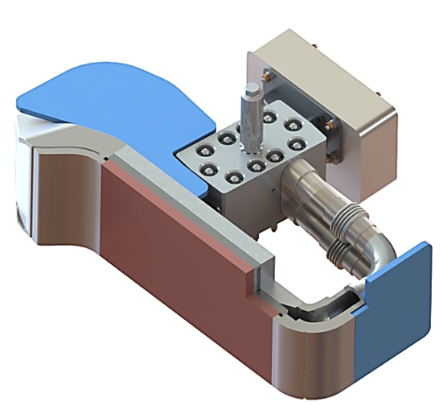
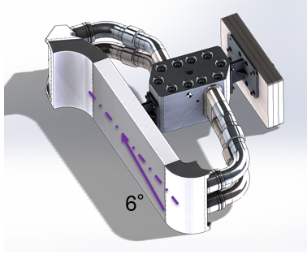
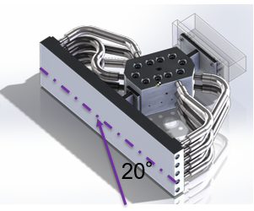
Power ramp up plan: Beam dump
10 kW
we are here
1 kW
30 kW
400 kW
Rotatable
10 kW
Mini-channel
Water cooling
Mini-channel static
Rotating drum
20 deg static
6 deg static
Primary beam
$$6^{o}$$
Water cooling
Primary beam

Slide 9
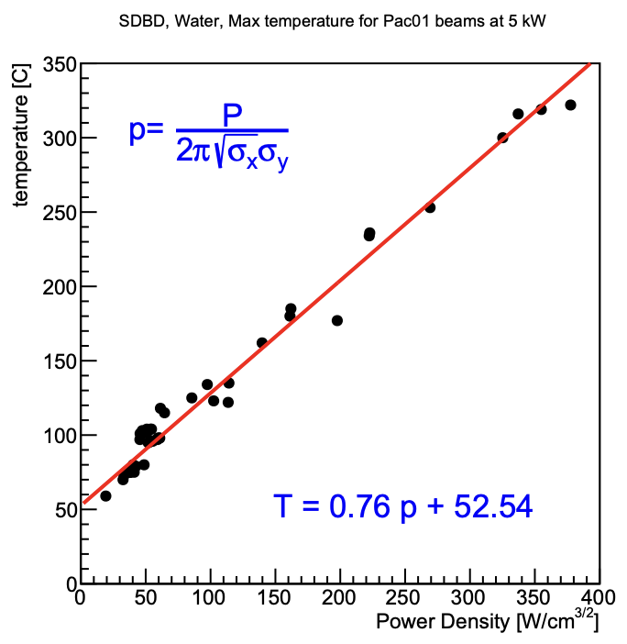
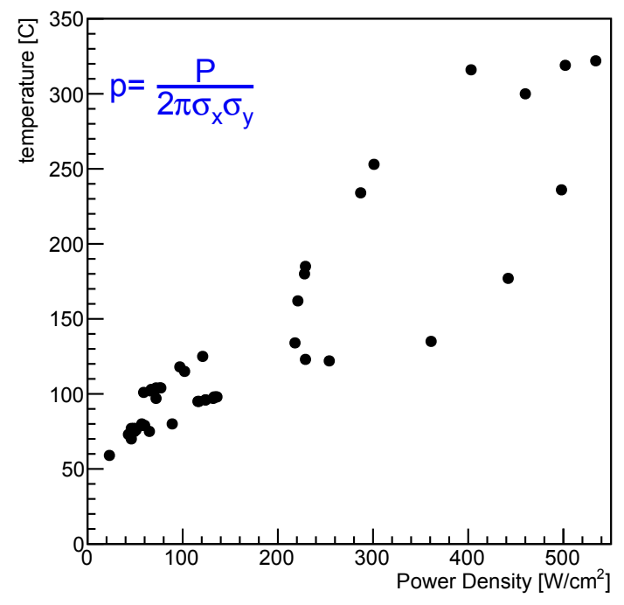
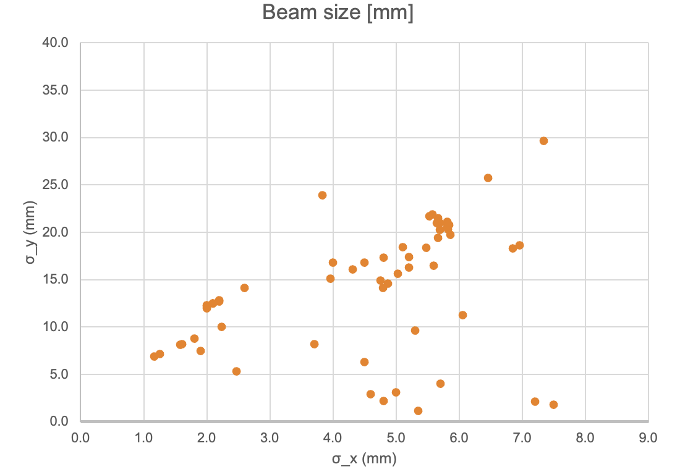
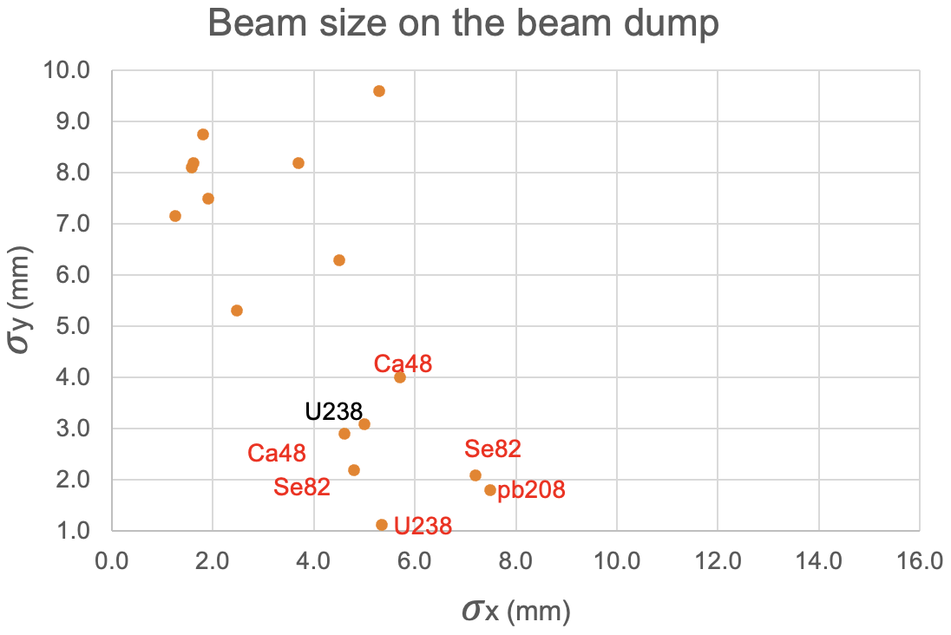
Beam sizes on beam dump
The varying beam sizes on the beam dump, depending on experiments or optics, make it challenging…

Slide 10
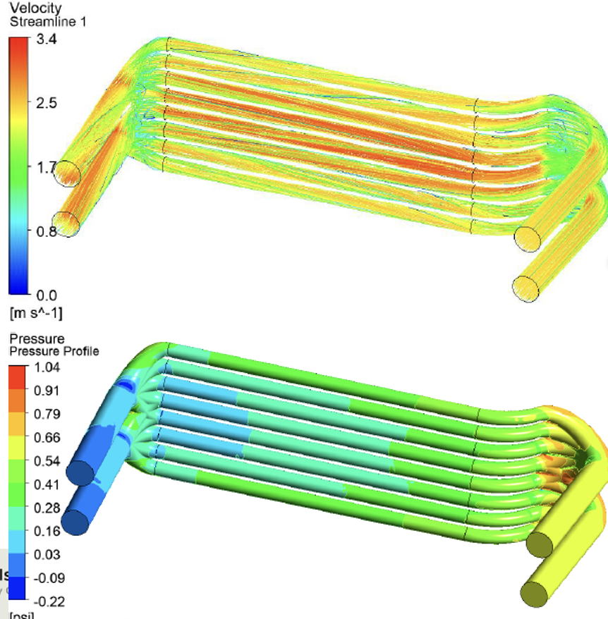
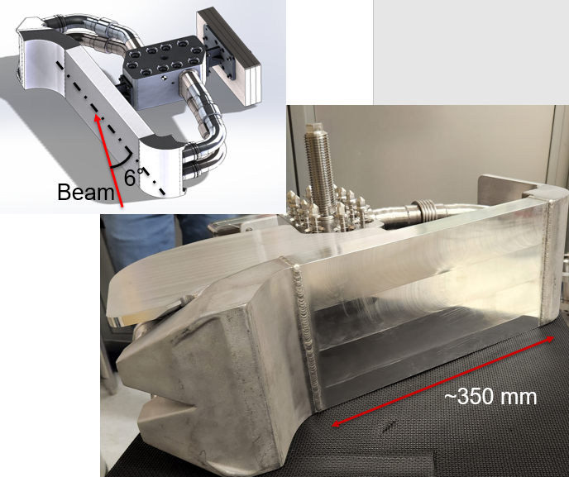
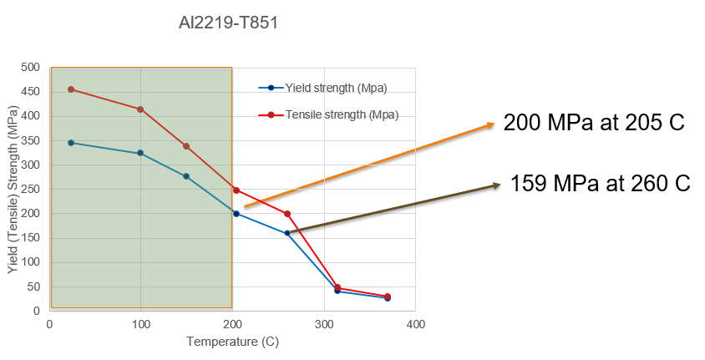
Current Beam dump
Criteria for determining the maximum beam power
Al plate temperature < 200 C
The max stress reaches 185 MPa at 194 C and a criterion has been conservatively set not to exceed a yield strength of 200 MPa at 205 C
Water temperature < 130 C
Set not to exceed the boiling point of water at 3 bar.
Conditions
Flow rate: 60 gpm
Pressure drop: 0.63 psi
Average speed: 2.4 m/s
Average Heat transfer coefficient: 8800 $W/m^{2}K$
DPA
~ few dpa per a week

Slide 11
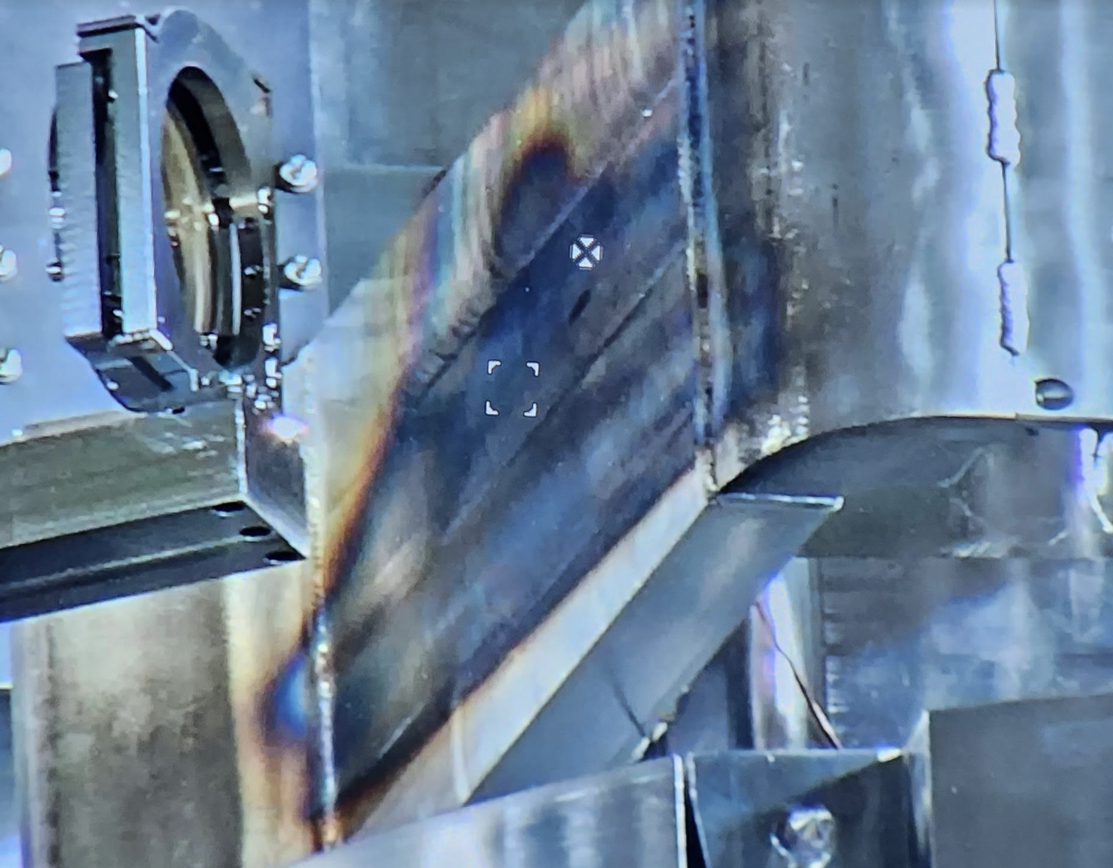
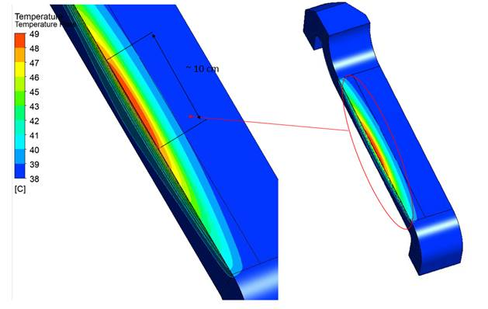
Beam dump thermal image
Thermal image of the beam dump
A thermal camera is installed last spring
Thermal image of the beam dump during the 10kW run
The IR camera Temperature will be calibrated
Beam dump after 1 year of 3-5 kW beam operation

Slide 12
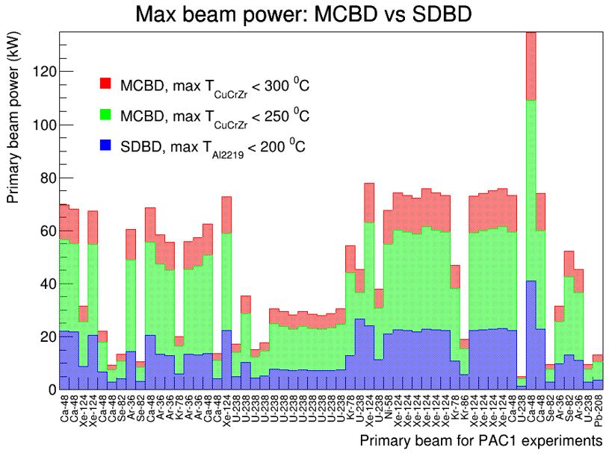
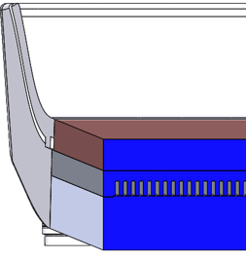
Mini-channel Beam dump
MCBD
The primary beam stops at the minichannel beam dump
Penetration depth < 1mm
Beam intercepting plate
CuCrZr/Al2219 (bimetal)
Thickness: Cu (15 mm), Al (5 mm)
Minichannel
water channel (2mm) wall (2mm)
Why CuCrZr?
High thermal conductivity (320 W/m*K)
High yield strength (380 - 550 MPa @RT)
High radiation resistance
Reference
K. Yoshida et al., High-power beam dump system for the BigRIPS fragment separator at RIKEN RI Beam Factory NIMB 317 (2013)
A. Cackett et al., Effects of radiation damage and precipitate distribution on micro-pillar compression testing of irradiated CuCrZr Journal of Nuclear Materials 553 (2021)
MCBD
Criteria
CuCuZr < 300 C, Al2219 < 200, Water < 130 C
Flow rate: 60 gpm
Pressure drop: 29.1 psi
Average speed in the mini-channel: 8 m/s
Average Heat transfer coefficient: 30,000 $W/m^{2}K$
Radiation damage
For 238U, peak DPA per a week for a 10kW operation, < 10 dpa
Minichannel Water cooling
CuCrZr
Al2219
2mm width minichannel
$$6^{o}$$
Primary beam
Water Supply
Water Return

Slide 13
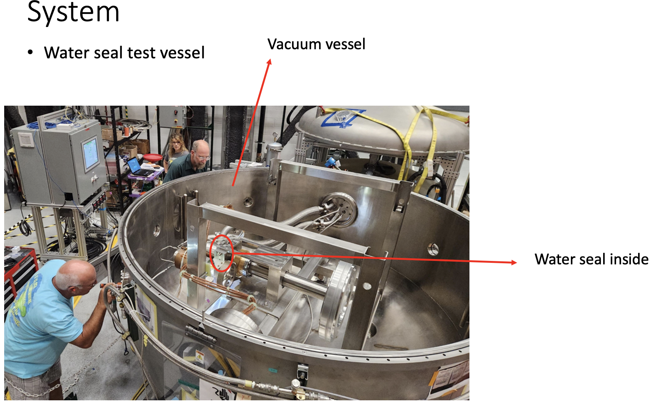
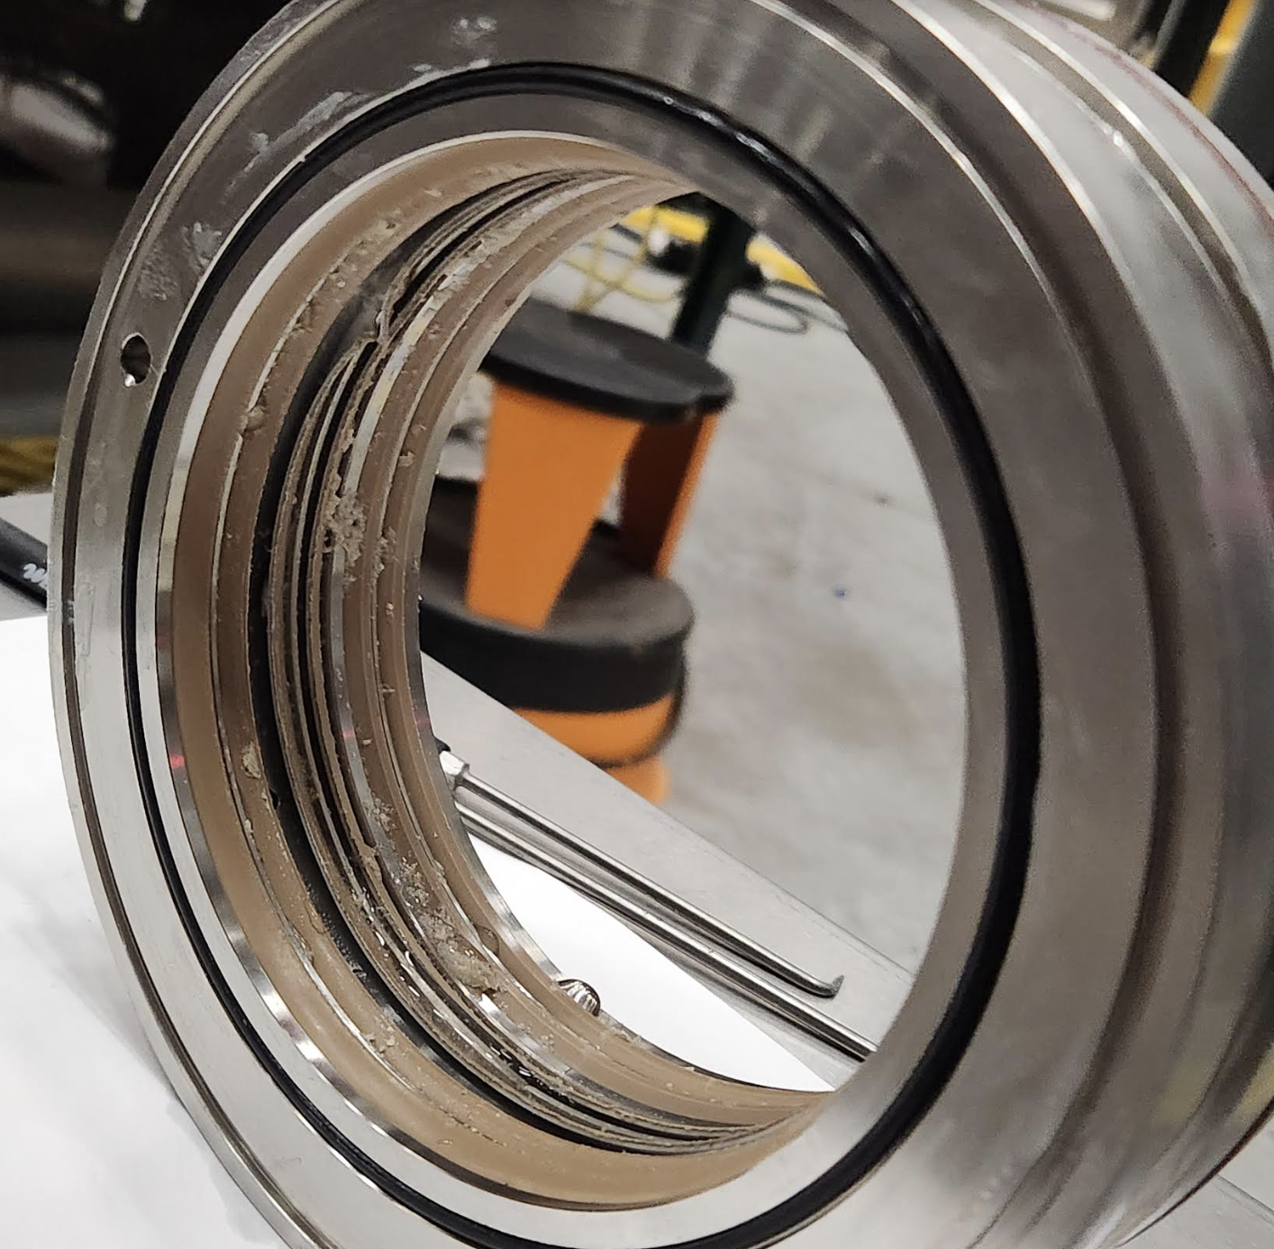
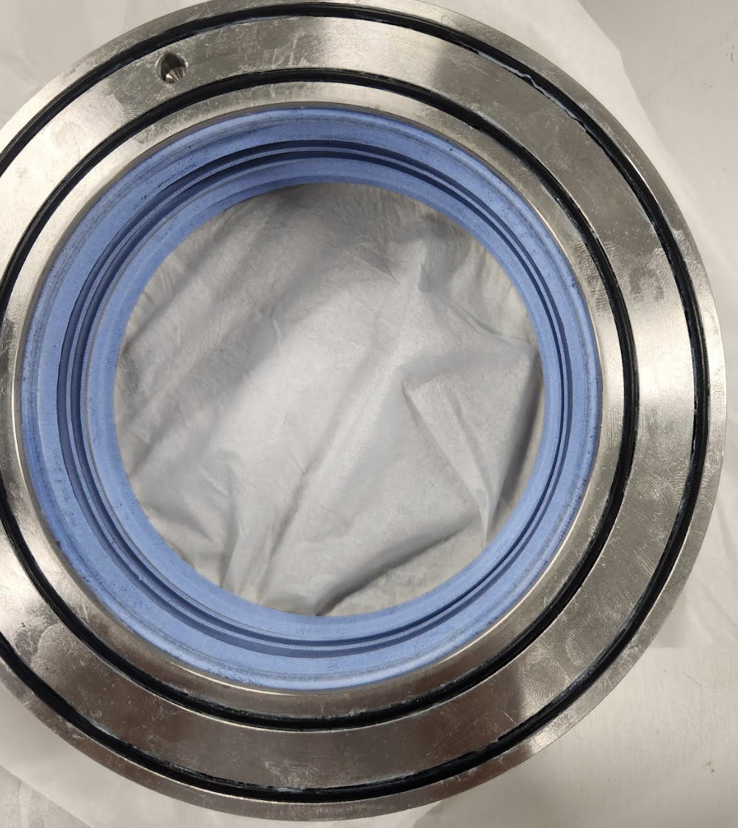
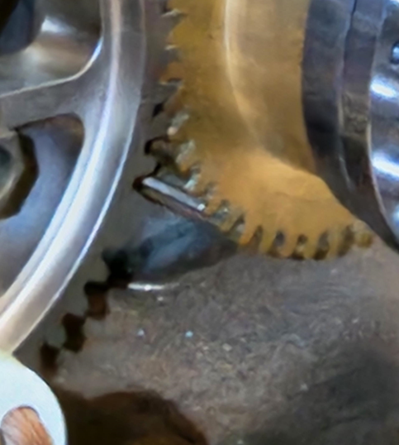
Rotating Beam dump
Concept
Beam stops in the water
Easy to remove the heat
Reduce the radiation damage
Current issues
Water seal development
Lip seal
Ferrofluid seal
Increasing a beam dump head height to cover multiple charge states of ²³⁸U beam
Water leak after couple of hour operation

Slide 14
Summary
Target
Single-slice
Multiple-slice
Beam dump
6 deg Beam dump
Mini-channel beam dump
Rotating beam dump
10 kW beam power available at FRIB now
Thank you for your attention!

Slide 15
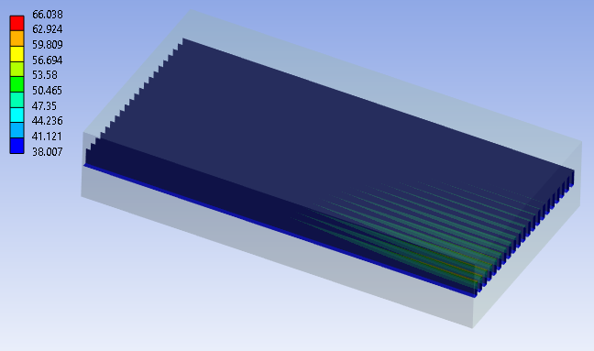
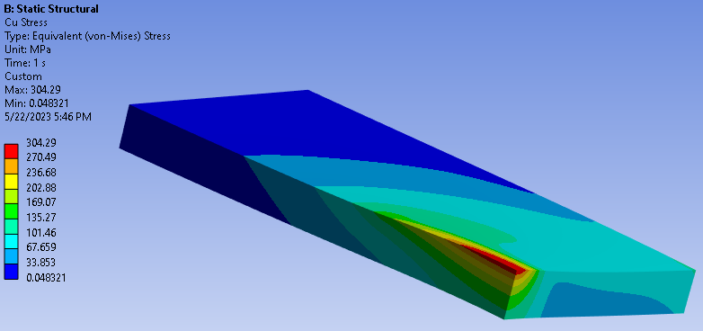
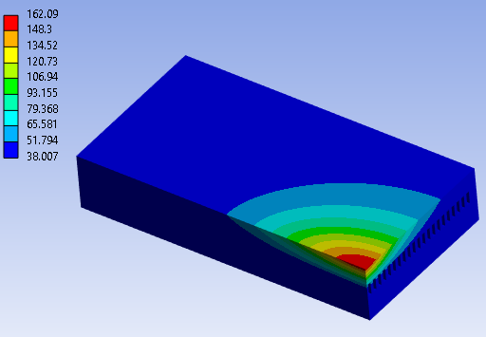
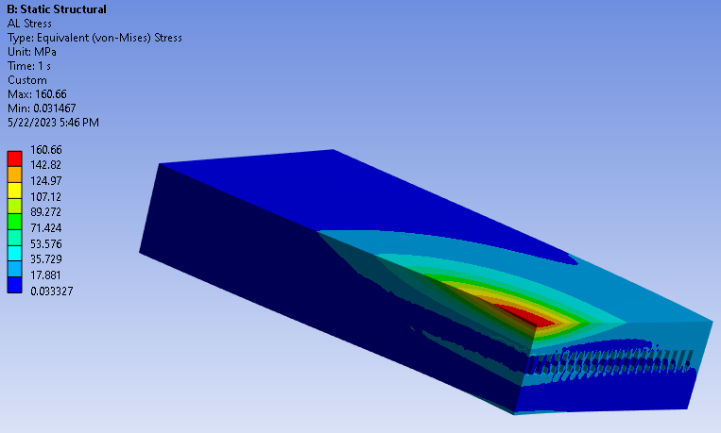
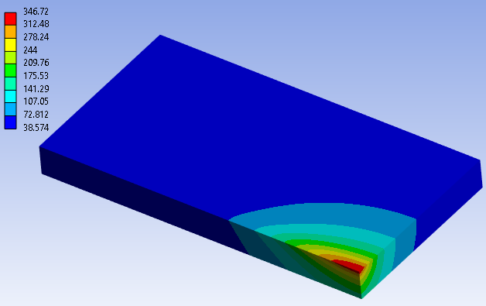
Backup slide
Thermal analysis results
Stress analysis results
CuCrZr, max stress is 304 MPa at 327 C, which is close to the yield strength of Cu alloy at 327 C, ~ 330 MPa.
Al2219, max stress is 161 MPa at 160 C, which is lower than the yield strength of Al alloy at 160 C, ~ 230 MPa.

Slide 16
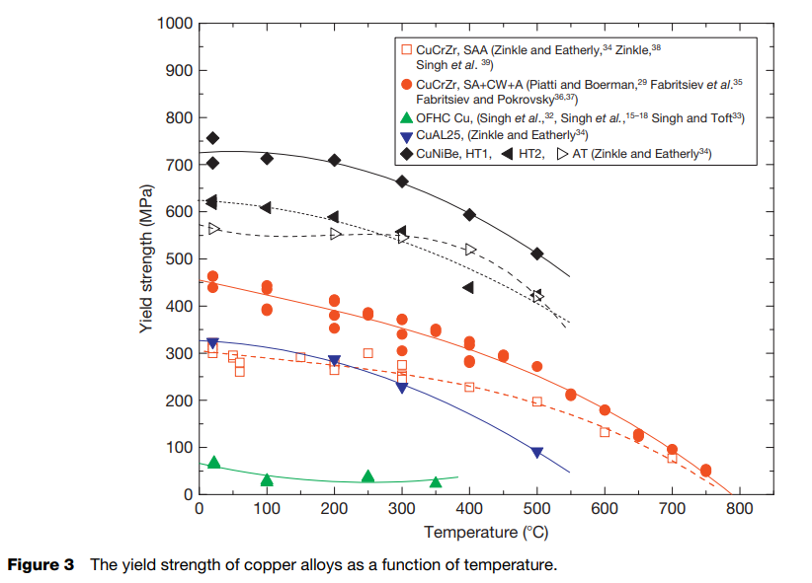
Acceptance Criteria
Maximum allowable temperature in Cu and Al plates, are 300 and 200 C, respectively.
CuCrZr < 300 C
Al2219 < 200 C

