Slide 1
HiRadMat: a high power targetry facility at CERN
A. Goillot, A. Ebn Rahmoun, P. Simon, V. Stergiou, E. Andersen, N. Charitonidis
10th November 2023 – HPTW2023

Slide 2
Outline
HiRadMat facility
Expertise provided to users
Highlight of experiments
Upgrade works
Transnational access

Slide 3
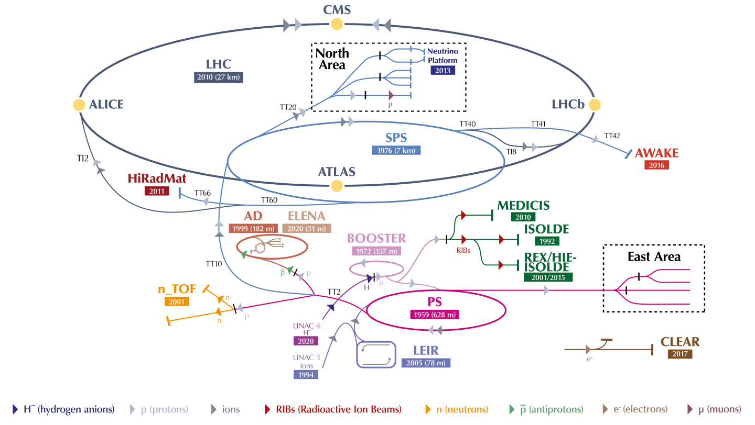
Introduction
HiRadMat: Short-pulse high-energy proton irradiation facility
Commissioned in 2011
Testing especially LHC components
Share the same SPS extraction line
High intensity instantaneous high-power beam
Study material properties
Worldwide scientific community
The CERN accelerator complex, layout in 2022. © CERN

Slide 4
HiRadMat, a flexible facility
 | Protons | ²⁰⁸Pb Ions
Beam Momentum | 440 GeV/c | 173.5 GeV/n (36.1 TeV/ion)
Pulse Energy | up to 2.4 MJ | up to 21 kJ
Bunch Intensity | 5·10⁹ – 2.3·10¹¹ protons | 3·10⁷ - 7·10⁷ ions
Number of Bunches | 1 to 288 | 52
Maximum Pulse Intensity | 3.46 · 10¹³ protons | 3.64 · 10⁹ ions
Bunch Length (4 sigma) | 1.5 ns | 1.5 ns
Bunch Spacing | 25 ns | 100 ns
Beam Size at Target | ~ 1 mm² | ~ 1 mm²

Slide 5
HiRadMat, a flexible facility
TT61 – shielded area
Injection from SPS
TNC – Irradiation area
Maximum flexibility to accommodate any request
Experimental stands
Shielded areas to protect electronics
Beam parameters
Beam Diagnostics
Transverse spot size
Bunch-to-bunch beam position
Beam losses
Test Stands
Remote plug’n’play
~300 signal connections
Cooling water, vacuum, press. air

Slide 6
Operation schedule
HiRadMat commissioned
2021 - 2025
2011 - 2012
Operation
2013 - 2014
2015 - 2018
Long Shutdown 1
Operation
2019 - 2020
Long Shutdown 2
Long Shutdown 3
2026 - 2028
Experiments
16 Materials R&D
11 Accelerator component prototyping
6 Targetry R&D
9 Beam diagnostics
2 Particle detectors
2 Plasma Physics
60 publications
Future experiments
High Lumi LHC program
DPA theory research
Plasma physics for astrophysics phenomena
ATLAS detector test
Also look for more

Slide 7
Timeline of experiment in HRMT
Initial phase
A first idea for an experiment arises somewhere in the world
Feasibility and time-line judged through initial discussion with HiRadMat team
Consultation / meetings between various experts at CERN or remotely
Preparatory phase
Experiment maturing: Scientific Board (scientific merit)
(if OK): Technical Board (technical feasibility and safety)
(if OK): experiment gets in the draft schedule of next year
Experimental phase
Beam time approval (protons) by the CERN ATS sector executive committee (IEFC)
Beam time allocated
Experiment performed
Post irradiation phase
Post irradiation analysis
Follow up of… Results presentation meetings, or small workshops

Slide 8
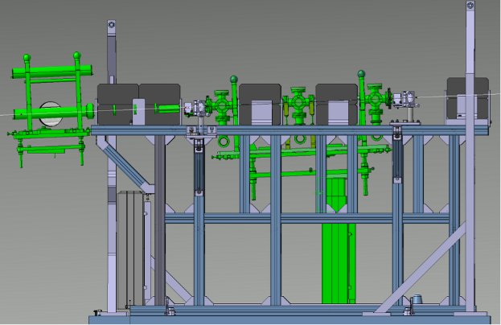
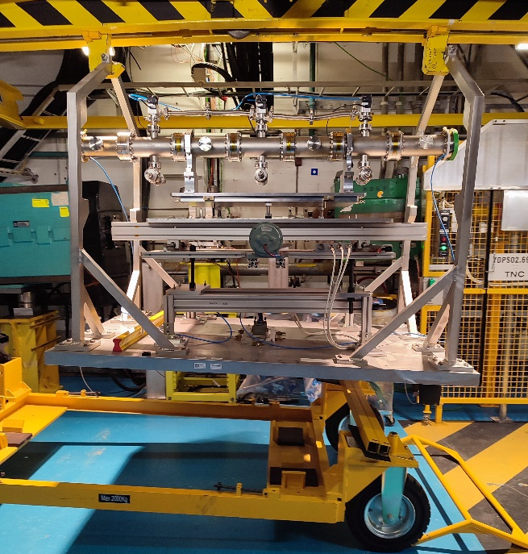
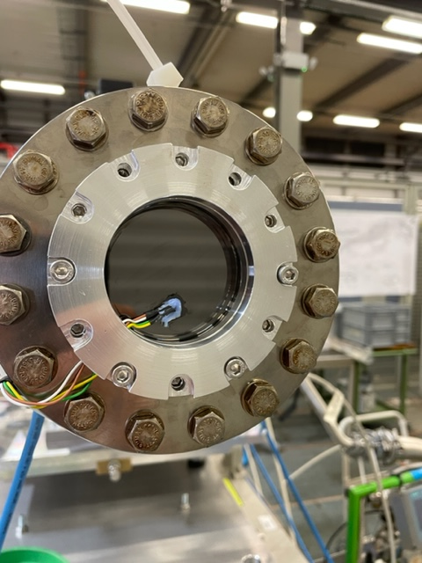
Expertise provided to users
Experiment preparation
3D integration & mechanical studies
Installation & survey
Transport and handling
On-line diagnostic equipment and expertise
Sensors, Cameras & LED
Movable stages (H&V)
Remote control of the equipment
Beam diagnostics
Beam parameters
Automatic parameter display
Auto-logging in CERN infrastructure

Slide 9
Outline
HiRadMat facility
Expertise provided to users
Highlight of experiments
Upgrade works
Transnational access

Slide 10
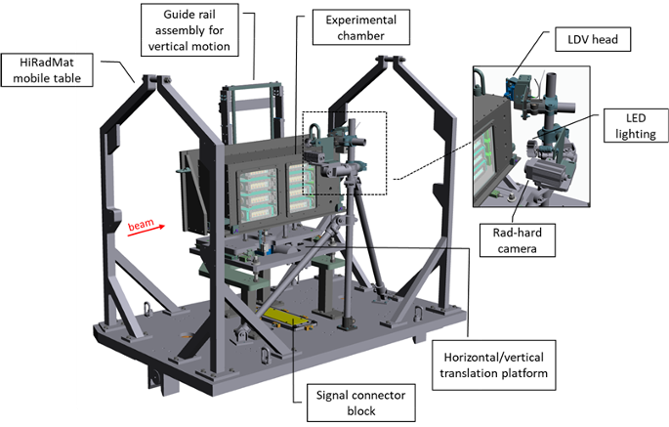
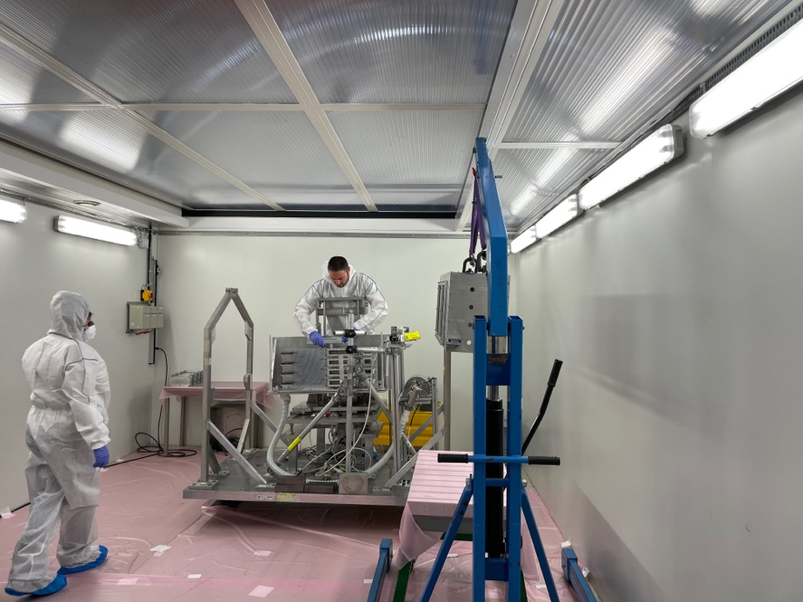
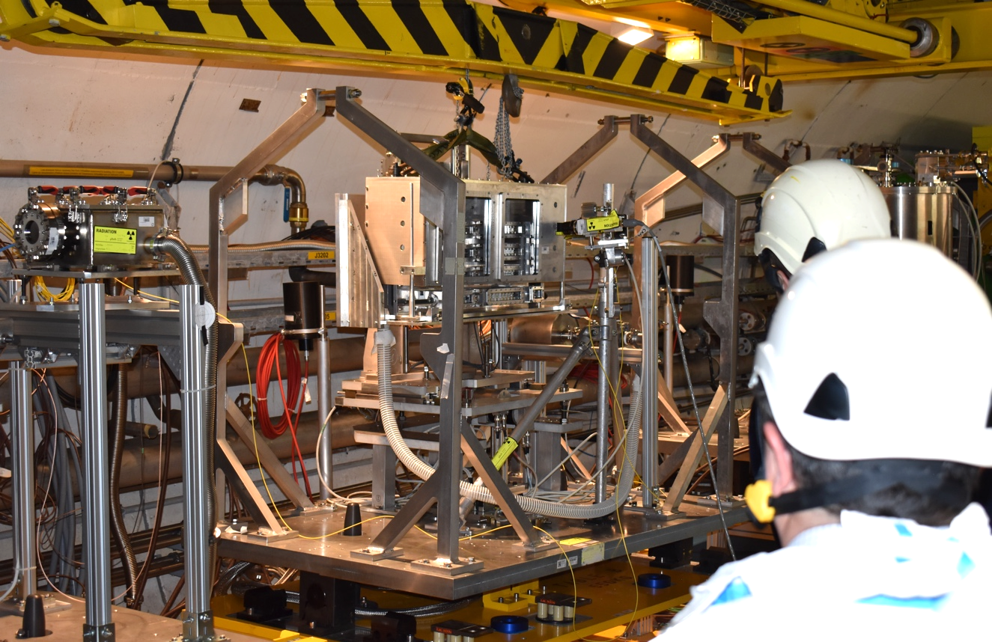
RaDIATE (2022)
On courtesy of Kavin Ammigan (and RaDIATE Collaboration)
Investigate thermal shock behaviour of beam-intercepting materials in support of current and future multi-MW accelerator target facilities and experiments
Motion stages (H&V)
LDV / Strain gages
LED + Rad-hard camera
Specimen disassembly in bunker
Experiment in 2025 (See talks of F. Pellemoine and K. Ammigan)

Slide 11
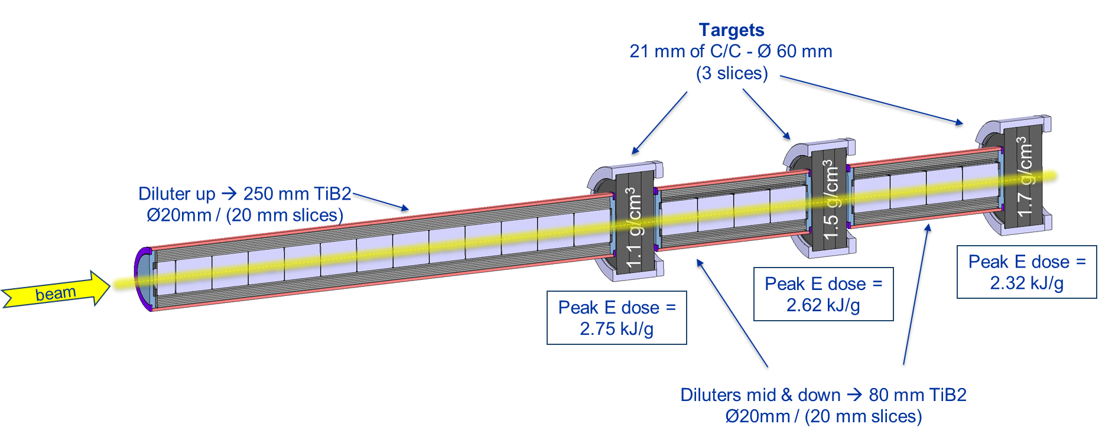
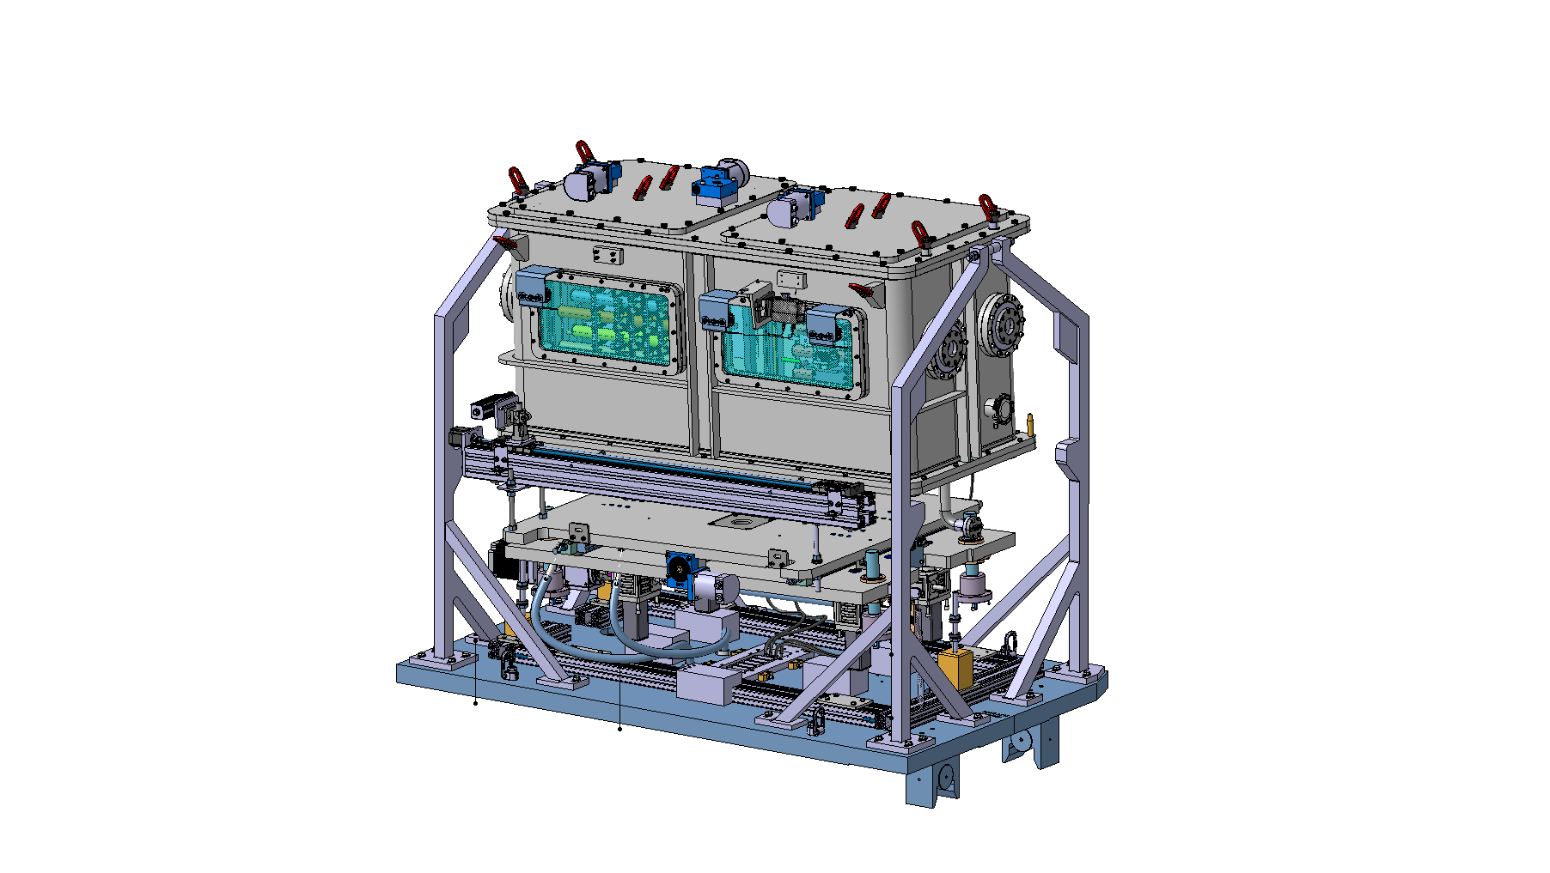
HED (2021)
On courtesy of Gabriel Banks and Pablo Andreu Muñoz (and the SY-STI-TCD section)
Validating design of the future HL-LHC External Beam Dump core
Size of the chamber
77 pulses in total at highest intensity (~2.6x10¹⁵ protons)
Follow up experiment planned for 2024
Higher energy density (1.8e11ppb)
Under argon
One shot yielding accidental scenario
See talk M. Calviani for HL-LHC dump upgrade
Beam parameters:
440 GeV / 1.1e11 ppb
beam
HRMT-56 tank CAD model

Slide 12
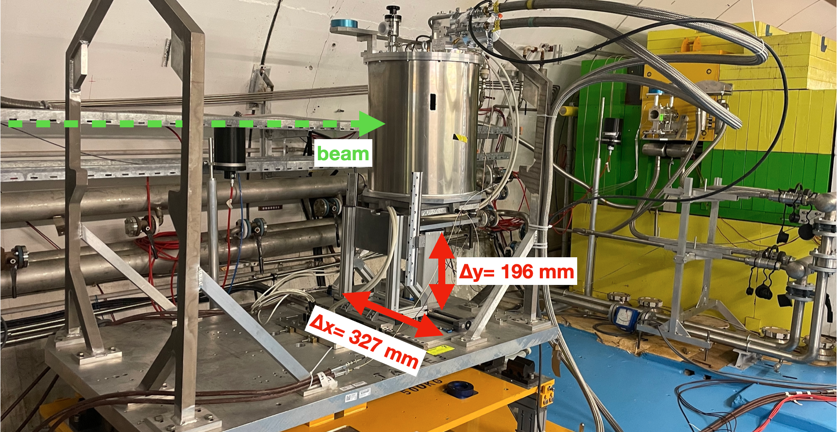
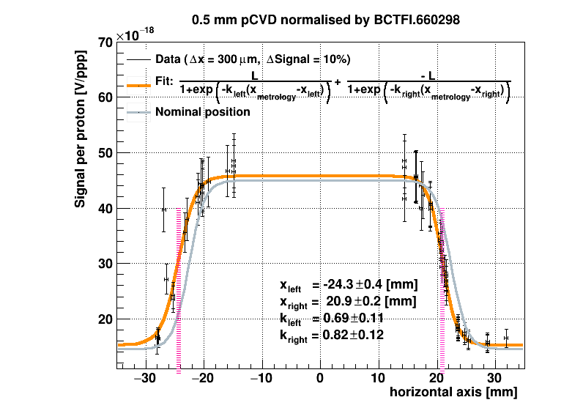
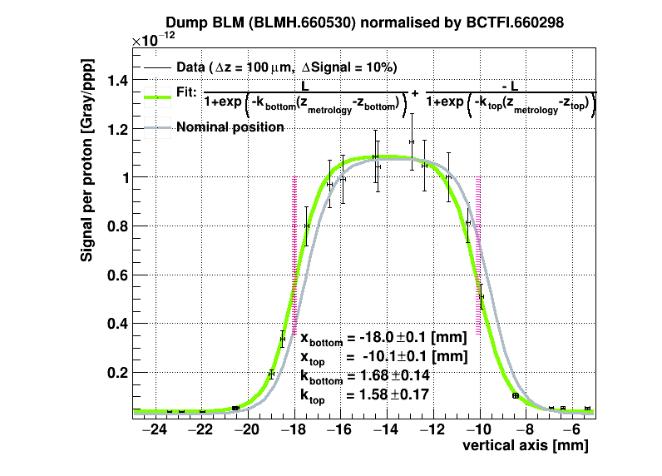
SC Coils (2022)
On courtesy of David Gancarcik (and the TE-MPE group)
Identify damage mechanisms in multilayer, impregnated coils due to instantaneous beam impact.
Cryogenic tank for low temperature (2nd experiment of this kind)
Diamond beam loss monitors
Temperature sensors
Heater
Motion stages (H&V)
Cooling water system

Slide 13
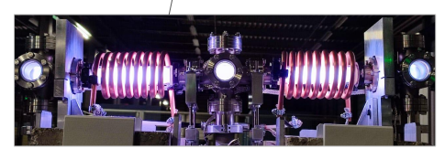
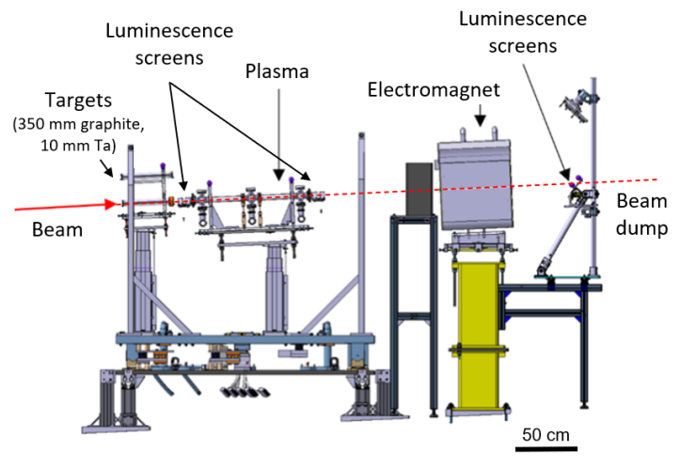
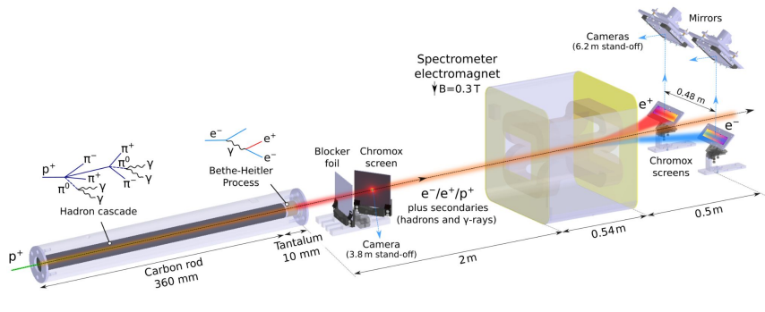
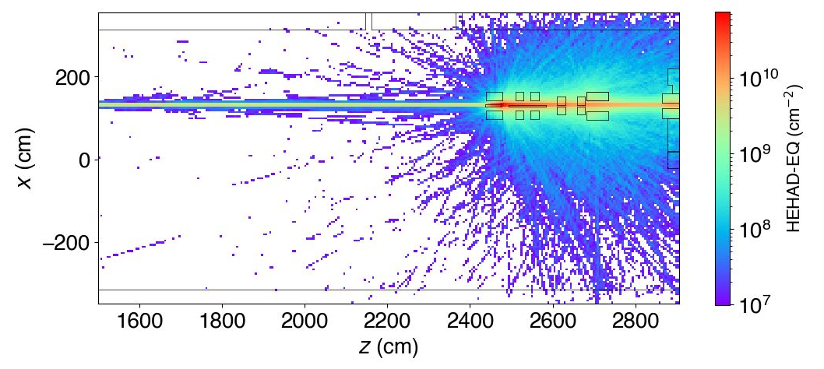
FIREBALL (2023)
On courtesy of Charles Arrowsmith (and the FIREBALL collaboration)
C. D. Arrowsmith et al. (2023) "Inductively-coupled plasma discharge for use in high-energy-density science experiments" Journal of Instrumentation 18 04 P04008. 10.1088/1748-0221/18/04/p04008
Produce a laboratory analogue to an electron-positron enriched astrophysical jet
Complex experiment with various equipments (Faraday rotation probe, Rad-hard cameras, sensors)
Fluka simulations for optimising shielding and background
Production of e⁻/e⁺ and electro-magnet (MNPA) as particle energy spectrometer
New experiment in 2024
Notes:
publications

Slide 14
Upgrade works
Increase intensity (accelerator complex upgrade)
Beam line and dump window failures
HiRadMat Facility Upgrade Study Group
Machine
Infrastructure
Beam dump
→ Works for upgrade

Slide 15
Upgrade works
TT61 – shielded area
Injection from SPS
TJ7 bunker
TNC – Irradiation area
Partition of the beam line vacuum sector
Be → glassy C
To separate this chamber from the extraction line
Vacuum recovering easier
Beam dump
Extension of the collimator
Make replacement of window easier in case of damage
Beam diagnostic
New downstream BTV
Beam angle

Slide 16
Transnational Access
GB
Funding of the mobility of international teams to come at CERN for collaboration
Preparation of the experiment
Installation time
Beam time
Supported more than 20 external users during 240 days of transnational access during one operational year

Slide 17
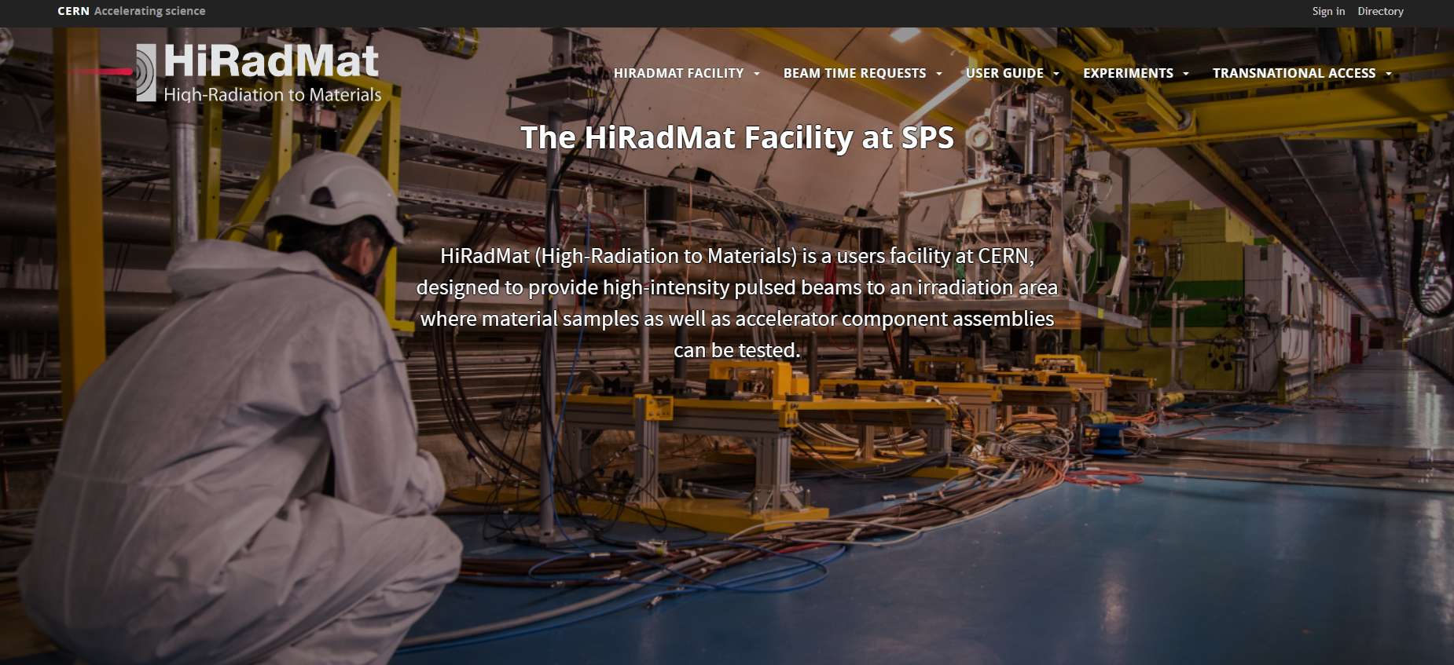
Remember
Look for more collaborations!
Single pulse high-energy proton facility for targetry test (or other…)
Flexibility
CERN environment -> technical and scientific support
Offer transnational access
hiradmat-operation@cern.ch
https://hiradmat.web.cern.ch/

Slide 18
A big thank you to all the groups along the ATS sector for their dedication and help in the operation of HiRadMat facility since 2011!
SY-ABT
BE-OP
EN-HE
BE-EA
ありがとうございます !
TE-MPE
BE-GM
BE-CEM
HSE-RP
SY-STI
EN-MME
SY-BI
BE-ASR

Slide 20
This project has received funding from the European Union’s Horizon Europe Research and Innovation programme under Grant Agreement No 101057511.

Slide 21
Courtesy of S. Gilardoni (SY-STI)

Slide 22
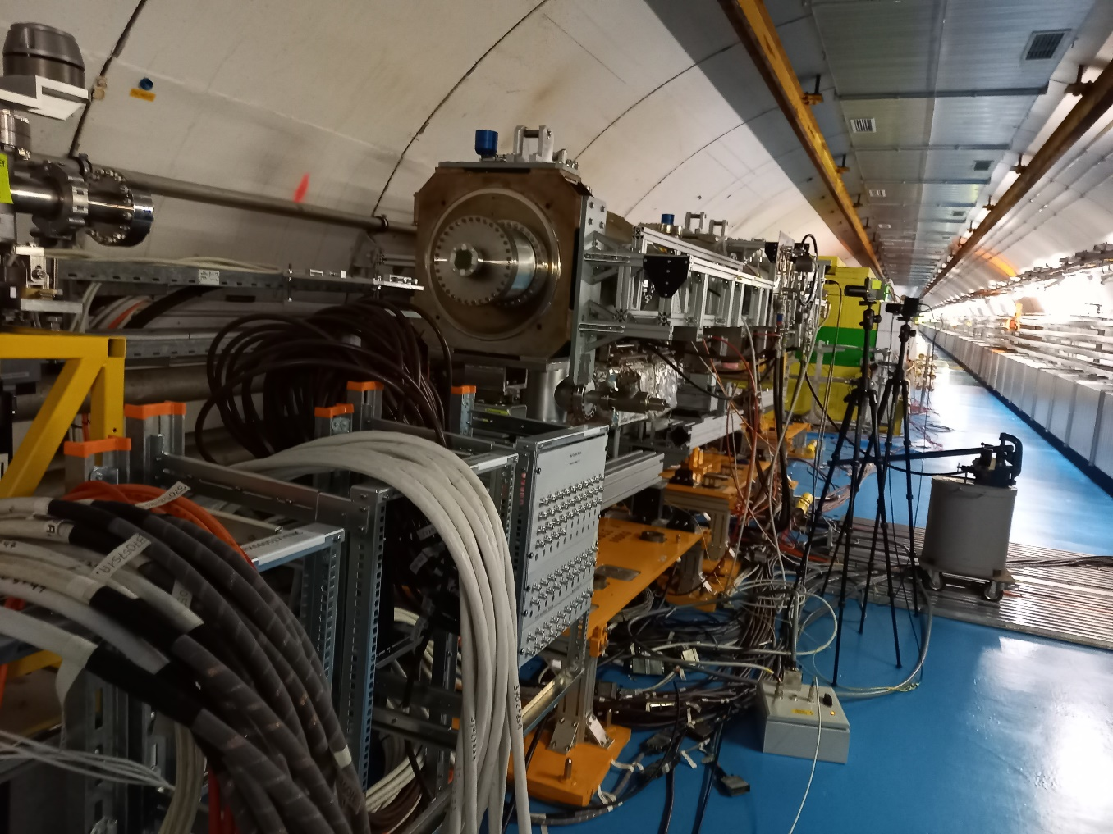
TPSG4-2 (2023)
On courtesy of Cedric Baud (TE-ABT)
Test the MSE protection element (diluter) in case of accidental shot and validate the simulations
6 tons of equipment
Exceptional size
Under vacuum and cooled down with water system
MSE
Magnet
TPSG4 diluter
Protection element

Slide 23
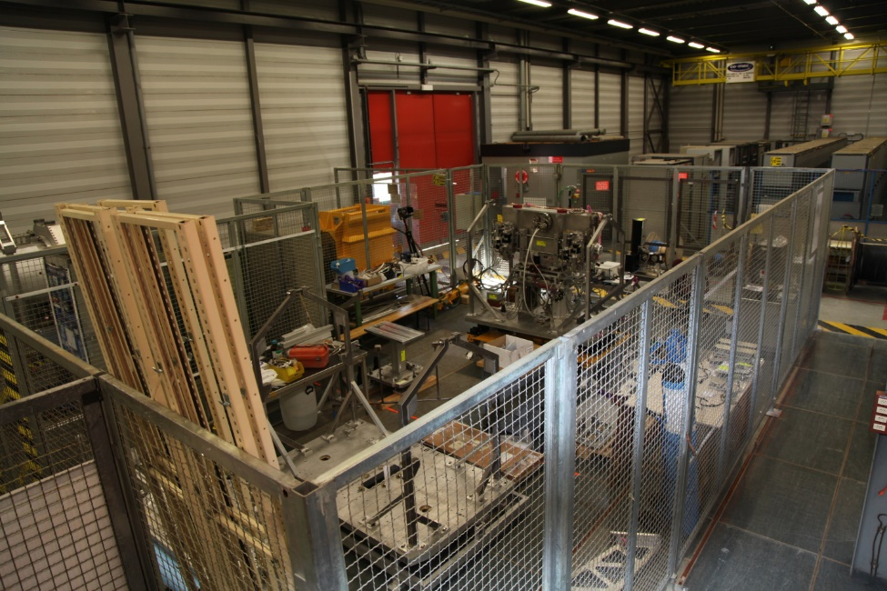
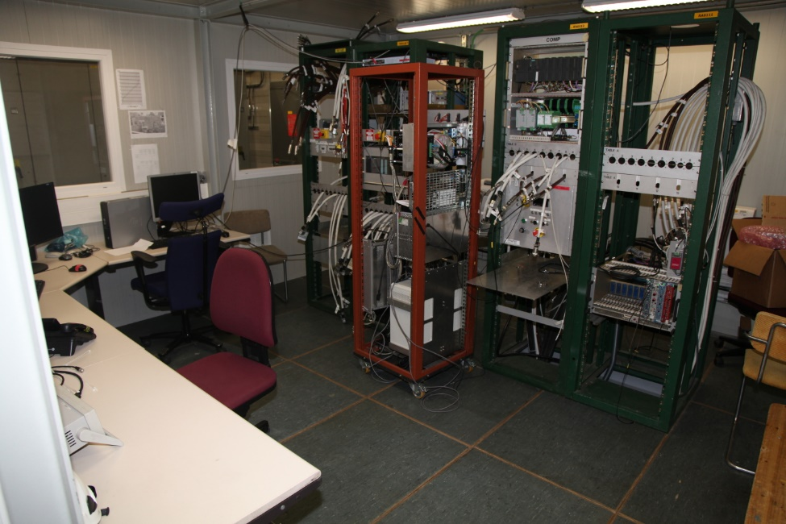
Layout HiRadMat
TT61 – shielded area
Tunnel infrastructures
Injection from SPS
TJ7 bunker
TNC – Irradiation area
Surface lab
Control room

Slide 24
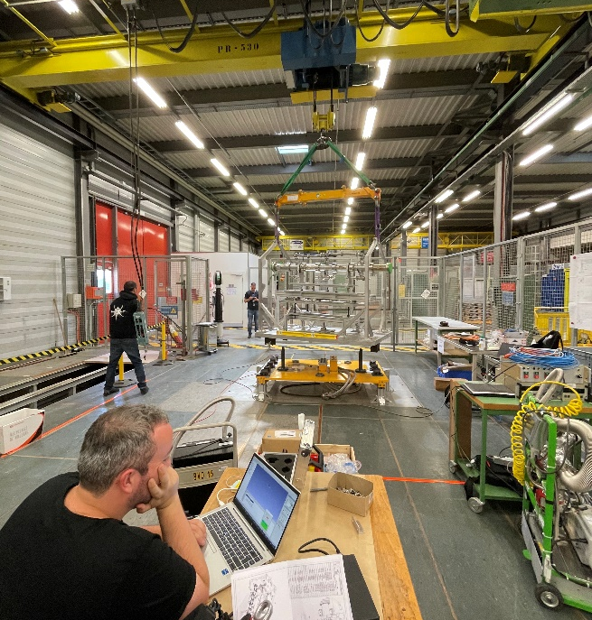
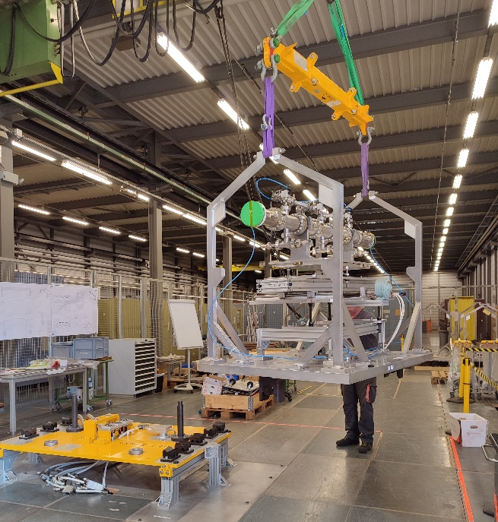
Experiment preparation
Integration in 3D layout
Mechanical evaluation
Survey (alignment precision < 1 mm)
Handling and transport
Disassembling
Assembly
Installation
Notes:
Split and less crowed and same bullet size

Slide 25
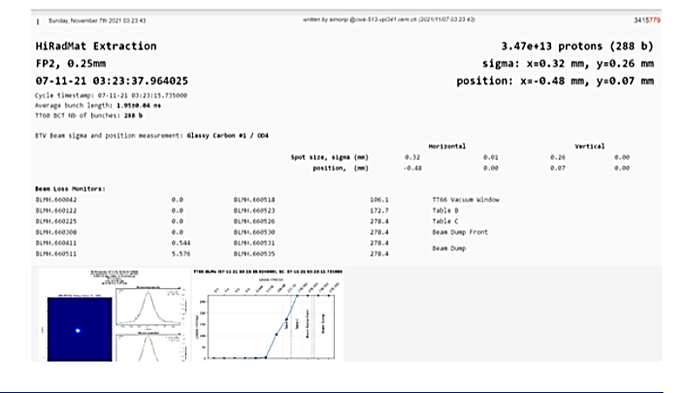
Beam diagnostics
HiRadMat vistar
Beam TeleVision
Beam Current Transformer
Beam Position Monitor
Bean Loss Monitor
Vistar and logging automatisation for each shot
HiRadMat auto e-logbook

Slide 26
Flexible software for users
Interface for motor stage control:
DC stage
Step-motor stage
Beam based alignment automatisation
Data acquisitions (temperature, cameras, pressure…)

Slide 27
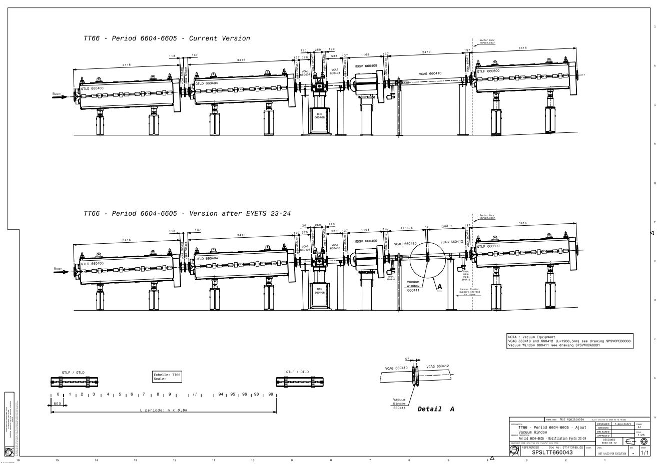
Partition of TT66 Vacuum Sector [TE-VSC]
In 2021 Be window failed twice: very expensive and long order delay
Material: Be window → glassy C
Vacuum sectorisation: one vacuum chamber VCAG.660410 → two smaller chambers

Slide 28
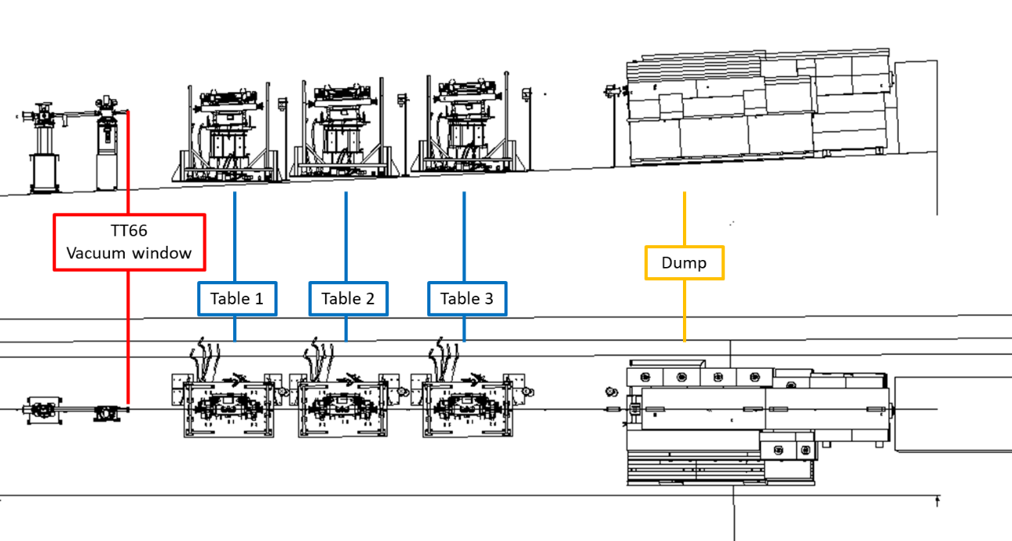
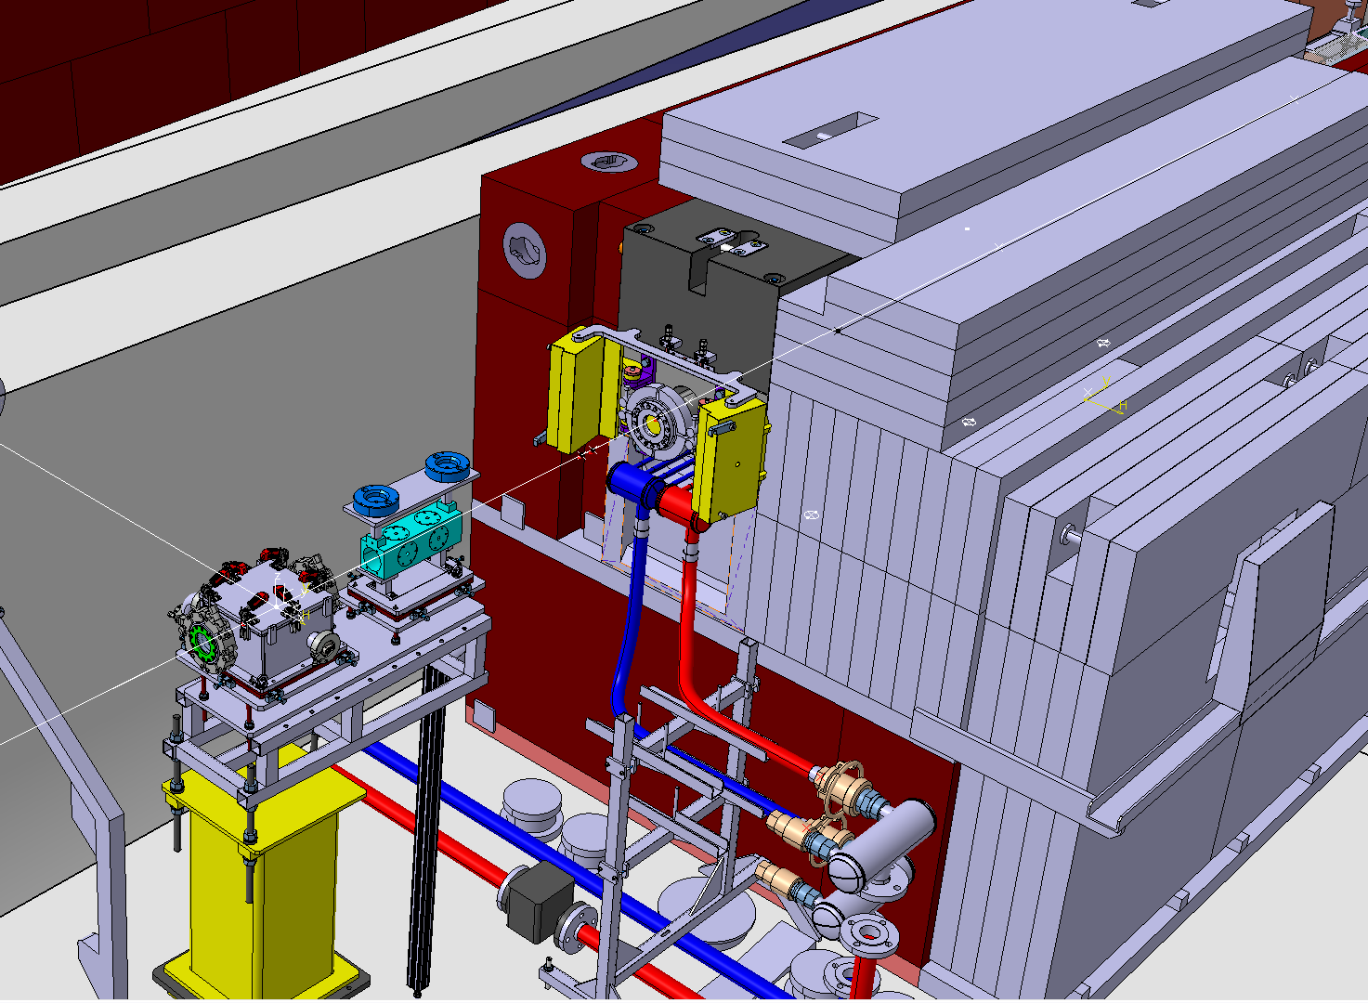
Dump upgrade [SY-STI]
Dump window not easily accessible and lies behind the collimator → difficult to fix during beam time failure
Situation after upgrade:
Dump entrance tube extended, the window will be accessible without any equipment removal
Addition of easily movable shielding in front of the collimator window
+ BPKG relocalisation

Slide 29
Vacuum upgrade
Primary pump
Primary pump
Valve controller
Gauge controller
Control valve
Control valve
Control valve
Gauge
Gauge
Gauge
TT66
Experiment Table 2
Experiment Table 3
BTV.660518
BTV.660528

