Slide 1
Target Systems Integration for a high intensity facility in the CERN’s North Area HPTW 2023 – RIKEN Wako campus (JP)
M. Calviani, J-L. Grenard, R. F. Ximenes – Systems department - CERN
Acknowledgement: J. M. Martin Ruiz, C. Ahdida, J. Bernhard, M. Brugger, L. Esposito, M. Fraser, R. Jacobsson, L. Krzempek, G. Mazzola, S. Niang, E. Nowak, R. Ramjiawan - CERN
10-11-2023

Slide 2
Outline
The existing High Intensity facility
Beam Dump Facility (SHIP) proposal
HIKE /SHADOWS proposal
Target complex service building
* Radioprotection aspects will be detailed in the talk of Claudia Ahdida

Slide 3
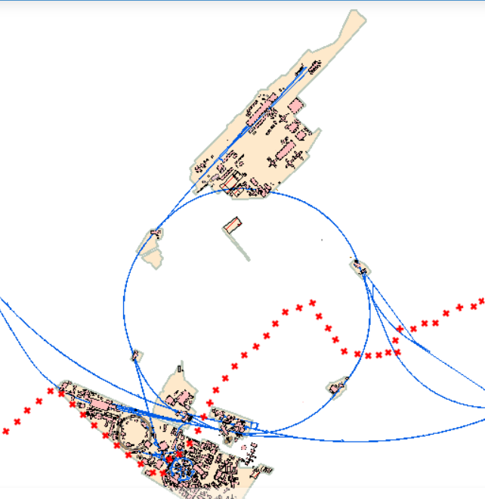
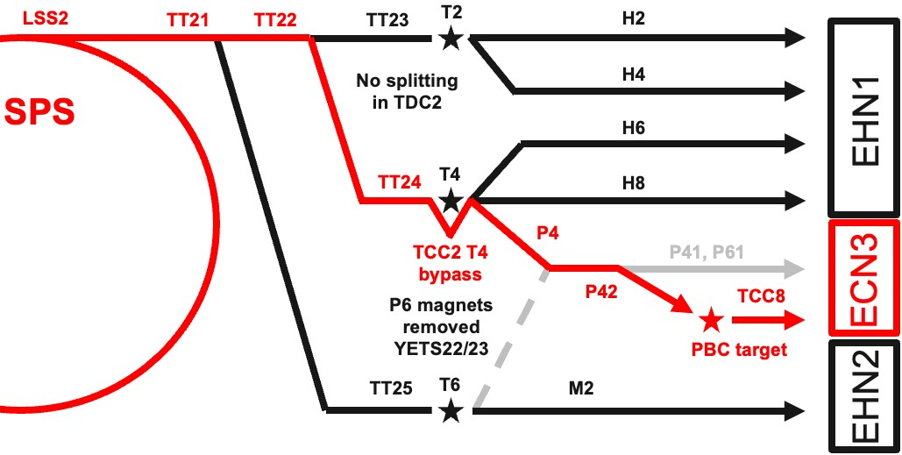
Target Complex in an existing facility
ECN3
Implementation in the SPS North Area ECN3 designed at construction in 70’s for a High Intensity (NAHIF)
Currently used by NA62 experiment
SPS North Area beam lines and associated infrastructure being currently consolidated
Would require the dismantling fraction of current beam line, target station, (and possibly the experiment)
Only one target station can be accommodated in the cavern
SPS extraction
towards North Area
CERN
Prevessin site
SPS
ring
CERN
Meyrin site

Slide 4
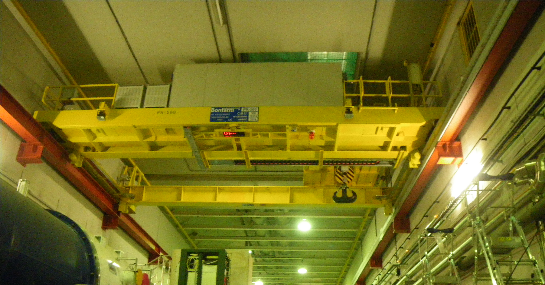
Target Complex in an existing facility
Benefit of being below ground level and having soil on top of the cavern
Existing overhead travelling crane 30t capacity
8m soil
TCC8 cross section (length 170m)

Slide 5
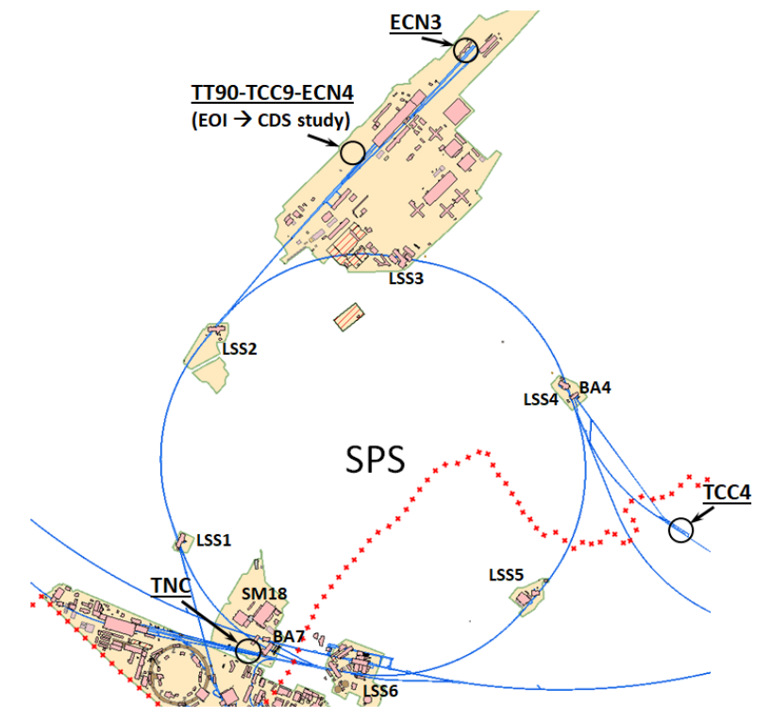
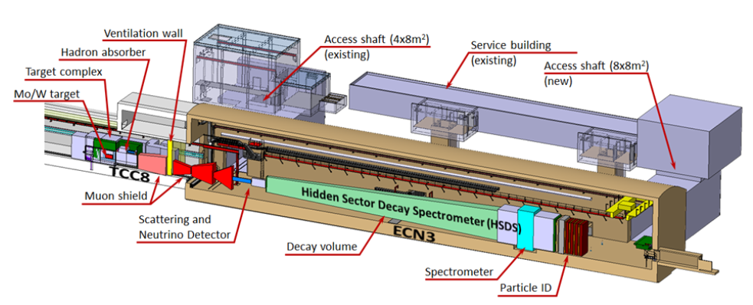
BDF target complex
Design of the target complex linked to the experiment SHIP
ECN3 has been evaluated as the most viable location to optimize cost

Slide 6
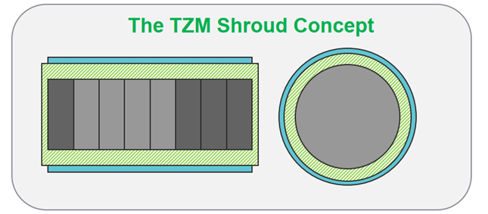
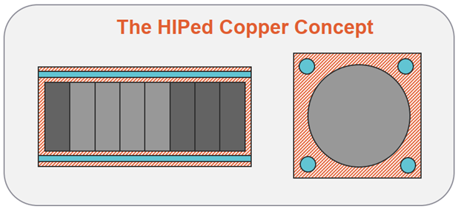
BDF target
Alternative designs
Target requirements
Physics: high-Z material & with short interaction length
Engineering: 350kW beam power. Thermal-induced stresses
Target design (baseline)
Assembly of 18 cylindrical blocks
High Z / high A refractory metals → TZM & W core cylinders
Water-cooling circuit → Corrosion-erosion → Cladded with Ta2.5W (1-1.5 mm thickness) by means of Hot Isostatic Pressing (HIP)

Slide 7
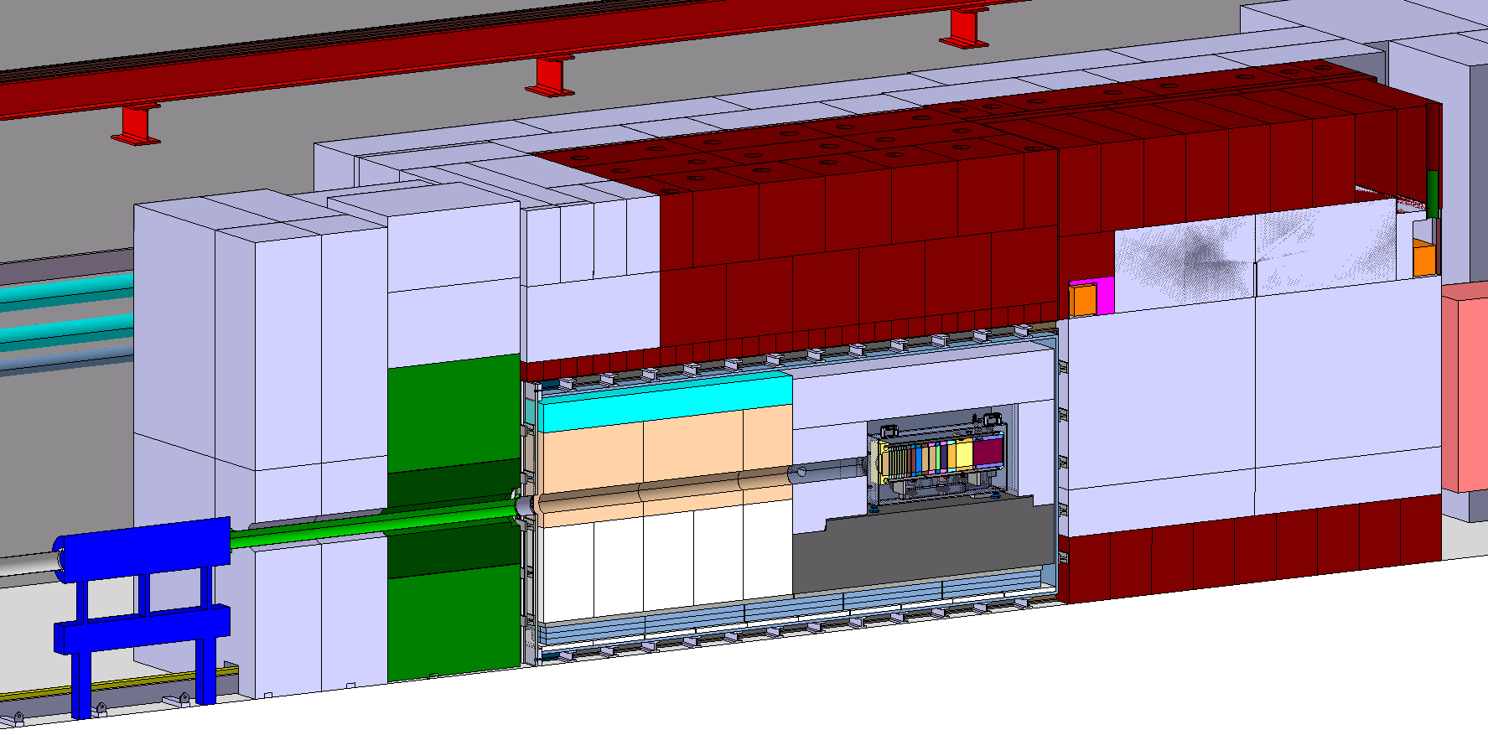
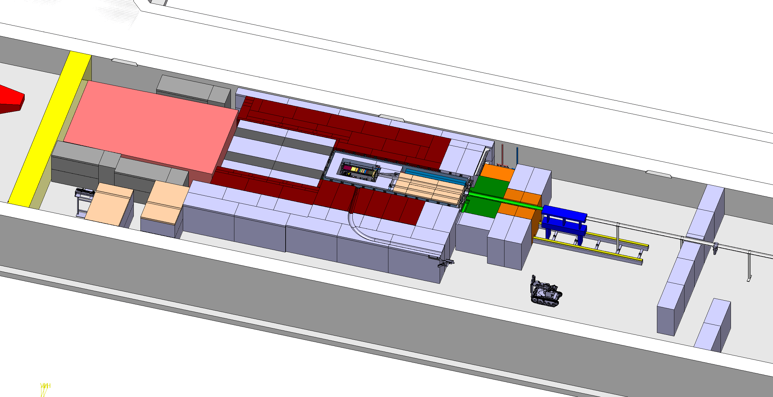
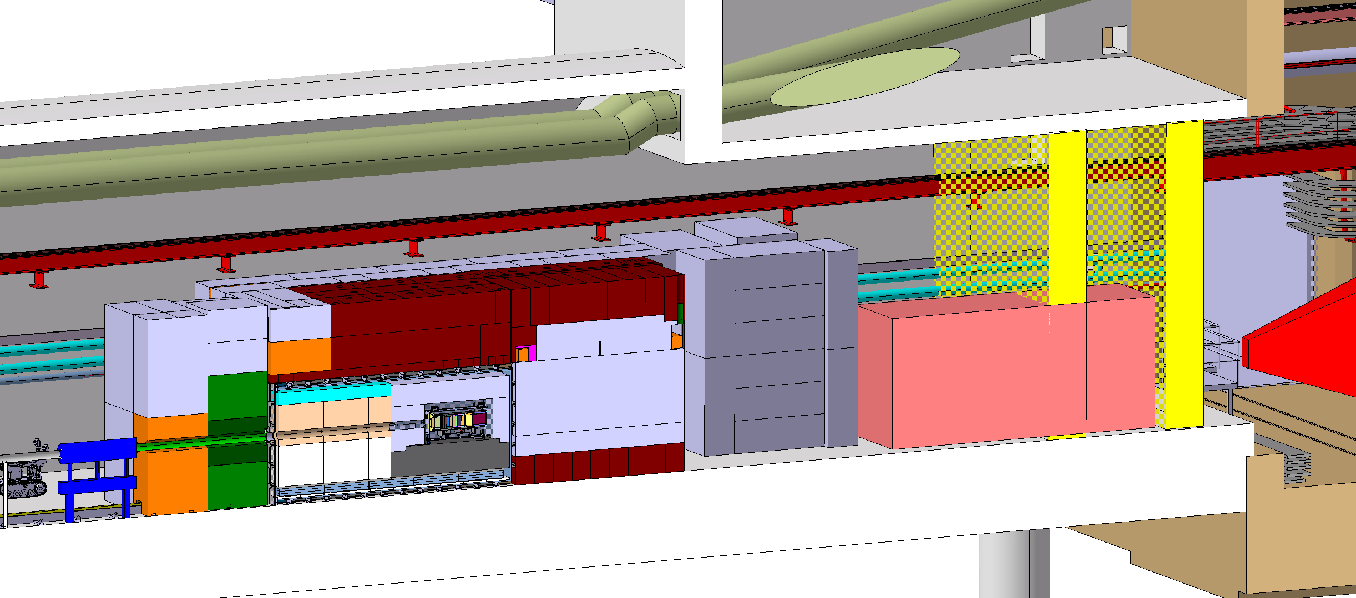
BDF Target complex integration
Upstream Shielding
Above Coil Shielding
Target area
Confinement wall
Magnetized
shielding
Beam instrumentation
Diluted 400Gev Proton beam from SPS
Mobile Shielding
Water cooled proximity shielding
Collimator
Vacum confinement
${(\sim 10}^{−1}$/ ${10}^{−2}mbar)$
Target
Target station
Beginning of SHIP experiment
Space for shielding temporary storage
Access chicane
Target complex footprint ~500m²
Target complex will be underpressurized (-20Pa)

Slide 8
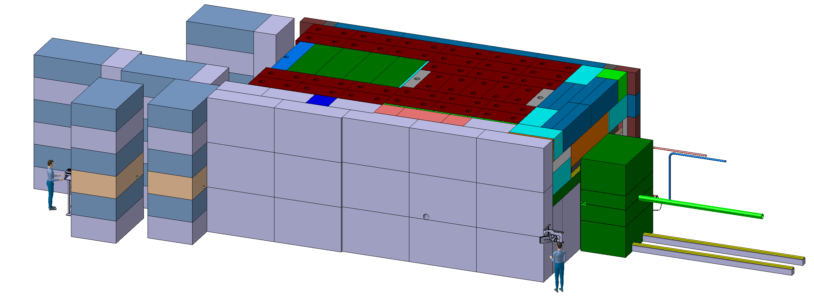
BDF Target complex integration
~ 180 m³ of cast iron* + US1010
~ 360 m³ of concrete / marble
*Some shielding embedded in the floor
bellow the target
~4,8m
~8m
~12m

Slide 9
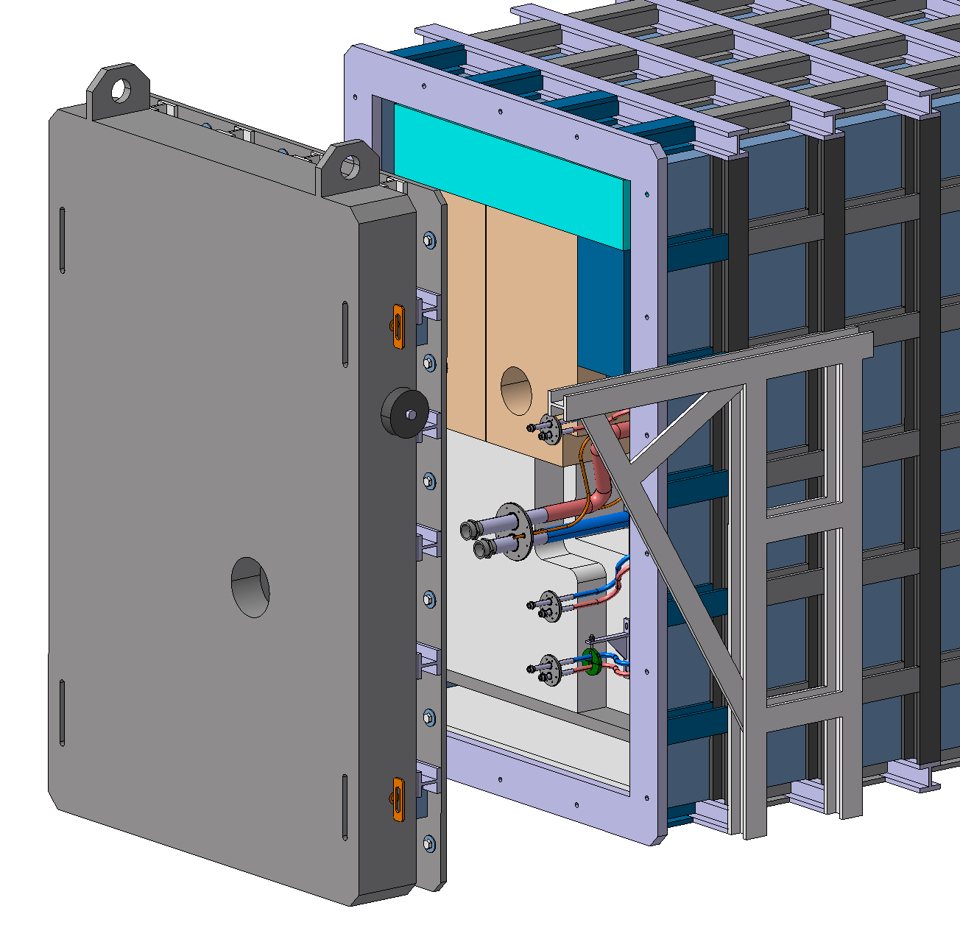
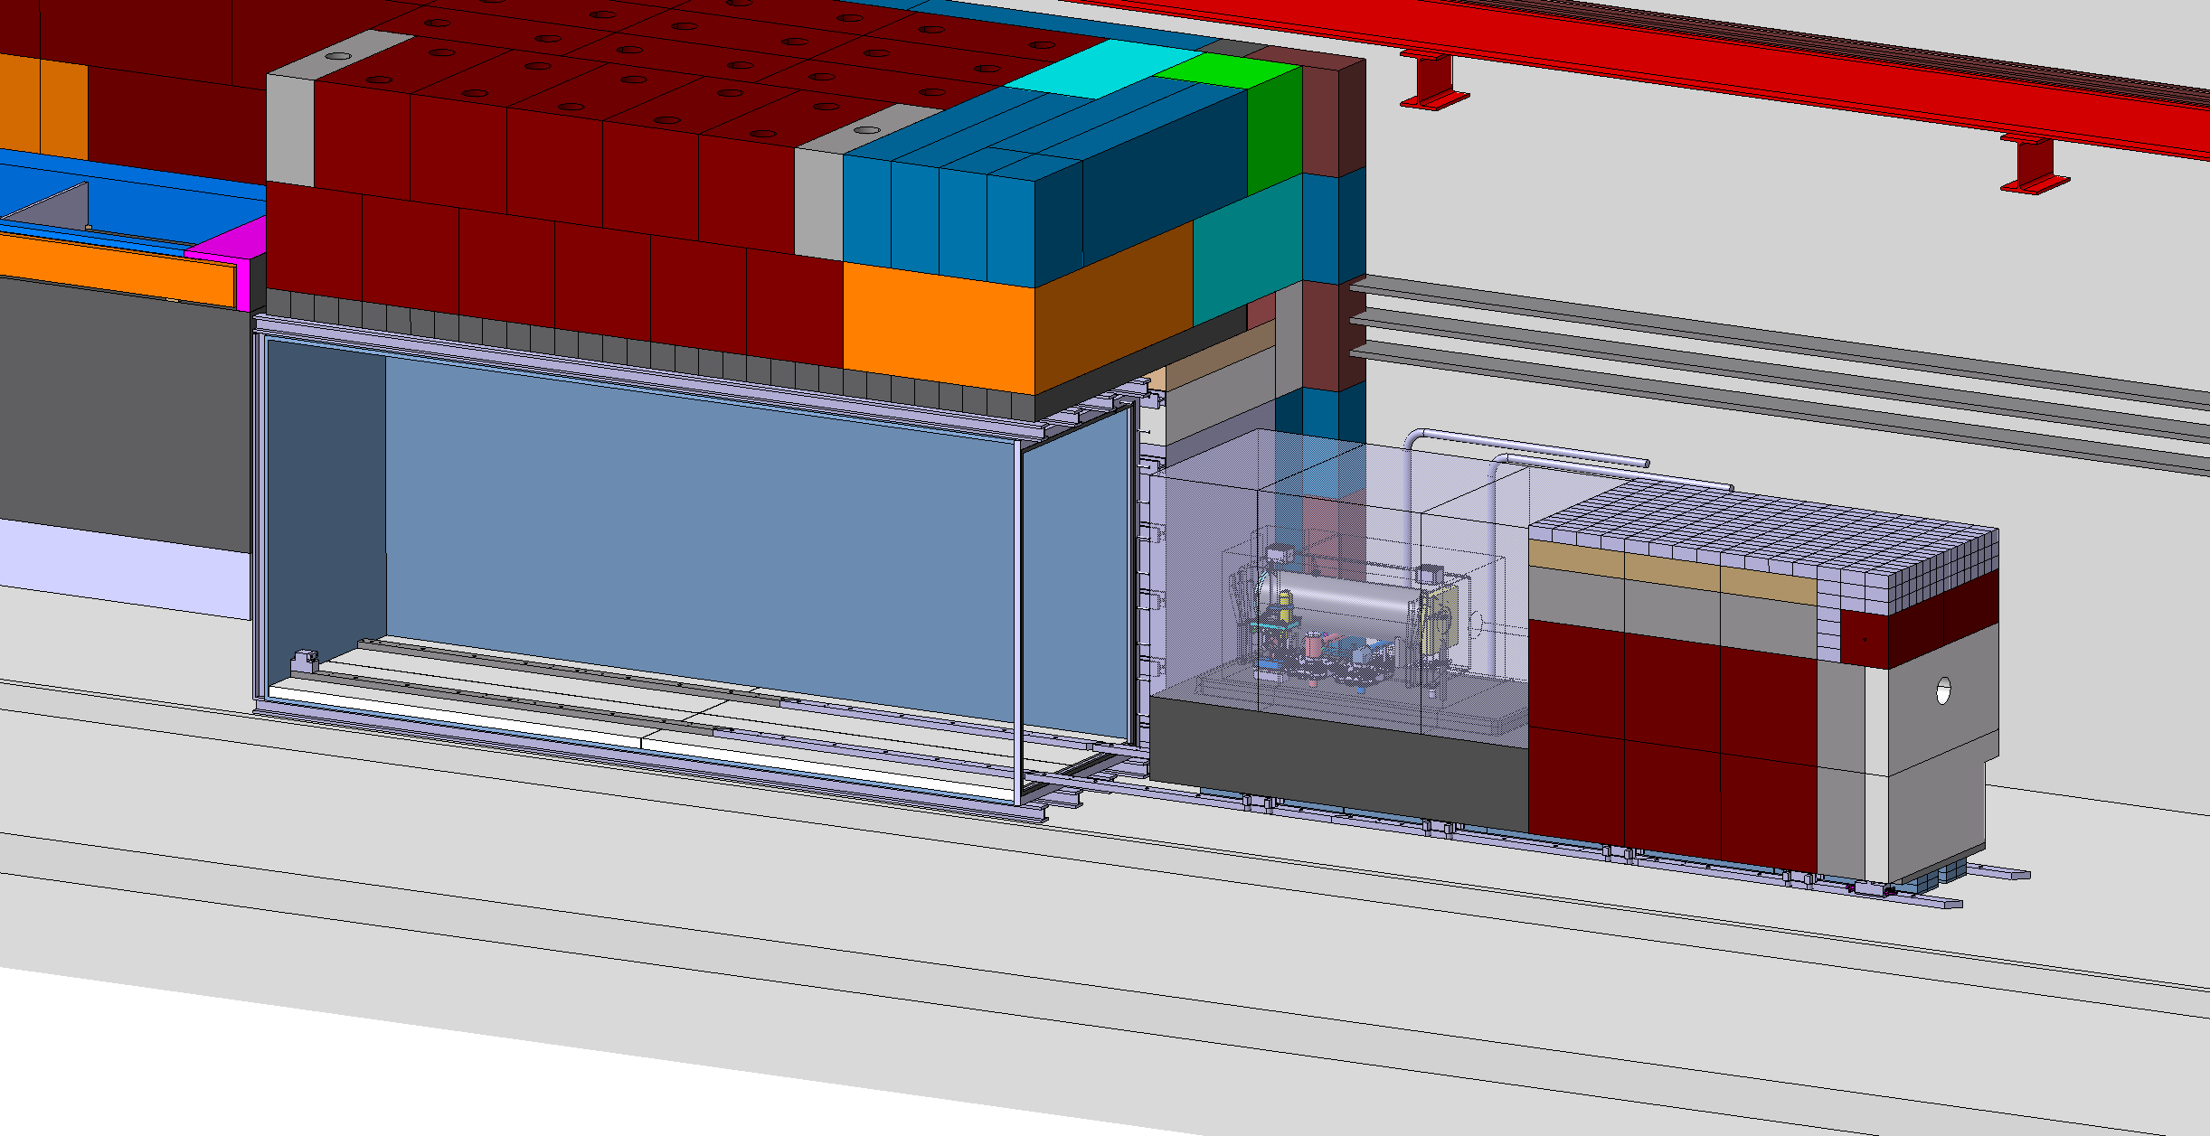
BDF Target complex integration
Extraction on a trolley mounted on full stainless steel chain action rollers
Mainly developed around ‘’standard’’ cast iron blocks
In view of reuse of existing blocks from old facilities

Slide 10
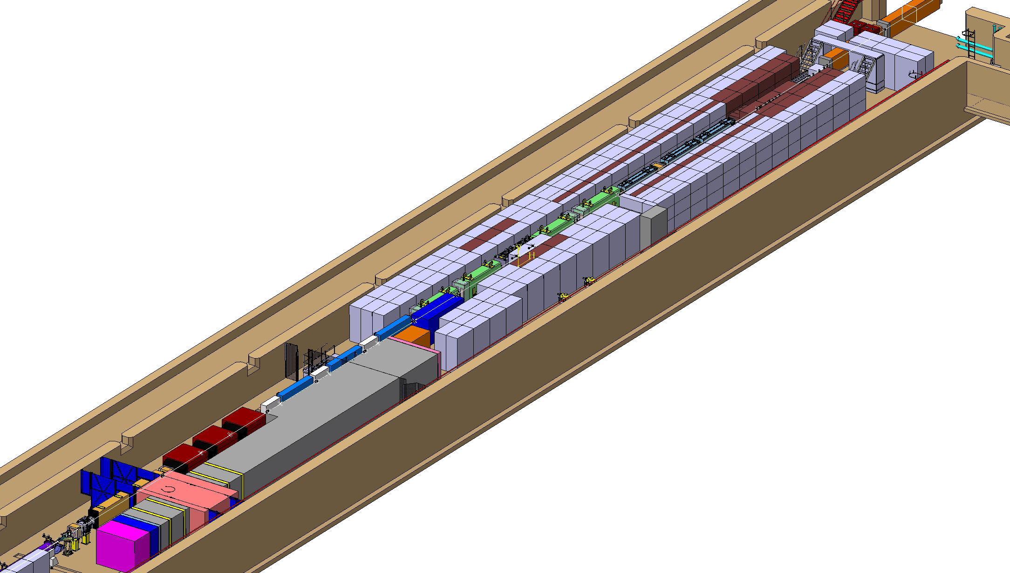
HIKE/SHADOWS target complex
Design of the target complex linked to the 2 experiments
HIKE phase 1 and 2 (upgrade of NA62)
SHADOWS (new off axis experiment)
400 Gev Proton beam from SPS
Secondary beam line
Towards HIKE experiment
Target station
(roof shielding not
represented for visualization)
SHADOWS experiment

Slide 11
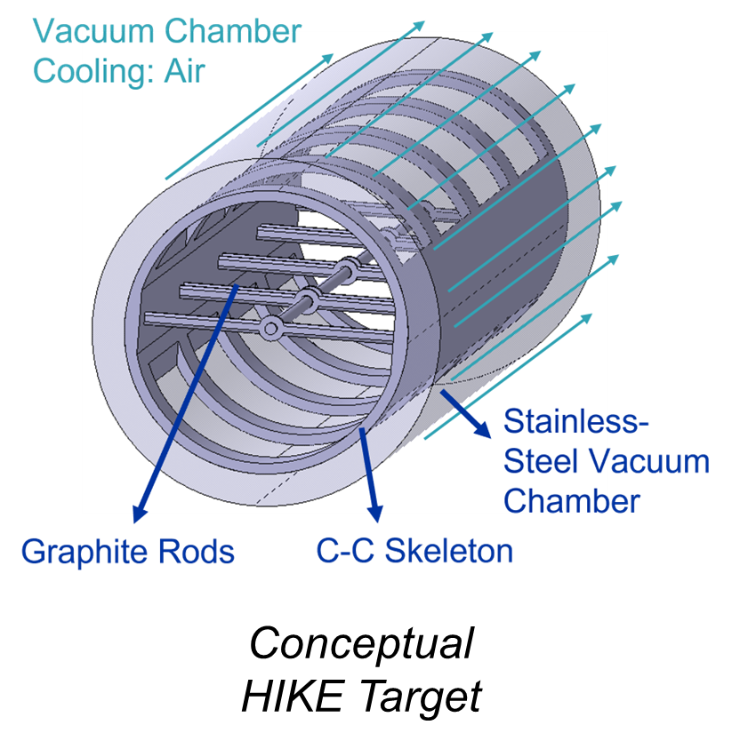
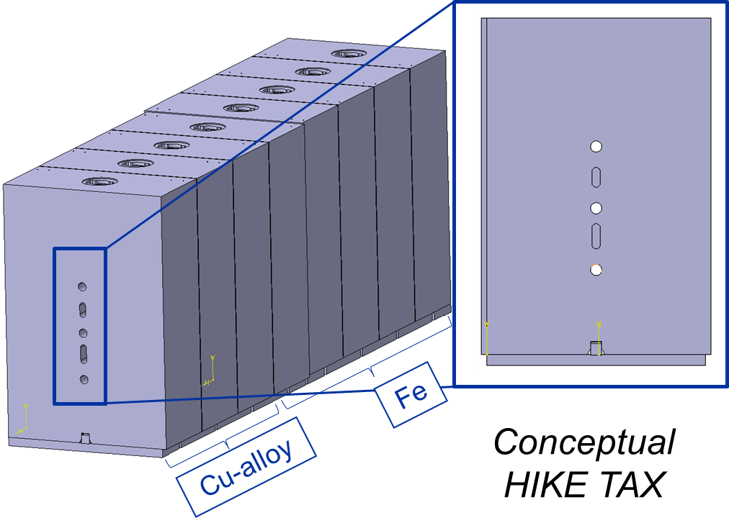
HIKE/SHADOWS target
Radiation-cooled graphite target or He-cooled beryllium for the production of hadrons. (D2x400mm) (Phase 1) ~1kW beam power
TAX (Target Attenuator for eXperimental areas) system. ~100kW beam power
Series of Cu-alloy and Fe blocks, designed with various aperture configurations and the capability to serve as a beam dump or collimator, depending on the operational setting.
TAX requires enhanced cooling system, possibly a CuCrZr absorber with SS Hot-Isostatically-Pressed (HIPed) cooling pipes

Slide 12
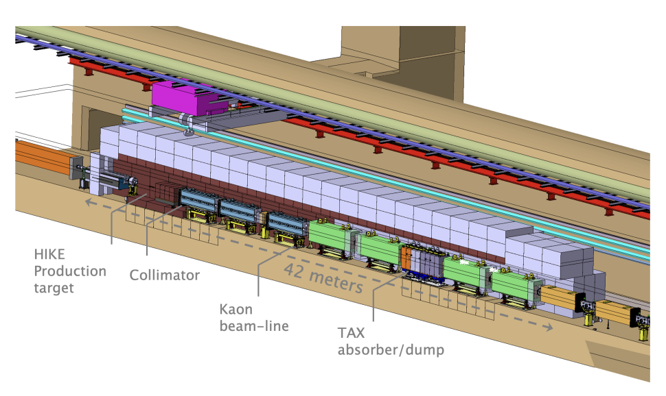
HIKE/SHADOWS target complex integration phase 1
Kaon beam line specificities:
Under vacuum
Pulsed warm magnets
Active cooling
Radiation tolerant mineral coils
→Many systems in a harsh environment
~ 150 m³ of cast iron*
~ 600 m³ of concrete / marble
*Some shielding embedded in the floor
bellow the beam line (between target – absorber/dump)
Target complex will be underpressurized

Slide 13
HIKE/SHADOWS target complex integration phase 2
Challenges in view of phase 2 implementation
Preliminary concept:
Kaon beam line (between target and TAX) need to be completely exchanged
Target requirement might evolve for this phase (diameter increase 2mm → 4mm)
Infrastructure and shielding need to be already made compatible during phase 1 implementation due to high ambient dose rates

Slide 14
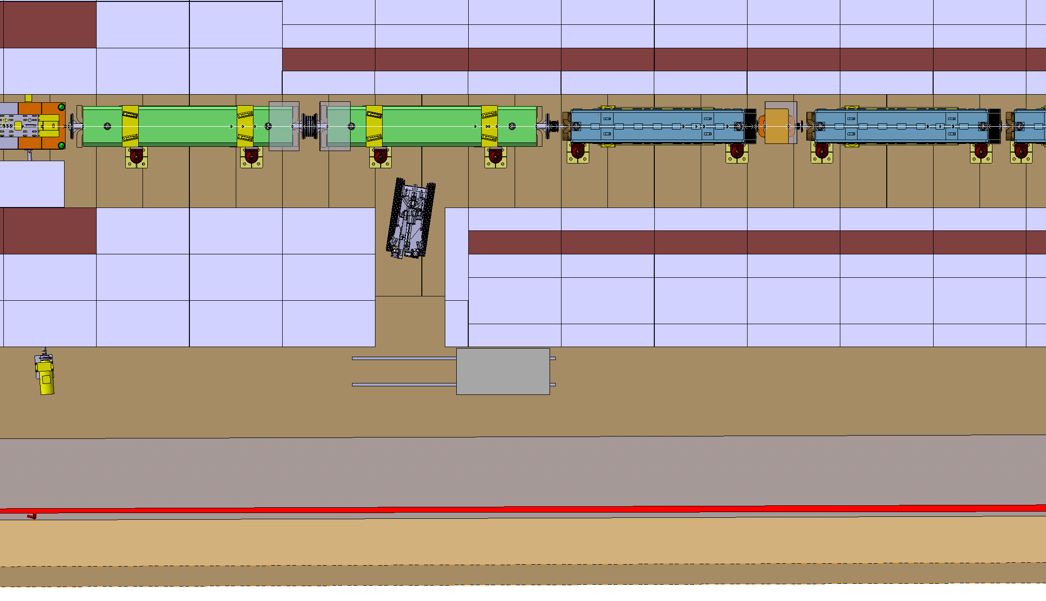
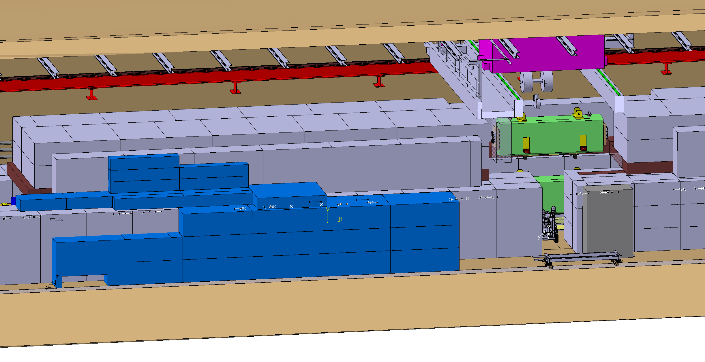
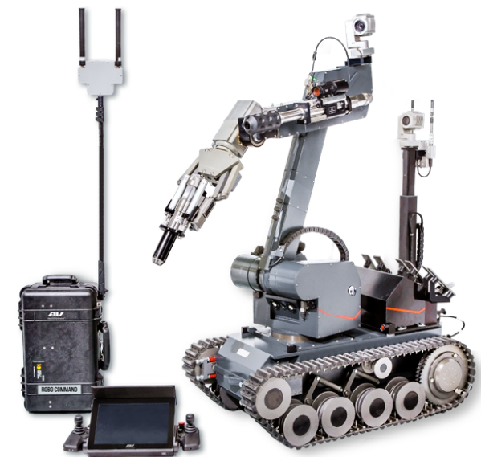
HIKE/SHADOWS target complex integration
Access corridor in the bunker to allow access for UGVs (to minimize hands-on tasks)
Handling of beam line components with the overhead travelling crane
Storage of shielding
for magnet exchange

Slide 15
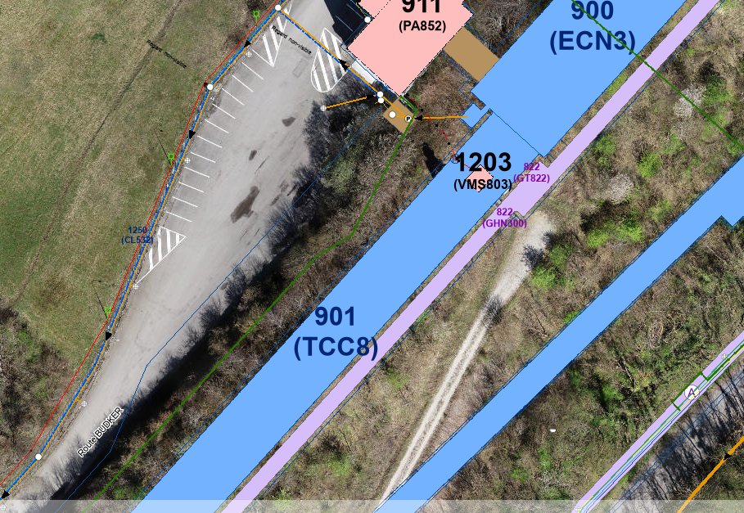
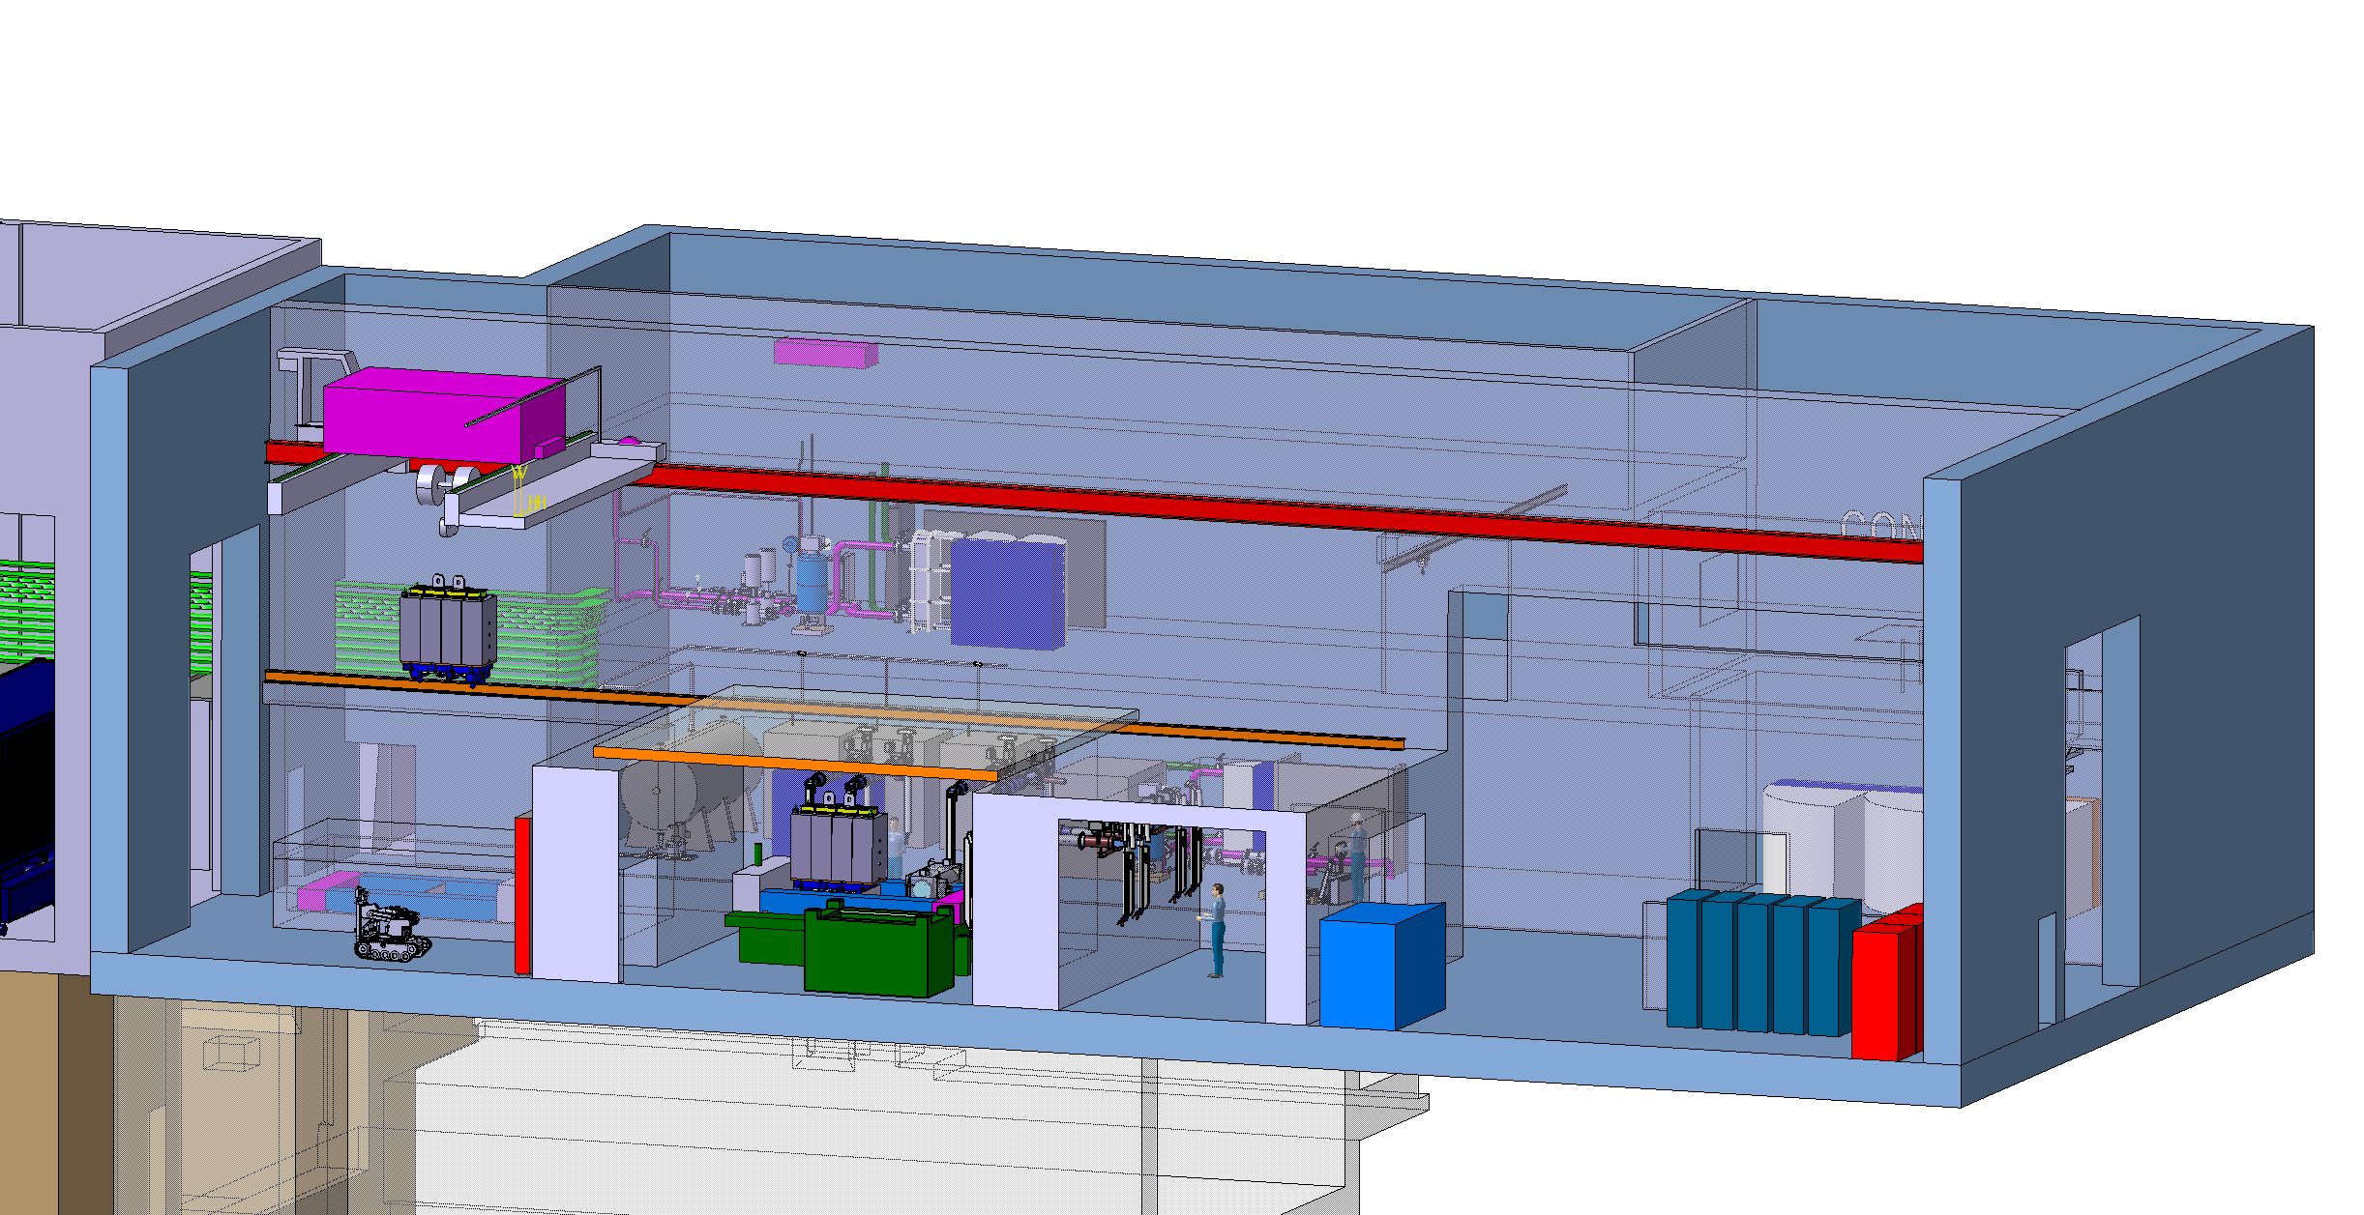
Service building
Nuclear ventilation system of the target area
Air handling units, filters, dehumidifiers (outside)
Target cooling systems
Pumps, Filters, Heat exchanger, Cooling instrumentation, He circulation system (target primary confinement)
Target controls systems
Target monitoring (sensors), Target control valves, vacuum vessel confinement
Service cell
Evaporator
Electrical distribution system
Power converters

Slide 16
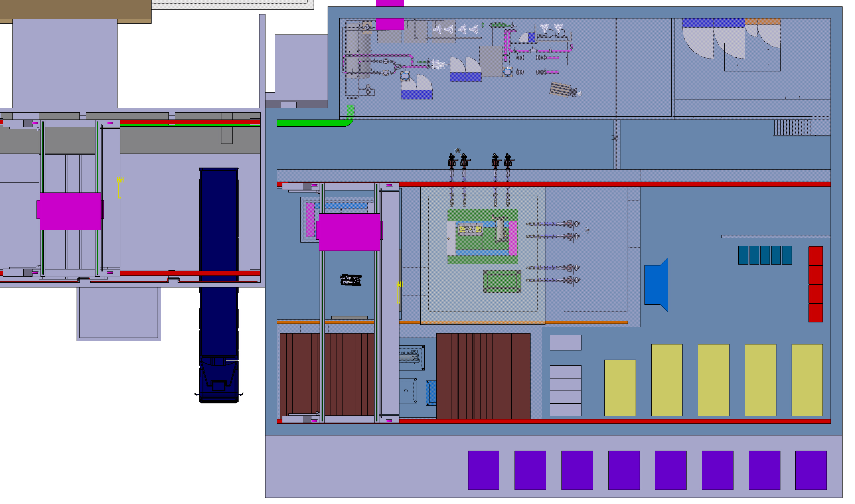
Service building
Cooling equipment
Control racks
Existing shaft
to underground
Lorry access
Power converters
and associated ancillaries
Material access
Shielded buffer zone
Overhead travelling crane
Service cell
with a movable roof
*equipement shown based from ECN4 design

Slide 17
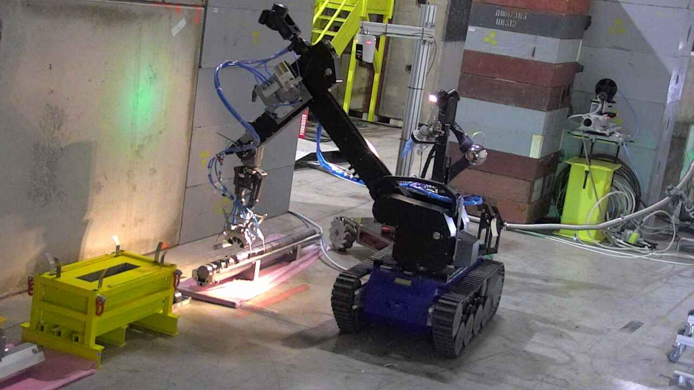
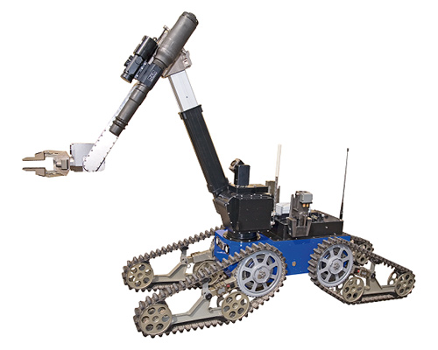
Service building – Service cell
Purpose
Repair of activated components
Size reduction and material separation for final disposal to optimize cost using different elimination path
Post Irradiation Examination
Tools envisaged
Master-slave manipulators
Robots (fixed and mobile)
Custom built machinery

Slide 18
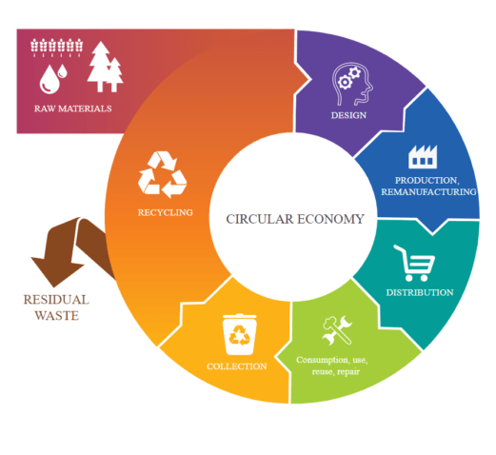
Target complex sustainability
Reuse of an existing infrastructure
Recovery of shielding blocks from former facilities (including already activated blocks)
Optimization of the shielding
Capability to repair activated components with the service cell

Slide 19
Summary
Significant benefit by reusing an existing infrastructure
The future target complex is fully dependent on the experiment which will be implemented
Preliminary shielding study have been designed and optimized according to radioprotection requirement
TDR is starting to finalize the design
Beam on target is foreseen by 2030
A service building will be implemented to support the target complex
Part of this building will be dedicated to a service cell to perform PIE and size reduction waste packaging
Remote handling technics being developed across various projects at CERN will be beneficial for ECN3-HI target complex

Slide 21
Bibliography
Post-LS3 Experimental Options in ECN3:
https://arxiv.org/abs/2310.17726
Findings of the Physics Beyond Colliders ECN3 Beam Delivery Task Force:
https://cds.cern.ch/record/2847433/files/PBC%20ECN3%20TF%20Final%20Report.pdf

Slide 22
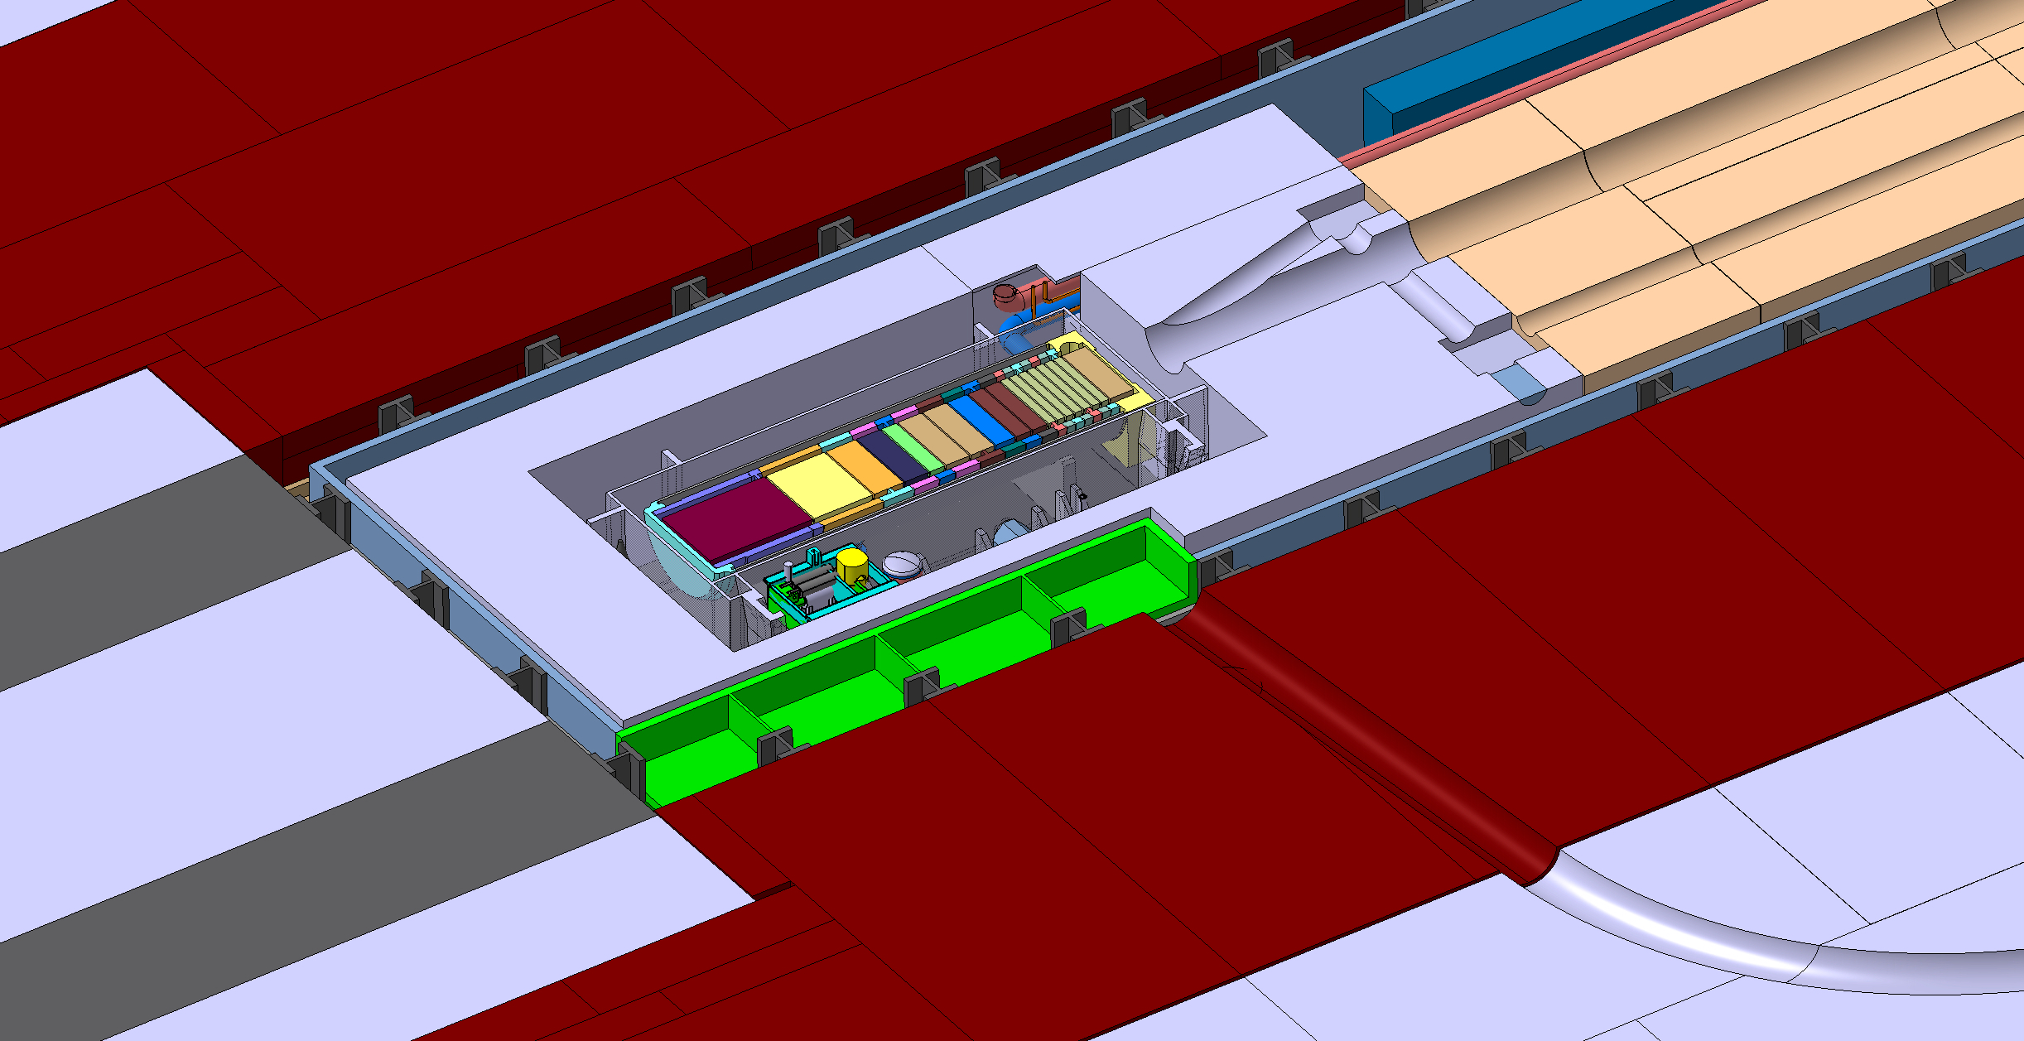
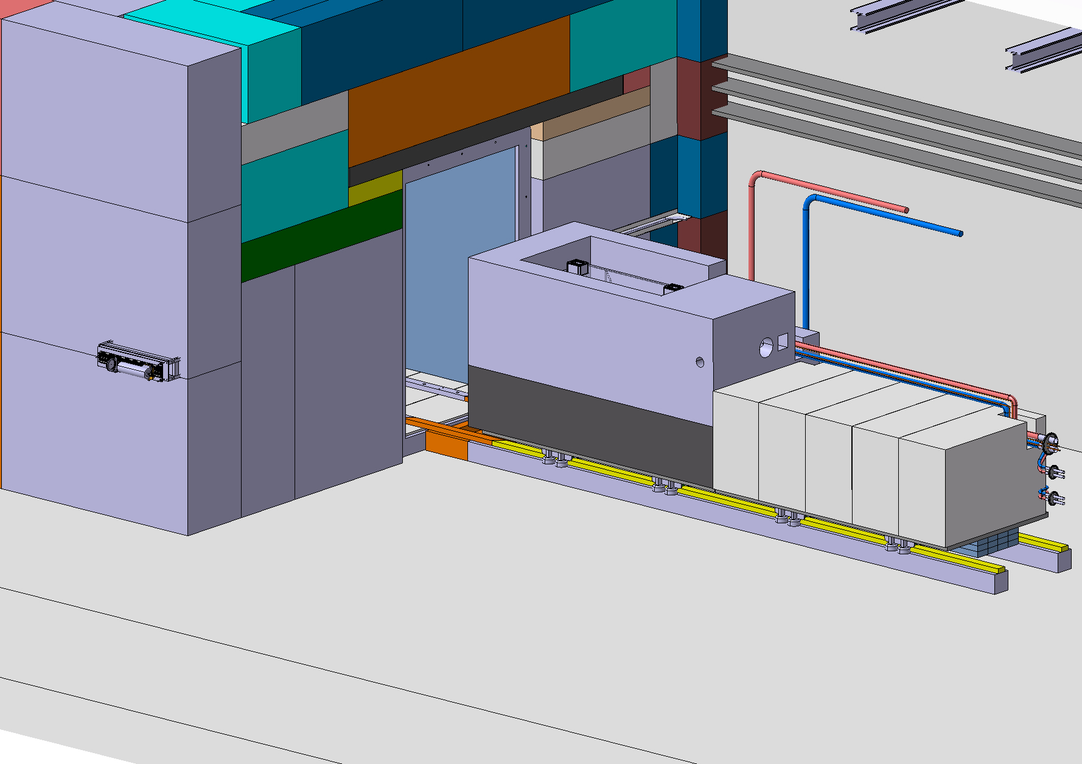
Irradiation station(s) - investigations
Irradiation rabbit penetration concept compatible with the extraction along the beam line
O(0.1-10) MGy
(including HE neutrons)
Possible slot for long irradiation > 1 year
±50-400 MGy/y (mixed field, neutron dominated, including HE neutrons)
PRELIMINARY
Potential applications:
Nuclear astrophysics and access to rare isotopes
Radiation to Electronics and proton irradiation for detector validation
Radiation to Materials
Neutron imaging with a neutron beam extracted from target station

