Slide 1
Radiation protection studies for a high intensity facility in the CERN's ECN3 area
C. Ahdida, F. Malacrida, G. Mazzola, E. Nowak, H. Vincke, J. Bernhard, M. Brugger, M. Calviani, M. Fraser, J.-L. Grenard, L. Krzempek, L.S. Esposito, R. Ximenes
8th High Power Targetry Workshop, 06 – 10 November 2023

Slide 2
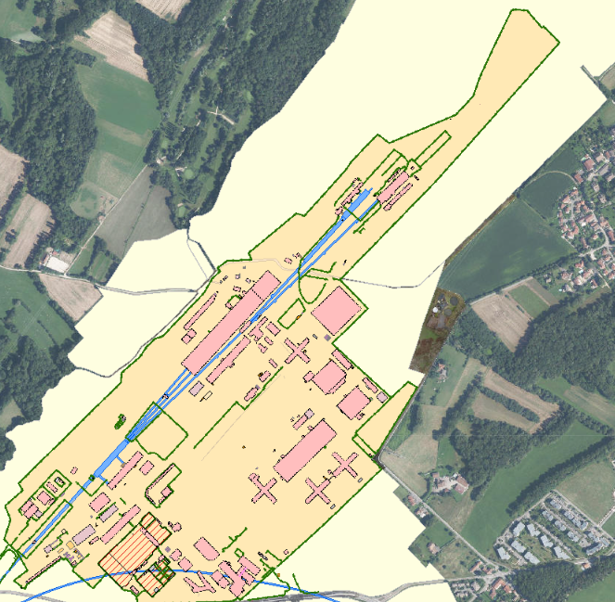
Introduction
CERN’s SPS North Area
ECN3 is an underground experimental cavern at the CERN’s SPS North Area
PBC Study Group has investigated siting a future high intensity experimental facility in ECN3 exploiting the 400 GeV/c proton beam C. Ahdida et al., Post-LS3 Experimental Options in ECN3, CERN-PBC-REPORT-2023-003
Several proposals for physics experiments including BDF/SHiP, HIKE and SHADOWS are being considered BDF/SHiP at the ECN3 high-intensity beam facility, CERN-SPSC-2023-033 High Intensity Kaon Experiments (HIKE) at the CERN SPS, CERN-SPSC-2023-031 SHADOWS Technical Proposal, CERN-SPSC-2023-029
TCC8
~150 m
~80 m
ECN3
BDF/SHiP HIKE + SHADOWS
Key beam parameters of the proposed projects
Not yet studied
 | BDF | HIKE Phase 1 (K⁺) | HIKE BD + SHADOWS | HIKE Phase 2 (K⁰)
Intensity (p/spill) | 4×10¹³ | 1.3×10¹³ | 2×10¹³ | 2×10¹³
Spill duration (s) | ≥1 | ≥4.5 | ≥4.5 | ≥4.5
Cycle length (s) | ≥7.2 | ≥14.4 | ≥14.4 | ≥14.4
Average intensity (p/s) | ≤5.6×10¹² | ≤0.9×10¹² | ≤1.4×10¹² | ≤1.4×10¹²
Annual POT | 4×10¹⁹ | 0.72×10¹⁹ | 1.2×10¹⁹ | 1.2×10¹⁹
Duration (years) | 15 | 5 | 4 | 6
Total POT | 60×10¹⁹ | 3.6×10¹⁹ | 5×10¹⁹ | 7.2×10¹⁹
CERN Prévessin site (fenced)
Non-fenced CERN domain
Target area
Experimental area
SPS
Proposed ECN3 projects
15.8×10¹⁹

Slide 3
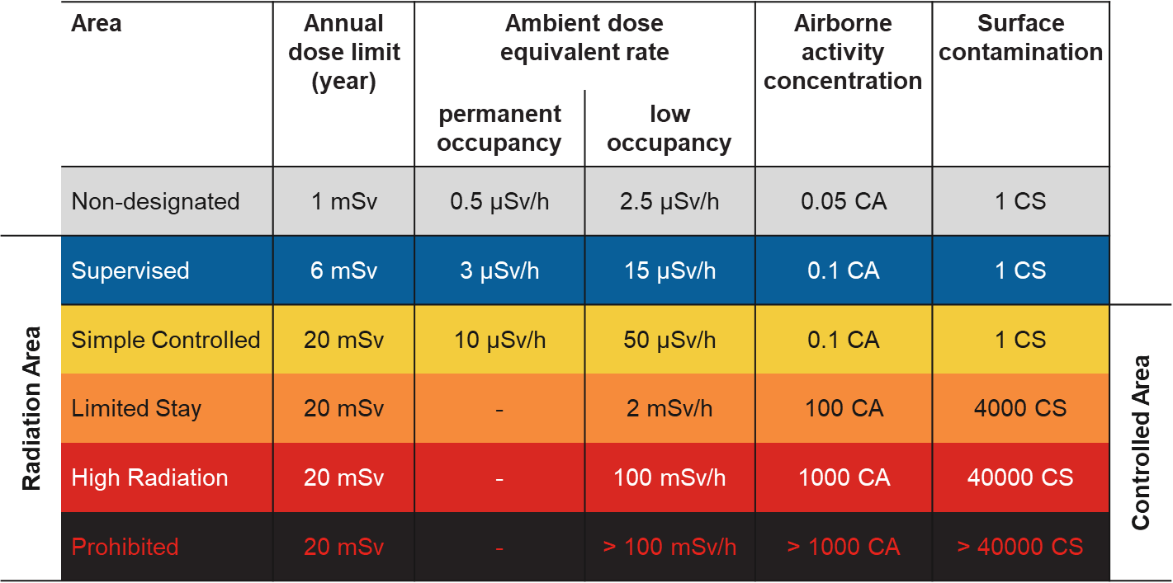
HI ECN3 facility design optimization
RP studies based on FLUKA MC simulations were performed for a design optimization of the proposed projects at ECN3
ALARA approach Optimization required to ensure that exposure of personnel to radiation and radiological impact on environment are As Low As Reasonably Achievable
Prompt radiation Reduce prompt radiation to comply with radiation area classification in the surrounding accessible areas as well as the 1 mSv limit at the CERN fence
Radiation area classification
residual radiation Limit activation of target and experimental area to reduce residual dose rates to be compatible with an adequate area classification
Air and soil activation Reduce activation of air and its releases into the environmental. Limit soil activation (³H<1000 Bq/kg, ²²Na<50 Bq/kg) and transfer to groundwater
Environmental impact Reduce environmental impact from prompt radiation and releases of activated air to fulfill CERN’s dose objective for the public of <10 uSv/year

Slide 4
BDF/SHiP

Slide 5
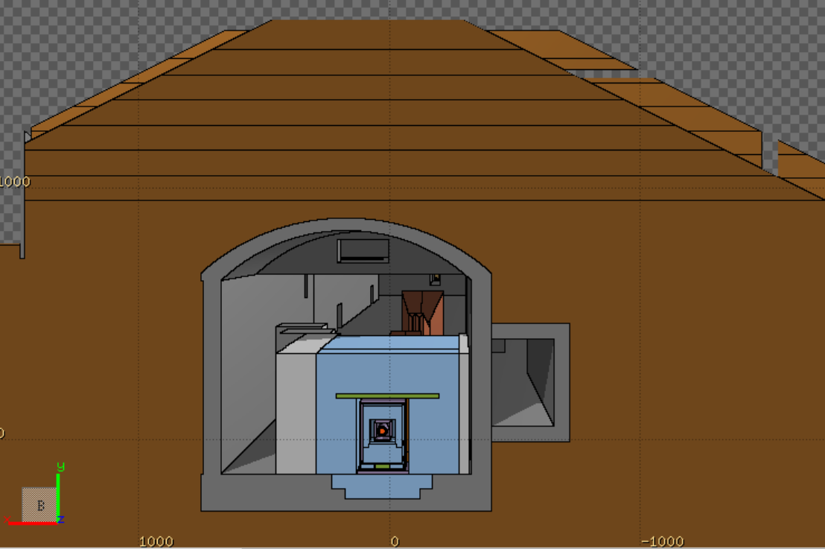
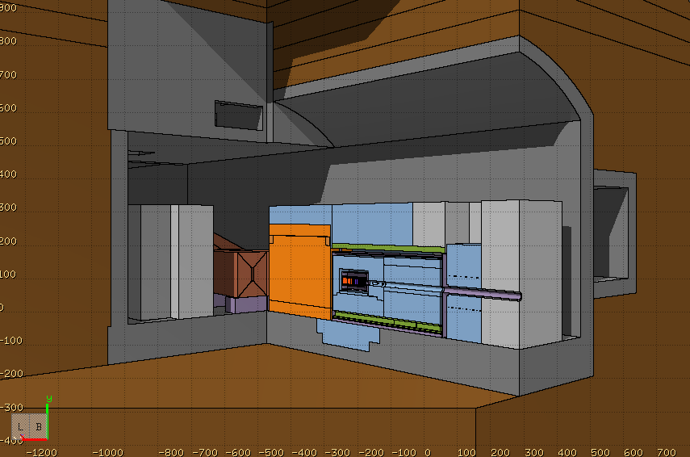
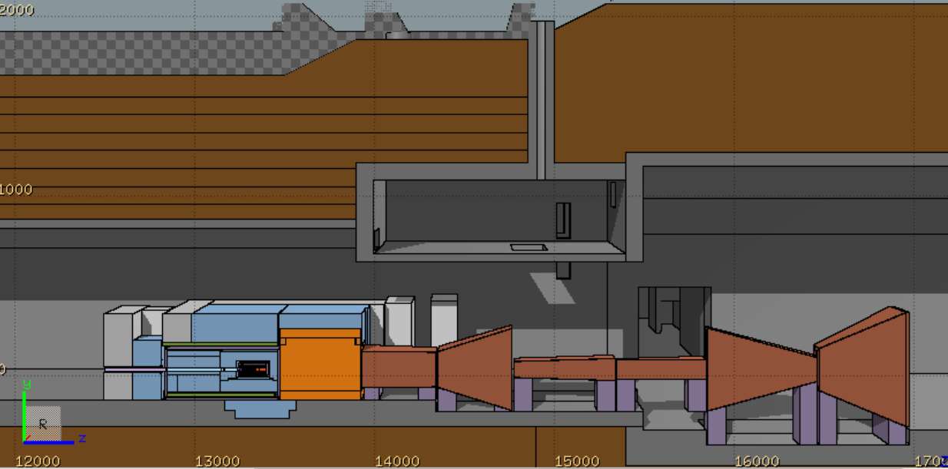
BDF/SHiP FLUKA model
FLUKA hosted by CERN (FLUKA v4-3.0) [1-3]
Target complex & muon shield, Created using FLAIR [4]
Moraine
8 m
A detailed BDF/SHiP target complex together with the muon shield was implemented in FLUKA
It was integrated in a FLUKA geometry including the full underground TCC8/ECN3 cavern and surrounding galleries, tunnels, rooms, etc.
Ground profile data from CERN’s Geographic Information System and technical drawings were used to model the surrounding ground
TCC8
Muon shield
1.6 m
11 m
1.6 m
W-TZM target
4.8 m
Magnetic part of hadron stopper
1 m
ECN3
Floor shielding (13.3 m³)
Stainless steel
US1010
Concrete
Moraine
Cast iron

Slide 6
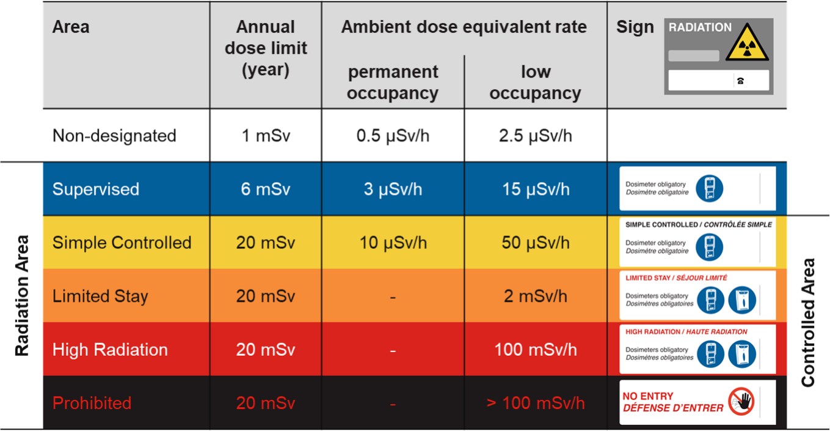
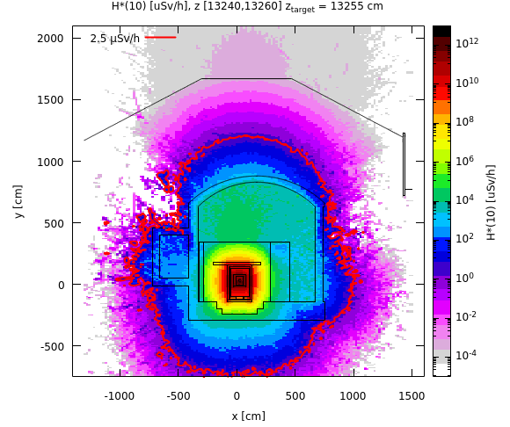
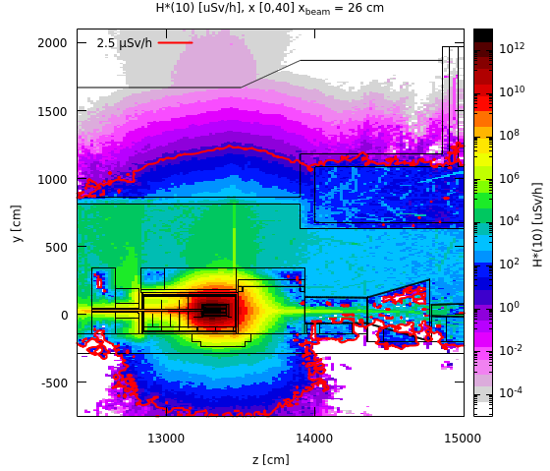
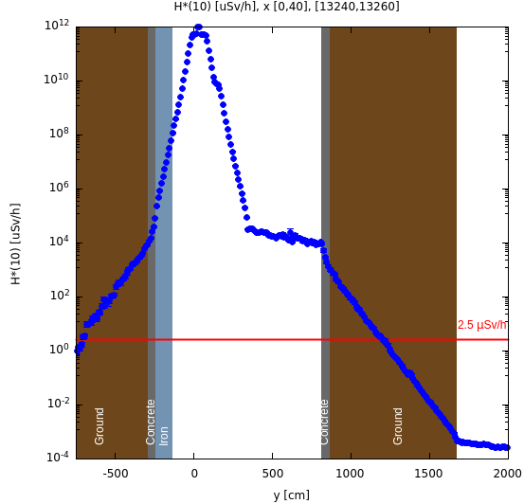
Prompt radiation in target area
Avg. intensity of 5.6×10¹² p/s
Cross-sectional view
Side view
Along y-axis
Shielding design is optimized for the prompt radiation
Thanks to shielding reinforcements towards the bottom, no increase of soil activation expected
100 rem = 1Sv

Slide 7
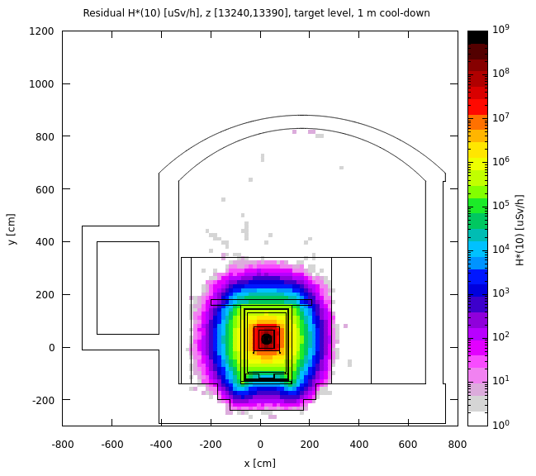
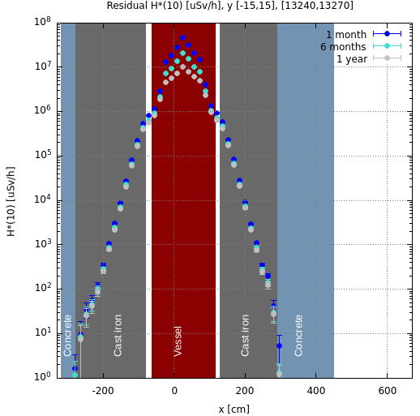
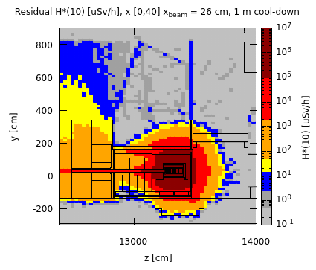
Residual radiation in target area
Total PoT 6×10²⁰
Cross-sectional view, target level
Along x-axis, working height
Upstream of vessel w/o upstream shielding Preliminary worst case manual intervention scenario
1 month cool-down
No shielding
x [0,40]
x_beam = 26 cm
After removal of the shielding upstream of the vessel, residual dose rates are within a Limited Stay Controlled Radiation Area
Supervised Radiation Area on the sides
Further optimization by movable shielding
The shielding design contains well the high residual dose rates reaching in the central target region several 10 Sv/h after 1 month of cool-down
The residual dose rates outside the shielding are < 1 uSv/h
100 rem = 1Sv

Slide 8
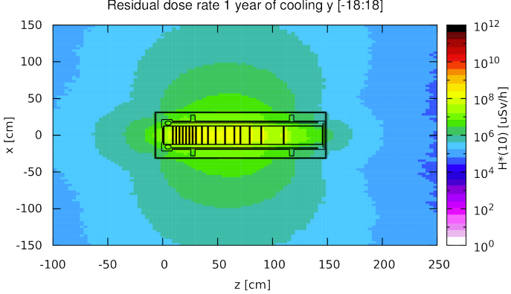
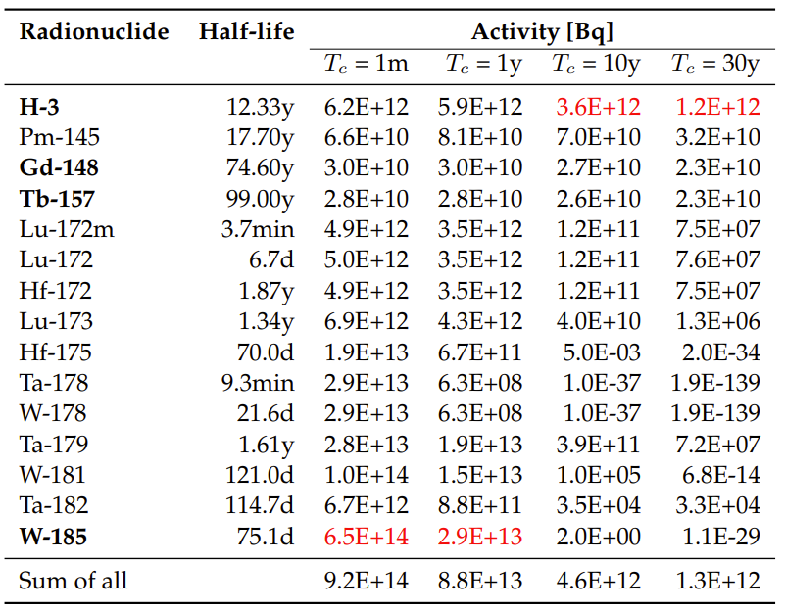
Target activation
Total PoT 4×10¹⁹ (5 yrs)
Longitudinal cut along the target
Radionuclide inventory of W part of target
Main contributors (>1%), sum for all radionuclides
1 year cool-down
The residual dose rates of the target after 1 year of cool-down are still of the order of a few Sv/h
Thick iron cask (~30 cm thick) for transportation and storage
Pure alpha/beta emitters are shown in bold
Dominant radionuclide is shown in red
100 rem = 1Sv

Slide 9
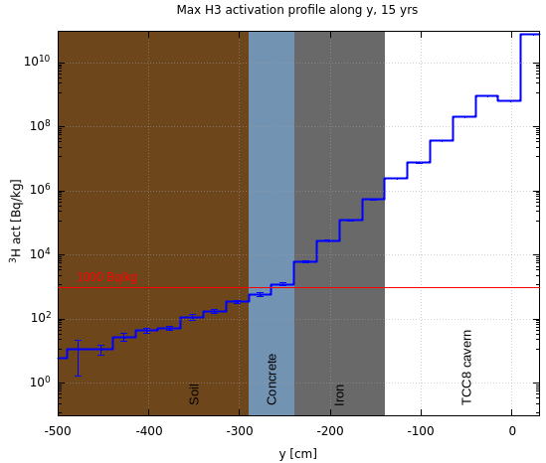
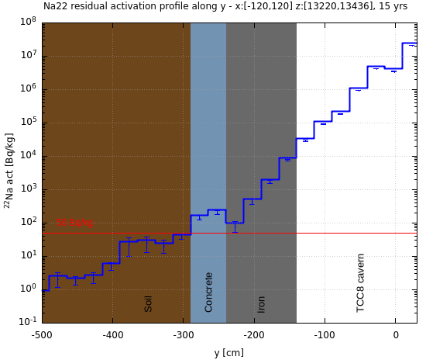
Air and soil activation
Total PoT 6×10²⁰
PoT 4×10¹⁹ per year
Specific activity of ³H and ²²Na in the soil below TCC8 (most critical area)
Air activation
Activation of air in target complex area were studied
Production of radionuclides evaluated with FLUKA in combination with ActiWiz [5]
³H
²²Na
¹
CASE 1: build-up of radionuclides during operation w/o air extraction and 30 min cooldown time before air release
CASE 2: constant immediate release of air (worst-case for upper limit of environmental impact)
Thanks to floor iron shielding, ³H and ²²Na activity concentrations in the soil are below respective design limits
A hydro-geological study is underway, which will allow to refine the design limits and possibly allow to reduce the required shielding
Flush of target complex with fresh air before any access to reduce specific airborne radioactivity to be compatible with 0.1 CA
¹ Person working 40h/w, 50w/y with standard breathing rate in activated air with CA = 1 receives 20 mSv

Slide 10
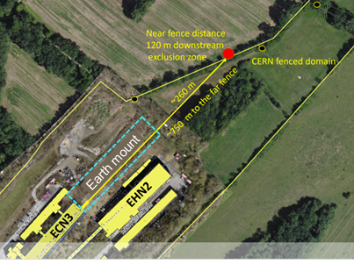
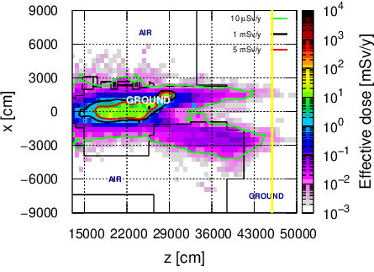
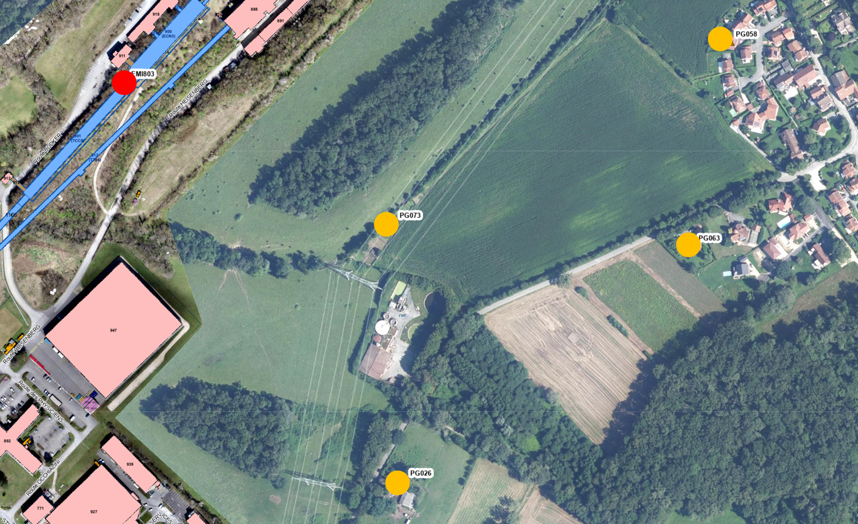
Environmental impact
Dose from air releases
Dose from stray radiation
Used max. dose coefficients from different age groups [6]
Positions of nearby population groups
Effective dose estimates
Muon prompt radiation aboveground downstream ECN3
Release point
CERN fence
H-3 release due to air activation of ~80 kBq
Worst-case immediate air release (CASE 2) yields 3 nSv/year and is thus well below the annual dose objective of CERN
Exposure of members of the public due to air releases is negligible
Annual limit of Non-designated Area on CERN domain (5 mSv/y) and at CERN fence (1 mSv/y) as well as dose objective for members of the public (10 uSv/y) by far met
100 rem = 1Sv

Slide 11
HIKE + SHADOWS

Slide 12
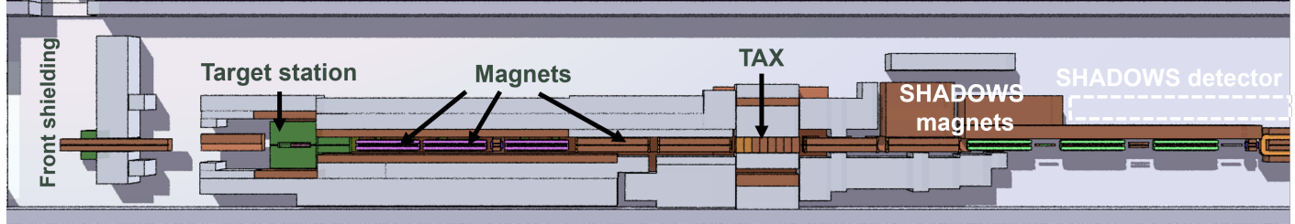
HIKE/SHADOWS FLUKA model
FLUKA hosted by CERN (FLUKA v4-3.0) [1-3]
Target area and secondary beamline, Created using FLAIR [4]
Top view
Same FLUKA geometry of the full underground TCC8/ECN3 cavern and surrounding galleries, tunnels, rooms, etc. as well as the ground profiles as for BDF/SHiP
Current FLUKA model based on NA62 design with additional shielding
Full model of secondary beamline of HIKE and SHADOWS magnets with their magnetic fields
~27 m
Target (40 cm, 2 mm ø, Be), target station and TAX design still based on NA62!
Side view
ECN3
Cast iron
Concrete
Total floor shielding (51 m3)
Iron
Moraine
Copper
CuCrZr

Slide 13
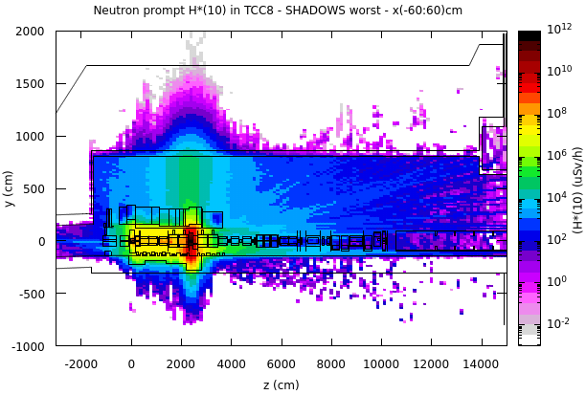
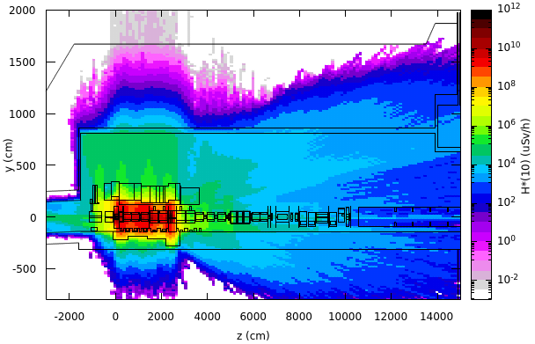
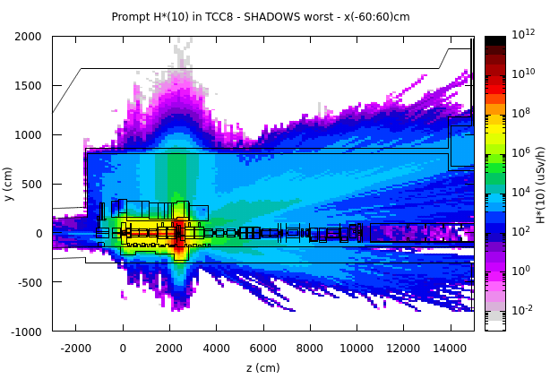
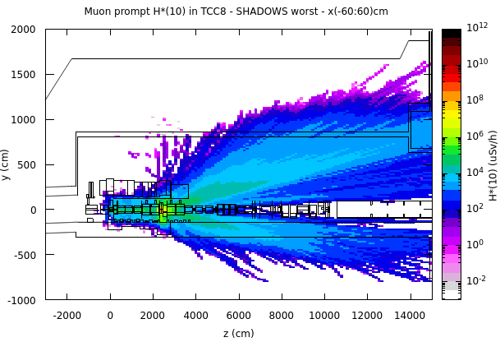
Prompt radiation in target area
Avg. intensity of 1.4×10¹² p/s
HIKE Phase 1
Side view
HIKE BD/SHADOWS
Side view
Neutrons
x [-60,60]
All particles
All particles
x [-60,60]
x [-60,60]
Muons
x [-60,60]
High radiation levels in region between target and TAX
Prompt radiation sufficiently reduced for a Non-designated Area above target-TAX area
Prompt radiation dominated by neutrons in target-TAX area and by muons downstream
100 rem = 1Sv

Slide 14
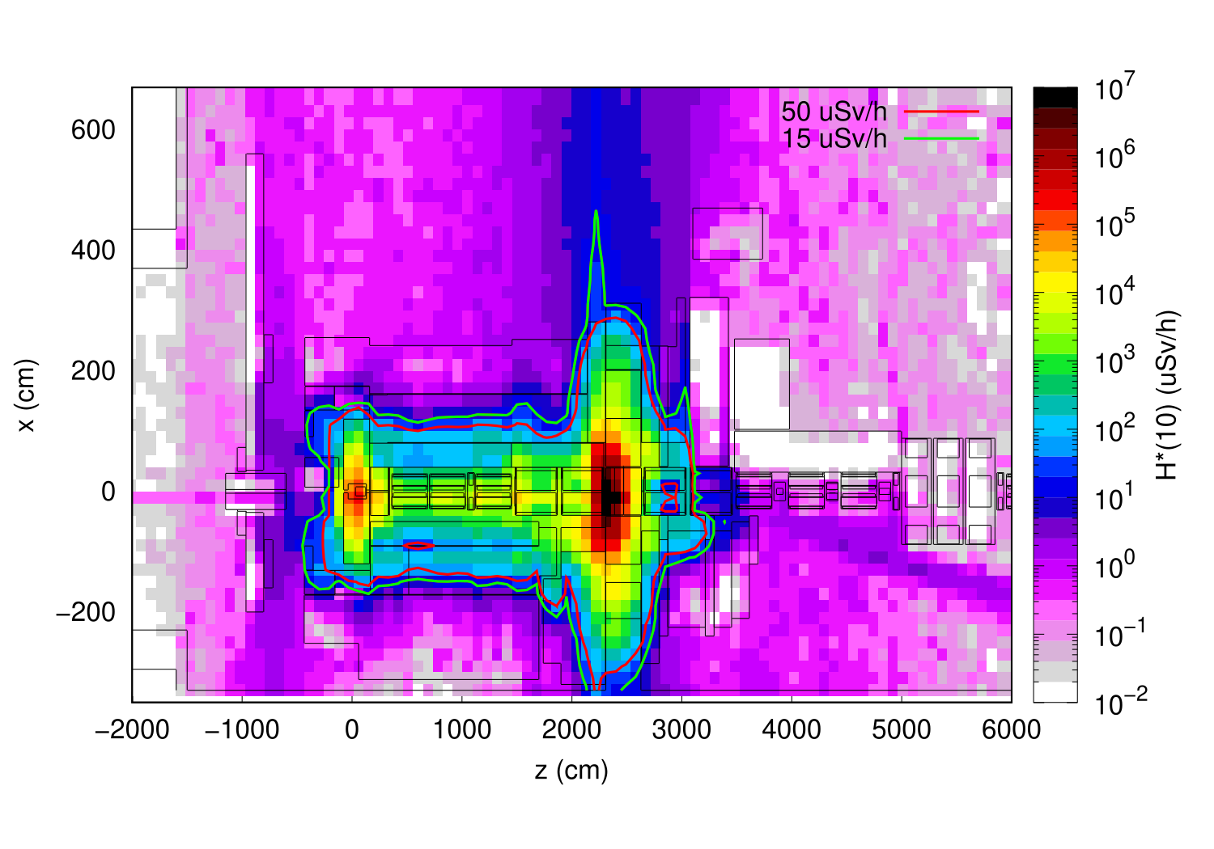
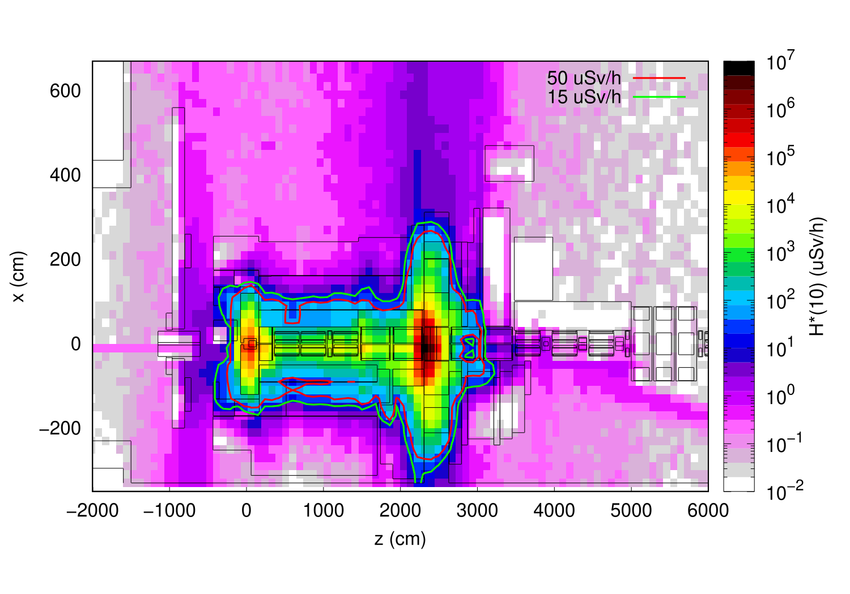
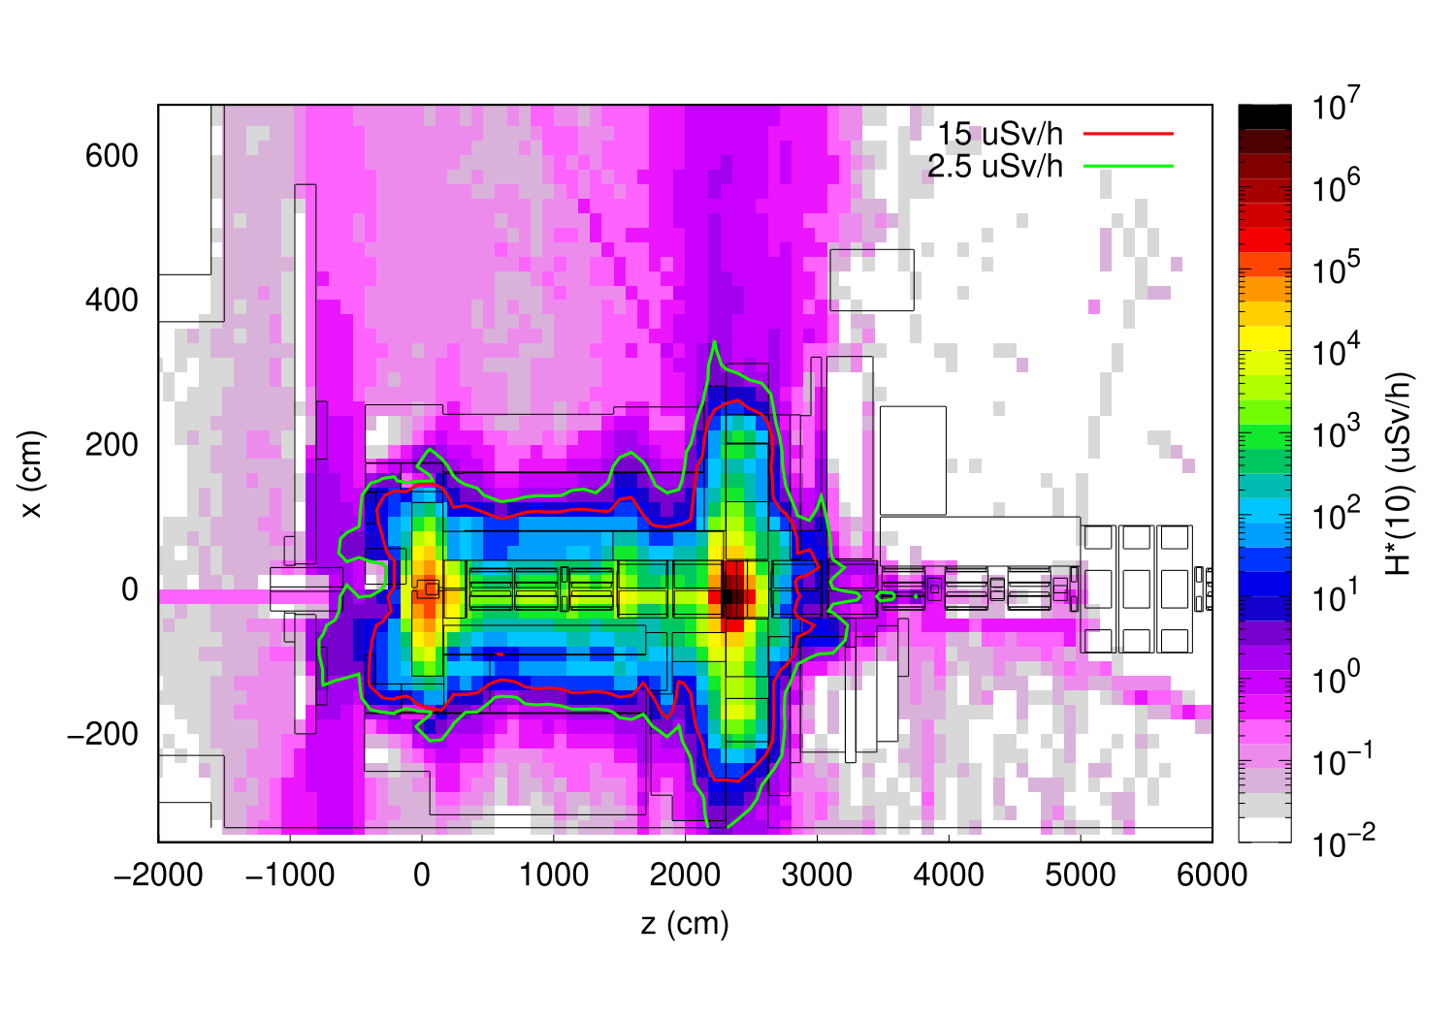
Residual radiation in target area
HIKE Phase 1 (PoT 5×10¹⁹/5 y), 2 y long shutdown, HIKE BD/SHADOWS (PoT 5×10¹⁹/5 y)*
Cross-sectional view, target level
1 hour cool-down
1 day cool-down
1 week cool-down
Residual dose rates well contained within shielding allowing for a Supervised Radiation Area in SHADOWS experimental area
High residual dose rates in secondary beamline requiring optimisation of interventions (e.g. remote operations, quick connections, cool-down, etc.)
* HIKE Phase 1 operation longer than in HIKE proposal (3.6×10¹⁹/4 y), HIKE Phase 2 not included
100 rem = 1Sv

Slide 15
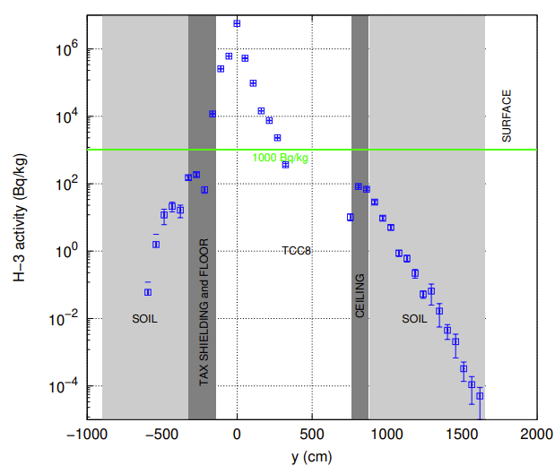
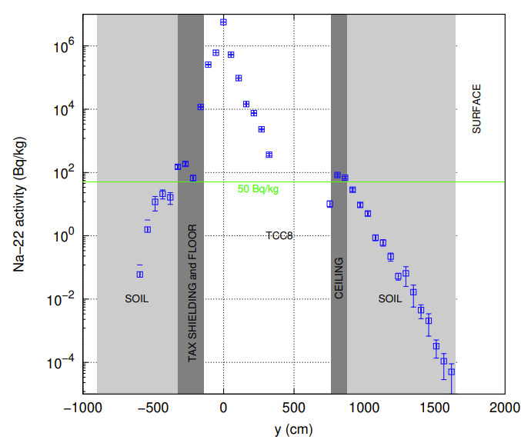
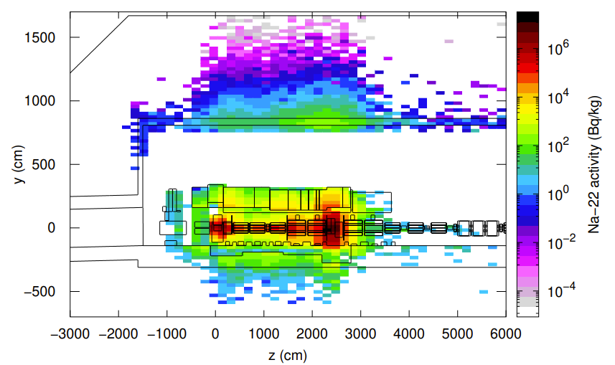
Air and soil activation
Total PoT 6×10²⁰
PoT 1×10¹⁹ per year
Specific activity of ³H and ²²Na in the soil
Air activation (HIKE Phase 1 - worst)
H-3 – TAX region
Na-22 – TAX region
Na-22 – Side view of TCC8 cavern
Production of radionuclides evaluated with FLUKA in combination with ActiWiz for different air regions since the target-TAX area will be separated from the downstream area by a wall
¹
Build-up of radionuclides during operation w/o air extraction and no cool-down
CA dominated by short-lived radionuclides (N-13, Ar-41, O-15, C-11) directly after beam operation
Thanks to floor iron shielding, ³H and ²²Na activity concentrations in the soil are below respective design limits
A hydro-geological study is underway, which will allow to refine the design limits and possibly allow to reduce the required shielding
Flush of target complex with fresh air before any access to reduce specific airborne radioactivity to be compatible with 0.1 CA
¹ Person working 40h/w, 50w/y with standard breathing rate in activated air with CA = 1 receives 20 mSv

Slide 16
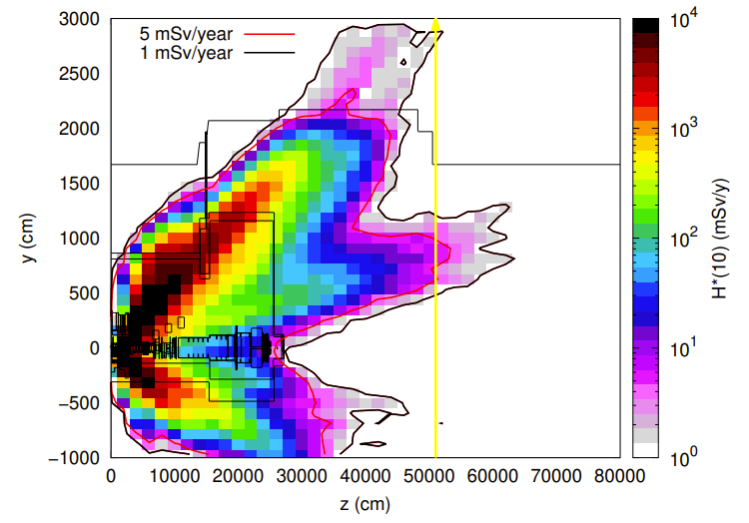
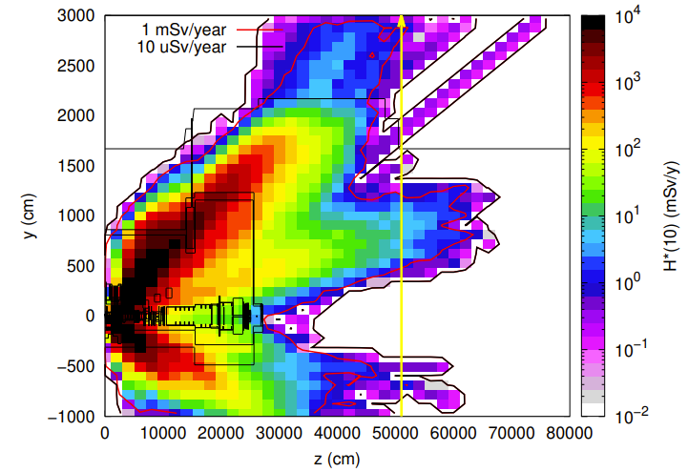
Environmental impact
CERN fence
Dose from air releases
Dose from stray radiation
Same dose coefficients as for BDF/ SHiP assessment
CERN fence
 | Total A (Bq)
Build-up, 30 min cool-down | 1.2 ×10⁹
Constant immediate release | 5.4×10¹³
Release point
H-3 release due to air activation of ~30 MBq
Annual effective dose for worst-case constant immediate release would amount to 1.35 uSv/y
For a more viable scenario, when production and decay build up processes are taken into account, while a realistic cooling time of 30 minutes is assumed, an effective dose of 5 nSv/y is reached
Additional iron shielding was added in ECN3 and 4 m of soil in the area downstream of ECN3 to reduce the dose due to high energy muons
Annual limit at CERN fence (1 mSv/y) and dose objective for members of the public (10 uSv/y) are met
Annual limit of Non-designated Area on CERN domain (5 mSv/y) slightly exceeded in small area, where additional soil can be put
100 rem = 1Sv

Slide 17
Conclusions
Main RP aspects regarding BDF and HIKE/SHADOWS in ECN3 were investigated
First shielding design for optimization of exposure of personnel to radiation and radiological impact on environment
Further detailed studies and optimization in the Technical Design Phase

Slide 18
Thank you for your attention!

Slide 19
Bibliography
[1] Website: https://fluka.cern
[2] C. Ahdida, D. Bozzato, D. Calzolari, F. Cerutti, N. Charitonidis, A. Cimmino, A. Coronetti, G. L. D’Alessandro, A. Donadon Servelle, L. S. Esposito, R. Froeschl, R. García Alía, A. Gerbershagen, S. Gilardoni, D. Horváth, G. Hugo, A. Infantino, V. Kouskoura, A. Lechner, B. Lefebvre, G. Lerner, M. Magistris, A. Manousos, G. Moryc, F. Ogallar Ruiz, F. Pozzi, D. Prelipcean, S. Roesler, R. Rossi, M. Sabaté Gilarte, F. Salvat Pujol, P. Schoofs, V. Stránský, C. Theis, A. Tsinganis, R. Versaci, V. Vlachoudis, A. Waets, M. Widorski, New Capabilities of the FLUKA Multi-Purpose Code, Frontiers in Physics 9, 788253 (2022)
[3] G. Battistoni, T. Boehlen, F. Cerutti, P.W. Chin, L.S. Esposito, A. Fassò, A. Ferrari, A. Lechner, A. Empl, A. Mairani, A. Mereghetti, P. Garcia Ortega, J. Ranft, S. Roesler, P.R. Sala, V. Vlachoudis, G. Smirnov, Overview of the FLUKA code, Annals of Nuclear Energy 82, 10-18 (2015)
[4] V. Vlachoudis, FLAIR: A Powerful But User Friendly Graphical Interface For FLUKA, in Proc. Int. Conf. on Mathematics, Computational Methods & Reactor Physics (M&C 2009), Saratoga Springs, New York (2009)
[5] H. Vincke, C. Theis, ActiWiz – optimizing your nuclide inventory at proton accelerators with a computer code, Progress in Nuclear Science and Technology (2014)
[6] P. Vojtyla, Models for assessing the dosimetric impact of releases of radioactive substances from CERN facilities to the environment – Air, CERN Internal report (2021)

