Slide 1
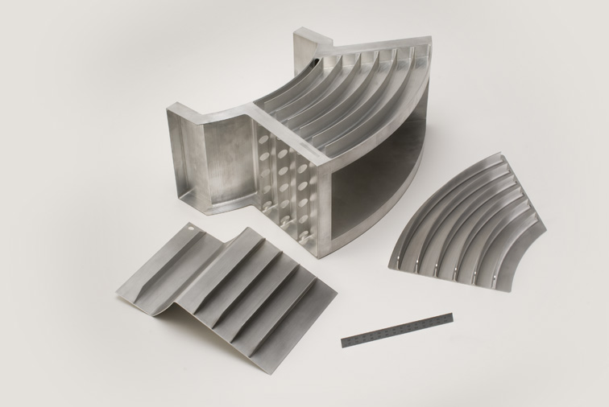
ISIS Target Station 2 – Horn Water Pre-Moderator Failure, Investigation, and Redesign
Mark Telkman¹, Leslie Jones¹, Daniel Blanco-Lopez², Daniel Coates¹, Henry Russell¹, Julius Bullock¹, Graham Wallace¹
ISIS Neutron and Muon Source, Harwell Campus, Oxfordshire, OX11 0QX, UK
Materials Physics Centre, CSIC-UPV/EHU, Paseo Manuel de Lardizabal 5, 20018 Donostia - San Sebastian, Spain.
Design of the horn pre-moderator first iteration
Newly designed horn pre-moderator
The ISIS Target Station Two (TS2) Horn (water) Pre-Moderator is a vital component in the process of moderating neutrons. The original pre-moderator, made from a 2000 series aluminium alloy, failed within the first year due to corrosion. Due to a failure of the most recent design in 2021, the pre-moderator has been redesigned after an investigation.

