Slide 1
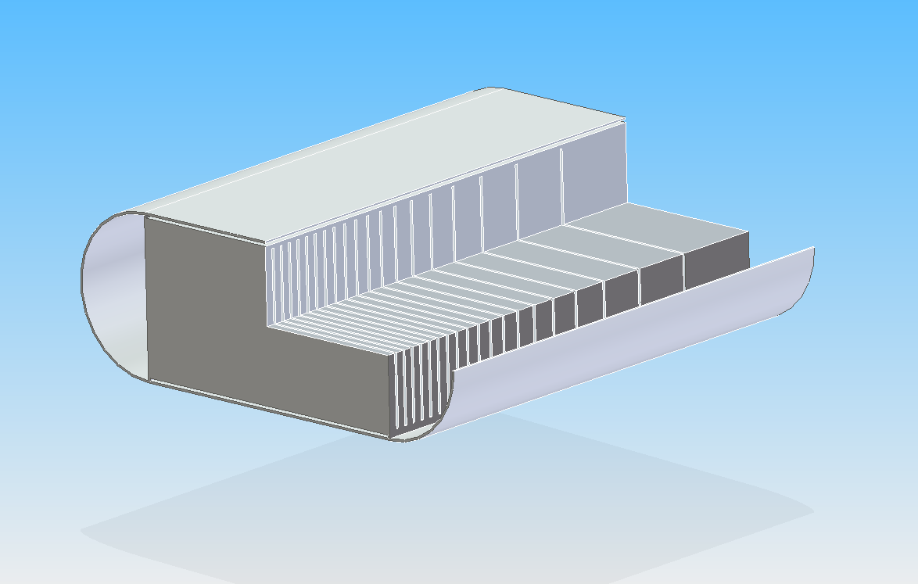
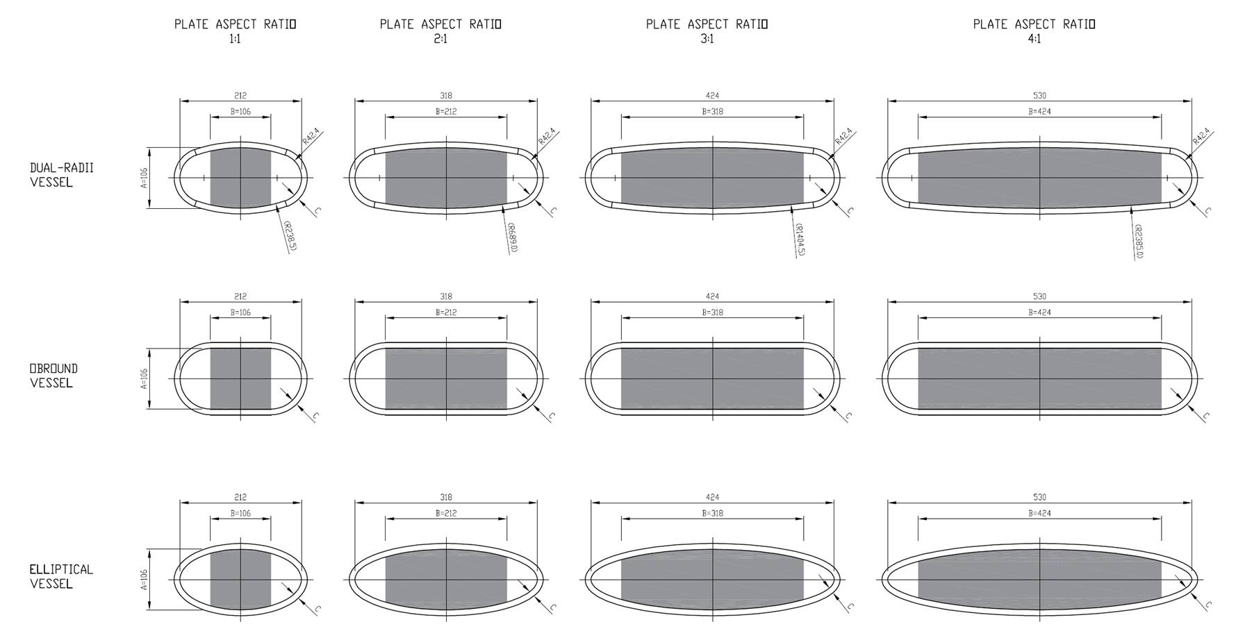
ISIS II Neutron Target and Pressure Vessel Design Optimisation
D. Wells Calvo
Rutherford Appleton Laboratory, Harwell Campus, Oxfordshire, UK
Helium cooling channels
He out
H2O out
H2O in
He in
Beam
Top-bottom Water-cooling channels
Target Tungsten Plates
Beam
Pressure Vessel – Target assembly with flow trajectories: He cross flow cooling and water top-down cooling
List of Pressure Vessel cross sections and AR researched
Helium cooled 10 plate Target under 104 kW beam a) Base; b) Fully optimised
For a conceptual stationary target for ISIS II:
Optimised pressure vessel cross section with minimal thickness to increase neutronic output and reduce heat deposition.
Optimised plate count, Aspect Ratio (width/height), coolant choice and pressures for highest achievable power (stationary target).

