Slide 1
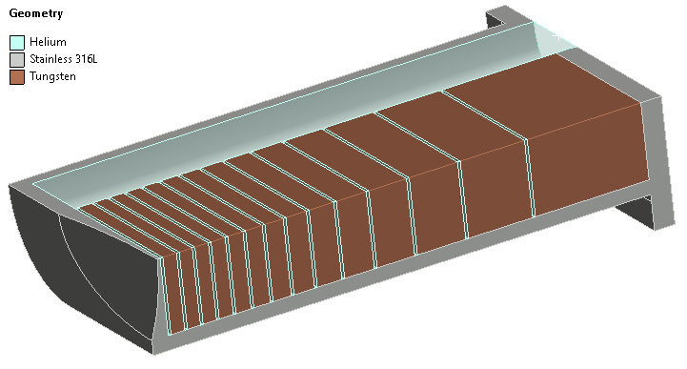
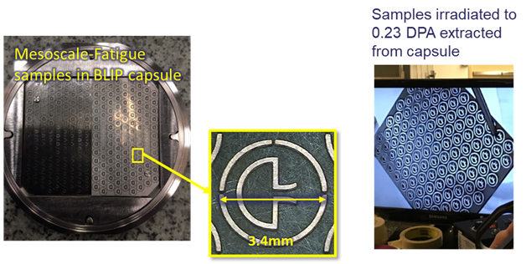
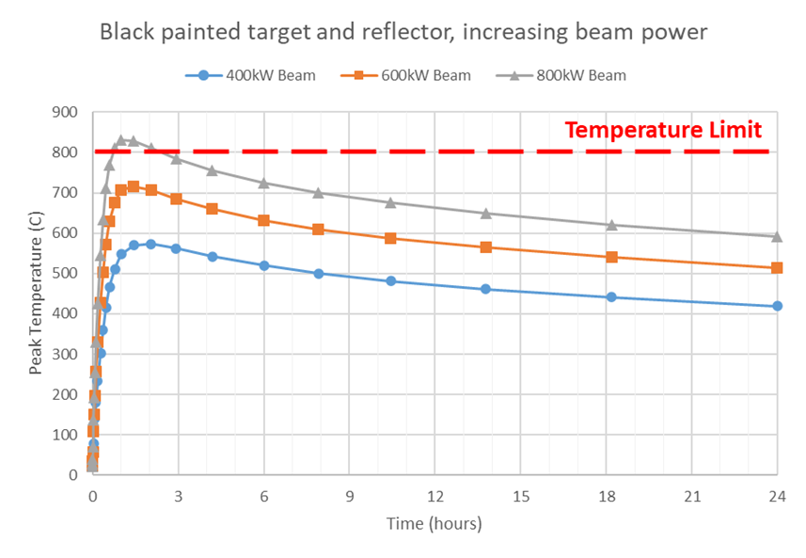
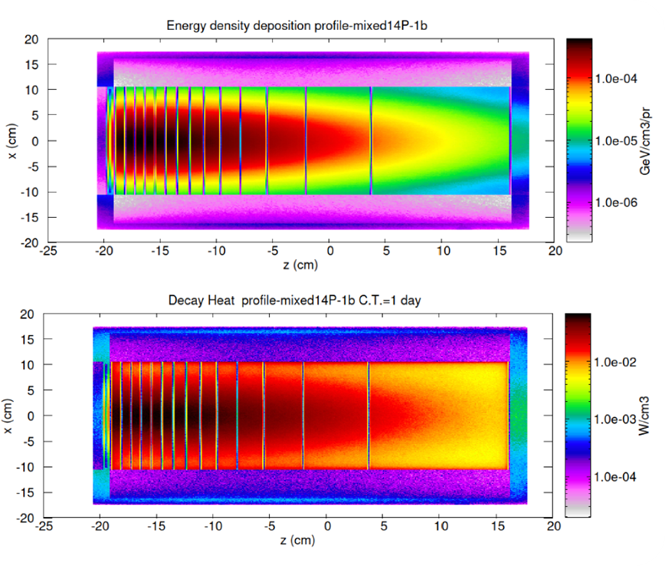
Initial Target Concepts for ISIS-II
Dan Wilcox, High Power Targets Group, Rutherford Appleton Laboratory, UK
ISIS-II static solid target conceptual design
Decay heat in LOCA could limit the beam power
Decay heat simulations for current and future targets
Irradiated material property testing plans
Summary of achievable beam power levels on static targets

