Slide 1
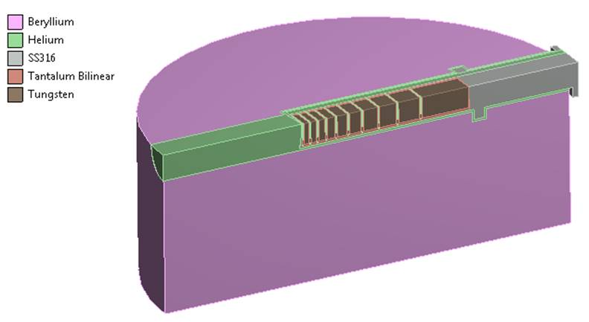
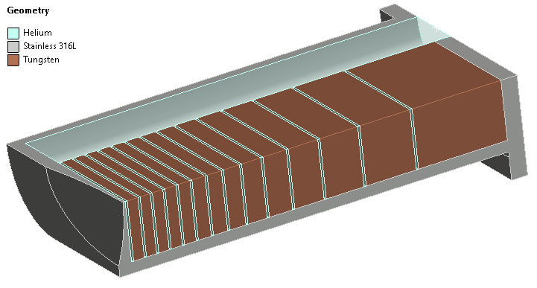
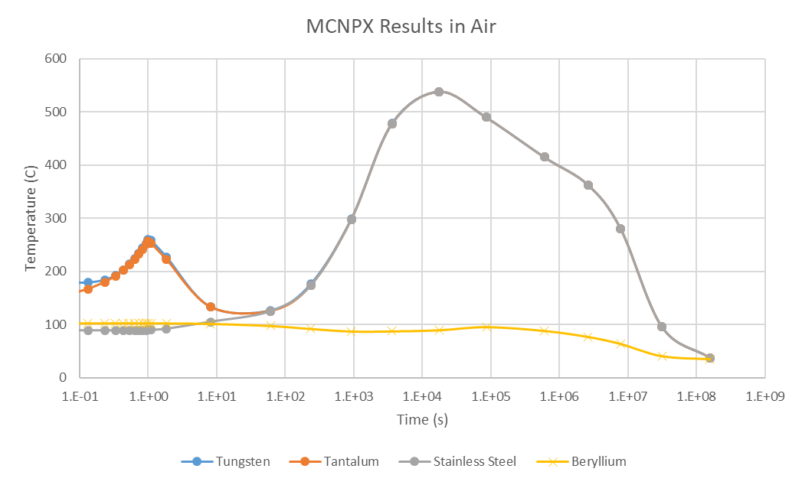
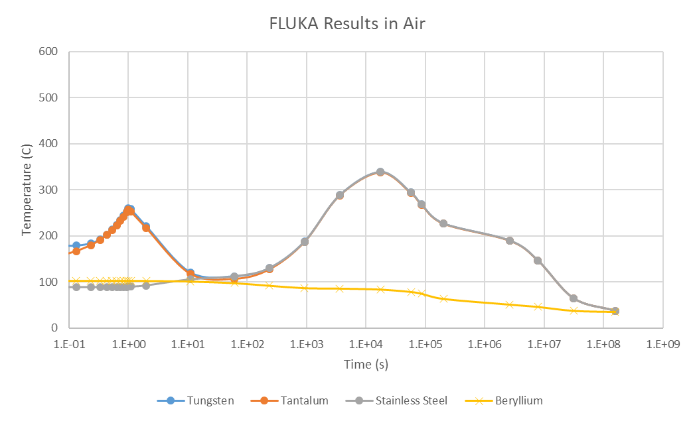
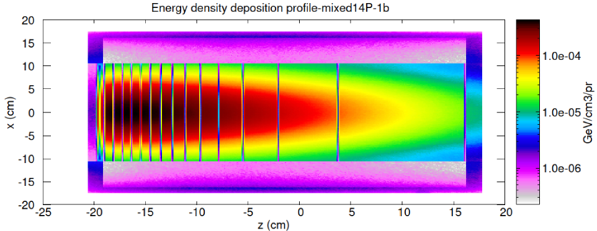
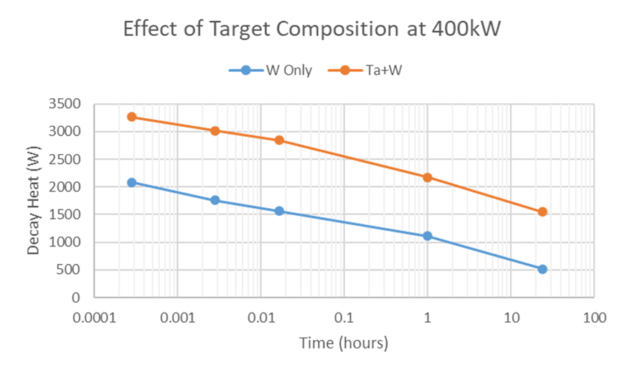
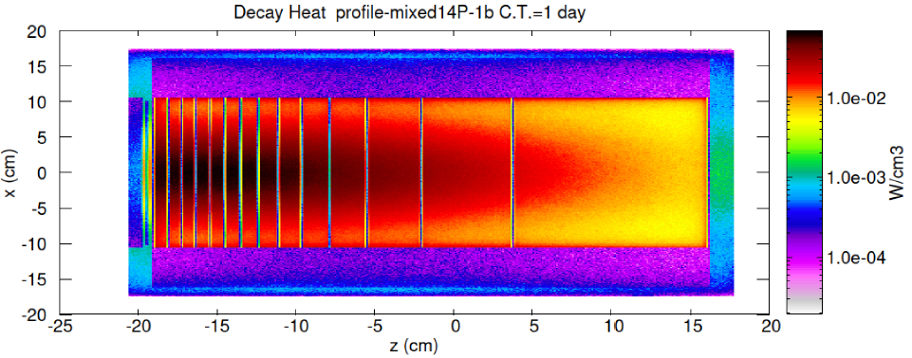
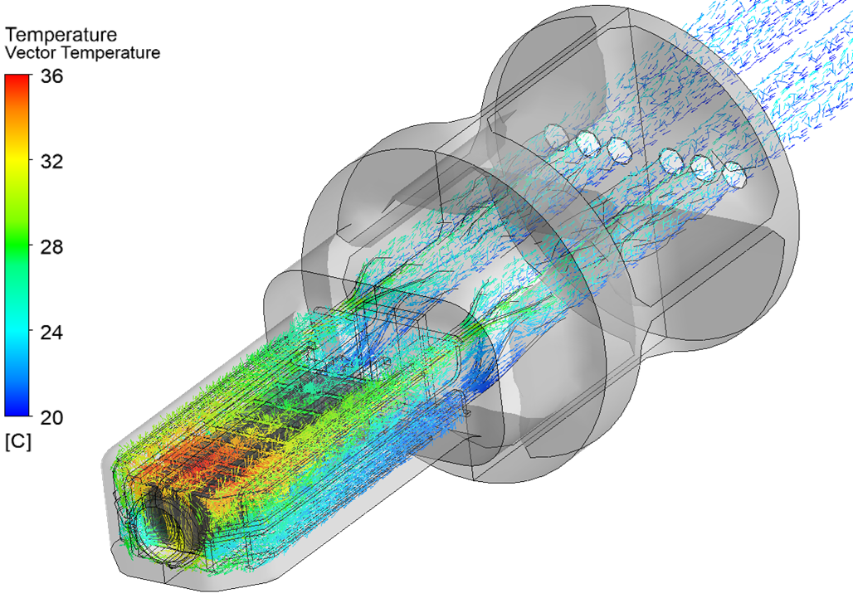
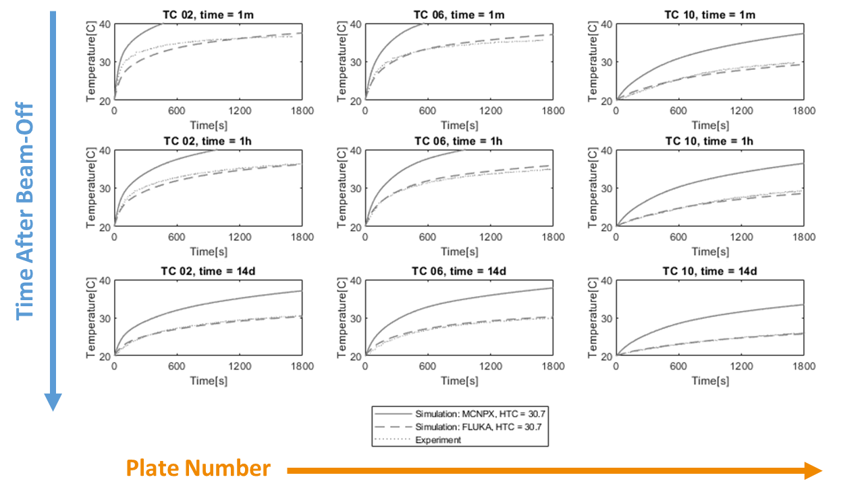
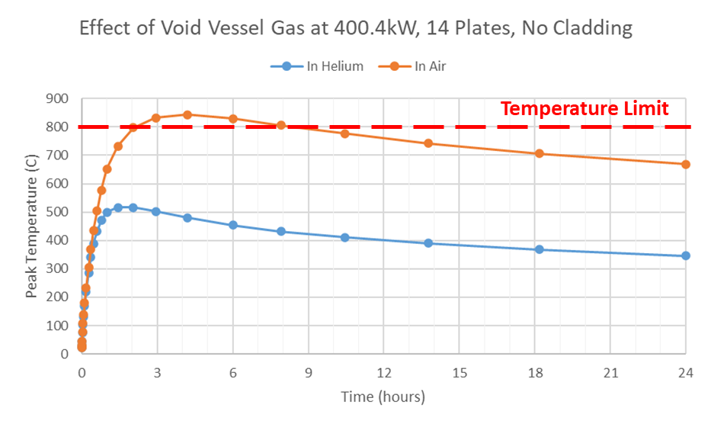
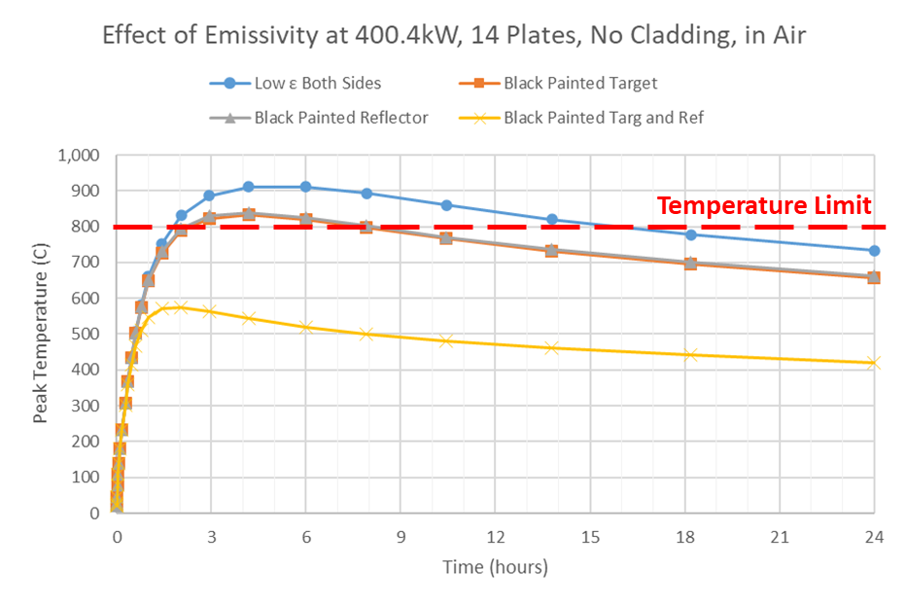
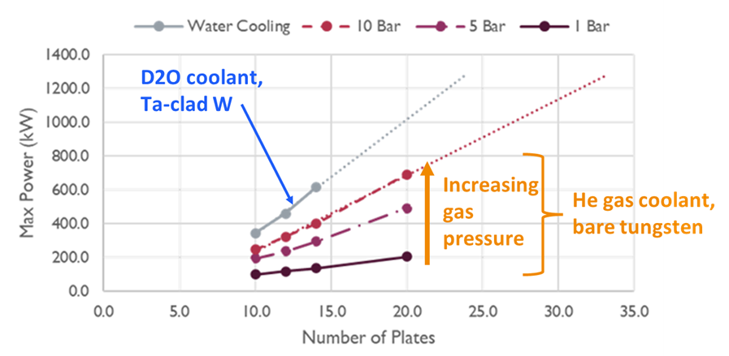
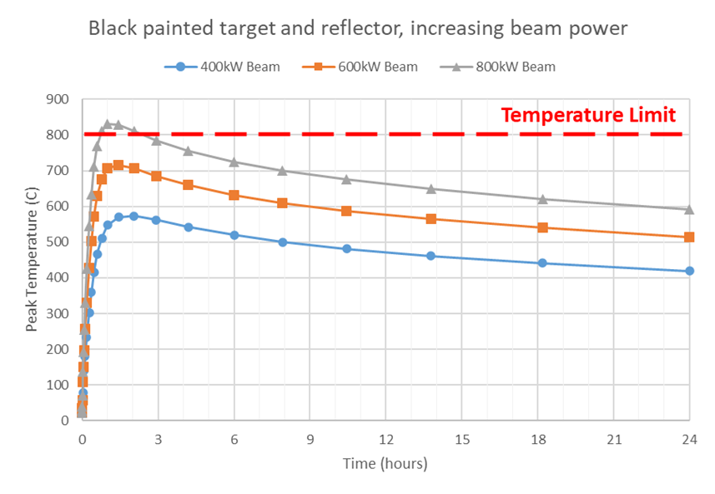
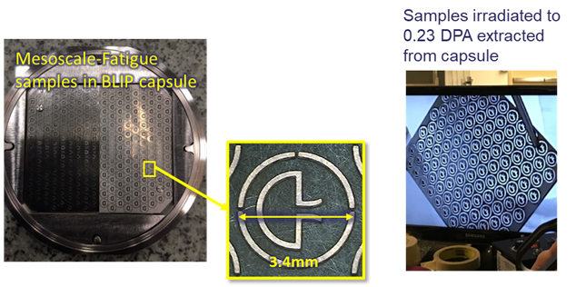
Initial Target Concepts for ISIS-II
Dan Wilcox, Daniel Wells-Calvo, Stephen Gallimore, Lina Quintieri, Goran Skoro
Rutherford Appleton Laboratory, Harwell Campus, Oxfordshire, UK
Background:
Conceptual design studies are now underway for ISIS-II, the successor to the UK’s pulsed neutron and muon source. Appropriate target technologies must be selected for each of the two proposed neutron target stations, to achieve a balance between neutronic performance and engineering reliability. An essential choice early in the design process is between a stationary solid target or a rotating wheel; therefore it is necessary to understand the limits of achievable beam power on a stationary solid target. Safe operating limits must be defined for direct beam on target, as well as residual decay heat in a Loss of Coolant Accident (LOCA) scenario.
Initial Static Target Concept
A range of optimised solutions were developed, all of which can withstand the direct beam [1].
Need to narrow down the parameter space for initial neutronic and decay heat simulations
First guess at a feasible static target:
Decay Heat Simulations - TS1 Project Target
Detailed target, simplified reflector
Conduction and radiation across gap
Reflector never exceeds initial temperature
Air in gap is much worse than helium
Large difference between Monte Carlo codes
Peak temperature ~1-4 hours after power off
Two options for coolant and material:
Helium cooled, bare tungsten plates
Water cooled, tantalum-clad tungsten
316L vessel, optimised for 10bar helium
Proton beam aspect ratio 2:1
Gaussian beam profile
14 plates (about the highest number possible for tantalum-clad plates)
Beam window based on TS1 Project target
LOCA simulation geometry – detailed target, simplified reflector
MCNPX in Air
FLUKA in Air
Initial static target concept geometry – helium cooled
1 hour
1 day
Decay Heat Simulations – ISIS-II Concept
Worst case LOCA: cooling fluid and void vessel helium are immediately lost and replaced with air
Decay heat values from FLUKA simulations by Lina Quintieri, with and without tantalum cladding
Results are very dependent on surface emissivity and void vessel atmosphere
Simulations of temperature following a worst case LOCA scenario on TS1 Project target
Ta+W
Direct beam:
Validation of Decay Heat Simulations
Test of a controlled loss-of-coolant scenario on previous generation TS1 target [2,3]
Decay heat simulated using MCNPX and FLUKA, including detailed geometry and irradiation history
Simulations with FLUKA agree well with data for all plate numbers and cooling times (1 min to 14 days) [4]
Ta+W
Decay heat:
FLUKA simulation results for direct beam and decay heat
Effect of tantalum cladding on decay heat
ANSYS CFX simulation of decay heat induced free convection in a previous generation TS1 target with no applied coolant pressure
Simulated and measured response to stalled coolant flow in TS1
Simulation results for 14-plate tungsten target in air and helium
Effect of best-case black paint/coating increasing emissivity to 0.9
Limiting Factors for Beam Power
Water cooled target with Ta cladding
Direct beam limit: ~600kW
~14 plates max, before front plates have more cladding than core
Decay heat limit: ~200-400kW
Assuming cladding doubles the decay heat
Helium cooled target, bare tungsten
Direct beam limit: 1MW+
Requires many thin plates or cannelloni rods
Neutronic performance may prevent this
Decay heat limit: ~400-800kW
Upper limit assumes mitigating strategies such as black paint/coating can be guaranteed to work
Neutronic limit: ???kW
Initial studies currently underway
Irradiated Material Plans
Significant unknows, particularly on fatigue and irradiation effects on tungsten and tantalum
Aim to benefit from overlapping interests with the RaDIATE collaboration
Currently planning fatigue tests on irradiated titanium foils
Methodology could also be applied to Ta and W;
Meso-scale fatigue cantilevers cut from thin foil
Irradiated with protons at a suitable source
Fatigue test in hot cell at Culham MRF
 | Tungsten | Tantalum
Tensile Data | Product size/form dependent | Some variability – impurities and product form?
Tensile after Irradiation | Good data | Retained ductility quite variable – effect of impurities?
Fatigue | Good data | Good data
High Cycle Fatigue | No data above ~2E6 cycles | Up to ~1E8 cycles, high and low frequency
Fatigue after Irradiation | No data | No data
Thermal Conductivity | Limited data with protons. Critical for core temperature | No data, but small effect from thin cladding
Maximum direct beam power for various optimised target designs [1]
Titanium mesoscale-fatigue samples, image c/o RaDIATE collaboration
Current extent of available data for ISIS target materials
Peak temperature in a LOCA scenario for 14-plate bare tungsten target
Conclusions
Conceptual design of stationary solid target which maximises achievable beam power
LOCA + decay heat simulations validated on real target, suggest this will be limiting factor for ISIS-II
We know the gaps in our current material property data and have plans to start addressing them
Future Work
Ongoing optimisation and detailed design of most suitable target concepts
A range of “engineering approved” concepts are now being assessed for neutronic performance
Still need to clearly define the worst case LOCA scenario, and develop mitigating strategies
References:
[1] ISIS-II Neutron Target and Pressure Vessel Design Optimisation, D. Wells-Calvo, HPTW2023
[2] D.J.S. Findlay et al., "Measurement and calculation of decay heat in ISIS spallation neutron target," Nucl. Instr. Meth. A, vol. 908, 2018.
[3] G.M. Allen et al., "Decay heat in ISIS spallation neutron target as function of cooling time," Nucl. Instr. Meth. A, vol. 933, 2019.
[4] L. Quintieri et al., "Decay heat in ISIS spallation target: simulations and measurements," Journal of Neutron Research, vol. 24, 2022.

