Slide 1
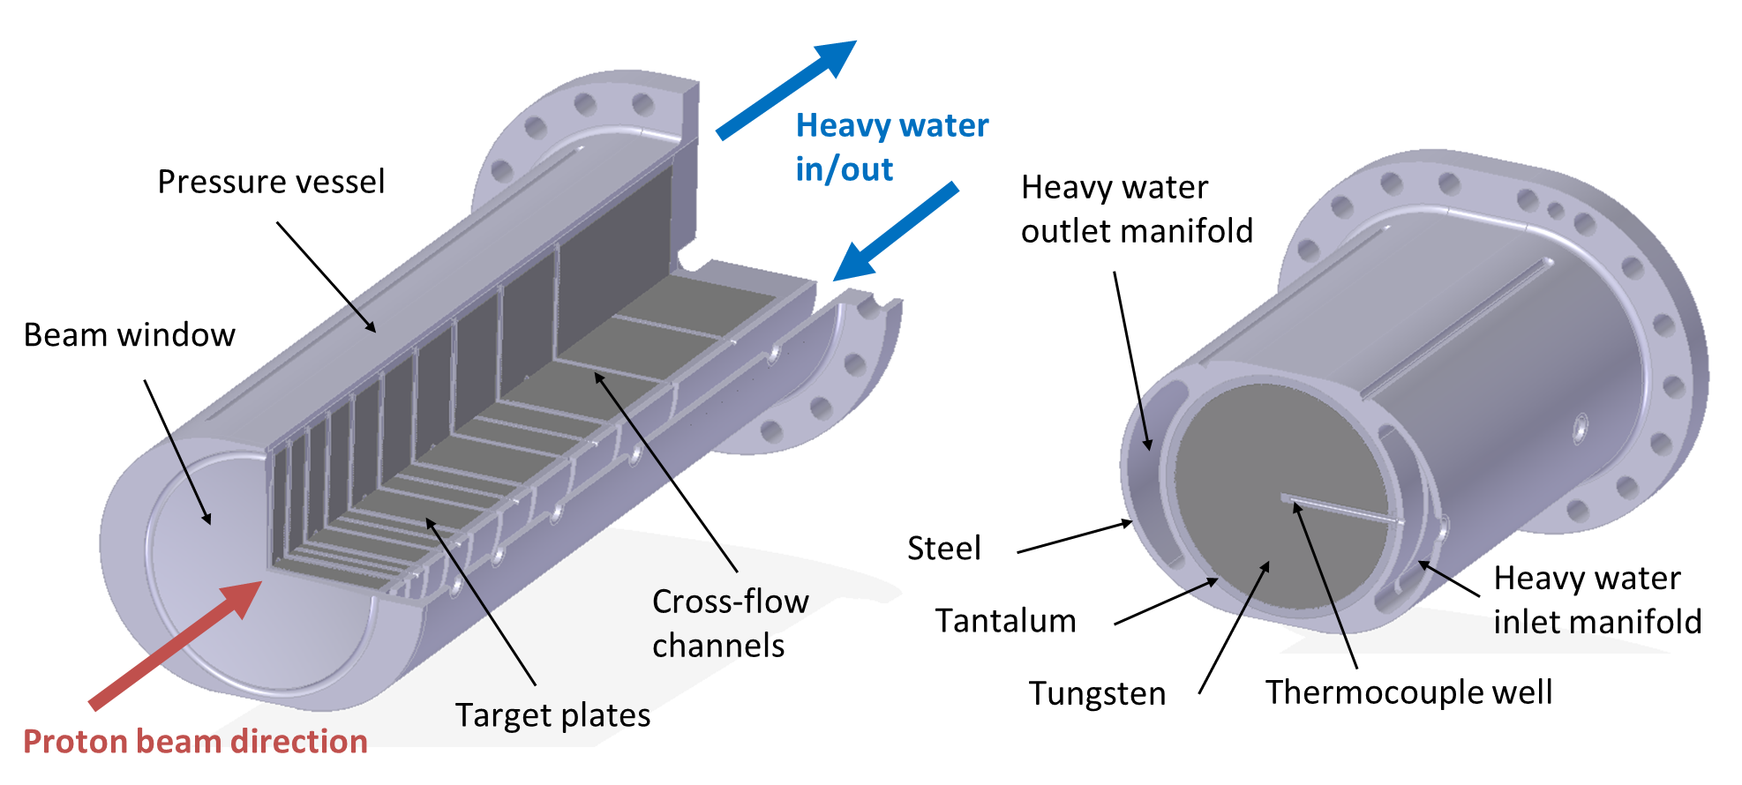
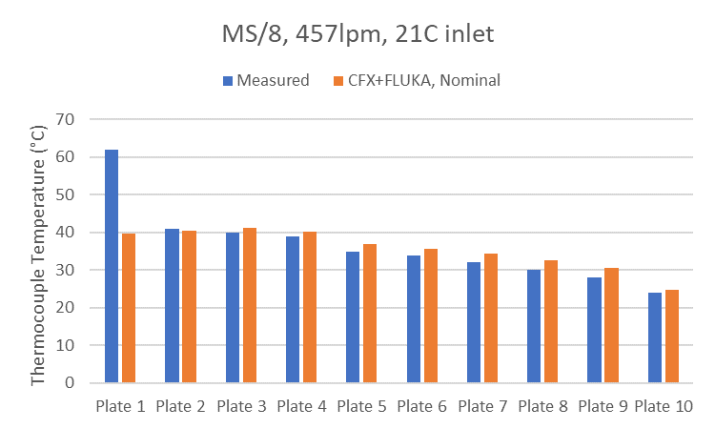
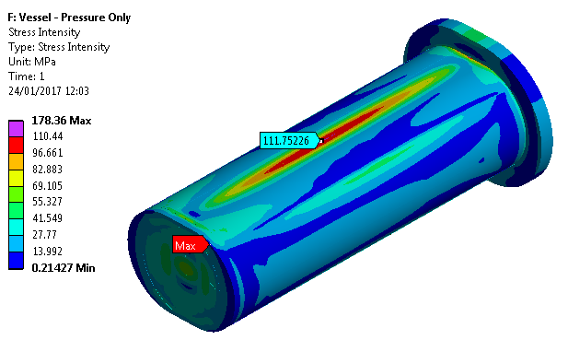
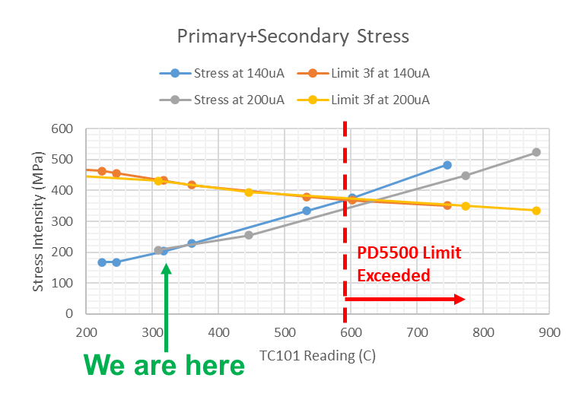
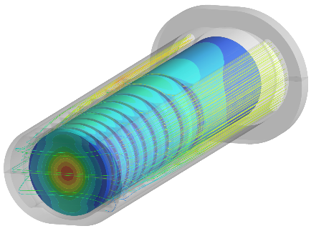
Simulated and Measured Performance of ISIS TS1 Project Target
Dan Wilcox, High Power Targets Group, Rutherford Appleton Laboratory, UK
New TS1 Target was designed, installed and operated successfully
Validation of FEA analysis
Investigation of abnormal plate 1 temperature reading
In-situ measurement of radiation damage?

