Slide 1
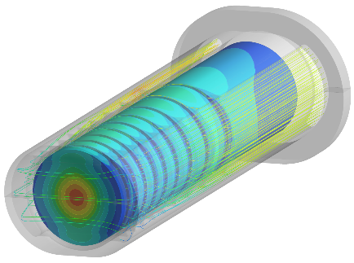
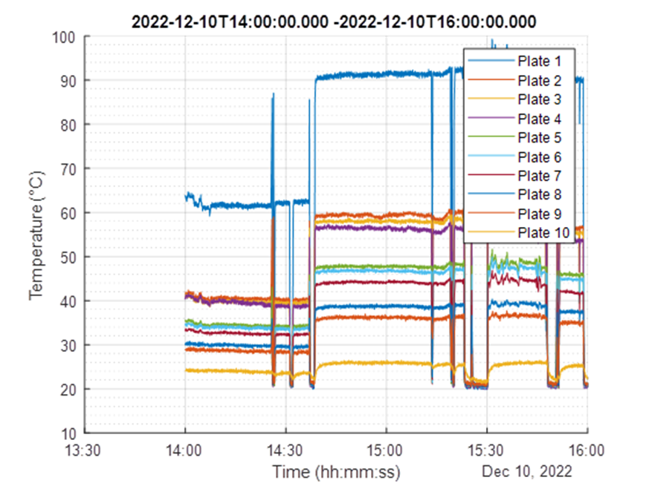
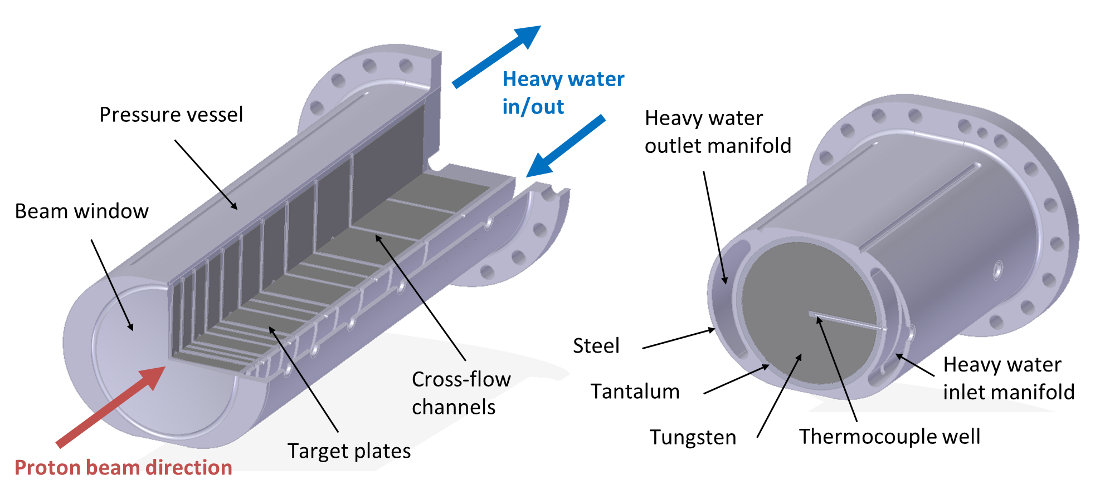
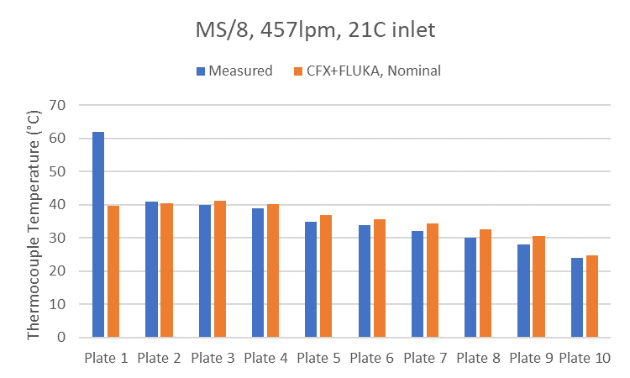
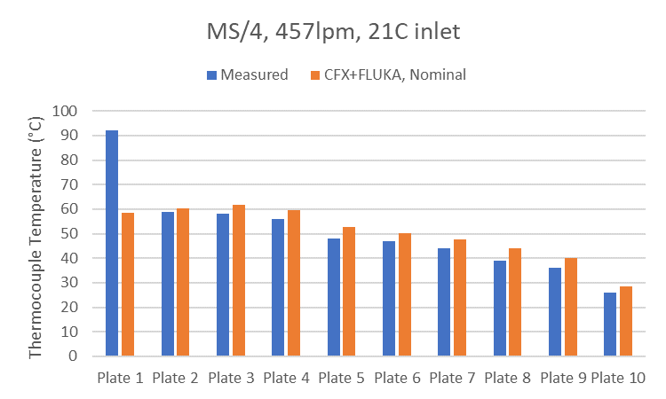
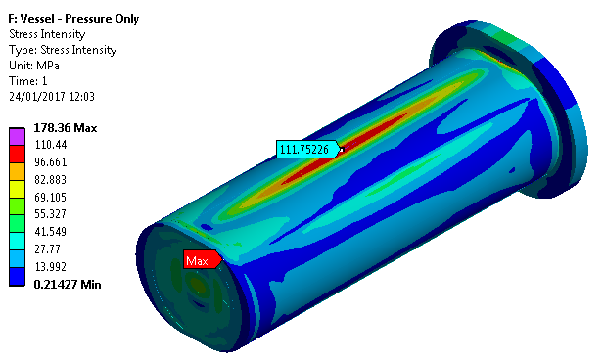
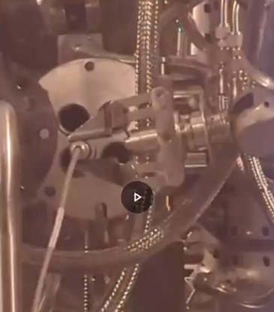
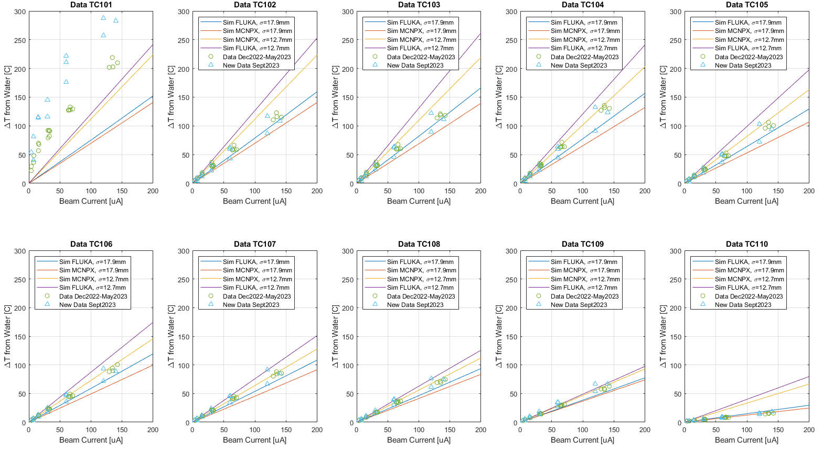
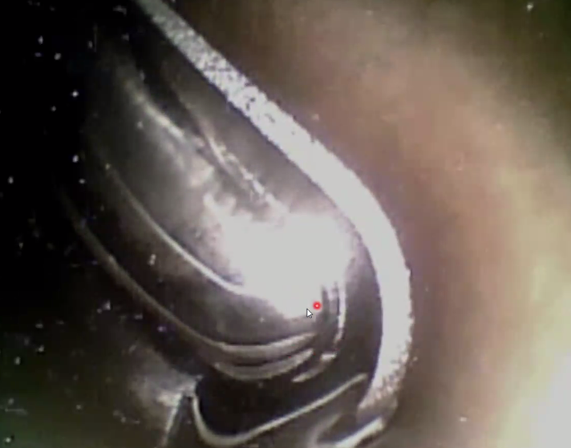
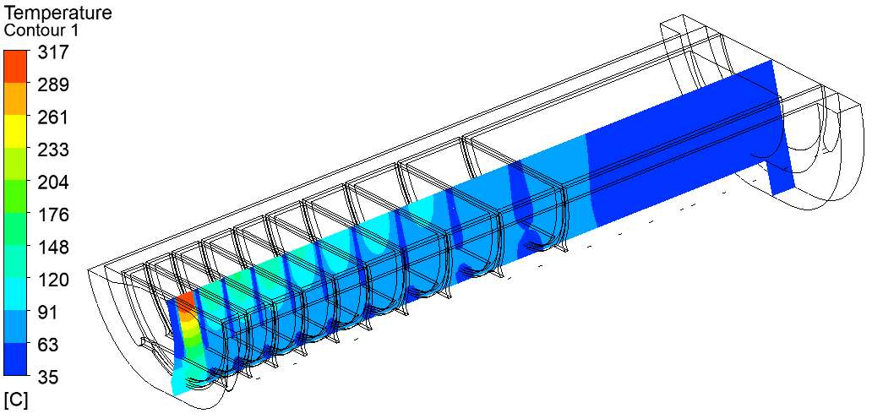
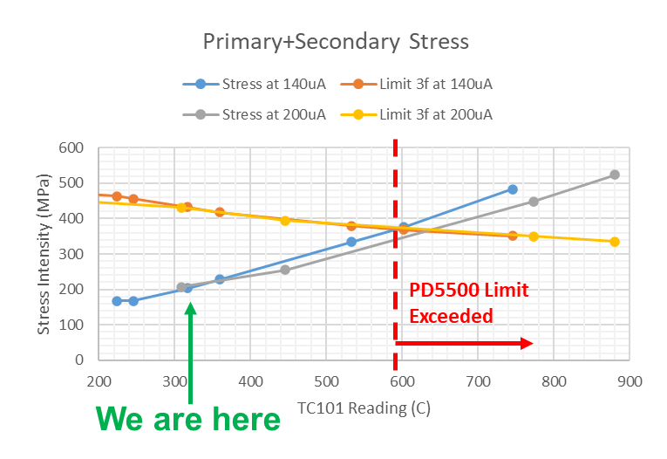
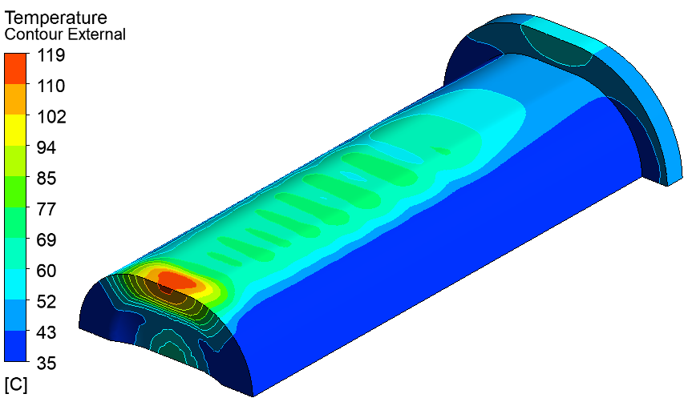
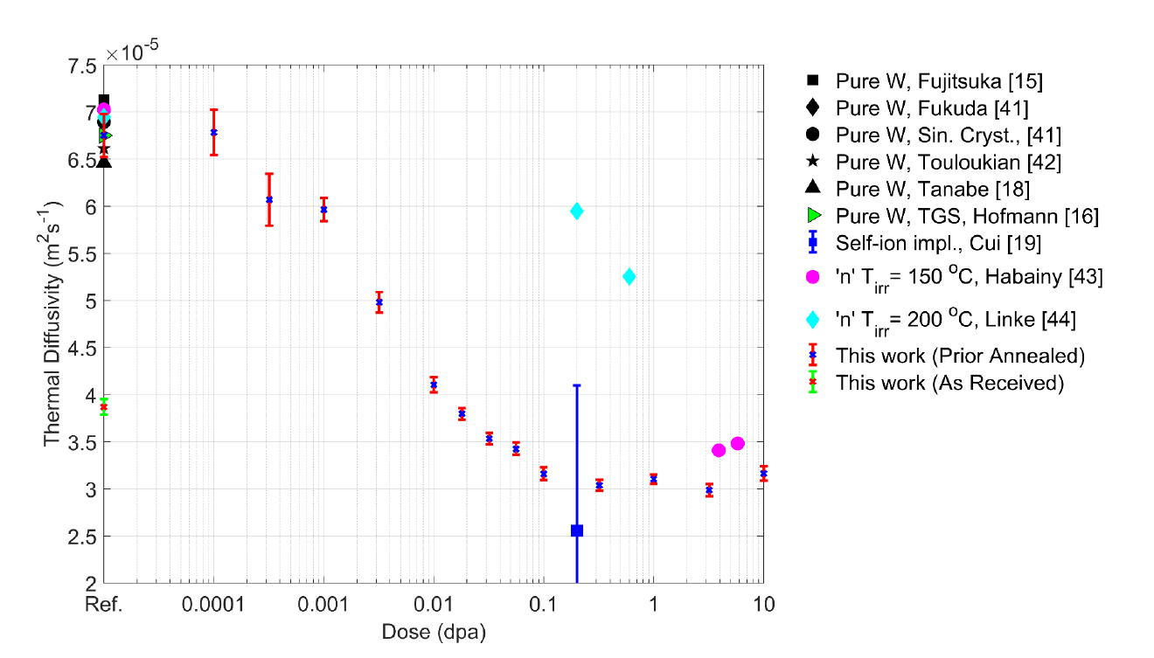
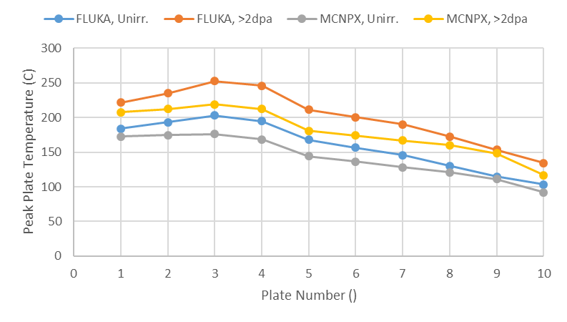
Simulated and Measured Performance of ISIS TS1 Project Target
Dan Wilcox, Molly Probert, Stephen Gallimore, David Findlay, Stephen Jago
Rutherford Appleton Laboratory, Harwell Campus, Oxfordshire, UK
Background
As part of the ISIS TS1 Project [1], a new design of spallation target has been installed and operated at ISIS TS1. Detailed Finite Element Analysis (FEA) simulations were used to guide the design process and predict target performance. Since the TS1 Project target began operation in November 2022, operating data has been collected and used to validate the simulation approach, and to diagnose the cause of unexpected temperature readings.
Target Design Overview
All-new TS1 target design developed using FEA analysis and prior operational experience
Pressure vessel design assurance “In the spirit of” PD5500 [2]
Simulated stresses no higher than previous TS1 target
Initial Commissioning Data – Unexpected Results
a)
Run on 10th Dec 2022 at 1/8 and 1/4 nominal beam power
Higher than expected temperature readings on plate 1
Simulations agree well with data, except on plate 1
1/4 Power
1/8 Power
b)
Measured and simulated temperatures at 1/8 (left) and 1/4 (right) of full beam power
Thermocouple data from beam ramp-up on 10th Dec 2022
Key design features of the TS1 Project Target
Target analysis: a) Conjugate fluid/thermal, b) Pressure Vessel integrity
Plate 1 Anomaly: Possible Causes
Bad thermocouple reading
Simulation error
Off-normal proton beam
Off-normal cooling flow
Heat transfer from beam window
Blockage in front channel
Air bubble around thermocouple
Bad contact at bonded interfaces
Validation of Simulations – Steady State
Good agreement with simulation on plates 2-10 over a range of times from Dec 2022 to Sept 2023
Observed scatter can be explained by variations in beam focus, coolant flowrate, etc
On plate 1 only, temperature is not proportional to beam current, and is increasing over time
Thermocouples tested, no issues
Good agreement on all other plates
Plates 2, 3 and 4 are about the same size and position as plate 1, and behave normally
Channel flow is too high. No knock-on effect from plate 1 on plate 2
Note: Plate 1 outer surfaces passed ultrasonic inspection of bond quality. However, it is not possible to inspect the bonds around the TC well
Nothing seen on fiberscope inspection
Fiberscope inspection of front cooling channel
Is it safe to increase the beam power?
Worst case (blocked channel) is not consistent with observations
Worst plausible case for vessel is bad thermal contact to clad faces – ran simulation to match data
Simulated temperatures for two codes (FLUKA/MCNPX) and two beam focus levels (12.7-17.9mm sigma), compared to measured steady state data
High temperature localised to centre of plate 1
Validation of Simulations – Transient
Good agreement in transient response to beam switching on/off, except for anomalies on plate 1
Thermal simulation with additional thermal resistance on clad faces of plate 1
Simulated pressure vessel integrity at higher temperatures
Radiation-Induced Thermal Conductivity Loss
Thermal conductivity of tungsten could be reduced by up to 50% after 2dpa (~4 months operation) [3,4]
May be possible to measure in-situ using plate thermocouples, but the effect is small compared to the uncertainties due to Monte Carlo code, beam focus, etc.
Delayed TC response time? ~0.75s delay expected
Neutron irradiated data
Very low cooling rate on plate 1 at low temperatures
Self-ion implanted data
Proton beam irradiated data
Simulated and measured transient response to beam switching on (top row) and off (bottom row), for target plates 1 to 5
Thermal diffusivity of irradiated tungsten after a range of damage doses and for various types of irradiation, from [4]
Simulated temperature profiles at 200uA for two codes (MCNPX/FLUKA) and two irradiation conditions (unirradiated, uniform 2dpa)
Conclusions
New TS1 Target has now run at close to full power with no ill effects
9/10 plates performing as expected, validating the FEA approach
Still no clear explanation for plate 1 temperature anomaly
Future Work
Ongoing simulation and monitoring – may be able to set up a “Digital Twin” or similar system
Look for evidence of in-situ radiation damage as operation continues, try to isolate effect of beam focus
Design and analysis for ISIS-II target conceptual design studies
References:
[1] ISIS TS1 Project summary – S. Gallimore et al 2018 J. Phys.: Conf. Ser. 1021 012053 DOI 10.1088/1742-6596/1021/1/012053
[2] “PD5500:2018 + A1:2018,” BSI, 2018.
[3] Thermal diffusivity of tungsten irradiated with protons up to 5.8 dpa – J. Habainy et al., Journal of Nuclear Materials, 2018
[4] Thermal diffusivity degradation and point defect density in self-ion implanted tungsten – A. Reza et al., Acta Materialia, 2020

