Slide 1
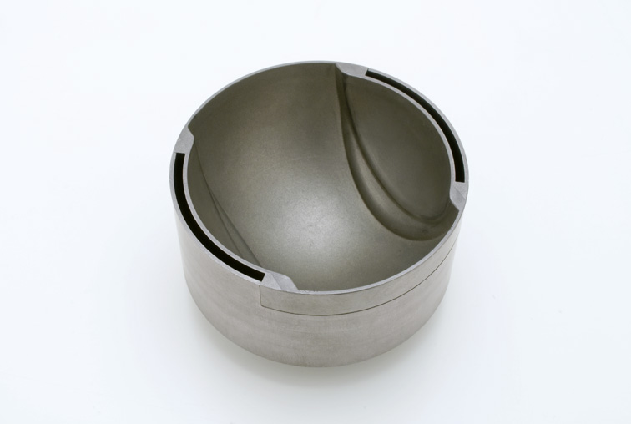
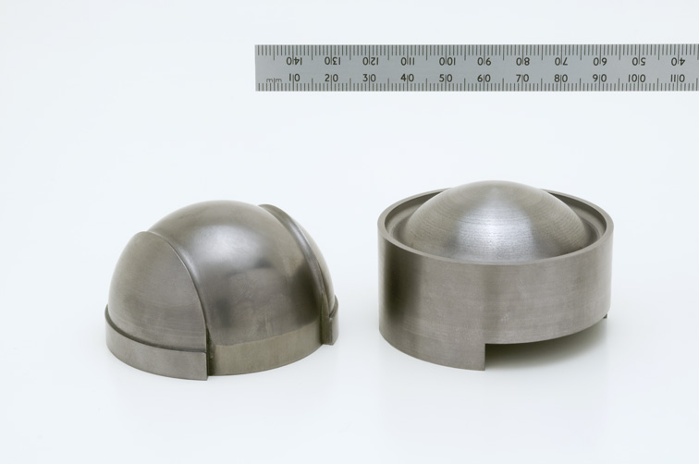
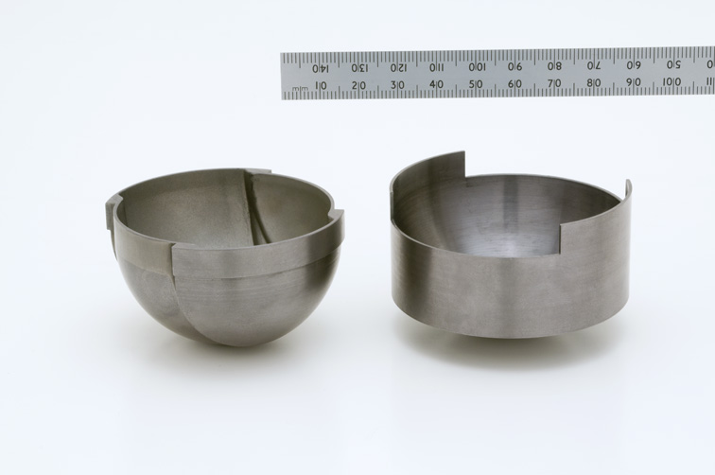
ISIS TS2 – Post Irradiation Examination of used Target Leslie Jones ISIS Target Design Group
Operation planned for Jan 2024
Removal of front end for visual examination
Understanding of cladding failure
Goal – extend service life of the target
Irradiated tantalum available for future materials testing
See how it will be accomplished
PIE Cutting Rig
Window Cap + Crossflow Guide
TS2 W/Ta Target

