Slide 1
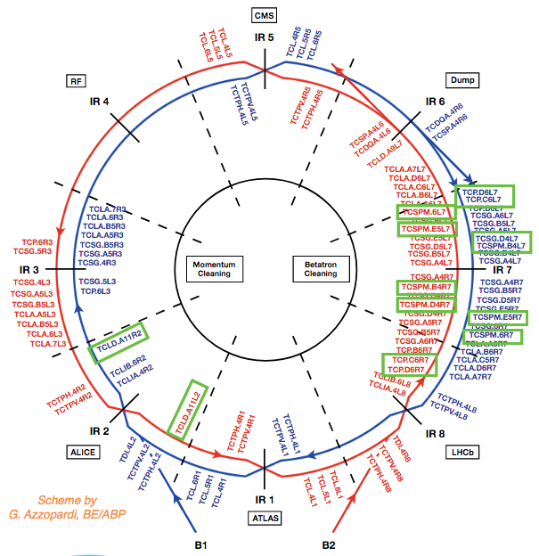
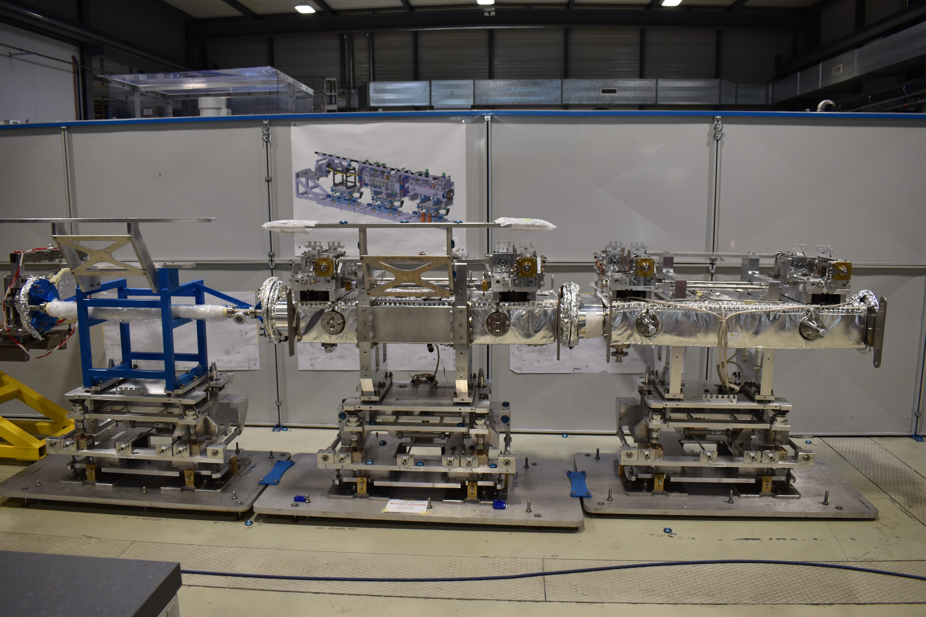
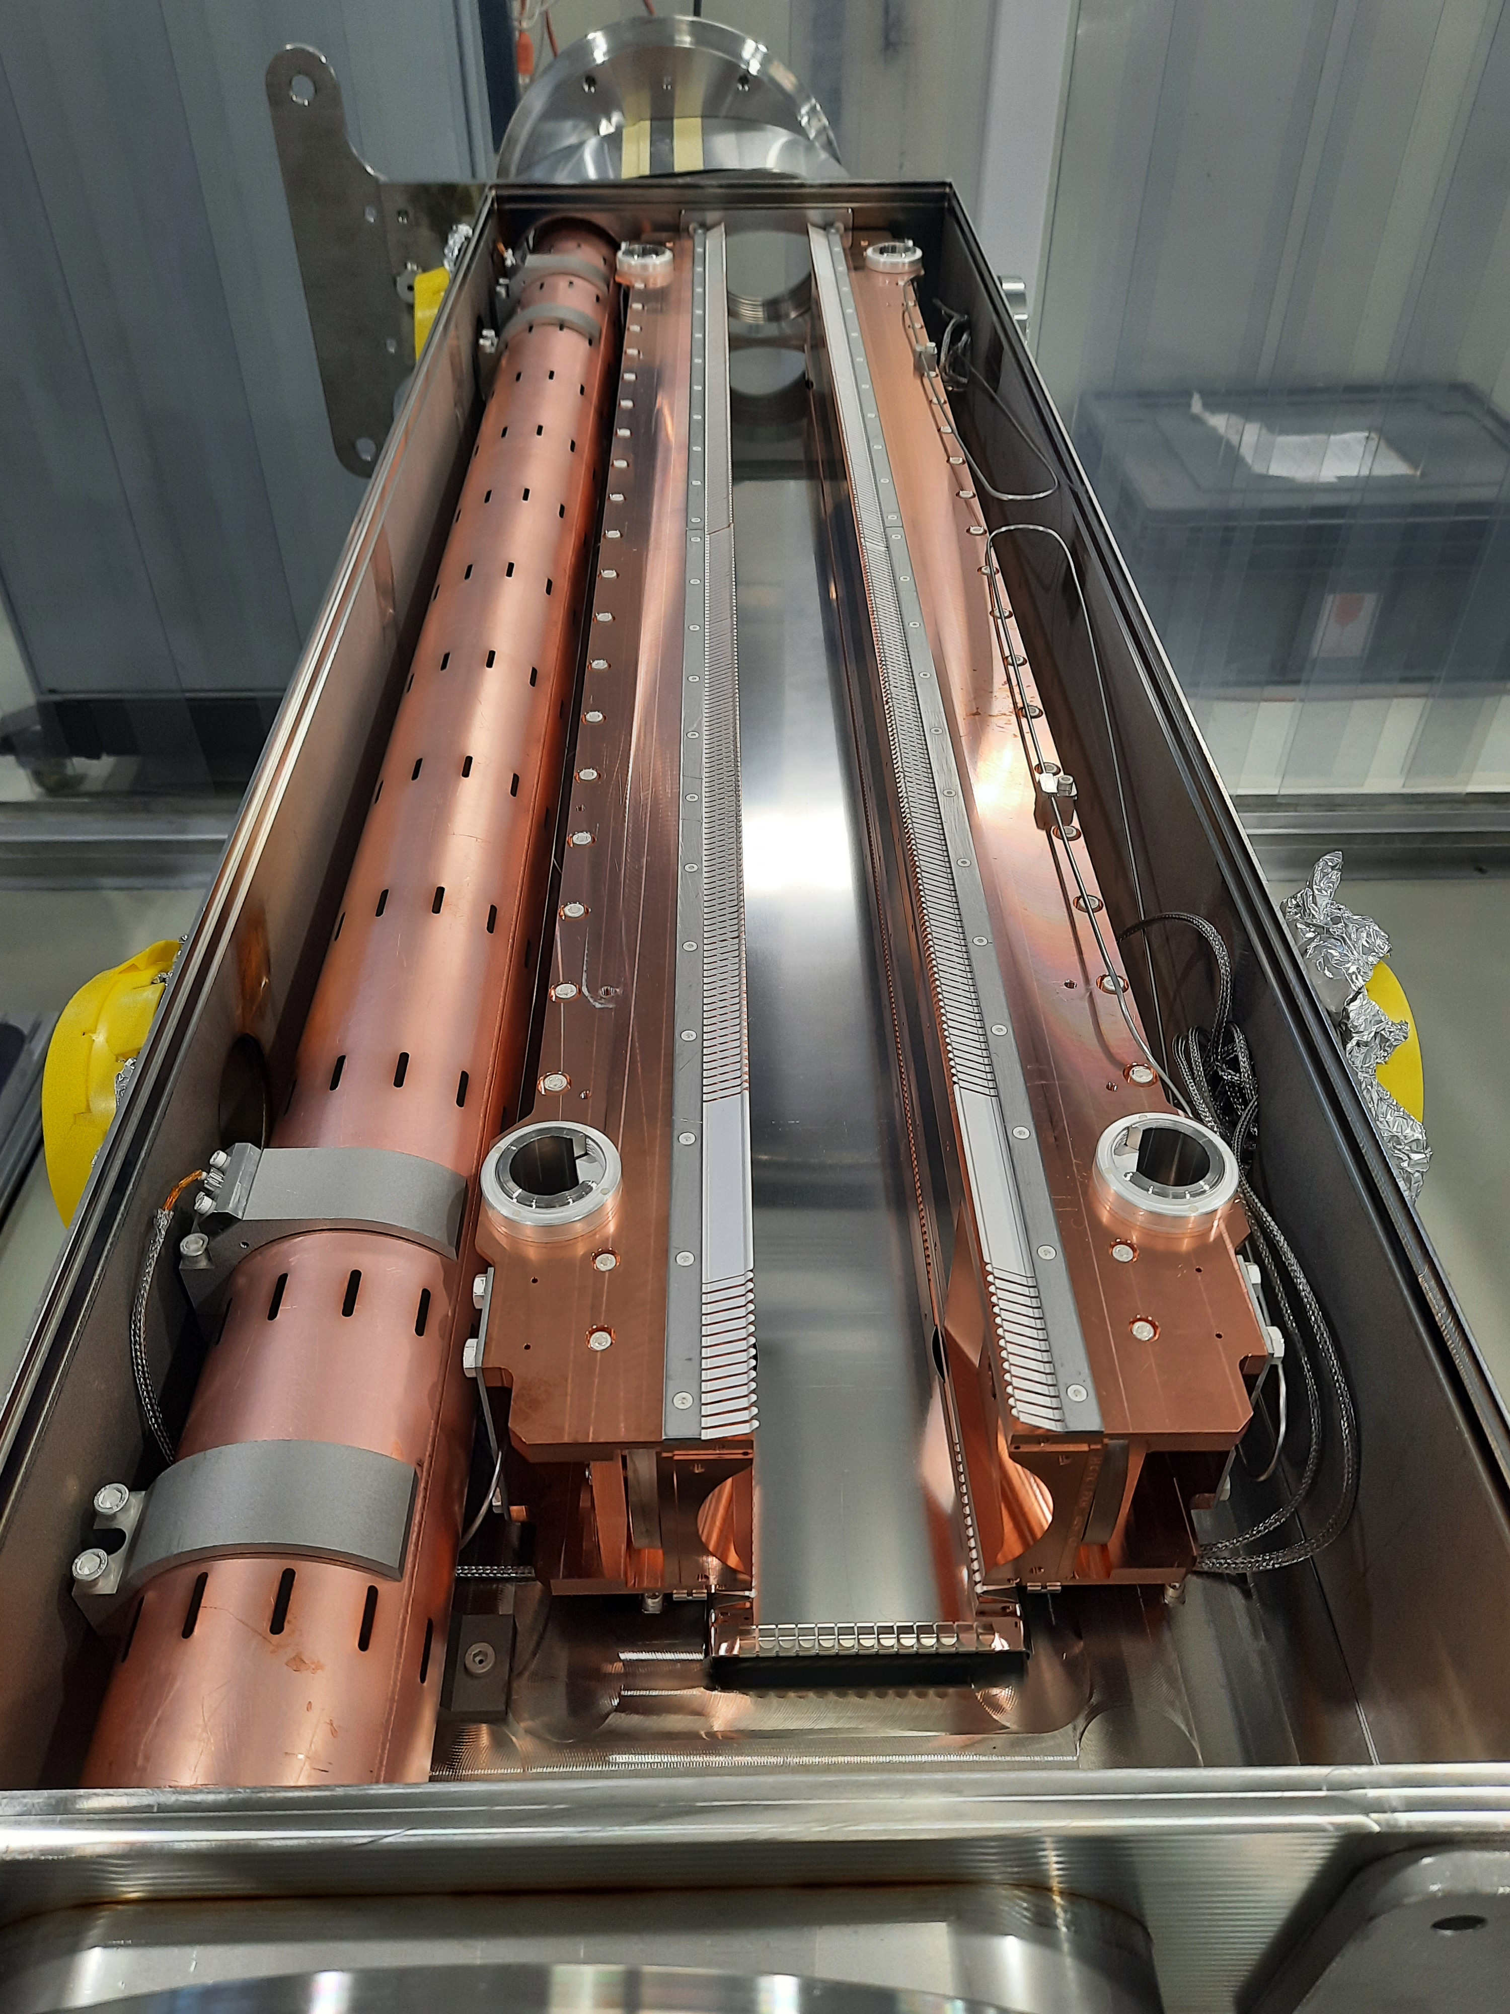
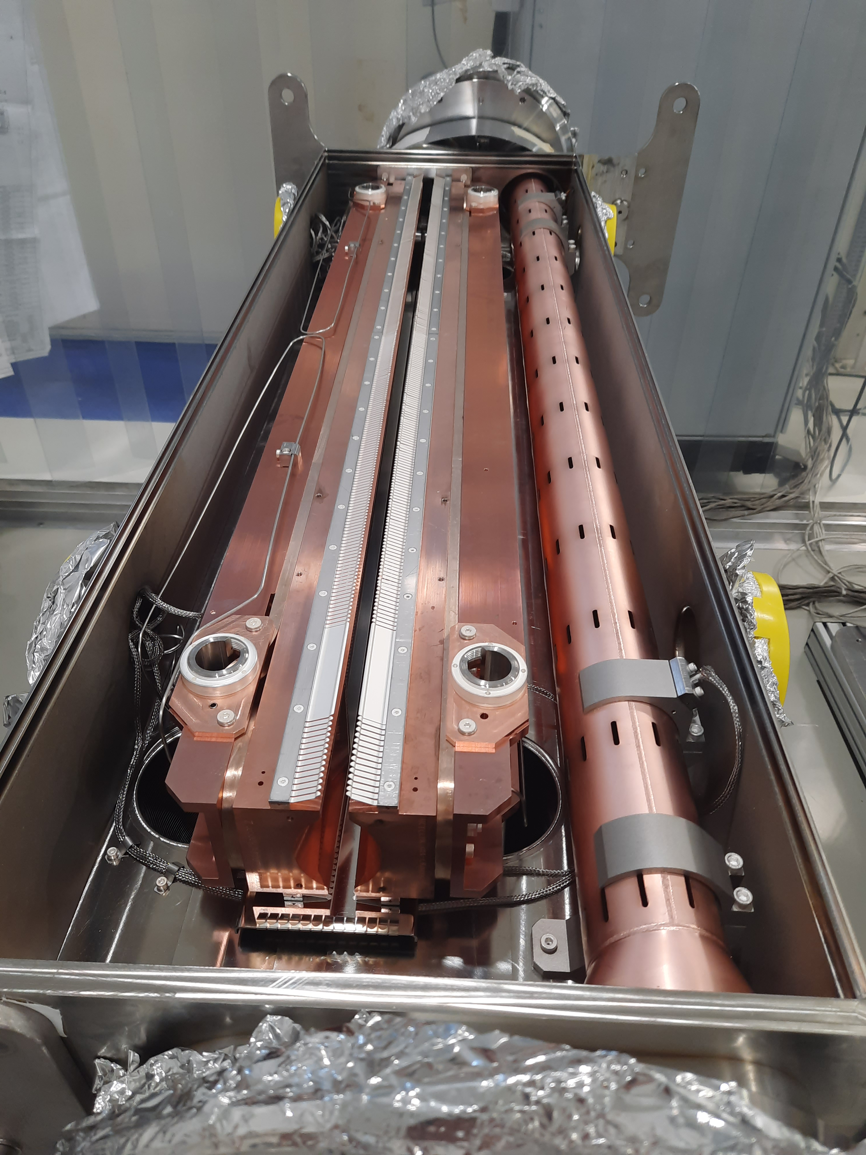
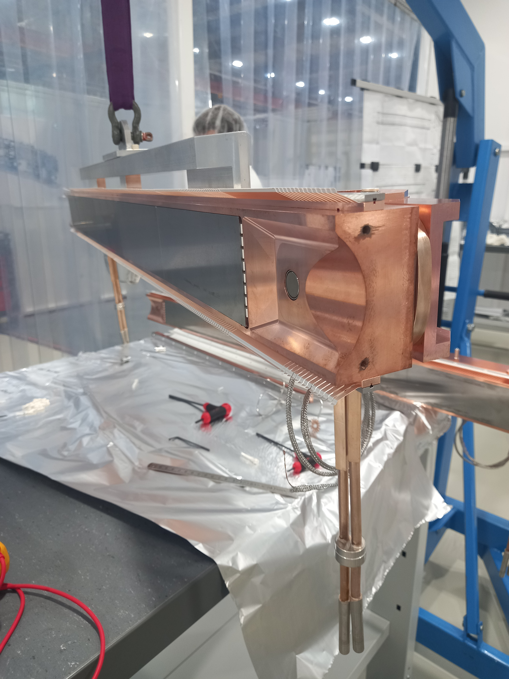
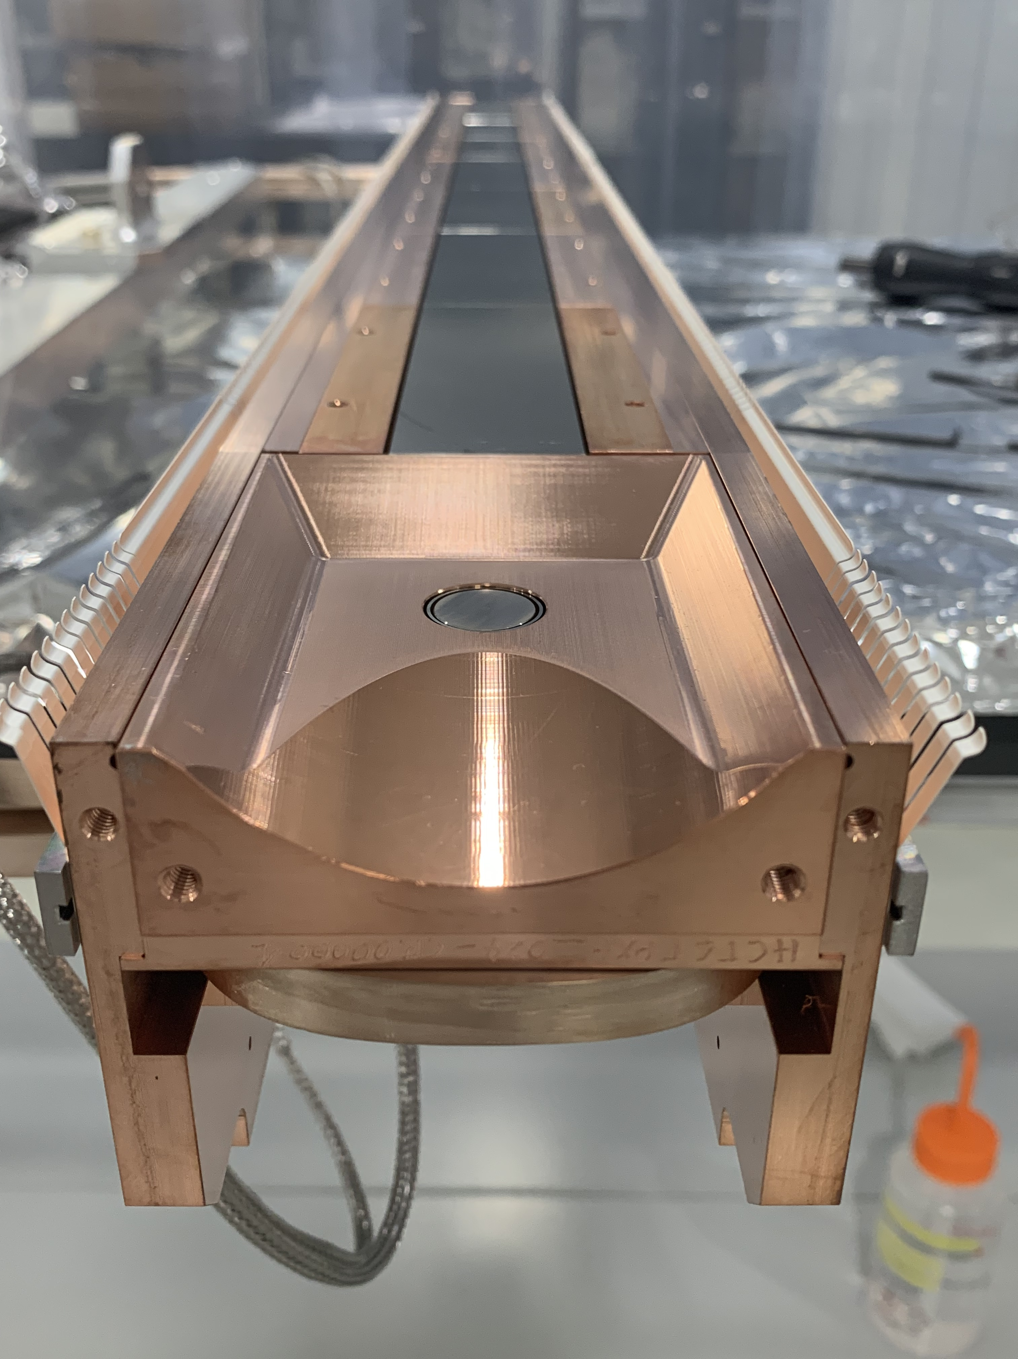
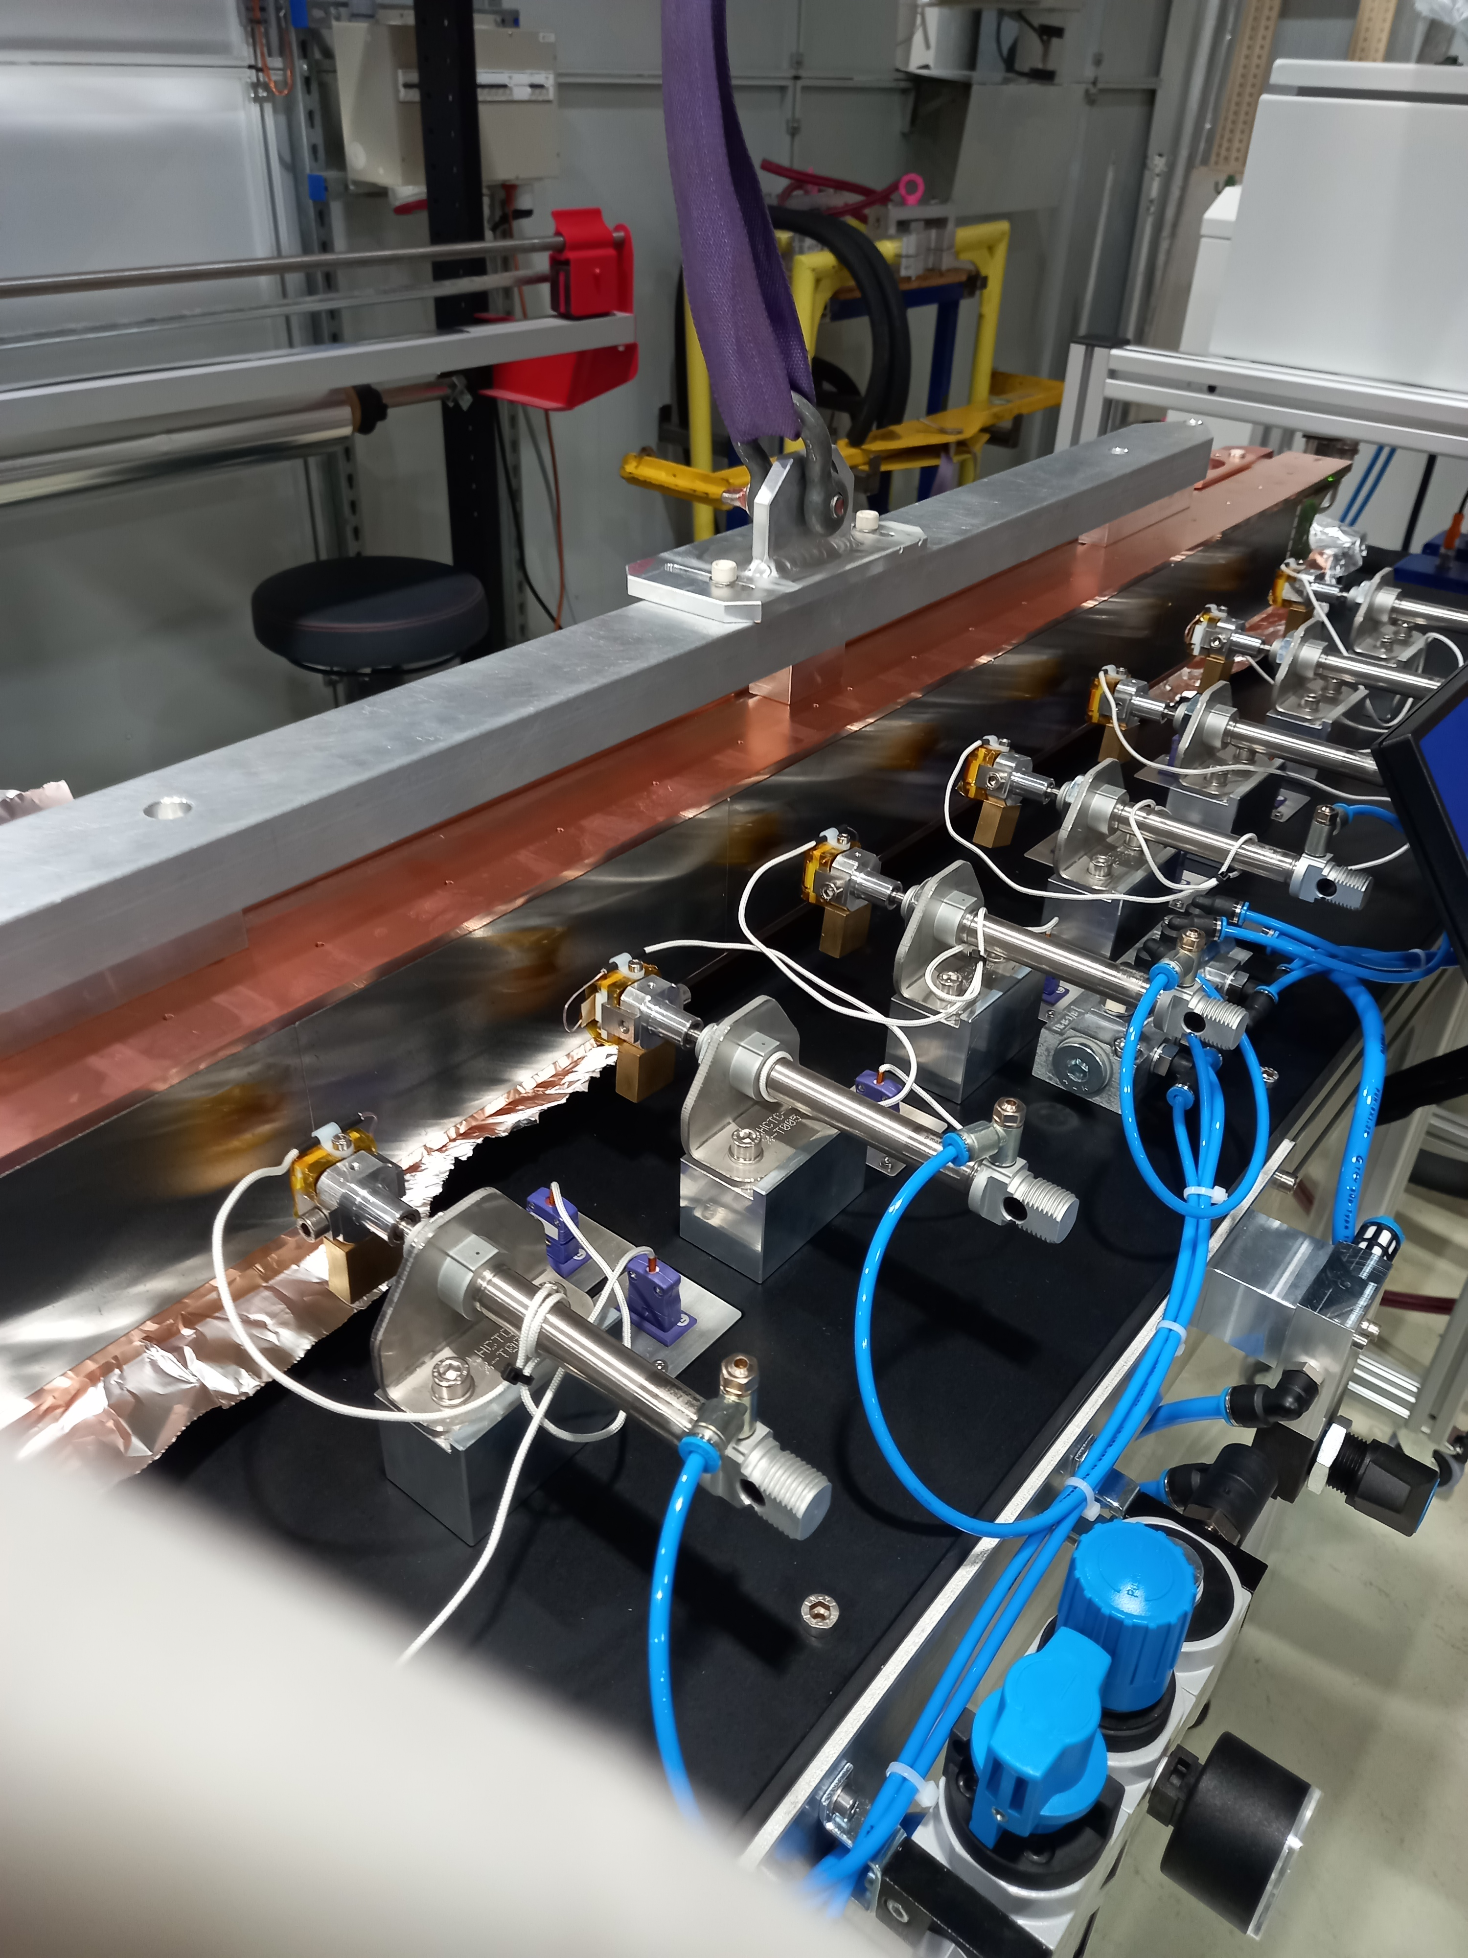
COLLIMATORS FOR THE HIGH LUMINOSITY LHC AT CERN
HiLumi LHC project requires upgrades in collimators
Several collimators have been already replaced and new ones need to be constructed and installed
The poster outlines the upgrade plans for the next Long Shutdown (LS3 – 2026-2028)
Prototypes (pre-series) have been built and tested (shown here)
Test bench to qualify thermal efficiency of jaws is also shown here

