Slide 1
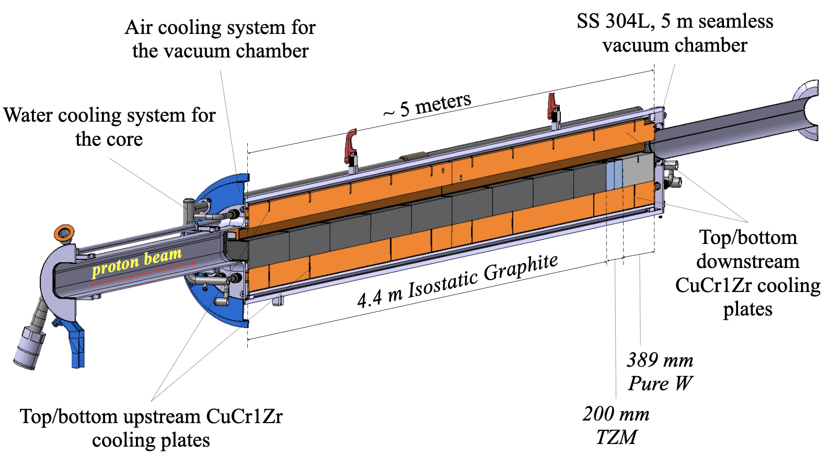
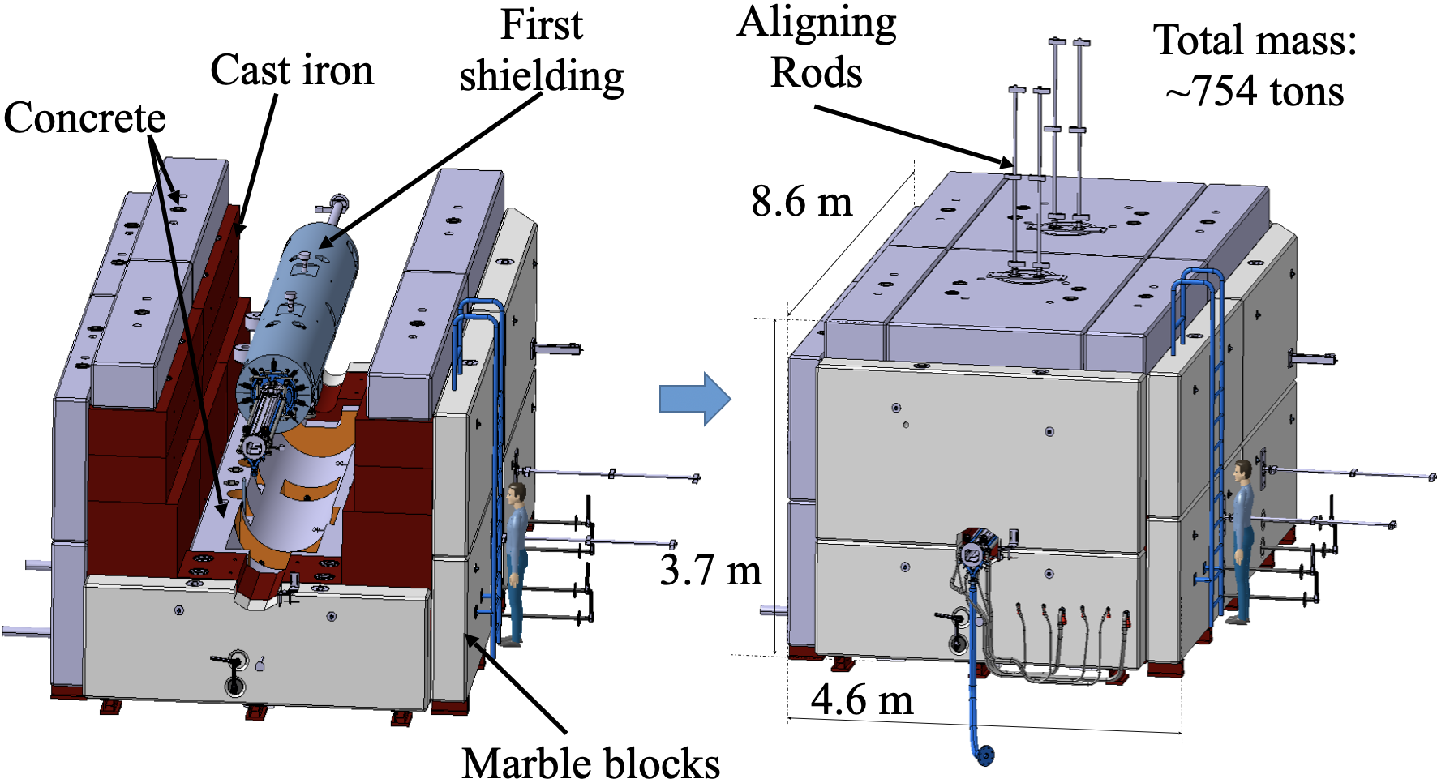
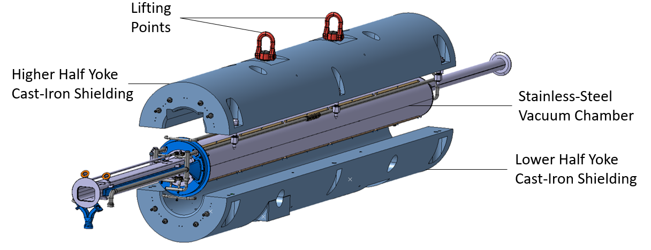
OPERATIONAL EXPERIENCE OF CERN SPS BEAM DUMP
LIU project involved beam power increase from ~60 to ~270 kW in the SPS
A new dump to fulfil the new requirements was built and installed in 2020
The design of the dump is shown here
This poster shows the first 3 years of operational experience
A numerical model of the dump was benchmarked with measurements with beam operation

