Slide 1
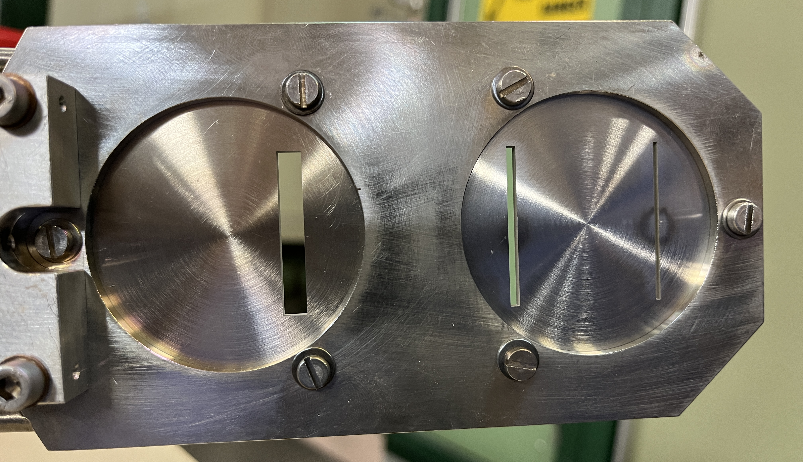
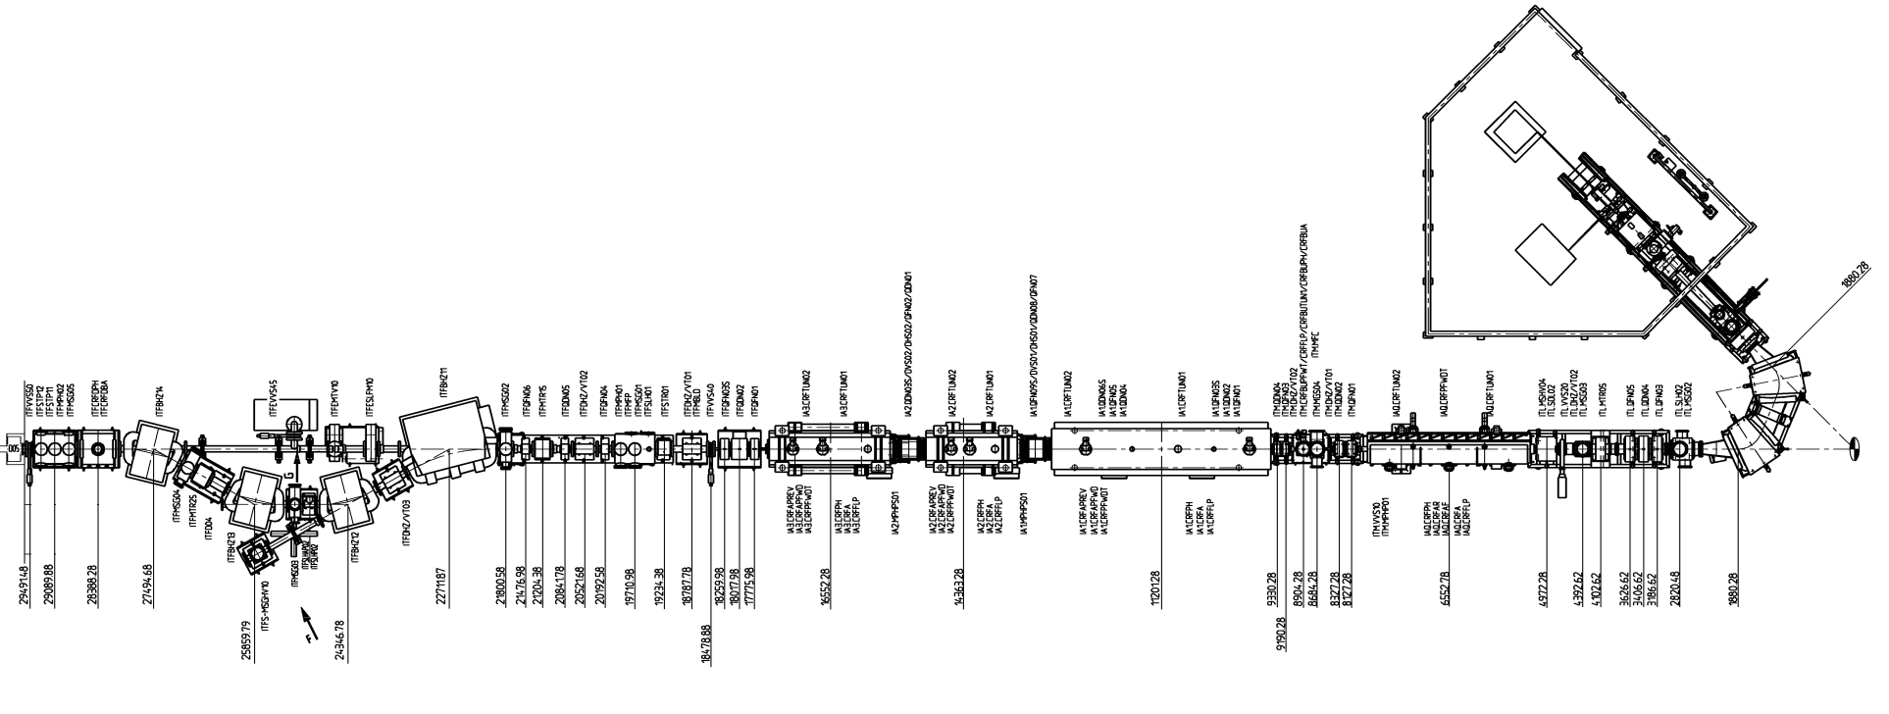
ID 49:LINAC 3 SLITs Consolidation
Designed in 1979
Source
Towards LEIR
1
4
2
3
5
LINAC 3 SLITS location

