Slide 1
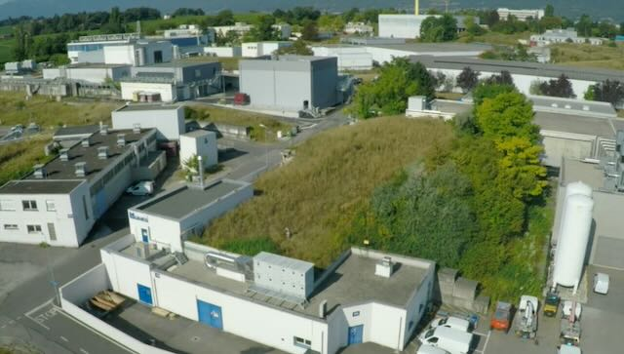
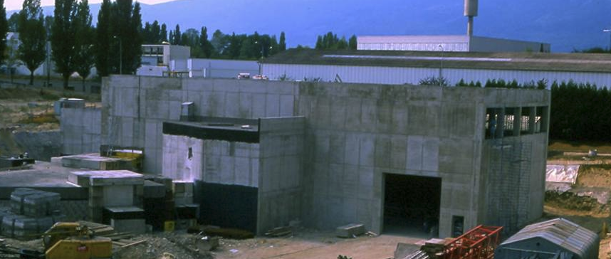
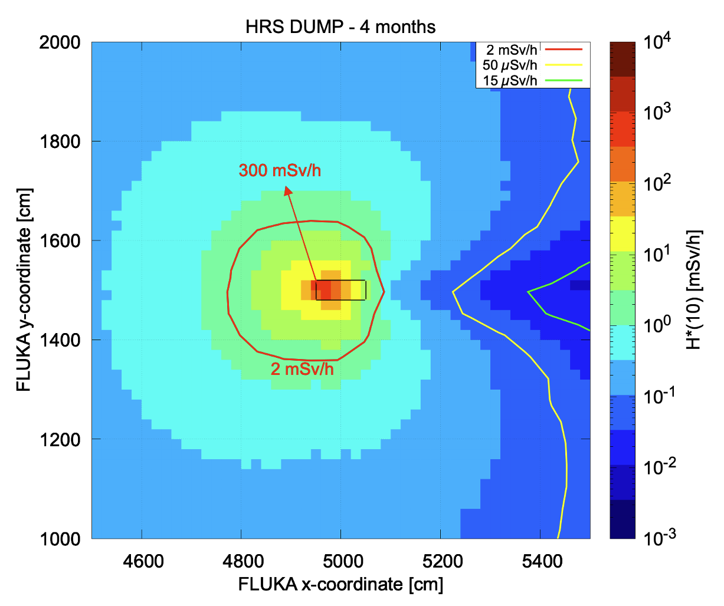
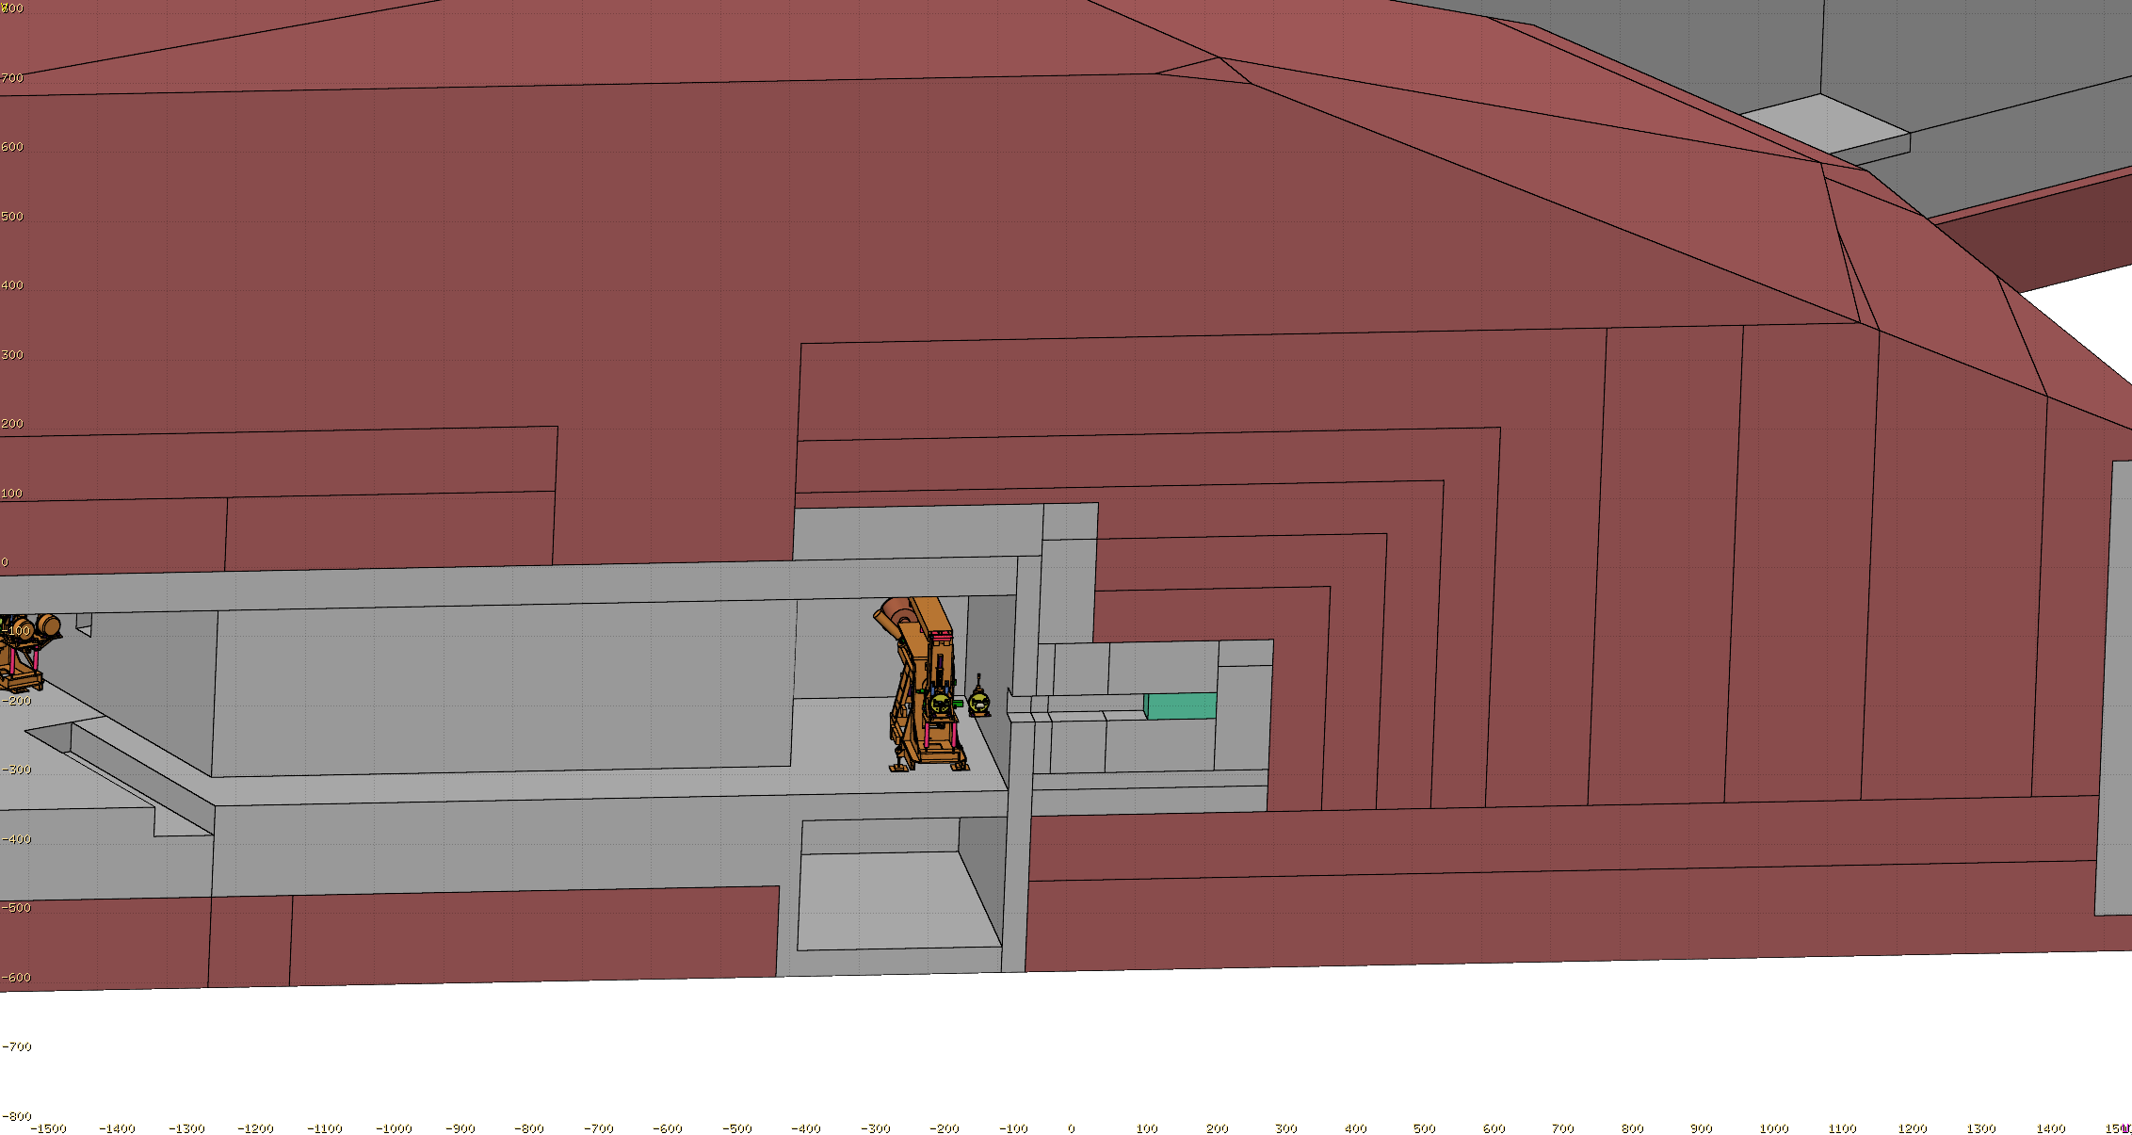
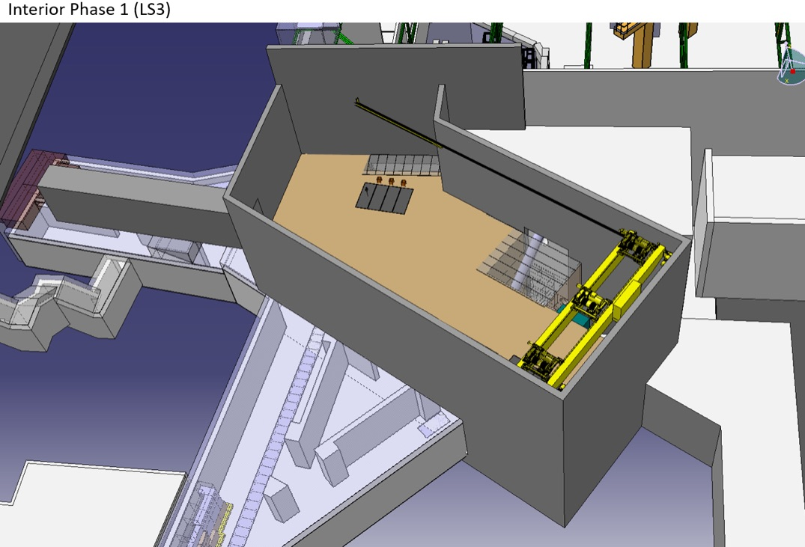
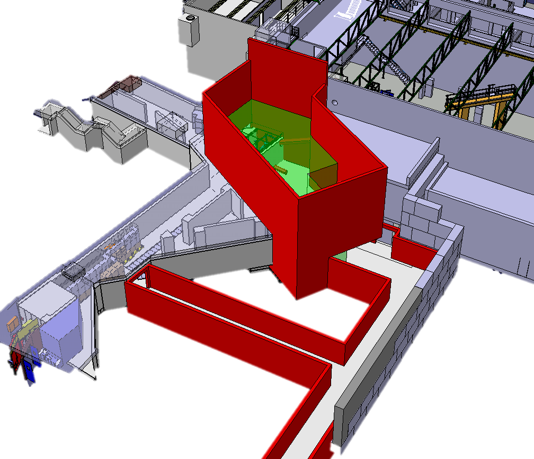
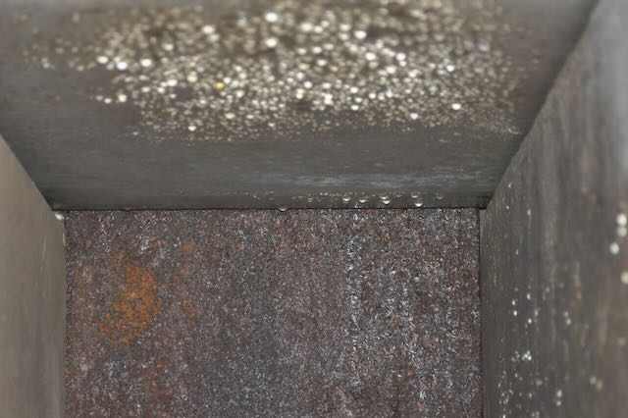
ISOLDE Beam Dump Replacement Study at CERN (Poster 12)
Today
ISOLDE 2023
Future
ISOLDE construction1991-1992
GPS dump
HRS dump
GPS dump and shielding
HRS dump and shielding
8–10m
of earth
Boris tube GPS
GPS dump
Boris tube HRS
Shielding
Activated earth
HRS dump
HRS target area
1x0.4x0.4m
p ⁺ beam
Dump
Future building hosting new dumps

