Slide 1
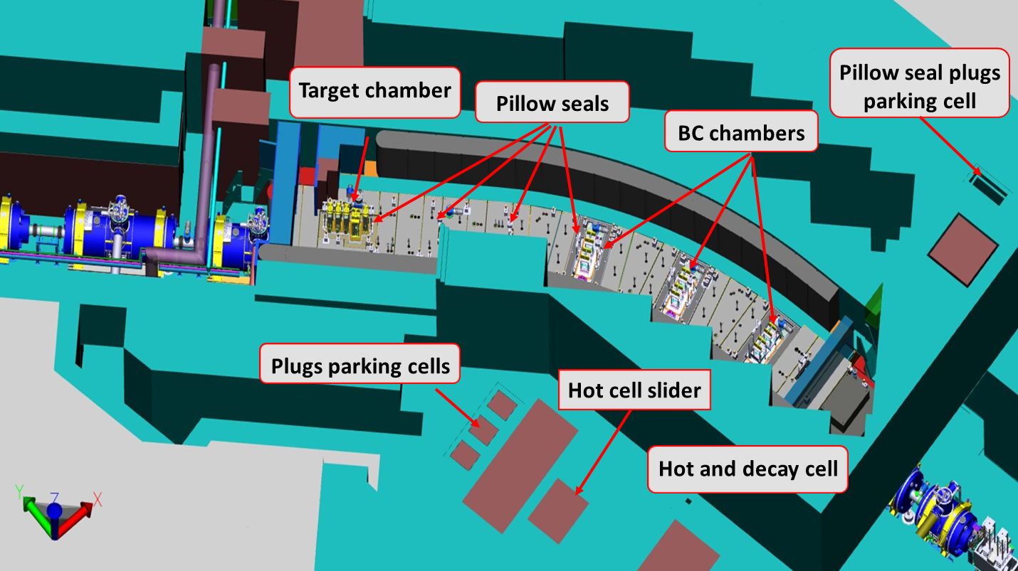
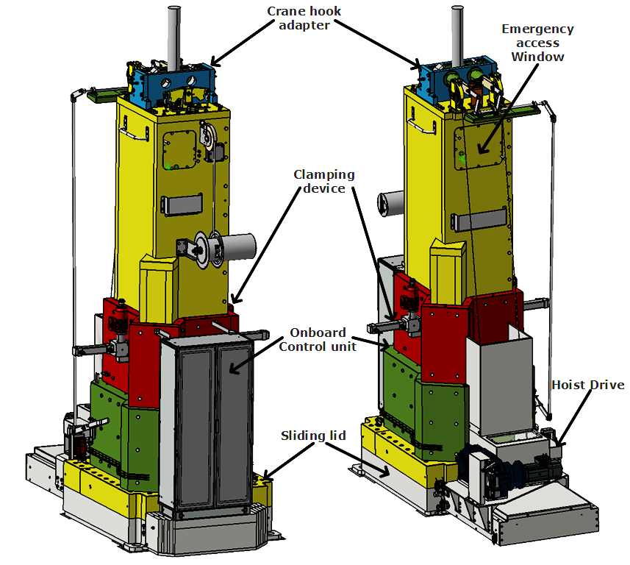
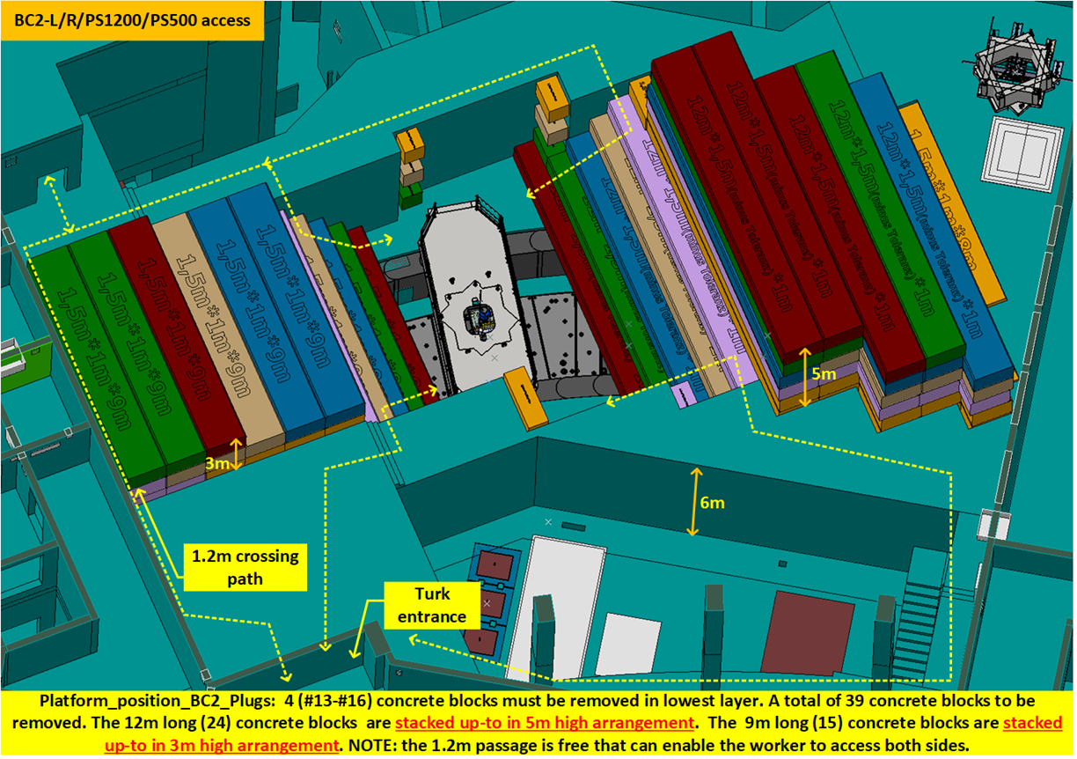
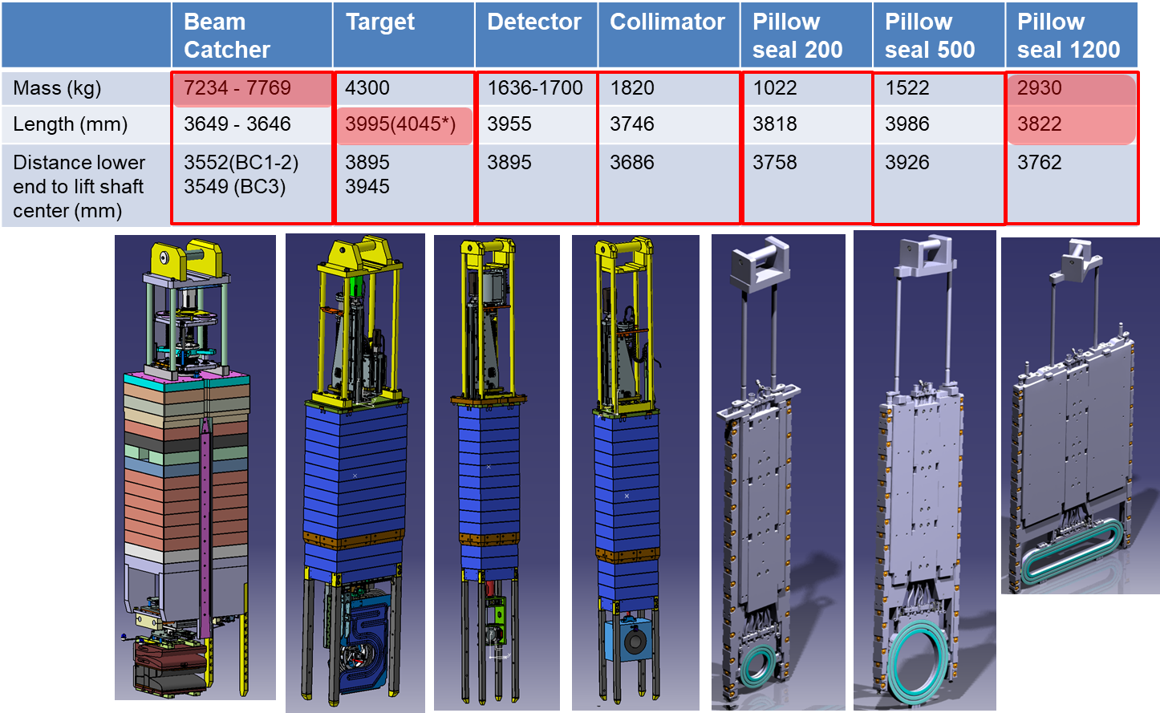
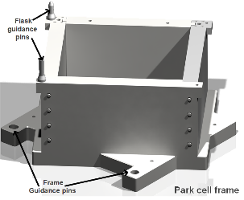
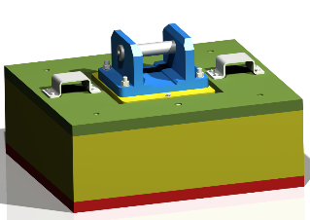
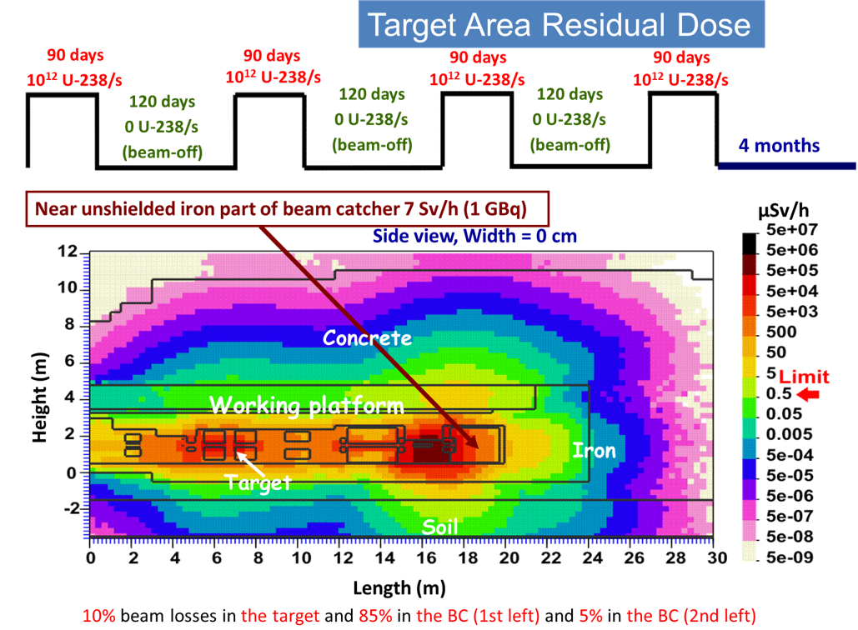
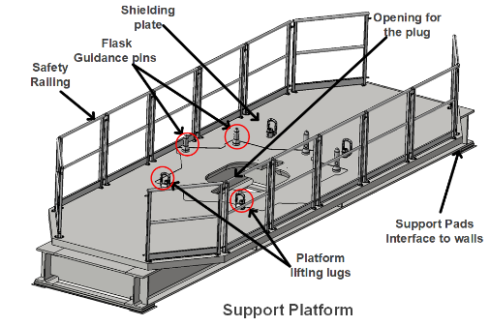
The Super-FRS Shielding Flask Setup
F. Amjad∗, C. Karagiannis, E. Kozlova , M. Duchene, H. Weick GSI Helmholtzzentrum für Schwerionenforschung GmbH, Darmstadt, Germany
Notes:
The Super-FRS target area at FAIR facility is equipped with a total of 21 beamline shielded inserts or Plugs of different shape and sizes.
During facility operation especially the target and beam catchers, that will require replacement and repair.
To do that we have to move the plugs from the beamline into the hot cell facility. However to transfer the activated plugs with in between beamline and hot-cell shielding flask is required. In this poster I will present the Super-FRS Shielding flask that will ensure the remote handling of the plugs and transfer in between beamline and hot cell. The Shielding flask contract was awarded to BNG in end of 2020, that is now under production. The delivery is planned for Q4 2024 with assembly and prolonged commissioning in Q1-2 of 2025.

