Slide 1
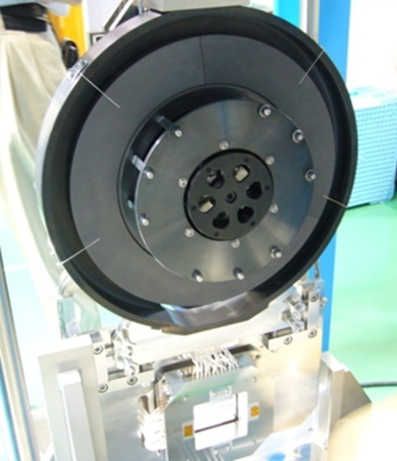
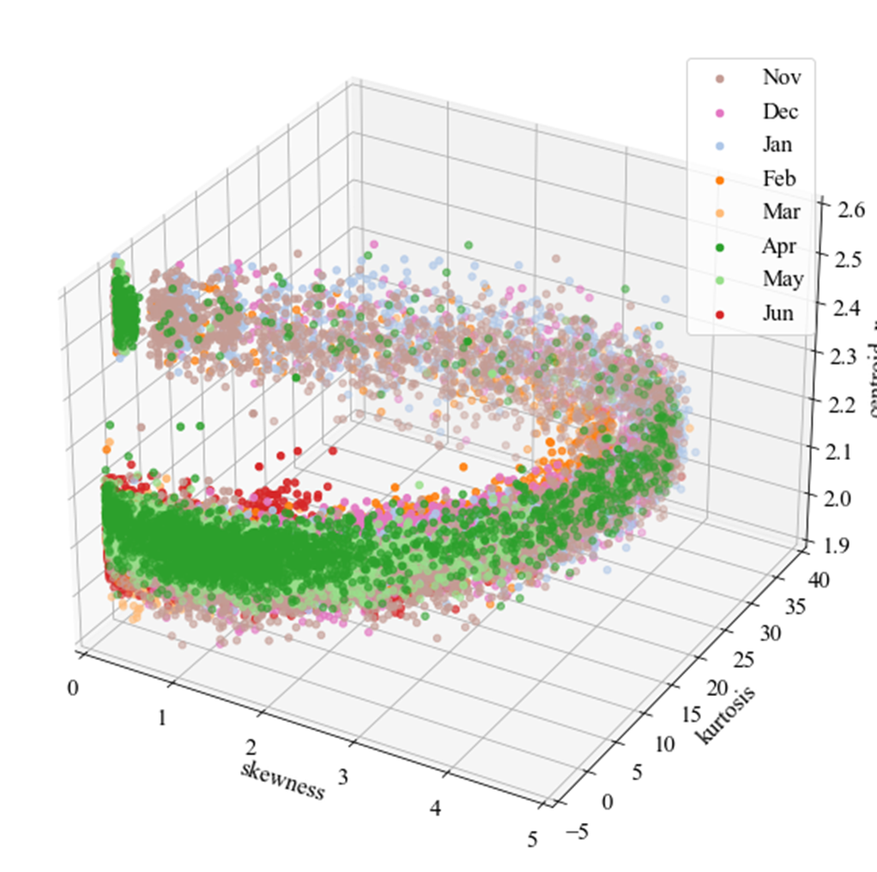
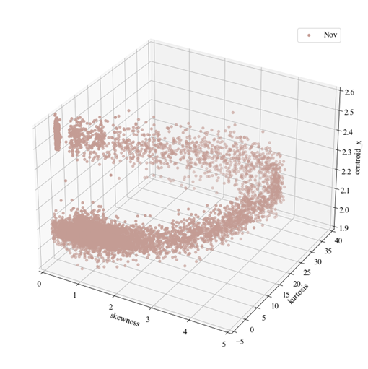
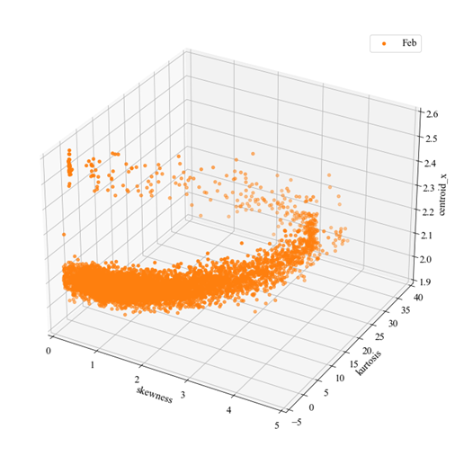
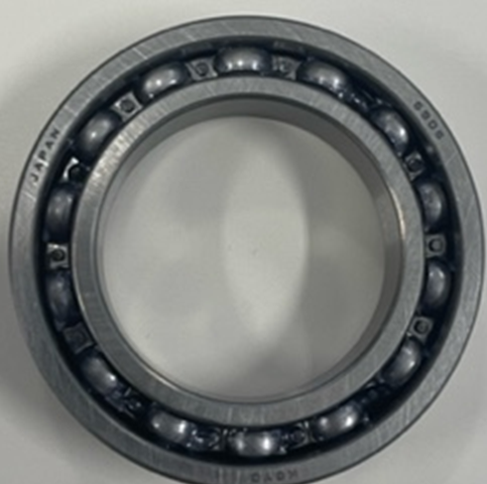
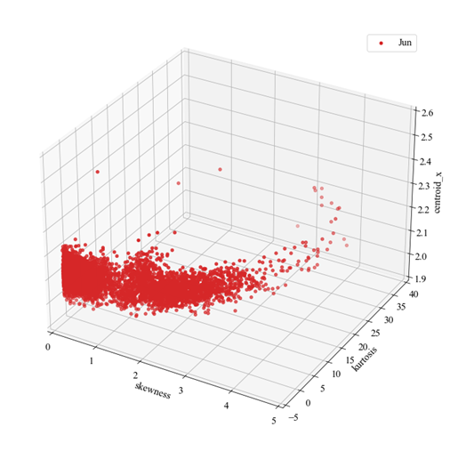
Analysis of rotational vibration of muon production target
at J-PARC MLF
P15
H. Sunagawa¹, S. Matoba¹, N. Kawamura¹
1 - High Energy Accelerator Research Organization, Institute of Material Structure Science
(KEK IMSS)
The rotational muon
production target
3 month later
Rotating
Vibration
Vibration Pattern of Bearing
6 month later
X-axis : Skewness
Y-axis : Kurtosis
Z-axis : Centroid_x
This shift means that vibration of bearing is increasing over time.
Bearing wear out

