Slide 1
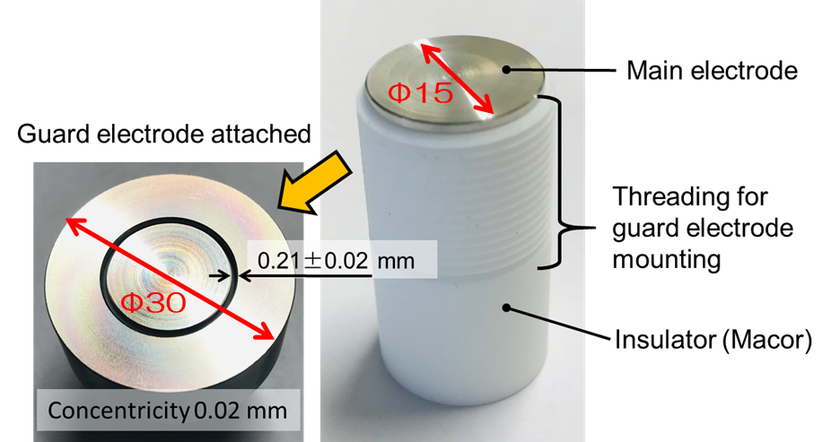
Poster #16
Development of radiation-resistant distance-sensor for rotating-disk-type target at J-PARC Hadron Experimental Facility.
Fumimasa MUTO for Hadron Beam Line Group ( KEK / IPNS )
The rotating target has many advantageous. On the other hand condition monitor is not easy task.
→ Fully inorganic distance-sensor for target monitoring is now under development .
Fully inorganic distance sensor & coaxial cable

