Slide 1
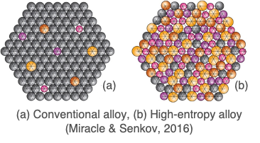
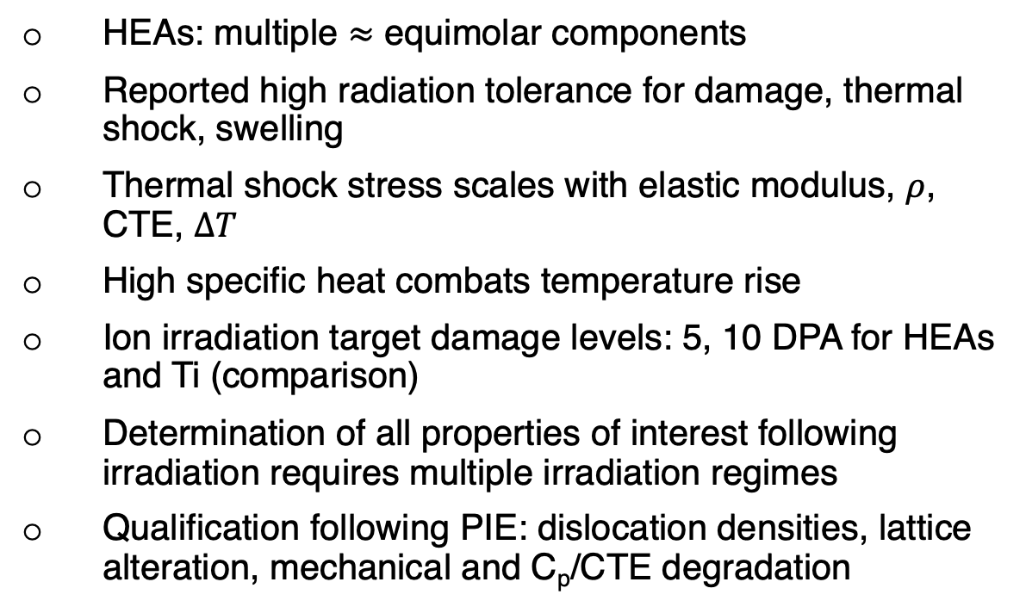
Novel materials irradiation and pre-characterization plans for high-power targetry applications
A. Burleigh¹, K. Ammigan¹, F. Pellemoine¹, S. Bidhar¹, A. Couet², N. Crnkovich², and I. Szlufarska²
¹ Fermi National Accelerator Laboratory, Batavia, IL
² University of Wisconsin-Madison, Madison, WI
High Entropy Alloys (HEAs) for high-power beam windows
HEAs: multiple $≈$ equimolar components
Reported high radiation tolerance for damage, thermal shock, swelling
Thermal shock stress scales with elastic modulus, $ρ$, CTE, $ΔT$
High specific heat combats temperature rise
Ion irradiation target damage levels: 5, 10 DPA for HEAs and Ti (comparison)
Determination of all properties of interest following irradiation requires multiple irradiation regimes
Qualification following PIE: dislocation densities, lattice alteration, mechanical and C_{p}/CTE degradation

