Slide 1
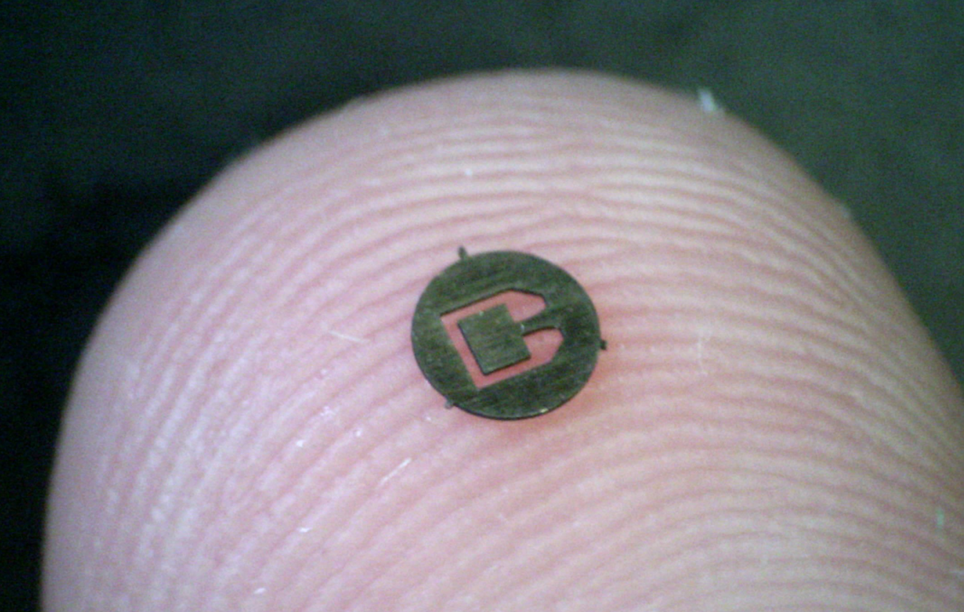
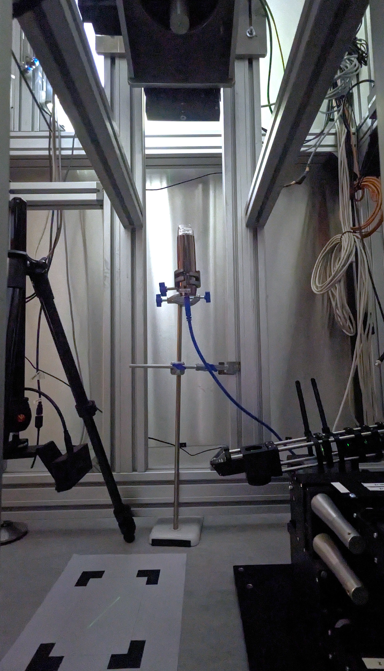
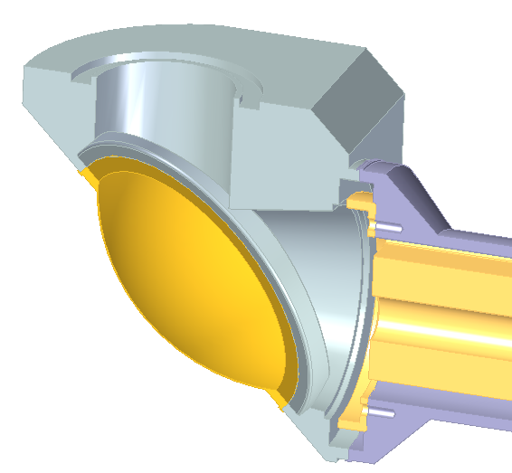
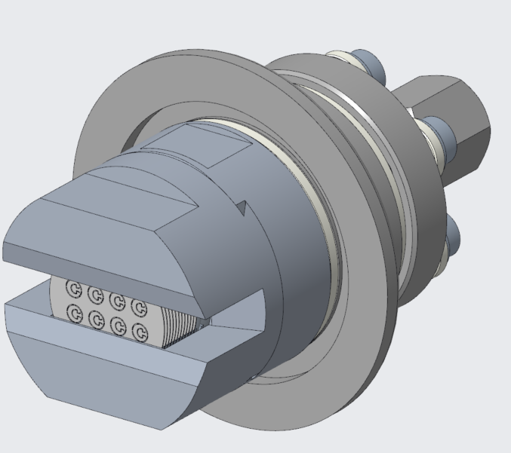
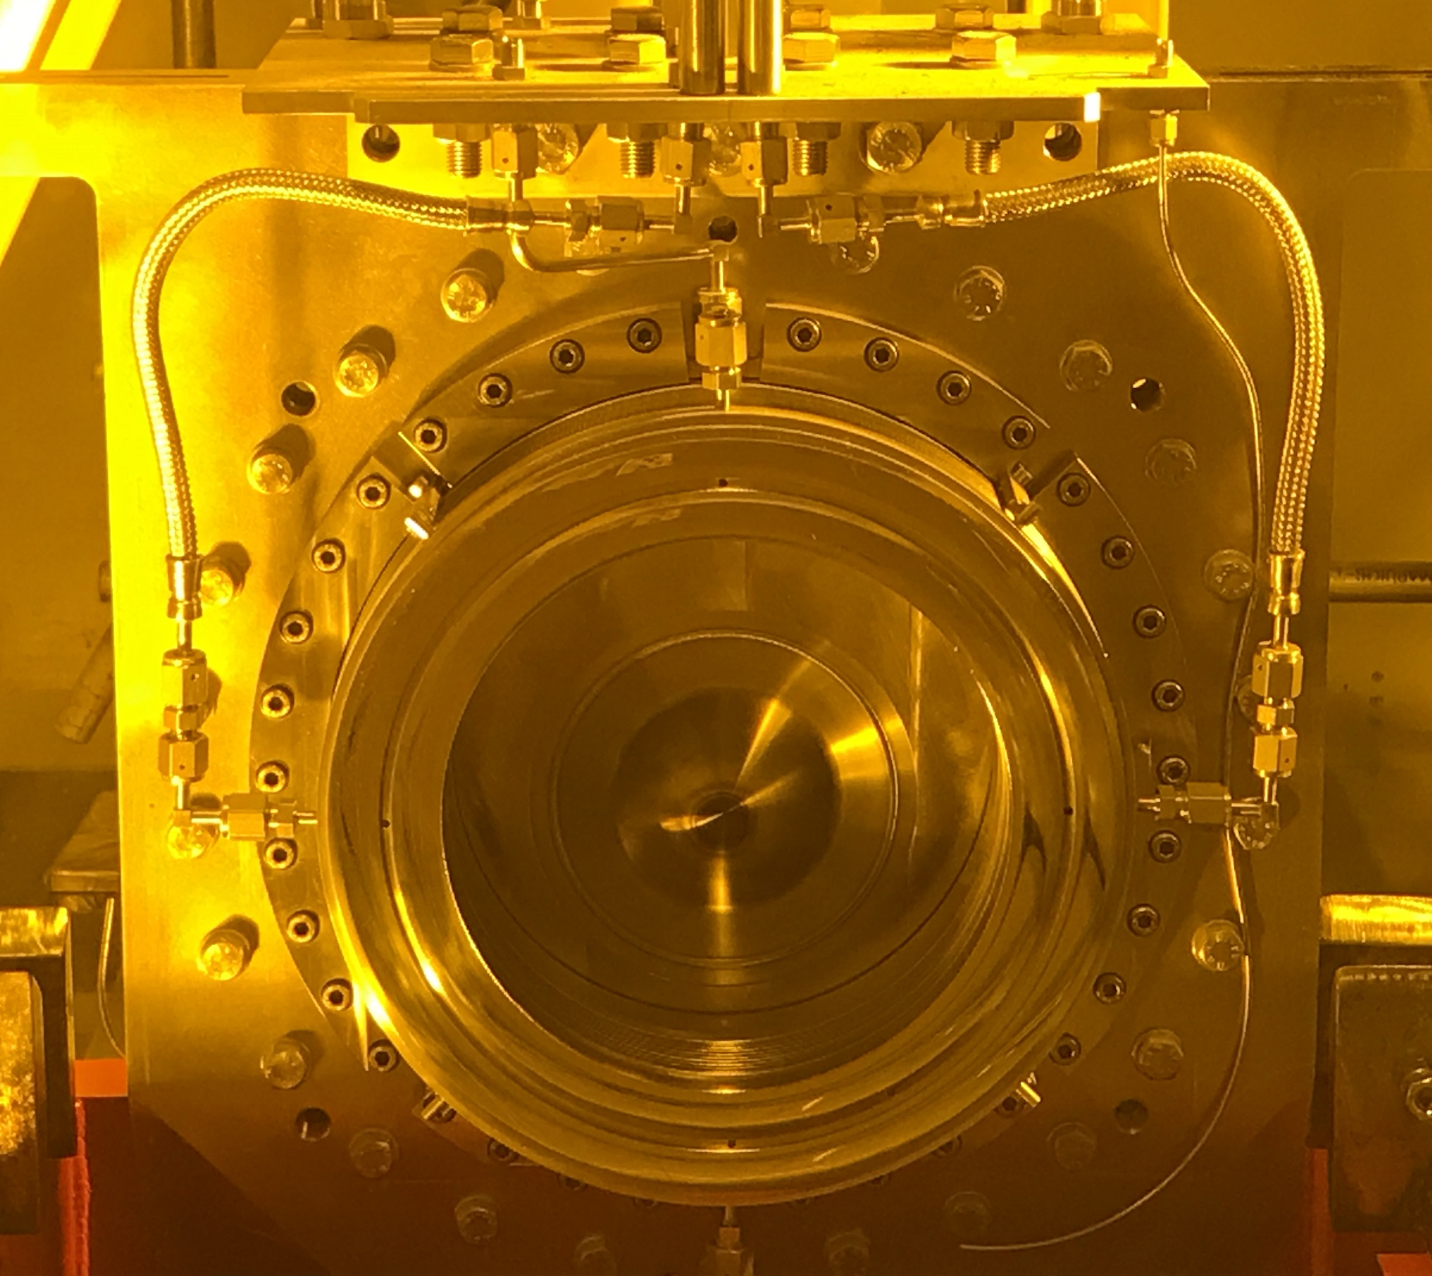
Testing Irradiated Titanium Alloys for High-Cycle Fatigue Richard Cowan, Phil Earp, Mike Fitton, Eric Harvey-Fishenden
1. Reasons: Beam Window Fatigue Worries
2. Samples: Benefits and Irradiation Campaigns
3. Commissioning: Ultrasonic Fatigue Rig Methods and Calibration Results
Meso-scale Cantilever
Ultrasonic Fatigue Rig setup description
Laser strain evaluation
Sample mounted to vertically oscillating ultrasonic horn and deflects due to inertia
LBNF Target Upstream Beam Window
Laser
Mirrored surface of sample reflects laser
LBNF 120Gev beam
Birmingham Sample Irradiation Environment
T2K Target Upstream Beam Window
Line formed corresponding to sample deformation
S-N Curve for unirradiated calibration samples
p⁺
N₂ gas
T2K 30 GeV beam

