Slide 1
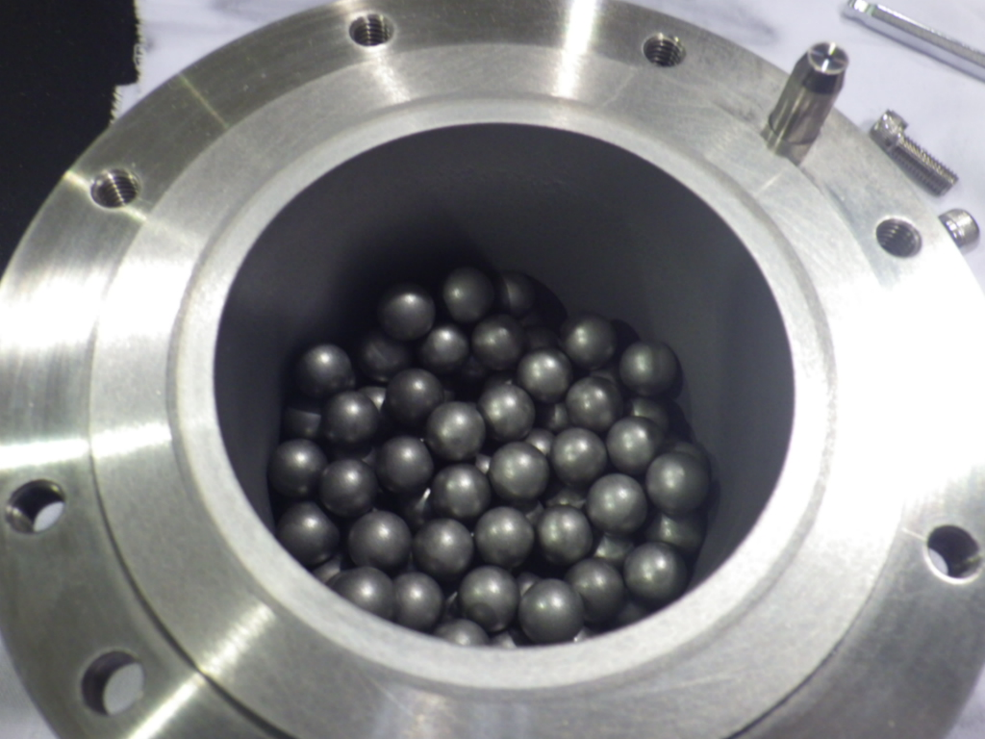
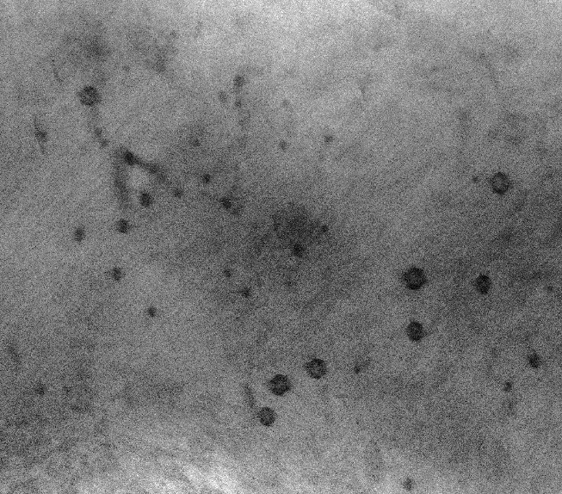
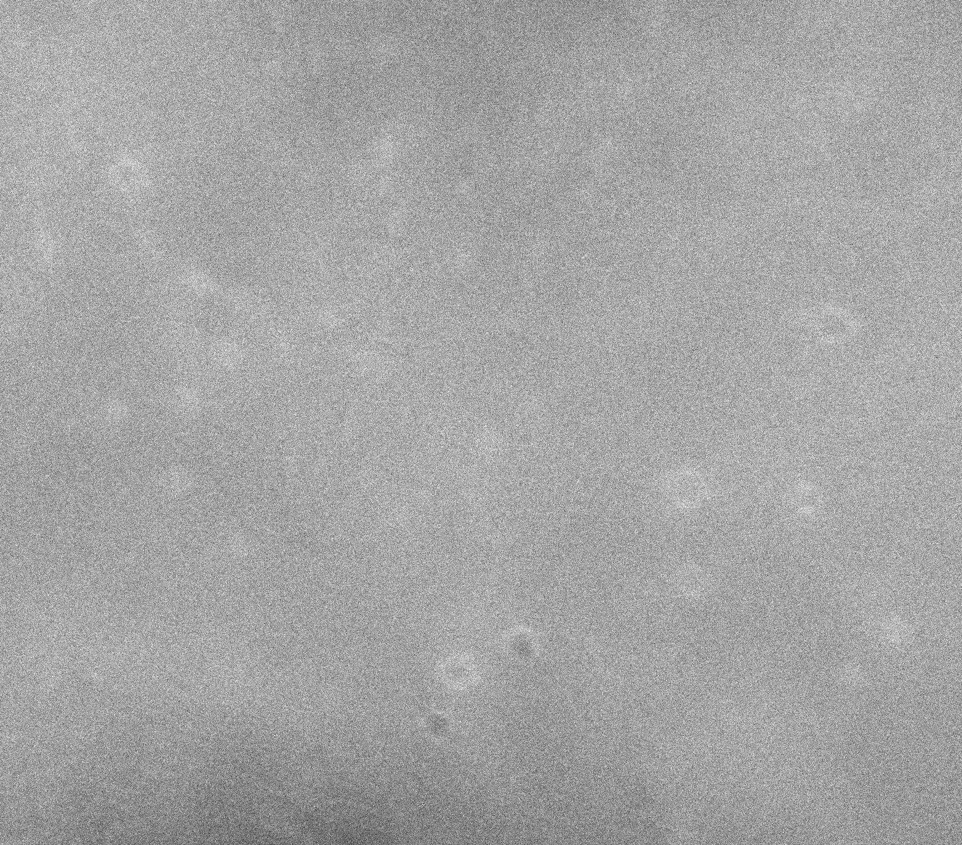
Fabrication of W-1.1%TiC with helium bubbles
via powder metallurgical route
incorporated with helium ambient mechanical alloying
There are no reports on bulk W alloys including only He bubbles.
W alloys with He bubbles were fabricated by MA in He atmosphere.
Bright Field Image
HAADF Image
He Bubbles
50nm
No radioactivity
Mechanical alloying
in He atmosphere
No ion implantation
No displacement damage

