Slide 1
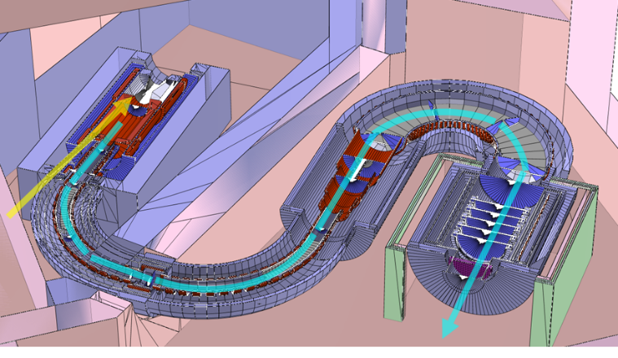
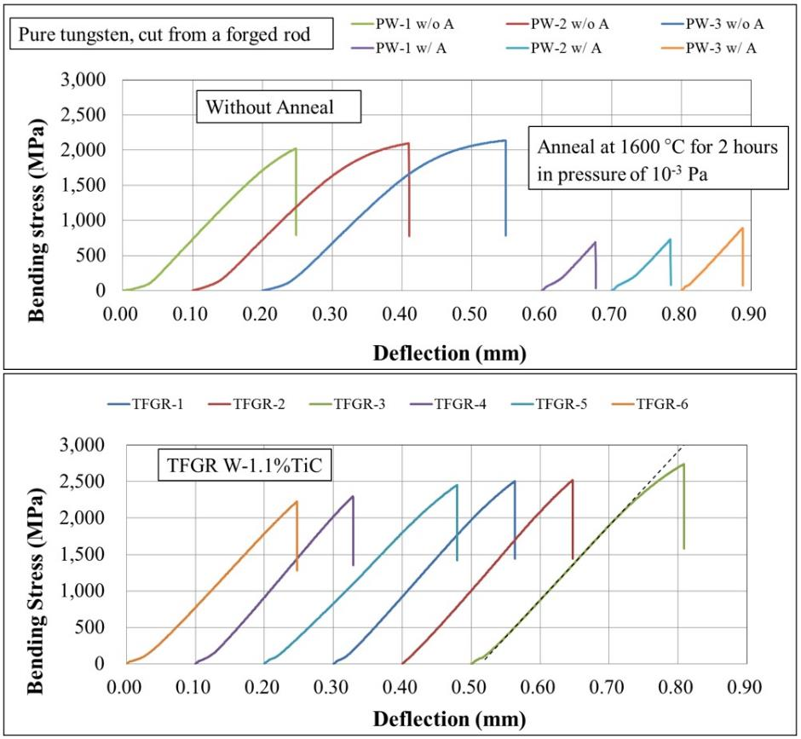
Recent Progress in development of
Toughened, Fine Grained, Recrystallized Tungsten
Shunsuke Makimura @J-PARC
Poster 22
ID98
COMET Phase 2
Pure tungsten
Annealing
Tungsten: expected as target
Brittle
Plastic working
TFGR W
Ductile
Revert at High temperature
After 1650 °C
Recrystallization embrittlement
Overcoming recrystallization embrittlement

