Slide 1
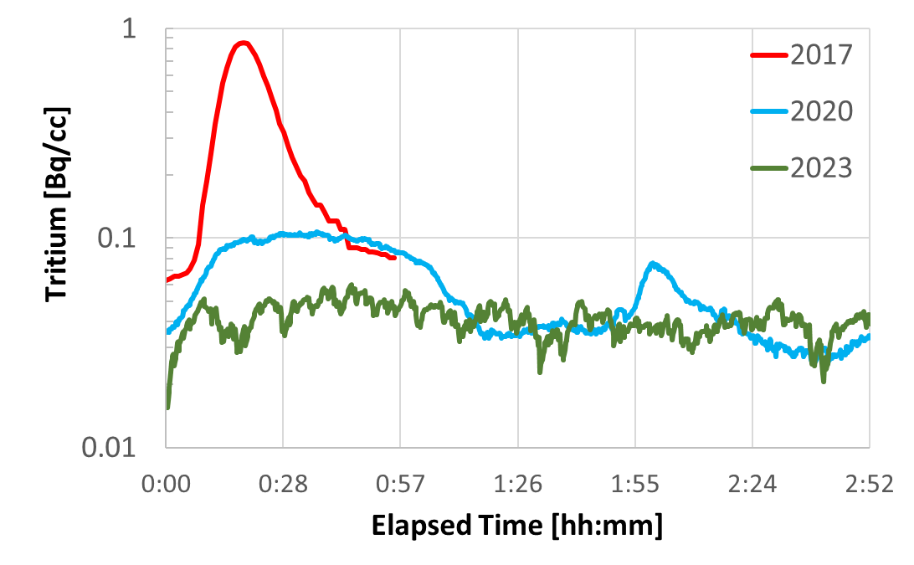
Poster 24
HPTW2023
Life cycle of the proton beam window in J-PARC MLF
- PBW replacement work in 2023 -
Motoki Ooi, Yuji Yamaguchi, Hidetaka Kinoshita, Shin-ichiro Meigo, Katsuhiro Haga
J-PARC center / JAEA
Proton Beam Window is boundary of Accelerator and Neutron source in J-PARC MLF.
The PBW is replaced every 3 years and we replaced from PBW #4 to the PBW #5 in last month.
My presentation is about PBW replacement work at J-PARC MLF.
Hands on work above PBW
Tritium concentration in air above the PBW after pillow seal released
Work hold point 0.8 Bq/cc
Work
Neutron target
Detection level
PBW
water dripped from pipe (2020)
Proton beam line
07/11/2023, 17:39

