Slide 1
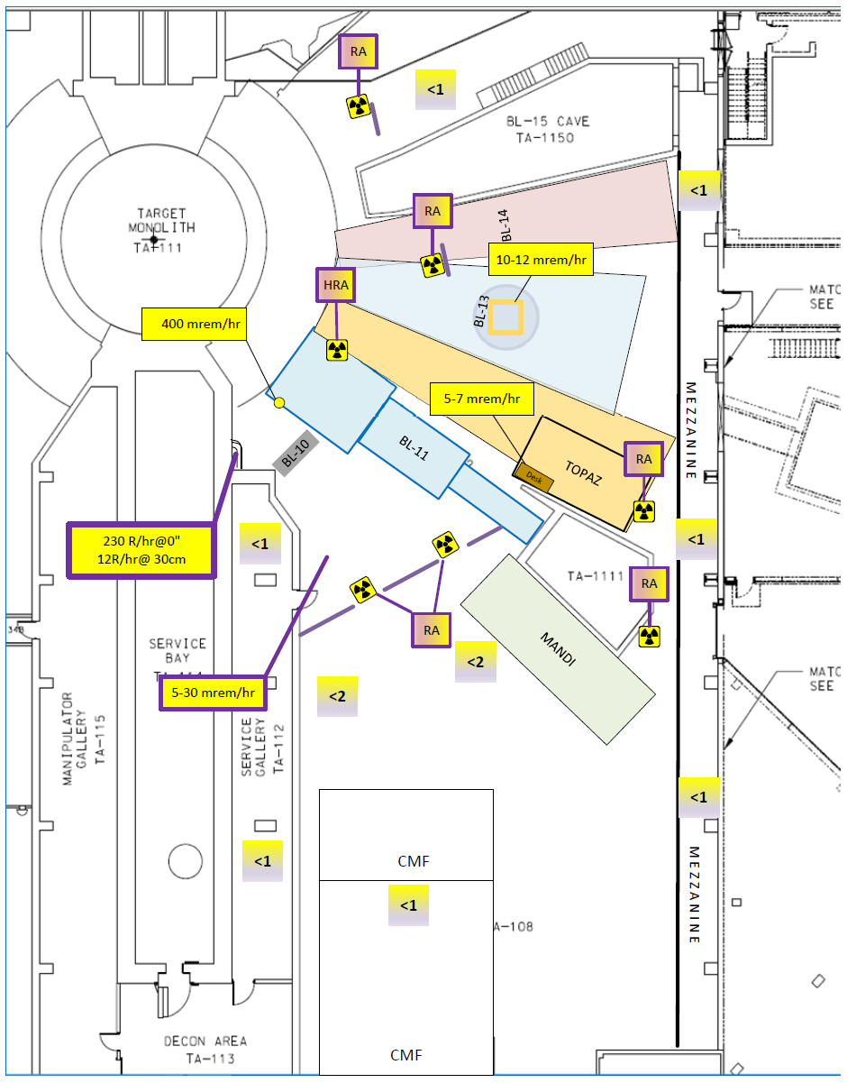
Impact and Lessons Learned from the Mercury System Filling Incident at the Spallation Neutron Source
SNS mercury process system contains 1600 L of radioactive mercury
On March 21, 2019, over 300 L of that mercury was blown out of the loop
A small amount of mercury created a 2.3 Sv/hr radiation source in an unshielded area
SNS was shut down for 3 months to address the safety issue

