Slide 1
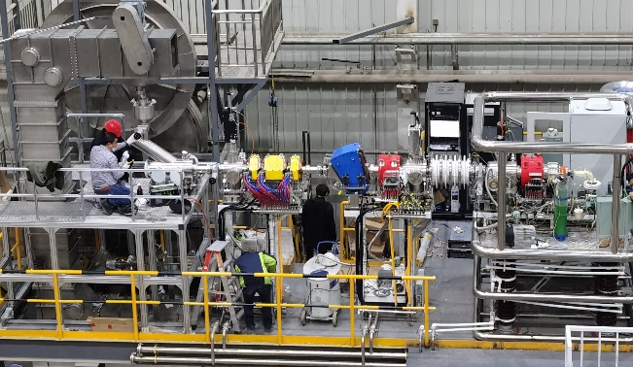
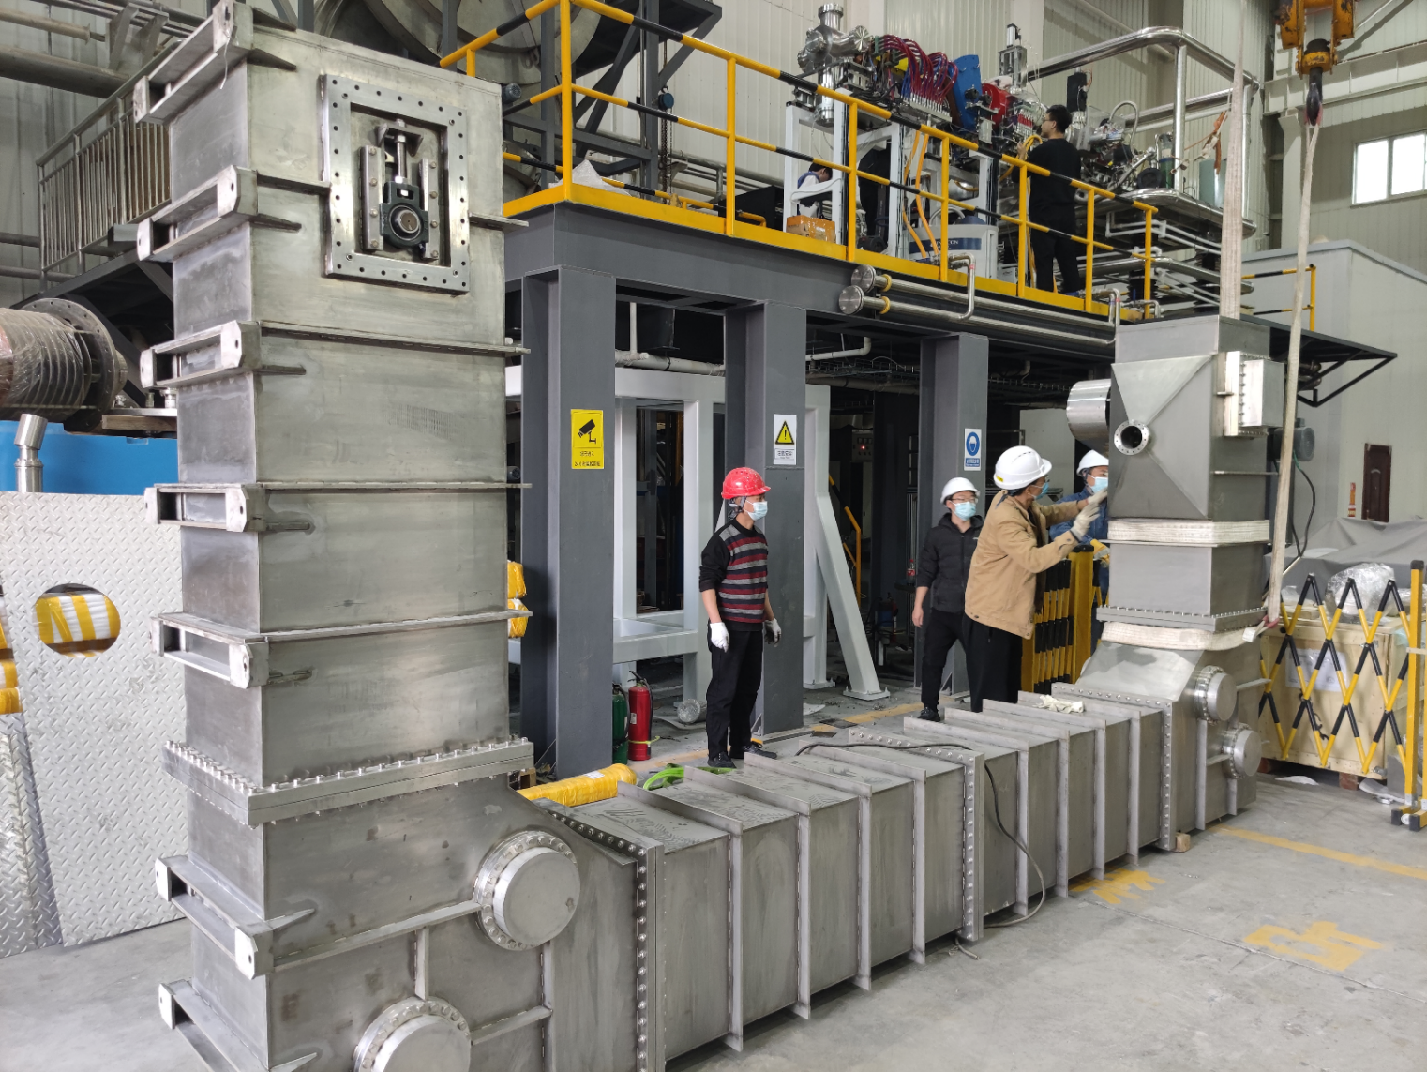
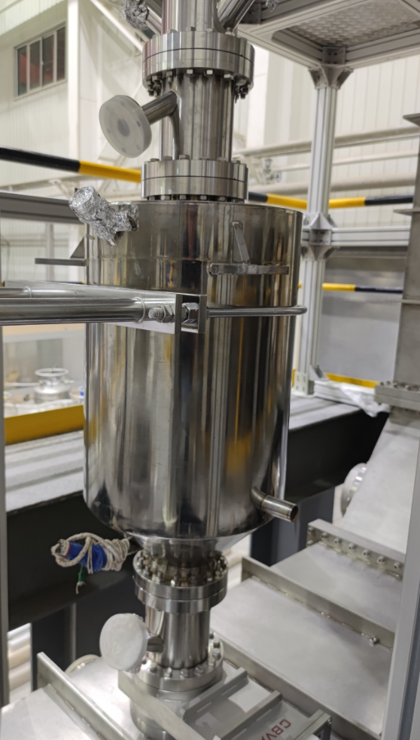
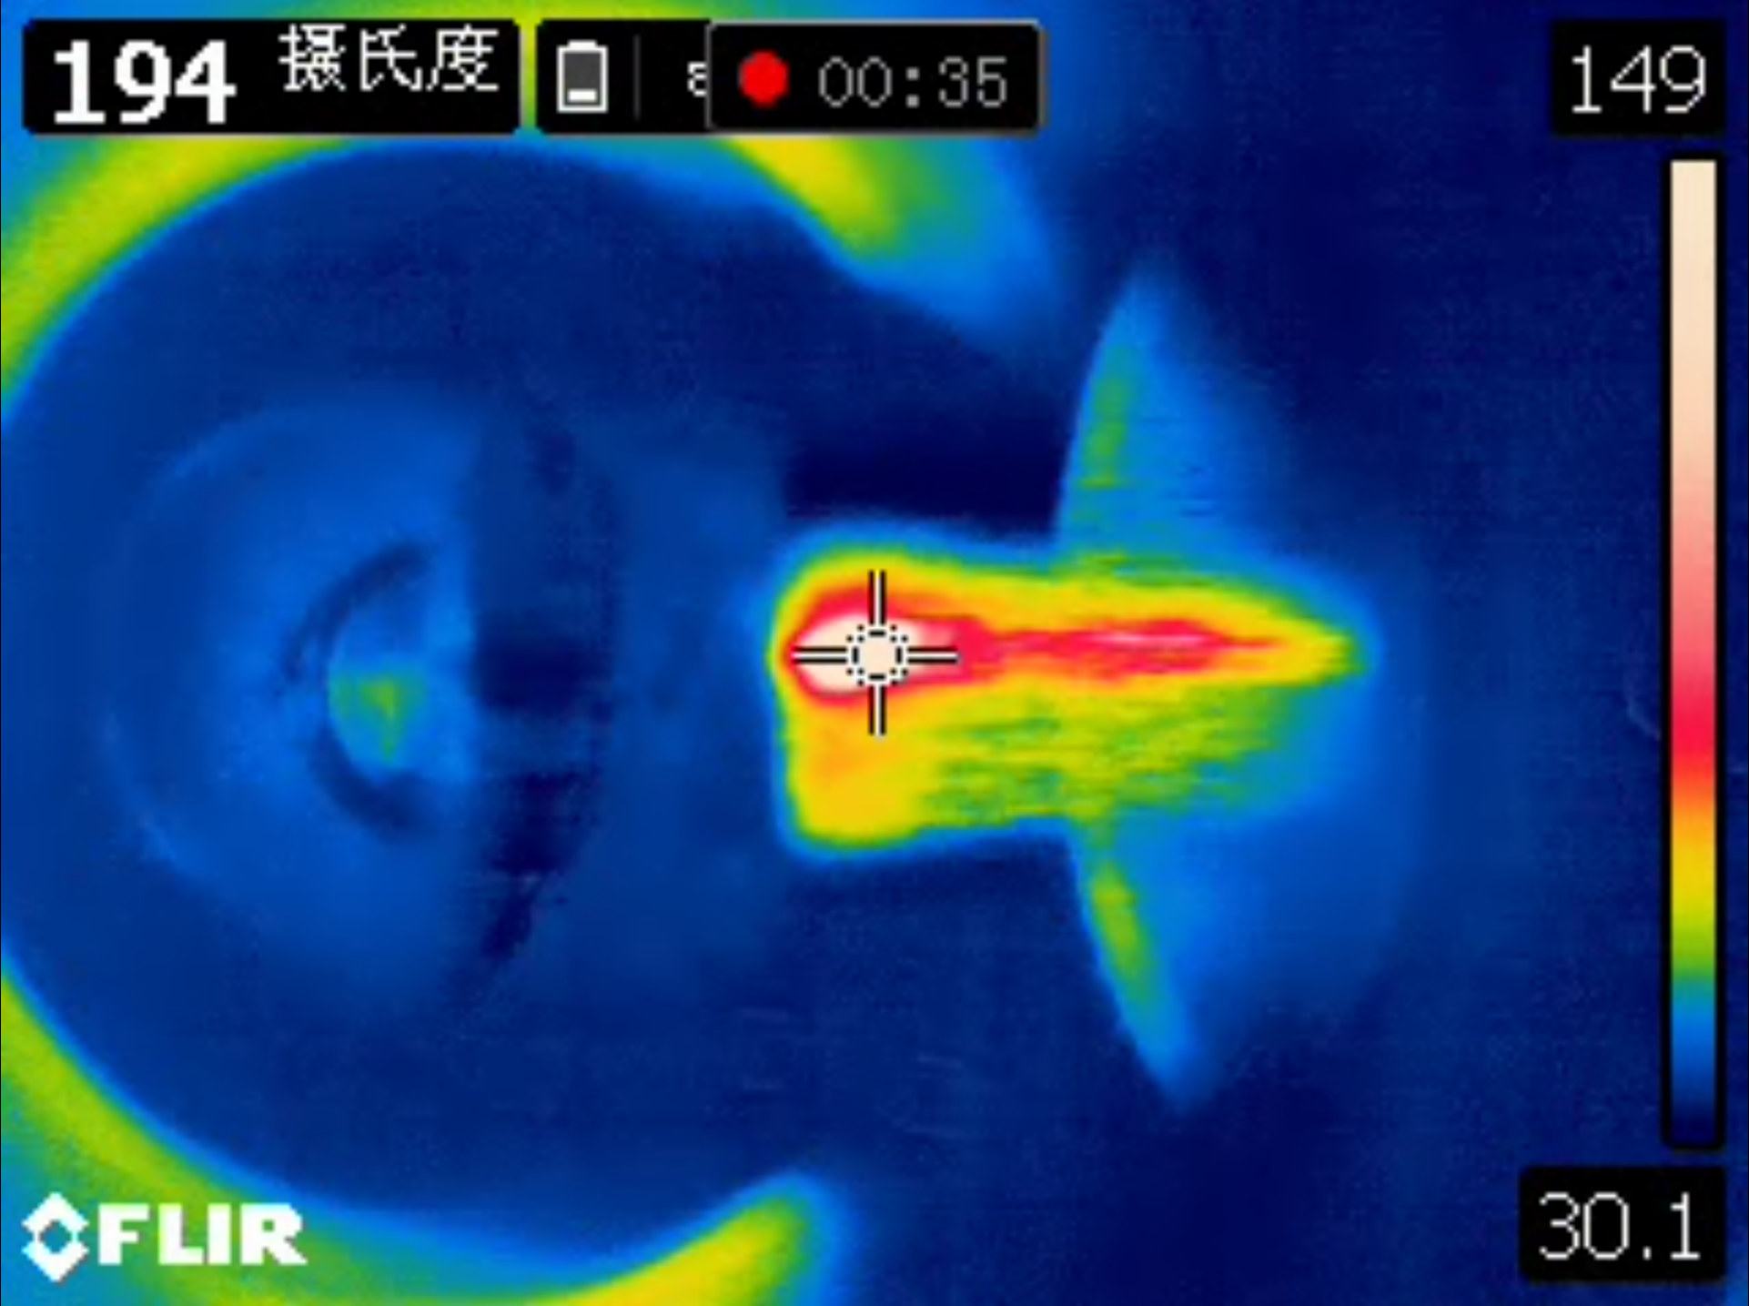
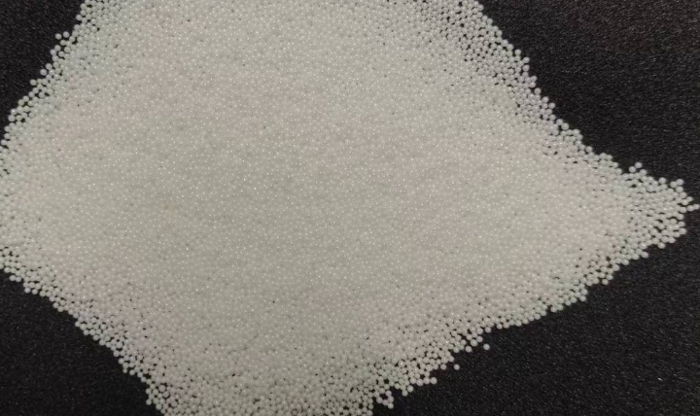
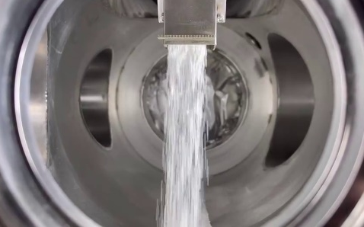
Performance test of Granular flow target
Lei Yang^{1,2}, Yanshi Zhang^{1,2}, Jianli Liu¹, Kewei Tao^{1,2}, Junyu Dong², Linghua Zheng², Xuezhi Zhang^{1,2}
Institute of Modern Physics, Chinese Academy of Sciences
Advanced Energy Science and Technology Guangdong Laboratory
The granular flow target is a novel target type for high-power applications. By utilizing granular material as a circulation medium, it combines the advantages of circulation cooling and the various solid candidate materials to achieve better performance in both heat removal and neutronics properties.
Granular flow target system
To evaluate the performance of this target, a system was established that is connected to a low-energy ion beam. A C-shaped elevator serves as the circulator, which drives the granular flow target using 1mm ZrO/Al₂O₃ ceramic spheres as target material. An upper storage canister buffers the granules and controlled the mass flow with a gate valve. Through the valve the flow leaves the channel and forms a free falling flow, where the beam bombarded the target material. At the bottom, the flow was collected and cooled by a tube heat exchanger. The granules flow down along water cooled tubes, so it is cooled.
To stabilize the material level in the heat exchanger, a flow controller is designed to synchronize the flow. The outflow from the heat exchanger enters the elevator and ends a loop. The entire system is vacuumized by mechanical and molecular pumps. The maximum flow is up to 500g/s.
Low energy beam coupling device
The beam coupling test is performed based on the intensive proton beam from a low energy proton accelerator. Its ion source outputs 40keV protons and further accelerates up to 240keV by an electrostatic accelerating tube.
The beamline connects to target through a differential vacuum system, avoiding the beam loss on the window. Thanks to the joint effort of bulk equipment and vacuum suppliers, the system reaches 5x10⁻⁴pa in irradiation chamber of granular circulation system and the best vacuum in the differential part further down to 2x10⁻⁶pa.
Beam test
In a recent test, the circulation test was calibrated to a flow rate of 96g/s from a 6mmx30mm outlet, and irradiated by a 182.5keV@11.7mA proton beam with a beam footprint of 6mm diameter. The reaction section was recorded by an FLIR inferred camera. The peak area in irradiation spot reaches about 194℃ for the 11.7mA current, with a surface power density of 7555kW/cm²

