Slide 1
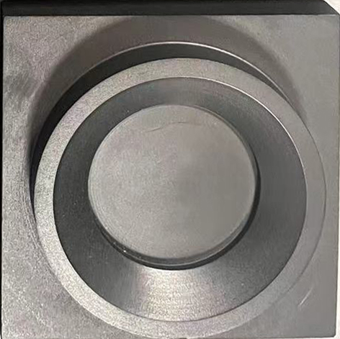
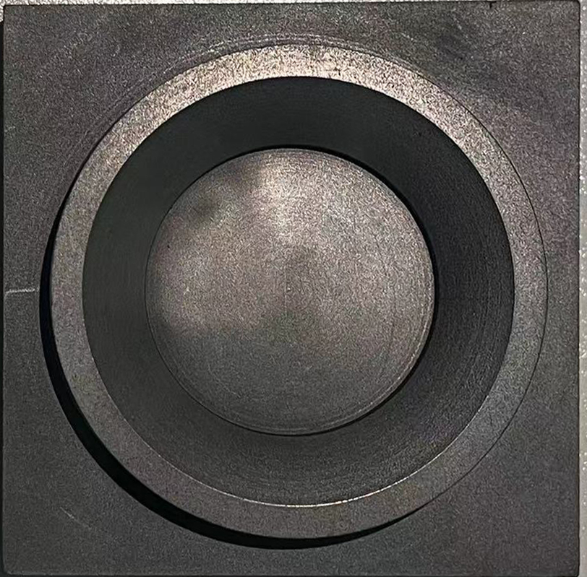
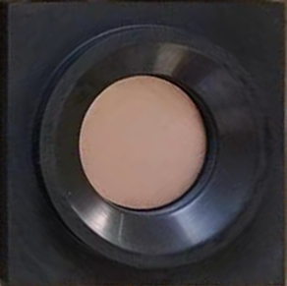
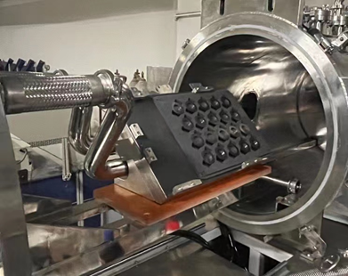
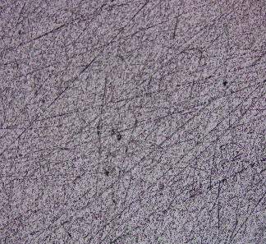
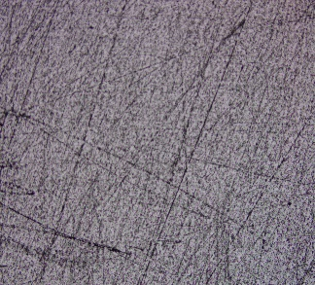
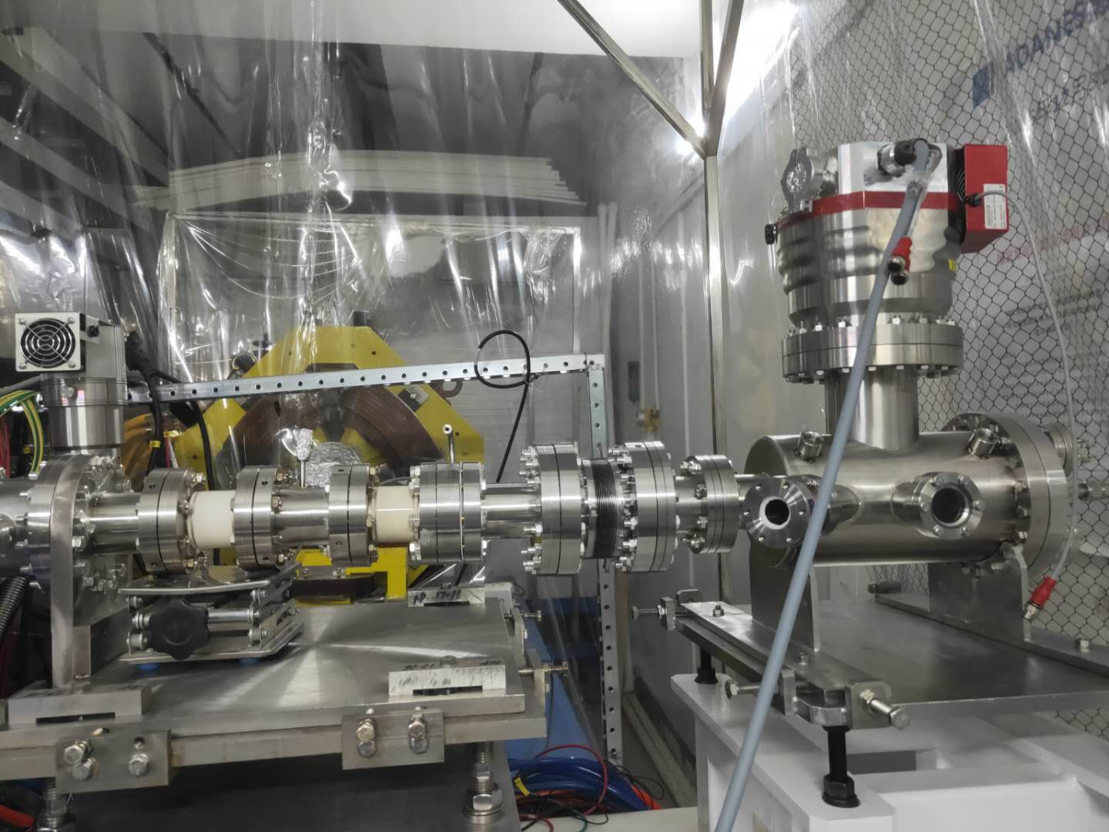
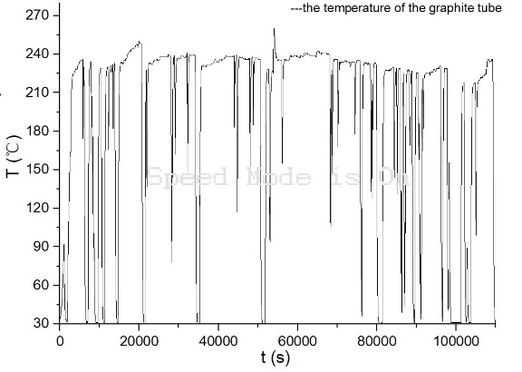
Graphite enclosure power density experiment
Jianrong Zhang^{1,2}, Qingfeng Tang^{1,2}, Lei Yang^{1,2}, Yaling Zhang^{1,2}, Heng Zhang^{1,2}, Xuezhi Zhang^{1,2}, Hongwei Zhao^{1,3}
Institute of Modern Physics, Chinese Academy of Sciences
Advanced Energy Science and Technology Guangdong Laboratory
Gansu Laboratory of Isotope
In the alpha radioisotope production, the radioactive leakage from the target causes issues of pollution in processes and violation of the radioprotection regulations, which is a crucial issue of the production of these isotopes using intensive accelerators beams.
Basic concept
To address this challenge, a graphite enclosure structure is developed for the target material. Graphite was used as beam dump material to lower the radioactivity. Our isotope production project uses 70MeV@500μA for the first stage, and the beam is further evened to 20 targets. Limited by the specific activity of liquid waste in the chemical process, the size of the target is decided to be 25mm diameter, which leads to 1.4kw/cm³ peak power density. So graphite structure is evaluated as qualified for the 10 days irradiation of isotope production with contact cooling, which makes the automatic processing easier. This structure aims to withstand higher temperature without serious consequence of target melting or massive release of gaseous radioactive substances. And the low activity in irradiated carbon makes it easy for radioactive waste processing.
The target setup and graphite enclosure sealings
Offline/ Low energy proton testing
The R&D of the graphite enclosure focus on two points, the endurance of material and cooling performance. Early tests focus on the material compatibility at high temperature. An EM heating oven heated graphite and potential cooler material, copper, to more than 1000℃, which reaches the limit of the thermal couple of the equipment. As a common crucible material, graphite easily survived during days of heating, and no significant adherent surface appeared between graphite and copper below 800℃. It also shows the porosity of graphite has no crucial effect on the vacuum, the system keeps performance better than 5x10⁻⁵Pa during the experiment. EM heated graphite with cooler experiment also performed with positive results. The base structure was also tested with 160keV@4mA beam. The result showed almost no surface change.
Base structure samples before/after irradiation and loaded with target material
Online tests
Later, the graphite enclosure was tested with linac. To avoid unnecessary environmental dose exposure, no metal target material was loaded. The experiment conducted using a 30MeV 4He2+ beam with intensity of 30 euA and beam sigma of 2 mm. These parameters were chosen to simulate the power density of the project’s goal. The setup was installed in a vacuum chamber with a water cooling plate in contact with the graphite enclosure. The test was conducted for 30 hours, with the graphite enclosure maintained at approximately 210°C. The temperature was measured using a thermocouple probe inserted into a hole in the structure, and the results were quickly responded to by the beam trips. The surface of the graphite has no visual change under microscope. But the sealing foil has minor deformation which need to be further optimized.
Before and after irradiation (microscopic view)
Experiment terminal setup and temperature record of base material

