Slide 1
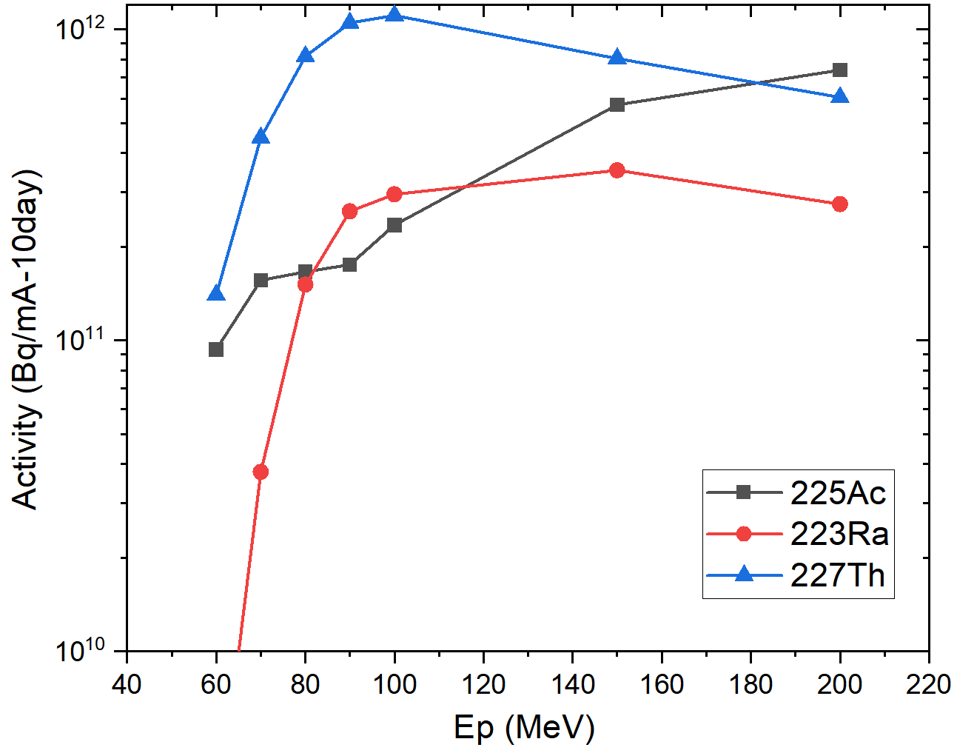
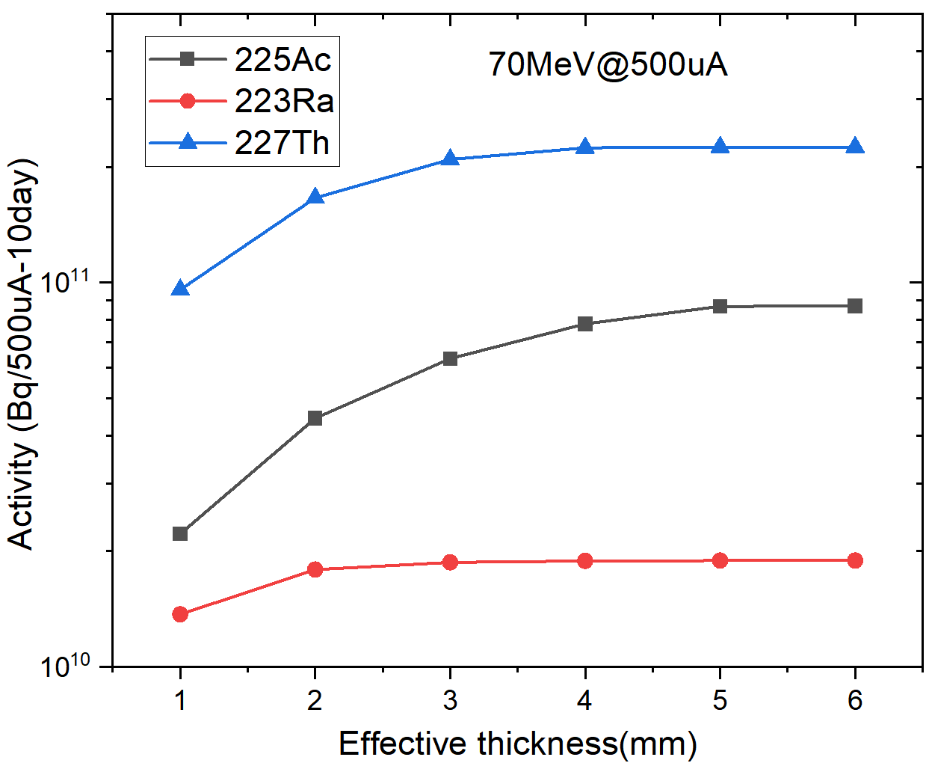
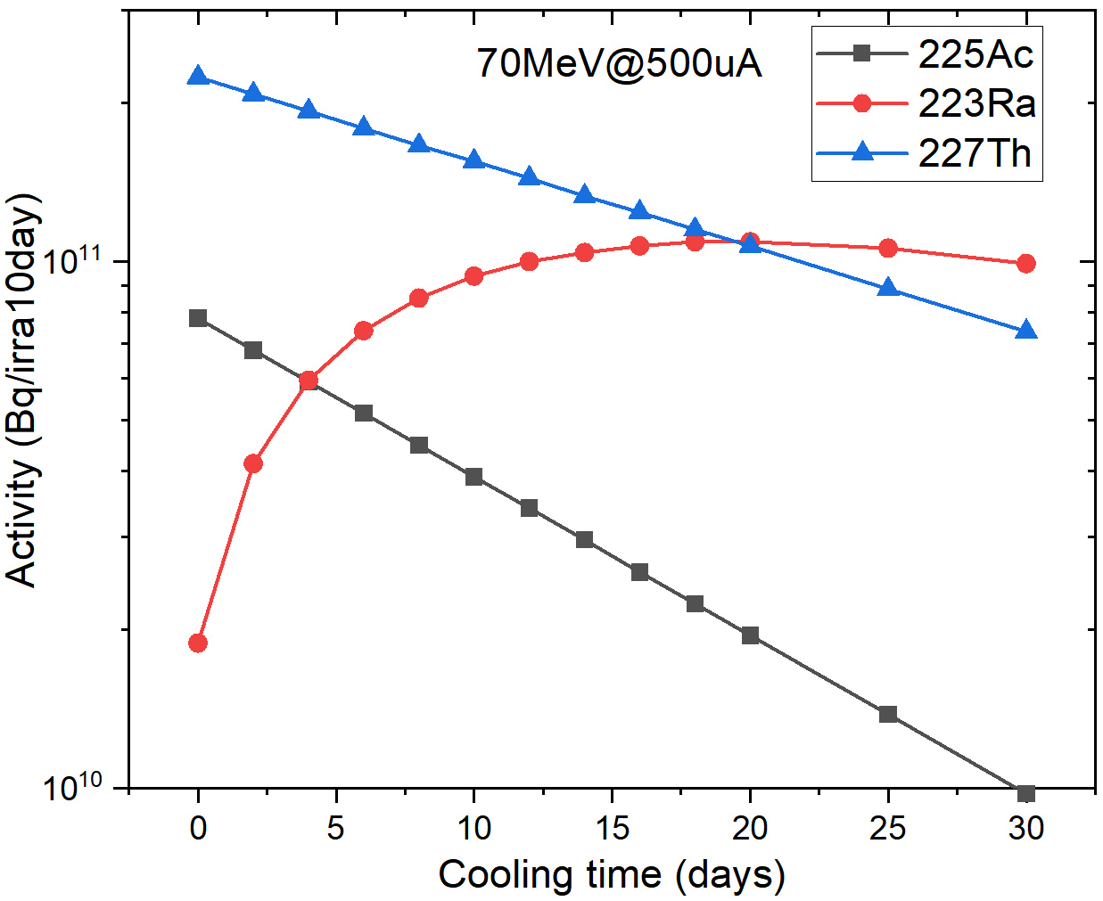
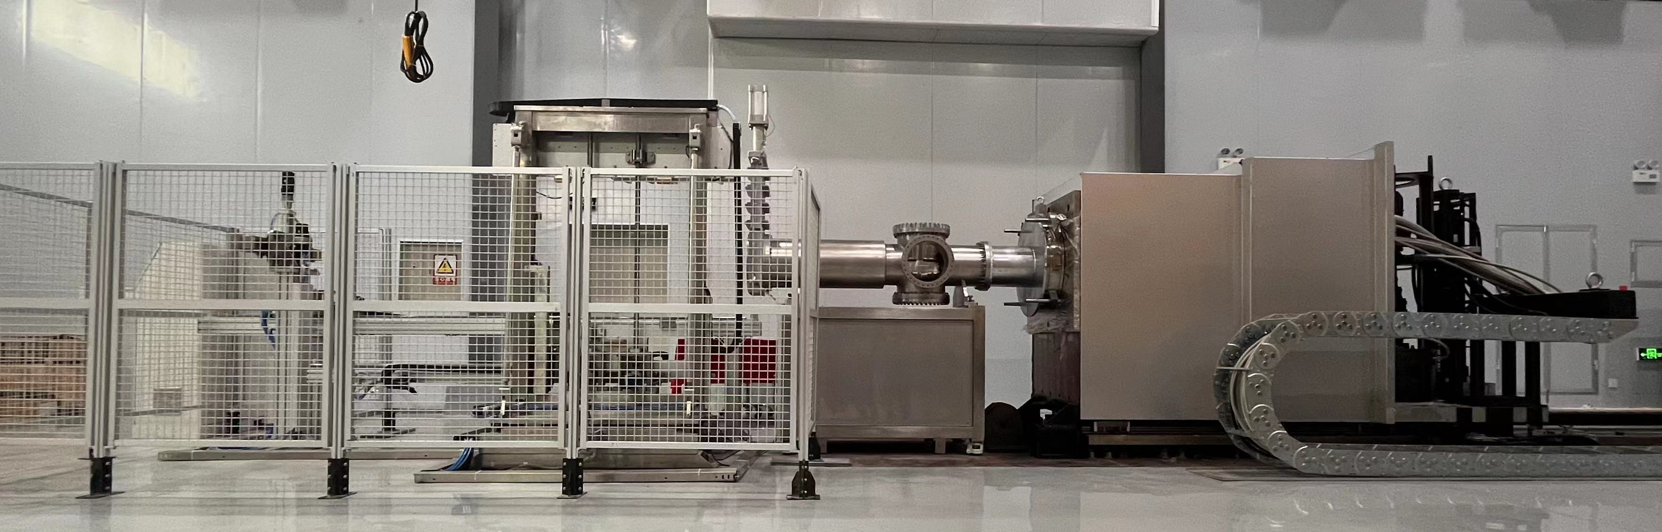
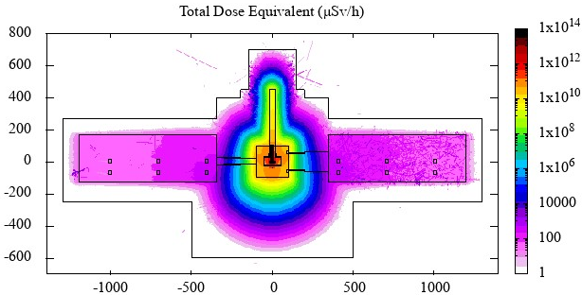
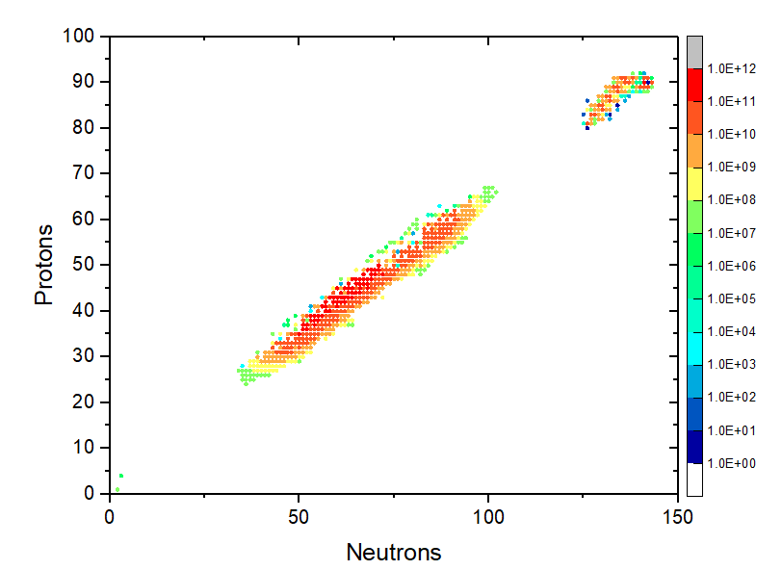
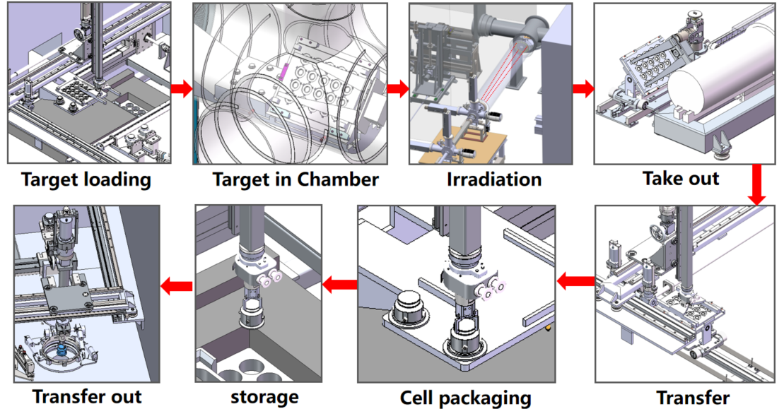
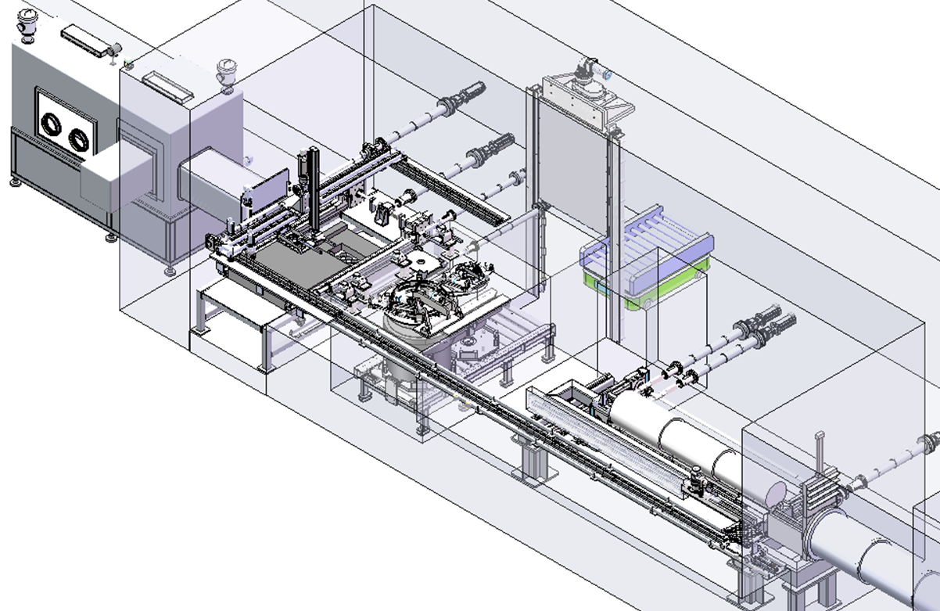
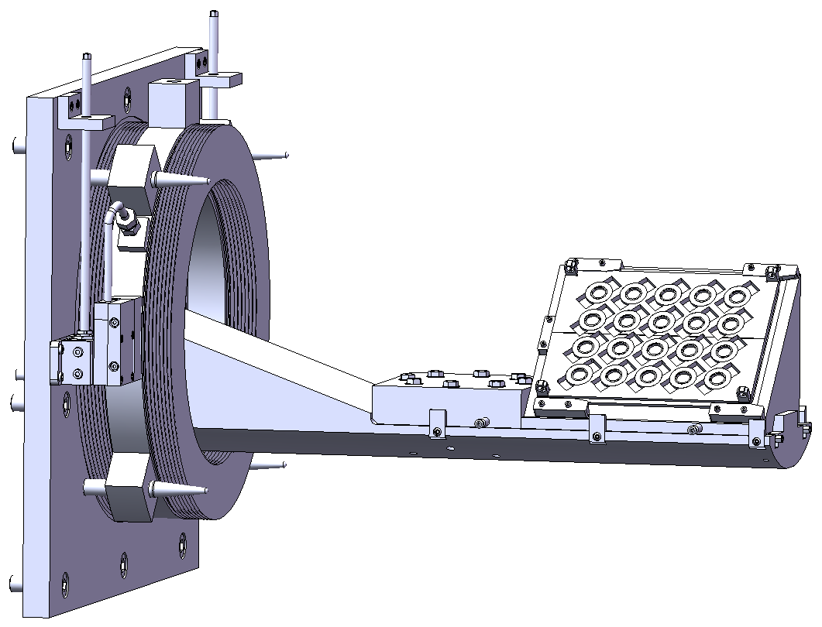
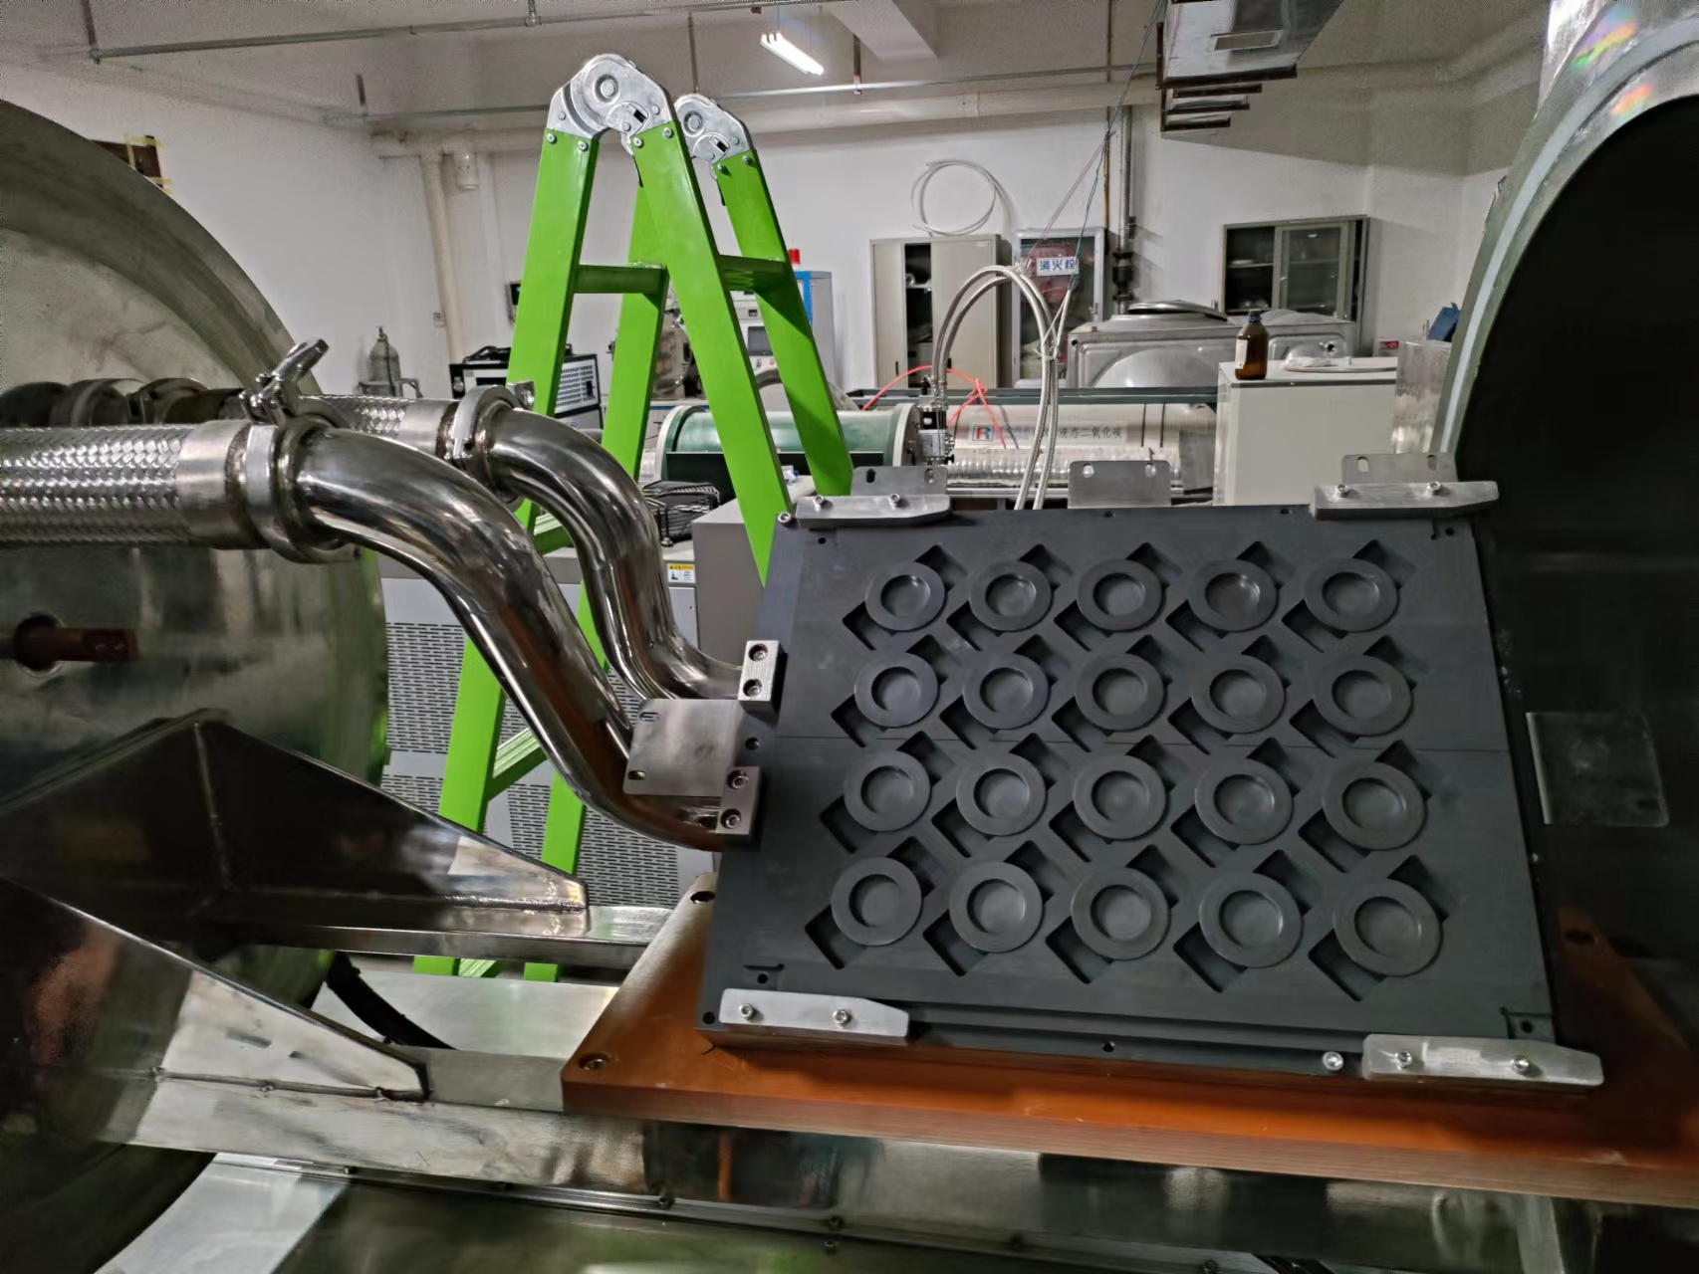
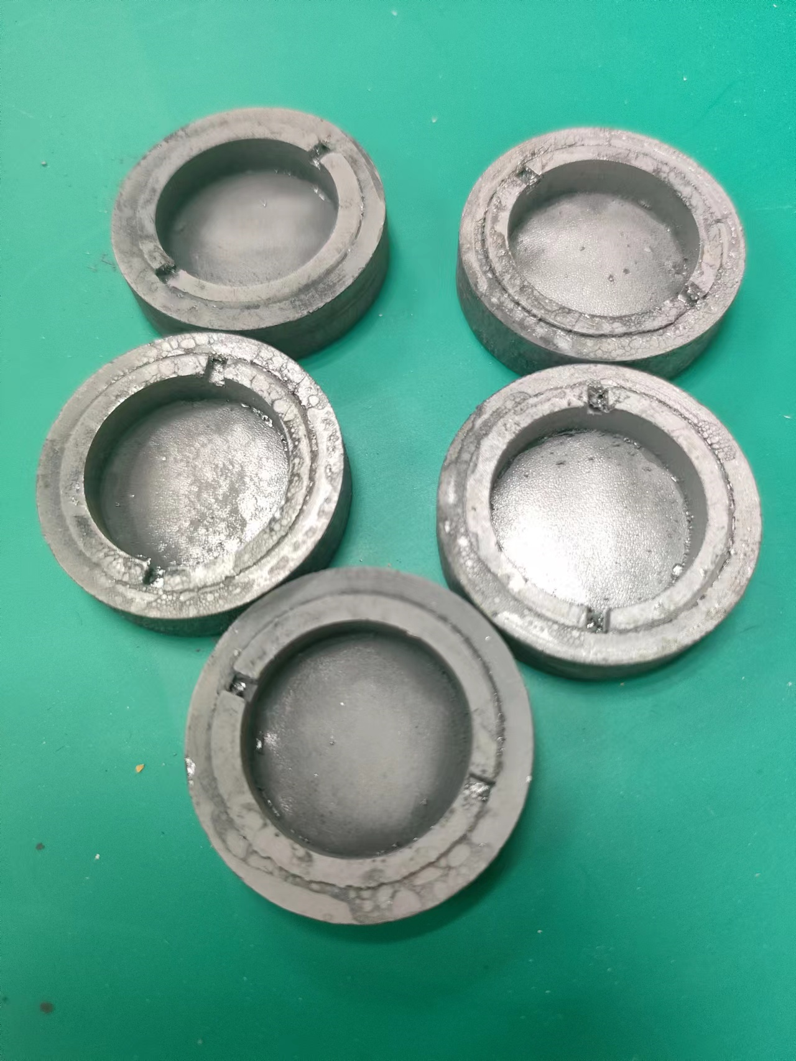
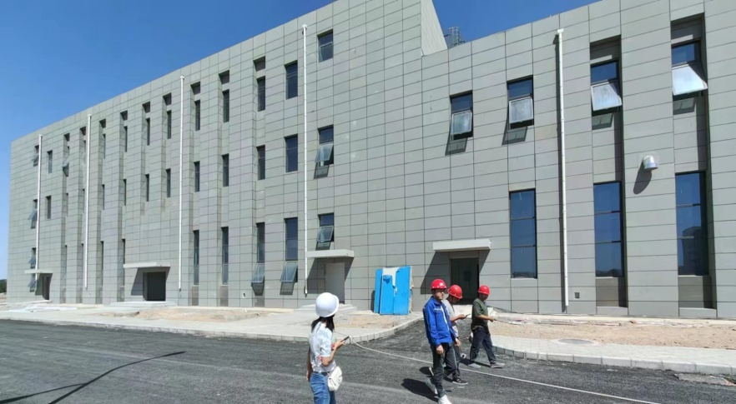
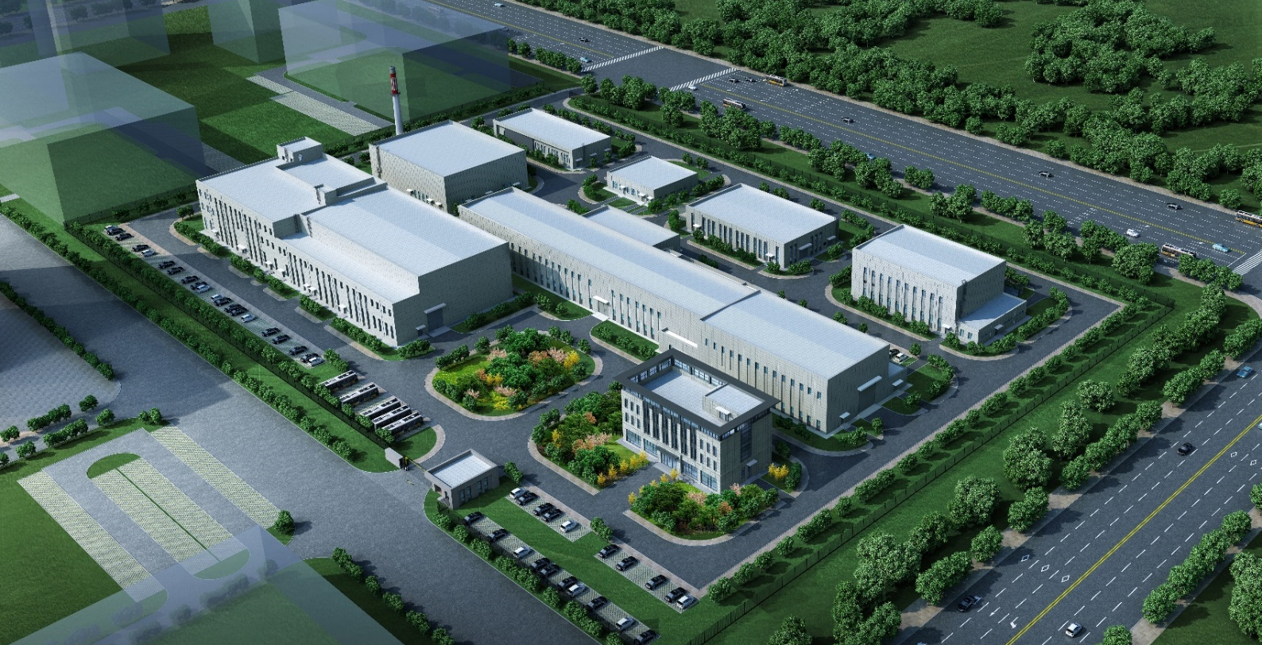
Isotope batch production target design
Yaling Zhang*^{1,2}, Xuezhi Zhang^{1,2}, Lei Yang^{1,2}, Jianrong Zhang^{1,2}, Heng Zhang^{1,2}, Qingfeng Tang^{1,2}, Hongwei Zhao^{1,3}
Institute of Modern Physics, Chinese Academy of Sciences
Advanced Energy Science and Technology Guangdong Laboratory
Gansu Laboratory of Isotope
To address the regional demand for advanced medical radioactive isotopes of the good quality, the research group came up with a batch production target design applied in the terminal of beam line.
Goal of Project
The final goal of target system is to produce isotopes including 225Ac and 223Ra with 100MeV@2mA proton beam, while the first stage is 70MeV@500μA. 2mm thick thorium pellets are selected as the target material to maximizing the goal isotopes’ specific activity and its portion in the total activity within technical limits.
Challenge of cooling and handling
With above parameters, 200kW/35kW cooling design is required for the reaction region. Meanwhile, the handling feasibility is also crucial. The highest on-line dose rate spot and the EOB total activity reaches 10¹⁴ Sv/h and 10⁴Ci respectively. Considering the half-life of the goal isotopes, the production shift is about 10 days.
Multiple parallel targets
To address above issues, instead of a big target, multiple parallel small targets are scanned by the beam to lower the peak factor of beam energy deposition. The smaller targets with lower activity of each piece, decrease the shielding and radiation resisting requirement of the follow-up systems.
Contact Cooling
With the eased power peak, a lower performance but better handling feasibility contact cooling system is adopted. A graphite enclosure works as a crucible to prevent the hazardous production escape. it ensures a higher temperature tolerance and enables a significant portion of beam power to be removed through radiation heat transfer. The contact cooling plate is modified based on the popular spallation source trolley, so the maintenance system and auxiliary supporting systems need not to be designed from very beginning.
Target chamber and equipment
The other benefit of contact cooling system is the targets are placed in dry chamber. The dry chamber is vacuumed, which is easier for accelerator interface design. An automatic robot handling system is in place to facilitate the transport and retrieval of targets for subsequent processes.
Project progress
The facility will be equipped with robots and AGVs to facilitate the transport of shielded cells. The building construction has closing up, and the project is expected to be commissioned within 3 years.

