Slide 1
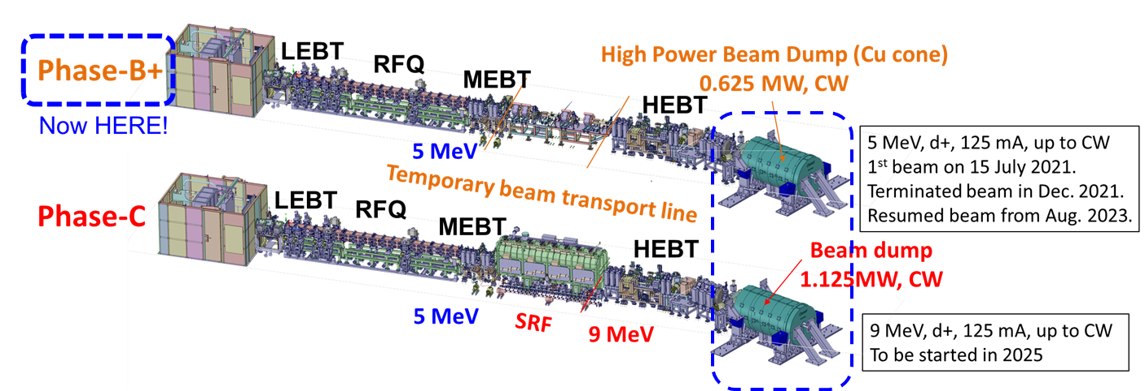
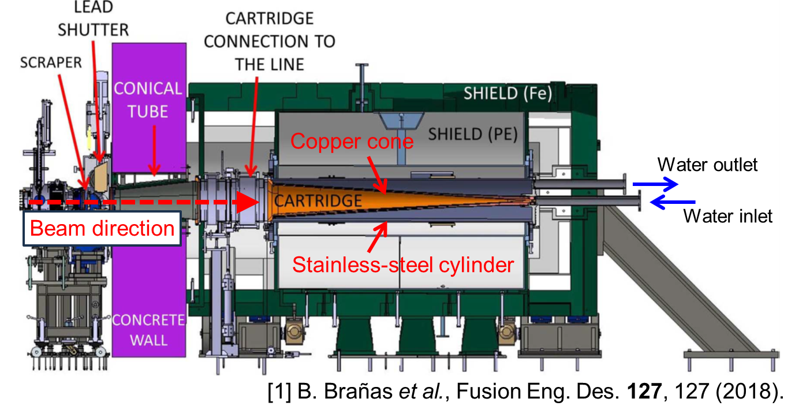
Evaluation on the beam dump activation in the linear IFMIF prototype accelerator (LIPAc)
Linear IFMIF Prototype Accelerator (LIPAc):
LIPAc Beam Dump:
Deuteron beam at 5 MeV was transported to the beam dump by increasing the beam current up of 113 mA with 0.015%DC in Sep. 2023 in Phase B+.
The shutdown dose rate of the beam dump was measured for radionuclides produced by nuclear reactions with deuterons and neutrons.

