Slide 1
ISIS Target Station One Upgrade Project. Replacement Of The Target, Reflector And Moderator Assembly
Dan Coates – ISIS Target Stations Design Engineer
Ste Gallimore – Project Manager
HPTW – Riken Institute,Japan
2023

Slide 2
AIM
Aim of this presentation is to provide you with an overview of the 2021 -2022 strip out and rebuild of the target, reflector, and moderators assembly (TRAM) on Target Station 1.
AGENDA
TS1 Project Aims
Target station layout
Dismantling of the existing TRAM
Testing and assembly of the replacement TRAM
Installation
Commissioning
Summary

Slide 3
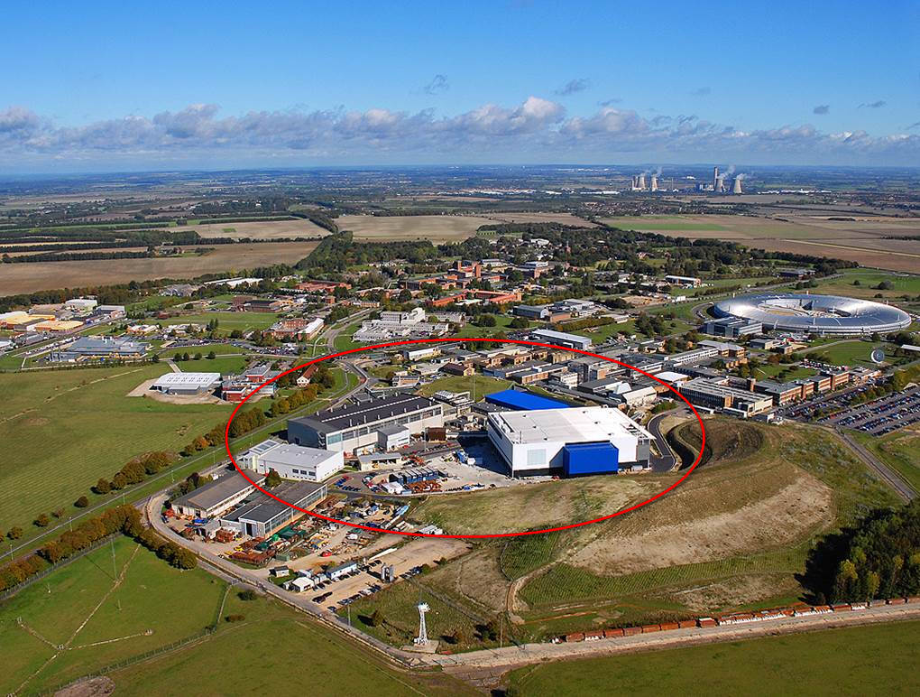
STFC - Harwell Campus
RAL
ISIS FACILITY

Slide 4
ISIS Target Station 1 (TS1) Project
The scope of the upgrade project is to :-
Future proof the operation of the Target Station 1 for long term operation
Modernise by utilising some of the lessons learnt from Target Station 2. Easier and lower risk to change the moderators on TS2.
Add flexibility for future upgrades and decommissioning.
Improve remote handling access to make moderator changes easier.
Improve the TRAM structure, closer fits. Less stainless steel. Edge cooled solid beryllium reflector.
Renew the cooling plant equipment. Remove the redundant uranium target backup systems.
New cryogenic moderator cold boxes. Commercial valves and circulators. Bring up to ATEX flammable gas standards.
One year Shutdown August 2021 – Restart September 2022 for the first user run. ISIS TS2 was able to continue operating during the shutdown.

Slide 5
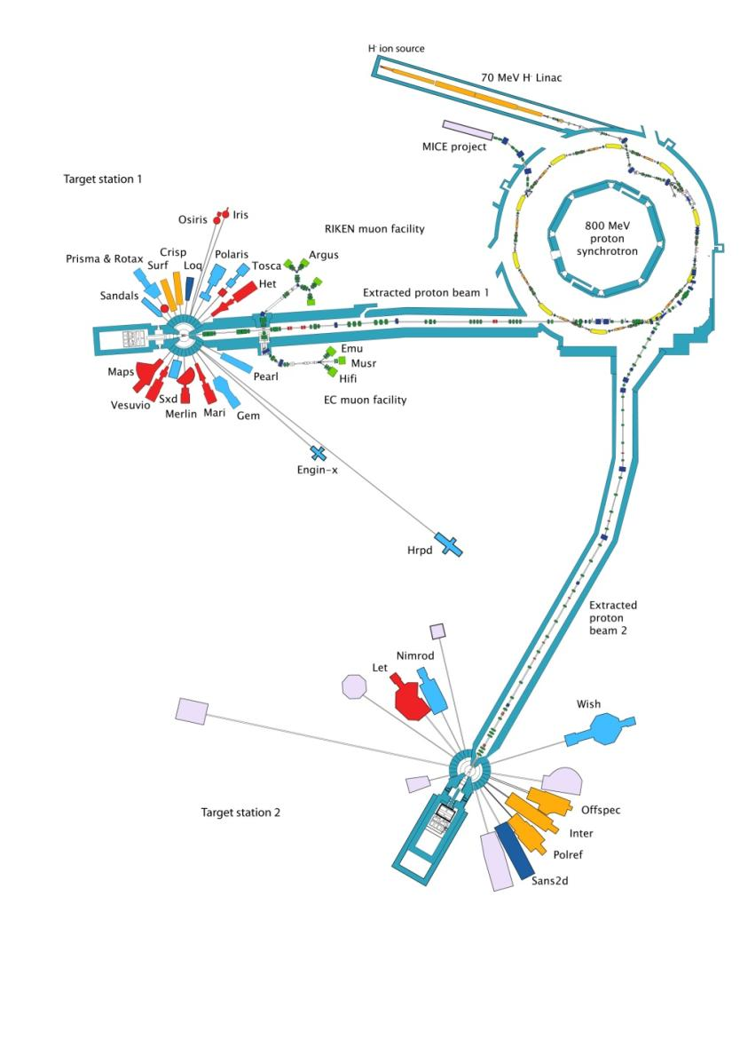
ISIS SPALLATION SOURCE
800MeV – 50Hz
Target station 1, shutdown for a year.
Target station 2, Operational.
Muon source, offline due to target station 1 shutdown.
160µA - 40Hz
40µA – 10Hz

Slide 6
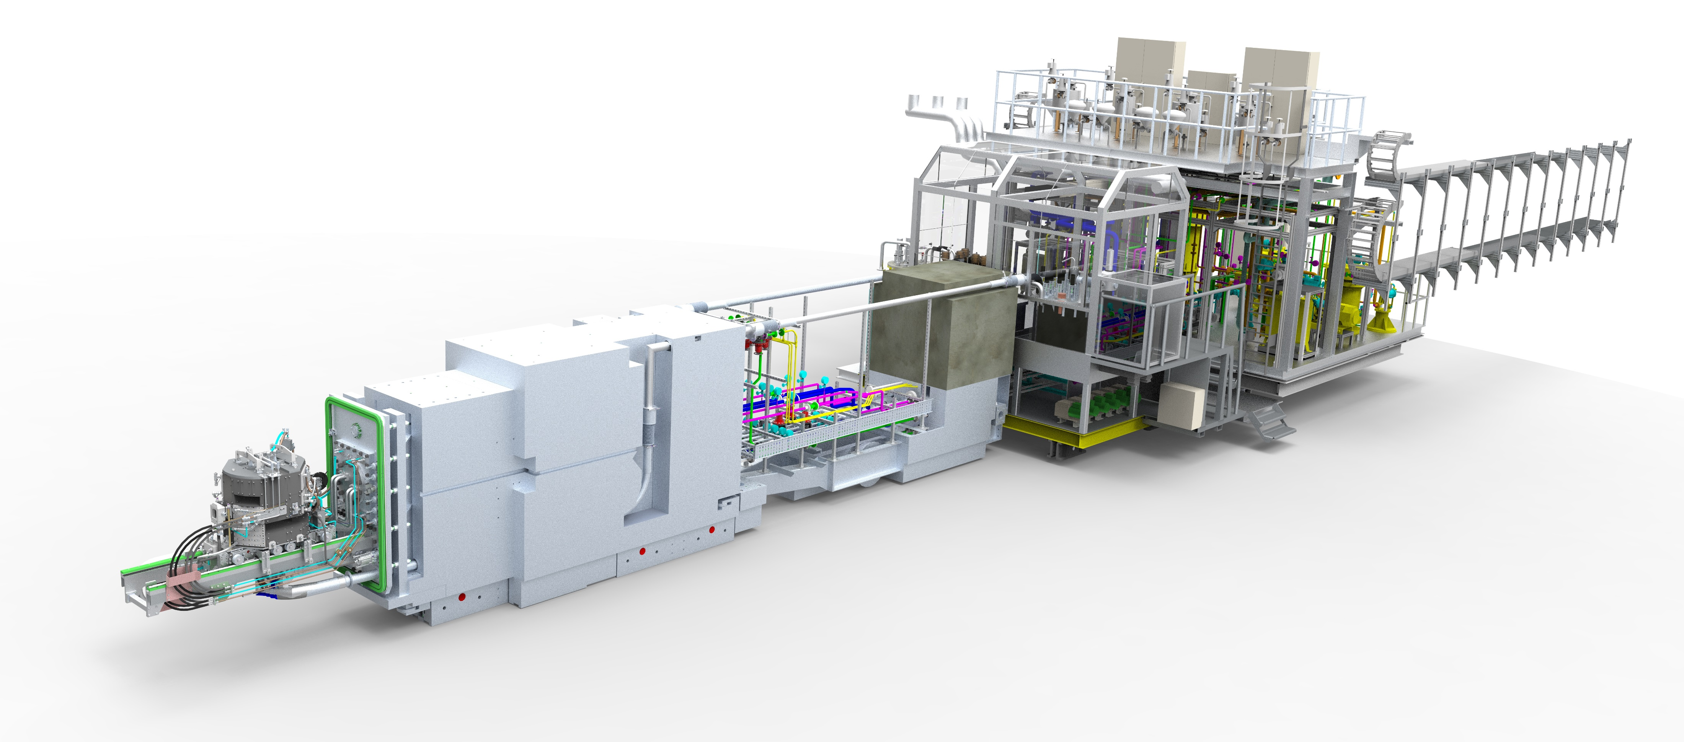
TARGET STATION 1 TROLLEY LAYOUT
SHIELD GAP, USED FOR TRANSPORTING COMPONENTS INTO REMOTE HANDLING CELL
REAR SHIELD PLUG
FORWARD SHIELD PLUG
TARGET, REFLECTOR, AND MODERATORS (TRAM)
THIS IS THE AREA THAT IS THE FOCUS OF THIS PRESENTATION.
CRYO TROLLEY, H2 & CH4 COLD BOXES
WATER SERVICES
VOID VESSEL DOOR & INFLATABLE SEAL
ISIS Target Station 2 is of a similar layout!

Slide 7
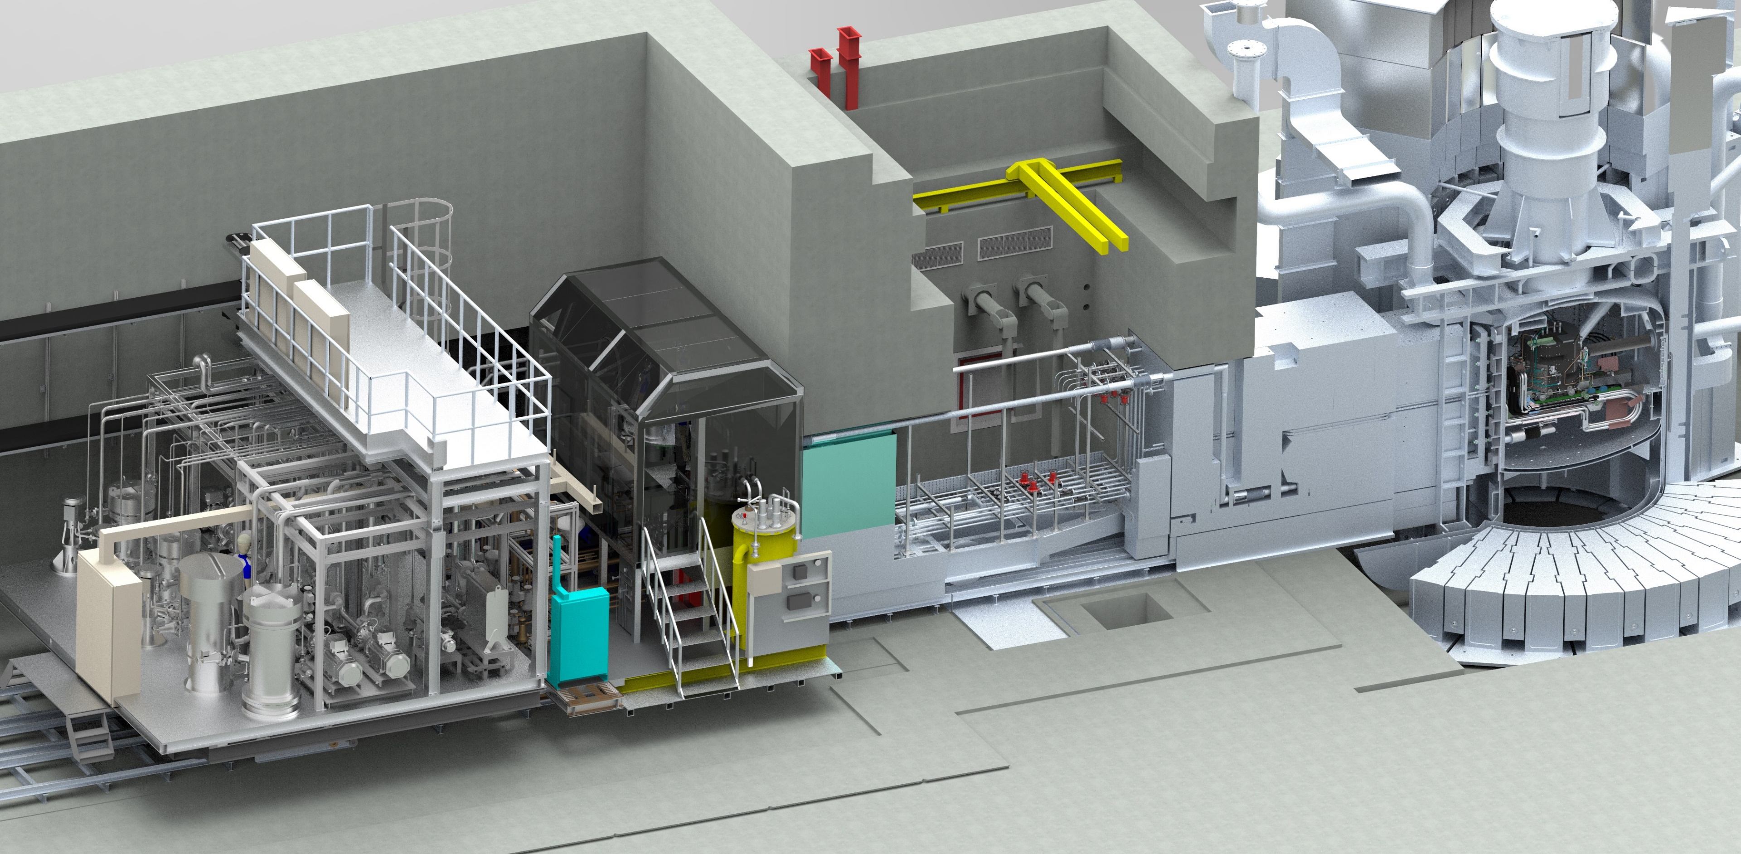
ISIS TARGET STATION 1 SECTION VIEW
TARGET STATION MONOLITH
REMOTE HANDLING CELL
TARGET SERVICES AREA
TROLLEY MOVEMENT
VOID VESSEL, He ATMOSPHERE
WASTE ROUTE, 1M X 1M TRAP DOOR TO TUNNEL
ISIS Target Station 2 is of a similar layout, but with a retractable void vessel!

Slide 8
ISIS TARGET STATION 1 REMOTE HANDLING CELL
Manipulator rooms each side of the cell.
Zinc bromide liquid shielded window.
4x CARRS manipulator arms. (2x per side), max load 5kg.
4x total operators.
1 ton crane (the 5th arm)
Storage well for target.
Trap door to tunnel.
4 fixed cameras, 2x flying lead cameras.
Cell entry via trap door, with trolley in forward position.
Access required to equip the cell, restrictive to conduct PIE.

Slide 9
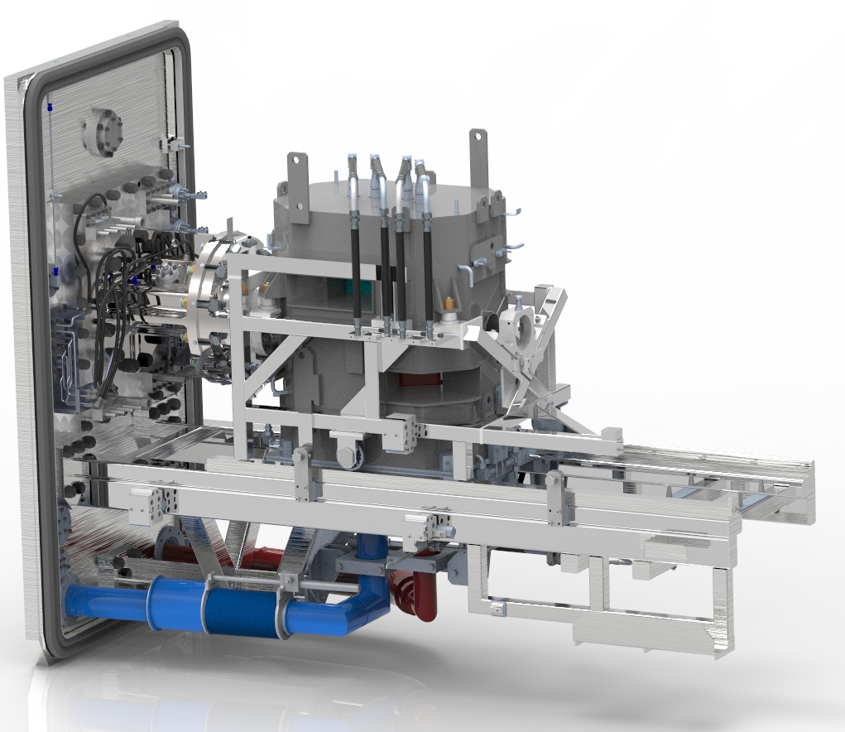
ISIS TARGET STATION 1 EXISTING TRAM
Old TRAM Assembly
Door
Target, Reflector & Moderator Assembly
Target fixed to the door
Reflector constructed of 6 stainless boxes filled with beryllium rods. D20 flood cooled.
Coupling for the methane moderator, out of sight under the support beam.
Little instrumentation of reflector temps.
To change the methane moderator, all water circuits are drained and purged. The upper reflector rolled forward. The target is removed and placed into a storage well. The lower 3 segments of the reflector disconnected and removed. Remove moderator. This process is carried out twice a year. It can take 2 weeks to carry out.
Everything apart from the door & seal, was replaced.
Direction of Proton Beam
2x Water Mods, CH4 & H2 Cryo mods

Slide 10
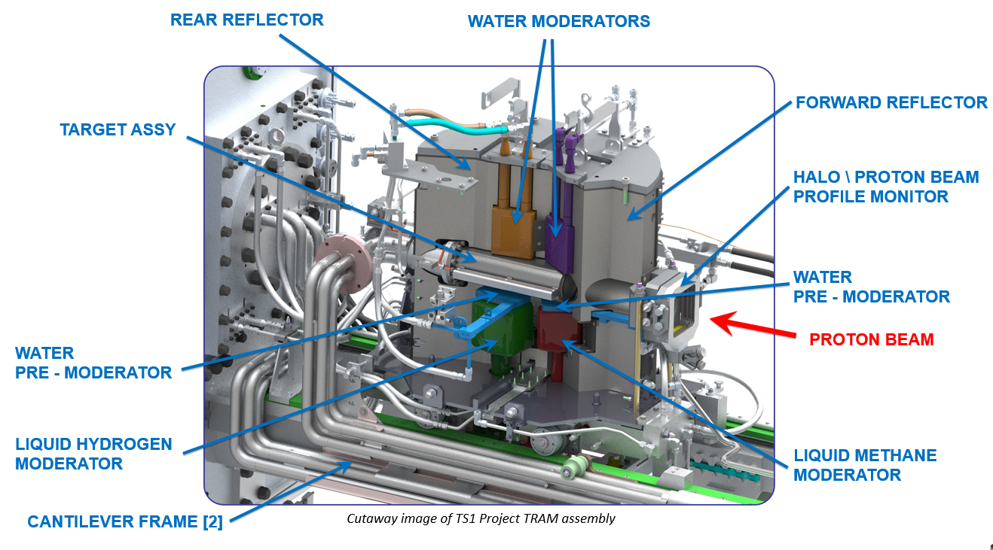
ISIS TARGET STATION 1 REPLACEMENT TRAM
New TRAM assembly
10 plate target mounted inside the rear reflector section.
Reflector constructed of 13 beryllium nickel plated blocks. Light water edge cooled.
Coupling for the methane moderator above the support beam.
Instrumentation to monitor reflector core temps.
To change the methane mod, the water circuits remain filled. The rear reflector rolled back so the target clears the moderator. The target is untouched and remained filled with coolant in the rear reflector. The forward reflector rolls forward to gain access to the moderator. The pressure clamp and vac clamp are released to remove the moderator. This process is carried out twice a year.
It is expected to take a couple of days to change the moderator.
2x Water Mods, CH4 & H2 Cryo mods

Slide 11
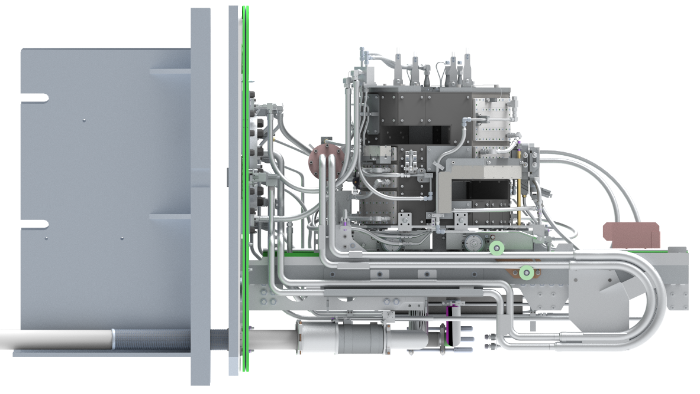
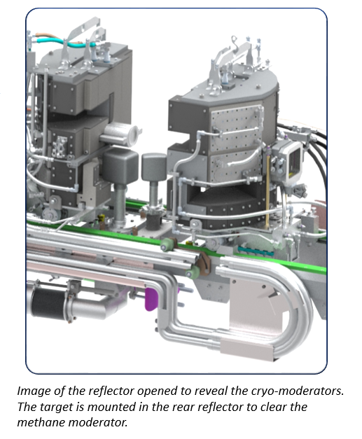
ISIS TARGET STATION 1 REPLACEMENT TRAM LAYOUT
New TRAM assembly
Target, Reflector and Moderator Assembly
Door
Direction of
Proton Beam
Target cooling flange
Target cooling flexible hoses

Slide 12
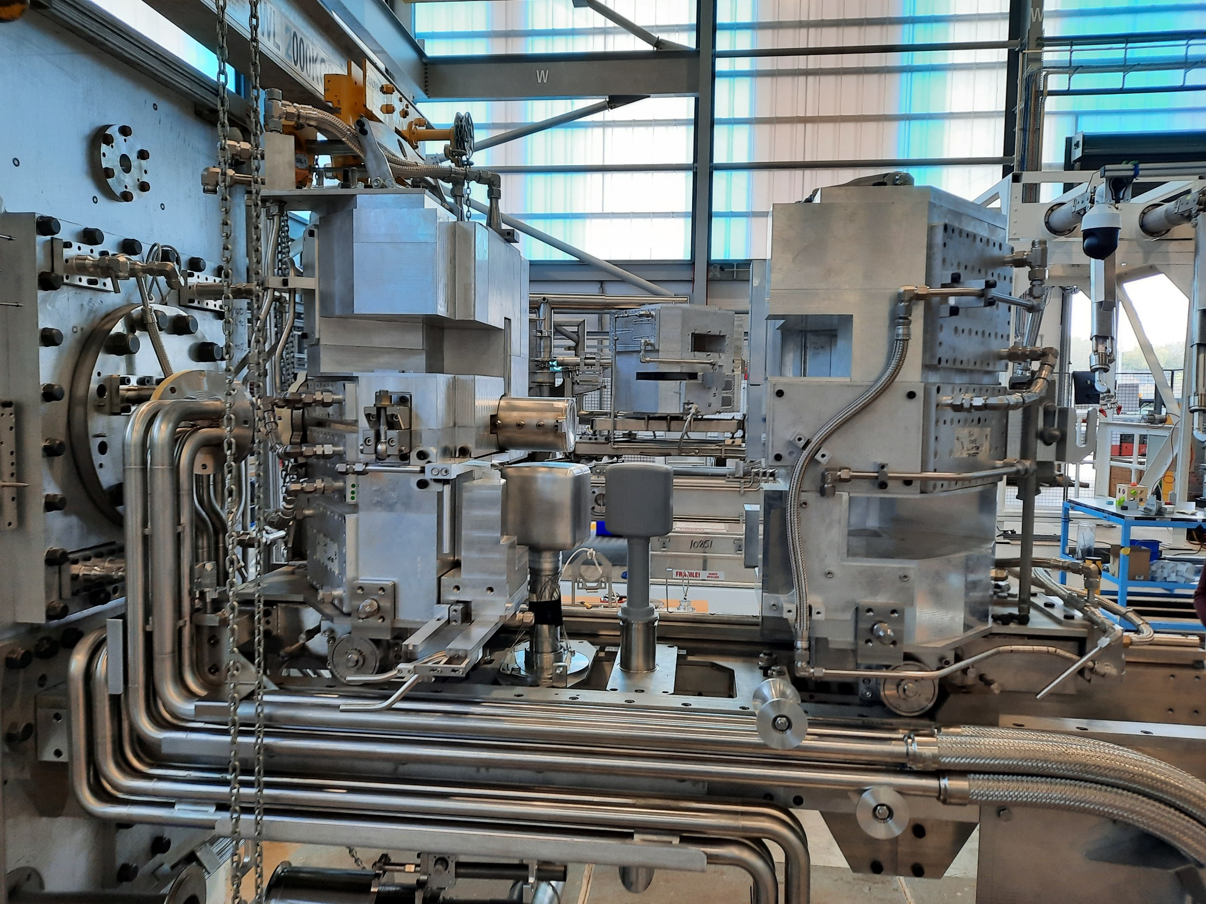
ISIS TARGET STATION 1 REPLACEMENT TRAM
New TRAM Mockup Assembly

Slide 13
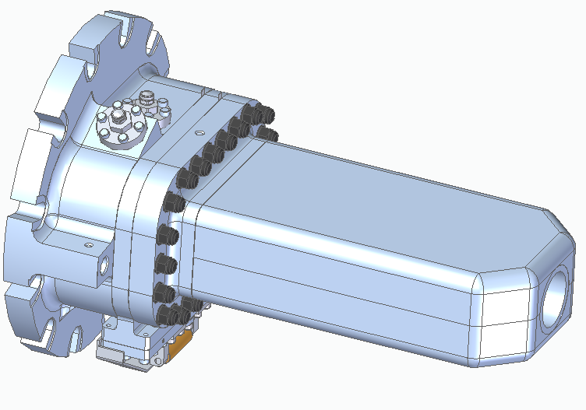
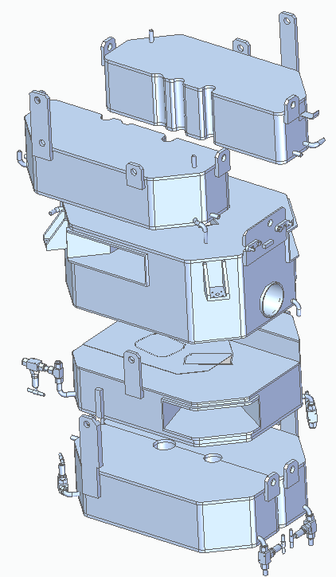
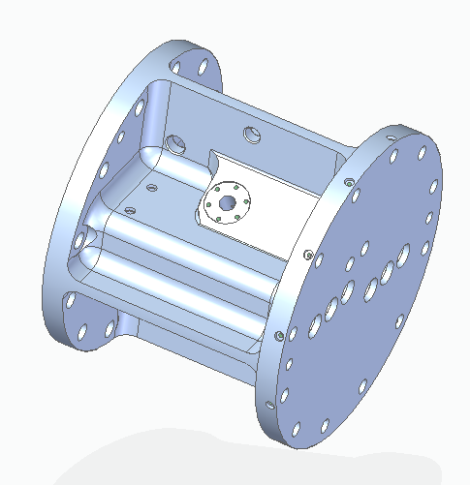
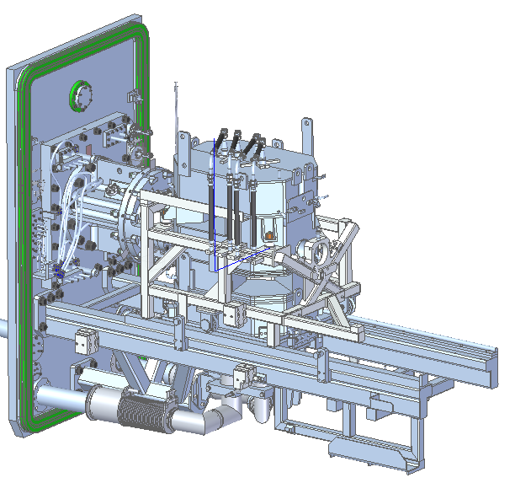
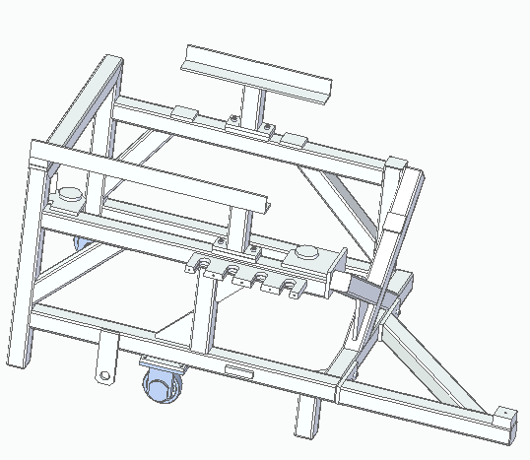
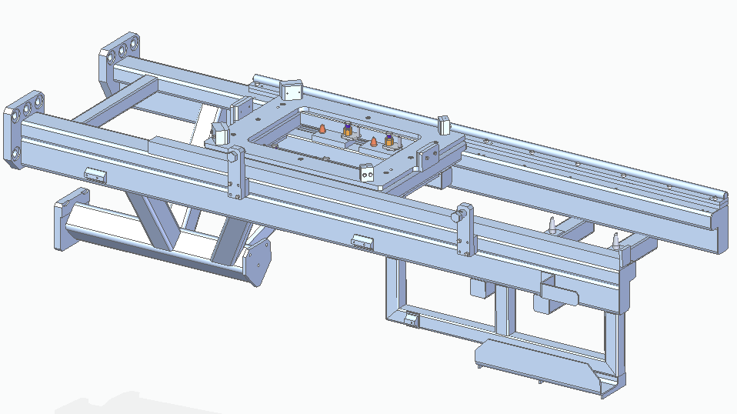
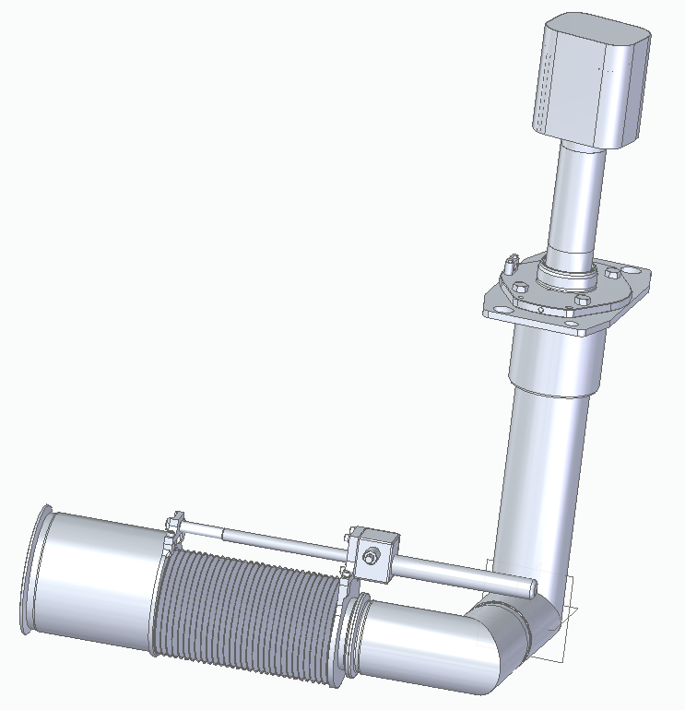
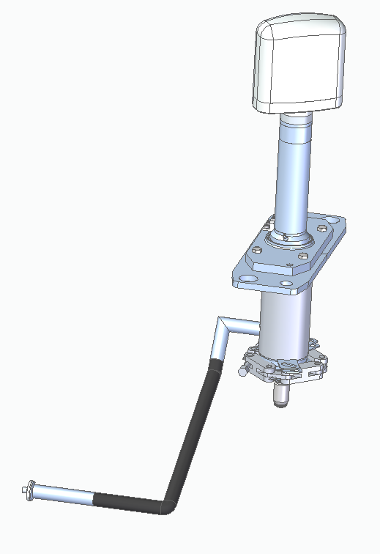
ISIS TARGET STATION 1 TRAM DISMANTLING
Target Manifold
5.6 sv/hr
18 yr Box of Beryllium
Rods Reflector
21.4 sv/hr
5 yr Target
125 sv/hr @0.5m
Upper Reflector
Trolley (Cropped)
37 yr Cantilever Support Frame
4.31 sv/hr
Door
14 yr Hydrogen Moderator
6.15 sv/hr
(Cropped)
6 month Methane Moderator
(Cropped)
On contact doses unless specified.

Slide 14
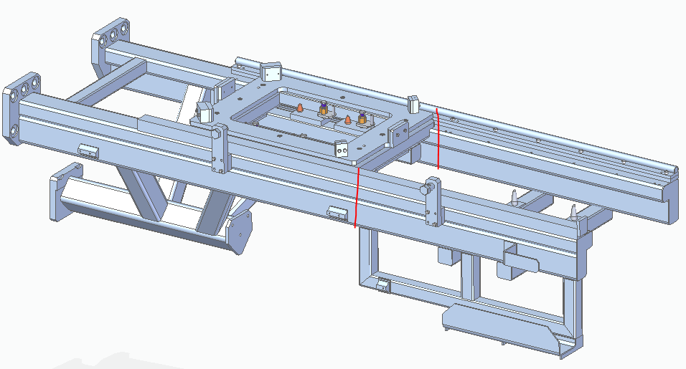
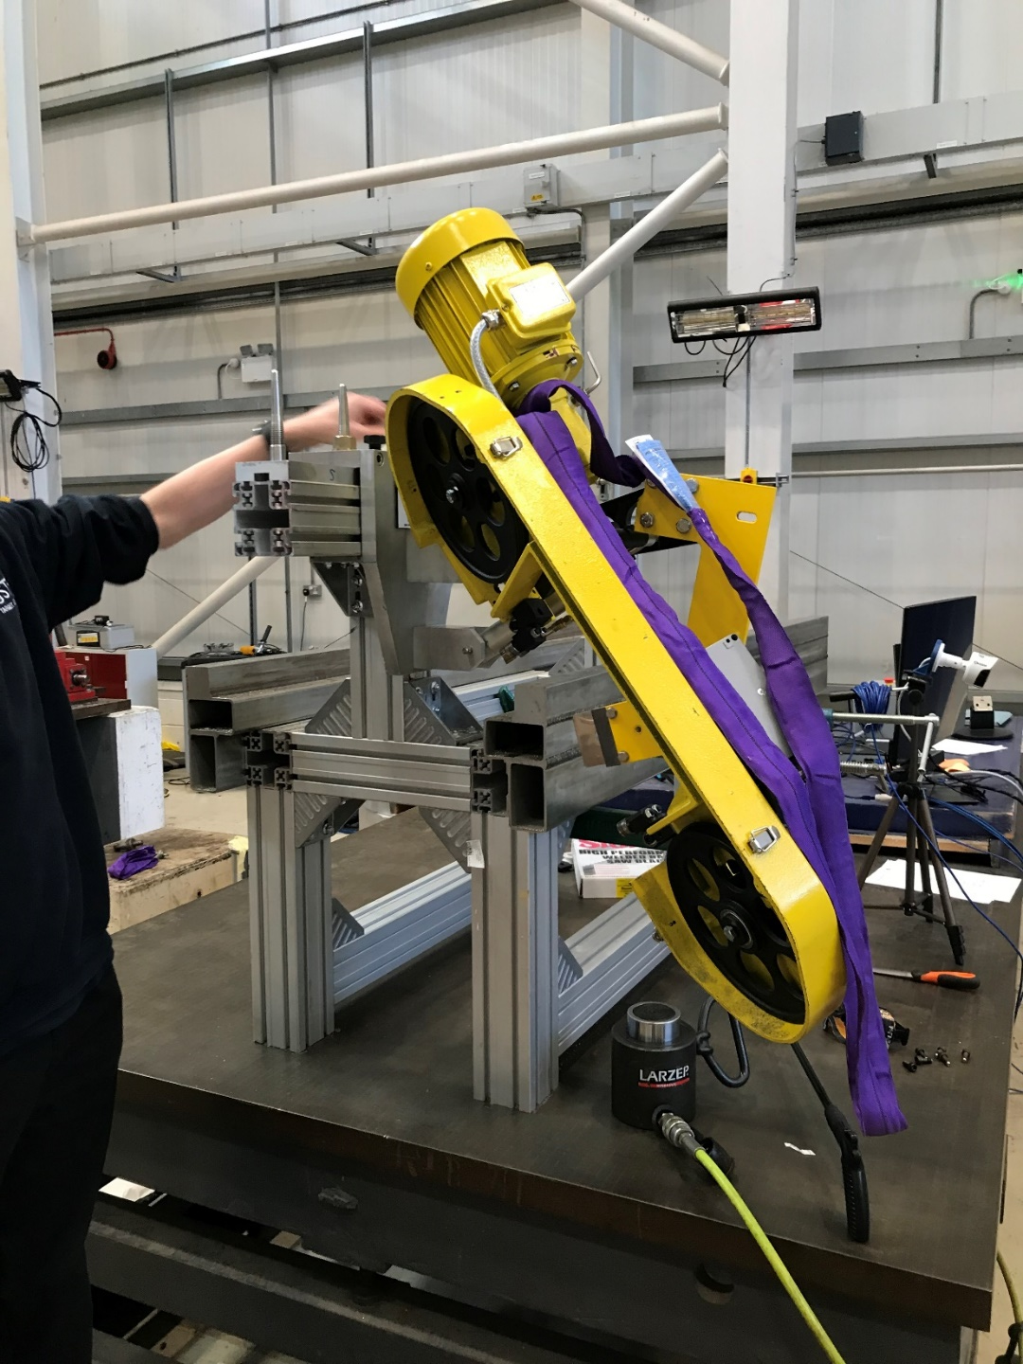
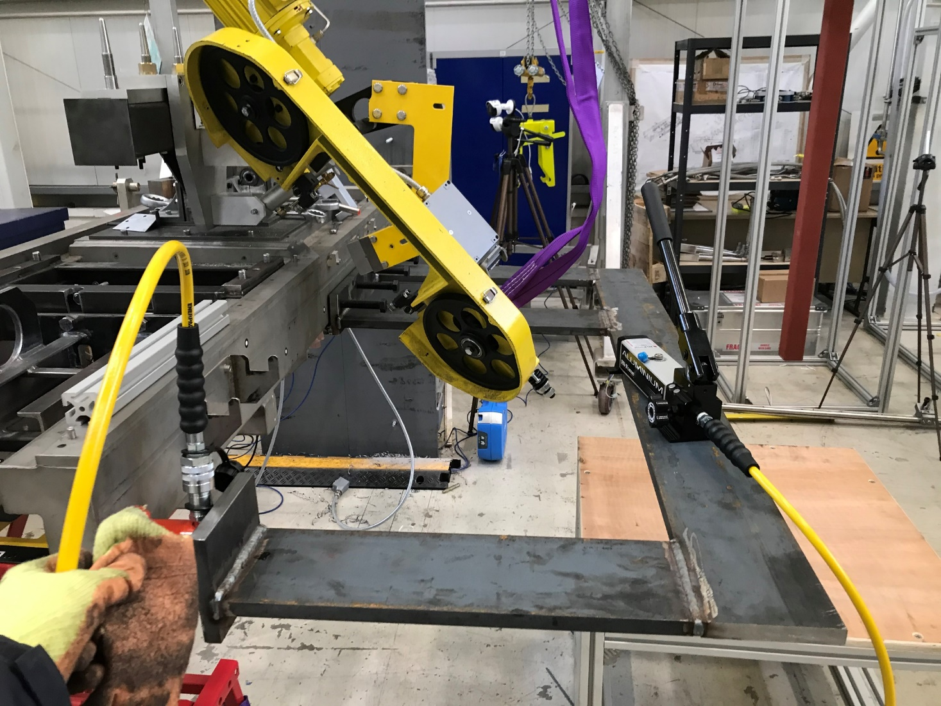
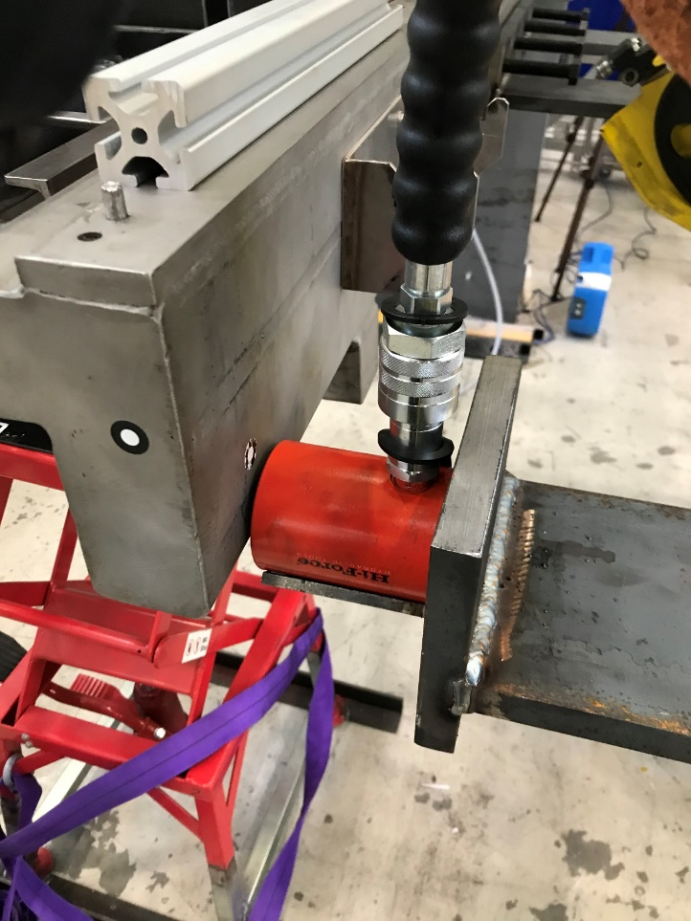
ISIS TARGET STATION 1 TRAM DISMANTLING
Installed since 1985
Fully welded support frame ST.ST 304. 300 Kg
Different types of saws were investigated. Bandsaw selected.
Dry cut
Slow is best.
Swarf capture.
Residual stresses.
Hardened Rail
Cantilever Beam Cutting Trials

Slide 15
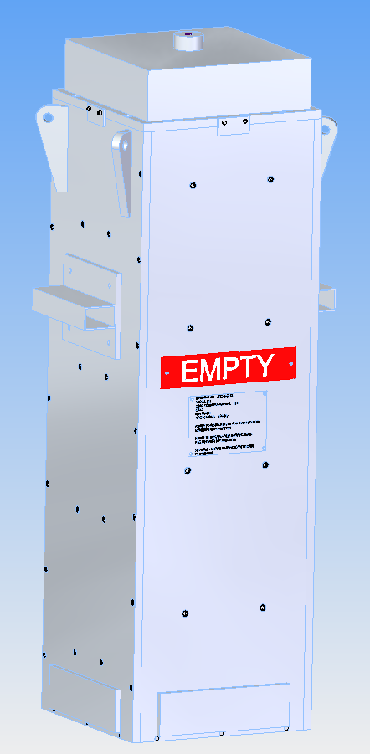
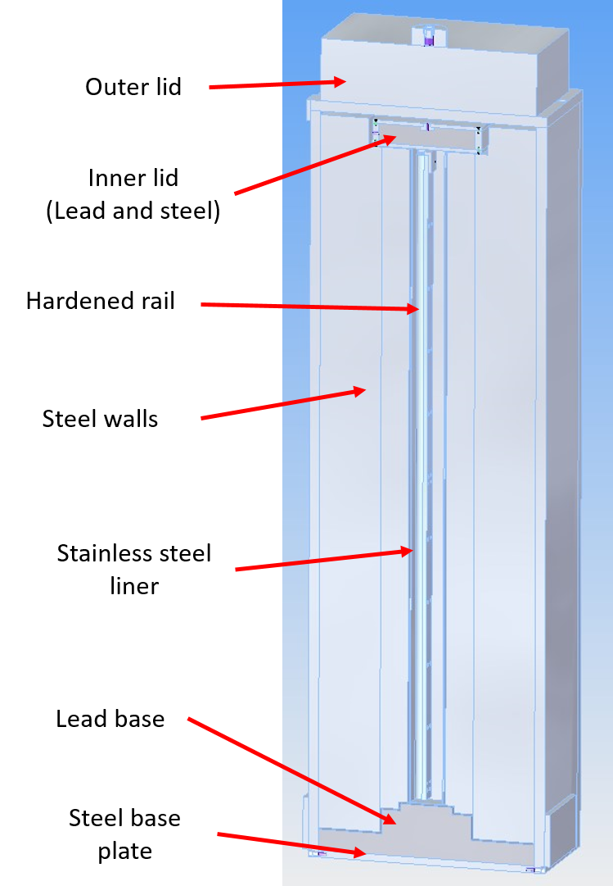
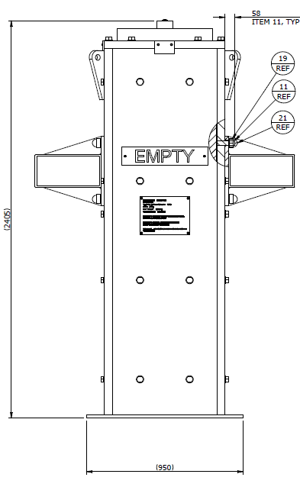
ISIS TARGET STATION 1 TRAM DISMANTLING
Hardened Rail
50Kg Rail = 10T Flask!

Slide 16
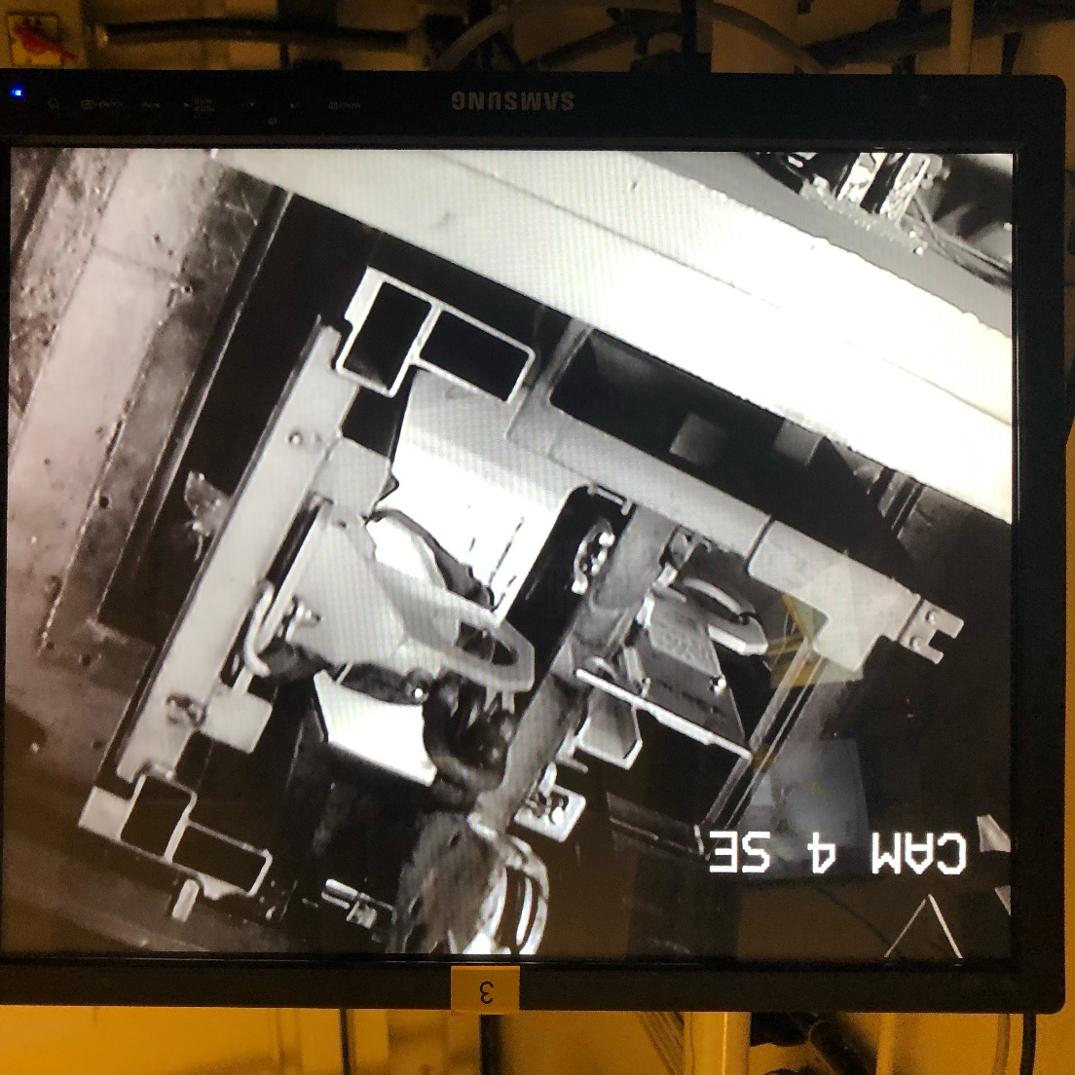
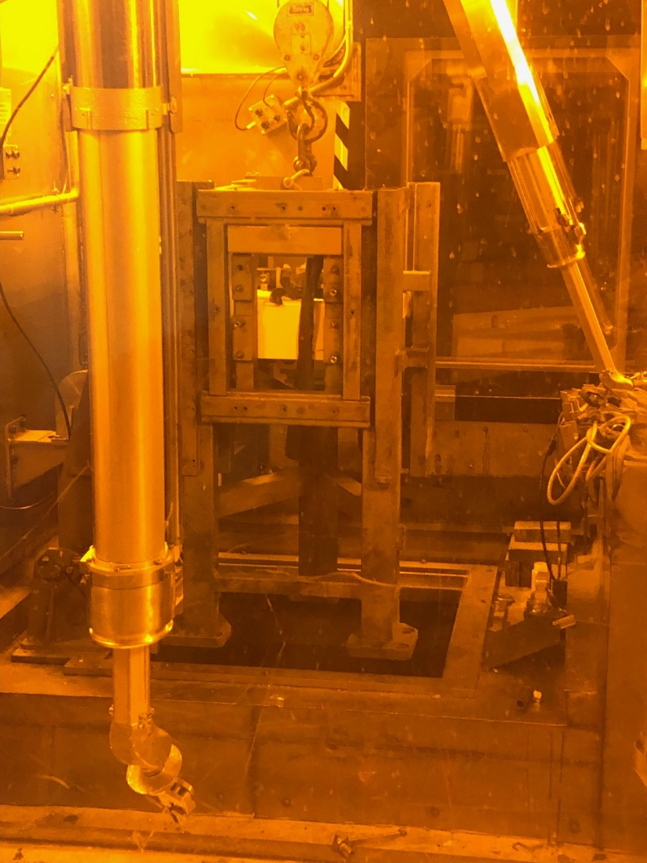
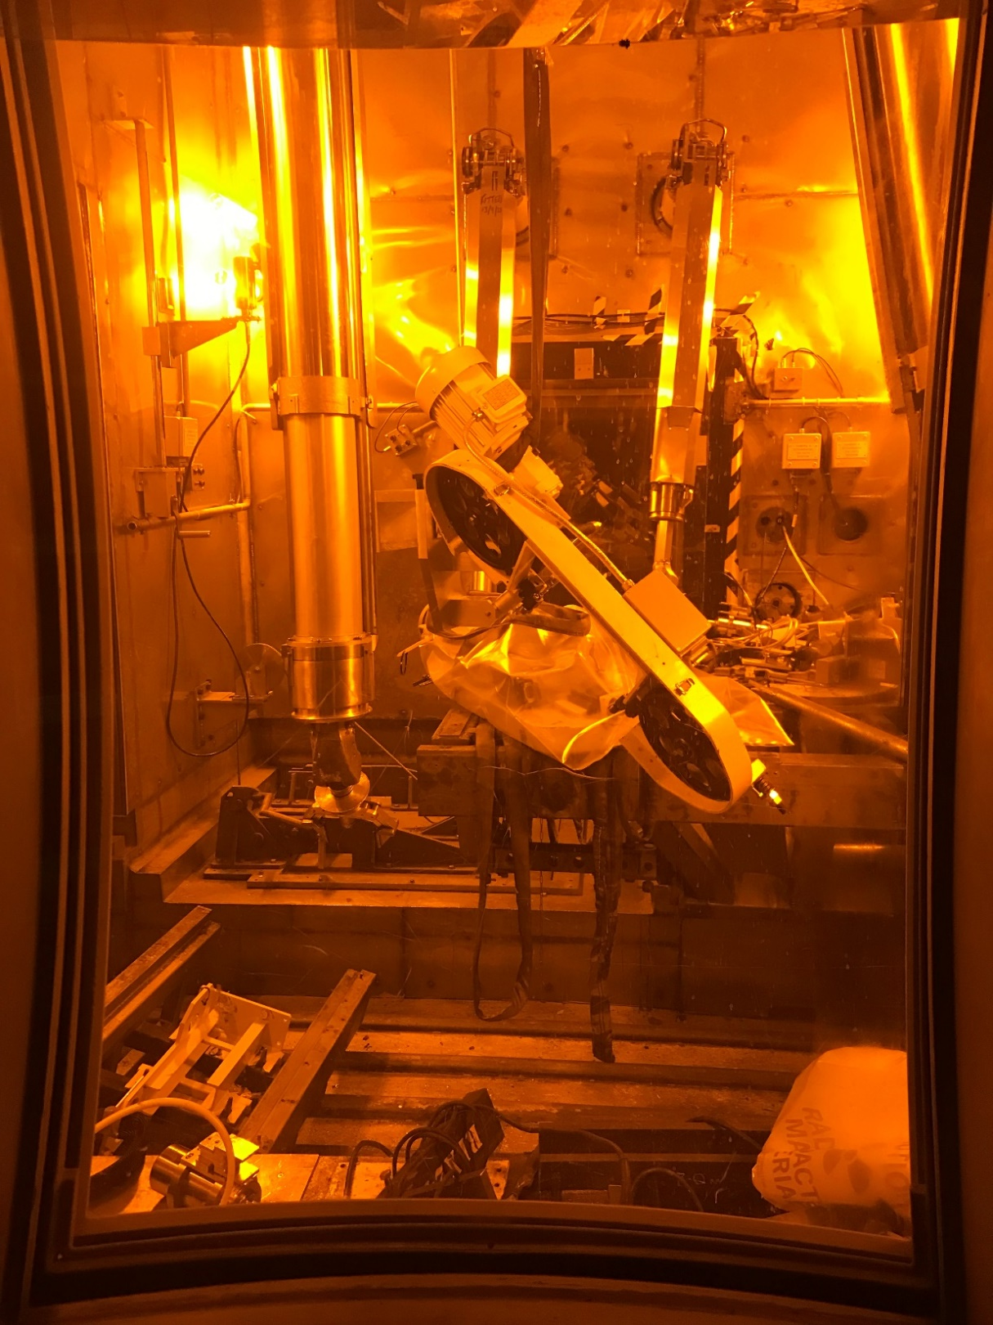
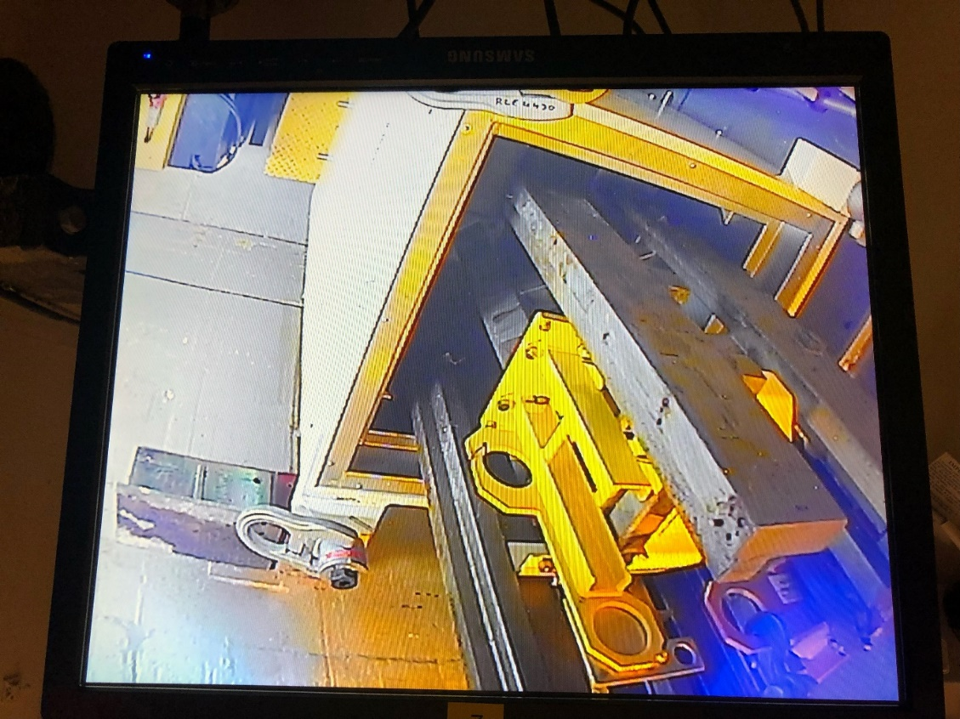
ISIS TARGET STATION 1 TRAM DISMANTLING
Cantilever Beam Cutting within the Hot Cell
First side cut fine.
Jack positioned under beam for support
Second side pinched!
Second saw used, but couldn’t cut through.
Hand held reciprocating saw finished the job!.

Slide 17
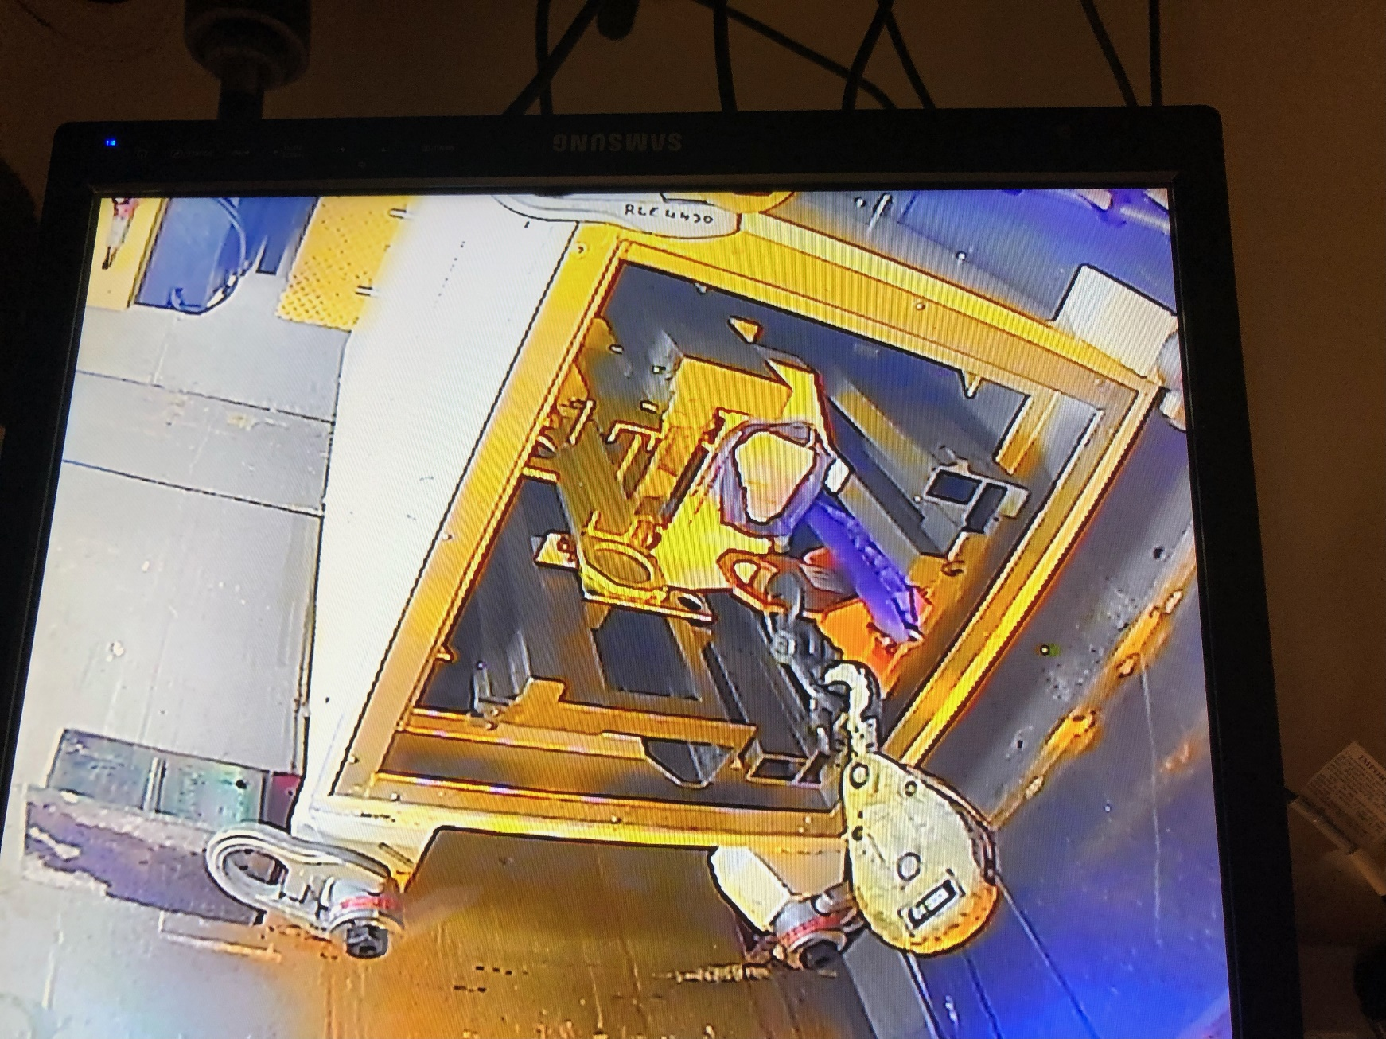
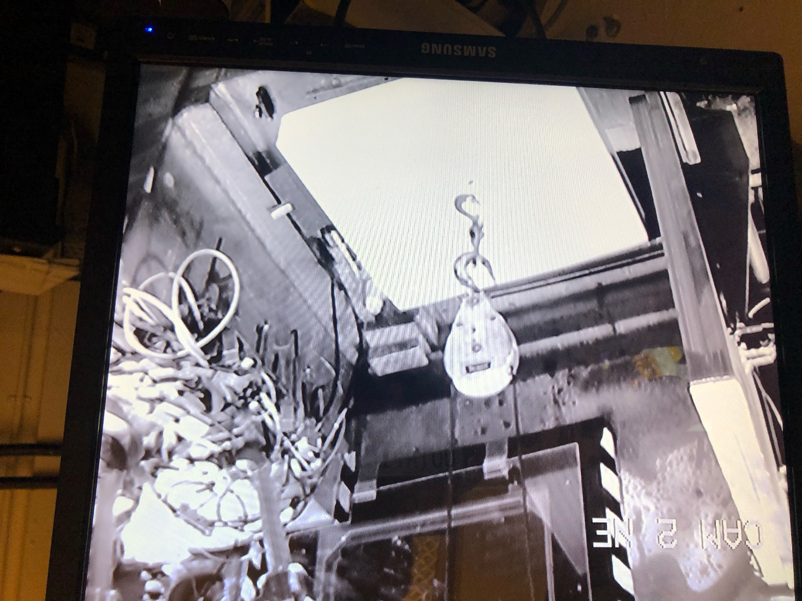
ISIS TARGET STATION 1 TRAM DISMANTLING
Cantilever Beam Removal Continued
Frame Shielding Flask
Shine Tray
A Clean Slate!

Slide 18
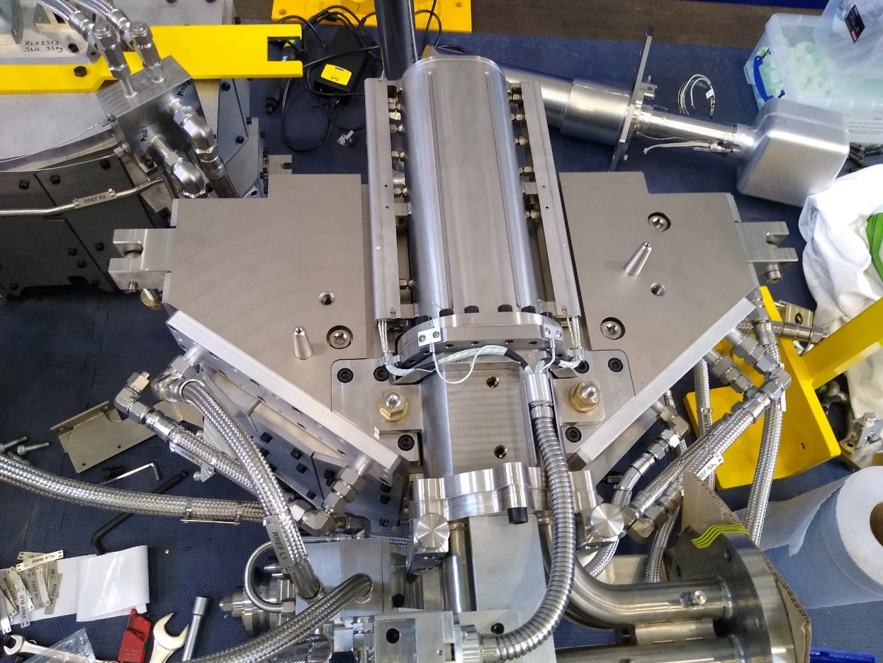
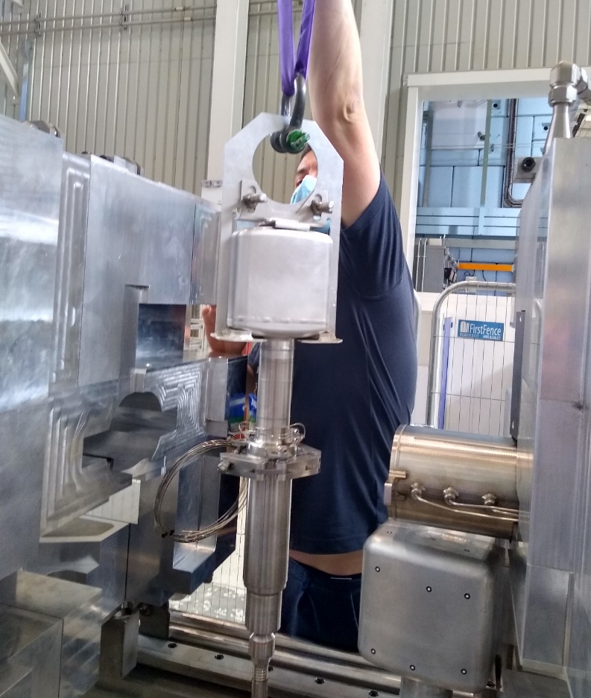
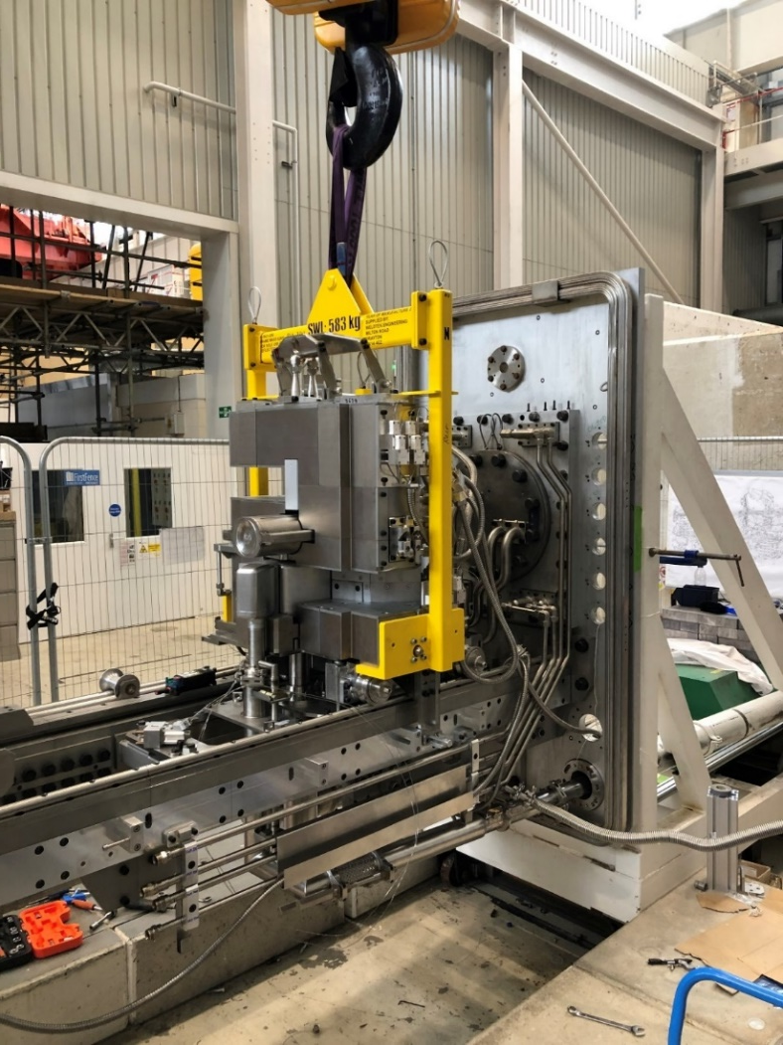
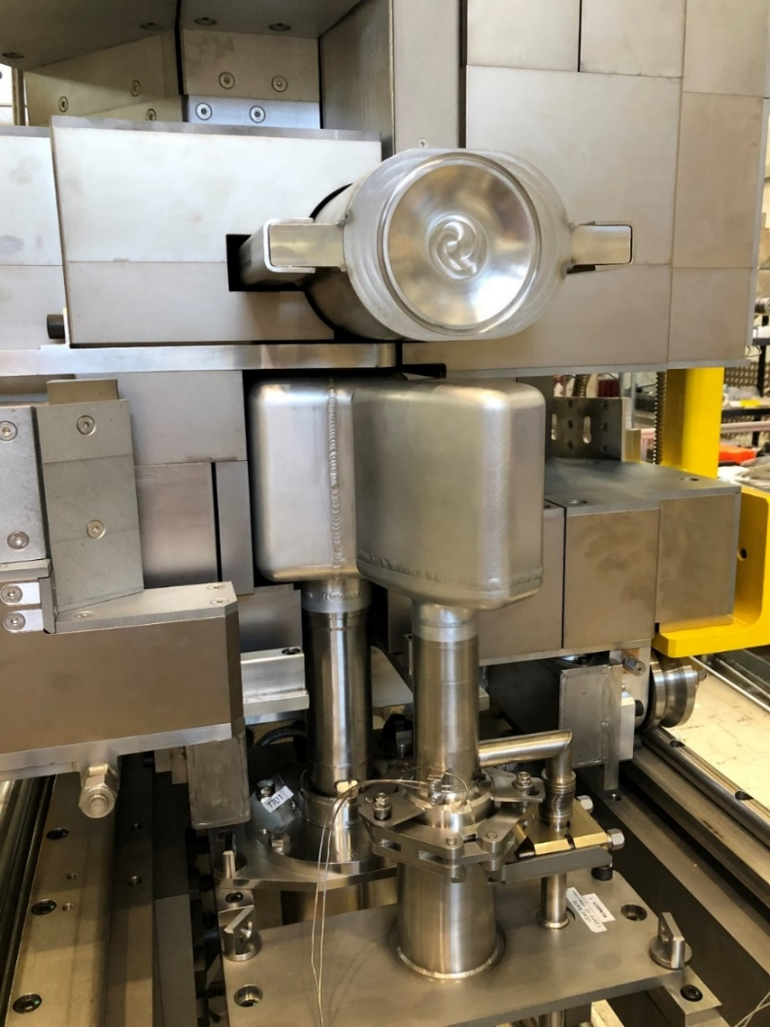
Testing
TRAM Assembly
Flow testing, reducing the system pressure drop, balancing of the system.
Pressure testing of the circuits.
Beam deflection checks.
Reflector, moderator alignment.
Development of remote handling procedures for moderator & target changes.
Leak check of cryo-moderator couplings.
Instrumentation, wiring checks.
Remote handling procedures & tooling for installation.

Slide 19
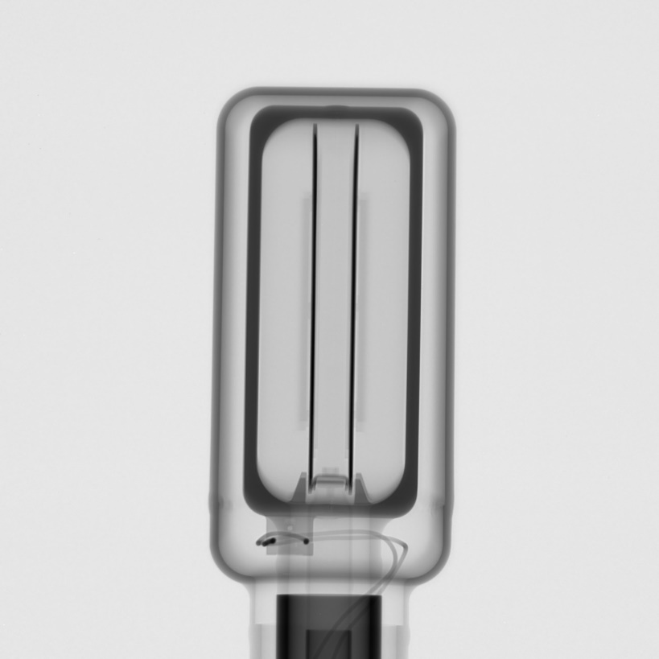
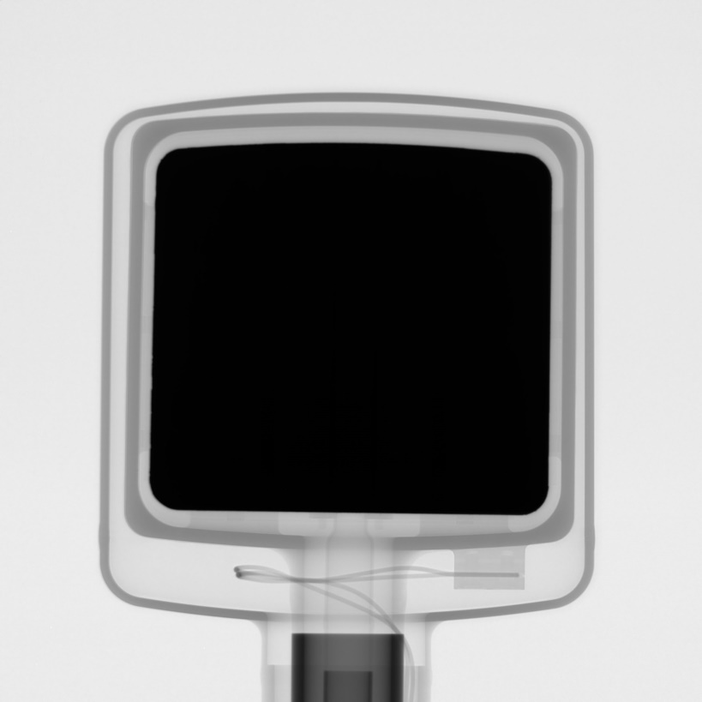
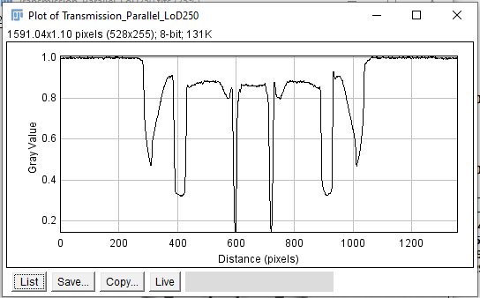
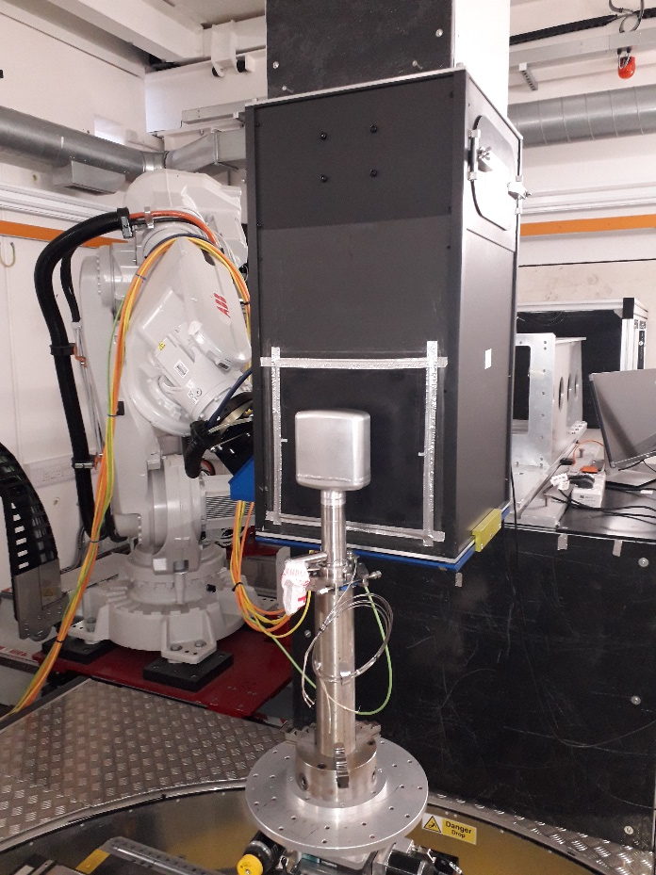
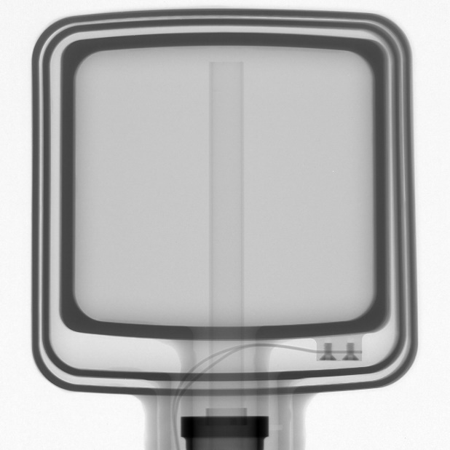
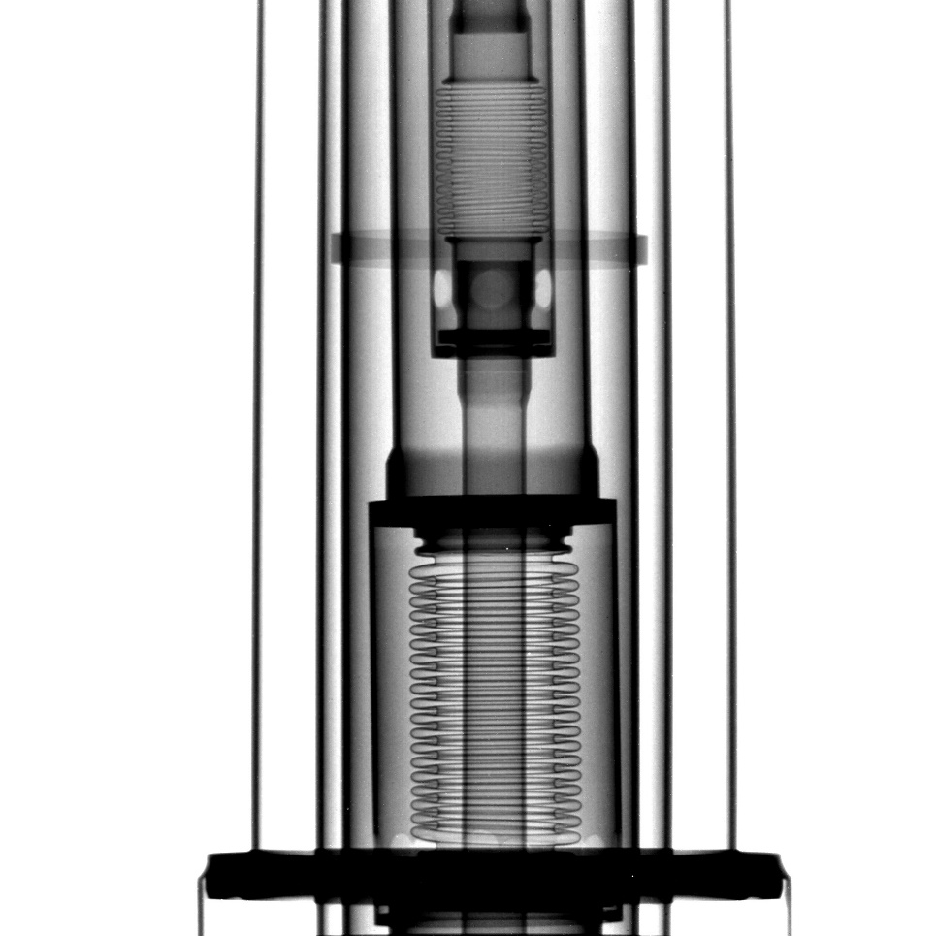
Testing
Cryo-Moderators – IMAT ISIS TS2 radiographies
CH4 Dual Poison Foil Moderator
Moderators were pressure \ leak tested.
3d Scanned for dimensional checks.
Imaged on the IMAT instrument to check for cold touch. The hydrogen was cycle pressure tested to check the operation of the expansion bellows.
H2 Moderator

Slide 20
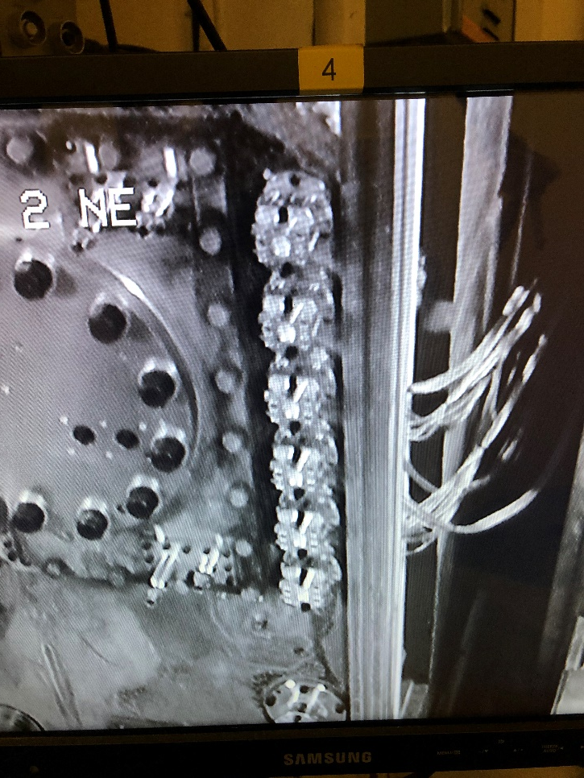
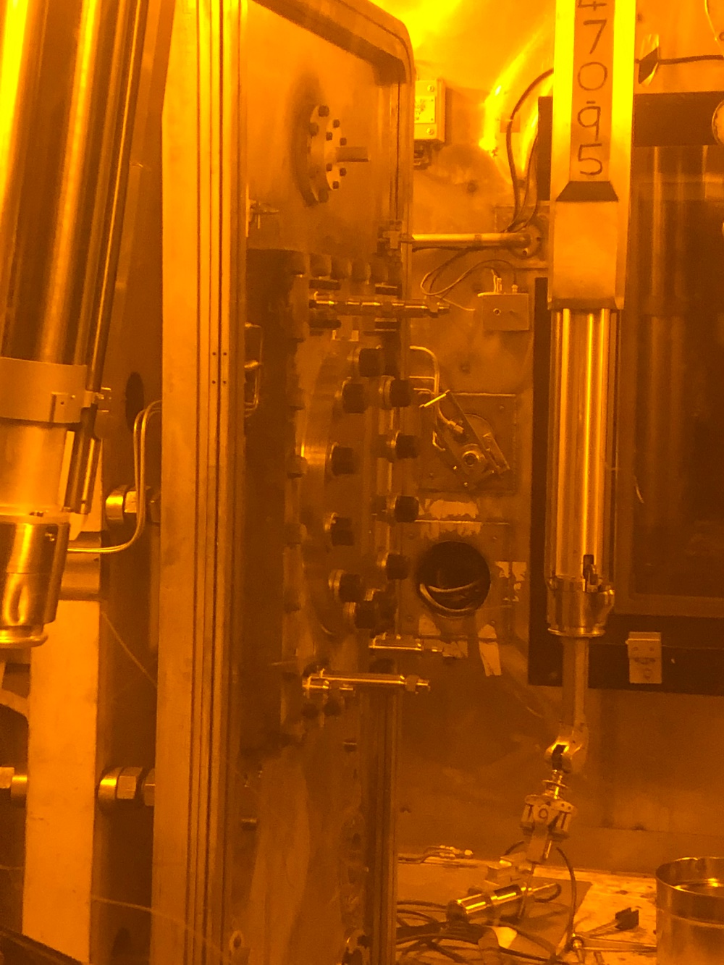
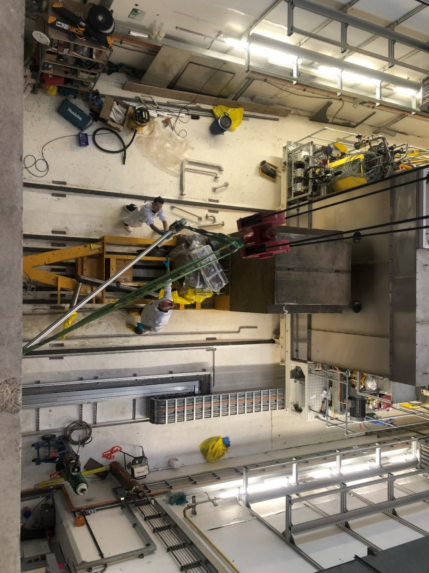
Installation
TRAM ASSY – First Stage
20 meter lengths of Rad hard cable from door.
Manifolds on the door
Methane transfer line sleeve

Slide 21
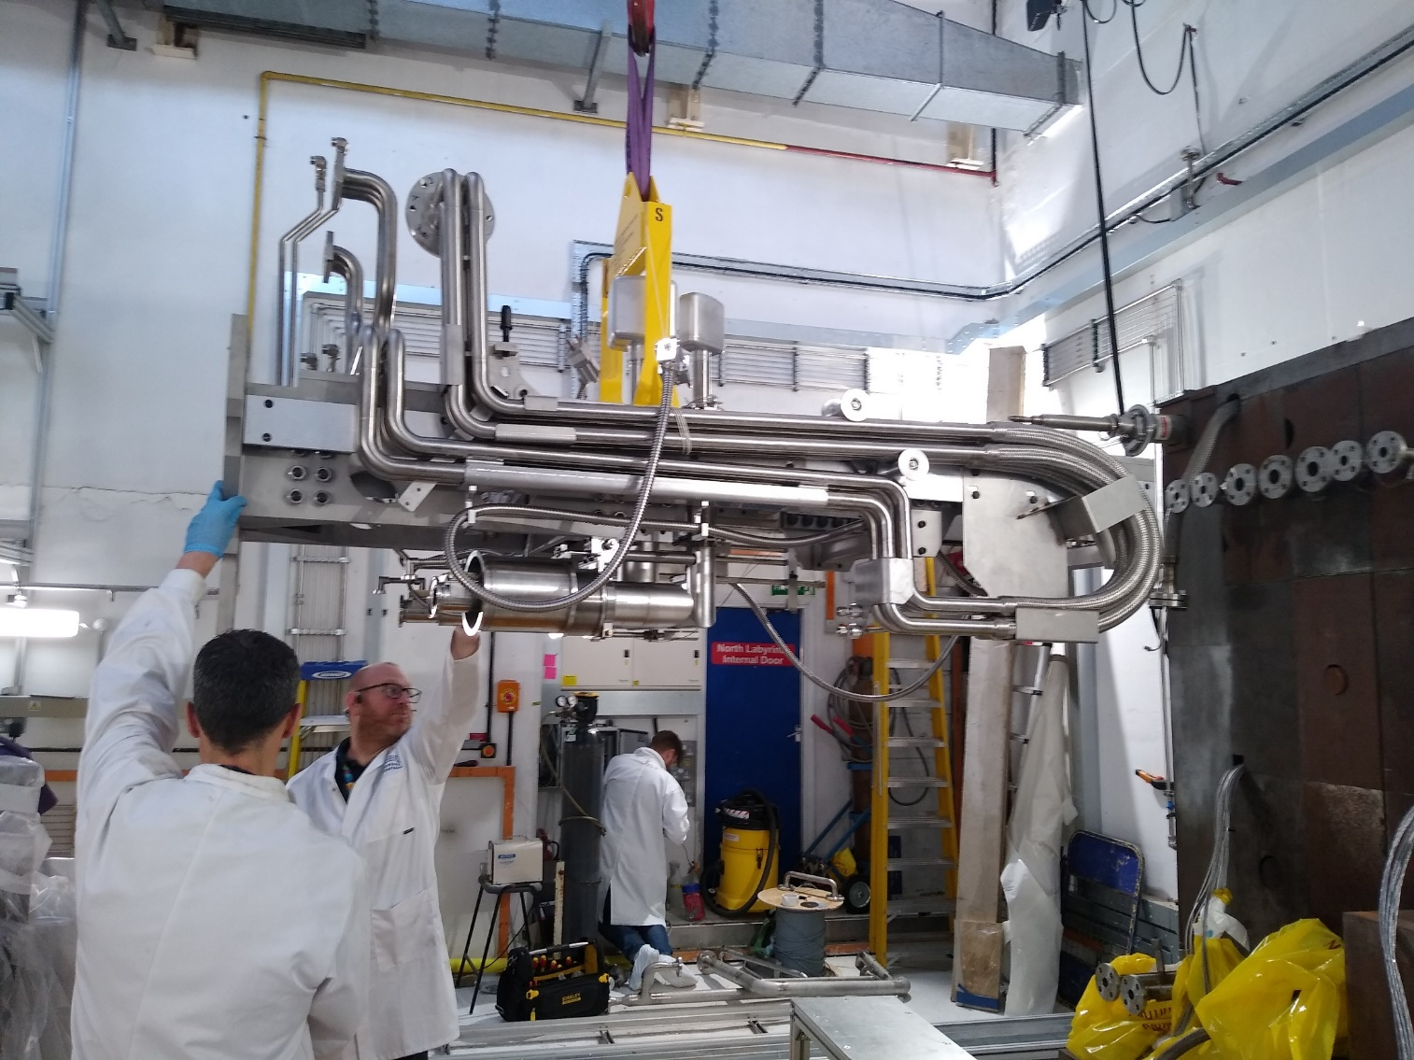
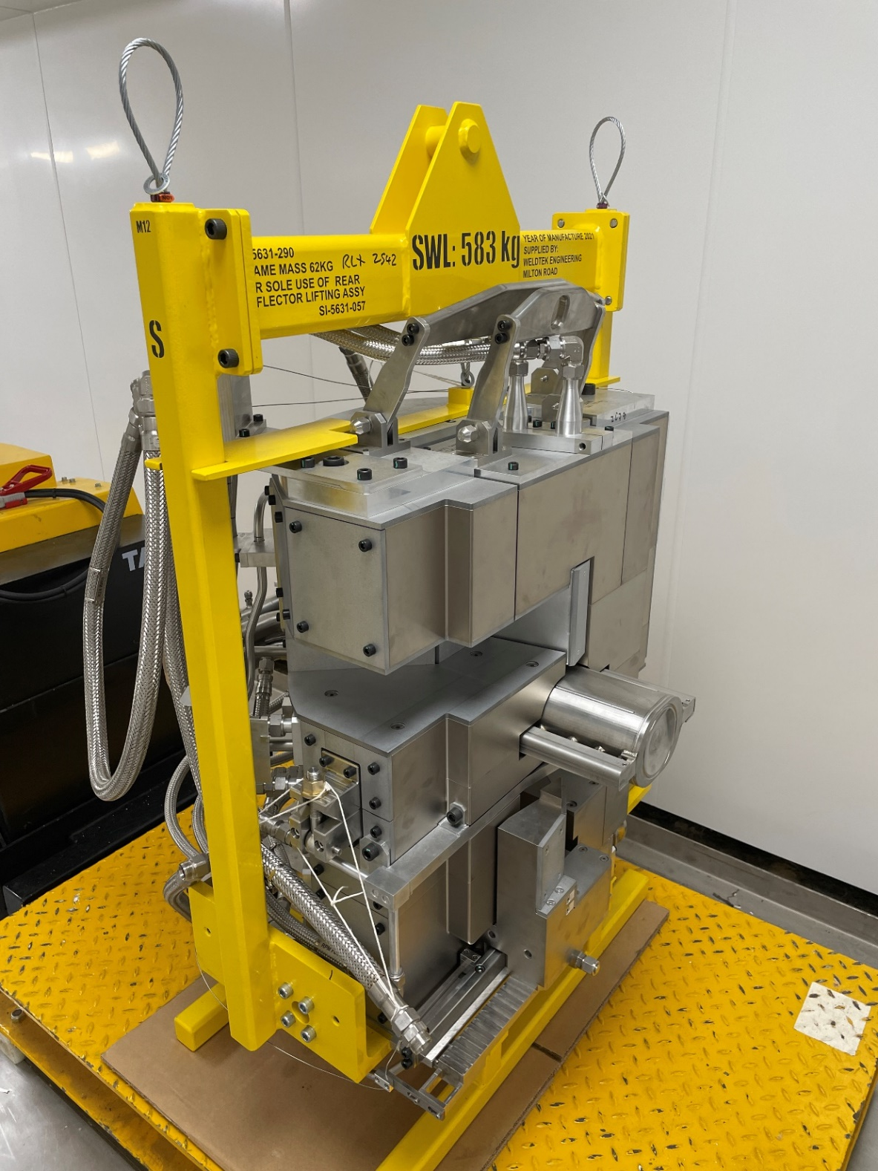
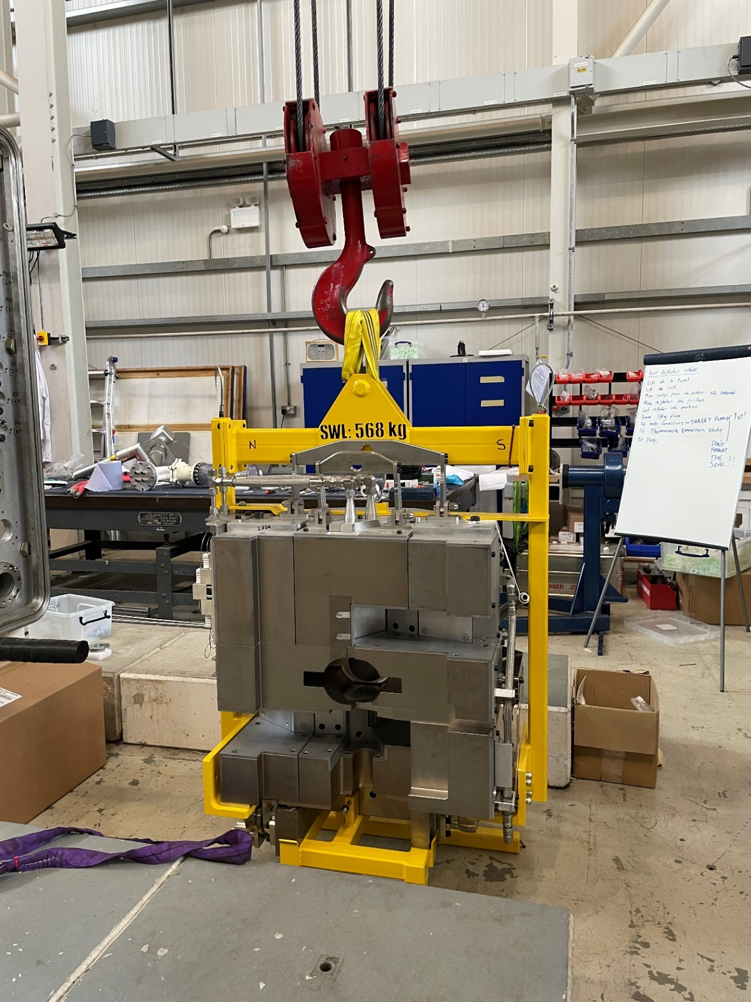
Installation
TRAM ASSY – Three Modules
3x Major components to reduce remote handling operations.
Balanced lifting frames, Removed once installed.
Designed to be within the 1 ton cell crane limit.
Reflector is sized to fit through the 1m X 1m cell trap door.
Cantilever frame, loaded on the gap within the shielding trolley.

Slide 22
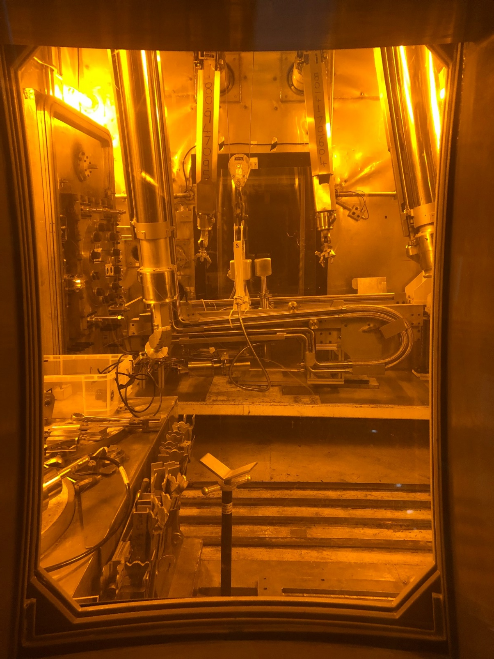
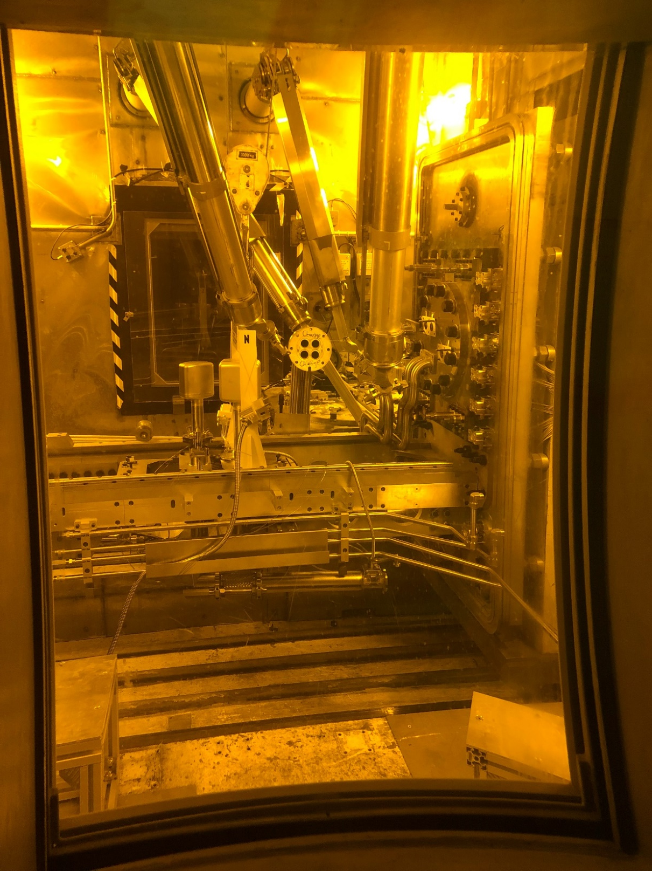
Installation
TRAM ASSY – Cantilever Frame Assembly
Cantilever beam bolted to door. Locations are dowelled.
Target water services connected.
Reflector & water moderator door connections made.
H2 & methane moderator lines inserted and clamped.
H2 & methane cryogenic \ vacuum joints leak tested.
Cantilever stowed, trolley moved back
Cantilever fitted

Slide 23
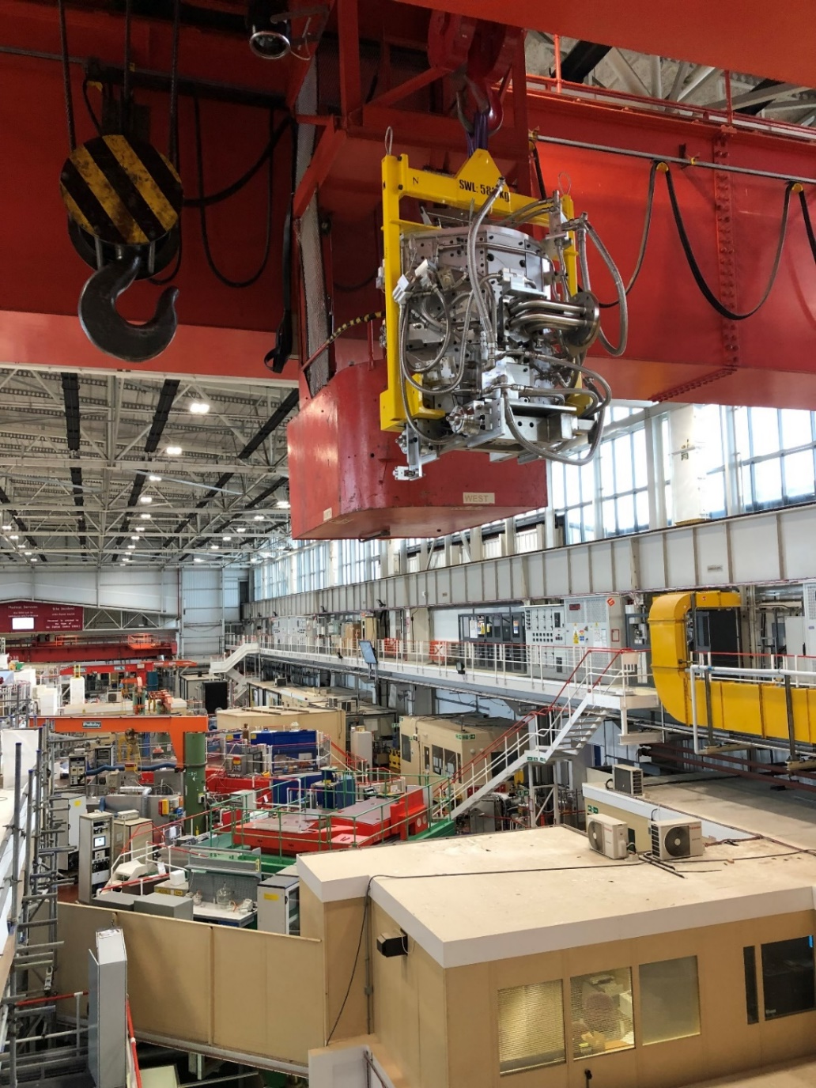
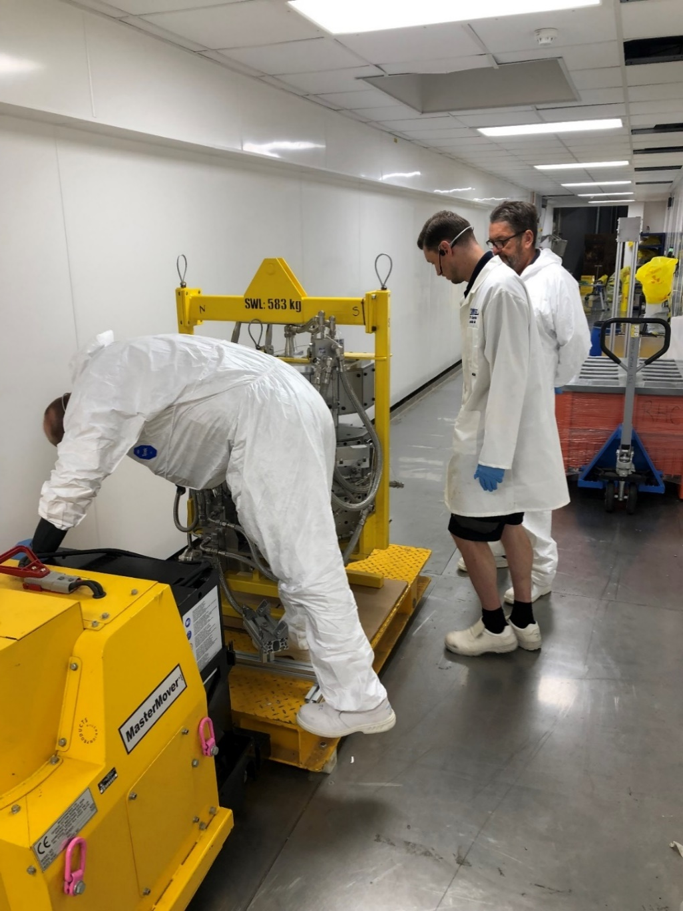
Installation
TRAM Assembly – Reflector
Reflector in flight
Down into waste tunnel
Up the hatch
In to the cell
Target water flange connected.
Reflector hoses connected to fixed frame pipework.
Electrical door connections made.

Slide 24
Commissioning
Installation of the TRAM went well with little issue. However,
Issue with the target front plate running hotter than expected @320deg C With Beam current at 140µA. Plates 2 – 4 @150 deg C. Internal borescope inspection to check for channel blockage – Nothing found. FEA analysis points towards a possible bonding issue within the front plate thermocouple thimble.
Some initial problems with the hydrogen system helium compressor heat exchanger becoming blocked from debris in the cooling water. Once the compressor issues were resolved, the hydrogen system appeared to be operating normally. However, in Feb 2023 the hydrogen system was struggling to maintain 20K. Investigation discovered a possible Leak from the hydrogen circuit to vacuum within the moderator. Possible design flaw within the moderator?.
Instabilities with the methane coldbox system during cool downs and charge changes. Getting to grips with the new circulators and coldbox layout. Managed to stabilise the system by tweaking the circulator speed parameters and learning the behaviour of the system. But the circulators are being pushed harder than expected. The flow rate is lower than expected. Suspect the restriction lies within the cryogenerator heat exchanger.

Slide 25
Summary
Installation of the TRAM went well with little issue. Well Planned!
Dan Wilcox and Leslie Jones are both currently investigating probable causes of the hot target front plate. See, Dan Wilcox’s Poster – Simulated and measured performance of ISIS TS1 project target.
First user cycle started March 2023 with 2x water moderators and methane moderator. First two cycles have been successful without any additional issues with the TRAM operating with a reduced beam current of @140µA. About to ramp up to 160µA
Replacement hydrogen moderator has been redesigned and is currently being manufactured. H2 & CH4 moderator change in Dec \ Jan Shutdown. Hydrogen has a much more complex change procedure, we were not expecting to change it for at least 20 years!
New cryogenerator heat exchanger being investigated to improve the methane flow rate. We will replace this item at a later date to see if this solves the instability issues.
No plan to replace the target. Continue monitoring temps.

Slide 26
Thank You for your Attention
Questions

Slide 27
Testing
TRAM Assembly

Slide 28
Testing
Modular plant and cryogenic platform to fit on top of existing trolley.
New (recyclable) ion exchange & filter columns.
Simpler plant with additional backup pump for the target circuit. Modern valves and instrumentation.
Plant was flow & pressure tested before installation.
New, sealed! ATEX room for the hydrogen and methane coldboxes.
New coldboxes, design and built by outside company using ATEX rated circulators, valves & instrumentation.
Coldboxes pressure & leak tested before installation.
Reconditioning of the TCF20 fridge for the hydrogen coldbox.
Development of lifting equipment for installation
TSA SERVICES & CRYOGENIC COLDBOXES

Slide 29
Plant Installation
Target Services Area – Water Services
Freshened up
Tensators replaced
New crane fitted
New lighting and electrics

Slide 30
Cryo-system Installation
Target Services Area – Coldbox, ATEX Room

Slide 31
Installation
Target Services Area – Comparison

Slide 32
Thank You for your Attention
Questions

