Slide 1
Upgrades and Progress in Increasing Beam Power Above 1.4 MW at the SNS
Drew Winder, Source Development and Engineering
Presenting work done by many, including:
Kevin Johns, Makayla Edwards, Greg Stephens, Brian Degraff, Mark Champion, and Franz Gallmeier
Notice: This manuscript has been authored by UT-Battelle, LLC, under contract DE-AC05-00OR22725 with the US Department of Energy (DOE). The US government retains and the publisher, by accepting the article for publication, acknowledges that the US government retains a nonexclusive, paid-up, irrevocable, worldwide license to publish or reproduce the published form of this manuscript, or allow others to do so, for US government purposes. DOE will provide public access to these results of federally sponsored research in accordance with the DOE Public Access Plan (https://www.energy.gov/doe-public-access-plan).
Notes:
ABSTRACT: The Spallation Neutron Source (SNS) at the Oak Ridge National Laboratory is currently the world’s
highest power pulsed neutron spallation source. The SNS first reached its design power of 1.4
MW in 2013 and began operating steadily at 1.4 MW in 2018. Part of the delay in reaching steady,
reliable 1.4 MW operation was due to the capabilities of the target systems. We are pleased to report
that the SNS is now operating at 1.7 MW and will ramp over time to 2.0 MW. This presentation will
provide an update on the recent history of the SNS target systems as they transitioned to steady
1.4 MW operations. It will also provide information about the ongoing Proton Power Upgrade
project, which is nearing completion. This project will increase the available accelerator power to
2.8 MW, double the original 1.4 MW design. This beam power will allow for 2 MW operation of
the SNS’s first target station and provide additional capabilities for a future second target station.
Several upgrades will be made to the first target station to ensure reliable operation at 2 MW.
This presentation will also describe these upgrades and their current status, including operational
unknowns, risks, and risk mitigation strategies.

Slide 2
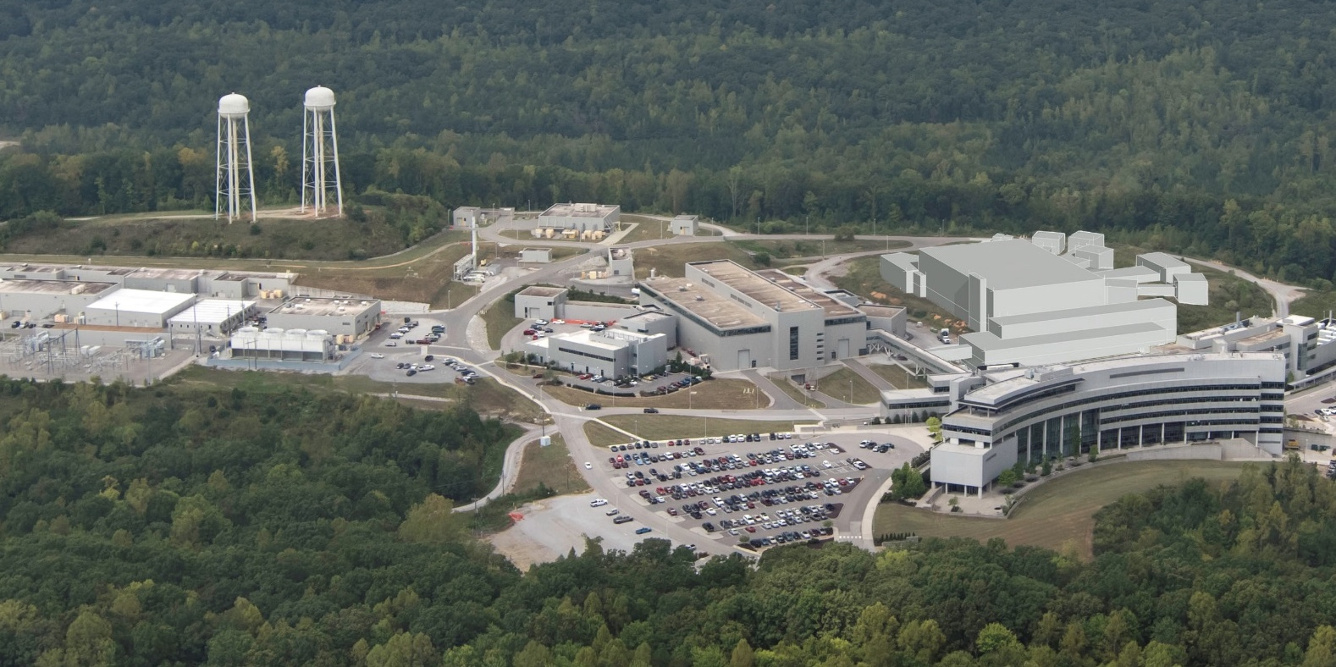
Spallation Neutron Source (SNS) Upgrade in Progress
Future
Second Target Station (STS)
US Department of Energy Scientific User Facility
Accelerator-driven pulsed spallation neutron source
Located at the Oak Ridge National Laboratory in the USA
Currently in a long outage for upgrades
Accumulator Ring
First Target Station (FTS)
Linac
FTS Parameter | Now | Soon | STS Era
Proton Energy | 1.05 GeV | 1.30 GeV | 1.30 GeV
Beam Power | 1.7 MW | 2.0 MW | 2.0 MW
Pulse length | 0.7 µs
Pulse Frequency | 60 Hz | 60 Hz | 45 Hz
Beam Size | 200 mm x 70 mm
Target Type | Flowing mercury
Moderator Types | 3 hydrogen, 1 water

Slide 3
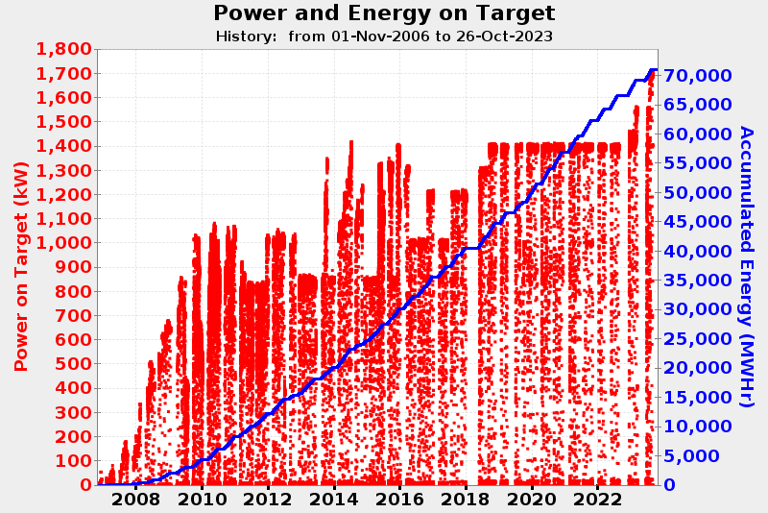
SNS has entered a new era of operation above 1.4 MW
Operating since 2007
Historically, power limited alternately by accelerator and target
Steady 1.4 MW operation since 2019
Now increasing power to 2 MW

Slide 4
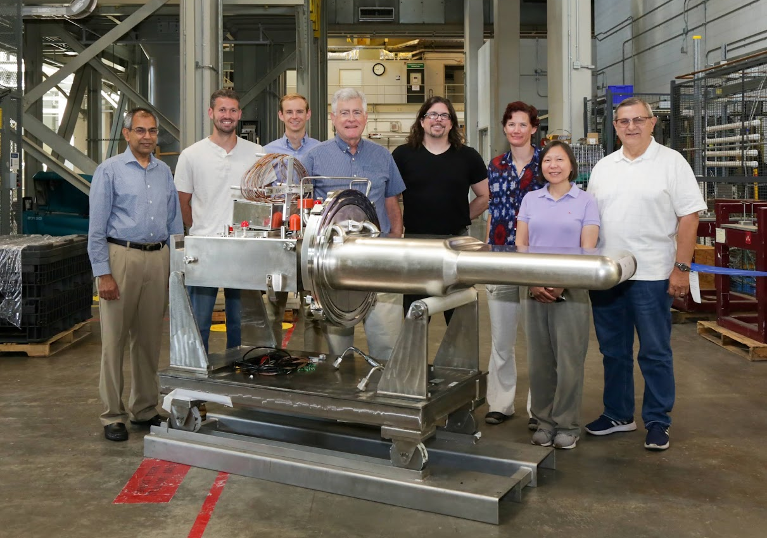
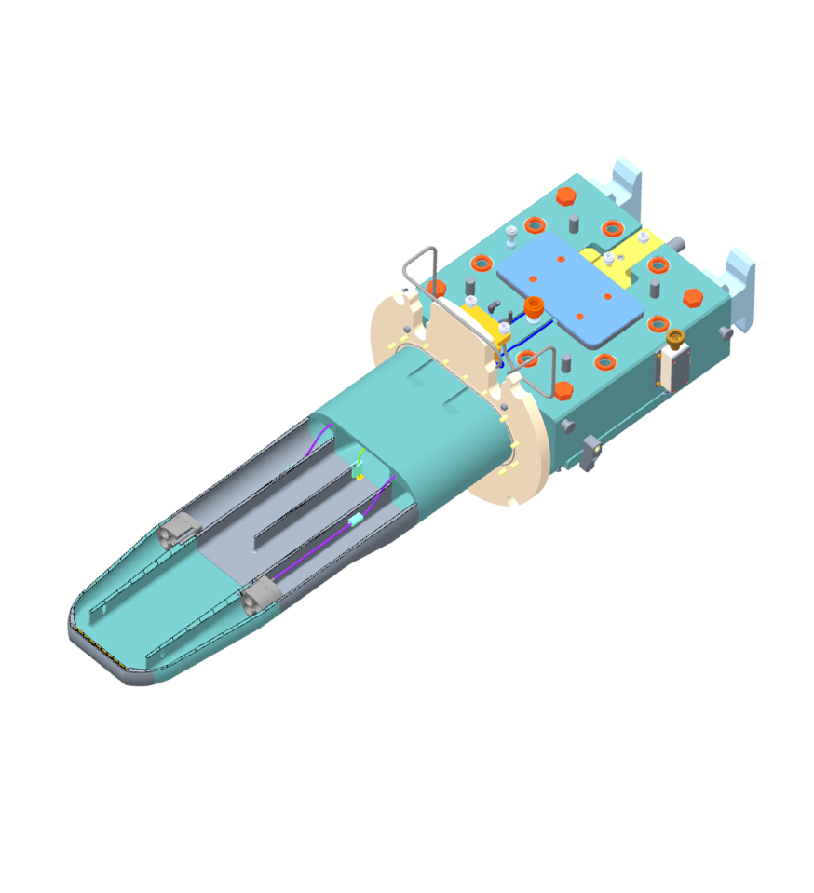
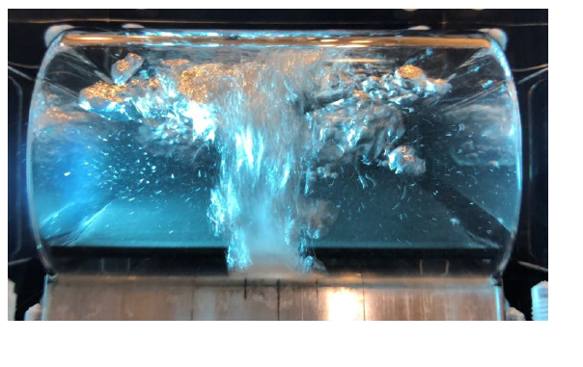
Proton Power Upgrade project nearing completion
Power increases to the accelerator
Target modifications
  Improved design against fatigue
  Improved gas bubblers
  2nd gas injection supply
Moderator ortho/para catalysts
  Consistent moderator performance
Many thanks to our
friends at J-PARC

Slide 5
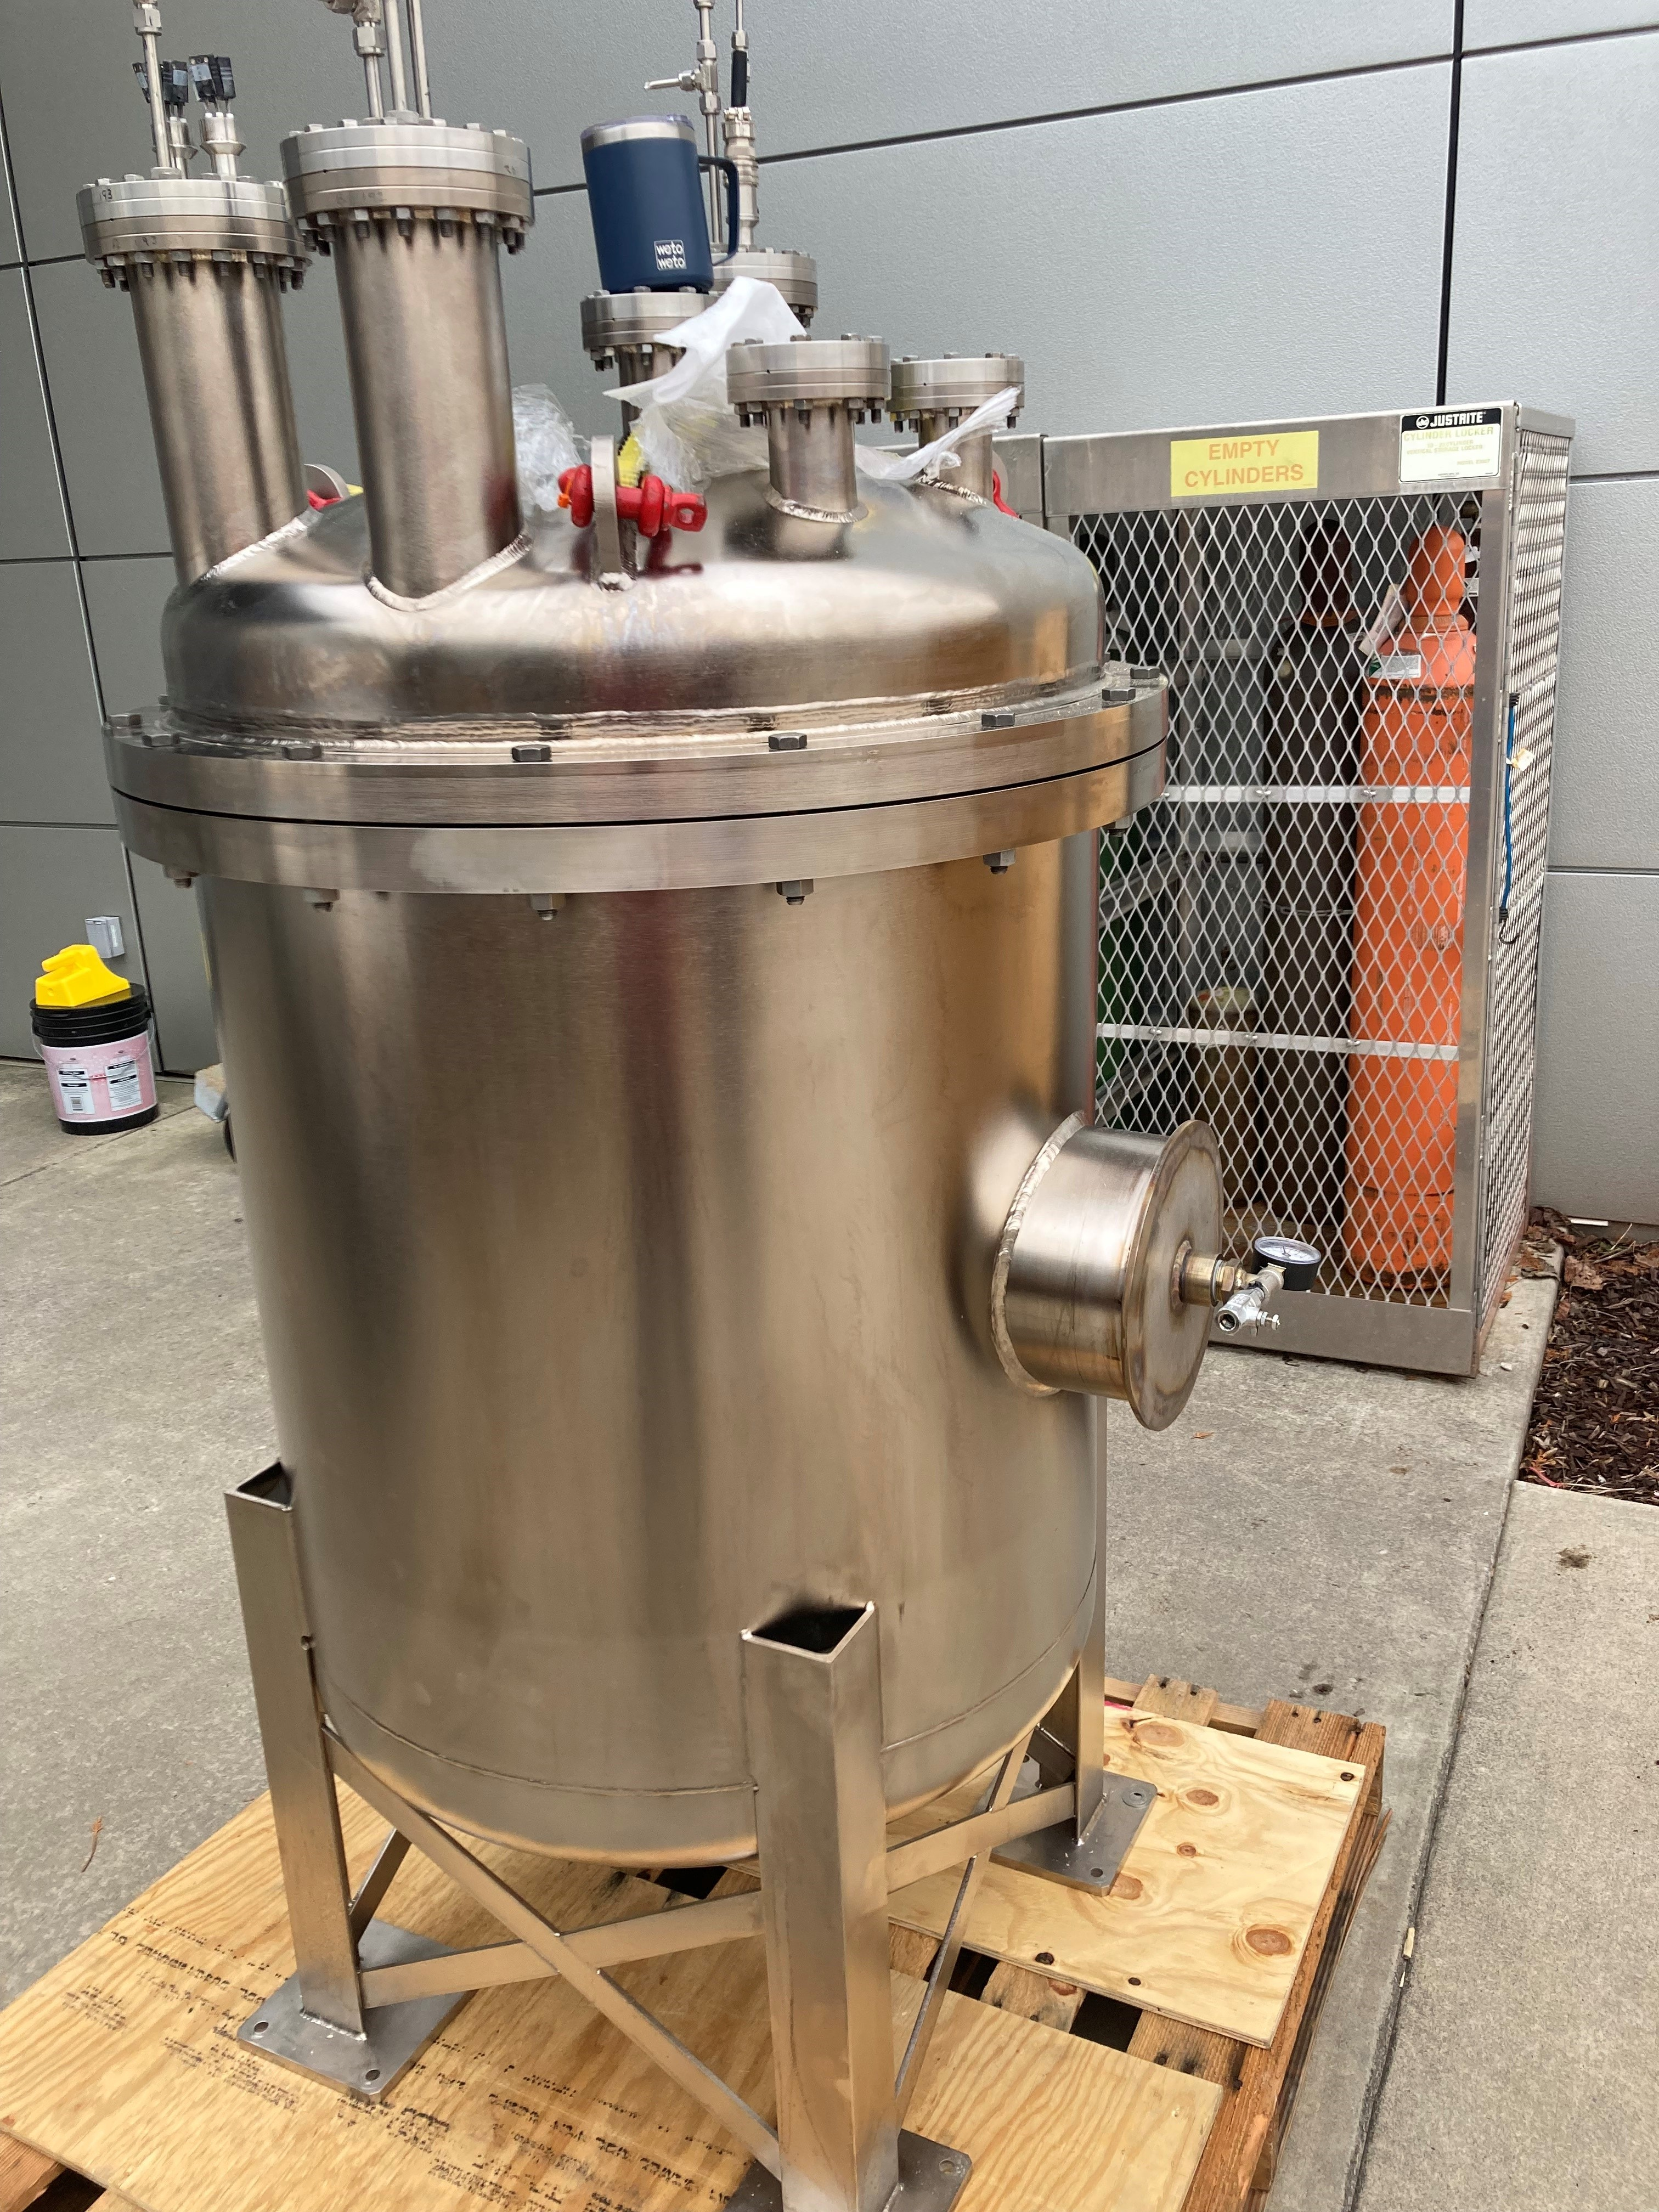
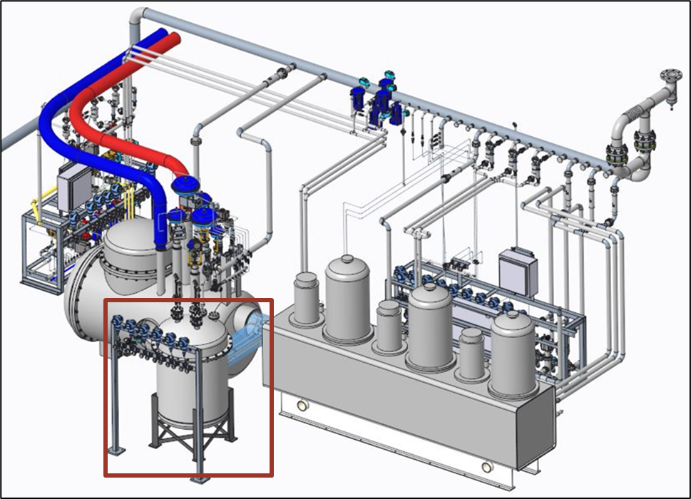
Hydrogen moderators add ortho/para catalysts and diagnostics
Want >99% para-hydrogen
  Current ratio is <70%, varies with time and power
3 catalyst beds will be added
  Continuous diagnostic system
Poisoned-decoupled moderator performance not scaling with power
  Changes to moderator hydrogen flow needed

Slide 6
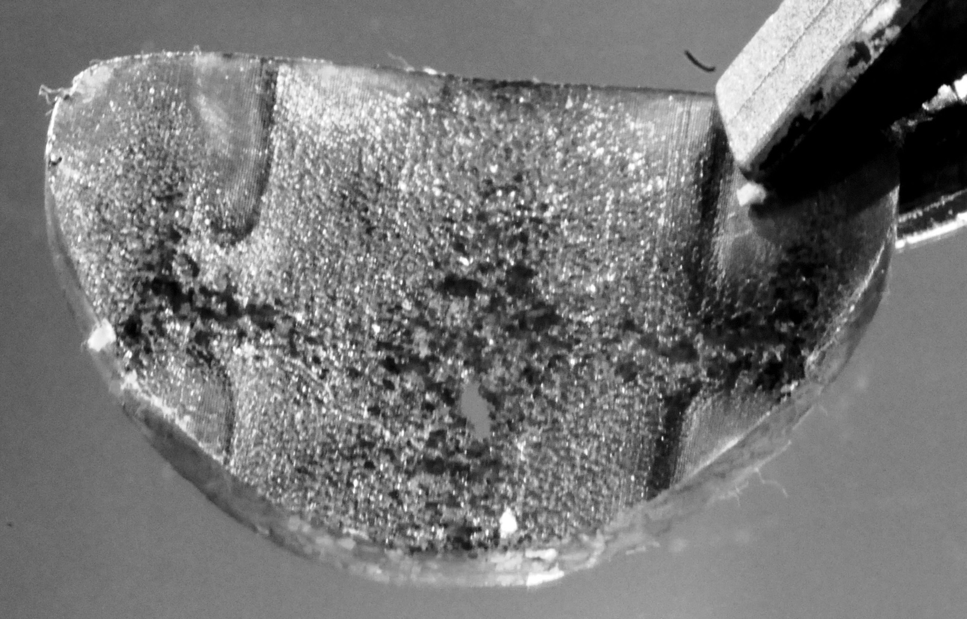
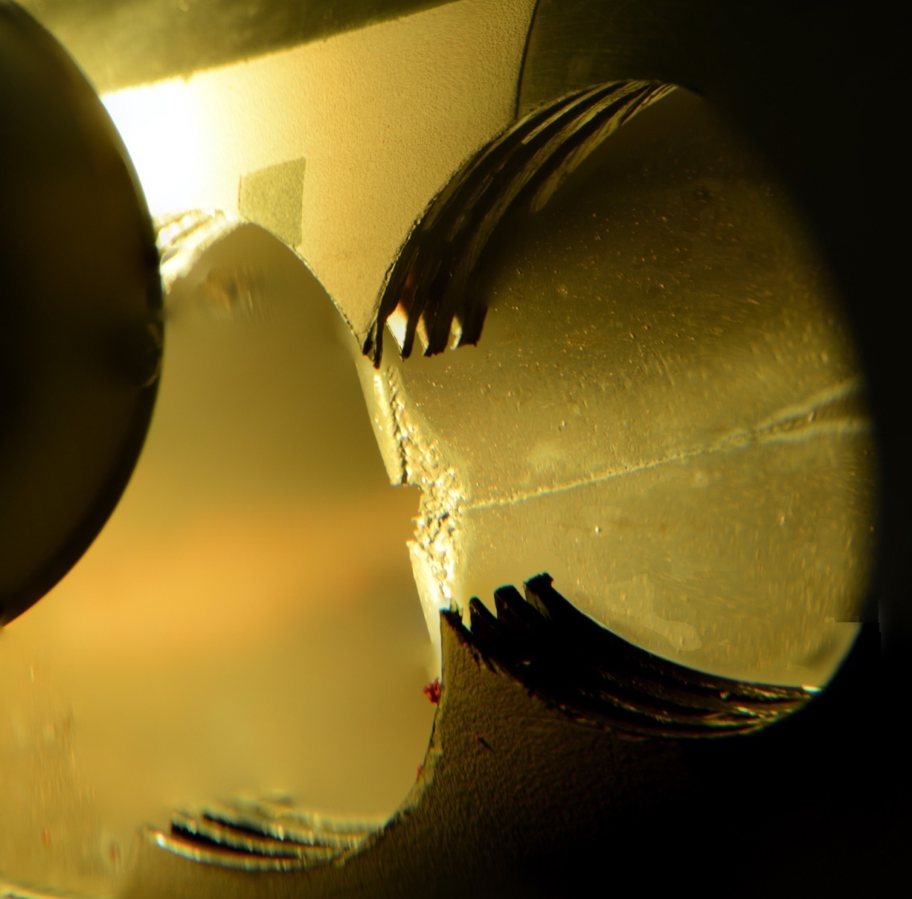
Early target issues related to cavitation and fatigue
High-power, pulsed beam leads to
  Cyclic fatigue of 316L stainless structure
  Mercury cavitation damage
    Measured by removing samples
9 of 31 targets leaked in service
  Interrupts user program
Only 2 of the last 18 targets leaked
  Advances in design, manufacturing, and operation
  Gas injection
Images by David McClintock

Slide 7
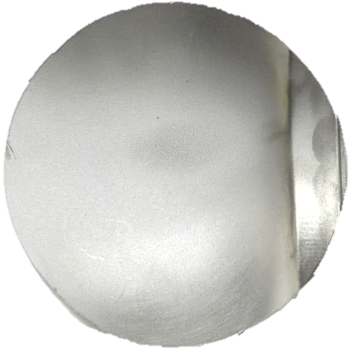
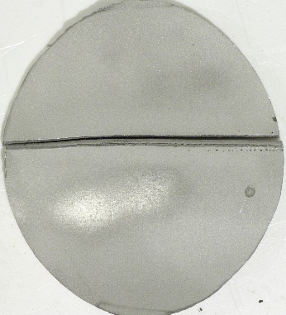
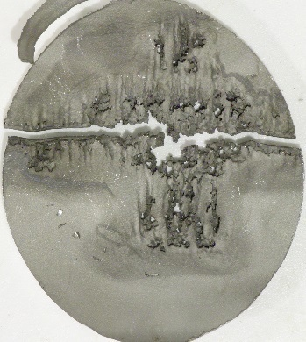
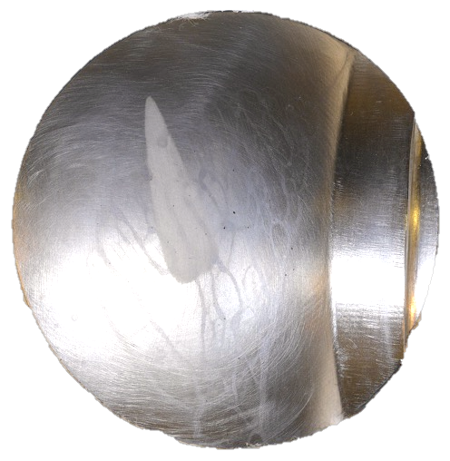
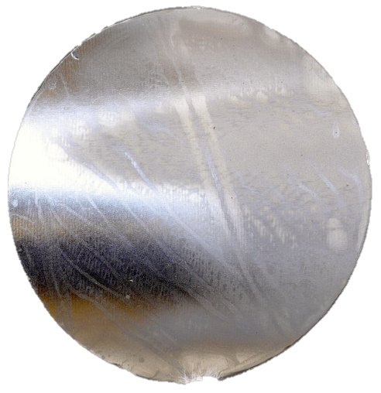
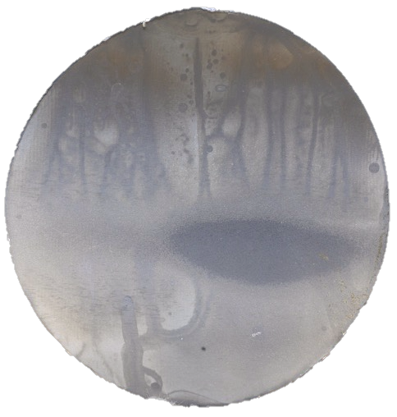
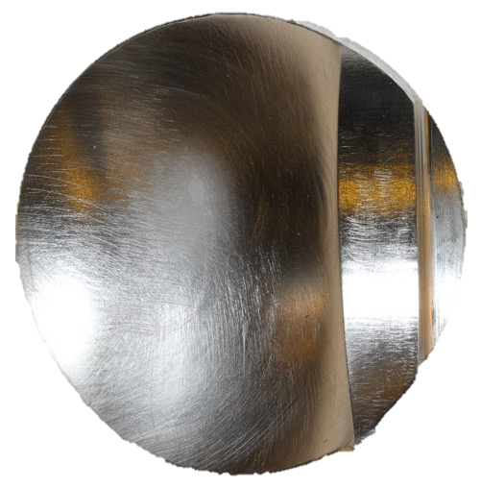
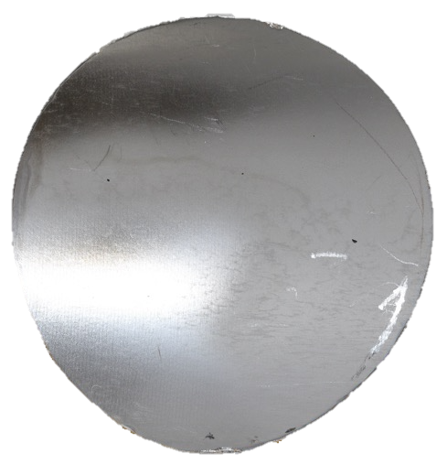
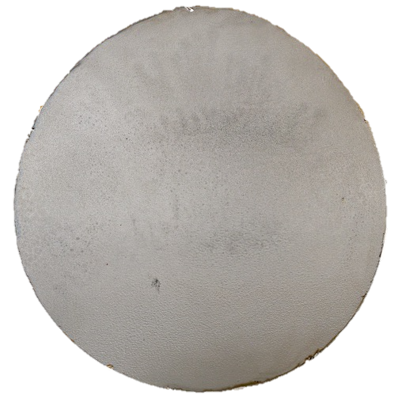
Gas injection key to reliability
Outside of beam
Beam Center
First used at J-PARC in 2012
Used at SNS since 2017
  Helium rates increased from 0.3 slpm to 4 slpm
  Helium volume fraction <0.1%
Cavitation damage greatly decreased
Strain decreased
  Varies by location, diminishing returns
Target 16
Jet-flow - no gas
P_{avg} = 968 kW
E_{total} = 1780 MWh
Target 28
Jet-flow
orifice bubbler
Q_{avg} = 1.58 SLPM
P_{avg} = 1330 kW
E_{total} = 3186 MWh
Target 29
PPU-test target #1
Swirl bubbler
Q_{avg} = 3.79 SLPM
P_{avg} = 1324 kW
E_{total} = 1931 MWh
Images by David McClintock

Slide 8
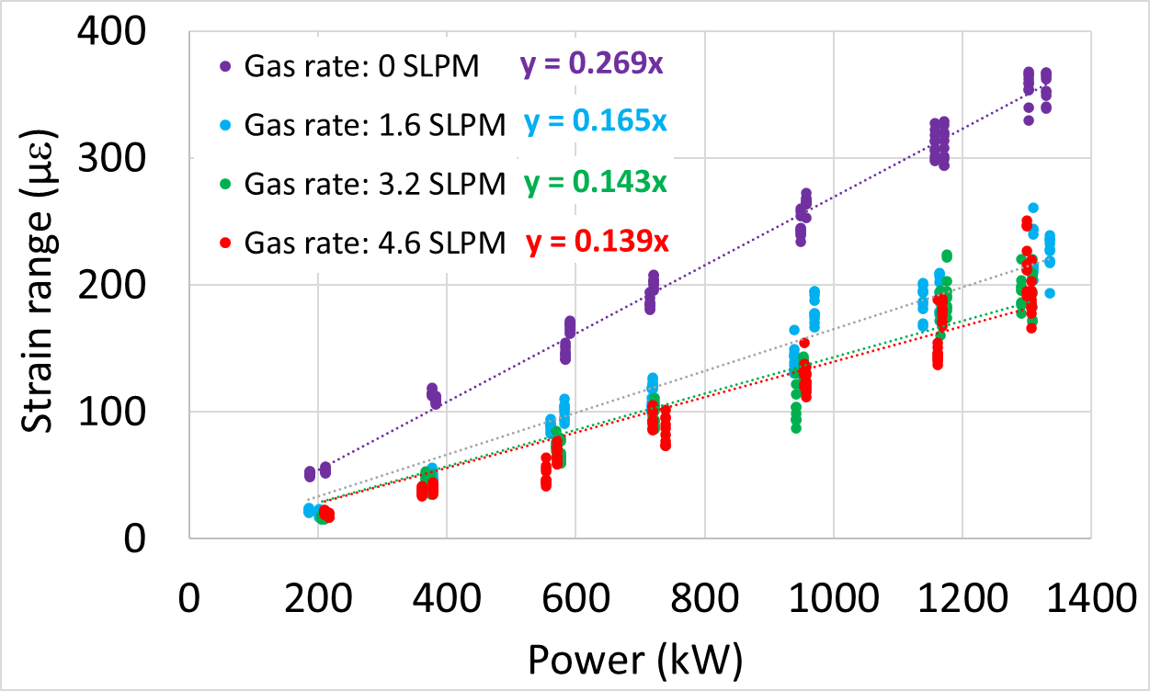

Gas injection key to reliability
First used at J-PARC in 2012
Used at SNS since 2017
  Helium rates increased from 0.3 slpm to 4 slpm
  Helium volume fraction <0.1%
Cavitation damage greatly decreased
Strain decreased
  Varies by location, diminishing returns
$y \left(Strain range\right)=k∗$($Power$)

Slide 9
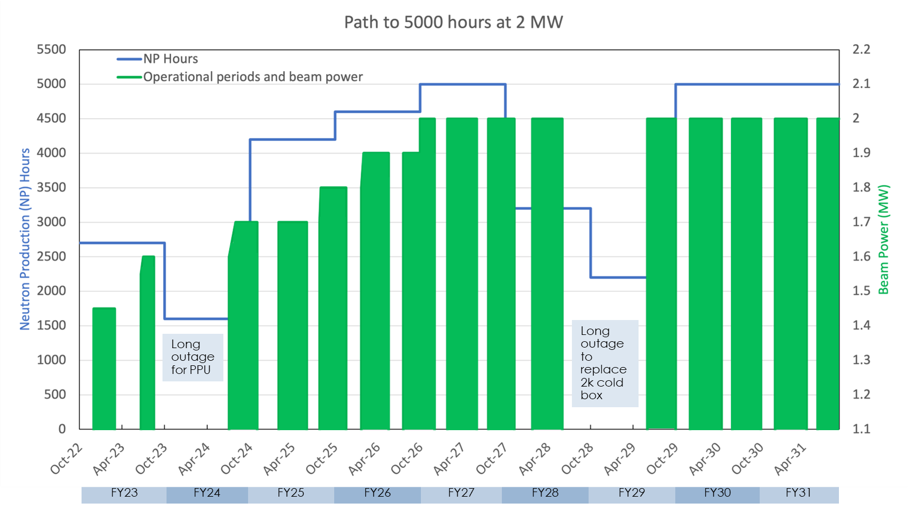
Post-upgrade ramp plan focuses on reliability
Reliable operation is most important
Ramp by 2027 to
  5,000 hours per year,
  2 MW

Slide 10
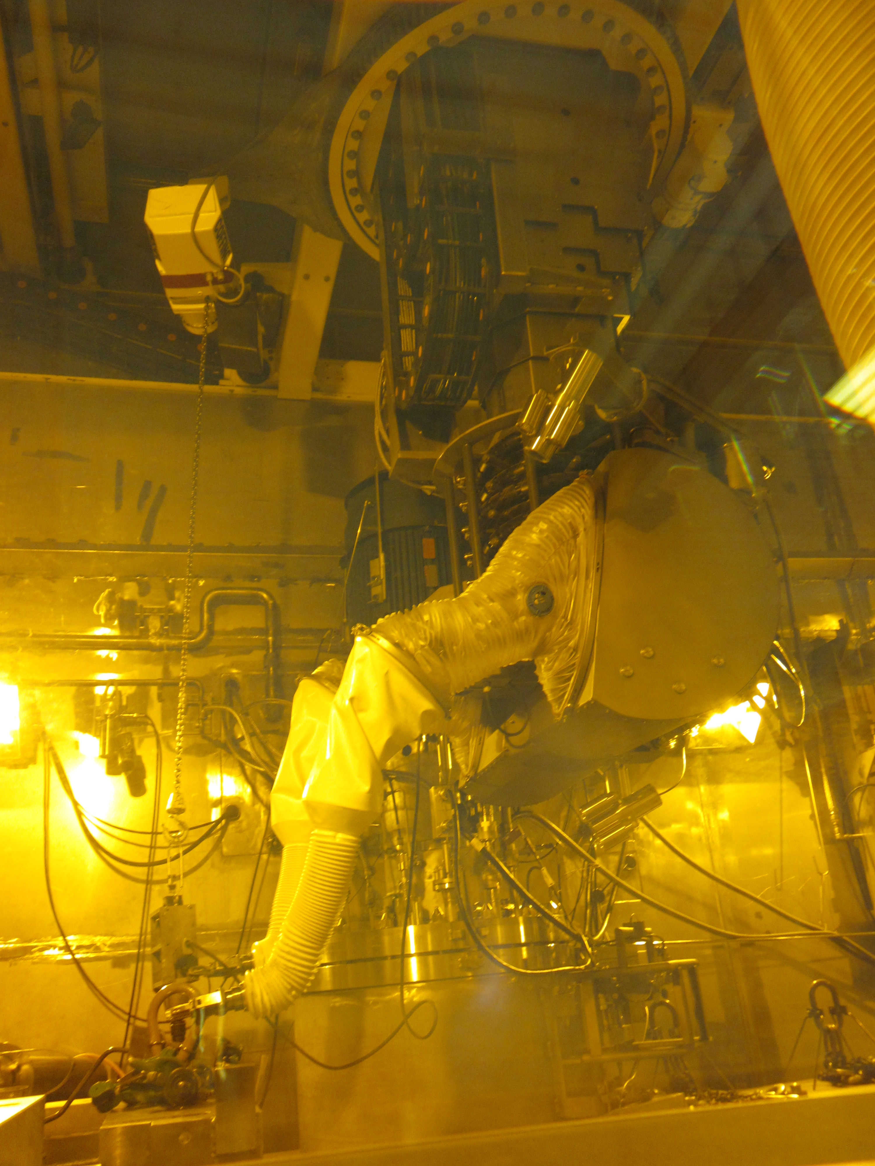
Target challenges remain after upgrade
Verify new target design at 2 MW
  Prepare for future 45 Hz operation
Higher power = shorter lifetimes
  Poster - Moderator and Reflector Fabrication Challenges at the Spallation Neutron Source
Aging equipment
  Poster - Impact and Lessons Learned from the
  Mercury System Filling Incident at the Spallation Neutron Source
Source improvements
  Optimize SNS FTS as part of a suite including HFIR and the STS
Telerob Servo Installing
Swivel Hoist Rings

Slide 11
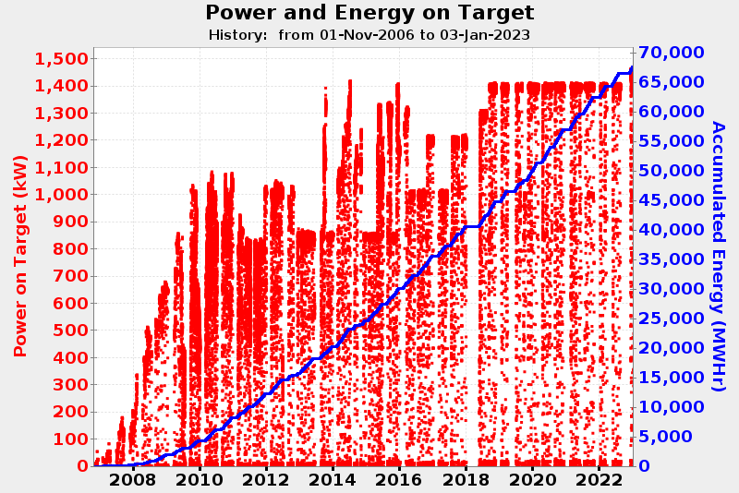
- Target (31)
2019 Hg Event
4
5
1
6
7
- PBW (7)
- IRP (1)
1
2
3
19
20
21
22
23
24
10
11
12
18
25
26
27
1
2
3
4
5
6
7
8
9
13
14
15
16
17
28
29
30
31

Slide 12
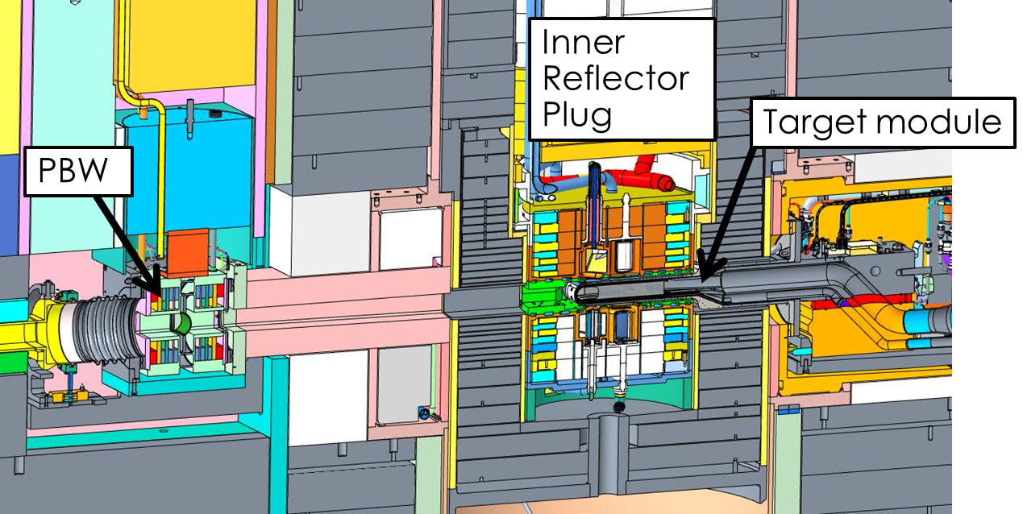
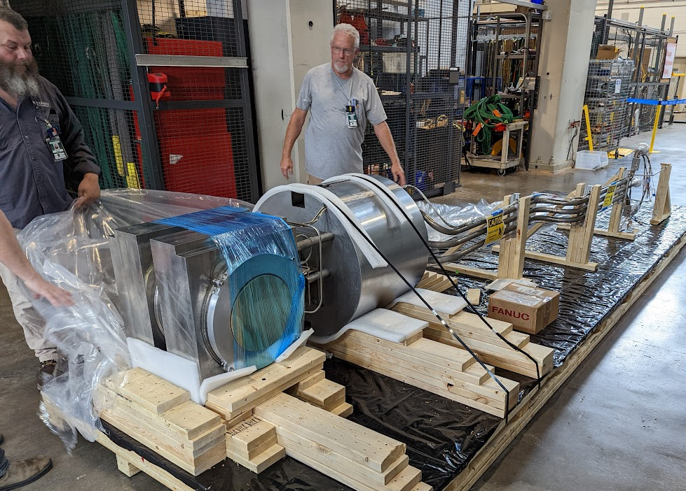
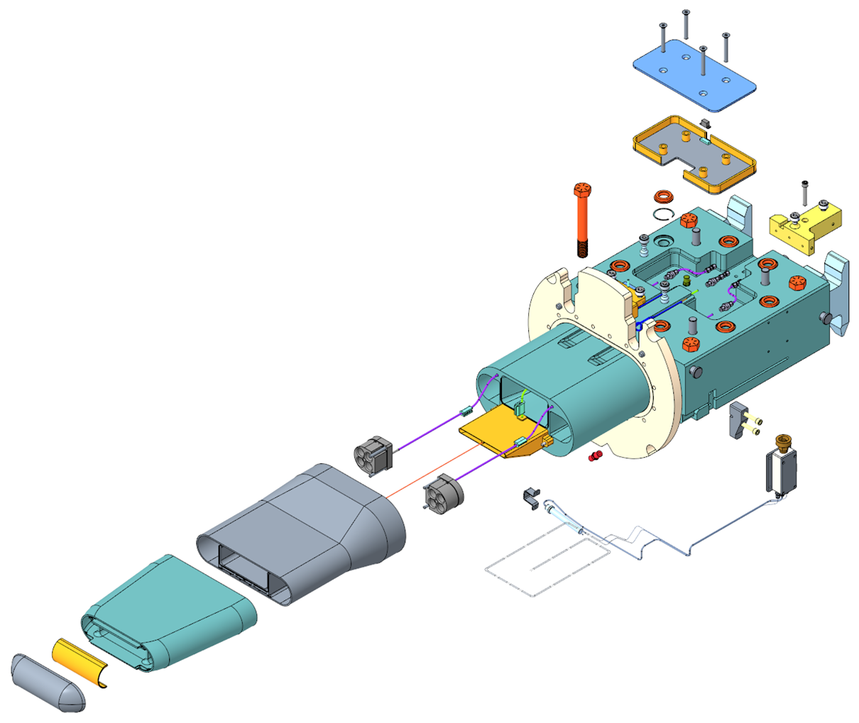
Summary
The SNS has demonstrated reliable 1.4 MW operation
  Gas injection was key to success
Upgrades to 2.0 MW underway
  Changes to accelerator, target, moderators
  Plan to ramp slowly to prioritize reliability
Future challenges include 45 Hz, aging hardware, increased consumption rate

