Slide 1
Challenges Encountered While Replacing the SNS Ring Injection Dump Beam Stop and Window
Ryan Schultz
Jeff Saunders
Dave Willis

Slide 2
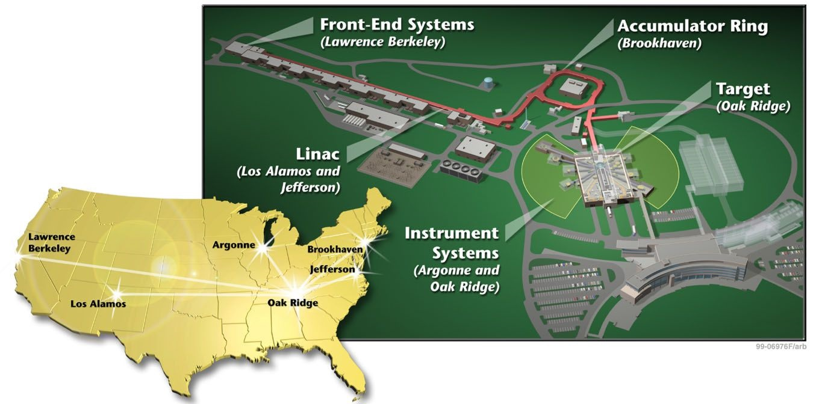
SNS is a megawatt-class, accelerator-based pulsed neutron source
~1 GeV protons are injected into a liquid mercury target at 60 Hz
Currently upgrading to 2MW

Slide 3
SNS Ring Injection Dump (RID) Overview
SNS has three dumps
Linac, Extraction & RID
Both the Linac & Extraction dumps are passive (no cooling) with an average power limit of 7.5kW
The RID is designed for continuous use accepting any portion of the HEBT beam not fully stripped
Nominally 2-10% of the injected beam with an average power of 50-60 kW
Power limit 150 kW
RID
Accumulator
Extraction
Linac
Target

Slide 4
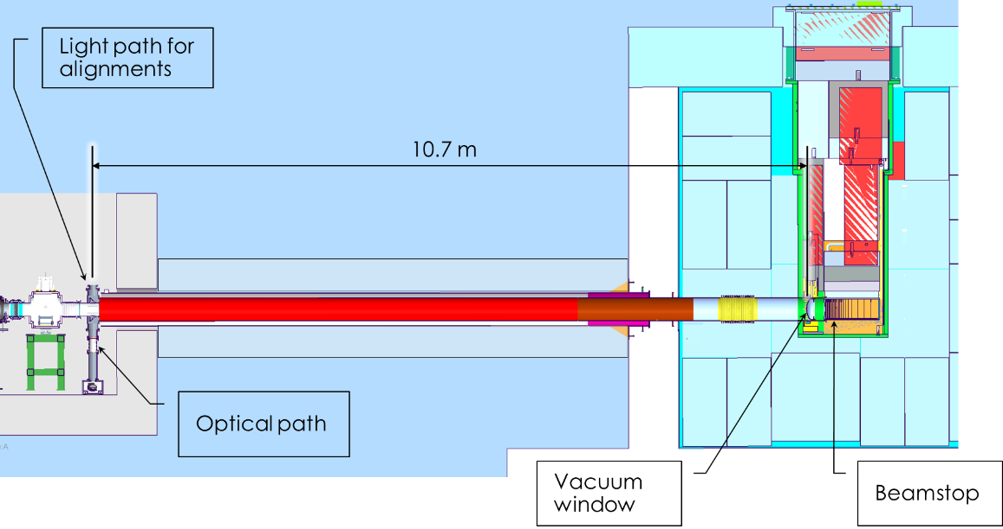
Ring Injection Dump Imaging System - Motivation
Uncertainty about beam position and density
Accurate measurement of beam size will improve RID window lifetimes, improve stability of operation
Requires replacement of the existing vacuum window
Requires luminescent coating

Slide 5
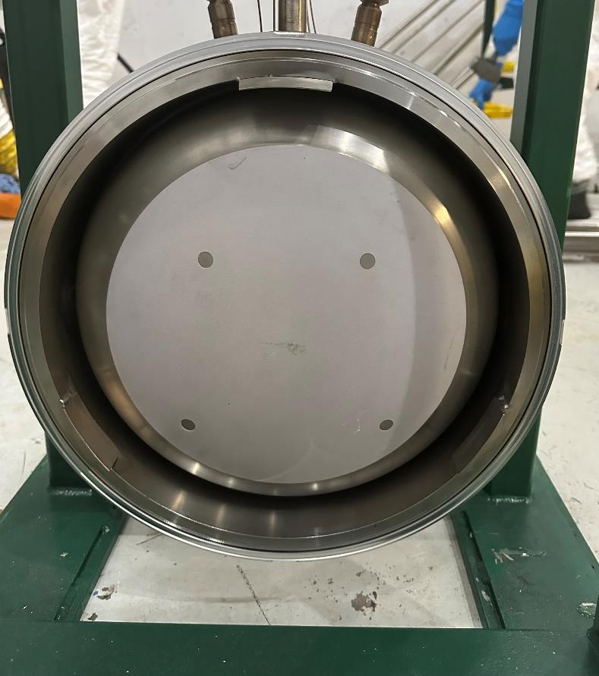
Florescent Coating… same coating as Target nose
RID Vacuum Window
s
Mercury Target

Slide 6
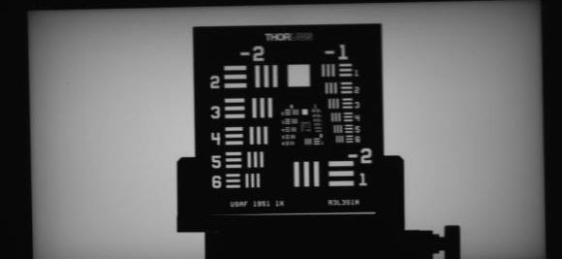
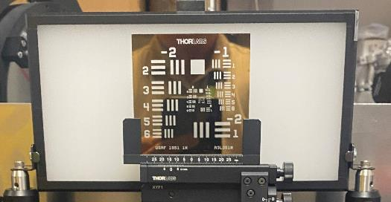
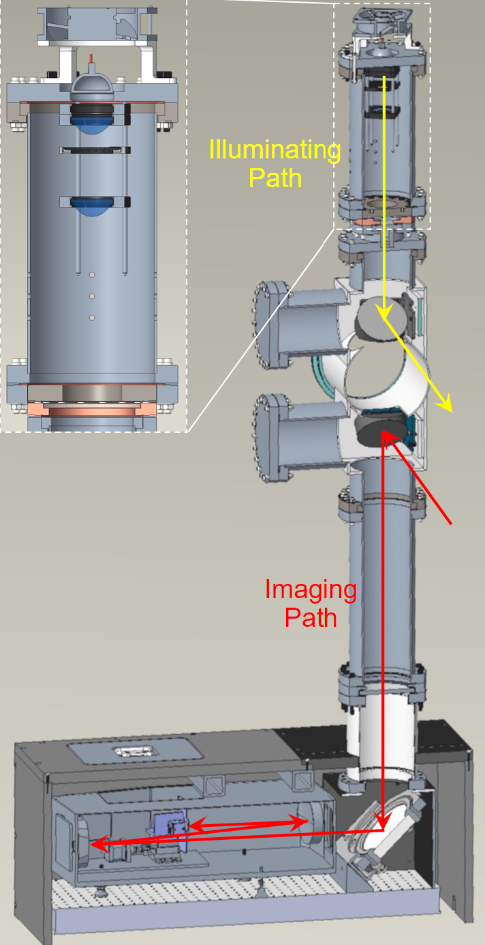
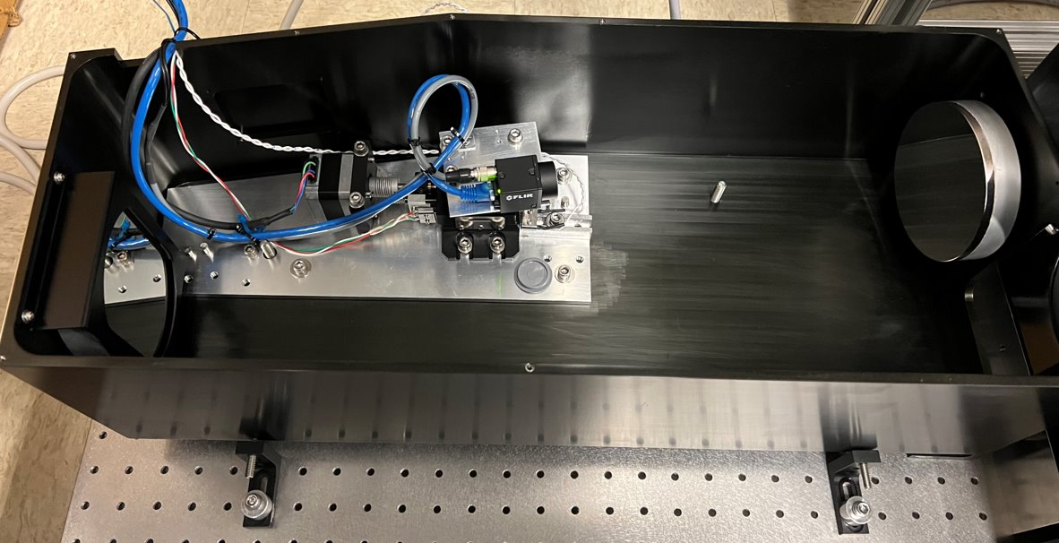
Imaging System
Test Setup
Image
Images From Telescope With Optical Testing at Distance of 35 feet
Off-Axis Schmidt-Cassegrain Telescope Ready to Operate

Slide 7
Beam Stop and Window Replacement
Imaging System required replacing both Beam Stop and Window
Both originally installed in ~2006
Hands on, NOT remotely
Vacuum window
Requires 1 e-7 torr
Remote connection of clamp will be difficult
Beam stop
Window

Slide 8
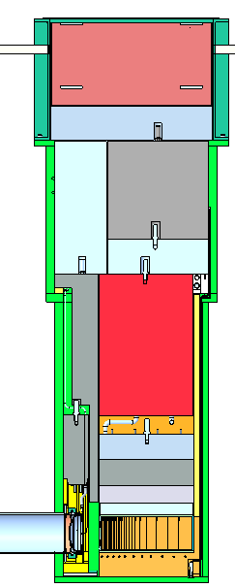
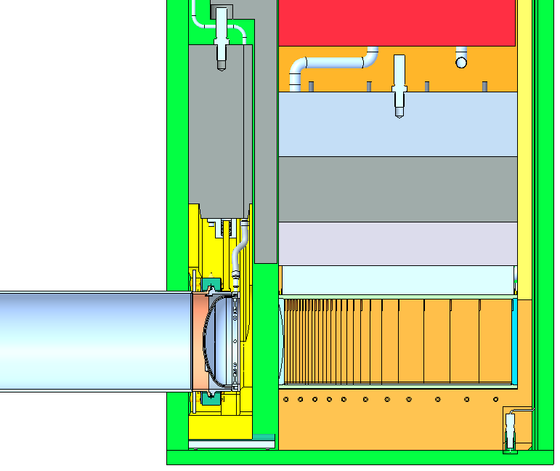
Cross section
Window
Beam Stop
Window
Clamp
4.3m
(14 ft)
Vacuum
Pipe

Slide 9
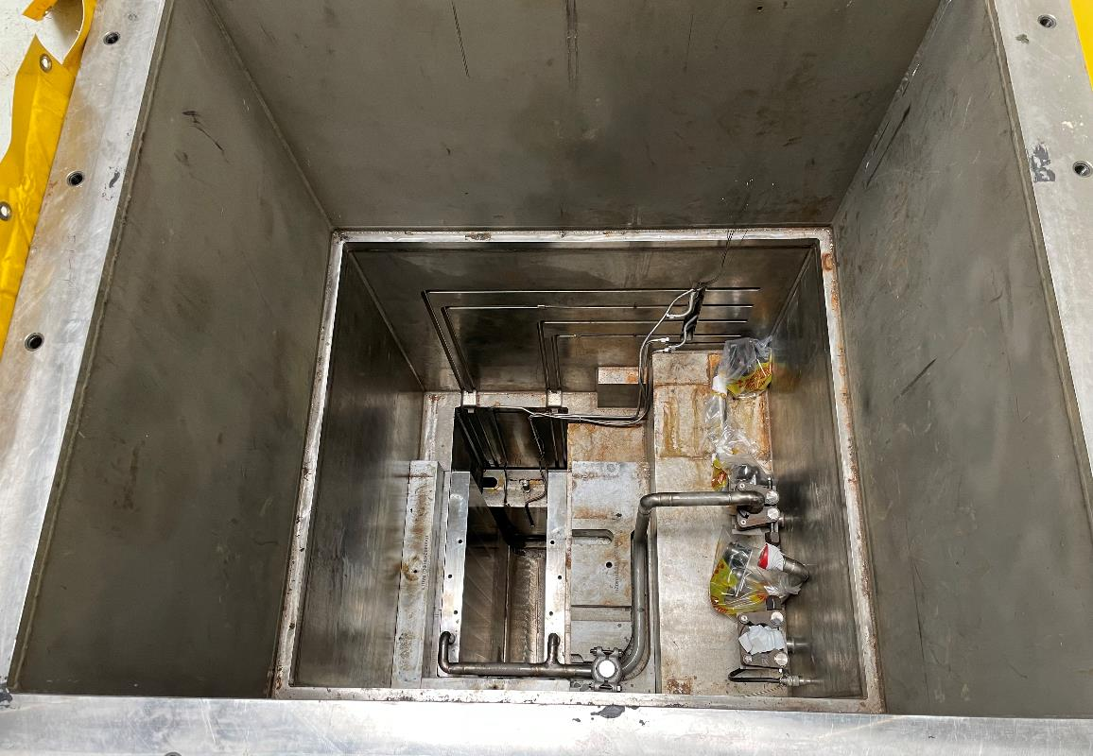
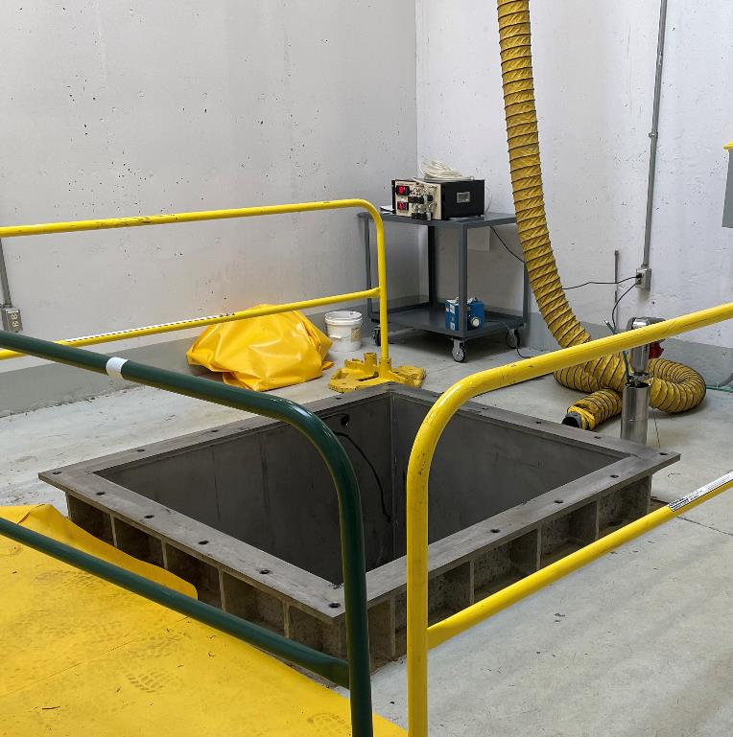
Hatch Enclosure
High dose rates requires remote handing
Cameras, borescope, long handled tools, etc.
16 Sv/hr
(1600 R/hr)
Window
28 mSv/hr
(2800 mR/hr
Beam Stop
0.28 mSv/hr
(28 mR/hr)

Slide 10
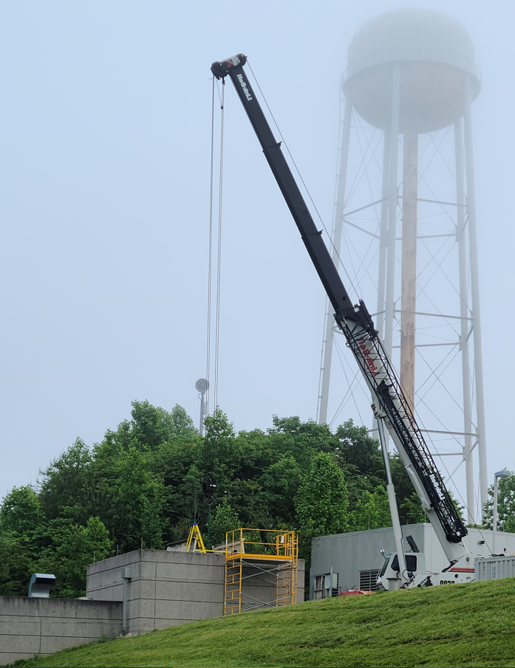
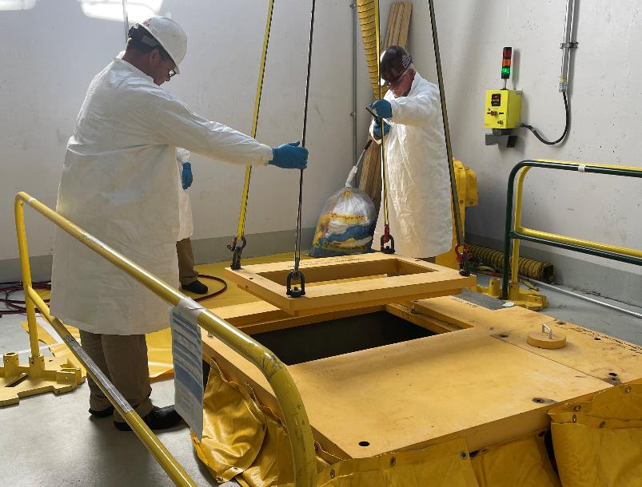
Mobile Crane
No building crane.
Mobile crane through hatch
Communicate 2-way radio

Slide 11
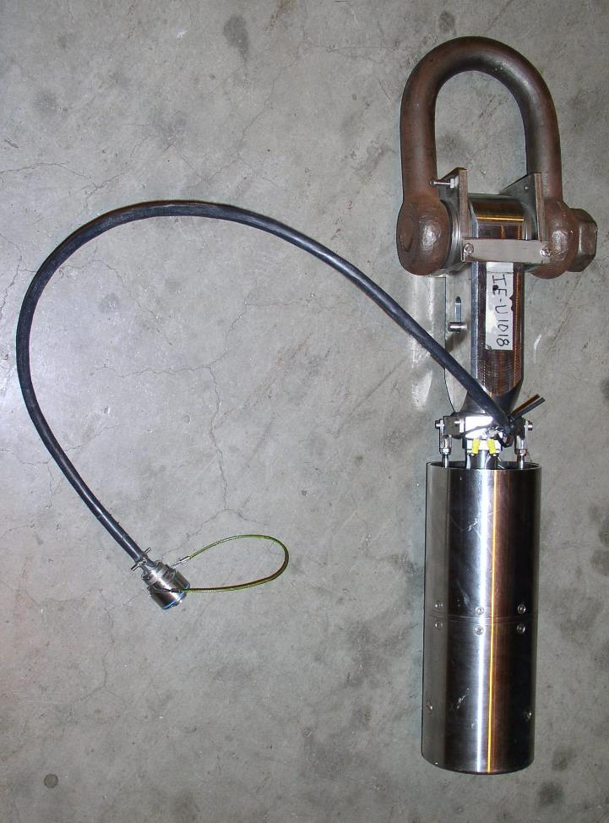
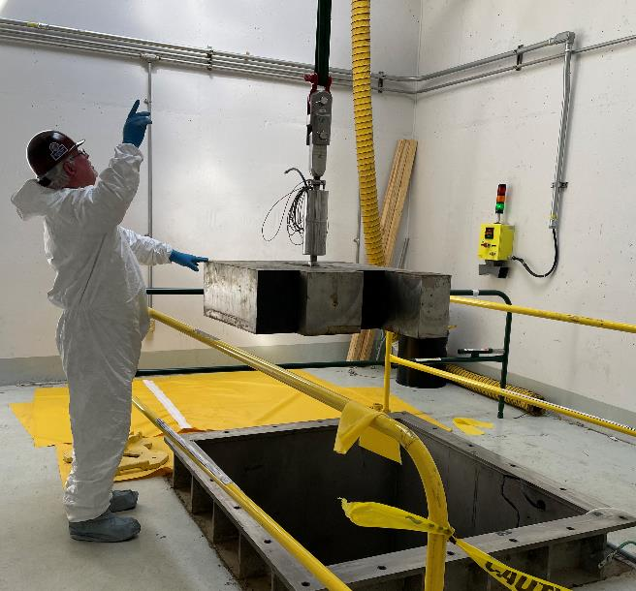
Remote Handling Zip Lift (Fastorq)
Rated for 15 Ton
Electrical and pneumatic release
Mechanical release cable
Shielding & Components
Electric Release

Slide 12
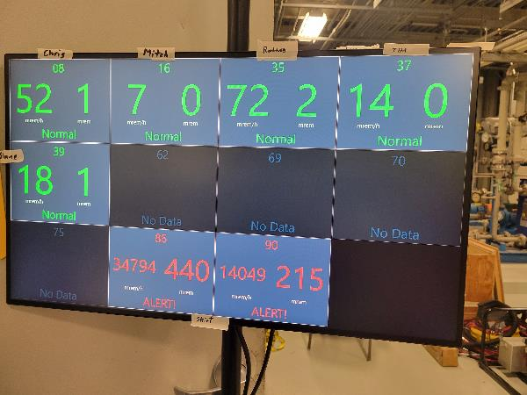
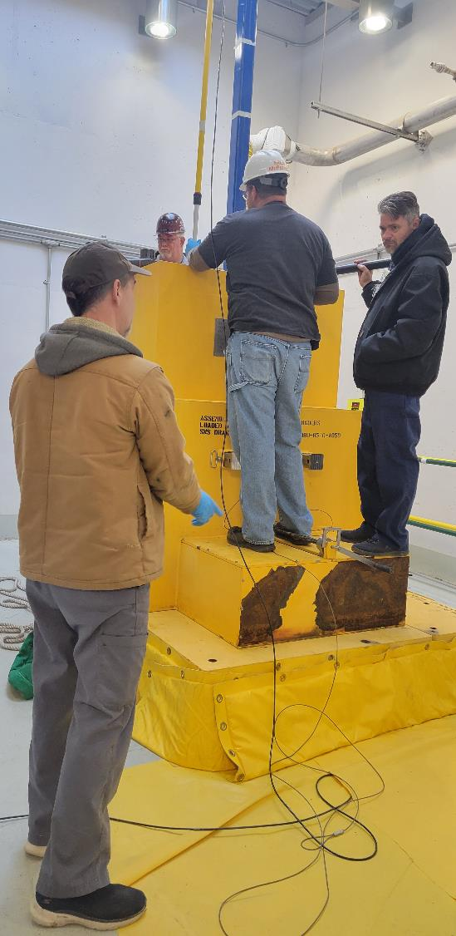
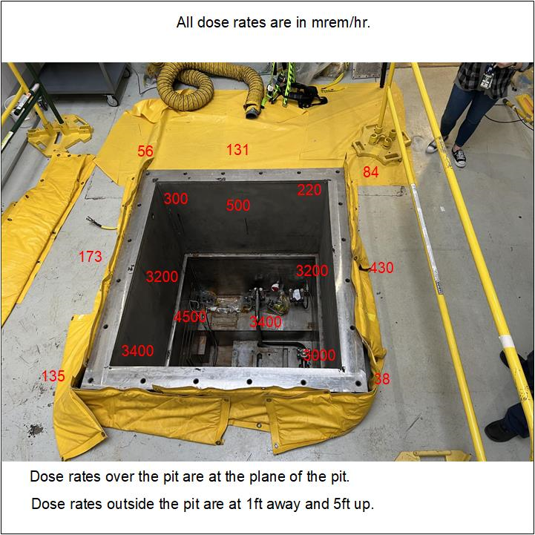
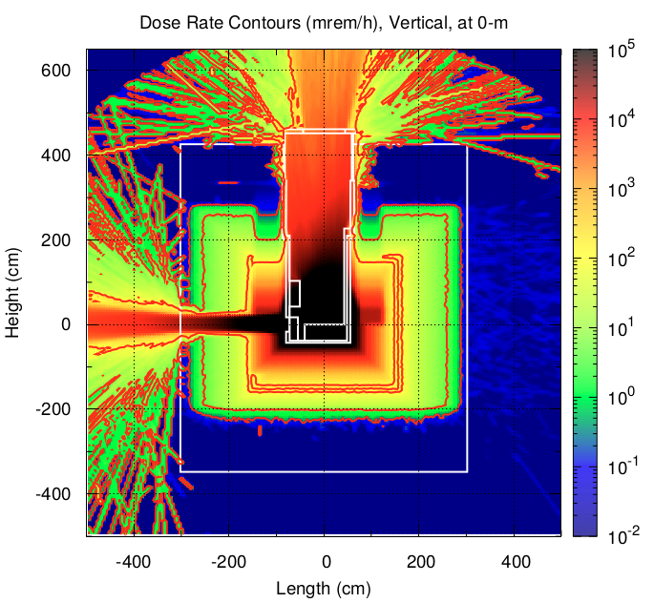
Radiation Safety Plan
62 mSv total estimate
6200 mR
Across 10-15 workers
28 mSv/hr
16 Sv/hr

Slide 13
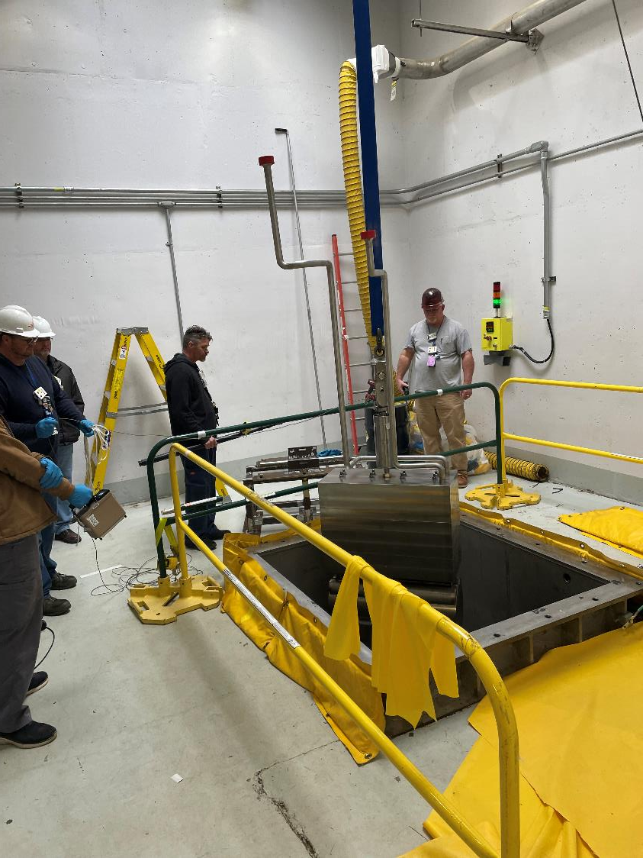
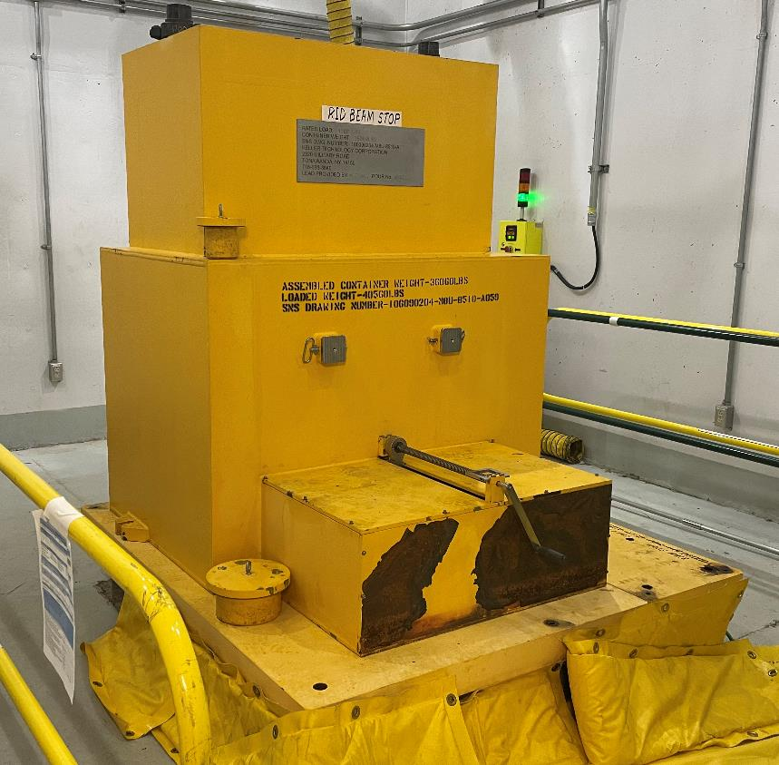
Beam Stop Replacement
No problems
Old Beam Stop Removal
New Beam Stop Install

Slide 14
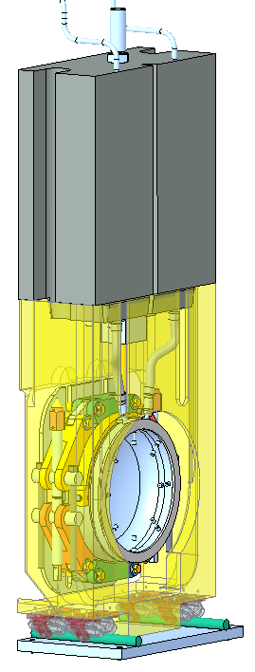
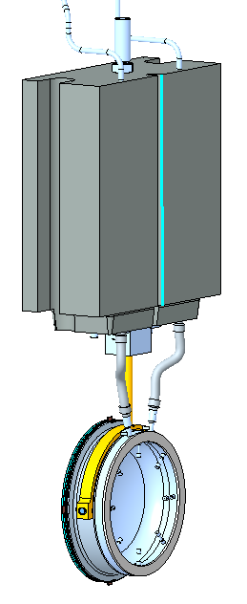
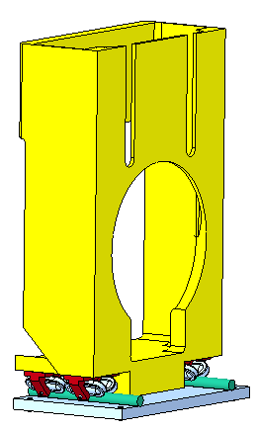
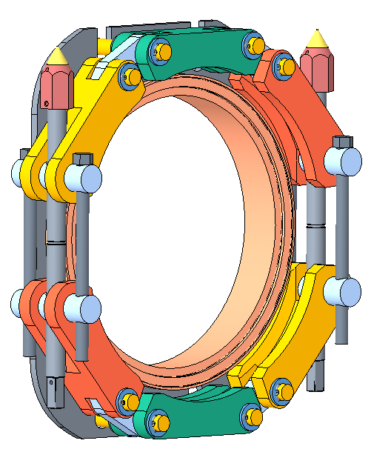
Vacuum Window Layout
Cage
Roller Bearings
and Rails
Clamp Nuts
Window Assembly
Vacuum
Clamp
Uses Helicoflex seal
9 cm
(3.5”)

Slide 15
Window Removal Steps
Remove
Window
Install New Window
Inspect
& Polish?
Vacuum
Sealing
Surface
Open
Vacuum Clamp
9 cm
Move
Cage
Cut pipes
9 cm
9 cm

Slide 16
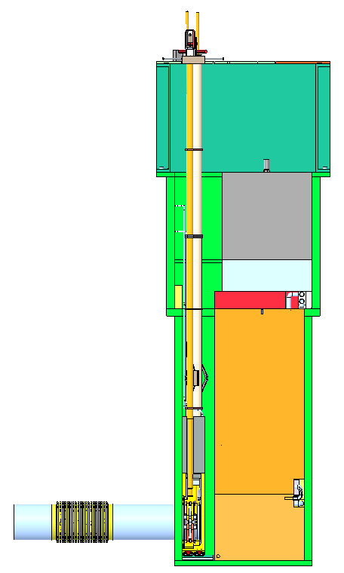
Window Tool
Designed during construction
(2005)
Raises/lowers window
Opens/closes clamp (long sockets)
Moves cage 9 cm
Worked fine during testing
Under ideal circumstances
Original window installation was not tightened using the window tool
Clamp was tightened directly
3.3m
Force
2 m
Movement
Friction

Slide 17
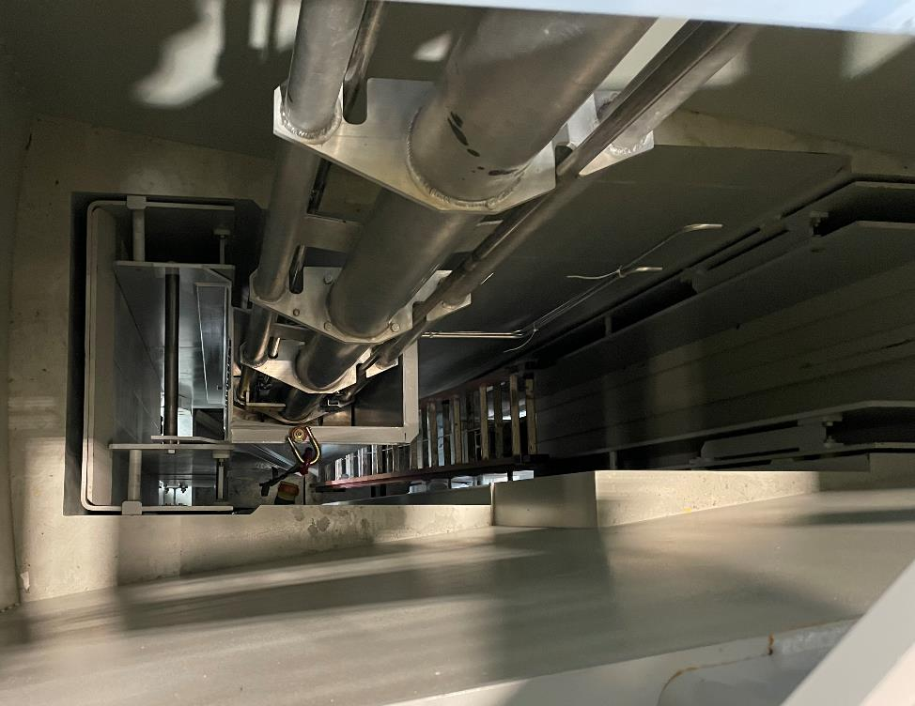
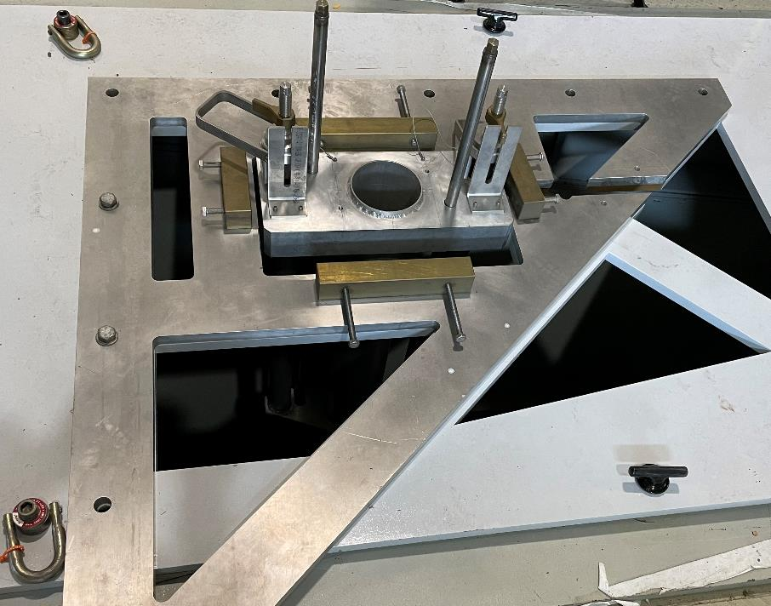
Mock Up Testing
Tested in 2006 & 2023
No problems
Tested
Raise/lower window
Move cage
Engage clamp

Slide 18
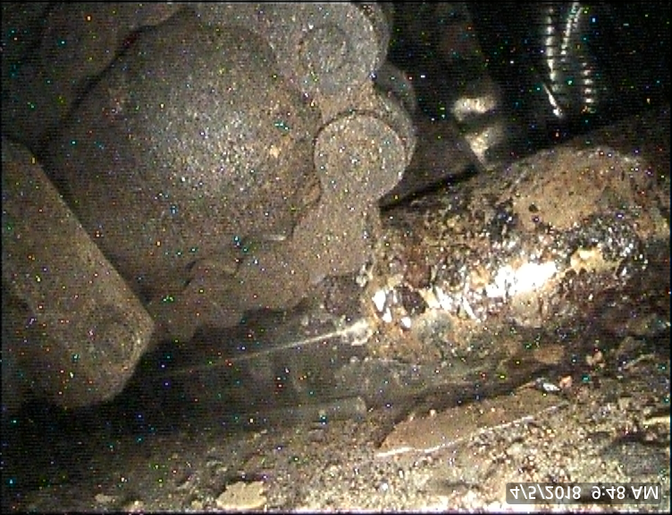
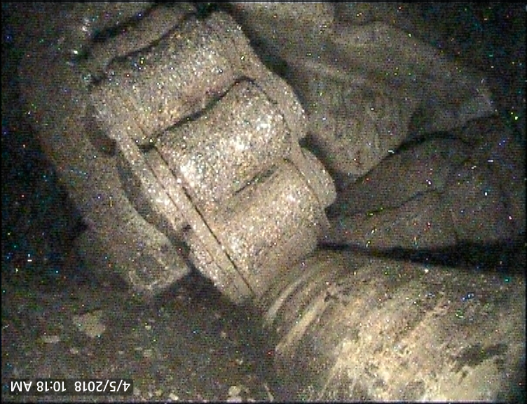
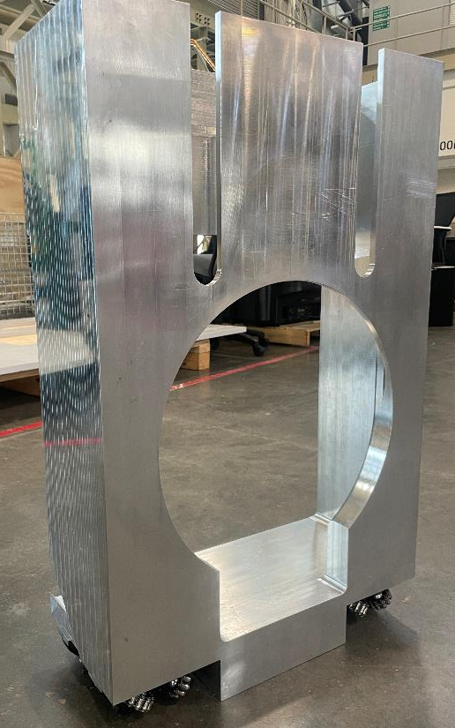
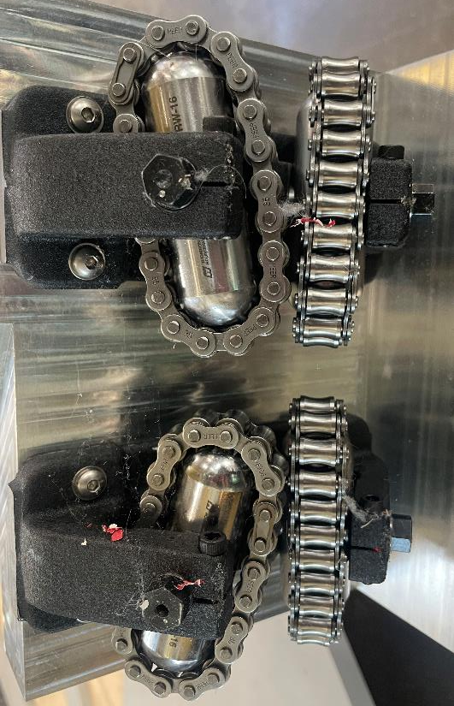
Window Cage & Rollers
Cage & Rollers
New Steel Roller Bearings
Rusty Steel Roller Bearings

Slide 19
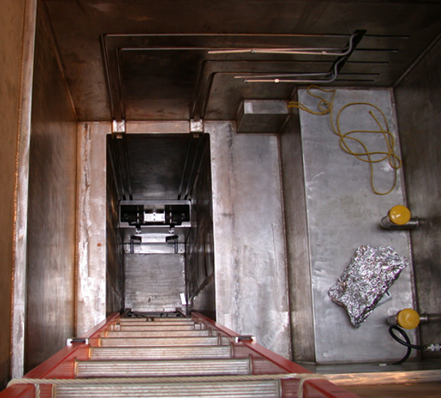
Enclosure Flooded
Enclosure is back-filled with He during operation
Since 2006
Should prevent rust
Enclosure was built before building above it was erected
Under water for weeks/months during construction
Rust began before 2006
Window cage installed before beam stop and cooling cradle
Window clamp assembled by hand

Slide 20
Window Tool
Window Tool can’t provide force required to overcome friction from rust
It flexes (made out of aluminum)
Jacking mechanism insufficient
Tried to lift up and move
Reduce friction force
Did not work
3.3m
8-9 kN
(1800-1900 lb)
2 m
5-6 kN
(1100-1200 lb)

Slide 21
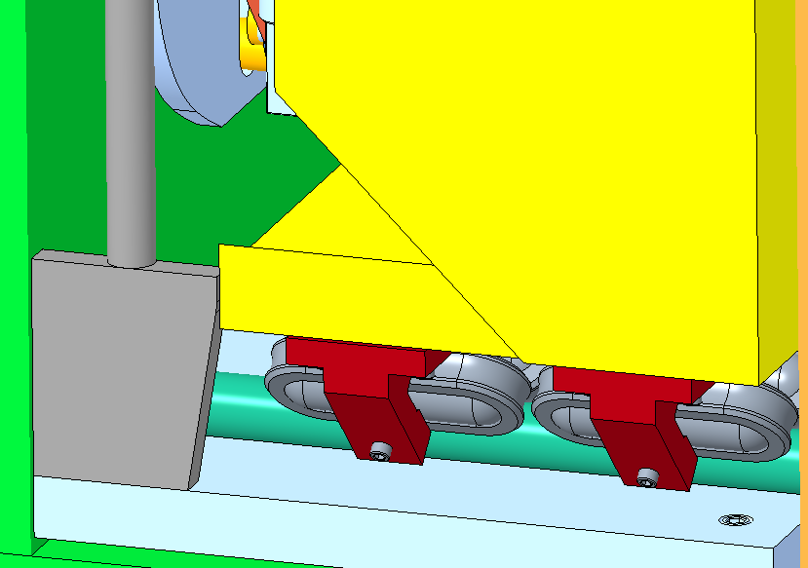
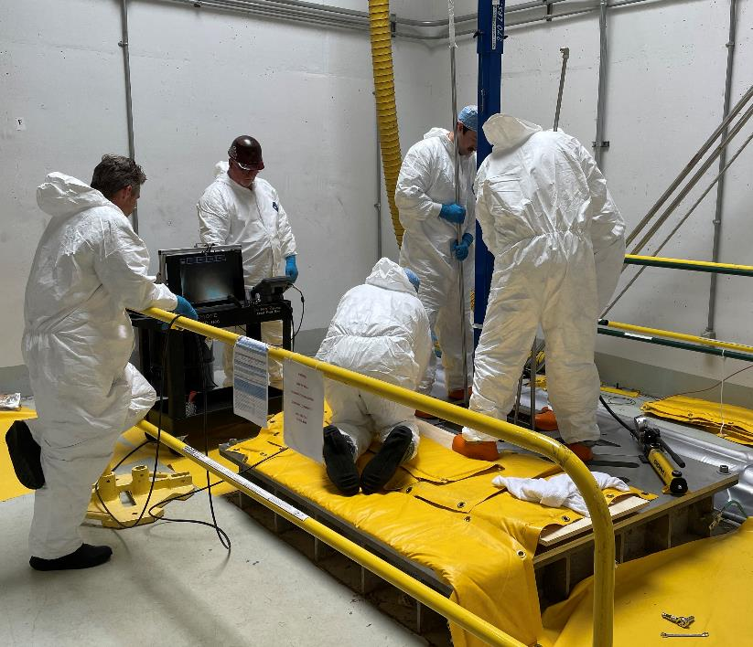
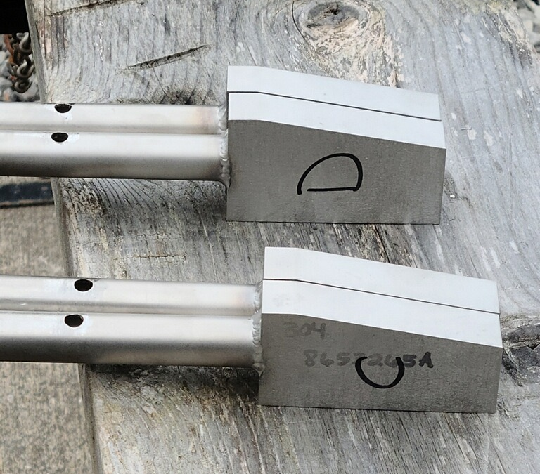
Wedges on long poles
Different Thicknesses
12 cm (1/2”) at a time
Were able to move it 9 cm, took days

Slide 22
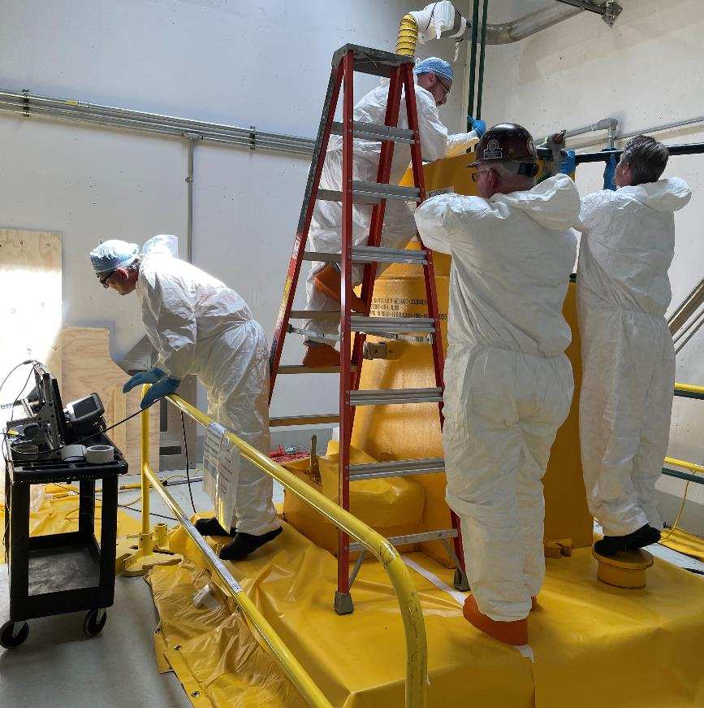
Window Removal
Wasn’t easy, but we got it out
Clamp interfered with window flange
Minimal clearance radially
Extensive use of borescope
Observe radial clearance/interference
Watch remote tools being used
Old Window
Into cask…

Slide 23
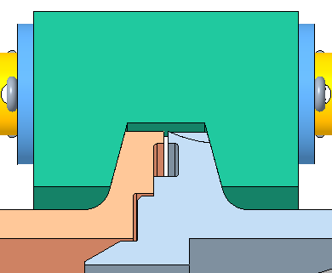
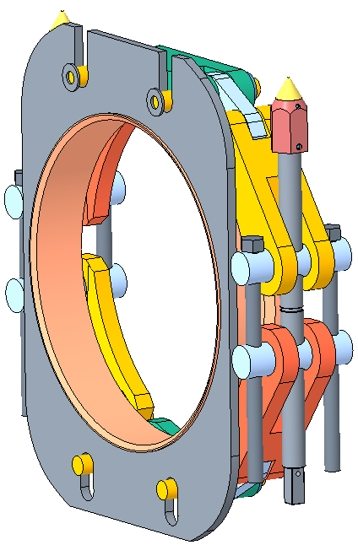
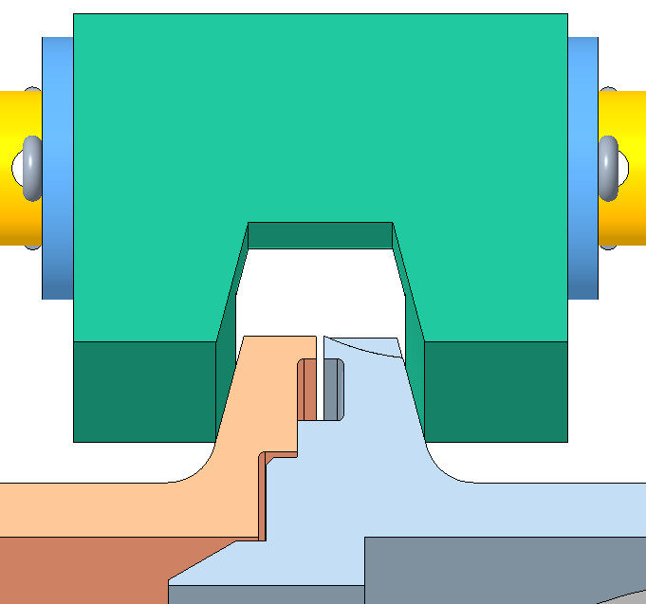
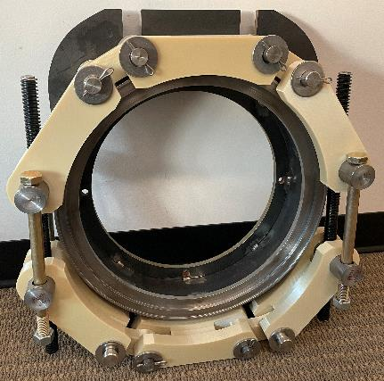
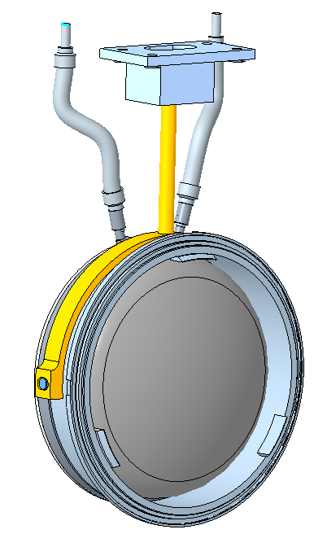
Problems with the Clamp
Closed Position
16 mm movement
Clamp moves In-Out freely
Allows yaw rotation
Becomes oblong when open
Doesn’t open enough
Only 3-5 mm clearance
Window must be < 8 mm in/out for engagement (all the way around)
Window can rotate freely on pedestal
Pitch and yaw
17 mm
25 mm
Open Position
Mock Up
pitch
yaw

Slide 24
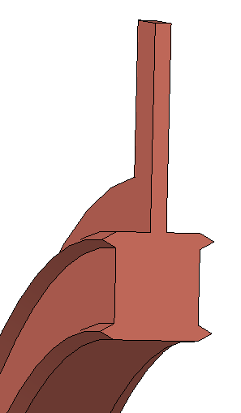
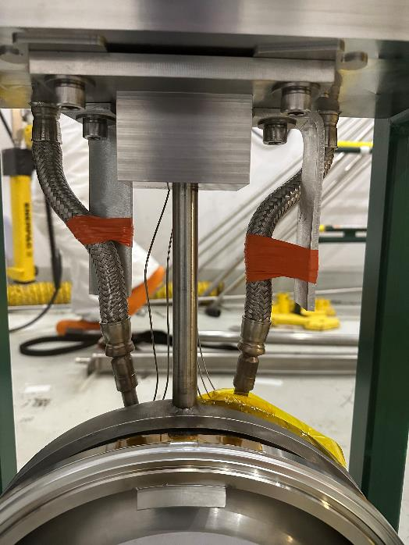
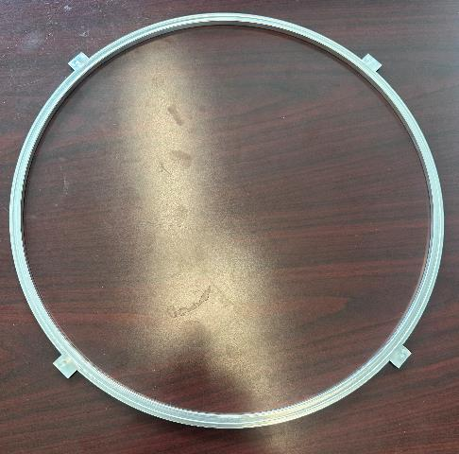
Window Installation
New Window
Going in…
New vacuum seal designed & fabricated
Diamond cross section
Constrain pedestal rotation
1100 Al
Diamond Seal Cross Section

Slide 25
Now the fun begins:
After lowering window in place:
Had to use wedges to move it back – 12 mm at a time
Flange-Clamp vertical misalignment
Had to remove window, and shim the window pedestal 2.5 mm down
Alignment was very challenging
Window pitch & yaw
Clamp fore-aft & yaw
Hours and hours of trial and error
Borescope and long handled tools
After much struggle, we finally got it clamped!
9 cm

Slide 26
Vacuum Test
1e-7 Torr Required
1e-9 Torr L/s Achieved!

Slide 27
Radiation Safety Plan
62 mSv total estimate
6200 mR
15 mSv total dose received
1500 mR
Across ~10 workers
28 mSv/hr
16 Sv/hr

Slide 28
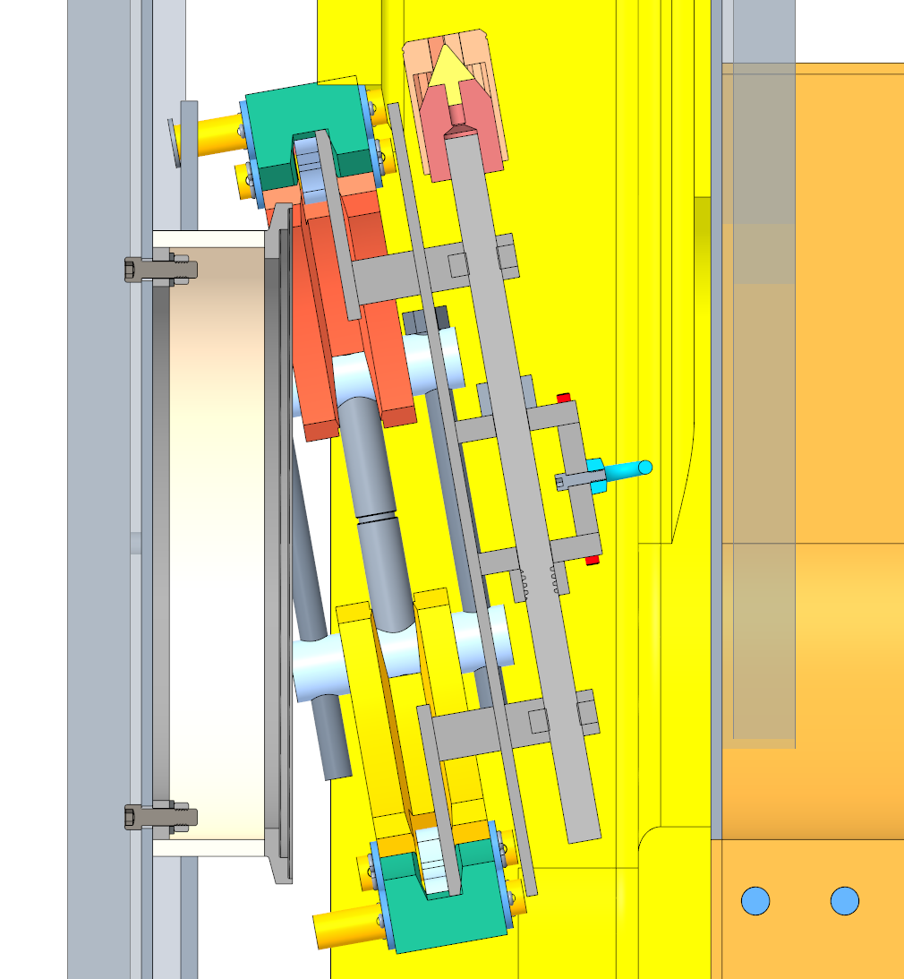
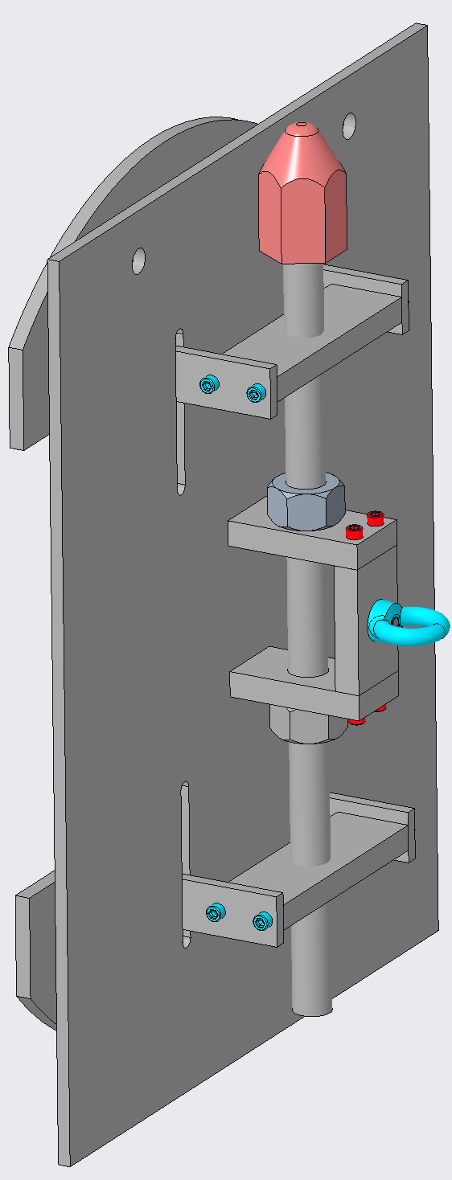
What about the rusty rollers?!?
Clamp must be removed FIRST, before removing cage
But the cage captures the clamp
Must be removed simultaneously using removal tool
Steps:
Remove clamp/cage
Install new modified cage/rollers
Replace clamp

Slide 29
Conclusion
Window design has too much compliance for remote installation
Window pedestal moved too much (pitch, yaw)
Window Tool originally designed was not sufficient
Clamp mounting allowed too much movement (fore/aft, yaw)
Able to move cage in ideal conditions, but not with rusted rollers
Despite these challenges, were able to mate up window
New diamond seal design worked great!
Did NOT replace rusty rollers, but have a design solution if needed.
Extensive ALARA planning and careful execution
Received ~25% of estimated dose
Successfully changed RID Beam Stop & Window
Through much perseverance! It took 8 weeks.
Currently installing new RID Imaging System – startup July 2024

