Slide 1
SNS Target Instrumentation Based on Fiber-Optic Sensors: Development and Application Experience
Y. Liu, C. Long, R. Sangrey, and D. Winder
Spallation Neutron Source (SNS)
Oak Ridge National Laboratory
Oak Ridge, TN 37831, U.S.A.

Slide 2
Outline
Background and motivation
Sensing principle and sensor instrumentation
Measurement results
Dynamic strain profiles
Application of measurement
Application experience
Summary

Slide 3
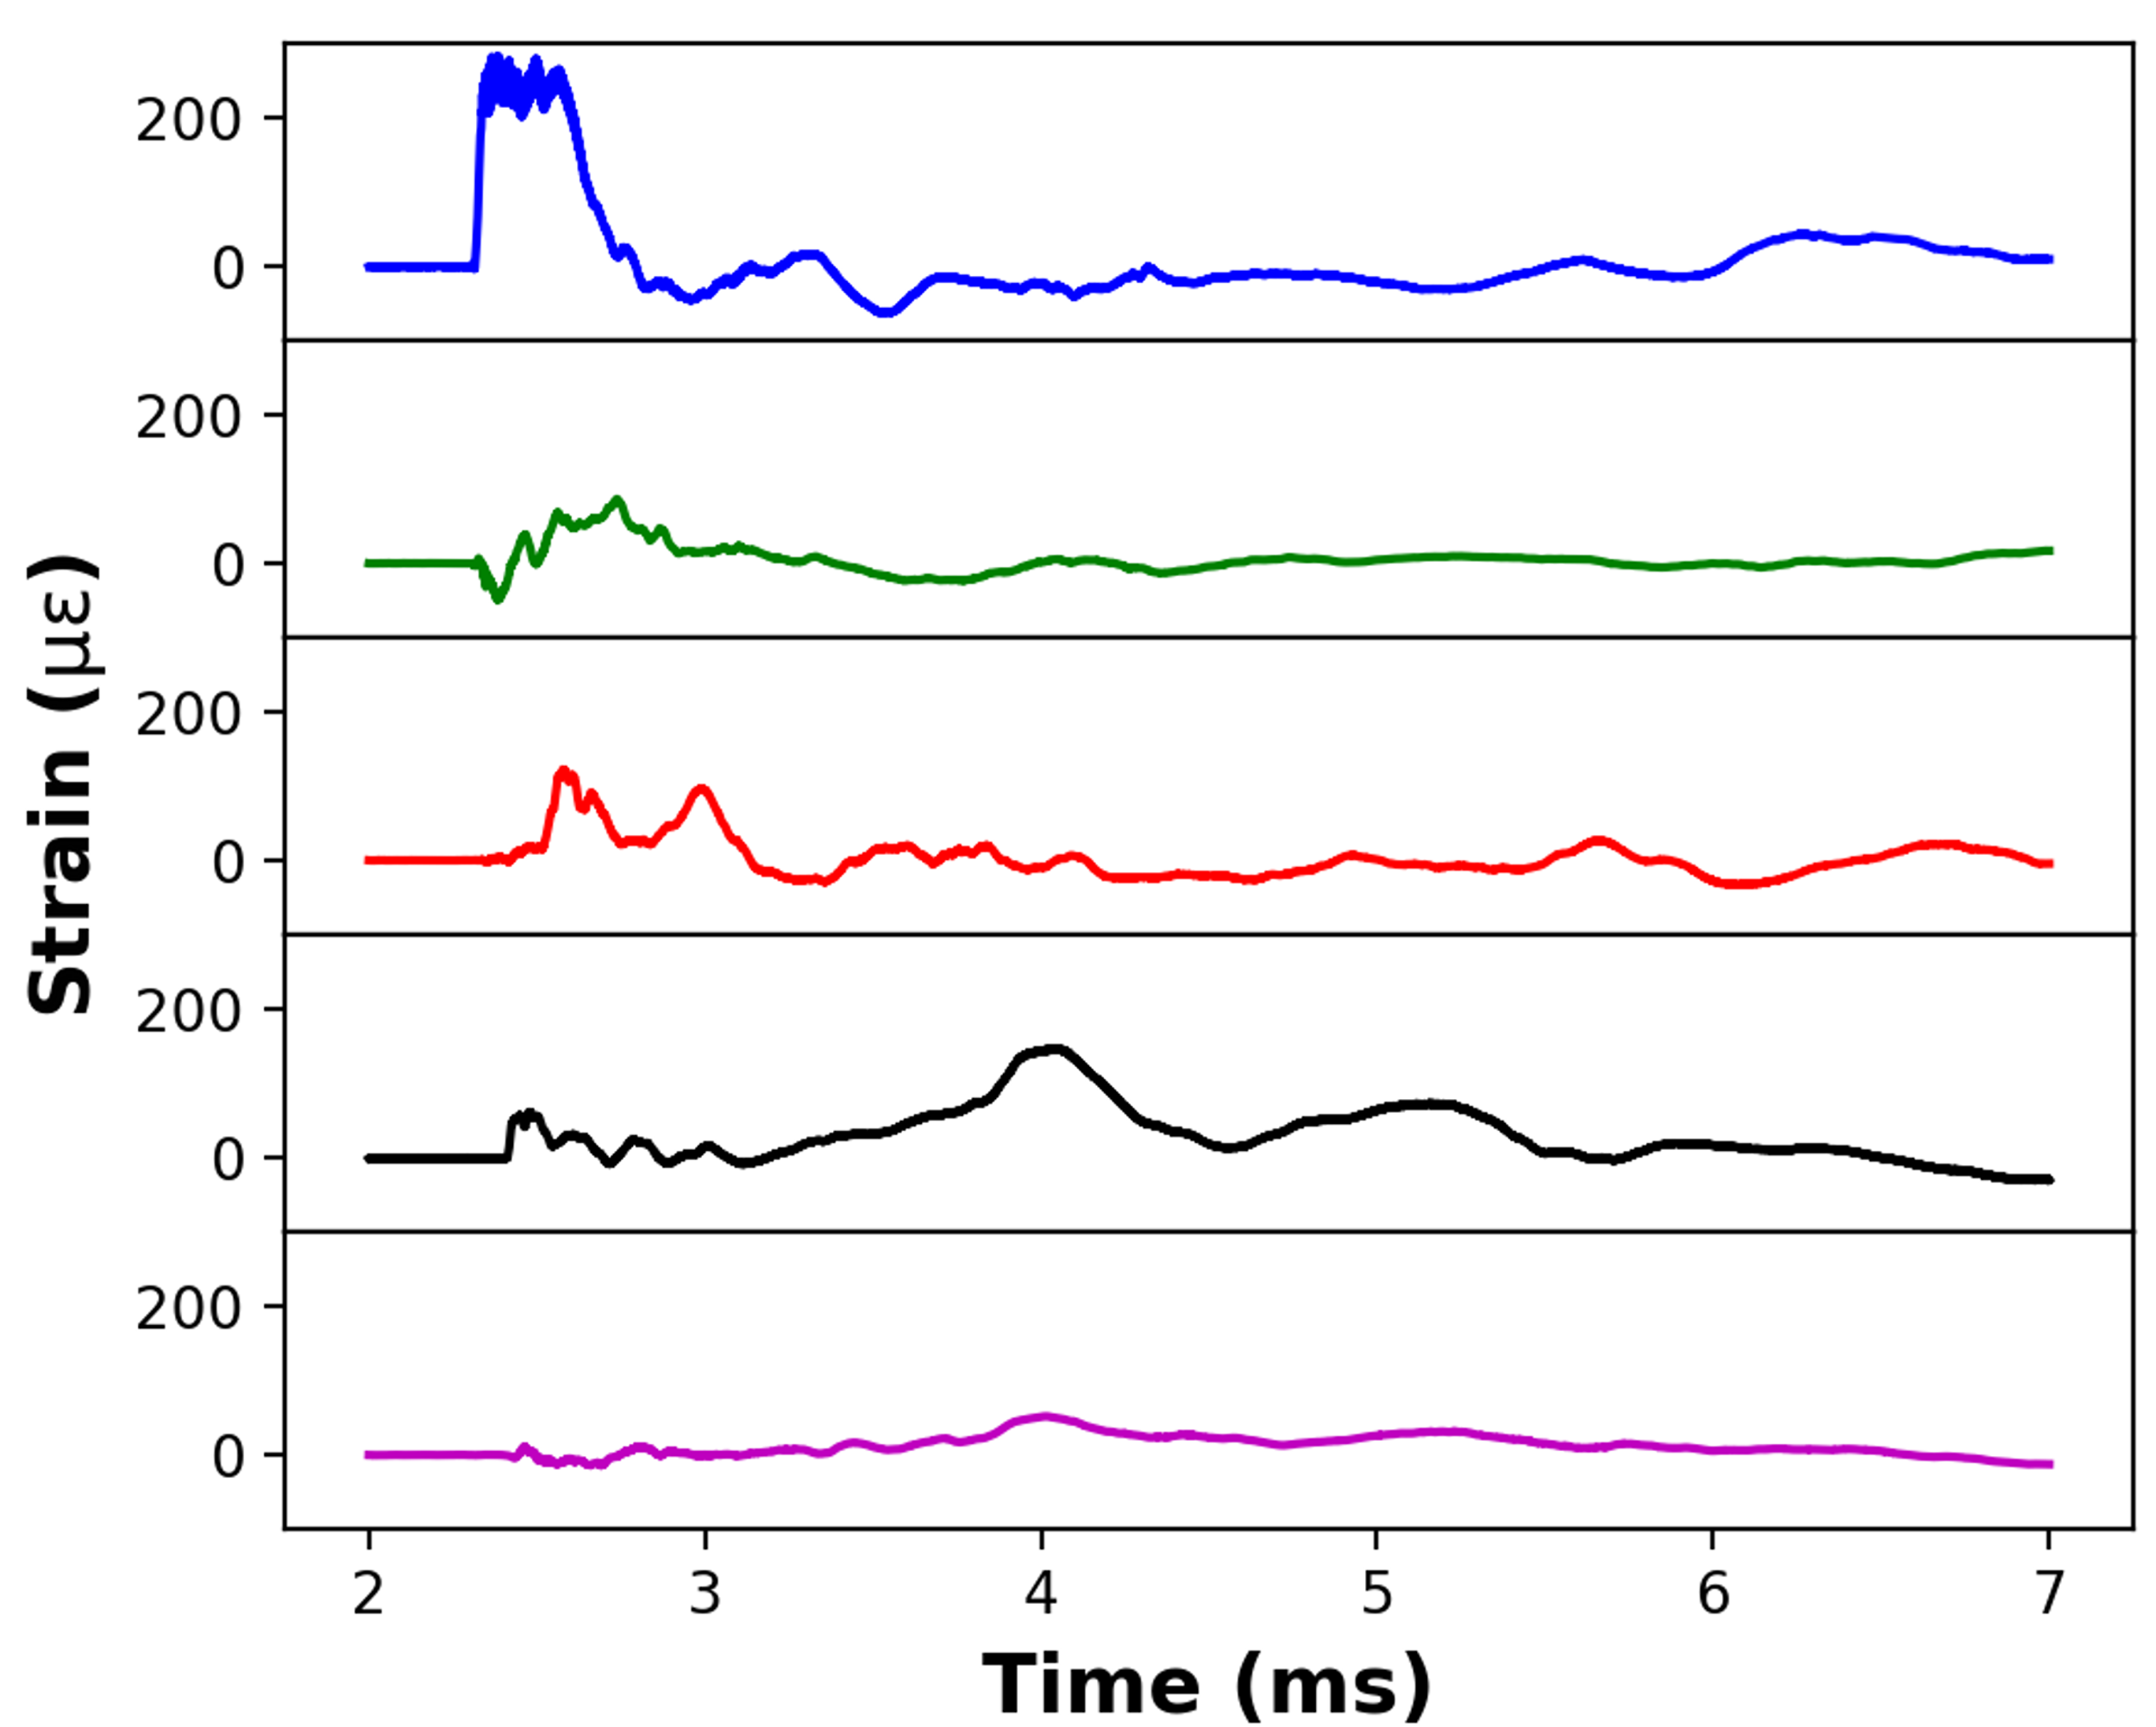
Why strain measurements?
Neutrons are produced through spallation reactions between high-energy intense (23 kJ / 700 ns / 1GeV) protons pulses and the mercury.
Proton pulses cause stress cycles in the mercury vessel which lead to fatigue cracks and cavity damage to the structure.
Measurement of the strain waveform on the mercury vessel is critical to improve target performance and lifetime.
Mercury Target
a
b
a
d
c
Protons
b
e
d
c
Strain Sensors
e
Challenges of strain measurement in the spallation target
Limited space
Strong E-M interference
High radiation dose
High bandwidth

Slide 4
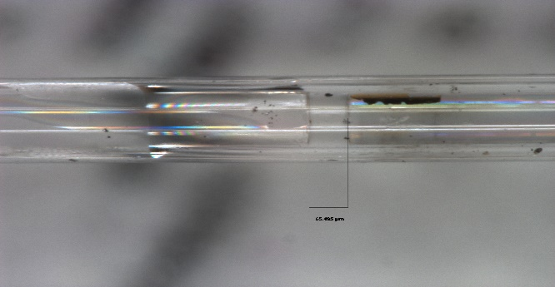
Fiber-optic interferometric sensors
~ 4 mm
Sensor head
Capillary tube
207 um
~ 4 mm
Single-mode fiber
Reflector
φ129 um
φ207 um
Incoming light
Fabry-Perot cavity
Thanks to Yasuhiro Takeda (KEK/J-PARC)
125 um
Advantages of fiber-optic sensors
Sensor head
~ 65 um
compact
sensitive
immune to electro-magnetic pulse
will not interfere with target leak detectors

Slide 5
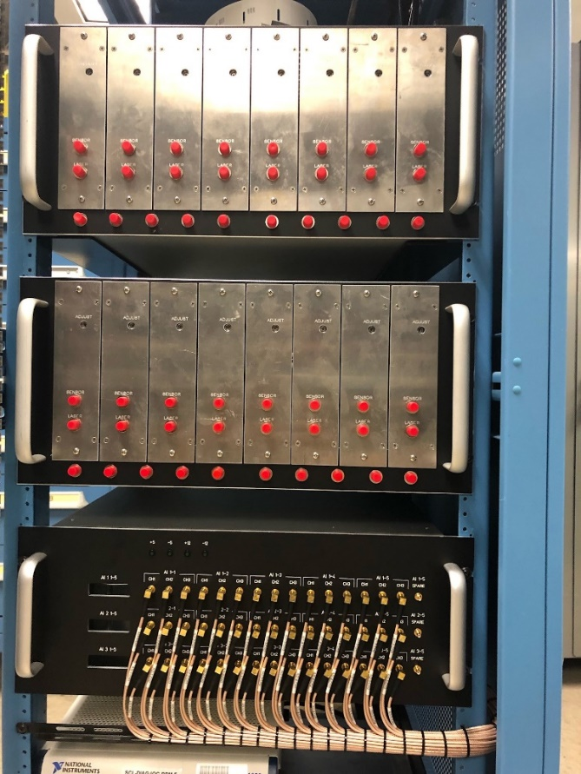
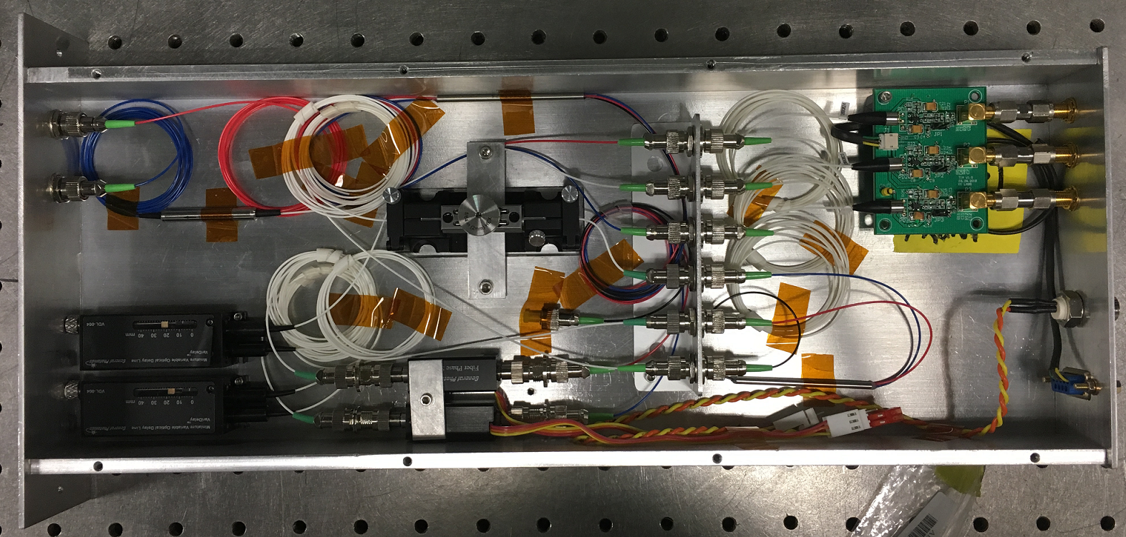
Optical processors for fiber-optic sensors
Laser
Fiber Circulator
Fiber Sensor
Low-coherence interferometry
All-fiber based system
Phase-shifted interference
Digital phase recovery
Self-calibration
Fiber transmission monitor
Delay line
Phase shifter
Faraday mirrors
PD1
3x3 FC
PD2
PD3
Opt. Express Vol. 27, 7319 (2019);
J. Lightwave Technol. Vol. 39, 2552 (2021).

Slide 6
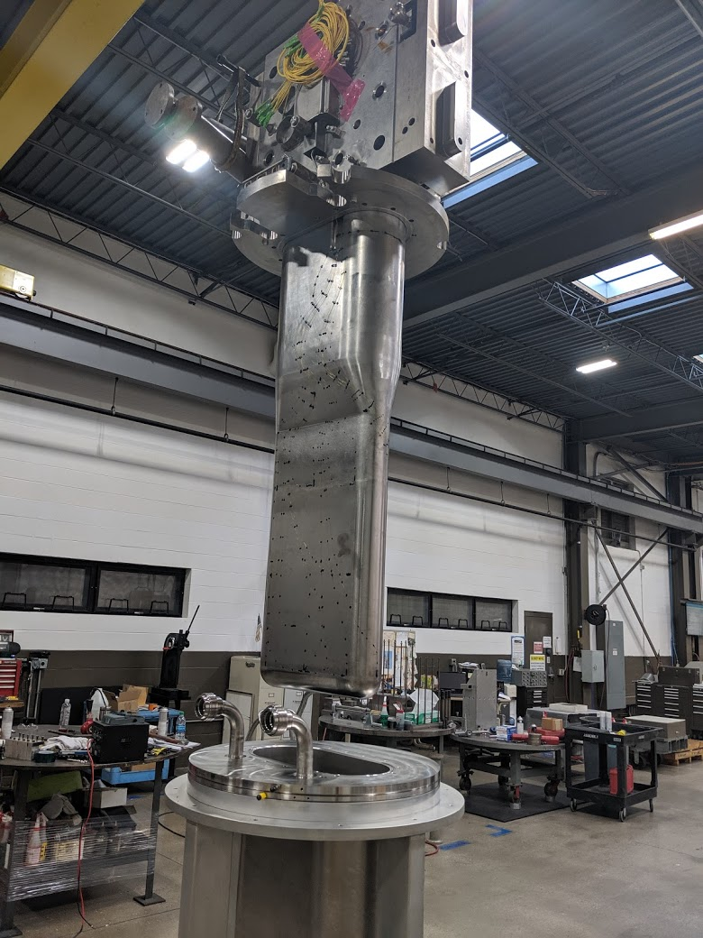
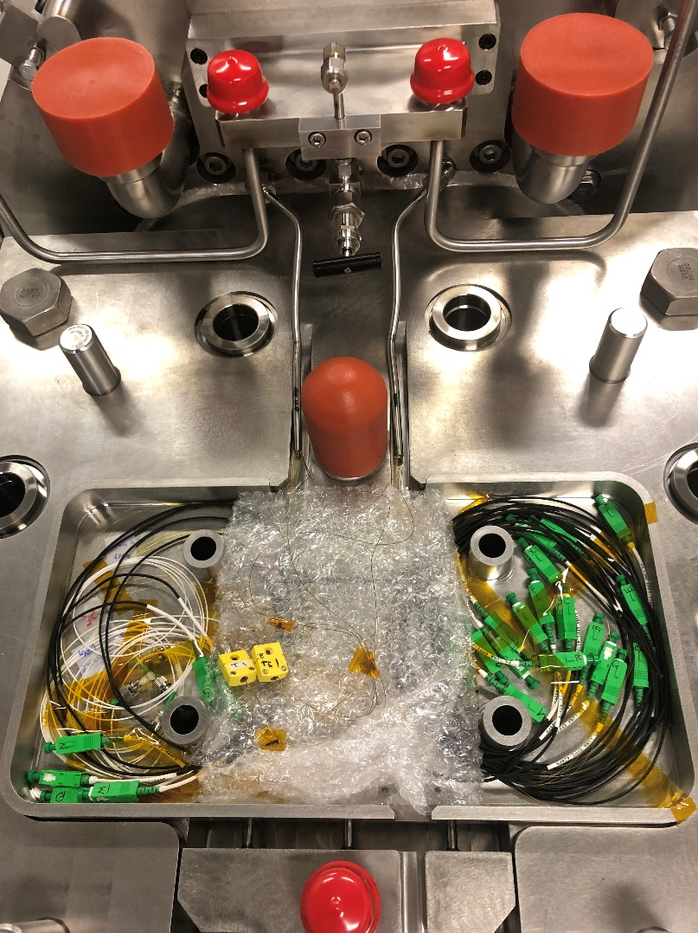
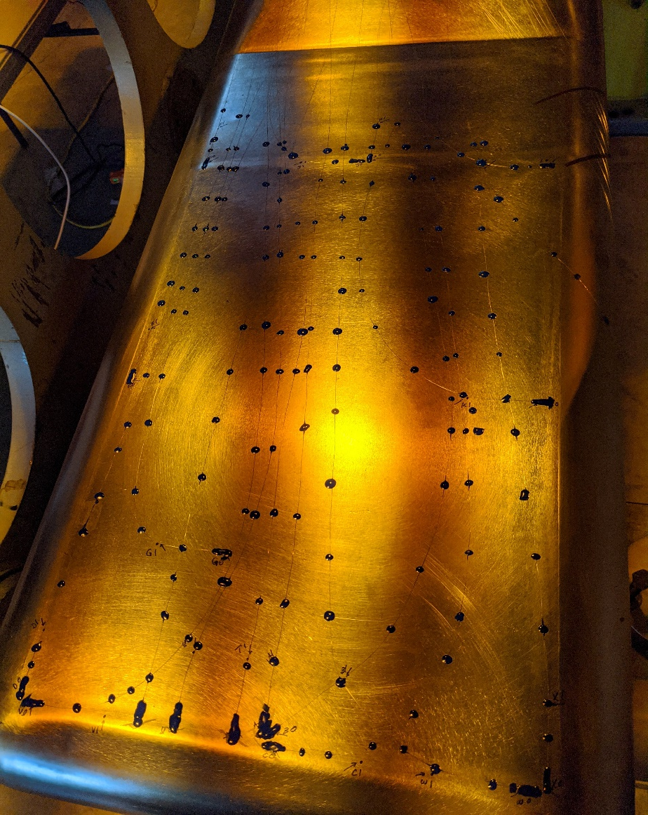
Instrumentation - sensor installation
Target module
Target assembly
Sensors on target
Target vessel
Water cooled shroud

Slide 7
Instrumentation - signal processing and data acquisition
Equipment rack
Software platform

Slide 8
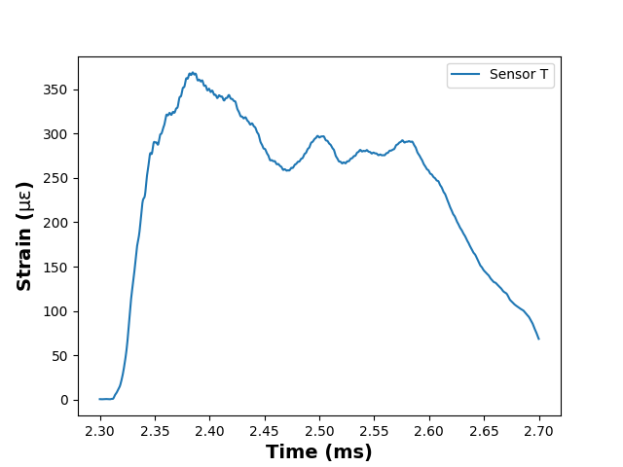
Examples of measured strain profiles

Slide 9
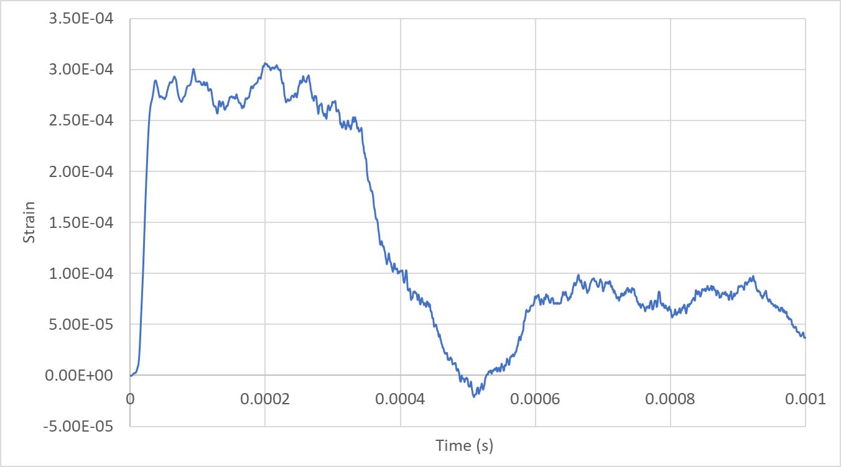
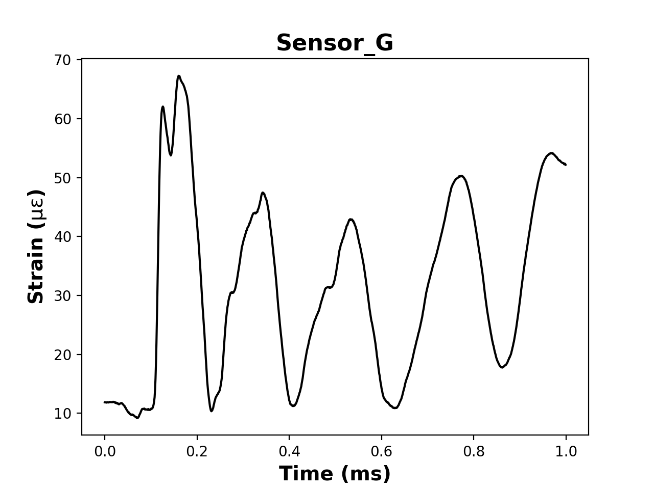
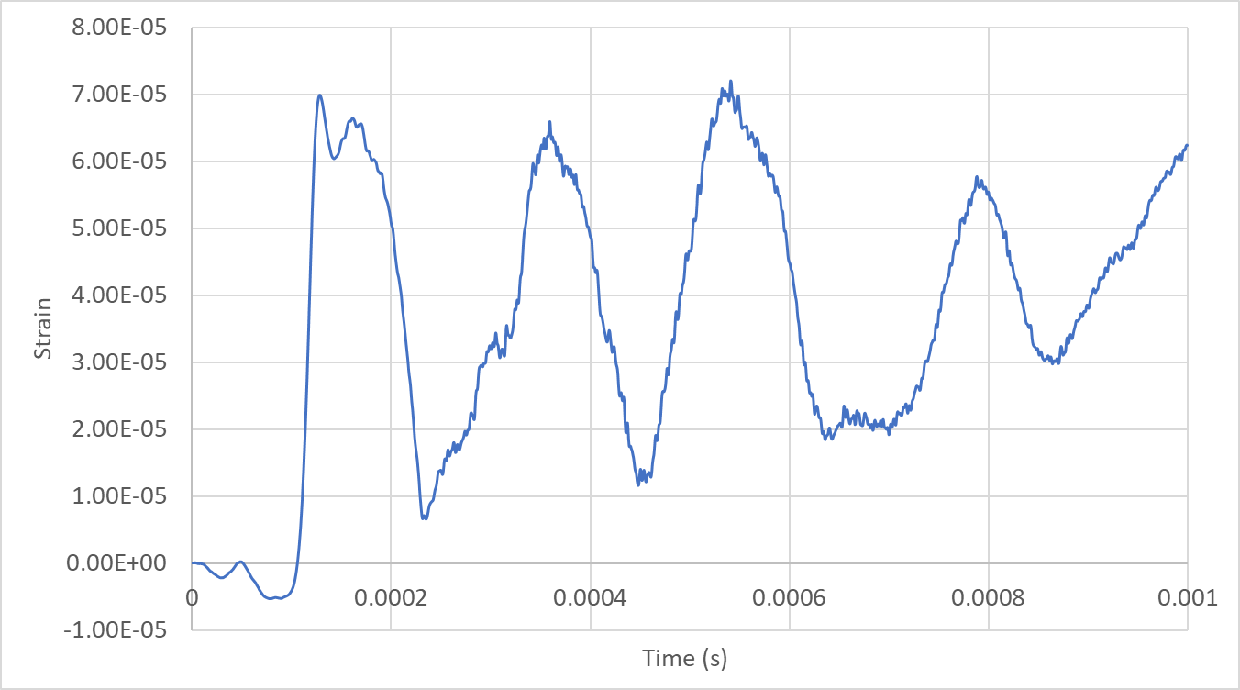
Validation of target modeling
Measurement
Simulation
Courtesy of J. Hao

Slide 10
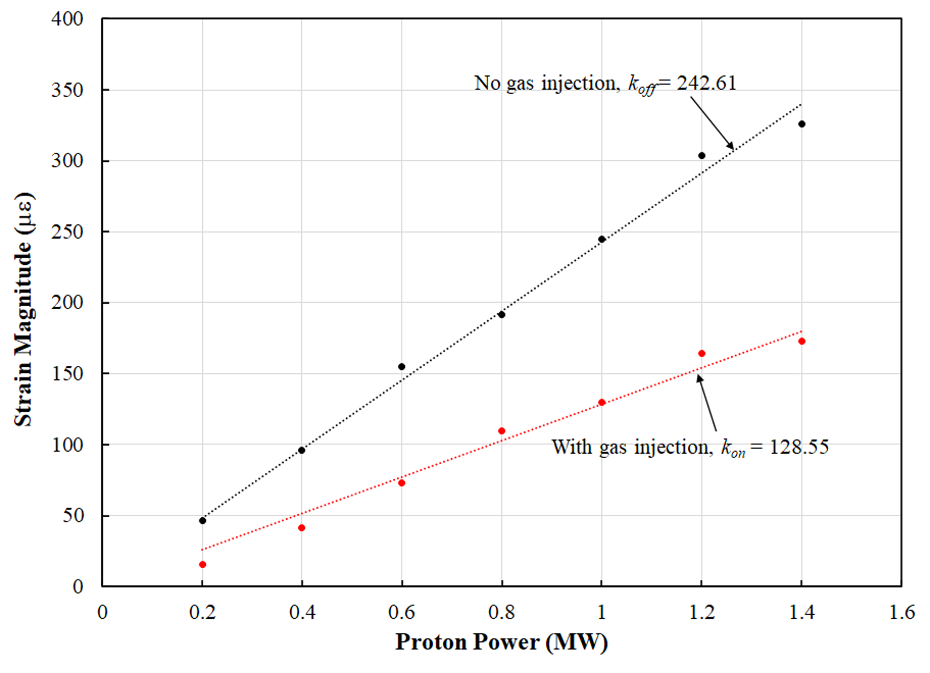
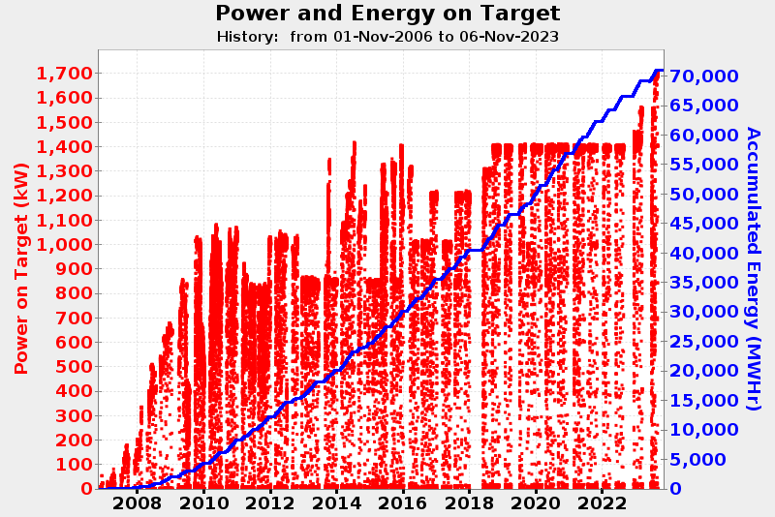
Validation of gas injection effect
Without gas injection
With gas injection
47% strain reduction!

Slide 11
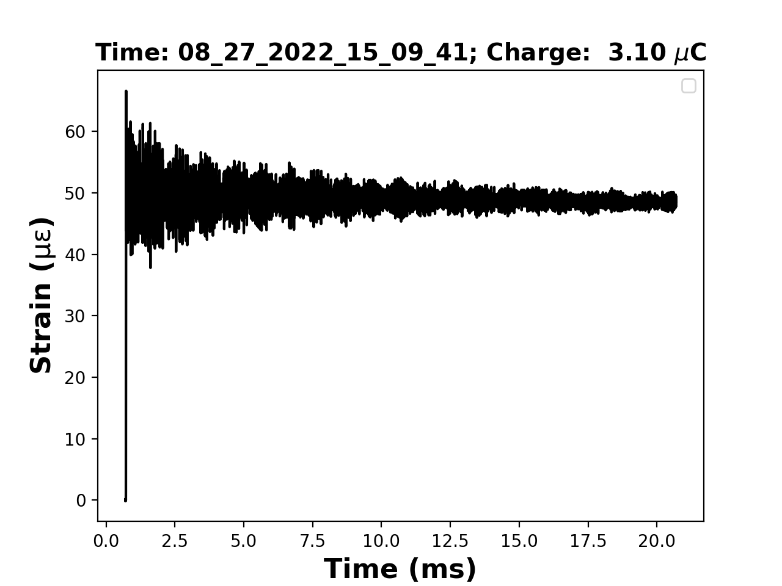
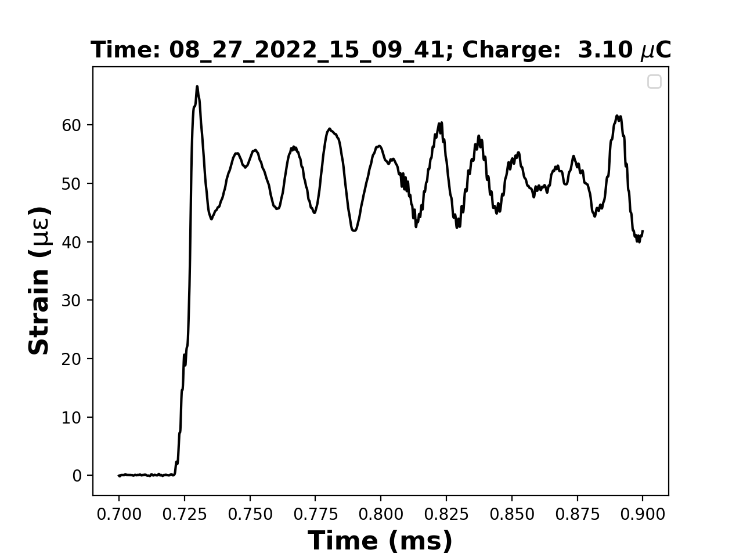
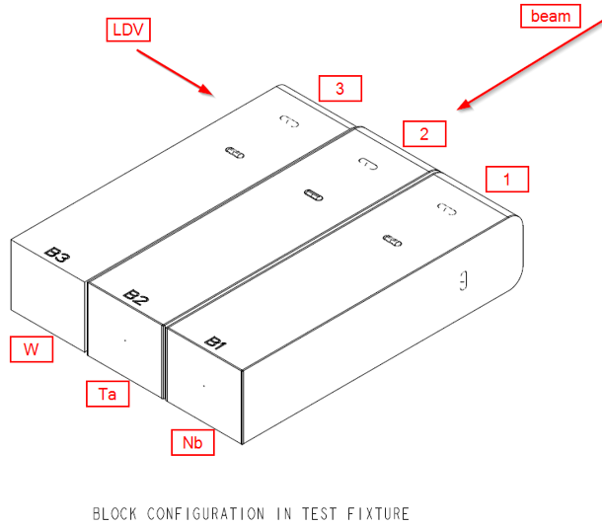
Strain measurement on STS target samples at LANSCE
Niobium-clad tungsten block
Tantalum-clad tungsten block
Unclad tungsten block
Validation of numerical modeling
Assessment of the damping of the strain responses between pulses
Assessment of the effect of cladding on the dynamic strain response

Slide 12
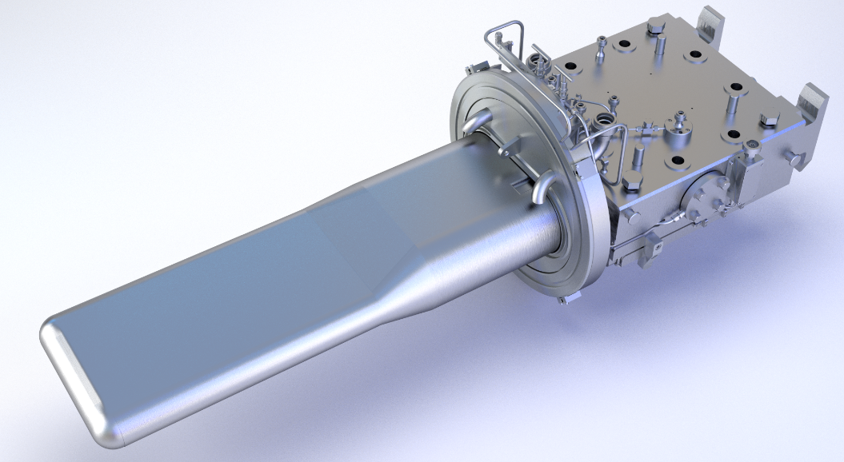
Radiation effects on fiber sensors
RIA: radiation-induced attenuation in optical fibers
Sensors stop functioning properly when RIA reaches 20 dB
~ 6×10⁵ Gy/MWHr
~ 2×10⁷ Gy/MWHr

Slide 13
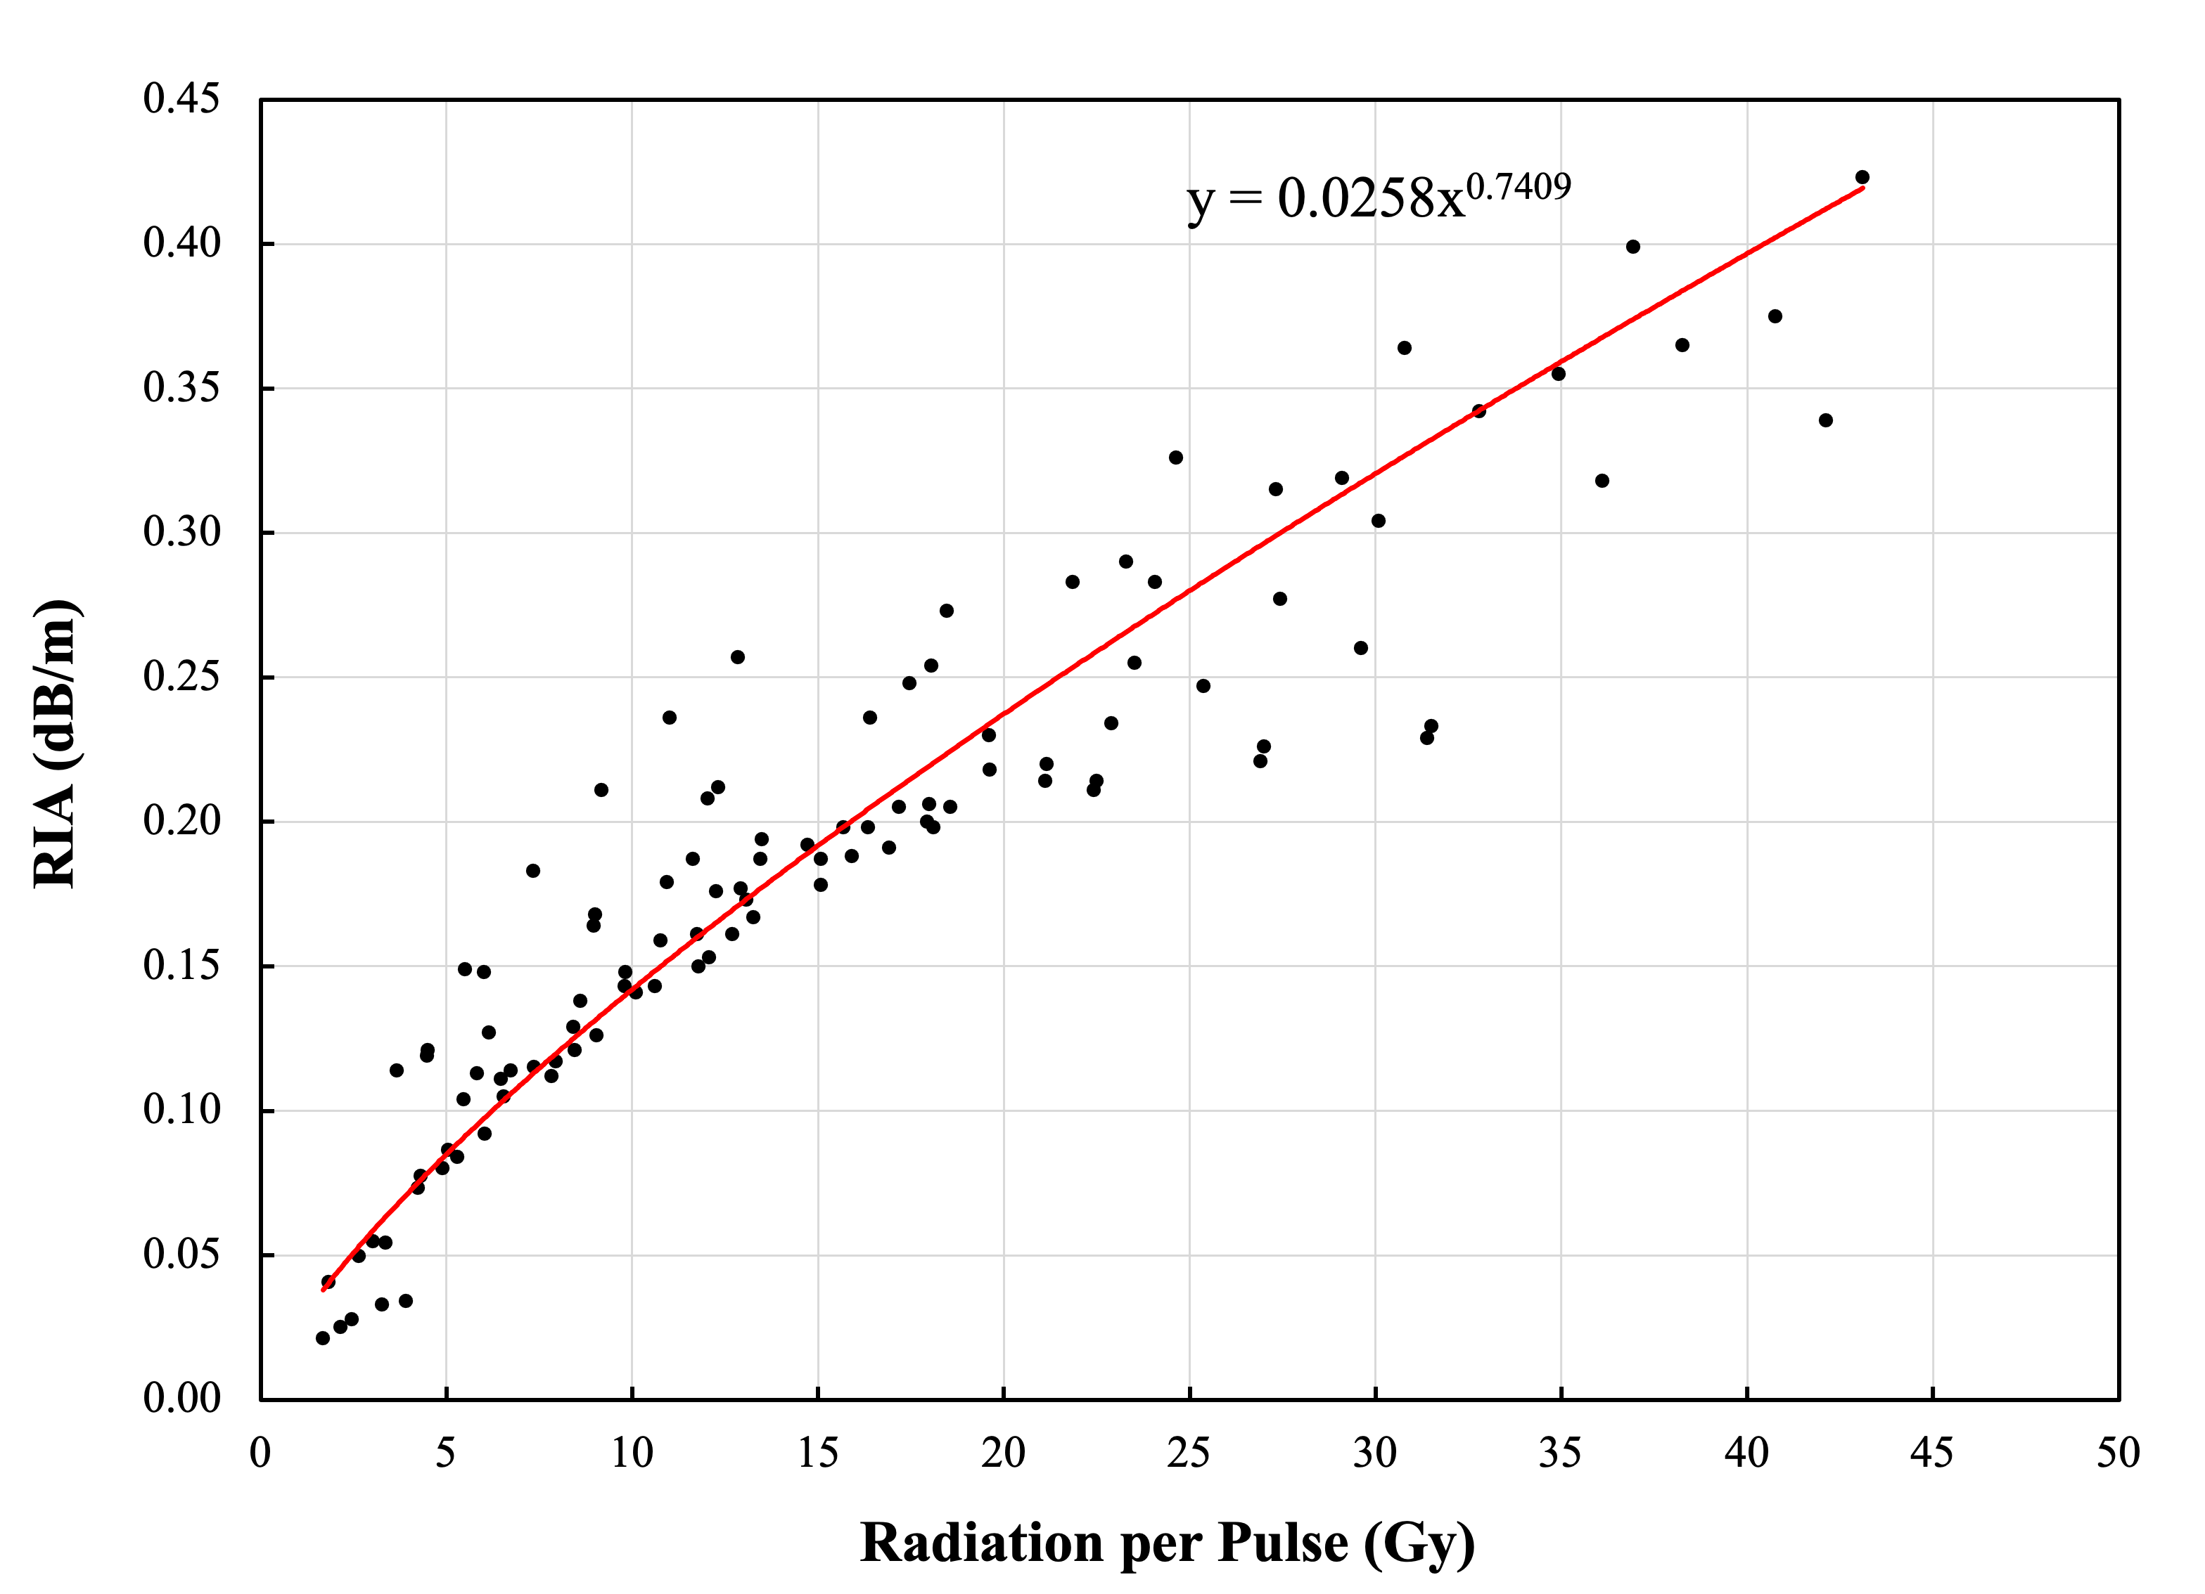
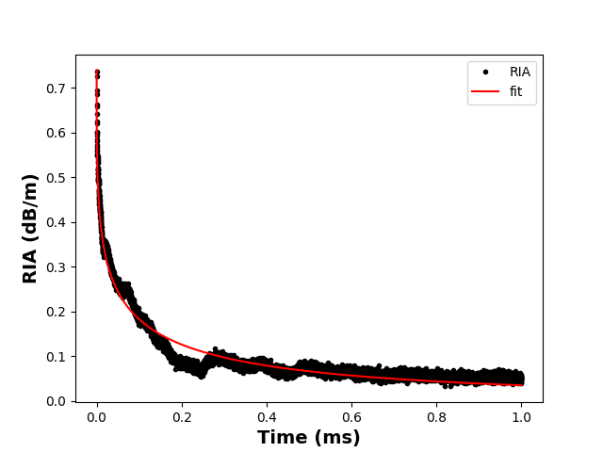
Radiation effects from single-shot proton pulses
$$q(t)=q_{max}exp\left[−{\left(t/τ\right)}^{γ}\right]$$
γ ≈ 1/3

Slide 14
Summary
We have developed a fiber-optic Fabry-Perot sensor and an all-fiber based signal demodulation system for strain measurement in a spallation mercury target.
The strain measurement demonstrated high stability, high dynamic range, high bandwidth, and high radiation tolerance.
The measurement results on the SNS mercury target have been used to validate the target modeling and the efficacy of strain reduction approach.
Radiation induced effects on sensors have been quantitatively investigated.

Slide 15
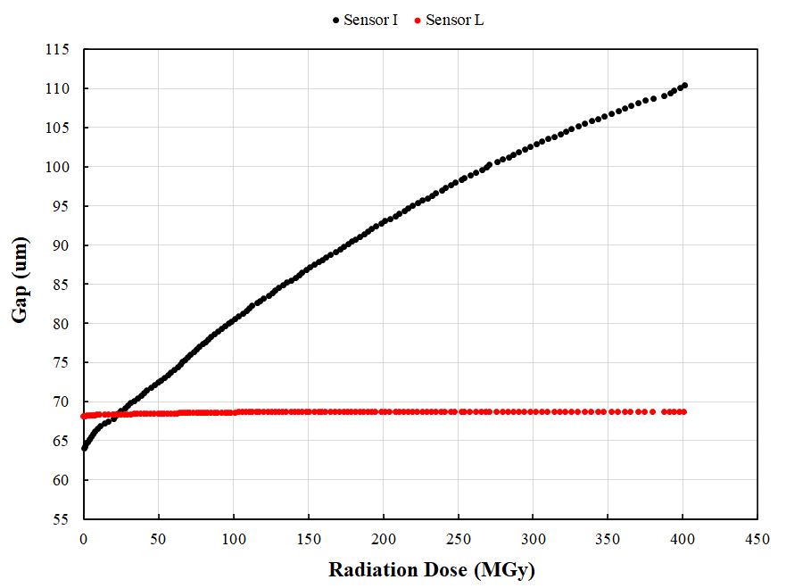
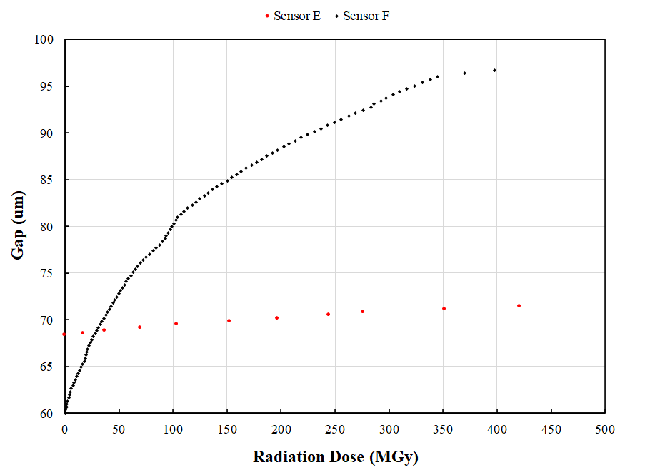
Radiation effects on epoxy
6.4×10⁵ Gy/MWHr
2.3×10⁷ Gy/MWHr
Two pairs of sensors were installed next to each other with different conditions
Sensors I&F: epoxy applied on the sensor head
Sensors L&E: no epoxy applied on the sensor head
Static gap of all 4 sensors were monitored as a function of the estimated radiation doses

