Slide 1
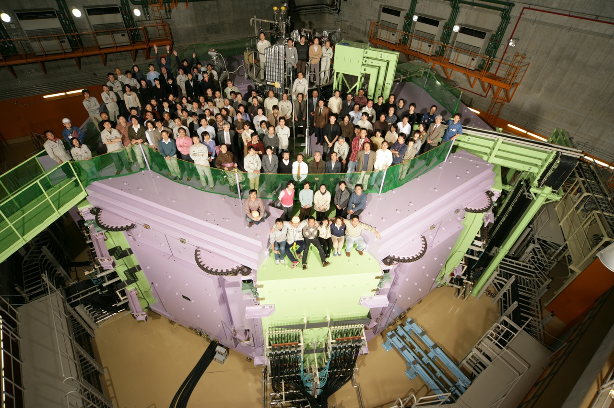
Welcome to HPTW2023
SRC
April 2006
RIKEN Nishina Center for Accelerator-Based Science Accelerator Group
Hiroki Okuno
Notes:
Good morning, everyone. I’m Hiroki Okuno from RIKEN, chair of HPTW2023.
On behalf of the local organizing committee, We welcome you all to HPTW2023.
The Covid19 pandemic is over, and I am very pleased to open this HPTW in person for the first time in five years.
We hope you enjoy this workshop.
Before we move on to the Scientific session, I would like to make a few announcements.

Slide 2
We appreciate your cooperation in keeping the meeting on time.
If you have not finished onsite payment yet, please do so during the coffee break, lunch time, or welcome reception.
We still have COVID 19 infection control measures. This means wearing a mask and disinfecting your hands with alcohol. However, it is up to you to carry this out.
LOC members wear yellow arm bands. If you have any problems, please find them to ask them anything .
The trading card of SRC. There is a mistake on this trading card.
Notes:
We appreciate your cooperation in keeping the meeting on time because our program is extremely full.
Longer presentations make the party time shorter.
If you have not finished onsite payment yet, please do so during the coffee break, lunch time, or welcome reception. Please finish your payment until the end of the workshop.
We still have COVID 19 infection control measures. This means wearing a mask and disinfecting your hands with alcohol. However, it is up to you to carry this out.
LOC members wear yellow arm bands. If you have any problems, please find them to ask them anything .
The trading card of SRC. There is a mistake on this trading card.
In this bag, you can find a trading card of SRC. There is a mistake on this trading card.

Slide 3
SRC trading card
Front side: of the 1st version with hologram
Back side contains a mistake.
Liq. He temperature:
摂氏-279度→摂氏-269度
The corrected version did not arrive in time.
Notes:
This is the front side of the 1st version of the SRC trading card with hologram.
The back side contains a mistake.
This number means liquid helium temperature.
-279celsius means -4K. It is completely wrong.
Please change it to -269.
The corrected version, the second version did not arrive in time.
If you need the corrected one, please contact me to exchange them with corrected version.
However the second version does not have hologram in the front side.

